Slide 1
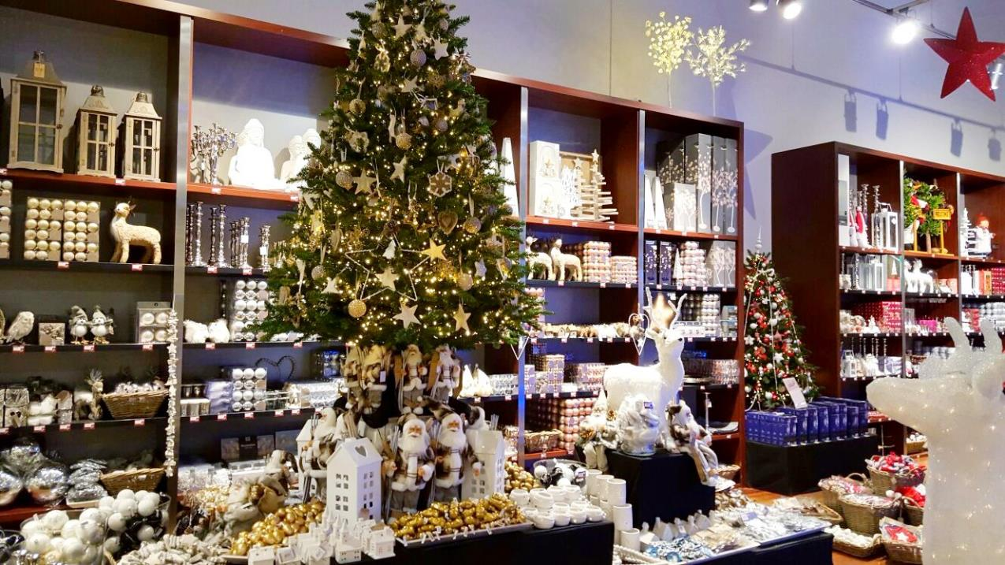
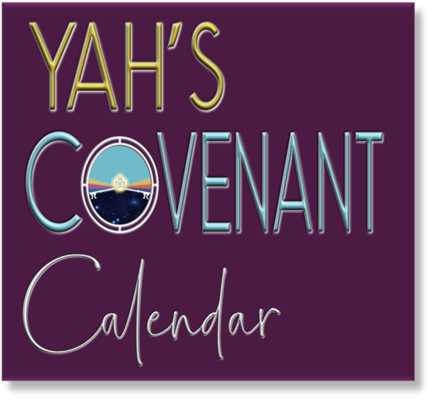

THE QUESTIONS ABOUT CHRISTMAS

Slide 2
Just a short note before I address the topic of this presentation. You might be shocked to hear that God, LORD and Jesus are fake names put into our Bibles to replace the Real Names of our Heavenly Father and His Beloved Son.
The True Names have been removed over 7000 times from our Bibles and replaced by God or LORD which are not Names but titles like Mr., Mrs. or Miss.
Also, “Jesus” is not the true name of our Messiah.
Isn’t it amazing that if you ask a Muslim who he worships he will say” Allah” which is the name of his Elohim and if you ask a Buddhist the name of his Elohim, he will say “Buddha” which is his name, yet we as professed believers in our Creator do not even know the name of Who we worship.

Slide 3

Q1 What do people like about Christmas?

Slide 4
Many say Christmas is the season to be jolly. It is a time of ornaments, red and green decorations, silver bells, holly, mistletoe and colored lights. It does not matter whether you believe in the Savior, all that matters is the family
get-togethers, the feasting and wonderful parties, gifts and decorating the tree; a time for friends and family, children and Santa Claus. Many people are atheists yet still enjoy the spirit of Christmas. The world has designed Christmas in such a way that most people get their vacation time during this period and unless you have no family.
It is the time that friends and family get together.

Slide 5
Q2 What happens at Christmas time?

Slide 6
Christmas is most often all about spending lots of money
trying to make everyone happy.
If you are not spending enough money, many people will even go into debt to enjoy the Christmas period by spending lots of money.
Shops, TV and media advertise about Christmas all the time as
they stand to gain millions over this Christmas period.
Too many people spend beyond their budget.
When you add the total spent on gifts, food, drink, travel,
new outfits, parties … it's ridiculous for just one day
(and unaffordable in the present economic climate).
Many then spend the rest of the New Year paying off all the unnecessary money you spent in order to please people, only to
start the cycle again in November for Christmas shopping.

Slide 7
Q3 What is the reason for the Christmas season?

Slide 8
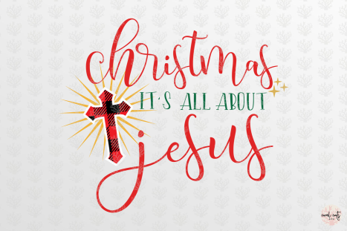

Christmas is most often celebrated to remember the birth of “Jesus Christ,” who Christians believe is the Son of God. Sadly, most people do not believe in the Savior, but partake of Christmas simply to please friends and family and to enjoy the party, feasting and gift giving.

Slide 9
Q4 Where does the name Christmas come from?

Slide 10
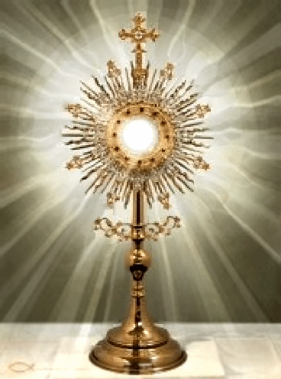
The name 'Christmas' comes from the Roman Catholic Church which is the ‘Mass of the Christian Christ’
(or the Christian Jesus).
A Mass service (which is sometimes called Communion or Eucharist) is where Christians remember that Jesus died for man and then came back to life. This is a Catholic teaching!
Of course, Jesus is the false
man-made Messiah created by Constantine in the 3rd century!

Slide 11
There was no one around
2,000 years ago
by the name of Jesus!
There was the Hebrew
Messiah by the name
of Yahusha at that time!

Slide 12
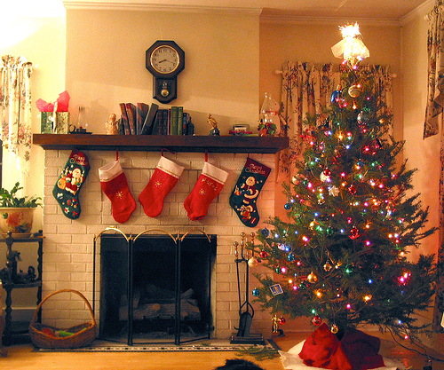
Christmas is strictly a Roman Catholic word.
The word "Christmas"
is a combination
of the words "Christ" and “Mass.”

Slide 13

Q5 Most people think that the word "Christmas" means
"the birth
of Christ."
Is this true?

Slide 14
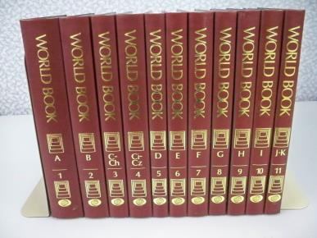
It means "death,” not the “birth”
of Christ.“ Let’s prove this by using the World Book Encyclopedia, the Catholic Encyclopedia, and a book entitled, “The Mass In Slow Motion.”
If you are an honest, sincere and discerning Christian, please read on. If not, you might as well stop right here. The World Book Encyclopedia defines "Christmas" as follows [coming on slide #16].

Slide 15

Q6 Where does the word
Mass of Christ
come from?

Slide 16
“The word Christmas comes from “Cristes Maesse,” an early English phrase
that means “Mass of Christ.”
It is interesting to note that the word “Mass,”
as used by the Roman Catholics, has traditionally been rejected by the so-called Protestants,
such as Lutherans, Baptists, Methodists, Presbyterians, Pentecostals and so on.
The word “Mass” is strictly a Catholic word
and thus, so is “Christ-Mass” …

Slide 17
“… It would stand to reason, that since all of these denominations love and embrace “Christ-Mass,” that December 25th is the great homecoming day, when all the Protestants become Catholic for a day. All the so-called “wayward daughters” of the Romish church return to their mother, the scarlet harlot.
Thus, all the so-called Protestant churches could sing to the Pope that popular song
“I'll be home for Christmas.”

Slide 18

Q7 What do Catholics believe when they daily sacrifice Christ at Communion?

Slide 19
Catholics believe that the communion wafer turns into the real body and blood of Christ and that He offers his Body
over and over at each Mass for the forgiveness of sins.
When Catholics take the round wafer, they literally believe this is the body of their Christ and when they drink the wine, they believe this is the blood of Christ that they are drinking.
This an abomination to our Savior. The Scripture says:
No one among you shall consume blood. [Lev 17:11]
According to Scripture, the true Yahusha Messiah entered the most Kadosh (holy) place once for all, not by the blood of goats and calves, but by His own blood, having obtained eternal redemption. According to Scripture, it is an abomination to believe that you are eating the real body of “Messiah” and drinking His blood.

Slide 20
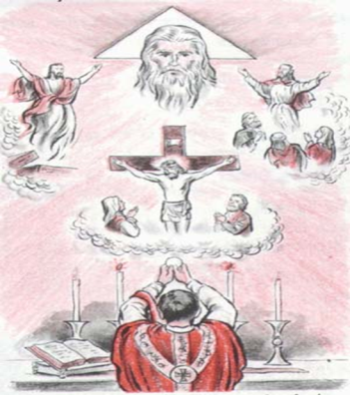
THIS IS A FALSE, MAN-MADE MESSIAH!
QUOTED FROM CATHOLIC SOURCES: “Catholicism does, indeed, teach that the priest functions on earth as another Jesus Christ on earth. The Mass is called the sacrifice of Christ which is offered via the priest's hands. Catholics believe in Transubstantiation meaning, "the change of the whole substance of bread into the substance of the Body of Christ and of the whole substance of wine into the substance of the Blood of Christ. …

Slide 21
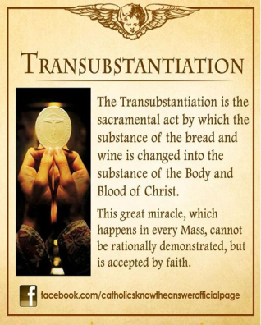
“… The sacrifice of this (man-made) Messiah,
the only Mediator, which in the Eucharist is offered through the priests' hands," is to be considered a true and proper sacrifice”
(The Catholic Encyclopedia, topic: "Sacrifice
of the Mass").
We must conclude that it is a sacrifice that
occurs repeatedly; and since it is said to be
a true and proper sacrifice must be a
re-sacrifice of Christ. If it is not, then how
can it be called a sacrifice of Christ? Also,
how could it be Christ is the sacrificial victim over Himself, over and over at each mass?

Slide 22
Q8 What does Scripture say about the sacrifice of
our true Messiah Yahusha?

Slide 23
“Yahusha (the true Hebrew Messiah) also, HAVING BEEN OFFERED ONCE TO BEAR THE SINS OF MANY, shall appear a second time for salvation without reference to sin, to those who eagerly await Him.” (Hebrews 9:28).
“He (Yahusha),having offered ONE SACRIFICE FOR SINS FOR ALL TIME, sat down at the right hand of Yahuwah.” (Hebrews 10:12).

Slide 24
We can see that Scripture tells us Yahusha offered Himself once, and that there is no need for repetition of His sacrifice. The failure of the Roman Catholic Church has been to distort the Biblical doctrine of the Master's Passover Supper, into a constant and repetitious sacrifice of the Christ of the Catholic church, which shows clearly, we are talking here about a false man-made Messiah.
It should be plain to the reader that the Roman Catholic position is not only unbiblical but anti-biblical.

Slide 25
Q9 What is wrong with saying
“Merry Christmas”?

Slide 26
Millions of people have been deceived into believing that it is the celebration of the birth of their Christ when in fact they are celebrating the death of their Christ.
What is so merry about re-sacrificing the Savior repeatedly and drinking His blood and eating His body?
The impact of this fact is horrifying and shocking; for when millions of people are saying, "Merry Christmas," they are literally saying "Merry death of Christ!"
(Let’s be reminded, however, that this Christ they
are serving [through ignorance],
is not the true Messiah that died for man.)

Slide 27
Q10 What is Santa really doing when he says,
“Ho, ho, ho?”

Slide 28
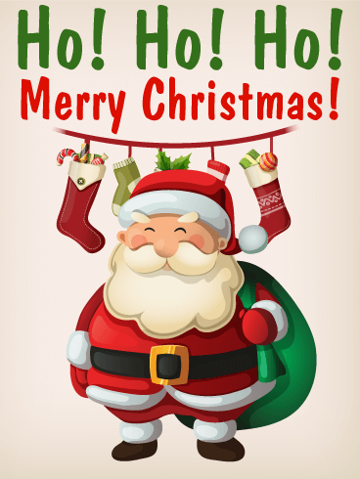
Furthermore, when the fat man in the red suit laughs and says, "Ho ho ho, Merry Christmas," he is mocking and laughing at the suffering and bleeding Savior, who died for our sins.
He does this while parents place their little children into his waiting arms to hear his false promises of gifts that he says he will give them.
Consider what you are saying when you say, "Merry Christmas."

Slide 29
Q11 What is so amusing about
our Savior's
painful death?
What is so funny?
Why is Santa laughing?
Why are so many people going along with this?

Slide 30

PEOPLE ARE BLIND
They have been deceived.
Jeremiah 16:19 states:
“O יהוה (YHVH) my strength and my stronghold and my refuge, in the day of distress the nations shall come to
You from the ends of the earth and say, ‘Our fathers have inherited only falsehood, futility, and
there is no value in them.’ ”
(The Scriptures 2009)

Slide 31
Your words do count and Satan knows it. Yes, the word “Mass” does mean “death sacrifice,” and to cement that fact, we will consider the definition of the inventors of the religious application of the word “Mass.”
I am looking at page 537 of the Catholic Encyclopedia, which says, “In the Christian law, the supreme sacrifice is that of the Mass.” It goes on to say, “The supreme act of worship consists essentially in an offering of a worthy victim to God, the offering made by a proper person,
as a priest, to the destruction of the victim.” …

Slide 32
… (2) Please note carefully the word, "victim" of the Mass. The Latin word for victim is "Hostia" from which the word "host" is derived. The Mass, by definition of those who coined the word, is a sacrifice involving a victim. … There is no other meaning for the word "Mass" or "Christ-Mass." On page 110 of a book entitled "The Mass in Slow Motion," we find the following words: "It is only with the consecration that the sacrifice of the Mass is achieved. In essence, the Mass is the ceremonial slaying of their “Jesus Christ” over and over again, followed by the eating of his flesh and the drinking of his blood. …

Slide 33
… The Mass is the death sacrifice, and the "Host" (communion wafer) is the victim. …
This is official Roman Catholic doctrine, and "Christmas"
is a word that they invented. Again, I ask, what is so merry about the pain, bleeding, suffering and death of Yahusha Messiah, which people believe they are celebrating? Satan has done quite a job of getting millions of so-called "Christians" to blaspheme our Savior who was not born on 25 December but at the Feast of Tabernacles at the end of September/early October.
What a deceiver Satan is!

Slide 34
Q12 What is the true name of our Savior?

Slide 35
Our Savior’s true name is Yahusha which means “Yah is Salvation.” His name, and His Father’s name Yahuwah, was removed from our Bibles over 7000 times from the Roman Catholic Church, and replaced with titles like LORD, God and [pagan name] Jesus. Titles and pagan names are not the name of our Savior or our Heavenly Father.
Yahusha was Hebrew, (not Greek), and His name could never have been Jesus as there is no letter J in the Hebrew alphabet. The name Jesus is not even a transliteration.

Slide 36
It is a corruption of a transliteration of a Hebrew word which had the mighty and powerful Name of Yahuwah removed from its original meaning.
The Theological Dictionary Of The New Testament, Kittel and Bromiley, Volume 3, page 284, tells us that the name Jesus (Iesous) is a Greek form of the Hebrew proper Name Yahusha. Keep in mind, however, that this name Jesus carries none of the meaning of the original Hebrew Name Yahusha, which means Yahuwah is salvation. Here you have the confession.

Slide 37
Q13 So what was the name of the new god of Christianity that came about 320 years after the ascension of Yahusha into heaven?

Slide 38
“Emperor Constantine wanted to unite all the different pagan religions into one and revived the pagan religion of Christianity by force of death. Constantine was the ruling spirit at Nicaea and he ultimately decided upon a new god for them. To involve British factions, he ruled that the name of the Druid god, Hesus, be joined with the Eastern Savior-god, Krishna (Krishna is Sanskrit for Christ), and thus Hesus Krishna would be the official name of the new Roman god. A vote was taken and it was with a majority show of hands (161 votes to 157) that both divinities become one God. …

Slide 39
“…Following long-standing heathen custom, Constantine used the official gathering and the Roman decree to legally deify two deities as one and did so by democratic consent. A new god was proclaimed and “officially” ratified by Constantine. That purely political act of removing the true Hebrew names of Yahuwah and Yahusha and legally placed Hesus and Krishna among the Roman gods as one individual composite. That abstraction lent earthly existence to amalgamated doctrines of the Empire’s new religion called Christianity; and because there was no letter “J” in alphabets until about 400 to 500 years ago, the name subsequently evolved from Iesous Christ into “Jesus Christ.” …

Slide 40
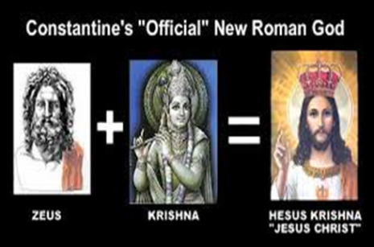
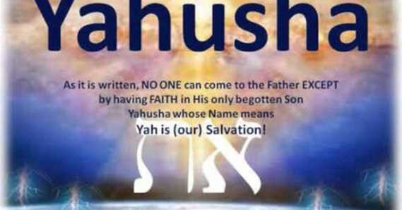
…Nexus Magazine, Volume 14, Number 4. “This was done because Constantine hated the Jews and wanted nothing to do with them and as a result created a new god and a new day of worship on Sunday thus separating Christianity from the true Biblical Israelites of the Scriptures.”

Slide 41
If the Christians could turn the Name of a man, Yahusha, who all authorities agree was a righteous Man, and whose Name glorifies Yahuwah, into the name of a detestable man-made pagan god called Jesus, then how much more could they twist this Man’s teachings to say that He taught against Yahuwah’s Laws (Torah)?
The shocking fact is that Christianity (led by false teachers) have accomplished both things, and have convinced the whole world (including most Jews) that these lies are truth …

Slide 42
…I challenge you to believe Yahuwah and His Word, instead of believing lying preachers who desire to “do away” with Yahuwah’s Laws – the very Laws that will bring peace, joy and eternal life to all who abide by them. The truth about this lying propaganda comes as a complete surprise to the vast majority of Christian believers who will not study for themselves. To them, everything in the Scriptures is a surprise. It’s just like the teaching of their preachers, that Yahusha (whom they call Jesus) and the twelve disciples “did away” with the Laws (Torah) of Yahuwah in the New Testament teachings. Such lies and deception.

Slide 43
By presenting these facts about Christmas, it is not intended to hurt, offend, condemn or judge anyone, but to be a wake-up call. It is for our own good to find out what is truth and what is false,
so one can turn away from paganism, and follow the Elohim of Abraham, Isaac and Israel and the written instructions He gave through Moses.
Many people do not like to hear the truth but hate anyone that is presenting the facts.

Slide 44
Q14 Where did the Trinity doctrine come from because it is not found in Scripture?

Slide 45
“One of the most cherished ideas of the pagans, adopted by the Christians, was that of the Trinity of Gods. The Savior whom the entire Christian world worships, currently, is nothing more than the continuation of the pagan Trinity.
The fact that this doctrine did not officially become formulated until centuries after Yahusha’s death, proves
to the fact that this doctrine does not come from Yahuwah’s Laws and prophets.” The New Bible Dictionary, 2nd edition by J.D. Douglas, page 1221, admits that the doctrine of the Trinity does not come from the Scriptures, but from philosophy influenced by paganism.

Slide 46
The word Trinity is not found in the Bible, and though used by Tertullian in the last decade of the 2nd century, it did not find a formal place in the theology of the Christian church till the 4th century. The Trinity is however, the distinctive and all-comprehensive doctrine of the Christian faith.
It makes three affirmations: that there is but one God, that the Father, the Son, and the Spirit is each God, and that the Father, the Son, and the Spirit is each a distinct Person.

Slide 47
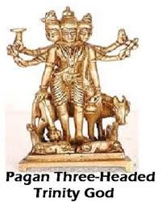
In this form, it has become the faith of the church since it was brought into the church doctrine. Many of the theories of Egyptian religion have penetrated the theology of Christianity. Scripture tells us Yahuwah is ONE - not three gods in one. [Deuteronomy 6:4]

Slide 48
Q15 From where did Christianity
get its teachings as most of Christianity is founded on traditions of men?

Slide 49
The Encyclopedia Judaica, Volume 5, page 511, admits this fact. With its spread among the gentiles, the pagan characteristics of Christianity gained in influence, and after Constantine the Great and the adoption of Christianity as the official religion of the Roman Empire, the traditional Hellenistic-pagan forms of civic, social, and cultural anti-Semitism merged with the specifically Christian theological motifs, to form a unity that has left a tragic legacy to history.

Slide 50
Q16 When you celebrate Christmas you worship another god, not the Savior Yahusha of the Scriptures. What should you do about it?

Slide 51
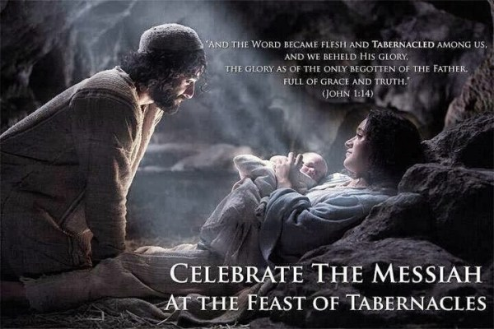
Yahusha Messiah was born on the first day of Tabernacles – some time in September/October and circumcised on the eight day according to the Torah.

Slide 52
The birthday of the Babylonian sun god “Tammuz” was celebrated
on December 25.
The birthday of the Egyptian sun god “Ra” was celebrated
on December 25.
The birthday of the Greek sun god “Zeus” was celebrated
on December 25.
The birthday of Roman sun-god “Mithras” was celebrated
on December 25.
The birthday of the Greek Jesus is being celebrated on December 25!
The Hebrew Messiah Yahusha, the One that died for man was NOT born on December 25, but during the Feast of Tabernacles. However, we are not commanded to celebrate HIS birthday but His death until He comes. Consider Ecclesiastes 7:1 “A good name is better than precious ointment; and the day of death than the day of one's birth.” Just something to ponder!

Slide 53
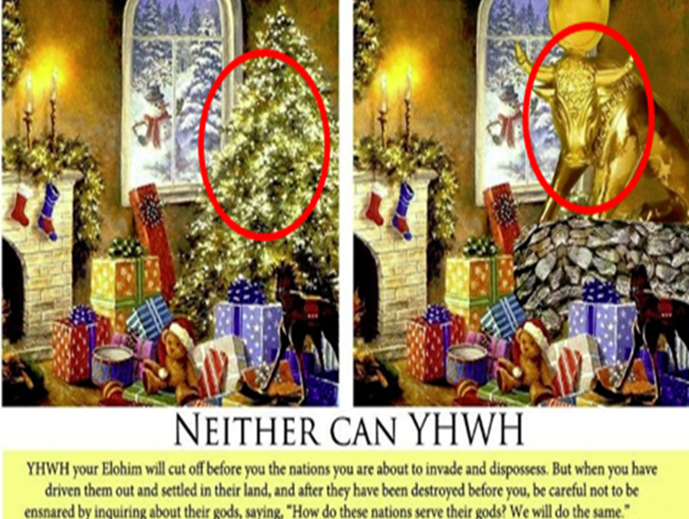
CAN YOU SEE THE DIFFERENCE?

Slide 54
The Catholic Encyclopedia states: "Christmas was not among the earliest festivals of the Church. The first evidence of the feast is from Egypt." "Pagan customs, centering around the January calendar, gravitated to Christmas."

Slide 55
The date of December 25th comes from Rome and was a celebration of the Italic god, Saturn, and the rebirth of the sun god. All of the customs of Christmas pre-date the birth of the Greek Jesus and are a collection of traditions and practices taken from many cultures and nations.

Slide 56
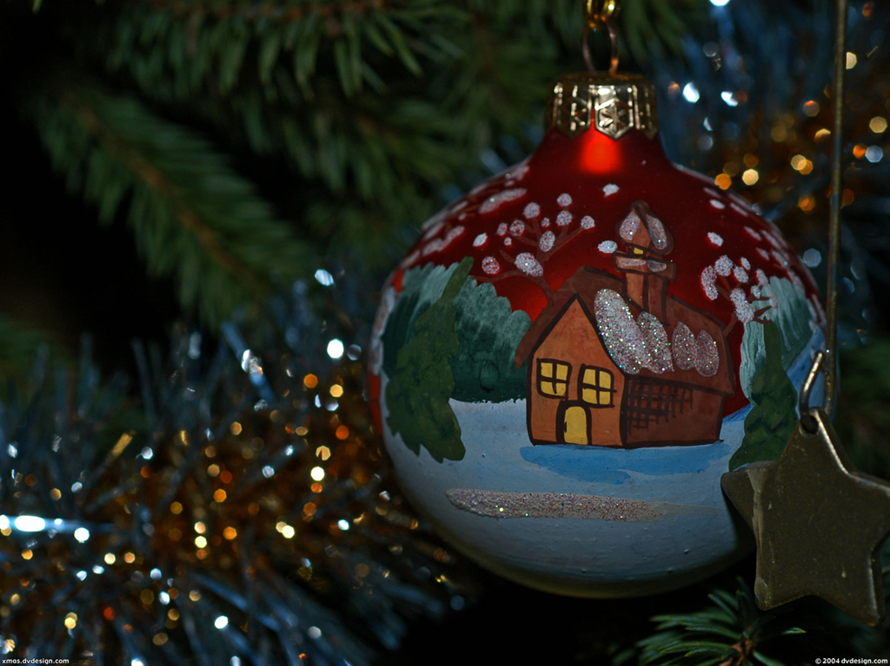
In Germany, the evergreen tree was used in worship and celebration of the Yule god, also in observance of the resurrected sun god.
The evergreen represented
life and also was regarded
as a phallic symbol in fertility worship. It was believed that the red holly was a symbol of the menstrual blood of the queen of heaven, Diana.

Slide 57
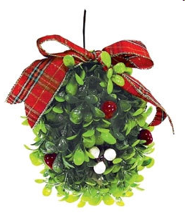
The white berries of mistletoe were the droplets of the semen of the sun god.
Branches of holly and mistletoe were hung in doorways of temples and homes and it was believed that kissing beneath them will make the spirits of the god and goddess to enter one's body and make them fertile.

Slide 58
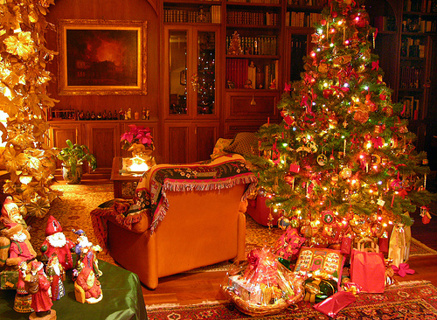
Trees, wreaths, holly, mistletoe and the like are strictly pagan and heathen!

Slide 59
Think about it!
Can we worship and honor Elohim by involving ourselves with customs and traditions, which He Himself forbade as idolatry?

Slide 60
We need to ask the question, “What is right about Christmas?”
Absolutely Nothing!

Slide 61




Think about it: would you feel honored?
Say that I want to honor you, so I throw a big party every year on your worst enemy’s birthday, decorate with your enemy’s favorite styles, and serve foods that your enemy loves but that are an abomination to you.
Would you overlook all this, and take it as an honor, if I said that even though these things had origins from your enemy, I was now dedicating them to you with a sincere heart and out of love to you?

Slide 62

Then what makes you think YHVH will?
Remember, Elohim will not be mocked.
(See Galatians 5:7.)

Slide 63
Israel was commanded not even to do “what” according to
Exodus 23:13 KJV?
“And in all things that I have said unto you be circumspect: and make no mention of the name of other gods, neither let it be heard out of thy mouth.”
“Make no mention of the name of other gods,
neither let it be heard out of thy mouth?”
Notes:
…………………..

Slide 64
Q17 What
do most Christians say about the birth of the Messiah?

Slide 65
Many say something like:
“we cannot know when Yahusha was actually born,”
or “what difference does it make”
or “it is the thought that counts.”
Maybe it is merely a lack of knowledge and understanding; maybe it is a matter of not wanting to shake their world.
In any event, what follows is what Scripture has to say about when Yahusha was born. Most “Christians” claim no one knows when Yahusha was born. YET, they allegedly claim to celebrate his birth on the Gregorian date of December 25. What a contradiction! If you study the Scriptures, you will know exactly when Yahusha was born.

Slide 66
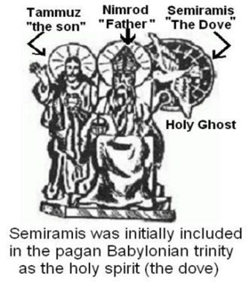
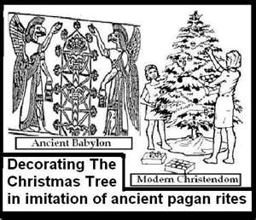
Why not honor the birth of Yahusha with the Feast of Tabernacles (Sukkot) vs. a pagan tradition? Christmas that is not honoring our Savior at all and is not even Biblical? Christmas is a Pagan Tradition.

Slide 67
Q18 Were the true believers called Christian in the days of Yahusha and the apostles?

Slide 68
No, the true believers were not called “Christians” but followers of “the Way” or “Nazarenes.” That is why Yahusha said He is the way, the truth and the life. No-one comes to the Father except through Him (John 14:6).
It is time to come out of Christianity which is a counterfeit gospel of the Anti-Messiah Jesus who never really existed but was an invention by Constantine and the Roman Church.

Slide 69
Q19 What will happen when Yahusha comes to fetch us during the Feast of Tabernacles?

Slide 70
We will be taken to heaven as He promised when Yahusha said “In my Father’s house are many staying places, I go there to prepare a place for you that where I am you will be also” (John 14:2).
And I heard as the voice of a great crowd, as the sound of many waters and as the sound of mighty thunders, saying, “Halleluyah, for יהוה Ěl Shaddai reigns! “Let us be glad and rejoice and give Him praise, for the marriage of the Lamb has come, and His wife prepared herself.” And to her it was given to be dressed in fine linen, clean and bright, for the fine linen is the righteousness of the set-apart ones.

Slide 71
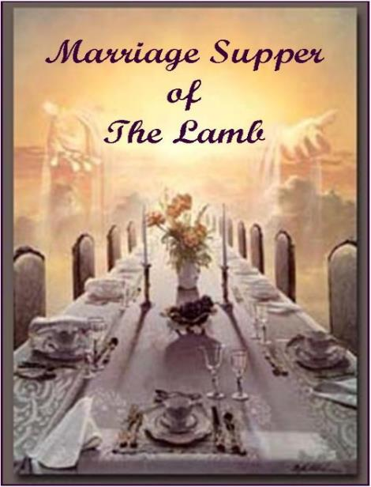
And he said to me, “Write, ‘Blessed are those who have been called to the marriage supper of the Lamb!’ ” And he said to me, “These are the true words of Elohim.”
Revelation 19:6-9.

Slide 72
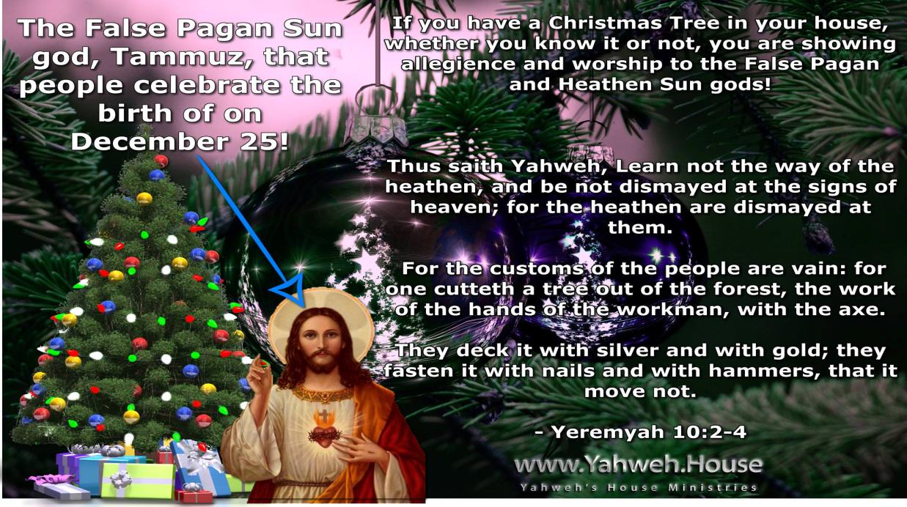

Slide 73

Why I no Longer Celebrate Christmas?

Slide 74
Looking for a Biblical Christmas?
You won’t find one because Christmas is not Biblical.
Christmas was not observed for at least three centuries after the true Savior’s birth!
As we learned in this presentation
the word “Christmas” means “Mass of Christ.”
The word "Mass" in religious usage
means a "death sacrifice."
The impact of this fact is horrifying and shocking;
for when millions of people are saying, "Merry Christmas," they are literally saying “Merry death of Christ.”

Slide 75
According to 1 Timothy 4:1
keeping Christmas means: “following the teachings
of demons.”

Slide 76
Yahusha also warns us:
“If you love father and mother more than me
then you are not worthy to be my disciple.”
We cannot allow our friends and family to be more important to us than obeying Scripture,
as this dangerous road will cause us to lose our eternal life. Obedience to everything written in Scripture is
the only way to truly love your Savior.
Yahusha said,
“IF you love me you will keep my Commandments.”

Slide 77
Yahusha Himself, during His Feast of Tabernacles,
asks that you seek and celebrate Him
during this time.
You should worship Yahusha in Spirit and truth,
not in compromise and traditions of men.
When you start to obey the truth, you become stronger in your faith and you acquire more wisdom and a peace that surpasses all understanding.

Slide 78

MY SIMPLE EXPLANATION WHEN PEOPLE ASK ME ABOUT CELEBRATING CHRISTMAS …

Slide 79
I respond that since I’m not Catholic, nor am I a Christian,
I don’t do the Christmas thing everyone else does.
But I do rejoice in Yahusha’s birth
at the Feast of Tabernacles!
But my greatest rejoicing is in His death & resurrection for this is what bought my spiritual liberty;
and this is what He commanded me to celebrate the most.
That is also why I celebrate the Passover
[not Easter - which is another pagan Christian tradition].

Slide 80
Most of all,
I rejoice in Yahuwah and my Savior Yahusha NOT Jesus Christ,
the Anti-Messiah and the god of Christianity, which teaches people
to break the Torah of Yahuwah.
The lawless one is Satan the father of lies.

Slide 81

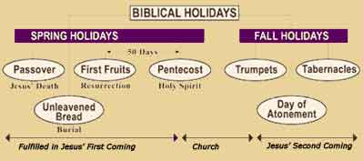

BIBLICAL HOLIDAYS
SPRING HOLIDAYS
FALL HOLIDAYS
Passover
Wave Sheaf
Trumpets
Tabernacles
Unleavened Bread
Pentecost
Day of Atonement
None of the feasts/festivals have had complete fulfillment yet.
Yahuwah's Feasts are NOT 'Jewish Feasts'
No! Yahuwah appointed His Eternal Plan of Salvation for all His Children. All Yahuwah’s Feast are Statutes found in Leviticus 23.

Slide 82
When I read of statutes,
I am thinking of Psalms 119:155,
where it states:
“Salvation is far from the wicked: for they seek not thy statutes.”
Yahuwah's feasts are statutes!

Slide 83
The Apostle Paul stated:
“Therefore, let us keep the feast,
not with old leaven of malice and wickedness, but with the unleavened bread of
sincerity and truth” (1Corinthians 5:8).

Slide 84
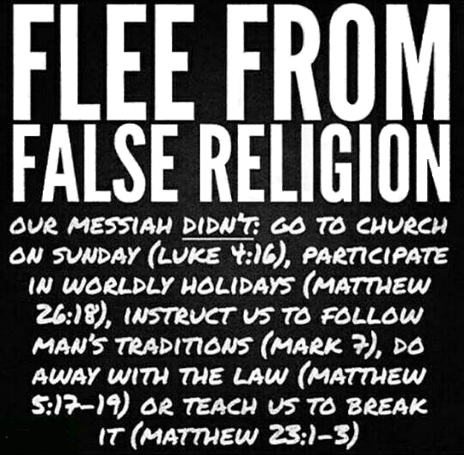
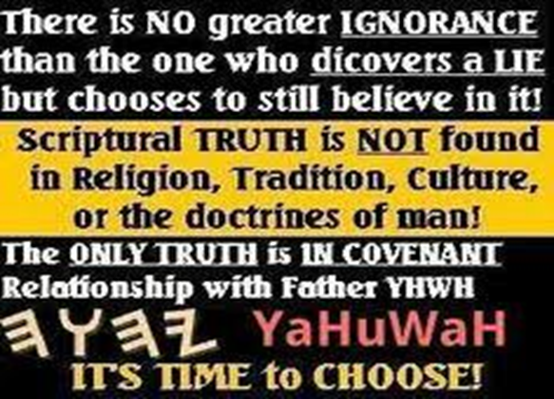

There is NO greater IGNORANCE than the one who discovers a LIE but chooses to still believe in it!
Scriptural TRUTH is NOT found in Religion, Tradition, Culture, or the doctrines of man!
The ONLY TRUTH is IN COVENANT Relationship with Father YHWH YaHuWaH IT’S TIME to CHOOSE!

Slide 85

SHALOM

Slide 86

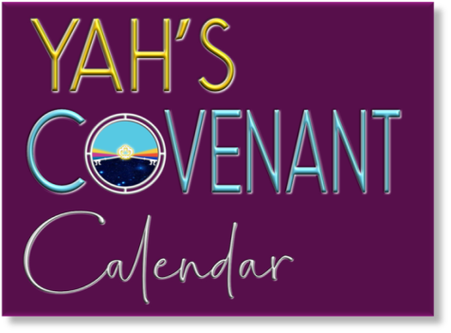


RETURN
to your
TRUE
ROOTS
DIVORCE
the
Babylonian
Church
System
The ultimate provider is
Yahshua Ha Mashiach.
This message was created
and recorded by:
Walter Tschoepe
Email:
malachi4dot4@gmail.com
Choose
COVENANT Torah!

