Slide 1

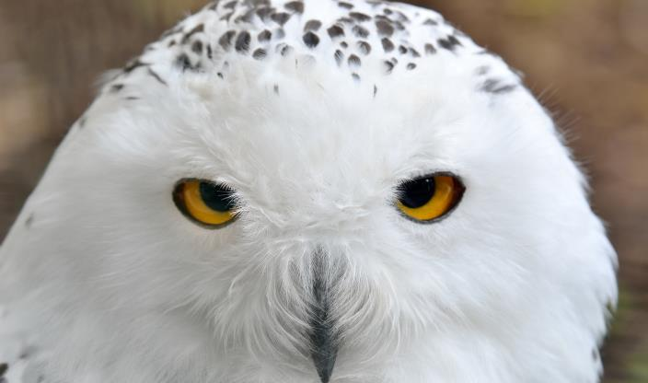

Troublemaker or Peacemaker?
A TEACHING FROM:

Slide 2

Just for clarification: In my presentations I am using YHVH (in Hebrew yod, hey, vav, hey) (pronounced as Yahuwah or Yahweh) instead of LORD, which is a title and not a name. I am using Yahusha or Yahshua instead of Jesus, which is not
a translation but a transliteration from a Greek mistransliteration and really has no meaning, neither in Hebrew nor in English! Yahuwah (Yahweh) and Yahusha (Yahshua) are the actual original names
and the true nature and character of them.

Slide 3

AS A BELIEVER IN YAHUWAH AND YAHUSHA
ARE YOU
A ….

Slide 4



Slide 5

Or a peacemaker?
What are you; what am i?

Slide 6
You are one or the other ...
But mostly both!
depending on
Who you ask!

Slide 7
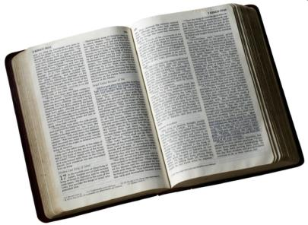
“Blessed are the peacemakers;
for they shall be called the children of Elohim.” KJV
The Scripture states in Matthew 5:9,

Slide 8
Peacemakers are blessed by YHVH...
Troublemakers are NOT!

Slide 9
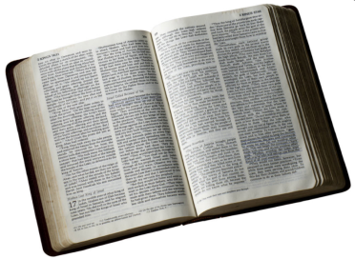
“How beautiful upon the mountains are
the feet of him that bringeth good tidings, that publisheth peace; that bringeth good tidings of good, that publisheth salvation …” KJV
Let’s look at Isaiah 52:7.

Slide 10

Aren’t the followers of Yahusha messengers of peace and of good news?

Slide 11

Yahusha said in John 14:27 “Peace I leave with you, my peace I give unto you: not as the world giveth, give I unto you…” KJV

Slide 12
“Great peace have they, which love thy Torah (instructions) and nothing shall offend them.” KJV
Psalm 119:165 states:

Slide 13

There is a difference between the peace of the world and the peace of Messiah.

Slide 14
There are 2 types of peace, the inner peace and the outer peace, an internal and an external peace.

Slide 15
There is a true peace, which Yahusha gives and there is a counterfeit peace secured by compromise.

Slide 16

Yahusha never purchased peace by compromising with evil principles, neither can His true followers.

Slide 17
The peace of Yahusha is not to banish division, but to remain calm amid strife and division!

Slide 18

He who has the meek and lowly spirit of Messiah will be a peacemaker!

Slide 19

So, the question is: AM I, are you such a peacemaker or maybe even a troublemaker?

Slide 20
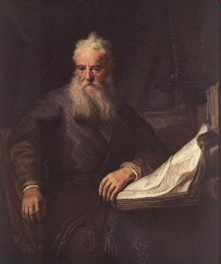
Paul states in Romans 12:18 “If it be possible, as much as lieth in you, live peaceably with all men.” KJV
Obviously, it is almost impossible to live in peace with all people without making some compromise!

Slide 21
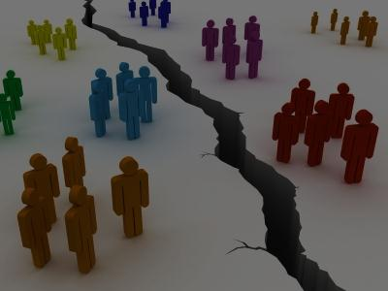
There is a point beyond which it is impossible to maintain union and harmony without the sacrifice of principle. Separation then becomes an absolute duty.
There are times one must separate, even if it hurts.

Slide 22
What may become an
absolute duty?
Separation!
Here is what YHVH says in 2 Corinthians 6:14-18.

Slide 23
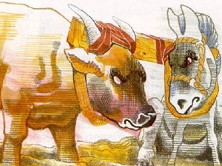
2 Corinthians 6:14-18 states,
Be ye not unequally yoked together with unbelievers: for what fellowship hath righteousness with
unrighteousness? And what communion hath light with darkness? 15. And what concord hath Messiah with Belial? Or what part hath he that believeth with an infidel? 16. And what agreement hath the temple of Elohim with idols? For ye are the temple of the living Elohim: as Elohim hath said, I will dwell in them, and walk in (them); and will be their Elohim, and they shall be my people.

Slide 24
17. Wherefore come out from among them, and be ye separate, saith YHVH, and touch not the unclean (thing); and I will receive you. 18. And will be a Father unto you, and ye shall be my sons and daughters, saith YHVH the Almighty.” Restoration Study Bible
Why is separation necessary?
Because spiritual, obedient people will be opposed by the disobedient and the worldly and are NOT welcomed.

Slide 25

The question is:
As a true, upright, faithful follower of YHVH can you live peaceably with all men, including professed believers?
Will everybody like you?
Can one please everybody?
Only Politicians try to do that!

Slide 26
“Woe unto you, when ALL men speak well of you: for so did their fathers
to the false prophets.”
Let’s see what Yahusha has to say about that in Luke 6:26 KJV.

Slide 27
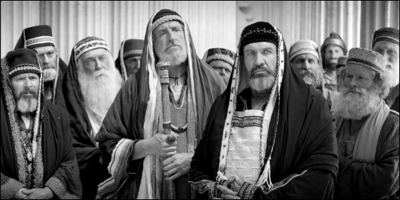
There is
a woe pronounced when everyone speaks well
of you!
Because, it is not possible for everyone to speak well of you, unless you are compromising!
Why?

Slide 28
Let’s look at some examples
of individuals in Scripture
that were trying to bring peace, but it seemed to
accomplish the opposite.

Slide 29
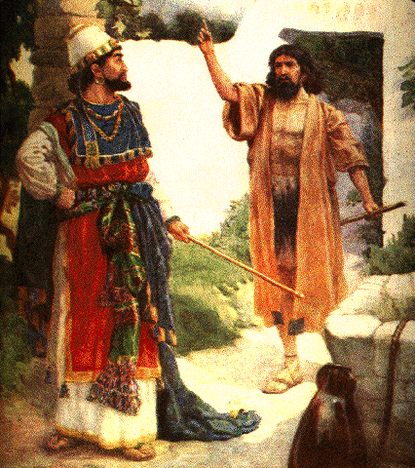

1 Kings 18:17 KJV, When king Ahab finally caught up with Elijah after looking for him for 3 ½ years of drought, the Bible says, “And it came to pass, when Ahab saw Elijah, that Ahab said unto him, art thou he that troubleth Israel?”
Are you the one that causes
all the uproar, the confusion,
the divisions, and the problems
that we have no rain?

Slide 30
Are you the troublemaker in Israel?
Elijah was accused of being a troubler in Israel!
But was he?
What was YHVH trying to accomplish through Elijah’s message?
Peace or trouble?

Slide 31

Was Elijah a peacemaker or a troublemaker?
It depends on who you ask!

Slide 32
EXAMPLE
#2

Slide 33
“Then the word of YHVH came unto me, saying 5. Before
I formed thee in the belly,
I knew thee; and before you camest forth out of the womb
I sanctified thee, and
I ordained thee a prophet unto the nations.” KJV
Let’s look at Jeremiah 1:4-5
Jeremiah was ordained as a prophet by YHVH!

Slide 34
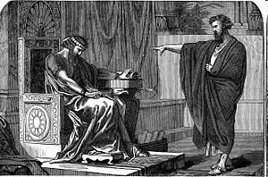
What was Jeremiah’s prophecy in chapter 34:2? “Thus saith Yahuwah, the Elohim of Israel; Go and speak to Zedekiah king of Judah, and tell him, thus saith Yahuwah; Behold,
I will give this city into the hand of the king of Babylon, and he shall burn it with fire.” Restoration Study Bible - SB
Was Jeremiah a man
of YAHUWAH speaking for HIM?

Slide 35
Was that message good news or
bad news for the nation of Israel?
Did the people like what Jeremiah had to say?
Did their leadership like it?
What was their response in Jeremiah 38:4?

Slide 36
“Therefore the princes said unto the king, we beseech thee, let his man be put to death: for thus he weakeneth the hands of the men of war that remain in this city, and the hands of all the people, in speaking such words unto them: for this man seeketh not the welfare of this people, but the hurt.” Jeremiah 38:4 (KJV)
Were they right or wrong?

Slide 37
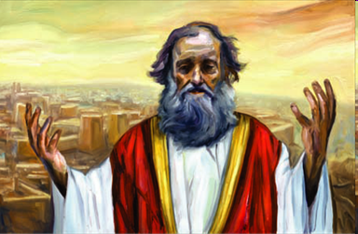
What was Yahuwah’s purpose in giving this message through Jeremiah?
Did He mean good or evil for them?
Jeremiah was accused of being a ‘traitor’ by delivering Yah’s message!
So what did Israel do to him?

Slide 38
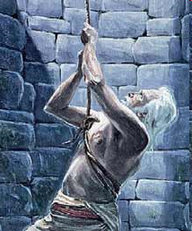
Jeremiah 38:6 “Then took they Jeremiah, and cast him into the dungeon … And in the dungeon, there was no water, but mire:
so Jeremiah sunk
in the mire.” KJV

Slide 39
Why was he cast into the dungeon?
Because he was considered a troublemaker and a traitor by the professed people of Yahuwah.

Slide 40
Was Jeremiah a troublemaker?
It depends on who you ask!

Slide 41
EXAMPLE
#3

Slide 42
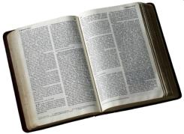
Let’s go to Acts 21:26-28 KJV …
“Then Paul took the men, and the next day purifying himself with them entered into the temple, to signify the accomplishment of the days of purification, until that an offering should be offered for everyone of them.
27. And when the 7 days were almost ended, the Jews which were of Asia, when they …

Slide 43
… saw him in the temple, stirred up all the people, and laid hands on him 28. Crying out, Men of Israel help:
This is the man that teaches all men every where against the people and the Torah (law), and this place: and
further brought Greeks also into the temple and
had polluted this holy place."
Was Paul guilty of all these charges?
Was he a peacemaker or a troublemaker?
It depends on who you ask!

Slide 44
Paul was accused of being a polluter of the temple.
In other words
“a troublemaker” and the leaders laid hands on him.

Slide 45
EXAMPLE
#4

Slide 46
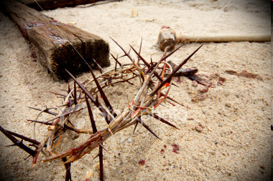
Let’s go to John 11:47,48, 53 KJV
“Then gathered the chief priests and the Pharisees a council, and said, what do we? For this man doeth many miracles. 48. If we
let him thus alone, all (men) will believe on him: and the Romans shall come and take away both our place and nation. 53. Then from that day forth they counsel together to put Him to death!”
For what reason was Yahusha crucified?
For being a peacemaker or a troublemaker?
Notes:
Then the chief priests and the Pharisees called the council together and said, "What should we do? This man is working a lot of miracles.
Joh 11:48 If we don't stop him now, everyone will put their faith in him. Then the Romans will come and destroy our temple and our nation."

Slide 47
Let’s go to John 11:47,48, 53 KJV
“Then gathered the chief priests and the Pharisees a council, and said, what do we? For this man doeth many miracles. 48. If we
Again, it depends on
Who you ask!
let him thus alone, all (men) will believe on him: and the Romans shall come and take away both our place and nation. 53. Then from that day forth they counsel together to put Him to death!”
For what reason was Yahusha crucified?
For being a peacemaker or a troublemaker?
Notes:
Then the chief priests and the Pharisees called the council together and said, "What should we do? This man is working a lot of miracles.
Joh 11:48 If we don't stop him now, everyone will put their faith in him. Then the Romans will come and destroy our temple and our nation."

Slide 48
Yahusha the Creator,
the Life-giver and Saviour
was being accused of being
a troublemaker and
He had to die for that!

Slide 49
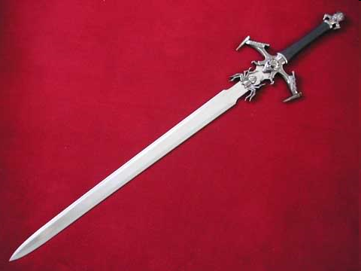
Even though He was the Prince of Peace according to Isaiah 9:6, he says of himself in Matthew 10:34 ~
“Think not that I am come to send peace on earth: I came not to
send peace, but a sword.” KJV

Slide 50

What is that sword He is referring to?

Slide 51
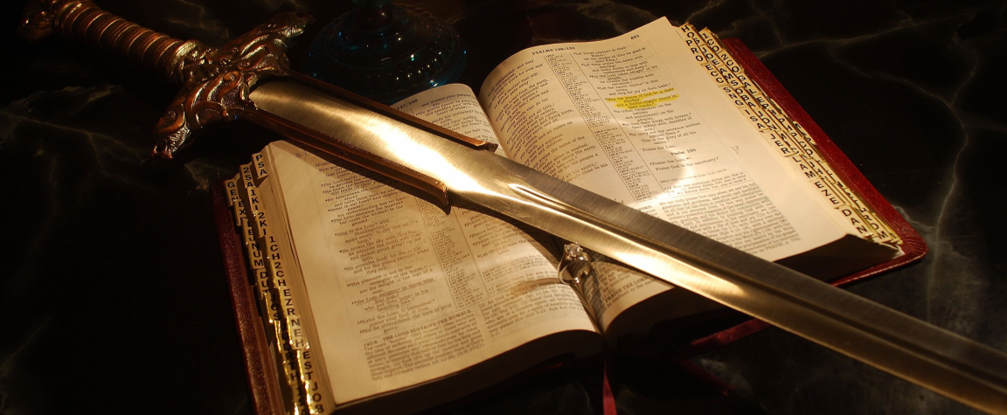
It was His Word starting in Genesis 1:1!

Slide 52

What about today?
Are there
troublemakers today?

Slide 53
Elijah was declared to be a troubler of Israel, Jeremiah a traitor, Paul a polluter of the temple. From that day to this, those who would be loyal to truth, meaning Torah have been often denounced as seditious, heretical, or schismatic.
Multitudes who are too unbelieving to accept the sure word of prophecy, will receive with unquestioning credulity an accusation against those who dare to reprove fashionable sins.

Slide 54
To be called seditious, heretical and schismatic are very serious accusations against those that try to follow the instructions of YHVH,
trying to be peacemakers,
trying to uphold HIS standards!
Notes:
GC 4548seditious, heretical, or schismatic

Slide 55
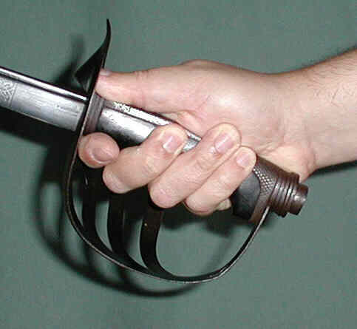
Let’s be reminded again of the words of Yahusha in Matthew 10:34-36 KJV.
“Think not that I am come to send peace on earth: I came not to send peace, but a sword. 35. For I am come to set a man at variance against his father, and the daughter against her mother, and the daughter in law against her mother in law
36. And a man’s foes shall be they of his own household.”

Slide 56
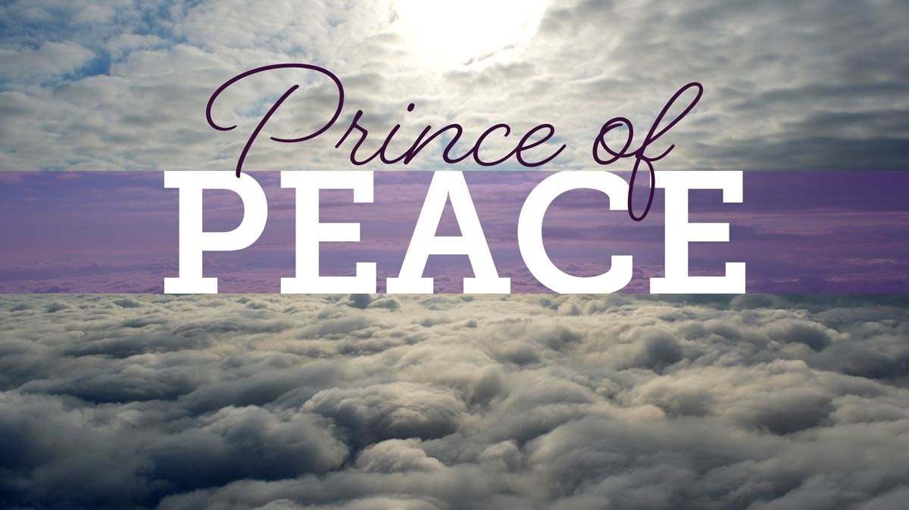
Think about it: the Prince of Peace was the cause of division. He who came to proclaim glad tidings and to create hope and joy brought controversy.

Slide 57
What can His followers
expect?
Think about it: the Prince of Peace was the cause of division. He who came to proclaim glad tidings and to create hope and joy brought controversy.

Slide 58
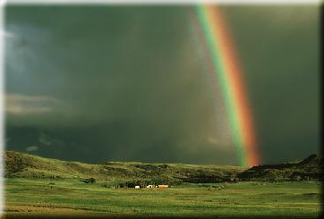
And He warns His followers, “In the world ye shall have tribulation.”
John 16:33 KJV
“They shall lay their hands on you, and persecute you, delivering you up to the synagogues, and into prisons, being brought before kings and rulers for My names sake.” Luke 21:12 KJV

Slide 59
"Ye shall be betrayed both by parents, and brethren, and kinsfolks, and friends; and some of you shall they cause to be put to death."
John 16:33; Luke 21:12, 16; KJV

Slide 60
Peacemakers or troublemakers? Which is it?
It is actually both!

Slide 61
It depends on
Who you ask!

Slide 62
Peacemakers are at times wrongfully labeled troublemakers by those
that are disturbed by
the message!

Slide 63
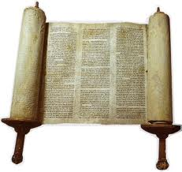
The world is no more in harmony with the principles of Yahusha revealed in the Torah today than it was in the past. The same hatred that prompted the cry, “Crucify Him! Crucify Him!”
the same hatred that led to the persecution of the disciples,
still works in the children of disobedience today.

Slide 64
The history of truth has ever been the record of a struggle between right and wrong, between good and evil, between truth and error.

Slide 65
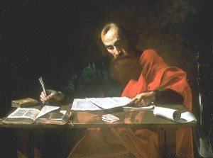
The apostle Paul declares in
2 Timothy 3:12 that all that will
live godly in Yahusha Ha Mashiach shall suffer persecution.
One reason that most people are not being persecuted because of their faith is because they have conformed to the world’s standards, teachings and traditions and therefore there is no opposition.
In other words they have compromised and do not follow the pure and holy faith of their spiritual fathers Abraham, Isaac and Israel!

Slide 66
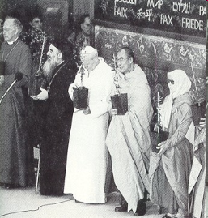
True followers of Yahusha cannot join the ecumenical movement as an example.
If they do anyhow, they will have to do some serious compromising with salvational issues and principles.
Remember, we can follow and obey
only ONE master. It is our choice to follow tradition or truth!
Living and proclaiming Torah makes enemies!

Slide 67
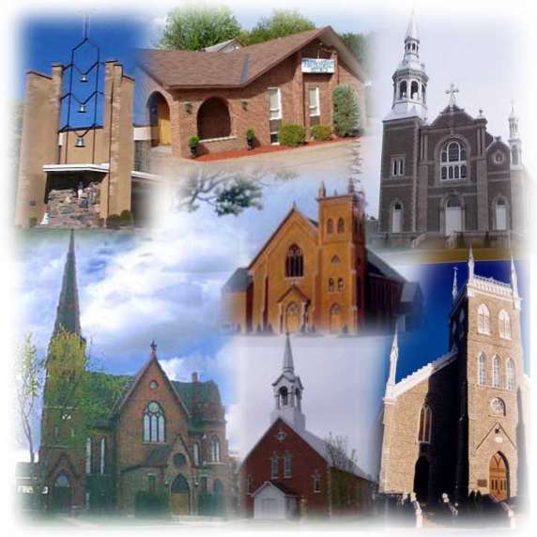
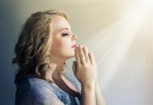
It is impossible to be a member of
any church or organization today in regular and good standing, and at the same time follow a “thus saith YHVH” because you must submit to their established creeds or doctrines in order to be part of their congregation.
The second commandment states “thou shalt have no other gods before me!” (Exodus 20:3) KJV
Following the traditions, teachings and doctrines of man would be worshipping other gods!

Slide 68
Paul had the same problem as he states in Galatians 4:16 “Am I therefore become your enemy, because
I tell you the truth?” KJV
What seemed to be the cause
of the problem for Paul?
It was TRUTH!

Slide 69
What is wrong with truth?
Why don’t people want to
hear the truth?
Why is there such resistance against truth?
Because truth requires a decision to stand for something. There is a change in thinking and action and sacrifices involved!

Slide 70
Here are the facts, wherever Paul preached there was either
a revival or a riot!
There was either a new congregation started,
or he was jailed.
The faithful presentation of the message of truth
will always cause division.
And upon the messenger of truth
the blame of the trouble will be cast.

Slide 71
Here are the facts, wherever Paul preached there was either
a revival or a riot!
There was either a new congregation started,
or he was jailed.
That is a promise!
The faithful presentation of the message of truth
will always cause division.
And upon the messenger of truth
the blame of the trouble will be cast.

Slide 72
Who, or what, should be causing division
and trouble?
Should it be the message or the messenger?
It is the message of truth alone
that must do the cutting,
not the messenger
presenting the message!

Slide 73
One must be sure that it is not the messenger that is causing the problem by his way of presenting the truth
in a condemnatory,
accusing & hateful manner!

Slide 74
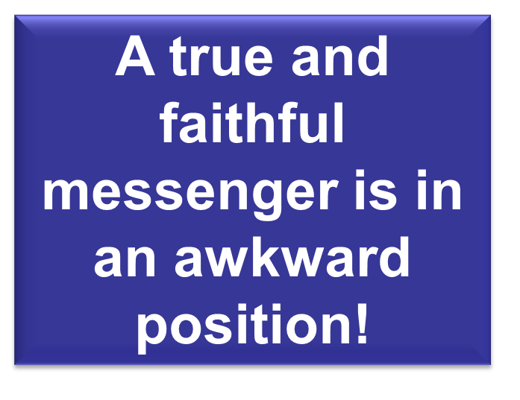

Slide 75
A faithful messenger of YHVH should have no scruples to preach the truth as it is found in Scripture. That was Paul’s advice to the young Timothy when he told him in 2 Timothy 4:2 KJV “Preach the word; be instant in season,
out of season; reprove, rebuke, exhort with
all longsuffering and doctrine.”
Truth must be proclaimed. Only the false shepherds preach a peace and safety message!

Slide 76
Anyone who defends the honor of YHVH and upholds HIS Torah will sooner or later bring censure and condemnation upon himself from the majority of people.
That was the case in the past,
it is the case at present and
will be so in the future.

Slide 77
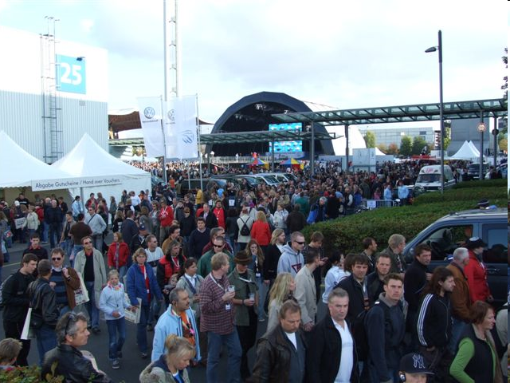
The majority was never right!

Slide 78

How does one become a troublemaker in a church?
What made Elijah a troubler in Israel?
What made Jeremiah
a traitor or Paul
a polluter of
the temple?

Slide 79
Very simple ~ just by living a set-apart life, by standing up for the principles of Torah and
by daring to reprove
fashionable sins!

Slide 80
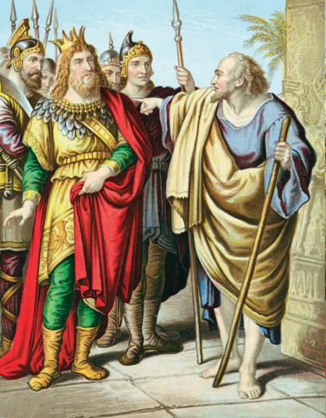
What was the question of Ahab
to Elijah?
“Art thou he that troubleth Israel?”
What was
Elijah’s answer?

Slide 81

“I have not troubled Israel; but thou and
thy father’s house,
in that ye have forsaken the commandments of YHVH, and thou hast followed Baalim.”
1 Kings 18:17-18 KJV

Slide 82

Yahuwah’s followers
are called to be peacemakers, not by compromise or watering down the message but by living the truth and preaching it with determination: lovingly, patiently and kindly.

Slide 83
However, it usually doesn’t matter how kindly, lovingly and carefully a person presents truth he/she
will most of the time
be considered by the majority as a troublemaker!
Why?

Slide 84

Because
Truth Hurts!
And Truth
Makes People
Uncomfortable!

Slide 85

The truth will set you free, but first it will
make you miserable. Attributed to James A. Garfield
Every truth passes through three stages before
it is recognized. In the first, it is ridiculed,
in the second it is opposed, in the third it is
regarded as self-evident. Arthur Schopenhauer

Slide 86
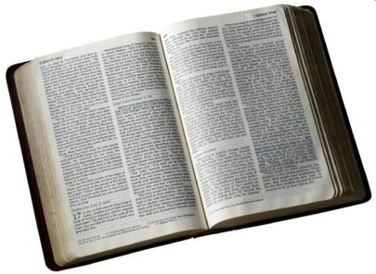
Yahusha spoke the truth.
That is the reason the Sadducees and Pharisees did not believe Him.
He said, “Because I tell you the truth, ye believe me not” (John 8:45).
It was the truth then that offended these
self-righteous men, and it is truth today
that offends people.

Slide 87
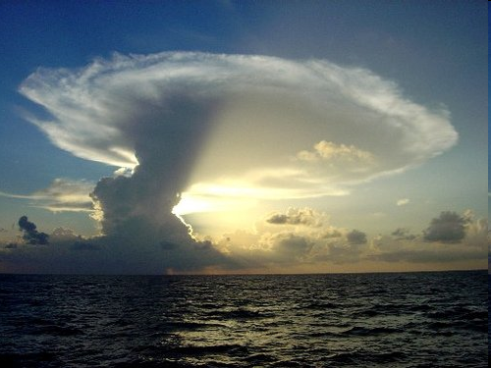
And truth is always truth, it never changes, because YHVH never changes according to Malachi 3:6!
87

Slide 88
Truth never changes because of circumstances. That means it is absolute and not relative as some people think.

Slide 89
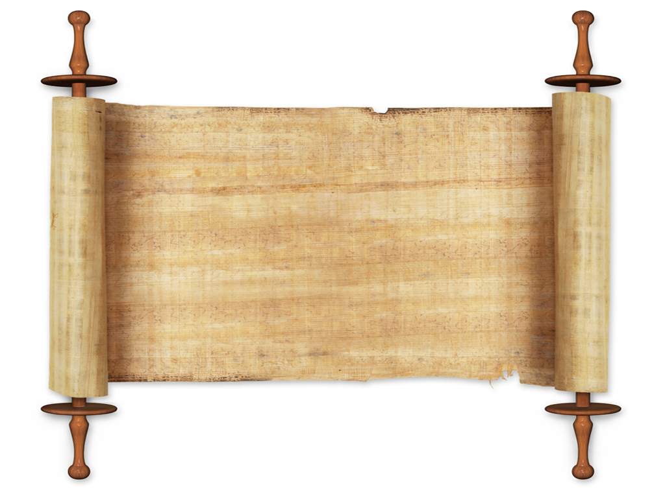
Think about that…
“It is better to be divided by truth than to be united in error!” (Adrian Rogers)

Slide 90
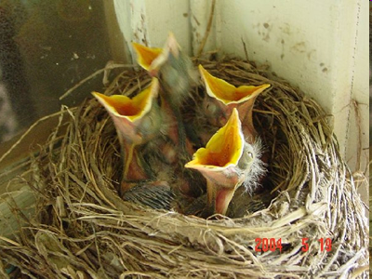
We can count on the birds; they know their time and they obey!

Slide 91
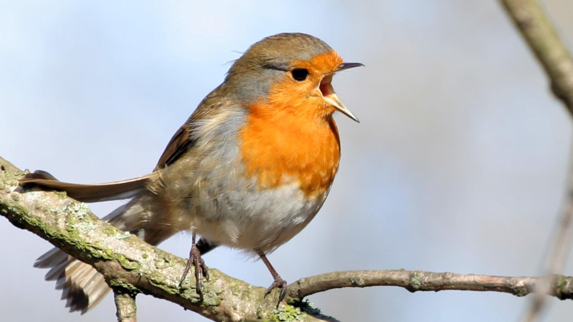
The birds know when the day begins by starting to sing even before dawn!

Slide 92
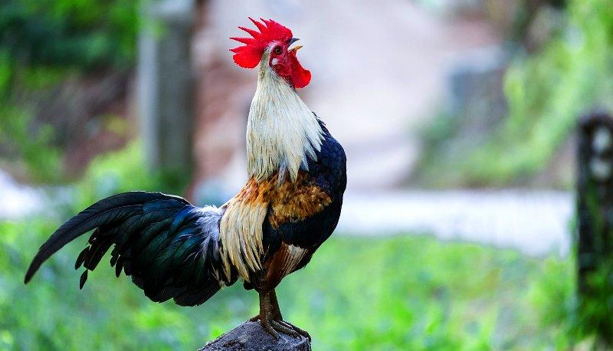
The rooster
knows that the day begins before dawn!

Slide 93
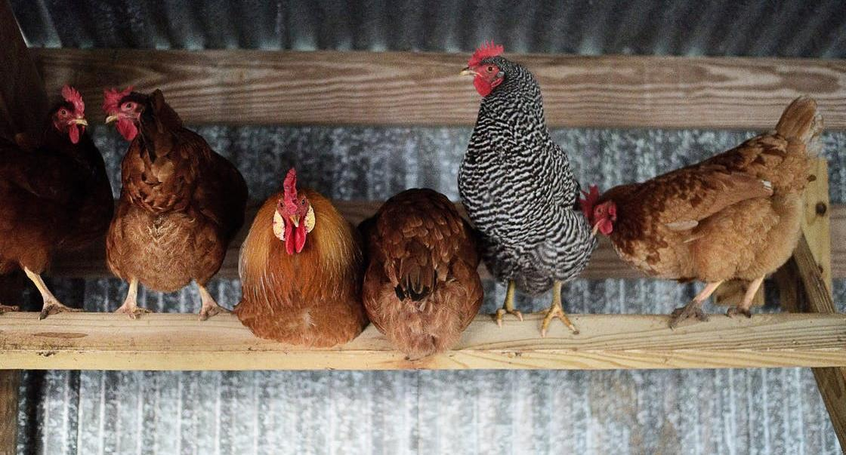
Chickens know that the night begins at dusk
and they start settling down for the night!

Slide 94
Only man is the
“troublemaker” trying to convince people that a
new day begins at sundown !

Slide 95

Question, if the day really begins at sundown, when does the night begin?

Slide 96
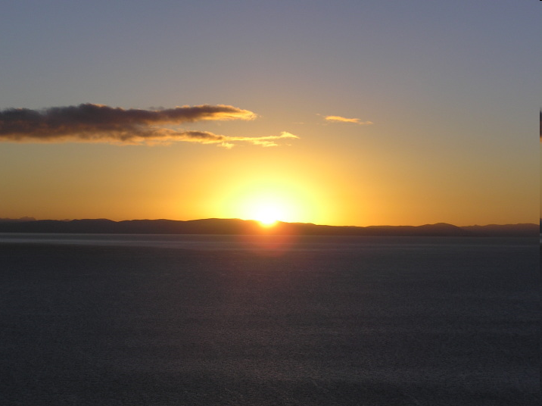
We can depend on the sun!
The sun knows when to rise and when to set. (Psalm 104:19)

Slide 97

We can count and depend on nature. That is absolute truth!
Why is that the case?

Slide 98
Who created all these things that we can count and depend on?

Slide 99
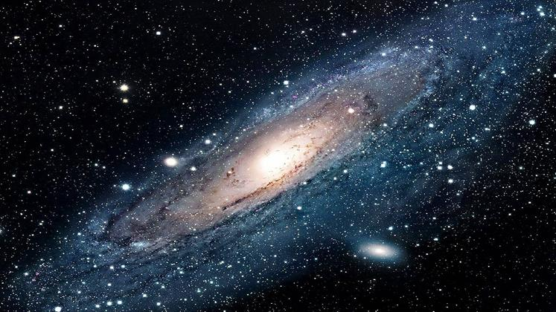
According to Hebrews 1:2 it was Yahusha,
the Son of YHVH.
And according to John 14:6 HIS Word (the Torah) is “The Truth!” KJV
THE ABSOLUTE TRUTH!

Slide 100
Yahusha is the mainstay of hope, security and guidance. He walked on water, was divine, performed miracles, healed the sick, calmed the storm with a command and rose from the dead. He was the truth, He was the originator of truth, the truth revealed.
That truth as stated is revealed in Torah!

Slide 101

When we look at Torah, we look into the righteousness of YHVH. The Torah is the will and wisdom of YHVH, His self-disclosure to the world. When we investigate Torah, we see our Master, we see His very character, the way,
the truth and the life. Yahuwah designed everything in Torah to remind us of who we are!
From the clothes we wear to the food we eat to the days
we celebrate; He gave us every instruction to remind us
that we are His set-apart and righteous people!
101

Slide 102

Being without Torah is like a fish without water.

Slide 103

lllll
But for some reason there
seems to be a problem when people hear about Torah, commandments and statutes.
They immediately get nervous and treat one as a troublemaker, even though the Torah contains good tidings and is designed to bring peace and happiness.

Slide 104
“And now, Israel, what doth Yahuwah thy Elohim require of thee, but to fear Yahuwah thy Elohim, to walk in all his ways, and to love him, and to serve Yahuwah thy Elohim with all thy heart and with all thy soul, 13. To keep the commandments of Yahuwah, and his statutes, which I command thee this day for thy good?” Deuteronomy 10:12-13 (KJV)

Slide 105
lllll
So, why are people getting upset and angry when the
Torah and the yearly appointed times
[as an example]
are being presented to them?

Slide 106
lllll
What’s wrong with
these instructions from
the Creator?
It is the covenant between Him and His people, renewed through Yahusha the Messiah.
The goal of Torah is Messiah, not Jewish expression.

Slide 107
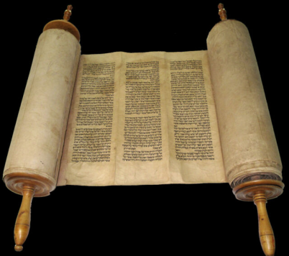
YHVH’s followers are to be sealed with His Torah according to Isaiah 8:16
“Bind up the testimony, seal the law
(#H8451 – Torah)
among my disciples.”

Slide 108
Are we as followers of Messiah
interested in causing trouble, or are we interested in pleasing Yahuwah
and in the salvation of souls?
But most of the times the followers of Yahuwah are wrongfully labeled troublemakers!
Let’s be encouraged by the words of the Saviour in
Matthew 5:10-12 …

Slide 109
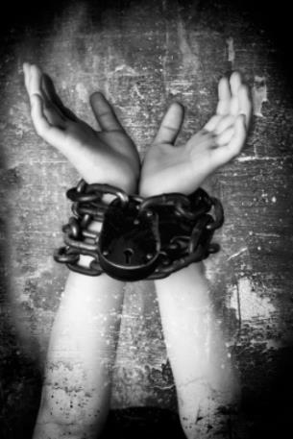
“Blessed are they which are persecuted for righteousness’ sake;
for theirs is the kingdom of heaven.
11. Blessed are ye, when men shall revile you, and persecute you, and shall say all manner of evil against you falsely, for my sake. 12. Rejoice, and be exceeding glad, for great is your reward in heaven, for so persecuted they the prophets, which were before you.” Matthew 5:10-12 (KJV)

Slide 110


Slide 111
YHVH’s people were called Troublemakers in the past and
they are being called that now,
because truth has not changed!

Slide 112
MY COMMITMENT!
I’ll walk with the Elohim of Abraham, Isaak and Jacob
From this day on, His helping hand I’ll lean upon.
This is my prayer, my humble plea, May Yahuwah ever be with me.
There is no fear when I’m near to Him.
I’ll lean on Him forever and He’ll forsake me never.
He will not fail me as long as my faith is strong,’
Whatever road I may walk alone.
I’ll walk with Yah, I’ll take His hand.
I’ll talk with Him, He’ll understand.
I’ll pray to Him each day, and He’ll hear the words that I say.
His hand will guide my throne and rod,
And I’ll never be alone, while I walk with YAH!
112

Slide 113

SHALOM

Slide 114
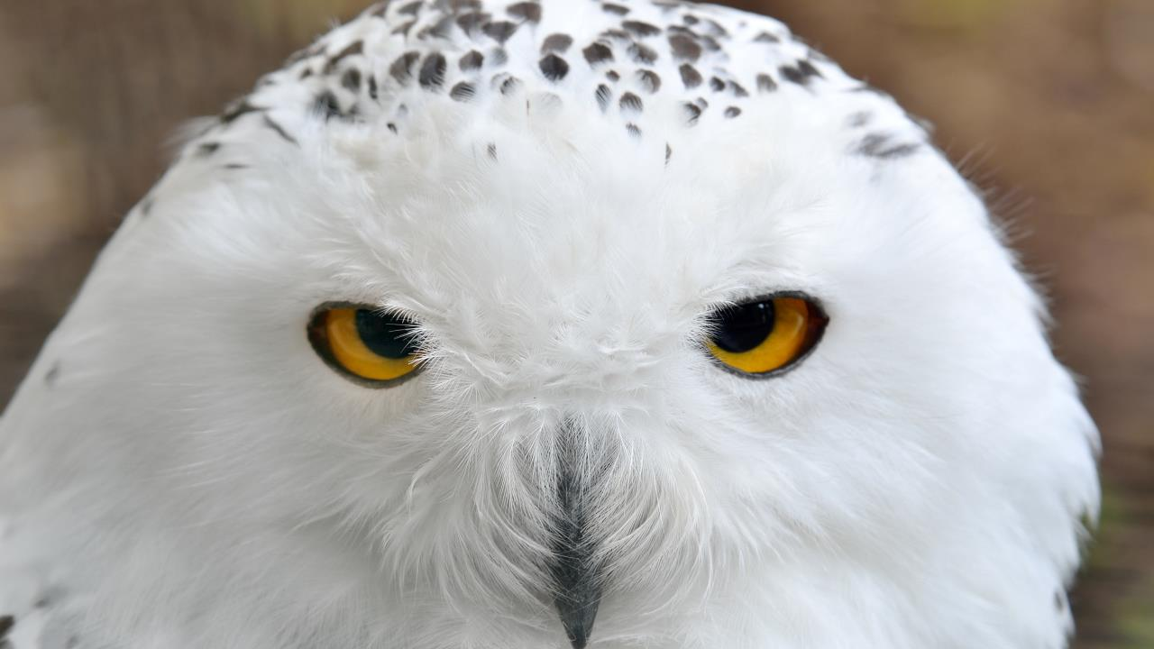


Slide 115

Supreme Provider
Yahusha Ha Mashiach
Arranged and narrated
by Walter Tschoepe
Malachi4.4@Reagan.com

