Slide 1
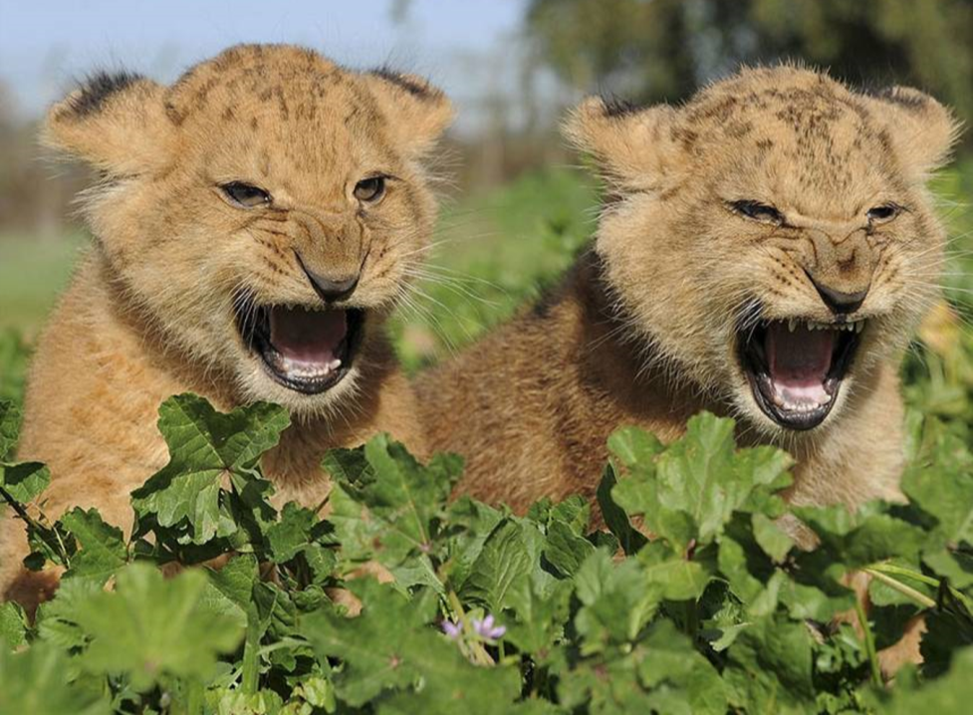

The Unpardonable Sin!

Slide 2
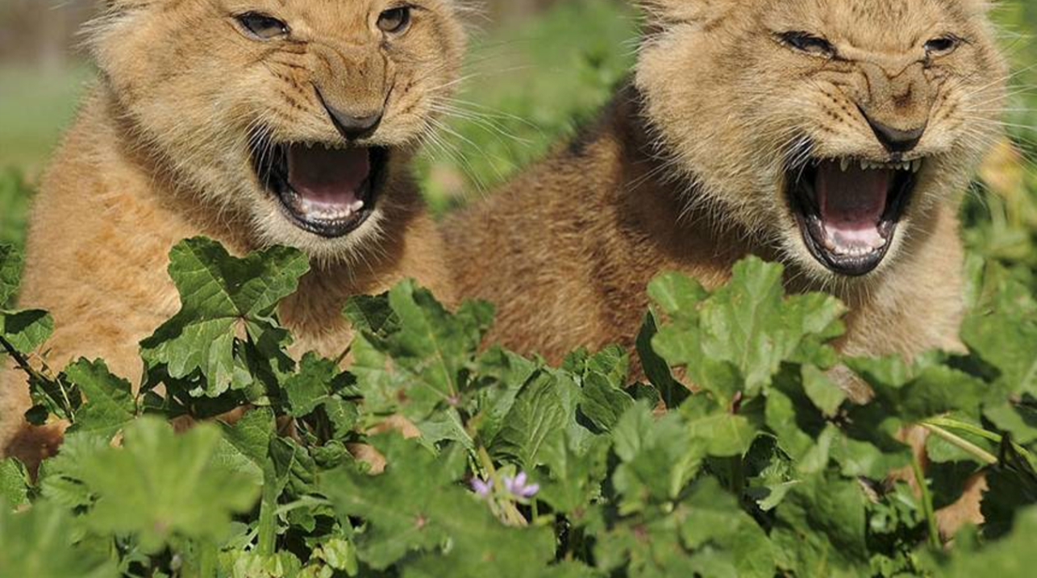
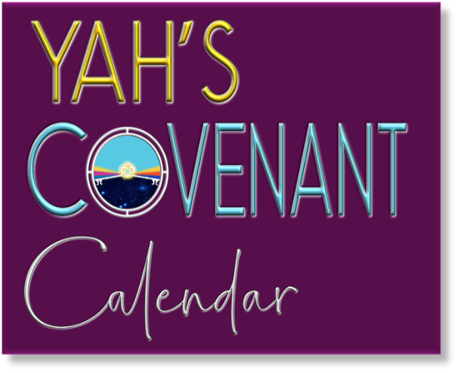
A TEACHING FROM:

Slide 3
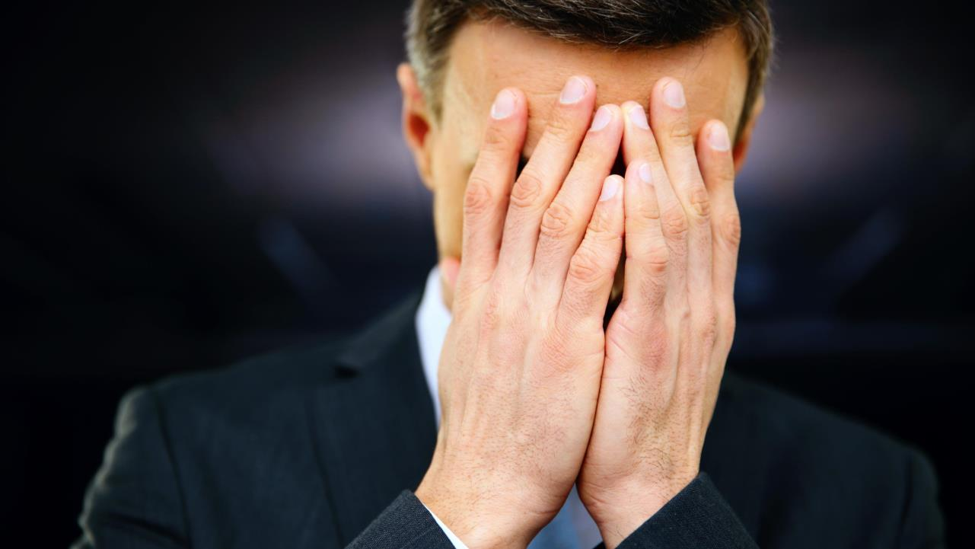
Also known as: “the great transgression,”
“the sin against the Holy Spirit” or
“sinning with
a high hand,”
or
“the sin of presumption.”

Slide 4

YHVH (pronounced as Yahweh or Yahuah) is the name of the Heavenly Father. His name, which He says is
"My memorial to all generations," (see Exodus 3:15) carries the meaning of "He is," or "He causes to be.”
Bible Translators admit to removing His Name over 7000 times from our Bibles and replacing it with the Title LORD and God, which applies to any pagan god or idol.
Why is it that Satan’s name does not change in the Bible, but the names of Yahuwah, and His Son Yahusha,
have deliberately been removed?

Slide 5
YHVH (pronounced as Yahweh or Yahuah) is the name of the Heavenly Father. His name, which He says is
"My memorial to all generations," (see Exodus 3:15) carries the meaning of "He is," or "He causes to be.”
Bible Translators admit to removing His Name over 7000 times from our Bibles and replacing it with the Title LORD and God, which applies to any pagan god or idol.
Why is it that Satan’s name does not change in the Bible, but the names of Yahuwah, and His Son Yahusha,
have deliberately been removed?
Was it done on purpose, inspired by Satan?

Slide 6
Now to our presentation
“The unpardonable sin!”

Slide 7

Matthew 12:31-32
“Wherefore I say unto you, all manner of sin and blasphemy shall be forgiven unto man, but the blasphemy against the Holy Ghost (Spirit) shall not be forgiven unto men 32. And whosoever speaketh a word against the son of man, it shall be forgiven him; but whosoever speaketh against the Holy Ghost, it shall not be forgiven him, neither in this world, neither in the world to come.” (KJV)

Slide 8
According to Yahusha we are dealing here with a profoundly serious sin, a sin that cannot be forgiven, neither in this world, nor in the world to come.
If something is that serious,
should we be aware of it?
Should we find out what this sin constitutes?

Slide 9
I personally believe when it speaks of the Spirit in these verses it refers to the Father Himself! Why? Because in John 4:24 it says, “Elohim is Spirit, and those who worship Him need to worship in spirit and truth.”
(The Scriptures 2009).
Or: John 15:26 “And when the Helper comes,
whom I shall send to you from the Father,
the Spirit of the Truth, who comes from the Father,
He shall bear witness of Me.” (The Scriptures 2009).

Slide 10
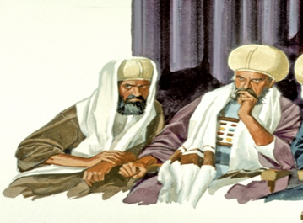
Yahusha was speaking to the Pharisees and Sadducees who
were accusing Him
of casting out demons by Beelzebub, the ruler of the demons.

Slide 11
So we need to understand that the Spirit of Truth is the power and breadth of YHVH given to Yahusha and given to us so that we can listen to that still small voice and obey His Scriptures.
If we choose to reject His Spirit that is pointing us back to repentance and obedience to His Torah,
we have rejected the only way
we will ever know what truth is.

Slide 12
By repeatedly and stubbornly refusing to obey Yahuwah’s commandments, statutes and judgments we are grieving His Spirit and eventually we will no longer hear His Spirit speaking to us.
Then we are made ready to receive the deceiving Spirit of Satan, to believe his lies of lawlessness. Therefore, it is so important to obey
the Scriptures the minute we understand what it says, and to change our ways.

Slide 13
Yahusha thus regards blasphemy against the Spirit as permanently rejecting His identity as attested by the Spirit’s works as the worst of sins (Matthew 12:18,28). Many pastors, elders and church members in Christianity, who refuse to obey YHVH’s Torah are committing the unpardonable sin because they have hardened their hearts for the love of money and preaching sweet messages of lawlessness to deceive their flock into remaining in their churches.

Slide 14
Consider Proverbs 28:9 “He who turns away his ear from hearing the Torah, Even his prayer is an abomination.” (KJV)
When the Jews rejected Yahusha, they rejected the only hope they ever had of being saved as Yahusha said ...
“I am the door: by me if any man enters in, he shall be saved, and shall go in and be saved” (John10:1). (KJV)
Acts 4:12 tells us: “There is no other name by which you can be saved.” And that name is Yahusha!

Slide 15
Consider John 14:6
“יהושע (Yahusha) said to him, “I am the Way, and the Truth, and the Life. No one comes
to the Father except through Me.”
(The Scripture Version 2009)
That claim cannot be made for the Greek Jesus!
This should be emphasized!

Slide 16
If you are trusting in the man-made “Jesus” (the lawless one), the one who did not die for your sins, you are deceiving yourself and deliberately grieving the Spirit of YHVH.
There was no Jesus 2,000 years ago that died for you.
You may have called on him unknowingly,
but when you hear the truth, and the facts,
you are accountable for your actions from then on.
When you know the truth, or could have known the truth,
and refuse to change your ways, it is sin to you.
(See James 4:17).

Slide 17
Look at Deuteronomy 18:15-19.
“YHVH your Elohim will raise up for you a prophet like me from among you, from your brothers. It is to him you shall listen, just as you desired of Yahuwah your Elohim at Horeb on the day of the assembly.
I will raise up for them a prophet like you from among their brothers. (Yahusha will come to them as a human, He is YHVH in the flesh), And I will put my words in his mouth, and he shall speak to them all that I command him. And whoever will not listen to my words that he shall speak in my name, I myself will require it of him.” (This is judgment!)

Slide 18
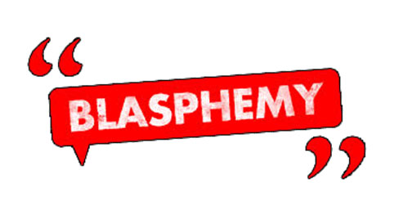
Yahusha thus regards blasphemy against the Spirit, as permanently rejecting His identity, (Matthew 12:18)
as attested by the Spirit’s works, (12:28)
as the worst of sins.

Slide 19

What happened in the city of Capernaum when people remained hard of heart and stubborn?

Slide 20
The situation was similar in the biblical city of Capernaum, where Yahusha performed an extraordinary number of miracles and taught many important public lessons.
In the end, most of the people of Capernaum remained unrepentant. Like the Pharisees, they persistently rejected the convicting ministry of the One who bore witness
to the true identity of Yahusha, their Messiah.
They turned away from the abundant light graciously provided to them and chose to remain forever in their unbelief.
They persistently refused to listen to anything
the set-apart Spirit was telling them.

Slide 21
Like the Pharisees, they chose self-imposed blindness and stubbornness. For this reason, they were strongly judged. “For unto whomsoever much is given,
of him shall be much required” (Luke 12:48). (KJV)
Thus, along with nearby Chorazin and Bethsaida,
Capernaum received a very stern warning from Yahusha,
“It shall be more tolerable for the land of Sodom in the day of judgment, than for thee” (Matthew 11:21-24). (KJV)

Slide 22
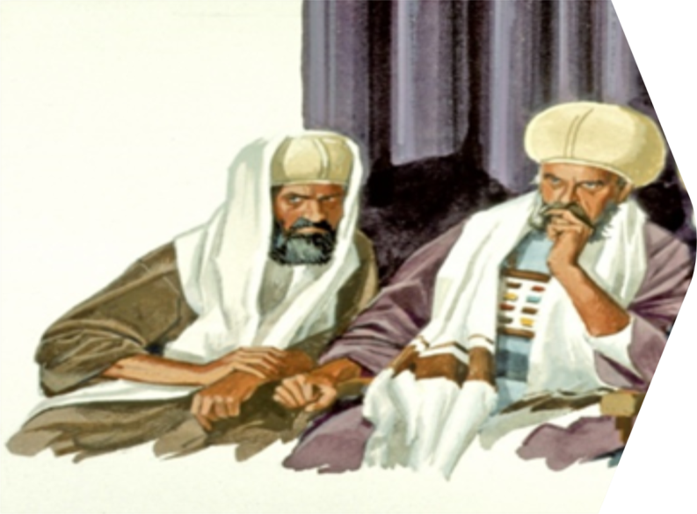
Let’s look at the sin
of the Pharisees and Sadducees. Why were these so serious to Yahusha?

Slide 23
The Pharisees had long observed the sinless Yahusha.
They knew the Scriptures about the coming Messiah, yet
they simply refused to accept Yahusha as their Messiah.
By the way, today they still reject Yahusha, the true Messiah. Bible prophecy about Yahusha was being fulfilled right before their eyes. They observed Him performing undeniable and powerful miracles that were,
at the very least, clear evidence of power supplied by YHVH. These impressive miracles were freely given in pure kindness and love to release people from obvious suffering
and the oppression of horrible evil.

Slide 24
The Pharisees had so firmly set their hearts against accepting Yahusha as the Messiah that they rejected the obvious truth before them and perversely twisted it to influence the crowds. They publicly credited the most ultimate evil being in the universe with these precious, divine miracles. In other words, they called the precious and set-apart Spirit of YHVH as the unclean spirit of Satan.
In effect, they charged Yahusha Messiah with sorcery;
one who is in league with Satan. These charges are not only appalling and extremely serious, but clearly absurd!

Slide 25
As Yahusha immediately responded,
“How can Satan cast out Satan? If a kingdom is divided against itself, that kingdom cannot stand.
And if a house is divided against itself, that house cannot stand. And if Satan has risen up against himself, and is divided, he cannot stand, but has an end. No one can enter a strong man’s house and plunder his goods, unless he first binds the strong man. And then he will plunder his house”
(Mark 3:23-27; also see Luke 11:14-23). (KJV)

Slide 26
King David knew about the unpardonable sin, which he called the sin of presumption.
We read in Psalms 19:13 his exact words:
“Keep back thy servant also from presumptuous sins, let them not have dominion over me:
then shall I be upright, and shall be innocent from the great transgression.” (KJV)
David also calls this presumptuous sin,
“the great transgression.”

Slide 27
Why did he call this sin “the great transgression?”
By committing this sin,
man is crossing the line of no return.
Then David uses the word “presumption.”
What does it mean? The word “presume” - “presumptuous” and “presumptuously” appears 11 times in the Bible
(10 times in the OT and 1 time in the NT).
Presumption according to the dictionary means = a thing taken for granted, an assumption or supposition.
In other words: you are assuming something
instead of checking it out.
.

Slide 28

reality, modesty, knowledge, humility, fact, shyness, timidity, measurement,
certainty, proof
what’s the
opposite of
presumption?

Slide 29
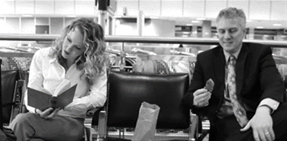
Who’s
Cookies?
I would like to prove this point with a story I received some time ago, called:

Slide 30

A woman was waiting at an airport one night.
With several long hours before her flight,
She hunted for a book in the airport shops.
She bought a bag of cookies and found a place to drop.
She was engrossed in her book but happened to see,
That the man sitting beside her, as bold as could be,
Grabbed a cookie or two from the bag in between,
Which she tried to ignore to avoid a scene.

Slide 31
So she munched the cookies and watched the clock,
As the gutsy cookie thief diminished her stock.
She was getting more irritated as the minutes ticked by,
Thinking, "If I wasn't so nice, I would blacken his eye."
With each cookie she took, he took one too,
When only one was left, she wondered what he would do.
With a smile on his face, and a nervous laugh,
He took the last cookie and broke it in half.

Slide 32
He offered her half, as he ate the other,
She snatched it from him and thought ... oooh, brother.
This guy has some nerve and he's also rude,
Why he didn't even show any gratitude!
She had never known when she had been so galled,
And sighed with relief when her flight was called.
She gathered her belongings and headed to the gate,
Refusing to look back at the thieving ingrate.

Slide 33
She boarded the plane, and sank in her seat,
Then she sought her book, which was almost complete.
As she reached in her baggage, she gasped with surprise,
There was her bag of cookies, in front of her eyes.
If mine are here, she moaned in despair,
The others were his, and he tried to share.
Too late to apologize, she realized with grief,
That she was the rude one, the ingrate, the thief.

Slide 34
How many times in our lives have we absolutely known that something was a certain way, only to discover later that what we believed to be true ... was not?
The lady in that incident was presuming something that was not true, and she made no effort of finding out the facts.

Slide 35
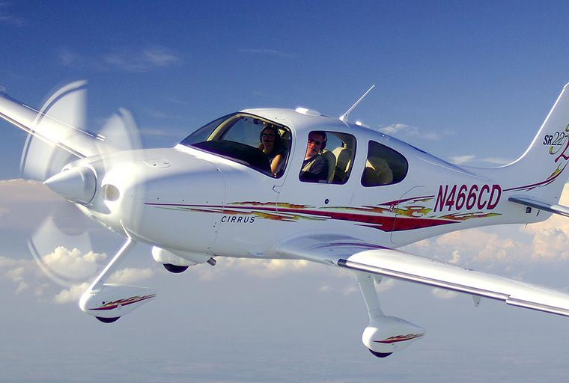
For example, you assume you have enough oil in your car, you assume you have enough fuel in your airplane.
Is that a safe position to take?
WHY NOT?

Slide 36
Because you are playing with your very life in this case, so you better be sure that you have enough fuel in
your airplane before you take off.

Slide 37
Can we ever be saved in presuming, assuming or guessing?
Either YHVH has said it and it is a salvation issue, and we accept and follow it, or YHVH has not said it, and it is not important, so we must ignore it!

Slide 38
The same applies to YHVH’s word.
We are warned several times in Scriptures,
not to add or take away anything from His word. Look at Proverbs 30:6 as an example, where it says, “Do not add to His Words, Lest He reprove you, and you be found a liar.” (ESV)
Still, our Bibles have been corrupted, changed, things removed, and things added. That is why we need to know the WORD of YHVH and what it says.

Slide 39
Some will argue with this statement,
because they do not know.
Here is just one very big example.
Our Father’s name YHVH (Yahuwah) has been removed almost 7,000 times and replaced with titles like LORD and GOD. This is just one example!

Slide 40
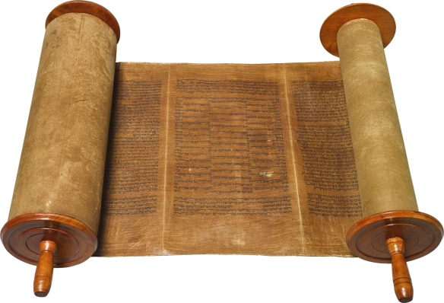
Everything must be compared with the written Torah (preferably the Hebrew Original), which is the foundation,
the constitution.
This is the only document that is trustworthy and dependable.
Whatever comes after the Torah must be compared with that document.

Slide 41
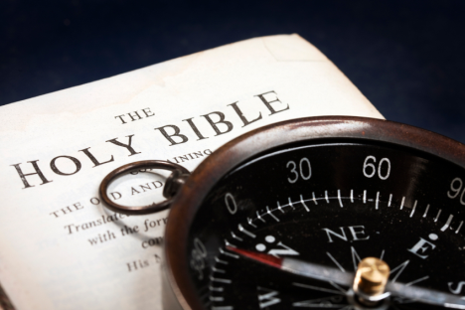
Man has no excuse for ignorance.
He has a chart pointing out every way mark on the heavenward journey; the Holy Scriptures starting in Genesis 1:1, and he should not guess at anything.
Why not? Because an eternity is at stake.
It is a matter of eternal life or eternal damnation.
Man has not been left in the dark.
He can know, and he should find
the answer for himself.
Do not trust a priest, a pastor or a minister of any church or denomination. Do not trust even your own heart.
Get on your knees and in prayer
search for the truth.

Slide 42

The Torah is the absolute truth!
It is dependable, factual and it is always truth!
In salvation issues there are
no gray areas.

Slide 43
According to the Bible, practicing presumption
is equal to deliberately, willfully, knowingly, stubbornly, & continually doing something,
that YHVH in His word said not to do – or – consistently making excuses and refusing to repent while the door of mercy remains open.
In all 11 times in the Bible “presumption”
is punishable by death.
Note, it is punishable by death!

Slide 44

Numbers 15:30-31
“But the soul that doeth ought presumptuously, whether he be born in the land, or a stranger, the same reproaches YHVH; and that soul shall be cut off from among the people.
31. Because he hath despised the word of YHVH, and hath broken his commandments, that soul shall utterly be cut off; his iniquity shall be upon him.” (KJV)
Serious?
There was only one cure, only one punishment,
for this type of sin! That was death!
There was no prayer, and no sacrifice for
the sin of presumption in the Old Testament.

Slide 45
Presumption is a common temptation, and as Satan assails men with this, he obtains the victory most of the time. The people who are most prone to this type of sin, are Christians that believe and preach that the Torah has been done away with at the cross. People that are trusting their spiritual leaders are being led astray. Presumption is Satan's counterfeit of faith.
Faith claims Yahuah’s promises and brings forth fruit in obedience. Presumption also claims the promises,
but uses them as Satan did, to excuse transgression.

Slide 46
In Hebrews 10:25 of the New Testament it says: “For if we sin willfully after that we have received the knowledge of the truth, there remains no more sacrifice for sin.” (KJV)
Is that clear enough?
According to Scripture, Heaven has made atonement
for all sins of ignorance, but there is no provision made
for willful sins or willful blindness.

Slide 47
There are only two kinds of basic sins
mentioned in the Bible:
First: the sins of ignorance
(sins I didn’t know, and I couldn’t have known) and
Secondly: willful sins, or sins of presumption
(these are known sins or sins that I know are wrong,
but I continue to commit them anyway and
refuse to give them up and repent).
James 4:17 - “Therefore to him that knoweth to do good, and doeth it not, to him it is sin.”
Please read Numbers 15:22-29 and Numbers 15:30-31.

Slide 48
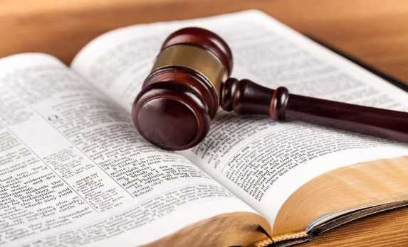
Let me repeat, for the sins of ignorance an offering was to be brought and it would be forgiven, but according to verse 30 for the person or people that presumptuously sinned there was NO hope, NO cure, NO offering, NO forgiveness, NO atonement … How do we relate to that?

Slide 49
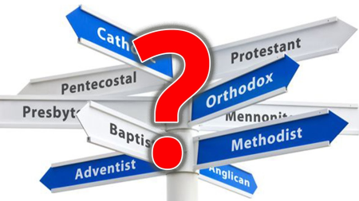
Let me go back to Christianity.
According to Scripture this means
all churches and denominations,
are called Babylon.
Christianity teaches lawlessness,
therefore a Satanic gospel.
Their slogan seems to be:
"We are not under the law, but under grace."
And many people swallow that lie.
That is the catch-all phrase that explains and excuses
all sin and unrighteousness in Christianity.

Slide 50

Here are some examples of statements from Christian denominations in reference to the law.
Question: Have the 10 Commandments been abolished?
Gospelway.com – speaking about “old Testament laws”
“Jesus removed the ordinances, so we need not keep the laws regarding foods, holy days, or the Sabbath (Col. 2:16). But the Sabbath was one of the Ten Commandments hence, all the Old Testament laws were removed, including the Ten Commandments and the Sabbath.”
- Gospelway.com – “Old Testament Laws”

Slide 51
Here is another one with the question from Bible.ca>: “Was the 7th Day Sabbath abolished?”
“Sabbath Keepers refuted.”
“The Sabbath commandment was stated to be abolished in Col 2:14-16. This means that under the New Covenant law, 9 of the 10 commandments have been carried forward and one is abolished.”
This Church comes to the same conclusion as the previous one,
but are they correct?

Slide 52
Here is another one with the question from Bible.ca>: “Was the 7th Day Sabbath abolished?”
Both are completely wrong!
“Sabbath Keepers refuted.”
“The Sabbath commandment was stated to be abolished in Col 2:14-16. This means that under the New Covenant law, 9 of the 10 commandments have been carried forward and one is abolished.”
This Church comes to the same conclusion as the previous one,
but are they correct?

Slide 53
These false teachings are signs of the end times.
The Wicked One referred to in 2 Thessalonians 2:8
is understood to be the "lawless" one.
It is the spirit of anti-messiah that wants to shake off the law, meaning the Torah, and claims it has no place in the life of the Christian believer.
This shows that Christianity is the anti-messiah.
The Bible states, there is “one Torah and one right ruling for you and for the stranger who sojourns with you” (Numbers 15:16).

Slide 54
These false teachings are signs of the end times.
The Wicked One referred to in 2 Thessalonians 2:8
is understood to be the "lawless" one.
It is the spirit of anti-messiah that wants to shake off the law, meaning the Torah, and claims it has no place in the life of the Christian believer.
This shows that Christianity is the anti-messiah.
This is still true today, because Yahusha stated in Matthew 5:17 - “Do not think that I came to destroy
the Torah or the Prophets, I did not come to destroy but to complete.” That simply means to do, to uplift.
The Bible states, there is “one Torah and one right ruling for you and for the stranger who sojourns with you” (Numbers 15:16).

Slide 55
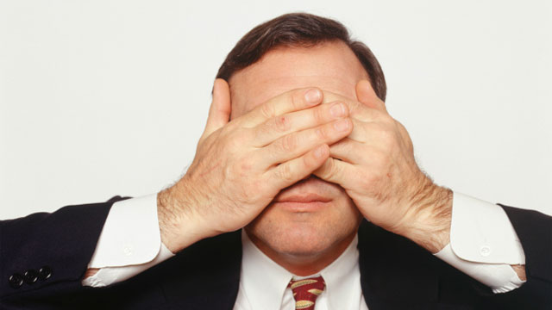
There is a reason for something being called “Babylon,” which is confusion. Christianity is preaching a lawless (Torah-less) gospel. Christianity is
sun-worship, teaching and keeping Sunday, Christmas, Easter, etc.
That is willful blindness!

Slide 56
Yahusha says: “In vain to they worship me,
teaching for doctrines the commandments of men” (Matthew 15:9).
Satan must be in complete control of Christianity, Judaism and all the other pagan religions. Yahusha told the leadership of the Jews when He was walking this earth in John 8:44 - “Ye are of your father the devil, and the lusts of your father ye will do. He was a murderer from the beginning,
and abode not in the truth, because there is no truth in him. When he speaketh a lie, he speaketh of his own: for he is a liar, and the father of it."

Slide 57

Where do we find in the Bible that we are to pray for the repentance of
corporate Babylon? Why not?
They have crossed the line set by YHVH. That is the reason the Bible states in Revelation 18:4 to “come out of Babylon, that ye be not partakers of her sins, and that ye receive not of her plagues.” (KJV)

Slide 58
What was Lucifer’s problem when he fell? Rebellion and Pride!
Did he have time to turn around, to repent? Absolutely! Be he refused to repent!
Where do we find in the Bible
that we are to pray for Satan?
Why not?
He crossed the line set by YHVH
and there is no return.

Slide 59
Are we to pray for the Jewish Nation as a corporate body? Consider Luke 19:41-42 - “And when he was come near, he beheld the city, and wept over it 42. Saying,
if thou hadst known, even thou,
at least in this thy day, the things which
belong unto thy peace! But now they are
hid from thine eyes.” (KJV)
Does that mean that their time as a body, as a nation to repent, has run out? You decide after reading the words of Yahusha in Luke 19!

Slide 60
All these examples show that they refused to admit their guilt, their errors and their rebellion to repent while their door of opportunity was open.
They even went so far as to kill the one that came to save them, the Creator of the universe.
They found themselves in the same position as Ephraim as we read in Hosea 4:17 -
“Ephraim is joined to idols, let him alone.” (KJV)

Slide 61
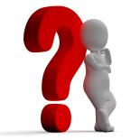
What about Laodicea?
The door for Laodicea is still open.
How long will the door of mercy remain open
for Laodicea? We do not know!!
We have an example in Jeremiah 6:16-17 in reference to Yahuwah’s ancient people, where it says: “Thus saith YHVH, Stand ye in the ways, and see, and ask for the old paths, where is the good way and walk therein, and ye shall find rest for your souls. But they said, we will not walk therein. 17. Also I set watchmen over you, saying, Hearken to the sound of the trumpet. But they said, we will not hearken.”
What do we call that?

Slide 62
What about Laodicea?
The door for Laodicea is still open.
How long will the door of mercy remain open
for Laodicea? We do not know!!
We have an example in Jeremiah 6:16-17 in reference to Yahuwah’s ancient people, where it says: “Thus saith YHVH, Stand ye in the ways, and see, and ask for the old paths, where is the good way and walk therein, and ye shall find rest for your souls. But they said, we will not walk therein. 17. Also I set watchmen over you, saying, Hearken to the sound of the trumpet. But they said, we will not hearken.”
What do we call that?
Rebellion!
This is the same attitude today.

Slide 63

Then we go to Jeremiah 7:16 to hear YHVH’s answer: “Therefore pray not for this people, neither lift up cry nor prayer for them, neither make intercession to me, for I will not hear thee.” (KJV)
WHY NOT?
They have crossed the line. When that happens,
we don’t know …
only YHVH knows.

Slide 64
Deuteronomy 17:12-13 - “And the man that will do presumptuously, and will not hearken unto the priest (the messenger of Elohim, the pastor, minister, elder, etc.) that standeth to minister there before YHVH your Elohim, or unto the judge, even that man shall die; and thou shalt put away the evil from Israel. 13. And all the people shall hear and fear and do no more presumptuously.” (KJV)
In the Old Testament if you disobeyed
the priest or the judge you had to die!
Does that still apply today?

Slide 65
If the minister says what YHVH says, his words have power. If he preaches his own ideas, there is no power. The priest or the minister does not make the law, neither can he change the law by adding or subtracting. He only can preach as it is written. He is authorized only to deliver the unadulterated message.
(Consider Deuteronomy 4:2; 12:32;
Proverbs 30:6 and Revelation 22:18-19.)
.

Slide 66
In the days of Yahusha there would have been many more that would have confessed HIM,
but because of the leadership they did not.
They were afraid of being disfellowshipped.
They were taught that membership assured them a ticket to heaven. (See John 9:22 where we find the story of the blind man that was healed by Yahusha,
and his parents were afraid to tell the truth,
for fear they would be kicked out of the Synagogue.)

Slide 67
Many more would have entered Noah’s ark if they wouldn’t have been misled by their leaders and been held back by their so-called friends.
Only 8 people survived the flood,
because of one man, called Noah.
According to Genesis 6:8 –
“Only Noah found favor in the sight of YHVH!”

Slide 68
Ask yourself the question “WHY?” Genesis 7:1 gives the answer, “Come into the ark, you and all your household, because I have seen that YOU are righteous before Me in
this generation.” (The Scriptures)

Slide 69
There were 7,000 men during the time of Elijah that did not bow their knee to Ba-al.
The Almighty has His 7,000 today, who have not bowed down the knee to the image of Baal (Romans 11:4). His people are not found in
a man-made organized Church or denomination. “For where two or three are gathered together in my name, there am I in the midst of them” (Matthew 18:20). (KJV)
That is His assembly.

Slide 70

I repeat, the Father made abundant provision
for sins of ignorance, but he made no provision
for willful sins.
The unpardonable sin is the sin that stubbornly refuses to confess and to be pardoned.

Slide 71

It is the refusal to listen to His instructions (Torah);
It is the sin of refusing to follow His instruction;
It is the sin of unbelief concerning his warnings;
It is the stubbornness of the heart that will not turn from sin,
that refuses to repent,
which seals the fate of any
people or any individual.

Slide 72
Yahuwah, the Father, works through His Spirit to reprove and to convict a person and if the Spirit’s work is stubbornly, willingly and knowingly rejected, there is no more that He can do for man.
Man will reap what he has sown - eternal damnation!

Slide 73
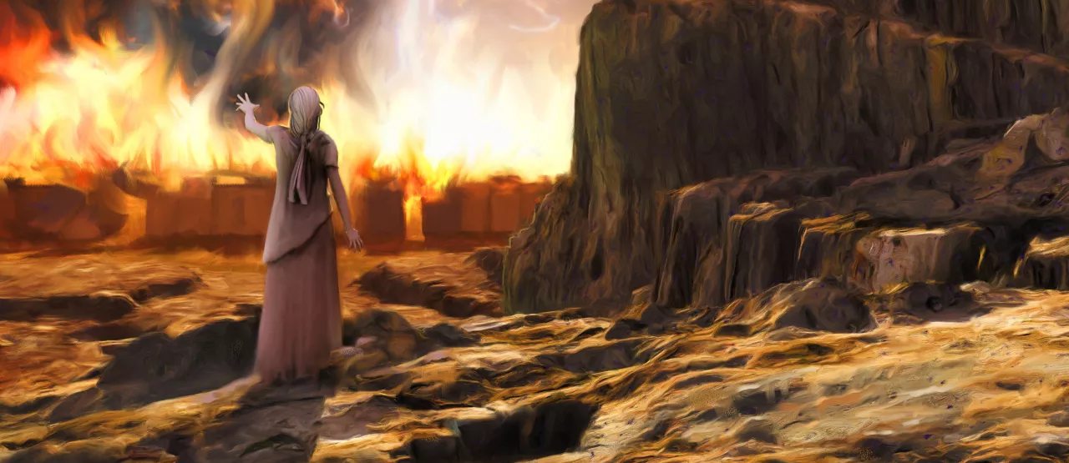
Let us quickly look at some examples of people in the Bible that committed the sin of presumption, or the unpardonable sin!
Lot’s wife is one of them!

Slide 74
She was told not to look back, but she presumptuously looked back anyway. By doing that she rejected the angel’s warning!

Slide 75
The angel explicitly told them in Genesis 19:17 “Escape for thy life; Look not behind thee, neither stay thou in all the plain, escape to the mountain, lest thou be consumed.”
(KJV)

Slide 76
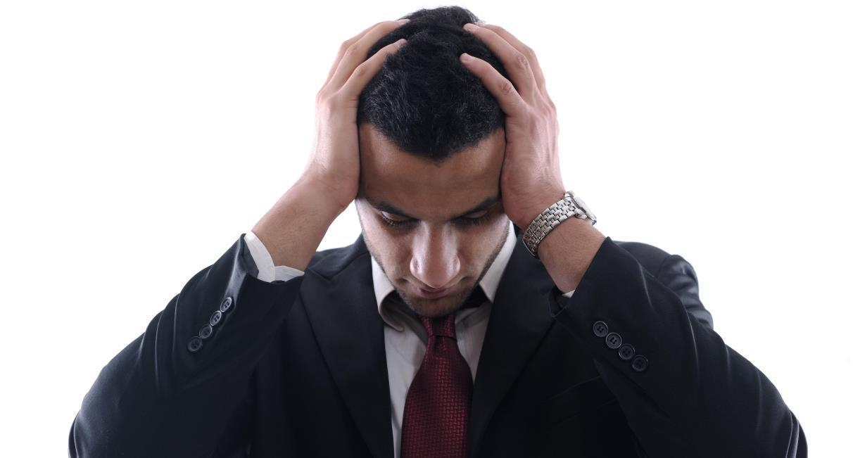
It is a hard lesson for man to learn, that the Most-High means what he says.

Slide 77
What about Nadab and Abihu, the 2 sons of Levi? They committed the sin of presumption by taking common fire and putting it in their censors.
They knew better!
This was in violation of Elohim’s express command.
Because these two sons of Levi knew what the instructions were, why did they not follow them? Who controlled their mind at the time?
Why? Because they were intoxicated.

Slide 78
What about Nadab and Abihu, the 2 sons of Levi? They committed the sin of presumption by taking common fire and putting it in their censors.
They knew better!
This was in violation of Elohim’s express command.
Because these two sons of Levi knew what the instructions were, why did they not follow them? Who controlled their mind at the time?
Why? Because they were intoxicated.
Someone else controlled
them at this time!

Slide 79
Another example is Uzzah.
He committed the sin of presumption when he touched the ark of the covenant, because he knew better.
This incident clearly shows the importance of strictly obeying Yahuwah's instructions.
(See 1 Chron 13:9-10.)

Slide 80
We have another example in Numbers 15:32-36 - “… they found a man that gathered sticks upon the sabbath day. … 35 And YHVH said unto Moses,
the man shall be surely put to death:
all the congregation shall stone him with stones without the camp.” (KJV)
That is exactly what the congregation did.
It was rebellion. There is no cure for rebellion!
Do you think that we have a problem with that type of sin today?

Slide 81

One more question that had been on my mind for a while: “What about King David?”
He was a man after
YHVH’s own heart
according to Scripture
(1 Sam 13:14; Acts 13:22).
He was committed to
Yahuwah's ways and demonstrated fidelity
to the Torah.

Slide 82
David is described as a man of faith (Hebrews 11); a man “after YAH’s own heart” (1 Samuel 13);
and an ancestor of Yahusha himself (Luke 1:32). He was one of the greatest men in Scripture.
Then in Psalms 18&19, he confidently confesses that he is blameless, pure, righteous, and perfect before YHVH who has rewarded him for his “cleanness,” for keeping the “ways of YHVH”
and not “wickedly departing” from HIM.

Slide 83

Yet, we read in Scripture
that he fell at one time
and became a murderous adulterer (2 Sam 11).
King David killed Uriah, the Hittite, after committing adultery with Bathsheba, Uriah’s wife.
How can we explain this action?
Was that the
unpardonable sin?

Slide 84
David was a just and righteous man and even though (to some people) this looked like a presumptuous sin that he committed … I believe it was not.
David fell through lust when he looked at that woman.
It was the second look that brought him down.
Satan arranged matters to tempt David,
because he also knew David’s weakness.
I am thinking about this connection in Proverbs 24:16 where it says, “For a just [righteous] man falleth seven times, and riseth up again:
but the wicked shall fall into mischief.” (KJV)

Slide 85
David fell because of lust, which was a grievous sin. The Father knew that, so He sent the prophet Nathan with some questions in this matter. What mercy! David was immediately convicted of this terrible crime and he penitently cried out “Have mercy on me, O YHVH, according to your steadfast love; according to your abundant mercy blot out my transgressions. Wash me thoroughly from my iniquity, and cleanse me from my sin… Against you, you only, have I sinned and done what is evil in your sight” (Psalm 51:1-5).

Slide 86
Since David acknowledged His sin, repented and pleaded for forgiveness, Nathan assured David
“YHVH also hath put away thy sin; thou shalt not die!”
However, the first child out of this union had to die. YHVH told him in 2 Samuel 12:10 - “Now therefore the sword shall never depart from thine house; because thou hast despised me, and hast taken the wife of Uriah the Hittite to be thy wife.” There was a heavy penalty for him to pay, but because he humbled himself and acknowledged this grievous sin, he was forgiven.

Slide 87

Suppose believers knowingly persist and
go to places they shouldn’t go
to entertain themselves?
Could that turn into the sin of PRESUMPTION?

Slide 88
Suppose believers go and eat things, knowingly, which are an abomination, hoping that YHVH will still bless them, hoping everything is o.k. What kind of an act is that?
PRESUMPTION?

Slide 89
Suppose believers do their own thing or working on the weekly Sabbath as an example, knowing that it is wrong? What kind of an act would that be? PRESUMPTION, that can become the unpardonable sin, if one persists in doing that.

Slide 90
Suppose a believer is dating someone that is an unbeliever according to Scripture, planning to marry that individual but knowing full well what the instructions are about this matter?
What kind of an act is that? PRESUMPTION?

Slide 91

We need to continually hold on to our Savior, Yahusha Ha Mashiach,
as David did, which is recorded in Psalms 19:13:
“Keep back thy servant also from presumptuous sins, let them not have dominion over me, then shall I be upright, and shall be innocent from the great transgression.” (KJV)

Slide 92

Time is short! The time to make things right and turn to the Savior is today!
Do not
push it off.
“Today if ye will hear his voice, harden not your hearts,
as in the provocation” (Hebrews 3:15).
The End

Slide 93
SHALOM

Slide 94


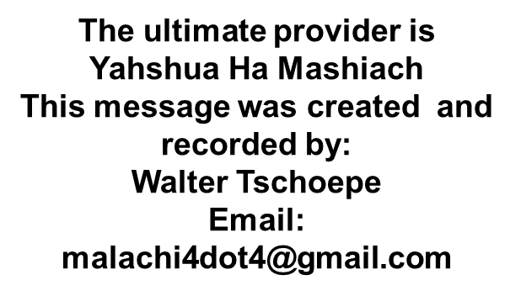
RETURN
to your
TRUE
ROOTS
DIVORCE
the
Babylonian
Church
System
Choose
COVENANT Torah!

