Slide 1



Video jpeg slide – see helps on slides 2, 9, 49, 62
Asked walter if he wanted me to edit and dress slides nov 11/20.
Let neil know the files will be sent after teaching.
Edited to slide 60 and then send a copy to kathleen, neil and walter.
The Spirit of Compromise!
A TEACHING FROM:

Slide 2


And what is the Spirit of Compromise?

Slide 3

Woe to those who call evil good, and good evil; who put darkness for light, and light for darkness; who put bitter for sweet, and sweet for bitter!

Slide 4
In the last days, good will be called evil and evil called good.
Isaiah 5:20

Slide 5
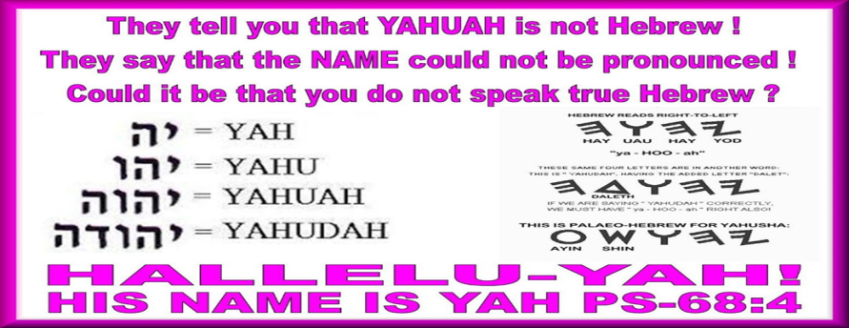
PLEASE NOTE THAT WE USE THE TRUE NAMES OF OUR HEAVENLY FATHER AND SON
Did you know that our Bibles have been deliberately changed to remove the true names of our Heavenly Father and His Son over 7000 times and replaced their true names with titles like God, LORD, Jehovah and Jesus Christ which was deliberately done to deceive us.
5

Slide 6
The world today is in an incredible state of flux and change. Traditional views and values have been altered and almost reversed within a relatively short time. Under the numbing influence of television and the highly mobile electronic media, minds have been manipulated, thought patterns set up, and decisions dictated. And most of the millions so influenced are almost oblivious to the powerful artificial agencies which were used to change their minds and their morals.
Our only safety is to recognize the clever camouflages of the enemy. A thousand disguised death traps have been planted all around us. Almost imperceptibly our thinking has been affected by what we see and hear. Spiritual convictions have softened and disappeared altogether. The fine sensitivity to sin has been blunted by incessant exposure to the apparent innocent influences of our baited society.

Slide 7

It is human to stand with the crowd; it is divine to stand alone.
It is manlike to follow the people,
to drift with the tide; it is godlike to follow a principle, to stem the tide. All compromise is not bad.
But if it concerns sin, and the word of YHVH “stand alone and make no compromise.”
If you feel you are alone, because you follow YHVH, don’t be discouraged, because you are NOT alone!

Slide 8

To give up something that you want or believe in order to make everyone happy. Compromise can also mean holding onto something you enjoy doing even though you know it is wrong in Yahuwah's eyes.
Compromise also means having no set standards or belief systems, go with the flow, to fit in with the crowd.
It's very similar to peer pressure.
Q1 What is the meaning of compromise?

Slide 9

If You Compromise Values to Keep the Peace, You Play a risky Game!
Remember this:

Slide 10
No, Yahuwah hates compromise.
“No one can serve two masters, for either he will hate the one and love the other, or he will be devoted to the one and despise the other.
You cannot serve
Yahuwah and money.”
Matthew 6:24 ESV
(English Standard Version).
Q2 Will Yahuwah understand when you compromise His Commands for the sake of pleasing your family or friends or church?

Slide 11
And calling the crowd to him with his disciples, he said to them, “If anyone would come after me, let him deny himself and take up his cross (beam) and follow me”
(Mark 8:34 ESV). This means denying your own pleasure of fleshly desires and lusts for the sake of loving Yahusha.
Q3 What does Yahuwah say we need to do in order to truly love Him?

Slide 12
“You adulterous people! Do you not know that friendship with the world is enmity (enemy) with Yahuwah? Therefore, whoever wishes to be a friend of the world makes himself an enemy of Yahuwah” (James 4:4 ESV).
“We must obey Yahuwah rather than men” (Acts 5:29 ESV).
Don't deceive yourself.
Yahuwah hates compromise and He will not understand. It's the same as being unfaithful in a marriage and then expect your partner to understand.
Q4 What happens if you love the world and the ways of the world more than Yahusha?

Slide 13
“But Daniel resolved that he would not defile himself with the king’s food, or with the wine that he drank. Therefore, he asked the chief of the eunuchs to allow him not to defile himself” (Daniel 1:8
English Standard Version).
Q5 Did Daniel give into peer pressure in order to please the Babylonian king?

Slide 14

#6
Yahuwah expects those committed
to Him and His ways to be uncompromising (1 Kings 18:21; John 8:47; 10:27; Matthew 6:24). His Word is our primary source of instruction and
What does Yahuwah expect from His people?
authority (Deuteronomy 4:2; Psalm 119:128; Revelation 22:18–19). Our devotion to Yahuwah and His ways leaves no room for deviation (Joshua 24:15; Psalm 119:10, 15). We must not be afraid to expose sin and evil. Remaining silent is the same as being guilty. Colossians 2:8 exhorts,
“See to it that no one takes you captive by philosophy and empty deceit, according to human tradition, according to the elementary spirits of the world, and not according to Yahuwah.” (ESV)

Slide 15
#7
Q 7 - Can we compromise our Biblical beliefs in order to keep unity and peace and focus on
what we have in common?
We are to defend the faith, correcting those who oppose it or are confused.
“Watch ye, stand fast in the faith, quit you like men, be strong. 14 Let all your things be done with charity” (1 Corinthians 16:13–14 KJV).
“And a servant of the Master should not quarrel but be gentle towards all, able to teach, patient when wronged, 25 in meekness instructing those who are in opposition, lest somehow Elohim gives them repentance unto a thorough knowledge of the truth” (2 Timothy 2:24–25 The Scriptures 2009).

Slide 16
#7 (Continued)
We stand firm and uncompromising in faith (truth of the Torah) as we rely on the power of the indwelling Spirit of Yahuwa. “In him you also, when you heard the word of truth, the gospel of your salvation, and believed in him, were sealed with the promised Holy Spirit, 14 who is the guarantee of our inheritance until we acquire possession of it, to the praise of his glory”
(Ephesians 1:13–14 ESV);
“Therefore, my beloved, as you have always obeyed, not as in my presence only, but now much more in my absence, work out your own salvation with fear and trembling; for it is Yahuwah who works in you both to will and to do for His good pleasure” (Philippians 2:12–13 ESV).

Slide 17
#8
Q 8 - What did Yahusha tell us to do IF we love Him?
Yahusha has warned us of the temptation to compromise and equipped us
to remain uncompromising. In John 14:15 Yahusha told His disciples,
"If you love me, you will keep my commandments” (ESV).
“For this is the love of Elohim, that we keep his commandments.
And his commandments are not burdensome ” (1 John 5:3 ESV);
“And this is love, that we walk after his commandments. This is the commandment, That, as ye have heard from the beginning, ye should walk in it” (2 John 1:6 KJV).

Slide 18
# 9
Q9 Why is it important to stay
rooted and grounded in obeying
the Scriptures daily?
The ways of the world are in opposition to the ways of Yahuwah. (Romans 8:6–9). There is a constant battle between the ruler of this world and the Ruler of eternity. As Israelites, we are to be aware of the struggle and choose the side of Yahuwah. There is no middle ground, you are either obeying Yahuwah or obeying Satan.
By your obedience you are serving Yahuwah or by your disobedience you are serving Satan.

Slide 19
# 10
Q10 What do you find in Christian churches today?
There is no longer any repentance and turning away from your sins preached and no-one speaks about obeying Yahuwah’s Commandments (His Torah). It’s all about grace and the Scriptures are twisted to say we no longer need to obey the Torah. Such deception. Everything is about tolerance even if it is wrong in Yahuwah’s eyes. We cannot have fake unity in disobedience to the Scriptures.

Slide 20

2 Timothy 4:3–4 says, "For the time is coming when people will not endure sound teaching but having itching ears, they will accumulate for themselves teachers to suit their own passions and will turn away from listening to the truth and wander off into myths." ESV
Therefore the churches have no more revival or spiritual growth today and look
at the state of the church and the world.
20

Slide 21
# 11
Q11 Surely a little compromise won’t do any harm but will keep the peace bringing people together to worship?
Evil doesn’t corrupt all at once. It is the slow, methodical compromise of morality that leads to destruction. In AD 321 Constantine created the first Sunday law in history to encourage followers of Messiah to honor Sunday instead of Saturday, which is the Biblical Sabbath. After much persecution of Bible following Believers who wouldn’t compromise their faith, and the influence of mixing pagan practices with some Scripture truth, many Christians today think it’s actually honorable to break one of Yahuwah’s commandments. Destruction comes by one tiny compromise at a time.

Slide 22
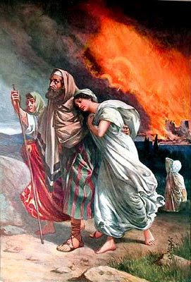

Q12 What price did
Lot pay for
a little bit of compromise?

Slide 23
Lot liked the evil city Sodom because it was very fertile and a good place to do business. Lot knew very well how wicked Sodom was but thought it would not affect his life or his family’s life. In the end, he would pay a terrifying and heart-breaking price for his choices. Living among wicked people, his family, especially his wife, started to enjoy the material things of that city and the evil ways of the culture there. Lot would see the rapid degeneration of Biblical values as an inescapable fact of life. His wife loved Sodom. His wife “looking back” at Sodom, as they ran for their lives out of the city, shows that she wanted to remain in the wicked city and was not Yah fearing or obeying Yahuwah. She already enjoyed all the pleasures of this wicked city. That is why Yahuwah turned her into a pillar of salt.

Slide 24
Lot’s daughters were engaged to be married to two men of the city, You can be sure that they also were wicked men, a move that would have ended his wife’s legacy of raising Yah fearing children. When the two men visited Lot to warn him to get out of Sodom, Lot was prepared to protect these men and rather offer his daughter to these wicked men of Sodom. How far did Lot fall away from Yahuwah. Instead of protecting his daughters and teaching them to love and respect Yahuwah, he did not protect his daughters against evil perverted men, as he should have done. How could Lot do such a thing knowing how wicked those Sodomites were? No one in Sodom listened to Lot’s warnings, including the two men who were about to become his sons-in-law.

Slide 25
The daughters had to make a choice to flee out of Sodom or lose their lives, leaving their future husbands behind. Lot and his daughters alone escaped, and the Satanic culture they left behind suffered a horrible end. Lot’s daughters panicked at the idea of never having children, so they got their father drunk and had sex with him. Lot had not taught his daughters about the fear (respect) of Yahuwah obedience to Yahuwah or trusting in Him. They had no concept that Yahuwah would care for them, if they would only honor and obey Yahuwah and put Him first in their life. They weren’t even willing to wait a few months to see what Yahuwah might do! All this evil and tragedy could have been avoided had Lot not compromised his faith. We have so many examples of tragedies that happened in the Scriptures because of compromise.

Slide 26
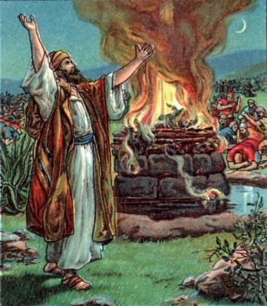
# 13
Q13 What did Elijah tell the people to do who were mixing true worship of Yahuwah with Baal/lord worship?
“Choose this day who you will serve. How long will you waver between two different opinions? If Yahuwah Elohim, follow Him; but if Baal/lord, then follow him” (1 Kings18:21 NIV). And the people did not answer him a word. Are you going to choose Yahuwah or Baal/lord?

Slide 27

# 14
Q14 How do we crucify the flesh
so we can obey Yahuwah fully?
“Put to death therefore what is earthly in you: sexual immorality, impurity, passion, evil desire, and covetousness, which is Idolatry” (Colossians 3:5 ESV).
“You shall love Yahuwah your Elohim with all your heart and with all your soul and with all your strength and with all your mind, and your neighbor as yourself” (Luke 10:27 ESV).

Slide 28
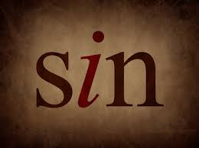
# 15
Q15 What happens when you deliberately go on sinning even though you know that what you
are doing is wrong?
“For if we go on sinning deliberately after receiving the knowledge of the truth, there no longer remains a sacrifice for sins.” (Hebrews 10:26 ESV).
“So whoever knows the right thing to do and fails to do it, for him it is sin” (James 4:17 ESV).

Slide 29
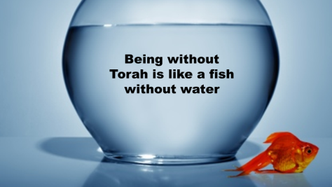
# 16
Q16 Why were the Israelites removed by Yahuwah from the Promised land?
After many warnings from Yahuwah and His prophets to tell the Israelites not to follow in the customs and pagan ways of worship of the other nations, Israel repeatedly disobeyed Yahuwah, one compromise at a time until Yahuwah
was so angry that he allowed Egypt and Babylon to enslave them because they refused to obey His Torah.

Slide 30


Q17 Why were Adam and Eve kicked out of the Garden of Eden?

Slide 31
Because Eve compromised and she made Adam compromise by simply disobeying what Yahuwah told them not to do. Eve’s sin was pure disobedience giving in to her temptations. Adam compromised when he chose between serving Yahuwah and the woman whom he loved, so he surrendered (compromised) to what he knew was wrong for the sake of physical gratification.
Sadly, Adam cared more for his wife than Yahuwah.
Look at the world today!
Can you see how dangerous a little compromise really is?

Slide 32
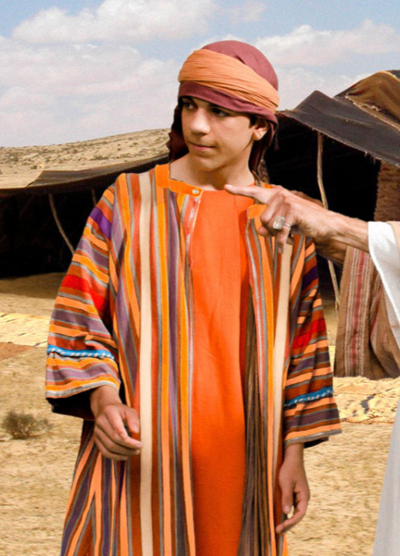
Q18 How
did Reuben compromise Joseph his brother?

Slide 33
Genesis 37:1-11 tells of Joseph being hated by his brothers because of Jacob’s favoritism and Joseph’s dreams of superiority. One day while Joseph was sent to see how his brothers were doing, his brothers who hated him wanted to kill him.
Reuben heard it and saved Joseph’s life warning them against killing him. He offered them a compromise. “Cast him into this pit” instead. Reuben’s plan was to return later and retrieve Joseph and return him to his father but his plan backfired. Joseph’s other brothers decided instead to sell him to a company of Ishmaelites. When Reuben returns, Joseph is gone, and he mourns.

Slide 34
What made Reuben’s act a compromise? He was willing to settle for less than what was right. He should have rebuked them for even thinking about what they were thinking and immediately returned Joseph to his father. Instead, he reasoned to himself to allow something less harmful with the intent of correcting it later.
In his compromise we find Reuben desired to avoid confrontation & family ties (on both sides). The problem is when he returned to retrieve Joseph the situation was now out of his control.
He could do nothing about it.
Today, many want to compromise for NOW with the intent of making it right later but sadly compromise always leads
to bigger problems and regrets.
.

Slide 35
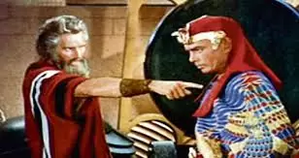

Q19 How did Pharaoh compromise with Moses?

Slide 36
In Exodus 8:10 Moses confronted Pharaoh demanding a release of Yahuwah’s people. At first, Pharaoh absolutely refused but as the plagues began to take their effect, 3 times he called Moses and
offered him compromises:
1st compromise - After the 4th plague of flies, Pharaoh told Moses to go sacrifice to Yahuwah in the land. Moses says “no” because their worship would be an abomination to the people.
Moses demanded a 3 days journey (Exodus 8:25-27).
2nd compromise - Pharaoh said he would let them go,
but don’t go very far (Exodus 8:28-29).
3rd compromise - Pharaoh said to Moses “Take your men with you.”
The idea being to leave behind their possessions and families.
Moses said NO, we will all go together (Exodus10:8-9).
.
.

Slide 37
Pharaoh’s compromise definitely involved material gain & a desire to avoid conflict. Many today, like Pharaoh see one who refuses to be swayed from the truth and offers a compromise. Many have no problem with you worshipping Yahuwah while using the compromises of man. Some want to let you serve Yahuwah just a little bit. The boss who says, “I’ll let you go every second Saturday, but that’s it.”
Many of Yahuwah’s people are afraid to step out in faith
and refuse to work on the Sabbath.
They compromise yet think that Yahuwah will understand.

Slide 38
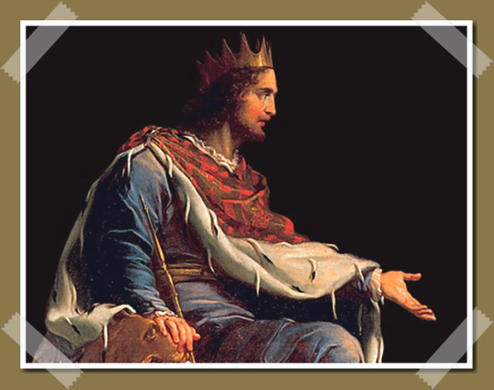

Q20 How did King Solomon compromise his faith?

Slide 39
Solomon Compromised His Faith. Yahuwah gave Solomon great wisdom but his love for foreign women made him compromise his faith for sexual pleasure and he landed up serving foreign gods and erected high places.
Solomon compromised his love for Yahuwah by putting his foreign wives first. Many today, like Solomon, because of their love for sexual gratification and material things, will compromise what they know is the truth for temporary satisfaction which will eventually lead to eternal destruction.
We cannot worship Yahuwah on our terms.

Slide 40

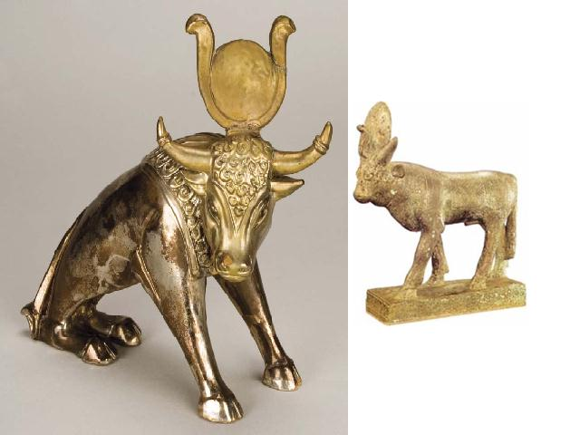
Q21 How did King Jeroboam compromise
his faith in Yahuwah?

Slide 41
After receiving the Northern Kingdom, Jeroboam is fearful that if the people go to Jerusalem to worship Yahuwah, that his people would not return. So as a compromise, for the true faith in Yahuwah, he builds golden caves in the cities of Dan and Bethel and tells the people that Jerusalem is too far for them to go to worship Yahuwah.
Instead, they could now worship these golden calves that he erected in honor of Yahuwah. This is the same compromise that Aaron allowed when Moses was away for forty days and nights. Instead of standing firm and telling the people to wait for Moses to return, Aaron helped them build a golden calf and said it was in honor of Yahuwah. Idolatry became THE sin of Israel until they were carried away into Egypt, then Babylon, then Assyrian captivity as they repeatedly compromised their faith for idolatry and learning the ways of the foreign nations.
.

Slide 42


Q22 What do many people today want that is displeasing to Yahuwah?

Slide 43
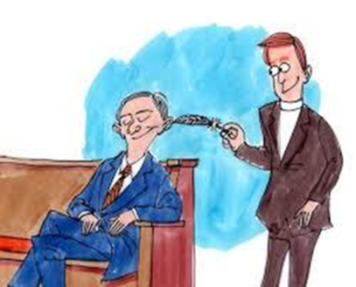
Many today want a religion of convenience and they are willing to compromise the truth to achieve it. Like Jeroboam, they will take on a FORM of the truth, but it is filled with man-made doctrines and traditions.
And too many, rather than investigating and ensuring that what they have is the truth (whether laziness, indifference or material gain), will follow these convenient compromises.
ITCHING EARS!
43

Slide 44
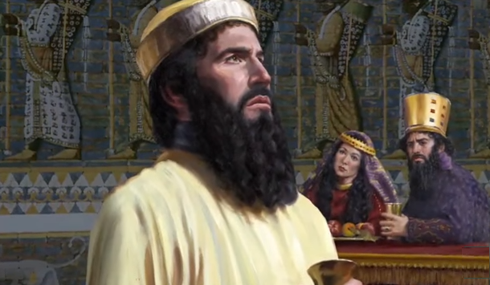
Q23 How was the prophet Nehemiah called to compromise?

Slide 45
Nehemiah has inspired Israel to rebuild the walls of Jerusalem.
But there were enemies who tried everything to resist and stop the work. Nehemiah 6:2 records two of these enemies (Sanballat and Geshem) send to meet with Nehemiah. The message was a desire to find a compromise. In fact that was just the lure because what they wanted was to get rid of him. But Nehemiah refused stating that he was doing a good work and he reasoned why should I leave it to come down to you. He was not willing to let ANYTHING stop him from accomplishing the work he knew Yahuwah wanted him to do. Even later in this chapter, there is another attempt to get him to stop working by drawing him into the temple and away from his fellow workers who needed him.
Nehemiah didn’t fall for that one either.

Slide 46

# 24
Q24 What is the temptation that most people accept when they compromise the truth of the Scriptures?
The love of money gained through compromise or bribery is the root of all evil. Often material and monetary gain is what the enemy will offer you so that you can compromise your faith. Most people hate conflict or standing for what they believe in for fear of being ridiculed or fired from their job.

Slide 47

Q25 How can you avoid compromises?

Slide 48
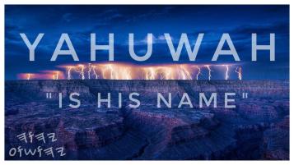

Put Yahuwah first in your life in all things and trust Him to supply all your needs because you remain obedient and faithful to Him. Do not be ashamed of what you believe and make it clear when starting a new job, that you are willing to work the other six days of the week but will not be able to work on Saturday. If the boss is not happy with that then find another job. Do not compromise.
If you compromise it is sin. Make time each day to meditate, pray and study the Scriptures so that you can live the faith by obedience not compromise.
SEEK FIRST

Slide 49


Q26 What happens when your boss or family member pressures you into submitting to
their demands on the Sabbath day and
Yahuwah’s feast days?

Slide 50
Be like Paul, stand firm in your faith. Do not feel guilty. Paul did not give in to false brethren even for an hour. “I urge you to contend earnestly for the faith entrusted once for all to the saints. For certain men have crept in among you unnoticed, ungodly men, who were designated long ago for condemnation. They turn the grace of our Elohim into a license for immorality (lawlessness), and they deny our only Master and Savior Yahusha Messiah” (Jude 1:3-4 Berean Study Bible).
When you hear pastors and preachers teaching false unbiblical doctrines, stand strong and expose their false teachings. If we remain quiet, we are just as guilty as if we agree with what they are preaching.

Slide 51

Q27 How did Satan encourage Yahusha to compromise his faith?

Slide 52
Satan tried to tempt Yahusha as He began His ministry.
Matthew 4:1-11 – 3 temptations.
Compromise 1 - Satan offers to Yahusha the kingdoms of the world (which were already His) if He will fall down and worship him. Yahusha obviously refuses and quotes Deuteronomy 6:13, “You shall have no other elohims before Me.”
Compromise 2 - Satan tried to tempt Yahusha by physically benefiting Yahusha and avoid confrontation with Satan (though it would bring about confrontation with the Father).

Slide 53
The best way to stop compromise is to quote Scripture like Yahusha did when He said three times it is written; “Man shall not live by bread alone but by every word that proceeds out of the mouth of Yahuwah. It is written you shall not tempt Yahuwah your Elohim and Him only you will serve. Get thee behind me, Satan: for it is written, Thou shalt worship Yahuwah thy Elohim, and him only shalt thou serve” (Matthew 4:7-9 KJV).
How many today when they are presented with offers “too good to refuse” will compromise their standings before Yahuwah?
If we keep the answer of Yahusha in our minds continually,
it can keep us from even considering a compromise of the truth.

Slide 54
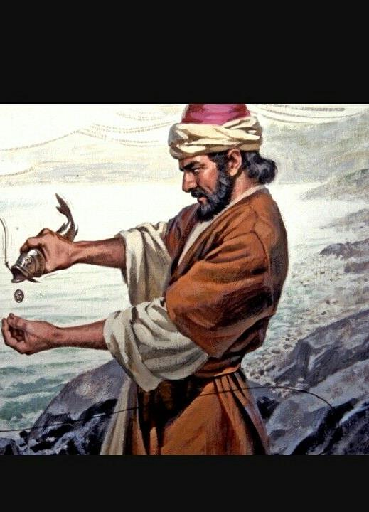
Q28 How
did Peter compromise his faith?

Slide 55
Galatians 2:11-13 – Paul has to rebuke Peter because “he was to be blamed.” Peter’s sin on this occasion was hypocrisy.
He would eat with the Gentiles until his Jewish brethren came around at which time, he would shun his Gentile brethren. Paul exposed his hypocrisy and even Barnabas was carried away by his sin. When Peter turned his back on his Gentile brethren, he both settled for less than his personal convictions AND he surrendered to that which he knew was wrong for personal gain. In this act, Peter gained something physically (prestige, etc.),
it dealt with his brethren (family), and it very easily could have involved fear (of the Jews), a desire to avoid conflict (after all there was enough already among the Jews) and a lack of faith
(in Yahuwah) to deliver him if problems arose.

Slide 56

Q29 Are you the same person no matter in whose company you are in?
There are many who change their conduct depending on who they are around. They may act one way around a particular group, but when they are around another group, they act the opposite way. We also need to remember that often our influence spills onto others as well and they too are led away by our failure to take a firm stand for the right.
# 29

Slide 57
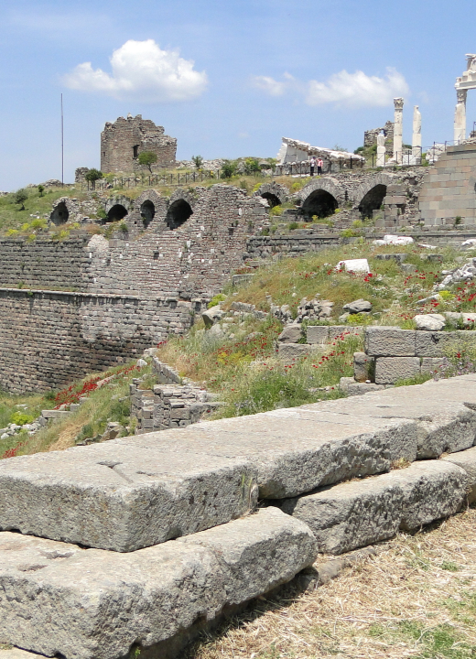
Q30 What was the compromise of the assembly of Pergamos that Yahuwah hated?

Slide 58
Revelation 2:12-17 – At Pergamos they had some who held to false doctrines in their midst. These were doctrines that involved morality and loyalty to Yahuwah.
They were warned to repent.
Their compromise gave them physical gain (numbers and whatever finances were involved) and avoided confrontation.

Slide 59
Moral issues (if we tolerate SOME immorality, it will spread to others) and doctrinal issues (the proper purpose of baptism, obedience to the Torah, the use of the Yahuwah’s money, etc. – because such things will CHANGE the entire structure of Yahuwah’s assembly). This has become a source of great contention among brethren in the past few years. There are some who teach that if one is sincere, regardless of what he teaches (in given areas) he can be accepted as long as he doesn’t dwell on the topic, or even bring it up in a meeting. What lies! 1 Corinthians 5:6-7 –
“a little leaven leavens the whole lump.”

Slide 60
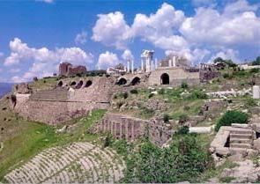

Q31 What was the compromise at
the assembly of Thyatira?

Slide 61
Revelation 2:18-23 – At Thyatira the assembly allowed false teaching to be taught. Their compromise was the same as that of Pergamos – physical gain and avoiding confrontation. When we allow false doctrine to be taught without exposing it immediately, we become guilty of compromise that will eventually lead to a spiritual decline for all the people there. The answer to the problem was to repent before it was too late. You can do all the good works and charity work for Yahuwah, but if you are compromising His Torah by disobedience, your actions mean nothing to Yahuwah. It’s like an unfaithful spouse who is away with their lover on the weekend but they do kind deeds for you during the week to make up for their sexual unfaithfulness. Obviously this cannot be acceptable. Why do you think that Yahuwah would accept your compromise?

Slide 62


Q32 Why are some people silent and do not expose false unbiblical teachings?

Slide 63
Sadly, many people seldom read or study the Scriptures to know what it says so they can defend their faith. They rely on their priest or pastor to tell them what to do which is very dangerous. It is like the law of a country. Even if you did not know it was a law that you broke, the punishment will still be given to you because ignorance is no excuse today.
We are not to be wishy washy about our faith, but solidly committed to Yahuwah’s ways (Deuteronomy 17:11; Proverbs 24:7; Revelation 3:15–16). We do this by actively growing in our relationship with Him, learning His truths, and relying on His power to help us walk without compromise.

Slide 64


# 33
Q33 What is our biggest enemy
that makes us compromise the Scriptures?
Loving the things of the flesh and pleasing people instead of pleasing Yahuwah.
Sin is an ever-present enemy to be hated and avoided at all costs. Compromising the Word of Yahuwah brings disastrous results.
Yahuwah commands us to steer clear of all worldly entanglements and pursue Him.

Slide 65


Q34 What does the book of Judges teach us
about compromise?

Slide 66
As we turn to Judges, we enter a book covering four hundred years of biblical history.
In the book of Judges, we meet 12 judges, view 7 tragic cycles where Israel sinned, served, supplicated and were saved and
2 appendices portraying the deadly danger of compromise.

Slide 67


Q35 What happens when you walk
in obedient faith in Yahuwah?

Slide 68
WALKING IN OBEDIENT FAITH REAPS DELIGHTS [Judges 1:1-18] A life of blessing, victory and conquest is offered by YHVH and taken by them.
FORSAKING YAHUWAHS OBEDIENCE REAPS DISASTERS [Judges 1:19-16:31] A life of defeats, bondage, servitude and captivity.
We may ask how and why did they forsake godly obedience? What may we learn from their steps down?

Slide 69


Q36 What happened when Israel tolerated their enemies and did not destroy them as Yahuwah instructed?

Slide 70
ISRAEL TOLERATED the enemies of Yahuwah and did not drive them out! [Judges1:19, 21, 27] They left remnants of the Canaanites lodged among them. Slowly the influence of sin pervaded their lives. It’s the same with us today. We have become tolerant of sin and evil. For example
we tolerate abortion, homosexuality, different religious groups; we tolerate pagan holidays and worldly music, dress code, language & immoral
TV programs to name just a few examples.

Slide 71
Q37 What happened to Israel when they continually disobeyed Yahuwah?

Slide 72
Israel CYCLED downward in disobedience away from Yahuwah. Starting in Judges 2:11 … Then the children of Yisra’ěl did evil in the eyes ofיהוה, (YHVH) and served the Ba‛als, they sinned; in 2:14 Yahuwah sold them to oppressors and they served; in 2:15,16 they cried to or supplicated to Yahuwah and He saved or delivered them. This pattern goes on for six more times. Each servitude is more fierce and harsh upon them. “So they forsookיהוה (YHVH) and served Ba‛al and the Ashtoreths. And the displeasure of יהוה (YHVH) turned against Yisra’ěl. Therefore He gave them into the hands of plunderers who despoiled them. And He sold them into the hands of their enemies all around, and they were unable to stand before their enemies any longer. Wherever they went out, the hand of יהוה (YHVH) was against them for evil, as יהוה (YHVH) had spoken, and as יהוה (YHVH) had sworn to them. And they were distressed – greatly” (Judges 2:13 to 15 The Scriptures 2009).
72

Slide 73


Q38 What happened to Israel when they neglected the Torah of Yahuwah?

Slide 74
Israel NEGLECTED pursuing the Torah of Yahuwah. According to Judges 2:10 they broke his commandments, statutes and judgments.
They neglected a personal relationship with Yahuwah through meditating on the Torah and prayer.
Do you make time each day to read the Scriptures, pray, study, memorize Scripture and serve Yahuwah? Or do you make excuses
that you don’t have enough time?
74

Slide 75


Q39 What happened when Israel married pagan unbelievers?

Slide 76
Israel MINGLED by intermarrying with the pagans (Judges 3:6). They shared life with those who denied their Master and learned their evil ways. Today it is happening all the time; one spouse is a believer, and the other is not.
This causes compromise and spiritual suicide thus disobeying Yahuwah for the sake of compromise.
Also in our world today, the sexual dancing, going to pubs, wild parties, exposure to indecent movies, sports, compromising dating relationships, immodest clothing and a basic hunger for set-apart living is lacking.
Sadly, Yahuwah is nowhere to be found.

Slide 77
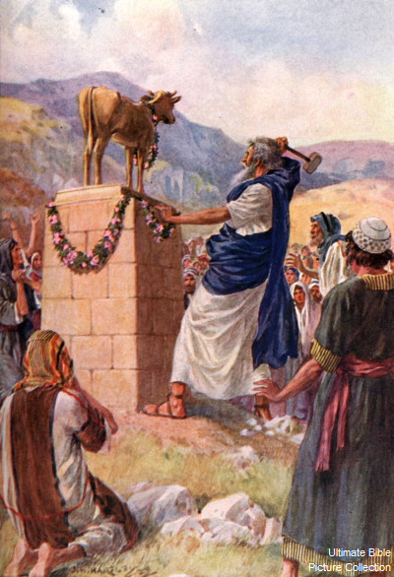
Q40 How did Israel abandon Yahuwah?

Slide 78
Israel ABANDONED the exclusiveness of Yahuwah by following other gods (Judges 3:7). This direction taken by Israel is known as syncretism, the blending together of various religions, truth and error. The idols of the pagans are demons sending the spirit of compromise to pull you away from Yahuwah.
Leviticus 17:7 And they shall no more offer their sacrifices unto devils, after whom they have gone a whoring. This shall be a statute forever unto them throughout their generations. Deuteronomy 32:17 They sacrificed unto devils, not to Yahuwah; to gods whom they knew not, to new gods that came newly up, whom your fathers feared not (KJV).

Slide 79
1 Corinthians 10:20 “But I say, that the things which the Gentiles sacrifice, they sacrifice to devils, and not to Yahuwah: and I would not that you should have fellowship with devils” (ESV).
When you partake in Sunday church services, Christmas, Easter and other pagan holidays you are worshipping demons. We cannot compromise with the ecumenical, interfaith ministry, including all Christianity which is so lukewarm and compromising; where doctrine is diluted or abandoned so no one is offended. If you truly love Yahuwah your obedience to the Scriptures will be your fruit.

Slide 80


Q41 Why does Yahuwah tell you not
to harden your heart?

Slide 81
Israel HARDENED their heart and they no longer heard the voice of Yahuwah’s Spirit because of their repeated disobedience. They had lived so long with defiled minds, sin no longer pained them. We see this in the growing insensitivity to sin all around us in the Christian churches. They DEPARTED from their true King and Ruler,
the Master!
When you do what is right in your own eyes,
you are not pleasing Yahuwah and you are not walking
in Covenant with Him (Judges 21:25).

Slide 82
REMAINING IN DISOBEDIENCE REAPS DESTRUCTION
(Judges 17-21).
Continuing in ungodliness results in a life of destruction, declension, defilement, darkness and despair.
There are two horrible illustrations of this
in the closing chapters.
Idolatry: see Judges 17-18; Immorality: see Judges 19-21.
IF WE WANT TO WALK WITH YAHUWAH IN SPIRIT AND IN TRUTH WE NEED TO BE SET-APART BY BEING OBEDIENT TO THE TORAH. Even though the world will hate you,
your loyalty and love is to Yahuwah.

Slide 83
We are to not mingle with those who are continually living in sin and disobedience as they will pull us into the net.
2 Corinthians 6:16-18 “And what agreement has the temple of Yahuwah with idols? For you are the temple of the living Elohim. As Yahuwah has said: “I will dwell in them and walk among them. I will be their Elohim, And they shall be My people.” 17 Therefore “Come out from among them and be separate, says the Master. Do not touch what is unclean, and I will receive you.” 18 “I will be a Father to you, and you shall be My sons and daughters, Says Yahuwah Almighty” (ESV).

Slide 84

Circumcise … the foreskin of your heart and be
no more
stiff-necked!
Deuteronomy 10:16 KJV

Slide 85


“And Now Israel, what doth YHVH (Yahuwah) thy Elohim require of thee, but to fear YHVH thy Elohim, to walk in all his ways, and to love him, and to serve YHVH thy Elohim with all thy heart and with all thy soul
to keep the commandments
of YHVH, and His statutes, which I command thee this day for thy good?”
Deuteronomy 10:12-13 KJV

Slide 86

SHALOM

Slide 87

For more information contact:
Supreme Provider
Yahusha Ha Mashiach
This presentation originated from
Lifeline to Yahusha Ministries
It was arranged for a
power point presentation
and recorded by Walter Tschoepe
Malachi4.4@reagan.com

