Slide 1
Tequfah’s Next Lesson
Joe Brown’s Lazy Dog jumps New Bunny Trail on Lunar
What happened this year in 2023 for the marking of the Tequfah Shadow Sign that we have not recognized before?
Should this be getting our attention?
Joe Brown’s Lazy Dog jumpesNew Bunny Trail on Lunar
Joe Brown’s Lazy Dog jumpesNew Bunny Trail on Lunar
Joe Brown’s Lazy Dog jumps New Bunny Trail on Lunar

Slide 2
Is Tequfah’s Next Lesson something about a special key?
Could this research be another KEY OF RESTORATION, Yahuah has handed to us, to understand the Knowledge ESTABLISHED ON Creation cycle #4 with the commission of the Mazzaroth?

Slide 3
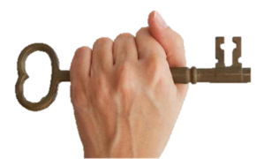
We heartily extend our thanks and appreciation to Faith Child in Western Virginia for his diligence to collect as much data as possible from around the world so you can have this presentation today!

Slide 4
Facts about Weekly Sabbath Worship days/cycles & dates!
This week, CCC Team leaders joined the Philippines again on Friday at 6 pm Pacific Daylight Time (Mar 31st) to teach them about Covenant Calendar.
We meet with people from Thailand, Malaysia, Philippines, West & East Australia; and New Zealand.
What “day” and “date” is it for 6 different areas of their world?
For each one joining us, it is already April 1st – their Shabbat.
8 AM – Thailand
9 AM – Malaysia, Philippines, W Australia
Noon – Queensland
3 pm – New Zealand
If Dubai decides to join us, it will be 6 AM Sabbath April 1st.

Slide 5
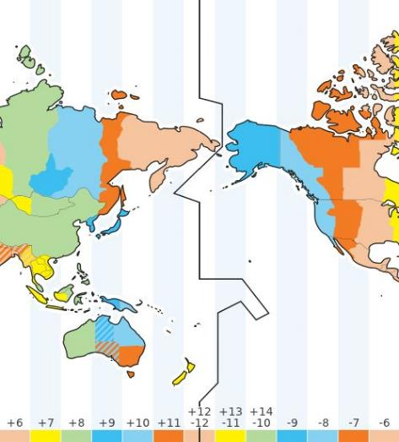
What do you think about this? Why are all of us not celebrating Sabbath at the exact same time?
While the sun is still shining brightly in AB and BC, some are nearing the end of their Shabbat Day Season in the South Pacific.
Most of us understand that due to the “man-made” International Date Line [IDL] and the Roman midnight-day start, that Sabbath is celebrated by many around the world before Sabbath reaches us in North America.
The IDL has been placed by “man” in a location that would be the least disruptive for the economic system of the world.

Slide 6
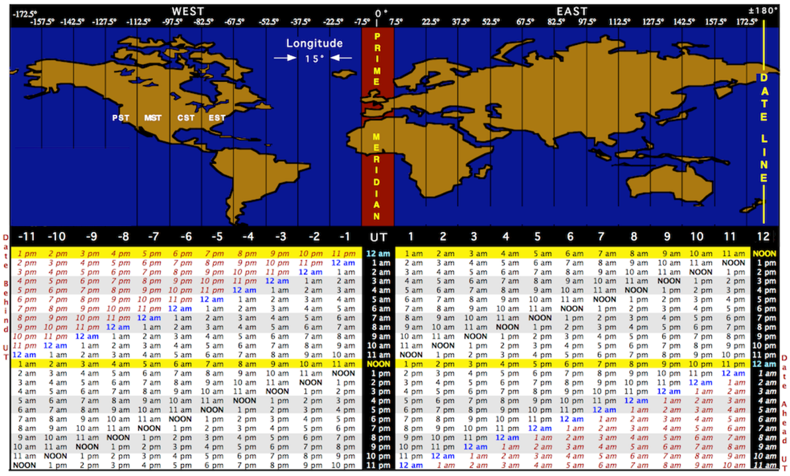
Example: when the Hawaiian Islands are at 6 AM Sabbath – New Zealand is already at 5 AM Sunday.
This happens on every day, on every Shabbat and on every Feast Statute.

Slide 7
We all say that is not hard to understand and we accept such things … UNTIL …
… the calculation of the feast days & dates seem very different and then all of a sudden every one is concerned that everyone in the world is not on the same Passover date of Apr 2nd, Apr 3rd, or maybe even Apr 4th!
What happened?
That is the exact question that Yahuah has been waiting for everyone to ask!

Slide 8
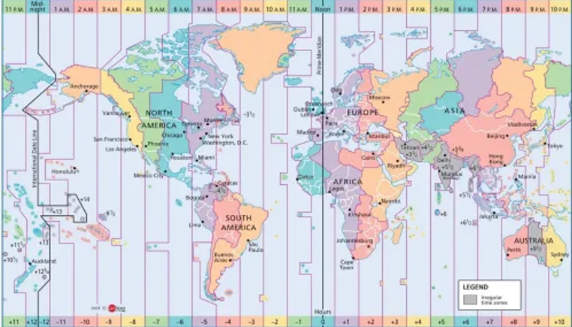
To complicate things even more, man has designed “another line” at Greenwich UK called Universal Time Coordinate. This time zone (that never changes to daylight time) announces the supposedly EXACT time of the tequfah (2023 = Mar 20th @ 9:24 pm). Every time zone in the world has to calculate what that time would be on their current clock.
Problem: somehow we have forgotten about the IDL and freely married ourselves to the UTC!
Have you ever thought to ask if Yahuah has His own Universal Time Coordinate and His own International Date Line where His timing begins for the calculations of Feast & Festival appointed times?

Slide 9
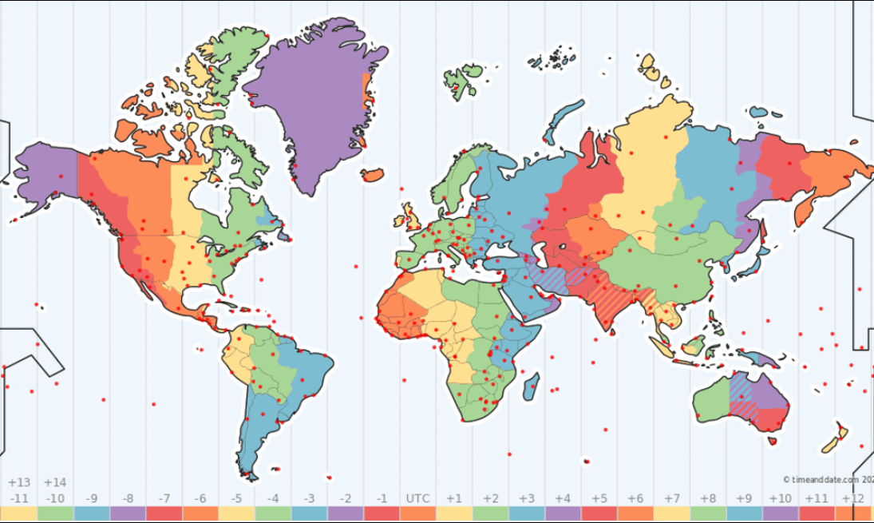
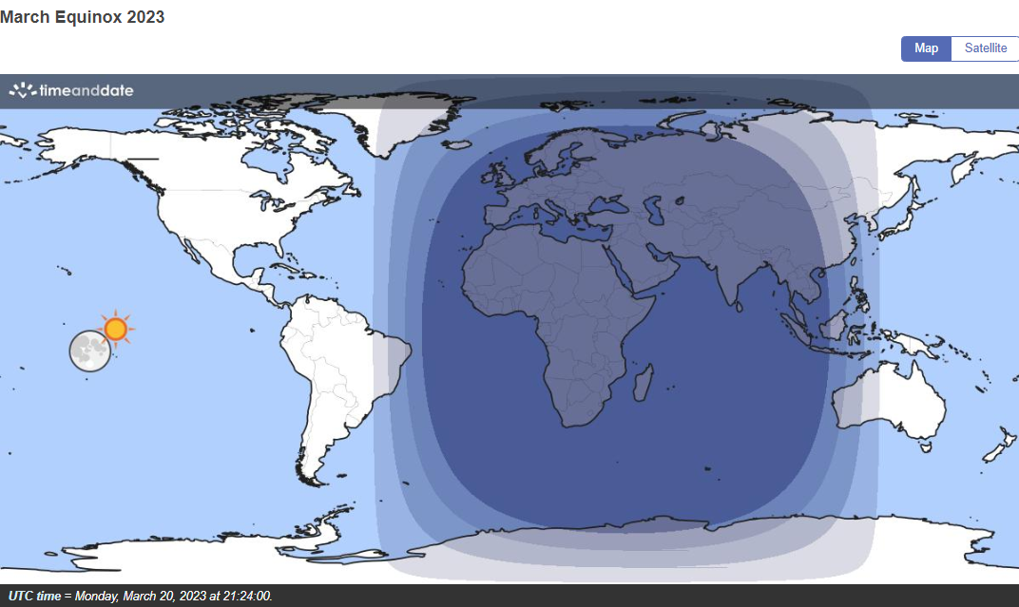
March Equinox 2023
Please note the position of the sun & moon on every tequfah slide.
2023 Tequfah 3/20/23 21:24 [9:24 PM] UTC
The Night Season location for Teq. 2023 …

Slide 10
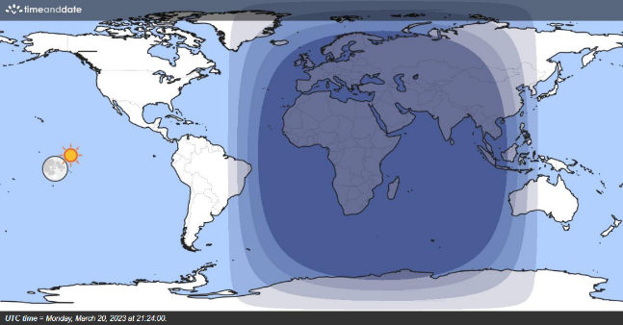
After examining the world map for Mar 20th tequfah 2023, these questions were asked:
Who will be able to sight the tequfah shadow sign first?
At first glance it appears that eastern Australia and New Zealand would be the first to see the tequfah shadow sign.
CCC Team Members were attempting to give some guidance to new people in the South Pacific so they could be prepared.
March Equinox 2023
2023 Tequfah 3/20/23 21:24 [9:24 PM] UTC
The Night Season location for Teq. 2023 …
Some CCC members were checking with one another on Mar 18, 19 & 20th, but it appeared our guesstimate was incorrect.
If you were the teacher, what would you have told them?

Slide 11
As Covenant Calendar Lessons Expand to Other Parts of the World, Everyone is Learning New Lessons!
Next, we are going to make some observations of what the world map looks like on the day of tequfah shadow sign from 2019 to 2030.
Please pay very close attention to see what is happening with the position of the Night Season and the dawn and dusk twilights that surround the both edges of the Night Season.
Also watch the red and blue bar markers – and their positions and the approx. # of time zones between them.
At the end there will be a brief summary before we start the next exciting part of this lesson.
Approx 5.5 time zones
~ OR ~
Approx 6 time zones

Slide 12
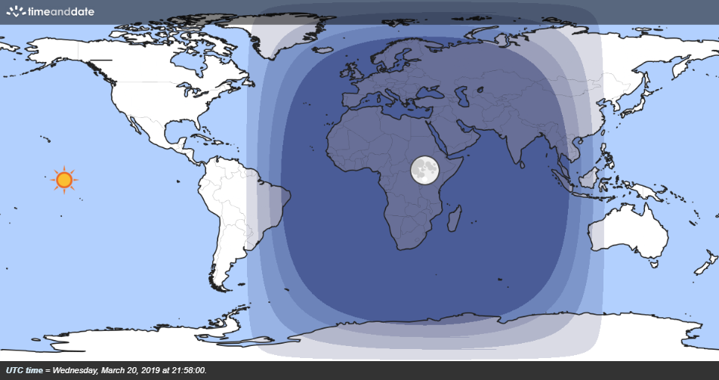
March Equinox 2019
Sun? Moon?
2019 Tequfah 3/20/19 21:58 [9:28 PM] UTC
The Night Season location for Teq. 2019 …
Let’s try to trust that these world maps from Time & Date.com are accurate as they chart the movements of the heavenly bodies.

Slide 13
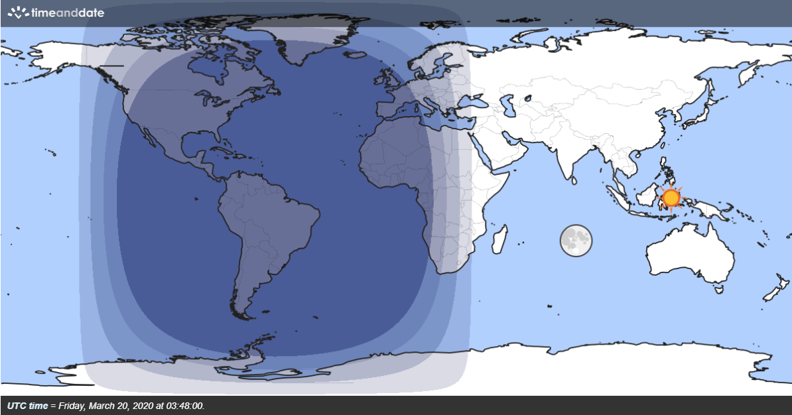
March Equinox 2020
Approx 5.5 time zones
Note the
Sun? Moon? position according to the red marker from now on.
2020 Tequfah 3/20/20 3:48 AM UTC
The Night Season location for Teq. 2001 …
Will the sun follow the red marker? And if so, will that mean anything?

Slide 14
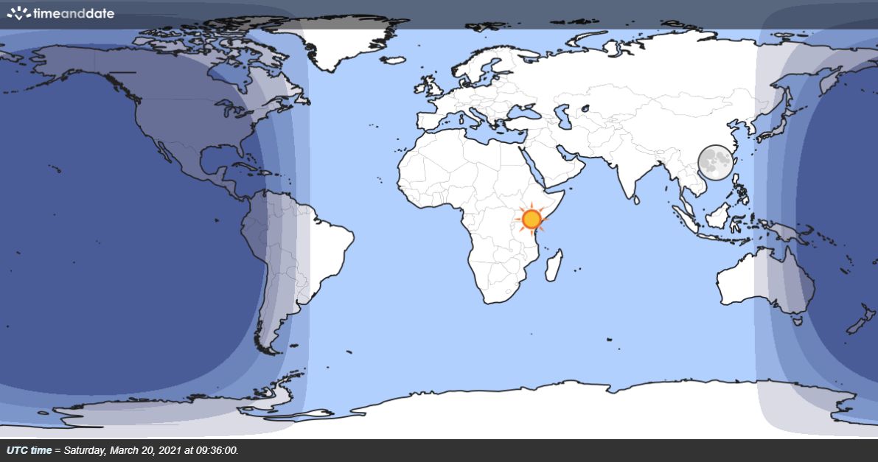
March Equinox 2021
Approx 5.5 time zones
Sun? Moon?
2021 Tequfah 3/20/21 9:36 AM UTC
The Night Season location for Teq. 2021 …

Slide 15
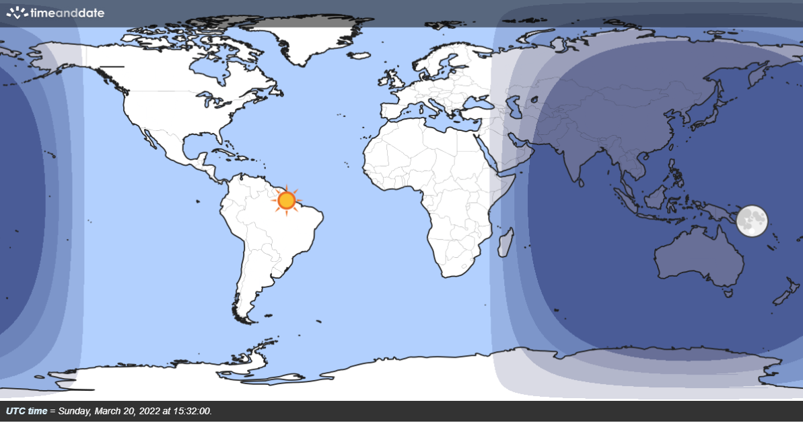
March Equinox 2022
Approx 6 time zones
Sun? Moon?
2022 Tequfah 3/20/22 15:32 [3:32 PM] UTC
The Night Season location for Teq. 2022 …

Slide 16
March Equinox 2023
Approx 5.5 time zones
Sun? Moon?
2023 Tequfah 3/20/23 21:24 [9:24 PM] UTC
The Night Season location for Teq. 2023 …

Slide 17
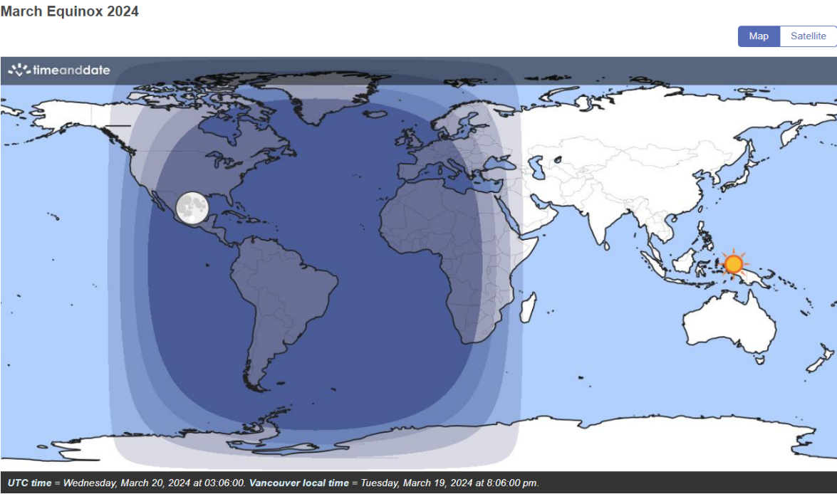
March Equinox 2024
Approx 5.5 time zones
Sun? Moon?
2024 Tequfah 3/20/24 3:06 AM UTC
The Night Season location from Teq. 2023 to Teq. 2024 moved west approx. 5.5 time zones.

Slide 18
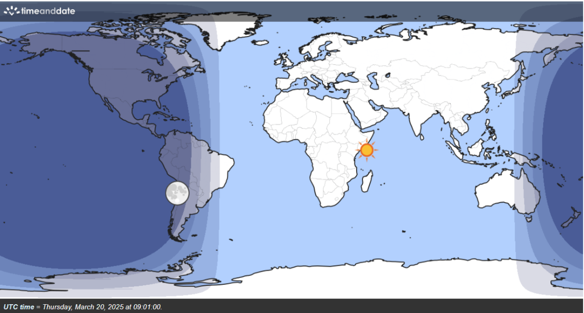
March Equinox 2025
Approx 6 time zones
Sun? Moon?
2025 Tequfah 3/20/25 9:01 AM UTC
The Night Season location from Teq. 2024 to Teq. 2025 moved west approx. 5.5 time zones.

Slide 19
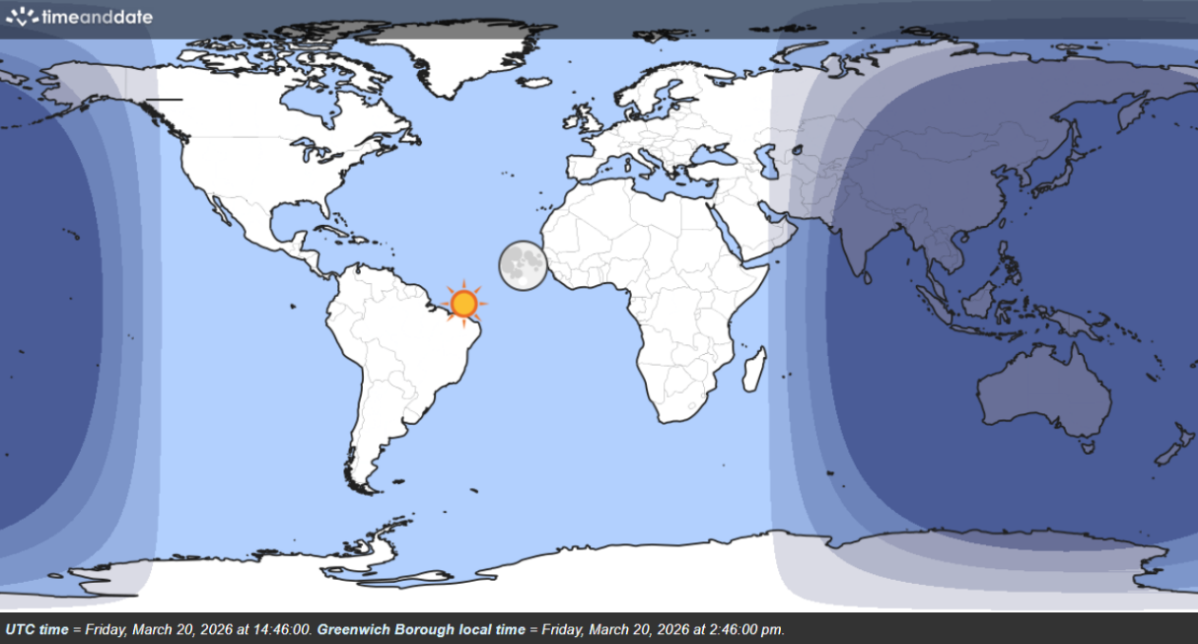
March Equinox 2026
Approx 6 time zones
Sun? Moon?
2026 Tequfah 3/20/26 14:46 [2:46 PM] UTC
The Night Season location for Teq. 2026 …

Slide 20
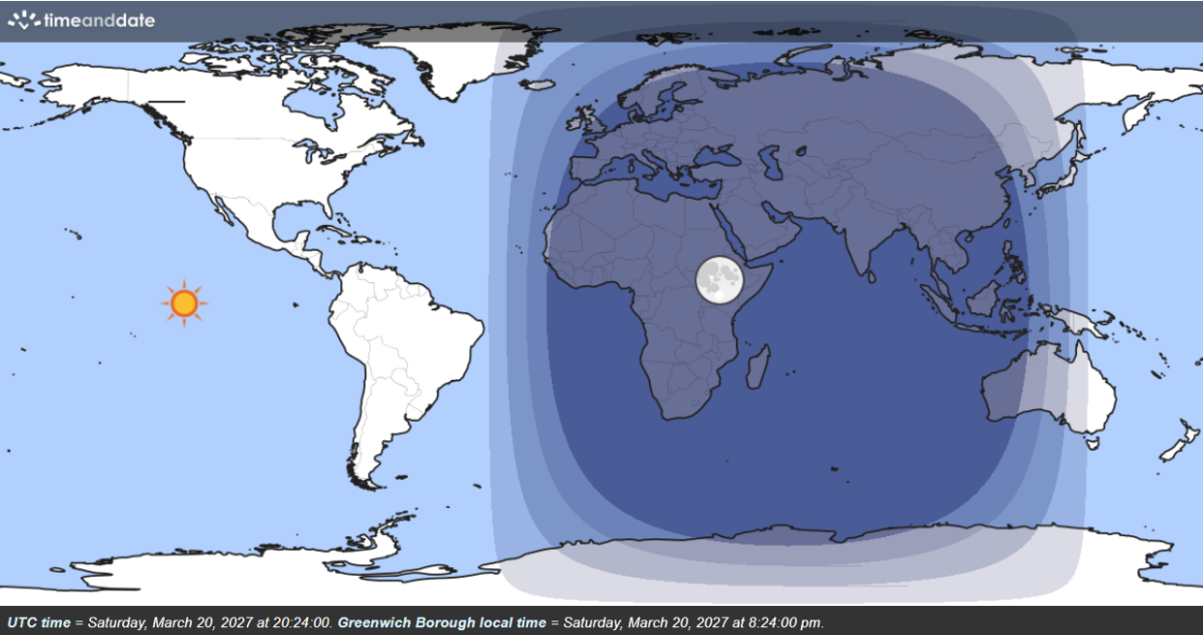
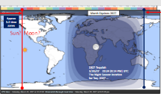
March Equinox 2027
Approx 5.5 time zones
Sun? Moon?
2027 Tequfah 3/20/27 20:24 [8:24 PM] UTC
The Night Season location for Teq. 2027 …

Slide 21
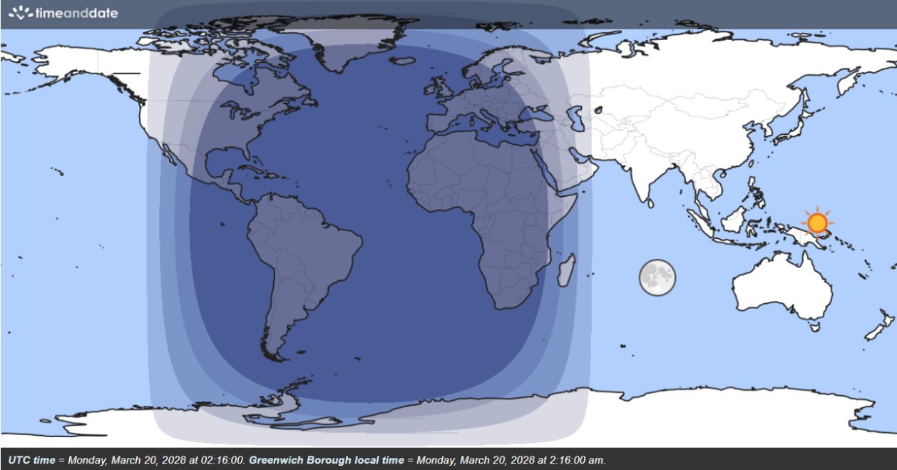
March Equinox 2028
Approx 6 time zones
Sun? Moon?
2028 Tequfah 3/20/28 2:16 AM UTC
The Night Season location for Teq. 2028 …

Slide 22
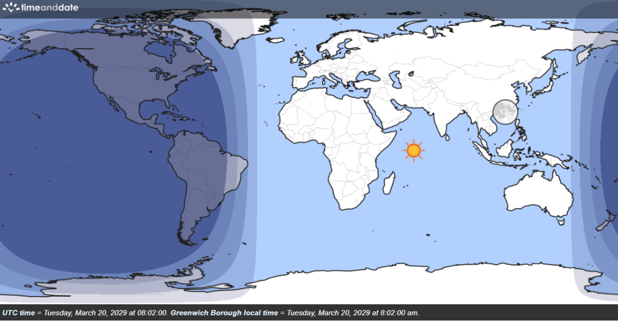
March Equinox 2029
Approx 5.5 time zones
Sun? Moon?
2029 Tequfah 3/20/29 8:02 AM UTC
The Night Season location for Teq. 2029 …

Slide 23
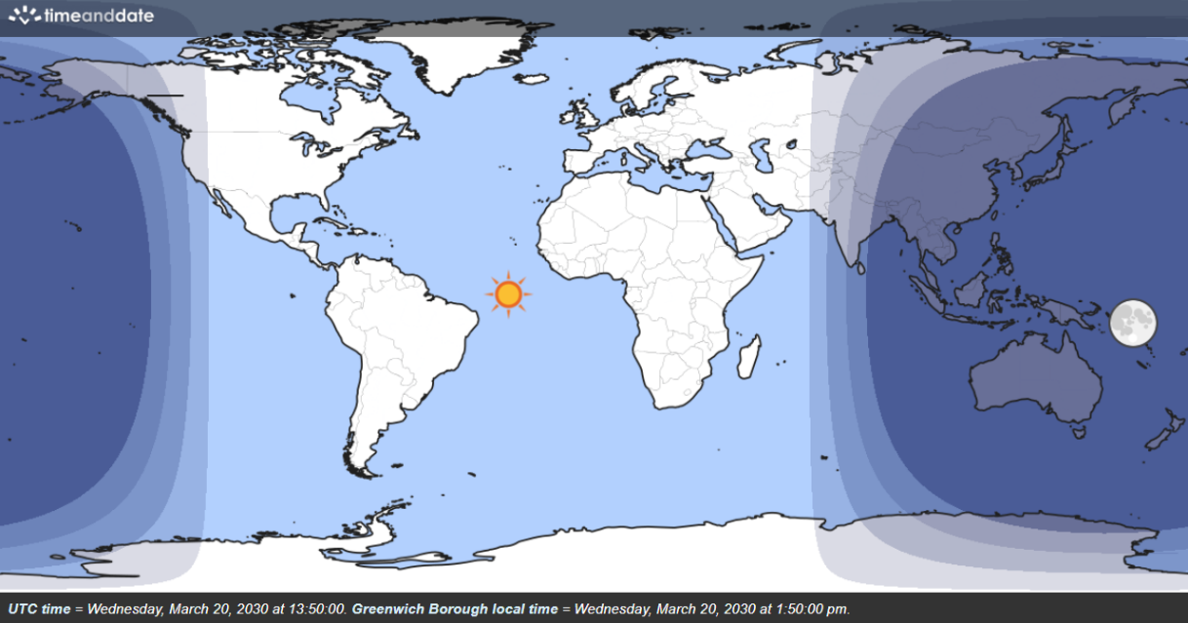
March Equinox 2030
Approx 5.5 time zones
2030 Tequfah 3/20/30 13:50 [1:50 PM] UTC
The Night Season location for Teq. 2030 …
Sun? Moon?

Slide 24
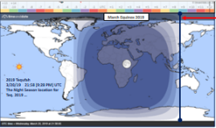
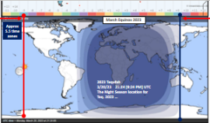
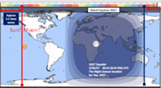
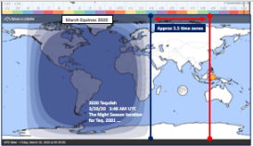
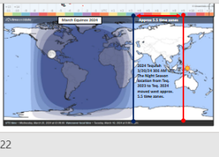
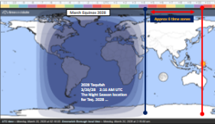
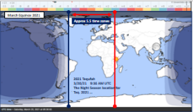
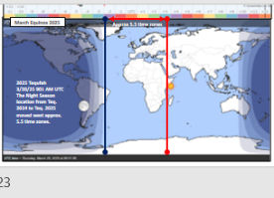
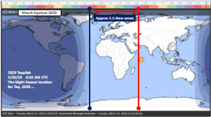
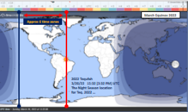
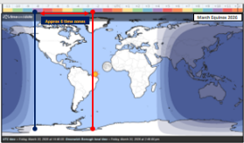
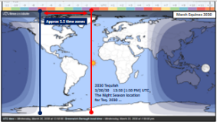
How many clues to
can you find?
Years 2019-2022
Years 2023-2026
Years 2027-2030
How many Patterns?
With the sun position?
With the moon position?
With the red/blue markers?
With the Night Season?
Will any of these patterns change in the near future?

Slide 25
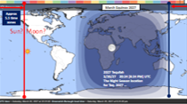
The red arrows are the angle pattern.
Years 2019-2022
Years 2023-2026
Years 2027-2030
Next, we are going to consider some new data from Nathaniel [Faith Child] to see if there could be any clues of how to determine “ahead of time” where Yahuah’s International Date Line will be found each year. It moves!
Will the angle pattern and the position of the sun along with a certain number of time zones have clues of how to determine WHO in the world will see the shadow first?
Remember, we thought it would be the South Pacific in 2023. It did not happen?

Slide 26
Tequfah Shadow Data - Nathaniel [Faith Child]
Nathaniel has been diligently trying to collect tequfah shadow sign data from anyone and anywhere in the world for several years.
The following data was received Mar 30th about noon PDT.
The data will be assessed with as much logic and common sense as we can muster – keeping in mind the equinox slides that have just been presented, and the patterns you have seen.
We will go through the chart, step by step watching for any key clues.

Slide 27
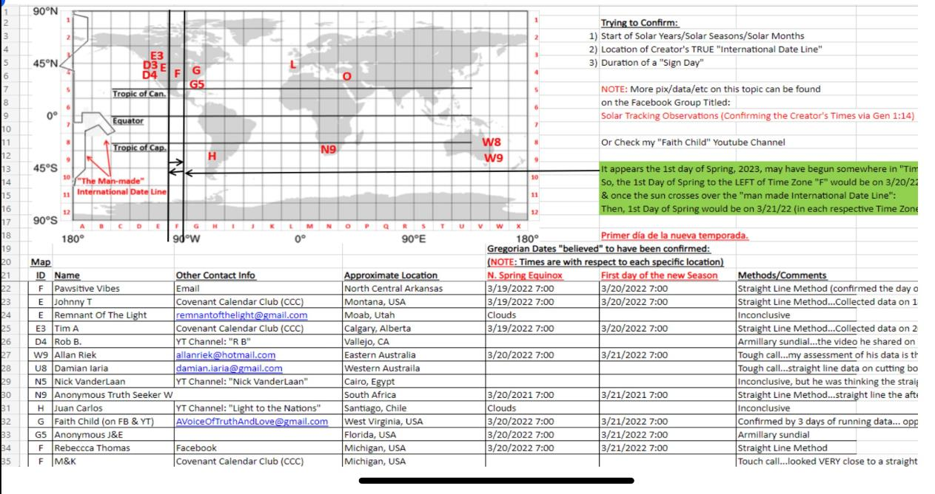

Slide 28
ID | NAME | LOCATION | SHADOW/ 1st day | COMMENTS
F | Pawsitive Vibes | N central Arkansas | 3/19 … 3/20 | Straight line method (confirmed the day of the 19th & they saw a spring curve on the 20th – they are claiming to have good sunrise and sunset data points-so seems reliable but no pictures of their data.
E | Johnny T | CCC Montana | 3/19 … 3/20 | Straight line Method … Collected data on 18th – saw a winter curve & 19th thought it was straight – 44 min into CCC video
E | Remnant of the Light | Moab UT | clouds | Inconclusive
E3 | Tim A | CCC Calgary AB | 3/19 … 3/20 | Straight line method … collected data on 21st – 49 min in CCC video; long spread of large data points – good early morning points.
D4 | Rob Barron | Vallejo CA |  | Armillary sundial…the video he shared on his channel was from the 20th but he mentioned he thought the line looked centered on the previous day as well – in an earlier video he was still seeing winter curves prior to the 18th
W9 | Allan Riek | Eastern Australia | 3/20 … 3/21 | Tough call…my assessment of his data is that the straight line was confirmed on the 20th (approx.) 9 hrs of data collected – he thought he was also seeing straight line on 21st – but only ½ day of data collected from 9 AM to 1 PM so I would say his data from the 21st is unfortunately inconclusive.
U8 | Damian Iaria | Western Australia |  | Tough call…straight line data on cutting board was taken on 21st – straight line or slight curve?
N5 | Nick VanderLaan | Cairo, Egypt |  | Inconclusive, but he was thinking the straight line happened on the 20th
N9 | Anonymous Truth Seeker | South Africa | 3/20 … 3/21 | Straight line method …straight line the afternoon of the 20th & [??] marks on the 21st
H | Juan Carlos | Santiago, Chile | clouds | Inconclusive
G | Faith Child on FB & YT | West Virginia | 3/20… 3/21 | Confirmed by 3 days of running data … opposite curves on the 19th & 21st – straight line on 20th – approx. 9-10 hrs of sundial marks collected each day.
G5 | Anonymous J&E | Florida | 3/20 … 3/21 | Armillary sundial
F | Rebecca Thomas | CCC Facebook Michigan | 3/20 … 3/21 | Straight line method
F | M&K (Kim) | CCC Michigan | 3/20… 3.21 | Touch call…looked VERY close to a straight line on the 20th – 31 min into the CCC summary video [PS: Kim used the straight line method.]

Slide 29
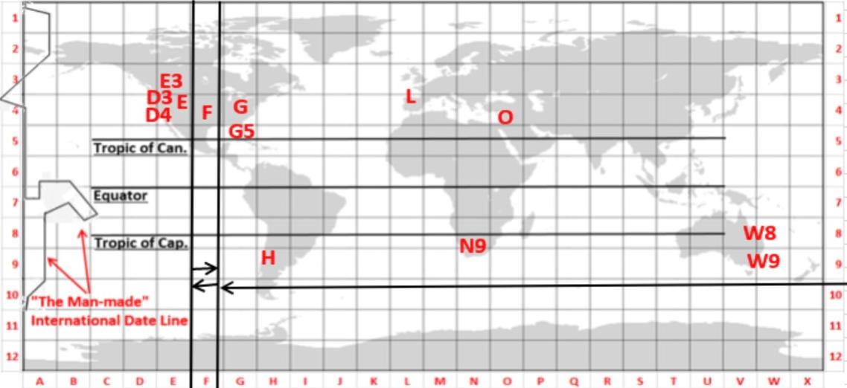
Summary of Best Data Collected:
Green F: Arkansas data **
Purple E/E3: Data 4 CCC Members **** Alberta/Montana/Michigan [2]
G: Faith Child Data ** West Virginia
D4: Rob B data ** California
From Arkansas: Straight line method (confirmed the day of the 19th) & they saw a spring curve on the 20th – they are claiming to have good sunrise and sunset data points-so seems reliable but no pictures of their data.
It appears the 1st day of spring may have begun somewhere in time zone F.
It also appears time zone F is equivalent to world time zone around -6. (It’s hard to tell because the map doesn’t seem to be showing a true scale.)

Slide 30
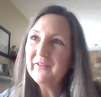
Summary of Best Data Collected:
Green F: Arkansas data **
Purple E/E3: Data 4 CCC Members **** Alberta/Montana/Michigan [2]
G: Faith Child Data ** West Virginia
D4: Rob B data ** California
From Arkansas: Straight line method (confirmed the day of the 19th) & they saw a spring curve on the 20th – they are claiming to have good sunrise and sunset data points-so seems reliable but no pictures of their data.
It appears the 1st day of spring may have begun somewhere in time zone F.
It appears the most reliable readings are from USA/Canada. Other notes:
CCC Tim & Johnny sighted Mar 19th shadow.
Arkansas sighted Mar 19th shadow.
W Virginia & MI sighted Mar 20th shadow.
South Africa sighted Mar 20th shadow.
It also appears time zone F is equivalent to world time zone around -6. (It’s hard to tell because the map doesn’t seem to be showing a true scale.)

Slide 31
Summary Comments from Nathaniel [Faith Child]
“Since zone F, and points west, sighted the tequfah shadow first – on Mar 19th, it appears this is where Yahuah’s International Date Line started the count for the new year – especially since Arkansas reported good data points.
“This is the 1st year (that we know of) where Yahuah’s IDL landed on a Land Mass, dividing the USA/Canada with interesting & consistent data.
“Usually this dividing line lands in the ocean somewhere, and doesn’t seem important. This year the division seems tricky, but be at peace,” remembering Yahusha’s words - John 4, to worship in spirit and truth wherever you are.
This year some will have Passover on Apr 2nd, and some will be on April 3rd with our Covenant Calendar family east of the “F” time zone.
It appears the 1st day of spring may have begun somewhere in time zone F.
Question: Where are you on this map?
If you were sighting the shadow, what data do you think you would have observed?
Let’s take a closer look at USA & Canada in hopes that will benefit your next important decision.

Slide 32
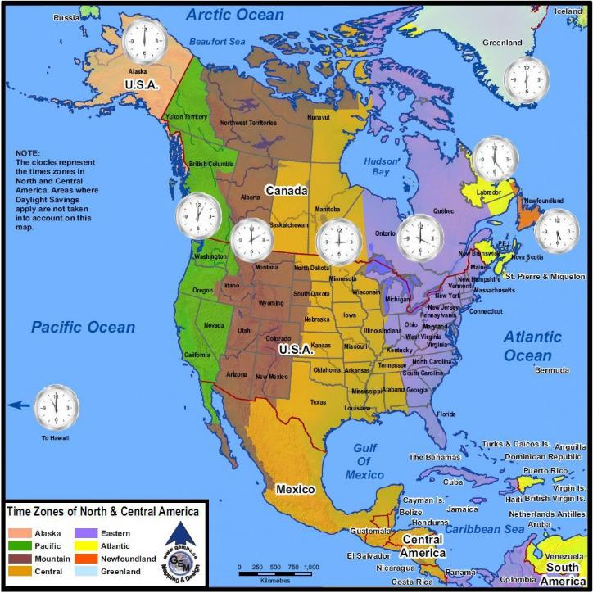
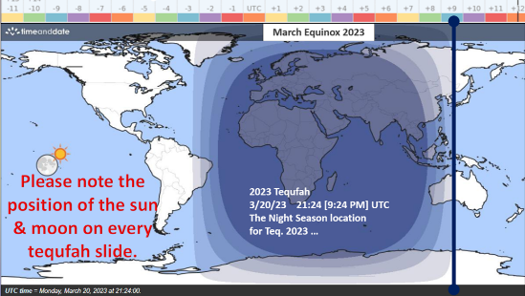
E
F
G
F
The time zone marked “F” is approx. -6 according to world time zone designation.
Take note of the sun’s position that marked the FIRST recorded shadow in the world from the red bar moving WEST.

Slide 33
Is it time to make a decision depending on where you live?
E
F
G
Just as there are many in the world that celebrate their weekly Shabbat on a “different” DAY and DATE – [and we’re OK with that], is there any reason to question that at times the Festivals will follow the same pattern even within one country or continent?
According to John 4 this is quite alright – especially when we know we all start within the same 24 hour timeframe!

Slide 34
According to Scripture, what are we instructed to do?
Ps 90:12 … Teach us to number our days, and apply our hearts unto wisdom.
What does this really mean?
Find the shadow (in the most accurate way) for where you live – then start counting - the next day! Start practicing now – use the summer solstice and fall tequfah to your advantage to be ready for the spring tequfah.
Count all the way to around 355 or so, and be ready to start marking the shadows at least a week in advance of when you expect to see the tequfah shadow SIGN. One of these years it will appear on the 360th count.
Collect data with others in your own time zone, so you can verify with other witnesses.
Join together in your time zones to celebrate together. (When in Rome …!)

Slide 35
Assessments – con’t
Did we not say at Sukkot Sundial 101 Workshop in 2022 that we can estimate the spring dates, but we will have to check the shadows to be sure, and if the shadow dictates otherwise, we will adjust accordingly?
Yet what happened? Few of us took the time to get ready to watch the shadow – when we should have been divorcing ourselves from NASA.
What is a conclusion to this? Perhaps we now understand that we do not have to depend on any NASA information – when we just faithfully do our counting, and be prepared just as the virgins that had enough oil.
Will each CCC member agree that we have been given an interesting lesson in 2023 – that Yahuah has been so faithful to catch our attention and to follow His ways so we all can know exactly what our marching orders are?
Summary: We’re almost done – there’s one more thing!

Slide 36
Assessments of Recommendations from CCC Team Leaders Last Week Mar 25th
On Mar 25th, the only data that CCC Team members had was presented to the panel that had the highest attendance in the last 5½ years.
At the time we felt the only reliable data we had was from AB and MT – because at the time we did not know if the MI data was accurate or not.
The data recommended was: Mar 19th shadow; Mar 20th as the 1st day; Passover relocates to Apr 2nd from Apr 3rd. This was the best decision possible under the circumstances since very few took time to watch the shadow. But, this decision seemed to cause much alarm & concern.
WHY? Is it because most of us have been “married” to NASA and the information on the equinox moment? Did we feel that was good enough and trustworthy enough to have a firm date for New Year’s Day?

Slide 37
What about
that sun?

Slide 38
March Equinox 2023
F
Did you notice that on every tequfah slide (2020-2030) the sun followed the red marker? Is there a clue here we can be watching for? Note the position of the sun in relation to the red marker for zone -6 [F].
Approx 3.5 time zones
Sun? Moon?

Slide 39
Let’s pose a
question & a theory

Slide 40
March Equinox 2023
Is it possible that when the sun follows the red marker, that Yahuah’s NEW International Date Line will be located about 3.5 time zones east of its location?
F
Approx 3.5 time zones
Sun? Moon?

Slide 41
Shall we test that theory
at the 2024 Spring tequfah?
This might be another KEY to help us understand “where” and “who” in the world will see the shadow first?
Please share your thoughts!

Slide 42
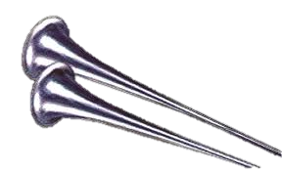
Joe Brown’s Lazy Dog jumps New Bunny Trail on Lunar
happy passover
Apr 2nd - Sunday
- OR -
Apr 3rd - monday
Joe Brown’s Lazy Dog jumpesNew Bunny Trail on Lunar
Joe Brown’s Lazy Dog jumpesNew Bunny Trail on Lunar
depending where you are!
The End
Joe Brown’s Lazy Dog jumps New Bunny Trail on Lunar
The tequfah shadow [for N America] was marked and verified on Mar 19th. Please download the updated Covenant Calendar for 2023-2024. Several varieties are included with this newsletter and on the website.
- Apr 9th

Slide 45
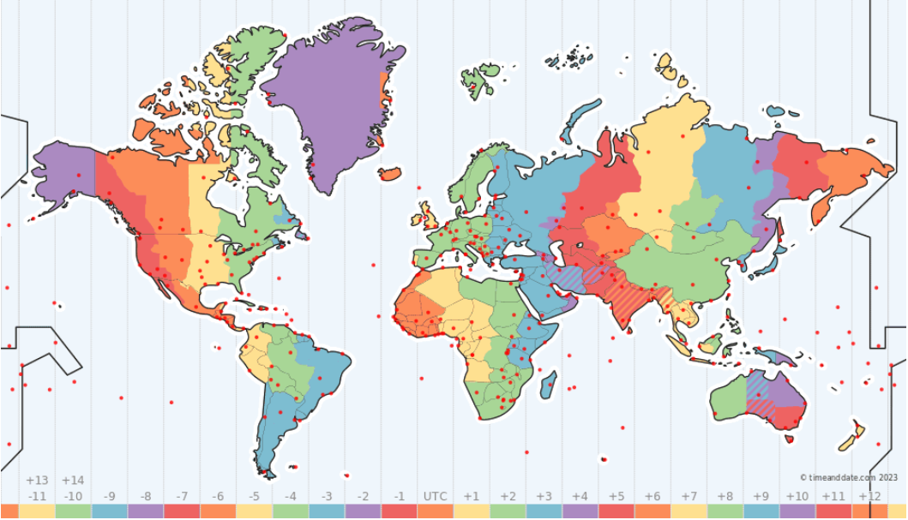
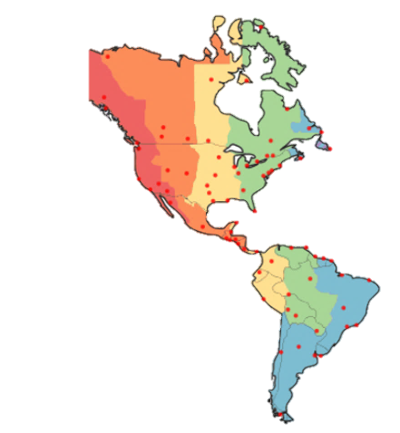

Slide 46
F
F

Slide 47
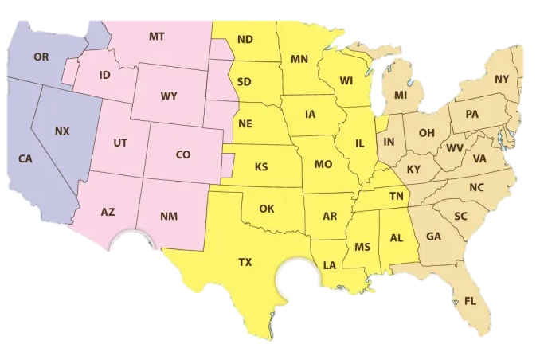
F
F

Slide 49
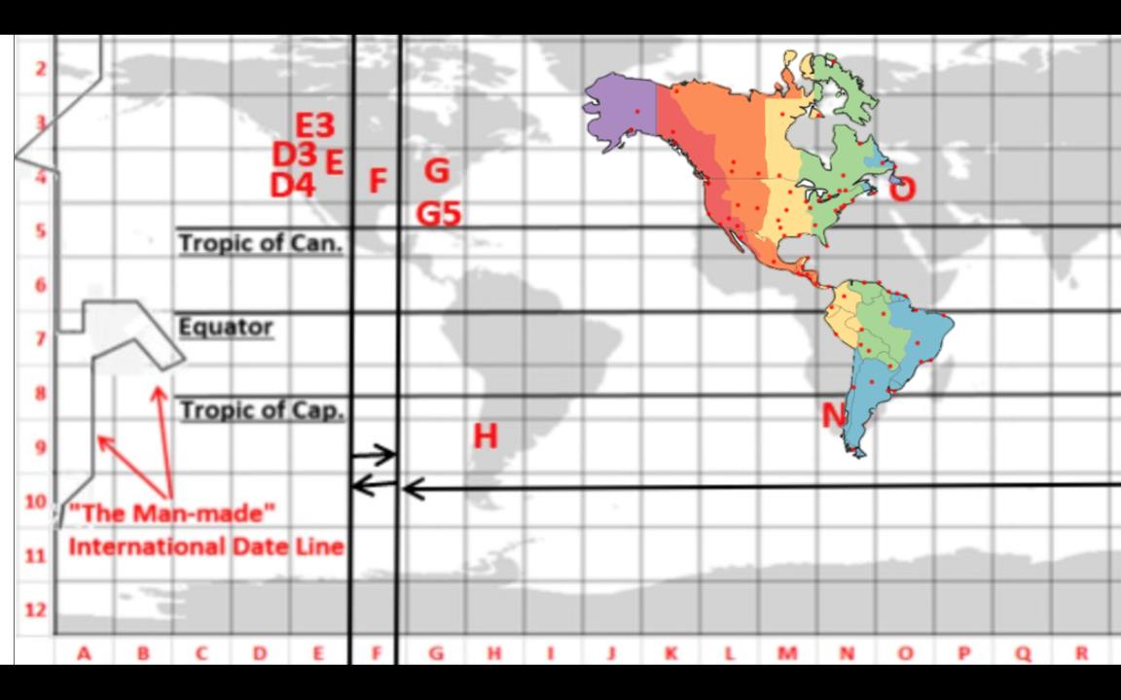

Slide 50
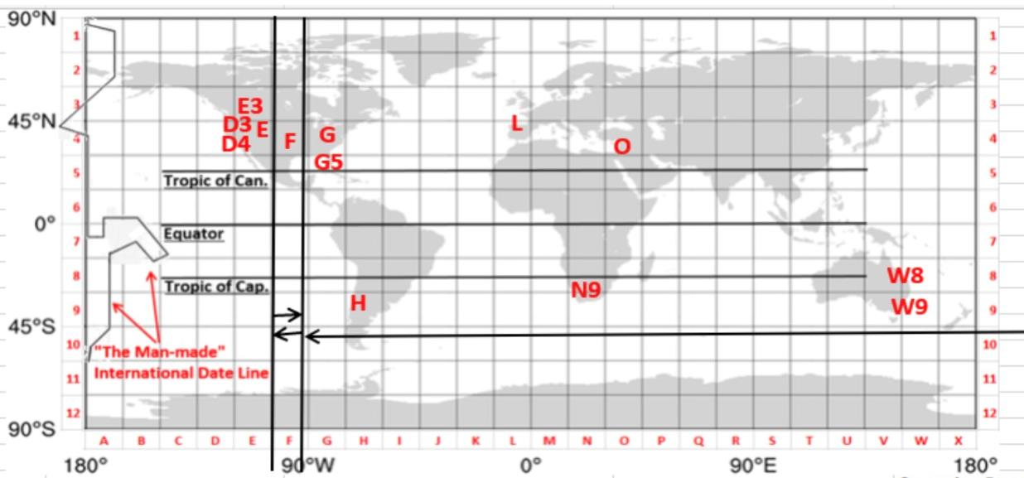
Working slide for #5
2023 Tequfah 3/20/23 21:24 [924 PM] UTC
The Night Season location for Teq. 2023 …

Slide 51
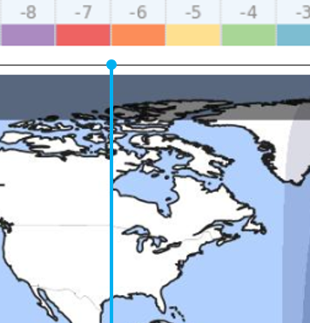
I tried to overlay a USA map along with the markings that Nathaniel had for where he saw the shadows FIRST recorded.
It appears that locations WEST of the blue marker recorded shadows on Mar 19th
There is also recorded information that EAST of the blue marker, straight line shadows were recorded on Mar 20th
What does that mean?
Those WEST of the blue marker would count their Passover on Sunday Apr 2nd
Those EAST of the blue marker would count their Passover on Monday Apr 3rd
It appears this year that the USA is getting a wake-up call … as the nation and continent is practically split right in half.
This scenario actually happens every year in the world, we just haven’t realized it yet, because we’ve been concentrating mostly on the USA.
Most of the world will have their Passover on the DATE of Apr 3rd. But remember, it is NOT the DATE that matters – as the whole world is NEVER on the same DATE for any 24 hrs, ever.
There is no way a joint decision could have been made by the CCC panel members for this tricky situation, because not enough people had marked their shadows.
Nathaniel’s compilation of data from various parts of the world held the clue as to what is going on.
On the next 2 slides are demo’s of how the Night Season is going to relocate further west by about 5.5 hrs each year.
April 2nd Passover
April 3rd Passover
F

Slide 52
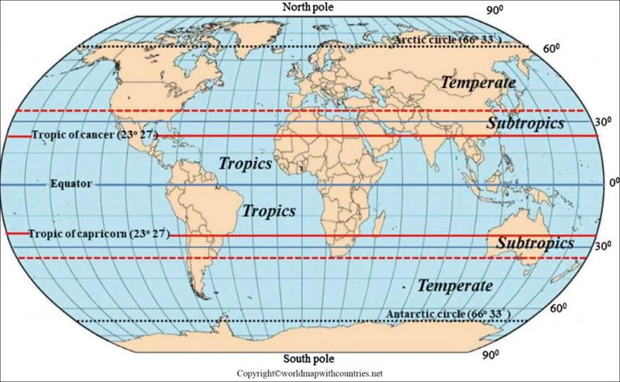
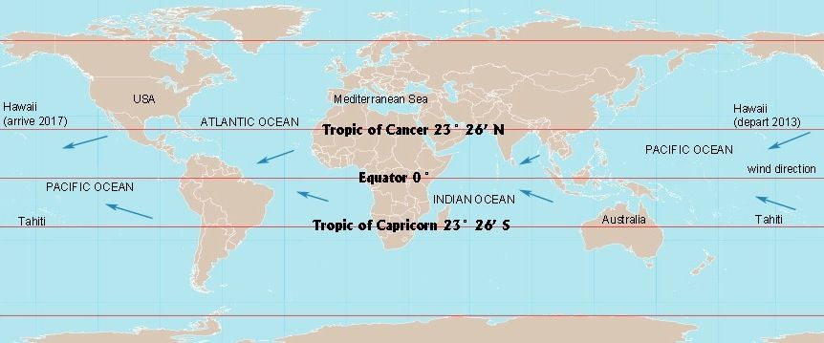
2023 Tequfah 3/20/23 21:24 [924 PM] UTC
The Night Season location for Teq. 2023 …
Working slide

Slide 53
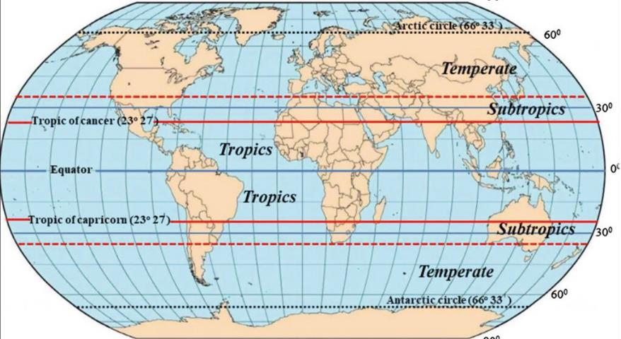

Slide 55
March Equinox 2023
2023 Tequfah 3/20/23 21:24 [924 PM] UTC
The Night Season location for Teq. 2023 …

Slide 56
Tequfah’s Next Lesson
Joe Brown’s Lazy Dog jumps New Bunny Trail on Lunar
Through the 2023 Tequfah Shadow Sign
Joe Brown’s Lazy Dog jumpesNew Bunny Trail on Lunar
Joe Brown’s Lazy Dog jumpesNew Bunny Trail on Lunar
Joe Brown’s Lazy Dog jumps New Bunny Trail on Lunar

