Slide 1



Slide 2

STRONG DELUSIONS!

Slide 3

I would like to say that in all my presentations, it is never my intention nor desire to offend, to judge or to condemn anyone, but to humbly present what I have found in Scripture!
Remember, truth hurts but it also heals.
It is better to be hurt by the raw Truth
than to be comfortably deceived!
By the way, no one should have to sacrifice who they are and what they believe just because someone else has a problem with it!

Slide 4
For clarification: In my studies I use the four Hebrew letters yod, hey, vav, hey, which are the letters YHVH in English (and I pronounce it as Yahuwah) instead of LORD, which is a title - not a name. I also use Yahusha instead of Jesus, which is not a translation but a transliteration from a Greek mistransliteration. The name Jesus has no meaning, in Hebrew nor in English! YHVH and Yahusha are the actual original Hebrew names that speak of our Saviour’s true nature and character.

Slide 5

Think of the verse in the book “Song of Solomon”
chapter 1 verse 3:
“Thy name is as oil poured forth; Therefore do the virgins love thee.” American Standard Version
That reminds me of the parable of the 10 virgins. Five of them were called “foolish” because they didn’t take any oil with them. Could it be that they didn’t know the Father’s name,
and didn’t have HIS name written on their foreheads?

Slide 6
Think of the verse in the book “Song of Solomon”
chapter 1 verse 3:
“Thy name is as oil poured forth; Therefore do the virgins love thee.” American Standard Version
Think of this
“… My people shall know
My name…!” Isaiah 52:6
That reminds me of the parable of the 10 virgins. Five of them were called “foolish” because they didn’t take any oil with them. Could it be that they didn’t know the Father’s name,
and didn’t have HIS name written on their foreheads?

Slide 7
That means,
If you are part
of His people
You will know His name!

Slide 8
Since the Scriptures have been modified, changed over the past centuries by the various translations, be it on purpose or by an oversight, I am inserting the original Hebrew names in my presentations.
Wherever the title “God“ appears, I will insert Elohim or YHVH; wherever “LORD“ is shown,
I will insert YHVH; wherever the word “Jesus” is used,
I will use HIS proper Hebrew name “Yahusha.”
All biblical references are taken from the
King James Version, unless otherwise noted.

Slide 9
STRONG DELUSIONS!

Slide 10
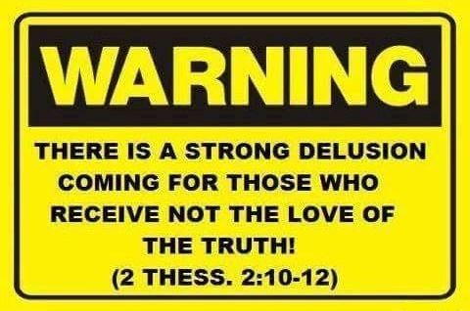
STRONG DELUSION

Slide 11

According to Scripture
Man is an empty vessel!

Slide 12

Each one of us was created as an …
But this vessel is always being
filled with something!
It cannot remain empty!

Slide 13
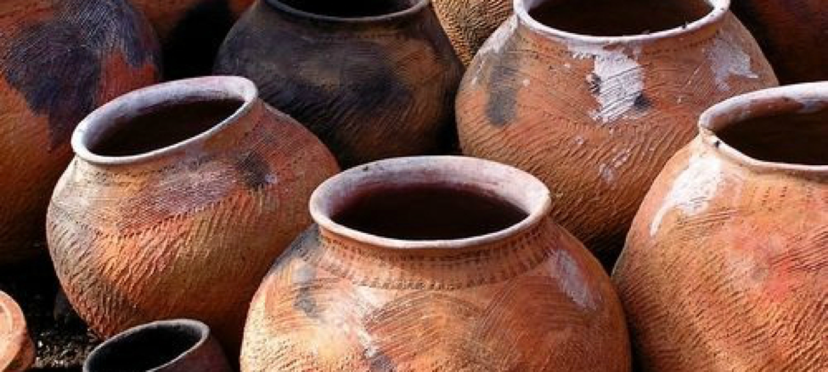
That is a fact and no one
can get around it!
We are filled and controlled
either by the Spirit of YHVH
or by demons!

Slide 14

That means that
there is no such
thing as being
neutral as some
people claim to be!

Slide 15
Again, an individual is
either filled with
The Spirit of YHVH
or with an
evil spirit, there is
no in-between!

Slide 16

According to Romans 9:21 and 23 man was created by YHVH as a vessel for HIS glory, for His honor.
Here is what it states in Romans:
“Does not the potter have authority over the clay, from the same lump to make one vessel for value and another not for value?
23 and that He might make known the riches of His esteem on vessels of compassion, which He had prepared beforehand for esteem.” The Scriptures
A vessel is a container.
It is different from any utensil or instrument.
A vessel is not used to
do something
but to contain something.

Slide 17
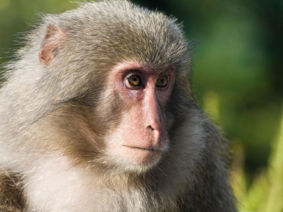
Darwin tells us that men are the descendants of monkeys.
Of course, that is nonsense.
Eventually, as Darwin was dying,
he repented of his devilish
teaching about evolution.
Man is not the descendant of a monkey.
Man was made a living soul.
He was made in the image and likeness of YHVH, the Creator.
(See Genesis 1 & 2.)
A monkey was NOT!
17
Notes:
.

Slide 18
Man was designed and formed to the very image of the omniscient Elohim, and that image had not yet been damaged by sin and the curse.
Man was unique in every way to reflect the image of His maker.
The animals were spoken into existence for various purposes.
Some would serve for transportation, some for labor, some as pets,
and in various other uses.

Slide 19

YHVH is a spirit.
Man, therefore, is not only
a physical being,
but a spiritual being as well.
Man is not in the image of Elohim because he has two eyes, two ears, one nose and one mouth.
He is made in the image and likeness of YHVH because He, too,
is a spiritual being in addition to being a physical being.
19

Slide 20

That is why there is a sacredness to the life of man that is not associated with
the life of animals.
Man as the culmination of the Creation of Elohim holds a special place.
20

Slide 21
According to Scripture man is being compared to a vessel of clay, which is weak, frail, inadequate and breakable. But he was destined unto honor and unto glory. YHVH has destined man to be His container to carry the message of salvation for the
salvation of souls.
The Creator knows our frame that we are but dust — not gold dust, but the common, ordinary kind.
(Psalms 103:14)
In 2 Corinthians 4:7 Paul states, “we have this treasure in earthen vessels, that the excellency of the power may be of Elohim, and not of us.”
21

Slide 22
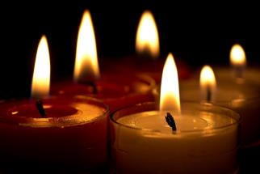
That reminds me of Ecclesiastes 3:20 where it says, “All are going to one place – all came from the dust, and all return to dust.” The Scriptures
That means we are ALL in the same boat; we are all made out of the same material, no matter what position we hold in life, no matter if we are rich or poor, of white or dark complexion or what language we speak. We are all in the same situation and for that reason we must not look down on other people, thinking we are better than others.
The only way we differ from each other is by what Spirit we are being filled with, controlled and guided by.
22

Slide 23
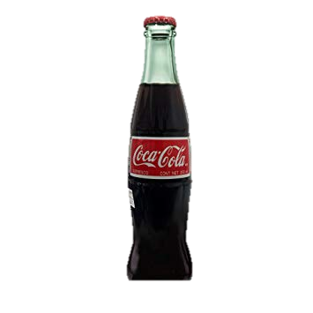
A Coca-Cola bottle is a vessel
made to contain Coke.
Man is not a Coca-Cola bottle.
Man is a bottle, which contains the Spirit of His Creator or the spirit of Demons. Man is a special living vessel
formed of clay and is therefore
different from the Coca-Cola bottle
or any other container.
23

Slide 24
This earthen vessel, bottle or container, called man, was designed to be the temple of YHVH as it states in 1 Cor 3:16-17,
“Know ye not that ye are the temple of Elohim, and that the Spirit of Elohim dwelleth in you? 17 If any man defile the temple of Elohim, him shall Elohim destroy; for the temple of Elohim is holy, which temple ye are.”
Since Adam and Eve fell into sin, things have changed. Satan stole this earth by deception from our first parents. Mankind came under the control of the evil one. Since then evil spirits control people or they are controlled
by the flesh – or – by the lower nature.
24

Slide 25
Romans 8:8-10 states, “Those controlled by the flesh (by evil spirits) cannot please Elohim. 9 You, however, are controlled not by the flesh, but by the Spirit, if the Spirit of Elohim lives in you. And if anyone does not have the Spirit of Messiah,
he does not belong to the Messiah. 10 But if Messiah is in you, your body is dead because of sin, yet your spirit is alive because of righteousness.…” Berean Study Bible
However, since Yahusha our Saviour came to this earth, giving His life for our redemption, gaining the victory over Satan,
we can be free from the power of evil
and be filled with His spirit.
25
Notes:
Romans 8:1 There is, then, now no condemnation to those who are in Messiah יהושע, who do not walk according to the flesh, but according to the Spirit.

Slide 26
What are some signs, which show
that an individual may be
controlled by evil spirits?
We need to know!

Slide 27

Has heaviness plagued your soul? Do you feel weighed down? Do you feel stuck in your spiritual walk? Do you feel paralyzed in your emotions? Life happens, emotions get out of balance, and tests and trials come at
us, but how do we know when it is a natural course of life versus a demonic spirit infiltrating our soul? We will have normal circumstances that weigh us down and make us feel sad. However, when we can't get unstuck or move past situations is when we need to start discerning if a demonic entity has infiltrated our soul.
27

Slide 28

Another sign could be this: if you find no pleasure now in the contemplation of heavenly things; if you have no interest in seeking the knowledge of YHVH; no delight in beholding the character of the true Hebrew Messiah
Yahusha Ha Mashiach; if holiness has no attraction for you, if you set your affections mainly on earthly things, on the things of this life, preferring the association of ungodly people, then you can be sure that an evil spirit is in control and you must take action by expelling this spirit from you.
28

Slide 29
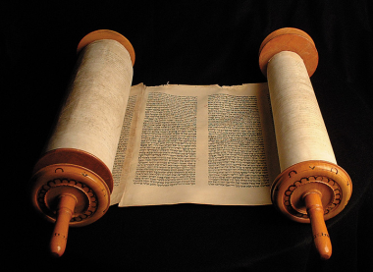
Evil spirits move in often, because
of rebellion and disobedience to
the Father’s instructions, His Torah.
Also if there is bitterness and resentment in the life against one another or towards the Creator, evil spirits are being invited, because they love such things.
Until you turn to Elohim, acknowledge your sins and ask for forgiveness through the blood of Yahusha, you will continue to have difficulties with demons. Evil spirits will not leave on their own. They have to be forced out. They must be resisted. We must immediately submit to YHVH, invite Yahusha into our life and be filled with His spirit.
29

Slide 30

Here is what Scripture has to say about this in James 4:7, “Submit yourselves therefore to Elohim. Resist the devil, and he will flee from you.”
First submit, then resist!
Study the word! Remember, when you carry Scripture, Satan gets a headache; when you open it, he collapses; when he sees you reading it, he faints; when he sees that you are living
what you read, he flees. I encourage everyone to test it.
You have nothing to loose but everything to gain!
30
Notes:
Be filled with His word, truth!

Slide 31

He stated in Matthew 5:43-45, “You heard that it was said,
‘You shall love your neighbor and hate your enemy.’
Footnote: (Hate your enemy was “said,” not “written.”)
44 “But I say to you, love your enemies, bless those cursing you, do good to those hating you, and pray for those insulting you and persecuting you, 45 so that you become sons of your Father in the heavens. Because He makes His sun rise on the wicked and on the good and sends rain on the righteous and on the unrighteous.” The Scriptures
Evil spirits don’t like this advice and they will flee, because they can’t handle it!
31
Notes:
Just because you are member of a Christian denomination, beware. Remember the 3 unclean spirits.
Revelation 16:13 And I saw three unclean spirits like frogs [come] out of the mouth of the dragon, and out of the mouth of the beast, and out of the mouth of the false prophet.
Romans 8:1 There is, then, now no condemnation to those who are in Messiah יהושע, who do not walk according to the flesh, but according to the Spirit.
Strong delusions!

Slide 32

The Scriptures are not to be just read,
but to be studied!
32

Slide 33
The Father wants to be worshipped in Spirit and in truth!
The problem is that most people
may not even know what truth is!

Slide 34
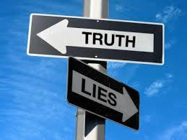
BECAUSE THEY HAVE BEEN DECEIVED BY RELIGION!
CONSIDER THIS:
34

Slide 35
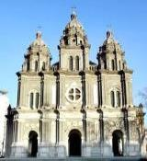
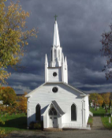


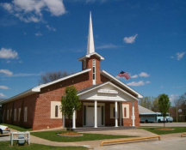
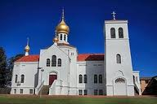
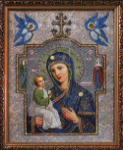
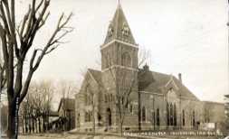
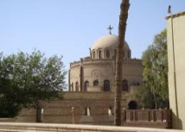

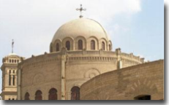
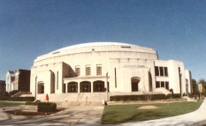
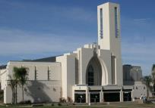
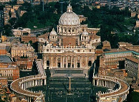







There are over 41,000 Christian Churches, denominations and Sects ALL claiming to have the truth!
But do they?
They all can’t possibly have all the truth as they can’t agree with each other, even though they basically claim to have the same Bible! THERE IS ONLY ONE TRUTH AS WE WILL SEE!
35

Slide 36
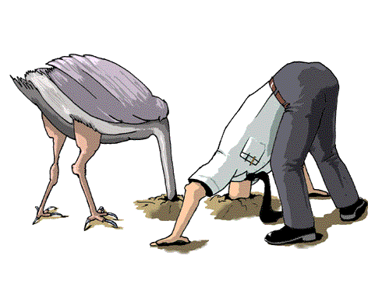
Let’s be honest, most people do not like to hear
the truth to begin with!
They would rather put their head in the sand and ignore truth!
36

Slide 37
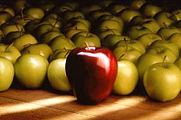
TRUTH WAS NEVER POPULAR!

Slide 38
Because truth hurts ~
truth makes enemies!
But truth also heals!
Truth frees and saves!
38

Slide 39
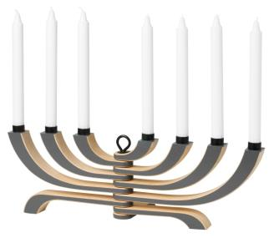
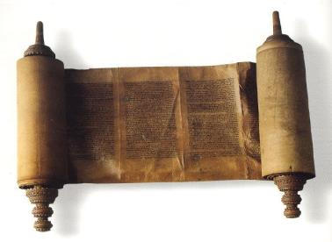
The fact that we believe something to be true does not make it true. Truth is truth whether we believe it or not! Truth stands on its own!
39

Slide 40
Truth is truth, whether no one believes it, and a lie is a lie,
no matter how many believe it.
40

Slide 41
Let’s look at John 4:24, “Elohim is Spirit, and those who worship Him need to worship in spirit and truth.” The Scriptures
So we MUST find out what the truth is in order to worship the Father not only in Spirit but in truth!
41
Notes:
Just because you are member of a Christian denomination, beware. Remember the 3 unclean spirits.
Revelation 16:13 And I saw three unclean spirits like frogs [come] out of the mouth of the dragon, and out of the mouth of the beast, and out of the mouth of the false prophet.
Romans 8:1 There is, then, now no condemnation to those who are in Messiah יהושע, who do not walk according to the flesh, but according to the Spirit.
Strong delusions!

Slide 42

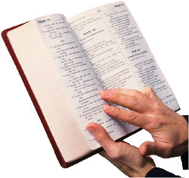
We do have the promise from Yahusha in John 8:32,
“Ye Shall Know The Truth!”
The truth will be revealed to us again,
If we continue in HIS word (John 8:31)!
That means all of HIS word,
starting in the beginning of the book, not in the middle!

Slide 43
Don’t ask your church or denomination, because they have no clue!
I know that sounds unkind, but it is the truth!
43

Slide 44

..the truth shall make you free!
Free from what?
44

Slide 45
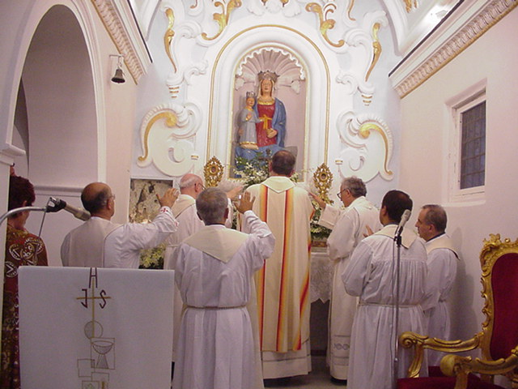
Free from organized religion and the doctrines and commandments of man! Free from error and false teachings!
Here we see priests saluting the QUEEN OF HEAVEN!
—Nothing has changed, this is still happening today!
45

Slide 46

Next, let’s consider 2 Thessalonians 2:3-12 where it states, “Let no man deceive you by any means: for that day shall not come, except there come a falling away first, and that man of sin (lawlessness – The Scriptures)
be revealed, the son of perdition; 4 Who opposeth and exalteth himself above all that is called Elohim, or that is worshipped; so that he as Elohim sitteth in the temple of Elohim, shewing himself that he is Elohim. ... For the mystery of iniquity (anomos – lawlessness) doth already work, then shall that Wicked be revealed, whom the Master shall consume … and destroy with the brightness of his coming: …
46

Slide 47
… whose coming is after the working of Satan with all power and signs and lying wonders, … with all deceivableness of unrighteousness in them that perish; because they received not the love of the truth,
that they might be saved. … for this cause Elohim shall
send them strong delusions, that they should believe a lie.
12 That they might be damned who believed not the truth,
but had pleasure in unrighteousness.”
Who is mainly being talked about in these verses?
47

Slide 48
According to Isaiah 14:12 this is talking about Satan, “How art thou fallen from heaven, O Lucifer, son of the morning! How art thou cut down to the ground, which didst weaken the nations!”
Lucifer, the fallen angel
is the deceiver that deceives
the whole world!
48
Notes:
Remember the 3 unclean spirits.
Revelation 16:13 And I saw three unclean spirits like frogs [come] out of the mouth of the dragon, and out of the mouth of the beast, and out of the mouth of the false prophet.
Romans 8:1 There is, then, now no condemnation to those who are in Messiah יהושע, who do not walk according to the flesh, but according to the Spirit.
Strong delusions! See 2nd Thessalonians 2:10

Slide 49

BUT
AND HE KNOWS IT ..
For it states in Revelation 12:12, “Therefore rejoice, [ye] heavens, and ye that dwell in them. Woe to the inhabiters of the earth and
of the sea! for the devil is come down unto you,
having great wrath,
because he knoweth that
he hath but a short time.”
FOR SATAN

Slide 50
According to 2 Corinthians 11:14
Satan transforms himself as an angel of light!
According to Matthew 24:5, the words
of Yahusha, many will come
claiming to be the Messiah!
That is Satan hiding himself!
50
Notes:
Remember the 3 unclean spirits.
Revelation 16:13 And I saw three unclean spirits like frogs [come] out of the mouth of the dragon, and out of the mouth of the beast, and out of the mouth of the false prophet.
Romans 8:1 There is, then, now no condemnation to those who are in Messiah יהושע, who do not walk according to the flesh, but according to the Spirit.
Strong delusions! See 2nd Thessalonians 2:10

Slide 51
But the Heavenly Father
allows these deceptions
to take place!
The question is why?
51

Slide 52
Because people
received not
the love of the truth!
(2 Thessalonians 2:3-12)
52

Slide 53

I asked myself the question “What truth”
do people reject?
In the prayer to His Father for
His disciples Yahusha said
“Sanctify them through thy truth: thy word is truth.” John 17:17
Man is being sanctified,
made holy, being set apart through obedience to His word!
Notes:
In the beginning was the Word, and the Word was with God, and the Word was God. 1:4 and the word was made flesh
Ps 119:142 “thy law (Torah) is the truth”

Slide 54
In John 1:1 we read,
“In the beginning was the Word, and the Word was with Elohim and the Word was Elohim.”
That Word is none other than YAHUSHA HA MASHIACH!
Then go to John 14:6, where
Yahusha stated of Himself
“I am the way, the truth, and the life:
no man cometh unto the Father,
but by me.”

Slide 55
Yahusha is the truth that
many people reject,
(especially in Judaism).
BUT WAIT, THERE IS MORE TRUTH BEING REJECTED!
55

Slide 56
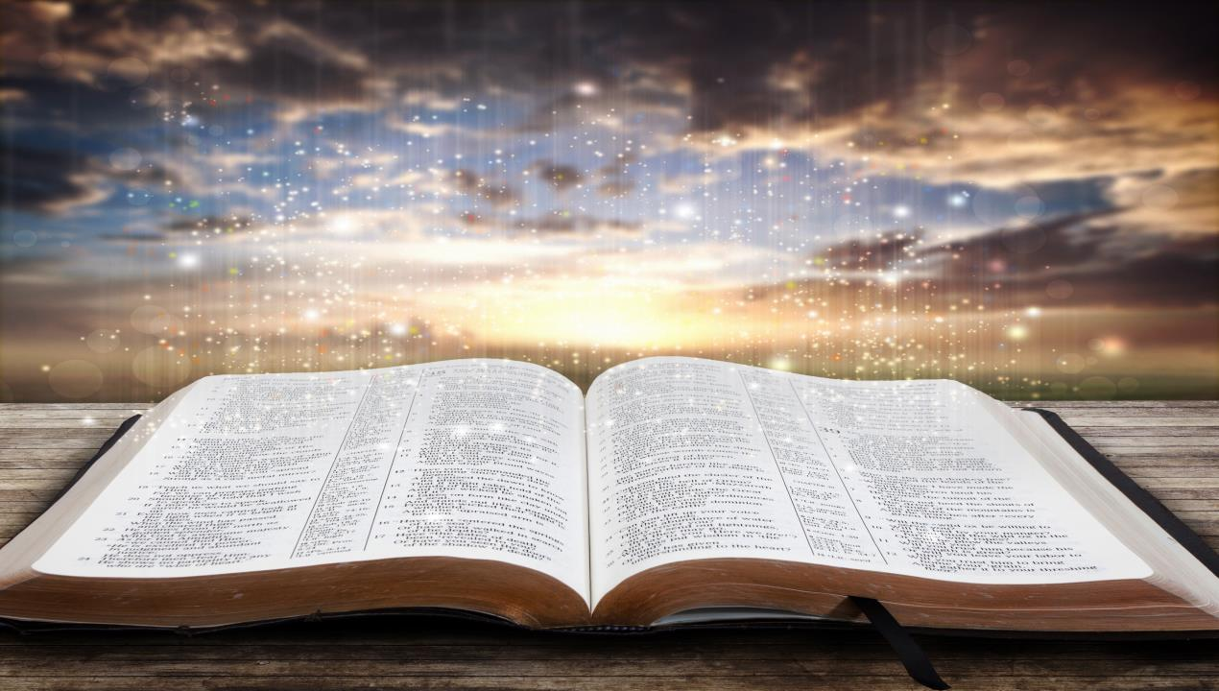
“Your righteousness is righteousness forever, And Your Torah is truth.”
Psalms 119:142 The Scriptures
56

Slide 57
The Torah (HIS instructions)
is the truth,
which most of
Christianity rejects!
57

Slide 58
Why do most professed
Christians reject the
Creator’s instructions,
called Torah?
58

Slide 59
Because they have been taught
and are being told that
these commands are
no longer binding,
which is a false claim!
59

Slide 60
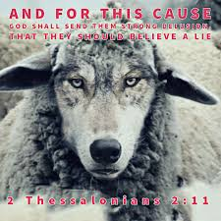
The Bible states, because of rejecting the truth of Yahusha and the Torah, YHVH Himself will send “strong delusions” that these people should believe a lie that they might be damned who believed not the truth but had pleasure in unrighteousness.
60

Slide 61
What would these
strong delusions
look like?

Slide 62

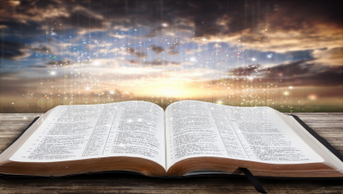
In Revelation 16:13
we find an interesting statement saying,
“And I saw three unclean spirits like frogs (come) out of the mouth of the dragon, and out of the mouth of the beast and out of the mouth of the false prophet.”
62

Slide 63

We could argue who the dragon, the beast and the false prophet might be. But is it possible that the three unclean spirits represent the three monotheistic world religions like Islam, Christianity and Judaism?

Slide 64
Islam is following
the moon;
Christianity follows
the sun;
Judaism follows both!!

Slide 65

I want to focus briefly on Christianity, because that is what I was raised in!
What would be a strong (powerful) delusion for Christians, who believe that they are head and shoulder above all other religions,
having the truth, serving the true Creator?
What if you discovered that people had been lied to by religion for the past 2,000 years as it states in Jeremiah 16:19 “Surely our fathers have inherited lies, vanity,
and [things] wherein [there is] no profit?”

Slide 66
If you discovered the following facts … would it shock you? “Christianity was not founded by the Hebrew Messiah of Nazareth, but by pagan philosophers a generation after the death of the last of His immediate followers! What if you discovered that the denominations, sects, churches, or factions, which make up Christianity are not followers of the genuine Saviour of the world! The doctrines He taught, the life He lived, the worship He practiced, are not those of modern Christianity. Christianity is Hellenic paganism, nationalized by Roman emperors for national solidarity. It was molded from the doctrines of Plato, Socrates and the Gnostic Grecian philosophers. Christianity is but a newer name of the old religion of the philosophers. It is modeled after them in doctrine, in practice and in worship. …
66

Slide 67
…Christianity, as such, was not firmly established as a religion until the time of Constantine the Great, who needed a national religion to solidify his empire. He, therefore, adopted the new religion, then going into apostasy, and made it into a national sect. He not only caused its acceptance as the one and only religion of the empire, but he formulated its policies, and caused its doctrines to be accepted, and stigmatized as heretics those who would not accept the new religion, banishing them from his kingdom, or putting them to death. Anyone may verify the above by referring to any religious encyclopedia on the topic of the Council of Nice, or the life of Constantine. Thus began the Roman Catholic Church, from whence sprang the church daughters making up the sects of Christianity…
67

Slide 68
…Mainline Christianity is not the faith of the Saviour, but an amalgamation of paganism, Judaism, sprinkled with a tincture of the true faith as taught by the Messiah. Hurlbut says, "As long as the church was mainly Jewish the Hebrew Sabbath was kept; but as it became increasingly Gentile the first day (Sunday) gradually took the place of the seventh." Story of the Christian Church, page 45.
Not only was the Sabbath dropped from the new religion, and Sunday (a holy day of the pagans) adopted; but they likewise rejected the Passover and the Feast of Unleavened Bread and adopted Lent and Easter (Astarte’s Sunday). The Feast of Tabernacles and the Day of Atonement were forgotten, and the birthday of the sun god took their place as Christmas…
68

Slide 69
…Sprinkling took the place of immersion; immortality of the soul, adopted from paganism, replaced the doctrine of conditional eternal life; the resurrection and day of judgment were forgotten, and a continuous judgment was taught, through which the dead entered heaven or hell for eternity, no resurrection being necessary in this program. … This new church, so different, was Christianity, and for its deities it adopted various ones from the heathen, discarding the Most-High of the Jewish scriptures, and His blessed Son Yahusha.”
http://www.giveshare.org/BibleStudy/007.pagan.html
COULD WE CALL THESE DOCTRINES STRONG DELUSIONS?
69

Slide 70
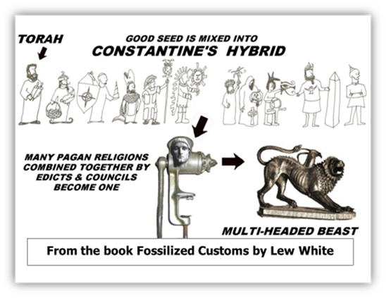
We can safely say that Christianity is not the Religion that the Hebrew Messiah Yahusha started nor supports.
It is a hybrid religion,
a mixture of some of the teachings of Yahusha, but not the same religion that He nor the
apostles taught!
70

Slide 71
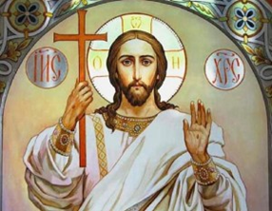
What if you discovered that this Greek Jesus
is not the Hebrew
Messiah with the name of Yahusha?
The name Jesus
is a mask for Tammuz!
Would that be
a strong delusion?

Slide 72

Some time ago I learned that the Christian Messiah, with the name of Jesus is not the Hebrew Yahusha. These are two completely different entities.
The name “Jesus” is a man-made invention, a
Greek Messiah with the sun disc, created by man,
but Yahusha is the Son of the Most High that was born to a Hebrew couple from Israel.
The name Yahusha means YHVH (the Father) saves.
72

Slide 73
There is only one truth revealed in the Scriptures. Down with Christianity, its pagan worship, its pagan deities, its pagan festivals, and its pagan doctrines, and back to the old pathway according to
Jeremiah 6:16, the way of salvation.
Worship the Mighty One of Abraham, Isaac and Jacob, follow the true Hebrew Saviour Yahusha and reject all traditions and commandments of men, worshipping the Eternal in Spirit and in Truth!
73

Slide 74

These are the facts, which are not intended to offend, condemn or to judge individuals, but to be a wake-up call.
It is for our own good to find out what happened
during the past 2,000 years and make a U-turn to
the Elohim of Abraham, Isaac and Jacob and to
the written instructions He gave through Moses.
WHY?
74

Slide 75
Because it is a Salvation issue!
Scripture states in Hosea 4:6, “My people have perished for lack of knowledge.
Because you have rejected knowledge,
I reject you from being priest for Me.
Since you have forgotten the Torah of your Elohim, I also forget your children.”
The Scriptures
75

Slide 76

Your eternal destiny will not be the result of chance but of
A PERSONAL CHOICE.
So choose LIFE by accepting Yahusha as your Saviour and
follow His instructions,
the Torah!
76

Slide 77
Stay away from religion
stay away from man-made teachings and traditions
stay away from churches
and denominations!
Follow the Lamb withersoever
he goeth. (Revelation 14:6)
Stay in contact and worship with those
that follow a “Thus saith YHVH!”
77

Slide 78

“
SHALOM
78

Slide 79


Supreme Provider
Yahusha Ha Mashiach
Prepared and recorded
By Walter Tschoepe
Malachi4.4@outlook.com

