Slide 1
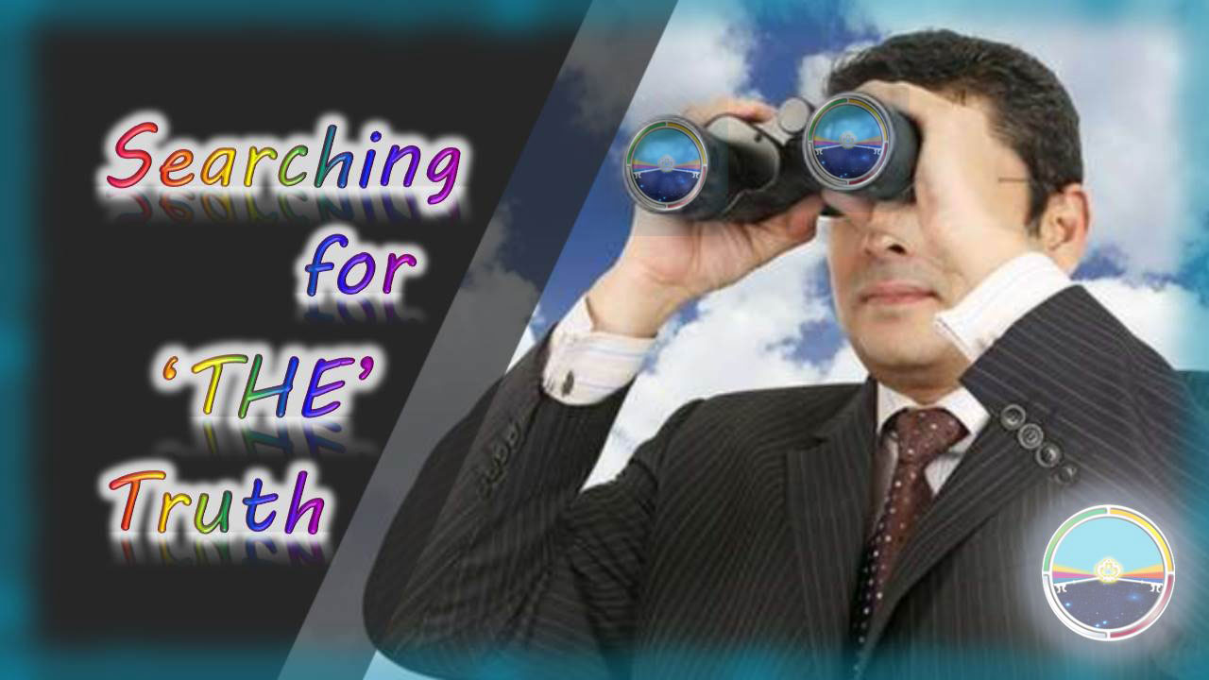



WHY IS THAT
IMPORTANT?

Slide 2

Only truth can make us free!
JOHN 8:32

Slide 3
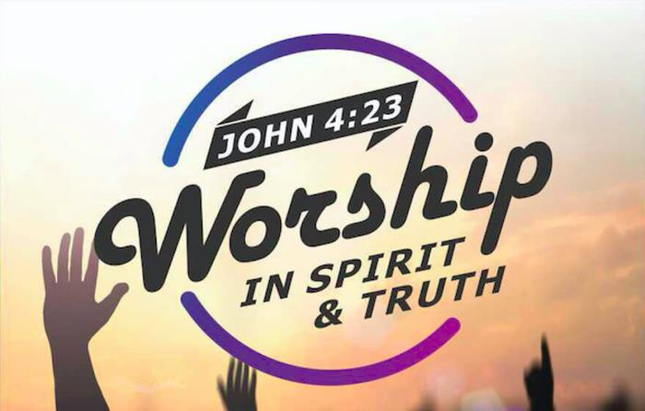
When we worship YHVH, we must not only worship Him in Spirit but also in TRUTH!
That is the only worship He can and will accept!

Slide 4

Just for clarification before I continue with my presentation: In my presentations I am using YHVH (Yahuwah) instead of LORD, which is a title and not a name and I am using Yahusha instead of Jesus, which is not a translation but a transliteration from a Greek mistransliteration and has no meaning, neither in Hebrew nor in English! YHVH (Yahuwah) and Yahusha are the actual original names and the true nature and character of them.

Slide 5


BACK TO OUR PRESENTATION WITH THE TITLE ….
Searching for “The Truth!”

Slide 6
You noticed I high-lighted the word “THE.” There is only one truth, and it is the absolute truth. If there are no absolute truths, we have chaos. Take the law of gravity, as an example. If it were not an absolute, we could not be certain we could stand or sit in one place until we decided to move. Or if two plus two did not always equal four, the effects on civilization would be disastrous. Laws of science and physics would be meaningless, and commerce would be impossible. What a mess that would be! Thankfully, two plus two does equal four. There is absolute truth, and it can be found and understood.
That applies foremost to the question why we are here, what is the purpose and where we are going, and who is in control of this universe.

Slide 7
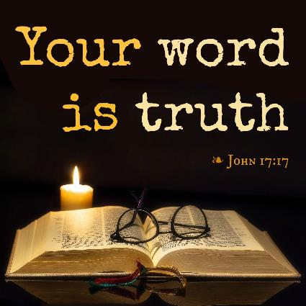
If we understand that our life is not an accident, it has a purpose and we are committed to the Great I AM, the Aleph – Tav, who is in complete control and we are determent to accept only what He says in His Word, make not flesh our arm, we will find the truth and salvation through Yahusha!

Slide 8

Truth seeking requires an open mind, determination, persistence and humility. A commitment to truth-seeking will take us outside our comfort zone, it may require from us to admit things we would rather deny or calling us to difficult decisions and actions, even to the point of losing so-called friends.

Slide 9

When you find biblical truth and practice it, you find out quickly who your true friends are!

Slide 10
Our yearning for truth must exceed our yearning to please people!

Slide 11

Let’s think about it, we show up on this planet and look around and wonder who the heck we are and what this world is all about. Learning the truth, finding out why we are here and what our purpose is in being here, involves a serious search, a serious desire and personal efforts to find out! We cannot leave this search to other people! This is a personal responsibility.

Slide 12

In today’s society we are being bombarded from all sides by a vast number of messages claiming to be the truth, but that are nothing but lies. We are being brainwashed by Government, by Religion, through Education, Advertising, Television and Internet. We are told what to think, what to believe, what to eat and how to dress, what medication to take or what to buy! Especially during the Corona Epidemic, we must ask questions, but can’t believe everything we hear, see and read. We need to prove ALL THINGS as Scripture commands!

Slide 13

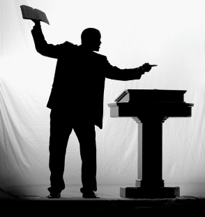
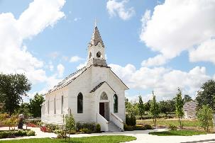
We should never trust anything what we hear, see or read in matters of religion. We must by all means ask questions and for everything any church or denomination presents as truth, we must require a “Thus saith Yahuwah!”

Slide 14

Why must we require a “Thus saith YHVH”?
Because whatever we do and whoever we follow, will affect were and how we will spend eternity!

Slide 15
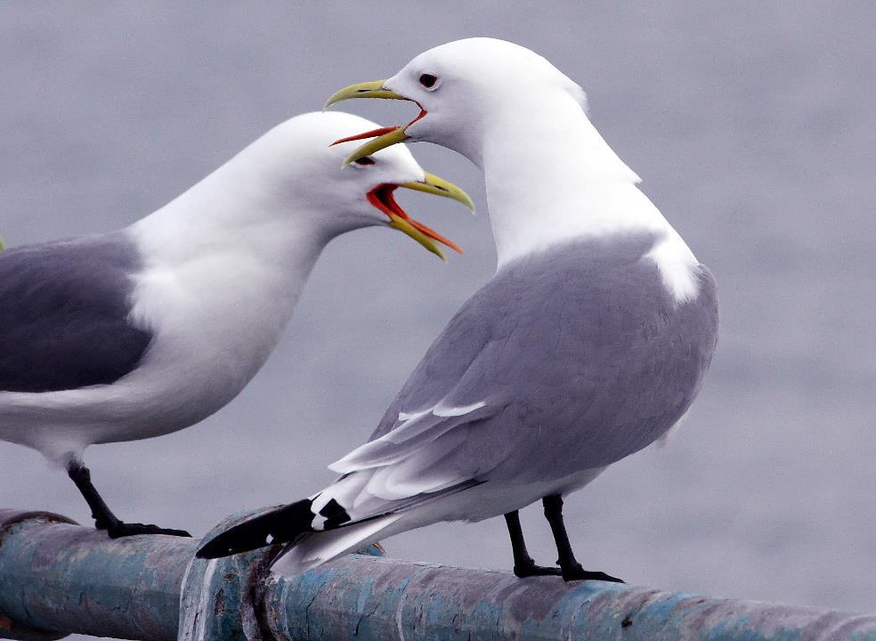

There are so many different opinions and interpretations
In Christianity in reference
to biblical doctrines as there are denominations!

Slide 16

The question is: “Who is right?”

Slide 17

Here is our first problem! Just saying YHVH (Yahuwah or Yahweh) instead of “LORD” in most of the Christian Churches, causes people to roll their eyes!
We need to ask why do they do that?
Because they don’t agree with that, find it strange , even wrong! They are ignorant because they don’t know the truth in this matter, they have been taught falsehoods!

Slide 18
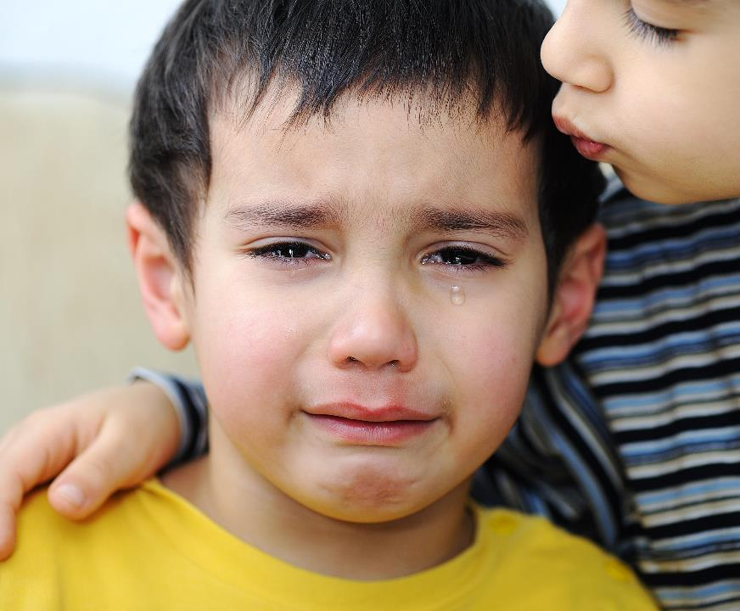
We all have been lied to during our whole life!

Slide 19
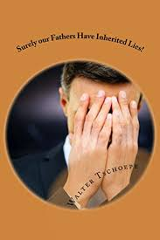
In Jeremiah 16:19 it states: O YHVH, my strength and my stronghold, my refuge in the day of trouble, to you shall the nations come from the ends of the earth and say: “Our fathers have inherited nothing but lies, worthless things in which there is no profit.” ERV

Slide 20

Therefore, believe nothing you hear, nothing of what you read, and only some of what you see!

Slide 21
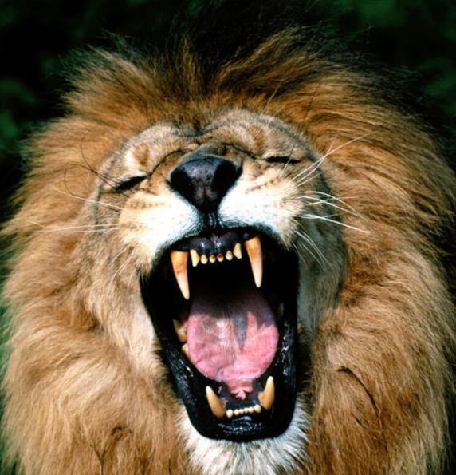
The reason being, because your adversary the devil, as a roaring lion, walketh about, seeking whom he may devour by deception.
(see 1Peter 5:8)

Slide 22
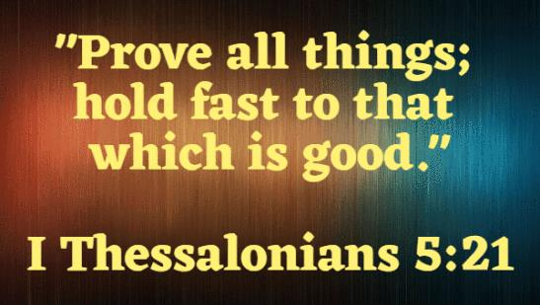
You and I are commanded to …
DON’T LEAVE IT TO SOMEONE ELSE!

Slide 23
The “Lord or Elohim” is a phrase in this world, which is well understood. The world hears the word “Lord” as an example and thinks whatever they have been programmed to understand.
As an example, Lord Krishna is “Ravi” in Hindi. Ravi is the title for their sun deity, Surya, and means “Lord”.
The 1st day of their week is called RAVIVARA, or the “Lord’s Day.” Sunday (the day of the sun) is accepted as the “Lord’s Day.” The true Name of our Creator, the Elohim of Abraham, Isaac and Israel, who blessed the 7th day as a remembrance of His rest and creation is NOT known, but HE has a name.
BUT MOST PEOPLE DON’T KNOW THAT NAME!

Slide 24
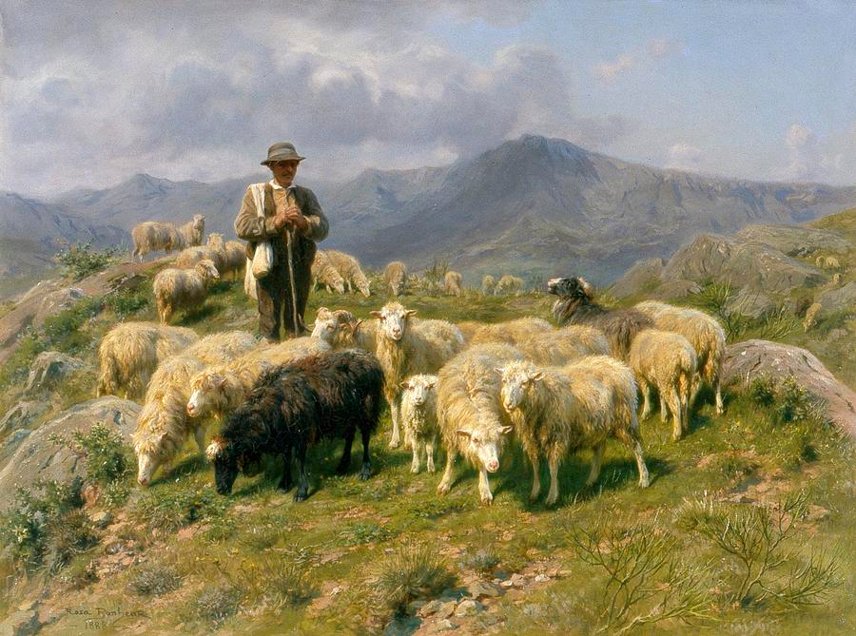
Psalm 23 begins with His name: “יהוה (YHVH) (Yahuwah) is my shepherd; I do not lack.”
However, if the Lord (as it states in the Christian Bibles) is our shepherd, then Baal could be our shepherd, because LORD is not a name, but a title and could mean anyone, like Allah, Buddah or Ba’al!

Slide 25
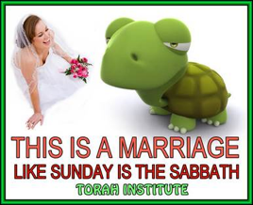
The removal of the true Name YHVH and substituting it with a title “LORD” goes against the 1st, 2nd and 3rd commandments. The replacement day of rest, Sunday, was done by Constantine in 321 CE and goes against the 4th commandment. Guarding the last 6 Commandments, which teach us how to love our neighbor is a fine thing to teach. But if we disregard the first 4 commandments that teach us how to love YHVH, what good is it? Sunday is the Sabbath like a covenant between a turtle and a woman is a marriage!
The 7th day is still blessed, and Constantine does not need our obedience. We are servants of the one we obey, so we need to be precise in both word and deed.

Slide 26
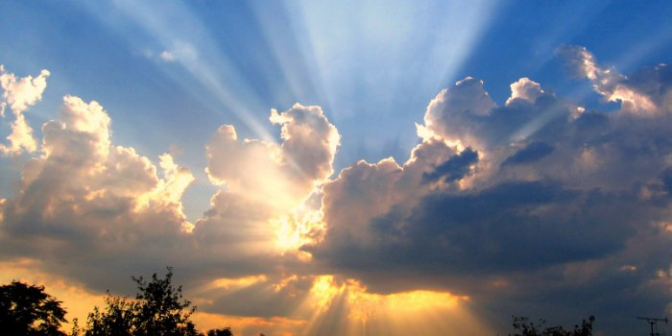
Again, we are dealing with eternal consequences, with eternal life or eternal damnation!

Slide 27
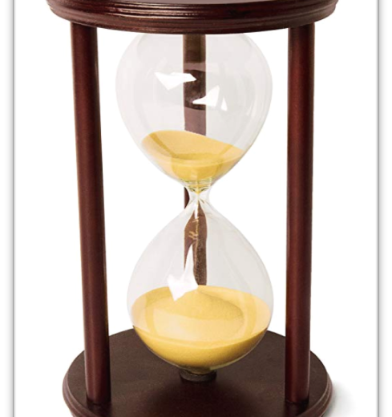
Let’s be reminded that this life is SHORT, but eternity is LONG!

Slide 28
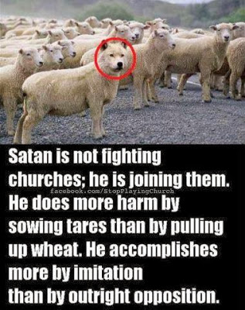
Believers are being commanded in 1John 4:1 (The Scriptures) “……. do not believe every spirit, but prove the spirits, whether they are of Elohim, because many false prophets have gone out into the world.“

Slide 29
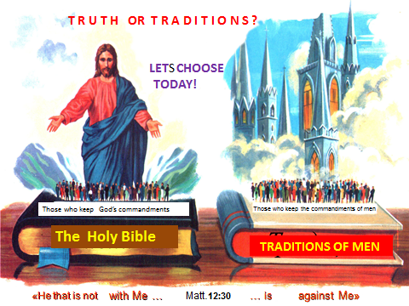
It is high time to prove the spirits and to cut loose from all traditions and doctrines of man that were introduced into Christianity during the past 2,000 years!

Slide 30
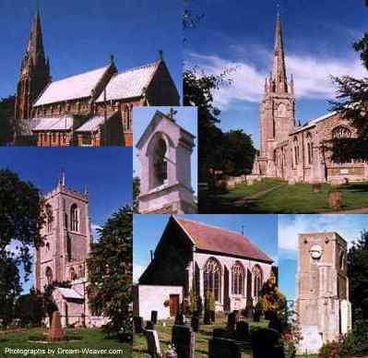
According to Wikipedia there are more than 41,000 denominations, churches, sects, individual unaffiliated churches, para-church groups etc. within Christianity alone, all are claiming one way or the other to have “The truth!”
They can’t all be right,
no way!

Slide 31

Let’s look at some Christian denominations and Islam as an example and their claims of being the only ones having the truth that leads to eternal life!

Slide 32
What does the Catholic Church teach?
“For it is through Christ’s Catholic Church ALONE, which is the universal help toward salvation, that the fullness of the means of salvation can be obtained.” (Catholicism the Second Vatican Council’s Decree on Ecumenism)
“Infallible guidance in interpreting the Bible comes from the church.” (Meaning the Catholic Faith)
Is this conviction or statement of the Catholic Church based on a “Thus saith Scripture” or is it based on traditions and promises of man?

Slide 33
Mormonism
“This church is the only true and living church on the face of the whole earth.” "There is no salvation outside the church of Jesus Christ of Latter-Day Saints.”
Again the question: is their statement of belief based on a “Thus saith YHVH” or is it based on opinions and teachings of man?

Slide 34
Jehovah’s Witness
“We acknowledge as the visible organization of Jehovah on earth the Watchtower Bible and Tract Society." “Outside the true Christian congregation what alternative organization is there? Only Satan’s organization …” (Watchtower, April 15, 1939 p. 125 and March 1, 1979 p. 24.)
The Jehovah's Witnesses are convinced that they are the visible organization of YHVH and everyone else is damned, but do they have a “Thus saith YHVH” for their stand or is it wholly based on the opinions of man?

Slide 35
International Church of Christ
“There is one church! There is one God. There is one kingdom of God and this is it!" “We’re the last hope the world has.” (Gordon Ferguson, Radical Men, Radical Times Hosea Radical Love of Elohim, Manila World Leadership Conf., Aug. 1994.)
What about this denomination? What gives them the assurance that they are it? Do they have a “Thus saith the Elohim of Abraham, Isaac and Israel” or are they basing their conviction on what some people have told them?

Slide 36
Seventh Day Adventists
"Since we keep all Ten Commandments and have Ellen White as our prophet, we Seventh-day Adventists are The Remnant Church!"
Here are some words from Ellen White, she stated: "In my books, the truth is stated, barricaded by a ‘Thus saith the Lord.’”
(Adventist Review, Oct. 1, 1992, p. 23.) “The local (SDA) church becomes the 'port of entry' to the kingdom of God.”
(Adventist Review, June 2, 1988, p. 9.) “... when we backslide from the church, we also backslide from God.”

Slide 37
Seventh Day Adventists
Here is a statement by Dan O’Ffill, a SDA evangelist: “The entire world is deceived today. Truth has been covered up with error. The Protestant churches have accepted the teaching of the antichrist…And so most (non-SDA) church members are in mortal danger, but don’t know it. … the Seventh-day Adventist Church is the world’s last hope for rescue …” (1994 R&H pp. 16, 18.)
People forget, it is not a church or a pastor that saves us. According to Scripture, Eternal life is to know Yahuwah, and Yahusha Ha Mashiach, whom He has sent and to obey their instructions, called Torah!

Slide 38
What about the members of the SDA denomination? Does that membership guarantee anyone eternal life? Do these people have a “Thus saith the Elohim of Abraham, Isaac and Israel for all their doctrines”? I used to believe it until I came to the conviction that this is not the case! Was I truly redeemed as I believed for so many years and others still believe to this day or can we speak about a serious deception based wholly on man’s promises?
Notes:
Thinking back, I deceived many others, I didn’t know, but I still deceived people at that time!

Slide 39
I am not the judge, and I am not interested in offending and condemning people, but I am interested in searching for the truth, knowing the truth, living the truth, sharing the truth, because only the truth makes us free!

Slide 40
The Philadelphia Church of God
“The “household” is God's Family or true church. It's the family that God rules. This is God's inner circle -- His very elect ... we are God's only true representative on this earth.” (The Philadelphia Trumpet, p.1 May 1995.)
What about these two denominations? What gives them the idea and confidence that they are the only true denomination? Do they have a “Thus saith YHVH”?
Living Church of God
“LCOG is the true Church of God which teaches and practices Apostolic Christianity!"

Slide 41
Cooneyites
"We are not following some way founded in the early 1900's, but it goes clear back to Christ." “Some people say there are other fellowships that can be alright. No, there can't be, because there is only one body that Jesus had." "People can come to Christ only through us."
Here are two more organizations with a strong conviction that salvation can be obtained only by being a member of their group! What is their conviction based on?
Iglesia ni Cristo
"Ours is the Church Christ founded." "Thus, outside the Church of Christ no one can be considered a true believer.'' (PASUGO, September/October 1981, p. 9.)

Slide 42
Church of God in Christ, Mennonite
“God has made no covenant with any other church.”
(John Holdeman, A History of the Church, p. 20.)
This is a very strong statement, and they are very sincere and confident that they are correct. However, what gives them this assurance? Did Yahuwah give them this promise or was it given by a man?

Slide 43
Judaism
“Jews believe that the Elohim of Abraham, Isaac and Jacob is the one and only true Elohim, the Creator of the universe. He entered into a covenant with the ancient Israelites, marking them his Chosen People, giving them a mission to spread the gospel of salvation to the rest of the world.”
They obviously possess the truth of salvation! They have the word from Yahusha himself, when he said to the Samaritan woman in John 4:22 (KJV) “salvation is of the Jews.” And Paul states in Romans 3:2 “unto them were committed the oracles of Elohim.”
Could these promises be conditional?

Slide 44
The Islam:
The Muslims claim that Islam is the only true religion that will guarantee a person eternal life and to enter paradise.
The final Prophet of Islam is reported to have said, “Anyone who says: There is no God but Allah, and dies holding that (belief) will enter paradise.”

Slide 45
In Qur’an 5:3 it states: “This day have I perfected your religion for you, completed my favor upon you, and have chosen for you Islam as your religion.”
Qur’an 3:19 "The only religion approved by God is Islam (Islam means Submission)"
Then Qur'an 3:85 “If anyone desires a religion other than Islam, never will it be accepted of Him.”

Slide 46
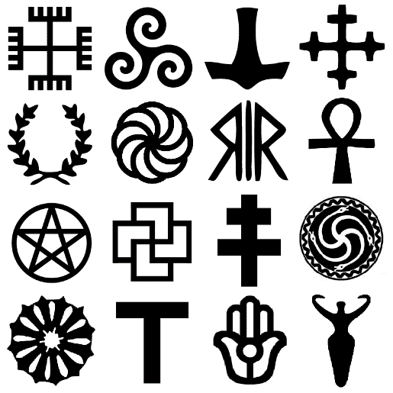
In addition, there are hundreds of different pagan religions like Buddhism, Hinduism, Shintoism, Taoism, Druidism, Shamanism, Wicca, Asatru, Neo-paganism, Eclectic paganism, and traditional Native American religions etc. all are claiming to enter into some life after death!

Slide 47

Confusion? We probably agree that most people, which are part of these religions or Christian denominations, are sincere and mean well, but they have been taught falsehood. Not only that, but they are also so convinced that they are right that they only have the truth that leads to eternal life, that most of them will shun or condemn anyone that does not agree with them, especially when they leave their denomination or group.
CONFUSION?

Slide 48
It must be obvious that all these religions and denominations cannot be right, because there can be only one absolute truth that leads to eternal life! According to Ephesian 4:5 (TS2009) there is only “one Master, one belief, one immersion (baptism)”.
CONFUSION?

Slide 49
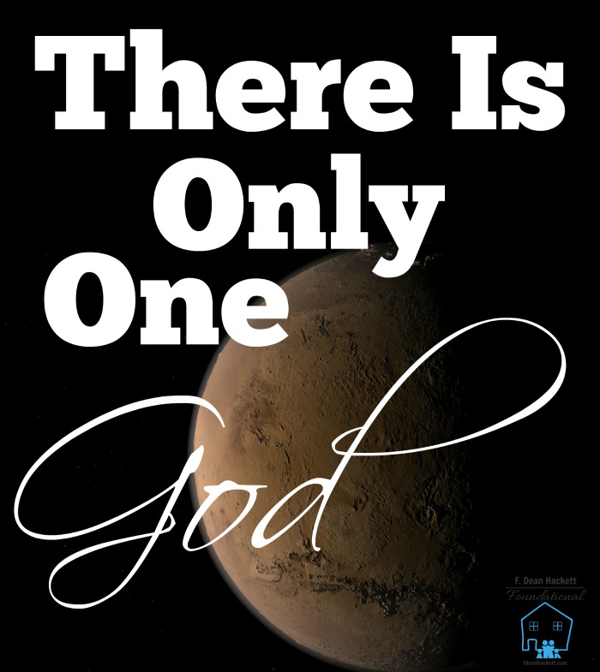
The bottom line is:
No matter what anyone says, there is only “One” Elohim, but many confused people!

Slide 50
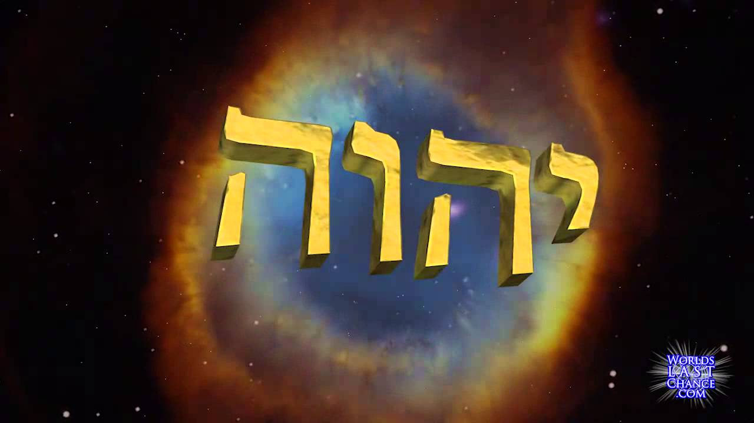
We have salvation only in one Name and that is in the name of “YHVH” – Yahuwah!

Slide 51

Very few people know that name, therefore, that name must be made known!

Slide 52
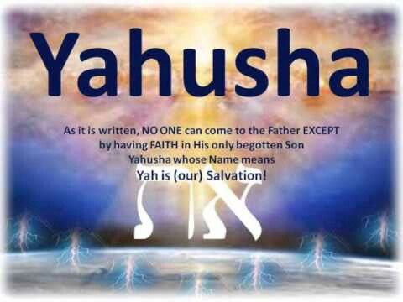
“And there is no deliverance in anyone else, for there is no other Name under the heaven given among men by which we need to be saved.” Acts 4:12 (TS2009)
YAH IS OUR SALVATION!

Slide 53
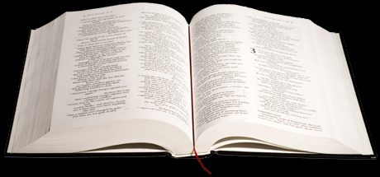
Here is the proof:
”And it shall be that everyone who calls on the Name of יהוה (YHVH) shall be delivered.” Joel 2:32 (The Scriptures 2009)

Slide 54
Peter quoted Joel 2:32:
”And it shall be that everyone who calls on the Name of יהוה (YHVH) shall be saved.” Acts 2:21 (The Scriptures – 2009)

Slide 55
The apostle Paul also quoted Joel 2:32:
”For everyone who calls on the Name of יהוה (YHVH) shall be saved.” Romans 10:13 (The Scriptures - 2009)

Slide 56
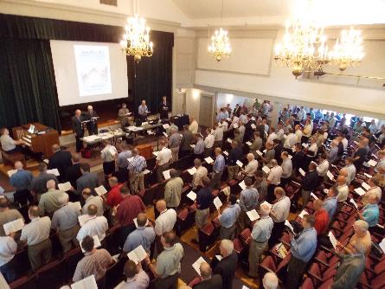
It’s heartbreaking that most Christians don’t know the Name of their Creator and Savior — especially now. We live at a time when people around the world are being told by political and religious leaders that we all worship the same Elohim, but we call him by different names. That’s not true. All of us do not worship the same Elohim. Satan is
the source of that lie. He has the most to gain from us not knowing Yahuwah’s Name and not declaring it to the world, but Satan’s lies can’t change the truth one iota. Satan can deceive us and make it difficult for us to see, but he has no power to alter Yahuwah's Word.

Slide 57
Deuteronomy 10:17 states:
“For YHVH your Elohim is Elohim of Elohims, and Lord of lords, a great Elohim, a mighty, and a terrible, which regardeth not persons, nor taketh reward.” (KJV)

Slide 58
Psalm 95:3 states:
“For YHVH is a great Elohim, and a great King above all Elohims.” (KJV)

Slide 59
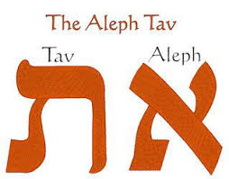
THE
ONLY
SAVIOR!

Slide 60

“I, I am יהוה (YHVH = Yahuwah) and besides Me there is no Savior.”
Isaiah 43:11 (The Scriptures)

Slide 61
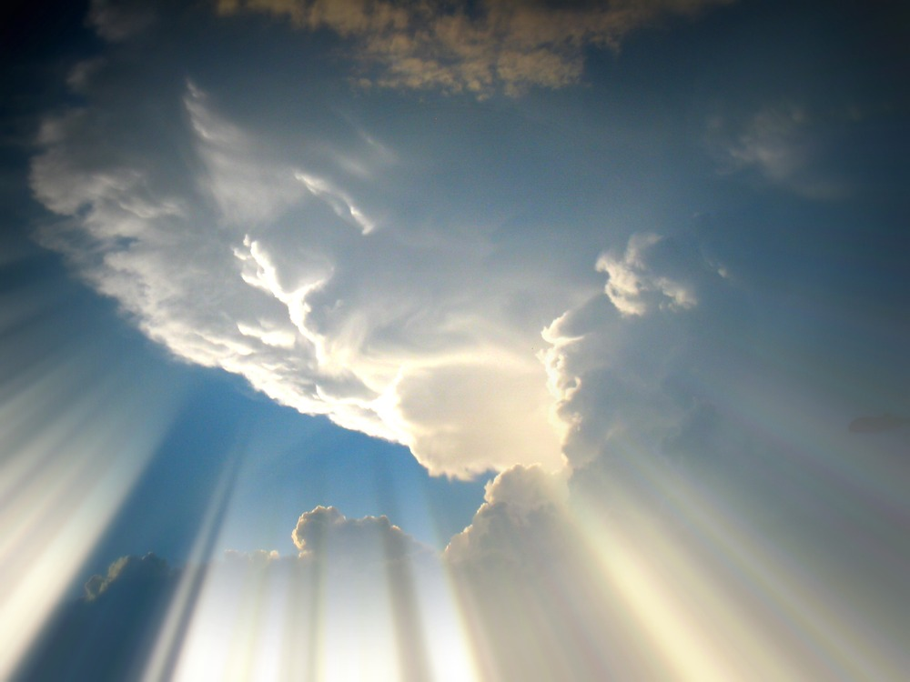
When Yahuwah looked down from heaven, he saw Abram, a man who would be faithful as a husband and father, commanding his children and his household. He saw someone who would take personal responsibility for those placed under his influence and make sure they did what Elohim willed.

Slide 62
He saw an individual who would enforce the way of YHVH in his household. He did not see a man making excuses for disobedience. He did not see a man seeking his own personal pleasure at other people’s expense. He was chosen to be the man by whom all nations came to be blessed.

Slide 63
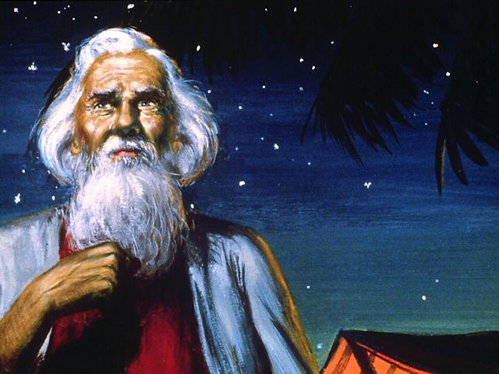
Here are the words of YHVH himself in Genesis 26:5 (The Scriptures) about Abraham: “because Abraham obeyed My voice and guarded My Charge: My commands, My laws, and My Torot (plural of Torah teachings) .”

Slide 64
Abraham grew up in an unbelieving and idolatrous society. He was raised in a home that was pagan. His native city of Ur was in Chaldea, between the Tigris and Euphrates rivers.
Isaiah refers to Abraham as “the rock from which you were hewn” and “to the hole of the pit from you were dug” (Isaiah 51:1-2- the Scriptures), reminding his fellow Jews that Elohim sovereignly condescended to call Abraham out of paganism and idolatry in order to bless him and the world through him. When YHVH spoke to him, he listened, when He promised, he trusted and believed and when He commanded, he obeyed willingly.

Slide 65
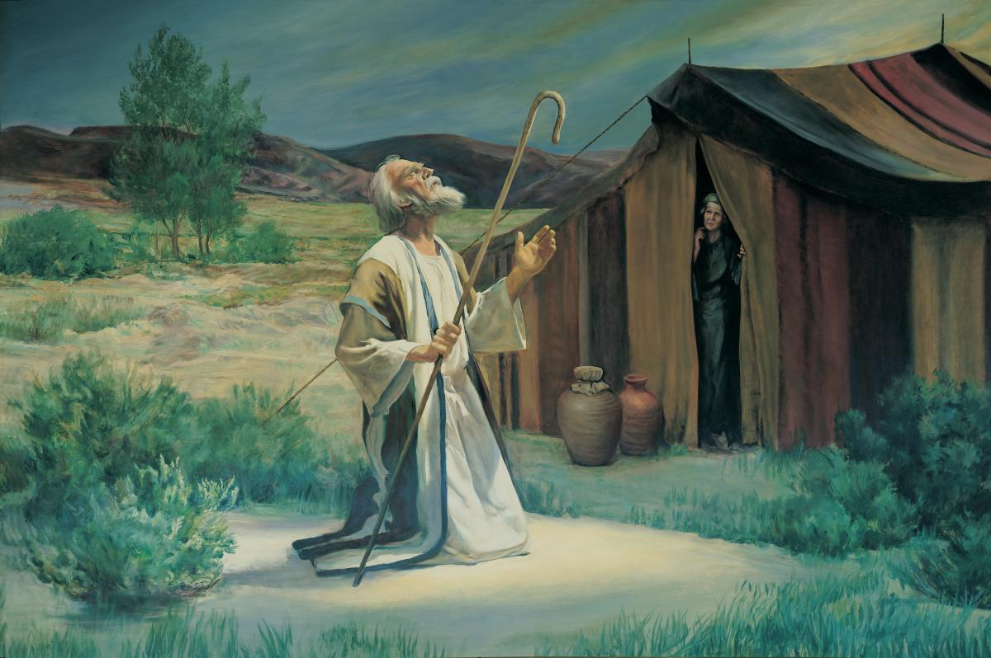
Yahuwah made a covenant with Abram. This covenant was an unconditional one. He did not say, "Abram, if you do certain things, then I will do certain things". Yahuwah's promise to Abram was unconditional.

Slide 66
He said, “And I shall make you a great nation, and bless you and make your name great, and you shall be a blessing! 3. And I shall bless those who bless you (Abram) and curse him who curses you. And in you all the clans of the earth shall be blessed.”
Genesis 12:2-3 (TS2009)

Slide 67
History shows that the coming of the Messiah, Yahusha, changed the whole world. Even our Gregorian calendar starts at His birth. The moral teaching of Yahusha in the so-called New Testament have shaped to a large degree all western nations. Those nations which are identified as followers of Yahusha, have prospered greatly.

Slide 68
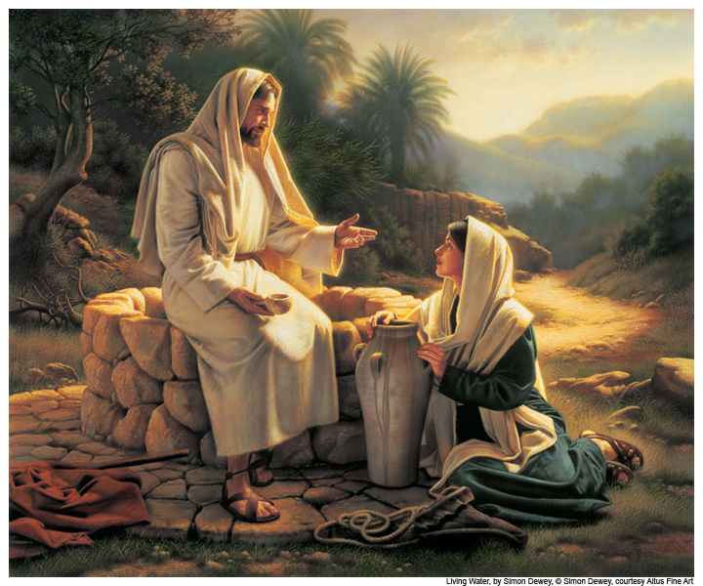
Let’s remember the words of Yahusha to the Samaritan woman in John 4:22 (KJV): “salvation is of (from) the Jews.”
In what way?

Slide 69
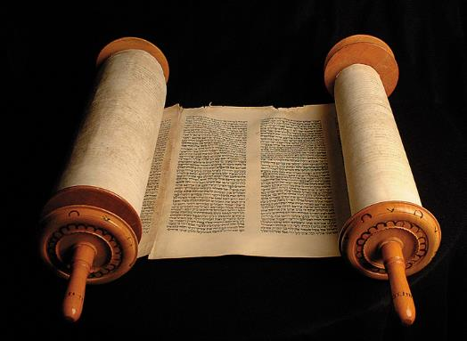
According to Paul in Romans 3:2 (KJV) “unto them were committed the oracles of YAH.”
Or from the Scripture translation: “they were entrusted with the Words of Elohim.” (Meaning the Torah, his instructions)

Slide 70

Paul is emphasizing the great privilege and responsibility that was committed to that people when Yahuwah gave His "oracles" to them, a word implying "divinely inspired utterances,“ a blueprint leading to eternal life!

Slide 71
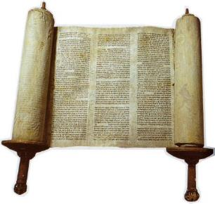
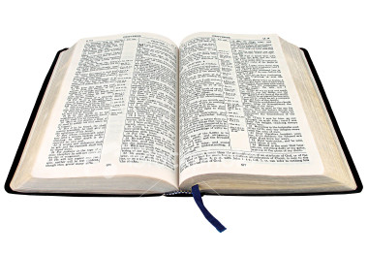
The "oracles of YAH“ the Torah, with the Prophets and Psalms constitute the very utterances of the Almighty. These obviously should be believed, studied, obeyed, and proclaimed by all who consider themselves followers of Yahusha.

Slide 72
The Torah is the expression of Yahuwah’s will, the unadulterated truth, and it is through obedience to that Torah that Yahuwah accepts the children of men as his sons and daughters.
Here is the proof!
“…If you listen to me and do what I tell you, I will be your Elohim, you will be my people, and all will go well for you.“ Jeremiah 7:23 (Contemporary English Version)
That still applies today, because according to Malachi 3:6 “YHVH does not change!”

Slide 73
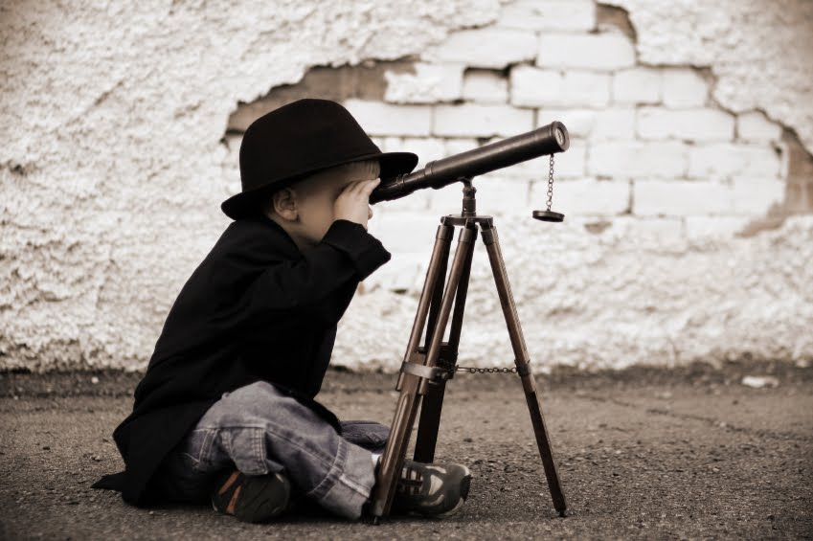
That simply means “STOP searching for the truth”, for Torah is “the” Truth!

Slide 74

The third chapter of the book of Proverbs (3:13-19), speaks of the Torah in terms of "Wisdom and Understanding", calling it a "Tree of Life." The Torah is this "Tree of Life" that founded the earth and established the heavens, the truth!

Slide 75
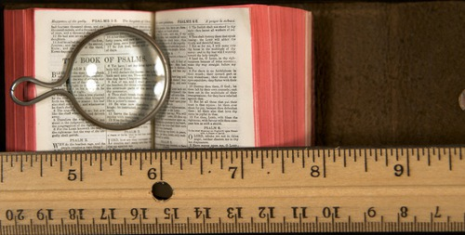
The Torah is a way of life. From birth to death, Yahuwah’s Torah teaches his people how to live a set-apart life. The Torah covers such areas as community, medicine, diet, health, clothing, housing, safety, morality, ceremonies, holy days, worship, relationships between family and neighbors and the list is practically endless.

Slide 76
The Torah is not a book to be left on the shelf but a living word to guide, lead and direct the lives of Yahuwah’s people each day. It is a book, we must meditate on day and night!

Slide 77
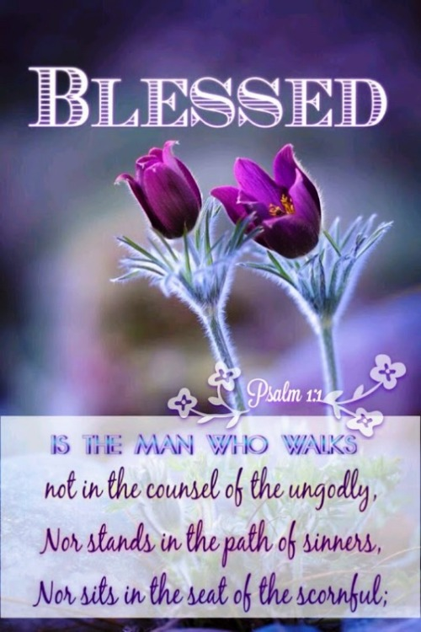
Here are the words in Psalm 1:1-2 (the Scriptures) “Blessed is the man who shall not walk in the counsel of the wrong, And shall not stand in the path of sinners, And shall not sit in the seat of scoffers, but his delight is in the Torah of יהוה (YHVH), And he meditates in His Torah day and night.“

Slide 78
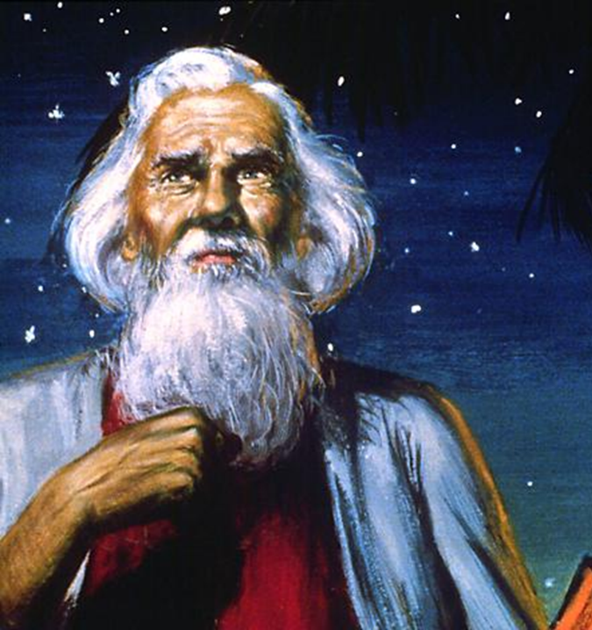
Yahuwah chose Abram, called him and established his covenant with him, which was Non-negotiable. He reiterated it six more times to Abraham, to his son Isaac and to his grandson Jacob. He reiterated His covenant with Israel through Moses, it was repeated by the prophets and rehearsed by the psalmists.

Slide 79
Yahuwah Himself affirmed it (Matthew 19:28), Paul articulated it (Romans 9-11), and the gates of the New Jerusalem will announce it forever (Revelation 22:11-12). This confirms that Yahuwah Elohim had chosen the faithful and covenant keeping people of Israel and those that are being grafted in.
He gave them His Torah, His instructions, the light of divine truth!
There was a time when the Jewish nation was faithful to YHVH and He honored them. They were blessed and favored above all the people of the earth. (Deut. 7:6-9)

Slide 80
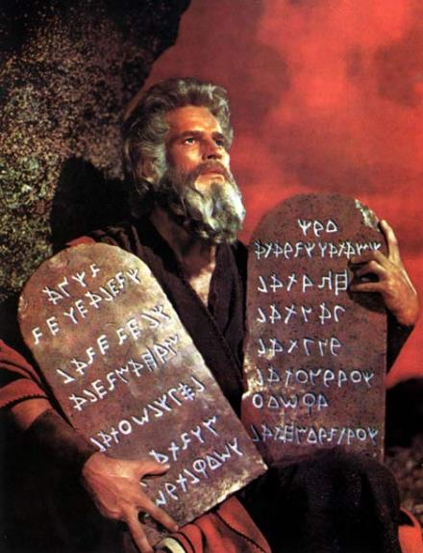
At the end of his life Moses warned Israel in Deuteronomy 34:16-18 that YHVH would abandon the nation, when it apostatized and served the no-gods of the heathen.
I encourage you to read these verses in chapter 34!

Slide 81
Yahuwah promised to forsake the Nation of Israel if they abandoned HIM for the sake of idols. If they abandoned Him, He would abandon them. He would leave them to the not-so-tender mercies of the heathen nations. The result of Israel’s apostasy, every time, was slavery to foreigners. The worship of foreign Elohims brought the tyranny of foreign rulers. This was the story from the time of the judges until the exile.
But inside the boundaries of Israel there was always a faithful remnant as we see in 1Kings 19:18. “And I shall leave seven thousand in Yisra'el, all whose knees have not bowed to Baʽal, and every mouth that has not kissed him.” (The Scriptures)

Slide 82
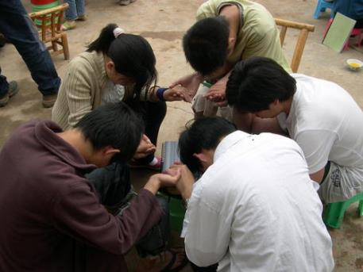
So, Yahuwah still honored His covenant with Israel in Elijah’s time because of the faithfulness of a small remnant, which preserved Israel from complete abandonment by Him. In short, even though the vast majority of Israel always seemed to depart into idolatry, a small remnant remained
faithful to YHVH. He preserved His covenant with Israel as a nation for His name’s sake, because of His covenant He made with Abraham, Isaac and Israel and because of a faithful small remnant. Jacob had announced prophetically in Genesis 49:10 that Israel would be preserved as a nation at least until Shiloh (Yahusha) came.

Slide 83
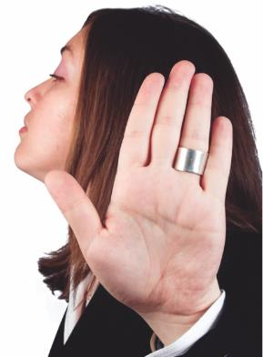
Yahusha did come, but they rejected the Messiah. They gave Him over to the Romans to be crucified. Yahuwah did not compel them to reject and to crucify His son. He did not compel them to forsake him, but they did so by their own free will. Yet their unbelief, rejection and the crucifixion of Yahusha did not defeat, thwart, overturn or even hinder Yahuwah’s purpose to grace to all people that will respond to Him. He did cast off the Nation of Israel, but the door is open for spiritual Israel. The 10 tribes were scattered among the nations. Only the tribe of Judah could return to the land.

Slide 84
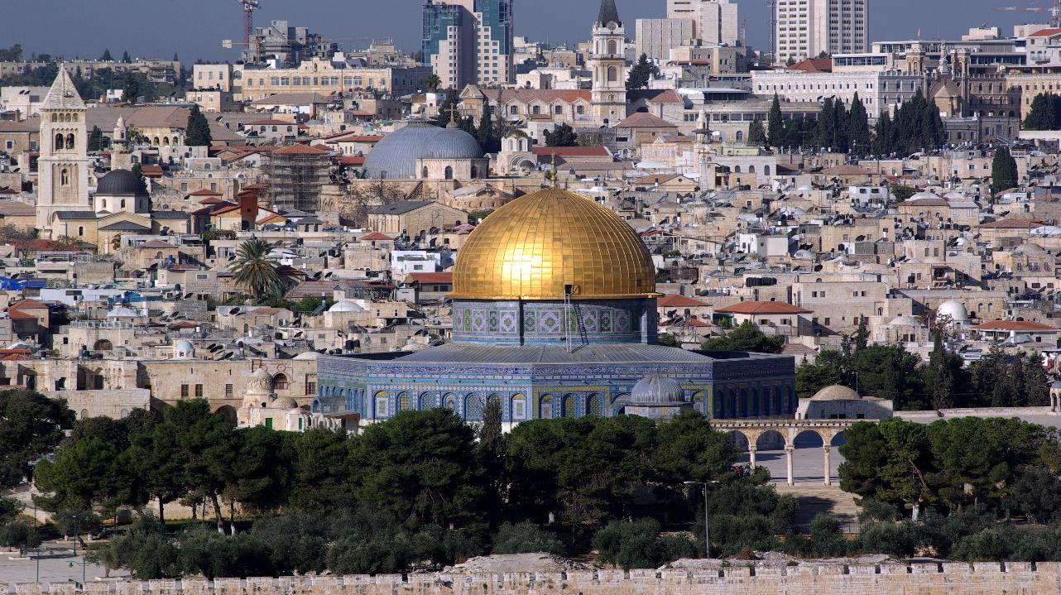
However, the Jewish religion today is only a show, an empty shell, a meaningless, useless, pointless changing of old prayers and traditions, because most of them still refuse to accept Yahusha as the Messiah.

Slide 85
The center of their present religion is the temple, the priesthood, the mercy-seat and the sacrifice, which they don’t have, but they desperately working on to reinstate these things. Their only hope is to accept the Messiah, they gave over to the Romans to be crucified.

Slide 86
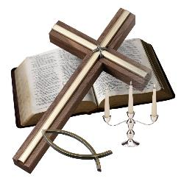
What about Christianity, the Christian Church that claims to have replaced Israel (meaning the Jewish people and the Land)? They claim to be the historic continuation of Israel and since Pentecost of Acts 2, the term "Israel," as found in the Bible, refers to them now. The promises, covenants and blessings ascribed to Israel in the Bible have been taken away from the Jews and been given to the Christian Church, but the Jews are subject to the curses found in Scripture, as a result of
their rejection of the Messiah. That doesn’t agree with reality, the truth, because YHVH never made or never will he make a covenant with Christianity. The new covenant is being made with the House of Israel and the House of Judah according to Scripture (see Jeremiah 31 and Hebrews 10) and those who are grafted in.

Slide 87
Christianity then and today has nothing in common with the Elohim of Abraham, Isaac and Israel. The disciples of Yahusha called themselves “the followers of the Way”. Others nicknamed the first followers “Christians”, which was not a compliment. Christianity is a mixture of Torah with customs from Babylonian Paganism! It is a way of life about the Messiah of Israel, divided into over 41,000 sects interpreting the Torah, with special days of the year adopted from Satanic, Pagan origins. Again, “Christianity” is not the religion that Yahusha established. Christianity as a system is corrupted as the Bible puts it. As far as their teachings and practices go, they are the religion of the Anti-Christ, the Anti-Messiah!

Slide 88

Stop looking! All religions are man-made, it is an attempt of man to lead people to the Creator. The opposite is true, to-days churches, organizations, denominations lead people away from the true Elohim, the Most-High to man-made doctrines and teachings.

Slide 89

In the next slides are some of the many biblical teachings that I and others re-discovered that had been lost during the past 2,000 years.

Slide 90
The division between Old and New Testament is man-made.
The covenant YHVH made with His faithful, obedient people is everlasting and still binding.
The Christian Church is filled with pagan doctrines & teachings.
YHVH has never made a covenant with Christianity and never will. He will make a covenant with the house of Israel & Judah.
Grace and Mercy cannot exist without obedience to Torah.
The Creator has a name and wants to be called by His Name, which he mentioned over 7,000 times in the Hebrew Scriptures.
The Trinity is a pagan doctrine.
Sunday, Christmas, Easter, Lent, Halloween, etc. are of pagan origin and are an abomination to YHVH.
Yahusha died on a Wednesday and was raised on a Sabbath during the year of crucifixion.

Slide 91
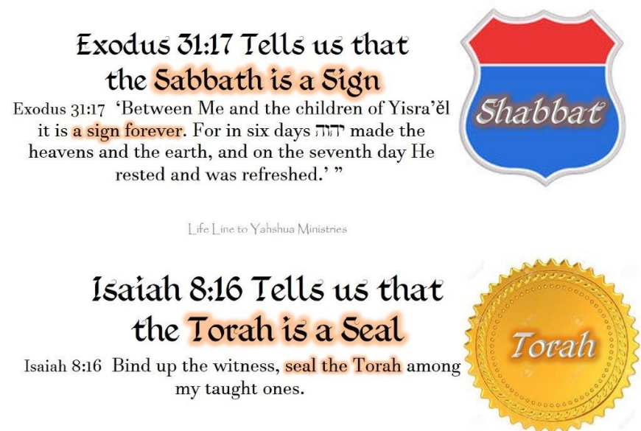
The Sabbath was and still is a sign of the covenant he made with His people.
The Torah is the seal, we must be sealed with, then and now.

Slide 92
Yahuwah’s seven yearly appointed feasts are a compacted prophecy of the plan of salvation. They were and still are, a part of the everlasting covenant, blood ratified by Moses at Sinai.
The Biblical day starts at dawn, meaning that the weekly Sabbath also starts at dawn, not at sundown as many Sabbath-keeper teach.
The moon does not determine the beginning of the month, nor year. The new year begins one day after the spring equinox.
Baptism according to Scripture is by immersion. Baby baptism originated in paganism.
There is no secret pre-tribulation rapture according to Scripture.
Yahusha will not reign on this corrupt, sinful planet for 1000 years. He will reign on the new earth, re-created by HIM.
Yahushas ministry lasted 490 days (1 yr pls) and not 3 ½ years,

Slide 93
At death, the soul does not immediately go to heaven, man sleeps in the grave until the resurrection at the Second Coming.
The cross as well as the steeples on Church buildings come from paganism.
Some denominations teach about a lunar Sabbath, once saved, always saved, a second probation, a temple being built during a 1,000-year reign of Messiah with animal sacrifices, a Sunday Law being the mark of the beast, the tithing system of the Levitical system, the law (Torah) ended at the cross, speaking in unknown tongues and more. All these teachings we discovered are not biblical, but doctrines and teachings of man.
Maybe you do not agree with some of the things that I listed here, so search Scripture for yourself as this is the command of YHVH.

Slide 94
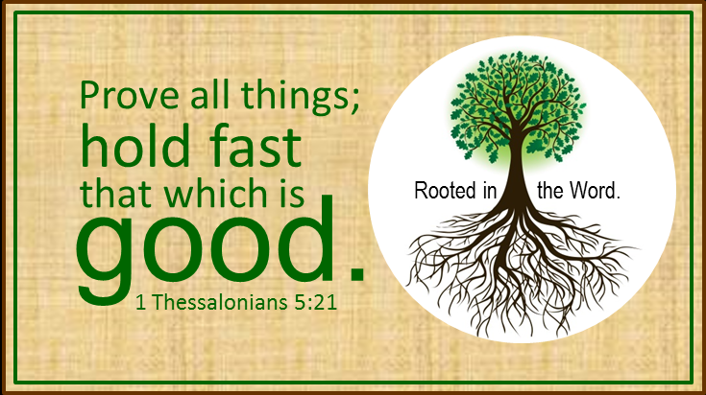

Slide 95

Our only hope and safety is to turn from man-made religion to the Elohim of Abraham, Isaac and Israel and to His Son Yahusha Ha Mashiach, accept His sacrifice and follow His instructions as revealed in Torah, the Tree of Life!

Slide 96
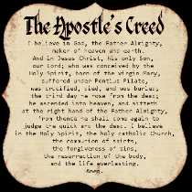
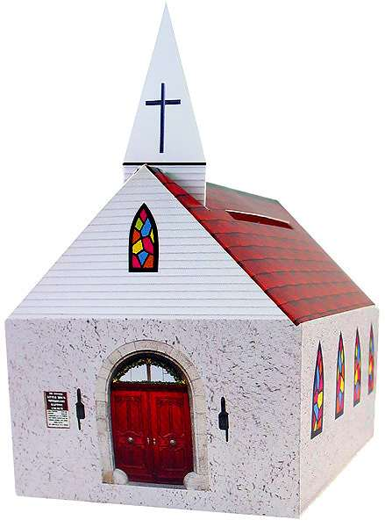

You can not be a member in regular and good standing in any Christian Church or denomination and at the same time follow a “Thus saith Yahuwah!” It is impossible. Being a member of any denomination, you must adhere to THEIR established creeds or be disfellowshipped!

Slide 97

If you demand and follow a “Thus saith YHVH” you are not welcomed there, because you are considered a TROUBLEMAKER!

Slide 98
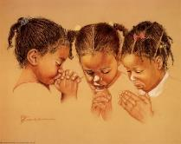
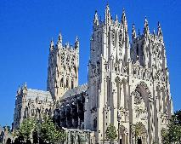
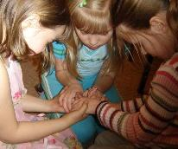

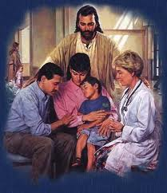

Yahuwah still has a people. It is not the great cathedral, neither is it the national establishment, neither is it the various denominations; it is the people who love HIM and keep His Torah, the commandments with the statutes and judgments.
Yahusha states in Matthew 18:20 "Where two or three are gathered together in my name, there am I in the midst of them."
Notes:
UL 315.5

Slide 99
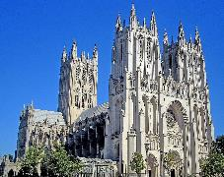

Where Yahusha is even among the humble few, those that a Torah observant, this is His assembly, his congregation, His people. Only the presence of one who inhabits eternity can constitute His assembly. Where two or three are present who love and obey His commandments, statutes and judgments, Yahusha presides, this may be in the desolate places of the earth, in the wilderness, in the city enclosed in prison walls, in a building,
yes, even in a Zoom meeting!
Notes:
UL 315.5

Slide 100

Again the question, what must we be looking for?
In no case should we be looking for a man-made church organization, which will be your damnation. Look for a few true and faithful believers, that love Yahuwah Elohim, the Elohim of Abraham, Isaac and Israel that will not fight His instructions as revealed in the written Torah and that follow the living Torah Yahusha Messiah and worship with them!

Slide 101

SHALOM

Slide 102
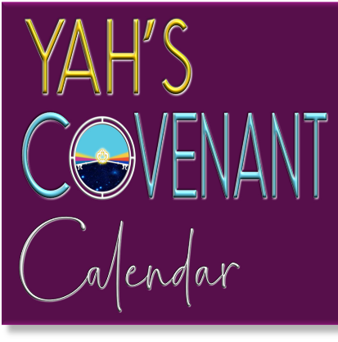

Supreme Provider is Yahusha Ha Mashiach
For more information go to website:
Studythecalendar.com
Produced and narrated by Walter Tschoepe malachi4.4@Reagan.com
Website: thefigtreegeneration.com

