Slide 1
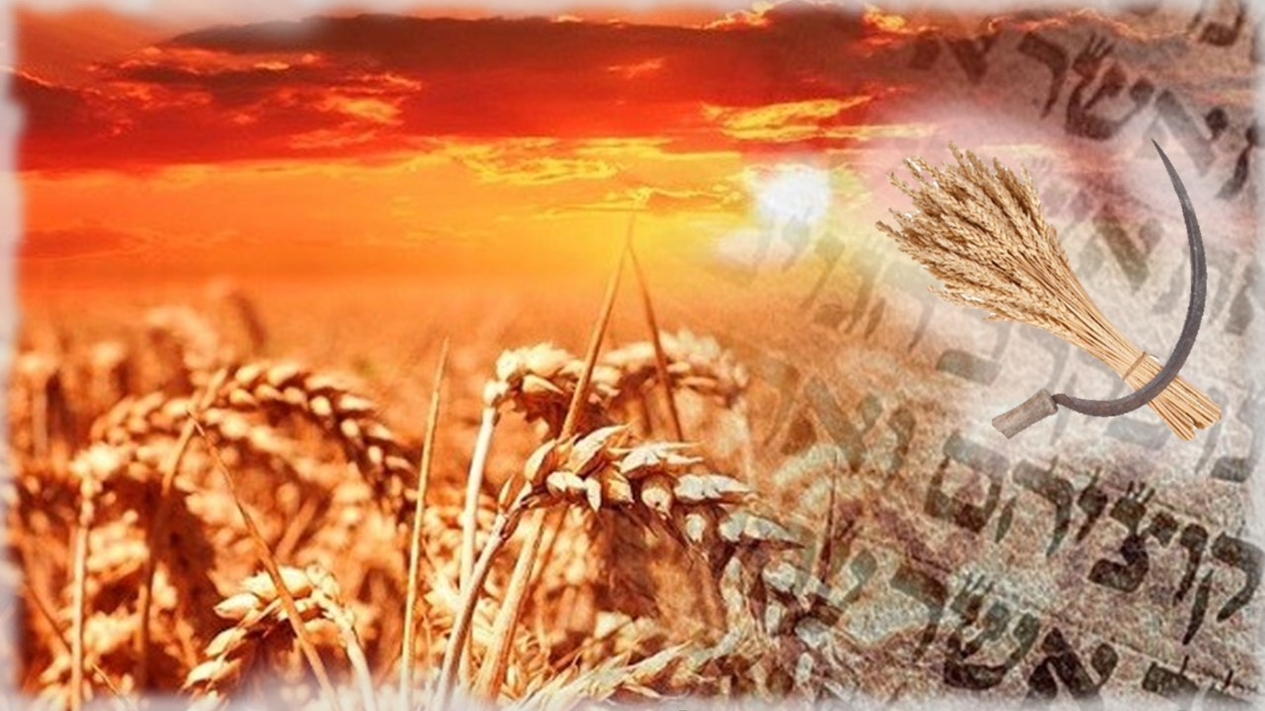

The Song of
Joshua’s Sickle Part 6
Yahusha’s 5 Encounters
with His Friends on His Wave Sheaf
Abib 18 in the Year 30 CE
Notes:
New jpeg for review teaching Nov 25/23 – in prep

Slide 2
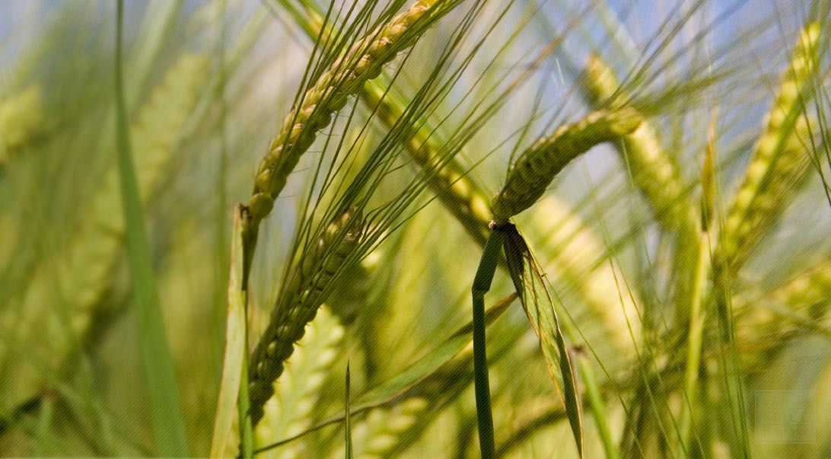

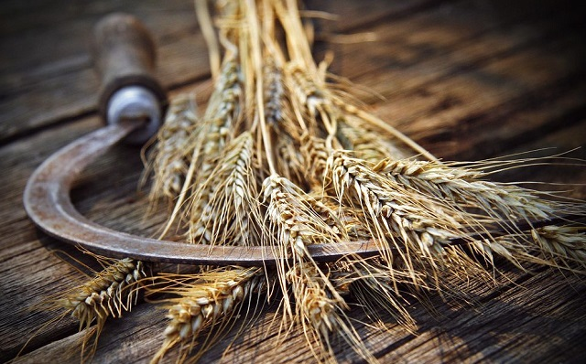
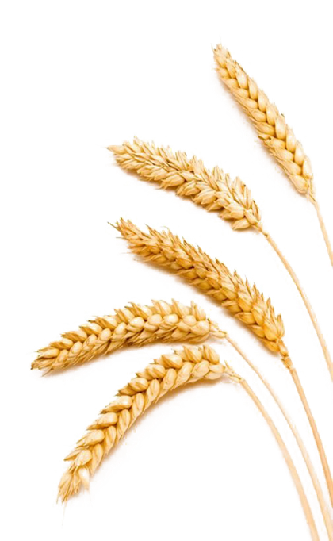
Exposing a Gospel Counterfeit Count
The Perfect Wave Sheaf Placement
Why do Zadok calendars
declare Abib 26th should have special mention
for Wave Sheaf?

Slide 3
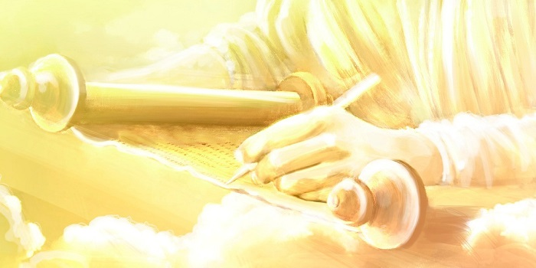


Covenant Calendar Studies Reveal Mysteries
Prov 25:2 It is the glory of Yahuah
to conceal a thing: but the honour of kings [Melek] is to search out a matter.
Remember: only truth can reveal a mystery!
Today’s mystery will be solved through a very careful look at Yahusha’s Wave Sheaf encounters.
Luke 8:10 And he said, Unto you it is given to
know the mysteries of
the kingdom of Yahuah.
It is true that many festal calendar keepers understand the Mystery of the Melchizedek Priesthood. Would that not include Yahusha’s Wave Sheaf ceremony back to His Priesthood?
3

Slide 4


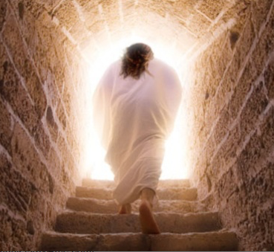
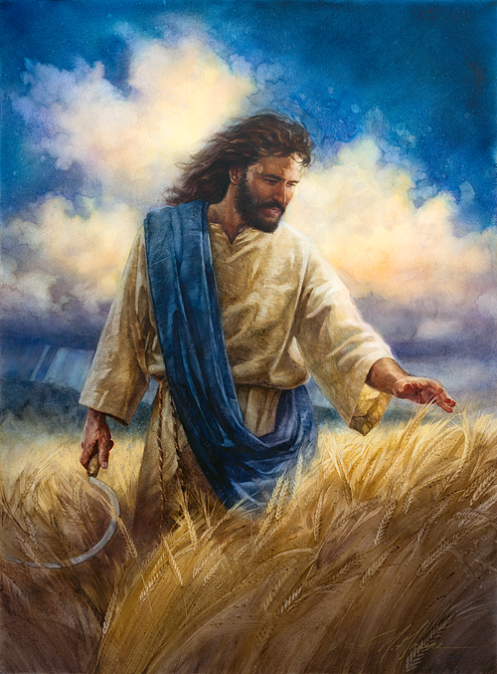
An Abib 26 Wave Sheaf Devastates the Foundation of Salvation
Where was Yahusha between His resurrection AND …
Is there anything in the Gospel Account to support the idea Yahusha delayed
His Wave Sheaf appointment for
7-8 days
after the Abib 18 Covenant
Wave Sheaf?
We shall see!
the alternate
Wave Sheaf
date of
Abib 26?

Slide 5


Introduction
Must Yahusha go through
7 “cleansing” cycles after His resurrection before having contact with humans? What about –
#1) His first greeting to
Mary Magdalene at the tomb
while it was still dark?
#2) His next greeting with the other women after sunrise on
the first cycle of the week?

Slide 6
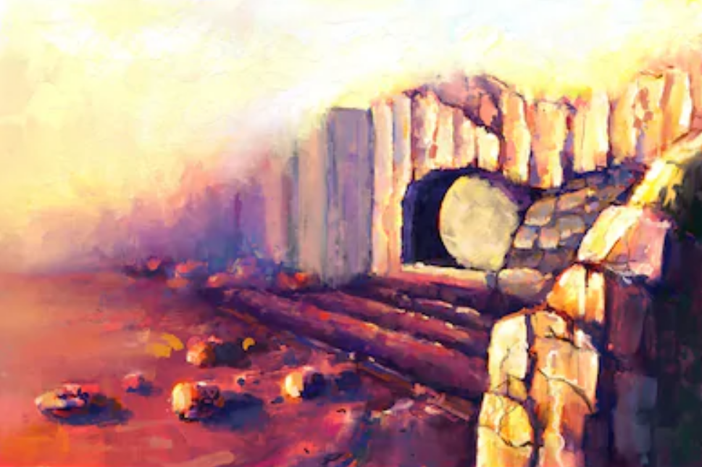
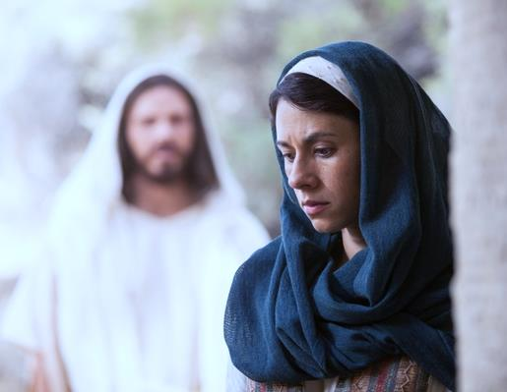
Question:
Why would Yahusha
return to the tomb on Abib 26
(minutes before Dawn),
to greet Mary Magdalene
when He had been raised
(and living)
a week earlier?
Did He have
something to conceal?

Slide 7

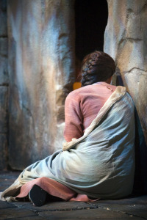

Why would Mary
arrive at the tomb
before Dawn
~ a week later?
Did she misunderstand
His prophecy of
“3 days and 3 nights”?
What would be
her purpose to arrive
a “week late”?
A HUGE Factor to Consider
To embalm Him again would be much too late!

Slide 8

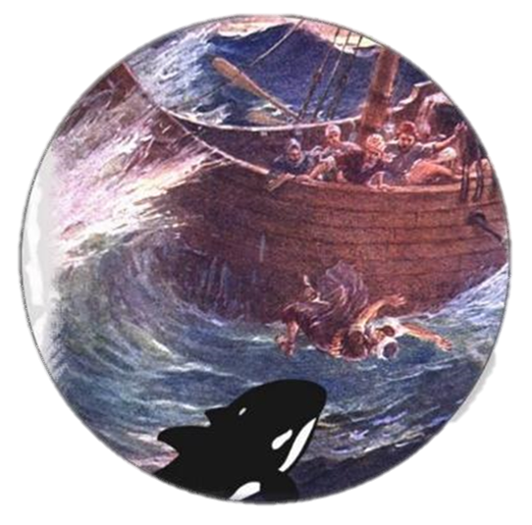
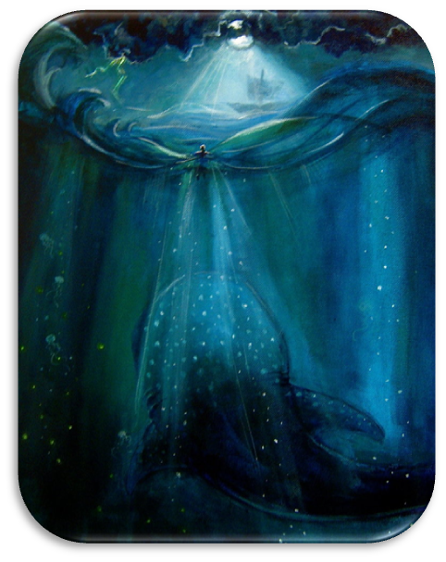
Another HUGE Factor to Consider
If no one saw Yahusha until [Abib 26]
8 DAYS after
His resurrection … where would be
the proof of
Jonah’s sign?
Who would have witnessed to
this factor of prophecy?

Slide 9

Why is it that some claim
“there must be 7 cycles of cleansing”
after Yahusha’s resurrection?
Why is this documentation not found in the Scriptures,
for such an incredible event
where everything else
is fully recorded?

Slide 10
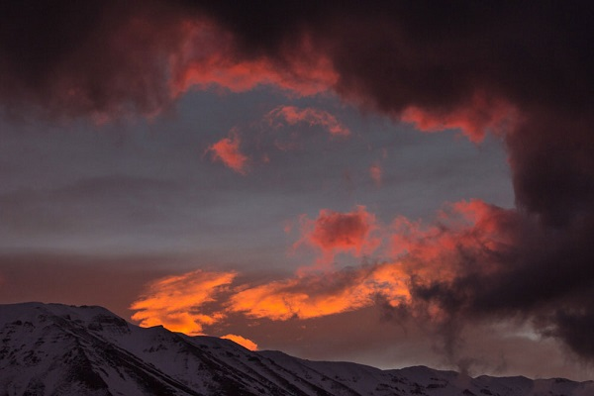


Is this in contrast to the Scriptures
which declare:
“I have spoken nothing in secret?”
Question!

Slide 11


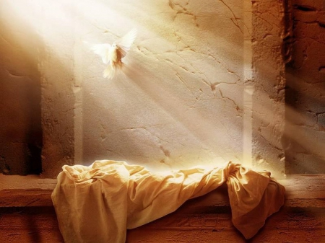

.
Was Yahusha Missing in Action?
1st (Sun) | 2nd (Mon) | 3rd (Tues) | 4th (Wed) | 5th (Thur) | 6th (Fri) | 7th (Sabb)
5 | 6 | 7 | 8 | 9 | 10 | 11
12 | 13 | 14 P/O | 15 ULB | 16 ULB | 17 ULB | 18 Ress.
19 W/S | 20 ULB | 21 ULB | 22 | 23 | 24 | 25
26 W/S | 27 | 28 | 29 | 30
Yahusha’s Passover was
not on a 3rd cycle [Tues]
as on Zadok’s calendar,
but let’s do the best we can to figure out where Yahusha was [on Torah’s count] for the 7-8 missing days between Abib 19 to the
end of Abib 26 (Monday).
Note: This “date” is obviously beyond the
“3 days & 3 nights”
of Yahusha’s prophecy.

Slide 12
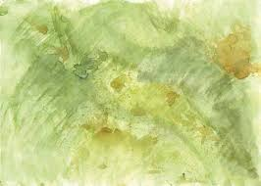
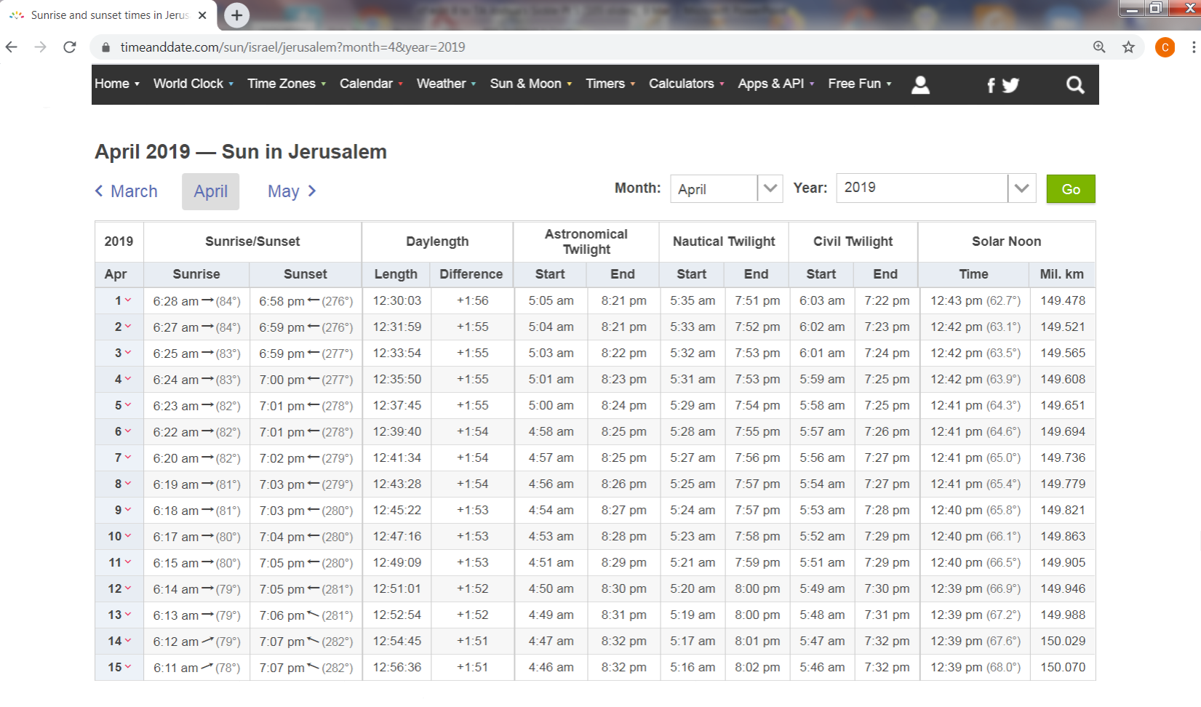
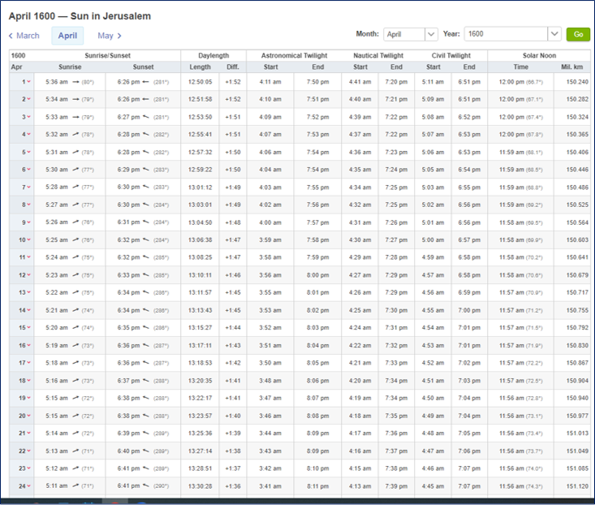
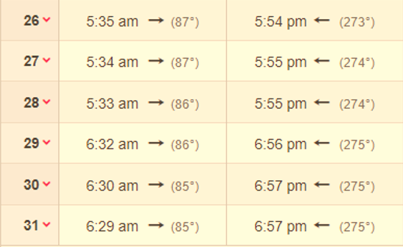
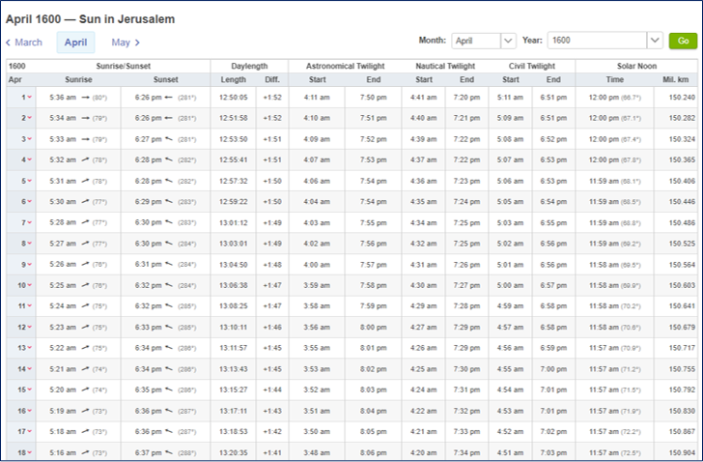
2019 has
a Wed. Passover to match the year of Yahusha’s Passover for specific astronomical
times.
Section 1
Time & Date Table for Jerusalem 2019 SPRING FEASTS
Sunrise/Sunset & Twilight Times
Passover 14th [Wed]
2019 Daylight saving time
in Israel began at
2:00 a.m.
on Friday,
March 29/19.
Adjust all time “back” one hour.
1st ULB Conv. 15th [Thur]
Resurrection 17th [Sabb]
Wave Sheaf 18th [Sun]
MARCH
Wave Sheaf 26th - Mon
Date of Zadok
12

Slide 13

Time & Date Table for Jerusalem 2019 Wave Sheaf
The blocks in the table that are emphasized are extremely important for the next section.
Date (Daylight Time Removed) | 4th Roman Watch & Roman Date | Astronomical Twilight Day-start | Sunrise | Sunset | Astronomical Twilight Day-end
Abib 13th |  |  | 527 AM | 5:59 PM | 7:21 PM
Passover 14th |  | 4:03 AM | 5:25 AM | 5:59 PM | 7:22 PM
1st ULB Conv.15th | Starts ~3:00 AM | 4:01 AM | 5:24 AM | 6:00 PM | 7:23 PM
Prep. Day 16th |  | 4:00 AM | 5:23 AM | 6:01 PM | 7:24 PM
Sabbath Ress.17th |  | 3:58 AM | 5:22 AM | 6:01 PM | 7:25 PM
Wave Sheaf 18th | Starts ~3:00 AM | 3:57 AM | 5:20 AM | 6:02 PM | 7:25 PM
Later on Abib 26th |  | 346 AM | 5:11 AM | 607 PM | 7:32 PM
“Hhm..?”
All times listed are according to Roman midnight time reckoning for our awareness.
All times listed exclude the “Daylight Savings Time” information.
Astronomical Twilight in the morning [boqer] is the official end of the previous day
and the beginning of the new day-start & the new Day Season.
Night following Astronomical evening [ereb] Twilight is the official end of the Day Season.
Can ‘boqer’ astronomical twilight be detected without an additional optical device?
13

Slide 14
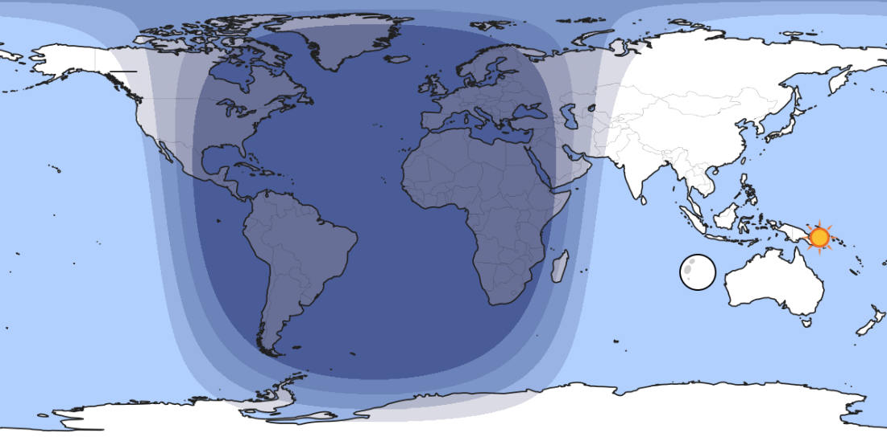


A Closer Look at TWILIGHT CATEGORIES
Night Season
Day Season
Civil dawn/dusk
All twilight components belong to the Day Season.
Nautical dawn/dusk
Astronomical dawn/dusk

Slide 15
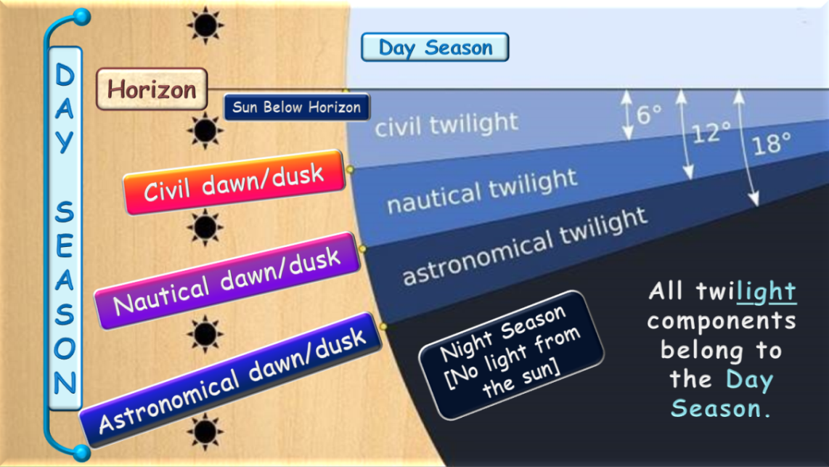
Definitions for the three recognized times of twilight:
There are three periods of twilight for the sun below the horizon:
(a) astronomical (sun is 12–18 degrees below the horizon);
begins when there is any brightening of the sky by the sun [boqer/morning];
(b) nautical (6–12 degrees below);
begins when a lookout on a vessel at sea can first see other ships with the naked eye;
(c) civil (0–6 degrees below); begins when there is enough natural light for people to see
what they are doing outdoors without the aid of any artificial light.
These three stages are visible to the naked eye and defined by naked eye observations.
City lights might make any sign of
astronomical twilight invisible.

Slide 16
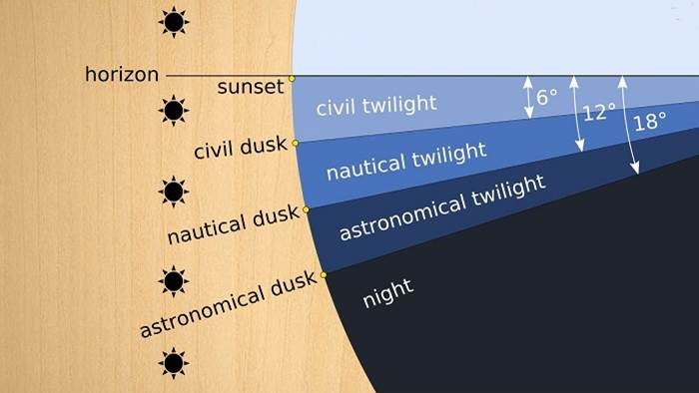


Covenant Calendar Confirmation on TWILIGHTS
Day Season
Horizon
Sun Below Horizon
Civil dawn/dusk
DAY
SEASON
Nautical dawn/dusk
All twilight components belong to the Day Season.
Night Season
[No light from
the sun]
Astronomical dawn/dusk

Slide 17
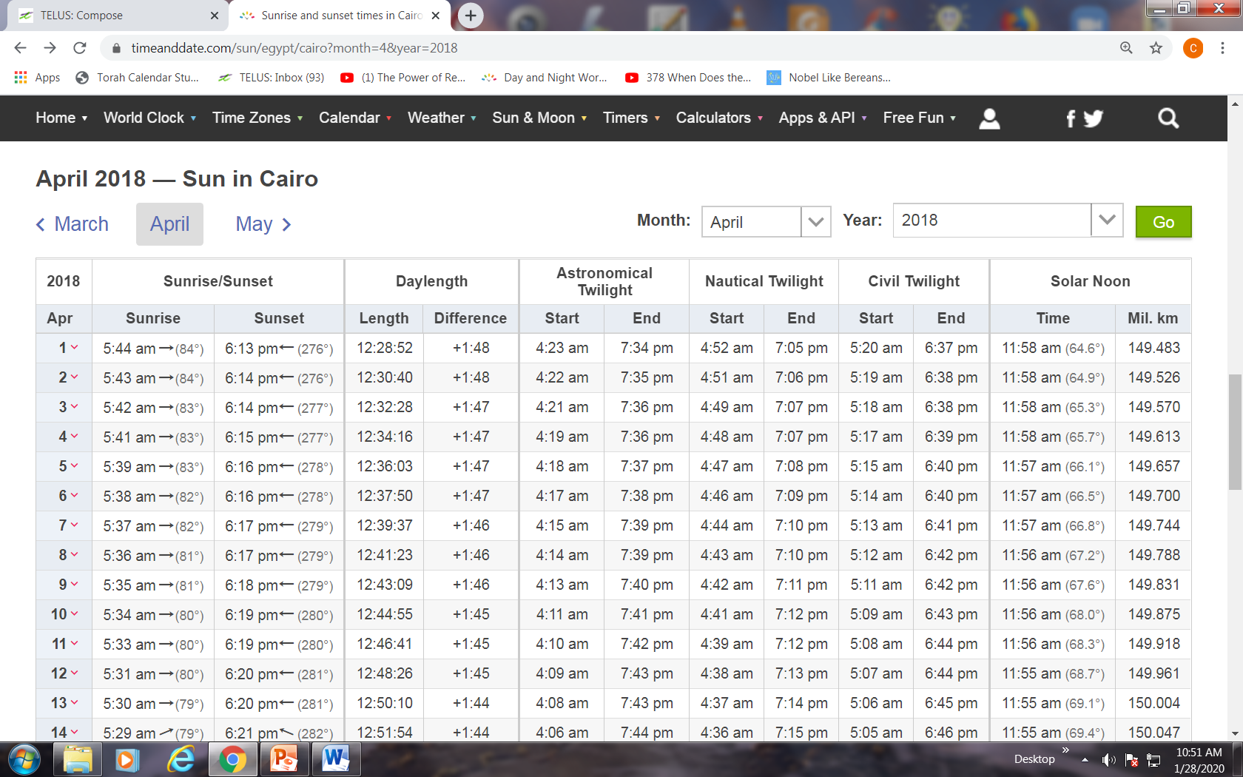
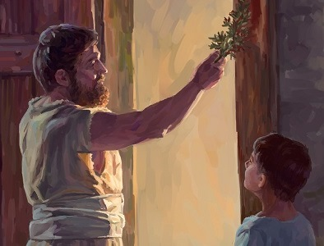
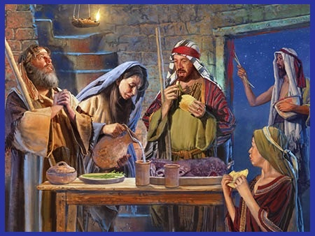
Section 2
Scriptural Patterns & Reasonable Assessments
Overview #1 Egypt
Often we can understand more about “timelines” and “timeframes” when Scriptural Patterns are considered.
The Scriptures do not include every single detail for the “hour” of every event. However, “type” and “anti-type” fulfillments often provide clues that will allow for a “reasonable assessment” in other areas.
#1 Example: Egypt
It is an UNreasonable assessment to assume Israel slaughtered their Passover lamb at the 9th hour (or 3:00 PM) when under hard bondage
from the Pharaoh to work from dawn to the darkness of dusk.
  It is reasonable to accept their lamb was sacrificed during the Night Season (“between the mixings”); 4-5 hours to roast.
  Facts: Sunset Abib 14: 6:15 PM; Night begins: 7:36 PM; Sacrifice
  & Roasting to about midnight; Eating the lamb: about 3 hours.
  Fact: Abib 15 boqer: Approximately 4:18 AM.
  Reasonable Assessment: Disposal of the Passover lamb left-overs by 3:00 AM – at least 60-75 minutes before boqer. (After that, the people were getting ready to leave Egypt at boqer [4:18 AM].)
Time for Egypt’s Passover 2018 (Tues): [No daylight time since 2014.]
Apr 4th Passover: Sunset 6:15 PM; Astron. Night begins 7:36 PM.
Apr 5th 1st ULB Convocation: Astronomical boqer at 4:18 AM.
How long does it take to cook lamb on a spit?
You can expect to roast a 25- to 30-pound lamb for four to five hours. The lamb can be removed from the coals when a meat thermometer inserted into the leg/shoulder registers 170 F/63 C. Allow the meat to rest for at least 15 minutes before carving.
Sep 26, 2019 – internet FAQ
Will there be similar patterns?

Slide 18
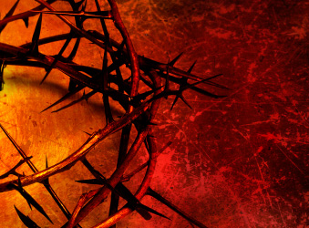
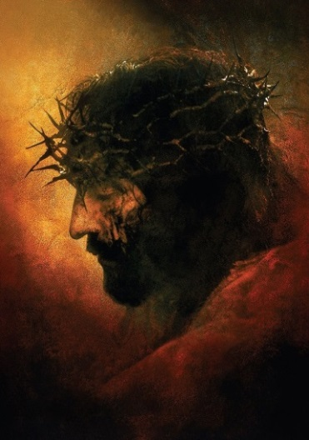
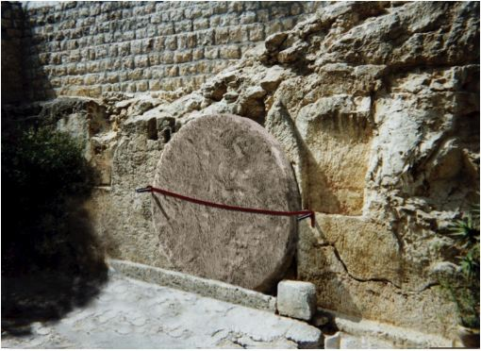
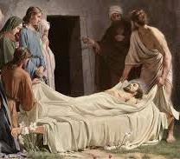
Section 3
Scriptural Patterns & Reasonable Assessments
Overview #2 Passion
Israel’s Passover 2019 (Wed) (Daylight time calculation removed.)
Apr 3rd Passover: Sunset 5:59 PM; Astron. Night begins 7:22 PM.
Apr 4th 1st ULB Convocation: Astronomical boqer at 4:01 AM.
#2 Example: Yahusha’s Burial ~ from the tree to the final moments.
It is an UNreasonable assessment to accept Yahusha was buried BEFORE sunset on His Passover day – when every single fact is carefully considered!
In fact, it is an impossibility!
  Facts: Sunset Abib 14: 5:59 PM; Joseph asked Pilate for Yahusha’s Body at evening/ereb [after sunset] (Matt 27:57, 58; Mark 1:32 & 15:42, 43 – supported by Luke 23:53, 54).
  Fact: Joseph & Nicodemus prepare Yahusha’s “according to the custom of the Jews” and lay the Body in the tomb. [Consider the time factor involved – most likely several hours of passionate labor.]
  Fact: The women come to inspect for proper burial etiquette near the close of Passover day; 1st ULB Conv. draws on (Luke 23:54-55).
  Fact: Abib 15 ULB boqer: 4:01 AM.
  Reasonable Assessment: The inspection and closing of the tomb would have been about 3:00 AM in respect for the soon-coming
  1st ULB Convocation within the hour. (Also read Luke 23:55, 56.)
Is it reasonable to conclude this pattern is similar to Exo 12?

Slide 19


Overview Section for “3 days and 3 nights”
The next section will establish with considerable detail events between the women that visited the tomb at Yahusha’s burial and then
the next time they returned to the tomb.
Question:
Will these (NEXT) events occur 7 days AFTER Yahusha’s resurrection on Zadok’s Abib 26
rather than
Covenant Abib 18
Wave Sheaf?
Astronomical
DAWN twilight timing is of
utmost importance.
DAWN
NIGHT
SUNRISE

Slide 20

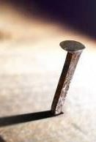

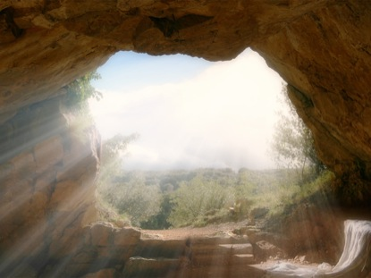

357AM Boqer
Overview
Yahusha’s Sign – “3 DAYS AND 3 NIGHTS”
Death: 4th cycle “midst of the week” & Resurrection: Sabbath
3rd HR
4th [Wed 14th] Passover |  |  |  |  |  |  |  | 5th [Thurs 15th] 1st ULB Conv. |  |  |  | 6th [Fri 16th] Prep. Day |  |  |  | 7th Day Sabbath [17th] |  |  |  | 1st [Sun 18th] Wave Sheaf
#1 #2 #3
At the 3rd hour:
Mark 15:25 And it was the third hour, and they crucified him.
3rd HR
6th to the 9th hour:
Mark 15:33
… there was darkness over the whole land until the ninth hour.
At the 9th Hour:
Mark 15:37 Yahusha cried with a loud voice, and gave up the Ruach.
John 19:30
“It is finished!”
Luke 23:46
“Father, into your hands I commit my spirit.”
6th HR
9th HR
At the 9th Hour on Sabbath:
Matt 27:53 [First Fruits were raised with Yahusha’s resurrection as His witnesses.]

Slide 21

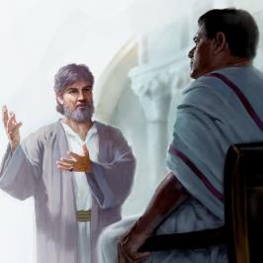
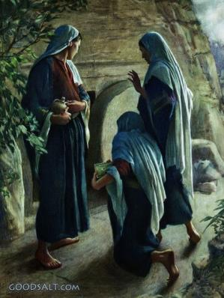
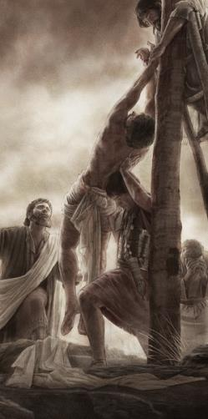
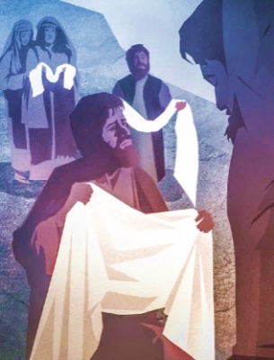
Overview
From Yahusha’s Death to Burial
Timespan between death and sealing of the tomb.
4th [Wed 14th] Passover |  |  |  |  |  |  |  | 5th [Thurs 15th] 1st ULB Conv. |  |  |  | 6th [Fri 16th] Prep. Day |  |  |  | 7th Day Sabbath [17th] |  |  |  | 1st [Sun 18th] Wave Sheaf
357AM Boqer
9th HR
Several women leave the tomb just before boqer of 1ST ULB Convocation.
Question: Were any of these men
or women “unclean” for touching this dead Body, or being in this tomb?
Mark 1:32
[defines evening]:
… at evening when the sun did set!
Mark 15:42-43 And now when the even was come, because
it was the preparation, that is, the day before the [High] sabbath, 43 Joseph of Arimathaea, an honourable counselor, which also waited for the kingdom of Elohim, came, and went in boldly unto Pilate, and craved the body of Yahusha.
To Be Continued

Slide 22
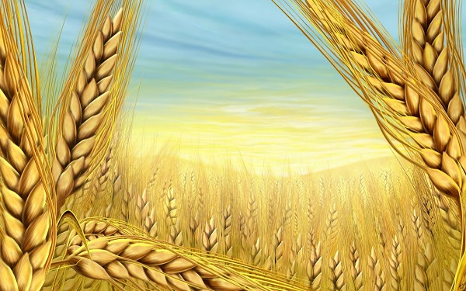
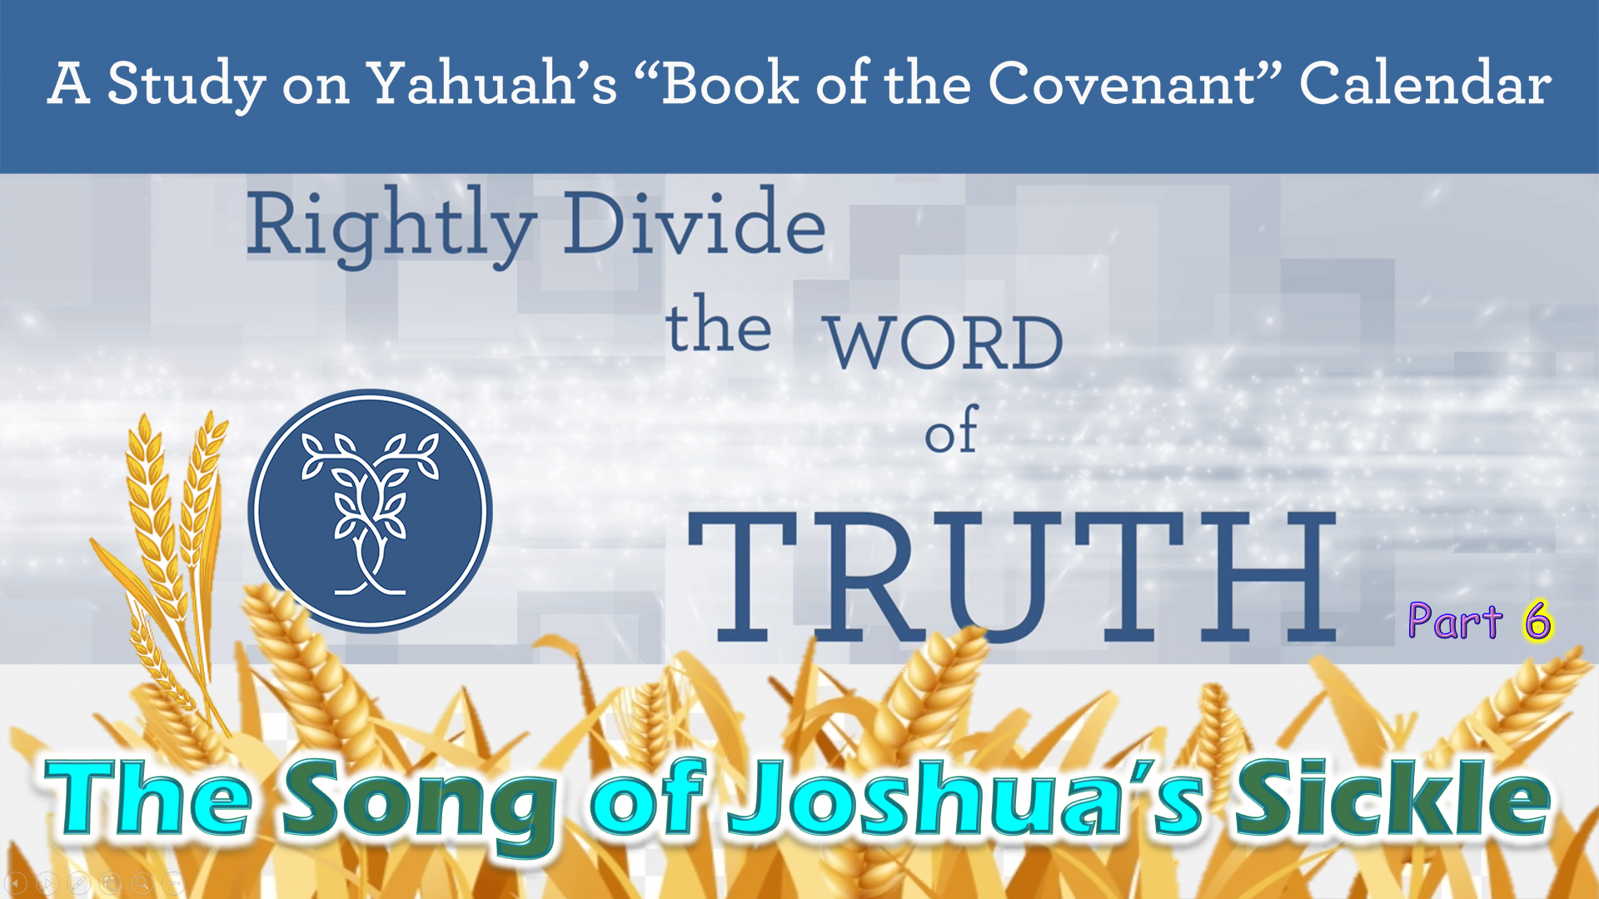

If you have Questions
&/or Comments
about this teaching,
please contact:
Covenant Calendar
question desk
questions@studythecalendar.com
Thank you!
Shalom!

