Slide 1
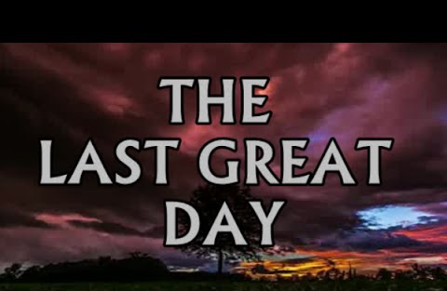


Slide 2

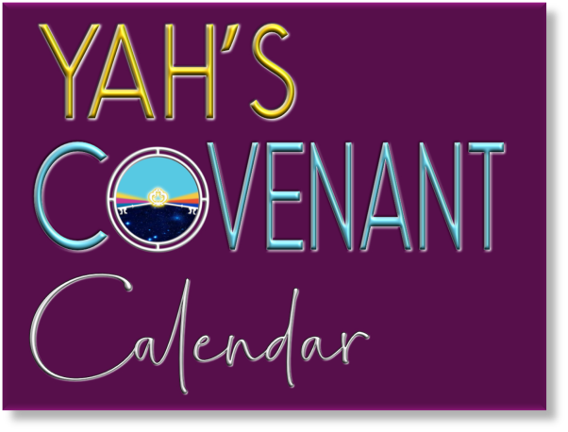
A TEACHING FROM:
FEAST OF
TABERNACLES

Slide 3
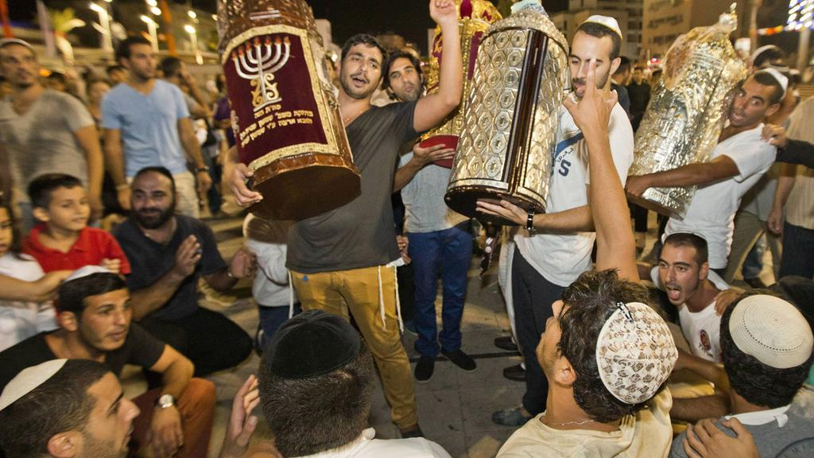
The last day of the Feast of Tabernacles is called the Last Great Day (Shemini Atzeret).

Slide 4
Shemini Atzeret means
“the eighth day of assembly.”

Slide 5
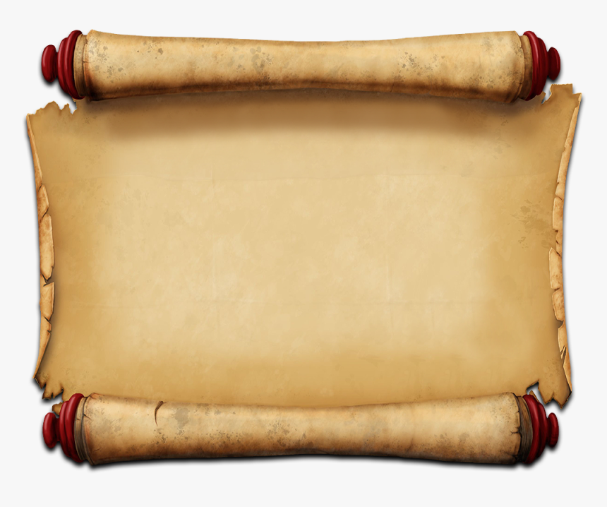

It states in Numbers 29:35
“On the eighth day you should hold a solemn gathering,
you shall not work at your occupation.”

Slide 6
Even though Shemini Atzeret immediately follows the
festival of Sukkot,
it is a totally separate holiday.

Slide 7
It is the eighth (8) day or the last day of the feast of Tabernacles. The whole feast and especially the 8th day represents a new beginning, and it is believed by some that this is the first day the redeemed will enter Heaven
in order to take part at the supper of the lamb.

Slide 8
It was on this day that Yahusha made an important statement “If any man thirst let him come unto me, and drink”
(John 7:37).

Slide 9
This is a beautiful passage, where Yahusha summarizes several different points by using the analogy of water. Namely, that He is the Messiah; that we must come to Him and 'drink' - that is, believe in Him and obey Him; that this water is free; and that those who believe will have living water flow from their hearts! His very name means "Yahuwah brings salvation.”

Slide 10
“Ho, everyone that thirsteth, come ye to the waters, and he that hath no money; come ye, buy, and eat; yea, come, buy wine and milk without money and without price”
Isaiah 55:1. (KJV)

Slide 11
"And YHVH shall guide thee continually, and satisfy thy soul in drought, and make fat thy bones: and thou shalt be like a watered garden, and like a spring of water,
whose waters fail not.”
Isaiah 58:11. (KJV) )

Slide 12
“But whosoever drinketh of the water that I shall give him shall never thirst; but the water that I shall give him shall be in him a well of water springing up into everlasting life”
John 4:14. (KJV)

Slide 13

We need that “living water”
for our spiritual life much more than we need water to give life to our physical bodies. Yahusha is offering us this living water,
His Ruach.

Slide 14
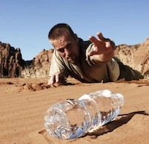
Then Yahusha said in Matthew 5:6 “Blessed are they which do hunger and thirst after righteousness:
for they shall be filled.” (KJV)

Slide 15
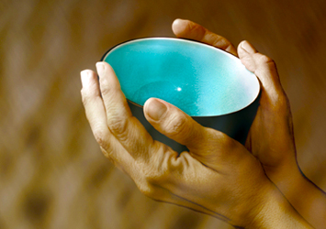
People must first be hungering and thirsting after righteousness in order to be filled!

Slide 16
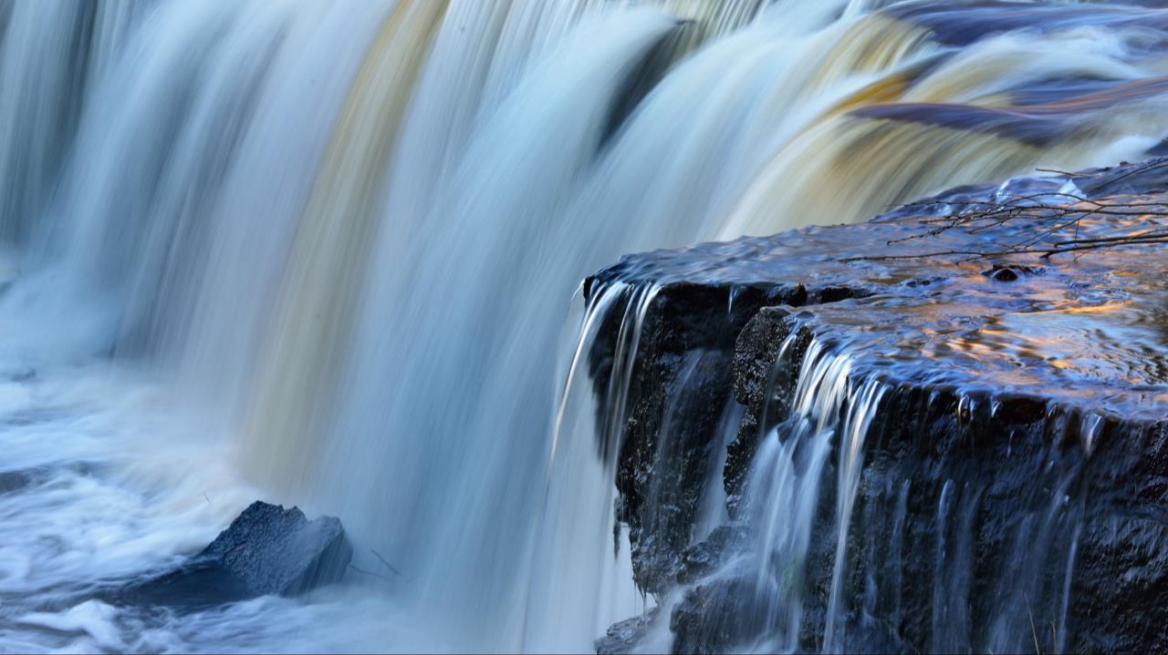
The invitation is also being repeated in the last book and the last chapter of Scripture - Revelation 22:17 ~
“And the Spirit and the bride say, Come. And let him that heareth say, Come. And let him that is athirst come. And whosoever will, let him take the water of life freely.” KJV

Slide 17
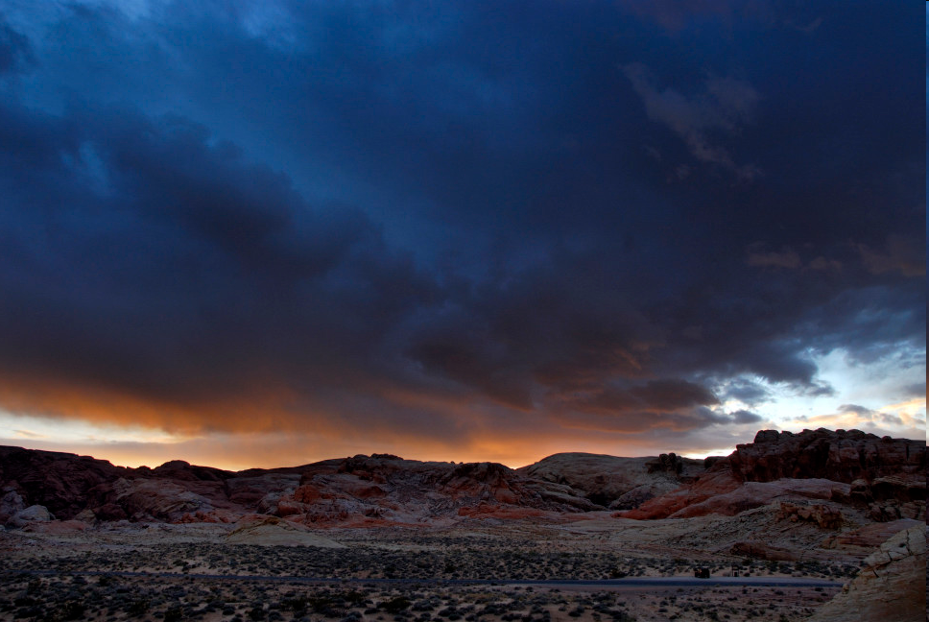
In the Bible the number eight means new beginnings!
17

Slide 18
Why is the feast eight (8) days long? In Hebrew the number eight as a noun means "superabundant fertility," "oil,” As a numeral it is the superabundant number.
As seven was so called because the seventh day was the day of completion and rest, so eight, as the eighth day, was over and above this perfect completion, and was indeed the first of a new series, as well as being the eighth. Eight by itself is 7 plus 1. Hence it is the number specially associated with Resurrection and Regeneration,
and the beginning of a new era or order.

Slide 19
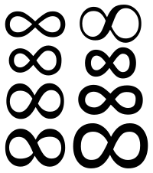
As seven represents the day of completion,
then eight, which
follows seven, means
“over and above perfect completion,” or
“the first of a new series.”
(From the book “Numbers in Scripture” by E.W. Bullinger, page 196).

Slide 20
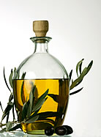
The Hebrew word for eight is shemoneh. This word taken from the root shaman meaning to nourish
to fullness and is dominantly translated as oil – particularly the anointing oil.

Slide 21
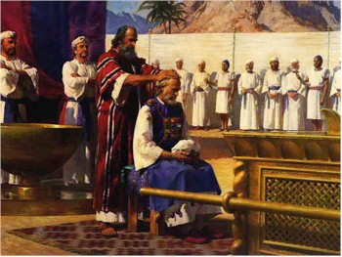
The priesthood was sanctified in 7 days and presented to YHVH on the
8th day when they began their ministry
(Lev. 8:33 & 9:1).
Notes:
21

Slide 22
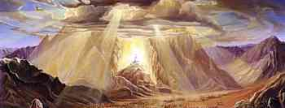
The Creator also revealed His Glory
on the 8th day
(See Lev 9:23-24 - KJV).

Slide 23
Starting with Verse 1:
1 And it came to pass on the eighth day that Moses called Aaron and his sons and the elders of Israel,
23 And Moses and Aaron went into the tabernacle of the testimony and came out and blessed the people; and the glory of Yahuwah appeared unto all the people. 24 And there came a fire out from before YHVH and consumed upon the altar the burnt offering and the fat, which when all the people saw, they praised and fell on their faces.

Slide 24

Yesterday, the Priesthood was of Levi. Today it is of Melchizedek. Revelation 20:6 reveals that the overcomers will be Priests of YHVH.

Slide 25
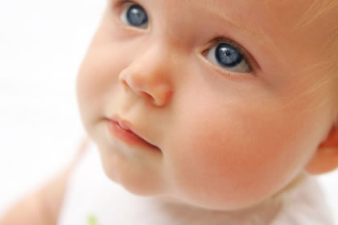
The first-born was given to YHVH on the 8th day
(See Exodus 22:29-30.)
Notes:
Circumcision was to be performed on the eighth day (Genesis 17:12), because it was the foreshadowing of the true circumcision of the heart, that which was to be "made without hands," even "the putting off of the body of the sins of the flesh by the circumcision of Christ" (Colossians 2:11). This is connected with the new creation. The first-born was to be given to Jehovah on the eighth day (Exodus 22:29,30)

Slide 26
Circumcision was to be performed on the eighth day (Genesis 17:12), because it was the foreshadowing of the true circumcision of the heart,
that which was to be "made without hands," even "the putting off of the body of the sins of the flesh by the circumcision of Messiah" (Colossians 2:11). This relates to the new creation. The first-born was to be given to YHVH on the eighth day (Exodus 22:29,30).

Slide 27

The 8th day signified a “renewed” beginning.

Slide 28
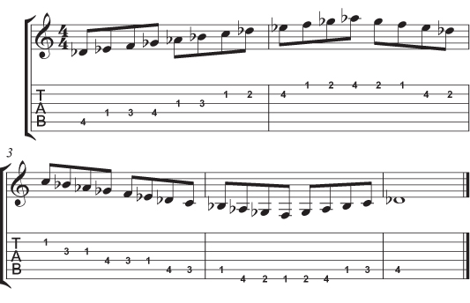
This can also be seen in the musical scale.
There are 7 whole notes in music. The 8th note begins a higher octave of the same 7 notes.

Slide 29
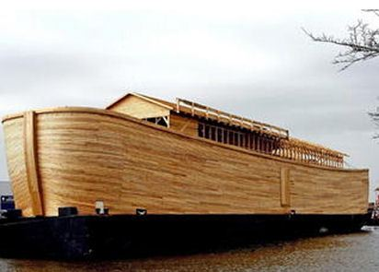
YHVH began the world anew
after the flood with eight people.
By the way, Noah’s ark came to rest on Mount Ararat during the Feast of Tabernacles. (See Genesis 8:4.)

Slide 30
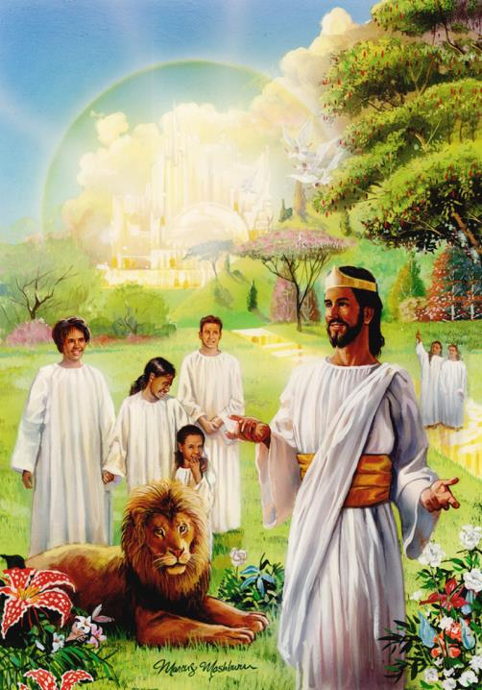
Yahuwah will also begin this earth anew by recreating it at the beginning of the 8th Millennium!
Interestingly, some believe that this earth was originally created at the Feast of Tabernacles.
(See the Book “Cross and Its Shadow” on page 240.)

Slide 31
Here are some interesting thoughts
in reference to the number “8.”
The New Testament was penned by only eight men (Matthew, Mark, Luke, John, James, Peter, Jude, Paul).
Abraham, the father of the faithful, had 8 sons' total.
They were Ishmael, Isaac, Zimran, Jokshan,
Medan, Midian, Ishbak and Shuah.

Slide 32
The Scriptures were composed by 40 different people. Number 40 is 5 times 8.
In terms of Bible, 5 is “Yahuwah’s grace” and
8 has a meaning of new beginning.
As a result, it is Yahuwah’s grace that gives a person
a second chance for a new and happy life
and the Scriptures are meant to help a person
find their way to a new beginning.

Slide 33
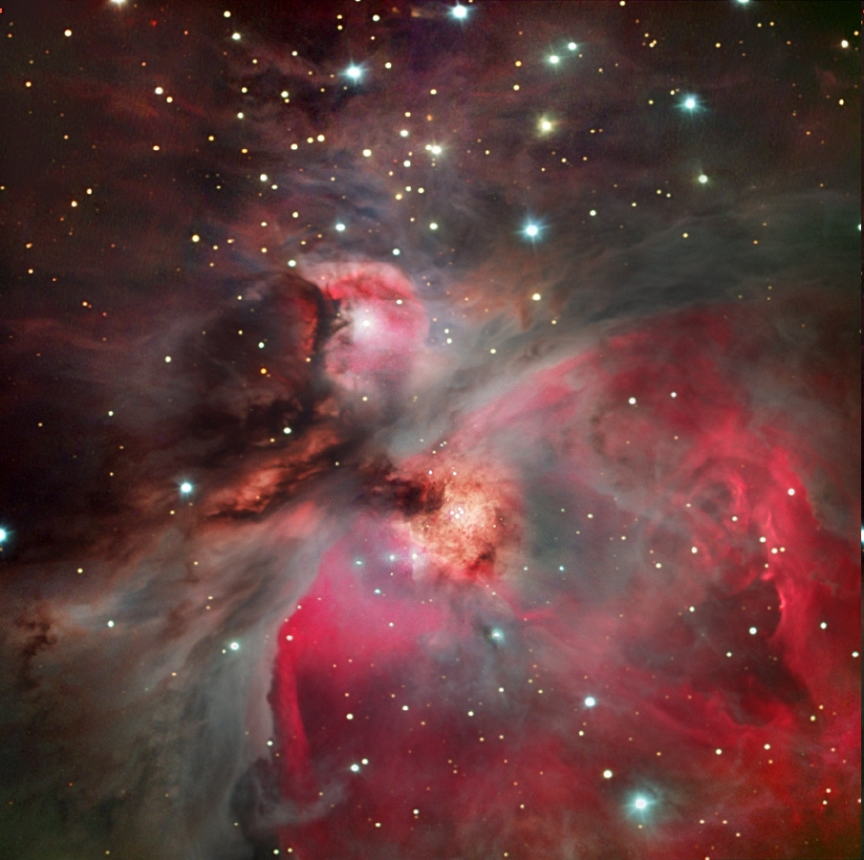
Here is another interesting thought in Ezekiel 46:1-2. There it says that the gate that looks to the east is the one that is opened so the Prince
can come.
When Yahusha comes back to earth to get His people, Scripture tells us that
He will come
from the east!
Orion Nebula

Slide 34
What about Ezekiel 43:2 ~
“And see, the esteem of the Elohim of Yisra’ěl came from the way of the east. And His voice was like the sound of many waters, and the earth shone from His esteem.” (The Scriptures)
Orion Nebula
Notes:
Other texts in the Bible tell us the same….

Slide 35
Or Matthew 24:27 ~
“For as the lightning comes from the east and shines to the west, so also shall the coming of the
Son of Adam be.”
(The Scriptures)
Orion Nebula

Slide 36
“And I saw another angel ascending from the east, having the seal of the living Elohim.” (Revelation 7:2)
Orion Nebula
Notes:
Revelation 7:2 ……………………..

Slide 37
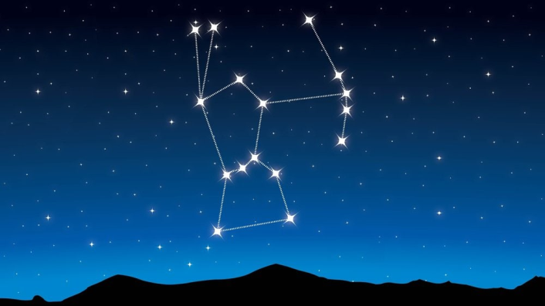
Heaven is east from this earth. Interestingly, Orion is very strikingly in the East in the Fall! Some people believe that Yahusha will come back through the constellation of Orion.
True or not,
I do not know,
but it is an interesting thought!

Slide 38
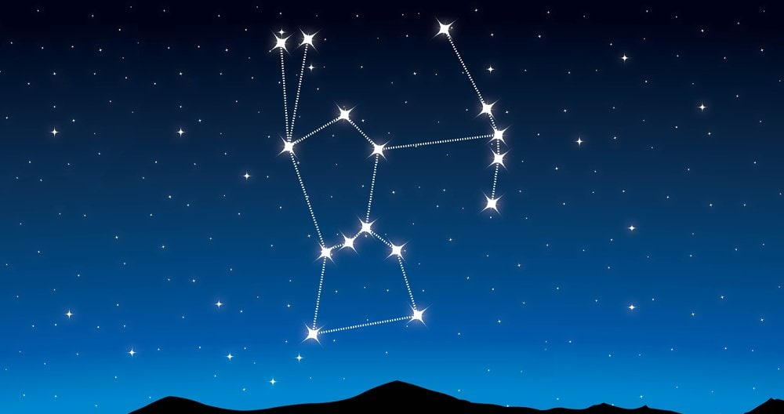
Is it a coincidence that the Constellation of Orion is strikingly in the east during the Fall Festivals; or is that planned?

Slide 39
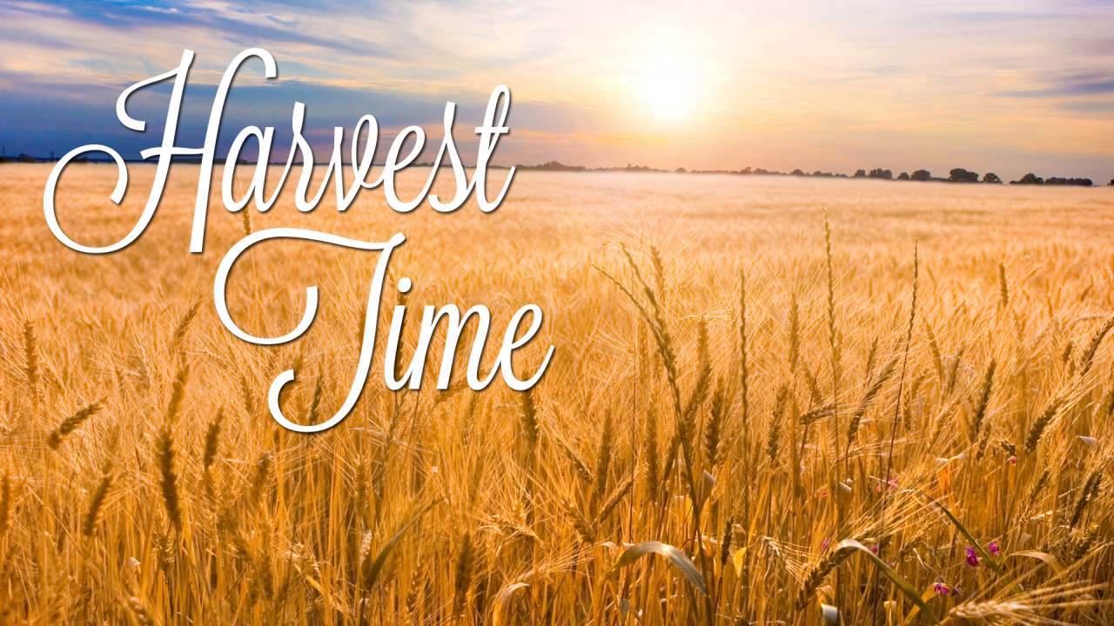
It will be in the Fall of one year during the festivals that Yahusha will return.

Slide 40
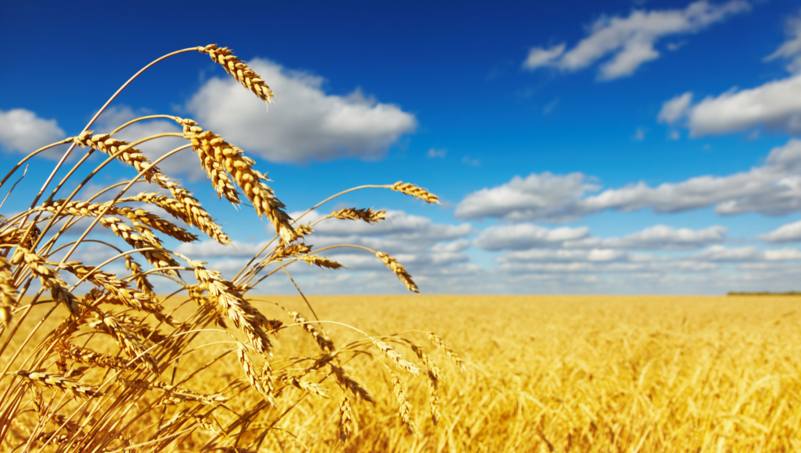
His Second Coming
is at the door!
The signs
are clear!

Slide 41
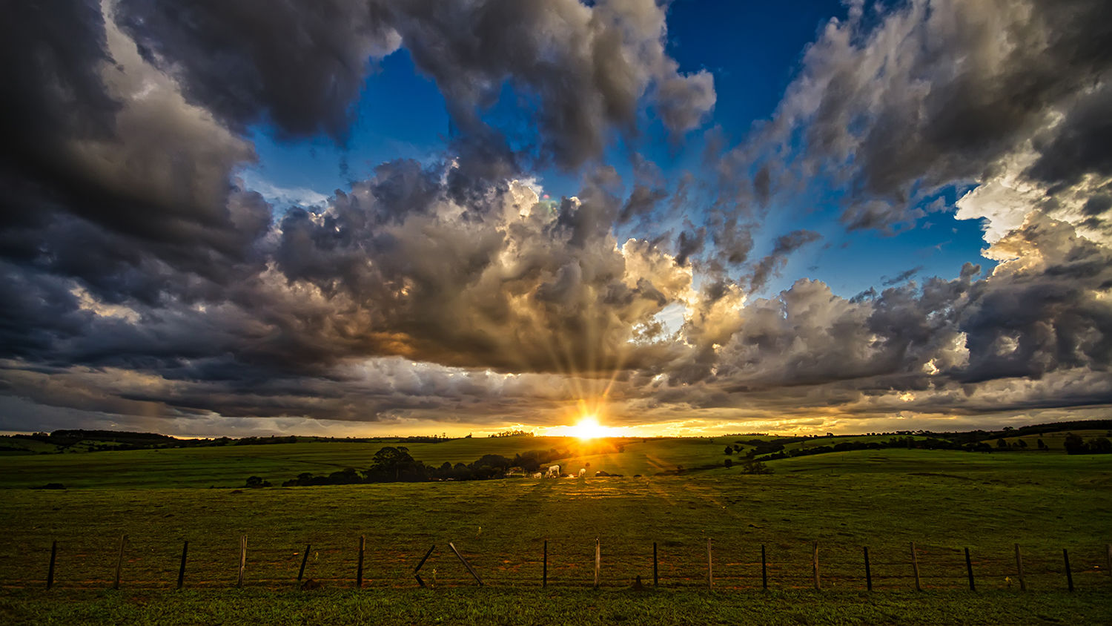
THAT IS GOOD NEWS!

Slide 42
“Let not your heart be troubled. Believe in Elohim, believe also in Me. 2 “In My Father’s house are many staying places. And if not,
I would have told you. I go to prepare a place for you. 3 “And if I go and prepare a place for you, I shall come again and receive you to Myself, that where I am, you might be too”
John 14:1-3. (The Scriptures)

Slide 43

The BOTTOM LINE:
BE READY FOR
THAT DAY!
43

Slide 44
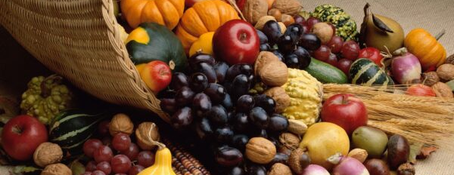
THE END

Slide 45
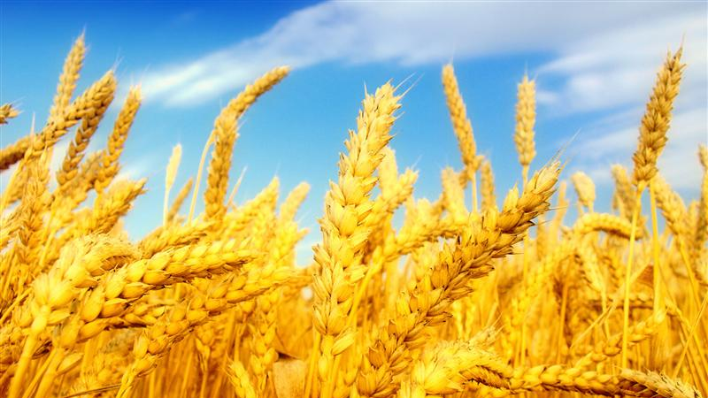

Prepared and Recorded
By Walter Tschoepe
Malachi4.4@reagan.com
Ultimate Provider is
Yahusha, Ha Mashiach

