Slide 1
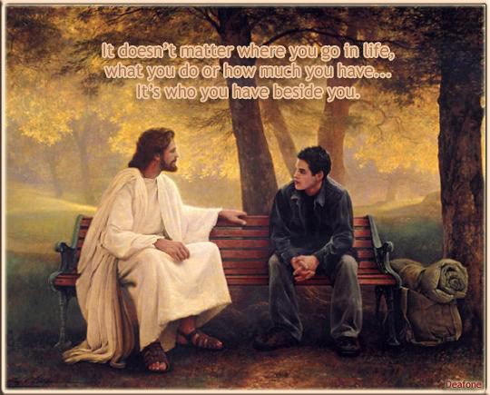
Feast-Keeping 101
Part 2

Slide 2

If any of you lacks wisdom, let him ask of Elohim, who gives to all generously and without reproach, and it shall be given to him.
James 1:5

Slide 3

Let’s ask Elohim for wisdom and understanding and then go to the Scriptures for answers !

Slide 4


First Task
Review a few Notes

Slide 5


Note: All Scripture will be taken from The Scriptures edition unless otherwise noted.
Note: This study will use the words Yahuah, Yahusha and Elohim (instead of the words God, Jesus, Lord, etc.), because of the pagan background associated with the commonly used terms for our Father, Creator and Saviour. It is my intention to stay as close to the original pronunciation of the names for Elohim as possible.
  “…What is His Name, And what is His Son’s Name, If you know it?” Proverbs 30:4

Slide 6
Note: Cycle/Season Definitions: We prefer to refrain from using the word “day” that has been translated from the original Hebrew word <yowm>. The word “Day” can indicate 12 or 24 hours, day or night, or both! To understand Scripture correctly we need to be more accurate. Preference is given to the word cycle, when referring to 24 hours, in place of the word day. When quoting Scripture, citing the Sabbath Day and/or the Feast day(s) you will see day. Otherwise cycle is the word of choice. The 24 hour cycle is further defined to pinpoint the two seasons.
Cycle = 24 hours containing the 2 seasons of: light – H216 <’owr> and night H3915 <layil>.
Season = H6256 - <‘eth>; 12 segments of time whether it is the Light Season or the Night Season.
An excellent application example for the word “Season” is found in Yerimyahu (Jeremiah) 33:20-25.

Slide 7
Note: Many times, during this study, you will see the terms “Feast Days” and “Appointed Times” being used. When using these terms we are not always referring to just the 7th Day Sabbath and the 7 Annual Qodesh Sabbaths.
Keep in mind that “Passover,” “First-fruits” and the cycles between the 1st and last Sabbaths of “Unleavened Bread” and the “Feast of Tabernacles” are also Yahuah’s “Feast Days” and “Appointed Times.” They are just not considered to be one of the Annual Qodesh Sabbaths.

Slide 8
Review of Part 1
First, let’s do a Review of Part 1 of this study.
We looked at all Ten of Yahuah’s “set apart gatherings” — in Leviticus 23 — which are:
7th day Sabbath
Passover
1st Sabbath of UB
First-fruits
Last Sabbath of UB
Pentecost - Sabbath
Trumpet - Sabbath
Atonement - Sabbath
First Sabbath of FOT
Last Sabbath of FOT

Slide 9
Review of Part 1
Yahuah claimed the Feasts days as being His “appointed times,” or “set apart gatherings,”
The Feast days were not given for the Jews only — they were given to last forever and were given to ALL of Yahuah’s
followers,
The Feast days were, and still are, a part of the Everlasting Covenant ratified by Mosheh at Sinai,

Slide 10
Review of Part 1
We briefly looked at Yahuah’s method for calculating when His new year begins,
We briefly looked at the Scriptural method for calculating how to determine when the Feast days are to occur,
Yahuah’s appointed times and the observation themes are directly related, but separate identities,
The “appointed time” is the day – or date — the “observation theme” is the “thematic Ritual” that is to take place on the appointed date - Examples seen in Ex 13:10, Num 9:2,3.

Slide 11

Purpose of this study
The purpose of Part 2 of this study is to find, from Scripture, answers to the following questions:
  What was “nailed to the tree” - the Ordinances, Oblations, Offerings, Sacrifices, Ceremonial Law, Mosaic Law or all of the above?
  How many feasts were “fulfilled” at the cross?
  Are we safe in using Yahusha as our example?
  Is Yahusha’s Sign and Covenant only attached to the 7th Day Sabbath?
  For how many Generations was Yahuah’s Sign and Covenant to remain valid?

Slide 12
We will move along now and address some of the questions and comments that are often asked and/or made by those who are unaware of what the Scriptures reveal about Yahuah’s
Appointed Times and Annual Sabbaths.

Slide 13

We often hear it said:
The feasts were a part of the Ceremonial Laws and Ordinances and they were all “nailed to the cross.” OR
If you keep the feasts today, you are showing that you have not accepted as your Saviour. The feasts were a part of the “Ceremonial System” that was “nailed to the cross.”
Are these concepts Scriptural?
Yahusha

Slide 14

Colossians 2:14
Blotting out the handwriting of ordinances that was against us, which was contrary to us, and took it out of the way, nailing it to his cross; KJV

Slide 15
Question
What exactly was nailed to “His Cross,” as spoken of in Col 2:14?

Slide 16
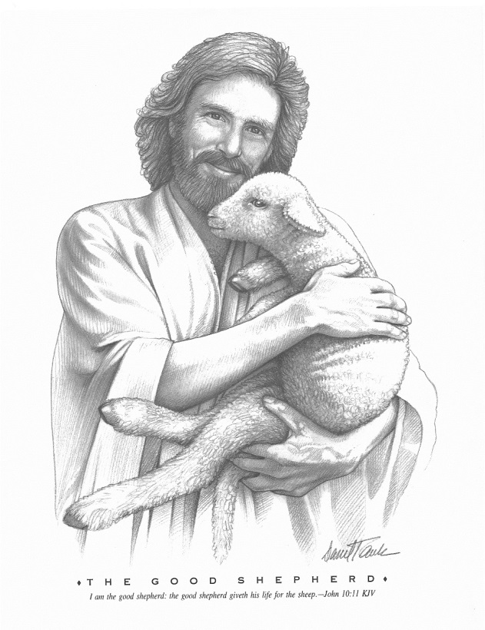
    Was it the:
        Ordinances,
          Oblations, Offerings, Sacrifices,
            Ceremonial Laws,
              Mosaic Law —
                All of the above—that got
            “nailed to the cross”?
OR,

Slide 17
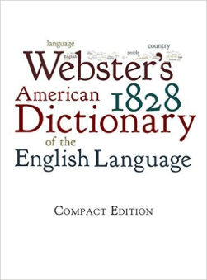

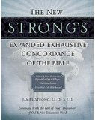

Definitions
We will look at the definitions and usage for these terms as well:
    Ordinances
    Oblations, Offerings, Sacrifices
    Ceremonial Law
    Mosaic Law

Slide 18
First we will look at the definition for
“Ordinances”

Slide 19
Ordinances
Webster’s Dictionary
OR'DINANCE, n. 1. A rule established by authority; a permanent rule of action. An ordinance may be a law or statute of sovereign power. In this sense it is often used in the Scriptures. Exo 15. Num 10. Ezra 3. It may also signify a decree, edict or rescript, and the word has sometimes been applied to the statutes of Parliament, but these are usually called acts or laws. In the United States, it is never applied to the acts of Congress, or of a state legislature.
2. Observance commanded. 3. Appointment.
4. Established rite or ceremony. Heb 9. In this sense, baptism and the Lord's supper are denominated ordinances.

Slide 20
Ordinances
Strong’s Concordance
There are several Hebrew terms for the word “Ordinances.”
H2706 חֹק chôq khoke
From H2710; an enactment; hence an appointment (of time, space, quantity, labor or usage): - appointed, bound, commandment, convenient, custom, decree (-d), due, law, measure, X necessary, ordinance (-nary), portion, set time, statute, task.
H2708 חֻקָּה chûqqâh khook-kaw'
Feminine of H2706, and meaning substantially the same: - appointed, custom, manner, ordinance, site, statute.
H4687 מִצְוָה mitsvâh mits-vaw'
From H6680; a command, whether human or divine (collectively the Law): - (which was) commanded (-ment), law, ordinance, precept.

Slide 21
Ordinances
Paul says:
Col 2:14 Blotting out the handwriting of ordinances that was against us, which was contrary to us, and took it out of the way, nailing it to his cross;
Col 2:15 And having spoiled principalities and powers, he made a shew of them openly, triumphing over them in it.
Continuing….

Slide 22
Ordinances
Eph 2:13 But now in [Yahusha ha’Mashiah] ye who sometimes were far off are made nigh by the blood of [ha’Mashiah].
Eph 2:14 For he is our peace, who hath made both one, and hath broken down the middle wall of partition between us;
Eph 2:15 Having abolished in his flesh the enmity, even the law of commandments contained in ordinances; for to make in himself of twain one new man, so making peace;
KJV

Slide 23
Ordinances
Paul makes it clear, in Colossians and Ephesians, that there were “ordinances” that were nailed to “His Cross.”
Question: which “ordinances” were “nailed to the stake”?
While you give this question some thought, let’s move on with the study and look at the words….

Slide 24

What do these words mean?
“Offerings”
“Oblation”
“Sacrifice”

Slide 25
Oblation, Offering, Sacrifice
Oblation, n. - Webster’s Dictionary
1. First-fruits. 2. Gift.
3. Offering, n. That which is presented in divine service; an animal or a portion of bread or corn, or of gold and silver, or other valuable articles, presented to God as an atonement for sin, or as a return of thanks for his favors, or for other religious purpose; a sacrifice; an oblation. In the Mosaic economy, there were burnt-offerings, sin-offerings, peace-offerings, trespass-offerings, thank-offerings, wave-offerings, and wood-offerings. Pagan nations also present offerings to their deities. Christ by the offering of himself has superseded the use of all other offerings, having made atonement for all men.
When thou shalt make his soul an offering for sin, he shall see his seed - Isa 53. 4. Sacrifice.

Slide 26
Oblation, Offering, Sacrifice
Strong’s Concordance
Oblation - H4503 - מִנְחָה- minchâh - min-khaw'
From an unused root meaning to apportion, that is, bestow; a donation; euphemistically tribute; specifically a sacrificial offering (usually bloodless and voluntary): - gift, oblation, (meat) offering, present, sacrifice.
We will now look at some Scripture verses that use H4503 as a bloodless meat offering (or Oblation). –

Slide 27
Oblation, Offering, Sacrifice
Lev 6:15 and shall take from it with his hand from the fine flour of the grain offering ^{H4503}, and from its oil, and all the frankincense which is on the grain offering ^{H4503}, and shall burn it on the altar for a sweet fragrance, as its remembrance portion to יהוה.
Lev 23:13 and its grain offering ^{H4503} : two-tenths of an ĕphah of fine flour mixed with oil, an offering made by fire to יהוה, a sweet fragrance, and its drink offering: one-fourth of a hin of wine.

Slide 28
Oblation, Offering, Sacrifice
In the Scriptures, H4503 is translated into the words Oblation, Offerings, Sacrifice, Presents and/or Gifts 211 times, in 194 different verses.
All of the Scripture uses of the words in colour above pertain to Offerings made to Yahuah— or they pertain to gifts given to others.
I could find no place in the Scriptures where H4503 has been translated into the words Statutes, Laws, Torah, Ten Commandments, Feast-Days and/or Appointed Time.

Slide 29


    It’s time now to look at the term “Ceremonial Law.”
    What do the Scriptures have to say about them?

Slide 30
Ceremonial Laws
    Even though the term “Ceremonial Law” is used by many, these words do not exist in the Scriptures. When I have heard people use the term “Ceremonial Law” they appeared to be referring to the feast days themselves, and to every ceremony and ritual related to keeping them, according to the Scriptures.
    Let’s take a look at two Scriptures and see if we can determine what was actually “nailed to the cross.”

Slide 31
Ceremonial Law
Daniel 9:27 “And he shall confirm a covenant with many for one week. And in the middle of the week he shall put an end to slaughtering and meal offering [oblations^{H4503}]. And on the wing of abominations he shall lay waste, even until the complete end and that which is decreed is poured out on the one who lays waste.”
Hebrews 10:8,9 Saying above, “Slaughter and meal offering, and burnt offerings, and offerings for sin You did not desire, nor delighted in,” which are offered according to the Torah, (v.9) then He said, “See, I come to do Your desire, O Elohim.” He takes away the first to establish the second.

Slide 32
Ceremonial Law
If the term “Ceremonial Law” is referring to what Yahusha nailed to “His cross,” then, according to Daniel 9:27 and Hebrews 10:8,9, it becomes very clear –
He nailed the
“…Slaughter and meal offering, and burnt offerings,…” to “His cross.”

Slide 33
Ceremonial Law
I have also heard it said: “the Feasts are a part of the Ceremonial Law, which were ‘nailed to the cross’; but, the 7th Day Sabbath is not a part of the Ceremonial Law so it is still binding upon us today.”
Questions:
If the Feast days themselves are ceremonial, then why is the 7th Day Sabbath not ceremonial — since it is the flagship Feast of Yahuah—with twice the Sacrificial requirements as the daily Sacrificial requirement had?
Is the “Day” itself ceremonial, or is it the “Thematic Ritual” that is performed on the “Day” that is ceremonial?
Did ancient Israel perform ceremonies on all of the Feast days, including the 7th Day Sabbath Feast?

Slide 34
Ceremonial Law
Can a “day of worship” be considered ceremonial?
A “day” is not a ceremony; however, what is done on a “day” can be ceremonial. The Merriam-Webster’s Dictionary defines Ceremony as:
“A formal act or event that is a part of
a social or religious occasion.”
Again, a “Feast day” and/or “Sabbath day” cannot be considered ceremonial — they are only days of worship.
is NOT
A “day”
“a formal act or event.”

Slide 35
Ceremonial Law
Twice daily the children of Israel were to bring offerings to Yahuah for both the morning and evening sacrifices:
Num 28:3 …This is the offering made by fire which ye shall offer unto [Yahuah]; two lambs of the first year without spot day by day,…
Num 28:5 And a tenth part of an ephah of flour… mingled with the fourth part of an hin of beaten oil.
Num 28:7 And the drink offering thereof shall be the fourth part of an hin for the one lamb: in the holy place shalt thou cause the strong wine to be poured unto [Yahuah] for a drink offering. KJV

Slide 36
Ceremonial Law
Listed below were the offerings they were to bring to Yahuah every 7th Day Sabbath – along with their regular daily offerings:
Num 28:9 ‘And on the [7th day] Sabbath day two lambs a year old, perfect ones, and two-tenths of an ĕphah of fine flour as a grain offering, mixed with oil, with its drink offering,
Num 28:10 the burnt offering for every Sabbath [7th day], besides the continual burnt offering with its drink offering [the daily sacrifices].

Slide 37
Ceremonial Law
We see, from the above texts, that there were daily Offerings & Sacrifices, plus, on the 7th day Sabbath there were extra Offerings and Sacrifices — along with the daily Sacrifices, that were required.
the yearly appointed times were “nailed to the cross” (because of the Offerings and Sacrifices that were offered on them) then the 7th day Sabbath would have been “nailed to the cross” as well (because of the Offerings and Sacrifices that were required on each and every 7th day Sabbath).
IT IS CLEAR
If

Slide 38
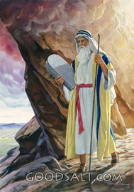
Mosaic Law
?
?
?
Whose
Law ?
?
?
?
?
?
?
?
?
?
?
?
?
?
?
?
?
?
?
?

Slide 39
Mosaic Law
What is the Mosaic Law that we often hear about?
The term Mosaic Law is the Torah (some call it the Pentateuch) – which is made up of the first five books of the Scriptures. Sometimes they are referred to as the “books of Moses.”
The Mosaic Law is the Covenant that Yahuah gave to Moses at Pentecost, on Mt Sinai, and its foundation is the Ten Commandments.
Was Moses the author of the Torah? Yahuah spoke the words and Moses wrote them down.
No,

Slide 40
Mosaic Law
Ex 24:3 And Mosheh came and related to the people all the Words of יהוה and all the right-rulings. And all the people answered with one voice and said, “All the Words which יהוה has spoken we shall do.”
Ex 24:4 And Mosheh wrote down all the Words of יהוה, and rose up early in the morning, and built an altar at the foot of the mountain, and twelve standing columns for the twelve tribes of Yisra’ĕl.

Slide 41
Mosaic Law or Torah
Strong’s Concordance
Torah G3551 νόμος nomos nom'-os
From a primary word νέμω nemō (to parcel out, especially food or grazing to animals); law (through the idea of prescriptive usage), generally (regulation), specifically (of Moses [including the volume]; also of the Gospel), or figuratively (a principle): - law.
When the Messianic Scriptures use the Greek word Law = <nomos> it is speaking of the complete Torah, not just the Ten Commandments, as some think. Yahusha’s death “fulfilled many of the regulation and prophecies of the Torah” – it did not abolish them.

Slide 42
Mosaic Law
Many people feel that when Yahusha died on the stake He abolished the Mosaic Law. Did He????
Matt 5:17 “Do not think that I came to destroy the Torah^{G3551} or the Prophets.¹ I did not come to destroy but to complete^{G4137} [or fulfill]. Footnote: ¹The Law and the Prophets is a term used for the pre-Messianic Scriptures.
Matt 5:18 “For truly, I say to you, till the heaven and the earth pass away, one jot or one tittle shall by no means pass from the Torah till all be done [fulfilled].
Book of the Covenant

Slide 43
Mosaic Law
Fulfill G4137 πληρόω plēroō play-ro'-o
From G4134; to make replete, that is, (literally) to cram (a net), level up (a hollow), or (figuratively) to furnish (or imbue, diffuse, influence), satisfy, execute (an office), finish (a period or task), verify (or coincide with a prediction), etc.: - accomplish, X after, (be) complete, end, expire, fill (up), fulfil, (be, make) full (come), fully preach, perfect, supply.
Throughout the Old Testament Yahusha’s death was prophesied – He fulfilled those Prophecies.

Slide 44
Mosaic Law
According to the Scriptures, is any part of the Book of the Covenant to be terminated
it is fulfilled?
Matt 5:18 For verily I say unto you, Till heaven and earth pass, one jot or one tittle shall in no wise pass from the law, till all be fulfilled.
Luke 16:17 “And it is easier for the heaven and the earth to pass away than for one tittle of the Torah to fall.”
BEFORE
KJV

Slide 45
Feast Fulfilled at Cross?
Were any of the “appointed times” or “set-apart gatherings” completely fulfilled when Yahusha died on the tree?
No
Only a portion of the “thematic ritual” aspect of the Passover was fulfilled at the cross. None of the “appointed times” were fulfilled at that time.

Slide 46
Feast Fulfilled at Cross?
Luke 22:15 And He said to them, “With desire I have desired to eat this Passover with you before My suffering,
Luke 22:16 for I say to you, I shall certainly not eat of it again until it is filled in the reign of Elohim.”

Slide 47
Feast Fulfilled at Cross?
In Luke 22:15,16, Yahusha was speaking about the meal (a part of the “thematic Ritual”), rather than the “appointed time” itself, that is to be “filled in the reign of Elohim.”
Plainly, the “thematic Ritual” portion of the Passover will not be completely fulfilled before Yahusha eats the Passover (meal) with us again in His Kingdom.
During the last supper with His disciples — the evening before His death — Yahusha showed them how they were to celebrate the Passover after His death. (see John 13:1-17)

Slide 48
Feast Fulfilled at Cross?
If the “Feasts” or “appointed times” had been fulfilled and “nailed to the cross” —
Why did Yahusha take the time to show His followers how they were to celebrate Passover after His death and resurrection?
Why did Yahusha tell His followers (in Luke 22:15-16) that He would be eating the Passover with them again when it was fulfilled in His Kingdom?

Slide 49
Feast Fulfilled at Cross?
    Clearly, the Ordinances, Oblations, Offerings, Sacrifices and Ceremonial Laws, (that pertained to the Sacrificial system and temple services) were the that were and/or “nailed to the stake.”
    The Sabbaths and Feast days are a part of the Ordinances, Oblations, Offerings Sacrifices and Ceremonial Laws, and they were “fulfilled” or “nailed to the stake.”
only laws
“fulfilled”
NOT
NOT

Slide 50
Our Example!
We are told that Yahusha is our EXAMPLE !!!
1 Peter 2:21 For to this you were called, because Messiah also suffered for us, leaving us an example, that you should follow His steps.
John 13:15 “For I gave you an example, that you should do as I have done to you.”
1 John 2:6 The one who says he stays in Him ought himself also to walk, even as He walked.

Slide 51
Our Example!
Yahusha left us an example to follow, after His death, in relationship to keeping His set apart gatherings and appointed times.
He observed the day of “First-Fruits” or Wave-Sheaf, AFTER His resurrection. He presented Himself before the Father, as “the First-Fruit of those having fallen asleep.”
He observed “Wave-Sheaf” at the proper time – the morning of the first cycle of the week (Sunday) – well before He met with His Disciples.

Slide 52
Our Example!
Yahusha briefly met with Mary at the tomb —
John 20:17 יהושע [Yahusha] said to her [Mary], “Do not hold on to Me, for I have not yet ascended to My Father. But go to My brothers and say to them, ‘I am ascending to My Father and your Father, and to My Elohim and your Elohim.’ ”
Yahusha celebrated “Firstfruits” AFTER HIS DEATH!! Had He “nailed” His “appointed times” “to the cross,” why would He celebrate “Firstfruits” AFTER His Resurrection??
Why?

Slide 53
Our Example!
1 Cor 15:4 And that He was buried, and that He was raised the third day, according to the Scriptures,
1 Cor 15:20 But now Messiah has been raised from the dead, and has become the first-fruit of those having fallen asleep.
Paul, as a second witness, is saying that Yahusha was buried and rose again, according to the Scriptures, He then became the “First-Fruit of those having fallen asleep” —
Yes, indeed, Yahusha is our true example!!
After His Death!!

Slide 54
Our Example!
Yahusha also celebrated Shavuot (Pentecost) on the appropriate date by bestowing the promised Ruach on His people during Shavuot.
It is obvious, from His actions, that Yahusha understood full well that He HAD NOT abolished the Feast Days (or appointed times) by nailing them to the tree with Him.
Had He done so He would have been violating the abolishing process and going against His Father’s Word by observing appointed times after His death.

Slide 55
Yahuah’s Sabbath
Sign and covenant
We will change gears now and take a closer look at Yahuah’s Sabbath
and
that He first made with Abraham.
“Sign”
“Everlasting Covenant”

Slide 56
Sign and covenant
Yahuah’s Sabbath Sign and Covenant
Ezk 20:12 “And I also gave them My Sabbath(s), to be a sign^{H226 - 1} between them and Me, to know that I am יהוה who sets them apart.” Footnote: ¹See Ex. 31:13-17.
Ezk 20:20 ‘And set apart My Sabbath(s), and they shall be a sign^{H226} between Me and you, to know that I am יהוה your Elohim.’

Slide 57
Definitions
Strong’s Concordance
Sign H226 אוֹת 'ôth oth
Probably from H225 (in the sense of appearing); a signal (literally or figuratively), as a flag, beacon, monument, omen, prodigy, evidence, etc.: - mark, miracle, (en-) sign,
Covenant H1285 בְּרִית b^{e}rı̂yth ber-eeth'
From H1262 (in the sense of cutting (like H1254)); a compact (because made by passing between pieces of flesh): - confederacy, [con-]feder[-ate], covenant, league.

Slide 58
Sign and Covenant
Ex 31:13 “And you, speak to the children of
Yisra’ĕl, saying, ‘My Sabbath(s) you are to guard, by all means, for it is a sign^{H226 - 1} between Me and you throughout your generations, to know that I, יהוה, am setting you apart. Footnote: ¹The only sign of יהוה setting us apart, the only sign of the everlasting covenant, is His Sabbath(s), one of them being the seventh day Sabbath….repeated in Ezk 20:12 & 20.
How many Generations does the “covenant” & “Sign” entail?

Slide 59
Thousand Generations
Deut 7:9 “And you shall know that יהוה your Elohim, He is Elohim, the trustworthy Ěl guarding covenant and kindness for a thousand generations with those who love Him, and those who guard His commands.”
1 Chron 16:15 Remember His covenant forever, The Word He commanded for a thousand generations.
Ps 105:8 He has remembered His covenant forever, The Word He commanded, for a thousand generations.

Slide 60

It’s Math Time
I
Scriptural thousand generations
Allow 25 years per generation
Total years for 1,000 generation
Less approximate years used to date
Balance of remaining years
We have at least 19,000 years remaining before the thousand generation time period expires; which would put the one thousand generations expiration date well after 21,000 A.D.
So, as you can see, we still have many years to go before Yahuah’s “Everlasting Covenant” expires.
1,000
x 25
= 25,000
– 6,000
= 19,000

Slide 61
Set-Apart Sabbath
Ex 31:14 ‘And you shall guard the Sabbath, for it is set-apart to you. Everyone who profanes it shall certainly be put to death, for anyone who does work on it, that being shall be cut off from among his people.
Ex 31:15 ‘Six days work is done, and on the seventh is a Sabbath of rest, set-apart to יהוה. Everyone doing work on the Sabbath day shall certainly be put to death.

Slide 62
Everlasting Covenant
Ex 31:16 “‘And the children of Yisra’ĕl shall guard the Sabbath, to observe the Sabbath throughout their generations as an everlasting covenant^{H1285}.
Ex 31:17 ‘Between Me and the children of Yisra’ĕl it is a sign^{H226} forever. For in six days יהוה made the heavens and the earth, and on the seventh day He rested and was refreshed.’ ”

Slide 63

Everlasting Covenant
Is this Sabbath sign^{H226} that Yahuah is speaking of something that He is serious about??
He says we are to:
Guard the Sabbath,
“Be put to death” if we work on His Day,
Observe it throughout our generations,
Accept it as an “Everlasting Covenant^{H1285},”
Accept that it has been “set apart” for us.
Absolutely!!

Slide 64
Sign and Covenant
When Yahuah gives us a “sign^{H226},” and makes a “Covenant^{H1285}” with us, as He did with His “Sabbath(s),“ then we are to take Him seriously.
Many people are aware of the fact that Yahuah gave us a “sign” and made an “Everlasting Covenant” with us regarding His set-apart, 7th Day Sabbath; however, we question if He actually included the 7 Annual Sabbaths in His “sign” and “Everlasting Covenant.”
Let’s continue with this thought….

Slide 65
Sign and Covenant
Ex 13:7 “Unleavened bread is to be eaten the seven days, and whatever is leavened is not to be seen with you, and leaven is not to be seen with you within all your border.
Ex 13:8 “And you shall inform your son in that day, saying, ‘It is because of what יהוה did for me when I came up from Mitsrayim [Egypt].’

Slide 66
Another Sign & Covenant
Ex 13:9 “And it [Unleavened Bread] shall be as a sign^{H226} to you on your hand and as a reminder between your eyes, that the Torah of יהוה is to be in your mouth, for with a strong hand יהוה has brought you out of Mitsrayim.
Ex 13:10 “And you shall guard this law at its appointed time from year to year.”

Slide 67
Another Sign & Covenant
Ex 34:21 Six days thou shalt work, but on the seventh day thou shalt rest: in earing time and in harvest thou shalt rest.
Ex 34:22 And thou shalt observe the feast of weeks, of the firstfruits of wheat harvest, and the feast of ingathering at the year's end.
Ex 34:23 Thrice in the year shall all your men children appear before [Yahuah Elohim], the [Elohim] of Israel.

Slide 68
Another Sign & Covenant
Ex 34:24 For I will cast out the nations before thee, and enlarge thy borders: neither shall any man desire thy land, when thou shalt go up to appear before [Yahuah] thy [Elohim] thrice in the year.
Ex 34:25 Thou shalt not offer the blood of my sacrifice with leaven; neither shall the sacrifice of the feast of the passover be left unto the morning.

Slide 69
Another Sign & Covenant
Ex 34:26 The first of the firstfruits of thy land thou shalt bring unto the house of [Yahuah] thy [Elohim]. Thou shalt not seethe a kid in his mother's milk.
Ex 34:27 And [Yahuah] said unto Moses, Write thou these words: for after the tenor of these words I have made a
with thee and with Israel. KJV
covenant^{H1285}
Yes

Slide 70
Sign and Covenant
In Exodus 13:7-10 and in Exodus 34:21-27 we saw clearly that the annual Feasts of Yahuah are also a “sign^{H226}” and a “covenant^{H1285}” and we were admonished to “…guard this law at its appointed time from year to year.”
Can it be made more plain to us? The same “sign” that Yahuah associated with the 7th Day Sabbath, He also associated with His Annual Feast days, and we are “commanded” to keep them for a “thousand generations.”

Slide 71

Review Quiz
  What was “nailed to the tree” - the Ordinances, Oblations, Offerings, Sacrifices, Ceremonial Law, Mosaic Law or all of the above?
  The Ordinances, Oblations, Offerings, and Ceremonial Laws (Book of the Law) relating to the Sacrifices and temple services were the only things “nailed to the cross,” along with Yahusha.
  How many feasts were “fulfilled” at the cross?
None of the feasts were completely “fulfilled” at the cross – Passover was only partially fulfilled.

Slide 72
Review Quiz
  Are we safe in using Yahusha as our example?
  “For I gave you an example, that you should do as I have done to you.” John 13:15
    Yahusha is our example in all things and He celebrated “First-fruits” AFTER His death and resurrection.
  Yahusha also celebrated Shavuot (Pentecost), on the appropriate date, by bestowing His promised Ruach on His people during Shavuot — after the cross.

Slide 73
Review Quiz
The fact that Yahusha celebrated “set apart, appointed times,” AFTER the cross, —brings up some serious…
Why would Yahusha observe a feast(s) after the cross, if they had already been abolished at the cross?
Would this not have been a violation of the abolishing process?
Would His feast observance after the cross then place Yahusha in conflict with the Torah had Yahuah desired to abolish the feasts at the cross?
Thought Questions

Slide 74
Review Quiz
Is Yahusha’s Sign and Covenant only attached to the 7th Day Sabbath?
All of the Feast days were, and still are, a part of the Everlasting Covenant ratified by Mosheh at Sinai.
For how many Generations was Yahuah’s Sign and Covenant to remain valid?
“He has remembered His covenant forever, The Word He commanded, for a thousand generations.” Ps 105:8

Slide 75
Coming up in – Part 3
We have come to the end of Part 2 of this study. In Part 3 we will answer the following questions:
Did Yahusha’s followers celebrate the “appointed times” after His resurrection?
Who “changed” the “appointed times”?
Were Yahuah’s “appointed times” replaced with other holidays?
If Yahuah’s “appointed times” were replaced, what were they replaced with? And More! ☺

Slide 76
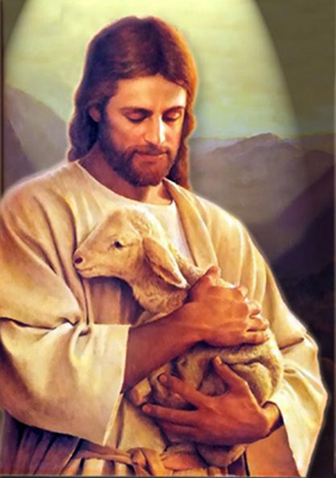
The End
The following PowerPoint studies are available to help clarify some of the points that were briefly mentioned in this presentation:
Moses' 10 Encounters with Mount Sinai
https://studythecalendar.com/10-trips-mt-sinai/
Beyn Ha Arbayim (Between the Evenings)
https://studythecalendar.com/exodus-12-beyn-ha-
arbayim/
Calculating Atonement Correctly
https://studythecalendar.com/calculating-atonement-correctly/
Closing Minutes of Sabbath – Matthew 28:1
https://studythecalendar.com/closing-minutes-of-shabbat/
Contact: questions@studythecalendar.com

