Slide 1
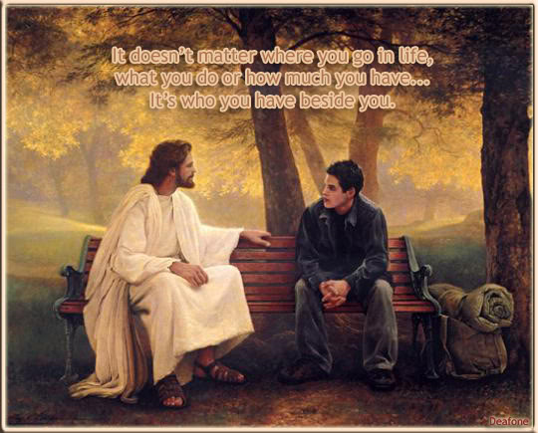
Feast-Keeping 101
Part 1

Slide 2
Elohim, is feast-keeping applicable to me today?

Slide 3
Son, where have I told you to look for answers?

Slide 4
“Set them apart in Your truth –Your Word is truth.” John 17:17

Slide 5
Yes! go and study “My Word” for your answers!

Slide 6

If any of you lacks wisdom, let him ask of Elohim, who gives to all generously and without reproach, and it shall be given to him.
James 1:5

Slide 7

Let’s ask Elohim for wisdom and understanding and then go to the Scriptures for answers !

Slide 8

First Task
.
Review a few Notes

Slide 9

Note: All Scripture will be taken from The Scriptures edition unless otherwise noted.
Note: This study will use the words Yahuah, Yahusha and Elohim (instead of the words God, Jesus, Lord, etc.), because of the pagan background associated with the commonly used terms for our Father, Creator and Saviour. It is my intention to stay as close to the original pronunciation of the names for Elohim as possible.
  “…What is His Name, And what is His Son’s Name, If you know it?” Proverbs 30:4

Slide 10
Note: Cycle/Season Definitions: We prefer to refrain from using the word “day” that has been translated from the original Hebrew word <yowm>. The word “Day” can indicate 12 or 24 hours, day or night, or both! To understand Scripture correctly we need to be more accurate. Preference is given to the word cycle, when referring to 24 hours, in place of the word day. When quoting Scripture, citing the Sabbath Day and/or the Feast day(s) you will see day. Otherwise cycle is the word of choice. The 24 hour cycle is further defined to pinpoint the two seasons.
Cycle = 24 hours containing the 2 seasons of: light – H216 <’owr> and night H3915 <layil>.
Season = H6256 - <‘eth>; 12 segments of time whether it is the Light Season or the Night Season.
An excellent application example for the word “Season” is found in Yerimyahu (Jeremiah) 33:20-25.

Slide 11
Note: Many times, during this study, you will see the terms “Feast Days” and “Appointed Times” being used. When using these terms I am not always referring to just the 7th Day Sabbath and the 7 Annual Qodesh (Holy) Sabbaths.
Keep in mind that “Passover,” “First-fruits” and the cycles between the 1st and last Sabbaths of “Unleavened Bread” and the “Feast of Tabernacles” are also Yahuah’s “Feast Days” and “Appointed Times.” They are just not considered to be one of the Annual Qodesh Sabbaths.

Slide 12
Bonus
Before we start Part 1 of our study I have a poem (I found in an old newsletter) that I want to share with you. It has a great message for each of us to consider.

Slide 13
Poem
The Scriptures Said It
Thelma Burton — Adapted by Sue
The Qodesh Scriptures said it—
Well....I never really read it,
But someone said, it said it,
So of course it must be so.
To prove my points, I'll quote it,
Though I can't show where they wrote it,
But someone said, it said it,
And that's all I need to know.

Slide 14
Poem
It saves a lot of time for me,
If I just listen carefully,
When others speak with utmost glee,
Of what they say it says—
Though I can't repeat it word for word,
I'll tell you what I think I heard,
And quote you things from "Yahuah's Word" ??
That no one's ever read.

Slide 15
Purpose of this study
The purpose of Part 1 of this study is to find, from Scripture, answers to the following questions:
  What exactly are the “appointed times”?
  Are the “appointed times” the Jews feasts?
  When (what dates) are the “appointed times”?
  How do we calculate the timing for the “appointed times”?
  Is there a difference between “appointed times” and “observation themes”?

Slide 16

Next
.
We will read about the Feasts Days directly from The Scriptures –
Leviticus 23

Slide 17
Question
.
Is the Seventh-day Sabbath considered to be a or an
“Feast Day”
“Appointed Time”?

Slide 18
Lev 23:1 And יהוה spoke to Mosheh [Moses], saying,
Lev 23:2 “Speak to the children of Yisra’ĕl, and say to them, ‘The appointed times of יהוה, which you are to proclaim as set-apart gatherings, appointed times, are these:
Lev 23:3 ‘Six days work is done, but the seventh day is a Sabbath of rest, a set-apart gathering. You do no work, it is a Sabbath to יהוה in all your dwellings’.”
My
Seventh Day Sabbath

Slide 19
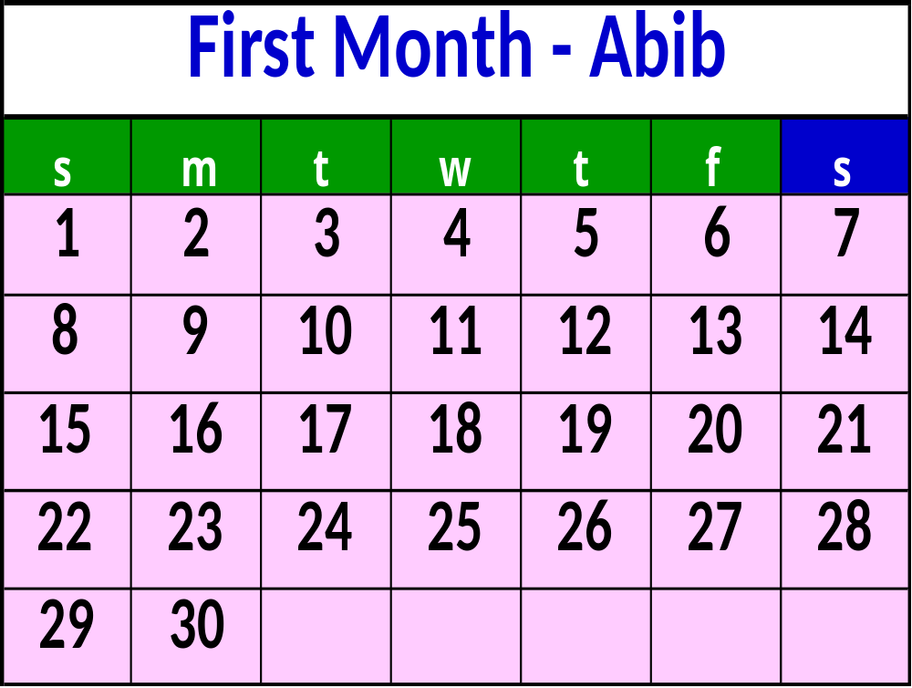
7
14
21
28

Slide 20

Yahuah then continues on in Leviticus 23 listing His remaining Appointed Times. Let’s take a close look at this chapter:
Lev 23:4 ‘These are the appointed times of יהוה [Yahuah], set-apart gatherings which you are to proclaim at their appointed times.
Lev 23:5 ‘In the first month, on the fourteenth day of the month, between the evenings, is the
to יהוה.
Passover — Pesach
Passover

Slide 21
Passover Is Not Annual Sabbath
7
14
21
28

Slide 22
Lev 23:6 ‘And on the fifteenth day of this month is the Festival of Unleavened Bread to יהוה – seven days you eat unleavened bread.
Lev 23:7 ‘On the first day you have a set-apart gathering, you do no servile work.
Lev 23:8 ‘And you shall bring an offering made by fire to יהוה for seven days. On the seventh day is a set-apart gathering, you do no servile work.’ ”
Unleavened Bread

Slide 23
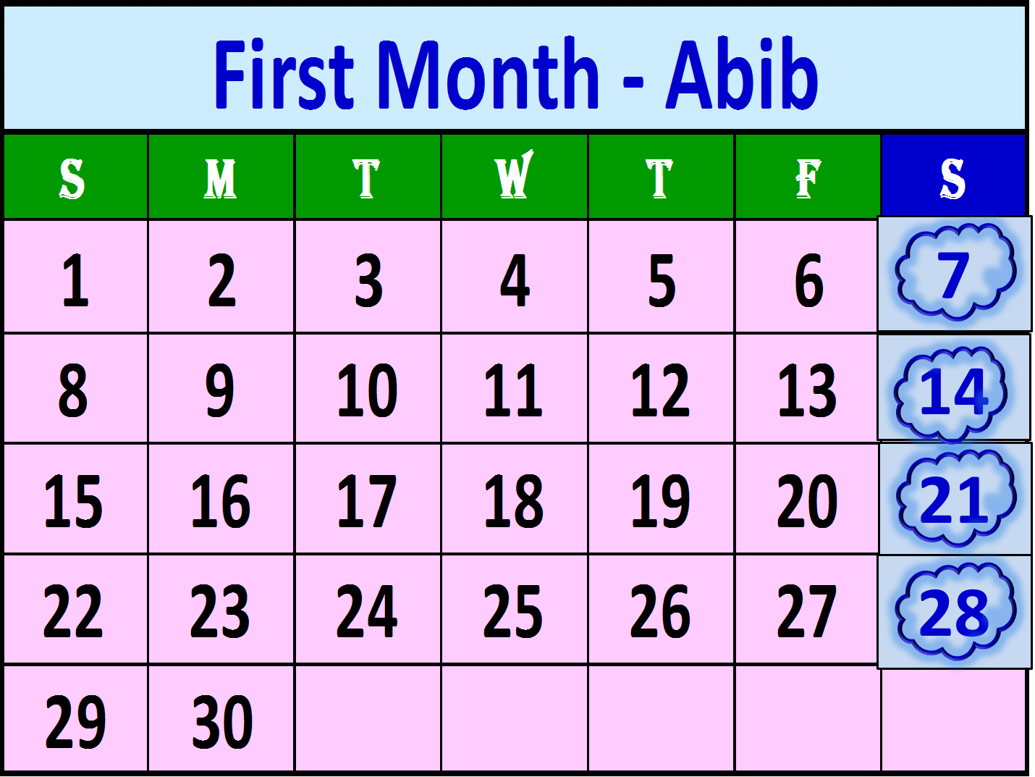
1st U - Bread
Annual
Sabbath
Passover Is
Not Annual
Sabbath
Feast of
Unleavened Bread
Last U - Bread
Annual Sabbath

Slide 24
.
Lev 23:9 And יהוה spoke to Mosheh [Moses], saying,
Lev 23:10 “Speak to the children of Yisra’ĕl, and you shall say to them, ‘When you come into the land which I give you, and shall reap its harvest, then you shall bring a sheaf of the first-fruits of your harvest to the priest.
Lev 23:11 ‘And he shall wave the sheaf before יהוה, for your acceptance. On the morrow after the Sabbath [7th Day Sabbath] the priest waves it.
Wave Sheaf

Slide 25
Lev 23:12 ‘And on that day when you wave the sheaf, you shall prepare a male lamb a year old, a perfect one, as a burnt offering to יהוה,
Lev 23:13 and its grain offering: two-tenths of an ĕphah of fine flour mixed with oil, an offering made by fire to יהוה, a sweet fragrance, and its drink offering: one-fourth of a hin of wine.
Lev 23:14 ‘And you do not eat bread or roasted grain or fresh grain until the same day that you have brought an offering to your Elohim – a law forever throughout your generations in all your dwellings.

Slide 26
1st U - Bread
Annual
Sabbath
Passover Is
Not Annual
Sabbath
15
Wave -
Sheaf
Feast of
Unleavened Bread
Last U - Bread
Annual Sabbath

Slide 27
.
Lev 23:15 ‘And from the the Sabbath, from the day that you brought the sheaf of the wave offering, you shall count for yourselves:
Lev 23:16 ‘Until the morrow after the seventh Sabbath you count
then you shall bring a new grain offering to יהוה.
Pentecost — Shavuot
morrow after
seven
completed
Sabbaths.
fifty days,

Slide 28
Lev 23:17 ‘Bring from your dwellings for a wave offering two loaves of bread, of two-tenths of an ĕphah of fine flour they are, baked with leaven, first-fruits to יהוה.
Lev 23:18 ‘And besides the bread, you shall bring seven lambs a year old, perfect ones, and one young bull and two rams. They are a burnt offering to יהוה, with their grain offering and their drink offerings, an offering made by fire for a sweet fragrance to יהוה.

Slide 29
Lev 23:19 ‘And you shall offer one male goat as a sin offering, and two male lambs a year old, as a peace offering.
Lev 23:20 ‘And the priest shall wave them, besides the bread of the first-fruits, as a wave offering before יהוה, besides the two lambs. They are set-apart to יהוה for the priest.
Lev 23:21 ‘And on this same day you shall proclaim a set-apart gathering for yourselves, you do no servile work on it – in all your dwellings throughout your generations.
a law forever

Slide 30
Before we go further we need to take a closer look at two verses we read above – Lev 23:15,16.
Yahuah has given us a pattern that includes separate requirements for calculating the count between Wave Sheaf and Pentecost.
Lev 23:15 And from the morrow after the Sabbath, from the day that you brought the sheaf of the wave offering, you shall count for yourselves: seven completed Sabbaths.
4
#1
#2

Slide 31
Requirement 1: “From the morrow after the Sabbath” (which would be the 1st cycle {day} after the 7th Day Sabbath) is the wave sheaf offering.
Note — There is a question about whether the Wave Sheaf celebration is to follow a 7th day Sabbath or an Annual Sabbath. We will address this concept in a later Requirement……
#1

Slide 32
Requirement 2: “You shall count for yourselves: seven completed Sabbaths.”
Note — By “completed,” Scriptures require that the 7th Day Sabbath has achieved the ordained duty of fulfilling, satisfying, giving closure to and finalizing the necessary 6 prior cycles of the week, for work. Not only must a 7th Day Sabbath give physical rest, and spiritual enrichment, by drawing one closer to Yahuah, but it must also “be completed” in finishing the full 24 hours of the cycle. Anything less is just not a completed Sabbath.
#2

Slide 33
Lev 23:16 Until the morrow after the seventh Sabbath you count fifty days, then you shall bring a new grain offering to Yahuah.
Requirement 3: “Until the morrow after the seventh Sabbath…”
Note — There are NO Annual Sabbaths in the third month of Yahuah’s Calendar for the 50th count to follow, so this “seventh Sabbath” must, BY DEFAULT ALONE, be a 7th day Sabbath. There are NO OTHER OPTIONS AVAILABLE for this “seventh Sabbath.”
#3
#4

Slide 34
Requirement 4: The “morrow after the seventh Sabbath” must be a count of “fifty days” from the “Wave-Sheaf” celebration.
Note — Here is another strict stipulation. There are to be “seven completed Sabbaths”; and, integral within this same count is to be the 50th cycle. No more, no less. Period!! Again, the 50th cycle is to fall on “the morrow after the seventh Sabbath.”
#4

Slide 35
All of the yearly Sabbaths (with only one exception) are often referred to as “floating Sabbaths.” This means they fall on different cycles of the week each year.
If the Wave Sheaf celebration were to follow a yearly Sabbath (unless it happened to fall upon a 7th Day Sabbath), then the 50 cycle count would NOT follow a “Sabbath,” as required by Yahuah in Lev 23:16 — it would usually, by default, follow another cycle of the week. This is why the Wave Sheaf celebration MUST follow a 7th Day Sabbath rather than a yearly Sabbath.
Let’s apply the Wave Sheaf information above (for calculating the timing of Pentecost) to our Calendar.

Slide 36
C
o
m
p
l
e
t
e
d
S
a
b
b
a
t
h
s
1st U - Bread
Annual
Sabbath
Passover Is
Not Annual
Sabbath
15
1
2
Wave -
Sheaf
Feast of
Unleavened Bread
Last U - Bread
Annual Sabbath

Slide 37
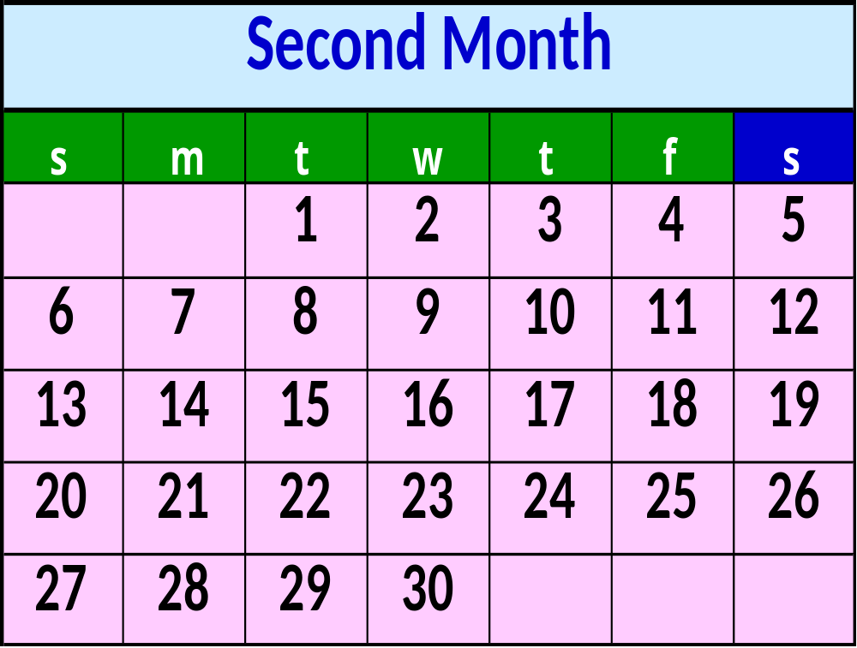
Completed
Sabbath
5
3
12
4
19
5
26
6

Slide 38
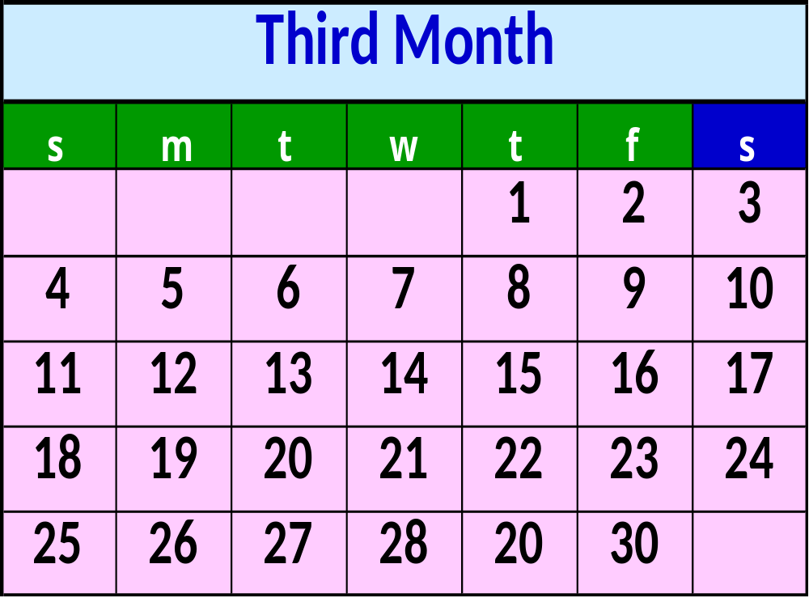
Pentecost
Shavuot
Annual Sabbath
Completed
Sabbath
3
7
10
17
24

Slide 39
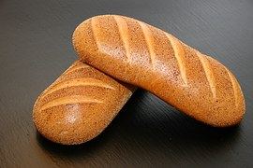
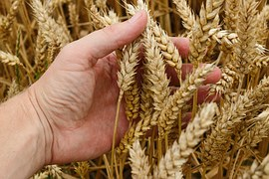
Note: Wave-Sheaf ALWAYS falls on the first cycle of the week – after the first 7th day Sabbath that comes within the 8 cycles of the required days for eating Unleavened Bread.
Unleavened Bread is to be eaten on the Passover Feast (Abib 14 evening/night) and on the following 7 cycles of the Unleavened Bread celebration.
Shavuot [Pentecost] ALWAYS falls after 7 completed Sabbaths have been fulfilled, following the Wave Sheaf celebration — and on the 50th cycle count.

Slide 40
We have now finished looking at Yahuah’s appointed times that fall in the Spring time — which included:
The Seventh Day Sabbath — a weekly event,
Passover — not an annual Sabbath,
Unleavened Bread — with its 2 annual Sabbaths — the 1st and last cycle of UB,
Wave-Sheaf — not an annual Sabbath but it falls the 1st day after the 7th day Sabbath that falls within the 7cycles of Unleavened Bread,
Pentecost — falls on the first cycle of the week, the 50th cycle AFTER Wave-Sheaf celebration.
Let’s move on now to Yahuah’s Fall Feasts….

Slide 41
.
Lev 23:23 And יהוה spoke to Mosheh [Moses], saying,
Lev 23:24 “Speak to the children of Yisra’ĕl, saying, ‘In the seventh month, on the first day of the month, you have a rest, a remembrance of blowing of trumpets, a set-apart gathering.
Lev 23:25 ‘You do no servile work, and you shall bring an offering made by fire to יהוה.’ ”
Trumpets — Yom Teruah

Slide 42
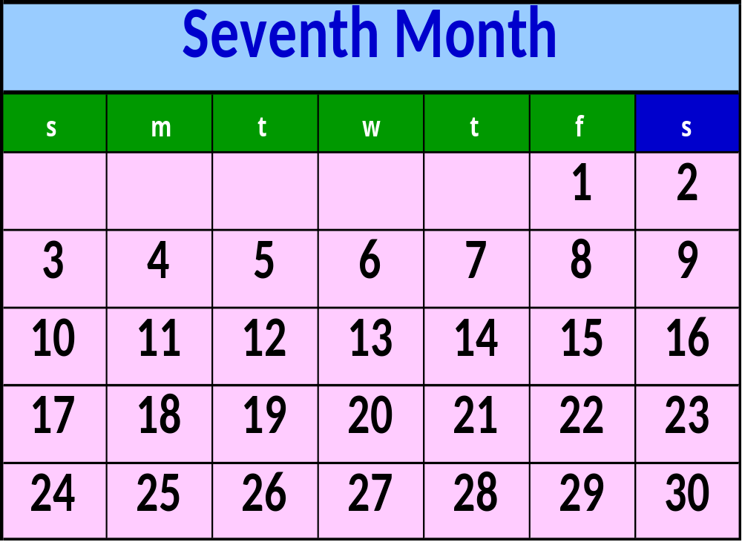
Trumpets
Yom Teruah
Annual Sabbath
2
9
16
23
30

Slide 43
.
Lev 23:26 And יהוה spoke to Mosheh [Moses], saying,
Lev 23:27 “On the tenth day of this seventh month is the Day of Atonement. It shall be a set-apart gathering for you. And you shall afflict your beings, and shall bring an offering made by fire to יהוה.
Lev 23:28 “And you do no work on that same day, for it is the Day of Atonement, to make atonement for you before יהוה your Elohim.
Lev 23:29 “For any being who is not afflicted on that same day, he shall be cut off from his people.
Day of Atonement — Yom Kippur

Slide 44
Lev 23:30 “And any being who does any work on that same day, that being I shall destroy from the midst of his people.
Lev 23:31 “You do no work – a law forever throughout your generations in all your dwellings.
Lev 23:32 ‘It is a Sabbath of rest to you, and you shall afflict your beings. On the ninth day of the month at evening, from evening to evening, you observe your Sabbath.”
For more information about “evening to evening” ask for the “Atonement” PowerPoint study.

Slide 45
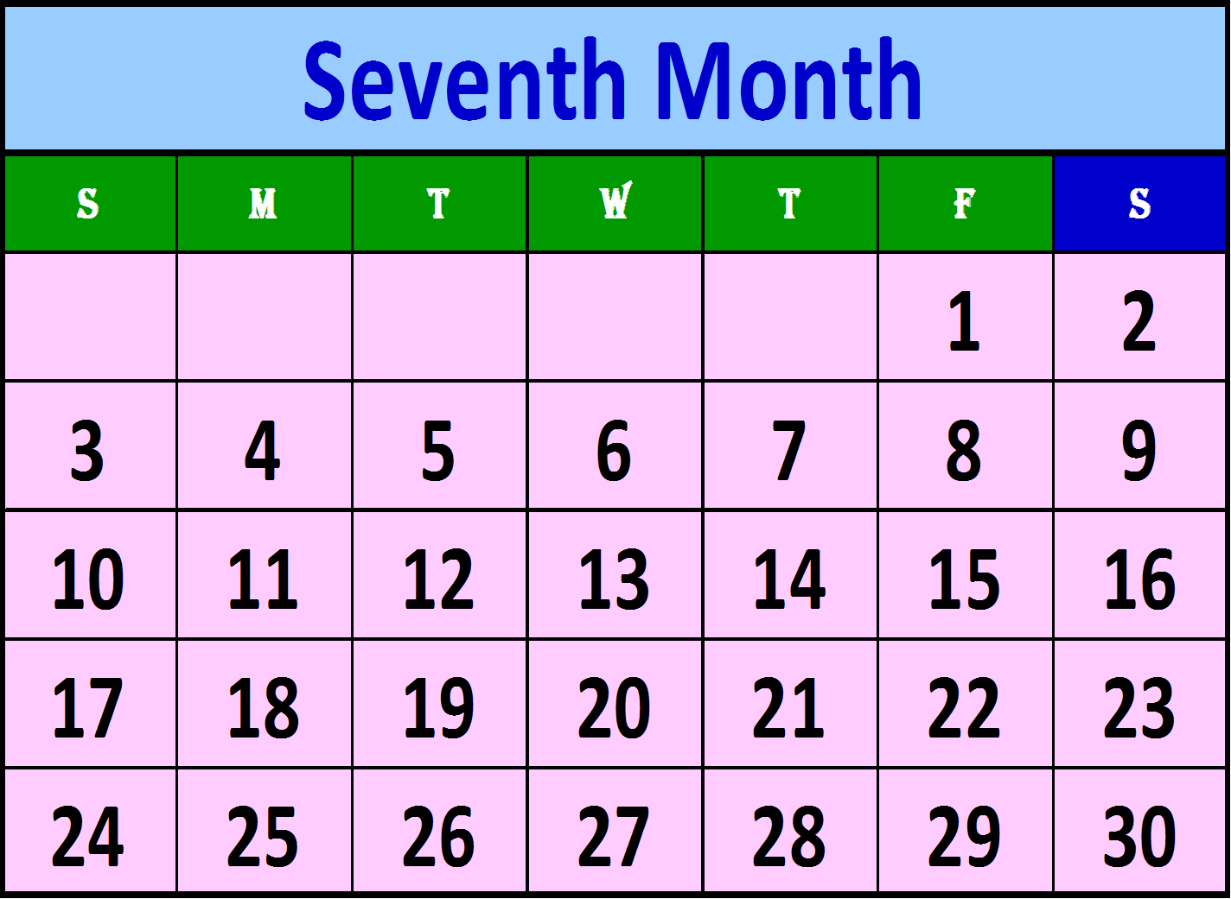
Day of
Atonement
Annual Sabbath
Trumpets
Yom Teruah
Annual Sabbath
2
9
16
23
30

Slide 46
.
Lev 23:33 And יהוה spoke to Mosheh [Moses], saying,
Lev 23:34 “Speak to the children of Yisra’ĕl, saying, ‘On the fifteenth day of this seventh month is the Festival of Booths for seven days to יהוה.
Lev 23:35 ‘On the first day is a set-apart gathering, you do no servile work.
Lev 23:36 ‘For seven days you bring an offering made by fire to יהוה. On the eighth day there shall be a set-apart gathering for you, and you shall bring an offering made by fire to יהוה. It is a closing festival, you do no servile work.
Feast of Tabernacles — Sukkot

Slide 47
Lev 23:37 ‘These are the appointed times of יהוה which you proclaim as set-apart gatherings, to bring an offering made by fire to יהוה, a burnt offering and a grain offering, a slaughtering and drink offerings, as commanded for every day –
Lev 23:38 besides the Sabbath(s) of יהוה, and besides your gifts, and besides all your vows, and besides all your voluntary offerings which you give to יהוה.
Lev 23:39 ‘On the fifteenth day of the seventh month, when you gather in the fruit of the land, observe the festival of יהוה for seven days. On the first day is a rest, and on the eighth day a rest.
Lev 23:40 ‘And you shall take for yourselves on the first day the fruit of good trees, branches of palm trees, twigs of leafy trees, and willows of the stream, and shall rejoice before יהוה your Elohim for seven days.

Slide 48
Lev 23:41 ‘And you shall observe it as a festival to יהוה for seven days in the year – a law forever in your generations. Observe it in the seventh month.
Lev 23:42 ‘Dwell in booths for seven days; all who are native Yisra’ĕlites dwell in booths,
Lev 23:43 so that your generations know that I made the children of Yisra’ĕl dwell in booths when I brought them out of the land of Mitsrayim. I am יהוה your Elohim.’ ”
Lev 23:44 Thus did Mosheh speak of the appointed times of יהוה to the children of Yisra’ĕl.

Slide 49
Day of
Atonement
Annual Sabbath
Trumpets
Yom Teruah
Annual Sabbath
Last Sabbath
Tabernacles
1st Sabbath
Tabernacles
2
Sukkot
9
16
23
30

Slide 50
.
Let’s do a quick overview of Leviticus chapter 23 before moving on — and see how many things we can remember.

Slide 51
Questions
According to Scripture, is the Seventh-day Sabbath a “set apart gathering” or Feast day?
Yes, it is both!
There were several “Feasts” spoken of in Leviticus 23. Do you remember how many?
Ten – How many do you recall?
Let’s quickly review them.

Slide 52
Feasts and Sabbaths
7th Day Sabbath — Shabbath — Weekly Event
Passover — Pesach — Not a yearly Sabbath
Unleavened Bread — Matstsoth — 1st & 7th Y- Sabbaths
First-Fruits — Wave-Sheaf — Not a yearly Sabbath
Pentecost — Shavuot [Weeks] — Yearly Sabbath
Trumpets — Yom Teruah — Yearly Sabbath
Day of Atonement — Yom Kippur — Y- Sabbath
Tabernacles— Sukkot —1st & 8th Yearly Sabbaths
How many Yearly Sabbaths are there?
Seven

Slide 53
more Questions
Were the Feasts, of Leviticus 23, to be considered as “Feasts of the Jews” ?
No – they were referred to as appointed times of Yahuah, or My appointed times, 12 times (in verses: 2^{(X2)}, 3, 4, 5, 6, 34, 37, 38, 39, 41, 44)
How many times, in Leviticus 23, did Yahuah say His Feasts were to be kept forever?
Four times – (in verses: 14, 21, 31, 41)
If Yahuah tells us something 12 times (or even 4 times) does He consider it to be important?
Absolutely!

Slide 54
Creation Calendar
Before we move on, as you saw on the last calendar slide, the Seventh Month is a very busy “Feast” month. It contains all of Yahuah’s Fall “appointed times.” On the next slide there will be a “Creation Calendar” showing the Biblical Year, as seen very clearly in the Genesis 7 and 8 flood story.
We will not look deeply into the Calendar aspect in this study; however, there is an excellent study available called Noah, Yahuah’s Chosen Captain that details the flood events, according to Yahuah’s yearly cycles, that is yours for the asking.

Slide 55
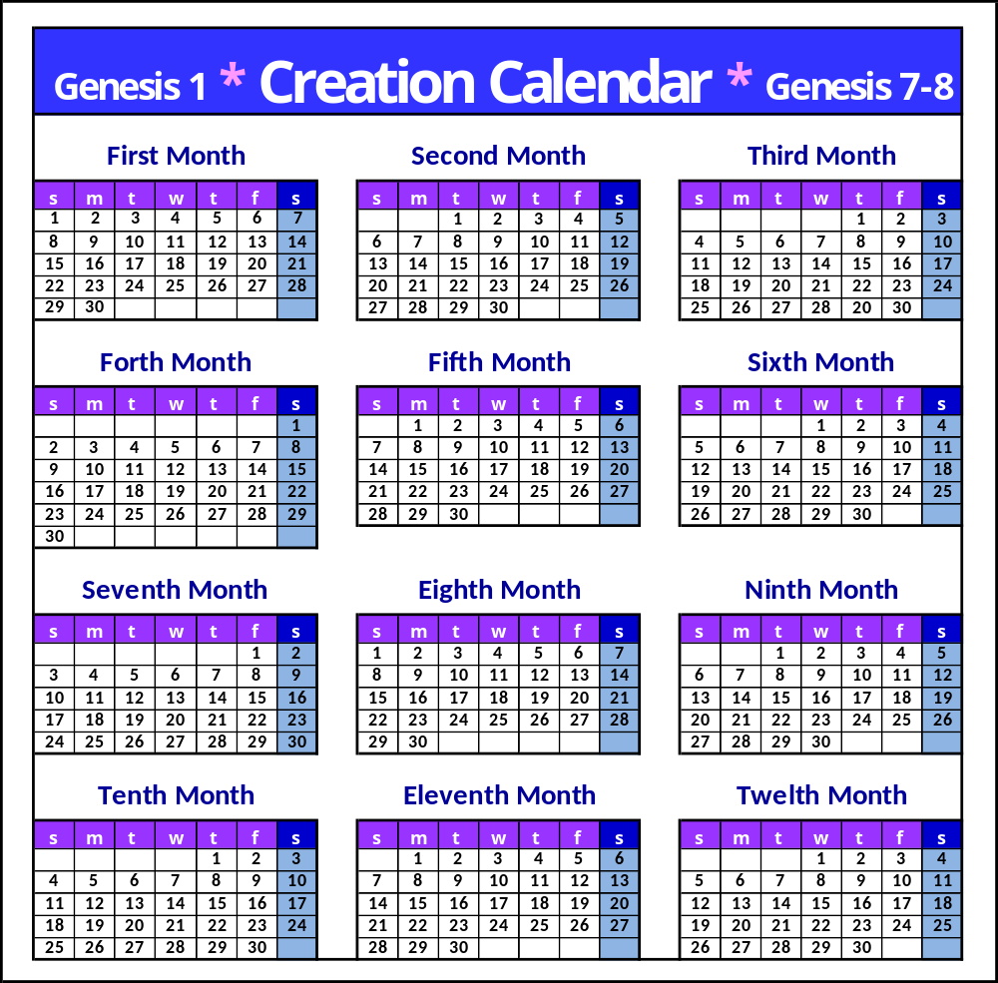
.
According to History and the Scriptures, our first calendar had a seven day weekly cycle, a 30 cycle month and a 360 cycle year.
Ask for more information if desired.

Slide 56
Covenant Calendar
The next slide will show the “Covenant Calendar.” Since most of the world functions on the Gregorian Calendar we have to consider it in the equation for calculating when Yahuah’s Feast days are to occur.
For the year 2017, Yahuah’s Calendar year begins on the 2nd cycle of the week – on March 20th. According to the Scriptures (Ex 34:22, 1 Sam 1:20, 2 Chron 24:23, Ps 19:6), the last cycle of Yahuah’s year comes on the Tequfah – which is also known as the Vernal Equinox. In 2017, the vernal equinox falls on March 19th, in north America, so that makes March 20 the first cycle on Yahuah’s Calendar year.

Slide 57
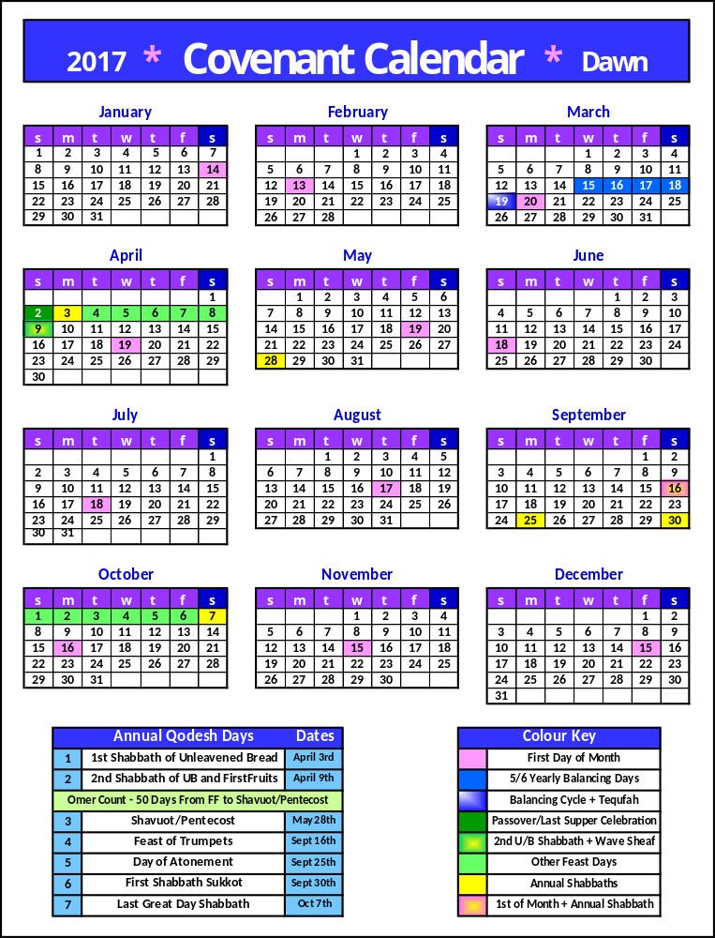
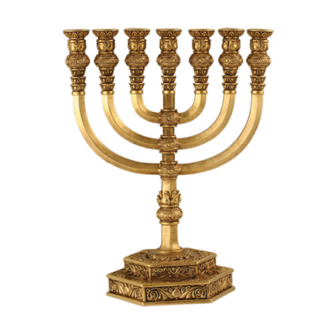
.
This Covenant Calendar shows the Feasts dates for 2017. They are superimposed over the Gregorian Calendar. You can see which dates (on the Gregorian Calendar) Yahuah’s Feasts fall upon.

Slide 58
Covenant Calendar
Many years after creation an incident occurred that caused an interference to take place within the 360 day yearly cycle; however, we do not have time, in this study, to address the subject.
For more info about when and what incident occurred that caused an interference to take place in Yahuah’s 360 cycle yearly pattern, please request the study entitled: “Yahuah’s Elegant Calendar.”
For more info on the Tequfah please request the power-point study entitled: “The Tequfah Unveiled.”

Slide 59

Hint
Extensive research on the Hebrew word –
Chodesh – has been done. This word has been translated by the scribes as – “new moon.” There is
in the Hebrew language, that can link the word – Chodesh – with the moon, in any of its many phases.
Yes Chodesh very definitely means – the renewing and/or the rebuilding and is correctly applied to the first cycle of the month, but it simply has zero connection to the moon.
Nothing — in any way, shape or form,

Slide 60


Yahuah’s appointed times (the physical time of the year) is a separate identity from the observation themes that rules how one is to observe an appointed time. They are separate identities, yet they go hand in hand.
Abib 14 is an appointed time, And…
the theme application for Abib 14 is Pesach (Passover).
Long before the Pesach “Feast” began in Mitsrayim (Egypt), the appointed time (Abib 14) was in effect.
Let’s look a little deeper into this concept. Does it really matter whose appointed times we choose to keep??
Note
Example

Slide 61
His Appointed Times
Yahuah has made it very clear – His Appointed Times are They must be proclaimed, performed and guarded according to His timing and calendar.
Lev 23:4 These are the appointed times of יהוה, set-apart gatherings which you are to proclaim at their appointed times.
Num 9:2 “Now, let the children of Yisra’ĕl perform the Passover at its appointed time.
Ex 23:15 “Guard the Festival of Unleavened Bread. Seven days you eat unleavened bread, as I commanded you, at the time appointed in the month of Aḇib….”
un-moveable.

Slide 62
Our Appointed Times
What are Yahuah’s thoughts about us making changes to His appointed times?
Hos 2:11 And I shall cause all her rejoicing, her festivals, her New [Months] Moons, and her Sabbaths, even all her appointed times, to cease,…
Isa 1:14 My being hates your New [Months] Moons and your appointed times, they are a trouble to Me, I am weary of bearing them.
Yahuah is weary because man has attempted to change His “appointed times” and He will cause them to
cease.

Slide 63
Observation Theme
We are not authorized to make any changes to Yahuah’s observation theme or appointed times; however, by His death Yahusha abolished the thematic rituals relating to the Sacrificial service that pointed forward to Calvary.
Yahusha also taught His followers how they were to celebrate the Passover after His death.
John 13:14 Then if I, Master and Teacher, have washed your feet, you also ought to wash one another’s feet.
1 Cor 11:26 For as often as you eat this bread and drink this cup, you proclaim the death of the Master until He comes.

Slide 64
Observation Theme
Interesting fact – the observation themes will also change after Yahusha’s 2nd advent. There will no longer be the need for us to use the appointed times to rehearse future events (as we know them to be).
~*~ ~*~ ~*~
Men may attempt to change, or abolish, appointed times and/or observation themes; however, Yahuah has set His appointed times “in stone” and they are still in place, no matter what – because Also,
Elohim is the only one with the authority to make changes within His observation themes. Are we willing to accept Man’s changes in Yahuah’s plain commands regarding His set-apart feasts?
they originated in Tzyon.

Slide 65
The “appointed times” are the dates upon which Yahuah gave us to have a “set-apart gathering.”
The “observation theme” is how we go about celebrating the “ceremonies,” or “thematic rituals,” that Yahuah has commanded us to observe during His “appointed times.”
A “set-apart gathering” is a Qodesh (Holy) Convocation.
Some of the “set-apart gatherings” are Sabbaths
Some of the “set-apart gatherings” are NOT Sabbaths
Even if man attempts to “change,” or “abolish,” Yahuah’s observation themes and appointed times they still exist – no matter what – because
Recap
they originated in Tzyon.

Slide 66
Review
Let’s do a General Review of our study thus far.
We looked at all Ten of Yahuah’s “set apart gatherings” — in Leviticus 23 — which are:
7th day Sabbath
Passover
1st Sabbath of UB
First-fruits
Last Sabbath of UB
Pentecost - Sabbath
Trumpet - Sabbath
Atonement - Sabbath
First Sabbath of FOT
Last Sabbath of FOT

Slide 67
Review
Yahuah claimed the Feasts days as being His “appointed times,” or “set apart gatherings,”
The Feast days were not given for the Jews only — they were given to last forever and were given to ALL of Yahuah’s
followers,
The Feast days were, and still are, a part of the Everlasting Covenant ratified by Mosheh at Sinai,

Slide 68
Review
We briefly looked at Yahuah’s method for calculating when His new year begins,
We briefly looked at the Scriptural method for calculating how to determine when the Feast days are to occur,
Yahuah’s appointed times and the observation themes are directly related, but separate identities,
The “appointed time” is the day – or date — the “observation theme” is the “thematic Ritual” that is to take place on the appointed date - Examples seen in Ex 13:10, Num 9:2,3.

Slide 69

We often hear it said:
The feasts were a part of the Ceremonial Laws and Ordinances and they were all “nailed to the cross.” OR
If you keep the feasts today, you are showing that you have not accepted as your Saviour. The feasts were a part of the “Ceremonial System” that was “nailed to the cross.”
Are these concepts Scriptural?
This will be addressed in Part 2
Yahusha

Slide 70
Coming up in – Part 2
We have come to the end of Part 1 of our study. In Part 2 we will answer the following questions:
  What was “nailed to the tree” - the Ordinances, Oblations, Offerings, Sacrifices, Ceremonial Law, Mosaic Law or all of the above?
  How many feasts were “fulfilled” at the cross?
  Is it safe to use Yahusha as our example?
  Is Yahusha’s Sign and Everlasting Covenant only attached to the 7th Day Sabbath?
  For how many Generations was Yahuah’s Sign and Everlasting Covenant to remain valid? ☺

Slide 71
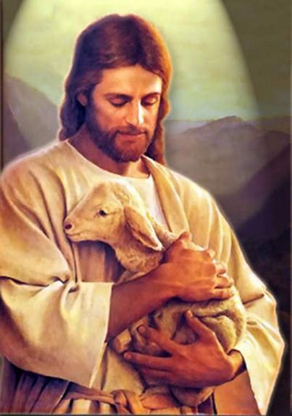
The End
The following studies are available to help clarify some of the points that were briefly addressed in this presentation:
Intro Exo 12 Passover to Exo 20 Pentecost
https://studythecalendar.com/intro-exodus-12-passover-to-exodus-20-pentecost/
Exo 12 Unleavened Bread Consumption Schedule
https://studythecalendar.com/exodus-12-unleavened
-bread-consumption-schedule/
Joshua’s Sickle/Wave Sheaf
(which also debunks other 364 day calendars):
Part 1 (2.14), Part 2 (2.15) and Part 3 (2.19)
https://studythecalendar.com/series-2-stepping-stones/
Contact: questions@studythecalendar.com

