Slide 1
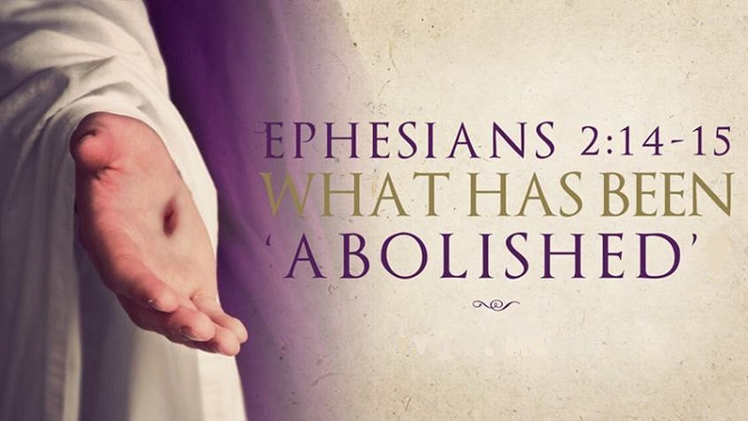

in the Flesh of Yahusha?
Notes:
Walter told me to choose the subtitle. July 28/21

Slide 2
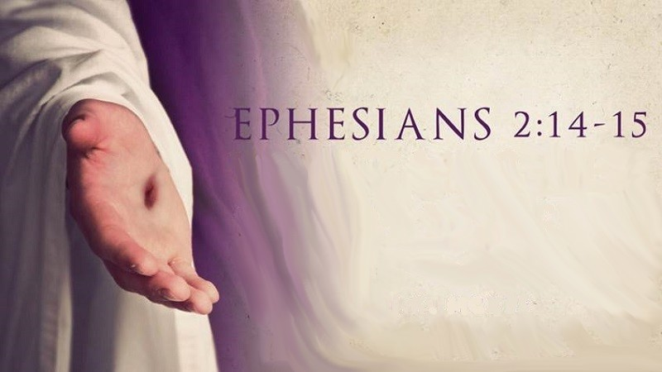
When reading
what is the
middle wall of
partition that has
been abolished?

Slide 3

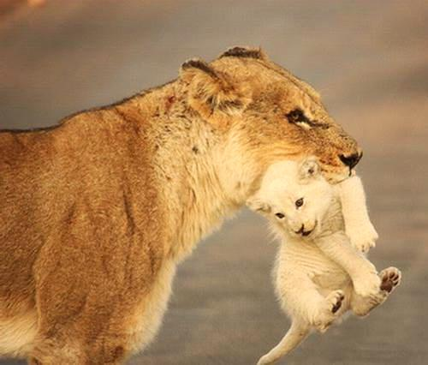

A teaching from:
Addressing Yahuah’s Feasts in Ephesians 2

Slide 4

Today we want to consider Ephesians 2:14-16, because this is a text which is often being used by those who hold that Yahusha abolished the Torah
by His death at calvary!
Really?

Slide 5

Through my studies a few years ago I learned that God and LORD are fake titles put into our Bibles to replace the Real Names of our Heavenly Father and His Beloved Son. The True Names have been removed over 7000 times from Scripture and replaced by God, LORD and/or Jesus of which two are not names but titles like Mr. or Mrs.
Isn’t it amazing if you ask a Muslim whom he worships he will say “Allah” which is the name of his god and if you ask a Buddhist the name of his god he will say “Buddha” which is his name. Yet we as professed believers in our Creator do not even know the name of who we worship!

Slide 6
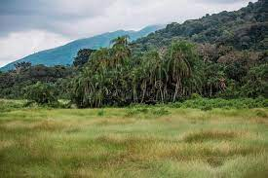
Therefore, I use the four Hebrew letters yod, hey, vav, hey
(in English YHVH), and I pronounce it as Yahuwah instead
of LORD, which is a title - not a name. I also use Yahusha instead of Jesus, which is not a translation but a transliteration from a Greek mistransliteration.
The name Jesus has no meaning, in Hebrew nor in English!
YHVH and Yahusha are the actual original Hebrew names that speak of our Savior’s true nature and character.
Since the Father has a Hebrew name,
the Son cannot have a Greek name, because the Son
came in the name of His Father (John 5:43)!

Slide 7
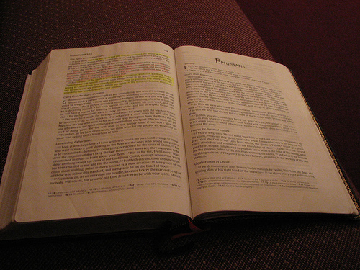
Let’s read Ephesians 2:14-16 (KJV): “For he is our peace, who hath made both one, and hath broken down the middle wall of partition between us; 15. Having abolished in his flesh the enmity,
even the law of commandments contained in ordinances;
for to make in himself of twain one new man,
so making peace; 16. And that he might reconcile both unto
Elohim in one body by the cross, having slain the enmity thereby.”

Slide 8
What is this
middle wall
of partition?
At face value, this verse sounds very confusing.
What does Paul say?

Slide 9
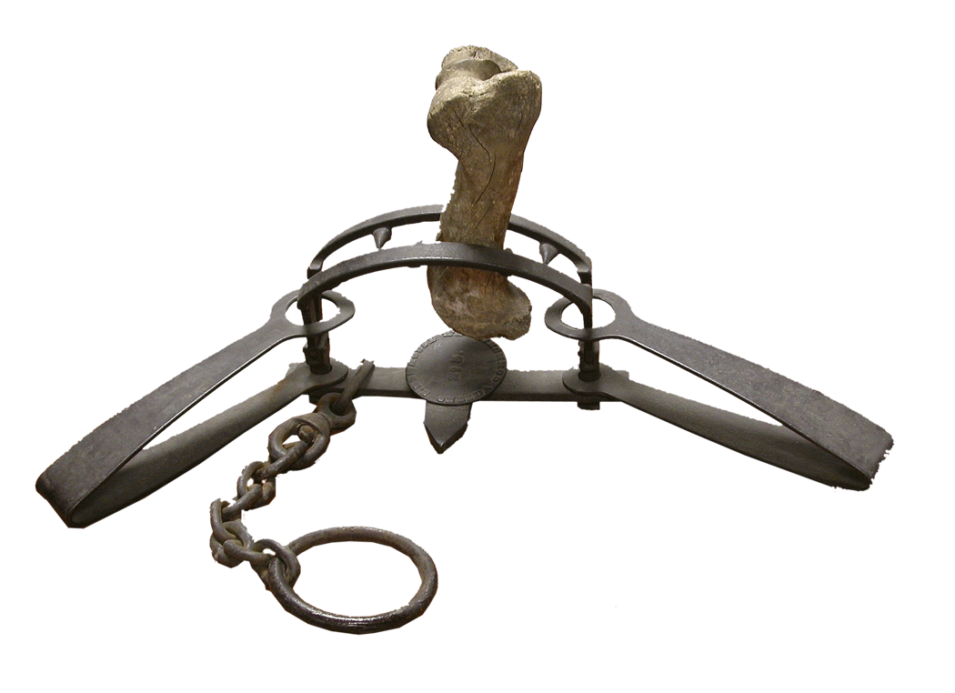
Millions of people have been, and are still being, deceived! Ministers and laymen alike have focused on this Scripture and have fallen into a trap, which Peter warned about. They have twisted it to say what it does NOT say and are bringing destruction upon themselves unknowingly!

Slide 10
Is that a serious statement “to bring yourself unknowingly to destruction?”
Much of the information in this presentation is taken from a
website called <torahresource.com>.

Slide 11
Peter spoke of our beloved brother, Paul, and says: “As in all his epistles, speaking in them of these things; in which are some things hard to be understood, which they that are unlearned and unstable twist, as they do also the other scriptures,
unto their own destruction.”
2 Peter 3:16 (KJV)
Notes:
………………………

Slide 12
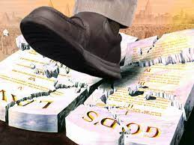
As mentioned, “Ephesians 2:14-15” is an often-used text by those who hold that YAHUSHA abolished the Torah by His death.
In other words: abolishing the commandments!
And people
believe this!

Slide 13
Let’s make one point very clear. The verses in Ephesians 2:14-15 as well as Colossians 2:14 cannot be referring to the sacrificial laws or any other divine laws. Not one of these laws were ever “against us” nor did they create “enmity.”
All laws were for the good of the people.
The only one that would be talking negative
about any of YHVH’s laws has to be Satan.

Slide 14
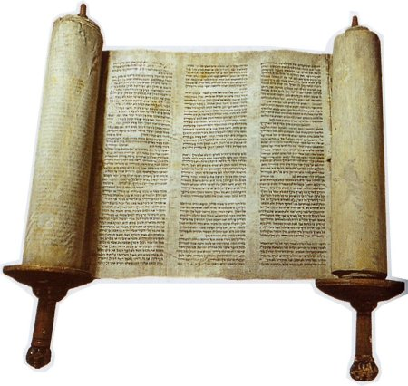
When Yahusha spoke of “law” He meant all of Elohim’s Word. He said “Thy Word is Truth” (John 17:17 - KJV).
All of YHVH’s Word is the truth just as His “law – Torah” according to Psalm 119:142. David understood it, yet why don’t people who profess to know Yahusha, understand it?

Slide 15

We know the familiar verses in Matthew 5:17-18 where Yahusha said, “Think not that I am come to destroy the Torah, or the prophets: I am not come to destroy, but to fulfill. For verily
I say to you, till heaven and earth pass, one jot or one tittle shall
in no wise pass from the Torah, till all be fulfilled.”

Slide 16

When one reads the 2nd Chapter of Ephesians, it can be seen that the central theme of Paul is the
oneness of Jew and Gentile as united in Messiah.
That the Gentiles should be blessed within the scope of the Abrahamic promise was never questioned.
What had been left a mystery was the manner
in which the blessing would come upon the nations!

Slide 17
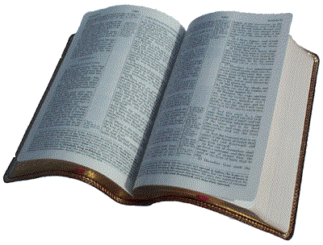
18. For through him we both have access by one Spirit unto the Father. 19. Now therefore ye are no more strangers and foreigners,
Ephesians 2:18-20
But fellow citizens with the saints and of the household of Elohim. 20. And are built upon the foundation of the apostles and prophets, Y’shua Ha Mashiach himself being the chief corner stone; In whom all the building fitly framed together groweth unto an holy temple in Yahweh. In whom ye also are builded together for an habitation of Elohim through the Spirit.

Slide 18

The method of blessing the Gentiles is emphasized by the words like fellow-citizen, fellow-heirs, fellow-members, fellow-partakers. The Gentiles would be blessed not in a separate community, a separate entity but by being
grafted into the ancient community of YHVH.
Both Jews and Gentiles would be wedded into one
and thus mutually share the blessings of Elohim.

Slide 19
Gentile believers were to be accepted as full citizens within the believing community without undergoing
the ritual of a proselyte.

Slide 20

This issue brought division within the early emerging Believers. Some felt that a non-Jew had fewer privileges within the community than a Jew;
some considered full ﬂedged salvation impossible apart from becoming a proselyte,
and still others refused to fellowship
in fullness with the non-Jews of The Way.

Slide 21
Each of these perspectives was for Paul
a “different gospel,” since union with Messiah
was the sole basis of entrance and privilege
within the family of Elohim. This union was a matter of grace, not of the works of the Torah.
All members had the same position before the Father, because all members were in Messiah.

Slide 22
Any activity that taught something different than this was to be cursed. We could assume that each party was sincere in their stand but grossly influenced by their past upbringing and teachings.

Slide 23
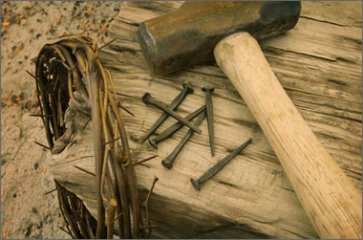
The text in Ephesians centers upon this uniﬁcation of Jew and Gentile in Messiah but does so from the perspective of the cross. It is the sacriﬁcial death of Messiah that has established the means of unity, for it was by His death that the enmity between Jew and Gentile was destroyed.

Slide 24
For Paul the sacrifice of Yahusha not only made atonement for sin, but it also established the basis for blessing the Gentiles by removing all the obstacles to unity with the chosen people.
Both Jew and Gentile, apart from union with Messiah, are excluded from
the blessing of YAH.

Slide 25

Placement in the kingdom is a matter of Yahuwah’s grace and leaves no room for anyone to boast, not even the Jew.

Slide 26
Biblical Grace is not only unmerited favor, or mercy, or forgiveness, but a change in the human condition,
because of a change in the human heart by YHVH!
Many bible translations and bible scholars
explain grace as simply unmerited favor.
However, according to Strong's Exhaustive Concordance,
the main connotation is, "that grace is that divine influence upon the heart, and its reflection in that life."
In 21st century language this means,
YHVH touches your heart and changes you.
When that change is reflected in your life, that's Grace!!

Slide 27
Grace is not divine permission to sin and do as we want, thinking it's all covered by grace anyway.
If you are going to sin, knowing that you shouldn’t,
you do not need grace, you need mercy, and forgiveness.
Grace is, in fact, a divine power that allows us to think
as YHVH thinks. It changes our heart; and it heals our hate, anger, hurt, fear, and betrayal.
Grace is the power of Elohim that gives us the desire to live right, and the ability to do so. It gives us the desire and the ability to please YHVH; and point people to Him.

Slide 28

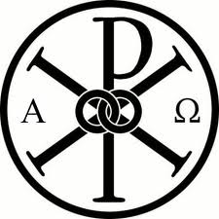
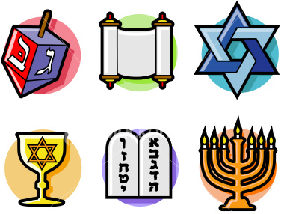

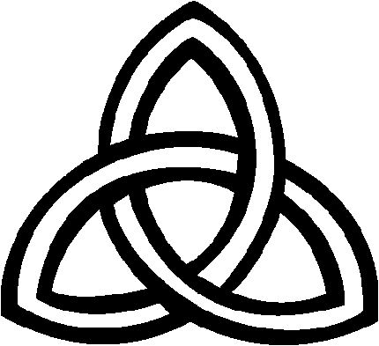
The external labels given by the established, religious churches or denominations are of
no real consequence, for YHVH is more
interested in the heart than in one's pedigree.

Slide 29
YHVH accepts into His family those whose sins have been forgiven by the death of the Messiah.
The Gentiles have been “brought near” because
the dividing wall that prohibited them from coming near has been broken down through the cross.
If Elohim the Father has accepted all who
come by faith in Yahusha, then clearly
the children ought also to accept each other.

Slide 30
Let’s look at some other Bible translations of Ephesians 2:14-15:
“For He Himself is our peace, who made both groups into one, and broke down the barrier of the dividing wall,
by abolishing in His ﬂesh the enmity, which is the Law of commandments contained in ordinances, that in Himself He might make the two into one new man, thus establishing peace.” NASB

Slide 31
“For He himself is our peace, who has made the two one and has destroyed the barrier, the dividing wall of hostility, by abolishing
in his ﬂesh the law with
its commandments and regulations. His purpose was to create in himself one new man out of the two, thus making peace.”
Ephesians 2:14-15 (NIV)

Slide 32
“For he is our peace; in his ﬂesh he has made both groups into one and has broken down the dividing wall,
that is, the hostility between us.
He has abolished the law with
its commandments and ordinances, that he might create in himself
one new humanity in place of the two, thus making peace.”
Ephesians 2:14-15 (NRSV)

Slide 33
“For he is himself our peace.
Gentiles and Jews, he has made the two one, and in his own body of ﬂesh and blood has broken down the barrier of enmity which separated them;
for he annulled the law with its rules and regulations, so as to create out of the two a single new humanity in himself, thereby making peace.”
Ephesians 2:14-15 (RSV)

Slide 34
“For he himself is our shalom — he has made us both one and has broken down the m’chitzah which divided us by destroying in his own body the enmity occasioned by the Torah,
with its commands set forth in
the form of ordinances.
He did this in order to create in union with himself from the two groups a single new humanity and thus make shalom.” Ephesians 2:14-15 [Jewish New Testament]

Slide 35

Taken at face value, some feel these translations present the text as a pointed assertion by the apostle Paul that Messiah abolished the Mosaic Torah by His sacriﬁcial death,
and that the Torah was the instrument of hostility that erected a dividing wall between Jew and Gentile.
Is that true?

Slide 36
Just reading these verses in Eph 2:14-15, you could come to the conclusion
(as most Christian Churches come to)
that the Messiah abolished,
and did away with the Law,
(or the everlasting Torah) at His death. However, the difficulty with such an interpretation is twofold:

Slide 37
First, it contradicts the clear teaching of Yahusha Himself that He did not abolish the written Torah (see Matthew 5:17-18)
and
Secondly, the written Torah never demanded a wall
between Jew and Gentile!

Slide 38
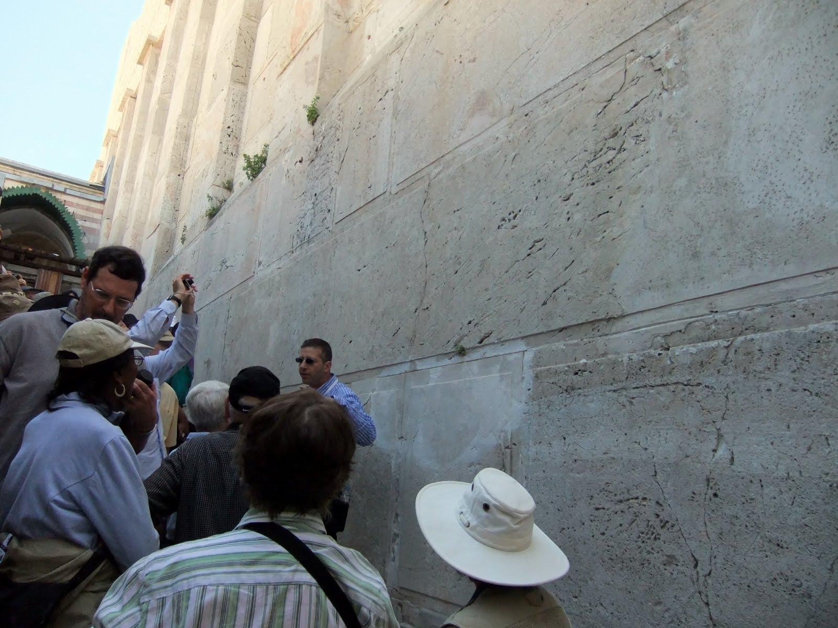
The dividing wall between Jews and Gentiles was 100% man-made!

Slide 39
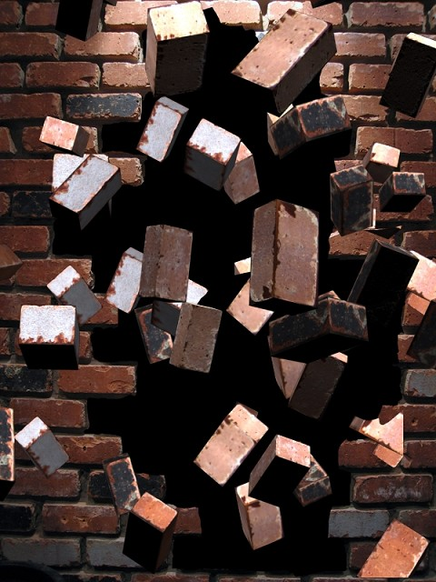
Ephesians 2:14 is making the plain statement that Yahusha didn’t create the wall but he “broke down” the dividing wall. The Greek term translated “broke down”
can mean “to loose,” “untie,” “set free,” “break up,” “destroy,” “bring to an end,” “abolish,” or “do away with.”
Notice, the LAST definition is “do away with.”
Contextually, the abolishing action is viewed as final = as a death. Thus, the barrier, whatever that barrier was, is done away with forever.

Slide 40
Then we have the word “Katargew” (katargeo), translated as “abolished” describing what Yahusha did to the “enmity” between Jew and Gentile. It usually means “to render void,” “make ineffective,” “powerless,” “abolish,” “wipe out,” or “set aside,”
and is used in the context of:
rendering laws or edicts of no more effect.
That is in verse 15 (Having abolished in his flesh the enmity, even the law of commandments, contained in ordinances) for to make in himself of twain one new man, so making peace.

Slide 41
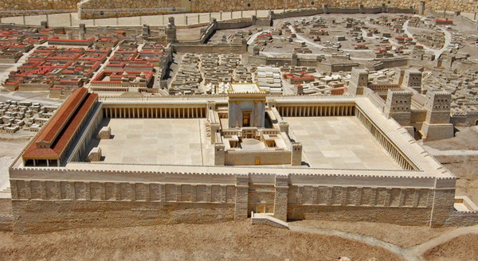
The object of the verb “to destroy” is
“the dividing wall of the barrier”
or the “middle wall of partition!”
But what is that dividing wall?

Slide 42
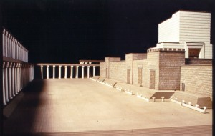
The Jews had actually a physical wall constructed even in the court of the temple to physically separate out the Gentiles.
Yet, spiritually, both were cut off from YHVH because both were sinners.
“All have sinned…” we read in Romans 3:23.
42

Slide 43
The Soreg is the small wall right before the stairs to go up to the Temple.
It was meant to keep Gentiles (non-Jews) away from this most holy place.
43

Slide 44
The Soreg was a five foot wall on the Temple Mount that kept the Gentiles away from approaching the Temple itself. The Temple area was considered holy and clean. Gentiles, on the other hand, were considered unrighteous and defiled. Thus, Jews could approach the Temple, Gentiles could not. In A.D. 1871, archeologists discovered the “Soreg Inscription.” The inscription was written in Greek with this chilling warning:
No Gentile may enter within the railing around the Sanctuary and within the enclosure.
Whosoever should be caught will render himself
liable to the death penalty which will inevitably flow.

Slide 45
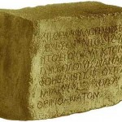
Here is a stone block from the original Soreg
(the Middle Wall) - The Temple Warning to Gentiles!

Slide 46
However, the wall spoken of by Paul in Eph. 2:14 could not be the physical dividing wall
made out of stone in the 2nd Temple
as some commentators have assumed. Why? Because: (a) it was still standing at the time Paul wrote Ephesians, and (b) the terminology Paul uses to describe the wall is different than the terms regularly used for that dividing wall in the Temple. <torahresource.com>

Slide 47
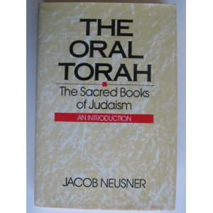
Secondly, the Greek term “fragmo" (fragmos) was used in the 1st Century to identify the Oral Torah
as a “wall” or “fence” around
the written Torah, and
the Pharisees as “builders of the wall.”
So who was the builder of the dividing wall?
It was the Pharisees!

Slide 48
Thirdly, aspects of the Oral Torah,
(not the Written Torah), laid the foundation for
a strict separation between Jew and non-Jew.
What we are simply saying is that the dividing wall that was abolished by Messiah was none other than those
Rabbinic laws which had enforced a separation between Jew and Gentile in opposition to the Written Torah.
In fact, the Tanakh gives very clear instructions against erecting barriers to separate Israel from the other nations.

Slide 49
Thirdly, aspects of the Oral Torah,
(not the Written Torah), laid the foundation for
a strict separation between Jew and non-Jew.
The foreigner who desired to worship the Elohim of Abraham, Isaac, and Israel was
to be welcomed into the community
and treated with the same respect
as was given the native born.
What we are simply saying is that the dividing wall that was abolished by Messiah was none other than those
Rabbinic laws which had enforced a separation between Jew and Gentile in opposition to the Written Torah.
In fact, the Tanakh gives very clear instructions against erecting barriers to separate Israel from the other nations.

Slide 50
Here are a few texts that support this:
“Thou shalt neither vex a stranger, oppress him;
for ye were strangers in the land of Egypt.” Exo 22:21 (KJV)
“Thou shalt not oppress a stranger: for ye know
the heart of a stranger, seeing ye were strangers
in the land of Egypt!” Exo 23:9 (KJV)
“The stranger that dwelleth with you shall be unto you as one born among you, and thou shalt love him as thyself; for ye were strangers in the land of Egypt: I am YHVH your Elohim.” Lev 19:34 (KJV)

Slide 51
“And if thy brother be waxen poor, and fallen in decay with thee; then thou shalt relieve him:
yea, though he be a stranger, or a sojourner;
that he may live with thee.” Lev 25:35 (KJV)
“When thou hast made an end of tithing all the tithes of thine increase the third year, which is the year of tithing, and hast given it unto the Levite, the stranger, the fatherless, and the widow, that they may eat within thy gates, and be filled.” Deut 26:12 (KJV)

Slide 52
The strangers were to be given full participation in matters of Torah and Torah-life. Like Sabbath keeping in Exodus 33:12:
“Six days shalt thou do thy work, and on the seventh day thou shalt rest: that thine ox and
thine ass may rest, and the son of thy handmaid, and the stranger, may be refreshed.” KJV
Then we have Leviticus 19:10 when gleaning the land: “And thou shalt not glean thy vineyard, neither shalt thou gather every grape of thy vineyard; thou shalt leave them for the poor
and stranger: I am the YHVH your Elohim.” KJV

Slide 53
The same applied to justice in Exodus 12:49:
“One law shall be to him that is home born, and
unto the stranger that sojourneth among you.” KJV
The same principle applied to the festivals,
worship and prayer times in the temple.
“Thus saith YHVH: Execute ye judgment and righteousness and deliver the spoiled out of the hand of the oppressor: and do no wrong, do no violence to the stranger, the fatherless, nor the widow, neither shed innocent blood in this place.” Jer 22:3 KJV

Slide 54
The prophets pronounced judgment upon any who would neglect the divinely-given responsibilities to the “stranger,” on the same grounds as neglect of orphans and widows. ……………..
This is what the Written Torah – or –
the law of Moses – has to say!

Slide 55
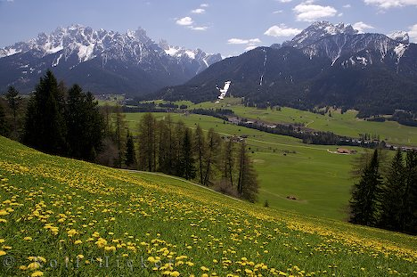
The promise that Gentiles could have access to know, love and treasure YHVH was spoken of in the Old Testament.
YHVH speaking through the prophet Hosea said,
“I will call those who were not my people, ‘my people,’
and her who was not beloved, ‘beloved.’ And it shall be that
in the place where it was said to them, ‘you are not my people,’ there they shall be called sons of the living Elohim.”
Rom 9:25-26 (New American Standard Bible)

Slide 56
The claim that Gentiles could have access to know,
love and treasure YHVH was fulfilled through Yahusha!
John 10:16 “I have other sheep, which are not of this fold; I must bring them also, and they will hear My voice; and they will become one flock with one shepherd…
I am the good Shepherd.” (KJV)
“He made known the riches of His glory upon vessels of mercy, which He prepared beforehand for glory, even us, whom He called, not from Jews only, but also from among Gentiles.”
Rom 9:23-24 (KJV)

Slide 57
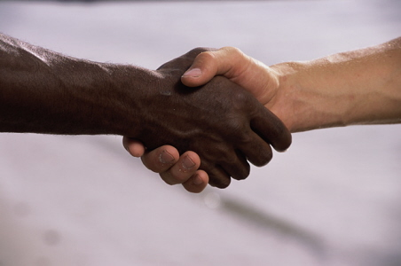
The reminder that Gentiles could have access to know, love and treasure YHVH was also re-emphasized through the Apostles.
Or, to put it as succinctly as Paul did:
“There is neither Jew nor Greek…; for you are all one in Messiah.”
Galatians 3:28 (KJV)

Slide 58
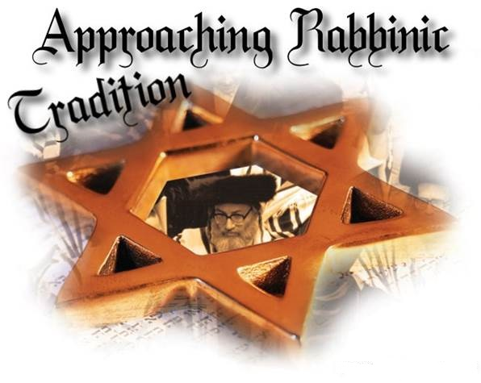
The practical outworking of the Rabbinic laws of purity,
raised a strong wall of separation between the observant Jew and the
non-Jew even if this was
not the original intent.
With the emphasis put upon purity by the Rabbis, separation from those things that rendered a person unclean was inevitable.

Slide 59
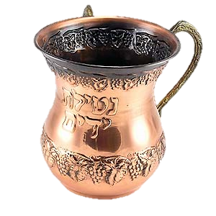
When Gentiles were added to the “list” of those things
that communicate uncleanness,
the wall was built
between Jew and Gentile.
According to Oral Torah,
mere contact with non-Jews
could render a person unclean,
as well as contact with the
residence of a non-Jew or even
with land outside the Land of Israel.
These were
man-made laws.

Slide 60
Contact with any object used for idolatrous worship was added to the list of what might render a person unclean.
Clearly, the oral Torah of the 1st Century functioned
to separate Jew and Gentile
in a dramatic way.

Slide 61

“The law of commandments contained in ordinances.” Ephesians 2:15
The text in Ephesians helps to deﬁne the
dividing wall with the appositional phrase
“the law of commandments contained in ordinances.”
The question is, “did Paul use this phrase
to denote those Rabbinic laws which had,
in fact, separated Jew and non-Jew?”

Slide 62
The ﬁrst thing to note is that the term “dogma” is never used in the Septuagint for any of the commandments, judgments, statutes, or laws of which, according to Genesis 26:5, the total Written Torah consists. In the Septuagint (LXX) “dogma” normally designates
the edicts of a king or court.
LXX = Septuagint – The oldest Greek Version of the Jewish Bible

Slide 63
The word “ordinance” in Ephesians 2:14-15 as well as in Colossians 2:14 is also translated from the Greek word “dogma” #G1378 from the base of #G1380
a law (civil, ceremonial or ecclesiastical - decree, ordinance) (Strong’s Concordance).
The noun ‘dogma’ is found ﬁve times
in the Apostolic Writings.
In Luke 2:1 and Acts 17:7 it is used of Caesar's decrees.
However, in Acts 16:4 it refers to the Apostolic decree
formulated at the Jerusalem council.

Slide 64
Therefore, this phrase according to the Greek (twn patriwn dogmatwn - ton patrion dogmaton) “the law of commandments contained
in ordinances” is best understood
not to refer to the Mosaic Torah
but to the “traditions of the fathers,”
the Halakah of the community.

Slide 65
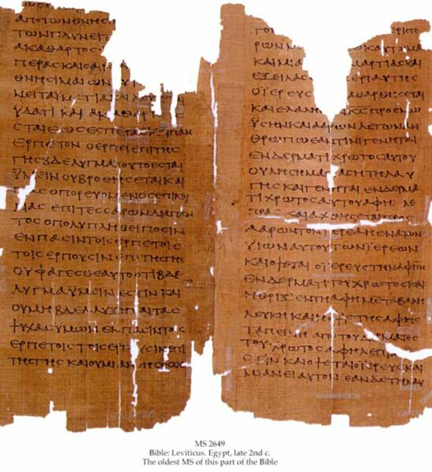
These man-made ordinances (#G1378) called ‘dogma’ prevented the salvation from extending past the Jews thus creating enmity. This is what was truly
“contrary” and “against” the Gentiles,
preventing them from being brothers in Messiah.
So the study of the word ‘dogma’ in the LXX (the Septuagint) and Apostolic Writings conﬁrms that the term was used of
man-made laws, and not of the
YHVH-given Torah of Sinai.

Slide 66

We may therefore conclude that
Paul adds it to his description
in order to identify
the abolished law as the legal fence
of the Rabbis,
particularly the parts of the Oral Torah that separated Jew and Gentile.
The result? They were at odds with
the Written Torah that prophesied
the unity of Jew and Gentile
all within the promise of blessing
given to Abraham.

Slide 67

This does not mean that Yahusha abolished the entire Oral Torah in His death on the tree. In fact, there are many instances recorded in the life of Yahusha where He gives clear allegiance to Oral Torah.

Slide 68
We have some examples of this in Matt. 9:14-15. The argument of Yahusha, in which He defends the way His disciples fast, is based upon a recognized Halakah that it is improper to fast
in the presence of a bridegroom.
This is not found in the Written Torah.

Slide 69
Matt 12:5 - Yahusha states that the priests profane the Sabbath but are innocent.
This teaching is not found in the Written Torah,
but in the Oral Torah. Halakah means Jewish Law:
2. Halakah originates from the Aramaic word, "hilkheta" (direction of the action) and the
Hebrew word "holech" (from the verb "to walk").
3. We combine the meanings. Hilkheta and Holech give us "Halakah" which means "This is the way to go."

Slide 70
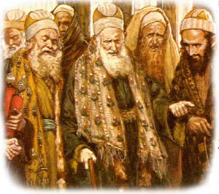
In Matt 15:1 the Pharisees are inquiring about the disciples of Yahusha: why do they transgress the traditions of the elders by not washing their hands according to Halakah before eating? Yahusha rebukes them, citing also their use of korban to ‘hide’ their wealth from
aging parents who needed their support.
In both cases, it is clear that the Pharisees consider
the Halakah, based on Oral Torah, as binding.

Slide 71
Another example is in Matt 22:40 where
Yahusha quotes the Shema and Lev 19:18,
stating that upon these two precepts
hang the Law and Prophets.
The terminology of the Law and Prophets hanging from something is derived from Oral Torah. Yahusha knew both the
“Written” and the “Oral” Torah.

Slide 72
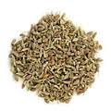
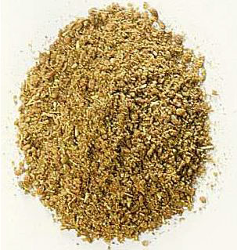
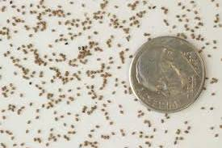
The matter of tithing very small amounts of produce from volunteer seedlings
is not taken up in the Written Torah
but is part of the Oral Torah (Matt 23:23).
anise
cummin
mint

Slide 73
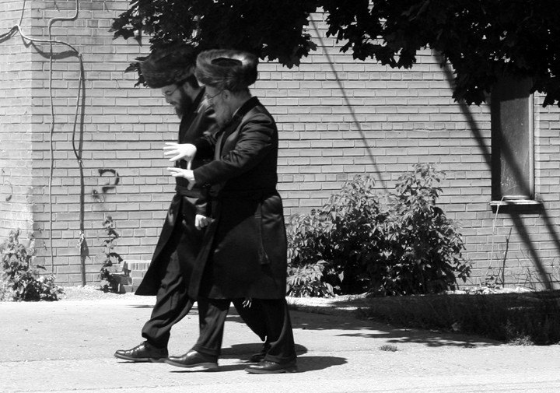
The whole issue of travel on the Sabbath is deﬁned in Oral Torah,
not Written Torah.
There are no speciﬁc prohibitions in the Written Torah restricting travel
on the Sabbath.
Man-made rules!

Slide 74
The Written Torah does not deﬁne
the dimensions of one's “place.”
It was the Oral Torah that developed,
for instance,
a “Sabbath-day's journey.”
Matt 24:20

Slide 75
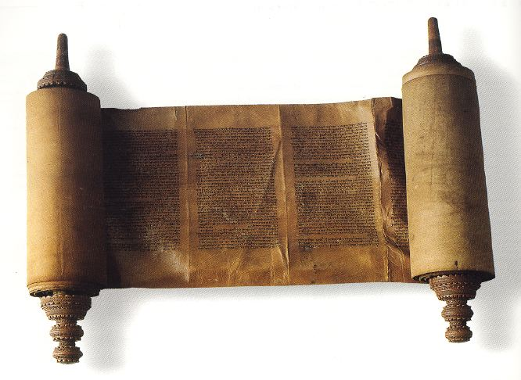
The Written Torah declares that a person is unclean from a corpse
if he touches it or is in
the same room with it.
(See Num 19:11-15.)
Did the Pharisees corrupt this too?

Slide 76
The Pharisees extended the communication of impurity
to any object overshadowed by a corpse (or part of a corpse)
or any object whose shadow contacts a corpse or tomb.
The Oral Torah further elaborates the means by which impurity is transmitted from a corpse to an object.
It appears that Yahusha accepted at least some of this
Oral Torah as grounds for His illustration of the Pharisees,
as concealed tombs in Luke 11:44,
that rendered those who overshadowed them as unclean.

Slide 77
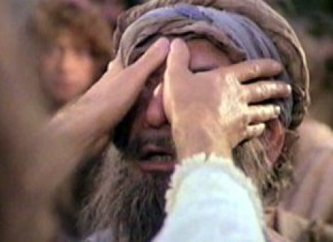
The issue of healing on the Sabbath is part of the Oral Torah, to which Yahusha no doubt refers as He asked the question in Luke 6:9
“I will ask you one thing; Is it lawful on
the Sabbath day
to do good, or to do evil, to save life or
to destroy it?”
KJV
77

Slide 78
We probably could recite many more like
Matt 26:20 - reclining when eating at the Passover meal, which is not prescribed in the Written Torah.
What law was violated in Acts 23:3
when Paul was struck on the mouth?
The idea that a person was innocent until proven guilty is a function of Oral Torah, not Written Torah.

Slide 79

Pharisees = Laws of the Jews
Sadducees = Against the Temple
And Rome = Against Caesar
The threefold designation in Acts 25:8, “law of the Jews, or against the Temple or against Caesar” (KJV) seems to deﬁne the three most powerful arms of law!

Slide 80

The only logical conclusion in regard to the Oral Torah, is that Yahusha abolished
those Rabbinic laws
which, when practiced,
actually set aside
the Written Torah of Elohim
by separating the Jew and Gentile, which YHVH intended
to make one in Messiah.

Slide 81
This was the “dividing wall, or the (Rabbinic) law contained in the ordinances (of the Oral Torah).” But, those parts of the Oral Torah that affirm
the Written Torah, or are in harmony with it,
remain viable for the Messianic believer
as the traditions of the father.

Slide 82
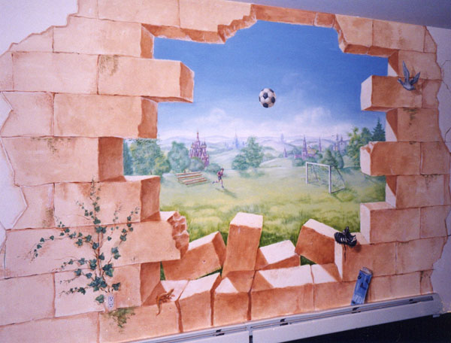
Praise Yahusha, for breaking down the
“middle wall of partition” between Jews and Gentiles, both physically and spiritually
at great cost to Himself, and
securing salvation for everyone that believes.

Slide 83
“There is neither Jew nor Greek, there is neither slave nor free man, there is neither male nor female;
for you are all one
in Yahusha Ha Mashiach.”
Galatians 3:28 (KJV)
l

Slide 84

Summary!

Slide 85

The middle wall of partition (the dividing wall)!
1) What is it? 2) Who made it?
3) How was it broken down?

Slide 86
The middle wall of division was the added “man made ordinances” from part of the Oral Torah. This prevented the salvation from extending past the Jews creating enmity.
This is what was “contrary”
and “against” the Gentiles, preventing them from being brothers in Messiah.

Slide 87
Paul called these man-made laws
“the law of commandments
contained in ordinances!”
The verses in Eph 2:14-15 cannot be referring to
the sacrificial laws or any other divine laws.
None of those laws were ever “against us”
nor did they create “enmity” but were
for the good of the people.
It was these “other man-made laws”
that were added and inspired by Satan.

Slide 88
Our Messiah broke down that middle wall of partition between Jew and Gentile by spilling His blood on Calvary. He broke down the wall separating anyone from YHVH.

Slide 89
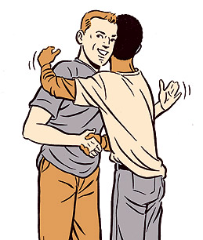
Jew and Gentile are both now
one new creation because of what our Messiah did.

Slide 90

Let’s remember Galatians chapter 3:26-29 “For you are all the children of Elohim by faith in Yahusha the Mashiyach.
For those who have been immersed in Mashiyach have
been clothed with Mashiyach.”
Aramaic English
New Testament

Slide 91
For there is neither Jew nor Aramean, nor slave nor free, nor male nor female, but you are all one in Yahusha the Mashiyach. And if you are of the Mashiyach then you are seeds of Awraham und inheritors by the promises.”
Aramaic English
New Testament
Notes:
Galatians 3:26-29

Slide 92

The central theme of Paul
in Ephesians 2:14-16
is the oneness of Jew and Gentile as united in Messiah by tearing down the
man-made wall of partition.

Slide 93
Paul is not saying that the Messiah was doing away with any law, ceremonial or moral.
He is talking about man-made laws!
That makes sense!

Slide 94

The End
Thank you &
SHALOM!
94

Slide 95


Supreme Provider YAHUSHA Ha Mashiach
Produced and Narrated
by Walter Tschoepe
Malachi4.4@reagan.com

