Slide 1
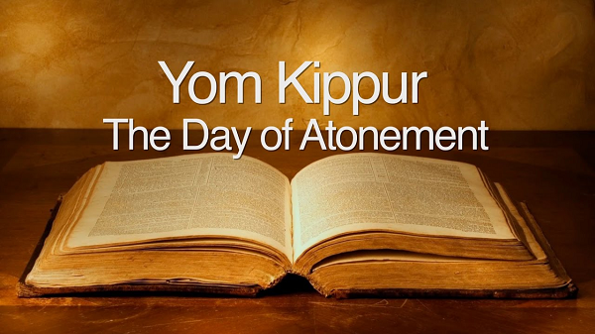


Slide 2

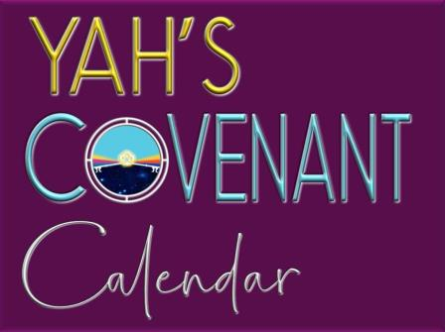
A Teaching Sponsored
From:

Slide 3
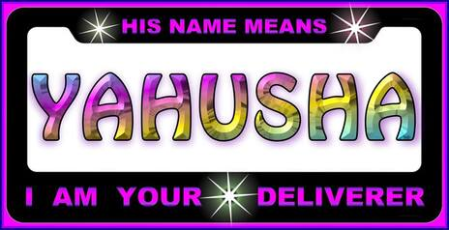
The Day of Atonement points directly to the Messiah, Yahusha, and His death on the tree to atone for the confessed and repented sins of His people. Yahuwah instituted it in Leviticus 16:1–34.

Slide 4
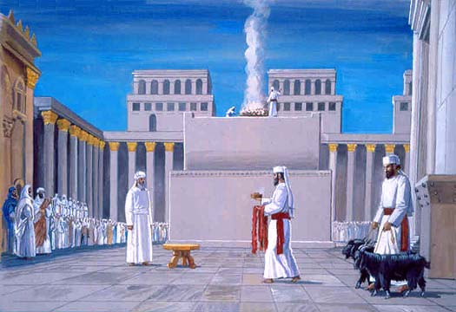
In Israel, one day each year the High Priest would draw aside the Veil and enter the Holy of Holies to make atonement (Heb. Kafar) and cover the nations sins from the judgment of YHVH and receive forgiveness. It took place on the 10th day of the 7th month, Tishri.
By our calendar that would
be around the end of September or early October.
Yom Kippur
(Day of Atonement)

Slide 5
This day revealed more clearly than any other the work of the High Priest as mediator between Elohim and man. On this day, as the official representative of the people, he alone had access to the presence of YHVH and the people shared this access in him.
Yom Kippur
(Day of Atonement)

Slide 6
By returning alive from the holy of holies the people knew that their covenant-keeping Elohim had once more extended his mercy to them. But this could not happen without repentance and the confession of sin and, of course, the blood of a substitute!
Yom Kippur
(Day of Atonement)

Slide 7

Yom Kippur, the Day of Atonement is the most important holiday of the Biblical year. Yom Kippur is a complete Sabbath.
On this day no work is permitted, but on the other holy days “no servile work.” Exodus 12:16 tells what servile work means.
“Except that which every man must eat, that only may be done of you.” It is well-known that you are supposed to refrain from eating and drinking (even water) on Yom Kippur. It is a complete, 24-hour fast beginning before sunset on the evening before Yom Kippur and ending after nightfall on the day of Yom Kippur.
7

Slide 8

What does the word
“Atonement” mean?
8
Notes:
Do we remember?

Slide 9
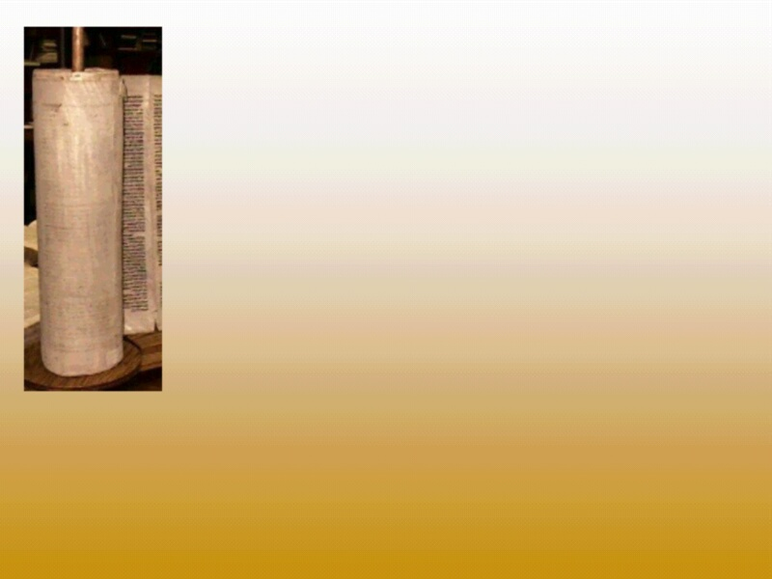
Webster’s Dictionary says:
“To join in one, to form by uniting.”
This day symbolizes Yahuwah and man being set at one, literally. Yahuwah and the created human race can never be fully at one, in full agreement, until the time, when man is redeemed and Satan with his group is cast into the lake of fire.
9

Slide 10

Most professing Christians don’t even know that this Holy Day exists. Or if they do, they think upon the death of the Messiah, it is no longer to be kept.
Is that
correct?
10

Slide 11
?
Was the Day of Atonement to be done away with the death of Yahusha, the true Hebrew Messiah?
Does this day apply only to the Jews as many people claim?
Leviticus 16:29 (KJV) states: “And this shall be a statute for ever unto you: that in the 7th month, on the 10th day of the month, you shall afflict your souls, and do no work at all, whether it be one of your own country, or a stranger (Gentile) that sojourned among you.”
The word “statute” means it’s a law.
But was it a law just for the Israelites?

Slide 12

The Day of Atonement as well as the other feast days apply to everyone that comes into covenant with Yahuwah and accepts the sacrifice of the Hebrew Messiah Yahusha for the forgiveness of their confessed and forsaken sins and who follows the instructions of Yahuwah, called Torah. (Proverbs 28:13)
12

Slide 13

By that I mean, it does not apply to unbelievers, it does not apply to those who follow the Christian Jesus created by Constantine. WHY NOT?
Because Christianity with their Greek Jesus, even though unknowingly, rejects the Torah, the statutes and judgments given by YHVH. Let’s remember, Yahusha and Jesus
are not the same Messiah.
13

Slide 14
Again, the yearly appointed times apply only to those who accept YHVH, the Elohim of Abraham, Isaac and Israel. They are binding for all people who come into covenant with Him, who accept Yahusha, the Hebrew Messiah, the only Savior!
14

Slide 15
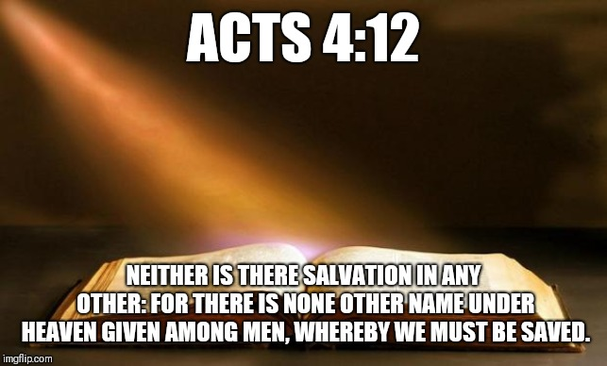

THAT NAME IS YAHUSHA,
HA MASHIACH!
15

Slide 16
Let’s be reminded that “Yahuwah's Chodesh Days, reveal His plan of salvation for all mankind, from the death, burial and resurrection of our Savior, through and beyond the resurrection of the last human being who will ever be born on the face of this earth. Each Festival has its own meaning, its own part to play. Like chapters in a book, or pieces in a puzzle, if one is missing, you would not get the complete story. There is ample evidence in the New Testament that Yahusha and His disciples kept these annual Chodesh Days, and also that, much later, the Apostles and other true believers were still keeping them, and teaching others to do so.”
https://hermanosenyahwshuahamashiach.weebly.com/what-does-it-mean-to-afflict-ones-soul.html

Slide 17
Galatians 3:29
“If ye be Messiah’s,
(that is talking about Yahusha, Ha Mashiach), then are ye Abraham’s seed and heirs according to
the promise.”
17

Slide 18
Now read Romans 11:17
“And if some of the branches be broken off, and thou, being a wild olive tree (Gentiles) were grafted in among them, and with them partakest of the root and fatness of the olive tree.” KJV
If we belong to YHVH, then we are spiritual Israelites!
18

Slide 19

The ritualistic laws of the Old Testament on the Day of Atonement were given to the ancient House of Israel to remind them of the need for the payment of their sins. These various sacrifices pointed ahead to the sacrifice of Yahusha who would come later as the Savior of all mankind.
Those laws were fulfilled by the events leading to and including Yahusha’s own sacrificial death. So we don’t sacrifice animals today, not only that, there is no priesthood to perform theses physical duties.

Slide 20
Let’s take a brief look at the Day of Atonement
in the Old Testament.
After making the covenant agreement with Israel, Yahuwah told the nation to build a Tabernacle, which is a physical type of Elohim’s habitation in heaven
(Ex. 25 – 27, 30; Heb. 9:23-24).
The Tabernacle consisted of an enclosed courtyard, containing an altar for animal sacrifices and a tent. The tent was divided into two sections by a veil.
The section behind the veil was called the Most Holy Place or Holiest of All.
The other section was the holy place (Ex. 26:33).

Slide 21
The Most Holy Place represented YHVH’s throne. Also located here was the Ark of the Covenant,
which contained the Ten Commandments and other items. The lid of the Ark was called the Mercy Seat; this was where YHVH manifested Himself
(Ex. 25:22).
The job of the high priest was given to Aaron;
his sons served as priests.
On the Day of Atonement, special animal sacrifices and ceremonies were conducted; these are explained in the 16th chapter of Leviticus.

Slide 22
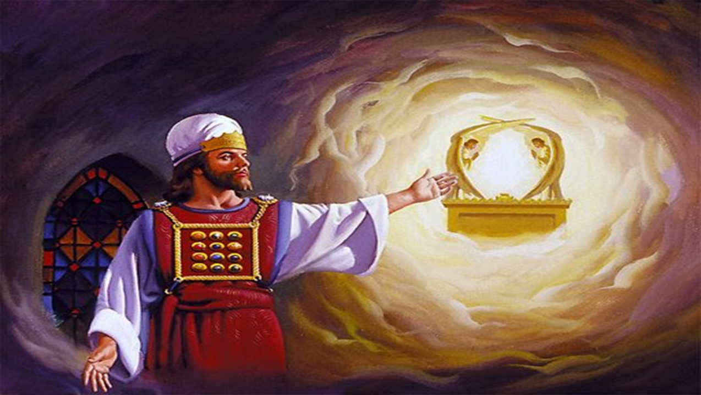
This was the only day Aaron could enter the
Most Holy Place.
It took place on the 10th day of the 7th month, Tishri.
By our calendar that would be around the end of September
or early October at the latest.

Slide 23
Before going into the Most Holy Place the High Priest had to bathe and dress himself in his priestly garments (Lev. 16:4). Once this was completed he took a censer, a vessel that held burning coals from the altar, and entered the Most Holy Place. He then took incense, an aromatic compound, and placed it on the burning coals. Next he sprinkled blood from the bullock on the mercy seat, which represented YHVH’s throne (vs. 11-14).
What did all this picture or point to?

Slide 24
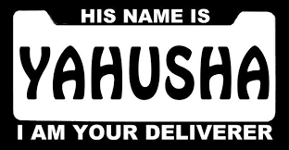
It all pointed to our Savior ….

Slide 25
First Aaron had to make atonement for himself as a sinning human before YHVH Elohim.

Slide 26
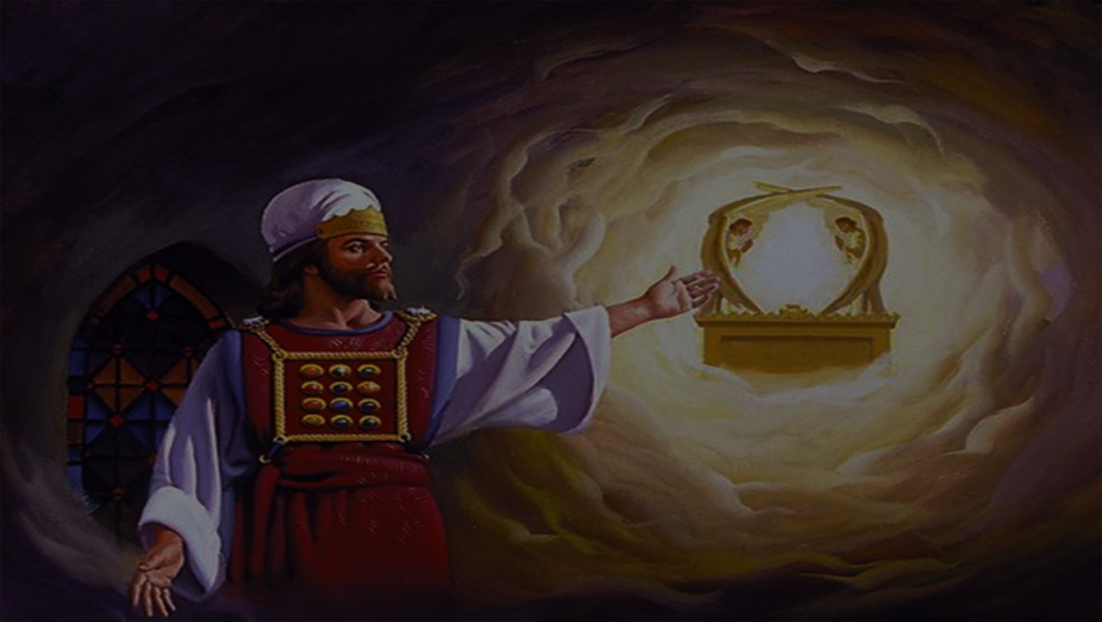
Washing himself pictured having his conscience changed to accept Yahuwah’s standard of righteousness (Heb. 10:22). The incense pictured prayers ascending to YHVH (Ps. 141:2; Rev. 5:8). His linen coat symbolized living a righteous life (Rev. 19:8). The blood represented the way sins are forgiven (Heb. 9:13-14; Rom. 3:25).

Slide 27

Aaron, the High Priest, was a type of Yahusha Messiah who is now our High Priest. By living a sinless life, He was qualified to offer Himself as a sin sacrifice for all humanity through His death.

Slide 28
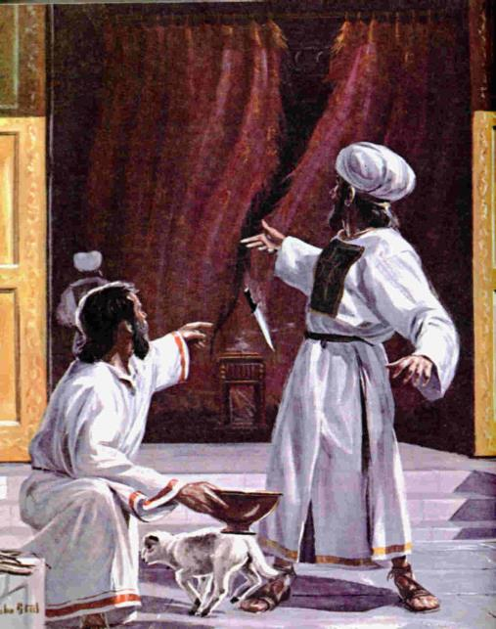
When Yahusha said it is finished, the veil in the temple was torn from top to bottom by an unseen hand, that means we now have direct contact with YHVH, the Father through prayer in the name of Yahusha.
28

Slide 29
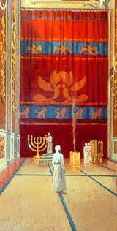
The veil represents the separation of a Holy God from sinful mankind because our sins have separated us from YHVH (Isaiah 59:2). The size and thickness of the curtain ensured that no one would accidentally fall into the Holy of Holies as the veil was 60 feet long, 30 feet wide, and was about one inch thick and was so massive and heavy that it took 300 priests to manipulate it so there was no way that someone could inadvertently trip and stumble into the Holy of Holies and subsequently die as a result.
https://forums.catholic.com/t/how-large-was-the-veil-in-the-temple/237693

Slide 30
Yom Kippur atones only for sins between man and YHVH, not for sins against another person. To atone for sins against another person, you must first seek reconciliation with that person,
righting the wrongs you committed
against them if possible.
That must all be done before Yom Kippur.

Slide 31
Leviticus 16:31 describes it as
"a Sabbath of Sabbaths."
That means it is a very, very high, important and holy day.

Slide 32
In God’s Word translation it states it this way: “This is the most important worship festival there is for you.
You will humble yourself.
It is a permanent law.”

Slide 33
The Day of Atonement is an opportunity, year by year, to obtain divine forgiveness of sin,
and to cleanse oneself before YHVH.
Leviticus 16:30 says “on that day shall
the priest make an atonement for you,
to cleanse you, that ye may be clean
from all your sins before YHVH.” KJV
That was an opportunity to restore oneself
to a state of wholeness or holiness.

Slide 34
Anyone that still had any sin left on their record had their name blotted from the Book of Life.
Therefore, a common greeting on the
Day of Atonement was “May your name be written in (or “not be blotted from”) the Book of Life.”

Slide 35
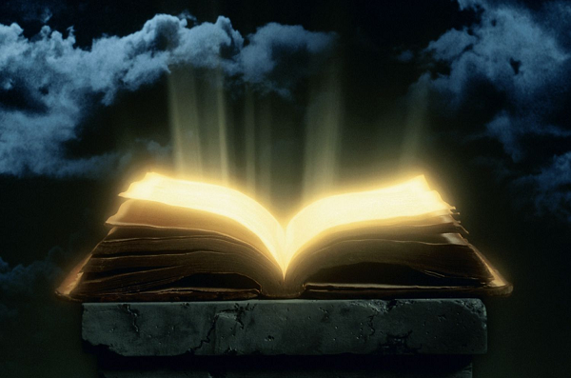
Is your name written in
The Lamb’s book of life?
Is there anything more important than having our names written in the book of life?

Slide 36
In Luke 10:20 Yahusha told the Seventy after they returned to him with joy, saying, Master, even the devils are subject unto us through your name: “rejoice not, that the spirits are subject unto you; but rather rejoice,
because your names are written in heaven.” KJV
36

Slide 37
Atonement involves individual as well
as collective purification.

Slide 38
In Leviticus chapter 16 are shown the physical rites of purification on the Day of Atonement like:
The washings, verses 4, 24, 26, 28;
The sacrifices, verses 5, 6, 11, 15;
The fumigations, verses 12-13;
The sprinkling of the sacrificial blood, verses 14-15, 18-19;
And the changes of clothes, verses 4, 23.
Notes:
Fumigation - Raeucherung

Slide 39
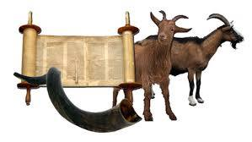
Which finally culminated in the act for Aaron, the high priest, to select two young goats (Lev. 16:5) and to cast lots to determine which goat would be “for YHVH”
and which for “the scapegoat.”

Slide 40
The word “scapegoat” was invented by William Tyndale in his 1530 English translation of the Bible. He translated the Hebrew word "Azazel," which only occurs in connection with this ceremony, as "ez azel" the "goat" (ez) which "escapes" (azel).
That seems like a good translation because in the ceremony the goat is indeed released in the wilderness.
The King James Version followed his lead,
as have many modern translations.

Slide 41
From the Hebrew definition of Azazel, the meaning is “goat of departure.” Leviticus 16:8 actually should read: “One lot for YHVH and the other for the goat of departure.” Because the first goat is called "a lot
for YHVH," the translators wanted the Hebrew word Azazel, to be a representation of someone.
Therefore some translators have concluded that
Azazel must represent an evil spirit or Satan.
Other translators see the scapegoat being sent to a place where Azazel, or evil spirit, is in the wilderness.

Slide 42
Some Bible translators use the word “scapegoat,” others use the Hebrew term “Azazel.”
This term “Azazel” has created much controversy.
NKJV uses the word “scapegoat.”
KJV uses the word “scapegoat.”
New American Bible (Catholic): uses “Azazel.”
Holy Scriptures (Jewish): uses “Azazel.”
The New English Bible: “one to be for the Lord and the other for the Precipice.”
The Septuagint Bible: “one lot for the Lord and one lot for the escape.”

Slide 43
According to Strong’s, the word “scapegoat” comes from the Hebrew “Azazel” which literally means
“goat of departure.” It is formed from the Hebrew
“ez” meaning goat and “azal” meaning “to go away.”
The precise meaning has been greatly disputed.
Some commentators believe “Azazel” refers to the name of the region, where the goat was sent.
Others believe it to be the proper name of a spirit, demon, or Satan himself.
43

Slide 44
The interpretation that Strong’s suggests occurs in both the Septuagint and the Vulgate and underlies the rabbinic view, “the goat that is dispatched”
in Mishnah Yoma 6:2.
In "Pentateuch & Haftorahs" by Dr.J.H. Hertz (Late Chief Rabbi of the British Empire), Soncino Press, 1990, pg.481, we read; "The Heb. Azazel, however, is not a proper name, but a rare Hebrew noun ... meaning, 'dismissal' or, 'entire removal'
(RV Margin, Gesenius, Hoffmann, and the Oxford Hebrew Dictionary).
44

Slide 45
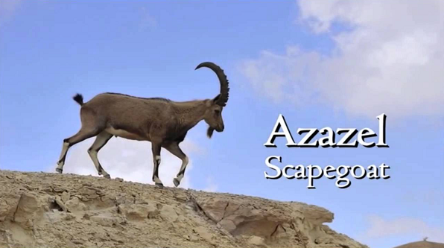
Again, the goat on which the lot fell for YHVH, was offered as a sin offering, but the goat on which the lot fell for the Scapegoat was presented alive before YHVH to make atonement over, and
it was sent away into
the wilderness!
(Leviticus 16:7-10)
45

Slide 46
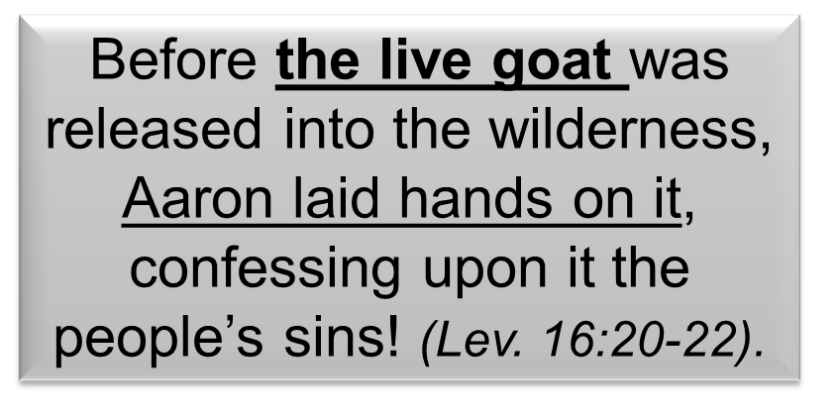
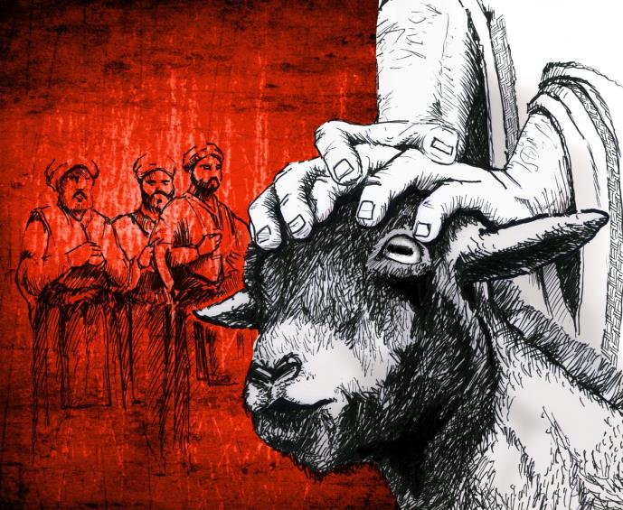

Slide 47
The act of laying on of hands (vs. 11; also Lev 1:4; 3:2; 4:4, 15, 29, 33) symbolizes the transference of sins from the guilty party (the children of Israel) to the innocent party (scapegoat). The innocent then becomes the sin-bearer. Yahusha undeniably fulfills the type (Isa. 53:4, 6, 11, 12).
Can Satan fulfill the type since he was never innocent?
It will not satisfy the justice of YAH to transfer the sins of the guilty to another guilty party. Since lots were used to decide which goat was “for YHVH,” it meant that both goats had to be unblemished, without a defect or flaw.
47

Slide 48
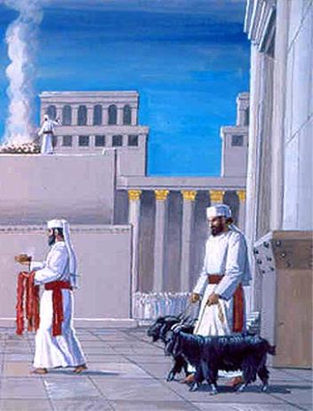
According to Leviticus 16:10 the scapegoat was designed for making atonement to Yahuwah because of the sins of Israel. This atonement has to be made to YHVH. If we choose to believe “Azazel” represents Satan, this leads us to the question of whether Satan can make an atonement for YAH’s people.
However, nowhere in Scripture is there
a reference to Satan having any part
in the atonement.
Both goats were representing the completed atonement!
48

Slide 49
Those who believe that Satan is the scapegoat and bears the sins of the redeemed and is going to be punished for them are saying that the death of Yahusha on the tree was not sufficient to save man. And that Yahusha somehow needed Satan’s help to complete the atonement to save mankind. If this were true, then the redeemed would be indebted to Satan as well as to Yahusha for all eternity for their salvation.
1 Pet 2:24 (NIV) "He himself bore our sins in his body on the tree, so that we might die to sins and live for righteousness; by his wounds you have been healed."
49

Slide 50

Two Goats -- One Offering!
The KEY to answering this question is found in Leviticus 16:5, which says: "And he [Aaron] shall take from the congregation of the children of Israel two male goats for A [singular] sin offering and one ram for a burnt offering.“ (English Standard version – ESV) In other words, the TWO goats made up a single offering -- not two different offerings!
Both goats were representing the completed atonement!
50

Slide 51
I personally, for over 50 years being a member of a Christian denomination, firmly believed that Satan represented the scapegoat and that Yahusha would put my confessed sins on Satan’s head and he would be punished ~ because they said so.
As an example it states in one of their books
Great Controversy, page 422:
“the scapegoat typified Satan, the author of sin,
upon whom the sins of the truly penitent
will finally be placed.”
51

Slide 52
In the same book on page 658, “the sins of God’s people will be placed upon Satan; he will be
declared guilty of all the evil which he has
caused them to commit.”
In another book called Early Writings, pp 294, 295: “Satan bore not only the weight and punishment of his own sins, but also of the sins of the redeemed host, which had been placed upon him.”
This explanation sounded good to me at the time,
but is it biblical and truth?
52

Slide 53
I made the serious mistake of trusting that explanation and accepting the official position of
that particular denomination as my authority,
instead of checking out Scripture alone!
I should have taken the advice, or better said the command, in 1 Thessalonians 5:21, where it states: “Prove all things; hold fast that which is good.” KJV
53

Slide 54
The bottom line is this: The Bible unequivocally declares Yahusha the Messiah to be the ONLY sin-bearer who not only died for the remission of sins, but also the One to take those sins away. When we realize that YEHOVAH's goat and the Azazel goat are ONE atonement offering -- rather than two separate offerings separated by thousands of years -- we can understand and appreciate the symbolic fulfillment more readily.
Yahusha is the perfect fulfillment of the typical atonement sacrifice. As YEHOVAH's goat his blood CLEANSED the heavenly sanctuary (Hebrews 9:23) and the Israel of YEHOVAH (Leviticus 16:17).
As "Azazel" he bore our sins and took them away forever!
www.hope-of-Israel.org/azazell.htm
The Bottom Line
54

Slide 55
After explaining the process whereby the two goats were chosen, author E. Raymond Capt adds that atonement was accomplished by the offering of blood and sprinkling it before the Mercy Seat.
The LIVE GOAT [Azazel] was public manifestation and proof of acceptance of the sacrifice in the Divine Presence and the transference of GUILT from the sinner to the Scapegoat.
What was accomplished "within" was manifested "without."
It signified the dismissal, (Azazel -- dismissal, R.V. margin) of our sins. Christ is our "Azazel," our "Scapegoat," "cut off out of the land
of the living: for the transgression of my people was he stricken"
(Isa. 53:8). -- King Solomon's Temple, Artisan Sales,
Thousand Oaks, CA. 1979, p. 59.
www.hope-of-Israel.org/azazell.htm
55

Slide 56
Azazel, the goat of departure, represented Yahusha, who took all the sins of His people upon Himself. He hath borne our griefs, carried our sorrows, was wounded for our transgressions, and bruised for our iniquities
Isa 53:4-5). Then He was nailed to a tree (stake), outside the camp (outside of Jerusalem), just like the second goat was taken into the wilderness to perish.
56

Slide 57
The purpose of the Day of Atonement was to re-direct Elohim's anger for the sins of the past year and seek his favor in the one that lay ahead.
It was the day on which the meaning of the sacrificial system reached
its highest point.
57

Slide 58
… Despite all the daily, weekly, and monthly sacrifices that had been offered, there was still sin that was not fully atoned for, and on this special day all the people sought Yahuwah for forgiveness.
58

Slide 59
The Day of Atonement is the only
commanded annual ‘fast’ day.
In Leviticus 16:29 it is commanded that we are to afflict our souls. This is a serious command, for in Leviticus 23:29 it says “For whatsoever soul (it be) that shall not be afflicted in that same day,
he shall be cut off from among the people! (KJV)
We begin fasting by missing the evening meal
of the previous day!
59

Slide 60
The English word “soul,” used here is translated from the Hebrew “nephesh” and simply means physical life, breath, or body. The same word is used elsewhere in reference to animals. It is not in any way referring to an “immortal soul” or a spirit within man, but rather to the physical body, the life.
60

Slide 61
The word translated “afflict” is #6031 in Strong’s Hebrew Dictionary, and is “ANAH,” pronounced “aw-naw.”
It means to depress, to abuse the self,
to afflict, chasten self, deal hardly with, defile, humble, hurt, submit self, weaken.
61

Slide 62
There are four main reasons for the command to ‘fast’ on
the Day of Atonement:
62

Slide 63
REASON # 1
1. By fasting we show contrition for the wrong we have done and the good we have failed to do. Fasting fulfills the need to make a self-sacrifice in order to demonstrate that one has repented and not merely given lip service of sorrow for past sins. Fasting affirms a man's sincerity, and shows he knows he deserves to be punished for his sins.
63

Slide 64
REASON # 2
2. Self-discipline. Repentance must be preceded by an attempt at self-discipline. The ideal person is one who is hard on himself but indulgent towards others. Fasting on the Day of Atonement serves
as a reminder for the need of self-discipline which leads to self-improvement.
64

Slide 65
REASONS # 3 & 4
3. Fasting is a means of focusing the mind on the spiritual.
4. Fasting is a means of awakening compassion for others.
(See Isaiah 58:6-7.)
65

Slide 66
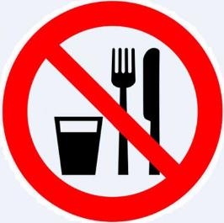

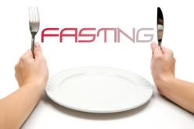
Fasting on this day reveals to us just how much
we still love ourselves and how difficult it is to
give up some of self. This day is a test to see
which we will put first, will it be for the cry of food,
or our sincere desire to obey YHVH!
66

Slide 67
As always, any restrictions, like fasting,
can be lifted where a threat to life or health is involved. In fact, children under the age of nine and women in childbirth (from the time labor begins until three days after birth) are not permitted to fast, even if they want to.
67

Slide 68
Older children and women from the third to the seventh day after childbirth are permitted to fast but are permitted to break the fast if they feel the need to do so. People with other illnesses should consult
a physician and a rabbi for advice.
68

Slide 69
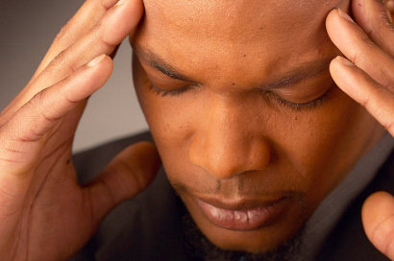
The Day of Atonement drives home the reality and ugliness of sin!
69

Slide 70
(1) That sin is real, and an offense against Yahuwah,
(2) That Yahuwah is willing to pardon sin, and
(3) That such pardon does not come unless man does something -- repents with fasting and rends his heart.
70

Slide 71

We must acknowledge our sins, claim the blood of Yahusha, repent and be born again by water and the Spirit!

Slide 72
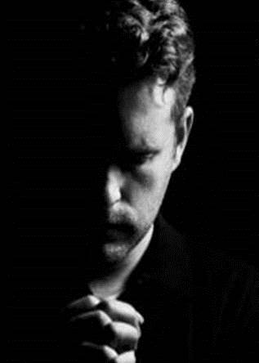
Teshubah, the Hebrew word for repentance, means "turning back." It involves,
(1) Contrition for the sin
committed and a
(2) Firm resolve not to repeat it.

Slide 73
True repentance is more than sorrow for sin.
It is a resolute turning away from evil and a turning towards YHVH and HIS Torah,
His instructions.

Slide 74
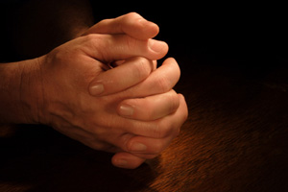
Isn’t that what the Bible says?
“He that covereth his sins shall not prosper but whoso confesseth and forsaketh them shall have mercy.” KJV
Proverbs 28:13

Slide 75

Prayer,
Bible Study, meditation,
and spiritual fellowship are our spiritual food during this annual "Sabbath of Sabbaths."
75

Slide 76
The following are some customs connected with the day of Atonement!
I want to stress “customs”
as these are not commanded
or suggested in Torah but
were created by man!
76

Slide 77
I need to emphasize also that not all customs or traditions are bad and should be shunned; only those traditions that make the commandments of YHVH of non-effect must be rejected! (See Matthew 15:2-6.)
77

Slide 78
It is customary to wear
white on this holiday,
which symbolizes purity and calls to mind the promise that our sins shall be made as white as snow (Isa. 1:18).
78

Slide 79
Before going to the Synagogue,
the father of the house blesses the children.
To sons, he says, “Elohim make you as Ephraim and Manasseh," and the daughters, “Elohim make you as Sarah, Rebekah, Rachel and Leah."
79

Slide 80
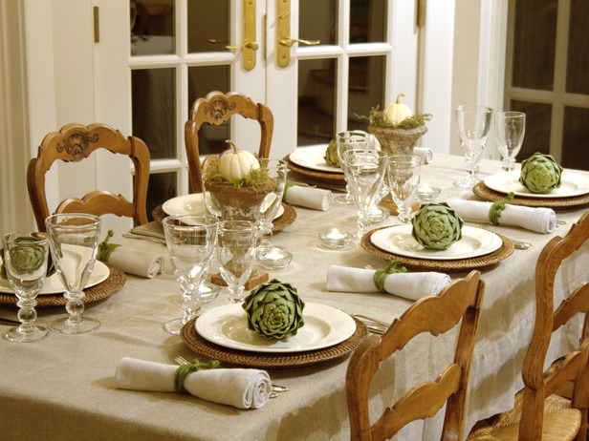
After Yom Kippur, Jews have a minor feast, quoting Ecclesiastes 9:7, "Go, eat your bread with joy, and drink your wine with a glad heart; for Elohim has already approved your works." (The Scriptures - version 2009)
80

Slide 81
Scriptures that are read on the Day of Atonement:
Leviticus chapter 16;
Numbers 29:7-11;
Isaiah 57:14 through 58:14, and
The Book of Jonah is read.
The theme of these latter passages is true repentance.
81

Slide 82
One of The Book of Jonah's major points is the contrast between the instant trust
and ready repentance of the heathen
and the lack of confidence and infidelity
of the servant of Yahuwah.
When the storm rages at sea, the idolatrous mariners immediately call upon their gods, but Jonah does not call on the true Elohim.
82

Slide 83
Instead, Jonah goes inside the ship to sleep. When they find out that Jonah is responsible for the tempest, they acknowledge YHVH. The king and the whole city of Nineveh fast in sackcloth and do repent, but Jonah is displeased.

Slide 84
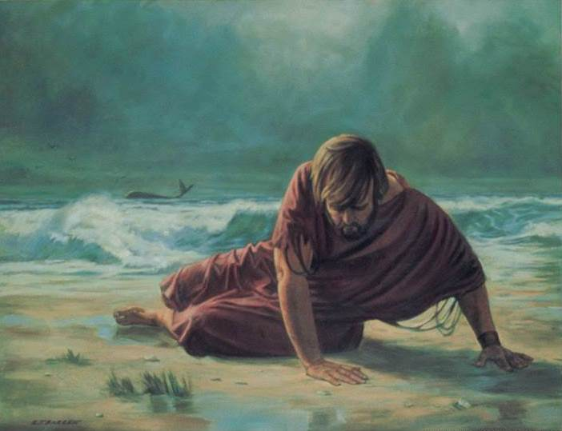
The "Atonement Lesson" of the Book of Jonah is that
(1) Yahuwah’s people sometimes have a harder time repenting than heathens do …

Slide 85
Why do you think that is the case?
Religious people, people in churches, and in denominations believe that they don’t need anything.
I am rich, increased with goods and in need of nothing! However, people outside any church group feel that they are in need of a change.
It is more obvious to a smoker, drinker, adulterer than one that doesn’t do these things.
There is always the need to reach higher!
85

Slide 86
(2) Fasting is necessary to r
eally repent,
(3) If YHVH accepted the repentance of heathen Nineveh, He will certainly accept the genuine repentance of His people, …

Slide 87
(4) It is impossible to flee from YHVH’s presence. He sees all, and “your sin shall find you out” according to Numbers 32:23.

Slide 88
We read of Israel’s
constant disobedience!
Isn’t that the same story today?
Has anything changed?
Is YHVH still the same today
as then?

Slide 89
Further readings on the Day of Atonement include Leviticus 18, which says in verse 4: "Ye shall do my judgments and keep my ordinances ...," and then it continues with the account of forbidden marriages, warning one not
to fall into (sexual) temptation.
Another passage is Micah 7:18-20, which emphasizes Yahuwah’s mercy.
89

Slide 90
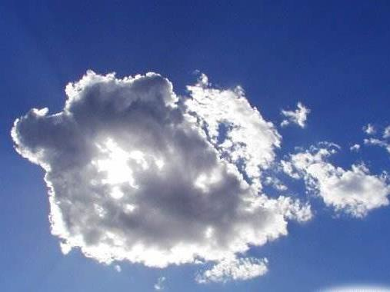
Let’s always remember Micah 7:18-20:
“Who is a Elohim like unto thee that pardoneth iniquity and passeth by the transgression of the remnant of his heritage? …

Slide 91
… He retaineth not his anger forever,
because he delighteth in mercy …

Slide 92
…19. He will turn again; he will have compassion upon us; he will subdue our iniquities; and thou wilt cast all their sins into the depth of the sea…

Slide 93
… 20. Thou wilt perform the truth to Jacob, and the mercy to Abraham, which thou hast sworn unto our fathers from the days of old.” KJV

Slide 94
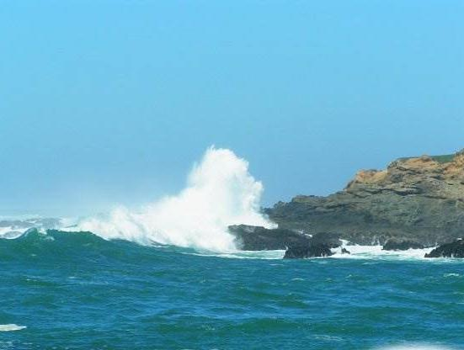
Yah’s forgiveness is not merely a judicial act by which He sets us free from condemnation.
It is not only forgiveness for sin but reclaiming from sin.
It is the outflow of redeeming love
that transforms the heart.

Slide 95
…David had the true conception of forgiveness when he prayed, "Create in me a clean heart, O YAH; and renew a right spirit within me." Psalm 51:10 KJV

Slide 96
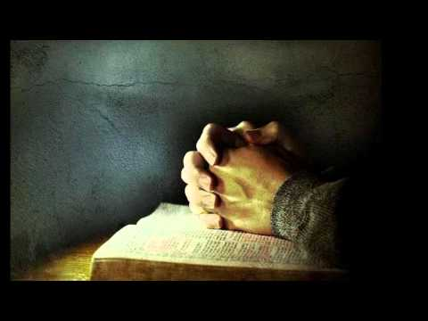
The promise that YHVH made to King Solomon in
1 Kings 6:12-13 KJV applies to every generation:
“If thou wilt walk in my statutes, and execute my judgments, and keep all my commandments to walk in them; then will I perform my word with thee, which I spake unto David thy father:
6:13 And I will dwell among the children of Israel and will not forsake my people Israel.”

Slide 97
This applies not only to Israel as a nation but to each individual as we read in Psalm 103:17-18. KJV
97

Slide 98

“The mercy of YHVH is from everlasting to everlasting upon them that fear him, and his righteousness unto children’s children; 18. To such as keep his covenant, and to those that remember his commandments to do them.”
Psalm 103:17-18 KJV
98

Slide 99
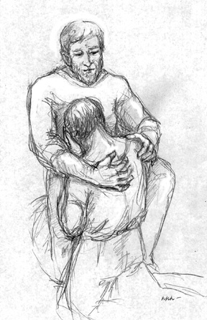
What a
gracious
Heavenly
Father
we serve!
99

Slide 100
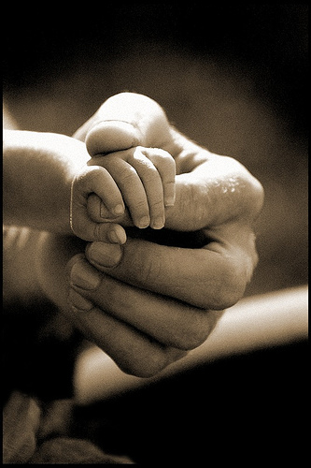
“Like as a father pitieth his children, so YHVH pitieth them that fear him. 14. For he knoweth our frame; he remembereth that we are dust.”
Psalm 103:13-14 KJV
100

Slide 101
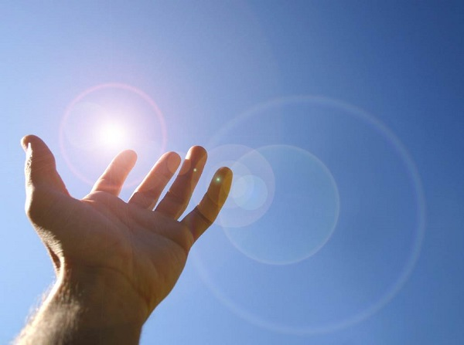
Therefore “Be glad in YHVH, and rejoice, ye righteous and shout for joy, all ye that are upright in heart.”
Psalm 32:11 KJV
101

Slide 102
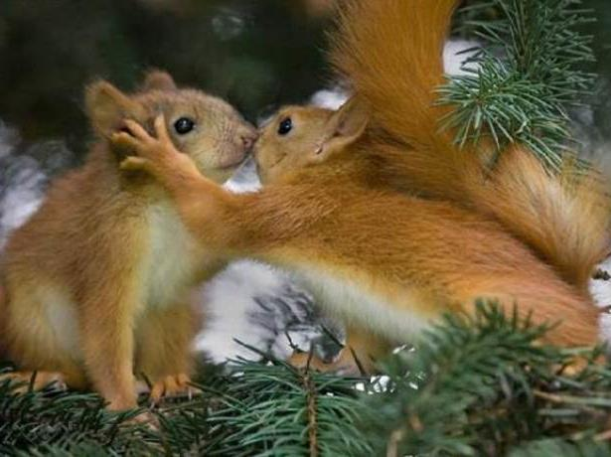
THE END
102

Slide 103

Supreme Provider
Yahusha Ha Mashiach
Produced and narrated by Walter Tschoepe
Malachi4.4@Reagan.com

