Slide 1
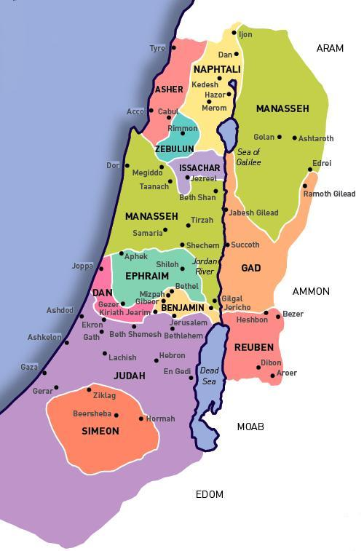
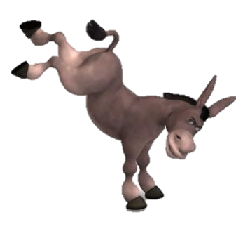
Belligerent Benjamites
All corrections done and emailed to Neil Jan 9/21 for PDF and SSH.
Encounter
Judgment!

Slide 2

A TEACHING FROM JUDGES 19-21
Date: ~1406 BC – or 50 years after Moses
Visit: studythecalendar.com
Note: All scriptures will be from the King James Version unless noted as The Scriptures.

Slide 3

An Unusual day-start study?
There are many studies in the Scriptures that speak of Yahuah’s day start, but
some of them have surprises.
Yes, some testimonies show the true commencement of Yahuah’s cycles through the most unusual circumstances.
Even for many – after reading this account, they may well ask …
“What in the
world was
going on?”
What can we learn from this testimony?

Slide 4
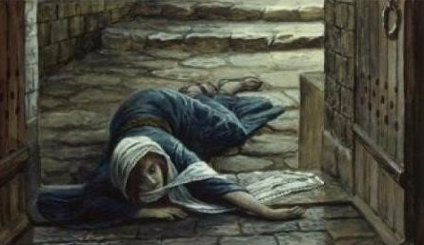
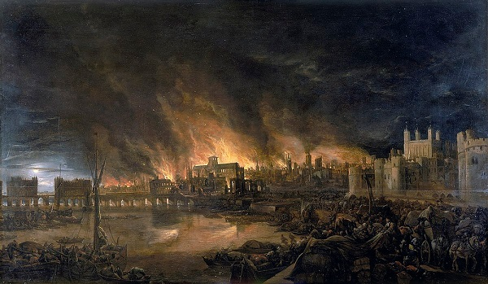
Overview of A Traumatic Testimony
This Scriptural testimony is an episode concerning a
Levite's concubine who was also from the tribe of Levi.
It is one of the most disturbing texts in the Hebrew Scriptures.
The record describes a Levite from Ephraim and his concubine, who travel through the Benjaminite city of Gibeah.
During an overnight stay, a mob from the tribe of Benjamin demanded to sodomize the Levite.
But instead, the Levite turns his concubine over to
the crowd, and they rape her until she dies!
Many lives were lost over this incident!

Slide 5
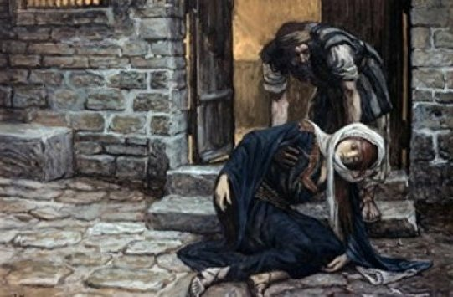
Conclusion of Overview
In short order, this resulted in a battle at Gibeah, in which the other tribes of Israel sought vengeance. In this civil war - the tribe of Benjamin was eventually defeated with the loss of the women and children. All but 600 men of Benjamin were killed. This happened because Benjamin chose to protect the guilty parties and refused to turn them over for justice.
Even though the fate of the concubine is particularly gruesome, for some reason
Yahuah preserved this testimony in
Covenant Calendar language.
This study will not try to unravel all
the details behind the event and
why things happened the way they did.
However, there is a significant amount of calendar language to be noted when examining Yahuah’s commanded day-start.
The complete testimony follows for context.

Slide 6
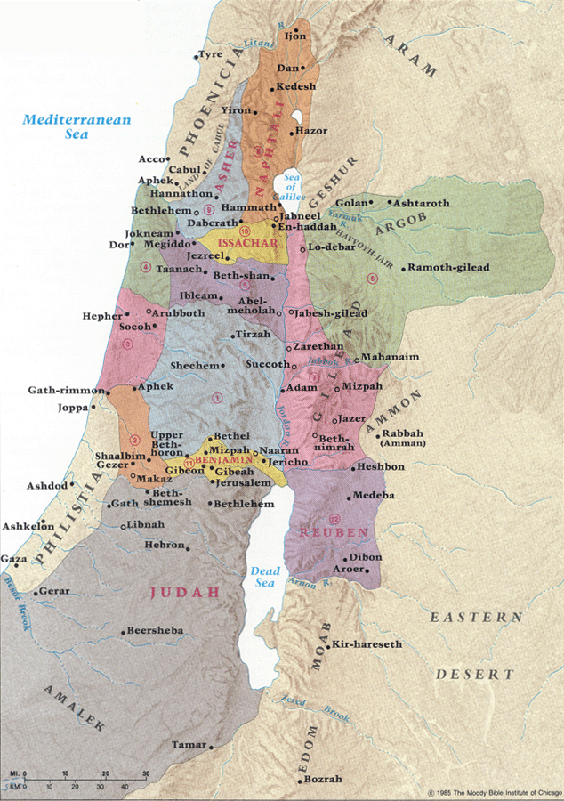
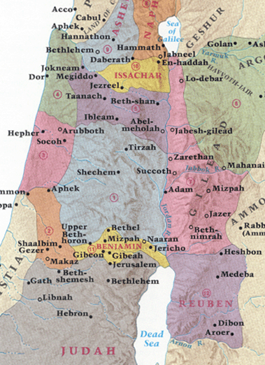

Getting Started
The Levite was from Shiloh,
traveling home from Bethlehem.
He bypassed Jerusalem to spend the night in Gibeah of Benjamin.
Gibeah was the scene of the crime.
All Israel from Dan to Beersheba & including the area of Gilead was summoned to Mizpah for a council.
Judah was summoned to go to war with Gibeah first – then defeated.
Eventually Benjamin was defeated – the whole tribe was destroyed – [save 600 men] because they would not deliver the Gibeonites to Israel for judgment of their crime.
There were no women left for the 600 men; Israel vowed not to supply.
Jabesh-gilead came under judgment for not showing up to help Israel.
These men were killed; the women given to Benjamin – but still lacking.
At Shiloh’s feast, the remaining Benjamites caught themselves a wife.
Shiloh
There was no king in Israel in those days,
and every man did whatever he thought was right.

Slide 7
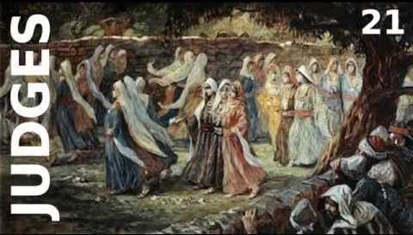
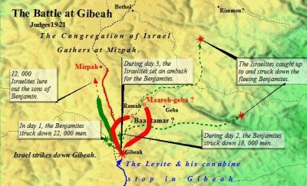

5. 600 Benjamites escape to Rimmon & safety.
Judges 20:47
6. Israelites took an oath at Mizpah to not give daughters to Benjamin.
Judges 21:10
3. During DAY 3, the Israelites set an ambush for the Benjamites.
Judges 20:30-44
4. The Israelites caught up to and struck down the fleeing Benjamites.
Judges 20:45-46
1. In DAY 1, the Benjamites struck down 22,000 men.
Judges 20:21
2. During DAY 2, the Benjamites struck down 18,000 men. Judges 20:25
Men of Israel Pursue the Benjamites

Slide 8
Judges 19 The Levite’s Concubine
TIM: PURPLE DEONNA: PINK CHARL: GOLD DAUD: BLUE
¹ And it came to pass in those days, when there was no king in Israel, that there was a certain Levite sojourning on the side of mount Ephraim, who took
to him a concubine out of Bethlehem Judah.
² And his concubine played the whore against him, and went away from him unto her father's house
to Bethlehem Judah, and was there four whole months.
³ And her husband arose, and went after her, to speak friendly unto her, and to bring her again, having his servant with him, and a couple of asses: and she brought him into her father's house: and when the father of the damsel saw him, he rejoiced
to meet him.
⁴ And his father in law, the damsel's father, retained him; and he abode with him three days: so they
did eat and drink, and lodged there.
⁵ And it came to pass on the fourth day, when they arose
early in the morning, that he rose up to depart: and the damsel's father said unto his son in law, Comfort thine heart with a morsel of bread, and afterward go your way.
⁶ And they sat down, and did eat and drink both of them together: for the damsel's father had said unto the man, Be content, I pray thee, and tarry all night, and let thine heart be merry.
⁷ And when the man rose up to depart, his father in law urged him: therefore he lodged there again.
⁸ And he arose early in the morning on the fifth day to depart; and the damsel's father said, Comfort thine heart, I pray thee. And they tarried until afternoon, and they did eat both of them.
⁹ And when the man rose up to depart, he, and his concubine, and his servant, his father in law, the damsel's father, said unto him, Behold, now the day draweth toward evening, I pray you tarry all night: behold, the day groweth to an end, lodge here, that thine heart may be merry; and to morrow [the sixth day] get you early on your way, that thou mayest go home.

Slide 9
Judges 19 The Levite’s Concubine
TIM: PURPLE DEONNA: PINK CHARL: GOLD DAUD: BLUE
¹⁰ But the man would not tarry that night [of the fifth],
but he rose up and departed, and came over against
Jebus, which is Jerusalem; and there were with him two asses saddled, his concubine also was with him.
¹¹ And when they were by Jebus, the day was far spent;
and the servant said unto his master, Come, I pray thee, and let us turn in into this city of the Jebusites, and lodge in it.
¹² And his master said unto him, We will not turn aside hither into the city of a stranger, that is not of the children of Israel; we will pass over to Gibeah.
¹³ And he said unto his servant, Come, and let us draw near to one of these places to lodge all night, in Gibeah, or in Ramah.
¹⁴ And they passed on and went their way; and the sun
went down upon them when they were by Gibeah,
which belongeth to Benjamin.
¹⁵ And they turned aside thither, to go in and to lodge in Gibeah: and when he went in, he sat him down in a street of the city: for there was no man that took them into his house to lodging.
¹⁶ And, behold, there came an old man from his work out of the field at even, which was also of mount Ephraim; and he sojourned in Gibeah: but the men of the place were Benjamites.
¹⁷ And when he had lifted up his eyes, he saw a wayfaring man in the street of the city: and the old man said, Whither goest thou? and whence comest thou?
¹⁸ And he said unto him, We are passing from Bethlehem Judah toward the side of mount Ephraim [near Shiloh]; from thence am I: and I went to Bethlehem Judah, but I am now going to the house of Yahuah; and there is no man that receiveth me to house.

Slide 10
JUDGES 19 GIBEAH’S CRIME
TIM: PURPLE DEONNA: PINK CHARL: GOLD DAUD: BLUE
¹⁹ Yet there is both straw and provender for our asses; and there is bread and wine also
for me, and for thy handmaid, and for the young man which
is with thy servants: there is
no want of any thing.
²⁰ And the old man said, Peace be with thee; howsoever let all thy wants lie upon me; only lodge not in the street.
²¹ So he brought him into his house, and gave provender
unto the asses: and they washed their feet, and did eat and drink.
²² Now as they were making their hearts merry, behold, the men of the city, certain sons of Belial, beset the house round about, and beat at the door, and spake to the master of the house, the old man, saying, Bring forth the man that came into thine house, that we may know him.
²³ And the man, the master of the house, went out unto them, and said unto them, Nay, my brethren, nay, I pray you, do not so wickedly; seeing that this man is come into mine house, do not this folly.
²⁴ Behold, here is my daughter a maiden, and his concubine; them I will bring out now, and humble
ye them, and do with them what seemeth good unto you: but unto this man do not so vile a thing.
²⁵ But the men would not hearken to him: so the man took his concubine, and brought her forth
unto them; and they knew her, and abused her all the night until the morning [H1242/boqer]: and when the day began to spring [H5927/`alah*], they let her go.
²⁶ Then came the woman in the dawning [H6437] of the day, and fell down at the door of the man's house where her lord was, till it was light.
²⁷ And her lord rose up in the morning, and opened the doors of the house, and went out to go his way: and, behold, the woman his concubine was fallen down at the door of the house, and her hands were upon the threshold.
*DAY BEGAN TO SPRING H5927 `alah (aw-law'); a primitive root; to ascend, intransitively (be high) or actively (mount); used in a great variety of senses (as follow):
KJV - arise (up), (cause to) ascend up, at once, break [the day], {etc.}.

Slide 11
CH 19 GIBEAH’S CRIME
TIM: PURPLE DEONNA: PINK CHARL: GOLD DAUD: BLUE
CH 20 ISRAEL’S WAR WITH THE BENJAMITES
²⁸ And he said unto her, Up, and let us be going. But none answered. Then the man took her up upon an ass, and the man rose up, and gat him unto his place.
²⁹ And when he was come into his house, he took a knife, and laid hold on his concubine, and divided her, together with her bones, into twelve pieces, and sent her into all the coasts of Israel.
³⁰ And it was so, that all that saw it said, There was no such deed done nor seen from the day that the children of Israel came up out of the land of Egypt unto this day: consider of it, take advice, and speak your minds.
¹ Then all the children of Israel went out, and the congregation was gathered together as one man, from Dan even to Beersheba, with the land of Gilead, unto Yahuah in Mizpah.
² And the chief of all the people, even of all the tribes of Israel, presented themselves in the assembly of the people of Elohim, four hundred thousand footmen that drew sword.
³ (Now the children of Benjamin heard that the children of Israel were gone up to Mizpah.) Then said the children of Israel, Tell us, how was this wickedness?
⁴ And the Levite, the husband of the woman that was slain, answered and said, I came into Gibeah that belongeth to Benjamin, I and my concubine, to lodge.
⁵ And the men of Gibeah rose against me, and beset the house round about upon me by night, and thought to have slain me: and my concubine have they forced, that she is dead.
⁶ And I took my concubine, and cut her in pieces, and sent her throughout all the country of the inheritance of Israel: for they have committed lewdness and folly in Israel.
⁷ Behold, ye are all children of Israel; give here your advice and counsel.

Slide 12
CH 20 ISRAEL’S WAR WITH THE BENJAMITES [CON’T]
TIM: PURPLE DEONNA: PINK CHARL: GOLD DAUD: BLUE
⁸ And all the people arose as one man, saying, We will not any of us go to his tent, neither will we any of us turn into his house.
⁹ But now this shall be the thing which we will do
to Gibeah; we will go up by lot against it;
¹⁰ And we will take ten men of an hundred throughout all the tribes of Israel, and an hundred of a thousand, and a thousand out of ten thousand, to fetch victual for the people, that they may do, when they come to Gibeah
of Benjamin, according to all the folly that they have wrought in Israel.
¹¹ So all the men of Israel were gathered against the city, knit together as one man.
¹² And the tribes of Israel sent men through all the tribe of Benjamin, saying, What wickedness is this
that is done among you?
¹³ Now therefore deliver us the men, the children of Belial, which
are in Gibeah, that we may put them to death, and put away evil from Israel. But the children of Benjamin would not hearken
to the voice of their brethren the children of Israel.
¹⁴ But the children of Benjamin gathered themselves together out
of the cities unto Gibeah, to go out to battle against the children of Israel.
¹⁵ And the children of Benjamin were numbered at that time out of the cities twenty and six thousand [26,000] men that drew sword, beside the inhabitants of Gibeah, which were numbered seven hundred [700] chosen men.
¹⁶ Among all this people there were seven hundred [700] chosen men lefthanded; every one could sling stones at an hair breadth, and not miss.
¹⁷ And the men of Israel, beside Benjamin, were numbered four hundred thousand men that drew sword: all these were men of war.

Slide 13
CH 20 ISRAEL’S WAR WITH THE BENJAMITES [CON’T]
TIM: PURPLE DEONNA: PINK CHARL: GOLD DAUD: BLUE
¹⁸ And the children of Israel arose, and went up to the house of Elohim, and asked counsel of Elohim, and said, Which of us shall go up first to the battle [on that first day of many days of battles] against the children of Benjamin? And Yahuah said, Judah shall go up first.
¹⁹ And the children of Israel rose up in the morning,
and encamped against Gibeah.
²⁰ And the men of Israel went out to battle against Benjamin; and the men of Israel put themselves in
array to fight against them at Gibeah.
²¹ And the children of Benjamin came forth out of
Gibeah, and destroyed down to the ground of the
Israelites that day twenty and two thousand men [22,000].
²² And the people the men of Israel encouraged themselves, and set their battle again in array in the
place where they put themselves in array the first day.
²³ (And the children of Israel went up and wept before Yahuah until even, and asked counsel of Yahuah,
saying, Shall I go up again to battle against the children
of Benjamin my brother? And Yahuah said, Go up against him.)
²⁴ And the children of Israel came near against the
children of Benjamin the second day.
²⁵ And Benjamin went forth against them out of Gibeah
the second day, and destroyed down to the ground of the children of Israel again eighteen thousand men [18,000]; all these drew the sword.
²⁶ Then all the children of Israel, and all the people, went up, and came unto the house of Elohim, and wept, and sat there before Yahuah, and fasted that day until even, and offered burnt offerings and peace offerings before Yahuah.

Slide 14
CH 20 ISRAEL’S WAR WITH THE BENJAMITES [CON’T]
TIM: PURPLE DEONNA: PINK CHARL: GOLD DAUD: BLUE
²⁷ And the children of Israel enquired of Yahuah, (for the ark of the covenant of Elohim was there in those days,
²⁸ And Phinehas, the son of Eleazar, the son of Aaron, stood before
it in those days,) saying, Shall I yet again go out to battle against
the children of Benjamin my brother, or shall I cease?
And Yahuah said, Go up; for to morrow I will deliver them
into thine hand.
²⁹ And Israel set liers [an ambush] in wait round about Gibeah.
³⁰ And the children of Israel went up against the children of Benjamin on the third day, and put themselves in array against Gibeah, as at other times.
³¹ And the children of Benjamin went out against the people, and were drawn away from the city; and they began to smite of the people, and kill, as at other times, in the highways, of which one goeth up to the house of Elohim, and the other to Gibeah in the field, about thirty men
of Israel.
³² And the children of Benjamin said, They are smitten down before us, as at the first. But the children of Israel said, Let us flee, and draw them from the city unto the highways.
³³ And all the men of Israel rose up out of their place, and put themselves in array at Baal-tamar: and the liers in wait of Israel came forth out of their places, even out of the meadows of Gibeah.
³⁴ And there came against Gibeah ten thousand chosen men out of all Israel, and the battle was sore: but they knew not that evil was near them.
³⁵ And Yahuah smote Benjamin before Israel: and the children of Israel destroyed of the Benjamites that day twenty and five thousand and an hundred men [25,100]: all these drew the sword.
[Note: only 600 men of Benjamin escaped.]

Slide 15
CH 20 ISRAEL’S WAR WITH THE BENJAMITES [CON’T]
TIM: PURPLE DEONNA: PINK CHARL: GOLD DAUD: BLUE
³⁶ So the children of Benjamin saw that they were smitten: for the men of Israel gave place to the Benjamites, because they trusted unto the liers
in wait which they had set beside Gibeah.
³⁷ And the liers in wait hasted, and rushed upon
Gibeah; and the liers in wait drew themselves along,
and smote all the city with the edge of the sword.
³⁸ Now there was an appointed sign between the men
of Israel and the liers in wait, that they should make a great flame with smoke rise up out of the city.
³⁹ And when the men of Israel retired in the battle, Benjamin began to smite and kill of the men of Israel about thirty persons: for they said, Surely they are smitten down before us, as in the first battle.
⁴⁰ But when the flame began to arise up out of the city with a pillar of smoke, the Benjamites looked behind them, and, behold, the flame of the city ascended up
to heaven.
⁴¹ And when the men of Israel turned again, the men
of Benjamin were amazed: for they saw that evil was come upon them.
⁴² Therefore they turned their backs before the men of Israel unto the way of the wilderness; but the battle overtook them; and them which came out of the cities they destroyed in the midst of them.
⁴³ Thus they inclosed the Benjamites round about, and chased them, and trode them down with ease over against Gibeah toward the sunrising.
⁴⁴ And there fell of Benjamin eighteen thousand men;
[18,000] all these were men of valour.
*
H4217 Mizrach east, eastward, place of sunrising, east side.
Note of interest: this word is one letter different than for Mazzaroth. It has a Chet instead of a Tav.
*

Slide 16
CH 20 WAR WITH BENJAMITES [CON’T]
TIM: PURPLE DEONNA: PINK CHARL: GOLD DAUD: BLUE
CH 21 ISRAEL SWORE AN OATH
⁴⁵ And they turned and fled toward the wilderness unto the rock of Rimmon: and they gleaned of them in the highways five thousand men; and pursued hard after them unto Gidom, and slew two thousand men of them.
⁴⁶ So that all which fell that day of Benjamin were twenty and five thousand men that drew the sword; all these were men of valour.
⁴⁷ But six hundred [600] men turned and fled to the wilderness unto the rock Rimmon, and abode in the rock Rimmon four months.
⁴⁸ And the men of Israel turned again upon the children of Benjamin, and smote them with the edge of the sword, as well the men of every city, as the beast, and all that came to hand: also they set on fire all the cities that they came to.
¹ Now the men of Israel had sworn in Mizpah, saying, There shall not any of us give his daughter unto Benjamin to wife.
² And the people came to the house of Elohim, and abode there till even before Elohim, and lifted up their voices, and wept sore;
³ And said, O Yahuah Elohim of Israel, why is this come to pass in Israel, that there should be to day one tribe lacking in Israel?
⁴ And it came to pass on the morrow [H4283], that
the people rose early, and built there an altar, and offered burnt offerings and peace offerings.

Slide 17
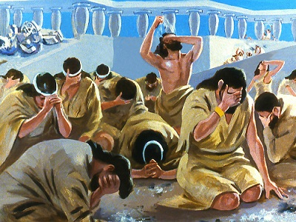
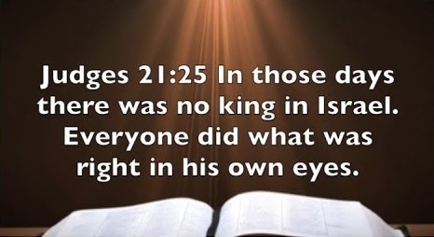
CH 20 WAR WITH BENJAMITES [CON’T]
TIM: PURPLE DEONNA: PINK CHARL: GOLD DAUD: BLUE
CH 21 ISRAEL SWORE AN OATH
⁴⁵ And they turned and fled toward the wilderness unto the rock of Rimmon: and they gleaned of them in the highways five thousand men; and pursued hard after them unto Gidom, and slew two thousand men of them.
⁴⁶ So that all which fell that day of Benjamin were twenty and five thousand men that drew the sword; all these were men of valour.
⁴⁷ But six hundred [600] men turned and fled to the wilderness unto the rock Rimmon, and abode in the rock Rimmon four months.
⁴⁸ And the men of Israel turned again upon the children of Benjamin, and smote them with the edge of the sword, as well the men of every city, as the beast, and all that came to hand: also they set on fire all the cities that they came to.
¹ Now the men of Israel had sworn in Mizpah, saying, There shall not any of us give his daughter unto Benjamin to wife.
² And the people came to the house of Elohim, and abode there till even before Elohim, and
lifted up their voices, and wept sore;
³ And said, O Yahuah Elohim of Israel, why is
this come to pass in Israel, that there should be
to day one tribe lacking in Israel?
⁴ And it came to pass on the morrow [H4283], that the people rose early, and built there an altar, and offered burnt offerings and peace offerings.

Slide 18


CH 21 WIVES PROVIDED FOR BENJAMITES [CON’T]
TIM: PURPLE DEONNA: PINK CHARL: GOLD DAUD: BLUE
⁵ And the children of Israel said, Who is there among all the tribes of Israel that came not up with the congregation unto Yahuah? For they
had made a great oath concerning him
that came not up to Yahuah to Mizpah,
saying, He shall surely be put to death.
⁶ And the children of Israel repented them
for Benjamin their brother, and said, There
is one tribe cut off from Israel this day.
⁷ How shall we do for wives for them that remain, seeing we have sworn by Yahuah that we will not give them of our daughters to wives?
⁸ And they said, What one is there of the tribes of Israel that came not up to Mizpah to Yahuah? And, behold, there came none
to the camp from Jabesh-gilead to the assembly.
⁹ For the people were numbered, and, behold, there were none of the inhabitants
of Jabesh-gilead there.
¹⁰ And the congregation sent thither twelve thousand men of the valiantest, and commanded them, saying, Go and smite the inhabitants of Jabesh-gilead with the edge of the sword, with the women and the children.

Slide 19
CH 21 WIVES PROVIDED FOR BENJAMITES [CON’T]
TIM: PURPLE DEONNA: PINK CHARL: GOLD DAUD: BLUE
¹¹ And this is the thing that ye shall do, Ye shall utterly destroy every male, and every woman that hath lain
by man [in Jabesh-gilead].
¹² And they found among the inhabitants of Jabesh-gilead four hundred young virgins, that had known no man by lying with any male: and they brought them unto the camp to Shiloh, which is in the land of Canaan.
¹³ And the whole congregation sent some to speak to the [600] children of Benjamin that were in the rock Rimmon, and to call peaceably unto them.
¹⁴ And Benjamin came again at that time; and they gave them wives which they had saved alive of the women
of Jabesh-gilead: and yet so they sufficed them not.
¹⁵ And the people repented them for Benjamin, because that Yahuah had made a breach in the tribes of Israel.
¹⁶ Then the elders of the congregation said, How shall we do for wives for them that remain, seeing the women are destroyed out of Benjamin?
¹⁷ And they said, There must be an inheritance for them that be escaped of Benjamin, that a tribe be not destroyed out of Israel.
¹⁸ Howbeit we may not give them wives of our daughters: for the children of Israel have sworn, saying, Cursed be he that giveth a
wife to Benjamin.

Slide 20
CH 21 WIVES PROVIDED FOR BENJAMITES
TIM: PURPLE DEONNA: PINK CHARL: GOLD DAUD: BLUE
¹⁹ Then they said, Behold, there is a feast of Yahuah in Shiloh yearly in a place which is on
the north side of Bethel, on the east side of the highway that goeth up from Bethel to Shechem, and on the south of Lebonah.
²⁰ Therefore they commanded the children
of Benjamin, saying, Go and lie in wait in the vineyards;
²¹ And see, and, behold, if the daughters of Shiloh come out to dance in dances, then come ye out of the vineyards, and catch you every man his wife of the daughters of Shiloh, and go to the land of Benjamin.
²² And it shall be, when their fathers or their brethren come unto us to complain, that we will say unto them, Be favourable unto them for our sakes: because we reserved not to each man his wife in the war: for ye did not give unto them at this time, that ye should be guilty.
²³ And the children of Benjamin did so, and took them wives, according to their number, of them that danced, whom they caught: and they went and returned unto their inheritance, and repaired the cities, and dwelt in them.
vs 25: There was no king
in Israel in those days,
and every man did whatever he thought was right.

Slide 21

Belligerent Benjamites
Study Verses:
Judges 19, 20, 21:1-4
Note: These dawn-commencement studies refrain from using the word “day”
translated from the original Hebrew word <yowm>.
The word “day” loses a massive amount of definitive correctness in its ambiguous definitions. “Day” can indicate 12 or 24 hours, day or night, or both! To understand Scripture correctly
it is imperative to be more accurate. Preference is given to the word cycle in place of day to denote the 24 hours. When quoting the Scriptures or citing the Sabbath Day, you will see it. Otherwise cycle is the word of choice and the 24 hour cycle will be further defined to pinpoint the two seasons found in each 24 hours.
1. Cycle = 24 hours containing the 2 seasons of Light – H216 <’owr> AND Night – H3915 <layil>.
2. Season H6256 - <‘eth>, = 12 Hour blocks of time whether it is the Light OR Night Season.
An excellent “season” application example is found in Yerimyahu (Jeremiah) 33:20-25.

Slide 22
What was the Problem With the Benjamites?
In Judges 19 we have read about the concubine who was abused until the dawn of the morning. She died with her hands upon the threshold of the door of the “old man.” The people of Israel wanting justice were challenged to war by the tribe of Benjamin.

Slide 23
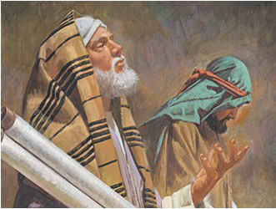
Judges 20:14
But the children of Benjamin gathered themselves together out of the cities unto
Gibeah, to go out to battle against the children of Israel.
The Hebrew men of war were all accounted for (verses 15 to 17), and then the Hebrew nation undertook a very important preliminary precaution; they assembled at the House of Worship, to ask guidance from Yahuah.
Judges 20:18
And the children of Israel arose, and went up to the house of
Elohim, and asked counsel of Elohim, and said, Which
of us shall go up first to the battle against the children of Benjamin?
And Yahuah said, Judah shall go up first.
This was the 1st of three occurrences
of the Hebrews in consulting with Yahuah
for guidance concerning this terrible event.

Slide 24
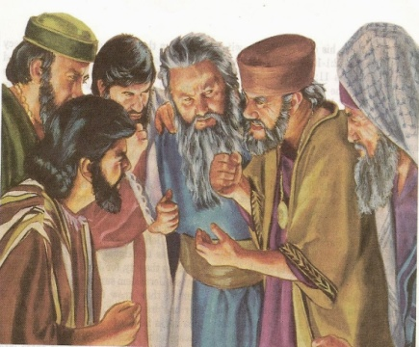
Judges 20:19
And the children of Israel rose up in the morning [<boqer>], and encamped against Gibeah.
morning H1242; <boqer>; from H1239; properly, dawn (as the break of day); generally, morning: KJV - (+)day, early, morning, morrow.
  H1239 <baqar>; a primitive root; properly, to plough, or (generally) break forth, i.e. (figuratively)
  to inspect, admire, care for, consider: KJV - (make) inquire (-ry), (make) search, seek out.
The warriors arose before sunrise, at Dawn, and prepared for war. However, they were soundly
defeated by the Benjamites. The next cycle (2nd day), they assembled before Yahuah for a 2nd time.
In this instance they were weeping and pleading until even.
Judges 20:23
(And the children of Israel went up and wept before Yahuah
until even, and asked counsel of Yahuah, saying, Shall I go up
again to battle against the children of Benjamin my brother?
And Yahuah, said, Go up against him.)
The Hebrew word used here for – even, is <orb> or <ereb>.

Slide 25
Etymological Dictionary of the
Hebrew Language
<orb> evening; to set (said esp. of the sun), to enter, go in, to go down, it became evening, it grew dark, to change, to exchange, to mix, mixed, mingled, mixed company, sunset, evening, entering of the sun, weft, woof.
Strong’s
H6153 `ereb; from H6150; dusk: -- + day,
even(-ing, tide), night.
A Hebrew Lexicon (by John Parkhurst – 1762)
to mix, to mingle, from midday to night.
(Note: There is a very revealing page excerpt from this source on the meanings of evening, which includes the phrase <ben ha arbayim> (between the two evenings) for the slaying of the Passover Lamb. If this interests
you, please request the excerpt.)
The Israelites were asking for guidance from Yahuah until the mixing of the Light Season with the darkness of Night Season. The battle commenced on the <boqer> morning – (Dawn) of the
next new cycle.
A 2nd time the Benjamites delivered the Israelites a resounding defeat
(Judges 20:25).
Here is the 3rd time the Israelites petitioned Yahuah (this time with
fasting and sacrificial offerings.)
It is the 2nd time Scripture records these words “until even.”

Slide 26
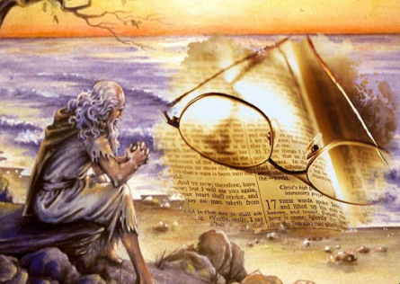

Judges 20:26
Then all the children of Israel, and all the people, went up,
and came unto the house of Elohim, and wept, and sat there
before Yahuah, and fasted THAT DAY until even, and offered
burnt offerings and peace offerings before Yahuah.
Recalling from the definitions, the timeframe is now in
the mixing of light <ereb> … evening/dusk is nearing.
What was Yahuah’s response to their inquiries?
Judges 20:28
And Phinehas, the son of Eleazar, the son of Aaron, stood before it in those days,) saying, Shall I yet again go out to battle against the children of Benjamin my brother, or shall I cease? And Yahuah said, Go up, for TOMORROW I give them into thine hand.
Yahuah said, Go up, for TOMORROW
I give them into
thine hand.

Slide 27
It is IMPERATIVE we understand the word – TOMORROW – <machar> correctly.
  Strong’s
  H4279 machar; maw-khar‘ - probably from H309; properly, deferred, i.e. the morrow; usually
  (adverbially) tomorrow; indefinitely, hereafter:-- time to come, tomorrow.
Etymological dictionary of the Hebrew Langauge
מ ח ר – to-morrow, time in front, the morrow.
A Hebrew Lexicon (by John Parkhurst – 1762)
(as a noun) or particle מ ח ר is used for commutation or change of time, as of to-morrow for this day.
Henceמ ח ר to-morrow, the morrow.
Also מ ח ר denotes time at a greater distance, time to come, time hereafter, Exo 13:14, Deut 6:20, Josh 9:6, Morrow, also morn, morning.
Yahuah said, Go up, for TOMORROW I give them into thine hand.
Webster’s Encyclopedic Dictionary of the English Language
The next day after the present or after any day specified. Good Morrow, a term of salutation. To-morrow, on the morrow, the next day.

Slide 28

OK … it’s time for a little perspective here:
➢ Three [3] times the Israelites petitioned Yahuah. (Judges 20:18, 23, 26)
➢ Two [2] times it is recorded they petitioned until the evening - <ereb>. (Judges 20:23, 26)
➢ The 3rd time they were desperately seeking advice so they added fasting, burnt offerings and peace offerings to their petitions. Out of desperation they eagerly went until dusk not letting any precious time slip by unnoticed. (Judges 20:26)
➢ At the end of the Light Season – evening – (dusk; after sunset), Yahuah answered them “… Go up, for tomorrow I will deliver them into your hand.” (Judges 20:28)
➢ When Yahuah was speaking/commanding, the dusk (<ereb>) was settling in.
The use of the word <machar> - tomorrow, for the timing start of the battle, would necessarily (by definition) cause the battle to begin at the following dusk, 24 hours away –
1. SUNSET BEGAN THE CYCLES! … OR …
2. The battle could begin tomorrow <machar> morning
as promised, according to Dawn Design per Creation exposure!
If:

Slide 29

Scripture tells us they went up to battle on the third <yowm> (day).
The men of Israel pursued and eliminated the Benjamites “toward the sunrising,” or … to the east side of the city. (Judges 20:43)
25,000 warriors died upon “that” day! (Judges 20:46)
Let’s place the 4th point (that Yahuah answered them in the evening of what to do) onto a chart to be sure of when Yahuah was answering the Israelites and exactly when the “tomorrow” would have been.
Men of Israel Pursue the Benjamites
Yahuah said, Go up, for TOMORROW
I give them into
thine hand.
Notes:
Map and video the levite and his concubine: https://www.youtube.com/watch?v=70zOjq02b8k

Slide 30
3rd 24 HR Sunset Theory Cycle
Chart #1of 3 Sunset Theory’s Attempted Application
of Yahuah’s Command
Sunset
Sunset
 | Battle #2 (Jdg 20:25)
1. On this second cycle (or was it the third cycle
by reason of a sunset?),
after their second battle with Benjamin,
the children of Israel gathered at the House
of Yahuah weeping,
fasting and offering
burnt offerings and
peace offerings,
UNTIL EVENING.
Judges 20:26
2. Yahuah answers:
“Go up, for TOMORROW
I give them into thine hand.”
Judges 20:28
3. Sunset’s tomorrow begins here!
Is this when the Israelites
“rose up early in the morning” to battle?
(See Judges 20: 30.)
The Israelites operated as in the former contests. Verse 19 tells us they were up at <boqer> (Dawn!) to begin the battle!
4. Was it actually
the 3rd cycle?
Question: If the Israelites were still gathered after sunset (evening/even)
on the cycle after the 2nd battle, what cycle was it according to Sunset Theory?

Slide 31
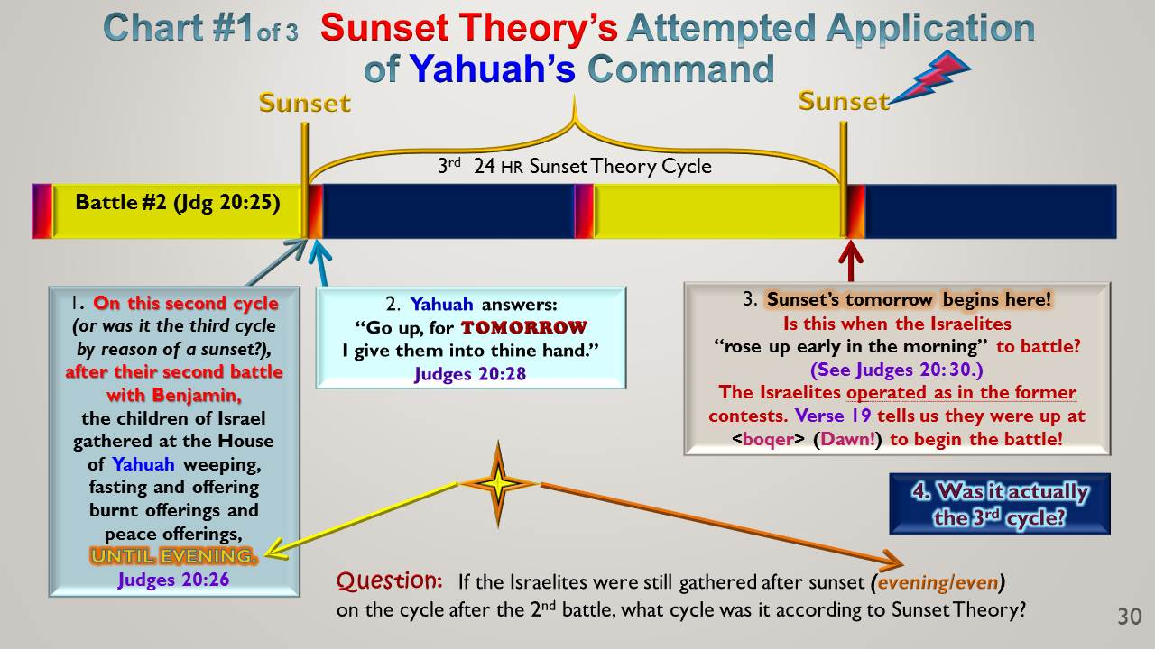
Scenario #1:
If Yahuah’s Words (spoken
in Box #2), were indeed spoken on the 3rd cycle, by reason of the Sunset Theory, and the Hebrew warriors went to battle the very next morning, or even sometime BEFORE THE NEXT SUNSET occurred in this 3rd cycle …
Here’s the question: Could Yahuah be held responsible for
NOT DELIVERING their Benjamite brothers (opponents) into their hands
BEFORE ”the tomorrow” began at SUNSET?

Slide 32
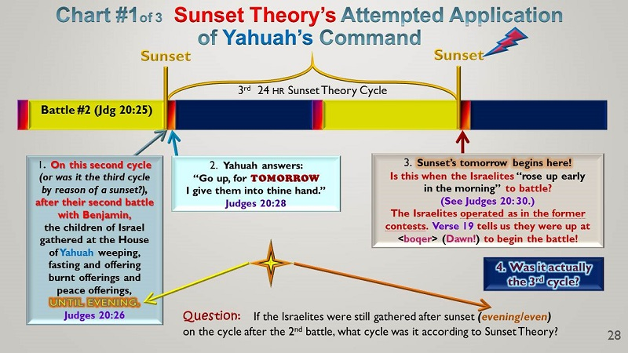

Scenario #2:
If the Hebrew warriors had waited for nearly 24 hours
until the sunset arrived bringing with it
“the tomorrow”
(& the promised deliverance) …
Question: Was the final battle actually fought on the 4th cycle (rendering the Scripture documentation INCORRECT)? (See Judges 20:30.)

Slide 33
Do you see the confusion here?
Do you see the definite misfit of information caused by the erroneous idea that sunset changes the cycles?
What happens when the divine system of Dawn, (beginning the cycles as documented in
Genesis 1), is arranged into this event?

Slide 34

Cycle #2
Cycle #3
Chart #2 of 3 Yahuah’s 2nd Cycle Command: Dawn Design
Dawn
Dawn
Dawn
 | Battle #2 (Jdg 20:25) |  |  |  | Battle #3 (Jdg 20:28)
1. On this second cycle after their second battle with Benjamin,
the children of Israel gathered at the House
of Yahuah weeping,
fasting and offering
burnt offerings and
peace offerings,
UNTIL EVENING.
Judges 20:26
2. Yahuah answers:
“Go up, for TOMORROW
I give them into thine hand.”
Judges 20:28
3. TOMORROW
< machar >
begins here with DAWN, as per the Creation account of Genesis 1.
Israel, as in the 1st battle,
rises at <boqer> (Dawn),
the start of the new cycle,
on “the tomorrow,” ready
to do battle with Yahuah as
their Commander in chief!
(See Judges 20: 30.)
The battle can begin on the
3rd cycle, as documented, reflecting perfect alignment
with the Hebrew language
it was recorded in!
Hhmmm….!!!
Please note: It becomes quite clear that the Dawn design from the Creation account fits firmly into these Scriptures with no juggling necessary! NICE!?

Slide 35

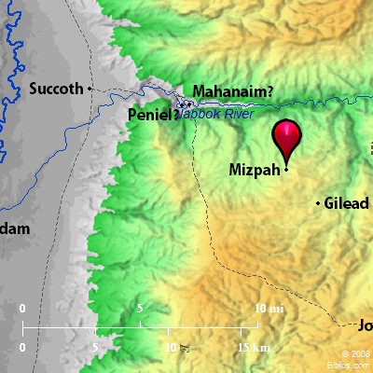

Is it possible to find a second witness to this revelation within the same book of Judges?
How about
the very next
chapter in
Judges 21:1-4
where something
happens at Mizpah?

Slide 36
The Decision at Mizpah - Judges 21:1-2
1 Now the men of Israel had sworn in Mizpah, saying, There shall
not any of us give his daughter unto Benjamin to wife.
2 And the people came to the house of Elohim, and abode there
till even before Elohim, and lifted up their voices, and wept sore;
Note again: The Israelites presented themselves before Yahuah, petitioning Him for answers. Yes, they were there until the Light Season began mixing with the darkness of the Night Season or “until evening.” This evening, <ereb>, is the identical time that Yahuah came to walk with Adam and Eve in the cool of the evening, when the gentle breezes began to blow. (Gen 3:8)
Judges 21:3
3 And said, O Yahuah Elohim of Israel, why is this come to pass
in Israel, that there should be TO DAY one tribe lacking in Israel?
Do you realize the petitioning words of “this come to pass” was spoken to Yahuah – after the sun had gone down? When the mixing of light was occurring??
Now let us understand the importance of the next verse.

Slide 37
Judges 21:4
4 And it came to pass on the morrow, that the people rose early, and built there an altar, and offered burnt offerings and peace offerings.
To be early, by definition, is to be at the very beginning of a specified identity. In accordance with Sunset Theory
the new weekly cycle begins at sunset.
Therefore IF Sunset Theory is applied to this verse,
“the morrow” (or tomorrow) would have the Israelites rising early on the morrow AT SUNSET to worship!!!
Do you see a problem here?

Slide 38
Yes, there definitely is a problem here!
We have already seen the definitions and determined the “morrow” <machar> begins with Dawn <boqer> on the next cycle.
The very next time the Dawn arrives, the morrow begins!
For this particular situation, we will consider one more chart demonstrating both Dawn days and Sunset Theory days. The chart will show the beginning of the events that lead up to the verses of Judges 21:16-23.
(Remember: The tribe of Benjamin needed wives, or eventually face the consequences of extinction!)

Slide 39
Battle #3 – 25,000 Benjamites smitten!
Chart #3 of 3 Arising Early on the Morrow!
Breaking of Day - Gen 32:24, 26
Dawn
Yahuah’s 24 hour cycle #1
Dawn
Yahuah’s 24 hour cycle #2
Judges 20:35 |  | Day of grief and restoration
24 hr Sunset to Sunset Deception
Sunset
?
1. So the people came to the house of Beyth El, and sat there until EVENING before Elohim, and lifted up their voices and wept bitterly.
Judges 21:2
2. And said “O Yahuah Elohim of Yisra’el, why has this come about in Yisra’el, that …………
there should be one tribe missing in Yisra’el?
Judges 21:3
3. And it came to be on the... MORROW, that the people rose EARLY
to build an
altar there, and brought burnt offerings and peace offerings.
Judges 21:4
4. Note the red box information.
Did the Yisra’elites arise “early
at sunset,” build an alter and begin worship services after sunset?
Did they then continue on sacrificing through darkness of the Night Season?
The word EARLY by definition demands a timeframe at the start of a given identity.
TODAY

Slide 40
Questions to Ponder:
Is it now possible for you to see the simplicity and perfect alignment when applying Yahuah’s Dawn Design to the Scriptures?
Do you see how impossible it is for Sunset Theory to align
with the original Hebrew words that Yahuah has preserved
for thousands of years?
How is it possible that Sunset Theory is still being taught as if
it were an established Torah truth?
Is it any surprise that Sunset Theory was adopted and incorporated by the same religion that tortured & crucified our Mashiach?
Is it now possible for you to see the simplicity and perfect alignment when applying Yahuah’s Dawn Design to the Scriptures?
Do you see how impossible it is for Sunset Theory to align
with the original Hebrew words that Yahuah has preserved
for thousands of years?
How is it possible that Sunset Theory is still being taught as if
it were an established Torah truth?
Is it any surprise that Sunset Theory was adopted and incorporated by the same religion that murdered our Mashiach?

Slide 41
The facts are these …
Most of us have been ingrained so heavily with established ideas, claiming to be truth from Scripture, that it has become very difficult to part with these falsehoods.
Through many personal experiences, it is a most difficult challenge to “unlearn” and let these warped traditions go.
To understand “how and why” Yahuah’s days commence with Dawn is very simple, if only we will accept the meanings of each Inspired Word at face value.
When we are willing to do this, understanding “Dawn” becomes quite simple, wonderful and easy.

Slide 42
This study ends with an appeal!
Friend, will you choose to be like
a “Belligerent Benjamite”
guarding convoluted traditions?
Or will you heed the Torah and accept the Dawn Day
to begin the weekly cycles, Shabbats, including all Feasts and Festivals just as Yahuah has so positively proclaimed throughout the Scriptures?
The right decision just may change your life!

Slide 43


This is just one of a multitude of testimonies for Yahuah’s Day – start at Dawn.
If you have been blessed,
share your joy with others.
Any questions & comments will be answered at:
questions@studythecalendar.com
Thank you & Shalom The End

