Slide 1

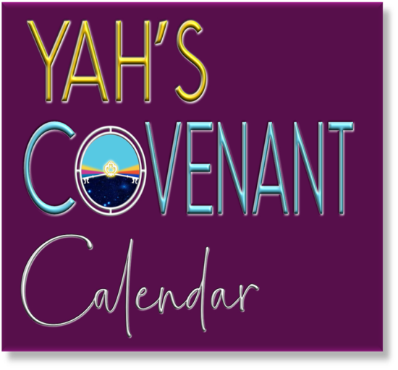


Slide 2

Just for clarification: In my presentations I am using YHVH (Yahuwah or Yahweh) instead of LORD, which is a title and not a name and I am using Yahusha or Yahshua instead of Jesus, which is not a translation but a transliteration and really has no meaning, either in Hebrew nor in English! YHVH (Yahuwah) and Yahusha are the actual original names and the true nature and character of them.

Slide 3
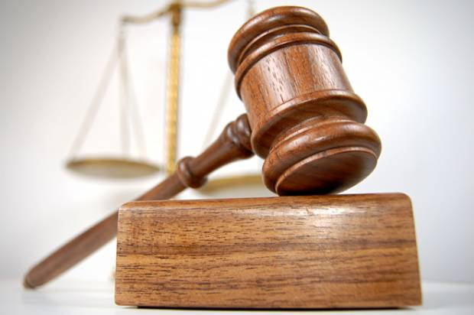
A Time To Be Silent!

Slide 4

Ecclesiastes 3:7
(New American Standard Version - NASV)
“A time to tear apart and
a time to sew together;
A time to be silent and a time to speak.”

Slide 5
There are times when we know something,
like a piece of gossip, and we should not say it;
we ought not to speak.
There are times when we ought to speak,
when something we are keeping secret would deliver someone or bring truth into a situation;
a time to speak up.
So there is a time to speak and
there is a time not to speak!

Slide 6
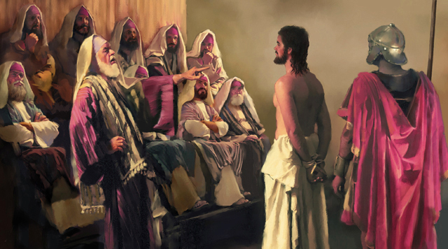
We have an instance in Mark 14:60 “Then the high priest stood up before them and asked Yahusha,
“Are You not going to answer? What
is this testimony that these men
are bringing
against You?”
61. But Yahusha remained silent
and gave no answer.

Slide 7
Yahusha gave no answer to the accusations of the high priest, because they were false accusations, neither do we have to defend ourselves,
when we are falsely accused.
Yahusha decided to not respond to false accusations. If He had denied the accusations, what would that have accomplished?
Absolutely Nothing.

Slide 8
However, when the high priest asked Him again, “Are you the Messiah, the Son of the Blessed One?” 62. “I am,” said Yahusha. “And you will see the Son of Man sitting at the right hand of the Mighty One and coming on the clouds of heaven.”

Slide 9
When Yahusha was presented with an opportunity to espouse and reveal truth, in this case who He really was,
He did not remain silent.
He could not, and neither can we, if we have the opportunity to witness for truth.

Slide 10

If you’re faced with a difficult situation at work, at home, in a friendship or witnessing for Yahusha, it’s important to know when to speak and when to keep quiet. When it comes to your life, your well-being or the life and well-being of someone else, you most definitely should speak up.

Slide 11
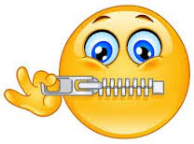
“The wise man knows when to keep silent. Only the fool tells all he knows.”
Proverbs 21:23 (English Standard Version) “Whoever keeps his mouth and his tongue keeps himself out of trouble.”
Psalm 141:3 (ESV) “Set a guard, O Yahuwah, over my mouth; keep watch over the door of my lips!”
Proverbs 10:19 (ESV) “When words are many, transgression is not lacking, but whoever restrains his lips is prudent.”
Proverbs 17:28 (ESV) “Even a fool who keeps silent is considered wise; when he closes his lips, he is deemed intelligent.”
1 Peter 3:10 (ESV) “Whoever desires to love life and see good days, let him keep his tongue from evil and his lips from speaking deceit.”

Slide 12
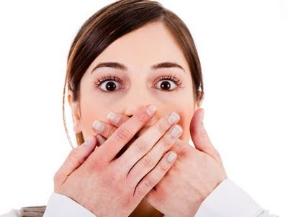
Biting our tongue! I think we can all benefit from doing it more often. We all know that, as we have personally learned the hard way on many occasions. The scriptures have much to say on this subject.
And, mankind has learned much from his experience. May we not only learn from our mistakes but let us learn from other’s experience.
We want to take the opportunity today to learn from the experience of a great man of Yahuah, the High priest Aaron himself.

Slide 13
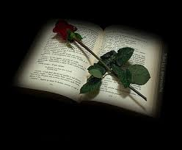
In Leviticus 10:1-3 we read (KJV): “And Nadab and Abihu, the sons of Aaron, took either of them his censer, and put fire therein, and put incense thereon, and offered strange fire before YHVH, which He commanded them not. 2. And there went out fire from YHVH, and devoured them, and they died before YHVH. 3. Then Moses said unto Aaron, This is it that YHVH spake, saying, I will be sanctified in them that come nigh me, and before all the people I will be glorified.
And Aaron held his peace.”
Bible in Basic English “And Aaron said nothing.”
CJB “And Aaron was silent.”
Contemporary English Version “And Aaron was speechless.”

Slide 14
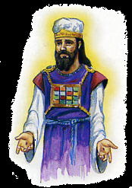
This must have been very hard for Aaron.
I assume he greatly loved his two sons.
How many would have responded in outrage? How many would have been disillusioned to continue in ministry unto Yahuah?
Not only do we learn from the mistake of Aaron’s two sons that we should not approach Yahuah and serve Him in any way we see fit,
and that we should serve and worship Yahuah according to what He has commanded…

Slide 15
… But, we also see from Aaron’s example how we are to handle tragedy that Yahuah has allowed in our life, and in general, any difficult situation.
When we experience a great tragedy or distress in our life will our faith crumble?
Have we placed more value in our relationships with people than we have placed in our relationship with the Elohim whom created us? Do we love Yahuah so much more than any other that we will continue to serve Him without skipping a beat, no matter what happens?

Slide 16
Although it would certainly be difficult to emotionally proceed in serving Yahuah in the situation that Aaron experienced…this is exactly what Moses prescribes. In Leviticus 10:6-7 (KJV) we read, “And Moses said unto Aaron, and unto Eleazar and unto Ithamar, his sons, ‘Uncover not your heads, neither rend your clothes; lest ye die, and lest wrath come upon all the people: but let your brethren, the whole house of Israel, bewail the burning which YHVH hath kindled. 7. And ye shall not go out from the door of the tabernacle of the congregation, lest ye die: for the anointing oil of YHVH is upon you. And they did
according to the word of Moshe.’

Slide 17

It is not that Moses or Yahuah was commanding that no one could mourn the deaths of Aaron’s sons. The point was that if you have been anointed and appointed by Yahuah to serve Him, nothing should get in the way of this, not broken relationships, or even the death of loved
ones. Our Master Yahusha taught us thus in Luke 14:26 (KJV), "If any man come to me, and hate not his father, and mother, and wife, and children, and brethren, and sisters, yea, and his own life also, he cannot be my disciple.”

Slide 18

This statement from Yahusha in Luke 14:26 (KJV) is sometimes misunderstood. Just a few chapters earlier (Luke 6:27, 31-32), He had given the charge, “But I say to you who hear: Love your enemies, do good to those who hate you…just as you want men to do to you, you also do to them likewise. But if you love those who love you, what credit is that to
you? For even sinners love those who love them.” Here, He was giving some of the elementary guidelines to being His followers. In verse 29,
He introduced the principle of “turning the other cheek.” Many “higher critics” target certain scriptures and use them to try to discredit the Bible, claiming that it contradicts itself.
But John 10:35 plainly shows that Yahuah’s Word does not contradict itself.

Slide 19
Luke 14:26 is an example of a scripture cited by such critics in order to “prove their point.” Here is the text “If any man come to me, and hate not his father, and mother, and wife, and children, and brethren, and sisters, yea, and his own life also, he cannot be my disciple.”
But is it contradictory? To fully understand Messiah’s meaning here, the meaning of the Greek word translated “hate” must be examined.
In this verse, the original Greek word is “miseo,” meaning “TO LOVE LESS” (Strong’s Exhaustive Concordance of the Bible). Therefore, Yahusha is saying that anyone following Him, making a commitment to His way of life, must love Him more than family and friends, and even life itself.

Slide 20
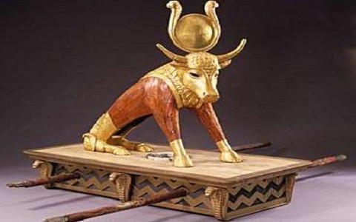
Coming back to Aaron. He may have felt guilty for the actions of his sons, that maybe he didn’t train them properly to approach Yahuah in holiness. As Fathers we all have the responsibility to teach this to our sons (and daughters). Previously, Aaron was guilty of making the golden calf that had so
angered YHVH the time before. Aaron may have felt like he was a failure, and that he had again failed the Elohim of Israel. But, if we are humble and silent before Yahuah, and we submit ourselves before Him, and commit our lives into His hands…He will lift us up. For He is an Elohim that is rich in grace, mercy, and long-suffering. We also see these same qualities in our Master Yahusha.

Slide 21
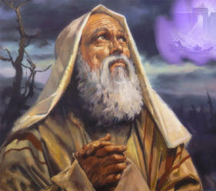
In John 21:14-17 we read about a man that we now consider to be great, but that had actually miserably failed Yahusha The Messiah on multiple occasions yet was shown much grace and mercy. Even in Peter’s failings, even to the point of denying Yahusha as His Master, Y’shua continued to call Peter (Kefa) to serve Him.
Starting in John 21:14-15 (KJV) we read, “This is now the third time that Yahusha shewed himself to his disciples, after that He was risen from the dead. So when they had dined, Yahusha saith to Simon Peter, Simon, son of Jonas, lovest thou me more than these?”

Slide 22
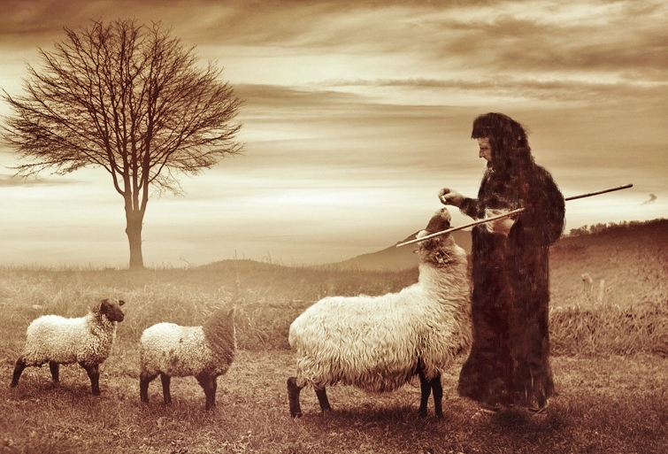
He said to him, "Yes, Master; you know
that I have affection
for you."
He said to him, "Feed my lambs."

Slide 23
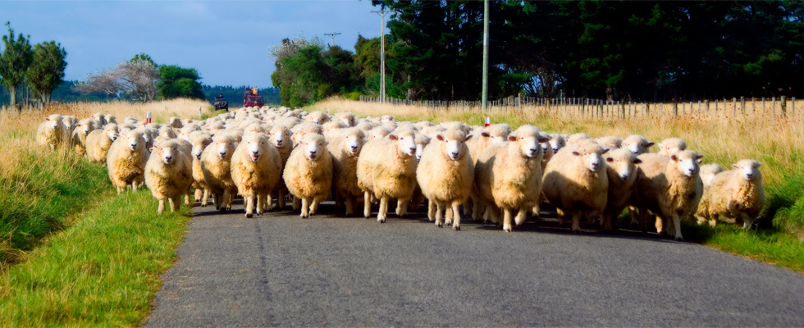
“He saith to him again the second time, Simon, son of Jonas, lovest thou me? He saith unto him, Yea, Master; thou knowest that
I love thee. He saith unto him, Feed my sheep."

Slide 24

He saith unto him the third time, Simon, son of Jonas, lovest thou me? Peter was grieved because
He said unto him the third time, Lovest thou me? And he said unto Him, Master, thou knowest all things; thou knowest that I love thee. Yahusha saith unto him, Feed my sheep.

Slide 25
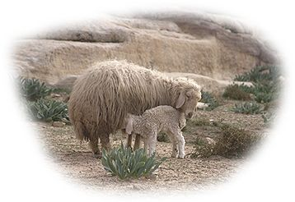
Even during emotionally trying circumstances, our best reaction is to do as Aron did, be silent
before Yahuah Elohim,
submit to Him, and listen to
His instructions, His Torah.
We are to humbly submit as Peter did and tend to Yahusha’s sheep. This is exactly what many in Yahusha’s Assembly today need to
learn and practice, to steadfastly continue serving YHVH in silence,
even through various distressing situations.

Slide 26
But intentions to serve YHVH, or simply talking about how you
want to serve Him doesn’t cut it.
It is better ‘to do’ than to talk about ‘doing’ or to talk about how much we have learned when this learning and experience is not resulting in doing Yahuah’s works.
When three strangers came to Abraham’s door he said, “Let a little water be brought, and then you may all wash your feet and rest under this tree. Let me get you something to eat, so you can be refreshed and then go on your way—now that you have come to your servant” (Genesis 18 : 4-5).

Slide 27
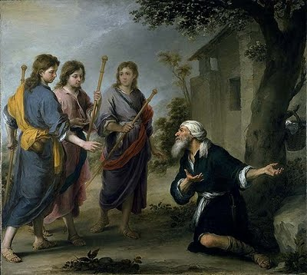
But then he told Sarah to kneed three seahs (about 50 pounds!) of their finest flour into bread. He next ran out to his herd and chose one of his best calves, choice and tender, and found a servant to prepare it. And then he brought some curds and fresh milk too. It would have taken most of a day to prepare this luscious feast. The bread would need to rise, and the calf
would need to roast for hours. I think there would have been enough food for fifty people or more. Abraham may have had no idea at first, who these strangers were who came to his door, and all he promised them first was
a little water and just a bite to eat to tide them over for their trip.
But instead, he rolled out the red carpet
and prepared a luxurious feast for them.

Slide 28
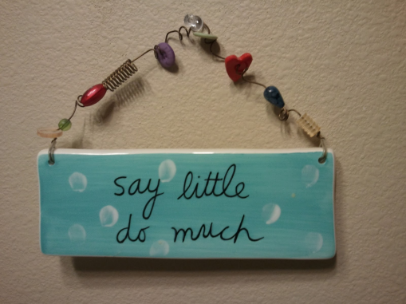
A great rabbi, who lived about fifty years before Yahusha, shared an excellent comment
on how to live by Abraham’s example: “Say little, do much.” A later rabbi added, “What does this mean? It teaches that the righteous say little and do much, whereas the wicked say much and do not even a little.”

Slide 29
Yahusha said a similar thing when He told the parable about the two sons in Matthew 21:28-31:
“What do you think? There was a man who had two sons. He went to the first and said, ‘Son, go and work today in the vineyard.’ ‘I will not,’ he answered, but later he changed his mind and went. Then the father went to the other son
and said the same thing. He answered, ‘I will, sir,’ but he did not go. Which of the two did what his father wanted?”

Slide 30
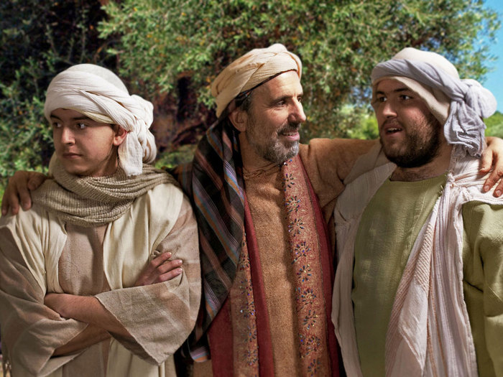
One son had the shocking shameless audacity (chutzpah) to say “no” to his father, something a son didn’t do back in those days!
But then he went and did what he was told.
The other respectfully said, “Yes, sir!”
And then he didn’t actually do what he was supposed to.

Slide 31
And, with this James agrees as we read in chapter 1:22-26 (CJB): “But be doers of the word, and not only hearers, deluding your own selves. For if anyone is a hearer of the word and not a doer, he is like a man looking at his natural face in a mirror; for he sees himself, and goes away, and immediately forgets what kind of man he was. But he who
looks into the perfect Torah of freedom, and continues, not being a hearer who forgets, but a doer of the work, this man will be blessed in what he does. If anyone among you thinks himself to be religious while he doesn't bridle his tongue, but deceives his heart, this man's religion is
worthless.”

Slide 32
Just prior to our last passage, it states the following in James 1:19-21 (CJB),
“So, then, my beloved brothers, let every man be swift to hear, slow to speak, and
slow to anger; for the anger of man doesn't produce the righteousness of Elohim.
Therefore, putting away all filthiness and overflowing of wickedness, receive with humility the implanted word,
which is able to save your souls.”

Slide 33
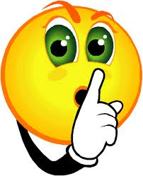
It is best to be silent
in absence of information!
Proverbs 18:13 (BBE) has this to say in reference to that: “To give an answer before hearing is a foolish thing and a cause of shame.”
The Contemporary English Version (CEV) puts it this way: “It's stupid and embarrassing to give an answer before you listen.”

Slide 34
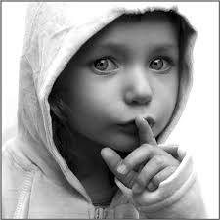
If all we have is hearsay, meaning we don’t have all the information at hand, we don’t have all the facts, then keeping silent is best and especially
in the presence of a talebearer!
The best and wisest policy is to hear a matter out
in full before you either repeat or respond to it!
In the mean time it is advised to KEEP SILENT!
We don’t want to become talebearers or make false accusations or false judgments because of not knowing the facts!

Slide 35
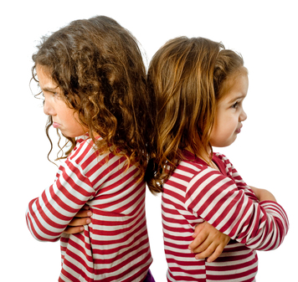
Let’s remember that failure to keep silent in these matters can and will ruin friendships!
Proverbs 16:28 in the Literal Translation of the Bible (LITV) states: “A perverse man causes strife,
and a whisperer separates close friends.”

Slide 36
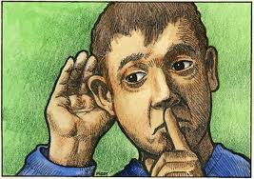
Also in situations that we find ourselves being agitated or when we are going through much emotional stress, we are encouraged to be slow to speak. In Proverbs 17:27-28 (CJB) we read, “He who spares his words has knowledge. He who is even tempered is a man of understanding. Even a fool, when he keeps silent, is
counted wise. When he shuts his lips, he is thought to be discerning.”
And again, in Proverbs 29:20,
“Do you see a man who is hasty in his words? There is more hope for a fool than for him.”

Slide 37
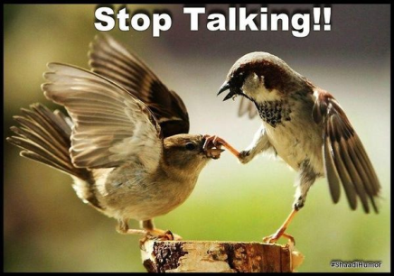
Especially when we are drawing close to serve YHVH, we need to be cautious how we conduct ourselves. We need to spend more time listening to HIM than we do talking to Elohim or others about how we plan to serve. In the book of Ecclesiastes (CJB) 5:1-3 we read, “Guard your steps when you go to Elohim's house; for to draw near to listen is better than to give the sacrifice of fools, for they don't know that they do evil.
Don’t be rash with your mouth and don't let your heart be hasty to utter anything before YHVH; for YAH is in heaven, and you on earth. Therefore let your words be few. For as a dream comes with a multitude of cares, so a fool's speech with a multitude of words.”

Slide 38
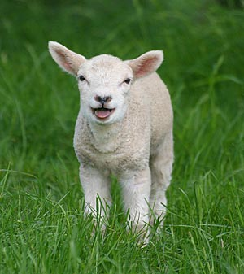
In the book of Isaiah 53:7 (Complete Jewish Bible - CJB) we read about Messiah’s sufferings.
It states, “He was oppressed, yet when He was afflicted He didn't open His mouth; as a lamb
that is led to the slaughter,
and as a sheep that before
its shearers is silent,
so He didn't open His mouth.”

Slide 39

Our Messiah was persecuted unfairly, but because of righteousness’ sake, He suffered patiently. In like manner, if we find ourselves suffering for faults not of our own, whether it be in personal relationships, at our work, or otherwise, we need to follow Messiah’s example of righteously responding with silence,
and not opening our mouth to guile.

Slide 40
1 Peter 2:18-23 states (CJB): “Servants, be in subjection to your masters with all fear; not only to the good and gentle, but also to the wicked. For it is commendable if someone endures pain, suffering unjustly, because of conscience toward Elohim.
For what glory is it if, when you sin, you patiently endure beating? But if, when you do well, you patiently endure suffering, this is commendable with YHVH…

Slide 41
… For to this you were called, because Messiah also suffered for us, leaving you an example, that you should follow His steps, who did not sin, "neither was deceit found in his mouth." Who, when He
was cursed, didn't curse back. When He suffered,
didn't threaten, but committed Himself to Him who judges righteously.”

Slide 42
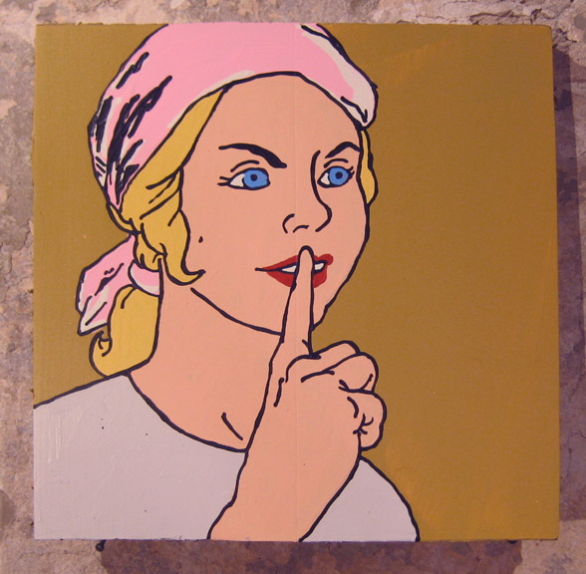
If we as Yahuah’s people can learn to bridle our tongues and learn more and more to be gentle with
quiet spirits, we will have come a long way in perfecting our walk before Yahuah. Chapter three
of the book of James has much to say about this.

Slide 43
"Let not many of you be teachers, my brothers, knowing that we will receive heavier judgment.
For in many things we all stumble. If anyone doesn't stumble in word, the same is a perfect man, able to bridle the whole body also. …

Slide 44
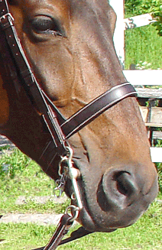
“… Indeed, we put bits into the horses' mouths so that they may obey us, and we guide their whole body. …

Slide 45

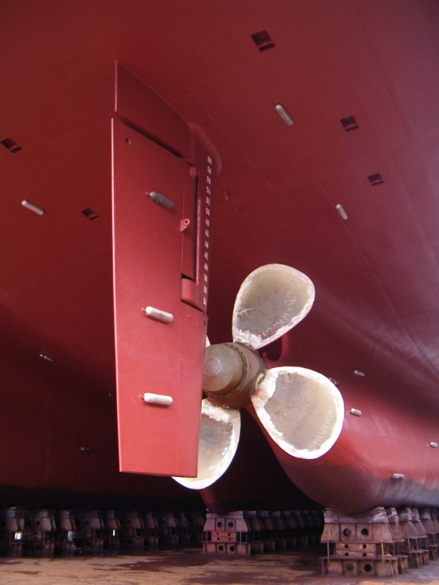
“…Behold, the ships also, though they are so big and are driven by fierce winds,
are yet guided by
a very small rudder, wherever the pilot desires. …

Slide 46
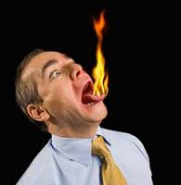
“… the tongue is also a little member and boasts great things. See how a small fire can spread to a large forest!
And the tongue is a fire. The world of iniquity among our members is the tongue, which defiles the whole body, and sets on fire the course of nature, and is set on fire by Gehinnom (Hell). For every kind of animal, bird, creeping thing, and thing in the sea, is tamed, and has been tamed by mankind. …

Slide 47
“… But nobody can tame the tongue.
It is a restless evil, full of deadly poison. With it we bless our Elohim and Father, and with it we curse men, who are made in the image of YHVH. Out of the same mouth comes forth blessing and cursing. My brothers, these things ought not to be so. …

Slide 48

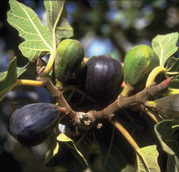
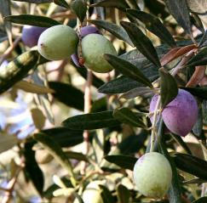
“… Does a spring send out from the same opening fresh and bitter water? Can a fig tree, my brothers, yield olives, or a vine figs? Thus no spring yields both salt water and fresh water. Who is wise and understanding among you?
Let him show by his good conduct that his deeds are done in gentleness of wisdom. But if you have bitter jealousy and selfish ambition in your heart, don't boast and don't lie against the truth. …

Slide 49
“… This wisdom is not that which comes down from above, but is earthly, sensual, and demonic. For where jealousy and selfish ambition are, there is confusion and every evil deed. But the wisdom that is from above is first pure, then peaceful, gentle, reasonable, full of mercy and good fruits, without partiality, and without hypocrisy. Now the fruit of righteousness is
sown in peace by those who make shalom.”
James 3:1-18 (Complete Jewish Bible)

Slide 50
I would like to consider Proverbs 17:27 again.
The KJV states: “He that hath knowledge spareth his words: and a man of understanding is of an excellent spirit.”
The Contemporary English Version states: “It makes a lot
of sense to be a person of few words and to stay calm.”
The NASV states: “He who restrains words has knowledge, and he who has a cool spirit is a man of understanding.”

Slide 51

To have “an excellent spirit,” “a cool spirit” and “to remain calm” means that one must “not lose control of his temper”!
Don’t become angry and speak out in a manner that would cause you to be sorry for what you had said or wish you could retract what you had said and could undo damage that can never be undone.
In Moments of Anger is the time to keep Silent!

Slide 52
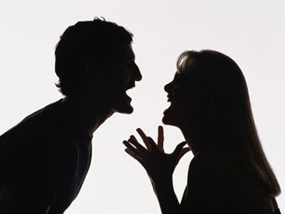
Proverbs 15:1
(KJV) “A soft answer turneth away wrath: but grievous words stir up anger.”
(Contemporary English Version - EV) “A kind answer soothes angry feelings, but harsh words stir them up.”
(Easy to Read Version - RV) “A gentle answer makes anger disappear, but a rough answer makes it grow.”
(Literal Translation of the Bible - LITV) “A soft answer turns back wrath, but a hurtful word stirs up anger.”
For this presentation I am interested in the last part of the verse because we are talking about when silence is best.

Slide 53
Proverbs 15:1
(KJV) “A soft answer turneth away wrath: but grievous words stir up anger.”
(Contemporary English Version - EV) “A kind answer soothes angry feelings, but harsh words stir them up.”
(Easy to Read Version - RV) “A gentle answer makes anger disappear, but a rough answer makes it grow.”
(Literal Translation of the Bible -LITV) “A soft answer turns back wrath, but a hurtful word stirs up anger.”
Grievous, harsh, rough or hurtful words should never be spoken. If you want to stir up a fuss, then of course you speak grievous words.
For this presentation I am interested in the last part of the verse because we are talking about when silence is best.

Slide 54

What are grievous words?
Grievous words are not necessarily words that make people feel bad, but these are words that are produced by the flesh instead of by the Spirit of Yahweh.
When they are produced by the flesh, then you can be sure they will stir up anger.
When they are produced by the Spirit of Yahweh, particularly in moments of anger, you will remain calm and probably silent!

Slide 55
Proverbs 16:32: The KJV states: “He that is slow to anger is better than the mighty; and he that ruleth his spirit than he that taketh a city.”
(Good News Bible) “It is better to be patient than powerful. It is better to win control over yourself than over whole cities.”
(God’s Word) “Better to get angry slowly than to be a hero. Better to be even-tempered than to capture a city.”
(Living Bible) “It is better to be slow-tempered than famous; it is better to have self-control than to control an army.”

Slide 56
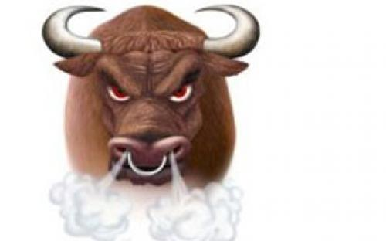
Let’s remember, if you can’t control your anger, and as a result you can’t control what comes out of your mouth,
you are the looser at the end!
For Scripture states in Matthew 12:37 (KJV):
“For by thy words thou shalt be justified,
and by thy words thou shalt be condemned.”

Slide 57
Therefore the advice is given in Ecclesiastes 5:2 (KJV) for each one of us: “Be not rash with thy mouth, and let not thine heart be hasty to utter [any] thing before Elohim: for Elohim [is] in heaven, and thou upon earth: therefore let thy words be few.”
According to this verse, to play it safe,
let your spoken words be few!

Slide 58
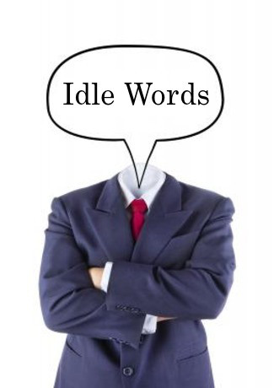
One needs to take that to heart. In the verse before Matthew 12:37, verse 36 Yasuah said: “…. every idle word that men shall speak; they shall give account thereof in the day of judgment.”

Slide 59

So the question is: Actually, what are idle words?
Idle words are useless for productive communication. Every empty, useless, unfruitful, unprofitable or careless word will be judged because it reveals the inner self. Believers should speak as those who are going to be judged at the judgment seat of Yahusha
(Jas. 2:12). Paul says Believers should not engage in “foolish talk” like this, and he categorizes it along with obscenity and coarse joking (Eph. 5:4). In many ways one’s conversation is an indicator of that person’s spiritual health (Jas. 3:1-12).

Slide 60

Idle words? – continued
Have you ever heard someone say, "I didn't really mean that! I wasn't thinking," or “I am just kidding!” Perhaps you've said something similar yourself. I know, I have done it!
An idle word is one that you said without careful thinking or consideration. Yahusha’s point is that you can tell a lot about a person's character, not by the major things they say, but by the little things which slip out, when they aren't putting much effort into being careful.

Slide 61
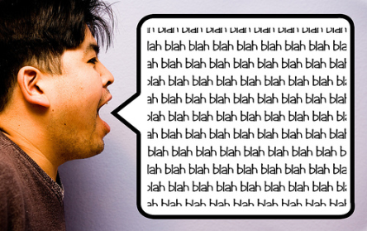
In today’s world idle words are all around us, on our cell phones, on our blackberries, in our emails, on the internet, on TV, on radio, raining down from our satellites, printed in our magazines and fictional books. We are bombarded by idle words
coming at us from a multitude of different ways. How many of these text messages, the emails that we get or even send at times are really idle words? Look at the Facebook and see how many words are crossing our path that can be called idle, useless, empty words. Some people spend hours and hours on the phone talking to everybody about everything.
Have you ever thought that at Judgment day we will have to give an account for every idle word that came out of our mouth? Is that a Sobering thought?

Slide 62
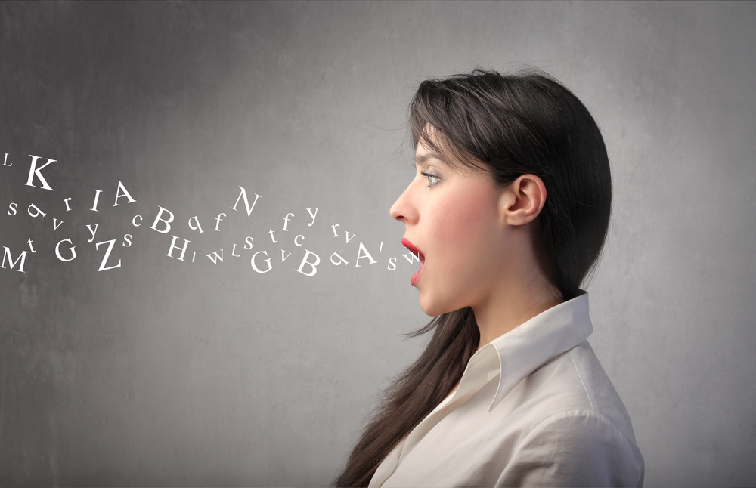
We can see that this whole matter of opening our mouth to communicate before man and before YHVH is of utmost importance.
Many times, what we don’t say is more important
than what
we do say.

Slide 63

Psalm 46:10 (KJV) states: “Be still, and know
that I [am] Yahuah:
I will be exalted among the heathen, I will be exalted in the earth.”

Slide 64
There is a time to be still, to be quiet, to keep silent in this present world while surrendering to Yahuah, the Elohim of Abraham, Isaac and Jacob, who is our refuge and strength! When we surrender to the sure truth that He is in complete control of this world, we will find Shalom from our temporary fears! Indeed, even though this present world will be shaken, with the nations raging and the kingdoms of men be moved, we will not fear since we know
Yahuah is our present help in time of trouble!

Slide 65
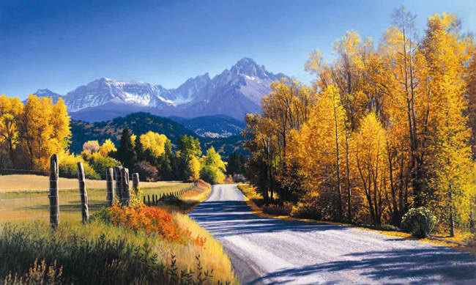
Time is indeed very short, and the world is shaking in fear.
Soon, very soon, we will see our King! So let’s be still, silent, confident and trusting, knowing that Yahuah is with us!

Slide 66
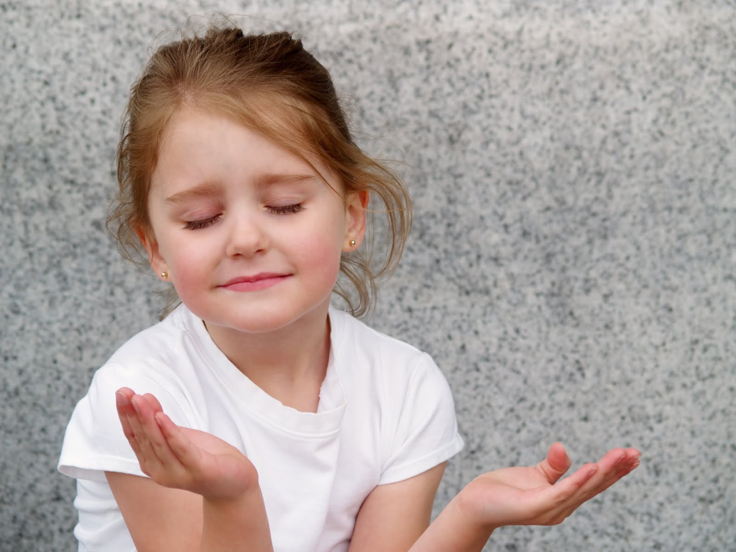
SHALOM

Slide 67
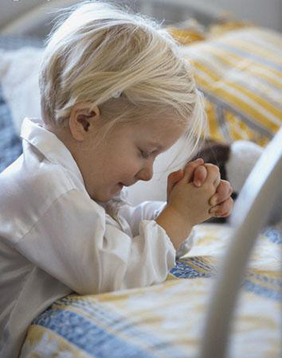
Supreme Provider
is Yahusha Ha Mashiach
Prepared and narrated by
Walter Tschoepe
Malachi4.4@Reagan.com

Slide 68
THE END!

