Slide 1


A SET-APART
PEOPLE, CALLED
HIS BRIDE!

Slide 2

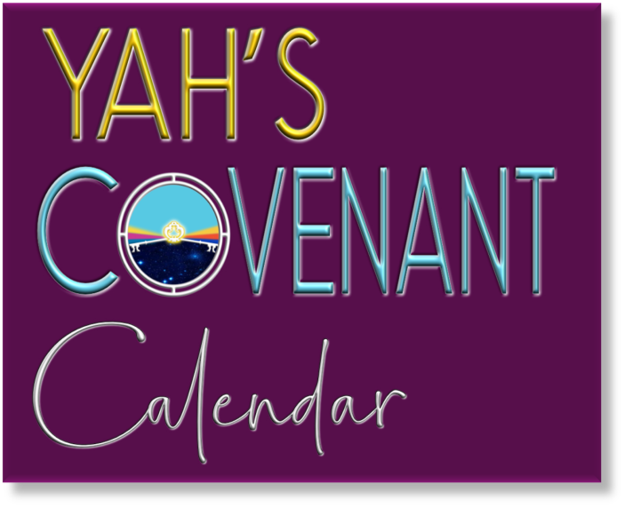
A TEACHING FROM:

Slide 3



Just a note, in my presentations I use the Hebrew Name of our Heavenly Father and His Son Yahusha. YHVH (pronounced as Yahweh, Yahuwah or Yahovah) is the name of the Heavenly Father. His name, which He says is "My memorial to all generations," (see Exodus 3:15) carries the meaning of "He is," or "He causes to be.” Did you know that the real name of our Heavenly Father is YHVH (Yahuwah, by some pronounced as Yahweh) and that Bible Translators admit to removing His Name over 7000 times from our Bibles and replacing it with the Title LORD and God.
Why is it that Satan’s name does not change in the Bible,
but Yahuwah and His Son Yahusha have deliberately been removed?
Was it done on purpose, inspired by Satan?

Slide 4
Why must His people, His bride,
His assembly, be set apart?

Slide 5
Because they
Belong to the
Great I AM!
He has redeemed, purchased them with a great price!

Slide 6
Being set-apart is
a salvational issue as it states in
Hebrews 12:14.

Slide 7
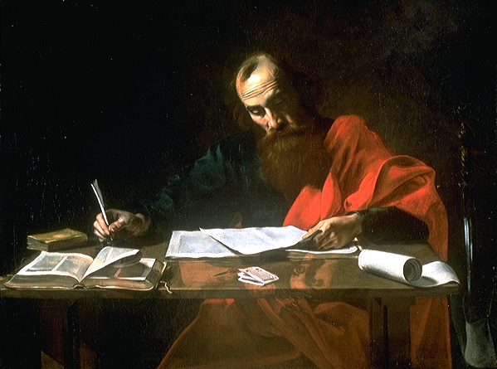
“Pursue peace with all and pursue apartness without which no one shall see the Master.” Hebrews 12:14 (The Scriptures)
Here are Paul’s exact words:

Slide 8
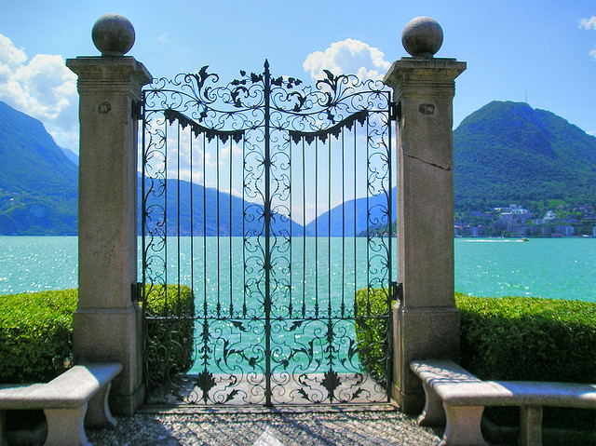
That means being
set -apart will OPEN
to us one of the gates
of the City of Yahuwah.

Slide 9
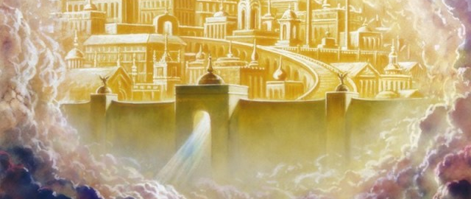
It states in Revelation 21:12 “And it had a wall great and high, with twelve gates, and at the gates twelve angels, and names written thereon, which are the names of
the twelve tribes of the sons of Israel.” (Jubilee Bible)

Slide 10
Did you notice, there is not one gate called Christianity, nor Lutheran, Catholic, Mormons, Yehovah Witnesses, Seventh-Day-Adventists, etc.
Notes:
We must become part of Israel, a spiritual Israelite!

Slide 11

Only those who are set-apart will receive the key to Paradise!

Slide 12

1 Peter 1:16 quotes the words of YHVH from Leviticus 11:44-45: “Be ye set apart
for I am set apart.”

Slide 13
As Yahuwah is, so must His followers be! Be set-part!

Slide 14
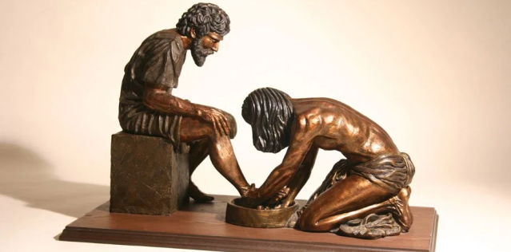
In John 15:20 Yahusha said: “Remember the word that I said unto you, The servant is not greater than his lord.
If they have persecuted me, they will also persecute you; if they have kept my saying, they will keep yours also.” (KJV)

Slide 15

HIS PEOPLE MUST BE
Which means …

Slide 16
They must “… have no fellowship with the unfruitful works of darkness,
but rather reprove them.”
Ephesians 5:11 (KJV)

Slide 17
“Thus said יהוה (Yahuwah) Do not learn the way of the nations, and
do not be awed by the signs of
the heavens, for the nations are
awed by them.”
Jeremiah 10:2 (The Scriptures)
17

Slide 18
“Now therefore, if ye will obey my voice indeed, and keep my covenant,
then ye shall be a peculiar treasure
unto me above all people:
for all the earth [is] mine.” Exodus 19:5
There is a condition!

Slide 19
“Who gave himself for us, that he might redeem us from all iniquity, and purify unto himself a peculiar people, zealous of good work.”
Titus 2:14

Slide 20
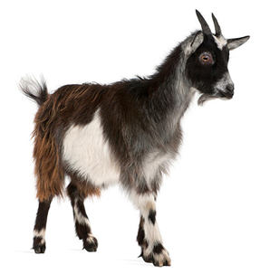
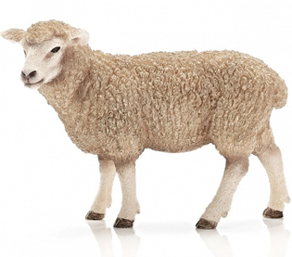

Are you a sheep or a goat?
It stated in this verse “zealous of good work!”
Ask yourself the question “Am I a sheep or a goat?”

Slide 21
“But ye [are] a chosen generation,
a royal priesthood, a holy (set-apart) nation, a peculiar people; that ye should show forth the praises of him who hath called you out of darkness into his marvelous light.”
1Peter 2:9 (KJV)

Slide 22
“But you are YAH’s chosen and special people. You are a group of royal priests and a holy nation.
YAH has brought you out of darkness into his marvelous light. Now you must tell all the wonderful things
that he has done. …” 1Peter 2:9
(Contemporary English Version)

Slide 23
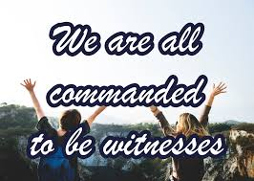
Now you must tell all the wonderful things that he has done.

Slide 24

What makes Yahuwah’s people distinct, peculiar,
set-apart, holy?

Slide 25

They are separated from this world, and the things of this world, from defilement, and evil, from impurity and from all that is common. They are clean and pure in thoughts, conversation and conduct.
They follow some special guidelines, [instructions] called the Torah, given by the Creator and Life-giver YHVH.

Slide 26

Being different could mean, one must stand alone. Being different means that others, like your friends,
co-workers and your own family may ridicule you, laugh at you, shun you and
make fun of you.
Because these people do not understand as they
are serving a different master, the god of this world!

Slide 27
Why would anyone want to be different from others, distinct, peculiar,
set-apart, called holy and being laughed at?
What is the reason?

Slide 28
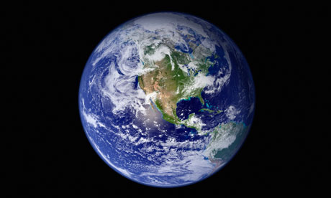
Many have come to the conviction,
that this world is NOT their home!
They concluded that there must be more to life than just eating, drinking and being merry, having a family, going to work and retiring some day!
28

Slide 29
When we come to the reality that we are just passing through, that our life is short and often filled with disappointments, difficulties and headaches then
we are ready to ask
some serious questions.

Slide 30

What is
this life
all about, what is the purpose?

Slide 31

FIRST
Yahusha said, “… seek ye first the kingdom of YHVH, and his righteousness …” Matthew 6:33
Notes:
Luke 14:26

Slide 32
“If any man cometh unto me, and hateth not his own father, and mother, and wife, and children, and brethren, and sisters, yea, and his own life also, he cannot be my disciple.” Luke 14:26 (American Standard Version)

Slide 33
You cannot be my disciple, unless you love me more than you love your father and mother, your wife and children, and your brothers and sisters. You cannot come with me unless you love me more than you love your own life..” Luke 14:26 (Contemporary English Version)

Slide 34
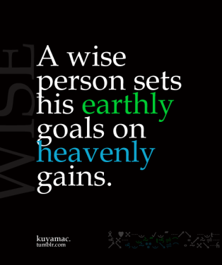
Yet, many professed believers fall into the confines of this world’s values and strive FIRST toward earthly goals. They budget their money and invest a chunk of every pay into various funds for their retirement; and they even collect many toys and valuable possessions to feel the status of success. They believe that these accomplishments are the things that fulfill their purpose in life, and so they are worth the struggle and the endurance. But this thinking is wrong.

Slide 35
Yet, many professed believers fall into the confines of this world’s values and strive FIRST toward earthly goals. They budget their money and invest a chunk of every pay into various funds for their retirement; and they even collect many toys and valuable possessions to feel the status of success. They believe that these accomplishments are the things that fulfill their purpose in life, and so they are worth the struggle and the endurance. But this thinking is wrong.
This world is not our home; we are just passing through. Do not forget that!

Slide 36
Just like Abraham, as recorded in Hebrews 11:10, the set-apart people will first be looking for a city, called New Jerusalem, whose builder and maker is YHVH!

Slide 37
A SET-APART
PEOPLE WILL
FIRST BE INTERESTED
TO PLEASE
THEIR MASTER, BECAUSE
OF THEIR LOVE
TOWARDS
HIM!

Slide 38
How can we
please YHVH?

Slide 39

By not being a friend of the world!

Slide 40
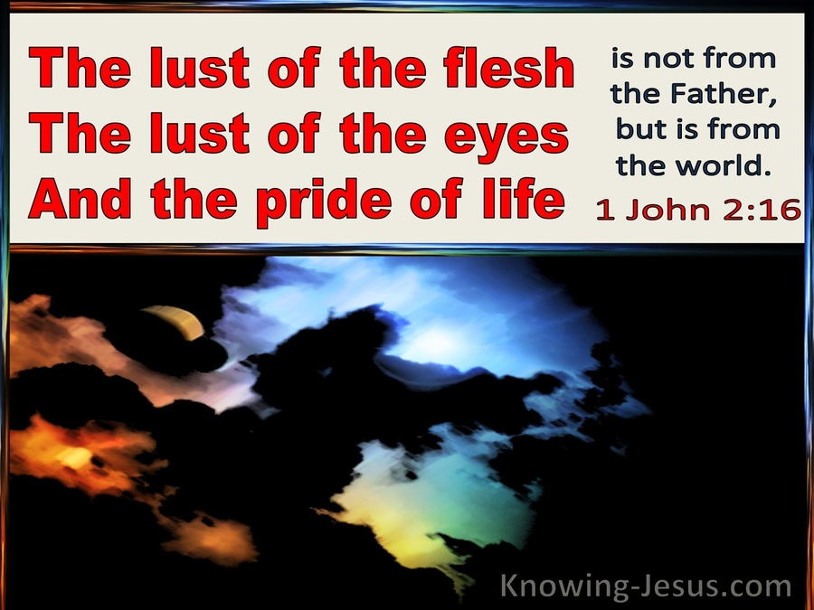

Slide 41
“Adulterers and adulteresses! Do you not know that friendship with the world is enmity with Elohim? Whoever therefore intends to be a friend of the world makes himself an enemy of Elohim.” James 4:4 (The Scriptures)
41

Slide 42
Being set-apart means to seek first the kingdom of Heaven, being devoted to YHVH, sanctified and pure in heart.

Slide 43
We please YHVH,
by being separated
from all evil!
43

Slide 44
יהוה (YHVH) takes pleasure
in those who fear Him,
In those who wait
for His loving-commitment.
Psalm 147:11 (The Scriptures)
44

Slide 45
Again 1 Peter 1:16 “Be set-apart, for
I am set-apart.” (The Scriptures)
This is a command,
not a suggestion!
45

Slide 46

Man was created in the image of YHVH!
This image
is able
to be holy
as He is holy,
if he wants to!
HOW?
46

Slide 47
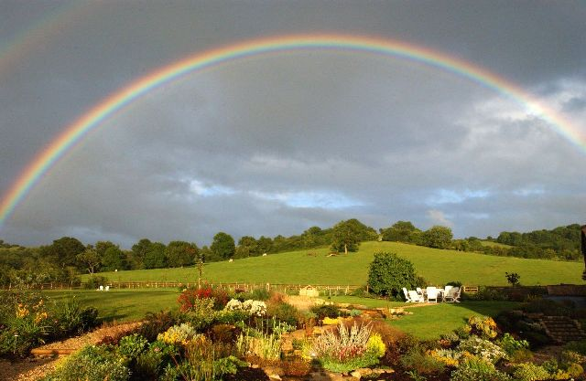
Because YHVH promised it!
He wouldn’t ask us to be set-apart as He is set-apart if it would not be possible!
Take Him by His word.
Walk in His ways, start putting one foot in front of the other.
By faith take one step at a time. It’s a choice. The instructions have been given, the power
is available, we can choose to be victorious!
47
Notes:
DA 311

Slide 48
Let’s remember that Every command of YHVH is a promise! He will help us to be and to stay set-apart if we ask HIM and cling to HIM following His instructions!
48
Notes:
DA 311

Slide 49

“I have strength to do all, through Messiah who empowers me.” Philippians 4:13
(The Scriptures)
49

Slide 50

The requirements for all who want to please YHVH and
to be set apart,
are that they must seek HIM by faith, walk in the Spirit and not in the flesh, and walk worthy of their calling in obedience and submission to the will as outlined in the Torah!
50

Slide 51
Paul reminds the believers in Rome that “they who are in the flesh cannot please YHVH.” (Romans 8:8)
51

Slide 52
Therefore, those that “are Messiah’s have crucified the flesh with the affections and lusts.” (Romans 8:8)
They are a new creation!
52

Slide 53
Only those who are set-apart, are HIS chosen people!

Slide 54
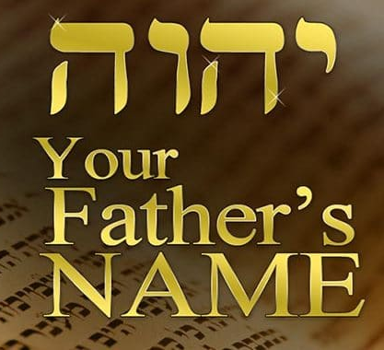
#1 His chosen, set-apart people, His Bride,
will know the Father’s name that they call upon!
“My people shall know my name.” Isaiah 52:6
(The Scriptures)
54

Slide 55
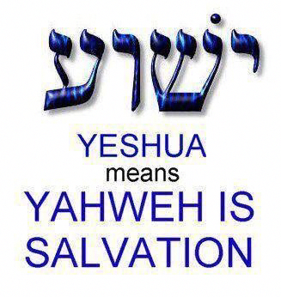
The Most-high has made His name known!
“I amיהוה (YHVH) that is My Name, and My esteem I do not give to another, nor My praise to idols.” Isaiah 42:8
(The Scriptures)

Slide 56
#2 His chosen,
set-apart people will know also
His Son’s name
that they call upon!

Slide 57
“Who has gone up to the heavens and come down? Who has gathered the wind in His fists? Who has bound the waters in a garment? Who established all the ends of the earth? What is His Name, And what is His Son’s Name, If you know it?”
Proverbs 30:4 (The Scriptures)
57

Slide 58
“Who has gone up to the heavens and come down? Who has gathered the wind in His fists? Who has bound the waters in a garment? Who established all the ends of the earth? What is His Name, And what is His Son’s Name, If you know it?” Proverbs 30:4 (The Scriptures)
Again, His set-apart people know His Name! If you don’t know His name, you are not part of His people!
58

Slide 59
How can you get to know someone without knowing his name?
Yahusha knows the names of His sheep according to John 10:3. His people will know His name according to Isaiah 52:6.
59

Slide 60
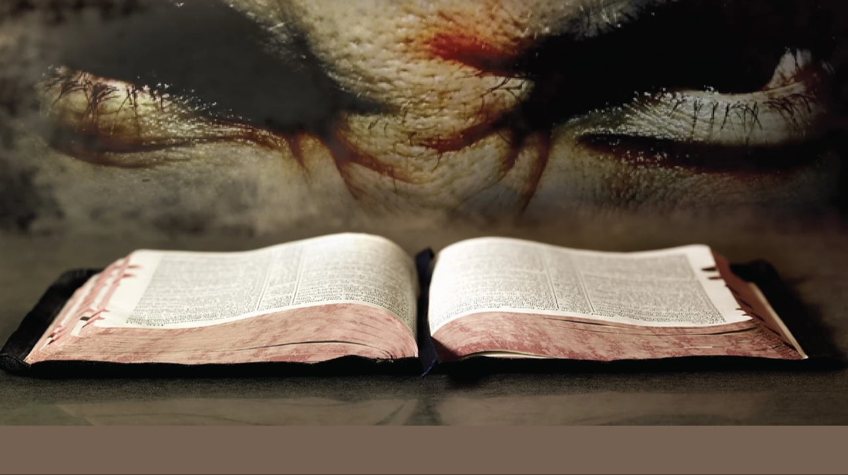
Our Bibles have been corrupted, changed and tampered with. Some was done through ignorance by translators and some on purpose by theologians over the past hundreds of years, of course inspired by Satan!
60

Slide 61
Our Father’s name YHVH (Yahuwah also pronounced as Yahweh) has been removed and replaced with titles like LORD and GOD.
Our Saviour’s name was changed from
His Hebrew name Yahusha to Jesus.
“The English name we use isn’t even a correct translation but is actually an English transliteration of a Greek mistransliteration of His actual Hebrew name, Yeshua. Consequently, we lost the original meaning of His name being salvation.” (From the book Decoding the Antichrist by Mark Biltz – page 20.)
FOR
EXAMPLE

Slide 62
In Exodus 23:21 we see a prophecy that the one sent to rescue Israel, and all of mankind as well, carries the Father’s Name within his own name. “Beware of him, and obey his voice, provoke him not; for he will not pardon your transgressions: for my name is in him.”
62

Slide 63
In Exodus 23:21 we see a prophecy that the one set to rescue Israel, and all of mankind as well, carries the Father’s Name within his own name. “Beware of him, and obey his voice, provoke him not; for he will not pardon your transgressions: for my name is in him.”
This is a reference to the Saviour Yahusha because only He is given the authority to pardon transgressions.
63

Slide 64
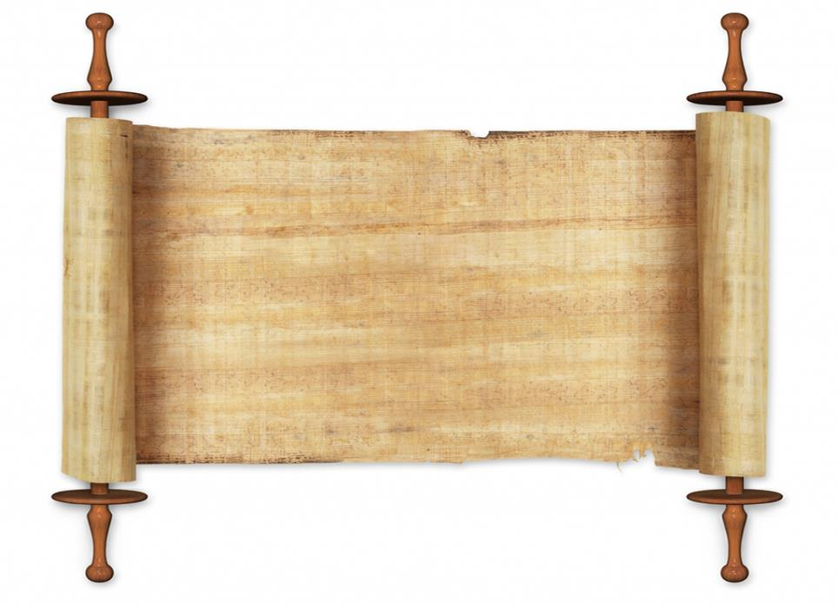



Here is the proof!
The Hebrew Messiah said in John 5:43 “I (YAHusha) am come in my Father's name (YAHuah), and ye receive me not: if another shall come in his own name (Jesus), him ye will receive.”

Slide 65
The only way to the Father is through the Son!
For the Son stated in John 14:6
“I am the Way, and the Truth, and the Life.
No one comes to the Father
except through Me.”
65

Slide 66
The only way to the Father is through the Son!
For the Son stated in John 14:6
“I am the Way, and the Truth, and the Life.
No one comes to the Father
except through Me.”
He stated in John 15:23
“He who hates Me hates My Father as well.”
66

Slide 67
Do you need more proof?
What is stopping you from calling the Father and the Son by their names!
67

Slide 68

“Thy name is as oil poured forth; Therefore do the virgins love thee.” Song of Solomon 1:3 (ASV)

Slide 69
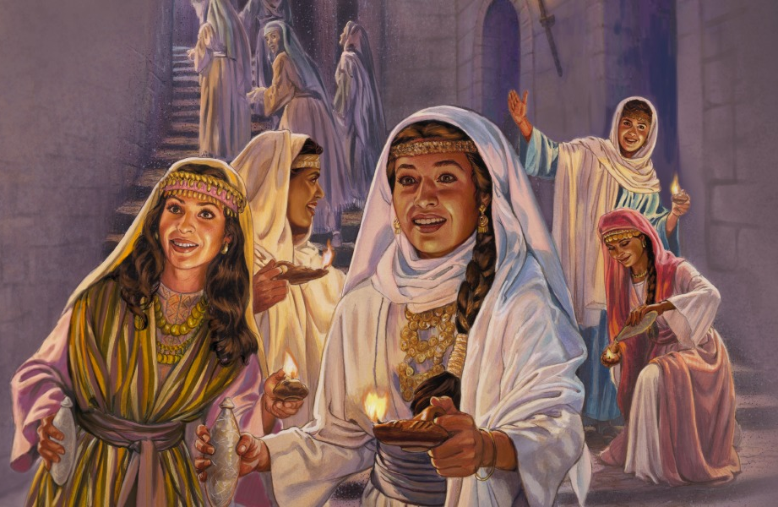
Remember the 10 Virgins? What was the problem with five of them?
They didn’t have enough oil!

Slide 70
Could it be that they didn’t know the Saviour’s name, which the Song
of Solomon is comparing to oil ?
70

Slide 71

Yahuah's set-apart people discovered by their research that Yahusha, the true Hebrew Messiah, was not a Christian. He did not start Christianity and did not follow any of their man-made teachings, which the Bible calls doctrines of demons.
(1Timothy 4:1)

Slide 72
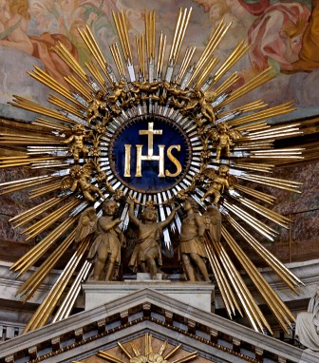
Christianity with their 41,000 plus denominations and churches is man-made; it was born at the Council of Nicaea with the Greek Jesus as their Messiah. The pagan doctrines
of the Trinity, Sunday worship, Christmas, Easter, baby baptism, Friday crucifixion, Sunday resurrection, immortality of the soul, hell fire, unclean animals as now clean, etc. are false.

Slide 73
Some teach about a coming Sunday Law, an investigative judgment that started in 1844, the lunar Sabbath, some teach once saved-always saved, a second probation, a temple being built during a 1000 year reign of the Messiah with animal sacrifices, the tithing system of the Levitical system in the Christian Churches.

Slide 74
The Christian Church is married to the Greek Jesus; the Jews are married to their father, the devil, according
to John 8:44.
Judaism claims that Moses gave us two Torahs, the written Torah and the oral Torah.

Slide 75
All these teachings cannot be proven from the Holy Scriptures but are man’s ideas and taken over from paganism, over the past hundreds of years.
We could go on and on.
That is confusion or as the
Bible calls it - “Babylon.”
However, YHVH’s set-apart people have no part with such false teachings, as they’ve came out of Babylon’s confusion.

Slide 76
Jews and many Sabbath keepers claim that the day starts in the evening at sundown, instead of in the morning at dawn as Scripture teaches.
They go by the moon to start the month and the year, even though this practice comes from Babylon.

Slide 77
Yahuah’s set-apart people also discovered that Yahusha did NOT practice Judaism and even told them that their father is
the devil.

Slide 78
YET He stated in John 8:29,
“.. I do always those things
that please HIM” - meaning His Father.

Slide 79
Can one please the Father (YHVH) without being a member of any church or organization?

Slide 80
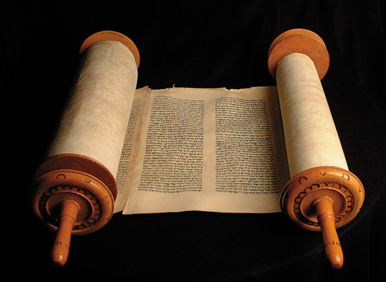
Yahusha followed
the written Torah,
the instructions with the commandments, statutes and judgements, which
He himself gave at
Mt Sinai, not only for Israel, but for all mankind.
So, He didn’t follow Judaism, meaning the traditions of the Scribes and Pharisees!
80

Slide 81

Yahuah’s set-apart people, His Bride, will do the same, following in their Master’s footsteps!
That is the only way we can please the Father, following in the footsteps of Yahusha!

Slide 82
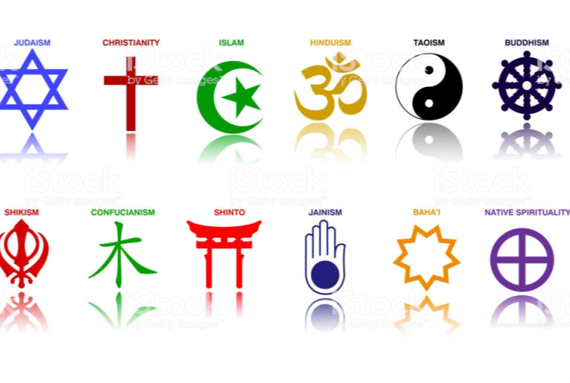
Yahuah’s people must be set-apart.
They cannot be part of any religion, including Christianity or Judaism!
I mean of any Church or denomination!
82

Slide 83
Yahuah’s people must be set-apart.
They cannot be part of any religion, including Christianity or Judaism!
I mean of any Church or denomination!
WHY NOT????
83

Slide 84
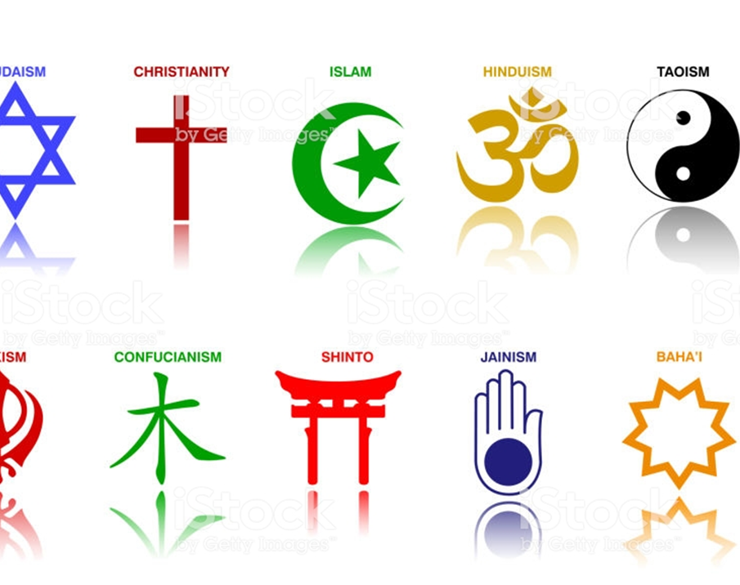
Being a member of any organization, you must abide by their man-made rules and creeds.
It is impossible to follow a “Thus saith YHVH!”
Believe me, I tried it and it is NOT
even ALLOWED in most places
to use the name Yahuwah or Yahusha!

Slide 85

Matthew 6:24 and Luke 16:13
85

Slide 86


We all know about the power of habits or being stuck in a box of traditions and doctrines of man! Our Heavenly Father wants us to get out of that box of man’s teachings. He says, “come out of her, my people!”

Slide 87
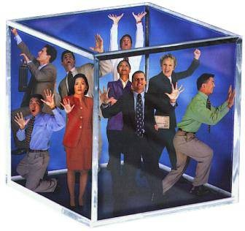
If someone trusts in man, his pastor, in a denomination and makes flesh his arm, he or she is stuck in a box!
87

Slide 88

But some people can’t get it and most people don’t want to get it! They have been deceived for so many years, and they refuse to find out if what they believe is true and maybe are doctrines of man, inspired by Satan?
I know from personal experience. I had been deceived for many years, until the Father
opened my eyes!
88

Slide 89
Is that the reason it states in Hosea 4:6 “My people are destroyed for lack of knowledge: because thou hast rejected knowledge,
I will also reject thee, that thou shalt be no priest to me: seeing thou hast forgotten the Torah of thy Elohim, I will also forget thy children.”
89

Slide 90

Did you know, that your religious leaders, pastors, ministers or your denomination can keep you out of heaven?
90

Slide 91

Here is what Yahusha said to the Jewish leaders at that time in Luke 11:52
“Woe unto you, lawyers! for ye have taken away the key of knowledge: ye entered not in yourselves, and them that were entering in ye hindered.”
He would be repeating the same words to all the 41,000 different Christian denominations of today!
Why can I make such a statement?
91

Slide 92
I repeat, Christianity is NOT the Religion that the Hebrew Messiah Yahusha started nor supports.
It is a hybrid religion, a mixture of some of the teachings of Yahusha, but not the same religion that He, nor the apostles taught! Don’t accept my word, check it out for yourself while there is time to do it!
92

Slide 93

These are the facts, which are not intended to offend, condemn or to judge individuals, but to be a wake-up call.
It is for our own good to find out what happened during the past 2,000 years and make a U-turn to the Elohim of Abraham, Isaac and Israel (Jacob) and to the written instructions He gave through Moses.
93

Slide 94

Your eternal destiny will not be the result of chance but of A PERSONAL CHOICE.
So choose LIFE by accepting Yahshua as your Saviour and follow His instructions,
the Torah!
94

Slide 95

This must be repeated over and over, that in matters of salvation we cannot trust any man, church or denomination!
There is only One we can trust, that is the Father Yahuwah and His Son Yahusha and their instructions, called Torah!
95

Slide 96
BE PART OF
HIS SET-APART
PEOPLE, HIS BRIDE!
96

Slide 97
ONLY YOU CAN
DECIDE; IT IS
A PERSONAL CHOICE!
97

Slide 98
SHALOM
98

Slide 99




A SET-APART
PEOPLE!
The ultimate provider is Yahusha Ha Mashiach
This message was created
and recorded by:
Walter Tschoepe
Email: malachi4dot4@gmail.com
99

