Slide 1



Gen 1
I AM theOwr –
Light of the World
Part 1
Notes:
7.8 Gen 1 Owr Light Part #1 [89] TA 27 July 2024
Website:
You-tube launch July 31/24: https://youtu.be/LQIdvQq_xyU

Slide 2
Gen 1:1,2 Part 1
BERESHITH
בראשית
In the Beginning …

Slide 3

Gen 1:2
Repairing a Breach!
ת

Slide 4


Yahuah’s End Time Message from Genesis 1:1-5

Slide 5


Getting Started
Note:
These studies try to refrain from using the word “day” that has been
translated from the original Hebrew word <yowm>.
The word “day” loses a massive amount of definitive correctness in
its ambiguous definitions.
Day can indicate 12 or 24 hours, day or night, or both!
To understand Scripture correctly we need to be much more accurate.
Preference is given to the word “cycle” in place of the word day.
When quoting the Scriptures or citing the Shabbat Day you will see it.
Otherwise cycle is the word of choice.
The 24 hour cycle will be defined below to pinpoint the two seasons.
Cycle = 24 hours containing the 2 seasons, one of light – H216 <’owr> and
one of night – H3915 <layil>.
Season H6256 - <`eth>, = (approx.) 12 Hour blocks of time whether it is the
Light Season or Night Season.
A very important application example of “season” is found in Yerimyahu (Jer) 33:20-25.

Slide 6
Gen 1:1 In the beginning Yahuah created the Heaven and the earth. Question:
Would not the very first verse in the Scriptures be important? Yes, it should be, but how many people just discount this verse as only a
“Heading of Introduction” not realizing the impact of what these few simple words are actually saying!
Gen 1:1 is detailed in - Creation’s Curtain Call.
Statement for Gen 1:1 - This verse is covered in Creation’s Sequences study. For this study, we understand that –
Everything needed for the building and forming of this earth, UP UNTIL CYCLE #5 , was fully created at the beginning of cycle #1, instantly, upon the voice of Yahusha Ha Mashiach (Elohim).
The forming of the base elements proceeded in cycles 2, 3 & 4.
Then, upon cycle #5, actual creation of living, breathing life, commenced.

Slide 7
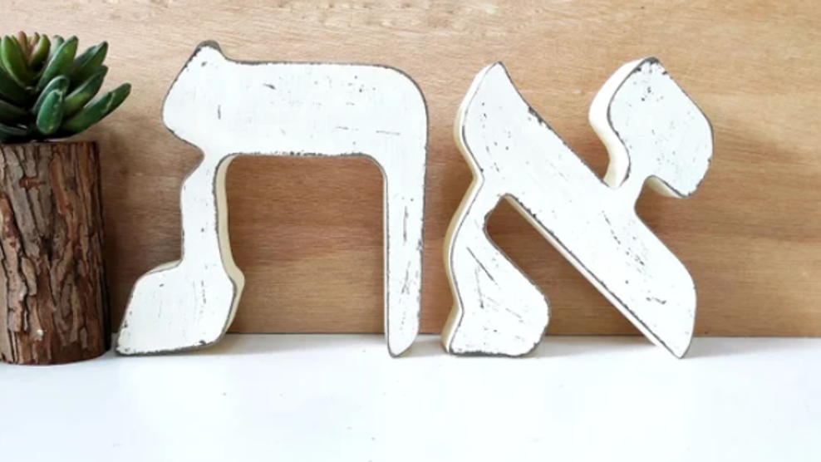
Introduction to aleph & tav
tav
aleph
Yahusha is referenced as THE - Aleph Tav,
the FIRST and the LAST - (letters in the Hebrew Aleph-Bet.)
Yahusha is the BEGINNING and THE FINALITY of ALL AUTHORITY.

Slide 8

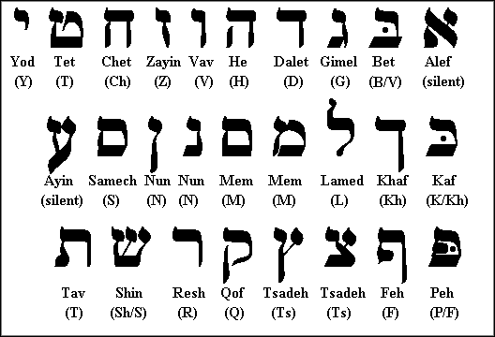
The FIRST and the LAST!
YAHUSHA Ha Mashiach
ALEPH
The last, (FINAL) letter of the Hebrew Aleph-Bet.
The FIRST, (Premier) letter of the Hebrew Aleph-Bet.
Tav
All things were made by him;
and without him was not any thing made, that was made. John 1:3

Slide 9





This study ON the 1st CYCLE of creation, questions the word
(found in) gen 1:2.
Genesis 1:2a in the KJV reads: And the earth
without form, and void;
and darkness was upon the face of the deep.
Why the word - ?

Slide 10
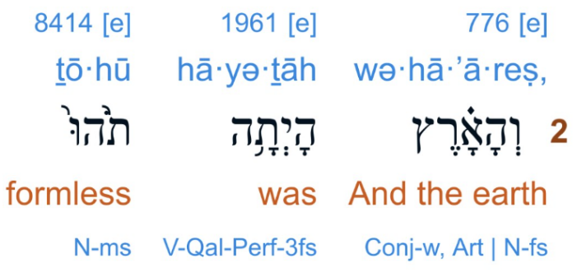
Is this correct?
Gen 1:2
1 Thess 5:21 PROVE ALL THINGS …

Slide 11






Gen 1:2a
And the earth …
KJV
H1961
<hayah>
TS 2009
H1961
<eithe>
WHO is the cause for these differences?

Slide 12

?
Should the be in
Gen 1:2
H1961, or not?
Tav
היה.
Tav
היתה.
For Gen 1:2a, which Hebrew word bears
catastrophic consequences?
Hayah? Or – Eithe? Or both?

Slide 13
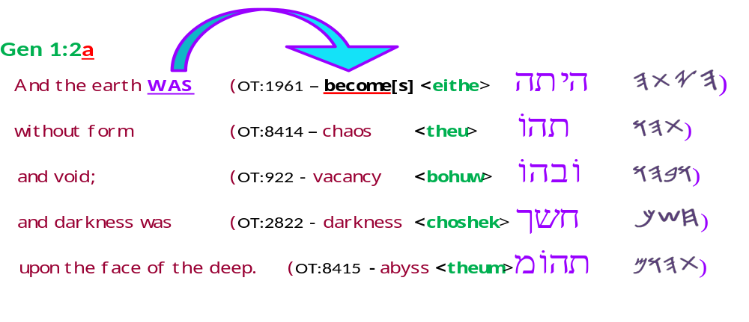
Note:
Hebrew Font Variants
H1961
Eithe = EiThe
ה י ת ה .- eithe
היתה .- eithe
- eithe
In this study you will only see Hayah written in the
Flame font.
Tav
Modern
Tav
H1961 היה. Hayah
Flame
Paleo

Slide 14
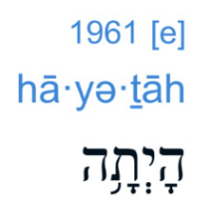
Note:
PRONUNCIATIONS!
Interlinear Scripture Analyzer
Strong’s
H1961 היה. Hayah
H1961
Eithe = EiThe
ה י ת ה .- eithe
היתה .- eithe
- eithe
Tav
Tav
Bible Hub

Slide 15
The Two Covenan s
T
Yahuah
Jer 33:20 “Thus said יהוה, ‘If you could break My covenant with the day and My covenant with the night,
so that there be not day and night IN THEIR SEASON.
Yahuah has ASSIGNED - A SPECIFIC SEASON –
(A QODESH - SEQUENTIALLY SPECIFIC - TIME FRAME)
for the OPERATIVE Covenants of –
The OWR (Light) Season & The LAYIL (Night) Season!
SEQUENCE MATTERS!

Slide 16

The Two Covenan s
T
Yahuah
Jer 33:20 “Thus said יהוה, ‘If you could break My covenant with the day and My covenant with the night,
so that there be not day and night IN THEIR SEASON.
Covenant of the Light
SEASON
Covenant
of the
Night Season
Will man ATTEMPT to CHANGE that which Yahuah has
ASSIGNED FROM THE 1ST CYCLE OF CREATION?
Dan 7:25
Dath & Zeman?

Slide 17
What is up -
Covenant of the Light
SEASON
Covenant
of the
Night Season
Night Season is first?
Isa 5:20 Woe to those who call evil good, and good evil; who put darkness for light, and light for darkness …
Light
SEASON?
Is DOWN ? Isa 5:20?

Slide 18


The Two Covenan s
Tav
Jer 33:20
Covenant of the Light
Covenant of the Night
Which came FIRST?

Slide 19

The Tav, being in one form,
a SIGNATURE
of “The ARTIST” is
the HEART of this study.
ת
How many “ARTISTS”
are recorded within the
FIRST 2 VERSES OF
Genesis 1?
FOCAL POINT

Slide 20
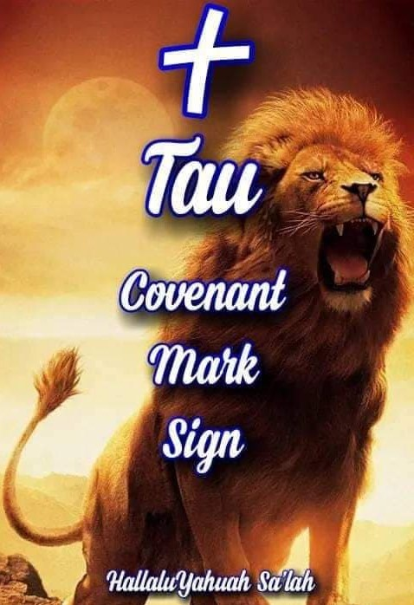

A Tav, connected to a person is
a Sign, SIGNATURE,
and Seal of, and
through, that character.
When the Tav is
directly connected to
the - Aleph-Tav -
Yahusha Ha Mashiach,
(see Gen 1:1) it reflects
His Character.

Slide 21
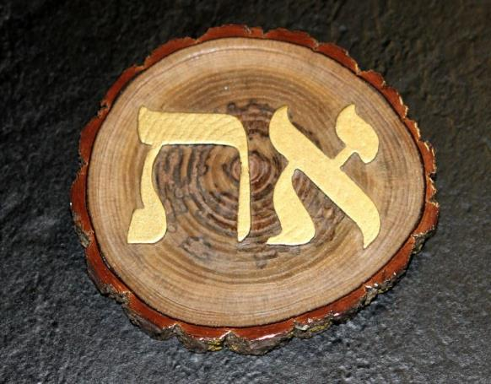
The Aleph-Tav as seen here, are very appropriately placed over the cyclical rings of life on a tree.
Aleph-Tav - the Beginning and the End.
The Absolute Authority over everything known to man.

Slide 22
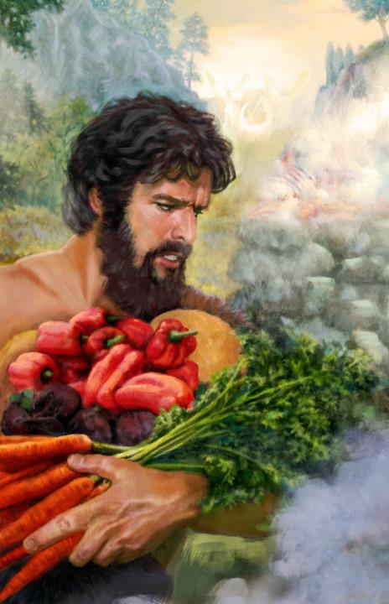
When a Tav is
directly connected to
a human, it reflects
his character.
Yahuah installed a Tav, a MARK (a recognition SIGN) and SEALED it to Cain to preserve his life while on this earth. (H226 - Auth)
Gen 4:15 And the Yahuah said unto him, Therefore whosoever slayeth Cain, vengeance shall be taken on him sevenfold. And the Yahuah set a mark upon Cain, lest any finding him should kill him.

Slide 23

Consider Genesis 1:1 -2a, Creation, do we find -
A MISSING COMPONENT?
vaT
Was i just “misplaced?”
Or PURPOSELY DISMISSED?

Slide 24



?
TAV?
Is H1961 -
eithe - or
Hayah ?
Or BOTH?
?
?
Could Context be a FACTOR to consider?

Slide 25
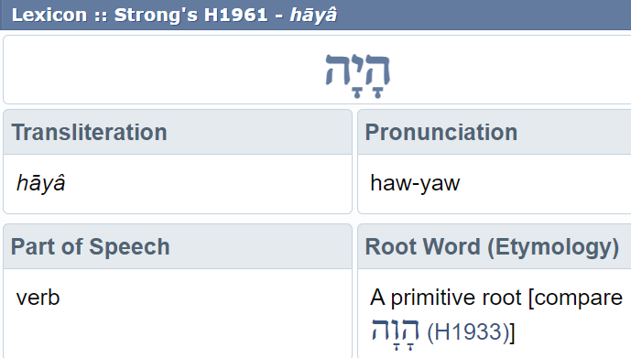

When searching Genesis 1:2 for the meaning of the word – “was” –
this is what is shown from the BLB. Strong’s information is used here
and is the identical Hebrew spelling to what is found in Gesenius’ Lexicon.
What is the original Script spelling in this highly specific location?

Slide 26
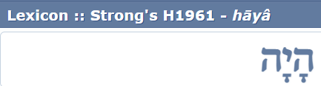
Gen 1:2 the original preserved script wording is -
Same Strong’s number designation!
But, with a TAV !
H1961 היתה. Eithe
Tav
WHY THEN, in Gen 1:2 specifically, has H1961 been altered to THIS – NO TAV?

Slide 27

Is it possible that THIS PARTICULAR spelling with
a TAV, was PRESERVED BY Yahuah to CLEARLY INSTRUCT
starting the Shabbat
and Mo-edim at -
H1961 היתה. Eithe
Dawn?
Tav
How so?

Slide 28
Shabbat
What Tav (character signature) was it that imposed the Choshek Darkness in verse 2?
What reason would there be to HIDE
or VEIL that
TAV SEAL?
THE OPPOSING VIEW:
Is it possible that this transliteration
WITHOUT A TAV,
could positively indicate the start of every day including
Shabbat, at sunset, PROCEEDING INTO DARKNESS?
Could there be a SPIRITUAL SEED application here?
28

Slide 29

Gen 1:2 specific!
YOU DECIDE!
Tav
היתה. Eithe
H1961
(hayetah)
היה. HAYAH
H1961

Slide 30

Paleo Tav.
NOT a cross!
The MAIN QUESTIONS
of this study.
[ULTIMATELY]: WHO took
the LIBERTY
to decide that Yahuah’s TAV,
is dispensable in this
HIGHLY IMPORTANT SPOT?
(Gen 1:2a)
Tav
SIGNs the spot!
Does it even matter?

Slide 31
Paleo Tav.
Your QUESTION
Could this “missing Tav factor” influence your decision of
when to start your days, Shabbat,
and Mo-edim?
Tav
Character Signature

Slide 32
Genesis 1:1 – 5, Creation and -
A MISSING COMPONENT?
As we progress through this study, focus on this question:
What ultimate purpose would it serve to remove the Tav from Genesis 1:2 - H1961 EI HE?
Tav
Was a SIGNATURE “purposely removed?”
Tav
32

Slide 33
In this study, you will see saTan written as such, and the “T” referenced as a Tav. This is referencing the CHARACTER SIGNATURE TRAIT and/or SEAL, and, by which the adversary can be POSITIVELY identified.
It is NOT declaring a Tav letter in SPELLING the name of the evil one. For that is but an
all encompassing “Tet!” ט

Slide 34

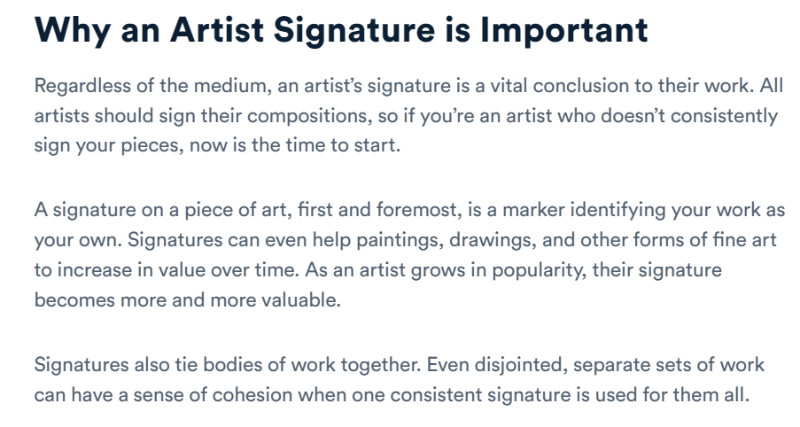

Slide 35
H1961 Ei The (hayah?) investigation!
Why in BLACK?
Starting on the next slide will be a 4 slide encapsulated view
of the EXTREME SERIOUS topic in focus.
This study will then begin to examine this controversy in detail.

Slide 36
The H1961 EiThe (hayah?) CONUNDRUM!
The first few words of Gen1:2 are –
And the earth was – KJV
and - And the earth came to be -The Scriptures
In Gen 1:2; What is Yahuah’s ORIGINAL Hebrew
word for – was / came to be ?
Hayah ??
EiThe ??
ה י ת ה – eithe - became (Interlinear Scripture Analyzer)
This word is found in the various Hebrew translations online
and in the Stone Edition Tanach.
Now we need to verify the meaning given for this word.

Slide 37

Let’s dig in to this word eithe (hayah with the Tav dropped)!
Is H1961 a verb exposing a transformation, or, is it a
summary statement/description of a past condition?
Etymological Dictionary of the Hebrew Language By Earnest Klein
ה י ת ה – eithe (a derivative of ה י ה) pg. 148
to exist, happen, become – Qal – was, existed, 2. came into being,
became 3. he remained 4. it came to pass, happened
Please ALSO note the ones that are NOT highlighted!
A Hebrew English Lexicon by John Parkhurst (1762)
to be, exist, denoting the state of condition of being.

Slide 38
#2 Still digging into eithe (hayah with the Tav dropped).
#2 Do these definitions portray – “WAS?”
Brown-Driver-Briggs lists several other definitions for the word “was”
ה.ת.י.ה- OT:1961. 1) to be, become, [became], come to pass, exist, happen,
fall out
a) (Qal) 1) a) to happen, fall out, occur, take place, come about, come to pass
b) to come about, come to pass
2) to come into being, become
a) to arise, appear, come
b) to become
1) to become
2) to become like
3) to be instituted, be established
b) (Niphal) 1) to occur, come to pass, be done, be brought about
Do you see a summary statement here?
Only the VERB definitions are highlighted green!

Slide 39
#3 “eithe” - Conclusive Statement – or – Transitional Verb?
A Hebrew Lexicon By W.H. Barker (1776)
נ ה י ה – neihe – is cognate with (same family of words) היתה .- eithe
become, be done, accomplished
Note the next 2 VERY POPULAR sources and their transliteration!
Hebrew and English Lexicon of the Old Testament
Based on the Lexicon of William Gesenius,
translated by Edward Robinson (1906)
pg. 135 H 1961 - hayah – destruction, ruin disaster
Strong’s Exhaustive Concordance
1961 – hayah – to exist, be or become, come to pass, accomplished
Might this describe the Choshek (Gen 1:2) enveloping the creation with tohu and bohu, (chaos and void)?

Slide 40
Question:
Hebrew and English Lexicon of the Old Testament
Based on the Lexicon of William Gesenius,
translated by Edward Robinson (1906)
pg. 135 H 1961 - hayah – destruction, ruin disaster
Gen 1:2, Is it – was – or – come to be?
Did Yahuah CREATE our intended HABITATION
in DESTRUCTION, RUIN AND DISASTER?

Slide 41
Most specific questions:
When the Tav is deleted from the word eithe in Gen 1:2, and it states the earth was in chaos and vacancy;
does this attribute a complete FAILURE on the part
of Yahuah - to create in a PERFECT state?
Remember the Tummin on Aharon’s breastplate?
PERFECTION!
YAHUAH there openly declared His state of being.

Slide 42

Genesis 1:1 B-RashyTh!
Luke 10:18
Is there a reason for this Tav SIGNATURE?
ת
Who proposes to CONFUSE it?

Slide 43
RashyTh definitions
First, Foremost, Chief,
Primary, Premier

Slide 44
Genesis 1:1 B-RashyTh!
ת
Luke 10:18
Will the removal of a Tav in Genesis 1:2
NEGATE this Tav?
Which identity wants this TAV annihilated?
Are you ready? ☺

Slide 45
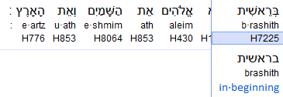
B-Rashy h Connection!
Tav
Yahusha Ha Mashiach
Gen 1:1

Slide 46
B-Rashy h Connection!
Tav
End & the Beginning
This H853 word is translated to us as – AND ??? The VAV is a nail upon which a connection can grasp. Can it then be understood that the Aleph Tav (Yahusha ha Mashiach) is ALSO - DIRECTLY connected – as in - COVENAN ED
(by a SIGNATURE) to this earth?
Tav

Slide 47
ת
A SIGNATURE!

Slide 48






Shall we consider the possibility of an insidious deception existing
at the beginning of our English Scripture editions?
Or shall we simply declare that the Hebrew aspect has no value to us and continue on in our blindness? Blindness? Yes, a veil of IMPOSED evil!
Shall we go with the translated “was” editions (Gen 1:2) and accept that Yahuah BLASPHEMED HIS OWN CHARACTER, BREAKING HIS OWN COMMANDMENT NOT TO TAKE HIS NAME (CHARACTER) IN VAIN?
Blasphemed?
Yes! If Yahuah were to create anything less than PERFECT, especially this earth which He declared it was created to SUSTAIN LIFE, and
IF Yahuah created this earth in CHAOS, VOID AND DARKNESS, then Yahuah would have BLASPHEMED His own Name – (read) CHARACTER!
Stay tuned, explanations forthcoming!

Slide 49
We know for absolute certain that Yahuah did not blaspheme
His own character!
So then, exactly, of what state was this earth created in?
And – just as important – HOW did this earth become enveloped in the Choshek (EVIL CONTAMINATED DARKNESS)?
Can we for a short time, adjust our murky mindset – (which has been shrouded by tradition), can we diligently set it aside,
even if only temporarily, and consider a -
MISSING HEBREW COMPONENT?

Slide 50
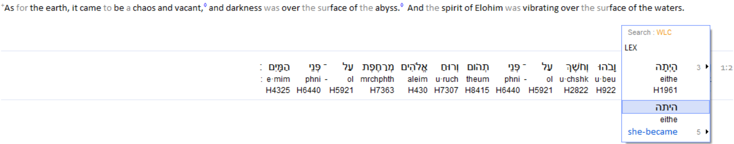
Tav - The Primary Focus Today!
Genesis 1:2
Look!
Upon reading Genesis 1:2, we see a Tav, within the H1961 word. Referencing this very verse from another source, the Strong’s concept then surfaces, and the representation from this word does NOT have a Tav!
Is this a PROBLEM? What is the importance of a Tav in this
most specific location?

Slide 51
Tav - The Primary Focus Today!
Genesis 1:2
Look!
This is the question!
In Genesis 1:2; is - Came to be – correct?
Or will the CharacTer of Yahuah – reveal –
was – is the proper translation??
Very, VERY serious implications
rest upon your final selection.

Slide 52
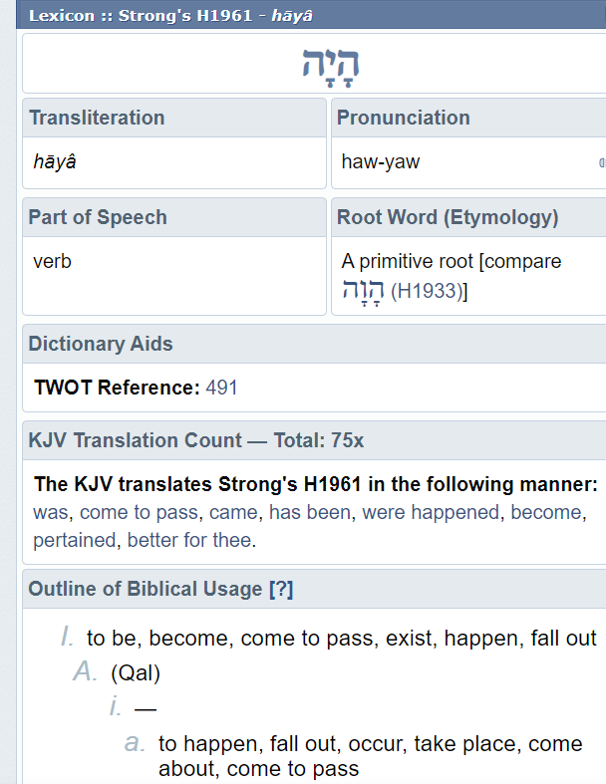
Note: This is what is seen for Exo 3:14 by
Strong’s exposure!
We will look at this
again, real soon!
Interesting Point! ??
When looking up H1961, in the Blue Letter Bible resource, it brings up Strong’s definitions. Please note the ABSENCE of the letter Tav!
What is most peculiar about this?
Let’s read a very pertinent verse!
ה
וֹ
ה
י
Exo 3:14 And God ^{H430} said ^{H559} unto Moses, ^{H4872} I AM ^{H1961} THAT I AM: ^{H1961} and He said, ^{H559} Thus shalt thou say ^{H559} unto the children ^{H1121} of Israel, ^{H3478} I AM hath sent ^{H7971} me
unto you.
Note this definition!

Slide 53

ה
וֹ
ה
י
Exo 3:14 And said unto
Moses, I AM ^{H1961} THAT I AM: ^{H1961}
We know Yahuah did not
“come to be”!
Yahuah simply existed
within PERFECTION, because of
WHO HE IS!
Back to the Tav in question:
Who’s Tav (found in verse 2),
WAS CHALLENGING THE ETERNAL EXISTENCE OF PERFECTION?
Note this definition!

Slide 54
The translators from the Masoretic text are counting on you to turn a blind eye to the meaning of the Hebrew letter Tav, found in Gen 1:2.
They want you to “just accept” their H1961 translation in Genesis 1:2 as – EXIST (“was” – NO TAV).
Not only have they IGNORED the deeper meaning of Yahuah’s Character context, PERFECTION, - but they have proceeded to BLASPHEME his Character! How? By implying that Yahuah created
a Choshek CONTAMINATED earth
for His children to inhabit!
Note this definition!

Slide 55
Luke 10:18
WHY were one of these definitions not chosen for Gen 1:2?
In REALITY,
WHO was directing
the choosing?
Was CONTEXT overlooked?

Slide 56
Yet even in the verse where Yahuah claims who He is, His actual Being of Existence, (Exo 3:14) the Hebrew letter Tav, - His SIGNATURE OF EVERLASTING - is not present in the Hebrew word H1961 – for this specific location!!
The questions are:
      Why is this even coming to the table for discussion?
      Is this even worth discussing?
      Or is it a “non”-issue?
The REAL QUESTION now becomes –
What is the SIGNIFICANCE (Hebrew definition /meaning)
of the - Tav, as seen in Gen 1:2?
We will be looking at this shortly.

Slide 57
יהוֹשע-- Yahusha
Artist & Author of Creation
Point To Ponder: Did Vincent Van Gogh and Leonardo Da Vinci have the same style of painting? Is it even possible to distinguish between them, who created the paintings?
Is it safe to declare that each one had their
very own unique and very distinguished style?
Shall we consider this?
Is it safe to assume that Yahusha/ELOHIM also has His own very distinguishable flavor to imprint on His Creation?
If so, WHAT MIGHT THAT SIGNATURE APPEAR AS?
PURE CALENDAR QUESTIONS!

Slide 58

יהוֹשע-- Yahusha
Author and Perfecter Heb 12:2
Artist & Author of Creation
PURE CALENDAR QUESTIONS!
What came first?
The Covenant of the Light Season?
Or
The Covenant of the Night Season?
LIGHT OR DARKNESS?
{Jer 33:21}

Slide 59
יהוֹשע-- Yahusha
Tav
ת
John 8:12 Therefore יהושע (Yahusha) spoke to them again, saying, “I am the LIGHT of the world. He who follows Me shall by no means walk in darkness, but possess the LIGHT OF LIFE.”
Is it even remotely possible that this statement provides a clue to Yahusha’s character, the Covenant Signature
(of The Artist) found imbedded in the TAV? The Tav?
What about the TAV that has been PURPOSELY SET ASIDE and HIDDEN from unsuspecting eyes?

Slide 60

יהוֹשע-- Yahusha
Could this actually be His Tav Signature? ת
Yahusha has proclaimed He is the
LIGHT of LIFE!
Then along comes Isa 45:18, where Yahusha declares He created this earth to be INHABITED (SUPPORTING LIFE)!
When man declares earth was created in DARKNESS, CHAOS AND VOID,
are we able to realize the DISCONNECT here?
Or, are we “OK” with DARKNESS, CHAOS AND VOID SUPPORTING LIFE from a PERFECT CREATOR who IS - LIGHT?

Slide 61
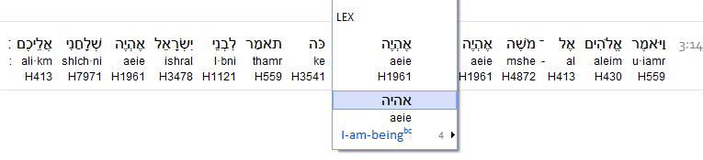
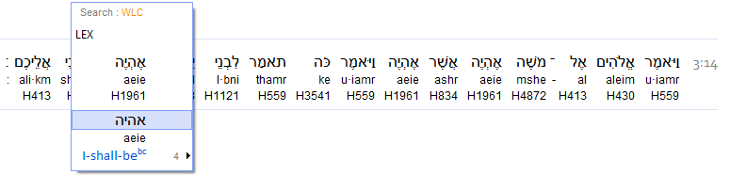
Exo 3:14 And Elohim said to Mosheh, “I am that which I am.”¹ And He said, “Thus you shall say to the children of Yisra’ĕl, ‘I am has sent me to you.’ ”
Footnote: ¹The Heḇrew text reads: ’eyeh ’asher ’eyeh, the word ’eyeh being derived from hayah which means to be, to exist, but the Aramaic text here in v. 14 reads: ayah ashar ayah. This is not His Name, but it is an explanation that leads up to the revelation of His Name in v. 15, namely: יהוה.
Look!
For comparison, this is Exodus 3:14.
The Stone Edition Tanach and the
Interlinear Scripture Analyzer do NOT show
a Tav in this verse either!
Yet it is still deemed as - H1961!

Slide 62
Tav - The Primary Focus Today!
Genesis 1:2
Look!
What is the importance of a Tav in this
most specific location?
Again:

Slide 63
We have briefly looked at the points where the Tav is found in one profound verse, and is not realized in another VERY PROFOUND verse , but is deemed
the same word – H1961!
HHHHMMMM!
For the next few verses, we will be looking at the type of creation established at the beginning, by Yahuah.
We will be returning back to the importance of the
“REJECTED” HEBREW LETTER!

Slide 64


In what STATE was earth
ORIGINALLY ESTABLISHED?
Isa 45:18 For thus said יהוה [Yahuah] Creator of the heavens, He is Elohim, Former of earth and its Maker,
He established it…
Note the terminology. Earth was ESTABLISHED. Established, shows a Life Supporting Completed Action. If the Hebrew word showed an incomplete format, that would expose an unprepared, faulty character trait .
That would be nothing short of BLASPHEMY by Yahuah, to His own Name! !!!
OWR - Light Season
The first Hebrew word of Genesis 1:1 tells us that light was established before the darkness. HOW? Keep tuned!
How do we know the OWR was already ESTABLISHED before the first ereb (evening?)

Slide 65



Are you ready for the journey?
Your answer:
Yes Yah, I am ready and waiting to go! ☺

Slide 66
Rebellion is as witchcraft. Did Satan “rebel” on the first cycle of creation? Have you considered the second verse in your Scripture edition?
The Missing Component!
What is it?
“SIGNATURE”
What occurs when a TAV is dropped?

Slide 67
EXACTLY WHAT WAS ACTUALLY ESTABLISHED AS A SIGNATURE, IN THE FIRST MOMENTS OF CREATION?
Was Light First???
Exactly WHAT TRAIT was ESTABISHED?
DARKNESS?
“SIGNATURE”
What occurred when the was dropped?
TAV

Slide 68

Is it OK to DELETE this TAV?
In strict accordance with - Genesis 1:2 -
Is H1961 -
eithe - or
Hayah?
Character identification!

Slide 69
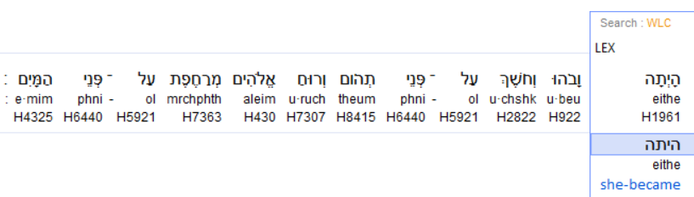
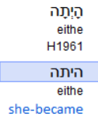
Rebellion - hidden - in our Scripture editions! Gen 1:2!
#1 Interlinear Scripture Analyzer
In Genesis 1:2 - Have you noticed the Tav as the 3rd Hebrew letter in this H1961 word?
Let’s look at another witness.

Slide 70
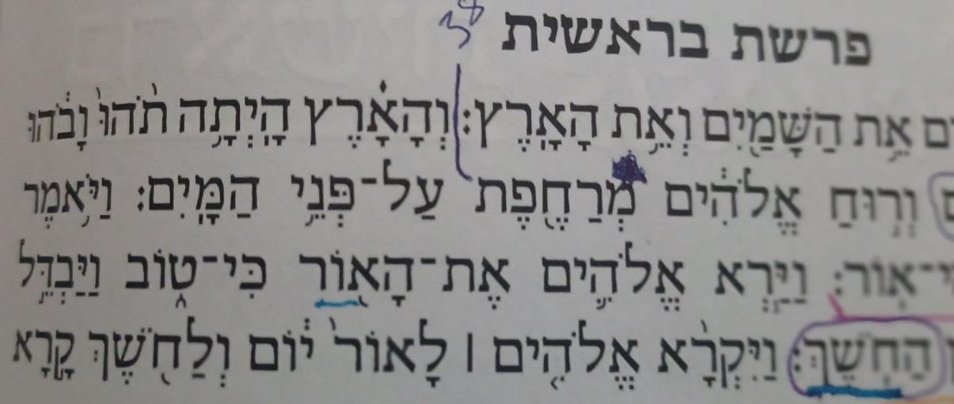
#2 Stone Edition Tanach Witness!
Yes the Tav is recorded here too!
Have you noticed the Tav as the 3rd Hebrew letter in this H1961 word?
Let’s look at another witness.

Slide 71
#3 Westminster Leningrad Codex!
Yes the Tav is recorded here too!
Again: Notice the Tav as the
3rd Hebrew letter in this H1961 word!
Let’s look at another witness. ☺

Slide 72
#4 HOT+ – Hebrew Old Testament
Yes the Tav is recorded here too!
Again: Have you noticed the Tav as the
3rd Hebrew letter in this H1961 word?
Let’s look at another witness. ☺

Slide 73
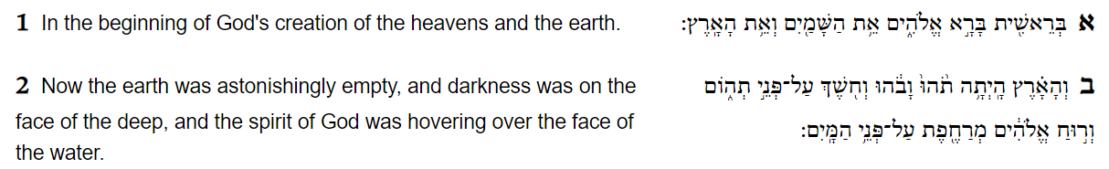
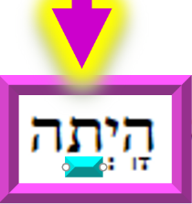
#5 The Complete Jewish Bible
Yes the Tav is recorded here too!
Enlarged for
positive viewing.
Again: Yes, the Tav is the
3rd Hebrew letter in this H1961 word!
Let’s look at another witness. ☺

Slide 74
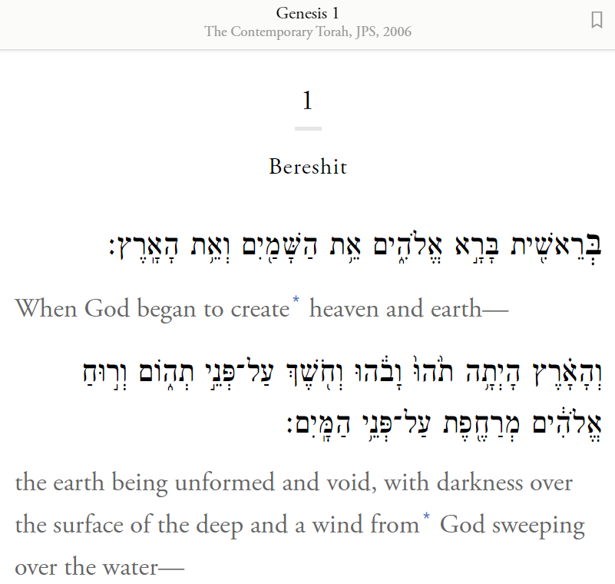
#6 The Contemporary Torah, JPS
Yes the Tav is recorded here too!
In total, we have seen 6 witnesses to the Tav being within the H1961 Hebrew word of the second verse.
Shouldn’t we be questioning this with every sinew in our body?

Slide 75
Why then are we given this to
simply accept
without question?
Was ??
Where’s the Tav?
What DIFFERENCE does it make – if any?

Slide 76
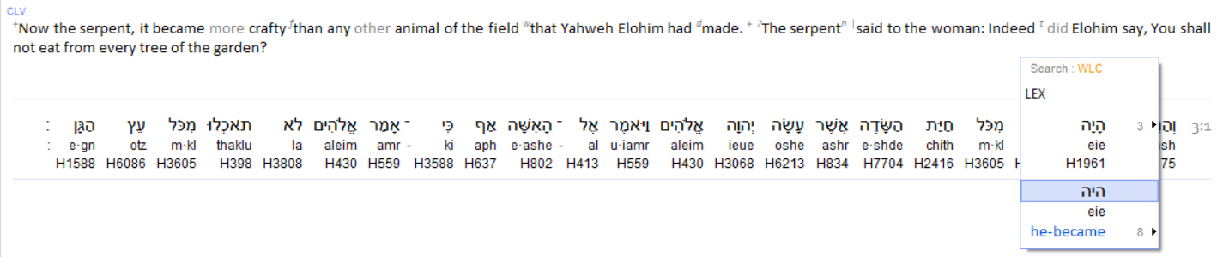
\
Gen 3:1
Speaking into the state of the serpent,
H1961 does NOT have a Tav in the word.
Yet it is translated as covering a TRANSITIONAL time span.
Why not a PERIOD OF TRANSFORMATION in Genesis 1:2? ??

Slide 77
AGAIN:
Why not - a PERIOD OF TRANSFORMATION in - Genesis 1:2? ??
Who would be delighted for us to believe that Yahusha created
a locale for His children, “TO BE INHABITED” in absolute
chaos, vacancy, darkness and evil contamination?
An utter creative disaster and FAILURE?
If this contemptable identity could not permanently destroy creation on the 1st cycle, what is to keep him from DESTROYING OUR BELIEF IN YAHUSHA AND HIS CREATIVE CAPABILITY, LATER, - in Genesis 1:1-2? Selah

Slide 78
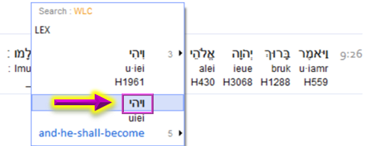
Gen 9:26
Again - H1961 does NOT have a Tav in the word. Yet it is once again translated as covering a TRANSITIONAL time span.

Slide 79

We have viewed H1961 in texts without the Tav and specifically Genesis 1:2 – WITH THE TAV.
We understand the Tav has a very specific meaning.
What benefit will the Tav meaning possibly supply
to Genesis 1:2?
Even much more important –
What identity CHALLENGE of
EXTREME IMPORTANCE
would be LOST in Genesis 1:2 when the
Tav
of H1961 is deleted?

Slide 80
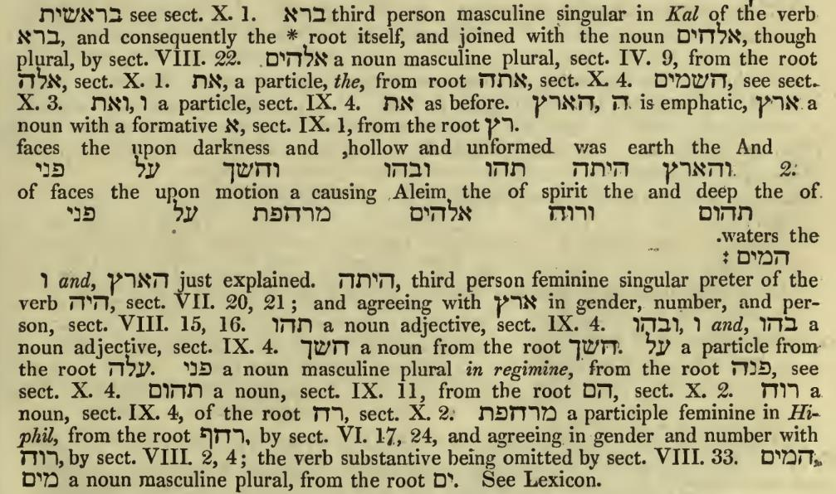
J. Parkhurst. A Hebrew Lexicon pg. 47 Gen 1:2 a
Gen 1:2
This is what it looks like. Let’s break it down on the next slide!
H1961 Eithe
Hayah
H1961 Eithe
Bohu
Tohu
Bohu
(pink)
Tohu
(pink)

Slide 81
J. Parkhurst. A Hebrew Lexicon pg. 47 Gen 1:2 a
Noting the purpose of a Vav as a prefix.
Eretz (earth)

Slide 82
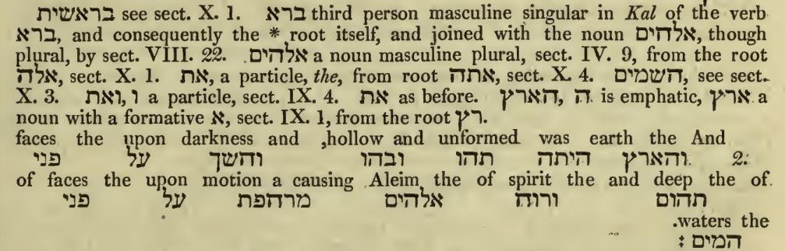
J. Parkhurst. A Hebrew Lexicon pg. 47 Gen 1:2 a
?
Gen 1:2 a Tav!
Yahuah preserved this Tav within the verb for a PURPOSE!
H1961 Hayetah
Bohu
Tohu
Now for J. Parkhurst’s Lexicon explanation!

Slide 83
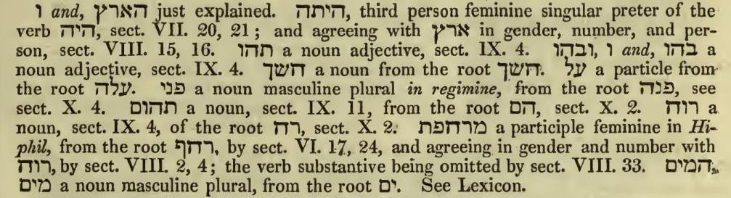
J. Parkhurst. A Hebrew Lexicon pg. 47 PRETER?
What does this word mean?
H1961 Hayetah
H1961 Hayah

Slide 84
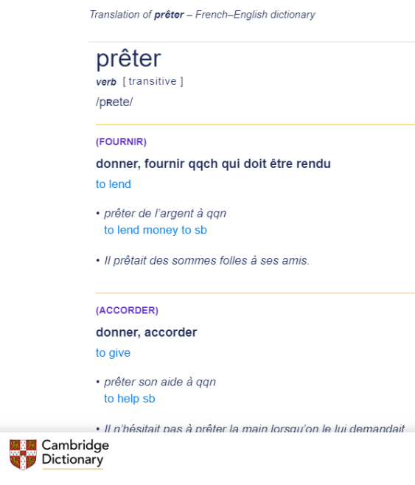
Dictionary.com
a prefix, meaning “beyond,” “more than,” “by,” “past,” occurring originally in loanwords from Latin (preterit), and used in the formation of compound words (preterlegal).
Miriam Webster
preter-
2 of 2 combining form variants or less
commonly praeter-
1
: past : by preterist
2
: beyond the range of : surpassing preternormal
“Someone” decided the Tav was not helpful! And that identity decided to have the Tav removed! WHO WAS IT?

Slide 85
Restoration of Creation’s Cycle #1!
WHO ATTEMPTS TO REMOVE the Tav?
(The answer is easy once we understand the IMPLICATIONS!)
The IMPORTANT QUESTION IS –
WHY WAS IT REMOVED AND WHAT DAMAGE CAN IT CAUSE WHEN DISREGARDED?

Slide 86
Restoration of Creation’s Cycle #1!
General Summary of the last 5 slides.
The Tav was inserted into H1961, forming – Hayetah - by Yahuah’s
Inspiration (Ruach), for assistance to improve clarification by determining a specific
ATMOSPHERIC AURA TRANSITION!
Comment:
This catastrophe followed the initial event of
Yahuah speaking this earth into a perfect
LOCALE FOR HABITATION.
Note the SPECIFIC terminology!

Slide 87

Questions for you!
Why does it seem that the Tav has been “dropped”?
Is there something to be gained by removing a simple Tav?
Tav Tampering!
Tav

Slide 88


Gen 1:2
End, for today! Part 2 will be -
Restoring Yahuah’s Charac er!
ת
t
a
v
The End

Slide 89


If you need assistance with
this study, please send your
questions to Timothy Astleford:
questions@studythecalendar.com
Thank-you!
Shalom!

Slide 90
How was the creation of “the heaven” accomplished?
Ps 33:6, 9 KJV
6 By the word of Yahuah were the heavens made; and all the host of them by the breath of his mouth.
9 For he spake, and it was done; he commanded, and it stood fast.
Ps 148:5, 3 KJV
5 Let them praise the name of Yahuah: for he commanded, and they were created.
3 Praise ye him, sun and moon: praise him, all ye stars of light.

Slide 91
Provisions for All of Earth’s Inhabitant’s
Ps 33:9 KJV
  9 For he spake, and it was done; he commanded, and it stood fast.
Ps 104:11-14, 16-18
  11 They give drink to every beast of the field: the wild asses quench their thirst.
  12 By them shall the fowls of the heaven have their habitation, which sing among the branches.
  13 He watereth the hills from his chambers: the earth is satisfied with the fruit of thy works.
  14 He causeth the grass to grow for the cattle, and herb for the service of man: that he may bring forth food out of the earth;
  16 The trees of the LORD are full of sap; the cedars of Lebanon, which he hath planted;
  17 Where the birds make their nests: as for the stork, the fir trees are her house.
  18 The high hills are a refuge for the wild goats; and the rocks for the conies.
  KJV
Ps 115:16
  16 The heaven, even the heavens, are Yahuah’s: but the earth hath he given to the children of men. KJV
Water was provided for the animals of the sky, sea and land. Vs 11
The branches of the trees are provided for the birds to have their habitation. Vs 12
Water is also provided so the earth can bring forth bountiful harvests of food for earth’s inhabitants. Vs 13
Grass is provided as food for the cattle. Vs 14
Herbs are provided as food for man. Vs 14
Trees were planted by the Word of His Command for the bird’s nests. Vss 16 & 17
High hills provide a home for the wild goats; rocks for homes of the rock badgers. Vs 18
By the end of verse 1, everything was ready and in perfect order for the earth to receive Yahuah’s intended inhabitant’s including the birds of the air, the beasts of the seas and land; AND mankind as His crowning act of creation. For a short season the earth must have resembled His most perfect garden.
Would Yahuah leave His signature?

Slide 92
Was Yahuah’s creation accomplished literally?
Hebrews 11:3 By faith we understand that the universe was formed at Yahuah's command, so that what is seen was not made out of what was visible.
Psalm 147:18 He sends forth His word and melts them; He unleashes His winds, and the waters flow.
Psalm 148:5 Let them praise the name of Yahuah, for He gave the command and they were created.
Lamentations 3:37 Who has spoken and it came to pass, unless Yahuah has ordained it?
Psalm 33:6 By the word of Yahuah were the heavens made; and all the host of them by the breath of his mouth.
Colossians 1:16,17 For by him were all things created, that are in heaven, and that are in earth, visible and invisible, whether they be thrones, or dominions, or principalities, or powers: all things were created by him, and for him: …

