Slide 1
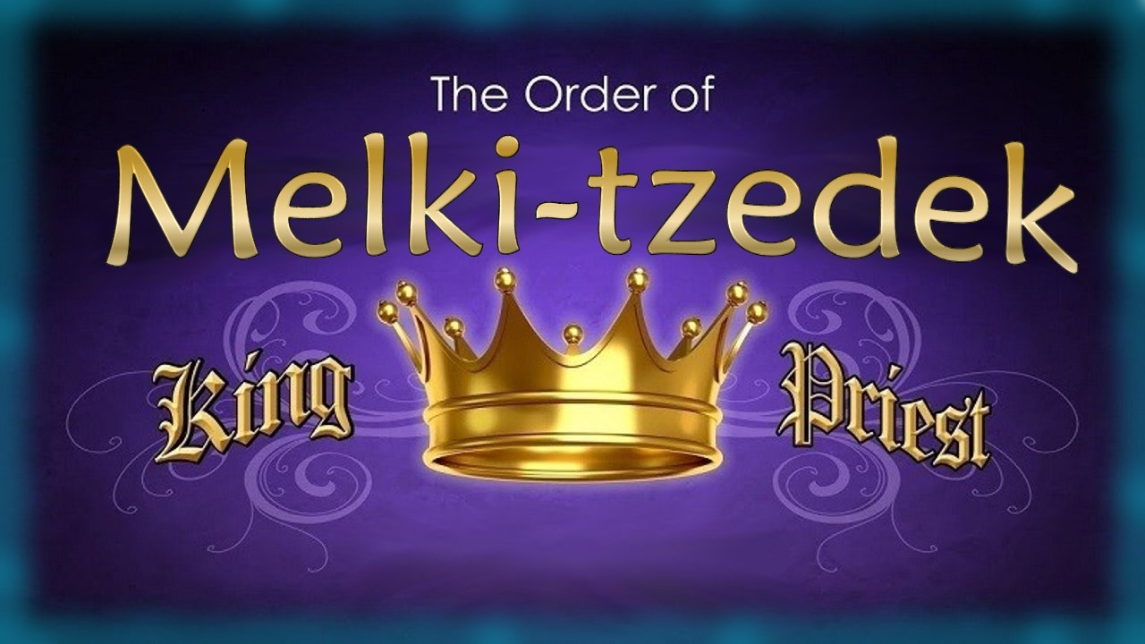
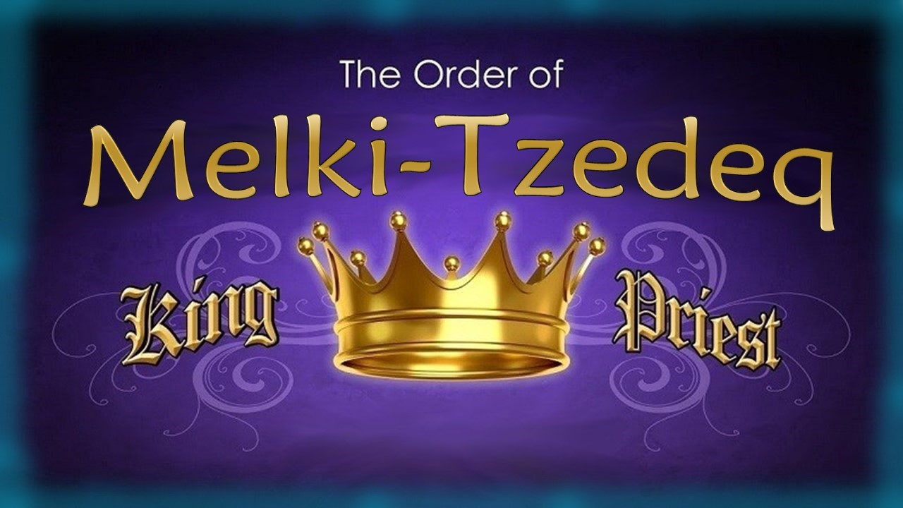

Part 1
Notes:
Tim and I had concerns about the content in this PPT – many errors. Need to let Life Line Ministries (Carmen & Andy) know as well. Apr 24/21
Sent PPT to Walter T for translation with Phil from Brazil (& Vivian).
7.5 Melki-Tzedeq Priesthood Part 1 [97] 4 May 2024
Website:
Youtube:

Slide 2
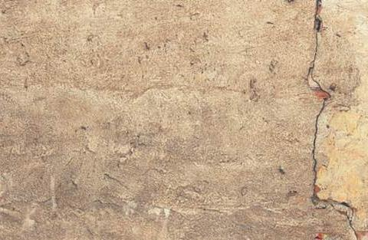

Practically, everyone that reads the Scriptures knows there was a Levitical Priesthood!
But do they know the
accurate term is Aharonic [Aaronic] Priesthood?
And do they know:
There is “another” Priesthood
that has been around much longer and is supreme today?
Do they know this is not another theory?

Slide 3
Introduction for the Beginning
Isaiah tells us 7 times that
we can know the end from
the beginning (See Isa 46:9-10.)
Most people understand that Yahusha is our Melki-Tzedeq Priest today, ministering in
the courts of heaven.
Therefore, He was also the Melki-Tzedeq Priest in the very beginning, qualifying as the:
  Aleph-Tav
  Alpha & Omega
  First & Last
Questions:
Did Yahuah implement an earthly
Melki-Tzedeq Priesthood position
for mankind at creation?
If so, how can this priesthood be found & traced in the Scriptures?
How did this earthly priesthood transfer back to Yahusha, the Sovereign Majesty of Heaven?
Does this priesthood message have anything to do with His Bride?
For this study many Scriptures
will be considered, not just a few!

Slide 4
Another Question for Consideration:
What kind of study needs
to be done to understand
the statement in Hebrews 7:12?
For the priesthood being changed,
of necessity there takes place a
change of law also.

Slide 5

Are “priesthood & law” connected to “covenants”?
What is a “covenant”
and how is it related to priesthood & law?

Slide 6
What is a Covenant?
“Covenant” is one of those words that just keeps coming up when you read the Scriptures—and certainly with study and research.
This word will have different definitions depending on who
you communicate with.
For the Jews/Shabbat keepers: covenant relates strongly to “law.”
For the nominal Christian:
covenant relates strongly to “grace.”
For many that hear of “covenant” today, it sounds like a lofty legal term for “contract,” or an “agreement.”
Most people look for ways to
“get out of this” if it has anything
to do with Yahuah’s laws.
Nevertheless, covenant is a weighty theme that dominates Scripture: it’s good to get an idea of what it means in the Scriptures.
This study will address likely the most important of all Scriptural covenants, and exactly what it means for everyone today.

Slide 7
Which Covenant is Being Addressed?
From the internet – some definitions:
There are several covenants in
the Bible, but five covenants are crucial for understanding the
story of the Scriptures and
Yahuah's redemptive plan:
the Noahic Covenant,
the Abrahamic Covenant,
the Mosaic Covenant,
the Davidic Covenant and
the New Covenant.
Some believe there are 8 covenants listed as:
Adam
Noah
Abraham
Mosaic Covenant with Israel
Aharon & Sons
Phinehas
David
Yahusha
This study will be addressing the Covenant of the Melki-Tzedeq Priesthood.

Slide 8
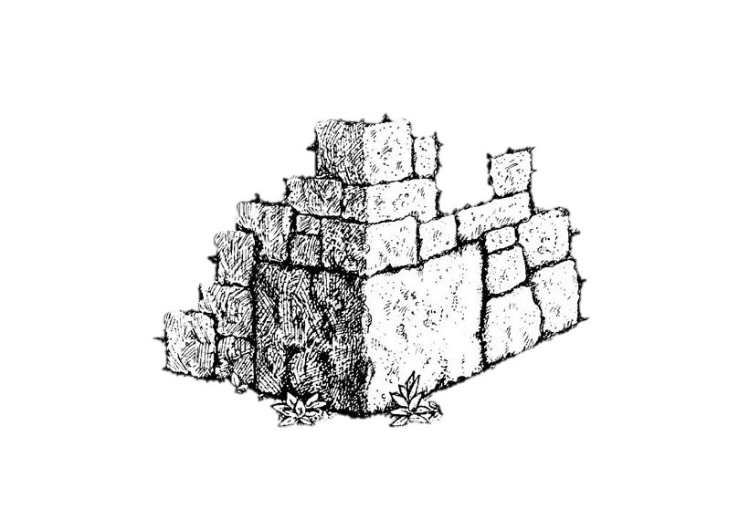

The Covenant Under the Order of Melki-Tzedeq
INTRODUCTION
This study is one of Priesthoods and respective Covenants.
It is the cornerstone of the Scriptures.
Few understand the Melki-Tzedeq Order,
never mind the covenants connected to it.
And there is confusion about how this covenant
relates to all the other Scriptural covenants.

Slide 9

What Comes to Mind First?
Question: When people hear the word “covenant” what is likely the first thing that comes to mind for many?
Answer: Old Covenant and New Covenant, right?
Then: the Old Covenant is done away with at the cross,
and the New Covenant is in place.
Meaning, the Old Covenant is Yahuah’s Law
from Mt Sinai that is old and worn out,
and the New Covenant is:
“Saved by grace since the cross!”
Is that true?

Slide 10


How can we find the truth
on the Melki-Tzedeq Covenant?
Here are some things that are true:
True: There is something that is “old.”
True: There is something that is “new.”
True: There are some things that Yahusha’s death has done away with!
Questions? But did His death do away with
the priesthood, the covenants, or the Law?
And if so: which priesthood? which covenant?
and which law?

Slide 11
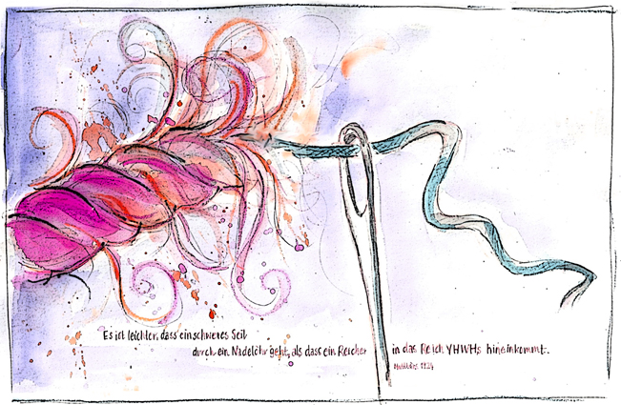
The Needle! One Strand of Yarn?
This study will attempt to unravel the many tangled pieces of the “Covenant Strand”
and thread them through the needle one at a time allowing that needle to weave this golden tapestry strand through
the Scriptures.
Art: compliments of Sabine

Slide 12

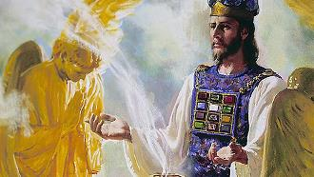
The Umbrella Illustration
Ps 110:4
“You are a priest forever according to the
order of Melki-Tzedeq.”
“forever” means from “eternity past” to “eternity future.”
This verse along with 6 other Scriptures is referring to the Majesty of Heaven.
When Adam and Eve sinned there had to be a “priest” to officiate over the sacrifice
for their offense. There was only ONE option – the “One” that was destined to be
the Sacrifice for the sins of the whole world in the Plan of Salvation.
This is important to understand, as many speak against any kind of priesthood before
the mention of the Aharonic Priesthood (Exo 25-31) about 2500 years after creation.
This multi-colored umbrella represents the all encompassing, glorious priesthood from before the beginning of the sin problem to the point where sin was defeated by Yahusha at His death, then continuing on forever.

Slide 13
Was there really a Royal King &
Royal Priest before Creation?
The Plan of Salvation was set down before the foundation of the world.
Requirements: 1) a priest 2) a sacrifice
Our Creator is the Royal King of His universe reigning supreme
over all heavenly beings before this earth was created.
With Adam & Eve He led them as their “Royal King” and taught them His ways as their “Royal Priest.”
As their King & Priest He walked with them in the cool of the evening and had “face-to-face” communion with His prize creation of mankind.
He gave Adam dominion over the earth (as earth’s “king”); taught them all of His perfect laws (nature, etc.); especially His laws of obedience and adoration.
Question: Would Adam not have been the earthly “priest” in his Eden home?
In summary our Creator’s Royal Law was: “Obey and live; disobey and die.”
Thus: Adam and Eve were under the umbrella of the Royal King & Priesthood known as Melki-Tzedeq
while at the same time Adam is the representative on earth of the heavenly order of Melki-Tzedeq.
Does all of this sound like a far stretch of the truth?

Slide 14
This study is about:
#1 Melki-Tzedeq Priesthood –
The Majesty of Heaven
as the High Priest for Adam
#2 Melki-Tzedeq Priesthood –
The Earthly Representative from Adam to Mosheh
(~2500 Yrs)
The
Umbrella Illustration Demonstrating Priesthoods
#3 Aharonic Priesthood –
on Earth From Aharon to
John the Baptist
(~1500 Yrs)

Slide 15



Illustrating “Priesthood & Covenant”
How can an umbrella demonstrate anything
about Yahuah’s Priesthood[s]?
Thoughts to Ponder in this study:
The Melki-Tzedeq Priesthood and the everlasting covenant was a perfect combination for all.
The Aharonic Priesthood and related temporary covenant became an “assistant” for ~1500 years?
Both Priesthoods and the people under these Priesthoods were to be in covenant agreement.
Question: If there is confusion over this “covenant agreement,” would that cause confusion around mandatory instructions of the related priesthood?
Priesthood
Covenant

Slide 16

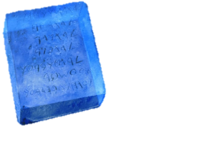
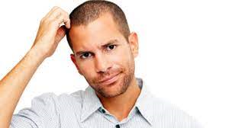
Old & New Priesthoods/Covenants?
OLD
Covenant
NEW
Covenant
Old
Laws?
New
Laws?
What’s the first thing most think about when they hear the word “Covenant?”
Do they think of “Law” instead of being in a covenant relationship?
Question: What’s the first thing most think about when they hear
“Old Covenant/Priesthood” & “New Covenant/Priesthood”?
Old Laws? … and New Laws?
Answer: Most think the “Law” is the OLD Covenant and is forever broken;
and they think the NEW Covenant has no “Laws.” In other words: most people think New Covenant means “under grace, and not under the law anymore.”
The idea of a “covenant relationship” is completely foreign to their thinking.

Slide 17
The question is: Old & New Covenants According to “who”?
Why?
ALL were
under the Law[s]
in the
OLD Testament!
Finally ALL are
under Grace
in the
NEW Testament!
Most Believe
“covenant”
only means
“the law”

Slide 18
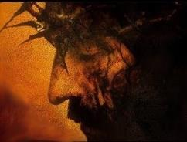

Because of this!
We’re no longer
under the Law[s]
of the OLD
Testament!
Finally all are
under Grace
in the NEW
Testament!
Everyone should be asking the question: “Is this true?”

Slide 19

What is this Study all About?
This will be a short introductory study around the Melki-Tzedeq Priesthood and a few related areas that are very important for our understanding of Yahuah’s perfect requirements for
His people in these last days of
earth’s history.
Acts 3:21 reveals there will be a time “of restoration of all things” – things that have been spoken of by Yahuah’s prophets since the beginning of time. That time is now!
Some “things” have been legally terminated and will not be restored – such as animal sacrifices.
Also, there are many “things” that have been lost through the ages that do need to be restored for our full restoration in relationship to Yahuah.
The study of the Melki-Tzedeq Priesthood shows with clarity what needs to be restored – what the words are of the everlasting covenant and where to find these words.
The study on the Aharonic Priesthood shows with clarity the temporary covenant that has been fulfilled with Yahusha’s death – what those words are and where to find these words.
Both priesthoods are important operating independently. Both have a purpose and should be fully understood including two very important books.

Slide 20
What Does Torah Include & Mean Today?
Torah includes the 5 books of Mosheh - Gen to Deut.
Torah includes everything found in the first 5 books.
Torah includes "law" and "laws" - every command given either by Yahuah, or Mosheh. (Mosheh asked for the
laws of divorce - they were not in the Book of the Covenant,
and not included in the Book of the Law at the beginning.)
Torah includes the 10 commandments.
Torah includes the laws found in the Book of the Covenant.
Torah includes the statutes, commands and judgments
of the Book of the Covenant linked to the 10 commands.
Torah includes the laws found in the Book of the Law.
Torah includes the statutes, commands and judgments
of the Book of the Law.
Torah includes the Melki-Tzedeq Priesthood.
Torah includes the Aharonic Priesthood.
Torah includes the sanctuary and all of its services.
Torah includes the sacrifices and offerings
... and a whole lot more - this is a basic list for starters.
Not everything listed in Torah is still to be kept and honored since the cross /tree [as noted in red] - that is the difference.
So when we say we have to "Keep the Torah" ... Hhmm.... it seems we have to "define" and "specify" what parts of Torah are kept since Yahusha's death. Could this be why so many still feel they need to keep 1) fleshly circumcision, 2) find Levitical priests, 3) rebuild the temple and 4) start up sacrifices?
We do not keep the parts of the Torah that have expired with Yahusha’s death, in accordance with statutes and prophecy. Only the part of Torah that is still binding is kept today.
This all boils down to Priesthood. Torah begins with Adam's Melki-Tzedeq Priesthood - we are given detailed instructions about what is kept under this priesthood for 2500 years after Adam ... and when this Melki-Tzedeq Priesthood is passed back to Yahusha - it is those precepts of Torah that are still kept and honored.
We do not keep ALL of Torah anymore. We do keep the Torah portions of the Majestic Heavenly Melki-Tzedeq Priesthood.
The binding parts of Torah are important for today and to be honoured.
Notes:
From Irma Nov 16/21: not sure if I know what she is trying to tell me – except the slide is not organized well enough and too much information. Charlene
very interesting and quite comprehensive. A serious study, indeed! Beloved sister, if all of that was on slide 3 as laid out, I have to tell you Galations 3 was much easier to follow Perhaps laying it out in table form would give it a visual effect thats easier for beginners like me to grasp. For example: Torah includes:1st column 2nd column
1. 5 books of Mosheh | a. Gen-Deut
| b. everything | in 5 books
|
2. “Law” and “Laws”.| a. every command given by Yahuah or Mosheh
3. Book of Covenant | a. all statutes b. all judgements
c. all commands
4. Book of Laws. | a. (repeat of previous… too tedious to type)
5. Melquizedeck
priesthood
6. Aharonic priesthood
7. Sanctuary and its
services
8. Sacrifices and
offerings
A third column could clarify further. The highlights in RED definitely are plus.Its just the repetitious way it was written begs a person skip the whole thing and turn the page. Red highlights could be in the 3rd column? I use to write procedures for my job so I had to be really detailed. But yours is teaching so, maybe that should be presented different. Just presenting my 2 cent suggestion.Forgive me. I’m eagerly looking forward to your study. Which reminds of a question I needed to ask when I first read thru WORKS filled slide 3. What should come first, the Melki-Tzedeq priesthood or the Torah applicable commands, laws, statues and judgement? For me, the Melki-Tzedeq priesthood anointing comes first; the Torah is then accomplished in its fullness. shalom

Slide 21
Two Priesthoods & Two Books
Melki-Tzedeq Priesthood
(a Kingdom “of” priests)
Aharonic Priesthood
(a kingdom “with” priests)
Connected to a blood ratified
ever-lasting Covenant.
Covenant Instructions [Book of the Covenant] were lived out by the patriarchs from Adam to Mosheh – as covenant testimonies.
Covenant Words are found between Exodus 20:1 - 23:33.
Book of the Covenant has
no additions or deletions.
Written on tables of stone
and placed inside the Ark
of the Covenant.
Connected to a temporary Covenant from the golden calf to Yahusha’s Passover day.
Temporary Instructions [Book of the Law] were also necessary from the point of the golden calf.
Original Temporary Words are found between Exo 25:1 to Exo 31:18.
Book of the Law covenant allows
for additions and deletions, etc.
Written on parchment and placed outside the Ark of the Covenant.
Both “books” are important; both “books” have a purpose.

Slide 22
Components of Two Different Priesthoods & Covenants
Melki-Tzedeq Priesthood
Aharonic Priesthood
… is connected to a blood ratified
ever-lasting Covenant.
Proposal to come into a covenant agreement has to be given.
Acceptance to the covenant agreement has to be given.
Covenant agreement must be blood-ratified to be everlasting.
Covenant Confirming Meal
that nothing will be added or removed from this covenant.
Upon acceptance, the one that breaks the covenant is under a death penalty.
… is connected to only a temporary covenant.
It is not valid when there is a Melki-Tzedeq Covenant in operation.
This covenant was imposed upon the people.
This covenant will be broken many times
(with accompanying curses).
Laws can be added to, or changed, at any
time by man under agreement of Yahuah.
According to prophetic instruction, this covenant is obsolete immediately upon
the arrival of Yahusha the Highest Priest and
Melki-Tzedeq when the priest acting in the Aharonic position annulled his future position.
Both covenants are important
and have a purpose.
Both “covenants” use a
different style of lingo!

Slide 23


Question #1
What was Yahuah’s original plan for mankind?

Slide 24


Yahuah’s original plan for mankind was to be a kingdom of priests and kings, obedient to the Book of the Covenant – UNDER His Melki-Tzedeq Priesthood. Their lives were to reflect His righteousness and also be a shining light to the whole world.
It was deemed that through their love, obedience
and kindness to mankind, many would come to know
the only true Elohim and Creator and to worship Him alone.

Slide 25
Exodus 19:5-6 “And now, if
you diligently obey My voice, and shall guard My covenant, then you shall be My treasured possession above all the peoples – for all the earth is Mine –
6 ‘and you shall be to Me a reign of priests and a set-apart nation.’ Those are the words which you are to speak to the children of Yisra’ěl.” TS2009
1 Peter 2:5, 9
5 You also, as lively stones,
are built up a spiritual house,
a set-apart priesthood …
9 you are a chosen race,
a royal priesthood, a set-apart nation, a people for a possession; that ye should proclaim the praises of Him who called you out of darkness into His marvellous light. TS2009
25

Slide 26

Question #2
How many know and understand there is a Melki-Tzedeq Priesthood
in the Scriptures?

Slide 27
Where is this “Melki-Tzedeq Priesthood” Found?
Psalms 110:4 Yahuah hath sworn, and will not repent, Thou art a priest for ever after the order
of Melki-Tzedeq.
Hebrews 5:6 As he saith also in another place, Thou art a priest for ever after the order of
Melki-Tzedeq.
Hebrews 5:10 Called of Yahuah an high priest after the order
of Melki-Tzedeq.
Hebrews 6:20 Whither the forerunner is for us entered,
even Yahusha, made an high priest for ever after the order
of Melki-Tzedeq.
Hebrews 7:11 If therefore perfection were by the Levitical priesthood, (for under it the people received the [book of the temporary] law,) what further need was there that another priest should rise after the order of Melki-Tzedeq, and not be called after the order of Aharon?
Hebrews 7:17 For he testifieth, Thou
art a priest for ever after the order of Melki-Tzedeq.
Hebrews 7:21 (For those priests were made without an oath; but this with an oath by him that said unto him, Yahuah sware and will not repent, Thou art a priest for ever after the order of
Melki-Tzedeq:)
Any phrase found 7 times should be investigated!

Slide 28
Question #2a
Who is this
High Priest under the Order of
Melki-Tzedeq
and why is this priesthood so relevant and important today?

Slide 29

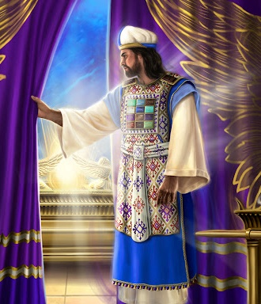
Hebrews 5:5-6 (He is a Son!)
So also the Messiah
did not extol Himself
to become High Priest, but it was He who said to Him, “You are My Son, today
I have brought You forth.” As He also says in another place, “You are a priest forever according to the order of Melki-Tzedeq.”
29

Slide 30

From Hebrews: The Son is Yahusha!
Hebrews 4:14,15 “Seeing then that we have a great high priest, that is passed into the heavens, Yahusha
the Son of Yahuah, let us hold fast our profession.”
Hebrews 7:26
“For such an high priest became us,
who is holy, harmless, undefiled, separate from sinners, and made higher than the heavens.”

Slide 31
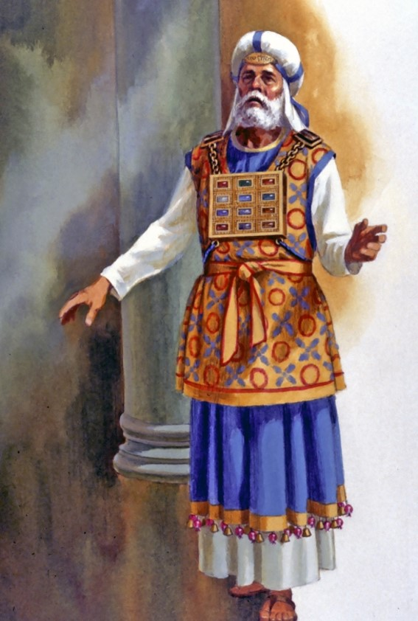
Why is the
Melki-Tzedeq Priesthood
so relevant and important
for us today?
For His people to be chosen as a “royal priesthood” they must be under
a High Priest.
31

Slide 32
Question #3
Who was
Melki-Tzedeq,
the King of Salem, mentioned in
Gen 14:18?
“And Melki-Tzedeq king of Salem
brought forth bread and wine:
and he was the priest of the most high Elohim.” KJV

Slide 33

Hebrews 7:1-3 “For this Melki-Tzedeq, king of Salem, priest of the most high Elohim, who met Abraham returning
from the slaughter of the kings, and blessed him; 2 To whom also Abraham
gave a tenth part of all; first being by interpretation King of righteousness, and after that also King of Salem, which is, King of peace; 3 Without father, without mother, without descent (genealogy), having neither beginning of days, nor end of life; but made like unto the Son of Yahuah; abideth a priest continually (forever).”

Slide 34
Question #4
What does
Melki-Tzedeq
King of Salem,
Priest of the
Most High mean?

Slide 35
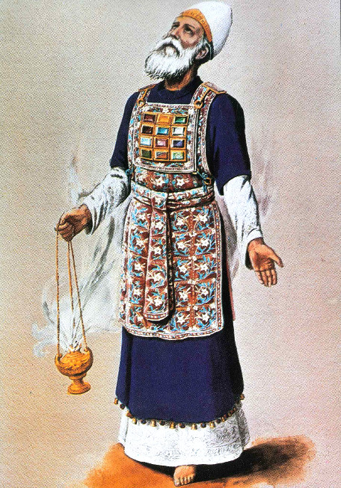
From Hebrews 7 we are told Melki-Tzedeq was king of Salem [H8004] and Priest of Yahuah the Most High. Exactly what does that mean?
H8004 Shalem (shaw-lame'); the same as H8003; peaceful; Shalem, [&] an early name of Jerusalem: KJV - Salem.
  Shalom; See H7965 [peace]. H7965 shalowm (shaw-lome'); or shalom; from H7999; safe, i.e. (figuratively) well, happy, friendly; also (abstractly) welfare, i.e. health, prosperity, peace.
“Salem” is used only 2 times in the Old Testament as
(1) “King of Peace” and (2) “city of peace.”
Genesis 14:18 And Melki-Tzedeq king of Salem [shalom/peace] brought forth bread and wine:
and he was the priest of the most high Elohim. KJV

Slide 36
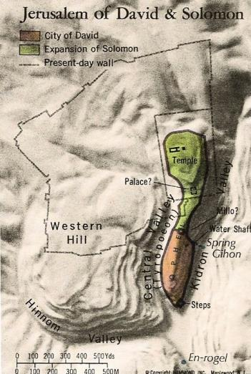
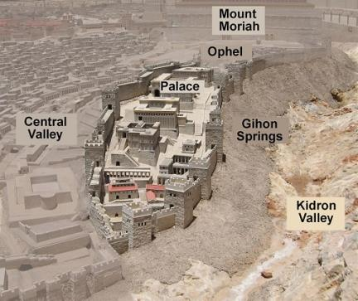
Remember: “Salem” is used only 2 times in the Old Testament as (1) “King of Peace” and (2) “city of peace.”
Psalms 76:2 KJV In Salem [Jerusalem] also is his
tabernacle, and his dwelling place in Zion [H6726].
“Zion” is found 152 times
in the Tanach – always in
reference to Jerusalem –
named as the
“city of peace.”

Slide 37
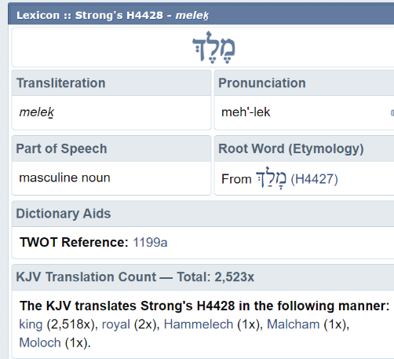
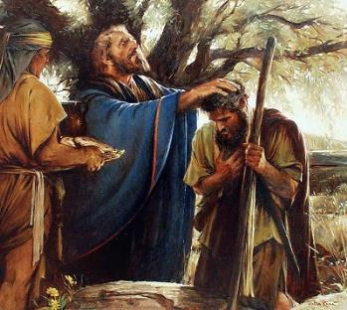
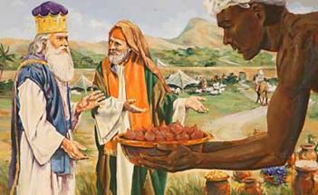
In Gen 14:18, the Melki-Tzedeq King of Salem met Abraham as he returned from the defeat of the kings. This Priest of the most high Elohim brought bread and wine and blessed Abraham. It is also recorded that Abraham gave him a tenth of everything.
Remember: King of Salem means King of Peace.
Melki-Tzedeq also has a special meaning:
“Malki/Melki” means “king”
“tzedek” means “righteousness.”
This “king of righteousness” (or “king of peace”)
is the Most High Elohim, Who will be known as the
One [Yahusha] that offers the sacrifice of Salvation.
This can only refer to the Majesty of Heaven – NOT – any Melki-Tzedeq representative from the lineage of Adam.

Slide 38
Question #5
How can we understand & trace
the Melki-Tzedeq Priesthood
as it was established first in Adam
by the Most High?

Slide 39
Yes, the order of the Melki-Tzedeq Priesthood was given to Adam so there would always be a “representative & mediator” between Elohim and mankind on this earth. This first earthly title of Melki-Tzedeq Priest belonged to Adam until he died, and then the title was passed to his 2nd son Seth.
From Seth to Noah, a pattern is found where the Melki-Tzedeq Priesthood
is passed from father to the son after the first born.
Noah inherited the title when Methuselah died even though Noah was Methuselah's grandson, because Methuselah outlived his son, Lamech.
Therefore, the order skipped over Lamech and went to Noah upon Methuselah's death.
Similarly, Enoch never inherited the Priestly order of Melki-Tzedeq because Enoch was "translated" [Heb 11:5] from the earth before his father, Jared, died.
The Bible calls Noah the eighth preacher of righteousness in 2 Peter 2:5.
39

Slide 40
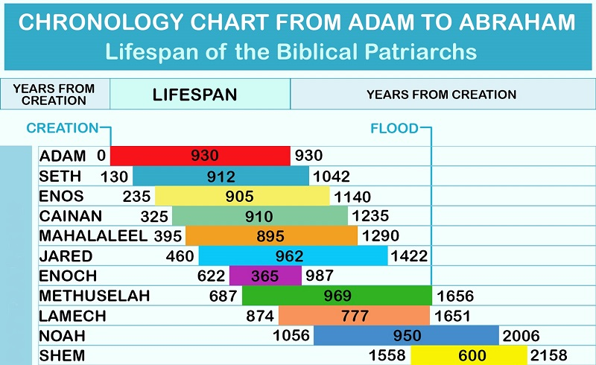
Noah: the 8th Preacher of Righteousness
CHRONOLOGY CHART FROM ADAM TO SHEM
(Note: Noah is the 10th Generation, not the 8th!)
2 Peter 2:5 and the old world did not spare, but the eighth person [priest], Noah, of righteousness a preacher, did keep, a flood on the world of the impious … YLT
2 Peter 2:5 and did not spare the ancient world, but saved Noah, one of eight people, a preacher of righteousness, bringing in the flood on the world of the ungodly … NKJV
#1
#2
#3
#4
#5
#6
#7
Died before Methuselah
#8
#9
40

Slide 41
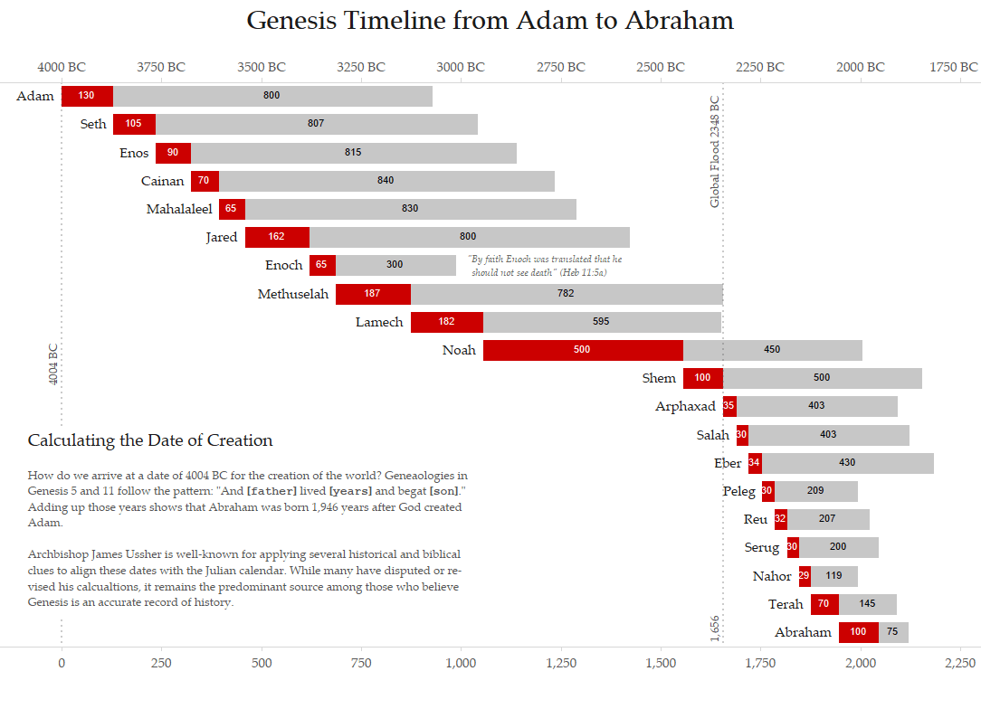
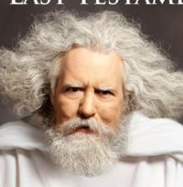
Adam
Adam was ordained the 1st earthly Melki-Tzedeq priest on earth and had the privilege and responsibility to instruct
8 generations after him up to Lamech for almost 1000 years.
He would have also honored, taught and preserved Yahuah’s Covenant commands, statutes and judgments including the worship statutes of Covenant Calendar.
Luke 3:38
… Adam, which was the
son of Yahuah.
41

Slide 42
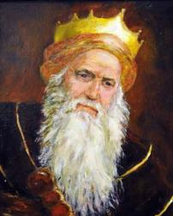
Enoch
During Enoch’s life he would have easily known Adam
the whole time and received instruction in Yahuah’s Covenant, including the Divine Covenant Calendar.
Enoch’s earthly residence ended before he was a priest.
Is it possible for Enoch to “walk with Yahuah”
and live in disobedience to the Covenant?
Gen 5:24
And Enoch walked with Yahuah: and he was not;
for Yahuah took him.
42

Slide 43
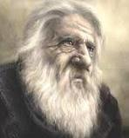
Counting the Patriarchs & Priests
Methuselah
~3317-2348 BC
Methuselah lived 669 years after his father Enoch was translated.
He was a witness to 11 generations - more than anyone in the world. Being instructed for 300 years by Enoch, with the Covenant truths confirmed in Adam and all previous generations,
Methuselah is an invaluable link by preserving every truth
for future generations.
Gen 5:22
And Enoch walked with Yahuah after he begat Methuselah three hundred years.
43

Slide 44
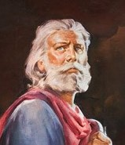
Noah
Enoch & Lamech are bypassed as Melki-Tzedeq priests.
Noah is the 10th generation
& the 8th Melki-Tzedeq Priest.
When Noah dies, Shem becomes the 9th Melki-Tzedeq Priest.
2 Peter 2:5 And spared not the old world, but saved
Noah the eighth person, a preacher of righteousness, bringing in the flood upon the world of the ungodly. [KJV]
Note: Melki-Tzedeq means “king of righteousness.”
When the italicized word “person” is removed, the
verse reads that Noah is the “8th” – rightly meaning
the “8th Melki-Tzedeq Priest” since Adam.
44

Slide 45
Noah
Gen 6:8-9
8 Noah found grace in
the eyes of Yahuah.
9 … Noah was a just man
and perfect in his generations,
and Noah walked with Yahuah.
Gen 7:5 And Noah did according unto
all that Yahuah commanded him.
2 Peter 2:5 Noah, a preacher of righteousness …
Noah was able to have instruction from 6 generations before
him that knew Adam and learned from his lips. Noah’s instructions, would have been handed down through the following 10 generations all the way to Abraham. Noah’s testimony for the timing of the flood calendar demonstrates many details of Yahuah’s Covenant Calendar!
45

Slide 46
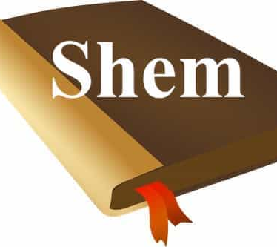
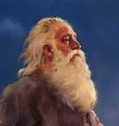
After Shem died,
the Melki-Tzedeq title continued
to be inherited from generation
to generation
until it reached Abraham, the father of all nations.

Slide 47
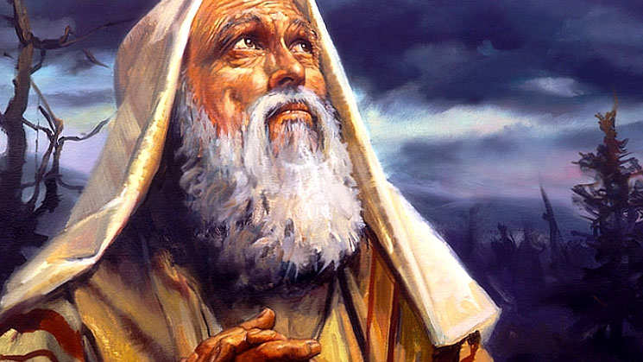
Abraham
Abraham, as a Melki-Tzedeq Priest, was given the promise in Gen 15 that his seed would be
delivered from bondage
in 430 years – because:
Gen 26:5 Abraham obeyed
my voice, and kept my charge,
my commandments,
my statutes, and my laws.
Next: How does the Priesthood continue through the generations from
Abraham up to Mosheh, Yahuah’s great “deliverer”?
Isaac, as the next Priest,
begins the next set of timelines.
47

Slide 48
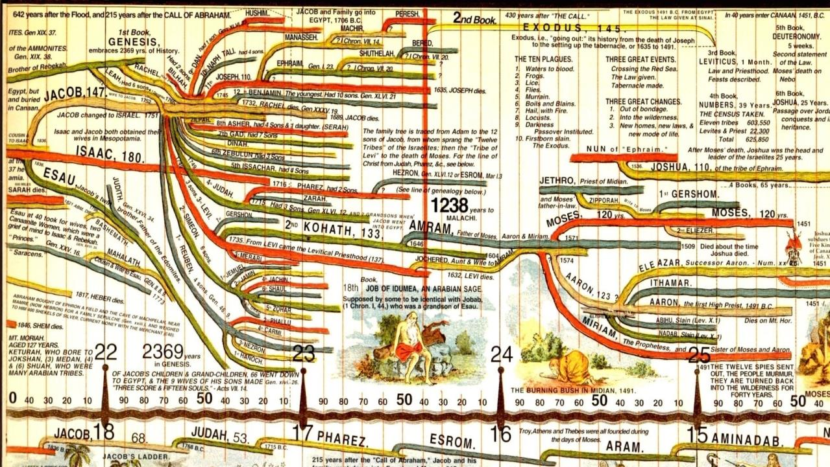
1 Chron 5:1-2 Now the sons of Reuben the firstborn of Israel -- he was indeed the firstborn, but because he defiled his father's bed, his birthright was given to the sons of Joseph, the son of Israel, so that the genealogy is not listed according to the birthright; 2 yet Judah prevailed over his brothers, and from him came a ruler, although the birthright was Joseph's. -- NKJV
Aharon is the 1st Aharonic Priest within the outline
of the [temporary] Book of the Law.
This alternative priesthood was meant to continue up to Yahusha’s Passover Day whereupon He would (and did) reinstate the everlasting Melki-Tzedeq Priesthood.
48
48

Slide 49
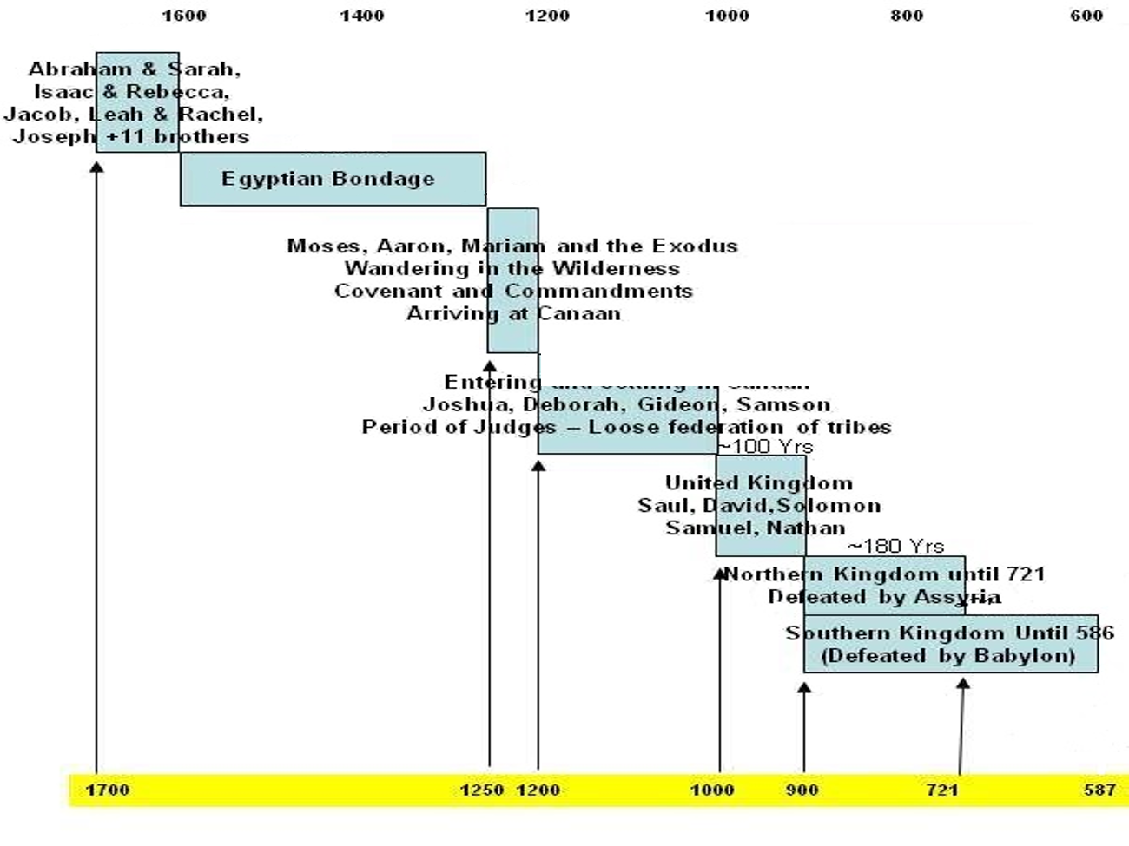

Mosheh
The Last Melki-Tzedeq Before Yahusha
Mosheh was chosen to deliver Abraham’s seed
from bondage around 1491 BC.
The generations that have faithfully handed down Yahuah’s covenant (orally) have all faded by now.
In Exodus 19-24, Mosheh is instructed to record Yahuah’s spoken Covenant from Mt Sinai in the Book of the Covenant (Exo 24:4, 7).
The words on this parchment were then re-written by Yahuah’s finger on tablets of stone, front and back (Exo 32:15).
This is now ~2500 years after creation.
Deut 34:10
And there arose not a prophet since in Israel like unto Mosheh, whom
Yahuah knew
face to face.

Slide 50
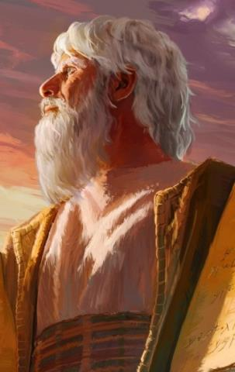
Mosheh and the blood-ratified
Book of the Covenant
The everlasting instructions of Yahuah’s covenant were given to Adam to be taught to every generation.
These were “oral instructions” –
there was no book at that time.
Mosheh was the first patriarch we
know of that actually wrote these instructions “in a book.”
That’s part of the story. This next section will address some details that are needed to understand the most important foundational truth of the Order of Melki-Tzedeq.
Yahuah called Mosheh to the Melki-Tzedeq Priesthood at the burning bush to be the mediator between Yahuah and Pharaoh to
“let the people go.”
At this point, Mosheh is in charge of the Priesthood.
50

Slide 51

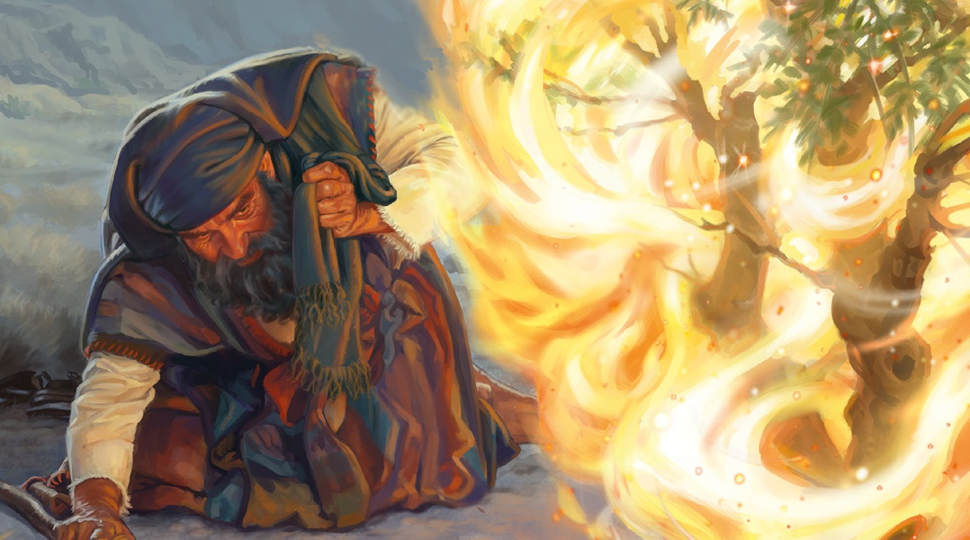
Mosheh – the last Melki-Tzedeq Priest of the Old Testament
Time to
re-Consider:
2 Books!
2 Laws!
And two
Priesthoods!
It all begins
in Exodus with Mosheh!
Melki-Tzedeq
Priest-hood
Mosheh
& the
Burning Bush.
Mosheh
commissioned to
lead Israel from Egypt.
Mosheh’s
encounter
with Pharaoh.
In one day - at the burning bush - Mosheh’s life changed forever.
The incredible events began in Exodus 3. Miracles abound in Egypt and
the Wilderness of Sinai; and also approaching Mt Sinai shortly thereafter.
Exodus 19-24 are extremely important chapters for this topic of study.
51

Slide 52

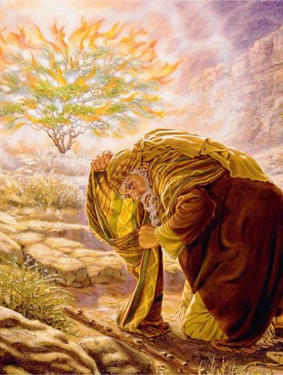
Mosheh’s 1st Encounter at Mt Sinai
Background Information for Mosheh: (All dates are approximates.)
~1571 BC of Exo 2: Mosheh was born to Levi's grandson, Amram, the son of Kehot. His wife, Jochebed [also of the tribe of Levi] bore him three children – Miriam, Aharon and Mosheh.
Aharon was older by three years.
Do take note that Mosheh is the “2nd born” son, and not the first.
~1531 BC of Exo 3 & Acts 7: At age 40, Mosheh flees Egypt.
~1491 BC of Exo 7 & Acts 7: At age 80, Mosheh is called to be Israel’s leader. Exodus 3 begins the story.
Mosheh’s attention is drawn to a burning bush that is not consumed [1st encounter at Mt Sinai]. Yahuah uses this opportunity to inform Mosheh He has a very special mission for him. Mosheh is chosen to be the one to deliver Israel from Egyptian bondage – Aharon will be a mouthpiece, but in every other detail, Yahuah will work with Mosheh – as the “mediator” and “deliverer.”
~1491 BC
52

Slide 53
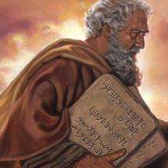
Component’s of a Blood-ratified Covenant
The narrative and commands between Exo 19:1 to 24:11
will include very pertinent information on the
4 components that formulate an
everlasting covenant with Yahuah
[also found in the Ancient Suzerain Treaties]. They are:
1. – Proposal
2. – Acceptance
3. – BLOOD RATIFICATION
4. – Covenant Confirming Meal
53

Slide 54
Exo 19:1 In the third month after the children of Yisra’ĕl had come out of the land of Mitsrayim, on this day they came to the Wilderness of Sinai.
2 For they set out from Rephiḏim, and had come to the Wilderness of Sinai, and camped in the wilderness. So Yisra’ĕl camped there before the mountain.
3 And Mosheh went up [trip #2 for Mt Sinai] to Elohim, and יהוה
called to him from the mountain, saying, “This is what you are to say
to the house of Yaʽaqoḇ, and declare to the children of Yisra’ĕl:
4 ‘You have seen what I did to the Mitsrites, and how I bore you on eagles’ wings and brought you to Myself.
5 ‘And now, if you diligently obey My voice, and shall guard My covenant, [the words of this covenant are not yet known] then you shall be My
treasured possession above all the peoples – for all the earth is Mine –
6 ‘and you shall be to Me a reign of priests and a set-apart nation.’
Those are the words which you are to speak to the children of Yisra’ĕl.”
1st Portion – Yahuah Proposes
54

Slide 55
Exo 19:7 And Mosheh came [down Mt Sinai] and called for the elders of the people, and set before them all these words
which יהוה [Yahuah] commanded him.
Question:
What PROPOSAL did Mosheh place before the people in Exo 19:5-6?
Answer:
Yahuah expressed His desire to position the Hebrew nation as a reign of Kohenim (priests) and to be a set apart nation under His Name – even though the people did not know the words of the covenant yet!
55

Slide 56
8 And all the people answered together and said, “All that יהוה [Yahuah] has spoken we shall do.” So Mosheh [on trip # 3 UP Mt Sinai] brought back the words of the people to יהוה.
9 And יהוה said to Mosheh, “See, I am coming to you in the thick cloud, so that the people hear when I speak with you, and believe you forever.” And Mosheh reported the words of the people to יהוה.
10 And יהוה said to Mosheh, “Go to the people and set them apart today
and tomorrow. And they shall wash their garments,
11 and shall be prepared by the third day. For on the third day יהוה shall come down upon Mount Sinai before the eyes of all the people.
2nd Portion – Proposal Acceptance
56

Slide 57
Exo 19:12 “And you shall make a border for the people all around, saying, ‘Take heed to yourselves that you do not go up to the mountain or touch the border of it. Whoever touches the mountain shall certainly
be put to death. [Any connection to the moedim “mount of the congregation.”]
13 ‘Not a hand is to touch it, but he shall certainly be stoned or shot with an
arrow, whether man or beast, he shall not live.’
When the trumpet sounds long, let them come near the mountain.”
14 And Mosheh came down from the mountain [trip #3] to the people and set the people apart, and they washed their garments.
15 And he said to the people, “Be prepared by the third day. Do not come near a wife.”
16 And it came to be, on the third day in the morning, that there were thunders and lightnings, and a thick cloud on the mountain. And the sound of the ram’s horn was very loud, and all the people who were in the camp trembled.
57

Slide 58
Exo 19:17 And Mosheh brought the people out of the camp to meet with Elohim, and they stood at the foot of the mountain.
18 And Mount Sinai was in smoke, all of it, because יהוה [Yahuah] descended upon it in fire. And its smoke went up like the smoke of a furnace, and all the mountain trembled exceedingly.
19 And when the blast of the ram’s horn sounded long and became louder and louder, Mosheh spoke, and Elohim answered him by voice.
20 And יהוה came down upon Mount Sinai, on the top of the mountain.
And יהוה called Mosheh to the top of the mountain,
and Mosheh went up [for trip #4].
21 And יהוה said to Mosheh, “Go down, and warn the people, lest they break through unto יהוה to see, and many of them fall.
22 “And let the priests [heads of each household of all tribes] who come near יהוה set
themselves apart too, lest יהוה break out against them.”
58

Slide 59
Exo 19:23 And Mosheh said to יהוה, “The people are not able to come up to Mount Sinai, for You warned us, saying, ‘Make a border around the mountain and set it apart.’ ”
24 And יהוה said to him, “Come, go down and then come up, you and Aharon with you [this will be a future trip]. But do not let the priests and the people break through to come up to יהוה, lest He break out against them.”
25 And Mosheh went down [Mt Sinai
for trip #4] to the people and spoke to them.
There are several important points to take note of in this chapter:
Mosheh acted as “mediator” for the people
in three separate trips up & down Mt Sinai.
The people trusted Mosheh for direction. Why?
vs 9: Yahuah said: “I am coming to you in
the thick cloud, so that the people hear when I speak with you, and believe you forever.”
The people knew Mosheh gave them the
exact same “words” as was spoken at the top
of Mt Sinai.
They trusted Mosheh to deliver the exact message from Yahuah!
This is extremely important
to remember!
H559 Amar
59

Slide 60
Everyone is ready to hear the “words” of Yahuah’s Covenant!
This is no ordinary covenant or agreement!
Thus far two conditions of an everlasting covenant have been realized.
Yahuah proposed to the people He had a covenant.
The people agreed they would come into covenant with Yahuah before they heard the “words” of THE COVENANT. This was their acceptance.
Exodus 20 is a well known chapter containing the
TEN Commandments or – the first “words” of the everlasting covenant.
How long will the people listen at the foot of a trembling mountain?
1st Component
2nd Component
60

Slide 61
Question #6
What are the
“Words” of the
Book of the Covenant and where
are they found?

Slide 62
The First Words of the Covenant:
THE “TEN” Commandments
What happens next is of major importance & missed by most!
Have no other gods before Me.
Do not make and worship images.
Don’t take Yahuah’s name
in vain.
Remember the Shabbat day.
Honour your parents.
Do not murder.
Do not commit adultery.
Do not steal.
Do not bear a false testimony.
Do not covet anything.
Exo 20:18-21
18 And all the people saw the thunderings, and the lightnings, and the noise of the trumpet, and the mountain smoking: and when the people saw it, they removed,
and stood afar off.
19 And they said unto Mosheh, Speak thou with us, and we will hear: but let not Yahuah speak with us, lest we die.
What just happened?
Yahuah’s voice has frightened them.
This never happened with Mosheh. Then look …
20 And Mosheh said unto the people,
Fear not: for Yahuah is come to prove you, and that his fear may be before your faces, that ye sin not.
21[a] And the people stood afar off …
62

Slide 63
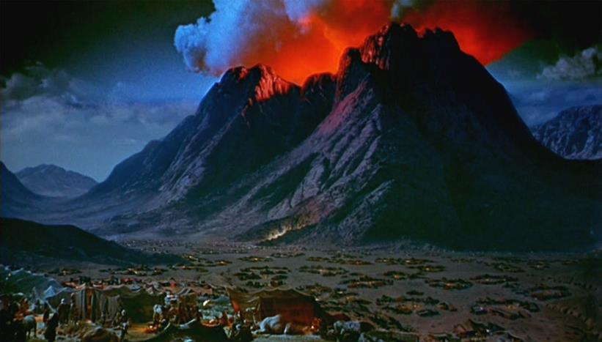
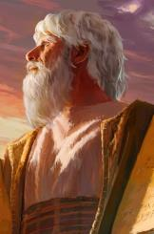
The people were “done” listening and beckoned Mosheh to mediate!
It is with Mosheh “only” that Yahuah gives the rest of the Debarim; - “words” of His covenant
for the people.
While Mosheh is upon the Mount, do the people hear Yahuah talking to Mosheh again?
Exo 20:21[b]
Mosheh drew near unto the thick darkness where Yahuah was [the 5th trip up Mt Sinai].
63

Slide 64

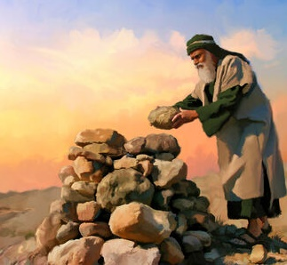
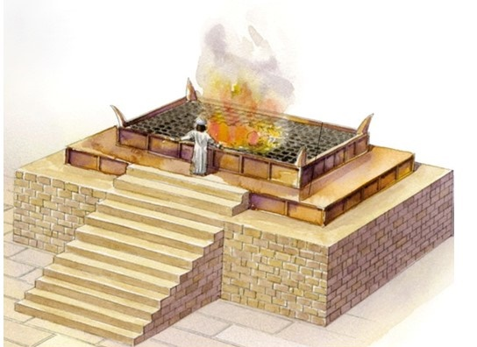
Yahuah begins to speak the rest of
the covenant “words” to Mosheh [vs 22]
Exodus 20 Vss 23-26 The Law of the Altar
Ye shall NOT make with me gods of silver,
neither shall ye make unto you gods of gold.
An Altar of earth thou shalt make unto me,
and shalt sacrifice thereon thy burnt offerings,
and thy peace offerings, thy sheep and thine oxen:
in all places where I record my name I will come
unto thee, and I will bless thee.
And if thou wilt make me an altar of stone, thou
shalt not build it of hewn stone: for if thou lift up
thy tool upon it, thou hast polluted it.
26 neither shall thou go up by steps unto mine altar,
that thy nakedness be not discovered thereon.

Slide 65
Yahuah continues speaking Judgments & Statutes of the Covenant “words” to Mosheh
Exo 21 to Exo 23:33 contain the rest
of the “Words” of the “Covenant.”
Exodus 23 - Judgments/Statutes
Vss 1-9 Justice for All
Vss 10-13 Law of the Sabbaths**
Vss 14-19 Three Annual Feasts, Etc.**
Vss 20-31 Conquest Regulations**
  6 National Directives
  12 National Blessings
Vss 32-33 Two National Warnings**
Exodus 21 - Judgments
Vss 1-11 Laws Concerning Servants
Vss 12-27 Laws Concerning Violence
Vss 28-35 Animal Control Laws
Exodus 22 - Judgments
Vss 1-15 Responsibility for Property
Vss 16-31 Moral & Ceremonial
Principles

Slide 66
Conquest Regulations
& 6 National Directives
Exodus 23:20-31
Obey and Yahuah will protect
Do not provoke Yahuah
Do not worship other gods
Break down the pagan gods and pillars
Drive out the Hittites, Perizzites; Canaanites;
Hivites; Jebusites
Set the boundaries of the land from Red Sea to Sea of
Philistines and from the desert to The River Euphrates
66

Slide 67
12 National Blessings
Exodus 23:20-31
An angel will keep you
I will bring you in the
place prepared for you
Blessing of your bread
Blessing of your water
Blessing of health
Blessing of no barrenness
Blessing of long life
Yahuah will fight for you
Yahuah will cause enemies
to turn away
Yahuah will cause confusion
in the enemy
Yahuah will send hornets to
drive out the enemy
Yahuah will protect you and
be the enemy to your enemies until you inherit the land
Covenant Ends with Warnings
67

Slide 68
Two National Warnings
Exodus 23:32-33
Note: there are NO National Curse[s] different than the individual limited family curse of the 2nd Commandment.
Note: Between Exo 20-Exo 23:33 there are eight reminders to NOT have a covenant with other gods. This is so important, the covenant ends with these last two reminders.
Exo 20:3-5 Thou shalt have no other gods before me. 4 Thou shalt not make unto thee any graven image, 5 Thou shalt not bow down thyself to them, nor serve them: for I Yahuah thy
Elohim am a jealous Elohim, visiting
the iniquity of the fathers upon the children unto the third and fourth generation of them that hate me.
32 Thou shalt make no covenant with them, nor with their gods.
33 They shall not dwell in thy land, lest they make thee sin against me: for
if thou serve their gods,
it will surely be a snare unto thee.
(Also see: Exo 20:3, 23; 22:28;
23:13; 23:24.)
68

Slide 69
What is so special about these “words” following the 10 Commandments?
There are usually several parts in a covenant agreement: the Large Print and the Fine Print.
The 10 Commandments act as the LARGE print or the outline
of general principles for all laws.
The rest of the “words” in
Exo 20:22-26, and Chapters 21, 22 & 23 are the smaller print that serve to govern a whole nation of people in every circumstance.
Facts on the Words of the Covenant
‘LARGE’ PRINT: ~300 words
‘small’ print: ~2700 words
Total words: ~3000 words!
NOTE: When Mosheh gave even more detailed instruction for any
of these covenant laws later
on – this would be “finer” print,
and still considered part of the everlasting Covenant Agreement.
69

Slide 70
Special Worship Statutes to Take Note of:
Exo 23:14 “Three times in the year you are to observe a festival to Me:
15 “Guard the Festival of Unleavened Bread. Seven days you eat unleavened bread, as I commanded you, at the time appointed in the month of Aḇiḇ – for in it you came out of Mitsrayim – and do not appear before Me empty-handed;
16 and the Festival of the Harvest, the first-fruits of your labours which
you have sown in the field; and the Festival of the Ingathering at the outgoing of the year, when you have gathered in the fruit of your labours from the field.
17 “Three times in the year all your males are to appear before
the Master יהוה [Yahuah].”
70

Slide 71
Mosheh has now obtained the complete Debarim (“words”) of the Covenant.
It’s time to give these “words” to the people.
Will the people listen to Mosheh and agree to the fullness of the Covenant which was completely spoken by Yahuah on the Mount that day?
This interesting story continues in:
Exo 24:1-3
And Yahuah said unto Mosheh, Come up unto Me [next time on trip #6 up Mt Sinai], thou, and Aharon, Nadab, and Abihu, and seventy of the elders of Israel; and worship ye afar off.
2 And Mosheh alone shall come near unto Yahuah: but they shall not come nigh; neither shall the people go up with him.
3[a] And Mosheh came [down from the 5th
Mt Sinai trip] …
71

Slide 72
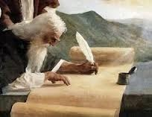
Mosheh now delivers the balance
of the Debarim (words) to the people.
This excitement builds in Exo 24:3[b] – 7.
3[b] [and] Mosheh told the people all the words of Yahuah, and all the judgments: and all the people answered with one voice, and said, All the words which Yahuah hath said will we do.
4 And Mosheh wrote all the words of Yahuah, and rose up early in the morning, and builded an altar under the hill, and twelve pillars, according to the twelve
tribes of Israel.
5 [Burnt & Peace offerings were sacrificed.]
6 [Mosheh sprinkled the altar with blood.]
The next five verses of
Exo 24:3-7
are extremely important.
2nd Proposal Acceptance
This is where we find out if the people accept Yahuah’s “words”
that Mosheh has brought back.
72

Slide 73

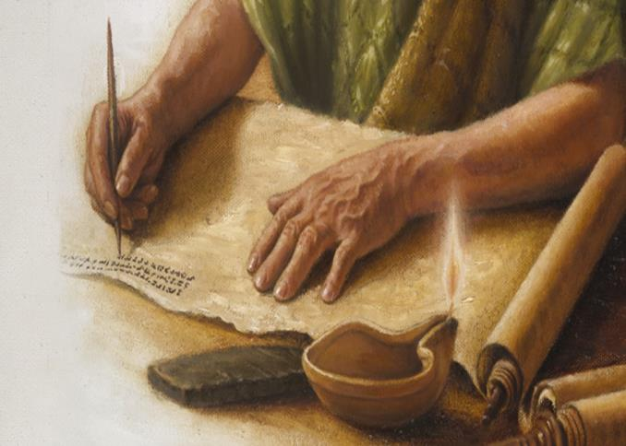
Exo 24:4
And Mosheh WROTE all the Debarim (words) of Yahuah!
Upon WHAT did Mosheh write?
Was it on the “tablets of stone?”
Or, was it on a parchment of some type?
Did Mosheh write out the original BOOK OF THE COVENANT - that being the very Debarim that Yahuah spoke to him PRIOR TO the blood ratifying ceremony?
73

Slide 74
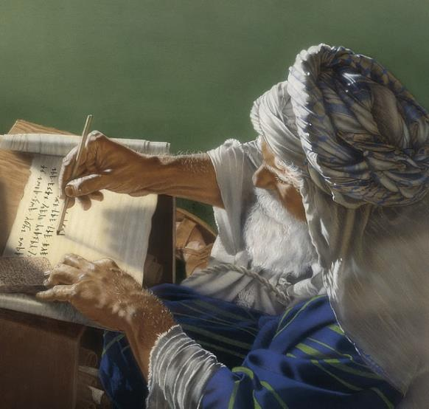

Was there a
BOOK
of the COVENANT
EVEN BEFORE
the Royal Blue Tablets
were imprinted with the
very finger of Yahuah?
When did Mosheh receive the Royal Blue Tablets?
74

Slide 75
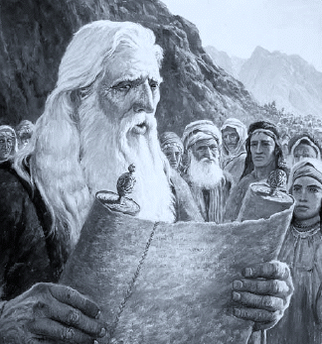
The “spoken words” become “written words”!
Exo 24:7-8
7 And [Mosheh] took the book of the covenant,
and read in the audience of the people: and they said, All that [Yahuah] hath said will we do,
and be obedient.
8 And Mosheh took the blood, and sprinkled
it on the people, and said, Behold the blood of
the covenant, which Yahuah hath made with you concerning all these words. (ref. also Heb 9:19)
3rd Proposal Acceptance
3rd Portion – Blood Ratification

Slide 76
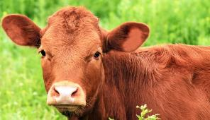

Question #7
What happened
after the
Book of the Covenant
was blood-ratified?
Heb 9:19
With SCARLET wool!
Towla Worm – Ps 22:6

Slide 77
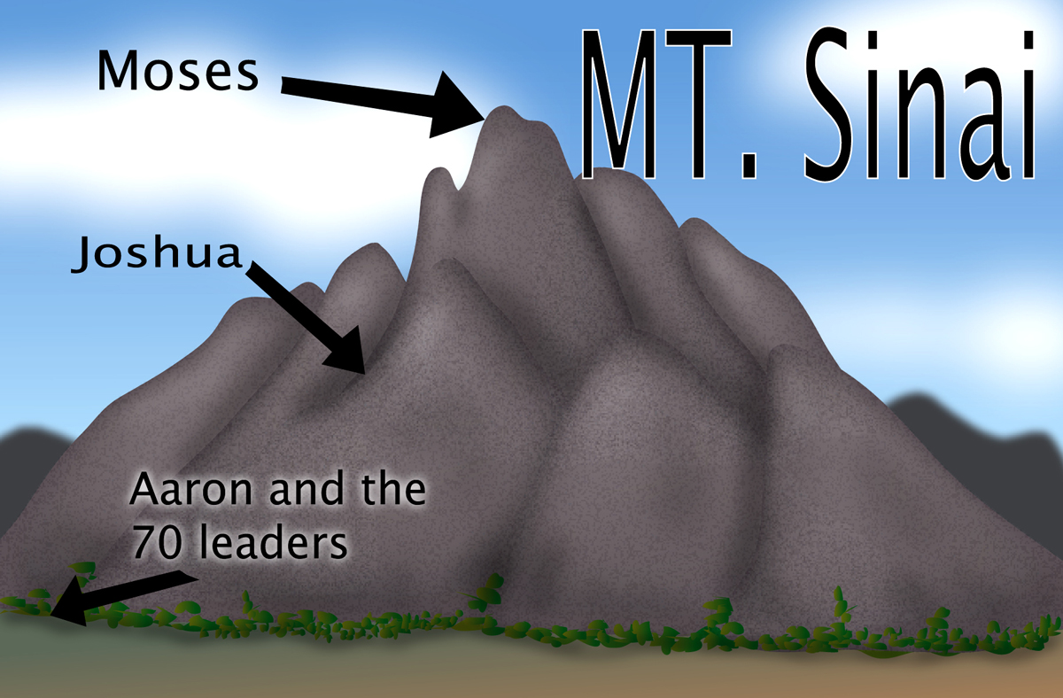
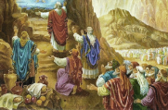
Mosheh
What About
Exo 24:8-18?
#6c Mosheh Alone: vs 15-18
Exo 24:8-18 introduces the 6th trip for Mosheh
up onto Mt Sinai.
There are 3 “legs”
to this journey.
#6b Mosheh & Joshua: vs 12-14
Aharon
#6a Covenant Meal: vs 8-11
77

Slide 78
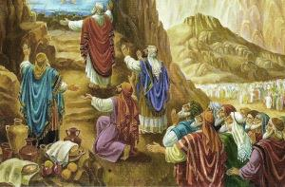
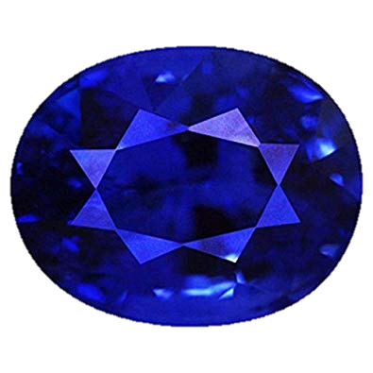
Heb 9:16 For where a covenant is, it is necessary for the death of the covenanted one to be established.
Heb 9:17 For a covenant over those dead is firm, since it is never valid while the covenanted one is living.
The Covenant Confirming Meal with 75 Men
Exo 24:9-11
Then went up Mosheh, [#6 Mt Sinai trip] and Aharon, Nadab, and Abihu, and seventy of the elders of Israel [total: 74 right now + Joshua = 75]:
And they saw the Elohim of Israel: and there
was under his feet as it were a paved work of
a sapphire stone, and as it were the body of
heaven in his clearness.
And upon the nobles of the children of Israel he laid not his hand: also they saw Elohim, and did eat and drink [this is the Covenant Confirming Meal – signifying nothing can be added, removed or changed from a Covenant that has been blood-ratified – upon penalty of death].
Exodus 19-24:11 is very clear of exactly what the [~3000] “words” are in the Blood-ratified Book of the Covenant.
4th Portion – Confirmation Meal
78

Slide 79
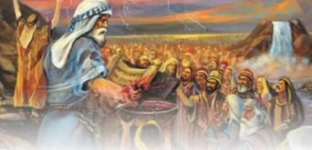
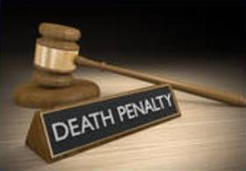
Remember the 4 components that formulate an everlasting
covenant with Yahuah include:
1. – Proposal
2. – Acceptance
3. – BLOOD RATIFICATION
4. – Covenant Confirming Meal
These 4 items - ACCOMPLISHED AND DOCUMENTED!
It was understood by both parties,
that whoever broke the covenant
knew there was a death penalty.
79

Slide 80
A Penalty of Death?!
Was this concept just - “simply an understanding?”
Yahuah provided a “treaty of authority” which was recognized by the people of that time as authoritative.
It was also the accepted authority of the current Ancient Suzerain Treaty.
Abraham was told to sacrifice and divide some of the carcasses of the sacrifices. Later, Yahuah passed between those very sacrifices in the
Night Season (layil) as a smoking furnace and burning lamp (Gen 15:17).
The death sentence (blood shed) of those original sacrifices by Abraham (Gen 15) signalled for all, the inevitable death sentence penalty (blood shed) for those who broke the Covenant.
80

Slide 81

The Book of the Covenant under the authority of Mosheh, a priest within the Melki-Tzedeq Administration (Order),
had been fully finalized, blood sprinkled
and the confirmation meal eaten!
And yet we have read nothing about either the:
1. Tablets of Stone; and neither the
2. Book of the Law which contained the
perimeters of the Sacrificial System specifically designated within the Aharonic Priesthood!
81

Slide 82

When did Mosheh receive the Ten Debarim (Words) on the Royal Blue
Tablets of Stone?
And whence cometh the
Book of the Law with a new set of laws not yet heard of?
82

Slide 83
Mosheh
What About
Exo 24:12 (a)?
Exo 24:12[a]
And Yahuah said unto Mosheh,
Come up to me into the mount,
and be there:
and I will give thee tables of stone …
Aharon
Here Yahuah commanded Mosheh up the mountain once again, where He will inscribe the Debarim [words] from the Book of the Covenant
onto the Royal Blue Tablets!
Is there more?
83

Slide 84
Mosheh
What About
Exo 24:12
(b)?
Exo 24:12 KJV
And Yahuah said unto Mosheh,
Come up to me into the mount,
and be there:
and I will give thee tables of stone,
Aharon
AND a law, AND commandments which I have written, that thou mayest teach them.
84

Slide 85
1. Did you notice: Yahuah said He wrote these laws and commandments?
Was Yahuah placing “an extension” onto the Book of the Covenant
which was already finalized and sealed by Blood? Yes? No?!
2. Did you notice: Yahuah intends for Mosheh to teach these laws?
Do you think that Mosheh was wondering “what are these laws?” as he knew
a completed treaty cannot be added to once it is sealed!
3. So what was this instruction from Yahuah in Exo 24:12 indicating?
4. Was Yahuah intentionally IMPOSING a ‘new’ ACCUMULATION of laws, statutes and commands
that were to be temporarily in place
for an event that would transpire in the next 40 days?
5. Would that imposition change the priesthood?
Heb 9:10
85

Slide 86
Note & Question #8
Note: The Covenant Torah pages are from
Gen 1:1 to Exo 24:11.
What happened after the
blood-ratified Covenant instructions were given in
Exo 24:12?

Slide 87


Mosheh
Gathering More
Information
Exodus 24:13-18 [summary]
13-14 Mosheh gives Aharon instructions to
wait, unless there is a difficulty; he takes
Joshua further up into the mount on trip #6.
15 Mosheh leaves Joshua to wait; he presses
upward into a cloud for 6 days.
16 -17 On the 7th day Yahuah calls Mosheh out.
To the children below they see Yahuah’s
glory as a devouring fire.
18 Mosheh was up in the mount for 40 days
and 40 nights.
What about this ?
Aharon
Did it really take 40 days for Yahuah to write 3000 words on stone?
87

Slide 88
Question #9
What was Mosheh doing
at the top of
Mt Sinai for 40 days while waiting to receive
the blue tablets?
Would it have something to do with
“those other IMPOSED instructions”?

Slide 89
A Busy 40 Days & Nights with Yahuah in the Mount
Exodus 25
Offerings for the Sanctuary
Ark of the Testimony
Table of Shewbread
The Golden Lampstand
Exodus 26
The Tabernacle
Exodus 27
Altar of Burnt Offering
Court of the Tabernacle
Care of the Lampstand
Exodus 28
Garments for the Priesthood
The Ephod
The Breastplate
Other Priestly Garments
Exodus 29
Aharon and His Sons Consecrated
The Daily Offerings
Exodus 30
Altar of Incense
The Ransom Money
The Bronze Laver
Holy Anointing Oil
Exodus 31
Artisans for Building the Tabernacle
Reminder of the weekly Shabbat Law given in the Book of the Covenant
The summary given here will
list the “added” commandments
and laws referred to in Exo 24:12(b).
These laws will
be “birthed” to
a temporary life
AFTER the golden calf violation.
31:18; 32:15 [When Yahuah was done speaking to Mosheh, he was given two tablets of the testimony, on stone,
written with His own finger – both sides.]

Slide 90
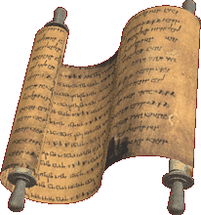
Conception of “The Book of the Law”
Mosheh knew he was acting on behalf of the people as their Melki-Tzedeq priest.
Exodus 25-31 definitely has extra commands, instructions & laws. They are not “narrative”!
These laws were to govern a different priesthood in conjunction with
a sanctuary - over 2500+ years after creation.
This new set of laws were the beginning of the “words” for “The Book of the Law” or Laws of Mosheh.
They were not blood-ratified, nor agreed to, nor written on tables of stone – only in a book.
Did Mosheh wonder about these new laws describing a new priesthood naming his brother Aharon above him?
90

Slide 91
Question #10
What was happening at the bottom
of Mt Sinai
during those
40 days?

Slide 92
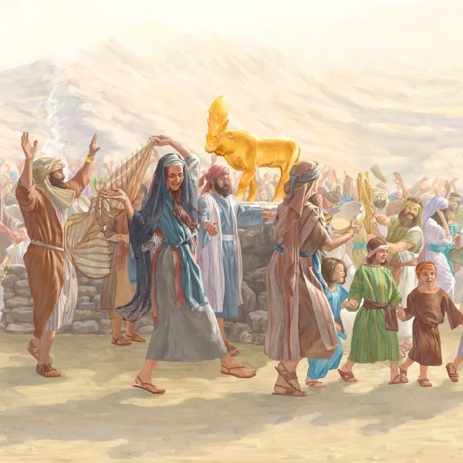
Apostasy!
One Covenant Command given EIGHT times
was broken!
Exo 20:3-5 Thou shalt have [1] no other
elohim before me. 4 Thou shalt not
make unto thee [2] any graven image,
or any likeness of any thing that is in
heaven above, or that is in the earth beneath,
or that is in the water under the earth:
5 Thou shalt not [3] bow down thyself to them,
nor serve them … visiting the iniquity of the fathers
upon the children unto the third and fourth generation …
Exo 23:32,33
Exo 20:23
Exo 22:20 He that [4] sacrificeth unto any elohim, save unto Yahuah only, he shall be utterly destroyed.
Exo 23:24 Thou shalt not [5] bow down to their gods, nor serve them, nor do after their works: but thou shalt utterly overthrow them, and quite break down their images.
92

Slide 93
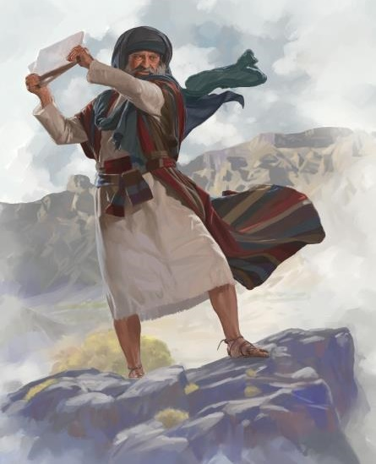

Mosheh broke the Stone Tablets because the people had just broken the everlasting covenant & rejected the Melki-Tzedeq Priesthood of Yahuah.
The people were now placed under a different priesthood with its additional laws (Book of the Law) which Yahuah said Mosheh will teach to the people.
“For the priesthood being changed, of necessity there is also a change
of the law.” What changed?
Heb 7:12
There are new laws for a New Priesthood & a few other things!
93

Slide 94

What happened to the DEATH PENALTY for breaking the Covenant?
Nowhere in the everlasting covenant was it ever mentioned that the “Death Penalty” would be executed immediately! However, the price of the “death penalty” can only be
paid with Yahusha’s better blood!
Heb 9:15
Paul uses the lingo of the temporary covenant to explain how the Book of the Law was only a school master to lead the people to the Messiah through the Aharonic priesthood.
Important note: Now that there are two different sets of laws and two different sets of priesthood, this also requires we understand there are two different sets of “conversational lingo” to distinguish “which is which” – especially in Paul’s writings.
94

Slide 95

Book of the Covenant
& the new Book of the Law
The IMPOSED Book of the Law was to
function for a set timeline (alongside),
in conjunction with the Book
of the Covenant’s everlasting
uninterrupted function in authority.
For how long? Book of the Law was
“an assistant” or BANDAID COVERING
to temporarily preserve life through
an alternate priesthood until Shiloh comes.
Gen 49:10
All the laws of the Aharonic priesthood and sacrifices will
now be intertwined with an earthly sanctuary as a teaching model to
point the people to the Messiah to come. The significant difference is this:
What was to be a - Kingdom of Priests (in Israel)
became a - “kingdom with a priest.”
95

Slide 96
The End of Part 1
Which Instructions are Eternal?
In Part 2:
Tables of
Stone?
Book of
the Law??
Come & See!
96

Slide 97
Questions &
Comments?
Please contact:
Tim Astleford or
Charlene Fortsch
questions@studythecalendar.com
May each one be blessed in your search!
Shalom

