Slide 1


Shemar the Shemesh Scurry!
Eccl 1:5
Part
2
Notes:
6.8 Shemesh Scurry Pt 2 [68] TA 6 Jan 2024
Website: https://studythecalendar.com/category/series-6/
Youtube launched 8 am Jan 7th: https://youtu.be/7xvzkQr2Tw8
Blurb by Tim:
In English, it seems that Abraham was resting comfortably in the shade of the door in his tent. Is this scenario plausible? Absolutely, indeed without doubt. But a very important question arises. Why would such a seemingly insignificant detail be recorded in the Scripture? Might there be a connection to the qualified sacrifice of which Abraham observed as a bystander only? Is there a spiritual element built within the oak trees of Mamre that will brilliantly reveal Abraham's internal fortitude in establishing his eternal pledge of allegiance that has DIRECT IMPLICATIONS and consequences for us today? Why not “Come and See”!? Shalom!

Slide 2
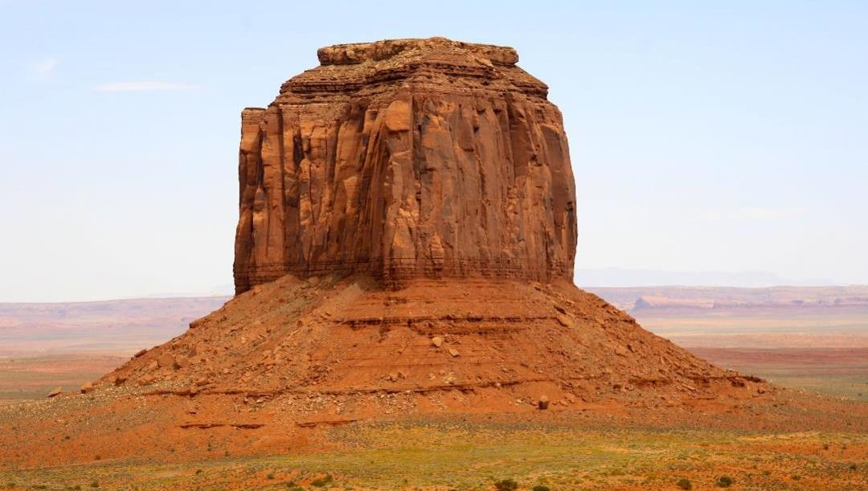

Shemesh Scurry
- Part #2
And if we find that indeed Abraham was directly connected to the ALNI (trees),
What Connection does this have with
The Way,
and the
SCURRY
of the SUN?
Did Abraham fashion his family’s
“NEST” (seat)
in the
Trees of Mamre?
Gen 18:1
What was the NAME of
Abraham’s
“Tree House”?
Righteousness
Tzadiqah?

Slide 3

#1. What could possibly be connected, with the sun being IN A HURRY within its Tequfah, to, its intense focus on - GASPING to ACHIEVE LIFE? ??
could connect this “HURRY” scenario, causing
Abraham to be found by Yahuah, SITTING IN THE DOOR of his DWELLING PLACE under the PROTECTIVE COVERING of the OAKS of Mamre?
Ecc 1:5
&
#2. What - on this earth
Pey
ף
Gen 18
Ya’aqov 1:17
shadow

Slide 4



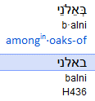
Was Abraham seated in The Way?
Or was he just
comfortable in
the door
of his tent?
Part 2 will be examining these Hebrew words.
Did Abraham pay attention to the “SCURRY” of the Shemesh (sun)?
Gen 18:1

Slide 5
Abraham chose to sit in the DOORWAY
of his tent.
Gen 18:1
Did Abraham choose to sit within Mamre’s OAK FRAMEWORK DOORWAY
as a LIFESTYLE for his posterity?

Slide 6

Abraham - is there any significance to - “Sitting”?
The letters for “sitting” are
Yod
Shin
Beit.
י
Gen 18:1
ש
ב
Yod – understood as the hand (works) of Yah.
Shin – set of teeth, which press in with intensity resulting in a separation which purposely reveals a distinguishing effect.
Beit – a house, a womb, The House.
Abraham encased himself and secured the family’s posterity within (sitting), the MelkiTzedek Structure of Yahuah which formulated a LIFESTYLE
Derek – The Way
distinguishing Abraham from the world.

Slide 7
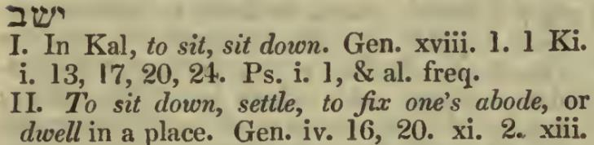
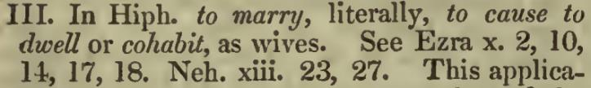
Was Abraham - “Sitting” as in CO-HABITING??
What if the translators had REALLY UNDERSTOOD Abraham’s circumstance on a SPIRITUAL level?
Gen 18:1
A Hebrew Lexicon by J Parkhurst (1762)
Is it even remotely possible, – OR IS IT ENTIRELY REALISTIC, that Abraham had intentionally formed his lifestyle according to
The Way (derek), that had been ORDERed by Yahuah?
Was Abraham submitted - CO-HABITING - WITH YAHUAH AS HIS PILOT?
Had Abraham configured his life to being - the co-pilot of his legacy?

Slide 8

Is there a REASON for this picture of a LARGE tree stump here!
Gen 18:1
WHERE was Abraham cohabiting? (Sitting, IN AN ESTABLISHED QODESH LIFESTYLE)?

Slide 9

Yes we read in English that Abraham was sitting in the door of his tent. Fine and good.
BUT –
Might this be too generic,
too BLAND
to
TRIGGER YOUR SPIRITUAL CURIOSITY?
Hopefully not!!
If you think it is possible that the Hebrew letters might add some pertinent insight into Abraham’s position, then, let’s explore it a bit shall we?

Slide 10





Abraham was SITTING in the DOOR of his tent. Our first inclination may be – Oh, that is a DALET!
A DOOR! But – not so!
The Paleo Hebrew letters for what we receive in
Gen 18:1, translated into English as “DOOR” are -
Chet
Tav
Pey
Pey is a mouth which speaks into a message.
Tav is a sign, seal, mark, COVENANT and/or a SIGNATURE.
Chet is a fence, a corral, a wall, that which surrounds, contains, and protects, &, (in turn) - separates.
Take these definitions of the original word and ask – WHAT WAS ABRAHAM DOING IN THIS ENVIRONMENT?
Was this Abraham’s own choice, or was he forced to fill this position?? What message is Abraham delivering?

Slide 11
NOTE: The Chet letter is in the form of a ladder which suggests an option for an - elevation process.
Chet
Tav
Pey
Is it possible Abraham had chosen to place his posterity within the entrance of THE PORTAL of Tzadiqah?
A LIFE for eternity, encased within the MelkiTzedek Administration
with Elohim?
Righteousness

Slide 12
Look closer at the Paleo Chet letter.
Being the eighth Hebrew letter, it contains the number
8 in numerical value!
#8 Contains the prophetic understanding of
NEW BEGINNINGS.
Chet is also in the form of a ladder (of types).
A ladder reveals a position for opportunity to be
– BY CHOICE – elevated, both physical and spiritual.
If Abraham did not CHOOSE to take the first and sequential steps {SHEMA}, that ladder was ineffectual.
Being positioned in a “portal” was not coincidence.
In terms of TIMING, what singular 24 hour event enabled Abraham to attain this incredible circumstance?
Again – what was really happening with Abraham?
Chet
Tav
Pey

Slide 13
Had Abraham CHOSEN UNDER THE UNCTION
of the Ruach Ha Qodesh to
SHEMA, {listen, AND ACT ACCORDINGLY}
by taking the first of sequential steps?
What was Abraham’s POTENTIAL RESULT?
Chet
Tav
Pey
Did the “travesty turned to a miracle” at Golgotha provide YOU with the same option of CHOICE as Abraham received?

Slide 14
Will you allow the Ruach Ha Qodesh to
RAISE YOU UP?
Chet
Tav
Pey
Abraham “sat” in The Portal.
Where is your “chair” placed?

Slide 15
Spiritual elevation; a more intimate relationship with Yahusha,
IS ONLY ACHIEVED THROUGH
A CHOICE!
Chet
Tav
Pey
Abraham had positioned himself (through the Ruach’s enabling) to enter into eternity.
Will the “scurry” of the sun within its
Tequfah (circuit) provide more insight?
We shall see. ☺
More Hebrew PLEASE!

Slide 16





Sitting
Be
I
t
Shin
Yod
Abraham was POSITIONED (sitting/firmly planted)
in a lifestyle portal which was separated
from this world, being supported and revealed as
conjoined to Yahuah’s House - Beit!
Choice of Theory & Method
Isn’t that - Shema??
The Beit being Yahuah’s House, the
(King(dom) of Righteousness – MelkiTzedek).
Yod - understood as - the PRODUCT OF Yahuah’s Hand.

Slide 17
Abraham by observing the DEREK (The Way) of Elohim,
was POSITIONED (sitting/planted)
on this earth, in a symbolically visible portal (OAK TREE), IN A LAND RIPE FOR OPPORTUNITY! But - An OAK TREE? What LAND?
Was Abraham observing THE WAY, or not? Note when Yahuah promised Sarah a child, Yahuah declared He would return according to the TIME of Life!
Time – Ayin Tav! Ayin can be understood as a symbol for eternity.
Tav, is Covenant. Yahuah fulfilled His promise (Isaac) according to a QODESH APPOINTMENT, that which- DUPLICATES INTO ETERNITY! This can only be – Shaneh – which REFLECTS the Aleph Tav (Gen 1:1), which equates in Gen 1:1,to PI (3.14/ 22/7) which has no ending! 22 Hebrew letters over 7 thousand years of this earth!

Slide 18
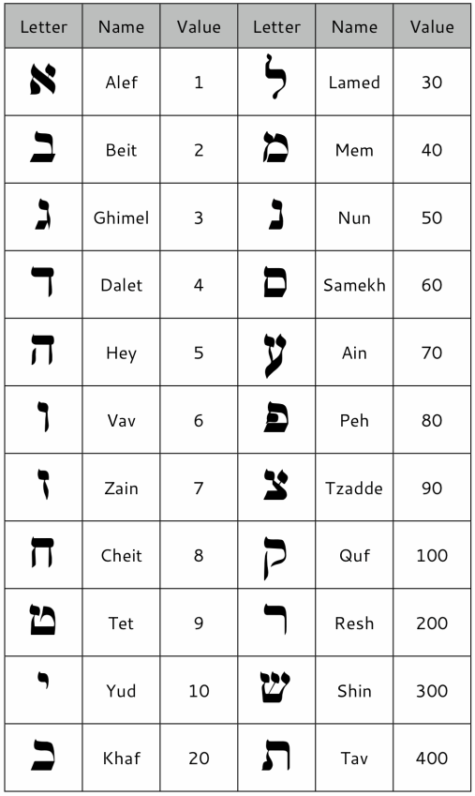
What is PI? In Genesis 1:1 Elohim created this earth. It was allotted a 7 thousand year timeline. Take this 7000 years, divide it by the Twenty Two Authorized Hebrew letters, and the result is PIE-3.14 / 22/7.
PIE has NO ENDING!
This earth’s beginning and ending; Aleph-Tav established at creation,
is interjected into ETERNITY!
The 360 day cyclical Shaneh (year) duplication SEEDED onto earth will replicate - on through eternity.

Slide 19
Have you ever charted out lunar years (of which there is no Scriptural Hebrew word), and realized it does not replicate, duplicate nor reproduce?
It is simply Rogue after Rogue after Rogue until earth’s allotted 7000 year timeline is up!
Revelation 12:1 with Bethula standing above the moon in a position of victory by Qodesh Authority reveals the demise of ROGUE ENTITIES! The moon is UNDER HER FEET in an eternal position of VANGUISHED AUTHORITY!

Slide 20

I AM the Door (portal for Entrance).
I AM the Light of the world (Yahuah’s Kingdom)
Beit
Inner Sanctum
The DOOR-LIGHT which stood at the
POINT OF ENTRANCE
into Yahuah’s Kingdom at its inception –
B’Rashyt (Gen 1:1),
STANDS STEADFAST AT THE 8TH PORTAL
AND DOES NOT ALLOW ENTRANCE ON
ROGUE UNSEEDED non-entities,
neither spiritual nor physical,
into Yahuah’s Kingdom which is based upon a
SEED WITHIN A SEED
ACCORDING TO ITS KIND, foundation!
Yahuah’s Eternal Kingdom Gen 1:1, eternity seen through
22/7, 3.14!

Slide 21
This eternal Shaneh duplication factor which
TIMED THE BIRTH OF THE HEBREW NATION UNDER ABRAHAM,
can only be achieved
UNDER THE AUTHORITATIVE AUSPICE of
the SHADOW! (HEZEKIAH!)
That SHADOW determines the COUNT to Abib 14, the 1st Annual
Qodesh Appointment of Yahuah! The next cycle is the HIGH CONVOCATION known to us as the first cycle of Unleavened Bread on Abib 15. .
Gen 17:21, 18:14, 21:2
It was upon this cycle that Yitzchaq (Isaac) was conceived!
Time of Life = that which duplicates (Gen 1:11, 12) into eternity!
I change not… – Mal 3:6 (Ya’aqov/ James 1:17)

Slide 22
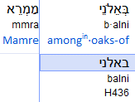
Can H1870 Derek, expose an OLD PATH directive to the Tree of Lives?
This tree is but a fraction of what it used to be!
This tree’s strength has all but been USURPED
by DEATH!
It once stood well over 1 mile (1.6 kilometers) into the atmosphere as a PILLAR OF STRENGTH!!
Has the god of this present earth decimated Yahuah’s
Mo-edim so
much that they
are observed but by a fraction
of people on
this earth?
Oak –
Mo-edim?
Gen 18:1

Slide 23
Is H1870 Derek, a LIGHT for the Old Paths THAT NEED RESTORATION?
We need to recognize this Old Path Appointment!
What was Abraham’s immediate action?
They made unleavened bread, & prepared a young calf.
It was an OFFERING! Abraham did not partake of this “meal” with the 3 visitors! Note: Abraham greeted them with the Name Yod Hey Vav Hey!
Abraham’s life was settled solidly in
The Way (Derek)
of Yahuah, so much so that Yahuah was “comfortable” physically appearing to Abraham!
Take Notice: It was Yod Hey Vav Hey that was there on a “business” trip.
Could these OAKS provide LIFE?
Gen 18:1

Slide 24





What is in – H436 ALNI (OAK)?
The Oaks of Mamre on
a physical basis;
they SUPPLIED rest, housing, shade, protection and retained water levels which SUSTAINED LIFE ITSELF for many sizes and shapes of life, founded within the bird and animal kingdom.
These OAKS supported an eco system all of their own!
(Beit [within the house]),
Aleph – The Almighty Provider symbolized
by an ox;
What is so intriguing about
“the oaks?”
Lamed – the staff that provides leadership;
Gen 18:1
Nun – Life that promulgates of itself;
Yod – known as the hand of Yah!

Slide 25
Is there a SPIRITUAL aspect to - “the oaks?”
ב
House – (within) THE KINGDOM
א
Aleph – strength, power, authority, provider, BEGINNING - YAHUAH
ל
Spiritual oak,
by modern Hebrew letters.
Staff – leadership, goad, guide, direction provider
נ
Nun – life (Mayim Chayim) springing forth
י
Yod – hand of Yah
Within the HOUSE (Beit) of Yahuah (Aleph), exists the Torah (Lamed) which BESTOWS LIFE (Nun) and fully originates, solely from the HAND (Yod) of Yah.
Is it possible that Abraham understood this?
Gen 18:1

Slide 26
Where were these – H436 – alni - oaks? Why was Abraham “SEATED?”
Abraham was SEATED among “THE OAKS
of Mamre”!
Mamre has two Mem letters which reveal -
a SOURCE which issues constant frequencies.
The Resh is the Head (of the universe) and the Aleph is known as the Ultimate Provider for mankind.
Abraham’s SEAT!
Abraham, through the Ruach, had intentionally designed (seated) his lifestyle,
being PLANTED SECURELY within the (oak) PILLARS OF STRENGTH and POWER. These “oaks” broadcasted their “FREQUENCIES” over the earth.
Spiritually: Yahuah’s Power and Strength!
Gen 18:1

Slide 27
Why – “Spiritually?”
We need to think carefully here. Do we really think that Yahuah preserved the Hebrew words of the Torah, just to have us understand that Abraham was sitting down, relaxing in the door of his tent, (sipping an iced tea)?
What IF there is a much more important hidden message that the Pey letter speaks into?
Do we really want to be the children of Abraham?
If so, should we not mimic his actions under his intentional Shema understanding?
Gen 18:1

Slide 28
Mamre by Hebrew letters:
Mamre – a physical & spiritual area, populated by Alni trees (oak), that resonated LIFE supporting frequencies exuded by the Alni (Oak)
trees, extended exponentially over
the earth.
Are we beginning to understand why Abraham “just happened” to be
SEATED within his Tent (dwelling place) at the Oaks of Mamre?
Gen 18:1
What about
“Mamre?”

Slide 29
The MelkiTzedek House of Yah
which LEADS, ENABLES and SUPPORTS
eternal life!
In Whose TENT was Abraham “SEATED?”
Abraham’s SEAT!
Abraham
Gen 18:19 “For I have known him, so that he commands
his children and his household after him, to guard
THE WAY of יהוה, to do righteousness and
right-ruling, so that יהוה brings to Aḇraham
what He has spoken to him.”
u-shemar-u
H8104

Slide 30
What was Abraham’s platform for existence?
which Cycles from the start (after the Shadow) of each Shaneh (year)?
Is it possible,the Way, is a description of the cyclical schedule of the Mo-edim of Yahuah -
Abraham’s SEAT!
Abraham’s life was magnificently entrenched in the
Mo-edim of the Covenant!
Could these OAKS of Mamre be symbolizing the Pillar of Strength platform (LIFE ITSELF) encased within the MelkiTzedek Covenant?

Slide 31
What was Abraham’s MODE OF OPERATION?
Did you note that Abraham ONLY OBSERVED the 3 heavenly identities while they CONSUMED his OFFERING?
RESPECT!
Again: what is it about Derek (The Way) that has a direct connection to the sun HURRYING back to the place it arose? Ecc 1:5 (360)
Abraham’s SEAT!
Did Yahuah favour Abraham with a visitation APPOINTMENT on Unleavened Bread?
(Gen 18)

Slide 32
What if Abraham was not supplied with a SIGN for an APPOINTMENT CALENDAR by which - to be - SEATED!
What if Abraham “happened” to be out on a journey instead, and MISSED THE APPOINTMENT with Yahuah?
HOW did Abraham know to make unleavened bread, and the young calf,
which were CONSUMED?
Shuaph
ISA, slide 44
What would happen if the sun had decided it was not important enough to “GASP FOR”
THE TESHUVA SHADOW SIGN FULFILLMENT?

Slide 33

What if the sliver moon found Abraham,
“VISITING” in the DOOR of ANOTHER TENT?
Might this have been the PORTAL alluded to
in Isaiah 14:13?
If the knowledge of the sun being in a hurry along with the importance of the shadow, was totally extinguished -
How would we know what “tent” we belong to?
We could or maybe go by the sliver moon, or go to
“Plan B” as instructed by a very popular lunar leader! (2018)

Slide 34
What if Abraham had
NO SHADOW SIGN?
What would happen if the sun had FAILED ITS COMMISION of purposefully returning back to the place it arose to establish the Teshuva Straight Line Shadow Sign
for Abraham to observe?
And let them be for SIGNS …
Ecc 1:5

Slide 35
Eccl 1:5 contains the Hebrew word description of the sun GASPING to return back to it original point of departure! The sun KNOWS ITS COMMISSION, officially established on the 4th cycle of creation!
The Shemesh (sun) had already begun its assigned Tequfah (circuit) on the 1st cycle, enabling the first ereb (evening twilight mixture – Gen 1:5).
If the sun had not realized the IMPORTANCE of its commission to establish a TESHUVA SHADOW SIGN on the last cycle of the year, Abraham would have not known where he was to be SEATED! Abraham would have not known when to start his count to the Unleavened Bread Appointment upon which he received a visit from the Almighty Yahuah.

Slide 36
If the sun diminished the importance of HURRYING back to the place it arose and “LAGGED BEHIND,” when Yahuah informed Mosheh that
“this is the first month of your year,” Mosheh might have been seriously confused, not having seen - THE SHADOW SIGN.
The TESHUVA SHADOW reveals the time schedule of the Plan of Salvation.
Without the Teshuva Shadow Sign for an indicator of when to COUNT, Mosheh might have slain the Passover lamb on Abib 2, 5 or 22 instead,
and still have expected to be released from bondage in Mitsrayim!
Would the blood applied to the Hebrew door frames of Goshen, on any other Night Season than Abib 14 have the authority to save their lives?
What if Mosheh had “missed the elusive sliver moon” and erroneously commanded the Passover Lamb’s blood to be placed upon the door
on Abib 15 Night Season instead?
How many lives would have been saved then?
Ps 90:12

Slide 37
What if Abraham had no time frame knowledge of when Sarah
was to conceive Isaac, starting the Hebrew nation?
Yahuah had PROMISED it was to be on a TIME APPOINTED!
Abraham and Sarah had a part of this function also!
Timing!
What if their timing count had no
positive starting point and the sliver moon had put them 2 weeks outside of
Yahuah’s Qodesh Schedule of Righteousness??
If they had attempted their part on an incorrect cycle, and the conceiving part did not occur, would they then have
questioned Yahuah’s promise?
Would they have been left in a state of confusion?
The sun HURRIES back to the place it arose! ☺

Slide 38
Let it be understood:
Yahuah was establishing – onto earth –
His Spiritual System – His Mayim Chayim –
(The) Water of LIFE - Cyclical Appointments.
A Seed Within A Seed Pattern
H4140 Mo-ed
Gen 18:14 “Is any matter too hard for יהוה? At the appointed time I am going to return to you, according to the TIME OF LIFE, and Sarah is to have a son.”
Abib 15!
H6256 Season
H2416 Chai
Can the statement on top, be supported from the Scripture? Let’s look at it.

Slide 39
What if, before the second year in the wilderness, the sun “forgot” Yahuah’s commission to establish a Teshuva Shadow Sign, and Mosheh
HAD NO ACCURATE WAY TO LAY THE ETERNAL FOUNDATION (Shaneh/ 22/7, 3.14 eternal replication) FOR THE TABERNACLE, the very next cycle?
Mosheh would not have been PREPARED!
Yahuah DID NOT LEAVE Mosheh in a state of confusion! That wilderness Tent of Meeting was nothing short of a celestial oriented earthly mobile compass, FIRST AND FOREMOST – SPIRITUAL, and secondly, physical. The Hebrew nation was not left to wander aimlessly in the wilderness. Yahuah placed in their midst the most accurate system of guidance known to man, and, far beyond human comprehension.
The sun had fulfilled its commission by laying down
a perfectly straight Shadow SIGN enabling the foundation layout PREPARATION (6th cycle) for the Wilderness Tent of Meeting!

Slide 40

Are we beginning to understand the reason the sun HURRIES
back to THE PLACE IT AROSE? Without this –
Teshuva Shadow Sign,
there would not be – THIS!
A Bee pollinating LIFE!

Slide 41



There is another word in Gen 18:1 that needs a closer look. It is recorded Abraham was sitting in the door of his tent, in the HEAT of the day. What HEAT was it?
Just physical heat from the sun? Or was there another source of HEAT bearing down on Abraham and his family?
Geneva 1587
Gen 18:1 Againe the Lord [Yahuah] appeared vnto him in the plaine of Mamre, as he sate in his tent doore about the heate of the day.
The Hebrew letters translated as “heat,” are Kaph, Chet, Mem.
Kaph = = palm of the hand, intentional capacity (i.e. bowl), order.
Chet = = fence, border, corral, encasement, elevating opportunity
Mem = = endless frequencies, water (that carries a seed), origin
כ
ח
ם
The question becomes: what/WHO’S SEED was encapsulated within this “HEAT of the day” in the area of Abraham’s abode?

Slide 42
What other source of HEAT was encompassing the area adjacent to where Abraham and his family were living?
What was the extended PURPOSE of this visit by Yahuah,
to Abraham? Was it just a cordial visitation? Or was
there a specific purpose revealed to Abraham,
combined within this visitation?
Geneva 1587
Gen 18:1 Againe the Lord [Yahuah] appeared vnto him in the plaine of Mamre, as he sate in his tent doore about the heate of the day.
Yes, indeed Abraham was physically sitting, probably relaxing, in the opening of his tent. Yet, there was a lifestyle theme incubating in the general geographical area that was, & IS TODAY, a serious affront to Yahuah.
Is there another way to understand – the HEAT OF THE DAY - ?

Slide 43
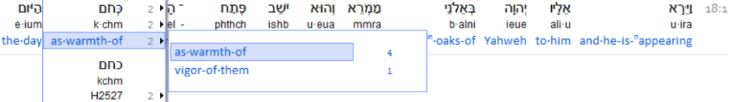
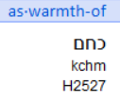
Gen 18:1 Recognizing a Secondary Hebrew letter format.
Regular “open” Mem
ם
מ
The Mem at the end of this word is in the
SOFIT format. It is a “closed” Mem.
This indicates it has a message within,
(waiting) TO BE DISCOVERED.
The closed Mem is known as a final Mem because the sofit letters are found at
the end of a word.
NOTE:
Sofit closed Mem

Slide 44
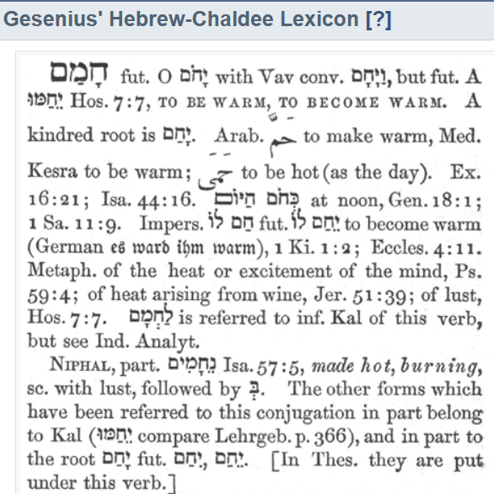
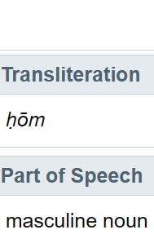
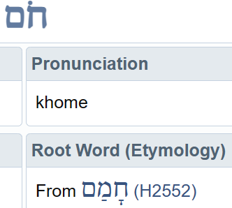
This is the 2 letter root word used in Genesis 18:1 translated as “heat of the day”.
Let’s have a closer look at it.
H2527
What was the
2nd purpose
of this visitation
from Yahuah?

Slide 45
The MAIN purpose of Abraham’s visitation
from Yahuah!
Genesis 18:14, the announcement of the Hebrew nation under the lineage of Abraham!
What was the secondary purpose?
Gen 18:16 And the men rose up from there and looked toward Seḏom, and Aḇraham went with them to send
them away.
Gen 18:17 And יהוה said, “Shall I hide from Aḇraham what I am doing?”

Slide 46
Root of H2527, slide #41
Let’s dig a bit more in this same quote!
NOTE:
It is important to recall
the evil contamination
and abomination that
was presently occurring
in the area of
Sodom and Amorha!

Slide 47
The Hebrew word translated as – warmth H2527, in Gen 18:1, – has the first two letters recorded as –
Kaph Chet.
Let’s have a look at these two letters together and see if there is
a message there also?
Proper Hebrew reading direction is right to left – Chet Kaph

Slide 48
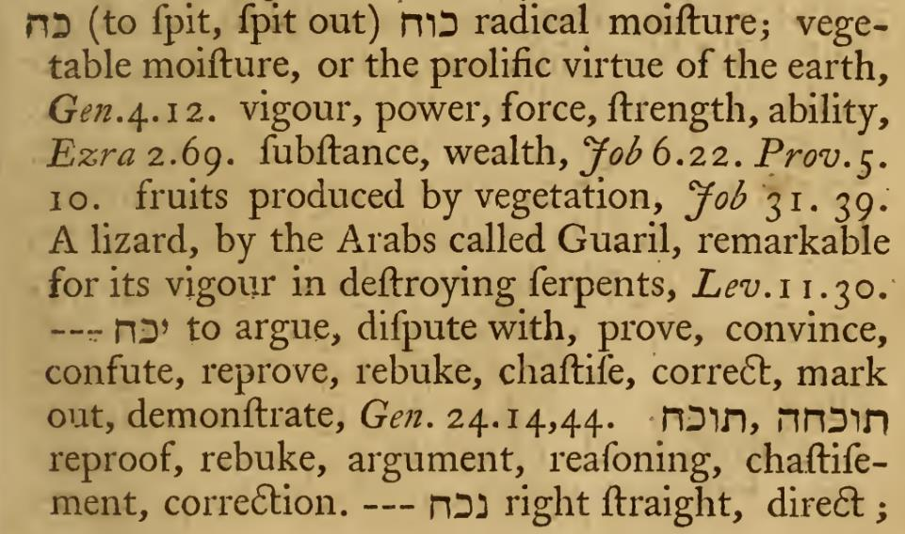
Another Lexicon, more interesting information for us to - Cepher!
W.H. Barker A Hebrew Lexicon Pg. 97 (1776)
Notice how the root word Kaph Chet is used, and also, within other words.

Slide 49
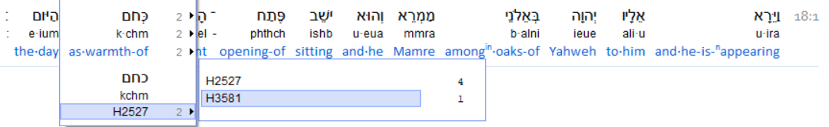
Gen 18:1
International Scripture Analyzer
Let’s look at another usage of this same word. The ISA provides direction to another verse that has the exact same Hebrew word letter arrangement, with another number - H3581.
On the next slide, we will look at this arrangement
and the translated meaning.

Slide 50
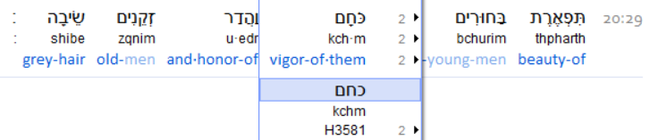
Prov 20:29
The same letters are rendered as VIGOR! Vigor can also be understood as - HEAT OF INTENSITY.
Is it possible that this same word could also expose the
heat of intensity in the battle of LUST (DARKNESS/Sodom),
in opposition to Virtue in Righteousness?

Slide 51
It’s time to reflect on Abraham. Was Abraham sitting in the door of his tent in the high sun heat of the day? Certainly it is acceptable. Was Abraham dependant on the Teshuva Shadow for Timing his life and that of his future family? Beyond doubt! Abraham provided FINE FLOUR for unleavened cakes, and a suitable (PERFECT) calf for the offering to Yahuah. The Heavenly visitors then partook of the offering, sanctifying it as acceptable.
It was a Set-Apart Appointment verifying Covenant correct timing!
Note the comment given describing Abraham.
Gen 18:19 “For I have known him, so that he commands his children and his household after him, to guard the
Way of יהוה, to do righteousness and right-ruling,
so that יהוה brings to Aḇraham what He has spoken to him.”

Slide 52
Side Note: Tell me, how can this verse be understood at depth, and it still be declared - that the Shabbat was not given until the Manna Week? [About 400 years later.]
If Abraham was observing by – The Way – is not the Shabbat the PREMIER FESTIVAL WITHIN The Way? Lev 23:1-4
Gen 18:19 “For I have known him, so that he commands his children and his household after him, to guard the
Way of יהוה, to do righteousness and right-ruling,
so that יהוה brings to Aḇraham what He has spoken to him.”

Slide 53

Hosea 4:6
My people are DESTROYED for lack of knowledge:
because thou hast REJECTED KNOWLEDGE,
I will also reject thee,
that thou shalt be no priest to me:
seeing thou hast forgotten THE LAW
of thy God,
I will also forget thy children.
Is it worth sacrificing our children on an alter, (rejecting Torah) to build a worship system of OUR OWN DESIGN?

Slide 54
The final comment on the last slide might have seemed to reference physically placing children on an altar. While that is not fully accurate, it is not totally discounted either.
What does this word – destroyed – insinuate?
Hosea 4:6 My people are DESTROYED for lack of knowledge:
If people do not have knowledgeable contribution to guide their progeny, they are effectively silenced and ultimately removed from the equation of guidance in Yahusha Ha Mashiach. This factor will place families on what is known to us as THIN ICE!
Or – A SEVERE DANGER ZONE!
Are we paying attention?
destroyed: H1820
damah (daw-mam'); a primitive root; to be dumb or silent; hence, to fail or perish; trans. to destroy:
KJV - cease, be cut down (off), destroy, be brought to silence, be undone, utterly.

Slide 55
WHO has SILENCED and REMOVED them from
the spiritual nourishing leadership position??
The FATHER of spiritual complacency!
If entertainment HAS NOT TOTALLY REPLACED the Ruach’s pleading for our attention, the CURSE of TRUSTING IN MAN
(PULPIT OF ORGANIZED RELIGION),
has taken control of those who simply do not take the
HOPE FOR ETERNAL LIFE - SUFFICIENTLY !
If people do not have a KNOWLEDGEABLE contribution …
Again: Are we paying SUFFICIENT attention?

Slide 56
Back to our study with Abraham in the “HEAT OF THE DAY”!
The Hebrew language provides multilevel understanding concepts. Abraham had established himself in a lifestyle of Righteousness. With this in mind, what HIGHLY INTENSE HEAT OF THE DAY, might be referenced for those seeking more understanding within a geographical & spiritual nature?
Abraham’s Set-Apart offering meal was accepted and consumed (Gen 18:8). The promise of Set-Apart Appointment visitation producing an offspring was stated, (Gen 18:14, 21:2).
Yet Yahuah had pre-purposed yet another appointment, of a different nature.
When we look at this specific Hebrew word for “heat” in Genesis 18:1, it has a Mem as the last letter. Yahuah did not arrive just to “visit” with Abraham.

Slide 57
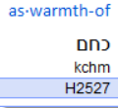
The burnt orange arrow is pointing to the final Mem letter. A Mem indicates
a constant, persistent undulation such as the waves of an ocean. This shows there was a certain FREQUENCY permeating the region.
Why did not Yahuah use H2750 chori, or H2721 choreb?
These Hebrew words indicate heat as well!
Yet there is another Hebrew word that would strongly indicate the sun heating the earth as in the midday! Let’s look at it.

Slide 58
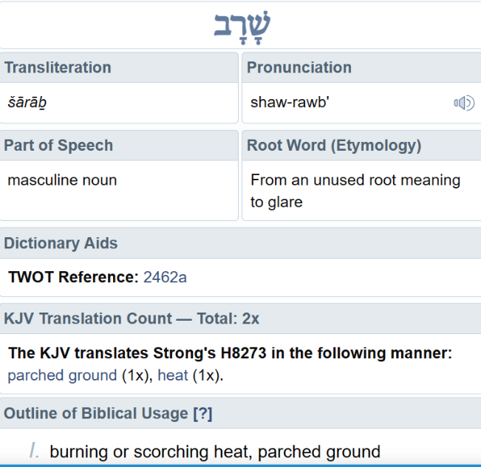
Look at this word! It would have BRILLIANTLY introduced Abraham’s relief, relaxing in the shade of his tent door!
So why did Yahuah preserve
kchem instead? It is translated as “heat of the day”!
Was this just a “slip up”
by the Ruach?
Or has Yahuah strategically inserted a NUGGET TRAIL
for us to search?
H8273

Slide 59
Was there more than the heat of the sun
BEARING DOWN on Abraham AND HIS FAMILY?
Was there an UNWELCOME FREQUENCY authorized by the same father of CHOSHEK (darkness, Gen 1:2), that had insidiously assumed control of the surrounding area?
Might Lot and family, have been on Abraham’s Prayer List?
Might this frequency (mem) invading the atmosphere, have caused Abraham consternation to the point of speaking a BURNING heartfelt prayer, pleading to Yahuah for help?

Slide 60
And if a BURNING HEARTFELT PRAYER had been spoken to Yahuah begging for help, is it possible this visitation on a Set-Apart Appointment,
was an answer to prayer?
Gen 18:17 And יהוה said, “Shall I hide from Aḇraham what I am doing?”
Maybe Abraham’s heart was being crushed in concern
for his brother and family.
Would the regional spiritual frequency emitted by Sodom and Amorrah cause a “heat of the day” for Abraham?

Slide 61
Reading further we find that these Qodesh visitors from Tzyon continued
on with their mission to “extinguish the heat” that was being released
from the pits of hell, being Sodom and Amorah.
In English we understand that Abraham was relaxing around mid noon,
in the shade of his tent, among some beautiful trees.
The Hebrew letters reveal to us that Abraham had purposely chosen to position his full allegiance to the Torah of Yahuah, specifically in obedience
to The Way, the cyclical Mo-edim system of Worship to Yahuah.
Abraham accepted the Shaneh’s Teshuva Shadow Sign, then with the
Dawn indicating the very start of Abib 1
and the 14 cycle COUNT to Pesach.

Slide 62
Abraham chose to sit in the DOORWAY
of his tent.
Repeated slide:
We are near the end of this presentation. Will the words here now have a deeper meaning to you, with the information we have just heard?
Gen 18:1
Did Abraham choose to sit within Mamre’s OAK FRAMEWORK DOORWAY
as a LIFESTYLE for his posterity?

Slide 63
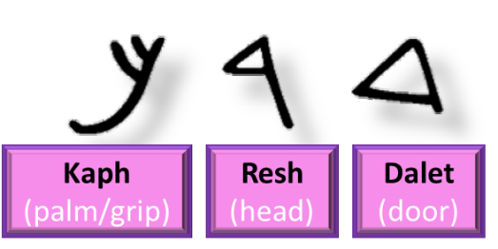
A Pointed Question for this Study:
Abraham PURPOSELY CHOSE to
What was (spiritually) “on his beard??”

Slide 64
Psa 133:1 See how good and how pleasant it is
for brothers to dwell together in unity –
Psa 133:2 Like the precious oil on the head, Running down on the beard, The beard of Aharon, Running down on the collar of his robes –
Psa 133:3 Like the dew of Ḥermon, That comes down on the mountains of Tsiyon. For there
יהוה commanded the blessing, Life forever!

Slide 65
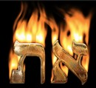

HAYAH ASHER HAYAH
I Am the Beginning and the End. Aleph Tav.
7 Thousand Shaneh/
22 Hebrew Letters =
This earth was inserted into ETERNITY. Are you interested?

Slide 66
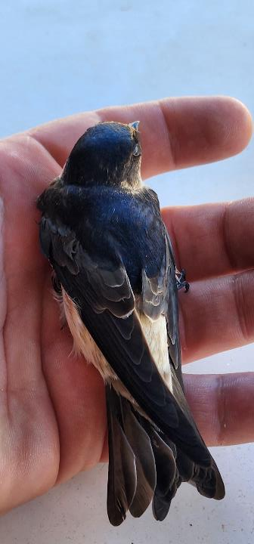

The
Teshuva Shadow Sign,
is the very catalyst for
LIFE ETERNAL!
Gen 1:14
Whose PALM are you SEATED in?

Slide 67
Oak –
Mo-edim!
Let us be a RESTORER of
“OLD TREES” to “SIT” UNDER!
The End

Slide 68
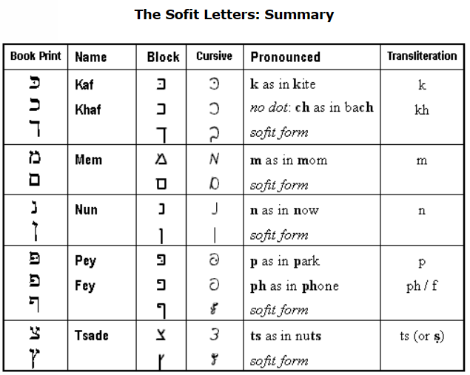

Any Questions for Ecc 1:5
and the Scurry of our Shemesh?
Just email Timothy Astleford (Researcher)
for Covenant Calendar Classroom @
questions@studythecalendar.com
Thank-you!
Shalom!

