Slide 1



Creation’s
Curtain Call
of Gen 1:1
1
Notes:
Nov 4/23: Creation’s Curtain Call of Gen 1 [95] TA Website Link:
Youtube: https://youtu.be/0949NwAJSJg
The first verse of Genesis is one of those verses that many do not know what to do with. In fact, most people (including many scholars and theologians), believe Gen 1:1 is just an introductory verse to the Creation Week! Well, we understand why many people “think that” and “go no further than that” … for a very simple reason. They don’t know what else to do! In this teaching every letter of the Paleo Hebrew word will be broken open with deeper meaning into what is actually happening in this verse. The word “beginning” (b-rashith) has such a depth of meaning in the Paleo Hebrew that one would never glean out of the English word “beginning.” So what does all of this mean? If Gen 1:1 is not properly understood, then it is very difficult to properly understand verse 2 and also the 4th day of creation. Another important word to pay attention to is “created” (Hebrew: Bara/Bra). There will be some follow-up studies to continue into verse 2. But before that, do “Come and See” a bit of what Gen 1:1 has to offer.

Slide 2
Is Gen 1:1
–
A Feather Soft Intro to Creation Week?
Creation’s Curtain Call

Slide 3
Gen 1:1
Creation’s Curtain Call
OR
A SEVEN WORD DOCUMENTARY?

Slide 4
Creation’s Curtain Call
DID Yahusha plan His death, (4th cycle)
from BEFORE Creation’s Curtain Call?
Before the first word
of Scripture?

Slide 5

Creation
Gen 1:1 In the beginning Elohim created the heavens and the earth.
Bara, written twice! Why this DOUBLING EFFECT?
Was there a SHAKING of the SHYT?
Hebrew reads from right to left!
[1254] created [7225] Beginning

Slide 6






B-Rashyt
Ancient Hebrew Beit
This is the entrance
to the Beit. Yahusha‘s
function is - The Door.
He is the
“Passport for entrance”
but this “entrance”
is not the Dalet!
tyhsaR-B
Context!
Beit: The Kingdom “Container” holding all
that Yahuah intends to impart.

Slide 7
B-Rashyt
Ancient Hebrew Beit
Hebrew reads from right to left!
Let’s breakdown the letter Beit.
tyhsaR-B
Who?
Beit, the 2nd letter of the Aleph-Bet. Looking at the Orange arrow, it points to the opening - (the DOOR) – of a dwelling place, a house, a tabernacle …
The Green arrow points to the inside, the actual dwelling area (the inner sanctum),
within the “house.”
WhoSE SIGNATURE??? (Tav)
With this Beit letter first and foremost, is this a positive indication OF POSSESSION as to WHO is claiming this HOUSE - (as HIS Kingdom: this earth)??

Slide 8
tyhsaR-B
Ancient Hebrew Beit
Gen 1:1
Read - John 14:6
Please note: It is within the very first Hebrew letter of Scripture that THE DOORway
(the entrance into the dwelling place of – The Kingdom), has been established.
John 10:9 I am the door: by me if any man enter in, he shall be saved, and shall go in and out, and find pasture.

Slide 9
tyhsaR-B
ENTER into MY COVENANTED KINGDOM OF TZADIQ …
John 10:9 I am the door: by me if any man enter in, he shall be saved, and shall go in and out, and find pasture.
Pasture = Sustenance: do we find an ALEPH (OX) nearby? ???
And also a - RESH? The TOP AUTHORITY IN YAHUAH’S KINGDOM?
Pasture? Physical? – Yes. But - Exponentially more important –
SPIRITUAL SUSTENANCE – LIFE!

Slide 10

NOTICE!
Gen 1:1 – first word – B’rashyt
John 8:12 Then spake Yahusha again unto them, saying,
he that followeth ME shall not walk in darkness,
but shall have the LIGHT OF LIFE.
If there was NO light at this point, but choshek (contaminated darkness), then the
TWO NEXT LETTERS [Resh & Aleph] CANNOT EXIST IN THIS FIRST WORD! Why? For the
Resh represents (in context) Yahusha Ha Mashiach, and the Aleph represents Yahuah.
Elohim IS LIGHT. No light is darkness.
NOTE the LIGHT! Burning bush, cloud and fire at the Red Sea, light between the split Rock,
Mosheh’s face (the presence event on Mt Sinai!).
I am the Light of the world:

Slide 11
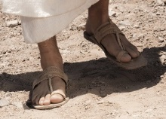
tyhsaR
Ancient Hebrew Resh
Resh, the second letter, is known as - the head, first, front, foremost,
authority, source, Tzadiq, decision maker …
The first whole Hebrew word (Rashyt) begins with the Central Authority,
the One who controls & makes decisions concerning this
Kingdom being created,(BRA).
Shema!
Deut 6:4
Might Yahusha Ha Mashiach “fit the sandals”?

Slide 12
tyhsaR
Ancient Hebrew Aleph
Aleph, the ox head. Why an ox? The ox in ancient times gave power to
sustain life to every family. It carried the wood for fire, the food to eat, the
crops for commerce, the tent and family supplies for relocation and much more.
It does not take much to realize that the ox is attributed to
Yahuah Himself as THE SUSTAINER of Life.

Slide 13

tyhsaR
Ancient Hebrew
Shin
Matt 10:34
Shin - A set of teeth which clamps on with intensity, cuts apart, sets apart, divides, distinguishes, spirit, refiner, orderly alignment, a brilliance.
The Authority above all (Resh / Aleph) is in the process of establishing creation’s foundation which will contain orderly alignment (Shin) and will be distinguished by its assigned (Tav / Covenant) refinement in Tzadiq
(Righteousness within Perfection, [Thummin, Breastplate of Aharon]).

Slide 14
Ancient Hebrew
Yod & Tav
tyhsaR
Yod, the hand of Yah, also – the arm of Yah, the works of Yah, strength,
plumb line, maintain, restore, manifest, potter’s hand.
(of whom)?
Tav – Covenant/ Signature, Sign, Seal & Mark!
OH! Did we just go “full circle”? A Cycle? A Hebraic Trait?
These 4 Hebrew letters all culminate into the last letter of this 1st word.

Slide 15
tyhsaR
Ancient Hebrew
Tav
Tav, a Sign, Seal, Mark, Signature, and/or COVENANT
Within this house (beit) the absolute AUTHORITY (Resh), THE One that supplies and sustains all LIFE (Aleph), has formed and applied a distinguishing (Shin) character, through the work of Elohim (Yod), and has placed His Seal of Authorship and Authority in the form of a Covenanted SIGNATURE (Tav) which reveals the (Shyt [GARMENT of PROTECTION]) Code of Righteousness which WAS DESIGNED TO ENVELOP this earth!

Slide 16

Within this house (beit)
the absolute AUTHORITY (Resh),
THE ONE that supplies and sustains all LIFE (Aleph),
has formed and applied a distinguishing (Shin) character,
through the work of Elohim (Yod),
and has placed His Seal of Authorship and Authority in the form of a Covenanted SIGNATURE (Tav),
which reveals the (Shyt [GARMENT of PROTECTION]) Code of Righteousness which WAS DESIGNED TO ENVELOP this earth!
Tzadiq - Righteousness

Slide 17
tyhsaR
Ancient Hebrew
As we see, the modern Hebrew accumulates these letters down into one word – Rashyt. Let’s have a look. ☺
This first word b’rashyt, used 5 times in this specific spelling order,
Gen 1:1, Jer 26:1, 27:1, 28:1, & 49:34, is always transliterated as “in the beginning.” The root word Resh Aleph Shin – shows - A TOP PRIORITY.
FIRST and FOREMOST – “SIEMPRE”! ☺ (Always)

Slide 18
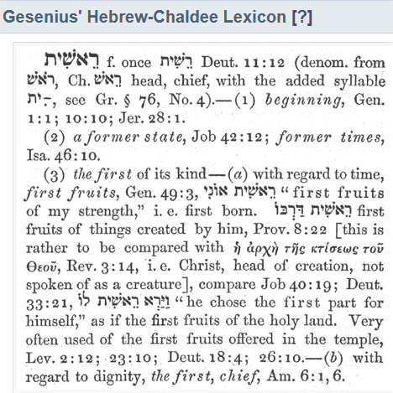
tyhsaR
Remember the first cutting?
Once that sickle touched the stalk of wheat the very first time and instant, it was only that cutting ALONE, that could suffice to be presented to Yahuah as
THE FIRST CUTTING in the form
of a sheaf of wheat.
A second cutting sheaf would be nothing short of rebellion.

Slide 19
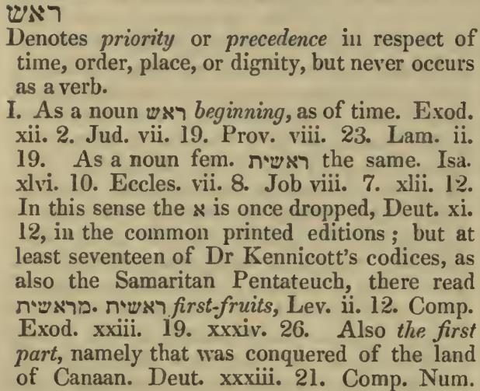
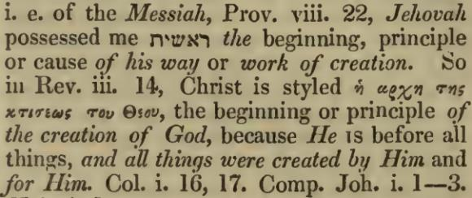
Foreword to - Rash
hsaR
A Hebrew Lexicon J Parkhurst pg. 552
When RASH is applied to time; then adding the Yod (work of Yah); and the Tav (SIGNATURE) thoughts, it becomes quite clear this word speaks to the initial moments of creation seen in Genesis 1:1.

Slide 20
Please read these definitions again,
VERY CAREFULLY!
A Hebrew Lexicon J Parkhurst pg. 552
Did Mosheh “DROP THE MEMO” from Yahuah indicating that
time did not begin until the 4th cycle of creation?
Zadok / Enoch, DSS, if the Sun, Moon, Mazzaroth and stars were not created until the 4th cycle of creation week,
WHY IS THIS WORD RASH NOT SEEN IN Genesis 1:14 – 18?

Slide 21
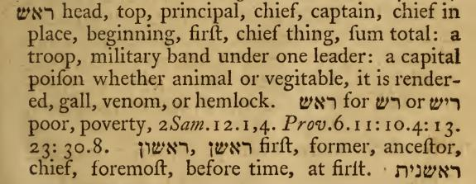
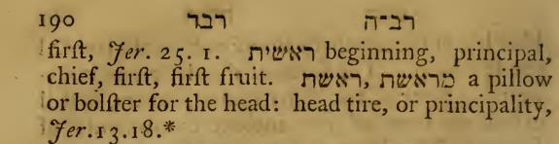
hsaR
A Hebrew Lexicon W H Barker (1776) Pg. 189

Slide 22
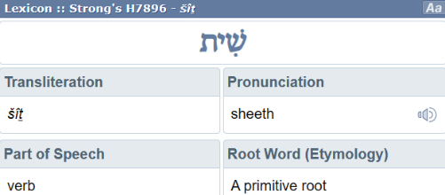
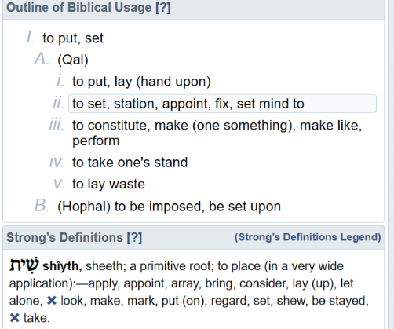
B’Rashyt
Time to go a bit DEEPER in the 1st Word of Scripture. Note the last 3 letters:
Shin Yod Tav. H7896
Could there be more meaning here too?
Something QODESH was being PREPARED FOR THIS EARTH AND HEAVENS, EVEN BEFORE IT WAS CREATED – BRA!
A “RECEIVING BLANKET” FOR THE “NEW BIRTH” Gen 2:4,
(if you will?).
This is not referencing earth proper!
The temporary Aharonic Priesthood, type of shyt.

Slide 23

B’Rashyt
Shin Yod Tav.
A “BLANKET”? ????
Is a “RECEIVING BLANKET” for the “NEW BIRTH”
just a bit “out there”? Beyond acceptable?
Gen 2:4 These are the BIRTHS of the heavens and the earth when they were created, in the day that יהוה Elohim made earth and heavens.
Maybe a “swaddling blanket of Light in Righteousness” makes a bit more sense?

Slide 24
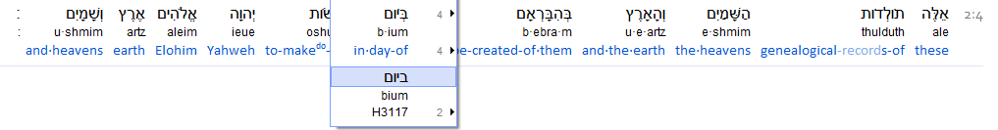
Attention!
Gen 2:4 These are the BIRTHS of the heavens and the earth when they were created, in the day that יהוה Elohim
made earth and heavens.
Yowm is NOT PLURAL!
Why do the Scriptures declare, the heavens were made IN ONE DAY, being the exact same day as the earth, BUT YET WE ARE BANTERED WITH THE IDEA THAT THE CELESTIAL IDENTITIES WERE NOT CREATED UNTIL THE 4TH CYCLE?
Even when the Hebrew word Bra (to create out of that which
does not exist), is not present in cycle #4?

Slide 25
Attention!
AGAIN!
Gen 2:4 These are the BIRTHS of the heavens and the earth when they were created, in the day that יהוה Elohim
made earth and heavens.
Yowm is NOT PLURAL!
If the Heavens were created (EMPTY) on the 1st cycle, and the Sun, Moon, Mazzaroth and stars were created on the 4th cycle, this word – YOWM in the singular format, would be INCORRECT! If multiple (2) cycles were needed to create ALL these identities, it would be necessary for YOWM to be plural
as in YOWMIM! But that is not what is WRITTEN!

Slide 26
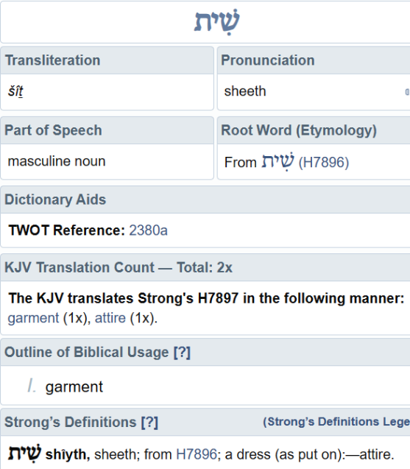

Back to Genesis 1:1
H7897 shyt
Can Shin Yod Tav equate to
the KINGDOM
“RECEIVING BLANKET?”
Let’s look at two verses!
Ps 73:6 Therefore pride compasseth them about as a chain; violence covereth them as a garment. ^{H7897}
Prov 7:10 And, behold, there met him a woman with the attire ^{H7897} of an harlot, and subtil of heart.
SHYT = Garment, Attire. (a Robe)

Slide 27
SHYT - a Garment?
Within - Brashyt, - are the 3 letters for the word Bra – to create!
What was being created, FORMULATED, for a GARMENT (SHYT) with which to place (envelope/ cradle) this earth in order to exude a DISTINGUISHING (Shin), ATTIRE (SHYT) of Righteousness?
The Righteousness is seen from the Aleph , the Resh
and SEALED BY A SIGNATURE COVENANT within the Tav .
AND WHY “SHYT”
when there are many other words that contain definitions for garment/ “clothing”?
H8071, H3801, H155, H899, H4055, H8008, H8509, H3830 ???

Slide 28
Slide design is not by accident. We are attempting to look deeper than a surface understanding. It is imperative!
As we go through the next set of slides for Shyt, please understand, we are looking at the USAGE of the SHYT ROOT in the revealing of different applications of this root.

Slide 29
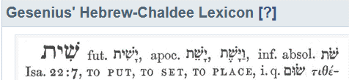
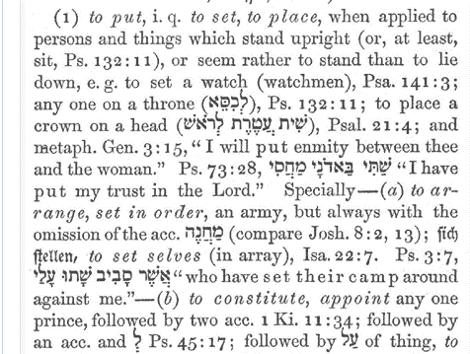
Is a 7000 year “WATCH” “Garment of Tzadiq” (Righteousness)
too far fetched to accept?
2Ti 4:8 For the rest, there is laid up for me the crown of righteousness, which the Master, the righteous Judge, shall give to me on that Day, and not to me only but also to all those loving His appearing.
Gesenius’ Lexicon - SHYT
Righteousness - Tzadiq –
End from the beginning!
Seed within … HHMMM!

Slide 30
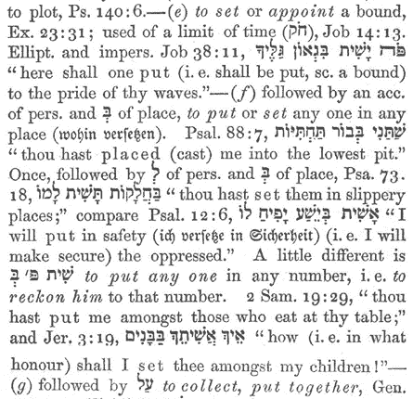
Gesenius’ Lexicon - SHYT
If this SHYT (Garment) were indeed designed to protect a new birth (earth) - to whom would the APPOINTMENT of Judge within the SHYT of Tzadiq (Righteousness), be assigned to?
Will the first 3 Hebrew letters reveal the answer most brilliantly?
Or, did Yahuah hide this AUTHORITY from His children?
LOOK for the Watch!

Slide 31
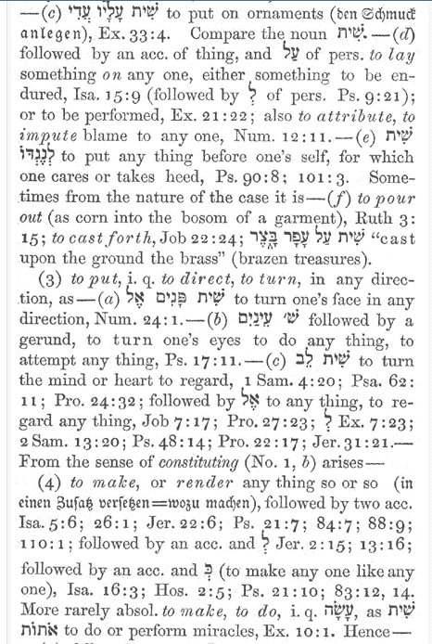
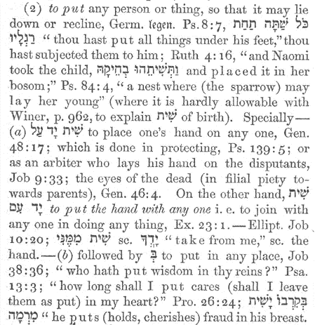
Gesenius’ Lexicon - SHYT
Is B’Ra-
SHYT
the 1st revealing
of – Seed within a Seed accord-
ing to
its kind, “DNA” STIPULA-
TION?
Gen 1:11,
12!

Slide 32
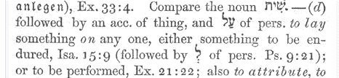


A 2ND LOOK!
AMPLIFYING - SHYT
What was being SEEDED?
Was it choshek (confusion in emptiness and waste) of contamination being seeded?
Or is it possible that Righteousness of the MelkiTzedek Order was being SEEDED on this earth as the FIRST in ORDER?
CHOSHEK?
Ornament of contamination or of Righteousness?
Would Yahusha do this,
knowing He was going to DIE?

Slide 33

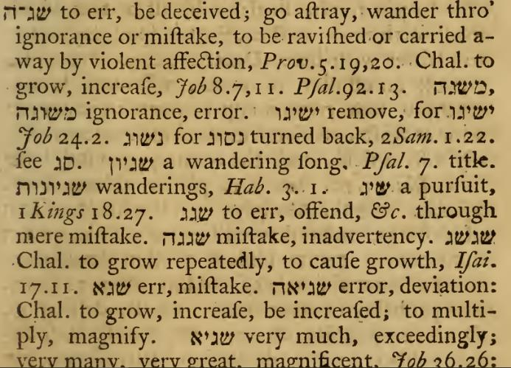
For SHYT, What does W H Barker direct?
Interestingly, we see “ERROR” and “TO BE DECEIVED,” directly from this word!
Is it possible the highly specific letters in Brashyt are there to positively identify Yahuah’s SIGNATURE OF RIGHTEOUSNESS (Tav) describing the GARMENT intended for this earth?
Was this GARMENT intended to prevent man from going astray by the theme of Righteousness SEEDED FROM the Heavenly city of Tzyon?

Slide 34
We are transitioning (hayatah)
to - RASH,
another word built inside of
B’Rashyt!

Slide 35
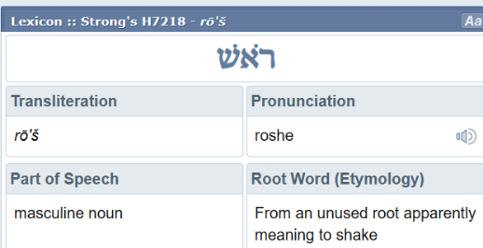

Before moving to the next context, let’s take a brief look at another aspect of B’Rashyt. Note the letters Resh Aleph Shin in H7218. Note also the root word meaning from etymology. A Shaking, (setting a standard of great significance).
Eze 9:10 “But as for Me, My eye shall not pardon, nor would I spare,
I shall recompense their deeds
on their own head.”
Eze 11:21 “But to those whose hearts walk after the heart of their disgusting matters and their abominations, I shall recompense their deeds
on their own heads,” declares the Master יהוה.”

Slide 36
A reconstructing of life??
Eze 16:43 “Because you did not remember the days of your youth, but troubled Me with all this, so see, I shall also bring your way
on your own head,”
declares the Master יהוה.
“And shall I not do this thought
for all your abominations?”
Eze 17:19 Therefore thus said the Master יהוה, “As I live, My oath which he has despised, and My covenant which he has broken, shall I not put it
on his own head?”

Slide 37
Yahuah imposed a SHAKE UP.
Eze 22:31 “Therefore I have poured out My displeasure on them, I have consumed them with the fire of
My wrath. And I have put their way on their own head,”
declares the Master יהוה.”
Psa 7:16 His trouble turns back upon his own head, And his wrongdoing comes down
on the top of his head.
In these last few verses, is it possible to conclude the
SHAKING ON ONE’S HEAD for a life of sin, might reveal
a “WAKE UP CALL” in the structure of that life?

Slide 38
Could a SHYT (Earth’s GARMENT OF RIGHTEOUSNESS) ALSO RECEIVE A VIOLENT SHAKE?
Yahuah created this earth – B’Rashyt – knowing all things.
Is it possible that Yahuah knew before hand the Garment of Righteousness created to support life on this earth with His audible voice, was going to be SHAKEN AND SHATTERED?
Could Yahuah have known PRIOR to creation that this Garment (SHYT) of Righteousness would be shattered by man, resulting in sin?
Known - Prior to Creation? ?
And would this same knowledge translate to the understanding that Yahusha would need to die to pay for sin in the heavenly courts?

Slide 39
B-Rashyt
Points to Ponder – {Selah}
Yahuah knows all things fore and aft.
Yahusha knew full well, yet He established this garment (shyt) of righteousness upon earth, while understanding THE SHYT GARMENT OF RIGHTEOUSNESS
was going to be SEVERELY DAMAGED on the initial Light Season of creation.
The incredible assault required the cleansing action of the
Ruach Ha Qodesh on the waters. What SEED was IMPOSED on the waters?
Yet even more incredible, Yahusha knew the Shyt (Garment of Righteousness) would be SHATTERED, BY MAN, not once, but 2 monumental times, -
1st Adam, 2nd the Golden Calf.
Add to this, the knowledge that sin causes death and, the price must be paid!
WHO WAS GOING TO PAY THE PENALTY?

Slide 40
B-Rashyt
The understanding of - THE DOOR (Yahusha Ha Mashiach) was
plainly shown (established/made visible - within Beit ),
within the first word/letter of Genesis 1:1 – at creation.
Yahusha knew this great sacrifice coming His Way
before the words to create were even spoken.
ARE WE NOW ABLE TO UNDERSTAND THAT YAHUSHA
KNEW HE WAS GOING TO DIE,
RIGHT FROM CREATION’S OPENING MOMENT -
B’Rashyt!?

Slide 41

All “CAME TO BE” through Him…
John 1:3
We are transitioning (hayatah),
from the first word of Scripture
to the SECOND WORD.

Slide 42

WHO CREATED?
Bra
Next up!
2nd word.
Let’s continue to the second word of Scripture. ☺
The second time we see these same letters! “Beit Resh Aleph.”
John 1:1 In the beginning was the Word, and the Word was with Elohim,
and the Word was Elohim.
John 1:2 He was in the beginning with Elohim.
Yahusha the PASSPORT FOR ENTRANCE into the Kingdom of Yahuah, was the ONE creating! Is this correct?

Slide 43
WHO CREATED?
Bra
The “Passport”/ Doorway & Creator!
John 1:3 All came to be through Him,¹ and
without Him not even one came to be that came to be. Footnote: ¹Eph. 3:9, Col. 1:16, Heb. 1:2, Heb. 11:3, 2 Peter 3:5.
John 1:4 In Him was LIFE, and the LIFE was the LIGHT of men.
John 1:5 And the LIGHT shines in the darkness, and the darkness has not overcome it.

Slide 44
Understanding John 1:2 in the very most base, visible format.
John 1:2 He was IN the beginning with Elohim.
Genesis 1:1
John 10:9 I am the door …
John 8:12 Then spake Yahusha … I am the LIGHT of the world:
B’Rashyt

Slide 45
Please tell me, even on the lowest level of understanding,
HOW IS IT THAT WE ARE ASSAULTED with the
INSIDIOUS NOTION,
that DARKNESS came first in Gen 1:1? HOW?
How long will THE SPOKEN WORDS OF YAHUSHA Ha MASHIACH
be DISMISSED?
John 10:9 I am the door …
John 8:12 Then spake Yahusha … I am the LIGHT of the world:
B’RashytGenesis 1:1

Slide 46
John 10:9 I am the door …
John 8:12 Then spake Yahusha … I am the LIGHT of the world:
This Beit (2nd Hebrew letter) is a TYPE OF SUKA.
It is a DWELLING PLACE. A TEMPORARY dwelling
place! Why temporary? Because even though earth was created within the SHYT (garment) of ABSOLUTE PERFECTION, it became contaminated through assault from evil. Most especially man’s consistent persistent sin.
This TEMPORARY DWELLING PLACE – EARTH – will be re-constructed once again into a state of ABSOLUTE TZADIQ (RIGHTEOUSNESS.)
It will then fulfill the original intent of Yahuah in being His KINGDOM.

Slide 47
Back to the 2nd word.
Bra
In context, in the most simplest format:
Concerning this new Kingdom of Yahuah, - BEIT –
The Corporate Director - Resh –
Forged a decision to FORMAT a locale that would
SUSTAIN LIFE WITHIN the AUTHORITY of RIGHTEOUSNESS.
Melek / King
MelkiTzedek Administration - (Order of Righteousness )

Slide 48
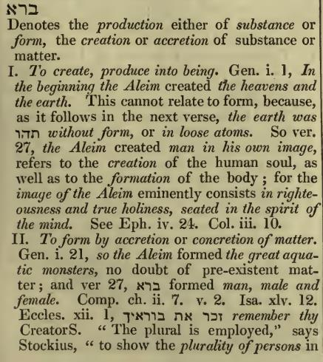
The initial moments
of Tzyon’s Corporate decision to produce that which was not yet existent!
Bra
Notice: the control factor, that which PRODUCES AND SUSTAINS LIFE, THE HEAVENS, are recorded first in line, to having been formulated out of that which had not previously existed!

Slide 49
LIGHT WAS BROUGHT FORTH
FIRST AND FOREMOST!
Bra
The MelkiTzedek Order of Righteousness, demanded, a fundamental system of establishing accountability in terms of TIME, which must exist first.
Without substance determining TIME, THE BEGINNING simply cannot exist.
To produce TIME, as in THE BEGINNING, (Genesis 1:1),
THE ELEMETS FOR DETERMINING TIME MUST EXIST – FIRST!
In the heavens, the sun started its Tequfah circuit of the 1st cycle of 360, at Yahusha’s opening SPOKEN WORDS.

Slide 50
The MelkiTzedek Order of Righteousness, demanded, a fundamental system of establishing accountability in terms of TIME, which must exist first.
Without substance for determining TIME, THE BEGINNING of time
simply could not exist.
Example: Ask a person what time it is. If they look at their wrist to determine time, and their wrist bears no timepiece (watch),
their answer for time, is positively negated.
Yet if their wrist carries the appropriate mechanism to ascertain time correctly, a factual determination can be accepted.
If at The Beginning, cycle #1, there was not a timepiece (Sun, Moon, Mazzaroth) was Yahuah correct in Inspiring Mosheh to write – B’Rashyt –
IN THE BEGINNING?

Slide 51
Bra
If the sun was not created until the 4th cycle of creation, then time did not exist for this earth until that 4th cycle. The Shaneh (year, – duplication of mirror like quality/ do a second time), did not and could not, start until the cycle after 360th day, being the Teshuva (shadow). BIG PROBLEM! Without the orb of the sun, the Tequfah circuit could not have started
to account for a 360 cycle Shaneh (Gen 1:14).
The Tequfah (circuit) could not exist!
There would have been NO SHADOW OF TESHUVA, 357 CYCLES LATER,
FOR THE NEXT SHANEH TO START - FOLLOWING THE SHADOW!? ?????
If the sun was not created until the 4th cycle, there is a
VICIOUS CIRCLE OF UTTER DESTRUCTION IMPOSED UPON – annihilating Genesis 1 and every word following.
Period.

Slide 52

Bra
What IF the sun was not created until the 4th cycle of creation?
The 1st cycle of creation recorded in Genesis 1, first of the week,
month, year and Jubilee, did not exist within earth’s allotted time as documented by Inspiration to Mosheh.
Creation would then not be part of the beginning of this earth.
Adam could not be part of this earth for it is recorded he was created
on the 6th cycle of creation week.
So Adam’s first year of living would not have been on this earth’s allotted time and consequently the Scriptures claim of Adam living 930 years
could not include the creation week’s final work day, nor the first year!
The question then is: – Is Adam’s life count part of this earth?
Or did he actually only live 929 years on this earth?

Slide 53

But most importantly, because of the characteristic of the Hebrew word Shaneh, if the first 357 cycles were not a complete 360 cycle Shaneh, it could not FULFILL THE NAME Yahuah gave it! So at the time of the spring equinox/teshuva, it could not fulfill the Seed Within a Seed, According to its Kind – “DNA” commissioned platform! See Genesis 1:11. 12.
Therefore, TIME AS COMMANDED, FORMULATED and DOCUMENTED BY YAHUAH, could not exist! Why?
Because nothing in terms of time, could fulfill His words.
The questions then arise –
WHO CREATED THE START OF THIS EARTH ON THE 4TH CYCLE?
WHO created the sun on the 4th cycle?
It certainly was not Yahuah!
Moving forward.

Slide 54
You might consider
re-reading
this slide, concentrating solely on the SPIRITUAL application!
Bra
A side question!
John 1:5 And the LIGHT shines in the darkness,
and the darkness has not overcome it.
What “darkness” is this? Is it the Ruach cleansed, acceptable Layil darkness, of our Night Season sky, that cannot overtake
the LIGHT of Yahusha Ha Mashiach?
Why would a CLEANSED DARKNESS (layil) attempt to overtake LIGHT?
Or, is it possible that the adversary has its own SIGNATURE & TEMPLATE of DARKNESS as revealed in the choshek (H2822, darkness), which attempts to attain victory over LIGHT?

Slide 55
Bra
Beit / Beginning
John 1:1 In the BEGINNING was the Word, and the Word was with Elohim,
and the Word was Elohim.
John 1:2 He was in the BEGINNING with Elohim.
Two times we see the Beit, both times it contains THE DOOR
for entrance into the Kingdom, (The House of Yah!)!
John 10:9 Then said Yahusha unto them again,
Verily, verily, I say unto you, I am the DOOR of the sheep.

Slide 56
John 14:6 יהושע said to him,
“I am the Way, and the Truth, and the Life.
No one comes to the Father except through Me.

Slide 57

John 14:6
No one comes to the Father except through Me!
He is –
THE DOOR!

Slide 58

Will we enter Yah’s Kingdom if we do not go through the doorway (AUTHORITY) of BEIT?

Slide 59

tyshaR’B
I am
The Door
NO ONE comes to the Father but by Me.
Kingdom TombstonePassport!
Abba Yahuah’s Inner Sanctum
(Kingdom)
Kingdom Entrance Requirements
Kingdom Entrance Procedure:
ROLL AWAY the TOMBSTONE TRADITIONS that BLOCK YOUR ENTRANCE! How?
Accept: Yahusha allowed Himself to be crucified (from even before earth was made {in LIGHT of Life}), FOR YOU!
Place a “LIFE GRIP” onto His Festal System (The Way, Mo-edim) for Salvation.
Don’t look back! (Pillar of Salt)!
Spiritual - NOW!
Physical Entrance – Shemini Atzaret 7,000!

Slide 60
I am - The Door,
Bra
Once again the “house of Yah” is seen in the Beit, once again it has the DOOR.
In the beginning was the Word, and the Word was with [Yahuah], and the Word was fully [Yahuah].
Joh 1:2 The Word was with [Yahuah] in the beginning.
Joh 1:3 All things were created by him, and apart from him not one thing was created that has been created.
Joh 1:4 In him was life, and the life was the light of mankind.

Slide 61
The Door: entrance
to The Kingdom!
Bra
The Resh (head, foremost authority) was in the process of establishing a corporate decision which manifested in and of itself, creation, by a spoken command. Isa 48:3. This CREATIVE THOUGHT TO VOICE process produced a physical event which manifested in the characteristics of Aleph.
This Aleph production , CONTAINED THE ABILITY TO SUSTAIN LIFE through its AUTHORITY.

Slide 62
The Door:
I Am the Way!
Bra
It was the ABILITY TO SUSTAIN LIFE – the ALEPH, which was
CHALLENGED by the adversary [in vs 2] THROUGH his
SIGNATURED ASSAULT OF DESTRUCTION & DEATH (choshek).
This reality is revealed through the Tav definitions, applied and pertaining
to the TWO INDIVIDUALIZED characters realized in Genesis 1:1, and 2!
The SEPARATION revealed by the IMPOSED SHYT (GARMENT CHARACTERISTICS) in the CONTEXT OF –
the ARRIVAL of TOHU, BOHU and CHOSHEK CONTAMINATION in Genesis 1:2.

Slide 63
The described characteristics within the context, determines, through TAV (Sign, Seal, Signature & Mark),
to whom these identifying signature traits belong.
Tav = T =
Towla!
=
Tav = T =
Life
=
Hades
Same Tav letter, different characteristics, separate identities!

Slide 64
Looking at - Bara (to create) A Hebrew Lexicon by J Parkhurst 1762 Pg. 131
accretion
ə-krē′shən
noun
Growth or increase in size by gradual external
addition, fusion, or inclusion.
Something contributing to such growth or
increase.
The growing together or adherence of parts that
are normally separate.
concretion
kən-krē′shən
noun
The act or process of concreting into a mass;
coalescence.
The state of having been concreted.
A solid hard mass
?

Slide 65
Looking at - Bara (to create) A Hebrew Lexicon by J Parkhurst 1762 Pg. 131
The word Bra to create indicates
by multiple Lexicons in agreement;
to produce substance out of that which did not previously exist.
So, why then does J Parkhurst declare the sea life was made from “pre
-existent matter” if Bra means to - produce substance out of that which
did not previously exist? It was the factor of introducing the RUACH OF
LIFE, into the Sea BODIES, which produced a LIVING BREATHING ENTITY,
which DID NOT PREVIOUSLY EXIST!
Then how does this format apply to Adam if the breathing seas life was already in existence? Wasn’t he created - Bra - also?

Slide 66
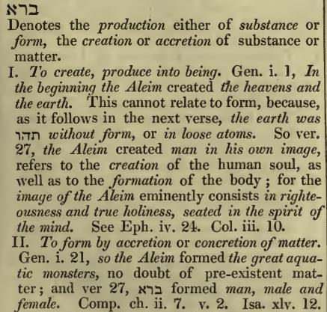
NOT assembly or formation!
Looking at - Bara (to create) A Hebrew Lexicon by J Parkhurst 1762 Pg. 131
Is it possible that the loose atoms (pre-existent matter) could have been accumulated (as in a formation), into a body named Adam? And if so for Adam, does that discount anything else in the creation process that was, and is,
much less than - Adam?
Adam QUALIFIES for Bra, most exquisitely in that Adam was a Seed within a Seed production, formatted in A PERFECT DUPLICATED IMAGE of Yahusha ha Mashiach. An IMAGE entity of this format did not previously exist before Adam!
Bra!

Slide 67
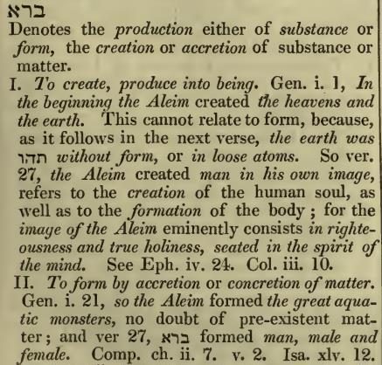
Looking at - Bara (to create) A Hebrew Lexicon by J Parkhurst 1762 Pg. 131
The question is: These original loose atoms; were they created by Elohim in a contaminated state? Or, were the LOOSE ATOMS created in absolute flawless perfection -
(Yahuah’s character), -
AND THEY BECAME (H1961 , Eithe: Gen 1:2) a case of contaminated - (Tohu/Bohu) - loose atoms?
?
Next up – Elohim!

Slide 68




Elohim
The next word in Genesis 1:1 is – Elohim.
Note the Title starts with an Aleph,
(that which supplies and sustains LIFE).

Slide 69
Elohim
The ALEPH! First and foremost in AUTHORITY AND identity.
The ONE which provides and sustains all life
- indefinitely.
The great “I am”!
The one who was, who is, and who will - eternally exist!

Slide 70
Elohim
Lamed – to lead, guide, nurture, direct, instruct, shepherd,
scepter, yoke, whip, judicial application.

Slide 71
Elohim
HEH! – (Or- HEY literally!) a revealing, attention! look! projection, pointer, evidence portrayed, proscribed path, blatant
The question is: WHO has the right to demand your attention?
Will the next Hebrew letter answer this question?

Slide 72
Elohim
Yod – the hand of Yah, the arm of Yah, the works of Yah, strength, create, catalyst for response, plumb line.
Question: How are these concepts related to us as humans?
Do we need another letter?

Slide 73
Elohim
When in Gen 1:3 the Ruach of Yah was VIBRATING on the waters, is it possible it was this frequency of CHAI (LIFE IN RIGHTEOUSNESS) that was CLEANSING THE EVIL SEED OF THE ADVERSARY from the “WATERS”?
Mem, a womb for frequency, origin and producer, to broadcast, consistency, endless, seed, blessing or cursing
Let’s pull these definitions together on the next slide, BUT FIRST -

Slide 74

Elohim
3
2
1
The GREAT ELOHIM of which there is no equal in any way shape or form, Who inherently possesses all authority, is coupled with the ability to guide, shape and form through Righteousness (Tzadiq). He provided unquenchable evidence
of His ability and claim to this earth as His work of creation and extension of His Kingdom. Elohim, just in His very Title, DEMANDS OUR UNDIVIDED ATTENTION.
Hey!
HeH!

Slide 75
Elohim
3
2
1
Next we will unfold the THREE identities listed here in verse 1 that
had been established by His Voice. THREE? ??
COUNT THEM!

Slide 76

Aleph-Tav
AAHH! Finally, absolute proof that Yahusha was created!
#1.
???
Careful! Not so quick!
Yahusha “The Vav Man,” declares He existed at the beginning of
Yahuah’s Way! (Verse forthcoming.) That is LONG BEFORE creation of this earth!
Yes, Yahusha did declare He is the Aleph and the Tav.
(That is if He spoke Aramaic and Hebrew, ☺ ), - Not Alpha and Omega!

Slide 77
Yahusha openly declared He existed long before this earth was brought into existence.
What could this first revealing of the Aleph-Tav be indicating?
It is most certainly not just “space filler” material!
Genesis 1:1 does state - IN THE BEGINNING (pertaining to this earth’s existence), that, this particular understanding of
Aleph-Tav, was AT THIS SPECIFIED POINT IN TIME - CREATED!!!
WHAT THEREFORE WAS - CREATED?

Slide 78
#1. Aleph-Tav
How can it be understood the Aleph & Tav was created alongside
the Shemayim and the Artz? Is there another application?
What could these two Hebrew letters portray here?
Again: How can it be claimed the Aleph & Tav were created here?
BECAUSE, THAT IS WHAT IS RECORDED IN THE ORIGINAL HEBREW SCRIPT!
Maybe it is OUR UNDERSTANDING that needs fine tuning?

Slide 79
#1. Aleph-Tav
Let’s read Yahusha’s statement of existence.
Pro 8:22 [Yahuah] hath possessed Me in the beginning of his
Way: I was BEFORE his workes of olde. Geneva 1587
This understanding prevents an error in thinking the Aleph Tav was the creation of Yahusha Ha Mashiach written in Genesis 1:1.
Yahusha WAS before, LONG BEFORE Genesis 1:1!
Remember: The Way (H1870 derek), the cyclical Festal system of worship that was SEEDED onto this earth, it also existed LONG BEFORE THIS EARTH!
Again: What could the Aleph-Tav portray, as being created in Gen 1:1?

Slide 80
Verses for Consideration
Prov 8:23 I was set up from everlasting, from the beginning,
or ever the earth was.
Ecc 3:11 He hath made every thing beautiful in his time: also he hath set the world in their heart, so that no man can find out the work that [Yahuah] maketh from the beginning to the end.
Isa 40:21 Have ye not known? have ye not heard? hath it not been told you FROM THE BEGINNING? have ye not understood from the
FOUNDATIONS OF THE EARTH?
Isa 41:4 Who hath wrought and done it, calling the generations from the beginning? I Yahuah, the first, and with the last; I am he.

Slide 81
Aleph-Tav -
Applied
Isa 46:10 - Declaring
THE END FROM THE BEGINNING, and from ancient times the things that are not yet done, saying,
My counsel shall stand, and I will do all my pleasure.
Isaiah has given us this message no less than 7 times. If we desire to understand the ending, we MUST understand the beginning!
Question: Did Yahuah formulate (establish), through creation’s opening moment, the scenario of earth’s END TIME?
The transition into eternal LIGHT, established in Genesis 1:1?

Slide 82
#1. Aleph-Tav
The Aleph is the beginning. The Tav is the ending.
Shall we consider that Yahuah was making knee jerk decisions and frantically formulating ways to preserve His people step by step through history?
Is that His Way? Struggling to assemble remnants of shattered pieces?
WHAT IF, Yahuah spoke into fruition RIGHT THERE IN Genesis 1
the Last Great Day, when Yahusha will arrive to gather His flock?
WHAT IF, the end was spoken out in an audible voice by Yahuah establishing the Final Events creating an ESTABLISHED ORDER?
Was this Righteous PLAN, COVENANTED BY A TAV in – B’RashyT?
The MelkiTzedek Order in a SIGNATURE TAV, SEALED,
AUTHORIZED & MARKED BY THE ALEPH?
Would the DEATH of the MelkiTzedeq Kohen Ha Gadol -Yahusha
provide direct linkage to this idea?

Slide 83
#1. Aleph-Tav
For your consideration:
As The MelkiTzedeq (Yahusha) was speaking this earth into fruition; the complete Plan of Salvation was also spoken into eternity.
That Plan is for the MelkiTzedeq, from the Beginning, to culminate events at the very final moments of this earth’s tragic timeframe, OPENING THE VERY DOOR OF BEIT seen in B’rashyt of Genesis 1:1. Hence establishing – RESTORING the ORIGINAL SHYT (GARMENT of RIGHTEOUSNESS) that was in the opening moments of this earth’s BEGINNING!

Slide 84


B’Rashy
t
End from the Beginning
Gen 1:1, Yahuah established HIS CLAIM TO THIS EARTH, being HIS KINGDOM. It is HIS “HOUSE”!
Yahusha was present AS
THE DOOR!
Gen 1:1, Yahusha will finalize
HIS CLAIM and RETURN to earth
BEING - HIS KINGDOM.
Yahusha - THE DOOR, will usher in eternal LIGHT!
I AM THE LIGHT OF THE WORLD John 9:5
LIGHT
LIGHT
to
DAWN
DAWN
Seed within a Seed, according to its kind.

Slide 85

End from the Beginning
Could it be, there,
in Genesis 1?
What is recorded as being created – next?

Slide 86

#2. Shemayim
Elohim created the Heavens.
What prefixes this word?
Consider a Shemayim created full of emptiness! No Sun, Moon, Mazzaroth or Stars. What then would be the reason for the Hebrew letter HEH (HEY)??
No reason to call your attention. Nothing to produce a revealing of any kind, just ponder the emptiness? What about the lack of evidences of the glory of Yahuah (Psalms 19?) and an absence for anything to bring one closer to the Creator! No possibility of starting the Tequfah circuit nor achieving the shadow of Teshuva FOR ETERNITY! Eternity? Why? The Mode of Operation was for a Shaneh. It failed by starting on the 4th cycle! If Yahuah FAILED to do it the first time, what makes us think He could do it on a second try?
Heh – attention, look, a revealing, consider acutely, evidence, focal point Now - apply these definitions to the – Shemayim.

Slide 87
#2. Shemayim
Elohim created the Heavens.
What is within this word?
Heh- now let’s pay attention to the revealing!
Shin – set of teeth, press in with intensity, cut asunder, distinguish,
set-apart, divide, refine, orderly arrangement.
Does the Mazzaroth, Sun & Moon define and distinguish anything?
Mem – incubator of frequencies, origin, consistent, sureness, plurality, truth.
Is there any indication of consistently producing Righteousness from within the Heavenly Bodies?

Slide 88
#2. Shemayim
Heavens continued.
Yod – hand/arm/works of Yah, strength, specification, quality, authority.
Is this verse in Psalms applicable here? ?
Psa 19:1 The heavens declare the glory of Yahuah; and the firmament sheweth His handywork.
Mem – virtuous, chaste, motherly, blessing (or cursing), gestation expectation (6000 year?), (as a suffix - indicates a plurality).
Is there a Plan of Salvation (motherly protection), imprinted within the Mazzaroth message, embedded into the upper atmospheric Heavens? Is there evidence of a gestation expectation timeframe where this salvation will be finalized? Consider the Sun and Moon, do they provide commissioned specific life sustaining characteristics?

Slide 89
#2. Shemayim
Heavens in PAUSE ???
Or was the shemayim waiting in emptiness
until the 4th cycle?

Slide 90
#2. Shemayim
Considering the 1st heaven of which our “lifted up” eyes can observe:
There are various Mem frequencies being repeated every 2x-12, & 24 hours, twice per Shaneh (year) and once per Shaneh, (just to note a few). These physical frequencies reveal the authority of Elohim, the love and nurturing care for His children. The support and provision for life itself has been DISTINGUISHED not just physical but SPIRITUAL in Righteousness as well, even far beyond our ability to comprehend. Also, the revealing of curses that are an option as well.
The Regal authority within the visual effects are unmistakable, and the Path leading to Yahuah’s Kingdom has been delineated immaculately. The basic necessity of heat and light are a surety. Navigation both physical on earth and Spiritual has been provided. This information and life support system within the Shemayim operates continually which underscores the origin and production of these Qodesh frequencies. Do note this life support system is listed as having been established FIRST before the earth came to be!

Slide 91
Next word:
and

Slide 92


Next word: And ???
Vav – Nail, hook, tent peg, connector, vehicle, chrysalis, cogged wheel, intermesh, correction, support
Why – chrysalis?
Could this Vav REVEAL AN AUTHORITY CONNECTION TO WHOM the next “COG IN THE WHEEL“ of CREATION, is being DIRECTLY LINKED (hook)?
Is it possible to relate this back to the SHYT (Garment of Righteousness) prepared for earth in B’Rashyt?
Merraim Webster - chrysalis noun
1. a: a pupa of a butterfly broadly: an insect pupa
b: the hardened outer protective layer of a pupa
2. a protecting covering also: a sheltered state or stage of being or growth
Might this also include Yahuah’s previously established LIFE SUPPORT SYSTEM (tent peg)? From where & WHOM might this Corporate Authority derive?

Slide 93
Next: Aleph - tav
That Vav, is prefixed to – CONNECTING, LINKING TO -
THE ALEPH – TAV!
THE QODESH AUTHORITY seen within these letters! Yahusha Ha Mashiach, decided for one more addition (EARTH), to be established within the “MelkiTzedeq pupa,” the controlled environment supporting Righteousness in Life!
The Aleph Tav is designed to be the THE LINK (Vav) between this (then) forthcoming creation and the heavenly realm of Yahuah.
Earth’s linkage to Yahuah is through Yahusha ha Mashiach! (“The Vav Man”.)
The Beginning and the End.

Slide 94
and.
The English transliteration provides for you –
Next - The final word in Genesis 1:1 – earth.

Slide 95


Earth
Genesis 1:1 The Towla Crimson SHYT PUPA!
Heh – (or Hey) - LOOK, a revealing! Attention! View,
Focal Point
Yahusha created a locale enveloped within absolute Righteousness of which He claimed, “I am the LIGHT of the world”! This light was encapsulated within His Tav (SIGNATURE, GARMENT - SHYT) in the first recorded word – B’rashyt.
Earth was created to sustain life IN LIGHT, & nothing short of it.
Aleph - sustainer of life, provision, certain, authorized agenda, righteous purpose, steadfast, silent author
Resh - corporate authority, collective refiner, decision maker,
Tzadi - The Word, Righteousness, Order (by design),
epitome of excellence, chosen

Slide 96
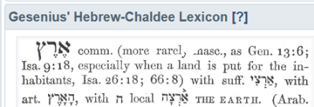
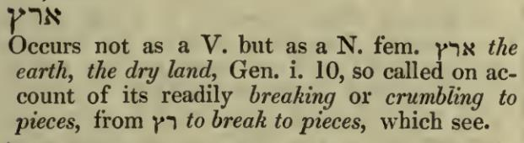
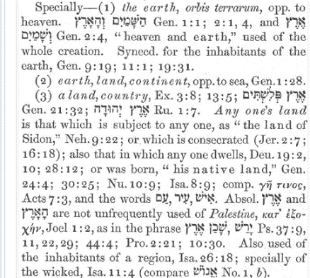

Earth
J Parkhurst A Hebrew Lexicon Pg. 103
H776
A Hebrew Lexicon W.H. Barker Pg. 28
H6206

Slide 97
Aleph
Tav
We now have a question for you.
You might not agree with all that has been presented.
However, I ask:
Will you ever again apply only a fleeting glance at Genesis 1:1
as just a bland introductory sentence unworthy of your time
(as many theologians insist upon)?
The intent is to expose but a miniscule glimpse of the vast amount of information we have been missing when sitting stagnant and / or floundering because of our English language.
Please don’t misunderstand; I am very thankful for my upbringing reading the “English Bible.”
I am however, massively more grateful to Yahusha for
introducing me to the Hebrew language.
Shalom.

Slide 98

Any Questions for Gen 1:1?
Just email Timothy Astleford (Researcher)
for Covenant Calendar Classroom
questions@studythecalendar.com
Thank-you!
Shalom!
98

