Slide 1
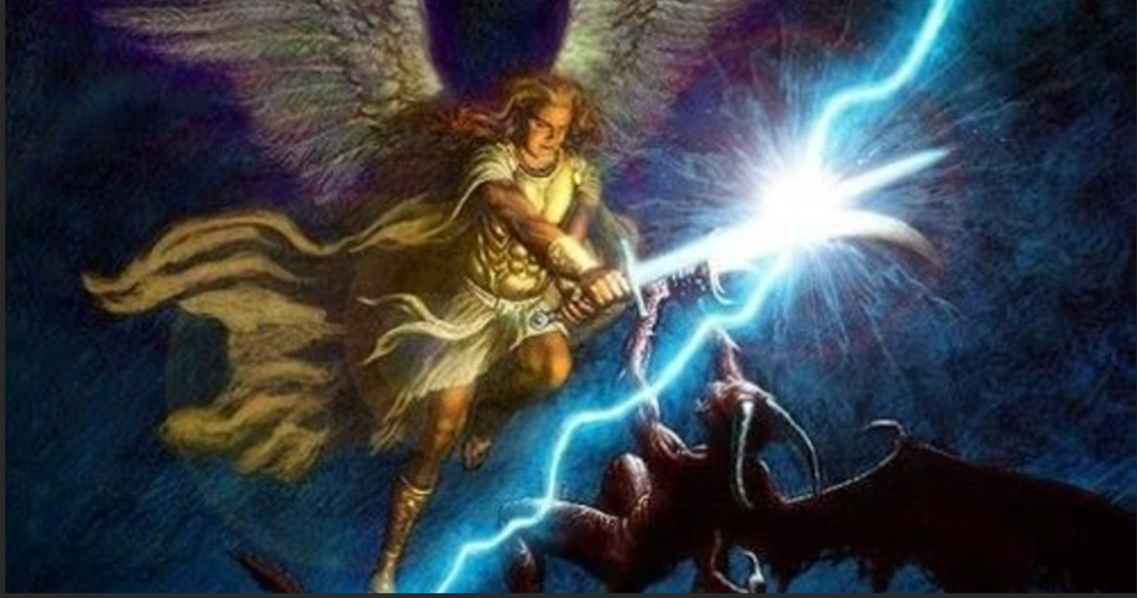
Yahusha
Messiah
of Light
or
Lucifer
the Deceiver
of Darkness

Slide 2
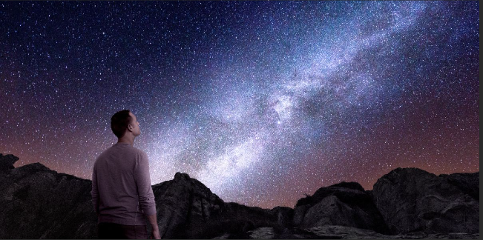
Why are we on earth and not in Heaven, and why do they call it a fallen world?

Slide 3
To understand the nature of this world that we are living in these last days, we need to understand what happened in the beginning.
9. Remember the former things of old,
For I am Yahuah, and there is no other;
I am Yahuah, and there is none like me,
10. Declaring the end from the beginning,
And from ancient times things that are not yet done,
Saying, ‘My counsel shall stand,
And I will do all My pleasure.
- Isaiah 46:9-10

Slide 4
Have ye not known?
Have you not heard?
Has it not been declared to you from the beginning?
Have you not understood from the foundations of the earth?
Isaiah 40:21

Slide 5
How far back should we be looking in order to understand what scripture refers to as the beginning?

Slide 6
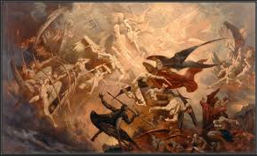

7.And war broke out in heaven: Michael and his angels fought with the dragon; and the dragon and his angels fought, 8.but they did not prevail, nor was a place found for them in heaven any longer.
9.So the great dragon was cast out, that serpent of old, called the Devil and s.a.tan, who deceives the whole world; he was cast to the earth, and his angels were cast out with him.
– Revelation 12:7-9

Slide 7
What was the reason for the war in heaven?

Slide 8
“Your heart was lifted up because of
your beauty;
You corrupted your wisdom for the
sake of your splendor;
I cast you to the ground,
I laid you before kings,
That they might gaze at you.
- Ezekiel 28:17

Slide 9
How did sin come into lucifer’s life, if there was no sin in heaven?

Slide 10
You were perfect in your ways from
the day you were created,
Till iniquity was found in you.
- Ezekiel 28:15

Slide 11
Lucifer thought that the new creation,
Earth and the heaven that earth resided in,
would be in his image … in His splendour.

Slide 12
Then he would discover the harsh reality …

Slide 13
And Yahuah said …
Let us make man in our image
- Genesis 1:26

Slide 14
What is Yahuah’s image?

Slide 15
…The workmanship of your timbrels
and pipes
Was prepared for you on the day
you (s.a.tan) were created.
- Ezekiel 28:13

Slide 16
You were perfect in your ways from the day you (s.a.tan) were created …
- Ezekiel 28:15

Slide 17
In the beginning Yahuah created the heavens and the earth
- Genesis/Bereshit 1:1 created – Brown-Driver-Brigg’s Hebrew Lexicon H1254 <bara’>

Slide 18
Praise Yahuah.
Praise Yahuah from the heavens;
Praise Him in the heights!
2. Praise Him, all His angels;
Praise Him, all His hosts!
3. Praise Him, sun and moon;
Praise Him, all you stars of light!
4. Praise Him, you heavens of heavens,
And you waters that be above the heavens!
5. Let them praise the name Yahuah;
For He commanded, and they were created.
- Ps 148:1-5

Slide 19
For He spoke, and it was done;
He commanded, and it stood fast.
- Psalm 33:9

Slide 20
I have declared the former things
from the beginning;
They went forth from my mouth, and I shewed them; I did them SUDDENLY, and they came to pass.
- Isaiah 48:3

Slide 21

So does this mean the Earth was already perfectly created before s.a.tan’s fall!?
But hold on … I thought the Earth was only created over 6 days i.e. creation week …

Slide 22
What does it mean to make man in his image?
Like Yahuah can create, man can procreate and s.a.tan hates that!

Slide 23
By the abundance of your trading
You became filled with violence within,
And you sinned;
Therefore I cast you as a profane thing
Out of the mountain of Yahuah;
And I destroyed you, O covering cherub,
From the midst of the fiery stones.
– Ezekiel 28:16

Slide 24
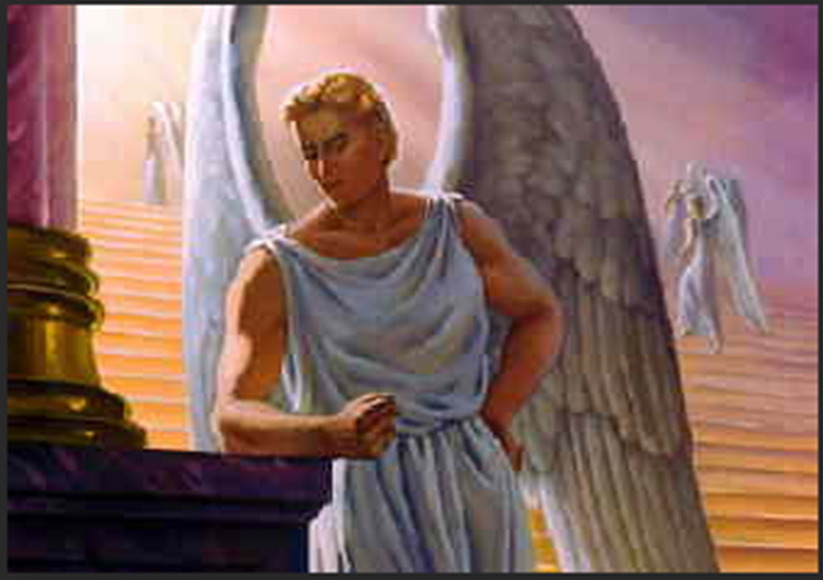
Here we can see Lucifer was angry.

Slide 25
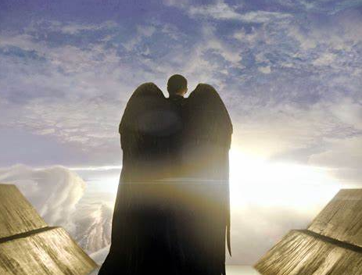


Slide 26
13. For you have said in your heart:
‘I will ascend into heaven,
I will exalt my throne above the stars of Yahuah;
I will also sit on the mount of the congregation
On the farthest sides of the north;
14. I will ascend above the heights of the clouds,
I will be like the Most High.
- Isaiah 14:13 - 14

Slide 27

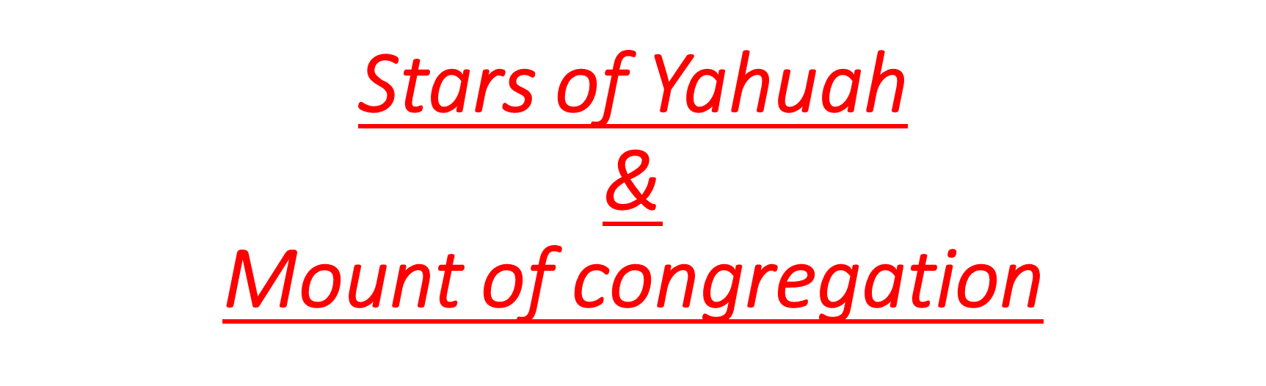

Slide 28
¹² How you are fallen from heaven,
O Lucifer, son of the morning!
How you are cut down to the ground,
You who weakened the nations!
¹³ For you have said in your heart:
‘I will ascend into heaven,
I will exalt my throne above the stars of Yahuah;
I will also sit on the mount of the congregation
On the farthest sides of the north;
¹⁴ I will ascend above the heights of the clouds,
I will be like the Most High.’
- Isaiah 14:12 - 14

Slide 29
The word congregation in verse 13 is the word Mo‘edim (H 4150).
This means s.a.tan plans to sit on:
Yahuah’s Feasts … Yahuah’s calendar(timing)

Slide 30
Remember ….
Mo’edim can mean:
Appointment of agriculture seasons, therefore the moon is appointed for agricultural seasons. The sun & moon are appointed together
(The moon is first ordained for agricultural appointed times on
creation's 4th day.)
2) Festivals as worship seasons; conventionally a year; by implication,
an assembly (as convened for a definite purpose); technically the
congregation; by extension, the place of meeting; also a signal
(as appointed beforehand).
3) Appointed times of breeding & migration of animals.

Slide 31
He shall speak pompous words against the Most High, shall persecute the saints of the Most High, and shall intend to change times* and law. Then the saints shall be given into his hand for a time and times and half a time.
– Daniel 7:25
*Note: ”times” is Aramaic <H2166, zemann; an appointed occasion> for the Hebrew <H4150, mo’ed>.

Slide 32
Who would hide this?!

Slide 33
Understanding the role lucifer held in Heaven

Slide 34
“You were the anointed cherub who covers;
I established you;
You were on the holy mountain of Yahuah;
You walked back and forth in the
midst of fiery stones.
- Ezekiel 28:14

Slide 35
And Yahuah said to s.a.tan,
“From where do you come?”
So s.a.tan answered Yahuah and said,
“From going to and fro
on the earth, and from walking
back and forth on it.”
- Job1:7

Slide 36
Did you know Lucifer was the morning star in Heaven?

Slide 37
“How you are fallen from heaven,
O Lucifer, son of the morning!
How you are cut down to the ground,
You who weakened the nations!
– Isaiah 14:12

Slide 38
Lucifer, son of the morning – Strong’s OT:1966; heylel; from OT:1984 (in the sense of brightness); the morning-star: KJV - lucifer (the king of Babylon).

Slide 39
Lucifer, son of the morning – Brown-Driver-Brigg’s H1966; heylel; Lucifer = "light-bearer" 1)
the shining one, the morning star, Lucifer.
Note: Others see the Hebrew – halal, heylel (haw-lal') – to be family terms to the word hallelujah, thus signifying Lucifer as heaven’s choir director, likely connected to the OT:1984 definitions of sing and praise. (See Eze 28:13 “… the workmanship of thy tabrets and of thy pipes …”)

Slide 40
And no wonder! For Satan himself transforms himself into an angel of light.
- 2 Corinthians 11:14

Slide 41
Lucifer knew that light came first, and he also knew that light is called day … then came the darkness (layil) of the night.
darkness OT:2822; [1] the dark; hence (literally) [2] darkness; figuratively, [3] misery, [4] destruction, [5] death, [6] ignorance, [7] sorrow, [8] wickedness: KJV - dark (-ness), [9] night, [10] obscurity. Remember, everything created in verse 1 would have been perfect. Most of the definitions of this particular darkness have nothing in common with anything done by our Creator.

Slide 42
He understood that the day started with light.

Slide 43
Then Yahuah said,
“Let there be light”;
and there was light.
Genesis 1:3
And Yahuah saw the light,
that it was good; and
Yahuah divided the light from the darkness.
– Genesis 1:4

Slide 44
Yahuah called the light Day, and the
darkness <layil> OT:3915 He called Night.
So the evening and the morning were the first day.
– Genesis 1:5
This was restoration of light

Slide 45
“Thus says Yahuah: ‘If you can
break My covenant with the day and
My covenant with the night, so that
there will not be day and night in their
season,”
- Jeremiah 33:20

Slide 46
What was the consequence of Lucifer
and the angels’ that chose to follow him
for their rebelliousness?

Slide 47
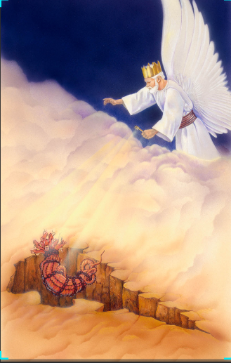


Slide 48
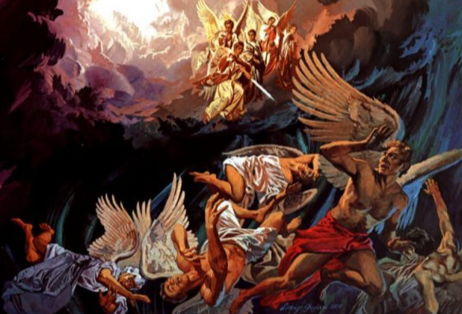


Slide 49
What happened to Lucifer and the angels that were cast out of heaven and what were they up to next?

Slide 50
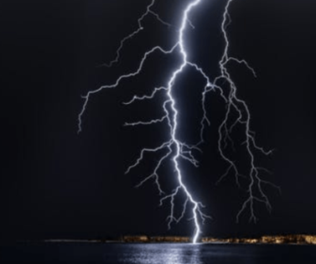
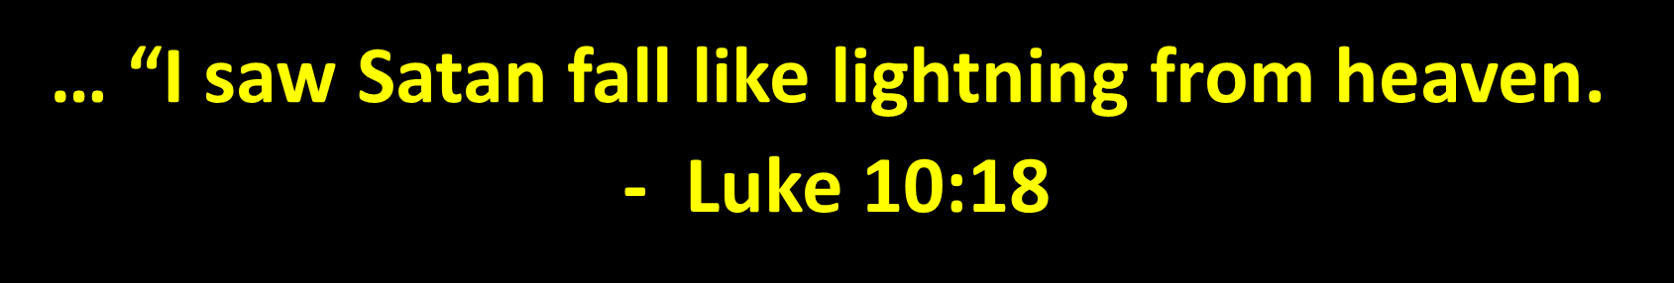

Slide 51
Here are some definitions for the word – “cast”
cast – Strong’s NT:906; ballo; a primary verb; to throw (in various
applications, more or less violent or intense): KJV - arise, cast (out),
dung, lay, lie, pour, put (up), send, strike, throw (down), thrust.
Compare NT:4496.
NT:4496 rhipto; a primary verb (perhaps rather akin to the base of
NT:4474, through the idea of sudden motion); to fling (properly, with
a quick toss, thus differing from NT:906, which denotes a deliberate hurl; and from
teino [see in NT:1614], which indicates an extended projection); by qualification, to
deposit (as if a load); by extension, to disperse: KJV - cast (down, out), scatter abroad,
throw.
Thayer's Greek Lexicon NT:906; balloo; to throw -- either with force, or without force
yet with a purpose, or even carelessly.
Notice where the sinful host were cast … “to the earth.”
to the earth – Strong’s NT:1093; soil; by extension a region, or the
solid part or the whole of the terrene globe: KJV - country, earth (-ly),
ground, land, world.

Slide 52
Note: When Lucifer/Satan and 1/3 of the angels were cast out of their heavenly home to the earth, they had to first pass through the “heavenly sphere (or waters) belonging to this earth” before violently connecting with the ground of the earth. Would that have resulted in a catastrophe?
This is something to think about.
Since his fall, s.a.tan is known as the “prince of this world” and the “prince of the power of the air.” John 12:31 Now is the judgment of this world: now shall the prince of this world be cast out. Eph 2:2 Wherein in time past ye walked according to the course of this world, according to the prince of the power of the air, the spirit that now worketh in the children of disobedience.

Slide 53
Genesis 1:2a
We are told a deep, intense darkness (OT:2822 – darkness (Choshek)) existed upon the deep (or abyss). Between verses 1 and 2, there is no written indication of Yahuah creating “this deep” ( or abyss).
And the earth came to be (OT:1961 – become[s].ת.י.ה(
without form (OT:8414 – chaos תהוֹ(
and void; (OT:922 - vacancy וֹבהוֹ(
and darkness was (OT:2822 - darkness חשך (
upon the face of the deep. (OT:8415 - abyss תהוֹמ(

Slide 54
Wait … so in the beginning Yahuah created everything perfectly, then when s.a.tan was thrown out of Heaven he destroyed the already created Earth and the heaven it was in … hence that the moon does not shine on its own …
If even the moon does not shine, …
- Job 25:5

Slide 55
By the way, have you ever noticed that
when there is lightning, there is thunder
and often there is some sort of damage?

Slide 56
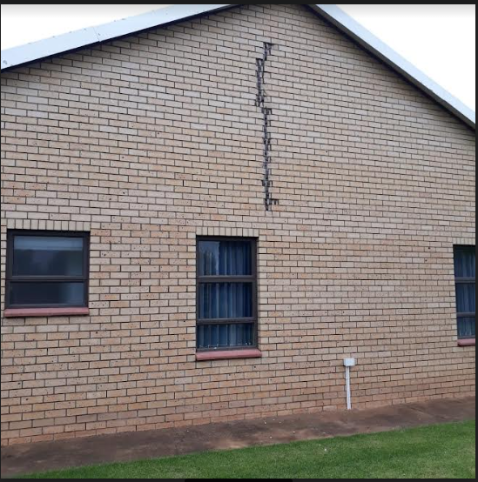

Slide 57
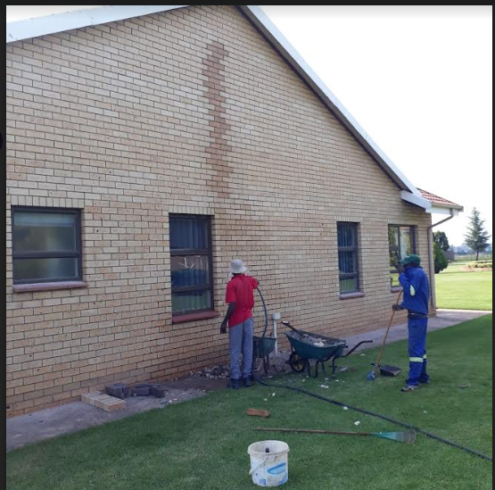

Slide 58
His tail drew a third of the stars of heaven and threw them to the earth. And the dragon stood before the woman who was ready to give birth, to devour her child as soon as it was born.
- Revelation 12:4

Slide 59
Lucifer hated everything Yahuah created
that not only did he want to destroy mankind
but also the angels, praise Yahuah that he was
only able to deceive one-third of the angels.

Slide 60
What accusation did Lucifer have
against Yahuah from the beginning?

Slide 61
“Have You not made a hedge around him,
around his household, and around all that
he has on every side? You have blessed the
work of his hands, and his possessions have
increased in the land.”
- Job 1:10

Slide 62
Therefore Lucifer accused Yahuah that
His creation only obeyed his command
because Yahuah provided for them, and that
if Yahuah removes the blessings, then his
creatures would curse Him.

Slide 63
Why is he still allowed to deceive us today
and why didn’t Yahuah destroy s.a.tan in the
beginning?

Slide 64
… ‘An enemy has done this.’
The servants said to him,
‘Do you want us then to go
and gather them up?’ But he
said, ‘No, lest while you gather
up the tares you also uproot
the wheat with them. Let both
grow together until the harvest,
and at the time of the harvest
I will say to the reapers,
“First gather together the tares and
bind them in bundles to burn them,
but gather the wheat into my barn.”
- Matthew 13:28-30

Slide 65
Beloved, do not think it strange concerning the fiery trial which is to try you, as though some strange thing happened to you;
- 1 Peter 4:12
In order that the proving of your belief – much more precious than gold that perishes, and proven by fire – might be found to result in praise and respect and esteem at the revelation of Yahusha ha’Mashiah,
- 1 Peter 1:7

Slide 66
Knowing that the testing of your faith produces patience.
But let patience have its perfect work, that you may be perfect and complete, lacking nothing.
- James 1:3-4
Blessed is the man who endures
temptation; for when he has been
approved, he will receive the crown
of life, which Yahuah has promised
to those who love him.
- James 1:12

Slide 67
For if Yahuah spared not the angels that sinned, but cast them down to hell, and delivered them into chains of darkness, to be reserved unto judgment;
And spared not the old world,
- 2 Peter 2:4-5
Yahuah knows how to rescue the
reverent ones from trials and to keep
the unrighteous unto the day of
judgment, to be punished:
- 2 Peter 2:9

Slide 68
Yahusha said to him,
“I am the way, the truth, and the life.
No one comes to the father except through Me.”
– John 14:6

Slide 69
No temptation has overtaken you except
such as is common to man; but Yahuah is
faithful, who will not allow you to be
tempted beyond what you are able, but
with the temptation will also make the way
of escape, that you may be able to bear it.
– 1 Corinthians 10:13

Slide 70
14. And no wonder!
For s.a.tan himself transforms himself
into an angel of light.
15. Therefore it is no great thing if his
ministers also transform themselves
into ministers of righteousness,
whose end will be according to their works.
- 2 Corinthians 11:14 -15

Slide 71
His tail drew a third of the stars of heaven
and threw them to the earth. …
– Revelation 12:4

Slide 72
Would this not be the reason why this had to happen, why Heaven & Earth were created and that we had to go through this ordeal and trial?!

Slide 73
Does the fact that the Messiah
Yahusha died on a tree for us, give us right of passage to eternal life?

Slide 74
My people are destroyed for lack of knowledge.
Because you have rejected knowledge,
I also will reject you from being priest for Me;
Because you have forgotten the law (Torah) of your Elohim,
I will also forget your children.
- Hosea 4:6

Slide 75
And to completely restore to favour both of them unto Elohim in one body through the stake, having destroyed the ENMITY by it.
– Ephesians 2:16.

Slide 76
What was the reason for Yahusha’s crucifixion?
18. Knowing that you were not redeemed with corruptible things, like silver or gold, from your aimless conduct received by tradition from your fathers, 19. but with the precious blood of Mashiah, as of a lamb without blemish and spotless, 20. foreknown, indeed, before the foundation of the of the world, but manifested in these last times for your sakes,
- 1 Peter 1:18-20

Slide 77
You were the anointed cherub who covers; I established you
You were on the
holy mountain of Yahuah
You walked back and forth in the midst of fiery stones.
- Ezekiel 28:14 -15

Slide 78
Definition of pyramid is
“fire in the midst”.
Pyramid - Prye = fire; Mid = middle ; "fire in the middle"
And furthermore, as the dictionary points out, "pyre" is often a "a piled up fire used for cremating a corpse" and "a fire for purification rituals"
from Latin pyra, from Greek pura hearth, from pur = fire]
So we have Pyramids having a fire in the middle for the purpose of purification or transformation.

Slide 79
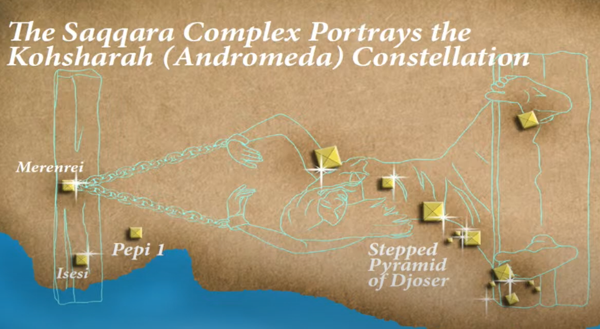
Located in Egypt, some 30 km (19 mi) south of modern-day Cairo, Saqqara covers an area of around 7 by 1.5 km (4.3 by 0.9 mi).

Slide 80
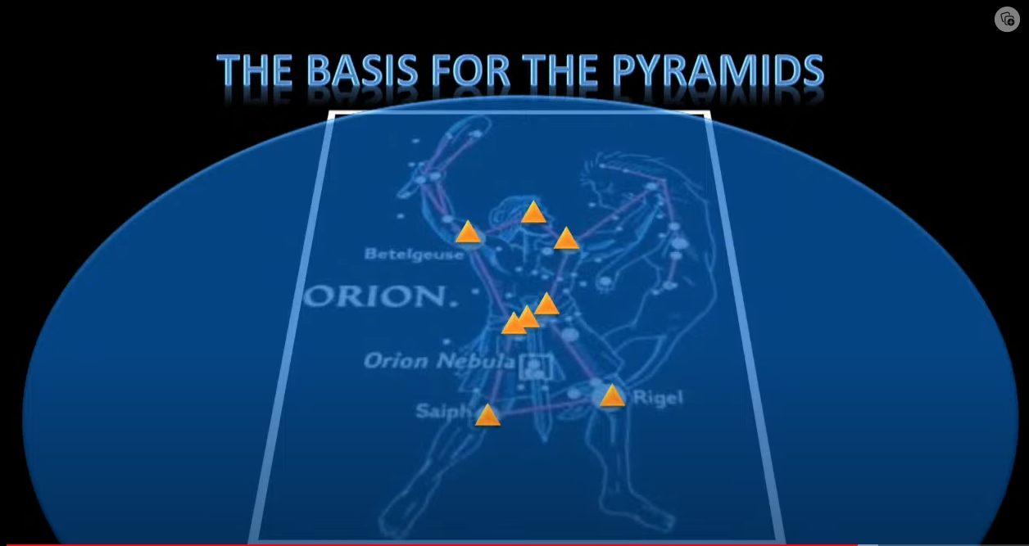

Slide 81
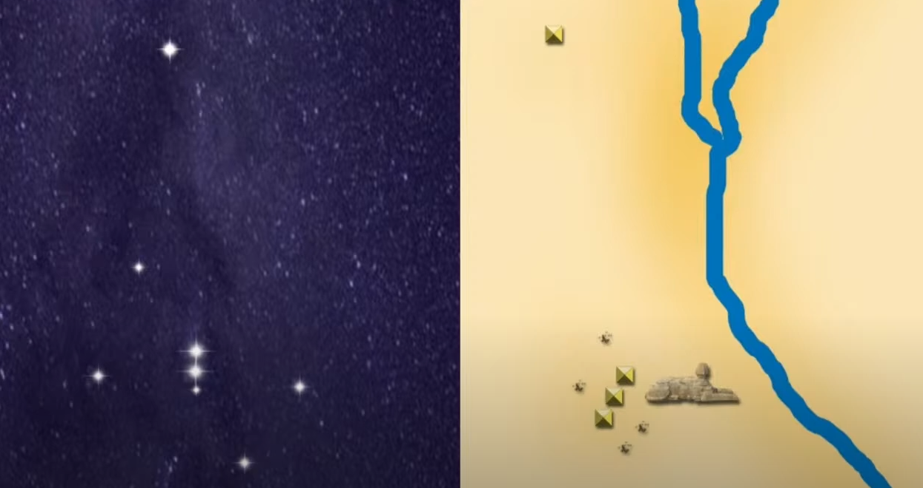


Slide 82
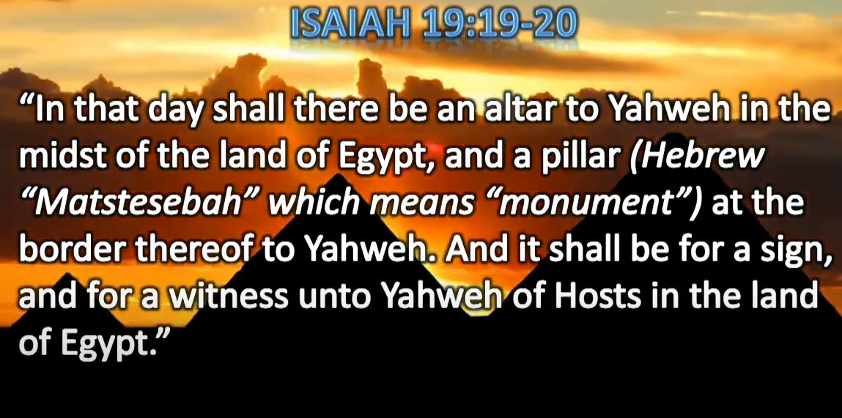

Slide 83
“These words Yahuah spoke to all your
assembly, in the mountain from the
midst of the fire, the cloud, and the thick
darkness, with a loud voice; and He
added no more. And He wrote them on
two tablets of stone and gave them to me.
- Deuteronomy 5:22
…fiery stones.
Ezekiel 28:14

Slide 84
When I went up into the mountain
to receive the tablets of stone,
the tablets of the covenant which
Yahuah made with you, then I stayed
on the mountain forty days and forty
nights. I neither ate bread nor drank
water.
- Deuteronomy 9:9

Slide 85
4. And Moses wrote all the words of Yahuah.
And he rose early in the morning, and
built an altar at the foot of the mountain,
and twelve pillars according to the
twelve tribes of Israel. 5. Then he sent
young men of the children of Israel,
who offered burnt offerings and sacrificed
peace offerings of oxen to Yahuah.
6. And Moses took half the blood and
put it in basins, and half the blood he
sprinkled on the altar.

Slide 86
7. Then he took the Book of the Covenant
and read in the hearing of the people.
And they said, “All that YAHUAH has said
we will do, and be obedient.” 8. And Moses took
the blood, sprinkled it on the people, and said,
“This is the blood of the covenant which Yahuah
has made with you according to all these words.”
Exodus 24:4-8
This represents the blood ratified Covenant Calendar!

Slide 87

But wait a minute … weren’t we taught that Yahuah spoke only the 10 commandments …
and that was all that was given to the people …

Slide 88
Then they said to Moses, “You speak with us,
and we will hear; but let not Yahuah speak with us,
lest we die.” 20. And Moses said to the people,
“Do not fear; for Yahuah has come to test you,
so that you may not sin.” 21. So the people stood
afar off, but Moses drew near the thick darkness where
Yahuah was.
- Exodus 20:19-21
From verse 22 the rest of the covenant was given to Moses to pass the rest of the covenant to the Israelite nation!

Slide 89
This shows that the Father and Son represent the covenant, the fiery stones represent the 12 stars of Yahuah.

Slide 90
So if Lucifer knows about Dawn start
of the day and the appointed
times/statutes of Yahuah, then what
does Yahuah allow Satan to use for
spiritual deception?

Slide 91
For we do not wrestle against flesh
and blood, but against principalities,
against powers, against the rulers of the
darkness of this age, against
spiritual hosts of wickedness in the
heavenly places
- Ephesians 6:12

Slide 92
  “How you are fallen from heaven,
  O Lucifer, son of the morning!
  How you are cut down to the ground,
  You who weakened the nations!
  ¹³ For you have said in your heart:
  ‘I will ascend into heaven,
  I will exalt my throne above the stars of Yahuah;
  I will also sit on the mount of the congregation
  On the farthest sides of the north;
  ¹⁴ I will ascend above the heights of the clouds,
  I will be like the Most High.’
  - Isaiah 14:12-14

Slide 93
And there appeared a great wonder in heaven; a woman clothed with the sun, and the moon under her feet, and upon her head a crown of twelve stars:
² And she being with child cried, travailing in birth, and pained to be delivered.
³ And there appeared another wonder in heaven; and behold a great red dragon, having seven heads and ten horns, and seven crowns upon his heads.
⁴ And his tail drew the third part of the stars of heaven, and did cast them to the earth: and the dragon stood before the woman which was ready to be delivered, for to devour her child as soon as it was born.
⁵ And she brought forth a man child, who was to rule all nations with a rod of iron: and her child was caught up unto Yahuah, and to his throne.
⁶ And the woman fled into the wilderness, where she hath a place prepared of Yahuah, that they should feed her there a thousand two hundred and threescore days.
⁷ And there was war in heaven: Michael and his angels fought against the dragon; and the dragon fought and his angels,
- Revelations 12:1-7

Slide 94
What do these
heavenly bodies represent spiritually?

Slide 95
If sacred regard is given to the sun and/or the moon for any reason, is this classed as worship?
If the sighting of the sun and/or moon are part of setting your worship calendar, is that action regarded as worship or serving?

Slide 96
Sun-day keeping giving homage to the sun god.
Sighting the Sun-set to give homage to the sun god.
And sighting their new moon for their festal month start giving homage to the moon god.

Slide 97
Sunday Christians honour their day of worship
on Sunday giving homage to the sun god.
Sabbath keepers honour their day of worship
beginning with the sighting of sun-set and the
night before Sabbath – giving homage to the
sun god – Set.
Wikipedia
Set is a god of deserts, storms, disorder, violence, and foreigners in ancient Egyptian religion. In Ancient Greek, the god's name is given as Sēth. Set had a positive role where he accompanies Ra on his barque to repel Apep, the serpent of Chaos. Set had a vital role as a reconciled combatant. He was lord of the Red Land, where he was the balance to Horus' role as lord of the Black Land.

Slide 98
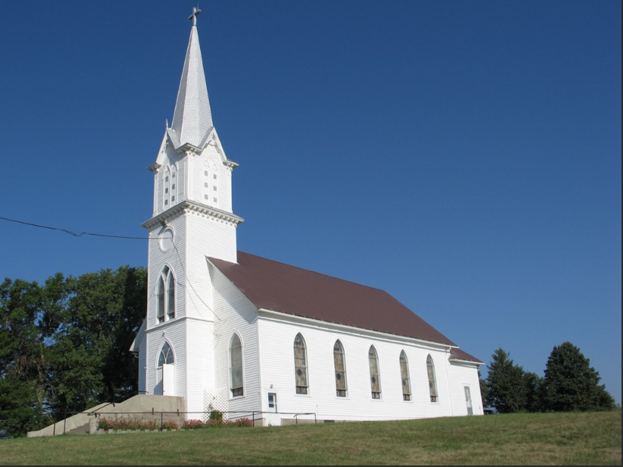

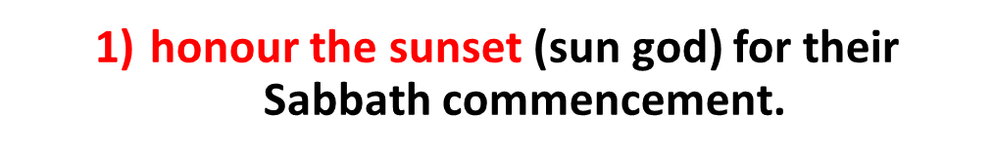
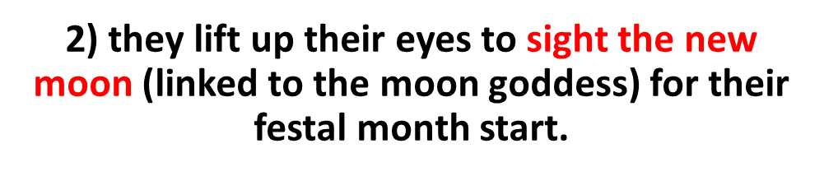

Slide 99
Apostasy Among Yahuah’s People
(630 BC)
I will stretch out My hand against Judah, And against all the inhabitants of Jerusalem.
I will cut off every trace of Baal from the place,
The names of the idolatrous priests with the pagan priests,
Those who worship the host of heaven on the housetops;
Those who worship and swear oaths by Yahuah,
But who also swear by Milcom(Ammonite god); Those who have turned back from following Yahuah
And have not sought Yahuah, nor inquired of him.”
- Zephaniah 1:4-6

Slide 100
What About a Conspiracy Theory Against Moses’ commands in Deuteronomy 4 & 17?
“If there is found among you, within any of your towns that Yahuah your Elohim is giving you … who does what is evil in the sight of Yahuah … in transgressing his covenant, and has gone and served other gods and worshipped them, or the sun or the moon or any of the host of heaven, which I have forbidden, and it is told you and you hear of it … and if it is true and certain that such an abomination has been done in Israel, then you shall bring out to your gates that man or woman who has done this evil thing, and you shall stone that man or woman to death with stones.”
- Deuteronomy 17:2-5

Slide 101
Who would hide these two commands?

Slide 102
Now that it’s clear Lucifer was the highest appointed angel in heaven, the morning star, which proves he knew that a day starts at dawn before sun rise and not at sun-set, he knew exactly how the mount of Yahuah/ appointed times worked.

Slide 103
Many Jews don’t read their Bibles.
They rely on the 613 commandments and the Talmud.
Is it possible that the key to
Yahuah’s calendar is being strategically
hidden from us, and them?
“Woe to you lawyers!
For you have taken away
the “key” of knowledge. …
- Luke 11:52

Slide 104
The key …
Tequfah
(Vernal spring equinox – Northern Hemisphere)
And it came to pass at the end [H8622 Tequfah] of the year [H8141 Shaneh],
- 2 Chronicles 24:2
Every good gift and every perfect gift is from above, and comes down from the Father of lights, with whom there is no variation or shadow of turning.
- James 1:17

Slide 105

Its like the stop sign … you first see the stop sign then you stop! So the Tequfah is the stop sign and then the next day is the 1st day of the new year.

Slide 106
When did Moon Worship start?
Was Moon Worship a “change” of Yahuah’s “times”?
The answer to these questions goes all the way back to Babylon, after the flood.
When Nimrod died, he was the first human that became deified as the sun god, eventually named baal.
His wife, Semiramis, became the moon goddess while she was alive (also named Ashtoreh).
Tammuz, the illegitimate son, became the false messiah.
These are the 3 main false gods of s.a.tan.
Where does this lead us to!?

Slide 107
There are Five major religions in the world today.
Christianity … which is centred in sun worship.

Slide 108
The other four …
2) Judaism
3) Islam
4) Hinduism
5) Buddhism
But did you know … these four establish their worship calendar on the moon.

Slide 109
Something to think about !
Its is the glory of Yahuah
to conceal a matter,
But the glory of kings is
to search out a matter.
– Proverbs 25:2

Slide 110
Righteous covenant versus the evil covenant
“Now therefore, if you will indeed obey My voice and keep My covenant, then you shall be a special treasure to Me above all people; for all the earth is Mine. 6. ‘And you shall be to Me a kingdom of priests and a holy nation.’ These are the words which you shall speak to the children of Isreal.”
– Exodus 19:5
“You shall make no covenant with them, nor with their gods.
– Exodus 23:32

Slide 111
Serving two masters
No one can serve two masters; for either he will hate the one and love the other, or else he will be loyal to the one and despise the other. You cannot serve Yahuah and mammon.
– Matthew 6:24

Slide 112
Sacrificing to demons
Therefore, my beloved, flee from idolatry. Speak as to wise men; judge for yourselves what I say. The cup of blessing which we bless, is it not the communion of the blood of Yahusha?
- 1 Corinthians 10:14 - 22
Why Flee from Idolatry?
Because we cannot serve 2 masters?

Slide 113
The end

