Slide 1
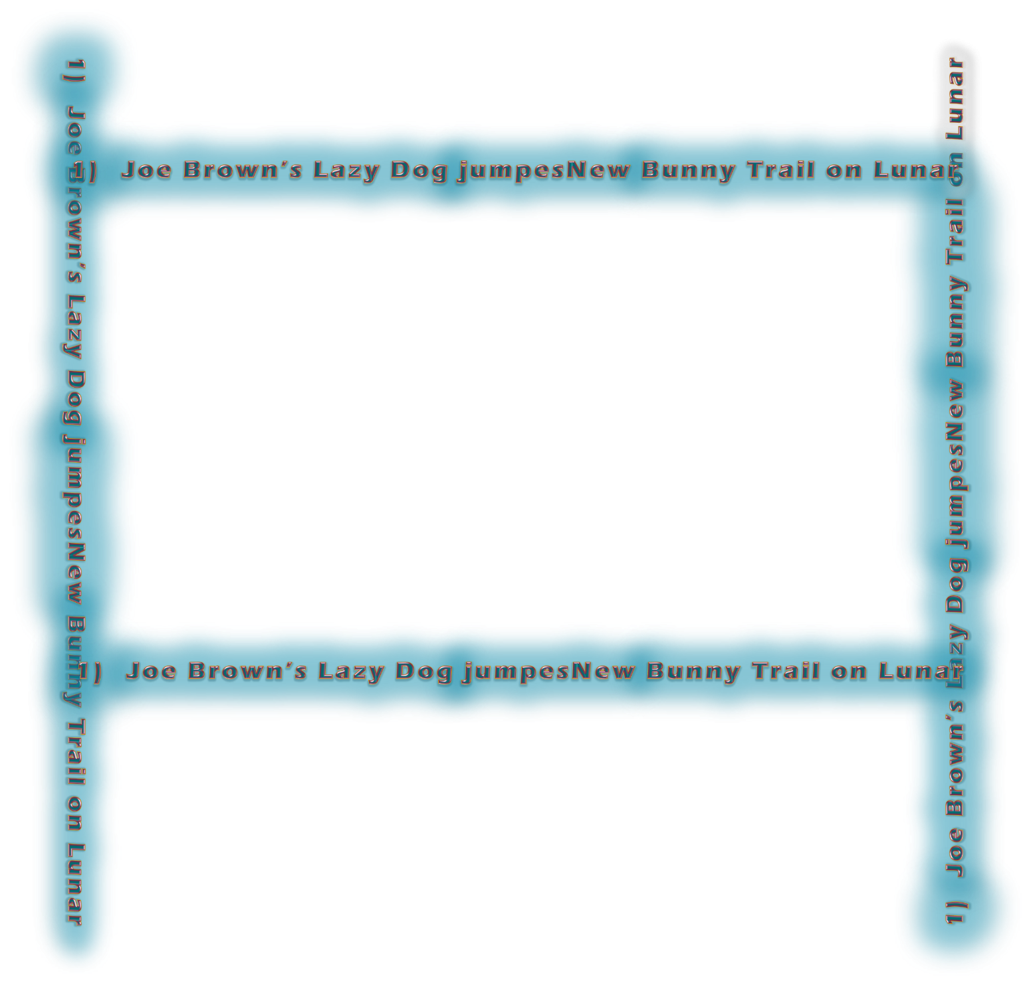
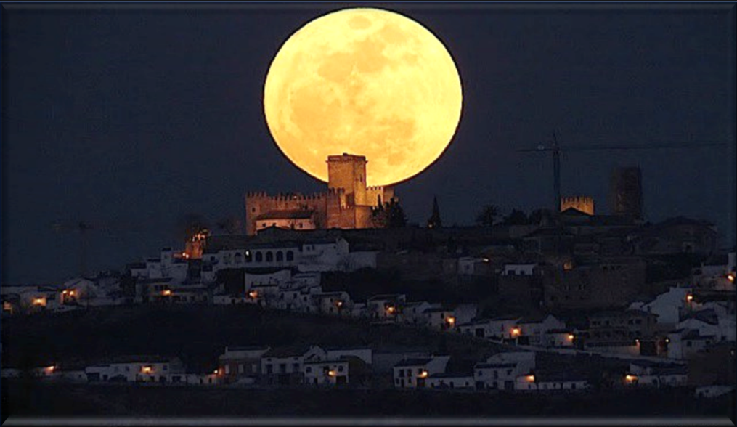

Emailed Edit 2 to Tim Jan 13/23. He may not have time to look at it till Monday.
1-15-23 Tim got to slide 26 – going slow to follow the new paradigm shift. New file is Edit 3; e: 550 pm
1-16-23 CF edit 4 – removed the 6 calendar slides – they are hidden at the end for now. New ending slide – to introduce part 2. I only checked the comment boxes today and the “new look” is appearing wonderfully. Emailed to Tim 440 pm Jan 16th.
1-17-23 from TA: slide 4 [6 now?]: should there be a little pic of a sliver moon on this slide? That is DIRECTLY what I am pointing to by the thistle comparison. The THORNS of lunar worship! Emailed 510 pm – edit 5 this time.
1-17-23 Edit 6 – Tim got to slide 60 … A few odds and ends to take care of. Emailed 930 pm.
1-22-23 Edit 8 – 1 pm [cf] I went through ever slide – emailed edit 8 to Tim at 3 pm. Back at 7 pm and sent edit 9 to tim at 715 pm … just slides 21 & 73.
1-23-23 – back to me and now edit 10 seems to be the final copy. Slide 73 deleted. CF added some spacing on sentence on slide 21 – is all. TA to let me know if I should start on the teaser.
1-30-23 – don’t release files and blurbs to Neil until the numbering system gets fixed on you-tube – sundial has to be added, files numbers are incorrect – email sent today. Files are made and ready to go.
Yahusha’s Contempt
for the Jews’
Lunar Feast of Tabernacles
John 7 Part 1
Notes:
5.9b Yahusha’s Contempt for the Jew’s Feast of Tabernacles Pt 1 [82 slides] TA 28 Jan 2023
Launched:
5.9b Website:
5.9b Youtube:
5.9b Blurb: John is the favorite Gospel for many people for various reasons. Why is this? At Covenant Calendar Club, we know why John is a favorite Gospel for just about every calendar teaching. This is because John records details of many events that the synoptic Gospels are completely silent on. Even in the Covenant Calendar studies, John is very detailed so that his studious readers can tell exactly Who the true Messiah is, and exactly what set-apart appointed times He kept. In Part 1 there are a lot of questions to be asked to prepare us if Yahusha is following Torah, or not. And if He isn’t, then would that be considered rebellion? Notice the very interesting clues that John gives for this extra-ordinary record of the unbelieving Jews’ Feast of Tabernacles. It will prepare you for Part 2 and we’re quite sure you’ll want to “Come and See.” Shalom!

Slide 2

If ever, in your journey, you have HEARD -
“Yahusha observed the Feasts of the Jews,” and wondered if in fact it were true, and desired Scriptural evidences, then this study in John 7, will be of
GREAT INTEREST to you.

Slide 3
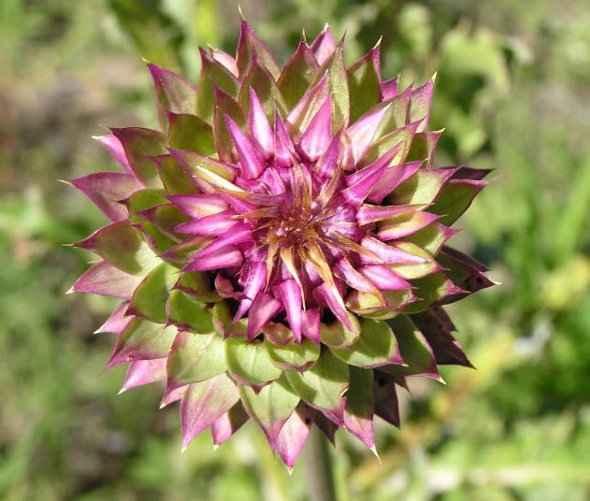
Yahusha addresses the
Lunar
Based
Calendar
John 7

Slide 4
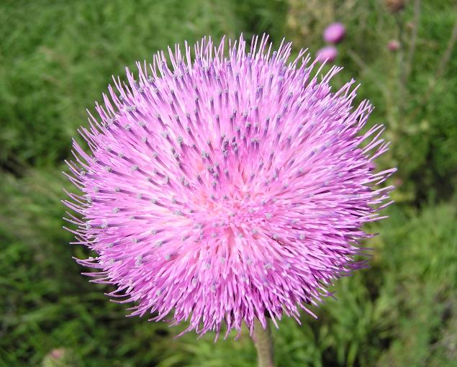
The appearance of the flower of this thistle is most beautiful.

Slide 5
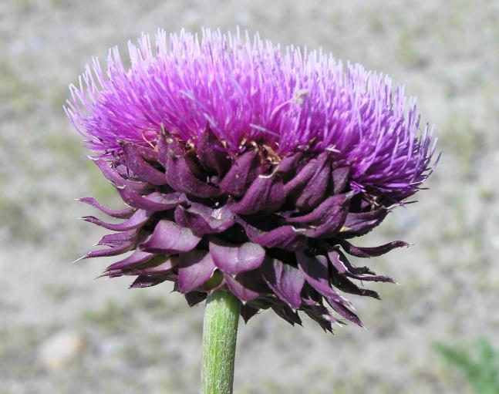
The top surface portrays exquisite beauty.
Just below the surface is a more rugged look.

Slide 6
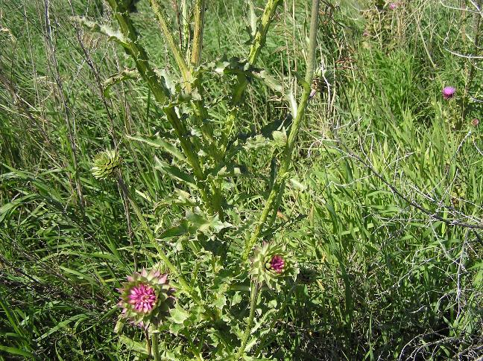
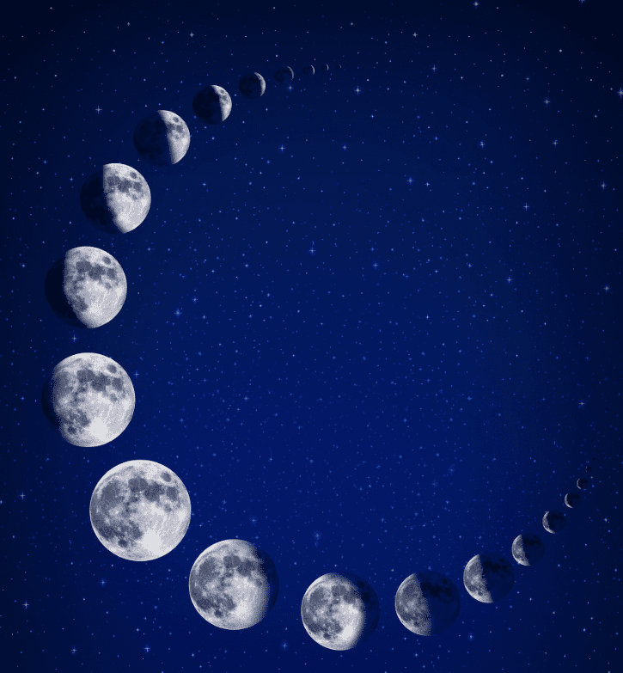
The deeper investigation reveals the location of the darker features.
The thorns that impale are in full abundance.
They are an integral part of this plant.
(Pun intended.)
The Lunar Deception was intentionally “planted”! Lunar THORNS invariably IMPALE Salvation’s invitation for us.
Treat it like
a salad &
TOSS IT!

Slide 7
Important! - The Blood Ratified Covenant Calendar of Yahuah has zero lunar connections. It is NOT a luni/solar calendar but a Mazzaroth facilitated, LIGHT BASED, Counted calendar!
Have we applied sufficient attention to the documentations addressing the lunar based calendar
from the Testimonies of the Tanach (Old Testament)?
Are there witness texts within the Scriptures that will give us a clear view of the solar vs lunar calendar controversy? Clues that we can directly connect in the life of Yahusha?
Will the life AND DEATH of Yahusha on this earth reveal knowledge on this highly contentious subject?

Slide 8
Was Yahusha in agreement with the
TIMING of the Feasts of the Yehudim (Jews)?
The book of John gives us a great place to begin.
John 7:1 And after this יהושע [Yahusha] was walking in Galil, for He did not wish to walk in Yehuḏah, because the Yehuḏim were seeking to kill Him.
John 7:2 And the festival of the Yehudim [Jews] was near, the Festival of Booths [Sukkot/Tabernacles],
John 7:3 So His brothers said to Him, ‘Get away from here and go into Yehuḏah, so that Your taught ones also see the works that You are doing.
John 7:4 “For no one acts in secret while he himself seeks to be known openly. If You do these works, show Yourself to the world.”
Paraphrased: Show us your works! Prove your worth!

Slide 9


Question
Why do the Scriptures declare –
...the festival of the Yahudim [Jews]...?
Leviticus tells us very clearly to Whom the Feasts and Festivals belong.
Why then do the Scriptures record this festival as one that belongs to the Yahudim?

Slide 10
Yahusha’s Brother’s Unbelief
John 7:5 For even His brothers did not believe in Him.
John 7:6 יהושע [Yahusha] therefore said to them, “My time [Yahuah’s Covenant Calendar] has not yet come, but
YOUR time [lunar based calendar]
is always ready.”
Question: Is it possible that the calendar of the 2nd Temple era was designed and adjusted according to the declared belief standards of the Jews – very similar to the lunar-solar calendar of - today?
G2092 – ready/ adjustable
Always - through lunar manipulation!

Slide 11
Important Questions
Why did Yahusha declare the Feast of the Jews to His brothers as “YOUR” time?
Yahusha is the One who Inspired the documentation within the Tanach (Old Testament).
Is it likely that we will find the same style of terminology used there too?
Why on earth would Yahusha intentionally distance Himself
from a Feast that was originally commanded by Yahuah?
Is not the Feast of Sukkot (Tabernacles) found in Exo 23:16, which is the Everlasting Covenant upheld under the Melki-Tzedek Administration?
Does the Festival in John 7, by Torah statute, require ALL MALES, to attend?

Slide 12
Your Time = Your Appointed Times
Yahusha spoke to His brothers and told them that THEIR TIME was ready.
But His Time – A WORLD CLASS EVENT STATEMENT - was - not yet!
What did Yahusha mean by this? Let’s look into Isaiah’s writings.
Isa 1:12 “When you come to appear before Me, who has required this from your hand, to trample My courtyards?
Paraphrased: - Who has taught you to desecrate My Principles?
Isa 1:13 “Stop bringing futile offerings, incense, it is an abomination to Me. New Moons, Sabbaths, the calling of meetings – I am unable to bear
What was it about these different (foreign) Sabbaths and assemblies that Yahuah emphatically despised?
UNRIGHTEOUSNESS AND ASSEMBLY.

Slide 13
Isaiah Continued
Isa 1:14 “My being hates YOUR New Moons and YOUR appointed times, they are a trouble to Me, I am weary of bearing them.
Isa 1:15 “And when you spread out your hands, I hide My eyes from you; even though you make many prayers, I do not hear. Your hands have become filled with blood.
Isa 1:16 “Wash yourselves, make yourselves clean; put away the evil of your doings from before My eyes.
Questions: What characteristic personalized THEIR Sabbaths, assemblies, THEIR “New Moon” and appointed times, that was a
to Yahuah?
From WHOM did this evil characteristic derive?
Stop doing evil!
?!
SERIOUS EVIL OFFENCE

Slide 14
“Your” – in Amos
Amos 5:21 “I have hated, I have despised YOUR festivals, and I am not pleased with YOUR assemblies.
Tell me please – were the Yisra’elites observing Feasts and Festivals that were opposed to the commands within the Everlasting Covenant?
Amos 8:9 “And it shall be in that day,” declares the Master יהוה [Yahuah], “that I shall cause the sun to go down at noon, and shall darken the earth on a day of brightness,
Amos 8:10 and shall turn YOUR festivals into mourning, and all YOUR songs into lamentation, and bring sackcloth on all loins, and baldness on every head, and shall make it like mourning for an only son, and its end like a day of bitterness.”

Slide 15
“Your” – in Malachi
Mal 2:3 “See, I shall rebuke your seed, and scatter dung before your faces, the dung of YOUR festivals. And you shall be taken away with it.”
Will we receive the message that there is something profoundly sinister about these events that Yahusha will have absolutely nothing to do with?
Why does He “pin” these events on humans? Yahuah did after all command His followers to observe the Feast and Festival assemblies!
Will we be able to discern a characteristic which Yahusha displayed in His life pertaining to His observing of the Feasts, a profound declaration supported by His actions {His – FEET?}, that will provide a clue to this mystery?

Slide 16

Was Yahusha obligated to observe any of the lunar calendar feasts?
Also; was Yahusha required
by statute to be at the temple
in Jerusalem for the lunar feast?
What about His FEET??
For SERIOUS Consideration:

Slide 17
Back to Yahusha ’s Conversation with His Brothers
John 7:7 “It is impossible for the world to hate you, but it hates Me because of it, [from a LIGHT based calendar viewpoint] that its (the 2nd Temple era traditional teachings) works
are wicked.
John 7:8 “You go up to this festival. I am not yet going up to this festival, for
has not yet been filled.”
According to Yahusha’s words in verse 8, it sounds like He is referring to the
Tequfah based Covenant Calendar for Sukkot timing. Yet - is He?
If that is so, why should Yahusha go and observe the Jew’s Lunar Sukkot/Tabernacles Festival when the Torah appointed, Qodesh (Set-Apart) LIGHT based designated time for Sukkot, is at a completely different time?
I bear witness
MY TIME [Blood Ratified Covenant Calendar Appointment]

Slide 18
Yahusha Witnesses? HOW!
Yahusha tells us in no uncertain terms –
When Yahusha actually physically witnesses to a situation, what is it that you would expect to notice? Would a very clear DISCERNABLE DISCREPANCY between the tradition of the Pharisees and the Torah Truth be exposed to us?
Could Yahusha’s witness extend even to a very physical example?
Will His witness pass unnoticed – VEILED BEFORE OUR EYES?
I am, and will, give you evidence through of this insidious evil!
My Witness

Slide 19
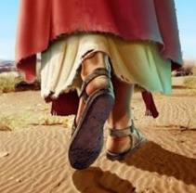
Yahusha refrains from going...
Was this a - WITNESS?
John 7:9 And having said this to them, He stayed in Galil.
Is this verse indicating to us that Yahusha from being required to obey the statutes and attend Appointed Times of Yahuah?
It APPEARS on the surface that Yahusha was ignoring the statute based command that need to present themselves before Yahuah at the Appointed Times – Mo-edim! (Reference specifically Exo 23:17.)
Exo 23:17 “Three times in the year your males are to appear
before the Master יהוה [Yahuah].
Could Yahusha’s FEET be AS IMPORTANT as His Tongue?
had an exemption
ALL MALES
ALL

Slide 20
Is there any place
in the Scriptures
where we learn that
Yahusha need not observe
the will of His Father?
What factor gave Yahusha the authority to “skip out” from
presenting Himself to the
Father at this LUNAR Sukkot?
More
Questions:

Slide 21
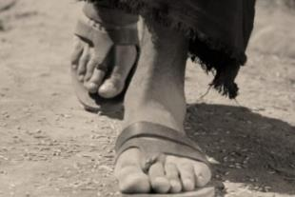

The Brother’s action: – Their WITNESS!
John 7:10 But when His brothers had gone up to the festival,
The brothers “feet” were witnesses to them delivering THEIR ALLEGIANCE to the lunar system of worship!
One does NOT need to be “on the knees, hands folded,”
to “deliver allegiance to the moon”! Quite the contrary, our “OUR FEET” reveal to whom
our service is dedicated!
BE CAREFUL
LITTLE FEET
WHERE YOU TREAD!

Slide 22
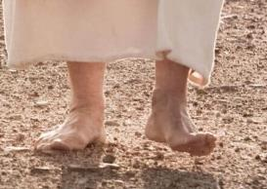
Yahusha’s FEET - WITNESS
John 7:10 But when His brothers had gone up to the festival,
then He also went up, not openly, but as it were in secret.
At the Feast, we learn in verses 11-12, the Yehudim (Jews) were wondering where Yahusha was, and were searching
for Him.
The Yahudim understood the statute that ALL MALES WERE TO PRESENT THEMSELVES BEFORE YAHUAH 3 TIMES PER YEAR, as written in Exodus 23:17.
The Jews were fully expecting Yahusha to observe their Feast.
Where was Yahusha Ha Mashiach?
When did Yahusha arrive at the Feast?
Was Yahusha Witnessing?

Slide 23
Working slide for a new calendar table:
In the next few slides a calendar table is given for
the days of the Feast of Tabernacles/Sukkot. Please note:
The blue numbers from 15-22 are the dates of Sukkot & the Last Great Day.
The black numbers only number the seven cycles of Sukkot.
There is a “middle” cycle in the 7 day feast of Sukkot. The green blocks indicate “about” the “midst of the week” as John has written.
Shemini Atzeret
Last Great Day
15 1 | 16 2 | 17 3 | 18 4 | 19 5 | 20 6 | 21 7 | 22 The Last Great Day
Again note: The 1st block does not indicate this “cycle”
is a 1st cycle/Sunday, nor that the 15th cycle of the 7th month is on a Shabbat. This is the same for all 8 cycles.

Slide 24
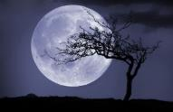
Feast of the Yahudim (Jews) #1
Lunar 7th Month; the Seven Days of Their Sukkot
John 7:6 יהושע [Yahusha] therefore said to them, “MY TIME has not yet come,
Lunar & Human Manipulation
but Your Time
is ALWAYS ready.”
Shemini Atzeret
Last Great Day
ONE Covenant Calendar
Set-Apart Appointment
Sukkot Feast of the Yahudim!
15 1 | 16 2 | 17 3 | 18 4 | 19 5 | 20 6 | 21 7 | 22 8
Yahusha was
“ON TIME” for
His Premier Cycle.
MIDST of the Feast of the Yahudim - John 7:14
Which “cycle”
was it, and what
type of Cycle was it?

Slide 25

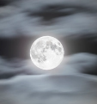
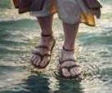
Sukkot Feast of the Yahudim (Jews) #2
But when His brothers had gone up to the festival,
up, not openly, but as it were in secret.
John 7:1o
John 7:11 The Yehuḏim, therefore, were seeking Him at the
festival, and said,
THEN He also went
15 1 | 16 2 | 17 3 | 18 4 | 19 5 | 20 6 | 21 7 | 22 The Last Great Day
“Where is He?”
Will the Roman Calendars with Lunar Sukkot dates document the Lunar 7/18 as a weekly Shabbat?

Slide 26

Yahusha – AWOL From Yahuah’s Feast?
To this date, there has not been a text found advising us that Yahusha was exempt from obeying the Torah Statutes of Exo 23:16, 17!
  Exo 23:16 “And the Festival of the Harvest, the first-fruits of your labours which you have sown in the field; and the Festival of the Ingathering at the outgoing of the year, when you have gathered in the fruit of your labours from the field.”
  Exo 23:17 “Three times in the year ALL your males are to appear before the Master יהוה [Yahuah].”
What Scriptural right did Yahusha have to be from
the first Shabbat of the Lunar Sukkot (Tabernacles) ??
absent

Slide 27
Did Yahusha purposely OPT OUT from the lunar festival of the Jews?
John 7:14 And about the MIDDLE of the festival יהושע [Yahusha] WENT UP into the Set-apart Place, and He was teaching.
What could possibly be Yahusha’s reasoning for arriving in the middle of the Jews’ Festival?
What Scriptural Calendar Reckoning could Yahusha cite that would still reckon Him SINLESS, - in alignment with Yahuah’s will, and justify being absent for the first part of the lunar festival
of the Yahudim? Could it be - OBEDIENCE??
2 Witnesses!

Slide 28
Did Yahusha Arrive “Late” - or - “Right On Time”?
John 7:6 יהושע [Yahusha] therefore said to them, “MY TIME has not yet come,
John 7:14 And about the יהושע [Yahusha]
went up into the Set-apart Place, and He was teaching.
but Your Time is always ready.”
G2092 hetoimos
ADJUSTABLE
What Time?
Lunar Sukkot Feast of the Yahudim!
15 1 | 16 2 | 17 3 | 18 4 | 19 5 | 20 6 | 21 7 | 22 LAST GREAT DAY
Are days 3-4-5 about the “midst” of Sukkot week?
Or, was Yahusha On Time for this “middle day” of their Sukkot week?
middle of the festival

Slide 29
Is Yahusha Allowed to Arrive “Late” to a Lunar Feast?
John 7:14 And about the יהושע [Yahusha] went up into the Set-apart Place, and He was teaching.
Lunar Based
Feast of the Yahudim!
15 1 | 16 2 | 17 3 | 18 4 | 19 5 | 20 6 | 21 7 | 22 LAST GREAT DAY
MIDDLE of the festival
What LEGAL right does Yahusha Ha Mashiach claim from the Scriptures that rightfully allowed Him to miss out on the first part of this Lunar Sukkot (Tabernacles) –
AND NOT BREAK THE STATUTES OF EXODUS 23:17?

Slide 30
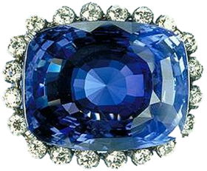

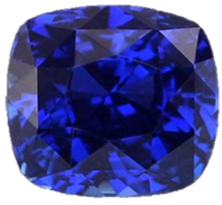
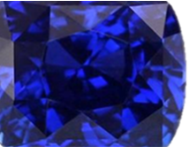
Yahusha’s Legal Right!
John 7:8 “You go up to this festival. I am not yet going up to this festival, for My Time has not yet been filled.” The Scriptures
Where do we find “Yahusha’s Time”?
Covenant Calendar – Gen 1:1 to Exo 24:11! ☺
What? Why?
How? & Where?
In the LIVING

Slide 31
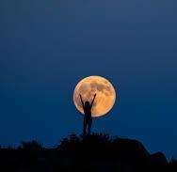

Melki-Tzedek Witness
or Lunar Confusion?
Covenant Festivals begin with the
John 7 Sukkot started here!
?
Mazzaroth!
Teach us to number our days … Ps 90:12

Slide 32
Yahusha’s Covenant Sukkot Time – Leviticus 23
Lev 23:24 “Speak to the children of Yisra’ĕl, saying, ‘In the seventh month, on the first day of the month, you have a rest, a remembrance of blowing of trumpets, a set-apart gathering.
Lev 23:34 “Speak to the children of Yisra’ĕl, saying, ‘On the fifteenth day of this seventh month is the Festival of Booths for seven days to יהוה [Yahuah].’ ”
When Yahusha said – “… For My Time has not yet been filled ...” it is these “times” found in the Torah, that must be fulfilled completely. Yes, even by Yahusha Himself!
Was Yahusha required to be in the temple on lunar festival timing, or, only on His timing?

Slide 33
Determining the Start of the Year for Covenant Calendar
To determine the 7th month correctly, the very first day of the year must be ascertained first.
There are 10 verses in the Tanach that indicate very clearly what celestial event develops, ending Yahuah’s year. One is Exo 34:22 in which the autumnal tequfah (equinox) signals final events of Yahuah’s worship calendar year.
6 Months prior to John 7 is the spring tequfah (equinox) which ushers in the start of the new year. If this is not realized specifically by the Torah instructions, the Feasts and Festivals will not be on Yahuah’s Qodesh (Set-Apart) Calendar.
Yahusha was living out the Torah and His Time was according to the tequfah (equinox) system for determining the new year (in 29 CE of John 7).
The Pharisees (Yahudim) of the second Temple era were observing times by the lunar calculations – beginning the year with the new moon after the equinox.
Yahusha could not, and would not, observe feasts of Yahuah on a lunar based calendar.

Slide 34
Yahusha – declares His METHOD of Witnessing
John 10:25 יהושע answered them, “I have told you, and you do
not believe.
they
concerning Me.
The WORKS that I DO
in My Father’s Name,
BEAR WITNESS
Have we been studying thoroughly enough to catch His WITNESSING events?

Slide 35
Yahusha’s FEET - SPEAK!
John 10:25 יהושע answered them, “I have told you, and you do
not believe. in My Father’s Name,
they concerning Me.
John 10:26 “But you do not believe, because you are not of My sheep, as I said to you.
John 10:27 “My sheep hear My voice, and I know them, and they follow Me.”
The WORKS that I DO
Listen to
HIS FEET!
BEAR WITNESS

Slide 36

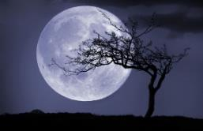
Did Yahusha WITNESS, OPPOSING the lunar based worship system of the 2nd Temple?
From where did Yahusha receive His DIRECTIVES?

Slide 37
Yahusha - a Witness for Yahuah
How can we know that Yahusha is testifying for Yahuah’s will?
Yahusha was teaching the people and they were amazed at the depth of understanding being delivered to them.
What was His response to their inquiry of where He received His knowledge?
John 7:16 יהושע [Yahusha] answered them and said, “My teaching is not Mine, but His who sent Me.”
Can we verify this from the Torah?
!

Slide 38
Yahuah Speaks to Mosheh – Your Clue
Deut 18:18 ‘I shall raise up for them a Prophet like you out of the midst of their brothers. And I shall put My Words in His mouth, and He shall speak to them all that I command Him.
Deut 18:19 ‘And it shall be, the man who does not listen to My Words which He speaks in My Name, I require it of him.’
With this information in mind, when Yahusha told His brothers –
from Whom did these words originate?
“My Time has not yet come ...”

Slide 39
Teaching by example, or just simple conversation?
When Yahusha told His brothers – “My Time has not yet come...” is it possible He was alluding to an imposter LUNAR calendar issue which was being enforced by the high priest at that time? Would that be the imposter high priest that later tore his faulty priestly garment? !!
Was Yahusha TEACHING his brothers with WORDS instilled in Him from Yahuah (Deut 18:18), and also by walking out His PHYSICAL EXAMPLE?
Let’s read His words further in the same conversation with His brothers –
John 7:17 “If anyone desires to do His desire, he shall know concerning the teaching, whether it is from Elohim, or whether I speak from Myself.
John 7:18 “He who speaks from himself is seeking his own esteem, but He who seeks the esteem of the One who sent Him is true, and no unrighteousness is in Him.”

Slide 40
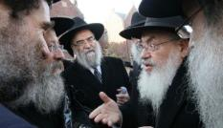
Yahusha’s Example
Luke 24:27 And beginning at Mosheh [Torah] and all the Prophets, He was explaining to them in all the Scriptures the matters concerning Himself.
Yahusha tells us (John 7:17) if we truly desire to know His Ways,
we will be given that understanding.
So, if we are truly desiring to be on the correct Worship Calendar of Yahuah, would it be appropriate to search the Torah for information
exposing – “MY TIME”????? (Reference to John 7:6.)
Or, shall we blindly accept the Rabbinical Luni/Solar calendar named the
“Hebraic Calendar” which is formulated and promoted by Judaism today?
Derek

Slide 41
Yahusha’s Example #2!
Luke 24:27 And beginning at Mosheh [Torah] and all the Prophets,
He was explaining to them in all the Scriptures the matters concerning Himself.
Why is it that we DO NOT read: And beginning at - Enoch - ?
Why is it that the Scriptures do NOT consider the books of Enoch as Truth?
Could it be that the evidences of the numerous books of Enoch (that all vary from each other), exposing they were written shortly prior to Yahusha living on this earth and through His lifetime; could these evidences be factual?

Slide 42
Yahusha’s HAMMER
John 7:19
“Did not Mosheh give you the Torah?
Yet not one of you the Torah!
Why do you seek to kill Me?”
Note: “DOES” is an action word, not a belief value. Physical steps must be taken to fulfill this word. What physical actions were the Pharisees, either innocently or intentionally, going afoul with by
observing their Feasts (the feasts of the Yehudim)?
Read also - Matthew 5:20. What is it that we need to be doing that
“exceeds” that of the Scribes and Pharisees?
What declaration from Yahusha should send red flags blazing into
the sky before our eyes?
DOES
!

Slide 43
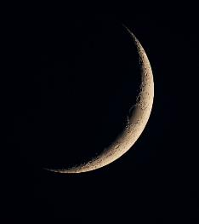
The Key of Knowledge removed!
?!
Luke 11:52 “Woe to you learned in the Torah, because you took away the key of knowledge. You did not enter in yourselves, and those who were entering in you hindered.”
Connection: The context of this conversation from Yahusha to His brothers, in John 7, is – What timing characteristic were the Scribes and Pharisees observing, which
had efficiently defiled the Torah?
Here in Luke 11, Yahusha is outlining
some of the things where the
Pharisees are going astray from
the Word.
timing.
DIS-Obedience!?

Slide 44

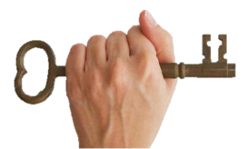

A key is a vital piece of information that opens
the portal to knowledge.
Question:
What is the “key of ”
that Yahusha was referencing?
Where in the Scriptures do we find
a description of infinite knowledge?

Slide 45
Yahuah tells us where to find KNOWLEDGE
Ps 19:1 The heavens are proclaiming the esteem of Ěl; And the expanse is declaring the work of His hand.
Ps 19:2 Day to day pours forth speech, And night to night reveals
Ps 19:3 There is no speech, and there are no words, Their voice is not heard.
Ps 19:4 Their line has gone out through all the earth, And their words to the end of the world. In them He set up a tent for the
Ps 19:5 And it is like a bridegroom coming out of his room, It rejoices like a strong man to run the path.
Ps 19:6 Its rising is from one end of the heavens, And its circuit to the other end; And naught is hidden from its heat.
Exodus 34:22 And thou shalt observe the feast of weeks, of the firstfruits of wheat harvest, and the feast of ingathering at the year's end.
1 Samuel 1:20 Wherefore it came to pass, when the time was come about after Hannah had conceived, that she bare a son, and called his name Samuel, saying, Because I have asked him of the LORD.
2 Chronicles 24:23 And it came to pass at the end of the year, that the host of Syria came up against him: and they came to Judah and Jerusalem, and destroyed all the princes of the people from among the people, and sent all the spoil of them unto the king of Damascus.
Psalms 19:6 His going forth is from the end of the heaven, and his circuit unto the ends of it: and there is nothing hid from the heat thereof.
KJV
knowledge.
THE MAZZAROTH
sun,
Tequfah

Slide 46

What KNOWLEDGE are we searching for?
contains the full accurate
outline in detail, of this
The Mazzaroth’s Tequfah is the “centering pin” which determines
the start of Yahuah’s new worship year.
The Tequfah is the ultra specific celestial event which places us on
the correct schedule to receive the full blessings of Yahuah!
When we accept the removal of the Tequfah, Yahuah’s “centering pin
of timing” and we follow along in the pagan lunar traditions, we then
have placed ourselves on the Adversary’s schedule.
The Dragon claimed in Isaiah 14:13 & 14 that he would control the Mo-edim.
By accepting the lunar traditions, we accept the Dragon’s usurped authority!
THE MAZZAROTH
Knowledge; the complete Plan of Salvation!

Slide 47
Questions
Why is the sun given prominence by receiving a special designated DWELLING PLACE (Ps 19:4) within the Master Time Clock – which is - The Mazzaroth – of Yahuah?
The sun’s tabernacle or - DWELLING PLACE in the Mazzaroth is the beginning and ending point of its circuit in the heavens – the Tequfah.
Many have been taught that the moon is the guiding light to start
the Worship year to Yahuah. Why then is there no mention of this supposed “all important figure” in the Mazzaroth – which is the Ultimate Eternal Master Time Clock of Yahuah? No mention that is, UNTIL REV 12:1 WHERE BETHULA STANDS ABOVE THE MOON!

Slide 48
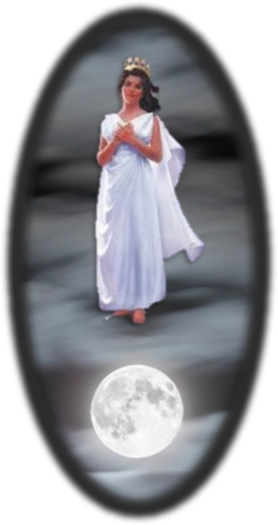

Seen approximately every third Sept 23 – Bethula, THE Bride of Yahusha, is NOT STANDING ON THE LUNAR PLATFORM OF THE MOON! (THIS IS A PAGAN RELIGIOUS FALSE DOCTRINE.)

Slide 49
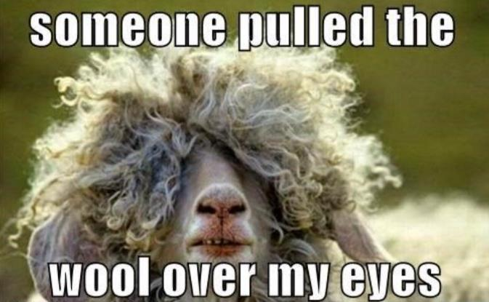
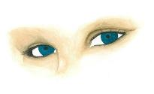
Final Question
Is it possible that the wool has been pulled over our eyes – AGAIN?
Jer 16:19 … Surely our fathers have inherited lies, vanity,
and things wherein there is no profit.

Slide 50
The Mazzaroth Constellations = Infinite Knowledge
Job 38:31 Do you bind the bands of Kimah, [Pleiadies] or loosen the cords of Kesil [Orion]?
Job 38:32 Do you bring out the constellations [Mazzaroth] in its season? Or do you lead the Bear [Arcturus] with its sons?
The Mazzaroth is the Master Time Clock of Yahuah! He used this system of determining time at the start of the Hebrew nation – see Genesis 17, 18, 21:2. Yahuah does not change.
The Yisra’elite’s exodus from Mitsrayim (Egypt) was timed by the Appointed Times (Mo-edim) which is governed by the Mazzaroth.
The entire plan of Salvation - within the Mazzaroth Constellations - as written
in the sky, passes by - every 24 hours.
KJV

Slide 51

Keys to Knowledge – Mazzaroth’s Rulership
Immediately after Job writes about the Mazzaroth in verses
31 & 32, he asks –
Job 38:33 Knowest thou the ordinances of heaven? canst thou set the dominion thereof in the earth? KJV
Job 38:33 Do you know the laws of the heavens? Or do you set The Scriptures
Job references the Mazzaroth, then within a question clearly indicates their commission for dominion over the earth! What Dominion?
The Mazzaroth has absolute governing control as the commissioned
TIME CLOCK of Yahuah over eternity.
their rule over the earth?

Slide 52
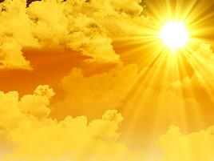
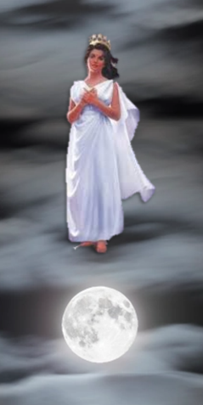

A Celestial Position Comparison
The Scriptures (Psalms 19:4) informs us that the sun has been
given a designated permanent residence within the Mazzaroth.
It is an ohel (H168), a dwelling place.
What physical position, in a spiritual sense, has been
applied to the moon in the final days of the earth?
Rev 12:1 And a great sign was seen in the heaven:
a woman clad with the sun,
and on her head a crown of twelve stars.
the moon under her feet,

Slide 53

Questions:
Have you considered the Scriptural concept
of the position “UNDER THE FEET” ?? ??
Is it a position of authority? Is it a solid platform
for a truthful belief system as many have been
coerced into accepting – without questioning it?
  For Scriptural insight/examples on this
  positioning – ask for –
It might not be as many have been previously taught !! !!
Standing On The Moon.

Slide 54
Mazzaroth Constellations
Twelve!
There are twelve Mazzaroth Constellations that expose
the full and complete plan of Salvation in the sky.
One constellation for each month of the year.
One Constellation for each month of the year that the Tree of Life produces fruit, as written in Revelation 22:2. Revelation tells us that there are twelve fruits. Let’s read it carefully –
Rev 22:2 In the midst of the street of it, and on either side of the river, was there the tree of life, which bare twelve manner of fruits, and yielded her fruit every month: and the leaves of the tree were for the healing of the nations. KJV
There is not a 13th constellation, nor a 13th month!!!

Slide 55
There are – TWELVE –
TWELVE fruits on the tree of life
TWELVE Mazzaroth Constellations
TWELVE captains reserved for taking care of Solomon’s kingdom – one for each month (1 Chron 27:1).
TWELVE tribes of Yisra’el
TWELVE hours in a Light Season declared by Yahusha – John 11:9
TWELVE months in prophetic years – (30 cycles per month)
TWELVE months in the year of Noah’s flood (proven 30 cycles per month)
TWELVE months in the year when Joshua entered Canaan
TWELVE months in the year when Yahusha stood up to speak on “that Last Great Day” of Sukkot/Tabernacles – John 7:37
TWELVE months in the year of Yahusha’s Ultimate Sacrifice

Slide 56
QUESTION -
WHERE IS A 13TH MONTH –
WITH A SECOND WITNESS AS
REQUIRED BY YAHUAH?
  WHERE?

Slide 57
The Next Set Of QUESTIONS -
Is it possible that Yahusha arrived at the Jews’ Feast of Sukkot in the middle of their celebration because He could NOT observe their Lunar Sukkot (Tabernacles) and stay within the statutes of
Is this what Yahusha meant when He said to His brothers –
“...My time has not yet been filled”? John 7:8 (HalleluYah Scriptures)
Was Yahusha fulfilling the Covenant Calendar by WITNESSING AGAINST the which was “PLANTED” after the death of Hezekiah?
Is the Metonic Cycle, the same lunar based calendar that is recorded by the Zadokite priests of Qumran; the one they so vehemently abhorred because it had insidiously crept into the 2nd Temple era worship traditions?
Is this lunar based calendar one of the reasons why the Essenes of Qumran abandoned the Tabernacle for their seclusion from evil traditions, and also the imposter leadership derived from the Hasmonean period leading into the 2nd Temple era?
Yahuah’s Will?
Metonic Cycle

Slide 58

Observation: the lunar system of worship was
PLANTED!
From whom do we find the lunar original seed?
The seed of
TOHU & BOHU!

Slide 59
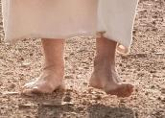

IN OPPOSITION TO - ?
Did Yahusha OPPOSE -
John 7:7 “It is impossible for the world to hate you, but it hates Me - because
I bear witness of it,
that its works are wicked.”
Are we just reading our Scripture? Or are we EXAMINING AND INTERNALIZING - Yahusha’s “feet speaking”?
Man’s Metonic Cycle?
Listen to His Feet!

Slide 60
What about a second witness - from Yahusha?
Yahusha is TWELVE years old! His parents took Him to “the” Passover.
Please note very carefully, the wording of this next text.
Luke 2:42 And when He was twelve years old, they went up to Yerushalayim The Scriptures
Question: Have you ever questioned why the Scriptures tell us it was according to the practice of the festival – instead of saying – according to the Torah?
Luke 2:42 And when he was twelve years old, they went up to Jerusalem after the custom of the feast. KJV
What, and/or who, set the customs of this feast of the Yehudim (Jews)?
according to the practice of the
festival.

Slide 61
“customs of the feast” – “A Mistake in translation?”
The Scriptures are very clear and quite eager to tell us exactly when the Torah is being followed.
Luke 2:27 And he came in the Spirit into the Set-apart Place. And as the parents brought in the Child יהושע [Yahusha], to do for Him
Luke 2:39 And when they had accomplished all matters
of יהוה [Yahuah], they returned to Galil, to their city Natsareth.
according to the usual practice of the Torah…
according to the Torah

Slide 62
Two Ideals - SIDE BY SIDE - a Visual, Psychological and
Contextual Separation
Luke 2
... according to the practice of the festival
... according to the Torah of יהוה [Yahuah]

Slide 63

Context – “...practice of the festival”
Luke 2:43 When they had accomplished the days, as they returned, the Child יהושע [Yahusha] stayed behind in Yerushalayim. And His parents did not know it.
The Scriptures
DO NOT SAY
“When they had fulfilled the Torah...”
By CONTEXT: are we to understand = When they had accomplished
THE DAYS, that this ALSO was in accordance with the
LUNAR BASED festival of the Yahudim?
Yahusha’s parents then: outright - left Him behind. This factor
ACCENTED the platform for Yahusha to fulfill RIGHTEOUSNESS
in accordance with the Torah, which is - Yahuah’s Will.

Slide 64
Something to think about:
Was Yahusha divinely
“left behind” to bring His parents “back” to Jerusalem during the Covenant time
of the Passover festival?
accented your words. Yes, this could have been the beginning of their belief transformation. YET, THEY STILL DID NOT KNOW YAHUSHA WAS GOING TO DIE! THEY STILL HAD A SERIOUS VEIL! STILL!!!!!!!!!!!
Another question:

Slide 65
Something else to ponder:
Might Yahuah have instilled in Yahusha’s parents, an intense passion through a “lost child,”
(“lost” in their LUNAR VEILED eyes);
to be purposely positioned by Yahuah,
expressly to
learn a Valuable Lesson in Righteousness
from Yahusha’s position – IN THE TEMPLE -
on the Covenanted Calendar’s timing?

Slide 66

CLARIFICATION
Yahusha was not simply in the LOCATION
of the temple at age 12; which occurred 3 cycles AFTER the lunar based feast of the Yahudim.
Yahusha exacted the POSITION
to ASSERT AUTHORITY
through RIGHTEOUSNESS !
Might this highly unique event have occurred
on an extremely IMPORTANT “DAY”?

Slide 67
Just a trivial accident? Or Torah Fulfillment?
When Yahusha’s earthly parents “forgot” about Yahusha and left on their return home journey, was this just a coincidental act of forgetfulness,
Wording this differently –
When Yahusha was found discovered by His parents in the Tabernacle, what was Yahusha’s response, and does it correspond to the teachings found in the Torah?
Again – When Yahusha was discovered, “after three days” (Luke 2:46),
witnessing to His Father’s Blood Ratified Covenant Calendar in the Tabernacle,
was He appropriately –
John 1:1 In the beginning was the Word, and the Word was with Elohim, and the Word was Elohim.
or was the Torah deliberately being fulfilled?
“Living the Torah?”

Slide 68

Yahusha’s Response to the Inquiry -
The Inquiry –
Luke 2:48 And having seen Him, they were amazed. And His mother said to Him, “Son, WHY have You done this to us? See, Your father and I have been anxiously seeking You.”
Yahusha’s Response –
Luke 2:49 And He said to them, “Why were you seeking Me?
Did you N-O-T K-N-O-W that
I had to be in the MATTERS of My Father?”
At age 12: Was Yahusha’s presence in the temple on “Covenant Timing” or the “Jewish timing” that was “the custom of the day”?

Slide 69
“The Matters” of the Father - Yahuah
Exo 23:14 “Three times in the year you are to observe a festival to Me:
Exo 23:15“Guard the Festival of Unleavened Bread. Seven days you eat unleavened bread, as I commanded you, at the time appointed in the month of Aḇiḇ – for in it you came out of Mitsrayim [Egypt] – and do not appear before Me empty-handed;
Exo 23:16 “and the Festival of the Harvest, the first-fruits of your labours which you have sown in the field; and the Festival of the Ingathering at the outgoing of the year, when you have gathered in the fruit of your labours from the field.
Exo 23:17 “Three times in the year ALL YOUR MALES are to appear before the Master יהוה [Yahuah].”

Slide 70
Another Thought
Did Yahusha [12 yrs] have a
much better understanding of the Exo 23 passage
than his mother Mary?
Or was this the beginning of a “belief transformation”
for Mary as she began to realize exactly who Yahusha was?

Slide 71
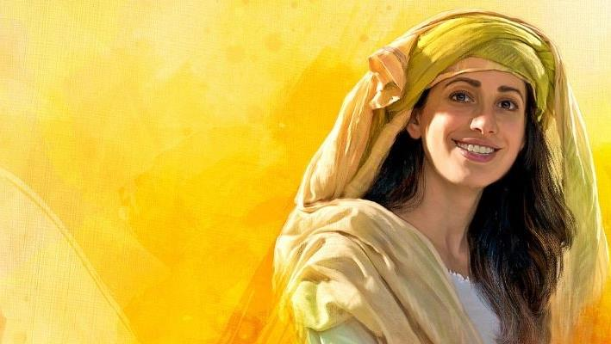
What About Mary?
The mother’s were not commanded to “go up to the Jerusalem temple” for the feasts.
Question:
Is it possible that Mary remained at home each year, as she was in the presence of the Messiah?
Is it possible that eventually
Mary realized that the
lunar feasts at “the temple”
were not the “feasts of Yahuah”?
What did Yahusha eventually say in John 7?

Slide 72

A Knee Jerk Response? OR -
In John 7:7 when Yahusha said –
“I bear WITNESS of it that its
works are WICKED.”
Was this just a quick answer from no where?
Or,
Was Yahusha actually telling us that He indeed provided us with His FOOT STEPS IN REAL LIFE,
of His INTENTIONAL LIFE ACTIVITIES –
“I came to FULFILL” - working for [and through] the Living Covenant Calendar, which was BLOOD RATIFIED by the 75 Hebrew Elders on Mt Sinai?

Slide 73
What “on earth” was Yahusha thinking? #2
The questions we then need to ask ourselves are –
1. By NOT observing the first Shabbat of the Feast of the Yahudim (Jews), did Yahusha incur a sin upon Himself?
2. Since Yahusha is deemed - sinless, what circumstance allows Him to skip the first Sabbath of the Feast of the Yahudim (Jews) and yet remain sinless?
Back to John 7:18: the context of TIMING (midst of the Festival, v:14) has just been set by Yahusha, then when questioned by the Yahudim, Yahusha declares to them outright that THEY DO NOT THE TORAH!
Yet they were all there observing their Sukkot Feast of the Yahudim!
What part of the Torah prevents the Feast of the Yahudim from being observed according to the statutes of Yahuah?
DO

Slide 74
What “ON EARTH” is this situation?
According to Yahusha -
There is a circumstance which inevitably prevents
the Yahudim from observing the Torah correctly.
Does this same optional lunar tradition effectively exclude Yahusha from Yahuah’s wrath when He began teaching
in the tabernacle
in the MIDDLE of THEIR Feast?

Slide 75
ON EARTH!!
Man’s OPTIONAL lunar worship deviant device!
AGAIN -
Does this same voluntary circumstance of
TRADITION
effectively exclude Yahusha from having incurred sin by entering at the
MIDDLE of THEIR Feast?
We have yet to find out what cycle of the week
was in the middle of THEIR Feast! A Shabbat?

Slide 76
Yahusha’s Contention!
Question: Was Yahusha IN AGREEMENT with the Metonic Cycle - the luni/solar calendar of the imposter 2nd Temple hierarchy?
Or, have the Scriptures efficiently exposed an obvious difference in observing Mo-edim between the Yahudim, - and Yahusha?
Recall the last slide: the VOLUNTARY LUNAR TRADITION CREATES
A CIRCUMSTANCE WHICH –
REMOVES YAHUSHA FROM BEING HELD ACCOUNTABLE by the Feast of the Yahudim!
PREVENTS THE YAHUDIM FROM OBSERVING THE TORAH!
“Yet of you does the Torah!” John 7:19!!!
NOT ONE

Slide 77
Questions
Why was Yahusha not conforming to the lunar/solar calendar of the 2nd Temple era in 29 CE? And what about CE 30?
Would there be any connection to the destruction of Jericho the very center of moon worship?
Would there be any connection with the order to Gideon to
destroy Zebah and Tsalmunna, moon worshipping leaders of
their people?
What about when Gideon retrieved the moon crescent
pendants from their camels necks which then became a snare
to Gideon later in life?
Is there a lesson here? Can we learn from these examples?

Slide 78

Next time you are asked –
Is there any proof of Yahusha being
NOT in agreement with the lunar based
calendar, in the Messianic Testament (NT) –
What will your answer be?
Next time you are asked –
How do we know Yahusha observed the Covenant Calendar
(while living on this earth) as it is recorded clearly in the
flood account with Noah, and the exodus from Mitsrayim?
What will your answer be? Might you say – FEET?
Shall we look at some Scriptural evidence that Yahusha was definitely NOT IN AGREEMENT WITH THE LUNAR SYSTEM OF WORSHIP?

Slide 79



What to Expect in Part 2
We will examine the scriptural evidence in Part 2 very specifically:
cycle by cycle,
week by week,
7th day Shabbat by 7th day Shabbat,
month by month, according to the phases of the moon
(after the equinox event), and per historical documentation …
and … according to how Covenant Calendar is laid out following the guidelines for Tequfah specifications as written in the Scripture. The Covenant Calendar will be compared
to the Lunar calendar being used during the time of John 7 (side by side) for direct comparison purposes.

Slide 80
Does the Festival in John 7, (by Torah statue), require
ALL MALES to attend?
Question from the beginning:
Are the MALES required
to attend lunar feasts according to pagan statutes?
Another question:

Slide 81



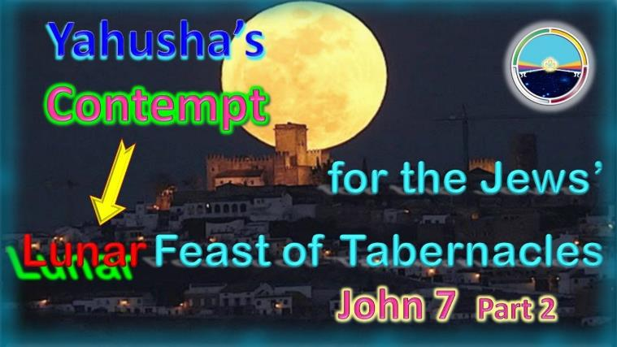
The former two questions are of utmost importance and will be answered in Part 2.
We will take a very serious DETAILED look at the Jews’ lunar calendar in comparison to the Living Covenant Calendar designed by Yahusha from the foundation of this earth.
“Come and See”
The End

Slide 82



Please send any
questions to:
Timothy Astleford or
Charlene Fortsch
questions@studythecalendar.com
Thank-you for being with us today!
Shalom!
82

Slide 83
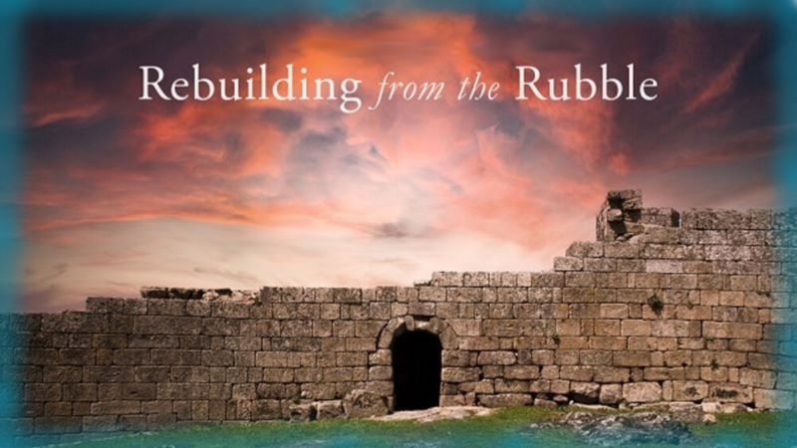

If you enjoyed this study today …
Please Join Us Live Each Week
Sign up with Covenant Calendar Club
for the Friday & Shabbat Zoom Meetings
(including live discussion)
** All studies can be
downloaded for FREE!
https://studythecalendar.com/sign-up/

Slide 84
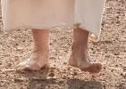
What “on earth” was Yahusha thinking?
Hi Tim: I think I’m having trouble understanding what you are trying to say with bullets 2 & 3.
My question: what IS the fearful implication of Yah arriving at the middle of the lunar feast?
Next question: bullet 3 … are you saying that if Yah arrived at the beginning of the lunar feast that would have been a disastrous failure on His part?
And I don’t see how bullet 2 and 3 link well with the last sentence.
I think this is one of those slides I tried to salvage. Would 72 flow into 74 (deleting 73)? Comments??
Yahusha attended the Festival of the Yehudim (Jews) entering in the middle of their Feast of Sukkot in John 7!
Note the fearful implication had Yahusha arrived at the MIDDLE of Yahuah’s Feast of Sukkot! !!!
Yahusha would have FAILED (at the beginning of Sukkot), to be in attendance AT THE TABERNACLE in accordance with the statutes of
Exo 23:15-17, Deut 16:2, 5, 6, 11, 16.
FAILURE to observe Yahuah’s statute(s) ALWAYS results in a SIN.
Back to
John 7

Slide 85


