Slide 1
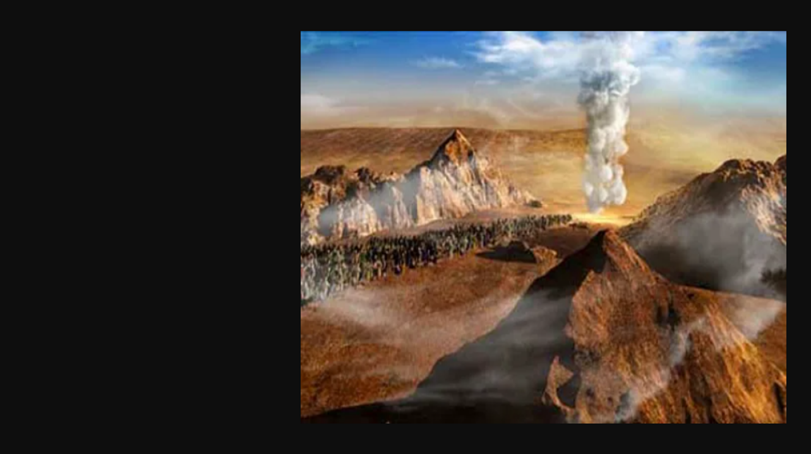
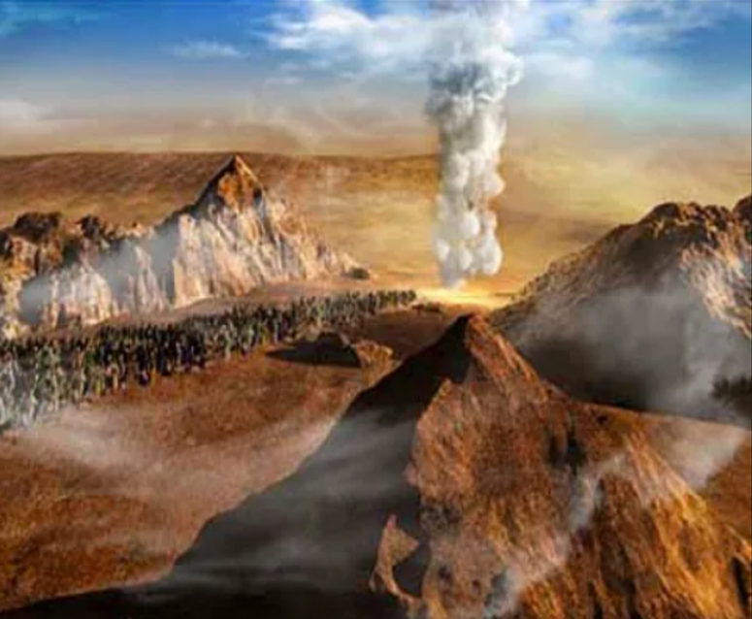

Viewing the
Lunar Sabbath through the
Pillar of Cloud Crosshairs!
Numbers 10
Joe Brown’s Lazy Dog jumpesNew Bunny Trail on Lunar
Joe Brown’s Lazy Dog jumpesNew Bunny Trail on Lunar
Joe Brown’s Lazy Dog jumpesNew Bunny Trail on Lunar
Joe Brown’s Lazy Dog jumpesNew Bunny Trail on Lunar

Slide 2


Will the “Pillar of Cloud” in Numbers 10 have something to say about that?
There are many today that believe a specific moon phase determines the weekly Shabbat ~ which can land on any cycle of the week?
Have you heard this before?

Slide 3

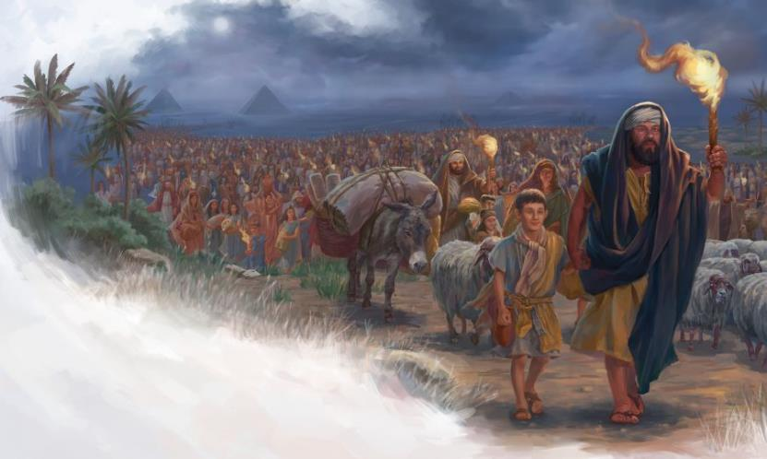
Will the “Pillar of Cloud” really command Moses and the children in the wilderness to actually travel on Yahuah’s weekly Shabbat?

Slide 4
Sample Lunar Sabbath Calendar
#1 Sun | #2 Mon | #3 Tue | #4 Wed | #5 Thu | #6 Fri | #7 Sat
 | 1st | 2nd | 3rd | 4th | 5th | 6th
7th | 8th | 9th | 10th | 11th | 12th | 13th
14th | 15th | 16th | 17th | 18th | 19th | 20th
21st | 22nd | 23rd | 24th | 25th | 26th | 27th
28th | 29th | 30th
Moon phase is sighted, declaring
the 1st day
of the month.
In this demonstration the
8th, 15th, 22nd, & 29th, are
the weekly Sabbaths on the
2nd cycle of each week!

Slide 5
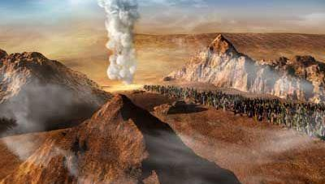


Do we have enough information about this “Pillar of Cloud” to know for sure if its instructions honor the weekly Shabbat?
Num 10:11 And it came to be on the twentieth day of the second month, in the second year, that THE CLOUD was taken up from above the Dwelling Place of the Witness.

Slide 6
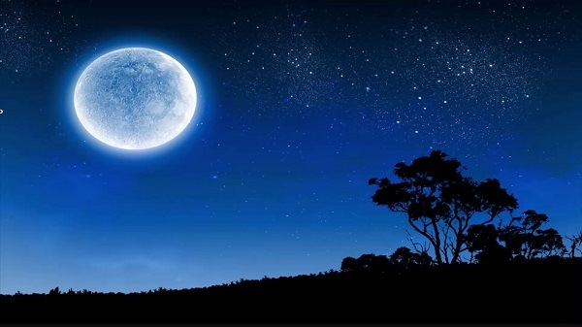


The Scriptures give every
needed detail to know for sure
if this “cloud” commanded
the observance of a
lunar based Shabbat?

Slide 7


If you do not know the answers to some of these questions …
then it is time to check out what Yahuah’s Torah has to say about a lunar-based Shabbat!
The End!

Slide 8



If you enjoyed this short introduction …
Plan to see the full study in detail!
And: Sign up with Covenant Calendar Club
for the Friday & Shabbat Zoom Meetings
(including live discussion)
https://studythecalendar.com/sign-up/
Thank-you!
Shalom!
8

