Slide 1


Midst of the Week
Introduction to
Daniel 9:27
Where is
the true Day-start?
Notes:
5.6a Teaser for Dan 9 Midst of the Week 16 slides – recording time:
Launched: website: You-tube:
Sent to Tim July 29th for recording on July 30th. 8 min.
Blurb for 5.6a: The phrase “midst of the week” from Daniel 9:27 has a lot of different explanations. Some feel the timeframe is only on one prophetic level that calculates the 70 weeks of prophetic time to 490 years of literal time. This timeline given by Daniel was for the express purpose for the leaders in Judah to teach the people when to expect the arrival of their Messiah. Even though this message was really not taught by the leaders – in fact a curse was put on any that wanted to study this prophecy – it is still true that our Messiah did “show up” during the last prophetic week of 7 literal years. This would be years 483-490. So, the “midst of the week” would split those 7 years into two segments of 3½ years. The question is this: “Did our Messiah actually arrive at that time, or not?” That is only one application of this phrase “midst of the week” … but there is another application on a 2nd level that aligns our Saviour’s sacrifice ON the “middle day/cycle” of a literal week of 7 days. Could that “day/cycle” be a Friday? Could it be Good Friday? If not, why not? However, this study is not a debate on “which day/cycle” Yahusha gave His Passover sacrifice, but rather – when did His Passover day begin – was it at sunset, midnight, or was it at dawn light? With a sunset day-start, where will the marker be for the “midst of the week” when the sacrifices and oblations were to cease? This is the prophetic marker that identifies the TRUE Messiah. If you don’t know, then “Come and See!” Shalom!

Slide 2


Dan 9:27 says:
And he shall confirm
the covenant with many
for one week: and in the
midst of the week
he shall cause the sacrifice
and oblation to cease …
This prophecy
has something
to do with the number …

Slide 3

Many people today know the symbolic 70th week of Dan 9’s prophecy has something to do with pinpointing EXACTLY
“Who” the true Messiah is!
This belief is grounded in the prophetic words “midst of the week” as the literal marker for
the middle of 7 literal years.
This is by using Scriptural rules
to interpret prophetic timelines.

Slide 4
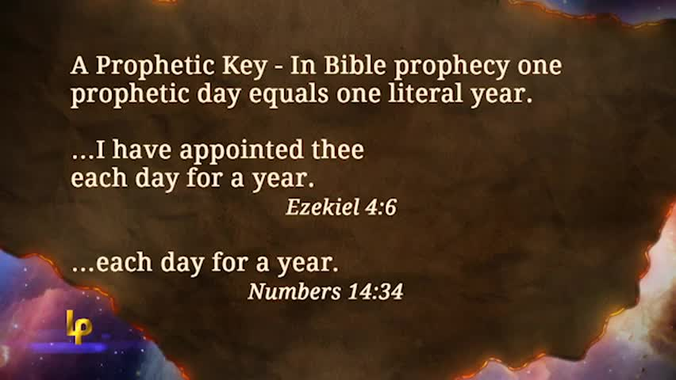
This rule is thus established by:
Note: This rule
has nothing
to do with
7 literal days.

Slide 5



3½ Years
3½ Years
Symbolic Calculation: “midst of the week”
(middle)
1st Yr | 2nd Yr | 3rd Yr | 4th Yr | 5th Yr | 6th Yr | 7th Yr
The symbolic meaning for the phrase
“midst of the week” is usually understood as the “middle marker of time” in a 7 year period, when the rule for a symbolic prophecy is applied – as “1 symbolic day = 1 literal year.” Thus:
7 symbolic days = 7 literal years.
Then the “midst of this literal 7 years”
will be at the 3½ year marker where Yahusha was to be “cut off.”
=
However, this study is not about that!

Slide 6
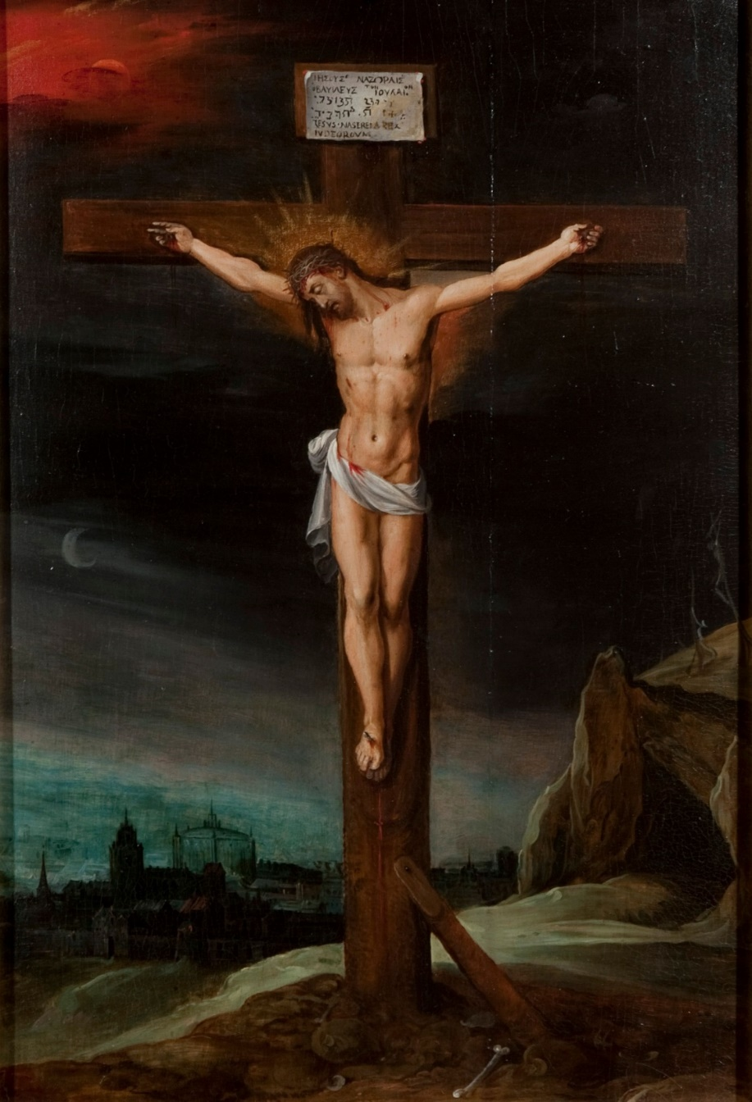

Many, many people in the world today believe the Saviour laid down His life
on what is now called “Good Friday.”
That is the false messiah, and …
FALSE!
from paganism!

Slide 7

How many have thought about this?
At the most: 5½ Days
Sacrifices Cease? “on Good Friday”?
1½ Days
1st Day | 2nd Day | 3rd Day | 4th Day | 5th Day | 6th Day | 7th Day
Dan 9:27 review:
And he shall confirm
the covenant with many
for one week: and in the midst of the week
he shall cause the sacrifice and oblation to cease …
IF our Messiah’s death is married to a Good Friday,
how can the 6th day/cycle be understood as the literal “midst of the week”?
But, this study is not about that!

Slide 8

Symbolic Meaning: “midst of the week”
Many believe that Yahusha died after His ministry of 3½ years.
However this is not true either! According to Exodus 12,
the Passover lamb was to be “of the first year.” In other words,
between the age of 1-2 years.
This 3½ cannot be interpreted to
indicate our Saviour, as “the true
last Passover Sacrifice.” He did not
have a ministry of 3½ years making
Him 33½ years old.
Studies have shown He offered His life
between the young age of 30-31 years.
But, this study is not about that either!

Slide 9

WHAT IS THE
What is this
study about?
This study is about a 2nd application.

Slide 10
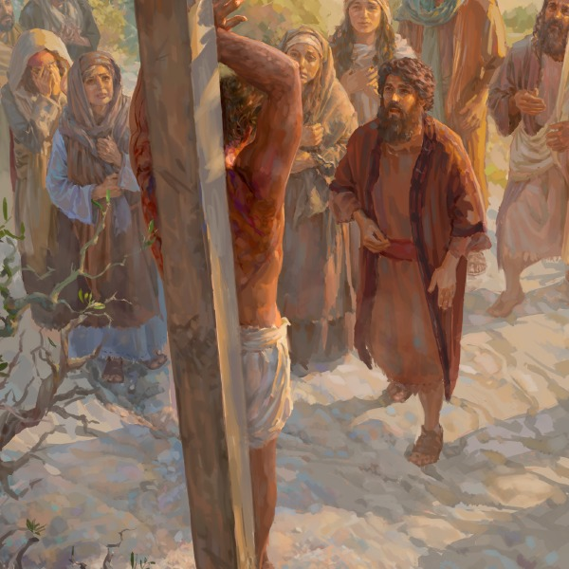
3½ Days
3½ Days
Literal Meaning: “midst of the week”
(middle)
1st Day | 2nd Day | 3rd Day | 4th Day | 5th Day | 6th Day | 7th Day
The 2nd application of Daniel 9:27
is around Yahusha’s death on
His Covenant Passover festival.
This is TRUE -
But, this study is not only about that!
According to
THE GOSPELS!

Slide 11

Question: How many others do not know …
the Daniel 9:27 prophecy is
so detailed, and so exact,
that it even includes the proper information for HIS Passover day-start, according to Gen 1? And also, this study connects to many other supporting examples found in
the Scriptures!
This study
includes some
of that information!

Slide 12


Have you heard this before?
“We both believe in a 4th cycle crucifixion!
I believe in sunset, you believe in dawn!
What could possibly be the difference?!”
Will “one” of these options
point to the true Messiah?

Slide 13

This study is determined to find the truth of day-start while comparing the exact “midst of the week” according: a) to the dawn day-start and b) the sunset theory day-start.
Which option will arrive at the
exact “midst of the week”
when Yahusha’s sacrifice ceased?

Slide 14

This study just might bring you to a crossroads in your journey and also determine the True Messiah?

Slide 15




Truth?
Sunset
or
Dawn
If you were taught
sunset begins Yahusha’s
Passover day ~ you may
want to consider this study
~ just one time?
The End

Slide 16



If you enjoyed this introduction today …
Please plan to see the full Dan 9 study!
Sign up with Covenant Calendar Club
for the Friday & Shabbat Zoom Meetings
(including live discussion)
** All studies can be
downloaded for FREE!
https://studythecalendar.com/sign-up/

