Slide 1
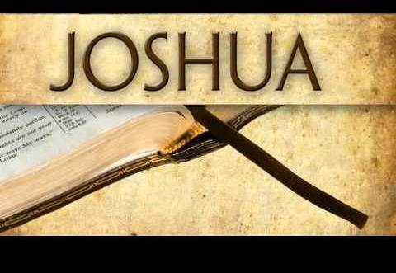


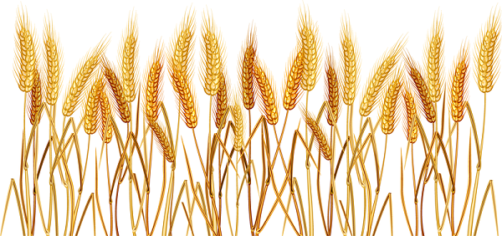
Part 2 of 3
Joshua’s First Observance
of Wave Sheaf in Canaan
Notes:
Slide 12 tim said a mic was open – remove ok Neil.

Slide 2

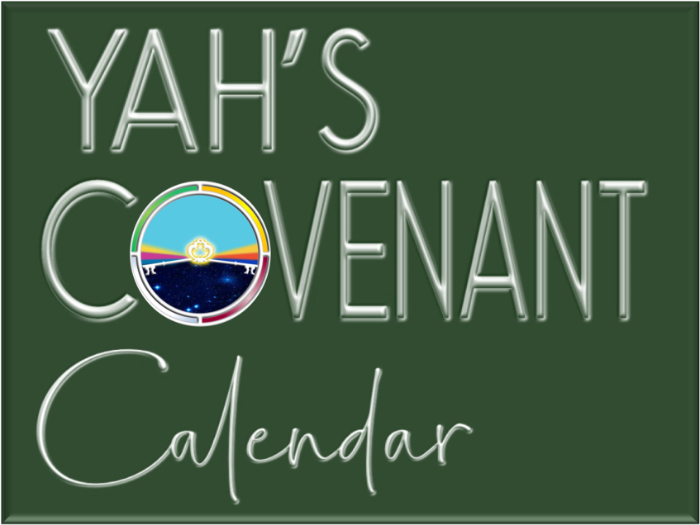

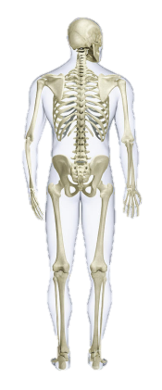
A teaching approx. 1451 BC just after Moses died.
Part 1
Visit: studythecalendar.com

Slide 3


Joshua’s Wave Sheaf
Part 2
With Wave Sheaf and
1st Sabbath of Unleavened Bread both on Abib 15, which one will take priority?
Which Feast will be the “backbone” of our salvation?
We Shall See!

Slide 4

Joshua’s statements have proven…
#2 Unleavened Bread Sabbath
is on Abib 15
#3 Wave Sheaf is
placed on Abib 15 – NOT Abib 16!
#1 Passover & the weekly Sabbath share the date
Abib 14
There is more!

Slide 5
The Intrigue of Part 2
#2 Joshua
#3
History
Joshua has more information on the meaning of
Wave Sheaf.
#1
Leviticus
& Numbers
Plus a thorough examination
of calendars in conflict!

Slide 6

Which Festival Secures First Place?
Wave Sheaf? ~ Unleavened Bread Sabbath?
R
E
V
I
E
W
Every Feast and Festival is
of utmost importance,
whether an annual Sabbath or not!
In Joshua’s account 2 festivals share Abib 15:
a. 1st Sabbath of Unleavened Bread
b. Wave Sheaf Festival
Will Joshua give priority to one of them?
Will Joshua make the right choice?
And … Does it matter?

Slide 7
The Wave Sheaf Grain Holds Clues
To understand the importance of Wave Sheaf and First Fruit, it is first helpful to investigate the grain in the land of Canaan.
  The grain holds clues to help understand how Wave Sheaf was fulfilled in Yahusha’s life. This is the first recorded time of Israel celebrating the full spring festival. Remember, there is no Scriptural account for the celebration of the Wave Sheaf Festival in the wilderness.
  Yahuah had promised the Israelites the grain of the land would be ready for harvest upon entering the land of Canaan. (Deut 6:10-11; Josh 24:13.)
  But ALL grain (whether old or new – wheat or barley) was declared “off limits” to eat, or use for personal purposes like preparing unleavened bread for Passover, until after the Wave Sheaf ceremony had been celebrated (Lev 23:14).

Slide 8
Special Instructions
for Wave Sheaf
There is one command that is extremely significant AND recorded twice:
The terms UNTIL – and –
ON THIS SAME DAY
are very important to understand.

Slide 9
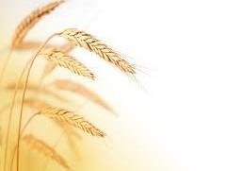
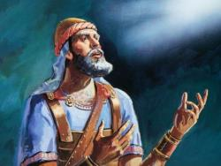
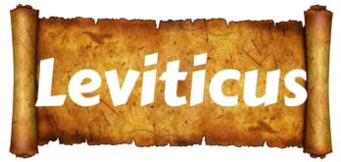
Josh 5:11 & Lev 23:14 Agree
Josh 5:11 And they ate of the stored grain of the land
on the morrow after the Passover,
unleavened bread and roasted grain ON THIS SAME DAY.
Lev 23:14 And you do not eat bread
or roasted grain or fresh grain UNTIL THE SAME DAY
that you have brought an offering to your Elohim – a law forever
throughout your generations in all your dwellings. HalleluYah Scriptures & The Scriptures
Joshua followed the Torah command:

Slide 10
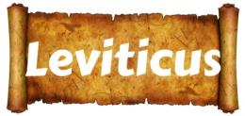

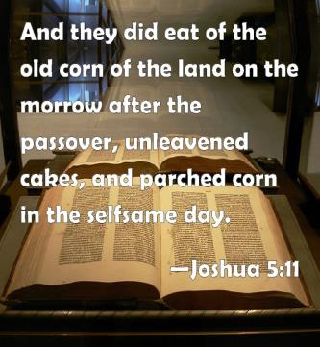
Joshua followed the Torah command:
“the same day”
“self-same day”
KJV
H6106 `etsem (eh'tsem);
from H6105; a bone (as strong); by extension,
the body; figuratively,
the substance, i.e.
(as pron.) selfsame:
KJV - body, bone, life,
(self-) same, strength, very.

Slide 11
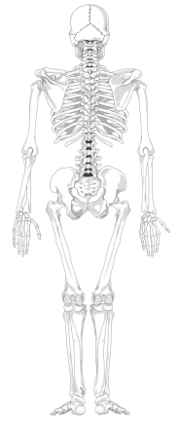
“ON THIS SAME DAY”
The primary point we need to pay attention to in the
Wave Sheaf ceremony of these Firstfruits are the words:
“UNTIL” THE SELF-SAME DAY
…translated from the Hebrew words - ehtzm zeh.
The main word meanings of ehtzm are:
firmness, solidity, bone
(as in basic skeletal structure),
essence and substance.
All definitions link the Wave Sheaf Firstfruit ceremony to:
THE SELF-SAME DAY
(“day” of the week; not “date” of the month),
to be fulfilled in the antitype.

Slide 12
Question for -“Self SAME DAY”
All definitions link the Wave Sheaf Firstfruit ceremony to:
THE SELF-SAME DAY
(“day” of the week; not “date” of the month),
TO BE FULFILLED in the antitype.
When Yahusha was hanging in agony ready to release His breath of life, and He said “It has
been accomplished” – did that include the future fulfillment of the Wave Sheaf AFTER His death? Was this Yahusha’s faith in victory over death?
Was that statement a prophetic statement?
Repeat

Slide 13
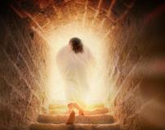
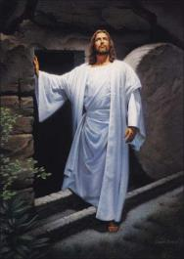
What about – Yahusha’s Life?
“We have often concentrated on – The Death – of Yahusha.
Might we submit a portion of our
thoughts to Yahusha’s Victory
of LIFE - over death?
AFTER Yahusha died, what single event, (that is commanded to be observed yearly),
was actually signed, sealed and forever etched into our Salvation for eternity?

Slide 14
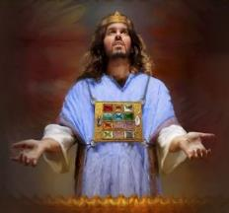

What about
His Offering of Life - that was Accepted?
Another Melki-Tzedek Covenant Connection& Fulfillment!
Yahusha’s death would have
no meaning had He not
Presented Himself
(Exo 23:16-17) before Yahuah.
It was here that
Yahusha’s Sacrifice was
ACCEPTED AS – PERFECTION !

Slide 15
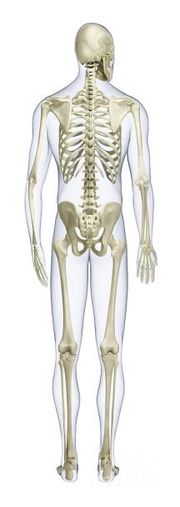
What is contained in this LIFE support system?
The Very Same
… Until - EH-TZEM – Day,
Lev 23:14
(Not - date!)
when the Wave Sheaf/First Fruit Presentation & ACCEPTANCE;
was fulfilled before Yahuah –
within the Melki-tzedek Covenant.
Lev 23:11
This event was THE EMBODIMENT,
THE – SKELETAL BONE STRUCTURE;
which was, and still is,
the quintessential
SUBSTANCE AND ESSENCE
of our Salvation!

Slide 16

What connects the skeletal bone concept to Yahusha’s - LIFE - support system?
Resh
Yahusha alone IS Salvation’s
Administration Center for LIFE!
This factor was finalized through YAHUAH’S ACCEPTANCE OF YAHUSHA the First-Fruit on the Festival of the Wave Sheaf.
It was on the 1st cycle of the week
following the 7 ^{th} day Sabbath
during the Passover Festival!

Slide 17
Yahusha’s skeletal bone distribution system
has a purpose!
Resh
THE
The [Eh-Tzem] “BONE” spinal cord central nervous support structure -
Wave Sheaf/ First-Fruit Festival;
through Joshua,
conveys vital
SALVATIONAL SUBSTANCE;
YEARLY TIMNG & MASHIACH CHARACTER IDENTIFICATION to …

Slide 18
Yes (…to -) Us!
Resh
Torah
Yahusha’s EHTZEM bone notification system for the Body of Yahusha; identifies the ESSENCE of our Salvation through Yahusha’s Sacrificial ACCEPTANCE on-
the 1st cycle after the
7th day Sabbath!

Slide 19
The Ultimate Bone
Distribution System
Resh
“EHTZM” directs us to … Wave Sheaf
as the backbone, (Spinal Cord if you will)
- the base foundation -
of Yahusha’s Plan to bring Salvation
to His Body of people.
Yahusha, by dying, then observing the
Wave Sheaf, presented Himself to Yahuah
(as THE First-Fruit of victory over death).
Yahuah accepted Yahusha’s monumental sacrifice.
That ACCEPTANCE is – the Substance and Essence of the Plan for OUR Salvation.

Slide 20
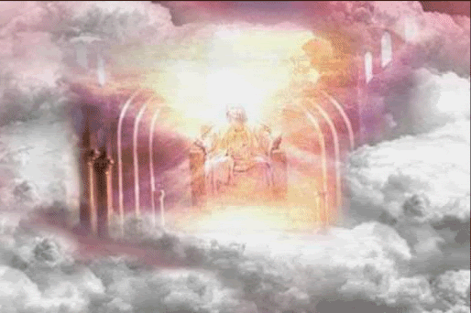
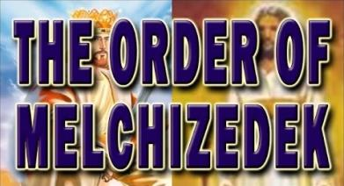
Wave Sheaf & Melki-tzedek
All feasts and festivals are “types” that have their complete fulfillment in our Messiah as the Highest Melki-tzedek Priest.
Through the premier “type” of the Wave Sheaf Festival, the first harvest purposely confirmed the standard for Yahusha as the “anti-type” on His “Wave Sheaf” presentation to be the Principal First-Fruit!
Wave Sheaf
Before the Throne
Canaan
Notes:
Remember, Yahusha had not ascended upwards yet when He met Mary in the garden on Sunday morning, as he gave her a command not to touch Him yet … until … after He came back.

Slide 21
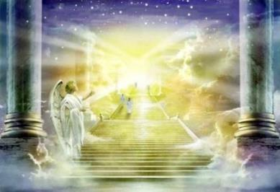
Melki-tzedek–The First-Fruit
This event looked forward to the time when Yahusha would ascend to receive Yahuah’s announcement of whether or not His blood Sacrifice fully paid the requirements of
our death penalty.
The actual cycle of the week where the Wave Sheaf “type” was truly fulfilled by the “antitype” was ONLY ON
the next 1st cycle of the
week (or Sunday) after
the Crucifixion event.
Wave Sheaf
Fulfilled
Notes:
Remember, Yahusha had not ascended upwards yet when He met Mary in the garden on Sunday morning, as he gave her a command not to touch Him yet … until … after He came back.

Slide 22
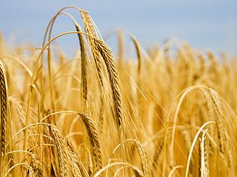
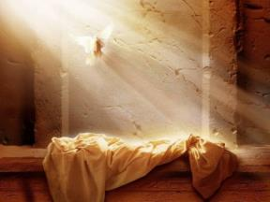
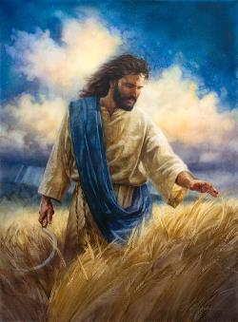
Timing of Resurrection & Ascension
Do not confuse these two facts:
Yahusha’s resurrection was
on the weekly Sabbath day
(not Sunday).
Yahusha’s ascension was
perfectly timed so that His presence was before Yahuah
as the earthly Wave Sheaf to
be waved heavenward – at
the early dawn hours of the
next day – (1st cycle/Sun).
(A study on the Wednesday crucifixion is
crucial if this fact is not recognized yet.
Ask for studies if you need more information.)
Notes:
This ascension is the fulfillment (antitype) of the “type.”

Slide 23
Charting Resurrection & Ascension
1st (Sun) | 2nd (Mon) | 3rd (Tues) | 4th (Wed) | 5th (Thur) | 6th (Fri) | 7th (Sabb)
4 | 5 | 6 | 7 | 8 | 9 | 10
11 | 12 | 13 | 14 P/O | 15 ULB | 16 ULB | 17 Ress.
18 W/S | 19 ULB | 20 ULB | 21 ULB | 22 | 23 | 24
These two very important events did not occur on the same day!
If Wave Sheaf is not observed at the exact correct time, numerous problems arise.
Notes:
This ascension is the fulfillment (antitype) of the “type.”

Slide 24
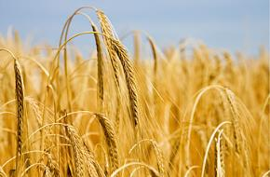
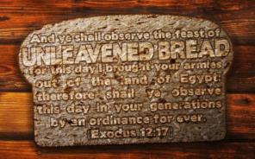
Which was Honoured First on Abib 15?
Wave Sheaf? or Unleavened Bread?
Joshua’s 1st honour was applied to:
the Wave Sheaf Festival event
(representing Yahusha’s
ascension during the early
pre-sunrise hours of this day).
Dawn - John 20:1-17
Joshua’s 2nd honour was bestowed upon:
The festival of the 1st Sabbath
of Unleavened Bread.
All else on Abib 15 pales in Comparison.

Slide 25


1st Honor: Wave Sheaf / Firstfruits
After the Wave Sheaf offering of the pre-sunrise hour,
the people were released from the command
to refrain from eating the yield of the land.
But now is Yahusha risen from the dead, and become the firstfruits of them that slept. 1 Cor 15:20 KJV
The significance of this Wave Sheaf prophecy of 1500+ years
(the presentation of the harvest
to Yahuah for acceptance)
should draw full attention to the
x
SKELETAL BONE STRUCTURE of the Plan of Salvation
through Yahuah’s Feasts and Festivals.

Slide 26





Is FirstfruitS (as plural) Correct?
But now is Yahusha risen from the dead, and become the firstfruitS of them that slept. 1 Cor 15:20 KJV
The Interlinear
Scripture Analyzer
Not plural, but – SINGULAR!

Slide 27
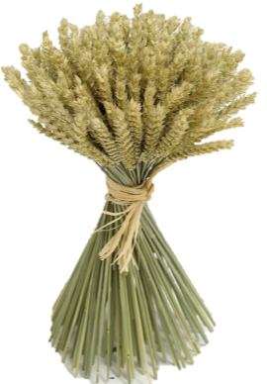
Some Qodesh Intricacies
#1 The Kohen Ha Gadol (High Priest) was the
only identity “approved and accepted” to
present the (singular) Wave Sheaf before Yahuah.
#2 Yahusha, as the Kohen Ha Gadol, presented
the Wave Sheaf before Yahuah according
to Lev 23:10, 11.
I still think this is an important point to be made. As the K/H/G Yahusha could only WAVE THE SHEAF that was GIVEN to Him. Lev 23:10. It was the first cutting and says nothing about fruit! Yahusha by set pattern and statute, could only wave the sheaf. What that sheaf consisted of is another matter. Conrad wants to eliminate this statute step fulfillment and go right to the First Fruit. Not so. Not by the statute pattern!
#3 Yahusha, first presented Himself as THE Wave Sheaf.
#4 Yahusha’s presentation CONSISTED OF THE FIRST-CUTTING
of Himself (the – “First-Fruit”) and His victory/power over death
{Lev 23:10}. Yahusha has the power to lay down His life and take it up again (John 10:17-18).
Note: Hebraically the word “fruit” is not seen in Leviticus 23 as Wave Sheaf. (Next: Two applications to be examined.)
Notes:
This ascension is the fulfillment (antitype) of the “type.”

Slide 28
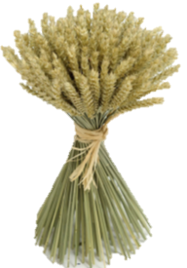
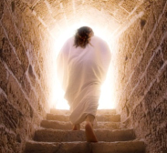
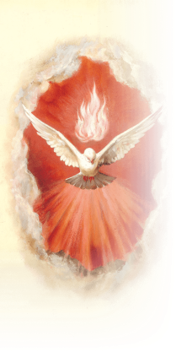
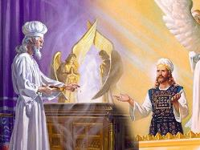
EH TZEM! Salvation’s Skeletal Structure!
Yahusha – THE Melki-tzedek
1st of 2 Applications
#1 Yahusha –
THE First-fruit
#2 Yahusha –
THE Wave Sheaf
#3 Yahusha –
THE Kohen Ha Gadol
High Priest In Every Function
#4 Yahusha –
The One
who sends the
Ruach
Ha Qodesh!
Notes:
This ascension is the fulfillment (antitype) of the “type.”

Slide 29
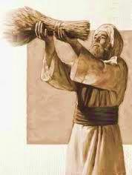
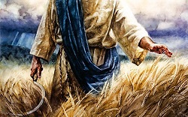
EH TZEM! The Skeletal Foundation!
2nd of 2 Applications
1 John 4:13 Hereby know we that we dwell in him, and he in us, because he hath given us of
his Spirit.
Yahusha - THE Kohen Ha Gadol WAVES HIS SHEAF CONTRIBUTION BEFORE YAHUAH! WHAT IS IT?
THIS Wave Sheaf consisted –
IN PLURALITY – many
individual stalks of wheat.
Yahusha presented each individual “stalk of wheat within the sheaf” (or the people raised at the earthquake
Matt 27:52) as HIS FIRST-FRUIT OFFERING to Yahuah!
Rev 5:12 Worthy is the Lamb that was slain …
Notes:
This ascension is the fulfillment (antitype) of the “type.”

Slide 30


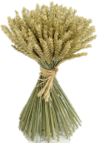

Yahusha – The “first”
First-Fruit
But now Messiah has been raised from
the dead, and has
become the Firstfruit of those having
fallen asleep.
1 Cor 15:20 ISR
There are Scripture versions that have the correct wording – to be in alignment with the Torah commands.
Yahusha became the “Premier” FIRST-FRUIT
and the “Principal” WAVE SHEAF!
He is the One that offered His Personal “firstfruits” as one Wave Sheaf … once!

Slide 31
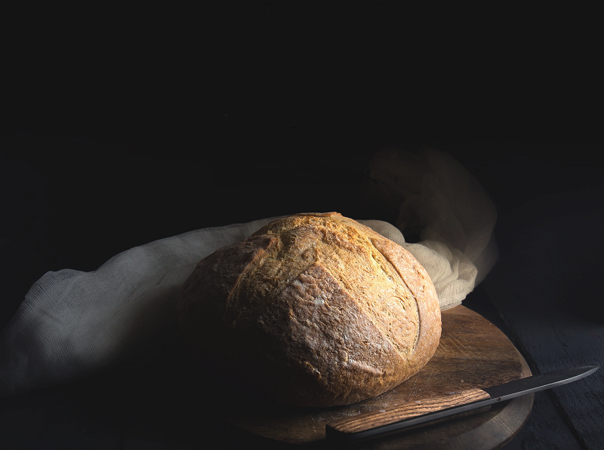
We will learn more about
Wave Sheaf after considering
the events on Abib 16!
“What? No More Manna?”

Slide 32
Abib 16 ~ No More Manna!
Chart #7 of 7 (A change of diet in the land of milk and honey.)
Box 27 – Josh 5:12 And the manna ceased on the morrow after they had eaten of the old corn of the land; neither had the children of Israel manna any more; but they did eat of the fruit of the land of Canaan that year.
Box 25 – Abib 15 – Josh 5:11
1st) Celebrated Wave Sheaf Festival 2nd) For ULB they ate the stored grain of the land
on the morrow after Passover.
NO MORE MANNA
H7676 Sabbath
H4744 ULB Convocation
Box 24 – Abib 14 Passover is preformed at even.
 | Abib 14 Passover 7th Cycle Sabbath |  | Abib 14 Night |  | Abib 15 – W/S & ULB 1st Cycle Sunday |  | Abib 15 Night |  | Abib 16 (No more Manna) 2nd Cycle Monday |  | Abib 16 Night
R
E
V
I
E
W
Box 26
Lev 23:11 ‘And he shall wave the sheaf before [Yahuah], for your acceptance. On the morrow after the Sabbath ^{[H7676]} the priest waves it.’
Lev 23:14 ‘And you do not eat bread or roasted grain or fresh grain UNTIL THE SAME DAY that you have brought an offering to your Elohim – a law forever throughout your generations in all your dwellings.’

Slide 33
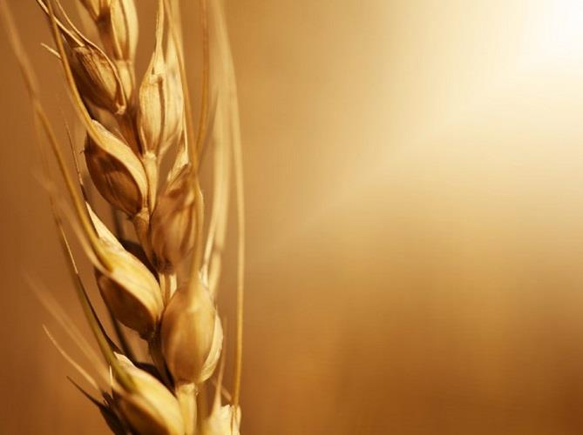
Joshua has definitely confirmed Wave Sheaf is on Abib 15
in this calendar year.
That means Wave Sheaf is not “married” to the Abib 16 date.
Note: When Wave Sheaf is permanently placed and observed on Abib 16, it is always a “floating” Festival,
as this date floats through every cycle of the week in
7 years. It will ONLY occur on the 1st cycle of the week about once every 6-7 years. There are three major problems with a Floating Wave Sheaf married to Abib 16:
Wave Sheaf is seldom placed after the H7676 weekly Sabbath within the Passover week.
(Addressed in Part 1 of this study.)
Abib 16 Wave Sheaf Activities conflict with the Resurrection Account. (2nd Category – 5 examples.)
The Omer count is disrupted when Abib 16
is the designated “date” for the Wave Sheaf [First Fruit] placement. (3rd Category.)

Slide 34


Importance of Wave Sheaf
Following the Weekly Sabbath
1st (Sun) | 2nd (Mon) | 3rd (Tues) | 4th (Wed) | 5th (Thur) | 6th (Fri) | 7th (Sabb)
4 | 5 | 6 | 7 | 8 | 9 | 10
11 | 12 | 13 | 14 P/O | 15 ULB | 16 ULB | 17 Ress.
18 W/S | 19 ULB | 20 ULB | 21 ULB | 22 | 23 | 24
Category 2
When Wave Sheaf is celebrated after the weekly Sabbath, the “type” that is fulfilled in the “anti-type” is: The resurrection is always on Sabbath & the ascension always FOLLOWS the resurrection - the next day!
There will be 5 examples to demonstrate Category 2 challenges if Wave Sheaf is placed only on Abib 16.
Notes:
This ascension is the fulfillment (antitype) of the “type.”

Slide 35



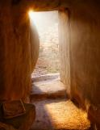


Conflict #1 SUN Passover & TUE Wave Sheaf
#1
1st (Sun) | 2nd (Mon) | 3rd (Tues) | 4th (Wed) | 5th (Thur) | 6th (Fri) | 7th (Sabb)
14 P/O | 15 ULB | 16 W/S? | 17 ULB | 18 ULB | 19 ULB | 20 Ress.
21 ULB | 22 | 23 | 24 | 25 | 26 | 27
Note: Every weekly H7676 Sabbath [during Passover Festival] also represents the
“anti-type” Resurrection Day
and will be noted as such.
Abib 16 [Tues] Wave Sheaf
Ascension is celebrated before
the Resurrection? No one will know the Wave Sheaf is to really occur on the 1st cycle.
ON Covenant Calendar!
#1
1st (Sun) | 2nd (Mon) | 3rd (Tues) | 4th (Wed) | 5th (Thur) | 6th (Fri) | 7th (Sabb)
14 P/O | 15 ULB | 16 W/S | 17 ULB | 18 ULB | 19 ULB | 20 Ress.
21 W/S | 22 | 23 | 24 | 25 | 26 | 27
In a Sunday Passover year, the 1st cycle Wave Sheaf Ascension is celebrated after the [H7676] weekly
Sabbath according to Torah statutes.
Notes:
This ascension is the fulfillment (antitype) of the “type.”

Slide 36
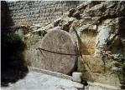

Conflict #2 TUE Passover & THUR Wave Sheaf
#2
1st (Sun) | 2nd (Mon) | 3rd (Tues) | 4th (Wed) | 5th (Thur) | 6th (Fri) | 7th (Sabb)
12 | 13 | 14 P/O | 15 ULB | 16 W/S? | 17 ULB | 18 Ress.
19 ULB | 20 ULB | 21 ULB | 22 | 23 | 24 | 25
Abib 16 Wave Sheaf Ascension is again celebrated before the Resurrection.
Abib 16 FAILS to prophesy the “day”
of Yahusha’s actual Wave Sheaf Offering!
ON Covenant Calendar!
#2
1st (Sun) | 2nd (Mon) | 3rd (Tues) | 4th (Wed) | 5th (Thur) | 6th (Fri) | 7th (Sabb)
12 | 13 | 14 P/O | 15 ULB | 16 W/S | 17 ULB | 18 Ress.
19 W/S | 20 ULB | 21 ULB | 22 | 23 | 24 | 25
In a Tuesday Passover year, the 1st cycle Wave Sheaf Ascension is also correctly celebrated after the
[H7676] weekly Sabbath according to Torah statutes.
Notes:
This ascension is the fulfillment (antitype) of the “type.”

Slide 37



Conflict #3 FRI Passover & SUN Wave Sheaf
1st (Sun) | 2nd (Mon) | 3rd (Tues) | 4th (Wed) | 5th (Thur) | 6th (Fri) | 7th (Sabb)
9 | 10 | 11 | 12 | 13 | 14 P/O | 15 Ress.
16 W/S | 17 ULB | 18 ULB | 19 ULB | 20 ULB | 21 ULB | 22
#3
Ascension is celebrated AFTER Resurrection!
In a Covenant Calendar year where Passover is observed on
Friday, Abib 16 will follow the weekly [H7676] Sabbath, and is
honored properly according to Torah statute.
However, this CANNOT endorse the Scripture’s 4th cycle as Yahusha’s Passover. It represents the false Friday Cruci-fiction!
ON Covenant Calendar!
1st (Sun) | 2nd (Mon) | 3rd (Tues) | 4th (Wed) | 5th (Thur) | 6th (Fri) | 7th (Sabb)
9 | 10 | 11 | 12 | 13 | 14 P/O | 15 Ress.
16 W/S | 17 ULB | 18 ULB | 19 ULB | 20 ULB | 21 ULB | 22
#3
Ascension is celebrated AFTER Resurrection!
There are no changes between this example and the
one just given above. However, be sure to recognize
the 6th cycle Passover does not fulfill the requirements of Yahusha’s messianic prophecy of “3 days & 3 nights” before His weekly Sabbath Resurrection.
Notes:
This ascension is the fulfillment (antitype) of the “type.”

Slide 38


Conflict #4 WED Passover & FRI Wave Sheaf
1st (Sun) | 2nd (Mon) | 3rd (Tues) | 4th (Wed) | 5th (Thur) | 6th (Fri) | 7th (Sabb)
11 | 12 | 13 | 14 P/O | 15 ULB | 16 W/S? | 17 Ress.
18 ULB | 19 ULB | 20 ULB | 21 ULB | 22 | 23 | 24
#4
This is Yahusha’s Passion Week – notice how serious this is when Wave Sheaf is placed on Abib 16. How can the Abib 16 Wave Sheaf Ascension be celebrated before any possible Resurrection?
This is a serious impossibility!
ON Covenant Calendar!
#4
1st (Sun) | 2nd (Mon) | 3rd (Tues) | 4th (Wed) | 5th (Thur) | 6th (Fri) | 7th (Sabb)
11 | 12 | 13 | 14 P/O | 15 ULB | 16 W/S | 17 Ress.
18 W/S | 19 ULB | 20 ULB | 21 ULB | 22 | 23 | 24
Ascension is celebrated AFTER Resurrection!
Yahusha’s “mid-week” Passover is followed by “3 days &
3 nights” in death, terminating with the [H7676] Sabbath
Resurrection – then His Ascension on the 1st cycle Wave Sheaf celebration. (Abib 16 PALES in comparison and removes the Backbone!)
Only #4: EVERY DETAIL FOLLOWS TORAH STATUTES PERFECTLY!
Notes:
This ascension is the fulfillment (antitype) of the “type.”

Slide 39
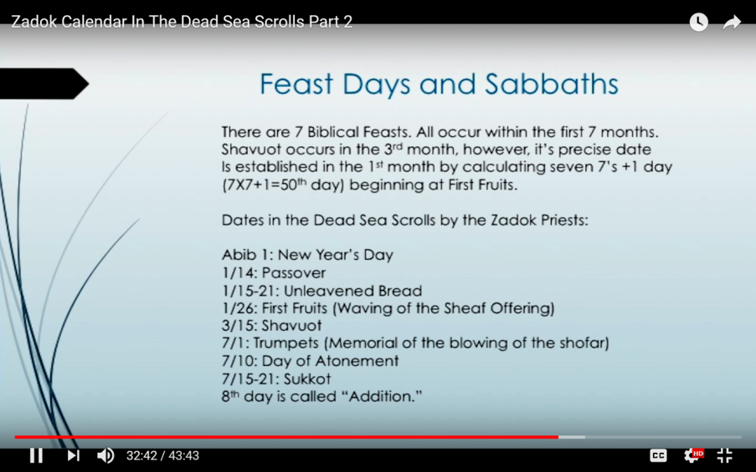

Enoch/Zadok Spring Festival Dates
Conflict #5
PARTIAL REVIEW
This evidence lists “dates” for Passover, ULB
and First Fruits.
(Side Note: Manna ends on Abib 16th. What does Enoch
offer for food
until Abib 26?)
There is nothing here to indicate
proper Resurrection timing!

Slide 40
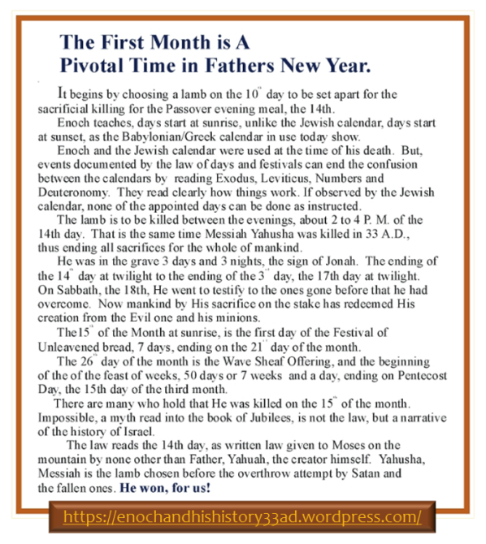

Enoch/Zadok
Spring
Festival Dates
This quote talks about 3 days & 3 nights, but there are several other problems also. The chart following will show why!
Remember, Joshua’s year had Wave Sheaf
& ULB on Abib 15!
Enoch’s Wave Sheaf on Abib 26th – with Pentecost on 15th day of the 3rd month!
Notes:
Enoch has the 18th as Sabbath, that is why the red box has incorrect information.

Slide 41


Charting Enoch’s Evidence for:
Conflict #5 TUE Passover & ABIB 18 Resurrection
Huge Counterfeit Conflict
#5a
1st (Sun) | 2nd (Mon) | 3rd (Tues) | 4th (Wed) | 5th (Thur) | 6th (Fri) | 7th (Sabb)
 |  |  | 1 | 2 | 3 | 4
5 | 6 | 7 | 8 | 9 | 10 | 11
12 | 13 | 14 P/O | 15 ULB | 16 ULB | 17 ULB | 18
19 ULB | 20 ULB | 21 ULB | 22 | 23 | 24 | 25
26 W/S | 27 | 28 | 29 | 30
START
RISEN
3 Days and 3 Nights
Serious Concerns with this Enoch calendar:
Tuesday Passover has no alignment with the “midst of the week” as documented in Dan 9:27.
Resurrection is s-t-r-e-t-c-h-e-d to the Sabbath morning twilight of Abib 18.
First Fruits does NOT follow the weekly Sabbath in the Passover festival week on Enoch’s Abib 19.
Notes:
This ascension is the fulfillment (antitype) of the “type.”

Slide 42


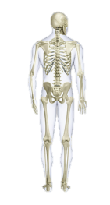
Charting Enoch’s Evidence for:
TUE Passover & ABIB 26 Wave Sheaf
1st (Sun) | 2nd (Mon) | 3rd (Tues) | 4th (Wed) | 5th (Thur) | 6th (Fri) | 7th (Sabb)
 |  |  | 1 | 2 | 3 | 4
5 | 6 | 7 | 8 | 9 | 10 | 11
12 | 13 | 14 P/O | 15 ULB | 16 ULB | 17 ULB | 18
19 ULB | 20 ULB | 21 ULB | 22 | 23 | 24 | 25
26 W/S | 27 | 28 | 29 | 30
#5b
Huge Counterfeit
START
RISEN
3 Days and 3 Nights
WAIT …
AND WAIT, AND WAIT FOR THIS WHOLE WEEK TO PASS TO ARRIVE AT ASCENSION DAY.
THEN -
Other Serious Concerns with
Enoch’s calendar:
Abib 26 Wave Sheaf Ascension
is on hold until another 8 days pass by.
Why Enoch? “Yahusha must refrain from human touch to not contaminate His pure offering before Abib 26.” Really?
Enoch removes the Skeleton Structure of our Salvation!
The 1st cycle of the week is the correct day for a Wave Sheaf – it’s just that Enoch is a week late for the anti-type event!
Notes:
This ascension is the fulfillment (antitype) of the “type.”

Slide 43

As just illustrated Wave Sheaf was NEVER to be celebrated as a floating festival each year – because it places the “Ascension” before the “Resurrection”!
The Wave Sheaf Yearly Prophecy
Every Wave Sheaf festival was prophetic of the exact day of the week that Yahusha would represent the Wave Sheaf ANTITYPE that had been rehearsed for ages.
The Prophecy was FULFILLED when Yahusha, as The Premier
WAVE SHEAF / FIRST-FRUIT, was PRESENTED BEFORE HIS FATHER after HE talked with Miriam at the tomb (John 20:17).
All this is the GOOD NEWS of Wave Sheaf!

Slide 44


Wave Sheaf Statute Placement
R
E
V
I
E
W
ABIB 15
1ST Unleavened
Bread Sabbath
Lev 23:6 And on the fifteenth day
of the same month is the feast of unleavened bread unto [Yahuah].
The DAY After:
#1
ABIB 14
PASSOVER
Abib 15 “ULB” always follows after Abib 14 Passover.
The DAY After:
#2
7th Day SABBATH (AFTER or ON PASSOVER)
Wave Sheaf always follows after the 7th Day Sabbath.
1ST CYCLE
Wave Sheaf
Ceremony
Lev 23:11 ‘And he shall wave the sheaf before [Yahuah], for your acceptance. On the morrow after
the Sabbath^{[H7676]} the priest waves it.’
Josh 5:11 fulfills both Calendar Statutes in Absolute Perfection!
Two “Morrows”
(#1) 1ST CYCLE
Wave Sheaf
Ceremony
a) Wave Sheaf gave permission -
Josh 5:11 And they did eat of the old corn of the land on the morrow after the Passover, unleavened cakes, and
parched corn in the selfsame day.
ABIB 14 PASSOVER
ON 7TH DAY Sabbath
in Joshua’s year!
(#2) ABIB 15
1ST Unleavened
Bread Sabbath
b) To eat the grain of the land.

Slide 45
The Highlight of Wave Sheaf
Every Wave Sheaf ceremony was a prophecy!
This is what it meant for 1500+ years…
The “moment of pre sun-rise light” marks Yahuah’s
“skeletal bone structure” plan for every single person.
THEN … at that time Yahusha, (as the Wave Sheaf / First-Fruit),
would completely fulfill every requirement
for the whole plan of salvation on THAT day!
That is when our death penalty was
fully satisfied and recognized through
Yahusha, the Highest Priest of the Melki-tzedek Order.
Does this information illustrate how/why the
Wave Sheaf Festival is so important for us?

Slide 46
Joshua’s Wave Sheaf
Part 3
How shall the correct method for Counting the Omer be determined?
What is the tradition of how Wave Sheaf became married to Abib 16.
We Shall See!
The End of Pt 2

Slide 47
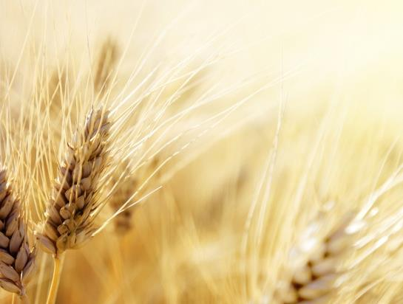




Questions/Comments
on the placement
of Wave Sheaf Pt 2?
Tim Astleford &
Charlene Fortsch
questions@studythecalendar.com
Thank-you!
Shalom!
Notes:
5.5c Joshua’s Wavesheaf Pt 1 [46 slides] Apr 10/22 Website:
Youtube:
Blurb 5.5c:

