Slide 1
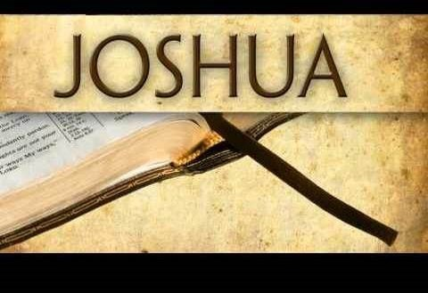

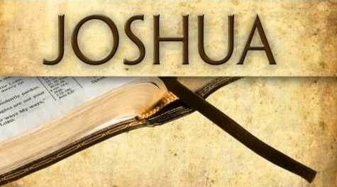

The Mini
Introduction!
Removes the Rubble of Tradition!
Notes:
Apr 2/22 We re-launched only the 5 min teaser this time – to see what the results will be. No changes in the blurb.
5:30 min: 5.3a Website: https://studythecalendar.com/5-3-yahushas-crucifixion-year/ Youtube: https://youtu.be/ytGEe-UDomM
** 5.3a Teaser - Yahusha's Crucifixion Year - Part 1 In less than 5 min, treat yourself to some thought provoking information - and see if you know the answers to questions that stem from the calendar study in the Gospels. Absolutely profound, to say the least, is the discovery of two calendars in the Gospels, yes, you read right! There is no doubt the Gospels record the "unbelieving Jews" were following their lunar calendar. And of course, Yahusha is going to stay true to His blood-ratified Covenant Calendar and lay down His life ON "HIS" Passover Day. But the question is: "How close is His Passover Day to the Passover day of the lunar calendar?" Have you ever heard of such a thing? Have you heard there is a 12 hour offset between these two calendars? Well if not, you now have an opportunity to "hear the rest of the story." Maybe the next few minutes will show you why? Shalom from Covenant Calendar Club, and May His Kingdom be Near Unto You!
Blurb for Website with Questions:
With many different calendars all laying claim to a specific year of the crucifixion, which ones can ALSO claim full and complete alignment with the words of the Scripture? Better yet, which calendars can reveal total compliance and timing fulfillment with each and every text of the Passion Week?
Which of these can accomplish a step by step pathway of the Lunar Calendar Passover of the Jews, and also, the Torah based Dawn to Dawn Passover of the Covenant, and still produce meticulous alignment with the Messianic Testament (New Testament) documentation?
And if these proclaimers of the Faith can achieve a suitable CE year with the Scriptural midst of the week (Wed) crucifixion as precisely detailed in the Scriptures, can they also,
find precise alignment with the crucial 12 hour offset which pinpoints the accurate CE year of the crucifixion by
defining the two different Passovers, of the two separate calendars as specifically recorded by Matthew and John?
Which of the years from CE 26 to CE 34 cannot apply?
What makes the CE year of the crucifixion so incredibly blinding brilliant, that it cannot be mistaken?
Apr 10/21 Tim felt he needed to teach this today since Stacey is ill – Apr 10th. This is the last edit from mar 10th on the moon phases. The teaching went very good considering Tim had not
seen this since Mar 10th. The CCC panel were well pleased and saw what was going on. This needed to be taught after LWM’s bashing the last 3 weeks. Charlene.

Slide 2

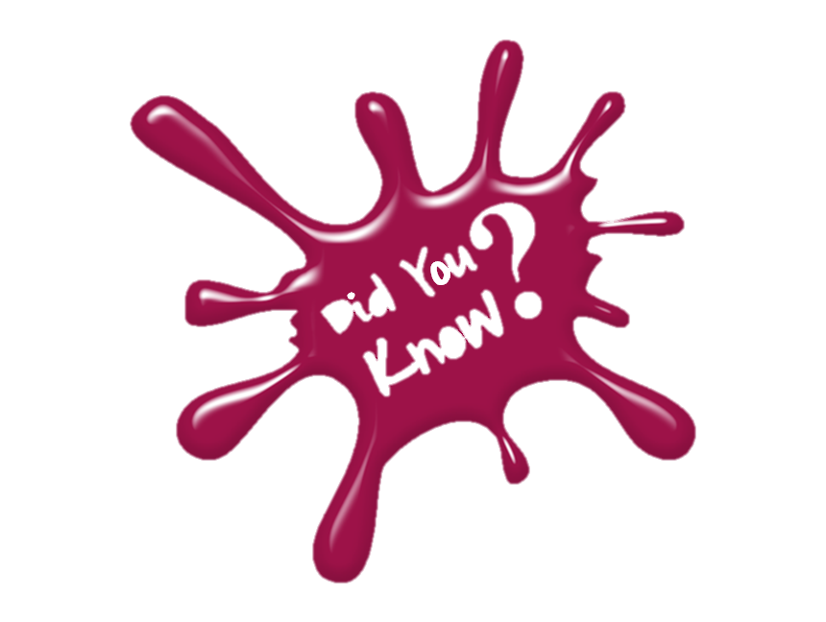


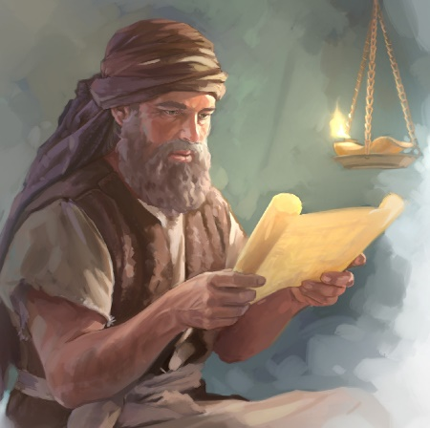

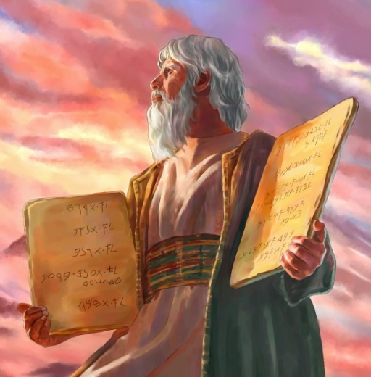

That Joshua was the
“right-hand man” for
Moses all through the
wilderness experience?
That Joshua was the appointed leader for Israel for 20 years after Moses died?
Why?

Slide 3


That Joshua understood the covenant calendar instructions of Moses?
That Joshua was the first
one to record the experience
of the Wavesheaf Festival
upon entering into Canaan?

Slide 4


Are the Scriptures accurate?
Are there Scriptural
characteristics in Joshua's book
that positively identify
the Wavesheaf Festival so precise,
it simply cannot be mistaken?

Slide 5

Is the Wavesheaf Festival really that Important?
Why?
How many feast camps have
you been to, that remember
the Wavesheaf festival?
How many feast camps actually announce why the Wavesheaf festival is SO important – and what does that have to do with anyone’s salvation?

Slide 6

Which is More Important?
What happens if (or
when) the 2nd Shabbat of Unleavened Bread shares
the same date/day with
the Wavesheaf festival –
which is the 1st day of
the week?
Which of these two feasts takes priority if/when these
two feasts are together?
Why?

Slide 7

How does the Placement of Wavesheaf Affect Shavuot/Pentecost?
Why?
Which calendar declares that Wavesheaf is NOT married to Abib 16?
How will all of
these details affect
the placement of Shavuot/Pentecost?

Slide 8
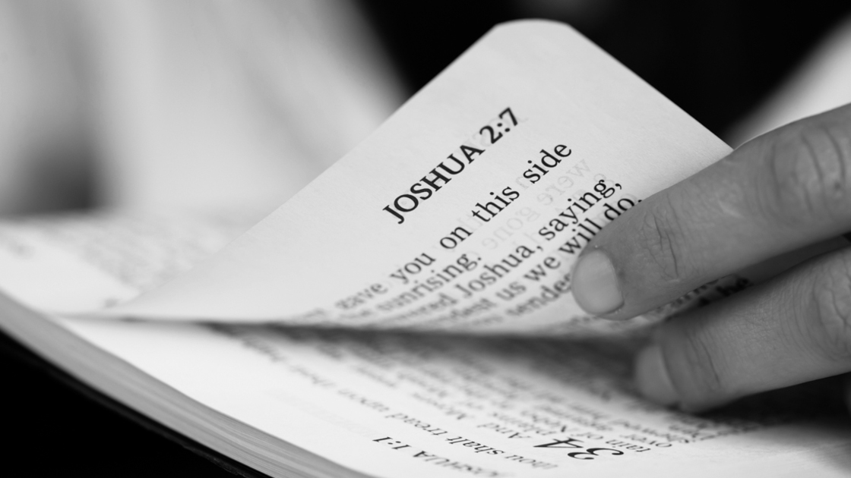
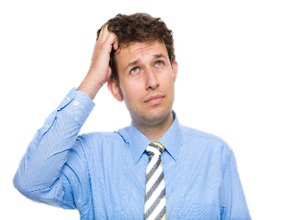
When was the
last time you read the chapters of
Joshua 1-5
very carefully?

Slide 9

These very important chapters are absolutely necessary to understand how to sort out 3 major counterfeit teachings of:
The Wavesheaf festival being married to the date of Abib 16 & who was responsible for this deception?
Adjusting the date on the festal calendar to
guarantee certain festivals never share the
same day/date with the weekly Shabbat;
Many Enoch/Zadok calendars declare the
Wavesheaf Festival is to be celebrated
after the Passover Festival week.
(Now where is that found in Torah?)

Slide 10

Would you find it amazing to know
that in just a few chapters, Joshua
sets the record straight on every
counterfeit teaching surrounding:
Not only the proper placement of the Passover celebration …
But also the proper placement of the Wavesheaf festival??

Slide 11

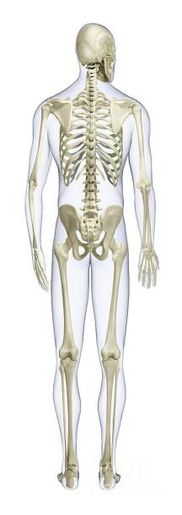


This skeleton is
a key that has
something to do with the meaning of
Wavesheaf!?

Slide 12

If you want to know how to find the answers to all these questions, and many more, then “Come and See” the
full presentation as recorded by Joshua for the very 1st Wavesheaf.

Slide 13
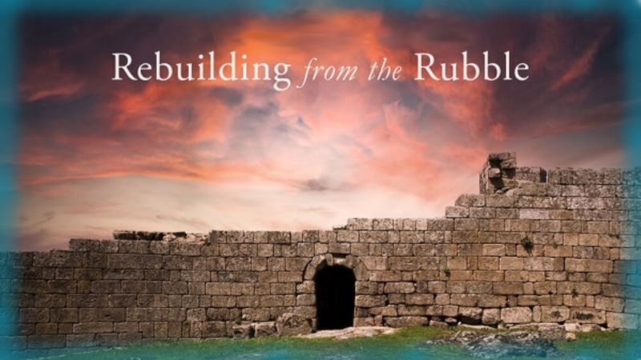


Just Join Us for Parts 1-3
Joshua’s 1st Wavesheaf
Sign up with Covenant Calendar Club
for the Friday & Shabbat Zoom Meetings
(including live discussion)
https://studythecalendar.com/sign-up/
Thank-you!
Shalom!

