Slide 1
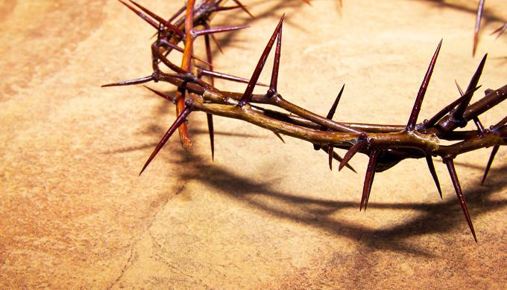

Dating the
Crucifixion Crunch!
The Detailed Edition!
Part 2 of 2
Notes:
Accuracy in the Passover Offset.
The Crucifixion Crunch.
This one is silly but I am going to add it as it might spur something else-
2,12,24 Crucifixion=30 LOL!
2 Passovers, 12 hours offset, in a 24 hour period, gives us the year 30! LOL!

Slide 2
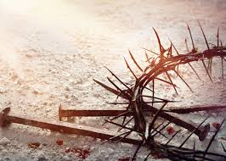


Is CE 30 the Year of Yahusha’s Crucifixion?
Let’s Dig Deep
in Part #2
Will CE 30 underscore the Crucifixion’s Uniqueness through both their Blueprints?
Notes:
Accuracy in the Passover Offset.
The Crucifixion Crunch.
This one is silly but I am going to add it as it might spur something else-
2,12,24 Crucifixion=30 LOL!
2 Passovers, 12 hours offset, in a 24 hour period, gives us the year 30! LOL!

Slide 3

First and Foremost –
This study is about establishing Torah and
directly elevating Yahusha, The Word John 1:1-4, Who exemplified His perfect fulfillment of the Covenant.
The focus is to determine the correct year of the crucifixion and therefore by default, identify from whom and more important, FROM WHAT SOURCE one receives their belief structure.
This study is ALL ABOUT DIRECTING US
BACK TO THE TORAH.
3

Slide 4
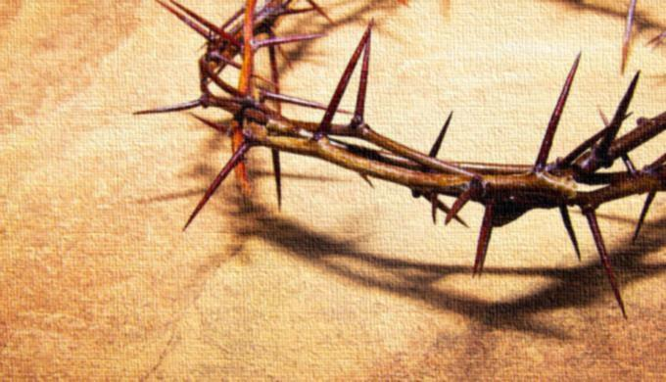
Part 2 of 2!
Will CE 30 support
Yahusha as the
LAMB of the First Year,
through the Lunar Calendar’s 12 hour offset, which followed Covenant Calendar?
Notes:
Accuracy in the Passover Offset.
The Crucifixion Crunch.
This one is silly but I am going to add it as it might spur something else-
2,12,24 Crucifixion=30 LOL!
2 Passovers, 12 hours offset, in a 24 hour period, gives us the year 30! LOL!

Slide 5
This study is a MAJOR lesson in the importance of Genesis 1 and Malachi 4:4.
Hold on!
Is this study not about the Crucifixion?
And now a reference to Genesis & Malachi?
Remember the Torah … Mal 4:4
Without Dawn to Dawn as explained starting with Genesis 1, correctly understanding the
crucifixion timing would be impossible to
accomplish while amalgamating these next points -

Slide 6
Abib 13 evening - Last Supper with the disciples.
A Midst of the Week (Wed) Abib 14 Crucifixion (Daniel’s prophecy) (combined with)
Matthew and John’s WRITTEN 12 hour Festal offset.
The Lunar calendar of the unbelieving Jews &
“NOT AT THE FEAST” (No crucifixion)-(scribes & Pharisees)
The 4 types of – Preparation – representation:
2 Calendar, 1 Burial, 1 Spice
3 days and 3 nights Sign fulfillment.
1st cycle at twilight - “I am ascending to My Father” (the Eh-tzem, Firstfruit fulfillment)
The 1st Ascension!

Slide 7
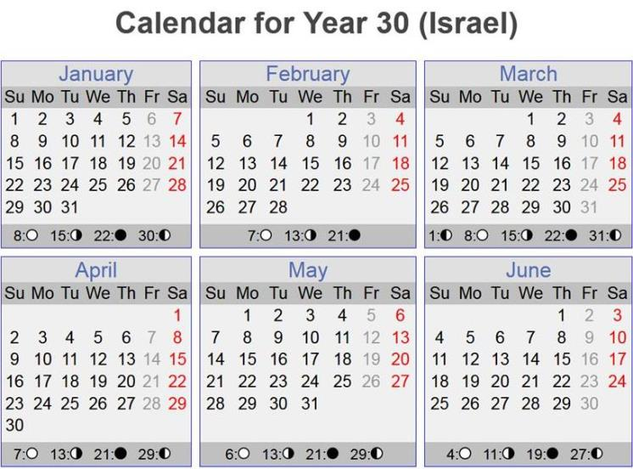
OK! Let’s -
open CE 30!
Why did Yahuah inspire Genesis 1:1-13 to be at the very beginning?
Will CE 30
align with -
Matt 26:5 & John 19:42

Slide 8

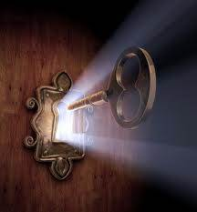

Could Dawn to Dawn be a
Spiritual Cornerstone?
Could it be one of the KEYS to UNDERSTANDING?
Yahusha’s Set-Apart Mo-edim
Why did Yahusha instruct us of the Dawn to Dawn start to
The Way, - at the very beginning of the Scriptures?
Could Yahusha’s commissioning of Light to the sun in the
midst of the week (creation) be a prophetic marker for the Son’s Crucifixion – slain from the foundation of the earth?
Is it possible to precisely determine the year of the Crucifixion without understanding the Dawn Day commencement?

Slide 9
Exo 10:23 They did not see
one another, nor did anyone rise from his place for three days, while
all the children of Yisra’ĕl had
LIGHT in their dwellings.
Physical Pattern – 3 cycles of DARKNESS?!
Yahusha’s retreat into the darkness of death for 3 complete cycles is a very significant factor that gives us LIGHT!
Yahusha, even in death, SUPPLIED LIGHT TO HIS PEOPLE!

Slide 10
Eph 5:8 For you were once darkness, but now you are light in the Master. Walk as children of light.
See also - 2:2, 4:18, Col. 3:7.

Slide 11
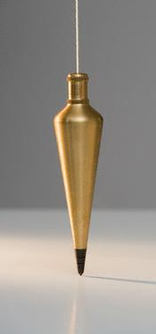
Tequfah
1 Th 5:5 For you are all sons of LIGHT and sons of the DAY. We are NOT of the night nor of darkness.
Let’s consider the command to WALK IN LIGHT, and use Yahuah’s (Shadow) Light as a plumb line, to search out the
year of the crucifixion with Yahuah’s intentional
EXTREME ACCURACY cemented within the Scriptures!

Slide 12
Up to this point - in Part 1, we have seen the IMPOSSIBILITY of finding the crucifixion’s
Scriptural 4th cycle & the 12 hour offset in the
CE years 26 – 29 and 31-34.
In these years, it really is - a dead end search!
Even when we looked at the idea of the Tequfah being the 1st cycle of the year, there has thus far,
been a FULL AND COMPLETE FAILURE.
Moving forward we will examine CE 30, searching for a 4th cycle Crucifixion possibility, COMBINED WITH, the Scriptural 12 hour offset between these two Calendars:
Covenant Calendar and the Lunar Calendar.

Slide 13
Prior to investigating CE 30 we must recall - Yahusha
was age 12 going into CE 12 so He could fulfill the
Word of Yahuah, being - IN THE TABERNACLE, observing the High Shabbat of Unleavened Bread (Luke 2).
By this and the documentation concerning the birth, and the age of John, we know Yahusha was CONCEIVED in Covenant Calendar’s 9th month (Dec) BC 2.
Yahusha completed His first year (12th Gregorian month) in
CC 9th month (Dec) just prior to CE 1.
For a comprehensive look at this, please examine the study, #3.5 Yahusha’s Birth Year, CE 12 and Death Timing,
Video link:
https://studythecalendar.com/4-9-yahusha-lost-and-found/

Slide 14

Points to consider thus far:
1. Based on Torah’s Covenant Calendar - there has been a
complete absence of a 4th cycle Abib 14 in the years
CE 26 - 29 & 31 - 34.
2. The Lunar faux pas Abib 14, 4th cycles we have seen, have
ZERO CAPABILITY of aligning with the
12 hour Calendar offset as written in Scripture.
What will CE 30 deliver? Will there be –
A 4th Cycle Abib 14? And will it provide for –
A Lunar 12 hour Offset Connection with Covenant Calendar?

Slide 15
Will CE 30
align with the
Word of Yahuah?

Slide 16

Investigating - CE 30
CC Looking for Yahusha’s Crucifixion
on a 4th Cycle!
.
Look!A 4th Cycle!
.
Tequfah
CC Abib 14 Passover
Abib 14 on a 4th Cycle!
This is the ONLY YEAR from CE 26-34 that establishes a Tequfah based Abib 14 for
a 4th Cycle Crucifixion, as per Scripture! :)
But WAIT! Is this ROUNDED OFF CHART ACCURATE?
WHAT SHOCKING EFFECT WILL THERE BE IF IT IS NOT??

Slide 17
To whom much is given, MUCH IS ACCOUNTABLE!
Yahusha has provided us today with much better accuracy! Shall we consider it? Absolutely! ☺

Slide 18
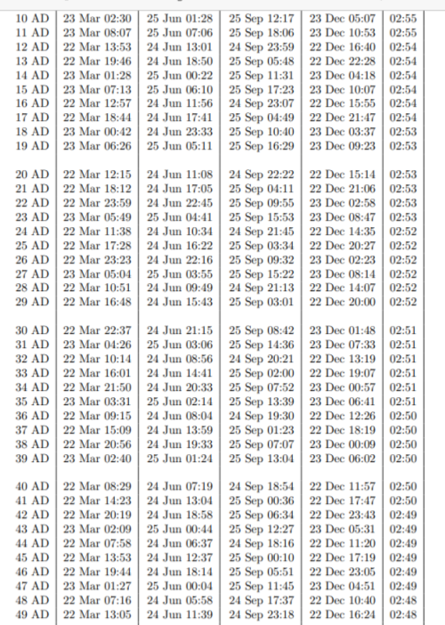

Remember this chart from Part 1? It is much more accurate and has not been rounded off. It does not support an agenda!
Look at the blue box on the left.
Note: the time is recorded in a 24 hour format. This time must be adjusted +2 hours to
reckon with Yerushalayim time!
This is the main chart we will
use in this research!

Slide 19

UT = Universal Time
@ Greenwich
Going with accuracy!
(Roman Reckoning)
The time of the Tequfah was at
UT 22:37 hours/min on Mar 22.
What time was this in Yerushalayim?
UT 22:37 + 2 hours sets the Tequfah at :37 minutes AFTER MIDNIGHT.
Man’s DATE now becomes Mar 23!
Mar 23 :37 AM Jerusalem
Compare these dates!
What cycle of the week was it now?

Slide 20
Let’s Investigate CE 30 - Sans Dawn!
Man’s date! ?
Tequfah
Where will Yahusha’s Crucifixion land WITHOUT Dawn?
Tequfah
Abib 14 – a 5th cycle Passover?
Mar 23 – Roman Reckoning
Has it occurred to you that without Dawn to Dawn, from CE 26 – 34, there is a complete and total void of a FULL 4th cycle Abib 14 in Covenant Calendar? Will we continue to wonder why Yahuah established Dawn to Dawn in the first 13 verses of Scripture?
Remember ye the Torah … Mal 4:4. There is a reason for these words!

Slide 21
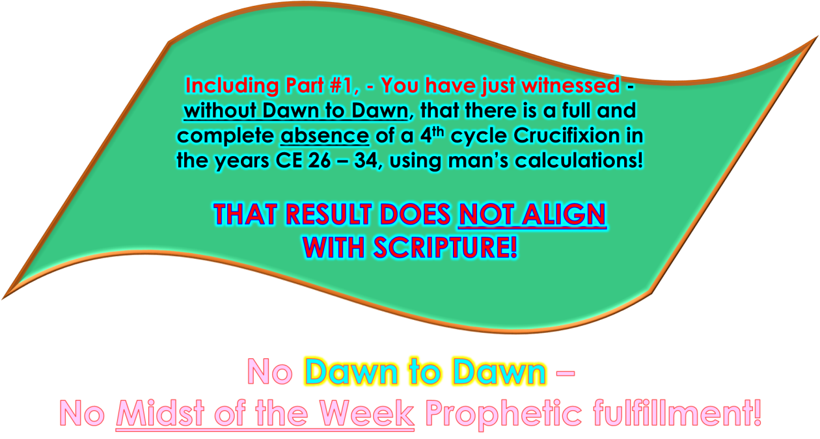

Slide 22
Who’s Covenant
has just been DISCARDED ?
Jer 33:20 reminds us - Yahuah’s Genesis 1 Covenant of the Light Season leads the Night Season, and Boqer (Dawn) is the catalyst point which exchanges the cycles of the week. NOT MIDNIGHT, NOT SUNSET!
So let’s revisit the Tequfah DATE of CE 30 and consider Yahuah’s Covenant!
DAWN TO DAWN!

Slide 23
But First – Understanding - Roman Reckoning!
Matt 27:19, John 19:14, 20:1
Adding 2 hours for Yerushalayim time. Note the proximity of midnight! And with it;
man’s date exchange!
Midnight – Point of Roman Reckoning date exchange.
CE 30 Tequfah –
UT 22:37 hours
(Greenwhich)
Mar 22 Wed
Mar 23 Thu
Dawn!
5 PM 17:00 | 6 PM 18:00 | 7 PM 19:00 | 8 PM 20:00 | 9 PM 21:00
10PM 22:00 | 11PM 23:00 | 12AM 00:00 | 1 AM 01:00 | 2 AM 02:00 | 3 AM 03:00 | 4 AM 04:00 | 5 AM 05:00 | 6 AM 06:00 | 7AM 07:00

Slide 24
CE 30 Mar 22 – UT 22:37 Hours
Adding the 2 hours for Yerushalayim Tequfah
Local Mean Time,
and in Yahuah’s Kingdom, it is STILL a 4th cycle. STILL a
“Mar 22” – Tequfah.
Midnight - Roman Reckoning date exchange has NO PLACE IN Yahuah’s Kingdom!
Dawn!
(Greenwhich) 22:37 hours
37 minutes, still the 4th cycle!
5 17:00 | 6 18:00 | 7 19:00 | 8 20:00 | 9 21:00
10 22;00 | 11 23:00 | 12 00:00 | 1 01:00 | 2 02:00 | 3 03:00 | 4 04:00 | 5 05:00 | 6 06:00 | 7 07:00
The hours are shown for our recognition purposes only!

Slide 25
Short Summary;
After applying Yahuah’s written outline for the Covenant of the Light Season and Covenant of the Night Season from Genesis 1, CE 30 proudly retains Abib 14 on a 4th Cycle, or a Wednesday in common terms.
Daniel’s prophecy fulfilled! ☺
Matt 5:17 Think not that I am come to destroy the Torah, or
the prophets: I am not come to destroy, but TO FULFIL.

Slide 26
Scenario #1.
The New Moonth day - according to the chart supplied by
Time and Date.com.
Now for the Lunar aspect!
Remember: CE 30 is the ONLY year in this grouping that reveals a Tequfah based, Abib 14, Midst of the Week!
Dan 9:27

Slide 27
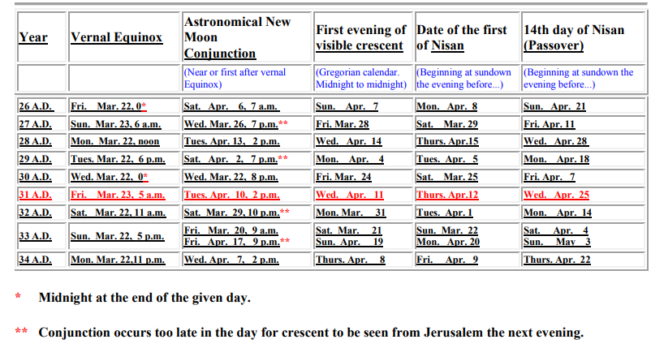
The astronomical Lunar data for CE 30: please note the conjunction occurred on
Mar 22 at 8 PM. Why are there NO DOUBLE ASTERISKS beside THIS number?
Yet the sliver is recorded as a very distant 46 hours away, (check the instruction)!
Have you noted the ever POPULAR FRIDAY CRUCIFIXION scenario!
The chart info does record the Gregorian dates for which it references
a sunset start as the Jews incorporate today!
Is it - A Smoke Screen Evasion Tactic?

Slide 28
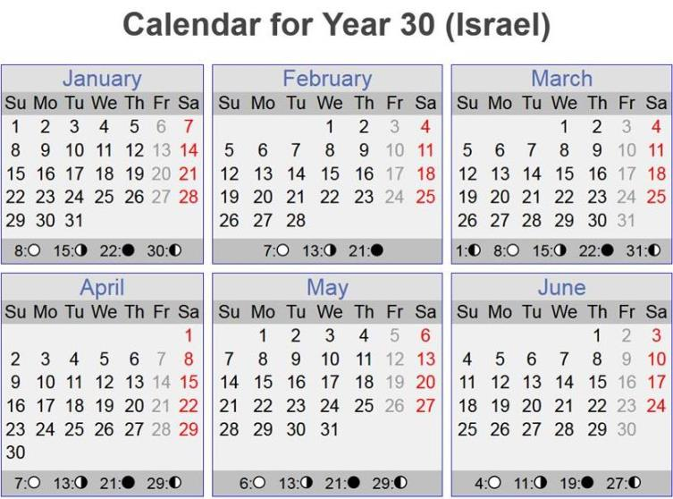
Lunar CE 30 - Forward
Question: Have we been given some convoluted information to purposely form the “Christian Friday Crucifixion?”
Lunar Abib 14 - Was it actually a Christian Friday Crucifixion?
Sliver Moon as per Naval Chart
Tequfah
Conjunction
CC Pesach
New Moonth day!
New Moonth day; 14 cycles to the Lunar Abib 14th, a 6th cycle (Fri) which would start AFTER SUNSET, on the evening before – being the - 5th cycle!
AGAIN - NO SCRIPTURAL ALIGNMENT!!

Slide 29
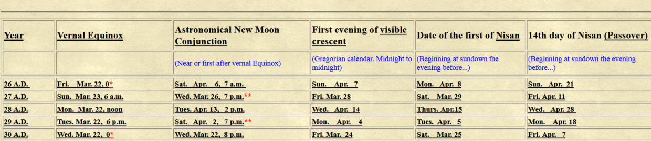
Yes, a Friday Crucifixion is their intentional delusion.
Anything to subvert the Scriptures and deny
the Mashiach is their order & design.

Slide 30

What if the crescent moon was CALCULATED to be on the 23rd of the Gregorian month of March?
Scenario #2!
Could this be - ANOTHER OPTION?

Slide 31


ANOTHER OPTION:
What if Yahuah allowed a thick cloud cover on the appropriate evenings for spotting the sliver moon?
What option would the controlling Jews of the day have then?
Remember, Yahuah instructed us to NUMBER our days.
Ps 90:12 Teach us to number our days. And bring our heart to wisdom.

Slide 32
Yahuah’s Take on CE 30
Yah’s Genesis 1 Light Season Covenant!
Tequfah
CC Abib 14 a 4th cycle Passover!
A 4th Cycle!
.
.
LOOk!
Dawn – Dawn,
declares the
4th cycle Tequfah!
Abib 14 on a 4th Cycle!
This is the ONLY YEAR from CE 26-34 that establishes a Tequfah based Abib 14, for
a 4th Cycle Crucifixion, as per Scripture! :)
Luke 11:52 (A) – Woe to you learned in the Torah, because you took away the KEY TO KNOWLEDGE.

Slide 33
Dawn to Dawn!
With the certain identification of a Midst of the Week Abib 14, we can now positively identify the
ONE and ONLY -
Creation!
Rev 13:8 … Lamb slain from the FOUNDATION of the world.
Ye are children of the LIGHT, not of darkness!

Slide 34


What if the Tequfah is the
First Cycle
of the year like many want to insist?
34

Slide 35

Tequfah: is it the FIRST cycle of the year? ???
Abib 14 Passover – a 3rd Cycle? ??
Tequfah
Daniel’s reaction?
Note Passover’s Green underline count!
By placing the Tequfah as the first cycle of the year, a TOTAL ELIMINATION of an Abib 14 – Midst of the Week Crucifixion between
CE 26 – 34 has effectively been accomplished!

Slide 36

Emphasis!
Tequfah as the FIRST cycle of the year?
A TOTAL ELIMINATION of an
Abib 14 – Midst of the Week Crucifixion!

Slide 37
The power of personal choice was restored by Yahusha which includes the 4th Cycle (Midst of the Week) Crucifixion.
You have a choice to count the Tequfah, as either the 1st cycle of the year which FOLLOWS the end of the solar circuit, - or as some do, reject the Hebrew definitions of Tequfah,
and insist on it being the first cycle of the Year.
Ultimately
it is - your choice.

Slide 38
Enoch’s Jerusalem Equilux View
Equilux - Bacchanalia/Dionysus
(celebrating paganism - Part 1)
CC Abib 14 4th Cycle Passover
Tequfah
New
Lux-Month day!
Enoch Equilux Abib 14 is on a 6th Cycle of the Week. ☺ Problems: Equilux cannot unify Yahuah’s people observing the Feast. No possibility of the 12 hour offset with the acclaimed Jewish Lunar Abib 14 of Friday April 7!
EQUILUX HAS NO HEBREW TORAH FOUNDATION
Do you see a “TRIPLE WHAMMY” EQUILUX FAILURE?

Slide 39
Moving Forward in the Investigation!
How is it that Scripture brilliantly reveals a 12 hour offset connection from the Calendar of Yahuah’s Covenant,
to the Lunar abomination (Isa 1:12-16),
doctrine of the unbelieving Jews
on this HIGHLY PARTICULAR Pesach (Passover)?
The lunar conjunction determines the timeframe
of the spotted sliver moon!
In CE 30, the time frame of the conjunction is said to prohibit a next evening spotting of the sliver moon!
What about a thick cloud cover?
We will view the Calculated Lunar Calendar option soon!

Slide 40
On another note: In the minds of the leading Jews of the time, Yahusha was considered an arch enemy. They knew full well of the Covenant Calendar which Yahusha was observing.
Yahusha, in life AND DEATH, lived out His Covenant!
John 7:7 “It is impossible for the world to hate you, but it hates Me because I bear witness of it, that its works are wicked.
The Jewish leaders knew the exact date of Abib 14 in Yahuah’s Covenant. Yahusha made certain it was not a secret (John 7:7).
Consider the very extensive documentation of how the 2nd Temple era leadership changed the DATES of the Festivals.
ALL OF THEM! Many times over, back and forth, splitting and reconnecting Passover to the Festival of Unleavened Bread!

Slide 41
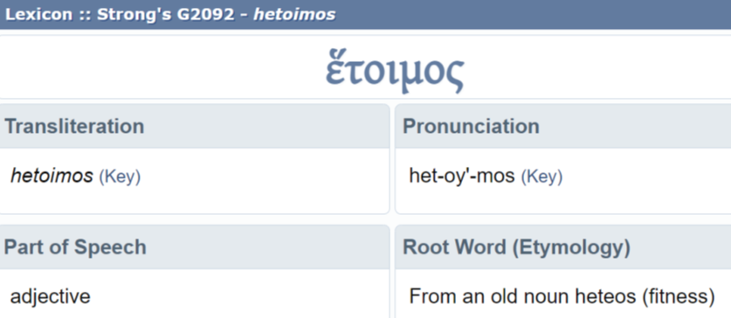
John brings this wicked variableness into the spot light.
John 7:6 Then ^{G3767} [Yahusha] ^{G2424} said ^{G3004} unto them, ^{G846} My ^{G1699} time ^{G2540} is ^{G3918 ➔} not yet ^{G3768} come: ^{G3918} but ^{G1161} your ^{G5212} time ^{G2540} is ^{G2076}
alway ^{G3842} ready. ^{G2092}

Slide 42
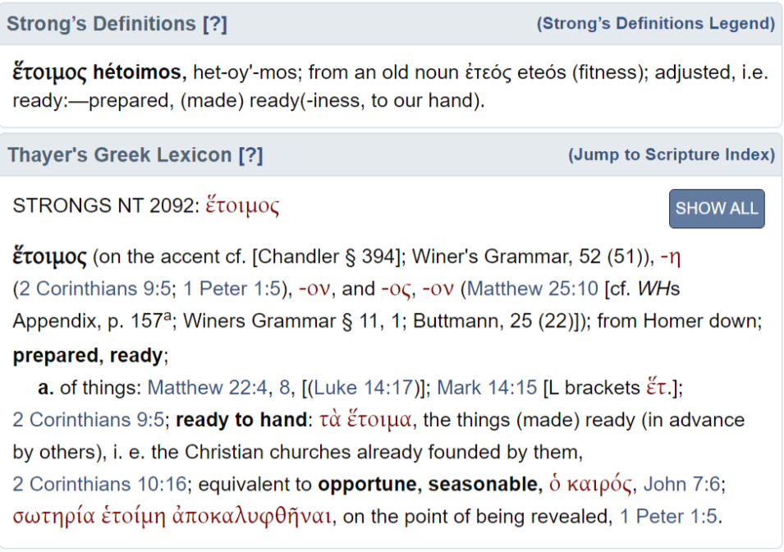
Yahusha, knowing all things fore and aft, He knew very well ALL
of man’s ADJUSTMENTS to HIS FESTAL CALENDAR!
(John 7:6)
Could it have happened AGAIN - at His Passover?

Slide 43
The Jews were not only changing the Festival characteristics but most importantly, changing the DATES OF EACH -
numerous times.
At this point the question becomes:
Could there be a more effective way to
morally assassinate the character of Yahusha, and HIS WITNESS,
to – the CALENDAR of the COVENANT,
than to crucify Him – (in the eyes of the already deceived)?
What more powerful damage could there be than to -
Publically and physically destroy Yahusha’s life,
On the day BEFORE the PUBLICALLY ACCEPTED Jewish Festival,
And then observe their Passover AFTER His death?

Slide 44
Consider the SPIRITUAL ASSASINATION IMPACT
of crucifying Yahusha PRIOR to the
deceived believer’s Lunar Passover festival!
Or - Spiritual
Yahusha was crucified in the Light Season prior to sunset and their Jewish feast of Passover.
Sunset
How effective was this moral character assassination?
Lunar Abib 13 PRIOR TO THEIR Festival
Lunar Abib 14 begun AFTER SUNSET!
Could this event have falsely confirmed in the people’s deluded minds, that Yahusha was JUST A USELESS CRIMINAL?
Would the average temple believer have entertained that Yahusha was & is
THE MASHIACH, even
for a fleeting second?
How easy was it for them to overlook the SPIRITUAL PURPOSE of our Saviour?

Slide 45
Yahusha was crucified BEFORE the Lunar based Passover which the deceived people understood as Scriptural truth!
Their deception, brought on by the lunar system, had removed proper understanding of the Torah!
Is it possible that – YET AGAIN the Festival of the Jews timing was manipulated to immediately follow -12 hours later - the
Dawn start to the Passover of the Covenant?
Was this their signature protest against Yahusha and Torah?
Could the Jewish leadership have considered their 12 hour offset Festival timing to be an “effective slam” to the
Dawn start of the Festival, which they so adamantly opposed?

Slide 46
When examining the phases of the moon in CE 30 on different charts, there is very little agreement between them.
Only confusing claims of phases of the moon is portrayed.
It is brutally difficult, as in next to impossible, to determine the accurate time of the spotted crescent moon, by reason of great differences in documentation in the lunar charts.

Slide 47

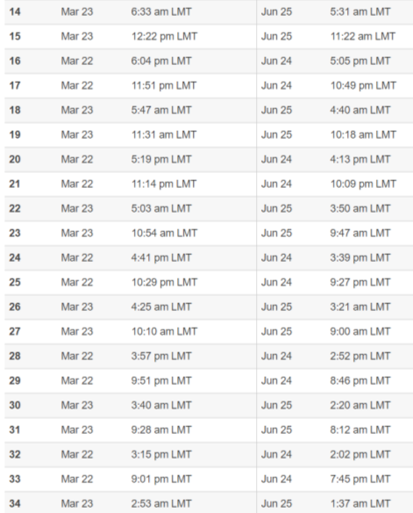
Let’s look at the declared timing of the Tequfah.
The Tequfah is reckoned at 3:40 AM.
This is over three hours different than other charts! Another calendar chart declares Mar 22,
this one - Mar 23!

Slide 48

Scenario #2.
Shall we consider that the sliver moon
was possibly obscured by cloud
and was never even spotted?
Might Yahuah allow this interesting circumstance to happen, permitting
His Plan of Salvation to be fulfilled IMPECCABLY?
48

Slide 49
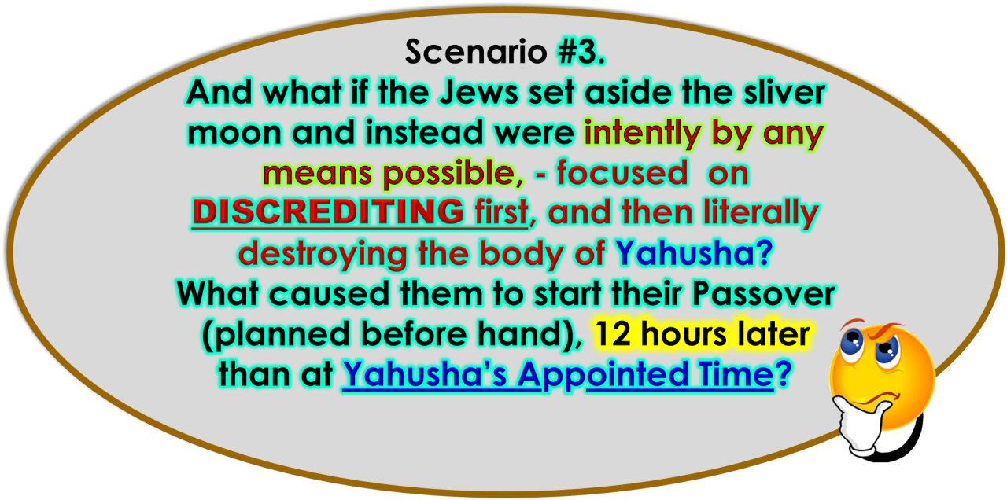
49

Slide 50

Did they hope to convince
the believers of the Tequfah based Covenant Calendar, that the
Jewish lunar system was victorious?
Was the adversary attempting a
SPIRITUAL REVERSAL, A REBUILDING OF the moon city’s CENTRAL BELIEF STRUCTURE?
{re: Yericho’s collapse?}
50

Slide 51
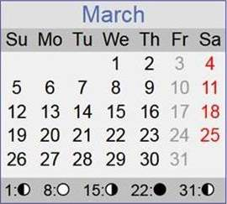

It becomes quite interesting to realize
that when the Jewish CALCULATED
Lunar calendar
is considered, the date
of the sliver moon is then calculated to land
upon Mar 23 – NOT 24!
Would this factor facilitate the Scripture’s
12 hour Passover OFFSET?

Slide 52
Question: If the sliver moon was hidden due to cloud cover, is it possible that the conjunction and consequently the start of the new month (March, Gregorian) was CALCULATED in CE 30?
Shall we look at the CALCULATED PATTERN?
In – The Moon and The Molad –
(A VERY EXTENSIVE DOCUMENT on the Jewish Calculated Lunar Calendar),
it is declared that the months have an
alternating pattern of 29 & 30 day/lunar months.
Is this so in CE 29 – CE 30?

Slide 53
Here is the lunar - conjunction to conjunction - alternating pattern from June CE 29 - through April of CE 30.
Next up, we will examine the result of applying this calendar.
Could this option have been used in CE 30?
Recall Yahusha’s words –
John 7:7 - … My Time is not yet, but YOUR TIME IS ALWAYS READY.
Note the alternating number pattern!
Conjunction to Conjunction
CE 29 – June – July = 29 cycles
July – Aug = 30 c
Aug – Sept = 29 c
Sept – Oct = 30 c
Oct – Nov = 29 c
Nov – Dec = 30 c
CE 29/30 – Dec – Jan = 29 c
CE 30 – Jan – Feb = 30 c
CE 30 – Feb – Mar = 29 c
CE 30 – Mar – Apr = 30 c

Slide 54
Note the alternating number pattern!
Could this Jewish Moon and the Molad system COUNTING OUT THE DAYS of the Lunar month option align to the
Scriptural 12 hour offset?
And what of the inconsistent charts that produce various results including the “late” conjunction resulting in a “Friday Crucifixion?”
Conjunction to Conjunction
CE 29 – June – July = 29 cycles
July – Aug = 30 c
Aug – Sept = 29 c
Sept – Oct = 30 c
Oct – Nov = 29 c
Nov – Dec = 30 c
CE 29/30 – Dec – Jan = 29 c
CE 30 – Jan – Feb = 30 c
CE 30 – Feb – Mar = 29 c
CE 30 – Mar – Apr = 30 c

Slide 55
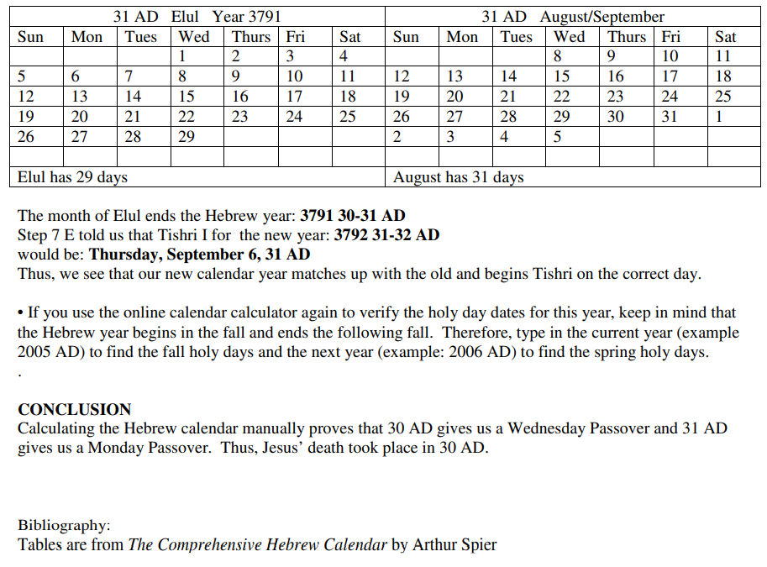
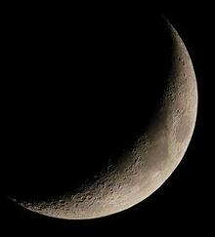
WORKBOOK FOR CALCULATING THE HEBREW CALENDAR FOR 29-30 AND
30-31 AD
(By permission of) Marie Casale
Copyright © 2011

Slide 56

When we reconvene in 10 minutes, your FULL ATTENTION will be imperative for the next slide to understand the remainder of the presentation.

Slide 57
Please, remember this Sunset to Sunset diagram!
Dawn
This triangle represents the lunar based sunset to sunset Light Season.
This dark triangle represents the lunar based sunset to sunset Night Season.
One “Sunset” Cycle
Next up: We will overlay the Sunset to Sunset format, overtop Creation’s day-start design of Dawn to Dawn from Yahuah.
Sunset to Sunset!

Slide 58

You are now going to see the sunset to sunset triangle symbols in this format.
Dawn to Dawn
This triangle represents the (following) morning and afternoon portion of 24 hours.
This format breaks Yahuah’s Covenant from Genesis 1.
This calendar rectangle represents the Dawn to Dawn 24 hour cycle as Yahuah designed at Creation;
but - MINUS THE PAGAN NAME.
It is here for your weekly cycle timing recognition purposes ONLY.
After the sunset, this triangle begins the first 12 hours with the twilight and night portion of their
24 hour cycle.
1 “Sunset” Cycle
Two Sunsets
Please remember this format to understand the following charts.

Slide 59
The CALCULATED Lunar View
The Calculated Conjunction and Sliver Moon provides for a
Mar 23 - after sunset sliver! Hence the
CE 30 New Lunar Month/Year
started on Mar 24.
Consequently; an
(after sunset)
MIDST OF THE WEEK
12 HOUR OFFSET START TO THE
LUNAR ABIB 14!
Calculated Sliver Moon
From this Blue triangle we find perfect Scriptural alignment for the 12 hour Festal offset as written in John 19:42 and Matt 26:5!
Tequfah
Calculated Conjunction
New Moonth day!
CC
Pesach
From New Moonth day, there are 14 cycles to the Lunar Abib 14th, the 5th cycle,
which would start at sunset
of the 4th cycle, IN THE EVENING! See the GRAY triangle!

Slide 60

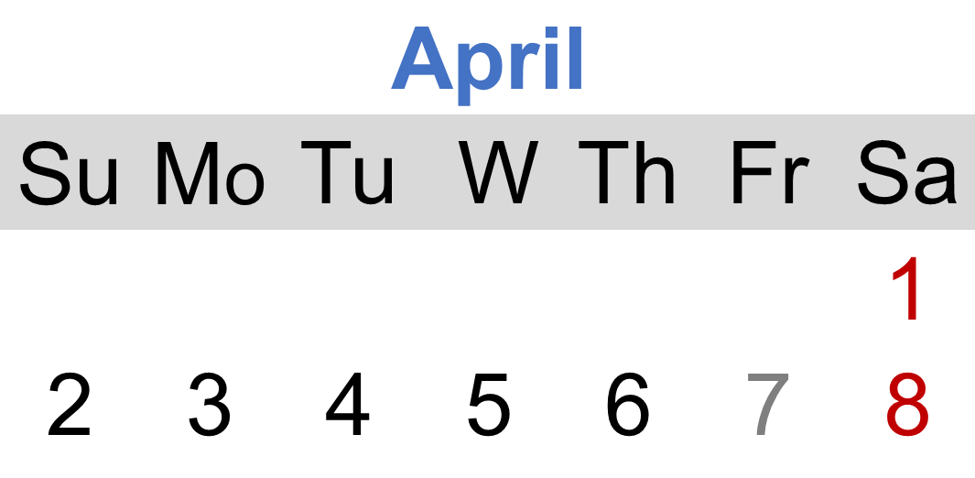

Lunar / Sunset’s 12 Hour Offset!
CC Pesach, Midst of the week.
DAWN TO DAWN!
At DAWN –
John’s FIRST Preparation announcement!
John 19:14 And it was the Preparation of the Passeouer, and about the
sixt houre: and hee sayde
vnto the Iewes,
Beholde your King.
Dan 9:27
Matthew 26:5
“Not at the Festival!”
Yahusha volunteered His “capture” in Gethsemane on Abib 13, both – Covenant Calendar,
AND Lunar calendar.
Will John announce a SECOND PREPARATION belonging to the
LUNAR Calendar which started
at sunset that same Light Season?
Roman Reckoning
Matt 27:19
Geneva 1587

Slide 61

What is a Preparation? It is the cycle before any Shabbat! John, at Dawn, & in accordance to Yahuah’s Covenant timing, announced the
Covenant Preparation of the Passover.
What need would John have to proclaim ANOTHER PREPARATION
(of the Yahudim) 12 hours later
- that same Light Season?
Look for John’s second announcement coming up soon!

Slide 62

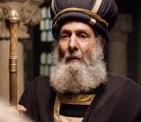
Sunset’s 12 Hour Offset!
CC Pesach, Midst of the week.
DAWN TO DAWN!
Abib 14 COVENANT CALENDAR
& yet – it was STILL the LUNAR morning
of Abib 13: Matt 26:5 It was -
“NOT AT THE FESTIVAL”
Again - Matthew 26:5
“Not at the Festival!”
Yahusha volunteered His “capture” in Gethsemane. It was Abib 13 on both – Covenant Calendar AND the Lunar calendar.
Yahusha was being CRUCIFIED!!
Dawn!
BUT -
NOT ON THEIR FESTIVAL!!!
The Key Factor
The Sunset event!

Slide 63
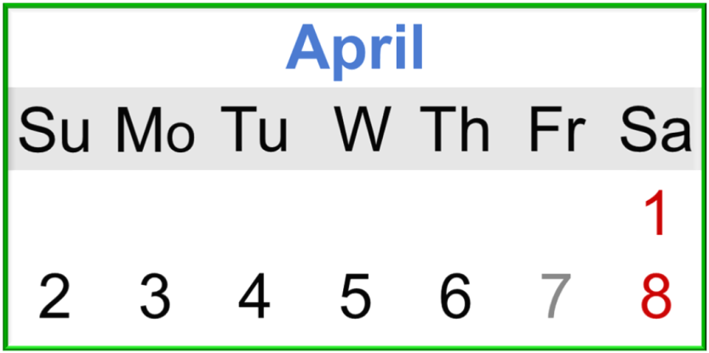
Lunar Abib 14 began at Sunset!
#2!
Abib 14, CC Pesach, Midst of the week.
Abib 14 Covenant Calendar /
& Abib 14 LUNAR – John 19:42
After the sun had set (Matt 26:57-61, Mark 1:32, 15:42-47) Yoseph requested the body of Yahusha.
“There then, BECAUSE OF THE PREPARATION OF THE YAHUDIM they laid Yahusha because
the tomb was near.”
Sunset occurred!

Slide 64
How many Preparations were there on the Light Season of the Crucifixion?
Had not John already announced the Covenant Calendar Preparation as written in John 19:14?

Slide 65

John 19:14 -Therefore since it was
the Preparation …
John 19:42 – Therefore then because of
the Preparation of the Yahudim … …
2 Preparations? When?
1
(Dawn - Covenant Calendar)
YAHUSHA was then CRUCIFIED!
(12 hours after Dawn - Sunset, Lunar Calendar)
2
The 2nd Preparation of the Crucifixion! !!

Slide 66
The TRIPLE Purposed Preparation!
John (& Matt) have exposed in the Scriptures that there were
EXACTLY TWO DIFFERENT PREPARATION CYCLES,
EACH FROM A SEPARATE CALENDAR; INDIVIDUALLY but SIMULTANEOUSLY FUNCTIONING DURING THE
BURIAL PREPARATION NIGHT SEASON
OF YAHUSHA’S BODY!
Two calendars, 12 HOURS OFFSET!
CE 30 ONLY!
Triple Operative!
One Burial - Two Calendars
66

Slide 67

A Preparation cycle always precedes an Annual Shabbat, just like every 7th day Shabbat! ☺
67

Slide 68
The Lunar Abib 14 began at Sunset!
Abib 14 LUNAR – It was
(John 19:42) THE PREPARATION OF THE YAHUDIM - immediately prior to their 1st Shabbat of Unleavened Bread which was to arrive with the following sunset -
(Sunset to Sunset).
Abib 14, CC Pesach, Midst of the week.
After the sun had set, when Yoseph was retrieving Yahusha’s body from the tree, the Jewish Passover –
Abib 14 (Lunar/sunset) had begun!
12 hour offset! !!

Slide 69
The Scriptural
12 hour Lunar calendar Abib 14 OFFSET -
REALIZED!
69

Slide 70
The vast majority of people depended upon the religious leaders to teach them truth. They were taught that the lunar system of worship was TRUTH! We must recall that even the parents of Yahusha did not fully understand
(Luke 2:49,50). So most people had no idea that Yahusha was captured Abib 13, and crucified on Abib 14,
the day of the Pesach in Yahuah’s Covenant.
Most thought Yahusha was another problematic criminal. Nature’s surreal events at the time were designed to wake the people out of their lunar induced slumber and recognize the Mashiach for who He was - AND IS!
Is it becoming a bit clearer why so many did not recognize Yahusha for who He was - AND IS?
Let’s continue -

Slide 71
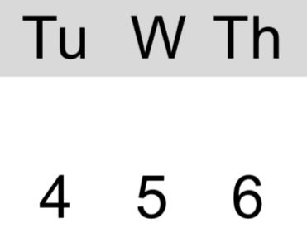
30 CE/31 CC
Luke 23:50 And see, a man named Yosĕph, a council member, a good and righteous man
Luke 23:51 he was not agreeing with their counsel and deed – from Ramathayim, a city of the Yehuḏim, who himself was also waiting for the reign of Elohim,
Luke 23:52 he, going to Pilate, asked for the body
of יהושע.
Luke 23:53 And taking it down, he wrapped it in linen, and laid it in a tomb hewn out of the rock, where no one was yet laid.
Luke 23:54 And it was PREPARATION DAY,
AND THE SABBATH WAS APPROACHING.
CC Abib 14. Yahusha Crucified!
14
AFTER SUNSET,
(Matt 27:57, 58;
Mark 1:32;15:42, 43) –
their Lunar Abib 14 Passover began
just as Yoseph was requesting the body of Yahusha from Pilate.
Approaching: Epiphosko – to GROW LIGHT! – Dawn!

Slide 72
30 CE/31 CC
Dan 9:27, midst of the week!
Luke 23:54 And it was PREPARATION DAY,
CC Abib 14. Yahusha Crucified!
Abib 15 High Shabbat of Unleavened Bread!
The 5th cycle of the week.
4th
14
AND THE SABBATH WAS APPROACHING.
Preparation Night Season! The body of
the Mashiach was being PREPARED
for burial!
Was there any better time to PREPARE - than this???????
Their Lunar Passover had begun. What DEED were the Pharisees and scribes doing the next morning? Remember: The Pharisees were extremely diligent and devout to their own belief system. Would they defile their lunar Abib 15 Shabbat by negotiating a deal with Pilate?

Slide 73
30 CE/31 CC
Matt 27:62 On the NEXT DAY, which was AFTER THE PREPARATION, the chief priests and Pharisees gathered together to Pilate,
Matt 27:63 saying, “Master, we remember,
while He was still alive, how that deceiver
said, ‘After three days I am raised.’
Matt 27:64 “Command, then, that the tomb be safeguarded until the third day, lest His taught ones come by night and steal Him away, and should say to the people,
‘He was raised from the dead.’ And the last deception shall be worse than the first.”
Dan 9:27,midst
CC Abib 14. Yahusha Crucified!
4th
14
Were they obedient to Yahuah’s statutes by presenting themselves in Yahuah’s Tabernacle
at HIS Feast? Or was their allegiance DIRECTED to ANOTHER (earthly) king?
See - Deut 31:20!
The Pharisees and scribes who were extremely adamant about observing their Sabbaths correctly to the point of ultra extremism,
yet somehow, they found it acceptable to be IN PILATE’S COURT negotiating an agreement for a 3 day guard over Yahusha’s tomb.

Slide 74


Deut 31:20
And I shall bring them into the land flowing with milk and honey, of which I swore to their fathers, and they shall eat and be satisfied and be fat, THEN THEY SHALL TURN TO OTHER MIGHTY ONES, AND THEY SHALL SERVE THEM, AND SCORN ME,
AND BREAK MY COVENANT!

Slide 75
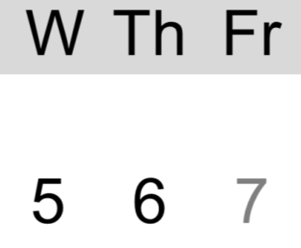
30 CE/31 CC
CC Abib 15 High Shabbat of Unleavened Bread
What were the Pharisees and scribes doing negotiating with Pilate IN HIS COURT, on the U/B Shabbat? Recall how they shunned entering the court at Yahusha’s night trials so they would be undefiled to observe their Passover!
John 18:28 “Then they led יהושע from Qayapha to the palace, and it was early. And they themselves did not go into the palace, lest they should be defiled, but that they might eat the Passover.”
Yet they had no problem defying the statute; to present themselves before Yahuah, in the place where He chooses His Name to dwell, on the premier Shabbat of the U/B Festival? Really?
CC Abib 14. Yahusha Crucified
midst of the week.
4th
14
15
Lunar Abib 14 Light Season!
Does their lunar Abib 14 Light Season compliment the context of this verse?
Matt 27:62 “On the NEXT day, which
was AFTER THE PREPARATION...”
Was it AFTER THE Preparation?
Or was their Abib 14 DURING YAHUAH’S ABIB 15 U/B SHABBAT?
To WHOM was their allegiance? Isa 14:13

Slide 76
30 CE/31 CC
Abib 15 High Shabbat of Unleavened Bread
The Pharisees were fully justified
in their minds, that they were not breaking the Shabbat. How?
Their lunar High Shabbat did not start until the following sunset
had been accomplished.
Consider this:
The people WHO DID NOT QUESTION AND “PROVE ALL THINGS” in their faith, followed the Pharisees and Sadducees along like sheep to a slaughter. They just accepted that this so called “problematic man” was justifiably crucified! … And that it was correctly done before interrupting THEIR festival.
CC Abib 14. Yahusha Crucified
midst of the week.
4th
14
15
Their Lunar Abib 14 Passover Light Season led into and overlapped the first 12 hours of Yahuah’s Abib 15
High Shabbat of
Unleavened Bread!

Slide 77
Shall we now recall the text recording THE PROBLEM
when Yahusha had responded to His earthly parents?
It was referencing Yahusha’s activity IN THE TABERNACLE –
3 days following the Jewish Festival!
What was the BASELINE PROBLEM then?
The lunar calendar was being vividly exposed;
BUT WAS THAT THE BASELINE UNDERLYING PROBLEM?
What is recorded about the condition of Yahusha’s
bewildered earthly parents who had NOT BEEN PAYING
SERIOUS ENOUGH ATTENTION TO THE TORAH?
THE WORD
– not – words.
BUT THEY DID NOT UNDERSTAND THE WORD
which He spoke to them! Luke 2:50

Slide 78
And so also it was at the time of the crucifixion.
The people HAD NOT QUESTIONED THE TEACHINGS!
They had not proven their belief structure according to
the words of the Scriptures!
THE MASHIACH was slain before their very eyes and the lunar delusion/deception caused them to look forward to another mashiach to come and save them!
Who could that other mashiach be?
For YOU have said in YOUR heart, “Let ME go up to the shamayim (heavens), let ME RAISE MY THRONE above the stars of El [Yahuah], let ME SIT IN THE MOUNT OF CONGREGATION
on the sides of the north.” Isa 14:13

Slide 79


Two Calendars, one of the abominable (Isa 1:13) Lunar type!
Some APPROPIATE Words spoken by our Creator –
John 7:19 “Did not Mosheh give you the Torah?
YET NOT ONE OF YOU DOES THE TORAH!
Why do you seek to kill Me?”
Matt 5:20 “For I say to you, that unless your righteousness EXCEEDS that of the scribes and Pharisees, you shall
by no means enter into the reign of the heavens.
See also -
Matt 15:3-9; Mark 7:7-13; Acts 7:53; Rom 2:23-27; Gal 6:13.

Slide 80
When the Pharisees were justified by their beliefs through
the lunar based calendar, to be negotiating with Pilate on Yahuah’s High Shabbat of Unleavened Bread morning –
WHAT “saviour” WAS RECEIVNG HONOUR, ADMIRATION
AND ALLEGIANCE FROM THEM?
Shall we continue with the Passion week expose?

Slide 81

30 CE/31 CC
Where was Yahusha in all this muddle?
According to the Torah, (& the Red Heifer Type)
Yahusha, the Antitype, was to be
processed and placed in the stipulated location, –
BEFORE THE DAWN OF MORNING!
Morning - DAWN of Abib 15 Shabbat of U/B!
Exo 12:10 ‘And do not leave of it until morning, and what remains of it until morning you are to burn with fire.’
We learn from the Red Heifer sacrifice TYPE; that the ash remains of the scarlet blood sacrifice MUST be placed in a CLEAN location (Num 19:9).
Luke 23:53 And taking it down, he wrapped it in linen, and laid it in a tomb hewn out of the rock,
WHERE NO ONE WAS YET LAID.
CC Abib 14. Yahusha Crucified
midst of the week.
4th
14
Matt 5:17
Do not think that I came to destroy the Torah or the Prophets.
I did not come to destroy but to complete.
DAWN
Linear fulfillment!

Slide 82
30 CE/31 CC
What function did the Ladies perceive?
CC Abib 14. Yahusha Crucified
midst of the week.
Luke 23:55 And the women who had come with Him from Galil followed after, and saw the tomb and how His body was laid.
4th
14
Lunar Abib 14 Night Season!
The ladies had been faithfully observing the burial process from a distance.

Slide 83
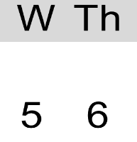
30 CE/31 CC
The High Shabbat started at Dawn!
Nearing the 5th cycle of the week, the ONE and ONLY High Shabbat of the year, but still the PREPARATION BURIAL NIGHT SEASON,
Luke recorded the ensuing Shabbat was about to - EPIPHOSKO!
TO GROW LIGHT! – DAWN!
CC Abib 14. Yahusha Crucified
midst of the week.
4th
14
15
Lunar Abib 14 Night Season!
Yes, another witness for Dawn to Dawn just as Genesis 1 clearly documents.
Scripture documents clearly that it was the Shabbat morning! HOW can Sunset Theory declare it to be still - Passover Abib 14 (Light Season)? WHY, HOW? & by Whom???

Slide 84
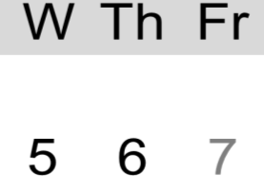
30 CE/31 CC
Abib 16 - The Purchase of more Spices!
1
2
Mark 16:1 And when the Sabbath was past,
(that is - Abib 15 U/B High Shabbat)
CC Abib 14. Yahusha Crucified
midst of the week.
4th
14
15
16
Lunar Abib 14 Night Season!
Miryam from Maḡdala, and Miryam the mother of Yaʽaqoḇ, and Shelomah bought spices, to go
and anoint Him.
The two Miryams, having seen the tomb and the Body where it was laid, knowing that Yoseph and Nicodemus had already performed the proper burial customs, they purchased spices with intentions to apply the additional spices on Yahusha for fragrance purposes.

Slide 85
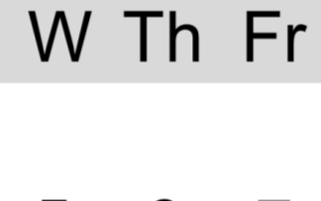
30 CE/31 CC
Abib 16 - The Purchase of more Spices!
1
2
CC Abib 14. Yahusha Crucified
midst of the week.
Luke 23:56 (A) And having returned,
they prepared spices and perfumes.
4th
14
15
16
Lunar Abib 14 Night Season!
It was now the 6th cycle Preparation.
Was there any better time than this to PREPARE spices? No! A Preparation is the VERY BEST time to PREPARE spices!
Yahusha was NOT crucified on “Friday!”
Not according to the Scriptures!
But what was
the lunar timing?

Slide 86

30 CE/31 CC
The Lunar system exposed!
CC Abib 14. Yahusha Crucified
midst of the week.
Yahusha was placed in the tomb just before Dawn, approximately 13 hours prior to their lunar Abib 15 Shabbat Night Season, which began at sunset – on the 5th cycle of the week.
*
4th
14
15
16
Lunar Abib 14 Night Season!
*
Sunset
Their Lunar Abib 15 Shabbat Night Season started half way through Yahuah’s Abib 15 Shabbat of Unleavened Bread.
Yahuah’s High Shabbat ended
at Dawn! Naturally! ☺
That very (*Shabbat) morning, the Pharisees had negotiated with Pilate for a 3 day guard. Their lunar Abib 14 Passover Light Season ended with the sunset. It was not yet an U/B Shabbat according to their deceptive lunar calendar!

Slide 87
30 CE/31 CC
Please allow me to repeat -
The Pharisee’s Lunar Abib 15 Shabbat
Night Season started half way through Yahuah’s Abib 15 Shabbat of Unleavened Bread; a 12 hour offset!
Yahuah’s High Shabbat ended
at Dawn! {Epiphosko – grow light}.
CC Abib 14. Yahusha Crucified
midst of the week.
4th
14
15
16
Lunar Abib 14 Night Season!
Sunset
The Scripture states in Isa 1:13 & 14 -
“Stop bringing futile offerings, incense, it is an abomination to Me.
New Moons, Sabbaths, the calling of meetings – I am unable to bear UNRIGHTEOUSNESS and assembly.
“My being HATES YOUR NEW MOONS and your appointed times,
they are a trouble to Me, I am weary of bearing them.”

Slide 88
30 CE/31 CC
A Lunar
CONUNDRUM!
1
2
CC Abib 14. Yahusha Crucified
midst of the week.
4th
14
If the lunar Shabbat of Abib 15 ENDED at sunset (as sunset theory demands) -
15
16
Lunar Abib 14 Night Season!
and the 7th day Shabbat STARTED at
sunset (as sunset theory demands)…
Where then does Mark 16:1 deliver Scriptural alignment?
And when the Shabbat was PAST, Miryam from Magdala, and Miryam of Ya’aqov, and Shelomah bought spices to go and anoint Him. (?????)
Did the ladies wait for the lunar Abib 15 Shabbat to pass, to PURCHASE SPICES ON THE sunset 7TH day SHABBAT thinking that would be the LESSER OF SINS?

Slide 89
30 CE/31 CC
Deeper into the Lunar
CONUNDRUM!
1
2
CC Abib 14. Yahusha Crucified
midst of the week.
4th
14
Two sunset Shabbatim
“back to back!”
15
16
Lunar Abib 14 Night Season!
Sunset’s Abib 15 Shabbat
Sunset’s 7th day Shabbat
Was this sunset a very special lunar designed sunset which provided a neutral time zone upon which there was no Shabbat command, when they could, for a minute or two, purchase spices without breaking Yahuah’s Shabbat statutes?
And what of the MIXING? (WORK?)

Slide 90
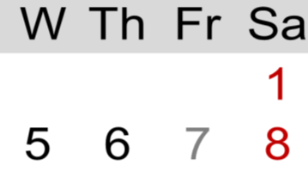
30 CE/31 CC
Deeper into the Lunar
CONUNDRUM!
1
2
CC Abib 14. Yahusha Crucified
midst of the week.
4th
14
Two sunset Shabbatim
“back to back!”
15
16
Lunar Abib 14 Night Season!
Sunset’s Abib 15 Sabbath
Sunset’s 7th day Sabbath
The Scriptures reveal -Luke 23:56 (b) … they prepared spices and perfumes. {WORK!}
And they rested on the Shabbat according to the command.
On WHICH SHABBAT did they Purchase, Transport, Mix AND REST?

Slide 91

The Gospels document the ladies arrived at the tomb on the first day of the week at Sunrise,
WITH THE SPICES THEY HAD
ALREADY PREPARED!
If one desires to stand by the sunset to sunset theory, then one must also be able to explain how the ladies avoided BREAKING YAHUAH’S SHABBAT!
Both of them!
Moving forward …

Slide 92
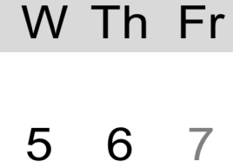
30 CE/31 CC
Yahuah’s Plan from Eternity!
1
2
CC
Abib 14. Yahusha Crucified
midst of the week.
When the Shabbat of Abib 15, the 5th cycle of the week, was past, Miryam from Magdala and Miryam of Ya’aqov and Shelomoh had OODLES IF TIME to “legally” purchase spices and
prepare them on the Preparation cycle
before the 7th day Shabbat.
Was there any better time than the Preparation cycle, to do this honourable duty for the Body of Yahusha, that was laying in wait for resurrection to FULFILL - the First Fruit?
4th
14
15
16
Is it possible Dawn starts and ends the Shabbat of Abib 15? This factor would give the ladies a full 24 hour 6th cycle period to purchase, transport, mix, package the spices and sleep. All this before being at the tomb at Sunrise – the first cycle of the week – only to find an empty tomb!

Slide 93
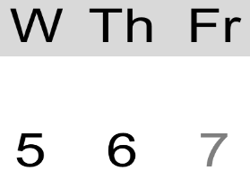
30 CE/31 CC
Shabbat - Lunar system exposure!
1
2
CC Abib 14. Yahusha Crucified
midst of the week.
4th
14
15
16
Lunar Abib 14 Night Season!
?
On Yahuah’s Preparation cycle, the Shabbat began with the sunset? ???
Jer 33:20 “Thus said יהוה, ‘If
you could break My covenant with the day and My covenant with the night, so that there be not
day and night in their season …
Man has attempted his asinine control
once again.

Slide 94
Jer 33:20 “Thus said יהוה, ‘If you could break
My covenant with the day and My covenant with the night,
so that there be not day and night in their season …”
Is it possible that one level of understanding this verse could be knowing that from Creation, the Light Season was COVENANTED by Yahuah to lead the 24 hour cycle?
And the Night Season was COVENANTED by Yahuah to follow in humble succession completing each 24 hour cycle – for eternity?
Let’s get back to the Passion week!

Slide 95

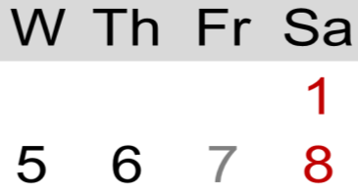
30 CE/31 CC
Shabbat is for Rest
1
2
3
CC
Abib 14. Yahusha Crucified
midst of the week.
It was the 7th cycle of the week. Nearing the end of this cycle, at the point just before Dawn of the first cycle of the week, Yahusha had met Mary Magdalene before He ascended to fulfill the Wave Sheaf.
Yahusha had already completed Jonah’s Sign prophecy of 3 Light Seasons and 3 Night Seasons
until His resurrection.
4th
14
15
16
The lunar worship system claims the title of CONFUSION by attempting to break Yahuah’s Covenants of the Light and Night Seasons. It declares the sunset gives authority to the Night Season to lead out the 24 hour cycle!
Notes:
Here’s my note: I see the text mentions Jonah 1st and then the tomb next.
Matt 12:40 KJV For as Jonas was [1] three days and three nights in the whale's belly;
so shall the Son of man be [2] three days and three nights in the heart of the earth.
[1] Jonah was held in “bondage” … no way out and no way of escape until Yah said so. I don’t believe Jonah was dead, or even unconscious because Jonah 2:1 says “he prayed” and THEN he was released. So, the two situations are not identical – but only a comparison that both had a timeframe of “3 days & 3 nights.” How did Jonah’s admission of fault begin? He confessed and told them to throw him into the sea. And they did after they tried one more time to save everything. Upon their words – their speaking voices began that timeline of 3 days and 3 nights – and at the same time they threw him overboard. Jonah was not released UNTIL his speaking voice prayed – THEN the fish vomited him upon the land.
The principles for both timelines are the same just as given in Dan 4. A speaking voice begins the timeline, and a speaking voice ends the timeline. There is no speaking voice recorded in the Gospels at the closing of the tomb. Only facts are given. We have to go back to the speaking voices to find the beginning and ending of Yah’s timeline. However, this other timeline of ABOUT 3 days and 3 nights from the closing of the tomb until Mary gets there – has no speaking voices, but it does have the 12 hr offset – in 2 places – and then of course, as I have mentioned, the antitype to this is found in Rev 11. That’s for later.
[2] From the time Yahusha died at the 9th hour, He too was in bondage to death – bound by circumstances that He promised He would not release Himself from UNTIL the 72 hours is completed.
He was not IN the heart of the earth, as “under the ground” as the tomb was above the ground. But, I see the “tree” and the “tomb” are the “heart location” of this whole earth – this was the location for the “heartbeat of salvation.” And if you want to expand and take this further, considering the flat earth truth … when looking down from heaven, indeed that very spot is the place of Heaven’s heart. It is at that spot where everything changes – where type’s are fulfilled, where the purest blood is accepted. None of this happened in the sanhedrin, Pilate’s court, or Herod’s palace, or the Garden of Gethsemane. THAT spot – from the tree to the NEARBY tomb - was the heart.
OK, I appreciate that you changed the wording in the box a little bit, but it doesn’t change the thought from what you had before. I will give another alternative in the scratch, and then I’m going to let this go for the moment due to the fact that you are totally bombarded by so many other things right now. However, we will have to sort this out one day. I just hope and pray no one, but no one picks up on this at this time. We also know the enemy wants to push the popular belief, and this timeline starting at the tomb closure certainly seems to be the popular belief. However, it is only popular because people do not understand Dan 4 and what it has to do with understanding how to work properly with timelines. It’s too bad that you have not had time to thoroughly investigate Dan 4 – especially with us at sukkot 2020 where I taught this for a very specific reason. I recognize s.a.tan is on our trail – and I’m not going to fight about this – we must sit down and study it out. Remember the time you had to spend with me to understand how to count to 3 (and 30) in Exo 12 and to the quail? It’s like that. It just took a while until I got it. I HAVE FULL CONFIDENCE THAT WE ARE GOING TO GET THIS FIGURED OUT SOON. (:

Slide 96
Lev 23:15 ‘And from the morrow after the Sabbath, from the day that you brought the sheaf of the wave offering, you shall count for yourselves: seven completed Sabbaths.
… the morrow after the Sabbath, from the day
that you brought the sheaf of the wave offering …’
Yahusha, the Antitype:
Did Yahusha fulfill this Festival correctly?
Or should we be looking for another, different Antitype?
Torah Fulfillment imperatively needed to be on the
1st cycle of the week!

Slide 97


30 CE/31 CC
The day after the 7th day Shabbat - Wave Sheaf.
1
2
3
CC
Abib 14. Yahusha Crucified
midst of the week.
John 20:1 “And on one of the shabbathoth, Miryam from Magdala came to the tomb in the morning, when it was still dim, and saw
that the stone had been removed from the tomb.”
Or – when it was still dark. This is Roman Reckoning for timeframe.
4th
14
15
16
17
18
9
What is Roman Reckoning? Roman Reckoning exists in our civilization today. The midnight marker is claimed to be the end and start of the 24 hour period.
John, living in Antioch, was writing to a Roman readership. He wrote in R.R. so they would recognize the timeframe.

Slide 98

30 CE/31 CC
Wave Sheaf Day
1
2
3
Yahusha said to Mary –
John 20:17 יהושע said to her, “Do not hold on to Me, for I have not yet ASCENDED to My Father. But go to My brothers and say to them, ‘I am ascending to My Father and
your Father, and to
My Elohim and
your Elohim.’ ”
CC
Abib 14. Yahusha Crucified
midst of the week.
4th
14
15
16
17
18
9
Yahusha, was fulfilling the requirement of presenting the First Fruit/Wave Sheaf, of which He was the official Antitype. Yahusha being the Kohen Ha Gadol
(High Priest), presented Himself as
the First Fruit to be presented by the
Kohen Ha Gadol, (Lev 23:11) before Yahuah.

Slide 99
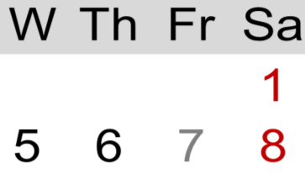

30 CE/31 CC
Yahusha returned!
1
2
3
We see in Matt 28:9 that Yahusha returned to earth quite quickly. He met with others and later met the two men of Emmaus.
However the meeting room of John 20:19 at evening is brilliant! Evening is twilight and is after
the sunset!
CC
Abib 14. Yahusha Crucified
midst of the week.
4th
14
18
15
16
17
John 20:19 When therefore it was EVENING ON THAT DAY, THE FIRST DAY OF THE WEEK, and when the doors were shut where the taught ones met, for fear of the Yehuḏim, יהושע came
and stood in the midst, and said to them, “Peace to you.”
Bells, Whistles, Sirens and Fireworks!

Slide 100
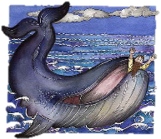

30 CE/31 CC
Yahusha returned!
1
2
3
CC
Abib 14. Yahusha Crucified
midst of the week.
Did you notice? It was evening on that day, the first day of the week!
What happened to
the sunset?
Why did the sunset not change the day on this particular time?
Did Yahusha’s return cause a
“Calendar Anomaly?”
4th
14
15
16
18
17
BIG SECRET! In the Scriptures (and the kingdom of Yahuah), the sunset NEVER changes any day of any kind! Full Stop!

Slide 101

The Wrap Up
1. Equilux - completely out of the equation.
Tequfah as the first cycle of the year – annihilated!
CE 26 – 29, 31 – 34, -- a 12 hour offset with the
midst of the week Crucifixion – NOT POSSIBLE!
4. Lunar Calendar verified and exposed – profoundly!
5. Year with Midst of the Week Crucifixion and 12 hour offset exposed by Scripture? Brilliantly!

Slide 102
Yahusha’s
Crucifixion
CE 30 –
The Tequfah happens March 22!
That Tequfah brings on
CC 31 ! !!
102

Slide 103

Yahusha’s
Crucifixion
CC 31 / CE 30
The End! For now! ☺
Why Covenant Calendar 31?
For no other reason than this was Yahusha’s age when He died.
He was The Lamb of the First Year.
103

Slide 104
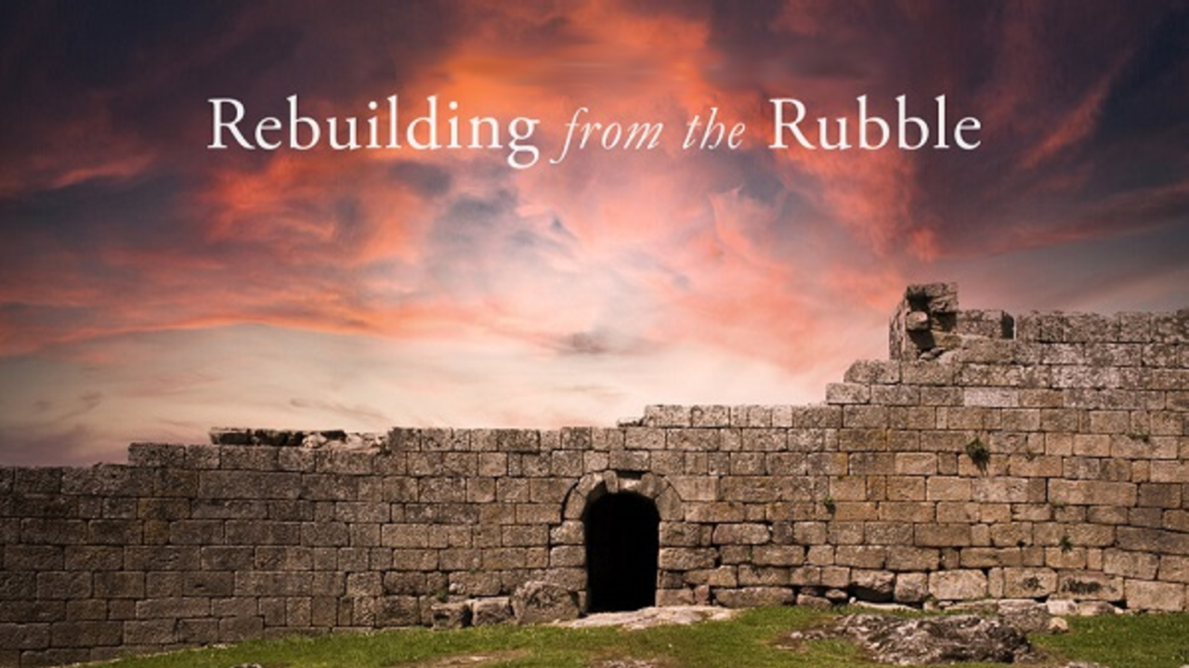


Please Join Us Live Each Week
Sign up with Covenant Calendar Club
for the Friday & Sabbath Zoom Meetings
(including live discussion)
https://studythecalendar.com/sign-up/

Slide 105
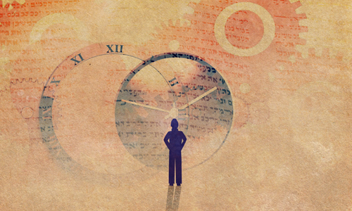

It’s time to empty your “TRADITION BOX!”
May Yahuah bless you greatly with wisdom,
peace and courage.
Send your questions and/or responses to –
questions@studythecalendar.com
Thank you & Shalom!
105

