Slide 1
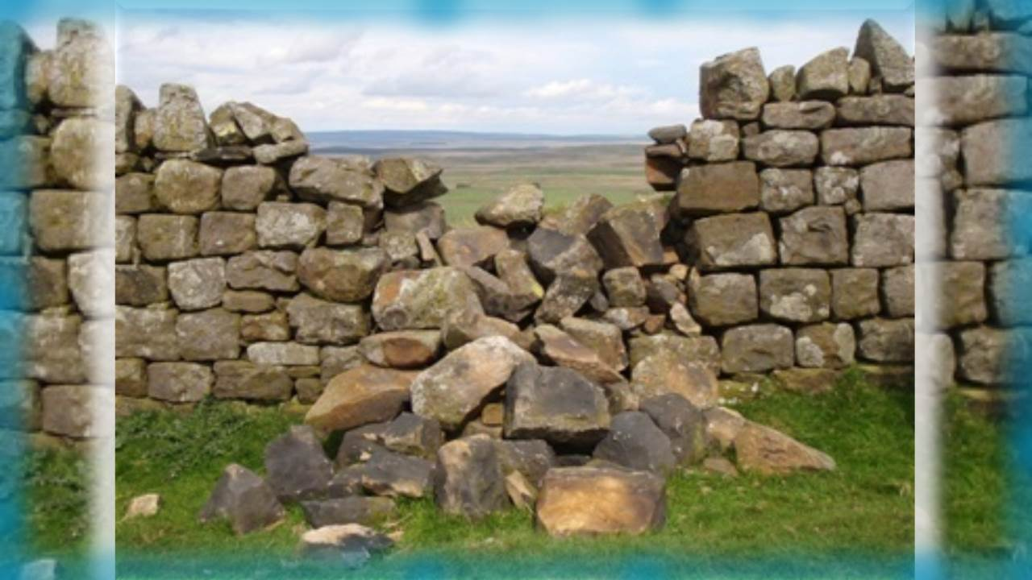


Yahuah’s
Covenant
Calendar -
The
Mini
Edition!
Removes the Rubble
of Tradition!
Notes:
Apr 2/22 We re-launched only the 5 min teaser this time – to see what the results will be. No changes in the blurb.
5:30 min: 5.3b Website: Youtube: https://youtu.be/ytGEe-UDomM
** 5.3a Teaser - Yahusha's Crucifixion Year - Part 1 In less than 5 min, treat yourself to some thought provoking information - and see if you know the answers to questions that stem from the calendar study in the Gospels. Absolutely profound, to say the least, is the discovery of two calendars in the Gospels, yes, you read right! There is no doubt the Gospels record the "unbelieving Jews" were following their lunar calendar. And of course, Yahusha is going to stay true to His blood-ratified Covenant Calendar and lay down His life ON "HIS" Passover Day. But the question is: "How close is His Passover Day to the Passover day of the lunar calendar?" Have you ever heard of such a thing? Have you heard there is a 12 hour offset between these two calendars? Well if not, you now have an opportunity to "hear the rest of the story." Maybe the next few minutes will show you why? Shalom from Covenant Calendar Club, and May His Kingdom be Near Unto You!
Blurb for Website with Questions:
With many different calendars all laying claim to a specific year of the crucifixion, which ones can ALSO claim full and complete alignment with the words of the Scripture? Better yet, which calendars can reveal total compliance and timing fulfillment with each and every text of the Passion Week?
Which of these can accomplish a step by step pathway of the Lunar Calendar Passover of the Jews, and also, the Torah based Dawn to Dawn Passover of the Covenant, and still produce meticulous alignment with the Messianic Testament (New Testament) documentation?
And if these proclaimers of the Faith can achieve a suitable CE year with the Scriptural midst of the week (Wed) crucifixion as precisely detailed in the Scriptures, can they also,
find precise alignment with the crucial 12 hour offset which pinpoints the accurate CE year of the crucifixion by
defining the two different Passovers, of the two separate calendars as specifically recorded by Matthew and John?
Which of the years from CE 26 to CE 34 cannot apply?
What makes the CE year of the crucifixion so incredibly blinding brilliant, that it cannot be mistaken?
Apr 10/21 Tim felt he needed to teach this today since Stacey is ill – Apr 10th. This is the last edit from mar 10th on the moon phases. The teaching went very good considering Tim had not
seen this since Mar 10th. The CCC panel were well pleased and saw what was going on. This needed to be taught after LWM’s bashing the last 3 weeks. Charlene.

Slide 2


Are the Scriptures accurate?
Are there Scriptural
characteristics in the Gospels
that positively identify
the Crucifixion year so precise,
it simply cannot be mistaken?

Slide 3

Can you verify your beliefs in Scripture?
Does Yahusha’s Life begin at Conception?
AFTER THE FEAST OF THE JEWS what was Yahusha OBSERVING IN the Tabernacle 3 Days “later”? Which statutes was Yahusha then fulfilling?
Did you know HE was not lost?
Was there really a Midst of the Week fulfillment, or was the crucifixion on Friday?
Was Yahusha a Lamb of the 1st Year or a lamb of the 3rd year?
Have you recognized from Scripture, the Two Different Calendars that functioned
simultaneously together in the Gospels - fulfilling prophecy?
Did you know the Gospels record TWO PASSOVERS - in ONE DAY!!
Have you ever heard that Matthew & John’s writings declare a
phenomenal 12 HOUR OFFSET at these TWO Passover timings?!
Did you know all of this information is documented with the
Dawn to Dawn Reckoning of Yahuah’s Covenant?
Why did the Scribes negotiate business with Pilate - ON SHABBAT?
Notes:
July 30 & 31/21:
We did 2 short versions: 27 min: 4.10a website: Youtube: https://www.youtube.com/watch?v=lV9Q1LjNiXM
5 min: 4.10b Website: Youtube: https://www.youtube.com/watch?v=76_lMeuYyh8

Slide 4
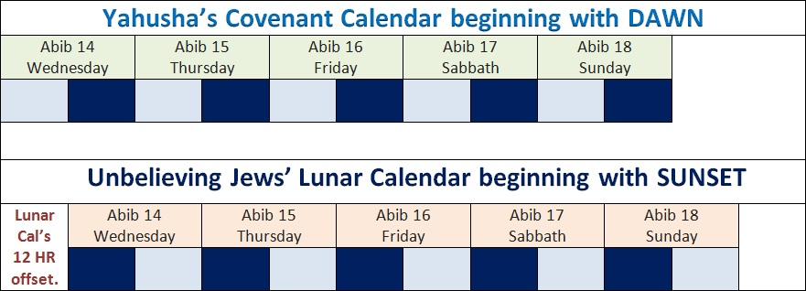
Visualizing the 12 Hour Offset
The 12 hour offset at Yahusha’s Passover is found only on the 4th cycle [Wed].
Yahuah’s Covenant Calendar begins the day with the Dawn twilight.
The lunar/solar calendar began its day 12 HOURS LATER – AT SUNSET.
According to Dan 9:27, Passover must be found on
a 4th cycle!
Yahusha crucified on the tree in this Light Season!
Matthew & John establish the 12 hour offset lunar calendar

Slide 5


How can we be sure about this offset?
Of Crucifying Yahusha - When the scribes declared -
NOT AT THE FESTIVAL
lest there be an uproar among the people.
Matt 26:5 … they said,
Of WHOSE Festival were they referencing?
Their Lunar Passover or the Passover of Yahuah’s Covenant?
Did the scribes and Pharisees fail to their word,
or were they STEADFAST in their word?

Slide 6
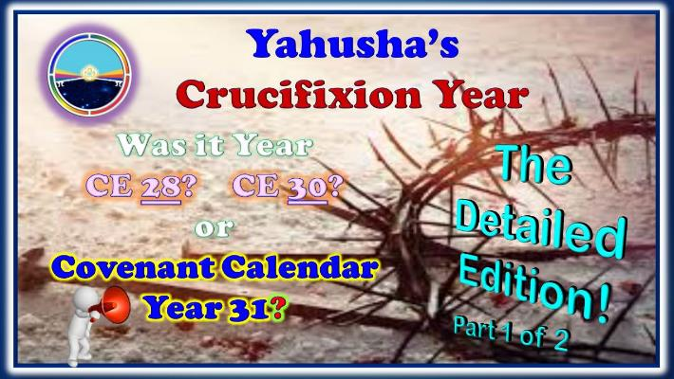
Your Questions Deserve Answers
Highly detailed documentation for CE 26-29 & 31-34 are provided with the study link below.
Check it out for yourself and be ready for the astounding Part 2.
What happens in CE 30? !!
Follow this Website link for the complete study:
https://studythecalendar.com/4-10-yahushas-crucifixion-year-part-1/
Notes:
4.10 Yahusha’s Crucifixion Year Pt 1: Website: https://studythecalendar.com/4-10-yahushas-crucifixion-year-part-1/
Youtube: https://youtu.be/-0sgiri4LuI

Slide 7
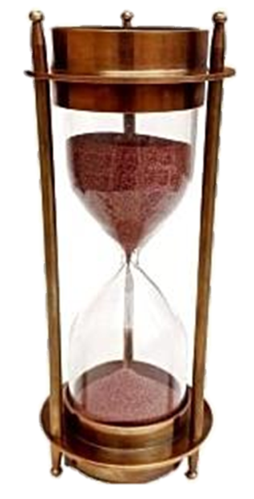

Yahuah marks the sands of time.
Questions & Comments can be sent to Timothy Astleford:
questions@studythecalendar.com
Web: www.studythecalendar.com
Thank –you & Shalom!

