Slide 1


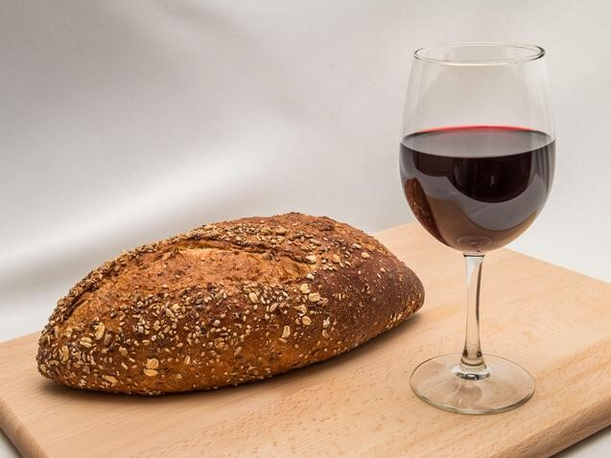
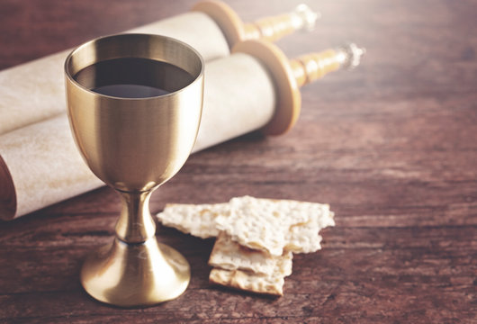
Was The Last Supper
Served with 2 Types of Bread?
Leavened
Bread?
Unleavened
Bread?
Notes:
5.2a Teaser for The Bread of the Last Supper 19 slides; 6 min; recorded 645 pm Mar 24th. Website: Youtube:
5.2a Blurb: Many have questions at this time of the year as Passover is approaching and everything is being made ready to celebrate the ordinances of Yahusha’s Supper as He instituted with His disciples only a few hours before He was “the sacrifice” for each one of us. It is getting to be more popular all the time for churches and assemblies to serve leavened bread and juice for these emblems. What happened for so many churches to make this switch? Didn’t our pioneers all understand that our Messiah’s Body can never be represented with “leavened products”? In this short introduction, our question is this: “Should not the gospel writer’s be able to give us clarity on the type of bread at this Last Supper?” Or is it acceptable to find our answers on the internet and hope it is correct? Perhaps this short introduction will help you formulate where the truth is to be found, so just “Come and See.” Shalom!

Slide 2


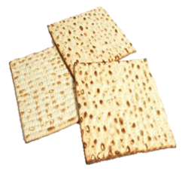
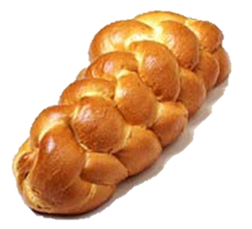


Why is it so Important to Know if the bread at
The Last Supper Table …
1. Leavened?
2. Unleavened?
3. Or … Both?

Slide 3
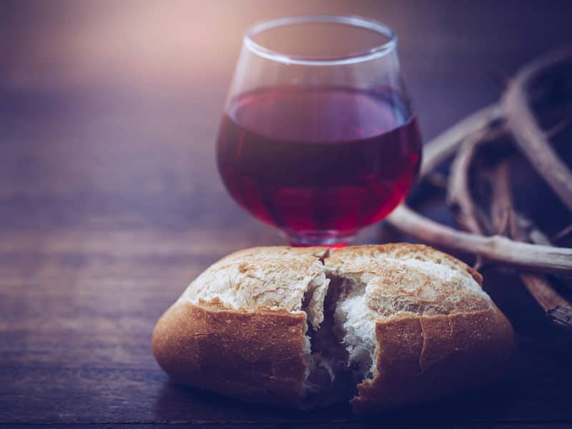
Has this happened to you?
You accepted to attend “communion” with your friend, only to find that leavened bread was being served for what this church called “holy communion”?

Slide 4
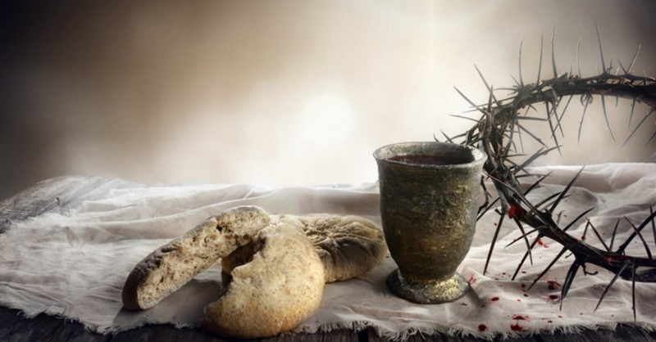
Did you begin to wonder?
If you were taught error
all your life? … or:
Was there some new explanation that makes everything
“modern” these days?

Slide 5

Or, did you reach for the internet to find an answer?

Slide 6


The Internet had
several answers:
You can use any bread for communion. People have totally misunderstood what communion is. It's just where you eat with brothers and sisters and remember Christ; it's that simple.

Slide 7

Answer #2:
The Eastern Churches (except the Armenians) make use of leavened bread, while the Western Churches, since the 11th century, have
used unleavened bread.
What?
Why?

Slide 8

Answer #3:
Eastern Christians associate unleavened bread with the Old Testament and allow
only for bread with yeast,
as a symbol of the New Covenant in Christ's blood.

Slide 9


Answer #4 – Check the Scriptures for “bread”:
The Greek word for “bread” is <artos>.
  Strong’s -- bread G740 artos;
  from G142; bread (as raised) or a loaf:
  KJV - (shew-) bread, loaf.

Slide 10

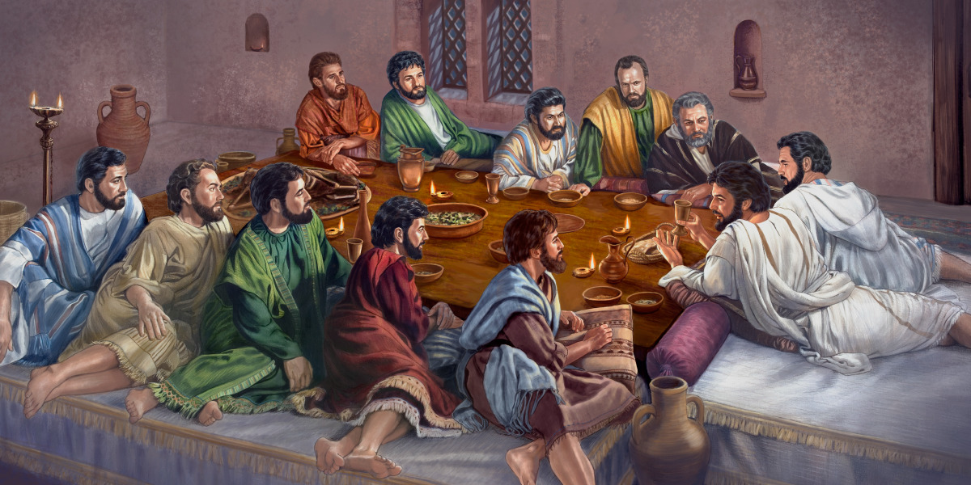
And even more questions?
The Greek definition for “bread” just caused another whole set of questions !
Did Yahusha really use leavened bread to represent His broken Body?

Slide 11
The Scriptures Said It
The Qodesh Scriptures said it—
Well ... I never really read it,
But someone said, “it said it,”
So of course it must be so.
Then you
remembered!
To prove my points, I'll quote it,
Though I can't show where they wrote it,
But someone said, “it said it,”
And that's all I need to know.
Thelma Burton — Adapted by Sue

Slide 12

It saves a lot of time for me,
If I just listen carefully,
When others speak with utmost glee,
Of what they say it says—
Though I can't repeat it word for word,
I'll tell you what I think I heard,
And quote you things from "Yahuah's Word" ??
That no one's ever read.

Slide 13


Out of
Surely we should be able to find the “right bread” for the Last Supper?

Slide 14

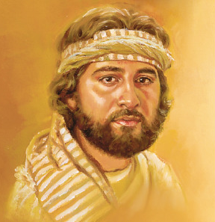
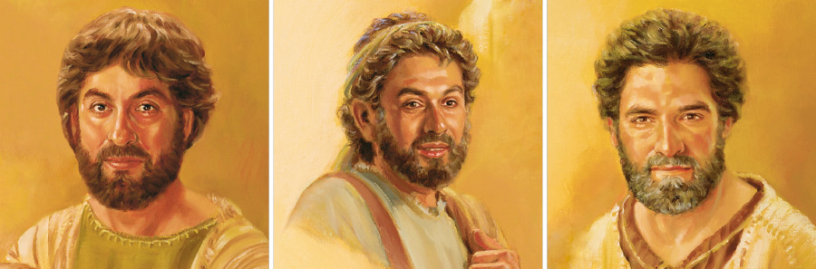

The writers of the Synoptic Gospels are 3 witnesses.
But just like in Part 1, they do not solve this important question!

Slide 15

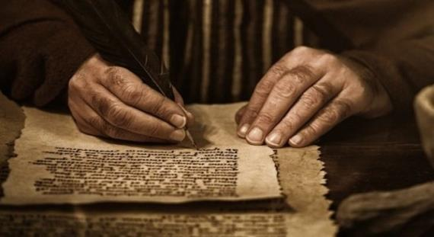
We already know that John’s Gospel is very unique!
Do we have to depend on John again, to solve this dilemma of the bread?

Slide 16

If you are interested
in finding the
then…

Slide 17


Come & See
How will the Scriptures
provide the
to another long standing
“Knotty Problem”?

Slide 18
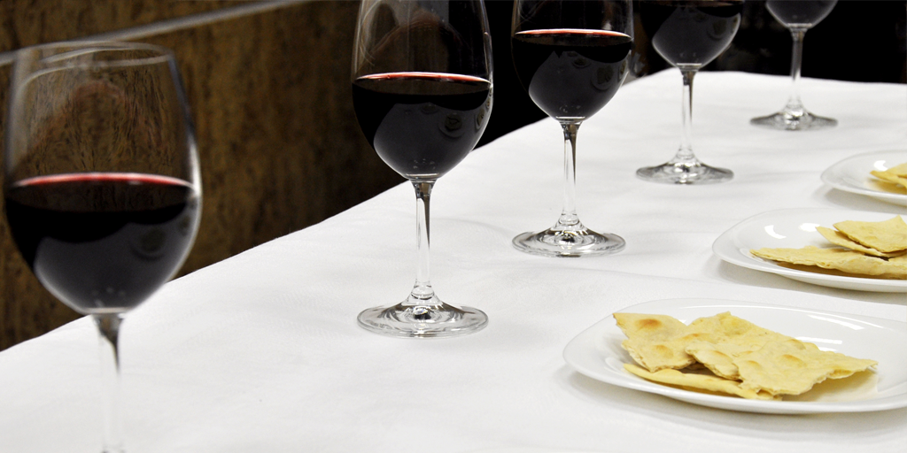
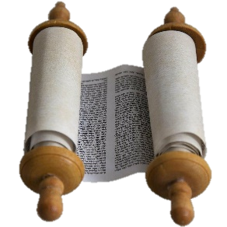
Then, you will be Prepared
for Passover!

Slide 19



If you enjoyed your time today
Join Us for the full study!
then
Sign up with Covenant Calendar Club
for the Friday & Shabbat
Zoom Meetings
(including live discussion)
https://studythecalendar.com/sign-up/
(All studies are free to download.)
Thank-you!
Shalom!
19

