Slide 1


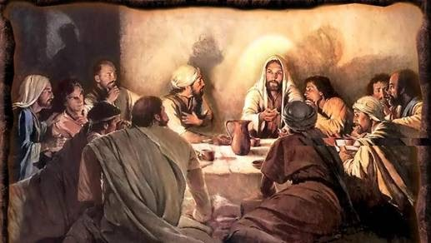
The Last Supper
in the Gospel Account
Part 1 of 2
Notes:
Mar 19/22 5.1b – The Last Supper 91 slides Website: Youtube:
Blurb for 5.1b: It was a very important event, that evening when Yahusha sat down with His disciples to celebrate the last few moments of His life. He had many things to share with them while there was still time. The Upper Room was secured and a Last Supper is written about in the Gospels. However with all the confusion of many calendars – especially around the day-start – this also lends to a massive amount of confusion as to the date/day of this Last Supper. Was it the evening of Abib 13th – or – the evening of Abib 14th? What day are the Gospels talking about? A Tuesday, or a Wednesday? Unfortunately, several phrases in the Synoptic Gospels confuse the timing even more. This is a calendar puzzle that will have a solution by one very special Gospel writer, as we inspect each clue one at a time. You can know the truth of this matter – just, “Come and See.” Shalom!

Slide 2
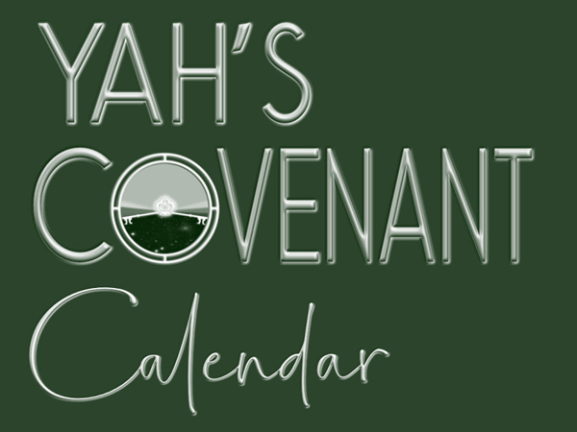

The Last Supper in the Gospel Account
Part 2 of 2
Approx. Date:
Abib in Year of
the Crucifixion
Visit: studythecalendar.com

Slide 3

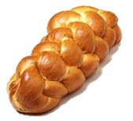
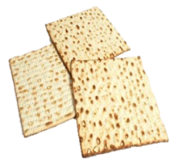

“The”
Last Supper
Part 1
Part 2
The Controversy
over the “date” of
The Last Supper
Both types of bread were at
The Last Supper Table
?
Abib 13th
Abib 14th
Was “The Last Supper” the Passover Meal?
ONLY one bread
can represent
Yahusha’s Body.
3

Slide 4

What was the “day” and month “date” of The Last Supper?
Part 1
?
Abib 13th
Abib 14th
Because there was leavened bread present the evening of
The Last Supper, that alone disqualifies the supper as
the Passover Meal, eaten on Abib 14.
However, that is only one witness. What about John 13:1?

Slide 5

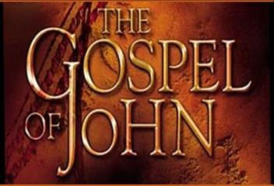
REVIEW
John 13:1 Should Settle the Question!
1 Now BEFORE the feast of the passover, when Yahusha knew that his hour was come that he should depart
out of this world unto the Father …
Verse 1 plainly states the timing was
"BEFORE the feast of the Passover," which is always on the 14th day of the first month. Logic demands the betrayal of Yahusha must occur before His sacrifice on the tree.
2 And supper being ended, the devil having now put into the heart of Judas Iscariot …
to betray him.
Verse 2: John shows
the Last Supper took place on the same night Judas Iscariot
betrayed Yahusha.
If not the 13th, then when?

Slide 6


What day? or … What date?
Why does it
matter when the
Last Supper
was celebrated
as compared to Passover?
Note: This study will be given according to the Dawn day-start.
Abib 13?
(3rd Cycle - Tues?)
2. Abib 14?
(4th Cycle – Wed?)
3. Or … Neither?
6

Slide 7

There Will Be 3 More Witnesses
#2 Phrase
“with desire
I desired”
#3 A Special
Meal
#1 John
Chapters
13-18-19
First: Magnifying Dan 9:27 then, review of the Synoptic Gospels

Slide 8
What is the Controversy for Part 1?
Note: If the “type of bread” could have settled the whole controversy of whether the Last Supper was on either:
Abib 13? or Abib 14? (or …)
Tuesday? or Wednesday? … (or maybe even a Thursday)?
… our study would be done.
However – there are other questions to be considered:
Does the “day” commence with sunset?
Does the “day” commence with the DAWN light?
Is the Passover Meal ever eaten 21 hours in advance
of the Passover Sacrifice?
The Argument Is This: If the Passover Meal is eaten before the Passover sacrifice takes place, how does that align with the
Torah instructions given in Exodus 12?

Slide 9




Conflicting Opinions?
What do you think about these different opinions:
Matthew, Mark and Luke record
The Last Supper was eaten on
the last night of Yahusha’s life.
Most tend to believe Matthew, Mark
and Luke record The Last Supper is
THE same as the Passover Meal.
John shows clearly this Last Supper occurred before the Passover feast.
Last Supper & Passover meal
are NOT
the same.
Most believe point #2.
Is there a way to reconcile
these differing opinions?
Let’s consider some facts first.

Slide 10

Gospel Writers Would Have Followed Torah
Exo 12:6 … Passover lambs were to be killed
"between the evenings" on Abib 14.
The Jews have traditionally interpreted
"between the evenings" to mean "in the afternoon."
At the time of Yahusha, the priests sacrificed
the Passover lambs in the afternoon of Abib 14.
In The Wars of the Jews, Josephus records many Passover lambs were slaughtered "from the ninth hour till the eleventh [hour according to the dawn-day]."
(Note: On the Roman clock today that would be understood as 3:00-5:00 PM.)

Slide 11

Historical Account From Josephus
"So these high priests, upon the coming of their feast which is called the Passover, when they slay their sacrifices, from the ninth hour to the eleventh, [3 PM to 5 PM Roman time] but so that a company not less than ten belong to every sacrifice . . . and many of us are twenty in a company, found this number of sacrifices was two hundred and fifty six thousand five hundred [256,500] which, upon the allowance of no more than ten that feast together,
amounts to two million seven hundred thousand and
two hundred persons that were pure and holy."
(Josephus, Wars of the Jews, Book VI, 9:3; 75 AD.)
Let’s compare this quote to the
prophecy given in Daniel 9:27.

Slide 12
Accuracy of Daniel 9:27
Dan 9:27 And he shall confirm the covenant with many for one week: and in the midst of the week he shall
cause the sacrifice and the oblation to cease …
This chart is according to a DAWN day-start.
1st Cycle | 2nd Cycle | 3rd Cycle
4th Light Season
4th Night Season
5th Cycle | 6th Cycle | Sabb.
The Ereb of the 4th cycle is the EXACT “midst of the week.”
Keep this information in mind as we consider the information in the Gospels.
Notes:
650 pm

Slide 13
Prophetic Account From Daniel
Dan 9:27 And he shall confirm the covenant with many
for one week: and in the midst of the week he shall cause the sacrifice and the oblation to cease …
1. Sacrifices completed by
the 11th hour [Josephus].
11th Hr
12th Hr
2. The 12th hour also fulfills
the Dan 9:27 prophecy.
1st Cycle | 2nd Cycle | 3rd Cycle
4th Light Season
4th Night Season
5th Cycle | 6th Cycle | Sabb.
6th Hr
Dawn of U/B
According to the
day-start at DAWN …
Ereb (the 12th hour from DAWN)
- on the 4th cycle - is the
exact “midst of the week.”
Notes:
600-640 pm

Slide 14
Yahusha – A Divine Corpse?
Dan 9:27 And he shall confirm the covenant with many for one week: and in the midst of the week he shall cause THE SACRIFICE and the oblation to cease …
12th Hr
1st Cycle | 2nd Cycle | 3rd Cycle
4th Light Season
4th Night Season
5th Cycle | 6th Cycle | Sabb.
At the moment of sunset, the 12th hour, THE SACRIFICE of Yahusha TERMINATED. At Ereb, Yoseph [of Arimathea] requested and removed His emaciated Body from the Tree. At that point, Yahusha was a “Divine Corpse” – IN WAITING!
Notes:
600-640 pm

Slide 15



Charting the “sunset” Day-start
If the day commences at “sunset” …
what marks the exact “midst of the week”?
Can this option for the “midst of the week” hour fulfill the Dan 9:27 prophecy and align with the quote from Josephus?
Count out 3½ days again for this tricky question!
1st Cycle [Sun] | 2nd Cycle [Mon] | 3rd Cycle [Tues] | 4th Cycle [Wed] | 5th Cycle [Thurs] | 6th Cycle [Fri] | 7th Cycle [Sabbath]
24 +24 +24 +12 = 3½ days marks “DAWN” of the
4th day as the “middle hour” of the week!
The DAWN of the 4th cycle as “midst of the week”
is NOT when the sacrifices & oblations ceased!
A sunset day-start will not align with Dan 9:27!
Next:

Slide 16


Out of
Surely we should be able to find the “date” for the Last Supper!
16

Slide 17


Is the Last Supper the same as the Passover meal and if so ~
which statement is true?
The Passover meal is known as the “Feast of Unleavened Bread” because of
the command to eat unleavened bread
at that evening meal on the 14th?
The Passover meal is known as a
“feast of unleavened bread” because of
the command to eat unleavened bread
at that evening meal on the 14th?
Let’s examine the Synoptic account.
17

Slide 18

Matt 26:17-21
17 Now on the first day of the Feast of the unleavened bread
the disciples came to Yahusha, saying to him,
"Where do you want us to prepare for you
to eat the Passover?"
18 And he said, "Go into the city to a certain man, and say
to him, 'The Teacher says, "My time is at hand; I will keep
the Passover at your house with my disciples."'
19 So the disciples did as Yahusha had directed them;
and they prepared the Passover.
Now: EVENTS FOR THE LAST SUPPER
20 Now when the even was come, he sat down with the twelve.
21 And as they did eat, he said, Verily I say unto you,
that one of you shall betray me. (NKJV)

Slide 19
Understanding Matt 26:17
When the italicized words are removed, the verse reads differently.
Now on the first day of the Feast of the unleavened bread
the disciples came to Yahusha, saying to him,
"Where do you want us to prepare for you to
eat the Passover?"
[Passover was indeed the first day unleavened bread was eaten, but it was NOT the first Feast Day of Unleavened Bread.]
NKJV: Matthew says it was “the first of Unleavened Bread.” Is that really when Yahusha held this Last Supper? On the surface, this appears to contradict John’s account, which
plainly states the Last Supper occurred
BEFORE the Feast of Passover.

Slide 20

Mark 14:12-18
12 Now on the first day of unleavened bread, when they killed
the Passover lamb, his disciples said to him, "Where do you want
us to go and prepare, that you may eat the Passover?"
13 And he sent out two of his disciples and said to them, "Go into the city, and a man will meet you carrying a pitcher of water; follow him.
14 Wherever he goes in, say to the master of the house,
'The Teacher says, "Where is the guest room in which I may eat the Passover with my disciples?"'
15 Then he will show you a large upper room, furnished and prepared;
there make ready for us."
16 So his disciples went out, and came into the city, and found it just as he had said to them; and they prepared the Passover.
Next: EVENTS FOR THE LAST SUPPER
17 And in the evening he cometh with the twelve.
18 And as they sat and did eat, Yahusha said, Verily I say unto you,
One of you which eateth with me shall betray me. (NKJV)
Sounds like the same challenge here!

Slide 21


Luke 22:7-16
7 Then came the day of unleavened bread,
when the Passover must be killed.
8 And he sent Peter and John, saying,
"Go and prepare the Passover for us, that we may eat."
9 So they said to him, "Where do you want us to prepare?"
10 And he said to them, "Behold, when you have entered the city, a man will
meet you carrying a pitcher of water; follow him into the house which he enters.
11 Then you shall say to the master of the house, 'The Teacher says to you, "Where is the guest room where I may eat the Passover with My disciples?"'
12 Then he will show you a large, furnished upper room; there make ready."
13 So they went and found it just as he had said to them, and they prepared the Passover.
Next Luke records the EVENTS FOR THE LAST SUPPER
14 And when the hour was come, he sat down, and the twelve apostles with him.
15 And he said unto them, With desire I have desired to eat this passover
with you before I suffer:
16 For I say unto you, I will not any more eat thereof, until it be fulfilled in the kingdom of Yahuah. (NKJV)
Is Luke just as challenging as Mark?

Slide 22



A closer look at: Matthew, Mark & Luke
IN THE NKJV
Context Abib 13: "Where do you want us to
prepare for you to eat the Passover?"
Matt 26:17 Now on the first day of the Feast of the Unleavened Bread the disciples came to Jesus [Yahusha] …
Mark 14:12 Now on the first day of Unleavened Bread,
when they killed the Passover lamb, His disciples said to Him, ...
Luke 22:7 Then came the day of Unleavened Bread,
when the Passover must be killed.
Is there emphasis on the Feast of Unleavened Bread?

Slide 23
[Other Versions] A closer look at: Matthew 26:17
Context Abib 13: "Where do you want us to
prepare for you to eat the Passover?"
[NKJV] Now on the first day of the Feast of the Unleavened Bread the disciples came to Jesus [Yahusha], saying to Him, …
[NIV] On the first day of the Feast of Unleavened Bread,
the disciples came to Jesus [Yahusha] and asked, …
[TS 2009] And on the first day of Unleavened Bread
the taught ones came to Yahusha, saying to Him, …
In these other versions for Matt 26:17, is the emphasis still on the Feast of Unleavened Bread?
23

Slide 24
[Other Versions] A closer look at: Mark 14:12
Context Abib 13: "Where do you want us to
prepare for you to eat the Passover?"
[NKJV] Now on the first day of Unleavened Bread, when they killed the Passover lamb, his disciples said to him,…
[NIV] On the first day of the Feast of Unleavened Bread,
when it was customary to sacrifice the Passover lamb, …
[TS 2009] And on the first day of Unleavened Bread, when they were slaughtering the Pesah lamb, His taught ones said …
In these other versions for Mark 14:12, is the emphasis still on the Feast of Unleavened Bread?
24

Slide 25
[Other Versions] A closer look at: Luke 22:7
Context Abib 13: "Where do you want us to
prepare for you to eat the Passover?"
[NKJV] Then came the Day of Unleavened Bread,
when the Passover must be killed.
[NIV] Then came the day of Unleavened Bread,
on which the Passover lamb had to be sacrificed.
[TS 2009] And the day of Unleavened Bread came
when the Pesah had to be slaughtered.
In these other versions for Luke 22:7, is the emphasis still on the Feast of Unleavened Bread?
25

Slide 26



Everything seems to indicate the Passover preparations were taking place on the first Day of the Festival of Unleavened Bread.
Something Does Not Make Sense!
If the disciples were actually planning preparations for Passover with Yahusha
on the first Day of the Unleavened Bread Festival, this is definitely not in alignment
with the Passover statute commands in Exodus.
Let’s take a closer look at the KJV!
26

Slide 27
A closer look at: Matthew, Mark & Luke
IN THE KJV
Context Abib 13: "Where do you want us to
prepare for you to eat the Passover?"
Matt 26:17 Now on the first day of the Feast of the unleavened bread the disciples came to Jesus [Yahusha], saying unto Him, …
Mark 14:12 And the first day of unleavened bread,
when they killed the Passover, his disciples said unto him, …
Luke 22:7 Then came the day of unleavened bread,
when the Passover must be killed.
There is no emphasis on the Feast of Unleavened Bread
in the KJV this time. Is there more to consider?
Were the disciples preparing for a “feast” or “Feast[ival]”?
Let’s check out a few facts to see if there is
a difference between three very similar terms!
27

Slide 28
Matthew, Mark & Luke say this:
(Watching for a closer examination on just 1 day!)
Matt 26:17, 19 Now on the first day of the Feast of the
unleavened bread the disciples came to Yahusha, saying to him,
"Where do you want us to prepare for you to eat the Passover?"
19 So the disciples did as Yahusha had directed them; and
they prepared the Passover.
Mark 14:12, 16 Now on the first day of unleavened bread, when
they killed the Passover lamb, his disciples said to him, "Where do
you want us to go and prepare, that you may eat the Passover?"
16 So his disciples went out, and came into the city, and found it just
as he had said to them; and they prepared the Passover.
Luke 22:7-9, 13 Then came the day of unleavened bread,
when the Passover must be killed.
8 And he sent Peter and John, saying,
"Go and prepare the Passover for us, that we may eat."
9 So they said to him, "Where do you want us to prepare?"
13 So they went and found it just as he had said to them,
and they prepared the Passover.
Just 1 day ~ singular!

Slide 29


Something to Think About
Was that
“day” … when
they killed the
Passover …?
Or?
Also the Day
when unleavened bread was eaten
the first time
(eg: Passover)?
The first Day
of the
Unleavened Bread Festival?
29

Slide 30



Important Crossroad Decision
We are now at a point where
a decision will
have to be made.
Do we have to choose between:
The Synoptic Gospels or the
Book of John?
Would it be better to see ALL the Gospels
in harmony with each other?
Or?
30

Slide 31
Charting the Four Gospels
Matt 26:17 Now on [as] the first day of the Feast of the unleavened bread
[day was approaching] the disciples came to Yahusha, saying to him,
"Where do you want us to prepare for you to eat the Passover?"
Vs. 17 Context & Time Reference:
“3rd Cycle” before
The Last Supper
Passover is the
1st “day”
of unleavened bread
that was approaching.
The Festival of Unleavened Bread
also had “7 days”
that were approaching.
Last Supper Timeframe
1st Cycle | 2nd Cycle | 3rd Cycle
4th Day Season
4th Night Season
5th Cycle 1st ULB | 6th Cycle 2nd ULB | Sabb. 3rd ULB
There is only one way for the Synoptic Gospels to be understood: there
were “days approaching” that were connected to unleavened bread. The context is about Passover day arriving!
Passover Meal
It was impossible for the disciples to place this request on either:
(1) Passover 4th cycle;
(2) Unleavened Bread 5th cycle.
31

Slide 32
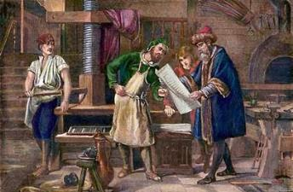
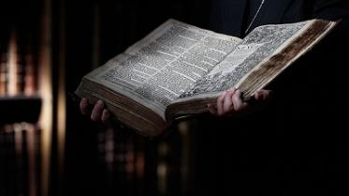

Translation Discrepancies
Remember, John’s gospel was written much later.
It’s very likely the Synoptic Gospels were already translated into Greek
by this time.
John would have seen the definite necessity to clarify
the proper meaning around
“day of unleavened bread” – (meaning Passover) taking
ALL readers BACK to what
the Hebrew mind-set would
originally understand.
Today the Greek translation has taken on a meaning that was never intended by any Hebrew writer/believer.
Next …
32

Slide 33
Is it a “feast”? – “Feast”? or “Festival”?
Gen 19:3 And [Lot] pressed upon them greatly;
and they turned in unto him, and entered into his house; and he made them a feast, and did bake unleavened bread, and they did eat.
‘feast’ H4960; mishteh; from H8354; drink,
by implication, drinking (the act); also (by implication) a banquet or (generally) feast:
KJV - banquet, drank, drink, feast ([-ed], -ing).
For Covenant Calendar Definitions:
The FULL Passover FESTIVAL includes:
Passover Day; Unleavened Bread Festival [of 7 days]
& Wave Sheaf Festival
This is Exo 12:18!
The Full Passover Festival has 3 Components
P/O Fest.
W/S Festival
Festival of Unleavened Bread
Passover
1st ULB | 2nd ULB | 3rd ULB | 4th ULB | 5th ULB | 6th ULB | 7th ULB
1st feast day of ‘ulb’
H2282 “chag” Festival of ULB
Festival of Unleavened Bread has:
7 days with a feast each day of unleavened bread (incl. W/S).
Wave Sheaf
On Abib 13 (in Matt, Mark, Luke) the disciples asked where to prepare the Passover – for the [Abib 14] FEAST “day” of unleavened bread that was approaching.

Slide 34
In many studies one must:
Watch the Content.
Watch the Context especially with words like “a” and “the” … as these words will cause a difference in the final context.
Compare other versions of Scripture.
Bible Versions that may have italicized words & capital letters where they do not belong can lead to a different context if
one is not paying attention.
Be sure to check and see what John has to say, as often his Gospel solves the controversy.
34

Slide 35
1st Witness for
the “day” and “date”
of Passover
The Synoptic Gospels seem to have some challenging phrases.
Let’s examine John.
John’s Gospel
Chapters 13-18-19

Slide 36
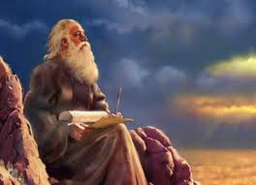
Considering John’s Gospel
Have you ever wondered why there are 4 Gospels for one story? Have you ever wondered why John’s Gospel is different than the Synoptics?
Many scholars believe John wrote his Gospel late in the first century; decades after the Synoptic Gospels had been written.
Greek-speaking Gentiles comprised a significant portion of the assembly (believing in the Roman midnight commencement for the day-start).
John's Gospel differs from the Synoptic Gospels because of the number of Gentile converts pouring into the assembly. He had to include missed details (separating truth from error) especially when the anti-Jewish bias began to take root.
John went to great lengths to emphasize the Messiah's heritage and to remove all possibilities of lingering
doubt, especially around the details of
Covenant Calendar, timing of events, etc.
Let’s review the beginning of John’s account of the Last Supper.

Slide 37
John 13:1-5
REVIEW
1 Now BEFORE the feast of the passover, when Yahusha knew that his hour was come that he should depart out of this world unto
the Father, having loved his own which were in the world, he loved them unto the end.
2 And supper being ended, the devil having now put into the heart of Judas Iscariot, Simon's son, to betray him;
3 Yahusha knowing that the Father had
given all things into his hands, and that he was come from Yahuah and went to Yahuah;
4 He riseth from supper, and laid aside
his garments; and took a towel, and girded himself.
5 After that he poureth water into a bason,
and began to wash the disciples' feet,
and to wipe them with the towel wherewith
he was girded.
Verse 1 plainly states the timing was "BEFORE the feast of the Passover," which is always on the 14th day of the first month. Logic demands the betrayal of Yahusha must occur before His sacrifice on the tree.
Verse 2: John shows
the Last Supper took place on the same night
Judas Iscariot
betrayed Yahusha.
Does this sound very different from the
Synoptic Gospels?
However, there are several other details to be noted.

Slide 38
John’s Timing of the Last Supper
John’s timing of the Last Supper is obviously referring to the night of Abib 13.
Sadly, the Synoptic Gospels do not have the same clarity in some areas. (Matt 26:17; Mark 14:12; Luke 22:7.)
John goes on to reiterate several times that these
events took place before Passover.
Clearly, the Passover meal traditionally eaten on the evening of Abib 14th had not yet been observed. Why?
REVIEW
The Passover lamb could only be eaten after the Passover sacrifice is slain, bled, skinned and roasted. That’s Torah!
By default alone, the Passover meal
could NOT have been observed by our Messiah, His disciples or any other Jews!!

Slide 39
John 13:21, 26, 27
EVENTS FOLLOWING The LAST SUPPER
& FOOT WASHING
21 When Yahusha had thus said, he was troubled in spirit, and testified, and said, Verily, verily, I say unto you, that one of you [Judas] shall betray me.
26 Yahusha answered, He it is, to whom I shall give a sop, when I have dipped it. And when he had dipped the sop, he gave it to Judas Iscariot, the son of Simon.
27 And after the sop Satan entered into him. Then said
Yahusha unto him, That thou doest, do quickly.
These events can only occur on the
Night Season of Abib 13,
the day before Passover on Abib 14.

Slide 40
John 13: 28-30
28 Now no man at the table knew for what intent he spake this unto him.
29 For some of them thought, because Judas had the bag, that Yahusha had said unto him, Buy those things that we have need of against the feast; or, that he should give something to the poor.
30 He then having received the sop went immediately out: and it was night.
Once Judas left, Yahusha gave His last words to the remaining 11 disciples. Chapters 14-17 include approximately 3000 words not recorded by the Synoptic Gospels.
Verse 29: Did you catch the calendar lingo?
The disciples thought Yahusha said: “Buy those things …”
This is obviously NOT the night of the 14th, as He is still with them.

Slide 41
John Has Many Extra Details
Chapters 14-17: John is the only Gospel writer that records many additional instructions from Yahusha
to His disciples – from the time Judas left the group until they went to the Garden of Gethsemane.
The details include:
Revealing of His Father; Promise of the Helper
(Ch 14)
Lesson on the Vine and the Branches (Ch 15)
The Coming Rejection (Ch 15)
Work of the Ruach [Holy Spirit] (Ch 16)
Yahusha’s Prayer for Himself and Others (Ch 17)

Slide 42
John’s Other Important Details
Let’s consider 3 examples of details in John’s Gospel not found in the Synoptic Gospels:
JOHN 18:28
Then they led Yahusha from Caiaphas to the Praetorium, and it was early morning. But they themselves did not go into the Praetorium, lest they should be defiled, but that they might eat the Passover.
  (This early morning is in the context of the Passover Day. John records all the passion events with Roman Reckoning of time – and the day beginning at midnight. Therefore, the “early morning” is correct for both “Dawn/sunset day-start” and Roman Reckoning timing.)
#1
Started that evening,
on their Lunar Calendar!
Notice: No one had eaten the Passover meal yet!

Slide 43
John’s Other Important Details
#2
JOHN 19:14
Now it was the Preparation of the Passover [the 14th Roman time], and about the sixth hour [Roman Reckoning of time from midnight is 6 AM].
And he [Pilate] said to the Jews, "Behold your King!
(The Synoptic Gospels count the “the sixth hour” from “dawn” day-start. (See: Matt 27:45; Mark 15:33 and Luke 23:44.) The
6th hour ends at the “hour of noon” when the sun was darkened
till the 9th hour. The timing of John’s account aligns perfectly.)
JOHN 19:31
Therefore, because it was the Preparation [the 14th], that the bodies should not remain on the cross on the Sabbath [or the 1st Unleavened Bread Sabbath] (for that Sabbath was a high day), the
Jews asked Pilate that their legs might be broken, and that they might be taken away. NKJV
#3
Interesting note: John is the only Gospel writer
to verify the “High Sabbath” is the
1st Sabbath of Unleavened Bread.
There is no indication that a “High Sabbath”
must include 2 Sabbaths on one day.

Slide 44

High Sabbath Observance
Exo 12:16-17 (Book of the Covenant)
16 On the first day [of Unleavened Bread, the 15th day of the 1st month] there shall be a holy convocation, and on the seventh day there shall be a holy convocation for you. No manner of work shall be done on them; but that which everyone must eat; that only may be prepared by you.
17 So you shall observe the Feast of Unleavened Bread, for on this same day I will have brought your armies out of the land of Egypt. Therefore you shall observe this day throughout your generations as an everlasting ordinance.
Lev 23:6-7 (Book of the Law)
6 And on the fifteenth day of the same month [Abib] is
the Feast of Unleavened Bread to Yahuah; seven days
you must eat unleavened bread.
7 On the first day you shall have a holy convocation;
you shall do no customary work on it. (NKJV)
Notes:
P 6 mar 25 132pm started this slide – charlene – still to fix this slide 142… mar 28th I think it is ok now.

Slide 45

John Has Clarity With Details
As you can see, John points out repeatedly that: (1) the Last Supper, (2) the betrayal
by Judas, (3) Yahusha’s arrest and
(4) the beginning of His trials occurred BEFORE the Passover cycle of Abib 14.
Therefore, the Last Supper
also occurred on the day
BEFORE Passover.
John 19:31 shows with certainty the day following the Passover Preparation Day was the annual high Sabbath, the First Day of Unleavened Bread, which fell annually on Abib 15. (Remember: The definition of a High Sabbath is NOT an annual feast Sabbath falling on the weekly Sabbath!)
Yahuah commanded the Israelites to observe this High Sabbath every year.

Slide 46

Semi-Review
Synoptic Accounts of the Last Supper:
The disciples came to Yahusha on Abib 13.
They asked Him where He wanted them to prepare to
eat the Passover meal, which would normally occur the
next night on Abib 14.
  (At least it appears that these disciples assumed they would
  be eating the Passover meal with Yahusha again.)
Yahusha instructed Peter and John how to find the place where they should prepare to eat the Passover on the night of Abib 14 (that is, because they thought they would be eating the meal together then).
He told them the owner of the house would show them
a large furnished upper room.
Mark and Luke both state that it was there, in that room,
that they were to prepare for the Passover meal to be eaten
(Mark 14:15; Luke 22:12).

Slide 47
AFTER the Supper ~ Early the Next Day
The following Synoptic testimonies follow
the events of the Last Supper – the next morning.
Matt 27:1-2 When the morning was come, all the chief priests and elders of the people took counsel against Yahusha to put him to death: And when they had bound him, they led him away, and delivered him to Pontius Pilate the governor.
Mark 15:1 And straightway in the morning the chief priests held a consultation with the elders and scribes and the whole council, and bound Yahusha, and carried him away, and delivered him to Pilate.
Luke 23:1 And the whole multitude of them arose, and led him unto Pilate. KJV
[Luke has no details of the morning.]
Typically, the Passover meal is to be eaten the “evening” of Abib 14, AFTER the sacrifice [according to Torah statutes] – not the evening BEFORE on the 13th about 21 hours
BEFORE the sacrifice.
What does this information have to do with the Last Supper?

Slide 48
John has more details of what happened early on Abib 14?
John 18:28 Then led they Yahusha from Caiaphas unto the hall of judgment: and it was early; and they themselves went not into the judgment hall, lest they should be defiled; but that they might eat the passover. KJV
Question: Who is being referred to as “they”?
a) The Pharisees?
b) Other disciples?
Whoever it was, the Passover meal had not
been eaten yet, neither by the Pharisees,
or any Disciples at the Last Supper
the night before!
Notes:
P 8 … New slide mar 27 743 pm … mar 28 … 1022 pm … ok

Slide 49

In John 18:28 he said it was EARLY when Yahusha was led from Caiaphas to Pilate.
How EARLY was it?
JOHN 19:14 – a very special verse!
Now it was the Preparation of
the Passover [the 14th Roman time],
and about the sixth hour [about 6 AM
for Roman Reckoning of time from midnight].
And he [Pilate] said to the Jews, "Behold your King!”
Note for Synoptic Gospels
Matthew and Mark record Yahusha was led to Pilate early in the morning marking the Passover of Abib 14. Along with Luke, their record of the 6th hour is when the sky became darkened hiding our sacrificial Messiah.
Here John’s specific timing is about 12 hours AFTER the
Last Supper and at least another 12 hours to a Passover meal.

Slide 50
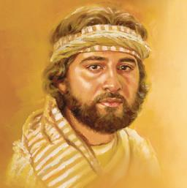
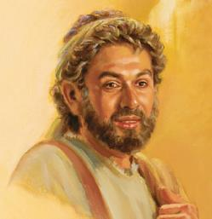
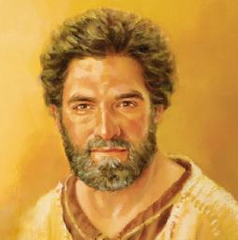
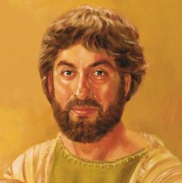
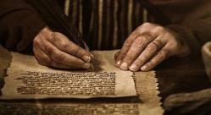

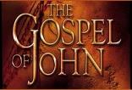
The timing of
the four Gospels
is finally perfectly synchronized!
Notes:
New slide mar 28 1025 pm … ok

Slide 51
Now that the Gospels have been aligned where it seems they did not agree, let’s examine an area where they do agree about 12 hours after The Last Supper.
Topic: Do the Gospel writers agree a new day begins with sunset?
Notes:
New slide mar 28 1025 pm … ok

Slide 52


Where Do the Gospels Agree?
These FOUR testimonies all follow the events of the Last Supper. Typically, the Passover meal would be eaten the “evening” of
Abib 14. By that time Yahusha had laid down His life.
Matt 27:57-58 When the even was come, there came a rich man of
Arimathaea, named Joseph, who also himself was Yahusha’s disciple:
58 He went to Pilate, and begged the body of Yahusha.
Mark 15:42-43 And now when the even was come, because it was the preparation [Abib 14], that is, the day BEFORE the [high] Sabbath [of the 15th],
43 Joseph of Arimathaea, an honourable counseller, which also waited for the kingdom of Yahuah, came, and went in boldly unto Pilate, and craved the body
of Yahusha. (Note: Sunset day-start is completely obliterated here!)
Luke 23:54-55 And that day was the preparation
[Abib 14], and the sabbath drew on. 55 And the women
also, which came with him from Galilee, followed after,
and beheld the sepulchre, and how his body was laid.
John 19:31 The Jews therefore, because it was the
preparation [Abib 14], that the bodies should not remain
upon the cross on the sabbath day [Abib 15], (for that
sabbath day was an HIGH DAY,) besought Pilate that
their legs might be broken, and that they might be taken away. KJV
What does this information have to do with the Last Supper?

Slide 53
Gospels Agree on a Passover Point
One example - the Gospels agree the day begins in the morning with DAWN.
5. Mark 15 says: The even was come – it’s STILL the [Passover] preparation day, the day BEFORE the Sabbath on the 15th.
4. 12th hour begins the “ereb” portion of the day-cycle.
6. Matt 27 says: When even was come – Joseph asked Pilate for the Body.
3. It is Accomplished! at the 9th hour.
7. John 19 says: It was the preparation day - the day BEFORE the High Sabbath.
PASSOVER & PREP. DAY
2. Darkness at the 6th hour.
8. Luke 23 says: That day was the preparation – and the High Sabbath drew on with the approaching light of DAWN.
1. DAWN begins Passover Day
11th Day | 12th Day | 13th Day
14th Light Season
14th Night Season
15th ULBS | 16th Day | 17th Sabb.
Last Supper
Dawn of U/B Sabbath after all these events!
Why? The “even” of Passover Day
does not change the date to Abib 15!
Burial of Yahusha
Notes:
600-640 pm

Slide 54
Let’s compare some other Bible Commentators to see if they have anything to say about this meal, called
“The Last Supper.”
Notes:
New slide mar 28 1025 pm … ok

Slide 55
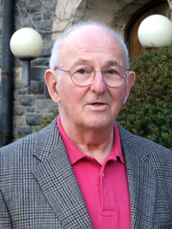
Jacob Neusner
In Jacob Neusner's translation of the Jewish Mishnah, we can see why the disciples would have been concerned with preparing for the Passover the evening of the 13th, even though the Passover meal wouldn't be eaten until the next night.
In his quote from Pesaḥim 1:3, please remember, he’s writing with the understanding that
Abib 14 begins at sunset on Abib 13.
(Note: Even though Neusner is using the reasoning that Abib 14 begins the evening before, in his context he is speaking of “deleavening” … and possibly “anointing”
the chosen room, so that it would be “clean” from all questionable activity in the past.
This rented room might have even needed
a good spring cleaning!)
Pesaḥim is the third tractate of Seder Moed
of the Mishnah and of the Talmud. It is concerned mainly with the laws of the Jewish holiday Passover as well as the Passover lamb offering. [Wikipedia]

Slide 56
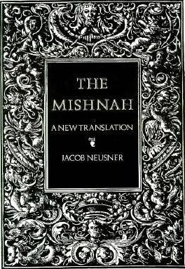
Jacob Neusner on Pesahim 1:3
PESAHIM 1:3
A. R. Judah says,
"They seek out [leaven]
(1) on the night of the fourteenth,
(2) on the fourteenth in the morning, and
(3) at the time of removal."
B. And sages say, "[If] one did not seek out [leaven] on the night of the fourteenth
{after sunset on the 13th}, he may seek it out
(1) on the fourteenth.
C. "If he did not seek it out on the fourteenth,
let him seek it out (2) at the appointed time
[11 a.m. to 12 noon on the fourteenth].
D. "[If] he did not seek it out at the appointed time, let him seek it out (3) after the appointed time [to nightfall]."
(p. 230, The Mishnah: A New Translation.)
Removal
of all
Leaven

Slide 57
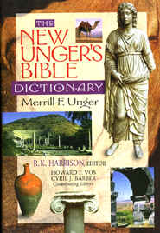
New Unger’s Bible Dictionary
Unger confirms how the Jews prepared for the observance of the Passover:
On the evening of the 13th Nisan, which,
until that of the 14th, was called the "preparation for the Passover" (John 19:14), every head of a family searched for and collected by the light of a candle all the leaven. Before beginning the search he pronounced the following benediction: "Blessed art thou, O Lord our God, King of the universe, who hast sanctified us with
thy commandments, and hast enjoined
us to remove the leaven.”
After the search he said, “Whatever leaven remains in my possession which I cannot see, behold, it is null, and accounted as the dust of the earth." (p. 411, "Festivals")

Slide 58

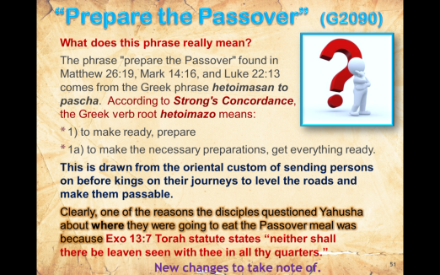
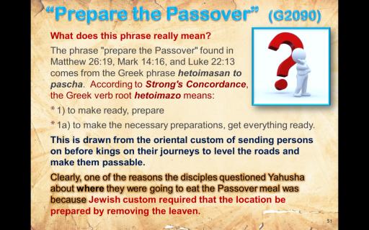
“Prepare the Passover” (G2090)
NT:2090 hetoimazo (het-oy-mad'-zo); from NT:2092; to prepare:
KJV - prepare, provide, make ready. Compare NT:2680.
NT:2092 hetoimos (het-oy'-mos); from an old noun heteos (fitness); adjusted, i.e. ready: KJV - prepared, (made) ready (-iness, to our hand).
NT:2680 kataskeuazo (kat-ask-yoo-ad'-zo); from NT:2596 and a derivative of NT:4632; to prepare thoroughly (properly, by external equipment; whereas NT:2090 refers rather to internal fitness); by implication, to construct, create:
KJV - build, make, ordain, prepare.
What does this phrase really mean?
The phrase "prepare the Passover" found in
Matthew 26:19, Mark 14:16, and Luke 22:13
comes from the Greek phrase hetoimasan to pascha. According to Strong's Concordance,
the Greek verb root hetoimazo means:
1) to make ready, prepare
1a) to make the necessary preparations, get everything ready.
This is drawn from the oriental custom of sending persons on before kings on their journeys to level the roads and make them passable.
Clearly, one of the reasons the disciples questioned Yahusha about where they were going to eat the Passover meal was because Exo 13:7 Torah statute states “neither shall
there be leaven seen with thee in all thy quarters.”

Slide 59
“Prepare the Passover” (G2090)
What does this phrase really mean?
The night the Passover meal was eaten, the Israelites followed the command to remove all leaven from their dwelling places.
Exo 12:18 “In the first month, on the fourteenth day of the month at even, ye shall eat unleavened bread, until the one and twentieth day of the month at even.”
Note: Unleavened bread was eaten on a total of eight days counting from the 14th to the 21st.
The following penalty was prescribed for eating leavened bread during this Feast of Unleavened Bread.
Exo 12:15 For a seven-day period shall you eat matzos [unleavened bread], but on the previous day [the Preparation Day] you shall nullify the leaven from your homes; for anyone who eats leavened food - that soul shall be cut off from Israel, from the first day [Abib 15] to the seventh day [Abib 21]. (Stone Edition Tanach)

Slide 60

How Could the Disciples NOT Understand?
When the disciples questioned Yahusha about
where they were going to eat the Passover meal
the next night (Abib 14), they still did not fully understand His life would be laid down by then!
The Messiah would not be able to eat the Passover lamb because He was destined to be sacrificed as ‘the’ Passover LAMB (1 Cor 5:7).

Slide 61
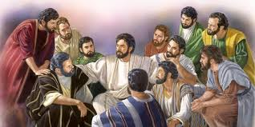
Yahusha Did Not Cause Undue Grief
Instead of explaining to them again that He would be in the process of being buried when the time came to eat the Passover meal, He simply told His disciples where to prepare to eat the Passover meal. After all, that’s what they wanted to hear, as they did not seem to hear and/or comprehend that Yahusha had already told them THREE times He was going to Jerusalem to die.
Yahusha used their final meal together on Abib 13
to instruct His
disciples one last time
before His death.

Slide 62
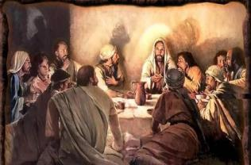
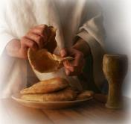
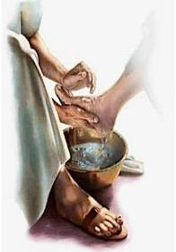
What else did Yahusha provide?
After Judas left the group, Yahusha provided many final instructions to His friends.
It’s likely the disciples knew they were gathering together on the evening of the 13th to receive some teachings/instructions as was common with a Rabbi
and his followers before
the feast season began.
Yahusha did give instructions to be remembered forever after, just as He showed them – which to this day is also a Chag!

Slide 63

What else did Yahusha provide?
Is it possible Yahusha provided this “Last Supper” room as He knew the disciples would have need
for it the next day after the Passover, even though
they thought they would
be using the room for
another purpose?
Yahusha chose this room (from one of His believers) where He knew His disciples would be safe from the Jews who would be seeking after them.
Is it possible this is the room where Yahusha
met them on his Wave Sheaf appearance?

Slide 64
1st Witness: the “day” & “date”
From Dan 9:27 we know the crucifixion was on Wednesday.
The Last Supper was the day before.
We know Passover is always on Abib 14.
The Last Supper was the day before & not
a Passover meal!
The day?
3rd Cycle - Tuesday!
2. The date?
Abib 13!
64

Slide 65
2nd Witness for Study
on the “day” and “date”
#2 Phrase
“with desire
I have desired”
The true intent of
this phrase will be examined in
Luke 22:15-16.

Slide 66
Understanding the Phrase
“with desire I have desired”
Luke 22:15-16 And he said unto them,
With desire I have desired to eat this passover with you before I suffer: 16 For I say
unto you, I will not any more eat thereof, until it
be fulfilled in the kingdom of Yahuah. KJV
What does this phrase really mean:
“with fervent desire I have desired
to eat this Passover”?

Slide 67

“with desire I have desired”
Luke 22:15 has been used to support the assertion
that the Messiah and his disciples ate a meal called
the Passover meal. Is this so?
In this Scripture, Yahusha says:
"With fervent desire I have desired to eat
this Passover with you before I suffer."
The Greek phrase translated "with fervent
desire I have desired" is epithumia
epethumesa. It literally means
"with desire I desired."
with desire I have desired Strong’s - G1939; epithumia (ep-ee-thoo-mee'-ah); from G1937;
a longing (especially for what is forbidden).

Slide 68

“epithumia” Exegetical Dictionary of the New Testament
The first word of this phrase
[with desire I have desired], epithumia,
is a noun.
According to the Exegetical Dictionary of the New Testament, usually this word "has the ambivalent sense, desire, strive for, long to have; do; be something."
It can also be "used for (forbidden) desire" (p. 27, vol. 2).
Yahusha uses epithumia in this sense in Luke 22:15.

Slide 69
Ferrar Fenton Translation
In his Bible translation, Ferrar Fenton accurately captures the meaning of Yahusha's words in these verses:
LUKE 22:15-16
And he said to them: 'I have longingly desired [epithumia epethumesa] to eat this Passover with you before my suffering; 16 however, I tell you that I shall not eat of it, until it can be administered in the Kingdom of Yahuah.'
(The Holy Bible in Modern English)
Do you see the clarity in this verse that:
a) The Last Supper is NOT the Passover …
b) But … He had asked them to prepare for the Passover
knowing full well they may not be eating it anyway.
This is another clarification to show this Last Supper was not on Abib 14 – only Abib 13.

Slide 70
2nd Witness: the “day” & “date”
a) Yahusha’s “desire to eat” the Passover will only be realized in the kingdom.
In this account …
b) Therefore, the day and date of the Last Supper was not the Passover meal
on Abib 14.
The day?
3rd Cycle - Tuesday!
2. The date?
Abib 13!
70

Slide 71
3rd Witness for Study
on the “day” and “date”
#3 A Special Meal
Could the last gathering of Yahusha and His disciples have been a special preparatory meal?

Slide 72

David H Stern, Jewish Scholar
David H Stern writes about the Last Supper meal:
“The Last Supper is considered by most scholars to have been a Passover meal or Seder. Many Pesach themes are deepened, reinforced and given new levels of meaning
by events in the life of Yeshua the Messiah
and by his words on this night.
“However, Joseph Shulam has suggested that
it may not have been the Seder but a se'udat-mitzvah, the celebratory banquet accompanying performance of a commandment such as a wedding or b'rit-milah.”

Slide 73

Here is the background for his argument …
“When a rabbi and his students finish studying a tractate
of the Talmud [!], they celebrate with a se'udat-mitzvah
(also called a 'banquet of completion,' i.e., graduation).
The Fast of the Firstborn, expressing gratitude for the saving of Israel's firstborn sons from the tenth plague, has been prescribed for the day before Pesach, Nisan 14 [he’s referring
to the sunset of Nisan 13], at least since Mishnaic times.
When it is necessary to eat a se'udat-mitzvah, this takes precedence over a fast.
With a modicum of foresight a rabbi can plan to complete
a tractate on Nisan 14 and thus avoid having to fast;
doing so is not construed as cheating, and in fact it
has become the custom.”
Would that be like making up your own rules?

Slide 74

Stern’s Quote Continues
“The tradition of the Fast of the Firstborn dates at
least from Mishnaic times.
But, Shulam reasons, if it goes back a couple of centuries more to the time of Yeshua, and if the
se'udat-mitzvah custom applied in the first century to the completing of any course of study, then Yeshua might have arranged to have himself and his talmidim finish reading a book of the Tanakh on Nisan 14.
Or, since Yeshua knew he was going to die, he may
have regarded it as appropriate to complete his disciples' earthly "course of study" with a banquet.
This solution would also resolve the perceived conflict between Yochanan [John] and the Synoptic Gospels
over the timing of the Last Supper.”
(p. 77, Jewish New Testament Commentary.)

Slide 75
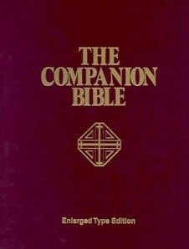

From the Companion Bible
In The Companion Bible comment on
Luke 22:15, Bullinger states that the Last Supper Yahusha and His disciples ate was "not the eating of the Lamb, but the Chagigah or feast which preceded it …" (p. 1500).
He goes on to explain that "it follows, therefore, that the Lord being crucified on 'the preparation day' could not have eaten of the Passover lamb, which was not slain until the evening of the 14th of Abib
(i.e. afternoon). …
Thus it is clear, that … no 'Passover lamb' could
have been eaten at the
'Last Supper' on the
previous evening."
(p. 180, Appendix 156.)
Bullinger knows Yahuah’s statutes well!

Slide 76

No Lamb at the Last Supper?
None of the four Gospels mentions a lamb being
eaten at the "Last Supper."
The time had not yet come to slay the Passover when the Messiah and His disciples
ate their last meal together.
In addition, the verses of Deut 16:2, 5-6 are Torah instructions for the sacrifice of the
Passover lamb. Even after The Last Supper,
were the disciples still intending to follow
through with the Torah guidelines for Passover?

Slide 77

Deut 16:2, 5, 6
2 Thou shalt therefore sacrifice the Passover unto Yahuah thy Elohim, of the flock and the herd, in the place which Yahuah shall choose to place His name there…
5 Thou mayest not sacrifice the Passover within any of thy gates, which Yahuah thy Elohim giveth thee:
6 But at the place which Yahuah thy Elohim shall choose to place His name in, there thou shalt sacrifice the Passover at even, at the going down of the sun, at the season [Aviv, see Deut 16:1] that thou camest forth out of Egypt. KJV
Note: At the Last Supper Yahusha had to show the disciples that NO more sacrifices were necessary after this
NEW Covenant Confirming Meal instituting NEW Ordinances! Soon they would understand the reason for such a HUGE change given on Abib 13 – the day before Passover!

Slide 78
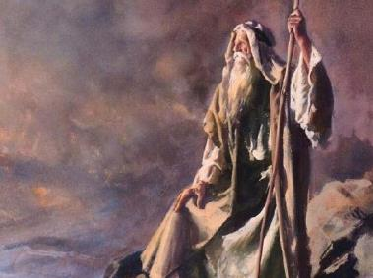
Instructions From Moses
Moses recorded the explicit
instructions regarding the
proper place to sacrifice the
Passover in Deuteronomy.
The Israelites were not
allowed to sacrifice the
Passover anywhere they
wanted, but only at the
place where Yahuah
chose to put His name.
During Yahusha's life, the Temple in Jerusalem was
the place where Elohim had placed His name.
That's where the priests sacrificed the Passover lambs
in accordance with this command.

Slide 79
The Synoptic Gospels (Matthew, Mark and Luke) DO NOT CONFLICT with John's account of the Last Supper when understood correctly.
A careful study of all four Gospels shows that Yahusha and
the disciples did not eat the commanded Passover meal
during their last time together before Yahusha died on His Passover because: no one can eat the Passover lamb/meal on Abib 13, before it is sacrificed and roasted on Abib 14.
They simply prepared for the upcoming Passover festival
fully intending to partake of a Passover meal on Abib 14.

Slide 80

Review
At that Last Supper, the
disciples could have eaten
some type of celebratory,
or preparatory meal in
Yahusha’s presence the
evening of Abib 13.
It was at this supper that,
Yahusha Himself, (as the High Priest of the Melki-tzedek Order), established this New Way to celebrate the Passover (without the lamb) through the simple symbols of the bread and wine. Then He also endorsed the foot-washing.
(Note: Yahusha did not partake of these symbols.)
After the meal (and foot-washing activity), Yahusha once again sat at the table to instruct His disciples and give another clue that there was a betrayer in the group.

Slide 81
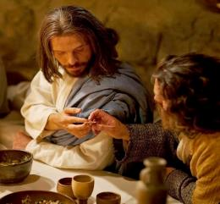
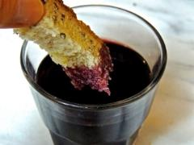
Review
The next clue was: the betrayer would receive the sop.
This is when Judas Iscariot arose and left after he received the sop, (illustrating the removal of leaven from the group), to carry out his plan to betray Yahusha to the Jewish authorities.
Would it not seem appropriate for Yahusha to use “leavened sop” to designate the “leavened disciple” in the group that was soon to betray Him?

Slide 82
Conclusion
Yahusha and His disciples obviously could not have eaten a Passover lamb with their meal the night of Abib 13.
The Scriptures, through Paul, clearly state “the” Messiah was our Passover (I Cor 5:7).
Matthew, Mark, and Luke all record that Yahusha
died at the ninth hour (3:00 PM Roman Reckoning of time).
This coincides with the same time as recorded by Josephus for when the slaughter of the Passover
lambs commenced.
Yahusha fulfilled the symbolism of the Passover lamb by giving His life on His Covenant Calendar Abib 14. (No future Passover lambs had to ever be sacrificed again.)
Do you know why there was no passover sacrifice
on the counterfeit Abib 14 of the unbelieving Jews?

Slide 83

The Fast of the Firstborn
There’s been considerable discussion on “who ate what?” and on “what day was it?” in this section.
What do we know for sure?
There was no lamb at this Last Supper.
The disciples partook of the “bread and wine”
as emblems of Yahusha’s body.
There is no record that Yahusha partook of these emblems, and there’s no reason for Him to do so
in the first place.
However, remember, He began His ministry with fasting,
and fasted many times up to His Passover
sacrifice that would fulfill the Torah “type.”

Slide 84
The Fast of the Firstborn
It is understood that the lamb chosen on Abib 10 for the Passover sacrifice, was “fasted” the last four days of life.
Because Yahusha fulfills all the “types” then He would also fulfill the fasting requirement as “the” Passover Lamb.
Could it be that if this Last Supper was a celebratory meal, that He would have been fasting anyway. He certainly did qualify for the “Fast of the Firstborn” – even if a tradition.
Yahusha would fast often during His full ministry, knowing He would soon face a great deal of temptation. Certainly this was the case for the upcoming events at His Passover.
There’s no doubt that He was fasting.

Slide 85
Questions: Is it Possible …?
The disciples would not think anything unusual about Yahusha fasting [again], as they would have observed
Him fasting many times throughout His ministry?
If so … then:
The Last Supper was very likely a celebration of finishing their practicum with their Master.
In that case, the Last Supper definitely was not the Passover meal, and did not take place on Abib 14.

Slide 86
The Synoptic Gospels Can Be Reconciled With John
Therefore, when the topic of this study is approached with an open mind and the belief that the Scriptures cannot be broken (John 10:35), we can reconcile all these accounts.
John 10:35 … the scripture cannot be broken. KJV

Slide 87
Epilogue
The Last Supper celebration on Abib 13 was the last time
the disciples were together with Yahusha before He died.
It is highly unlikely that any of the disciples ate a Passover meal during the evening of Abib 14, under the surprising circumstances.
However, there is something they did do – and that was lock themselves behind barred doors for fear of the Jews.
In fact, they were still there by the evening of the first day of
the week [Wave Sheaf] as noted by John.
John 20:19 Then the same day at evening, being the
first day of the week, when the doors were shut where
the disciples were assembled for fear of the Jews,
came Yahusha and stood in the midst,
and saith unto them, Peace be unto you.
Even though they missed the Passover meal on this Abib 14, would they have celebrated Passover in the 2nd month?
Torah does provide that option if the first Passover is missed.

Slide 88

3rd Witness: the “day” & “date”
(The Final Answer)
a) The Last Supper was special, and could have followed the tradition of a celebration meal with the Master.
b) Therefore, this banquet would not have been a Passover meal on Wed, Abib 14.
The day?
3rd Cycle - Tuesday!
2. The date?
Abib 13!
88

Slide 89

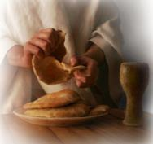
~60 AD: Paul’s Instructions on The Last Supper & the New Passover Ordinances
1 Corinthians 11:23-26
23 For I have received of Yahusha that which
also I delivered unto you, That Yahusha the same
night in which he was betrayed took bread:
24 And when he had given thanks, he brake it, and
said, Take, eat: this is my body, which is broken for
you: this do in remembrance of me.
25 After the same manner also he took the cup,
when he had supped, saying, This cup is the new testament in my blood: this do ye, as oft as ye drink it, in remembrance of me.
26 For as often as ye eat this bread, and drink this cup, ye do shew Yahusha’s death till he come.
The Wedding Supper is next – a celebratory
meal for the Everlasting Covenant!

Slide 90
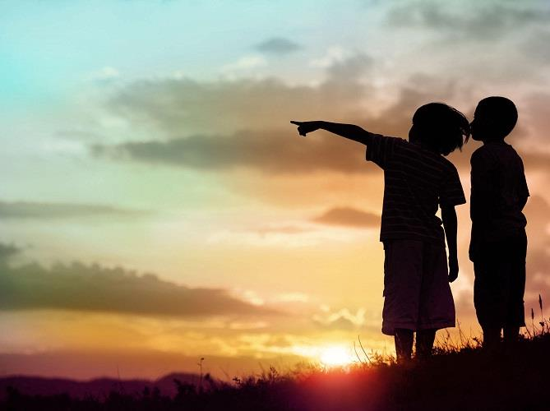

The Last Supper
Part 2
What kind of bread was at the table of the Last Supper? Leavened? or unleavened? or both?
If “both” which one represents Yahusha?
Come &See!
The End of Pt 1
90

Slide 91


Questions & Comments
can be sent to:
questions@studythecalendar.com
Thank you & Shalom!

