Slide 1

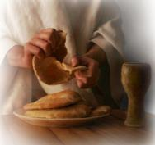

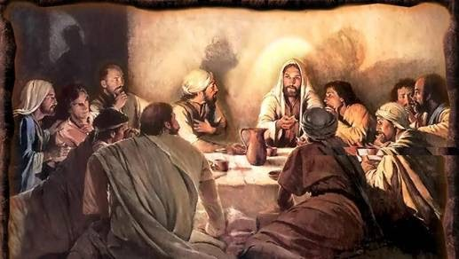
Was The Last Supper
also the Passover Meal?
Notes:
5.1a – teaser for Last Supper 12 slides 3 min Website: Youtube:
Blurb for 5.1a: If there was ever a confusing question about Yahusha’s Last Supper with His disciples, it has to be this: “Did He eat the Passover with His disciples, or not?” There are several factors that must be considered before this question can be answered – one of those factors has to do with “when the day begins.” For the sunset calendars, many claim the Last Supper was indeed the Passover meal, as after sunset was the beginning of Abib 14. However, Yahusha and His disciples were taking part in this Last Supper on Abib 13. The full study will have many answers, so “Come and See.” Shalom!

Slide 2


Can you Answer this Question?
If the Gospels are so easy to read, why are they not
so easy to understand?
Why do so many people not know that the Passover ordinances are conducted on “the” Passover day?

Slide 3

What is the Answer to this Question?
How difficult is it to understand that by
observing Passover on
any other date than
dictated by statute
results in
complete disobedience –
NO MATTER WHO IS INVOLVED?!

Slide 4

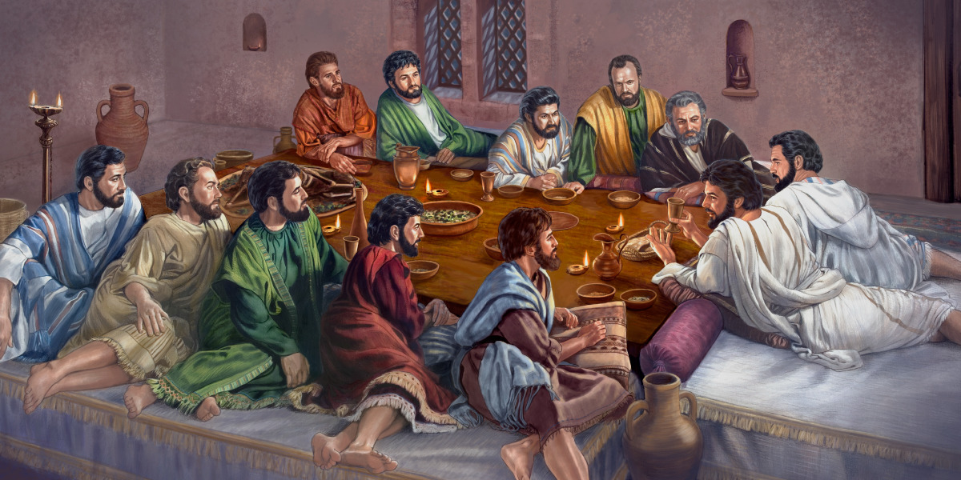


And ~ What About
this Question?
The Last Supper is a very special event between Yahusha and His followers at the end of His ministry!
Is this Last Supper the
same as the Passover Meal?
4

Slide 5


Out of
Surely we should be able to find the “date” for the Last Supper?
5

Slide 6

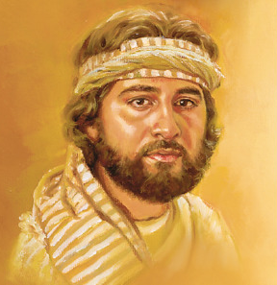
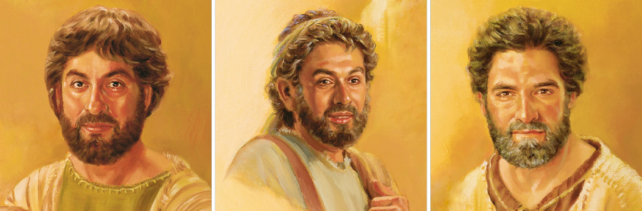
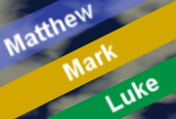
The writers of the Synoptic Gospels are 3 witnesses.
Can they solve the problem of the date of The Last Supper?

Slide 7

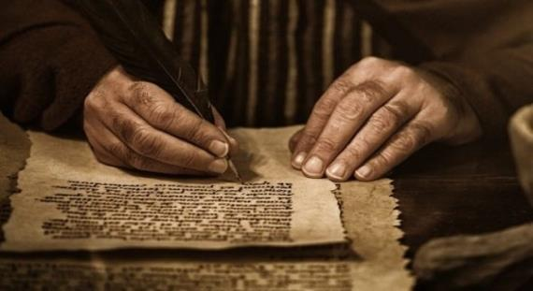
Most people recognize John’s Gospel is very unique!
Will the Gospels depend on John to solve the date of The
Last Supper?

Slide 8


Why is it so important to know?
What day? or … What date?
Tuesday? Or …
Wednesday?
Abib 13th? Or … Abib 14th?
8

Slide 9

If you are interested in finding the
then…

Slide 10


Which Gospel
Writer actually provides the
Come & See
to a long standing
“Knotty Problem”?

Slide 11


Are you Prepared for Passover?

Slide 12
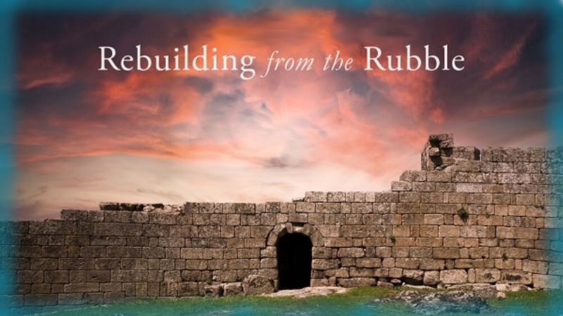


If you enjoyed your time today
Join Us for the full study!
then
Sign up with Covenant Calendar Club
for the Friday & Shabbat
Zoom Meetings
(including live discussion)
https://studythecalendar.com/sign-up/
Shalom!
Thank-you!
12

