Slide 1
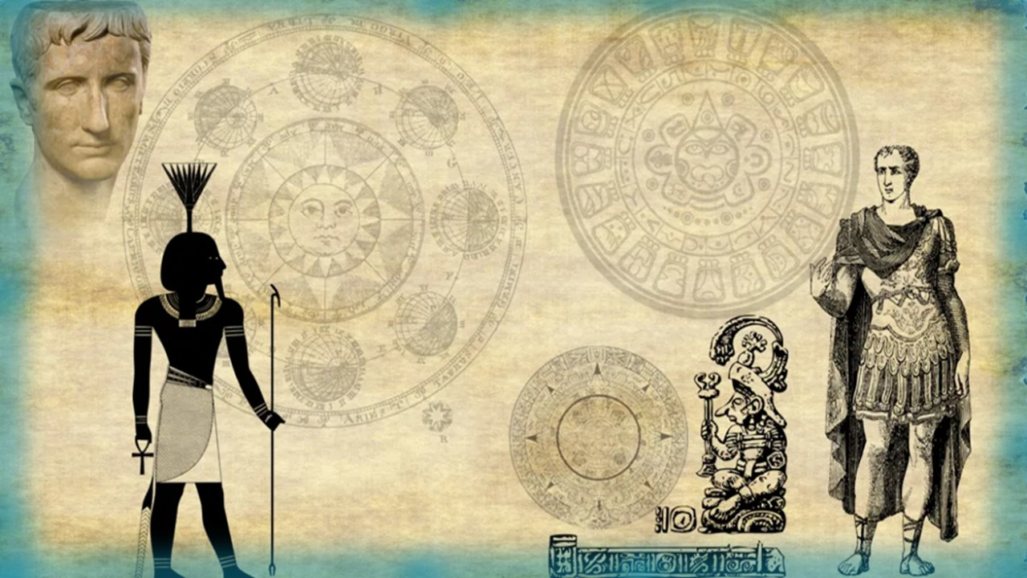

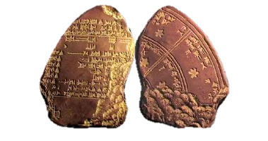
“Ancient
Civilization
Calendars”
Under Inspection
John 7
Part 6
“Ancient
Civilization
Calendars”
Under Brief
Inspection
Notes:
5.8b John 7 Pt 3 – Balancing days of Cov. Calendar
Website:
Launch: Youtube:
Edited by Tim and ready to go …
Blurb for 5.8b
Everything about the Covenant Calendar has to be grounded in the Torah, and then we should look for confirmation in the Gospels, especially during the ministry of Yahusha, as He lived and walked out the timing of His appointed worship statutes. The question has surfaced that the Feast of Trumpets should be placed along with the Fall Tequfah – as it is felt this is an important “king pin” for Covenant Calendar. That would mean the balancing days following the 360th day of the Scriptural calendar year, would be removed, and placed to follow the 30th day of the 6th month. Is this really what the Torah has intended? What happens when this “unauthorized” action is put in place? Does this decision follow any patterns given for the Spring Tequfah? Will Covenant Calendar begin to “intercalate” days at the end of month 6, when it does not – and – cannot endorse any intercalations used by lunar calendars, and also the Dead Sea Scroll calendars – namely: Enoch, Zadok and Essene. Lunar calendars must intercalate a 13th month about every 3rd year so the moon months stay in alignment with the heavenly seasons. The Dead Sea Scroll calendars are also faced with the same type of intercalation – adding in an extra week about every 6-7 years before the beginning of their new year. “Come and See” just why John 7 may have the final word on this theory of intercalating the balancing cycles at the end of month 6. Shalom!

Slide 2



What was revealed in Part 5 about
intercalation?
1. Roman Gregorian Calendar
Intercalates a leap day every 4 years;
it is a civil calendar only with 365/366 days.
2. Lunar Calendars
A brief examination of the most popular lunar calendars including a brief look at the lunar-sabbath calendar; all must intercalate an extra lunar month about every 3 years.
3. Qumran Calendars
From the Dead Sea Scrolls, the Enoch, Zadok
& Essene calendars generally all have a 364-day year; intercalate a 31st day to every 3rd month;
intercalate a full week about every 6-7 years!

Slide 3

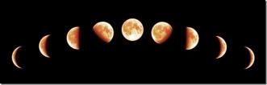

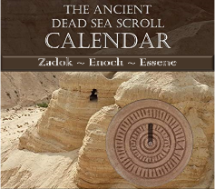
What else was revealed in Part 5?
1. Roman Gregorian
Calendar
A Civil Calendar of the World
2. Lunar
Calendars
Jewish, Messianic and/or
Hebrew Roots Festival Calendar
3. Qumran
Calendars
Another set of
Festal Calendars
All of the calendars in points #2 and #3 utilize the moon in various ways for the year-start.
None of them are completely based in the Torah with a pure Gospel witness.

Slide 4
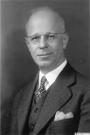
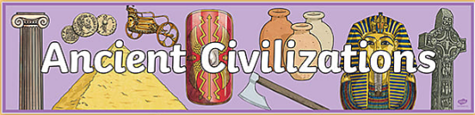

What will
be revealed
in Part 6 as intercalation
is examined?
1. Julian Morgenstern
The work of a wonderful calendar
historian sheds more light on
this topic of intercalation.
2. Ancient Civilizations
A brief examination of 11 nations
and how they handled intercalation.
Will the calendars of the Dead Sea Scrolls
be included in this examination?

Slide 5
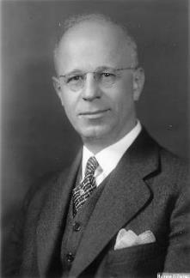
Secular Historical Documentation
There is more than enough documentation
for Yahuah’s Covenant Calendar in the
Scriptures as based in the Torah.
Julian Morgenstern has done excellent
research around lunar calendars (1930’s).
Does he have anything to add to the documentation of these calendars that
incorporate “intercalation”?
His comments are only a 2nd witness, not
the authority for truth! First: Who is Morgenstern?
Julian Morgenstern
1881-1976
The Calendars of
Ancient Israel
Notes:
Taught by Charlene & Tim on: Time:
5.14 John 7 Pt 6: Intercalation Calendars Under Inspection [ ] website:
5.14 Youtube:
Blurb:

Slide 6
Morgenstern, Julian (1881-1977)
MORGENSTERN, JULIAN (1881–1977), U.S. Reform rabbi, Bible scholar, and president of the *Hebrew Union College. Born in St. Francisville, Illinois, Morgenstern graduated from the University of Cincinnati in 1901 and was ordained at the Hebrew Union College in 1902. He received his doctorate at Heidelberg in 1904; his dissertation was published as Doctrine of Sin in the Babylonian Religion (1905). After three years as rabbi in Lafayette, Indiana, he turned to academic life, teaching biblical and Semitic languages, concentrating on biblical studies, at Hebrew Union College.
In 1921 Morgenstern became acting president of the college and in 1922 was elected president; he was the first alumnus to hold this office. During his presidency the number of students and faculty and the scope of college activity grew markedly. Departments of education, social studies, and Jewish music were established; new buildings were erected; an endowment fund was created; the college, previously a department of the Union of American Hebrew Congregations, was independently chartered, and the Hebrew Union School of Religious Education was established in New York City. Hebrew Union College Annual, founded in 1924, at once became one of the world's outstanding publications in Jewish scholarship. During the Hitler period, a dozen European scholars found a haven at the college, chiefly as the result of Morgenstern's efforts. At first anti-Zionist, Morgenstern later modified his position on the creation of a Jewish state. After retiring as college president in 1947, Morgenstern continued to teach Bible. He served as president of the American Oriental Society and the Society of Biblical Literature; he was for many years recording secretary, and then honorary president, of the Central Conference of American Rabbis and one of the founders of the World Union for Progressive Judaism.
Biblical Studies
U.S. Reform rabbi, Bible scholar, and president of the *Hebrew Union College. Born in St. Francisville, Illinois, Morgenstern graduated from the University of Cincinnati in 1901 and was ordained at the Hebrew Union College in 1902. He received his doctorate at Heidelberg in 1904; his dissertation was published as Doctrine of Sin in the Babylonian Religion (1905). After three years as rabbi in Lafayette, Indiana, he turned to academic life, teaching biblical and Semitic languages, concentrating on biblical studies, at Hebrew Union College.
In 1921 Morgenstern became acting president of the college and in 1922 was elected president; he was the first alumnus to hold this office. During his presidency the number of students and faculty and the scope of college activity grew markedly. …

Slide 7
Morgenstern, Julian (con’t)
Departments of education, social studies, and Jewish music were established; new buildings were erected; an endowment fund was created; the college, previously a department of the Union of American Hebrew Congregations, was independently chartered, and the Hebrew Union School of Religious Education was established in New York City. Hebrew Union College Annual, founded in 1924, at once became one of the world's outstanding publications in Jewish scholarship. During the Hitler period, a dozen European scholars found a haven at the college, chiefly as the result of Morgenstern's efforts. At first anti-Zionist, Morgenstern later modified his position on the creation of a Jewish state.
After retiring as college president in 1947, Morgenstern continued to teach Bible. He served as president of the American Oriental Society and the Society of Biblical Literature; he was for many years recording secretary, and then honorary president, of the Central Conference of American Rabbis and one of the founders of the World Union for Progressive Judaism. Biblical Studies

Slide 8


Well documented information from Morgenstern on the calendars of Israel addresses the question:
Did the Jews have Different Calendars? How many?
Calendar I Facts: (p. 18) Employed as late as 621 BCE up to 608 BCE.
It appears this is a solar calendar. The dates for Sukkot were different compared to Calendar II.
Calendar II Facts: (p. 3) May have appeared about 608 BCE (13 years later).
Morphs to a luni-solar calendar about 586 BCE [22 yrs] taking on Babylonian
characteristics; their cycle now begins at sunset as was practiced in Babylon.
Passover and Yom Kippur were transferred to “full moon” dates.
Their festal calendar New Year’s Day, was moved around several times from:
(1) 7th Mon/10th Day; (2) later to 7th Mon/1st Day; (3) then transferred back to
1st Mon/1st day; (4) finally it was placed back to 7th Mon/1st Day – adopted under
Babylon in 600 BCE (which affected the Jews in both Babylon and Palestine).
Calendar III Facts [of the 4th century BCE]: Intercalation was always changing, but
Calendar III has a more exact system of intercalation (p. 8). The New Year’s Day is fixed to
7th Mon/1st day even though a secondary New Year’s Day is marked as 1st Mon/1st Day. The
“fixing” of the New Year’s Day was the main difference between Calendar II and Calendar III.
Calendar IV: (Not discussed in this study.)
Julian Morgenstern
1881-1976
The Calendars of
Ancient Israel p 3-16
(and)
The Three Calendars
of Ancient Israel
p 18
Morgenstern also writes Israel changed
their calendars so many times it was almost completely lost!

Slide 9
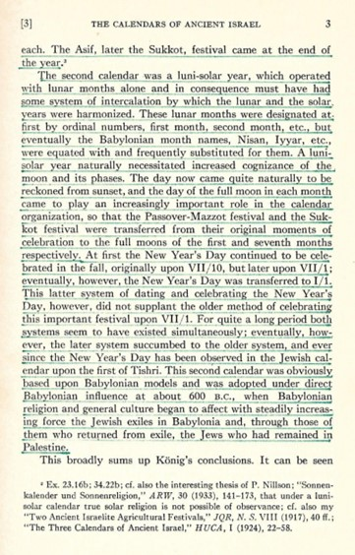
The Calendars of Ancient Israel p 3 (Konig’s Summary)
Calendar II was luni-solar and had a system of intercalation to harmonize the movements of the sun and moon. As Babylon’s moon took priority, the Jewish nation naturally adopted sunset.
Originally New Year’s day was reckoned on Yom Kippur.
THEN New Year’s day was changed to Feast of Trumpets.
After that, New Year’s day was moved to 1st day of the 1st month.
Next, both Trumpets & Yom Kippur had New Year’s day for a while.
FINALLY, Trumpets is selected as New Year’s day. (Today’s Problem!)
In 600 BCE the Jew’s Calendar II was adopted from Babylonian influence affecting the Jews in Babylon, those in Palestine, and the exiles that returned many years later.
(Additional note: About 450 BCE this Babylonian calendar was implemented into the Jewish culture and stands to this day.)
Question: Is it possible to see how the sun and moon deities from Babylon all “contribute to” and “form the foundation” of intercalation?
Note: These calendar roots were among the children of Israel when Joshua died. (~1430 BCE) Within 830 years, Babylon’s calendar was adopted; 150 years later Babylon’s calendar was implemented!
The Calendars of Ancient Israel

Slide 10
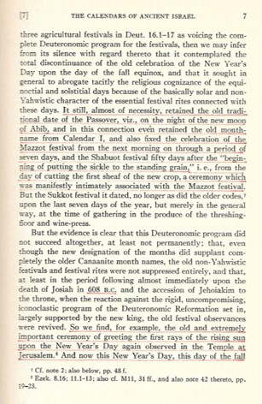
The Calendars of Ancient Israel p 7 (Summary)
Page 7 seems to contain a lot of “conflicting information” about the Passover falling on the new moon which isn’t the topic of this study. However the existing conflict does show there was very little calendar stability.
There is not enough context for this first paragraph, but it seems to indicate (through a lot of calendar silence) that New Year’s Day was separated from the FALL equinox – because of non-sacred rites attached to it from pagan nations.
THEN, in the last paragraph (around 608 BC) apparently New Year’s Day on the FALL equinox was revived – with the rays of the rising sun observed in the TEMPLE – this is on Calendar II.
Question: Is it not interesting that once again today some want to link the Summer Shadow Teshuva Sign (in Sept) with Feast of Trumpets? Is this idea stemming from some ancient pagan history?
It is also stated that Passover was on the night of the
new moon, NOT the full moon.
Notice: Mazzot festival is fixed to the NEXT morning after Passover (middle of page) – not to sunset on Passover cycle.
The Calendars of Ancient Israel

Slide 11
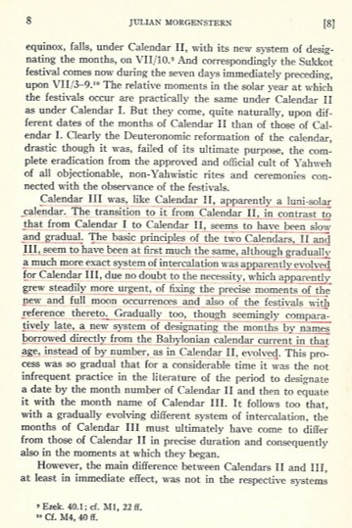
The Calendars of Ancient Israel p 8 (Summary)
The top of this page seems to indicate that Calendar I was solar and Calendar II was luni-solar.
Only the middle of the page talks about a more exact system of intercalation evolved to Calendar III thus the months of Calendar III differ from those of Calendar II.
Calendar III Facts (p 8): Intercalation was always changing, but Calendar III has a more exact system
of intercalation.
The New Year’s Day is fixed to 7th Mon/1st day even though a secondary New Year’s Day is marked as
1st Mon/1st Day.
The difference between Calendars II & III
fixed the New Year’s Day “date” to the 1st Day of the 7th Month.
The Calendars of Ancient Israel

Slide 12
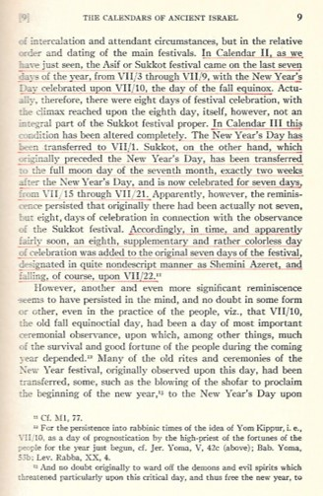
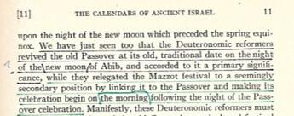
The Calendars of Ancient Israel p 9 & 11 (Summary)
An interesting comment to take note of: The New Year’s
Day was at one time on Yom Kippur – the 10th day of the
7th month which was ALSO the fall equinoctial day
– a very important day of ceremonial observance.
Calendar Facts (p 9 & 11): Those rights were transferred to the night of the new moon which preceded the spring equinox.
Note: There seems to be an obvious “serious” attachment to the fall equinox day, as several festivals were married to this day one way or another, without any Torah support.
And the same thing seems to be happening today!
The Calendars of Ancient Israel

Slide 13
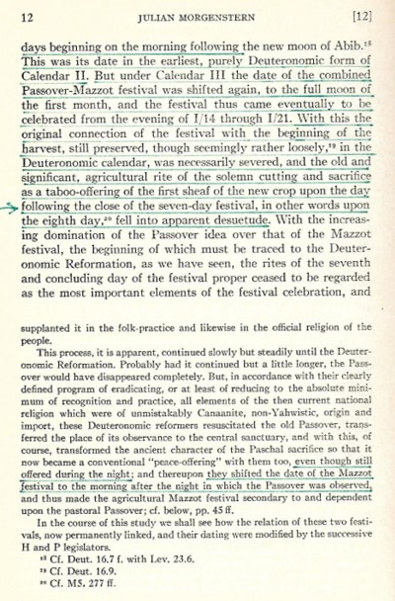
The Calendars of Ancient Israel p 12 (Summary)
Don’t miss this comment (in the days of Calendar II) [picking up from p 11]:
“Manifestly, these Deuteronomic reformers must have shifted the date of the old Canaanite, agricultural festival from the traditional moment of its celebration … in which the spring equinox fell, to the seven [p 12] days beginning on the morning following the new moon of Abib.”
Under Calendar III: The date of Passover was SHIFTED AGAIN – to be celebrated on the [full moon] of the 14th of Abib, starting at SUNSET!
In the footnotes of p 11, Morgenstern writes around the time of Elisha (842 BCE) Passover was considered an optional festival and that IF it was observed any leftover sacrifice
had to be burned before morning. No wonder he also notes:
“had it [non-observance of Passover] continued on a little longer,
the Passover would have disappeared completely.”
The old Passover was resuscitated; observance was restored to the sanctuary again.
Question: What IF Covenant Calendar of the Torah would have been followed without the sunset, the moon and intercalation?
The Calendars of Ancient Israel

Slide 14

Does reaching
for the moon
demand a
system of
intercalation?
What about
Enoch?
According
to
Morgenstern:

Slide 15
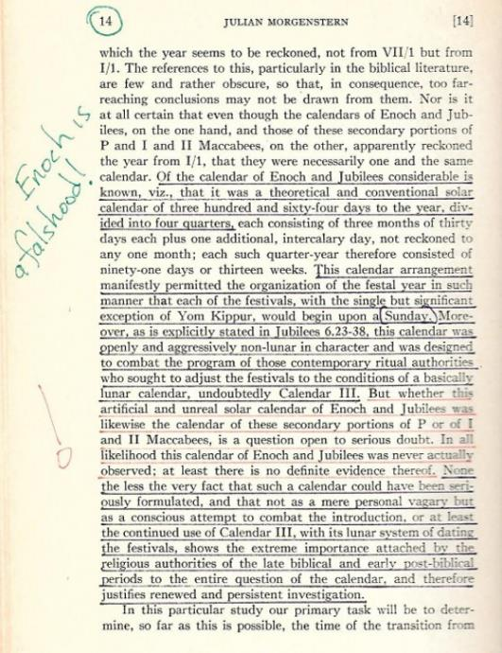
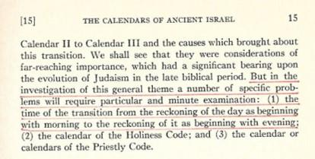

The Calendars of Ancient Israel
p 14/15 (Summary)
Take note of the underlined portions
of how the Enoch/Jubilee calendars
tried for recognition to oust Jewish Calendar III, but were never really observed. However the Dead Sea Scroll calendars are [sunrise] morning day start which seemed to have an effect on how some calendars of Israel began with the morning [p 15]. This could also be the reason why so many secular historical quotes over the past 2000 years from rabbis and scholars speak of the sunrise day-start, rather than dawn/boqer.
Seems to be a “battle of calendars” here & the battle still rages today.

Slide 16

Did the moon
have anything
to do with Israel’s
morning day-start?

Slide 17
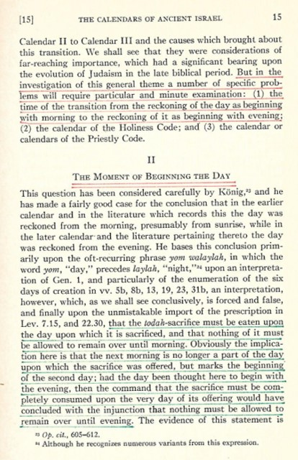

THE BEGINNING OF THE DAY: Here Morgenstern cites Konig’s research for the day beginning in the morning and eventually was reckoned to evening.
However, Morgenstern does not agree with that.
[p 15]
Needless to say, Morgenstern also goes on to cite Konig’s reason for boqer day-start by the statutes in Lev 7:15 & 22:30. All sacrifices must be offered on the same day; going on to conclude this is the only convincing evidence from Konig [p 16].
Morgenstern notes Konig’s understanding of how morning [sunrise] used to be the day-start for the Jews, and later evolved to the day beginning from the evening.
Question: Does Morgenstern link the day-start with lunar timing?

Slide 18
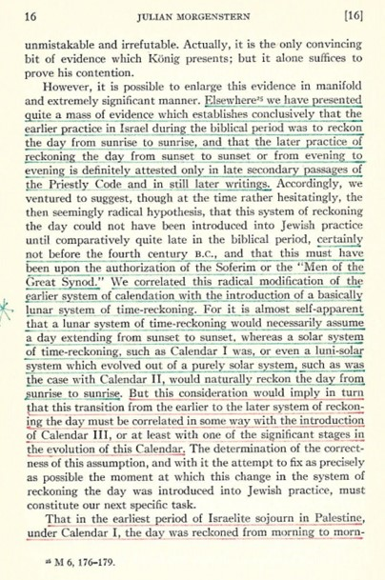
The Calendars of Ancient Israel
p 16 (Summary)
Morgenstern links the boqer day-start to Calendar I.
The change to the sunset/evening day-start appears between the transition of Calendar II to Calendar III – all at the same time that the Dead Sea Calendars have a presence – BEFORE the 4th century BC.
Note this quote carefully: “We correlated this radical modification of the earlier system of [morning] calendation with the introduction of a basically lunar system of time-reckoning. For it is almost self-apparent that a lunar system of time-reckoning would necessarily assume a day extending from sunset to sunset, whereas a solar system of time-reckoning, such as Calendar I was, or even
a luni-solar system which evolved out of a purely solar system, such as was the case with Calendar II, should naturally reckon the day from sunrise to sunrise.”

Slide 19
intercalation
& the moon
are involved
there is nothing
but problems?
Have you
noticed
when …
It’s time to consider some other documents and what they say about intercalation.

Slide 20
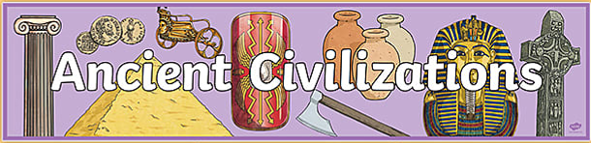
Have you heard
of the Original
360-day Year from
Did You Know?
… in past ages scholars
have come across ancient references of a 360-day year, but they have routinely tended to minimize its significance?
Did You Know?
… it was inconceivable to them that
the ancient world could actually have had a 360-day year and if sources would quote such information they were considered very unreliable?

Slide 21
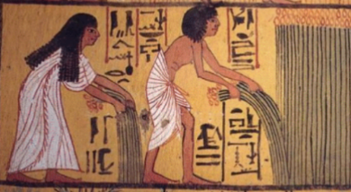
Did You Know?
… linguists attempting to make sense of ancient texts may even have mistranslated passages that when correctly translated might imply a 360-day year?
… the evolutionary paradigm of grunting cavemen conflicts with the actual widespread historical, anthropological and archaeological evidence proving ancient human civilizations were brilliant and sophisticated?
It is now known:
These ancient civilized races were graced with high intelligence;
a race who knew their teachings must be handed down through all the ages to this present day!
Why did they feel so motivated
to document their calendars?

Slide 22

Wikipedia Internet Snooping
Question for Wikipedia:
Did the Earth ever have a 360 day year?
Answer: Many say that several thousand years ago the earth year used to be shorter, closer to 360 days, and at one point a comet came close to the earth and caused the earth to slow down. And evidence of that is all calendars from different cultures around the world switched from 360 days to 365 days around the same time.
Study Question:
What did these
cultures do with
the extra 5+ days?

Slide 23
Definition of ‘Calendar’ & Why a “Calendar” is so Important to Cultures, Past & Present?
The word ‘calendar’ derives from the Latin word ‘calendarium’, which means register and structure. So having a calendar was a big leap forward for ancient cultures. A “Calendar” made it possible to structure festivals, daily routines and agricultural events – with the advantage of being able to plan in advance for these events. This
was particularly important when humans started to settle down and then getting together for celebrations/market day and other social events really took off. It was of course the calendar, the common structure for measuring everybody’s time, that made these events possible. Apart from timing celebrations it also enabled dates for planting, harvesting and collecting taxes.
It is hardly surprising that early man chose the path of the moon. Firstly it is the most visible object in the sky and in the absence of electricity was the only viable light at night (bar fire).
The path of the moon is also inextricably connected to the tides and the human fertility cycle. In fact, the moon had always been connected to fertility, rainfall, birth and death.
The Ancient Greek, Roman and Chinese year consisted of 12 moon cycles (354 days) and occasionally a 13th cycle was included to keep the Ancient Lunar year in sync with the seasons. Many religious calendars operated (and still do) in sync with this lunar calendar model. Others morphed into a lunisolar calendar model.
As can be seen, ancient calendars were calculated more on “what they saw” than on “how to count.”
https://www.livingwiththemoon.com/tag/history-of-lunar-calendar/

Slide 24


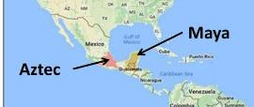
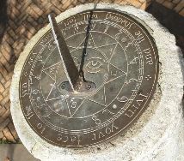

Around the World that had to Make
Decisions About Intercalation
ARMENIA
GREECE
BABYLON
These will be examined in a random order.
ROME
CHINA
INDIA
EGYPT
I
SRAEL
SUMERIA
Hezekiah’s Sundial: ~700 BCE

Slide 25
Note: Four of them are exceptionally unique! They are:
ARMENIA
BABYLON
EGYPT
SUMERIA
Note: All dates on the following historical documents are ONLY GENERAL estimates.

Slide 26

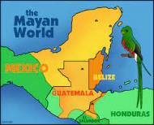
Did You Know Some Say?
The earliest excavated Mayan settlements date to 1800 BC.
NASA reports that back in 650 BC “Mayan astronomers [made] detailed observations of Venus, leading to a highly accurate calendar.”
The Mayan baktun calendar is similar to the 400 year prophecy of Gen 15 in that 400 hundred 360-day years = 144,000 days.
Mayans had varying interrelated calendars, but to identify an actual date in history, they used the Long Count calendar of 360-day years.
Mayans demonstrated tremendous mathematical skill with their base
20 number system.
Most worldviews simply cannot account for such extraordinary history. As a result this historical evidence often gets ignored.

Slide 27
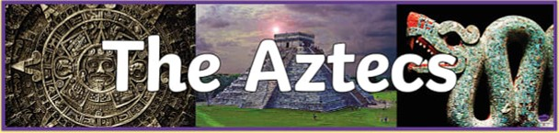
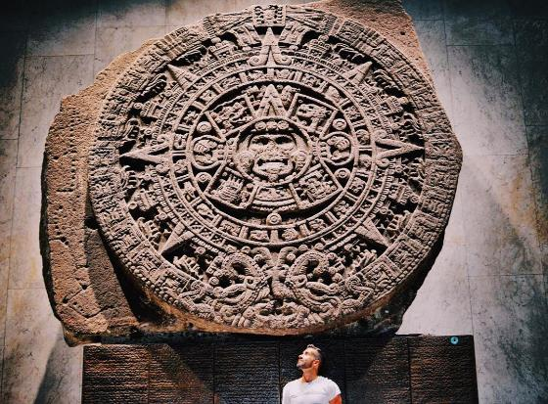
Did You Know Some Say?
Ring B of this calendar stone has 18 quincunxes which combines with the 20 uinal day signs for a 360 day year. Some researches say every day was named; the year is named after the 360th day.
Not based on the lunar system.
They had different complex calendar systems, yet their “solar year consisted of 18 months of 20 days.
With the 365-day year they tacked on the extra five intercalary days after the 360th day.
Aztec calendar stone is
12’ in diameter.

Slide 28
Armenia, Egypt, India & Sumeria
ARMENIA
INDIA
EGYPT
SUMERIA
Hezekiah’s Sundial: ~700 BCE

Slide 29
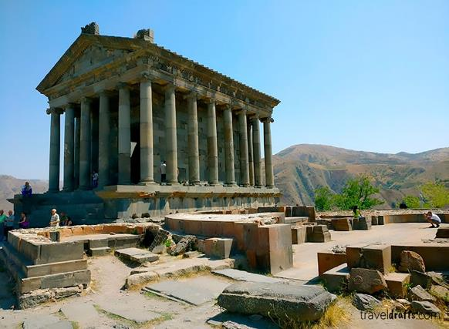
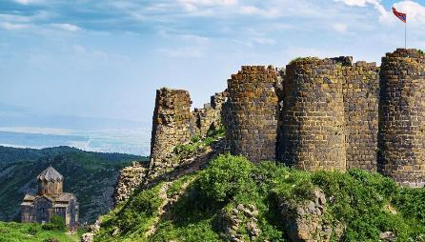
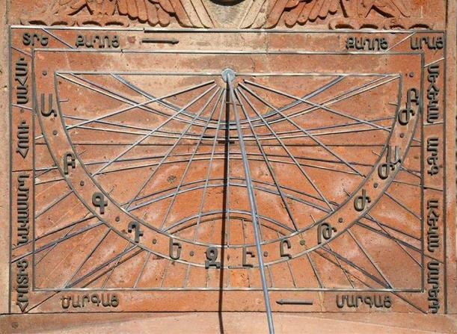
Did You Know Some Say?
Paris Herouni’s research on the Carahunge monument has been positively reviewed by the world’s leading expert in archeoastronomy for us to consider.
Herouni obtained Armenia’s calendar date of 2492 BC by various historical and calendrical means.
He also references a 7th century AD scholar (Anania Shirakatsi) for his list of the 24 Armenian names, one for each of the 24 hours in a day, and then 30 more names, one for each day of the month. Notably, no name is presented for a 31st day of the month because the Armenian calendar had only 30-day months.
Armenia
He also reports the following information which must link to the longer yearly circuit:
Armenian’s calendar consists of 12 months 30 days each, so 360 days plus 5 (or 6 once per every four years) additional days.
He notes that Egyptians followed the practice of the Armenians, in celebrating the 5 epagomenal days, which are not distributed to any of the 12 months
of the year. These days were inserted
after their 12th month.
Good map for Ararat; Armenia; iran no rivers or Babylon.

Slide 30
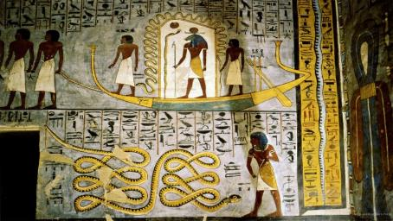
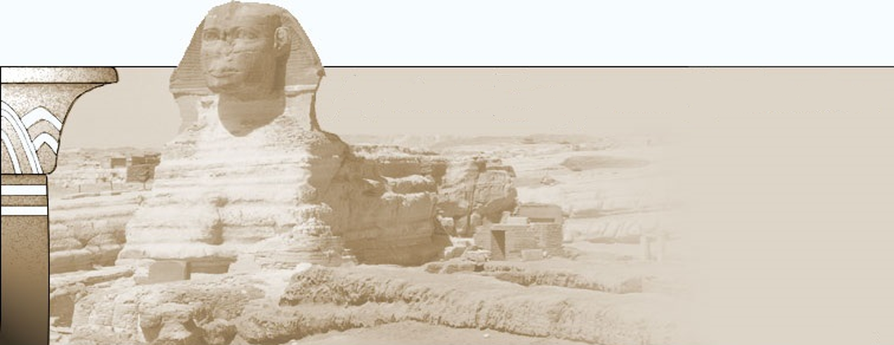
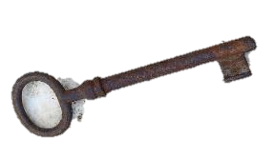
Ancient Egyptian Civilization
Extended Investigation into Egypt’s History
The Canopus Decree (238 BC)
The Rosetta Stone (196 BC)
These are two very interesting
inscriptions. Which one has the
“key” to unlock the other?

Slide 31
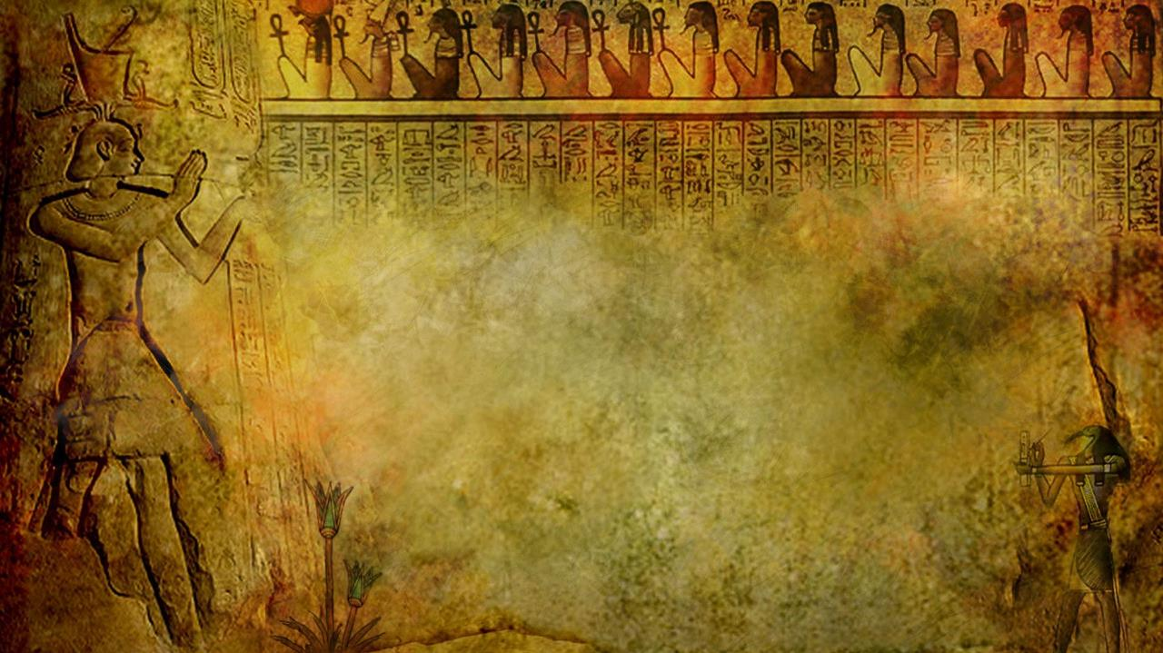
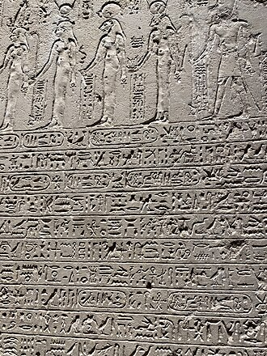
Canopus Decree ~ 238 BC
The Decree of Canopus is a trilingual inscription in three scripts, which dates from the Ptolemaic period of ancient Egypt.
These three writing systems are: Egyptian hieroglyphs, demotic, and Greek, on several ancient Egyptian memorial stones.

Slide 32
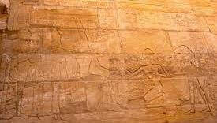
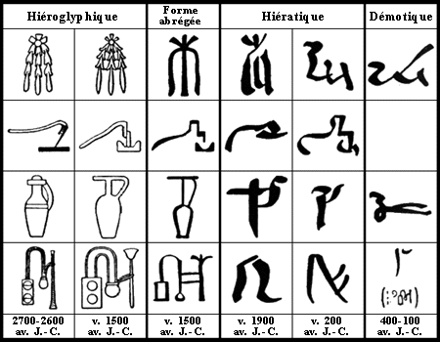
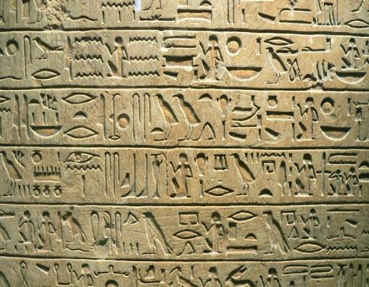
Definition: Hieroglyphics
Hieroglyphics are an original form of writing out of which all other forms have evolved. Two of the newer forms were called hieratic and demotic. Hieratic was
a simplified form of hieroglyphics used for administrative and business purposes,
as well as for literary, scientific and religious texts. In the third century A.D., hieroglyphic writing began to be replaced by Coptic, a form of Greek writing.
The last hieroglyphic text was written at the Temple of Philae in A.D. 450.

Slide 33
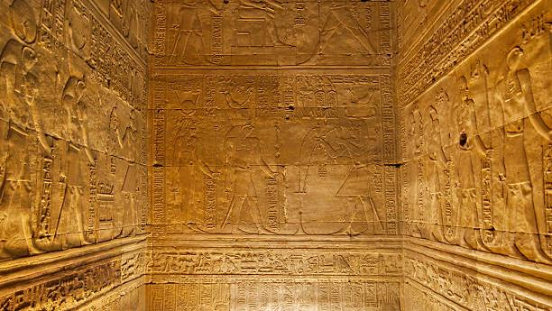
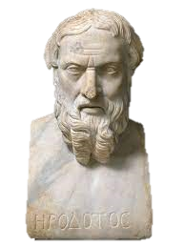
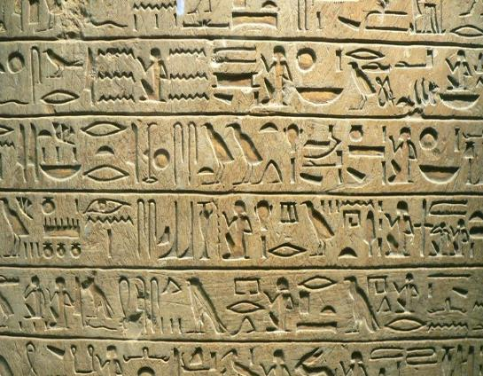
Definition: Demotic
Demotic (from Ancient Greek: 'popular') is the ancient Egyptian script derived from northern forms of hieratic used in the Nile Delta. The term was
first used by the Greek historian Herodotus to distinguish it from hieratic and hieroglyphic scripts.
Herodotus

Slide 34
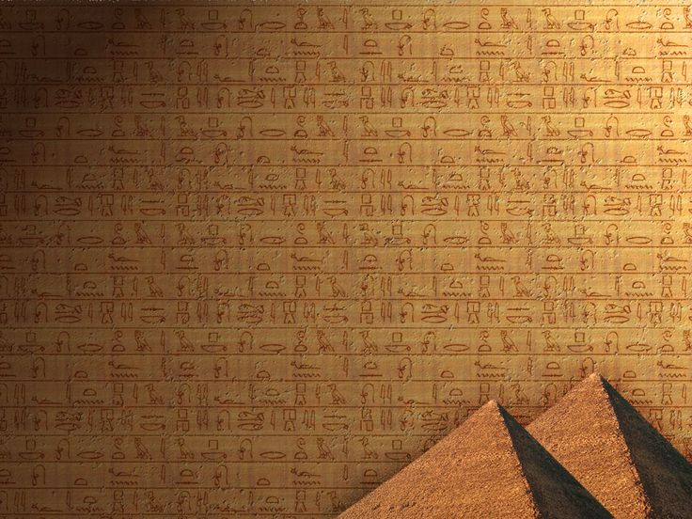
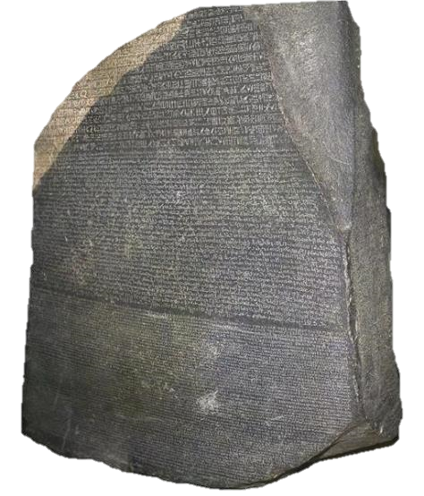
Rosetta Stone ~ 196 BC
Before we investigate anything around the Egyptian calendar, it is the Rosetta Stone (dated to 196 BC, found in 1799) that has been the key to unlock Egypt’s hieroglyphics.
Note this very important information: This “hieroglyphic key” also unlocked the Canopus Decree which had information about “reformation of the calendar”
in Egypt.
34

Slide 35

Canopus Decree & Calendar
The Canopus Decree attempted to reform the calendar to effectively a 365.25 year via
a modern leap year system.
Even though this was as late as 238 BCE,
still with great pomp the Egyptians would write, of “the year of 360 days and the
5 days added to their end …”
Columbia University translates it this way:
“… if the arrangement of the year remained of 360 days plus the 5 days later brought into usage …”
The setting aside of the last five days agrees with the practice which Herodotus [~440 BC] ascribes to the Egyptians of considering the 5 days over the 360 as scarcely belonging to the year, and not placing them in any month.
Is Egypt holding an important KEY of understanding?

Slide 36
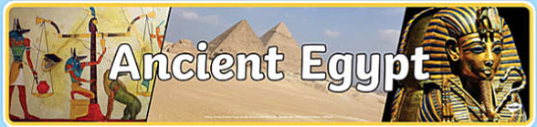
Did You Know This?
Like so many other cultures, though the Egyptian astronomers knew there were more days in a year, they disrespected the remainder and showed a deep loyalty to the history of the 360-day calendar.
Greek Historian, Herodotus (484-425 BCE, known as the father of Greek history from 550-479 BCE; Asia
& Egypt), wrote about 440 BCE:
“With regard to human affairs, all the priests agreed that the Egyptians were the first to discover the year and to divide it into 12 parts. They obtained this knowledge by studying the stars. The Egyptian calendar seems to me, to be much more sensible than that of the Greeks; for … the Egyptians, basing the calendar on twelve 30-day months, intercalate five additional days every
year, whereby the cycle of the season returns
with uniformity.”

Slide 37

Though Herodotus may have been correct, the priests still erred if they thought the 12 month division began in Egypt – for the observation of twelve 30-day months continued
in Mesopotamia from earlier times.
Thus the migration of people to Egypt [with their calendar] came from Asia Minor, Mesopotamia and Canaan.
In 1892, Lockyer inferred:
“Wherever the ancient Egyptians
came from, whether from a
region where the moon was the
time-measurer or not, as soon as
they settled in the valley” … “the solar
basis of their calendar was settled.”
Ancient Egypt also carved groups of stars into the ceilings of tombs and coffin lids from about 2100 BC. Why?
Herodotus
Father of
History

Slide 38
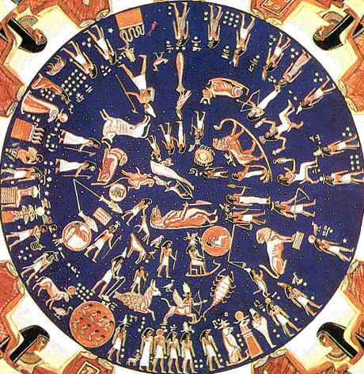
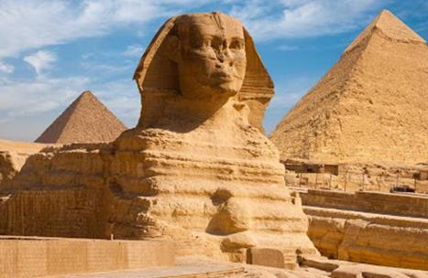
Did You Know?
The 36 decans of ancient Egypt were groups of stars carved into the ceilings of tombs and coffin lids beginning from about 2100 BC to Ramesses IV in 1150 BC.
It was the Egyptians who
named the 36 decans of the
stars because every 10th morning
(just before dawn) the next grouping of stars in the series would rise [more info with the Mul.Apin tablets].

Slide 39
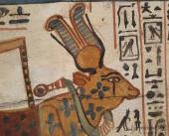
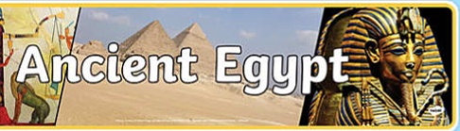
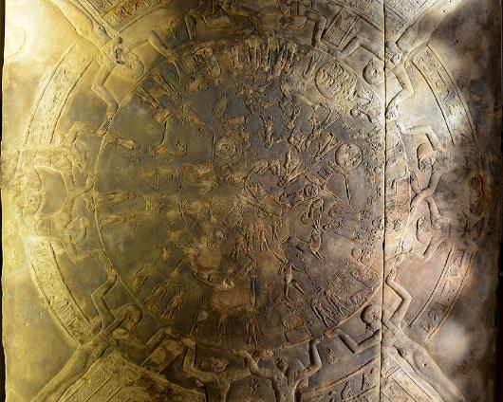
Dendera [Pagan] Temple – with 360-day year Support?
History: The Dendera Temple was built in Greco-Roman
times by Ptolemy IX SoterII. It is dedicated to the cow
goddess Hathor, one of the most important goddesses
of ancient Egypt.
What does the ceiling of the Dendera Temple depict?
Answer: A beautiful and unique star map!
The eight feet square sandstone ceiling panel from 50 BC is reputed to be the world's first horoscope. The bas-relief
depicts the 12 constellations of the zodiac, five planets, and
both a lunar and solar eclipse. It charts the movement of the
stars and depicts the zodiac constellations quite like we do today.
The Dendera Zodiac is a map of the stars on a plane projection. This zodiac is somewhat unique, as it is circular in shape, as opposed to the more usual rectangular ones. The heavens,
in the form of a disc, are shown to be held up by the four pillars
of the sky in the form of four female figures who are assisted by eight falcon-headed figures. In the circumference of the disc are 36 spirits of ‘decans.’ These are first magnitude stars used in the ancient Egyptian calendar to keep track of the days of the year. Hence, these spirits, each of which represents 10 days, were carved onto the Dendera Zodiac to symbolize
the 360 days of the ancient Egyptian calendar.
The most famous Egyptian star map is a
1st-century-BCE stone chart found in the temple at Dendera, now in the Louvre.

Slide 40

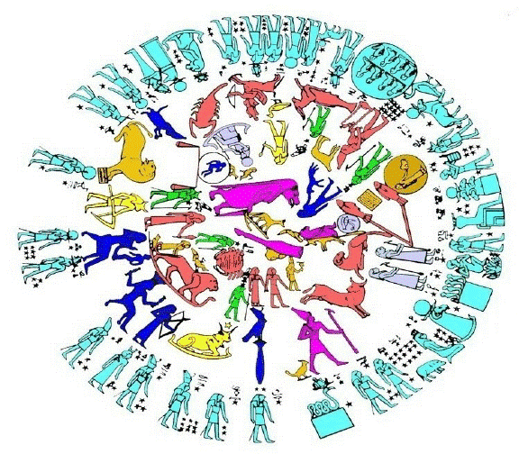
Did You Know we have to pause and
ask a question of this specific thought?
“In the circumference of the disc are 36 spirits of ‘decans.’ These are first magnitude stars used in the ancient Egyptian calendar to keep track of the days of the year.”
This statement cannot be overstated!
If Egypt was on anything other than a
Teshuva regulated calendar of
360-day years, this implication would
be absolutely IMPOSSIBLE!
In that case, does this historical quote align
with Torah and the time of Joseph in Egypt?

Slide 41
Did You Know?
The Egyptians divided the night sky into 36 groups of stars, or decans, forming constellations. Each decan was named and associated with a corresponding god or goddess. For the Egyptians, the most impressive constellation in the sky was Orion, and the most important star was Sirius, called the Dog Star by the Greeks. Egyptian mythology equated Sirius with Isis and saw her as Orion's companion. Together they dominated the southern sky.
Sirius was the brightest star in the night sky, and when it appeared on the horizon around July 9, it was a sign that the
Nile was about to rise and the season of inundation or flooding was about to begin. The inundation was crucial because the low Nile would mean less water for irrigation, causing a poor harvest.
Every 10 days, a different decan appeared on the dawn horizon just before the sun rose. Thus the 36 decans could be used
for measuring a 360-day year. By noting
the positions of decans, the Egyptians also could tell time during the hours of the night.

Slide 42
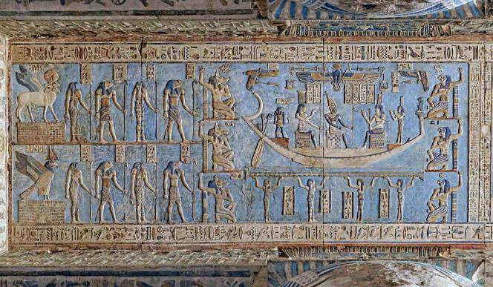
Did You Know?
Pictures of the decans, or star clocks, were sometimes painted on coffin lids or tomb walls. Eventually star clocks were more of a decoration than a timekeeper, for, at the end of every year, they were about six hours behind time, and after several years, they were off by weeks.
Although the decans and the god
and goddesses who represented
them were not used for telling time,
they continued to appear on the
walls and ceilings of tombs and as
coffin decorations until the
Greco-Roman period.

Slide 43
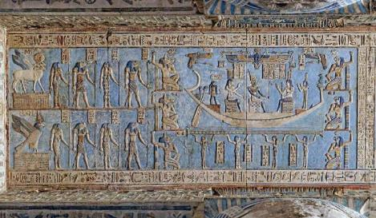
Did You Know we have to stop again to
ask a question of another specific thought?
“Eventually star clocks were more of a decoration than a timekeeper,
for, at the end of every year, they were about six hours behind time,
and after several years, they were off by weeks.”
This statement is incredibly interesting. WHY?
Could it be exposing the transformation period
to a lunar based calendar? WHY?
The lunar based calendar would have
introduced this 6 hour time situation.

Slide 44
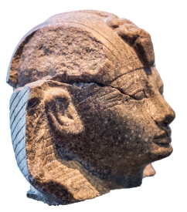
Did You Know?
About 1550 BC, The Ebers Papyrus, written during the reign of
Pharaoh Amenophis, presents a
360-day year calendar on the
reverse side of the first “page” of
the 66-foot long scroll?
This lengthy document also preserved many Egyptian medical practices for posterity including their knowledge of
the heart as the center of one’s blood supply with its vessels extending throughout the body.
https://biblearchaeology.org/research/exodus-from-egypt/3147-amenhotep-ii-and-the-historicity-of-the-exodus-pharaoh
The Astronomical Date in the Ebers Papyrus.
The Ebers Papyrus, an ancient Egyptian MS that dates the heliacal rising of Sothis to Year 9, Month 3, Season 3, Day 9 (ca. 15 May) of Amenhotep I's reign (ca. 1550-1529 BC), records this astronomical event that fixes its composition to an identifiable time in the 18th Dynasty.⁴⁰ Since astronomers can pinpoint this event by charting the positions of stars in antiquity, the papyrus can be dated to ca. 1541 BC, making his initial regnal year ca. 1550 BC. This dating, accepted by numerous Egyptological scholars, is based on the ancient capital of Memphis as the point of observation, despite the Theban provenance of the papyrus. A Theban point of observation, which is accepted by other Egyptologists, dates the papyrus to ca. 1523 BC.⁴¹ While the Egyptians never stated from where they observed the Sothic rising, Olympiodorus noted in AD 6 that it was celebrated at Alexandria, after having been observed at Memphis.⁴² Therefore, Memphis is taken to be the correct point of observation for the rising recorded in the Ebers Papyrus.

Slide 45
The Astronomical Date in the Ebers Papyrus
“The Ebers Papyrus, an ancient Egyptian manuscript that dates the heliacal rising of Sothis to Year 9, Month 3, Season 3, Day 9 (ca. 15 May) of Amenhotep I's reign
(ca. 1550-1529 BC), records this astronomical event that fixes its composition to an identifiable time in the 18th Dynasty. Since astronomers can pinpoint this event by charting the positions of stars in antiquity, the papyrus can be dated to ca. 1541 BC, making his initial regnal year ca. 1550 BC. This dating, accepted by numerous Egyptological scholars, is based on the ancient capital of Memphis as the point of observation, despite the Theban provenance of the papyrus. A Theban point of observation, which is accepted by other Egyptologists, dates the papyrus to ca. 1523 BC. While the Egyptians never stated from where they observed the Sothic rising, Olympiodorus noted in AD 6 that it was celebrated at Alexandria, after having been observed at Memphis. Therefore, Memphis is taken to
be the correct point of observation for the rising recorded in the Ebers Papyrus.”
https://biblearchaeology.org/research/exodus-from-egypt/3147-amenhotep-ii-and-the-historicity-of-the-exodus-pharaoh

Slide 46

Did You Know?
In the 1200s BC, Pharaoh Ramesses II had engraved an astronomical ceiling depicting
a 360-day year.
Marshall Clagett (science historian & scholar of the 20th century) noticed the five epagomenal days often added to complete ancient 360-day calendars were simply absent in these ancient EGYPTIAN calendars.

Slide 47






Did You Know?
The “1st law” of the Pharaohs was their pledge, taken on the day of ascension to the throne, to never change the calendar?!

Slide 48



Wikipedia Snooping for Internet Questions
How did Egyptians
count the days?
Wiki Answer: It is thought that, like most agricultural societies, the ancient Egyptians originally organized their calendar according
to the cycles of the moon and the agricultural seasons. Most scholars agree that the Egyptian day began at dawn, before the rising of the sun, rather than sunrise. The daily cycle was divided into twenty-four hours: twelve hours of the day and twelve hours of the night, the latter apparently reckoned based on the movement of groups of stars (“decans”) across the night sky.
https://www.metmuseum.org/toah/hd/tell/hd_tell.htm#:~:text=It%20is%20thought%20that%2C%20like,the%20sun%2C%20rather%20than%20sunrise.
What part of this answer
will Torah
agree with?

Slide 49



Did You Know?
All Veda texts (1500-500 BC) speak uniformly and exclusively of a year of
360 days, never mentioning intercalary days.
The Sanskrit Mahabharata from 1000 BC indicates a year of 12 months of 30 days which forced a 13th month every 5 years [likely after the sundial event]!
The Hindu lunar
months consisted
of 30 days – the
month being divided
into two parts of
15 days to represent the “bright half” as the moon was increasing and the “dark half” as the moon decreased. For a long time only the first 12 months had a god assigned; not the 13th month which was called “Unclean” until Vishnu agreed to represent this month.

Slide 50
Wikipedia Internet Snooping
Question for Wikipedia:
How long was a year in Noah's time?
Answer: In ancient times, twelve thirty-day months were used making a total of 360 days for the year. Abraham, used the 360-day year, which was known in Ur. The Genesis account of the flood in the days of Noah illustrated this 360-day year by recording the 150-day interval till the waters abated from the earth.
Date of
the Flood was approximately 2350 BC.

Slide 51

Did You Know?
The Sumerians are one of the earliest identifiable people groups that occupied the region of Babel.
The Sumerian calendar was related to
the ancient “base 60” numbering system (eventually picked up by Babylon).
This system of counting dates back
to ~3200 BC (when Methuselah
was about 100).
This system (without question) attests to
a 12 month, 360-day year in the ancient documents from the end of the 4th millennium [BC].
Eventually, by 2400 BC, the Sumerian scribes already used the schematic year
of 30 x 12 = 360 days.
The Ecliptic
Ancient Sumeria, Babylonia and some
in India divided the ecliptic circuit into 360 degrees which is a highly composite number and manages a calendar of 360 days very well.
360 days is reasonably divisible by
2 equinoxes/solstices; 4 seasons;
12 months & 24 hrs/day.
Even in construction, this base of 60 beats the Greeks to trigonometry by 1500 years; it is easier to use and
much more accurate.

Slide 52
Babylon, Greece, Rome, China, Israel
GREECE
BABYLON
ROME
CHINA
I
SRAEL
Hezekiah’s Sundial: ~700 BCE

Slide 53

Did You Know This About Babylon?
Babylon inherited Sumerian’s calendar
and the number system with 12 months,
360 day year giving rise to base 60.
In Babylon, 60 was unity, 60 was time,
and 60 was money.
Babylon seemed to have a greater respect for the 12 months of 30 days
than for the occasional intercalary month. This would have been at the
time when the year had only 360 days/year.
The 12 months were associated with the gods of Sumer, Akkad & Babylon.
Later, when the lunar calendar system demanded a 13th month about every 3 years to keep the seasons calibrated with the calendar, the intercalary month was connected to the northern Assyrian god Ashur, an idol from their enemy.
Babylon

Slide 54
More Notes on Babylon:
The use of lunar reckoning began to prevail in the
21st century BCE. The lunar year probably owed
its success to economic progress.
A barley loan could be measured out to the lender
at the next year’s threshing floor. The wider use
of silver as the standard of value demanded more flexible payment terms.
A man hiring a servant in the lunar month of Kislimu for a year knew that the engagement would end at the return of the same month, without counting days or periods of office between two dates. At the city of Mari about 1800 BCE, the allocations were already reckoned on the basis of 29 and 30-day lunar months. In the 18th century BCE the Babylonian empire standardized the year by adopting the lunar calendar of the Sumerian sacred city of Nippur.
The power and the cultural prestige of Babylon assured the success of the lunar year, which began on Nisanu 1, in the spring. When in the 17th century BCE the dating by regnal years became usual, the period between the accession day and the next Nisanu 1 was described as “the beginning of the kingship of PN,” and the regnal years were counted from this Nisanu 1.
Babylon

Slide 55

Did You Know Some Say?
~440 BC, Herodotus quotes Solon
of Athens (638-558 BC [this is well after 700 BCE]) saying: “…you ask me about human affairs. …
I propose 70 years as the average life span for a man. These 70 years represent, excluding intercalated months, 25,200 days.”
Divide these numbers – it equals
a year of 360 days.
This famed and learned ancient Greek calculated using a 360-day year. However, do note this:
Regarding the Attica calendar (for ancient Athens), “We read that in the ‘Attic year’ each month was divided in three decades” says Plunket. While she was not arguing for a 360-day year, she found the ancestors of the Aryan race did not count their months with 29½ solar days, but [the months were counted] as a portion of time containing three great equal divisions.” [Would that be 3 divisions of 10 days each?]
Still have to figure out what to do with the information in the lower scratch. And 331 BC?
CF: old note -- The green sentences have some information that is interesting, but I don't really agree with the dates, but I know they all guess on their dates too, so being out 100+ years isn't that much ... what do you think Tim?
TA old note: yes it could have been developing and as of 7th century was officially adopted as solid at that time. I have read this somewhere.
CF: June 8th 310 pm … I think I’m ready to scrap the scratch. Adding 3 months every 8 years is such new information, and it’s going to need a lot of explaining – I think we should stay focused on just the intercalation of the 5 days, not 3 months. Tim if you agree, just delete this blue box and the scratch.

Slide 56


Did You Know?
Meton of Athens was a Greek mathematician, astronomer, geometer and engineer who lived
in Athens in the 5th century BC. He is best
known for calculations involving the 19-year Metonic cycle, which he introduced in 432 BC
into the lunisolar Attic calendar about 100
years before Alexander the Great ruled the world.
Athens Sundial
Metonic Cycle is a period of almost exactly 19 years after which the lunar phases recur at the same time of the year. The recurrence is not perfect, and by precise observation the Metonic cycle defined as 235 synodic months is just 2 hours, 4 minutes and 58 seconds longer than 19 tropical years.

Slide 57

Did You Know Some Say?
… at one time Rome’s calendar year had only 10 months but this caused a difficulty when trying to count the lunar cycles of 29 or 30 days.?
Written around 115 CE, Plutarch’s Life of Numa states: “during the reign of Romulus [about 753-716 BC] they [Romans] had been irrational and irregular in their fixing of the months, reckoning some at less than 20 days, some at 35 and some at more; they had no idea of the inequality of the annual motions of the sun and moon, but held to this principle only, that the year should consist of 365 days.”
Note pg 229 from the 1859 Dictionary
of Greek and Roman Antiquities:
“The setting aside of the last five days agrees with the practice which Herodotus ascribes to the Egyptians
of considering the five days over the 360 as scarcely belonging to the year, and not placing them in any month.
So completely were these five days considered by the Romans to be something extraneous, that the
soldier appears to have received
pay only for 360 days.”

Slide 58


In the first years of the Zhou dynasty (1046–256 B.C.), known as the Western Zhou (1046–771 B.C.), the ruling house of Zhou exercised a certain degree of “imperial” power over most of central China.
CF: Eastern Zhou = Spring & Autumn period: 770-481 BC (was the 1st half of the eastern zhau period) The Warring States was up to 260 BCE. I don’t know what kind of calendar the Warring States had. Tim – the information is very confusing – I’m not going to do anymore, and mix it up worse.
Did You Know Some Say? [Solar Calendar]
The western Zhou dynasty ruled 1046-771 BCE.
Three traditional solar Chinese calendars were developed between 771 and 476 BCE, during
the Spring and Autumn period of the Eastern Zhou dynasty 770-481 BCE. There are three versions.
Solar Calendar uses a 5-elements calendar where
the 365-day year was divided into 5 phases of
73 days. Each phase corresponded to one of the
“Day 1” elements. Each phase began with a governing-element day, followed by six 12-day weeks. Each phase also consisted of two 3-week
months, making each year 10 months long.
https://en.wikipedia.org/wiki/Chinese_calendar#:~:text=Solar%20calendars%20were%20used%20before,Day%201%20Wu%20Xing%20element.
The traditional Chinese calendar was developed between 771 and 476 BCE, during the Spring and Autumn period of the Eastern Zhou dynasty. Solar calendars were used before the Zhou dynasty period.
One version of the solar calendar is the five-elements calendar (五行曆; 五行历), which derives from the Wu Xing. A 365-day year was divided into five phases of 73 days, with each phase corresponding to a Day 1 Wu Xing element. A phase began with a governing-element day (行御), followed by six 12-day weeks. Each phase consisted of two three-week months, making each year ten months long. Years began on a jiǎzǐ (甲子) day (and a 72-day wood phase), followed by a bǐngzǐ day (丙子) and a 72-day fire phase; a wùzǐ (戊子) day and a 72-day earth phase; a gēngzǐ (庚子) day and a 72-day metal phase, and a rénzǐ day (壬子) followed by a water phase.^{[4]} Other days were tracked using the Yellow River Map (He Tu).
Years began on a jiǎzǐ day and a 72-day wood phase;
Followed by a bǐngzǐ day and a 72-day
fire phase;
A wùzǐ day and a 72-day earth phase;
A gēngzǐ day and a 72-day metal phase;
And rénzǐ day followed by a water phase.

Slide 59


Five-phase & Four-quarter
Solar Calendar of China
Choose you this day,
your calendar!

Slide 60


Did You Know? [Solar Calendar]
Another version is a four-quarters calendar
having ‘four sections, eight seasons.’
The weeks were 10 days long;
One month consisted of 3 weeks;
A year had 12 months with a 10-day week intercalated in summer as needed to keep
up with the tropical year.
The 10 Heavenly Stems and 12 Earthly
Branches were used to mark days.
This system was built from
observations of the orbit of
Jupiter that was rounded off
from 11.86 years to 12 years.
The Chinese astronomers divided
the celestial circle into 12 sections according to the orbit of Jupiter.
Jonathan Smith has proposed that the first meanings of the earthly branches, were phases of the moon, with the heavenly stems at that point referring to divisions of the ecliptic.
After being adopted
as a calendar these would have lost their clear lunar reference, permitting their repurposing for
Jupiter stations.

Slide 61

Did You Know? [Solar Calendar]
A third version is the balanced calendar.
A year was 365.25 days, and a month was 29.5 days.
After every 16th month, a half-month
was intercalated.
According to oracle bone records,
the Shang dynasty calendar (c. 1600 – c. 1046 BCE) was a balanced calendar
with 12 to 14 months in a year.
Oracle bones are
pieces of ox scapula
and turtle plastron,
which were used for
pyromancy – a form
of divination – in
ancient China, mainly
during the late Shang
dynasty. Scapulimancy is the specific term if ox scapulae were used for the divination.
China also had Lunisolar Calendars!

Slide 62

https://en.wikipedia.org/wiki/Chinese_calendar#:~:text=Solar%20calendars%20were%20used%20before,Day%201%20Wu%20Xing%20element.
Lunisolar calendars
The first lunisolar calendar was the Zhou calendar, introduced under the Zhou dynasty. This calendar sets the beginning of the year at the day of the new moon before the winter solstice.
Several competing lunisolar calendars were also introduced, especially by states fighting Zhou control during the Warring States period.
The state of Lu issued its own Lu calendar.
Jin issued the Xia calendar with a year beginning on the day of the new moon nearest the March equinox.
Qin issued the Zhuanxu calendar, with a year beginning on the day of the new moon nearest the winter solstice.
Song's Yin calendar began its year on the day of the new moon after the winter solstice.
These calendars are known as the six ancient calendars, or quarter-remainder calendars; sìfēnlì), since all calculate a year as 365+¹⁄₄ days long.
Months begin on the day of the new moon, and a year has 12 or 13 months. Intercalary months (a 13th month) are added to the end of the year.
The Qiang and Dai calendars are modern versions of the Zhuanxu calendar, used by mountain peoples.
Did You Know? [Lunisolar Calendar]
The first lunisolar calendar was, also introduced under the Zhou dynasty between 1046-256 BCE.
From the ancient Chinese, as commonly around the world, lunar calendars were in use even though it was exactly the use of lunar, rather than solar calendars, which caused enormous difficulty with many varieties such as:
The Zhou dynasty set the 1st lunar calendar beginning the
new year with the new moon before the winter solstice.
There were many other competing lunisolar calendars against Zhou such as:
JIN: The new year beginning with the
new moon nearest the March equinox;
QIN: The new year beginning the day of
the new moon nearest the winter solstice.
SONG’S YIN: The new year beginning
the day of the new moon after the winter solstice.
Calendar formula for Metonic cycle:
The intercalary month was placed at
the end of the year. Confusion??

Slide 63


Immanuel Velikovsky (1950)
Worlds in Collision, Immanuel Velikovsky (1950)
Worlds in Collision is a book by Immanuel Velikovsky. Pg 333: More reference to the Canopus Decree and Ebers Papyrus – which has been given previously.
He also mentions Plutarch.
Why is Plutarch so important?
Plutarch was a Greek biographer and
author born in the 1st century CE whose works strongly influenced the evolution of
the essay, the biography, and historical writing
in Europe from the 16th to the 19th century.
Is Plutarch a reliable source? Leaning toward the sensational, Plutarch nevertheless relied on available sources for every thing he wrote.
He made nothing up himself and can be
considered as reliable as his source material.
63

Slide 64


Immanuel Velikovsky’s Summary (1950)
According to Worlds in Collision, many of the ancient cultures recorded a 360-day solar year, with a 30-day lunar cycle (a synchronized solar-lunar calendar that accounts for equinoxes marking the end of the year). Notice this quote:
“The ancient Vedas of India showed a 360 day year in
the Brahmanas and they record that the moon waxed
for 15 days and waned for 15 days in a month. The Brahmanas also state that the sun moved north 180 days and moved south 180 days in a year. In a later period, the Vedas record that the year was reformed to 365¼ days.
In ancient Persia, the calendar had 360 days; later, it was reformed to add 5 Gatha days to the year length. The Sumerians had a 360-day year with months of 30 days,
and the Babylonians adopted that Sumerian calendar.
At the beginning of the 7th century BC, Babylon added
5 days to the year length. In ancient Assyria, the clay tablets from the royal library in Nineveh showed a 360
day year occurred in the 8th or 7th century BC according
to Plutarch and the Book of Sotis, with 5 epagomenal
days added to the year length. The Mayans of Mexico
and Incas of Peru in Central and South America had a
360-day year calendar, later they added 5¼ days to the calendar. Other countries like China and Polynesia had 360-day calendars that they amended by adding 5 days to the year-China called their added 5¼ days, Khe-ying days.”
Worlds in Collision, Immanuel Velikovsky (1950)
Worlds in Collision, Immanuel Velikovsky (1950)
Definition of Gatha Days: The calendar reforms also introduced five intercalary days ("Gatha" days) following the twelfth month, and so, because the "all souls" festival was conventionally observed on the last day of the year, the festival was then also observed during the newly introduced last days of the year, i.e. the five intercalary days.
Definition of Epagomenal Days: Epagomenal days are days within
a solar calendar that are outside any regular month. And: The intercalary month or epagomenal days of the ancient Egyptian,
Coptic, and Ethiopian calendars are a period of five days in common years and six days in leap years in addition to those calendars' 12 standard months, sometimes reckoned as their thirteenth month.
64

Slide 65



Wikipedia Snooping for Internet Questions
Question: How long was a year in Biblical times?
Answer: In ancient times, twelve thirty-day months were used making a total of 360 days for the year. Abraham, used the
360-day year, which was known in Ur.
The Genesis account of the flood in the
days of Noah illustrated this 360-day
year by recording the 150-day interval
till the waters abated from the earth.
https://en.wikipedia.org/wiki/Prophetic_Year#:~:text=In%20ancient%20times%2C%20twelve%20thirty,waters%20abated%20from%20the%20earth.
Flood:
~2350 BC.
What part of this answer will Torah
agree with?

Slide 66
We should all know by now:
The Biblical Hebrew calendar of Israel today is no longer the pure calendar
count found in the Torah as most follow
the crescent moon & barley crops.
However, through all the generations
from Adam to Joshua, Yahuah’s people
did honor His Covenant Calendar.
From ~1425 BCE many of Israel’s leaders began following the pagan ways and worship festivals, continually changing their calendars. Only a remnant did not!
By the time of the Gospels, nothing much had changed; only a few (remnant) set their lives to be obedient to all the statutes, including Yahuah’s Covenant Calendar.
It is a very sad history, indeed!
Do the Scriptures speak of anything important happening on the
“new moonth” day? Yes! … and No!
Yes, there are 10
matches [9: OT & 1: NT]
that have the words
“new moon” referring
to the “day” of the
new moon.
NO! Not one “new moon” phrase refers to “moon/H3394/yareach.” Every phrase refers
to the words “new month/H2320/chodesh.”
Israel

Slide 67

Do the Scriptures speak
of anything important happening on the Covenant
“new month” day? Yes!
The phrases “first day” and “first month” appear together 6 times in the Tanach with very interesting context.
Gen 8:13 Noah removes the covering from the ark to see the ground is dry.
Exo 40:2, 17 Moses raises up the sanctuary on this “day” in the 2nd year.
2 Chr 29:17 Solomon begins to sanctify and dedicate Jerusalem’s temple.
Ezra 7:9 Ezra leaves Babylon on his trip back to Jerusalem after the 70 years end.
Eze 29:17 Ezekiel speaks the word that Babylon will plunder Egypt (~588 BCE).
Eze 45:18 Ezekiel (~574 BCE) is given future instructions for purification & consecration of the sanctuary.
Ezek 45:18
(1.) On the first day of the first month (upon new-year's day) they were to offer a sacrifice for the cleansing of the sanctuary (v. 18), that is, to make atonement for the iniquity of the holy things the year past, that they might bring none of the guilt of them into the services of the new year, and to implore grace for the preventing of that iniquity, and for the better performance of the service of the sanctuary the ensuing year.
And, in token of this, the blood of this sin-offering was to be put upon the posts of the gate of the inner court (v. 19), to signify that by it atonement was intended to be made for the sins of all the servants that attended that house, priests, Levites, and people, even the sins that were found in all their services. Note, Even sanctuaries on earth need cleansing, frequent cleansing; that above needs none. Those what worship God together should often join in renewing their repentance for their manifold defects, and applying the blood of Christ for the pardon of them, and in renewing their covenants to be more careful for the future; and it is very seasonable to begin the year with this work, as Hezekiah did when it had been long neglected, 2 Chron 29:17. They were here appointed to cleanse the sanctuary upon the first day of the month, because on the fourteenth day of the month they were to eat the passover, an ordinance which, of all Old-Testament institutions, had most in it of Christ and gospel grace, and therefore it was very fit that they should begin to prepare for it a fortnight before by cleansing the sanctuary.
(from Matthew Henry's Commentary)

Slide 68




Intercalation Placement of Extra Days?
ARMENIA
GREECE
BABYLON
ROME
CHINA
INDIA
EGYPT
I
SRAEL
SUMERIA
= NO Intercalation of extra days
= YES for Intercalation of extra days

Slide 69

Have You Noticed?
NOT ONE of these ancient civilizations had a
calendar that intercalated individual “days”
at the end of any months within the year.
All of the 5 (or 6) days were bundled and
added at the END of the year.
Have you noticed:
The Zadok, Enoch and Essene calendars
are missing from this list?
Had you noticed (Part 5), only the Dead Sea Scroll calendars intercalated
“an individual day” at the end of every 3rd month throughout the year.
Do you remember: John 7 exposed that Yahusha did not attend the Jew’s lunar Sukkot, debunking all lunar calendars?
Did you take note (in Part 5), that when “intercalation days” were added at the end of month 6, [following a pattern of the Qumran calendars], the “adjusted” sukkot feasts were almost in the same alignment as the lunar sukkot feast days?

Slide 70



Are You Noticing?
There are some similarities between the Covenant Calendar witnesses of Joshua and John?
Joshua’s Covenant Calendar testimony eradicated the accepted traditions for Passover
and Wavesheaf placement as well as eradicating all future calendars of the
Dead Sea Scrolls.
John’s Covenant Calendar testimony in chapter 7 seems to be doing the same thing:
Removing the counterfeit lunar calendars;
Removing all possibility of Qumran calendars as truth.
Which type of calendar is the larger challenge?

Slide 71

1st Intercalation Question
We just examined 11 ancient civilizations of which
10 of them worshipped other elohim, on different calendars. Israel was never meant to be classed as a pagan nation, even though they persistently apostatized, many times following many pagan gods, customs and feasts.
Exempting Israel, why is it that 9 pagan nations did not intercalate any extra days (5/6) past the 360th day into their calendars somewhere between the 1st and
12th month?
The seed of pagan nations sprang forth from Cain, and then from Nimrod after the flood. Where did they get their ideas of how to worship their elohim and construct their festal calendar? When extra days were added to the sun’s circuit, why did they not intercalate those days evenly throughout the year?

Slide 72
2nd Intercalation Question
Did you notice that out of the
11 ancient civilizations not one of them honored a calendar with 364 days,
or intercalated a week every 7 years?
Why is it that only the calendars from the Dead Sea Scrolls of Qumran intercalate extra days at the end
of months 3, 6, 9 & 12? Where did this idea come from?
Again, what would be the reason for Covenant Calendar to intercalate any waiting days at the end of month 6, when there is no Torah instructions for this, there is no Tanach instruction, nor did Yahusha set His example of keeping time in this way. Even the pagan nations did not use this 5-6 day intercalation method.

Slide 73


3rd Intercalation Question
How is it that
Qumran /DSS’s
demand to rewrite history by declaring a 364-day calendar from the start?
Again:
Are the DSS
calendars the
larger challenge?

Slide 74


Will the Mul-Apin Tablets
have more information?
Will they include clues
about the moon or star
patterns for the year-start?
We Shall See!
The End of Part 6

Slide 75





What is Next?
The research by Julian Morgenstern aligned with the Tanach history very well.
Part 7 will investigate the Mul-Apin Tablets to see
if they hold a “key” to the Calendar of the Covenant.
questions@studythecalendar.com
75

