Slide 1

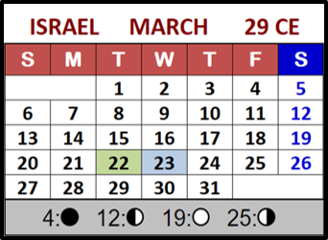

John 7 Part 4 Intro
The
“Covenant Count”
after 360!
361?
362?
364?
363?
365?
Notes:
5.12a John 7 Pt 4 – Balancing days of Cov. Calendar Recorded May 6.23 Time: 13 min
Website:
Launch: Youtube:
Blurb for 5.12a
Multitudes of people around the world are appreciating the fact that they have finally found Yahuah’s true festal “covenant” calendar. The know the Covenant Worship Calendar has a count of only 360 days each year. They understand how Covenant Calendar (as found in the Covenant Torah pages between Gen 1:1 to Exo 24:11) aligns perfectly with Yahusha’s ministry in the gospels. Yet there is one important question that has been most persistent in the last year, and it keeps coming up. That question is: “Why do we have 365+ days each year and what does Covenant Calendar do with those extra days beyond Yahuah’s allotted count of 360?” The second part of the question is asking why the extra balancing days are not added at the end of month six. Why? Because some are feeling the tequfah/equinox shadow sign should be aligning with the 1st day of the 7th month – the Feast of Trumpets! Is that what the Torah commands? Is that what can be documented in the gospel ministry of Yahusha? This introduction will show exactly what happens, but the full study for Part 4 will give all of the details and more, in preparation for the final teaching in Part 5. So, if you want to know all yo have to do is “Come and See.” Shalom!

Slide 2

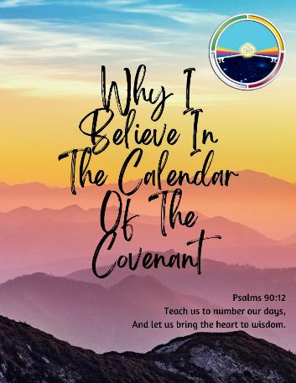
Multitudes of people around the world are appreciating the fact that they have finally found Yahuah’s true festal calendar.

Slide 3


They know the Covenant Worship Calendar has a count of only 360 days each year. They understand how Covenant Calendar (as found in the Covenant Torah pages Gen 1:1-
Exo 24:11) aligns perfectly with Yahusha’s ministry in the Gospels.
3

Slide 4

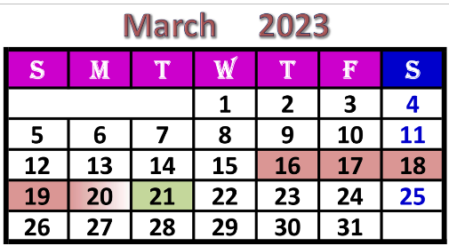

Yet, there is one important question that has been most persistent in the last year, and it keeps coming up! That question is:
Why do we have 365+days each year and what does Covenant Calendar do with those extra days beyond
Yahuah’s allotted count of 360?
4

Slide 5
Time for a Decision
It is clear Scripture does not use the terms “spring” or “fall” to describe any seasons.
  Therefore this study will NOT use the terms “spring tequfah” or “fall tequfah” [with regards to references north of the equator].
“Spring tequfah” will be referenced as –
Winter Shadow Sign marking the
last cycle of winter.
“Fall tequfah” will
be referenced as –
Summer Shadow Sign marking the
last cycle of summer.
5

Slide 6


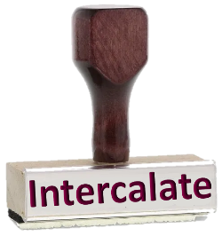

All other counterfeit festal calendars “intercalate” either extra days, weeks or months to fit their calendar count?
This is done to align with the current civil year of 365+ cycles/year in any fashion they want.
6

Slide 7




Lunar
Calendars
All Dead Sea Scroll Calendars
Enoch
Enoch
Zadok
Solar
Calendars
Essene
Do Barley Calendars ?
7

Slide 8
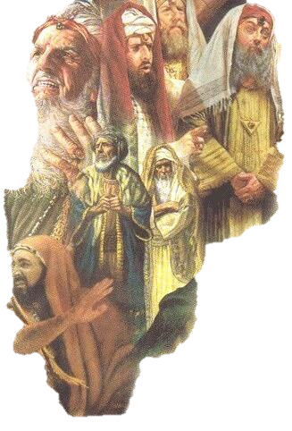
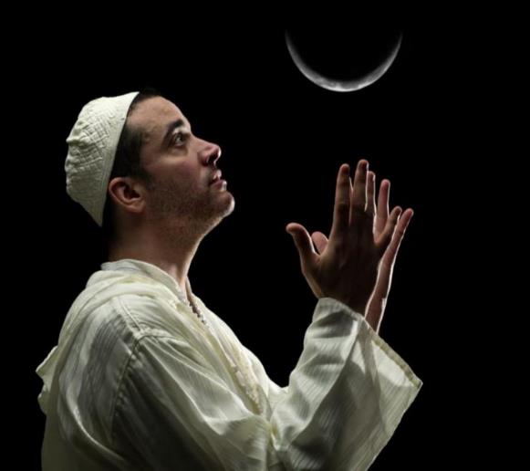

In Part 3 of John 7 it was shown how Covenant Calendar dates are counted out for 29 CE in comparison
to the Lunar Calendar
of the unbelieving
Scribes & Pharisees.
In this year their lunar
count began with the
crescent moon after the
tequfah shadow sign.

Slide 9
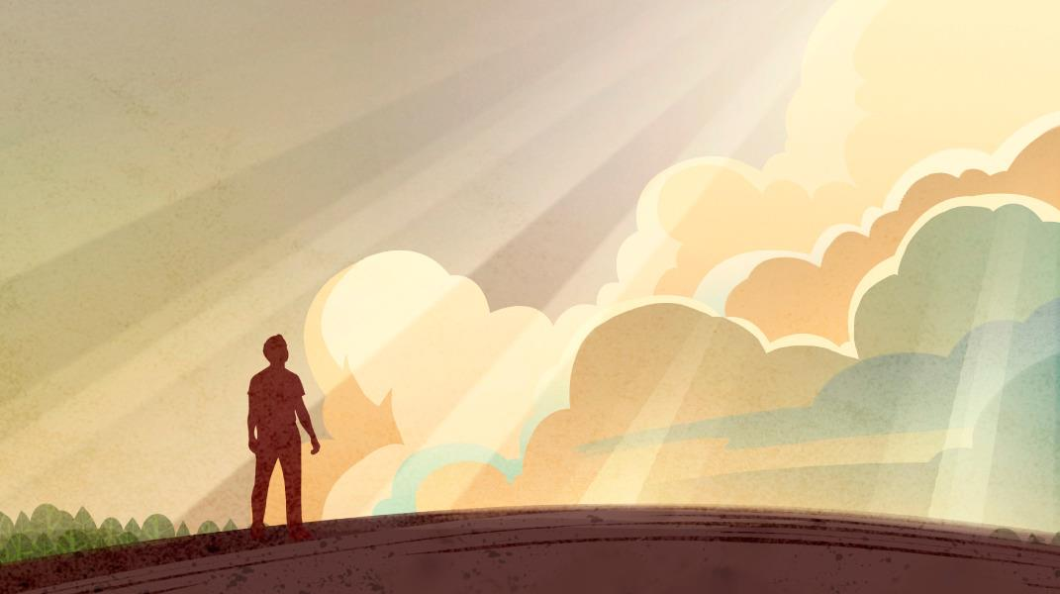
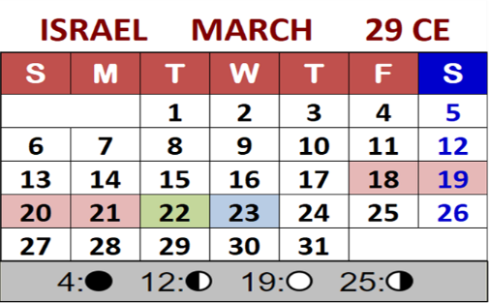

Part 4 is Going to Demonstrate:
Tequfah Shadow Sign
How the Covenant Calendar dates are counted out WHEN the extra days past 360 are added at the end of month 6 instead of before month #1.
9

Slide 10


Today [in this short introduction] this will be demonstrated on visual calendar months
[of Sept & Oct] so each one can see the differences between the final results
of Part 3 and Part 4.
This will be in preparation for the full and very detailed study of WHY Yahuah has NOT given permission to us to intercalate these extra
5+ days anywhere as we please.
10

Slide 11

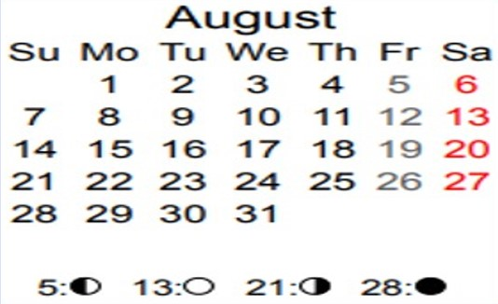
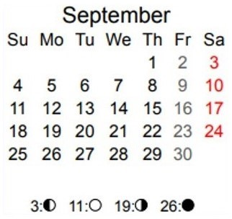
Covenant Calendar Count: Months 6 & 7
Please review where the dates are for the true
Covenant Calendar Months 6 & 7 in 29 CE.
Summer
Shadow
Sign
Date:
Sep 25th
1st cycle
6th Month - Aug 20
1st cycle
7th Month - Sep 19
29 CE/30 CC

Slide 12

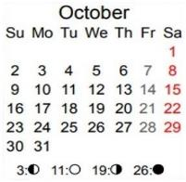
(1) In John 7 the Sukkot Feasts of both Lunar & Covenant Calendars
lay out on the Roman Calendar like this:
Oct 12-20: Lunar sukkot week
of the Jews in 29 CE.
Oct 3-10: Covenant Sukkot Week ends sooner!
Notice Yahusha arrived on the Shabbat in the midst of the lunar sukkot week.
Also notice Covenant 8th Rosh Chodesh [19th] coincides with the lunar Last Great Day [20th] when Yahusha stood up to read!
Notice the full moon is on the 14th cycle of the lunar 7th month.
Israel 29 CE 7th Month
12

Slide 13


What will happen to
the placement of
Covenant Calendar
Fall Feasts
when extra days
are added (intercalated)
following the 30th day
of the 6th month?

Slide 14




Balancing Cycles Follow Month 6??
(Note: Balancing Cycles & Waiting Cycles are interchangeable terms.)
Note the 30th cycle of Month 6 is on Sept 18th.
The “balancing cycles”
will begin on Sept 19th for examination purposes in this study.
7th Month
the 6
INTERCALATING
cycles of Sept 19-24
are no longer
part of Month 6?
6 Waiting Cycles
Late Summer Shadow
Sign
29 CE/30 CC

Slide 15

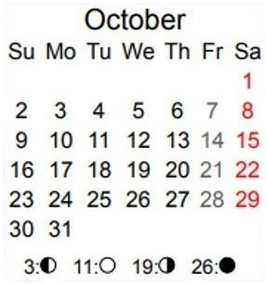

Something to Contemplate!
True Sukkot Dates
False Cov. Sukkot Dates
Oct 5 = intercalated D/A
Lunar Tabernacles
Lunar Tabernacles
Israel 29 CE 7th Month
Israel 29 CE 7th Month

Slide 16
The Next Observation!
False Cov. Sukkot Dates
As can be noticed very easily, the intercalation of extra days at the end of Covenant Calendar Month #6 now positions this Sukkot festival to OVERLAP with the lunar sukkot festival, making it APPEAR that Yahusha honored this lunar festival.
Oct 5 = intercalated D/A
Israel 29 CE 7th Month

Slide 17

Would there be any consequences if Yahusha honours the Jews’ lunar feast?
John 7:19 “Not ONE of you …”
Also, with INTERCALATION –
do you notice that Yahusha
no longer arrived at the
MIDDLE of the Jews’ Feast of Tabernacles, but is actually there
at the very beginning!
Did John get the message of Yahusha’s sandals mixed up?
In John 7 Part 4, we’ll find out! Come & See!
The End

Slide 18
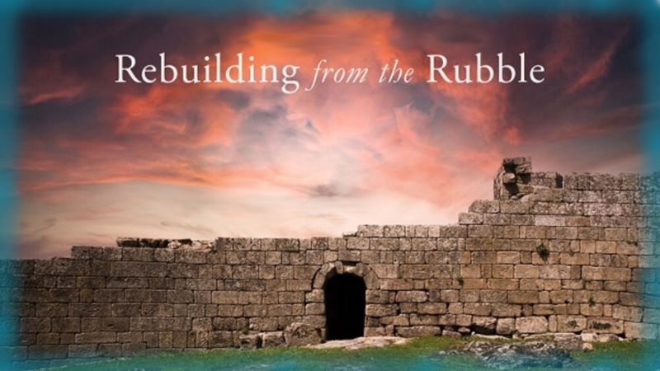


If you enjoyed this introduction today …
Please Join Us for Part 4
Sign up with Covenant Calendar Classroom
for the Shabbat Zoom Meetings
(including live discussion)
** All studies can be downloaded for FREE!
https://studythecalendar.com/sign-up/
Thank-you for
being with us today!
Shalom!

