Slide 1
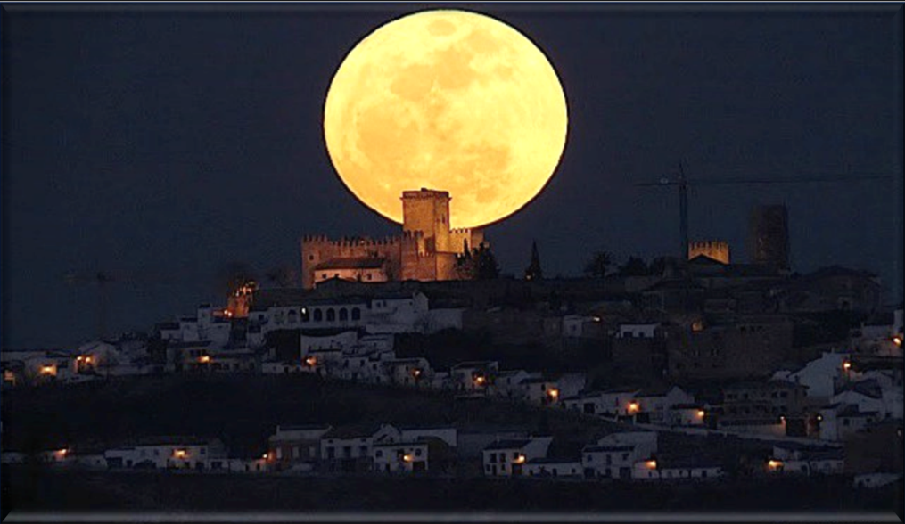

Yahusha’s Contempt
for the Jews’
Lunar Feast of Tabernacles
John 7 Part 2
Notes:
5.10b John 7 Part 2 Yahusha’s Contempt [44] TA 4 Feb 2023
Part 2 teaser was for both parts 2 & 3.
Website: https://studythecalendar.com/5-9-john-7-yahusha-the-jews-feast-of-tabernacles-part-1
You-tube launch:
Time: 52 min: ??
Blurb 5.10b:

Slide 2
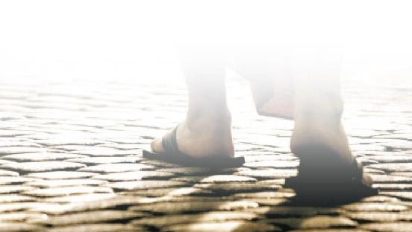
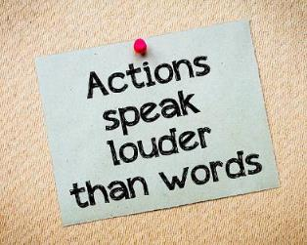
In Part 2 we’re going to discover that Yahusha’s
Yahusha deliberately avoided the first cycles of the Jews’ Feast of Tabernacles.
This was a SPIRITUALLY motivated PHYSICAL STATEMENT!
Also, this statement was highly calculated & intentional. It clearly exposes how
Yahusha adamantly WITNESSED and PROTESTED against the lunar calendar!

Slide 3

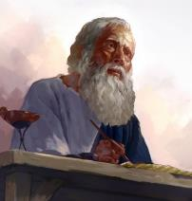
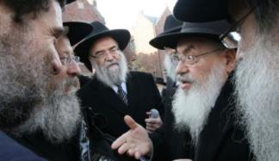
This important festival gathering for Sukkot [Tabernacles] is recorded ONLY in John’s Gospel!
The lunar festival being observed in John 7 was by the “unbelieving Jews” who were waiting & expecting Yahusha
to show up on time!
Note: Because
the synoptic
writers did
not include this
important event,
John was careful
to note every specific
detail that will have
a huge impact on the outcome of the full story line.
They had no idea that Yahusha was functioning on the Appointed Times according to the Covenant, to which their lunar calendar dates were and are
a total MISMATCH!
Let’s review
John 7 first.

Slide 4
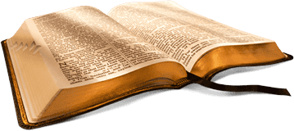
John Chapter 7 Starts Out Like This:
After these things Yahusha walked in Galilee: for he would not walk in Jewry, because the Jews sought to kill him.
Now the Jews' feast of tabernacles was at hand.
His brethren therefore said unto him, Depart hence, and go into Judaea, that thy disciples also may see the works that thou doest.
For there is no man that doeth any thing in secret, and he himself seeketh to be known openly. If thou do these things, shew thyself to the world.
For neither did his brethren believe in him.
Then Yahusha said unto them, My time is
not yet come: but your time is alway ready.
The world cannot hate you;
but me it hateth, because
I testify of it, that the
works thereof are evil.
Go ye up unto this feast: I go not up
yet unto this feast; for my time is
not yet full come.
When he had said these words unto them, he abode still in Galilee.
But when his brethren were gone up, then went he also up unto the feast,
not openly, but as it were in secret.
Then the Jews sought him at the feast, and said, Where is He?
And there was much murmuring among the people concerning him: for some said, He is a good man: others said,
Nay; but he deceiveth the people.
Howbeit no man spake openly of him for fear of the Jews.
Now about the midst of the [Jews‘]
feast Yahusha went up into the
temple, and taught. KJV

Slide 5
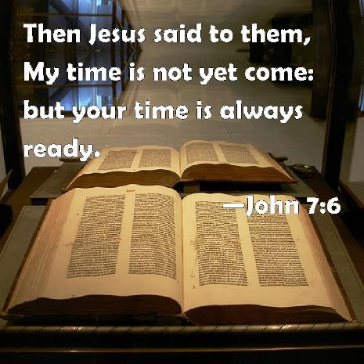
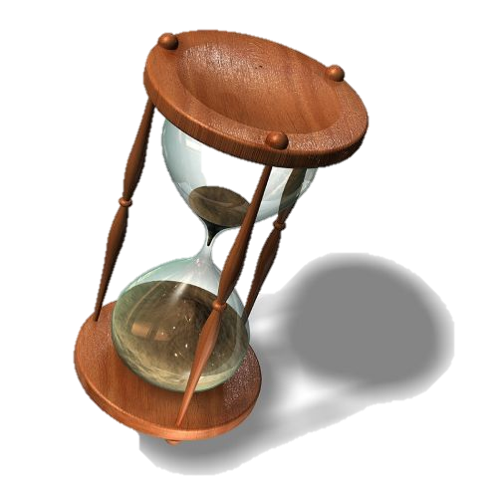
John’s Important Detail
Yahusha declared
the Feast of the Jews
to His brothers as “YOUR” time?
Note:
there is a difference
between
“My time” and
“your time”!
Yahusha

Slide 6
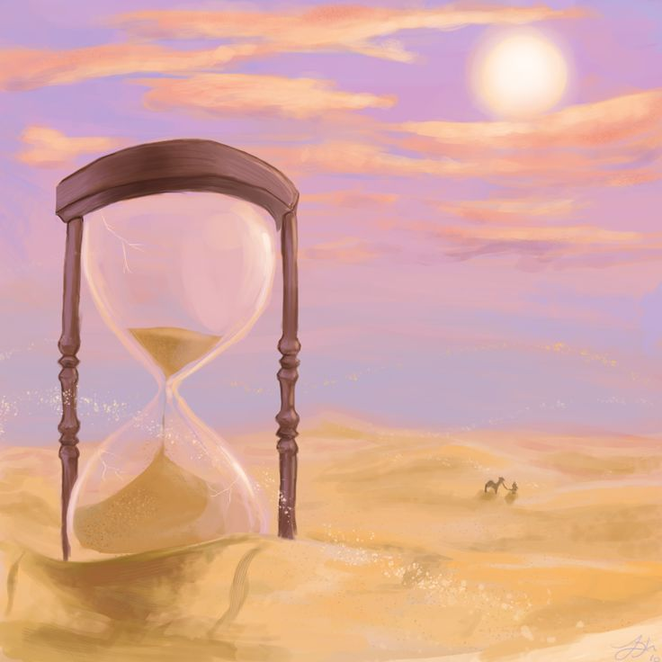
The Feast of Sukkot (Tabernacles)
(found in Exo 23:16)
is a Festival where
ALL MALES,
were required to
be in attendance
every year!
Why? It’s part of
the Everlasting Covenant
upheld under the
Melki-Tzedek Administration!
We should question …
Why on earth would Yahusha intentionally distance Himself,
from a Feast that was originally commanded
by Yahuah?
,

Slide 7

Is Yahusha required
to be there too?
Where?
“In their synagogues”
or “in their temples”?
We shall see!

Slide 8
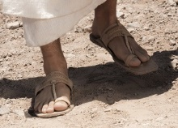
Under Torah, is
Yahusha allowed to show up late?
The Command is for “all” Males
The statute command reads like this [TS2009]:
Exo 23:14-17 Three times in a year you are
to celebrate a festival to Me: 15 Guard the Festival of Matzot … 16 and the Festival of the Harvest, the first-fruits of your labours which you have sown in the field … and the Festival of the Ingathering at the outgoing of the year, when you have gathered in the fruit of your labours from the field. 17 Three times
in the year ALL YOUR MALES are to appear before the Master יהוה Yahuah your Elohim.

Slide 9
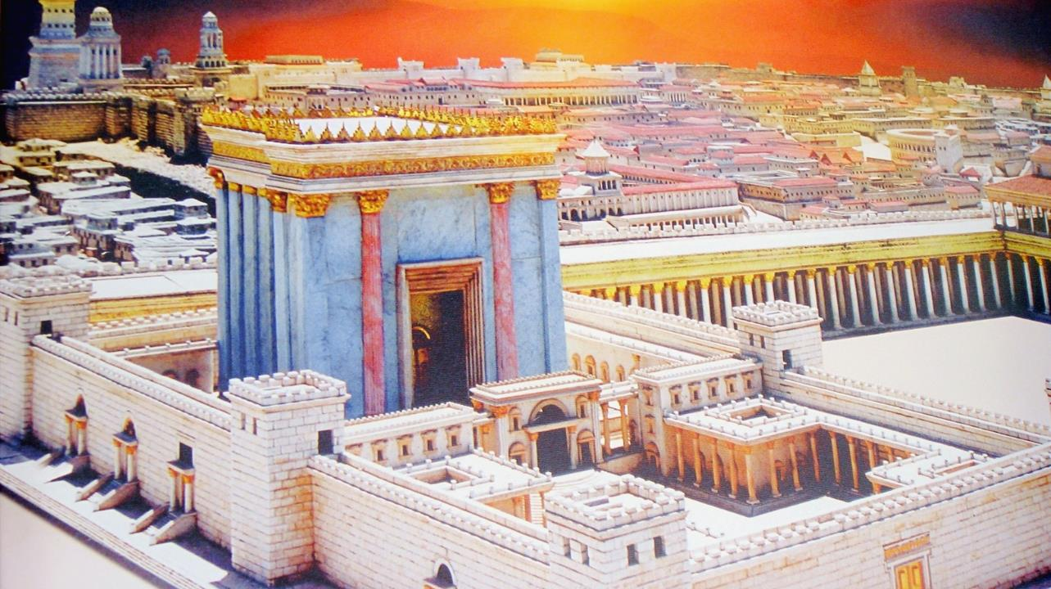
Was Yahusha in
full rebellion?
Or was Yahusha
adamantly PROTESTING and WITNESSING
against the deceptive
lunar calendar
of the [unb] Jews,
which, removes
His people from
His Covenant based
APPOINTED TIMES?

Slide 10

Did Yahusha Change His Mind?
“Go ye up unto this feast: I go not up yet unto this feast; for my time is not yet fully come.”
When he had said these words unto them,
he abode still in Galilee.
But when his brethren were gone up, then went he also up unto the feast,
not openly, but as it were in secret.
Why did He
go secretly?

Slide 11
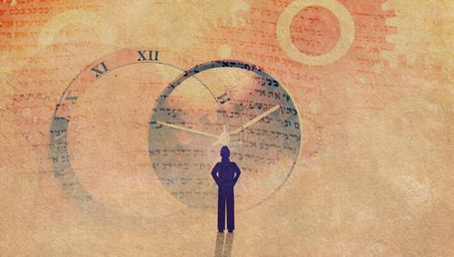

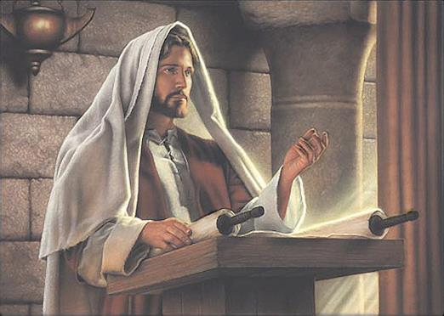

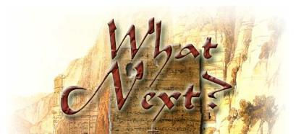
John records:
Now about
the midst of the feast
Yahusha went up
into the temple,
and taught.
“… midst of
the feast”?
Was Yahusha
LATE?
11

Slide 12

Because Yahusha is teaching in the temple:
… would “about
the middle of the feast”
possibly be a feast Shabbat, or a weekly Shabbat?
Remember: This is the middle day
of the 7 day feast.
“about the midst of the week”
15 1 | 16 2 | 17 3 | 18 4 | 19 5 | 20 6 | 21 7
Would you be surprised to find that John is going to tell us exactly which cycles of the week qualify for “middle days”? This is only through the comparison of the Jew’s Lunar calendar with Torah’s - Covenant Calendar!

Slide 13
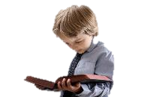

The only way that John 7 can be
so specific about the dating is because the Gospels contain the
Lunar calendar of the unbelieving Jews and also the Torah Covenant Calendar that Yahusha observed.
The Gospels expose both the
true & false calendars so all can know exactly which “calendar” Yahusha was following.
“Yes indeed
there
are!”
Are there really two
different calendars in John 7?
This study is going to expose the exact Lunar calendar that the unbelieving Jews were using at the time of John 7. It was the prototype lunar calendar
of which the Jews promote today.
All lunar calendars are counterfeit!
13

Slide 14



Some bold statements have
already been made.
Covenant Calendar will also declare many more bold statements.
John’s bold statements might be found “between the lines.”
Will we understand what John wants us to know about chapter 7?
What cycle was
it when Yahusha arrived about the “midst of the Jews’ feast”?
John 7:14
Does it really matter?
Next: some
background
information.

Slide 15
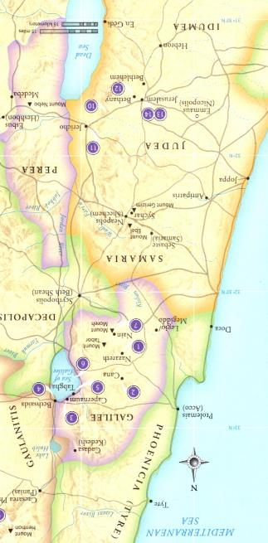
What is the setting of John 7?
John 7:1 And after this יהושע [Yahusha] was walking in Galil …
During the time of Yahusha there were three main regions mentioned in the New Testament: Judea in the south,
Samaria in the middle and Galilee in the north.
The first setting for John 7 is in Galilee. It included the
ancient territories of Issachar, Zebulun, Asher and Naphtali.
During the time of Yahusha’s ministry, Galilee measured roughly 80 km/50 mi north to south and about 50 km/30 mi east to west.
A general estimate of the population of Galilee at that time
was about 85,000+.
Galilee was the scene of the greater part of Yahusha’s private
life and ministry documented in the Synoptic Gospels.
John’s Gospel dwells more upon Yahusha’s connection in Judea.

Slide 16
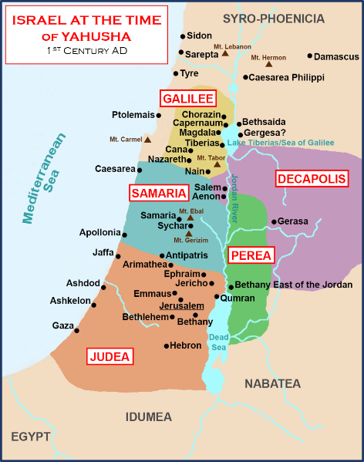
Distances of Galilee
We are not told the specific location in
Galilee for the John 7 conversation.
Possible options are:
Nazareth to Jerusalem (145 km/90 mi): Walking between Nazareth and Jerusalem
would take about 4-5 days (at the least).
Capernaum to Jerusalem (195 km/122 mi): The geography and distances involved to naturally walk this distance at 32 km/20 mi per day would be approximately 5-6 days.

Slide 17
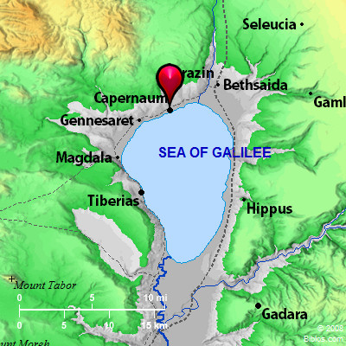
More on Capernaum
When we consider the location of Yahusha’s hometown, we generally think of Nazareth.
However, the biblical record indicates that, after being driven out of Nazareth (Luke 4:29-31), Yahusha relocated to the town of Capernaum (located on the northern shore of the Sea of Galilee)
for the period of His earthly ministry.
We will choose Capernaum for this study because Capernaum is the most likely
location for the geographical setting of John 7.
Matthew 4:13 tells us that Yahusha left Nazareth and went to live in Capernaum
after meeting temptation in the wilderness.
Here He met five of his future disciples:
James, John, Peter, Andrew (all fishermen),
and Matthew a tax collector.

Slide 18
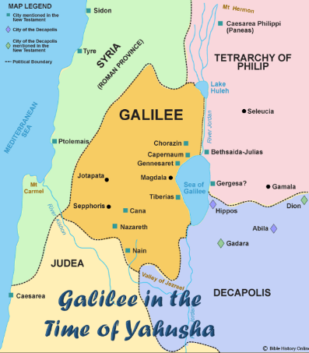
Capernaum ~ Yahusha’s Home Base
Matt 4:12-17 Now when Yahusha had heard that John was cast into prison,
he departed into Galilee;
13 And leaving Nazareth, he came and dwelt in Capernaum, which is upon the sea coast, in the borders
of Zabulon and Nephthalim:
14 That it might be fulfilled which was spoken by Esaias the prophet, saying,
15 The land of Zabulon, and the land of Nephthalim, by the way of the sea, beyond Jordan, Galilee of the Gentiles;
16 The people which sat in darkness saw great light; and to them which
sat in the region and shadow of
death[,] light is sprung up.
17 From that time Yahusha began
to preach, and to say, Repent: for
the kingdom of heaven is at hand. KJV
Luke 4:28-31 And all they in the synagogue [at Nazareth], when they heard these things, were filled with wrath,
29 And rose up, and thrust him out of the city, and led him unto the brow of the hill whereon their city was built, that they might cast him down headlong.
30 But he passing through the midst of them went his way,
31 And came down to Capernaum, a city of Galilee, and taught them on the sabbath days. KJV
Distance between Capernaum & Nazareth: 33 km/20 mi.

Slide 19
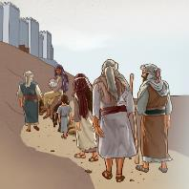
Capernaum to Jerusalem Journey
The Feast of Tabernacles, or Sukkot, is the third great annual pilgrimage festival when the Jewish people would gather together in Jerusalem to celebrate the seven days of Tabernacles, and the Last Great Day.
Coming from all over the land of Israel, some had a longer pilgrimage than others.
Capernaum - Nazareth: 33 km/20 mi
Capernaum - Jerusalem: 195 km/122 mi
Did the people arrive at Jerusalem on the last day before a feast, or did they plan to arrive early, if possible?

Slide 20
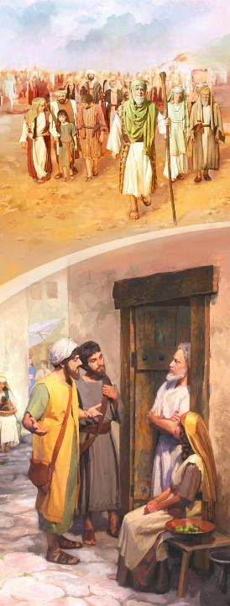
What was the Custom for
the Passover Pilgrimage?
John 12:1, 9
1 Then Yahusha six days before the Passover came to Bethany, where Lazarus was which had been dead, whom He raised from the dead
9 Much people of the Jews therefore knew that He was there: and they came not for Yahusha’s sake only, but that they might see Lazarus also, whom He had raised from the dead. KJV

Slide 21
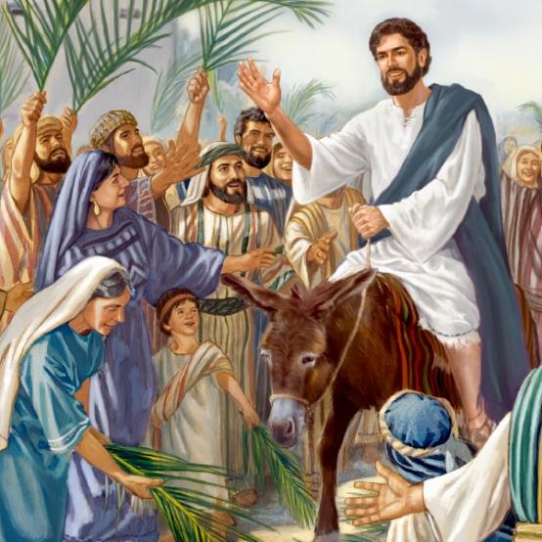
John 12:12-13
12 On the next day [10th day; 1st month] much people that were come to the feast, when they heard that Yahusha was coming to Jerusalem,
13 Took branches of palm trees, and went forth to meet Him [for His Triumphal Entry – 4 days before Passover], and cried, Hosanna: Blessed is the King of Israel that cometh in the name of Yahuah. KJV
Many of the people were early for the Passover Festival.

Slide 22
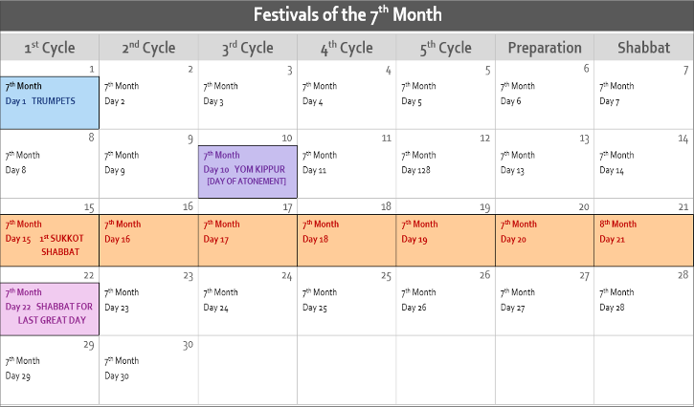
What would the Custom be for the Sukkot Pilgrimage?
Some things to remember:
Several festivals are found in the 7th month:
  Feast of Trumpets on
  the 1st day of the month was a reminder to be prepared for Yom Kippur.
  Yom Kippur was honored on the 10th day of the month.
  Sukkot included:
    7 Days of Feast of Tabernacles (15th –
    21st of the month)
    The Last Great Day
    (22nd of the month)
There was no requirement for the people to be present at Jerusalem for Trumpets & Yom Kippur.

Slide 23
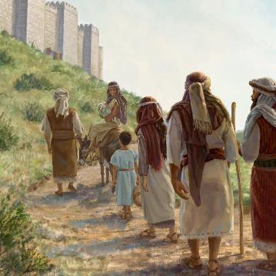
The common land owner was not required to attend Trumpets and Yom Kippur at Jerusalem. In every year except the Sabbatical and Jubilee years, they were harvesting their fall crops in time to attend Sukkot
with their offerings. Most of them likely began their pilgrimage right after Yom Kippur to arrive at Jerusalem as soon as possible to build their Sukkot.
However, the Scribes, Pharisees, Priests and other leaders that were scattered throughout the land
(that did not have a land inheritance with sowing and reaping responsibilities) would have been free to travel to Jerusalem well in advance of every festival to be prepared for wherever they were needed, etc.
Teachers, (such as Yahusha), and their followers would have also had the leisure of beginning their Jerusalem pilgrimage as early as they would have desired.
This would have been applicable to Yahusha and
His brothers that approached Him with their
request in the first place.
When did Pilgrimages
Begin?

Slide 24

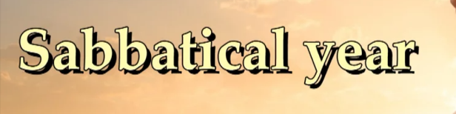
Were there exceptions for special Sabbatical Years?
Sabbatical Year: Every 7th year was a “year of release” as well as a year of rest for the land. The people were free from sowing and reaping duties.
Year of Jubilee – 50th Year: Every 50th year was also a Sabbatical Year beginning with the blowing of the trumpets at the end of Yom Kippur.
This was the year that all debts were cancelled, and all “land inheritance”
was returned to the original owner. Again, no sowing and reaping duties.

Slide 25

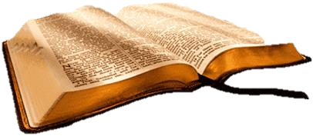
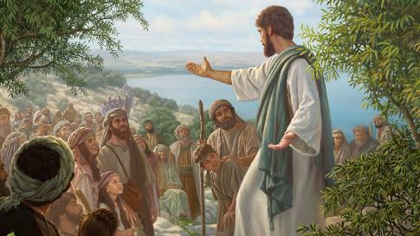
Was the “year” of John 7 a “special year”?
Yes!
From Yahusha’s baptism to
Day of Atonement it was a Sabbatical Year for everyone.
The context of John 7 is Feast of Tabernacles – which is now considered as the Year of Jubilee.
Did you ever wonder why the crowds could follow Yahusha everywhere
He went?
On the Day of Atonement
the silver trumpets announced the Year of Jubilee had begun.

Slide 26

John 7:2 And the festival of the Yehudim [Jews] was near, the Festival of Booths [Sukkot/Tabernacles] …
Vs 2: the Jews’ Feast of Tabernacles was at hand … this does not mean
(and cannot mean) “the feast was a few short days away” – but … that
“this is the time to prepare to go up to the feast.”
Just as many arrived for Passover many days in advance of the festival, so
too at Sukkot, many would make preparations well in advance of their travels.
At this time in John 7, everyone could make preparations to “go up to Jerusalem” for the feasts
as early as they wished. They had sukkot to build!
Question: Preparations would have been anticipated in advance for all of the
fall festivals, not just Sukkot. What are the possibilities this discussion between Yahusha and His brethren was well before the time of lunar Trumpets?

Slide 27
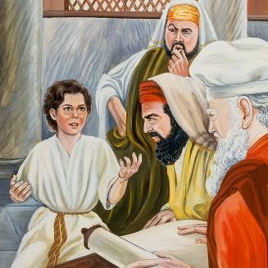
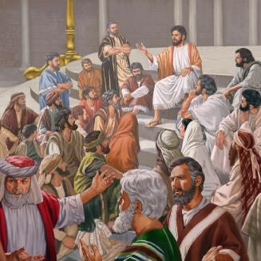
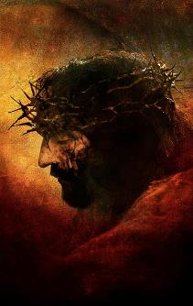

Facts We Do Know
Yahusha is the Creator of the Covenant Calendar
At His death,
He died on
His Covenant
Passover
Festival.
At age 12, Yahusha was
in the temple observing the High Shabbat of Unleavened Bread on His schedule,
Abib 15, which was Blood Ratified and Covenanted by
the 75 elders on Mt Sinai.
(Exo 24:1-11)
Where was Yahusha for Covenant Calendar’s Tabernacles
in John 7?
Careful with
this question!

Slide 28
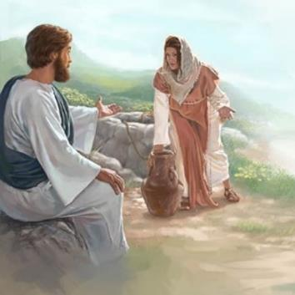
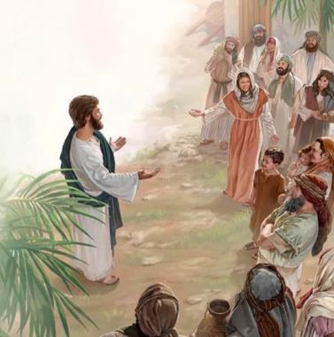
Consider John 4 (months before John 7)
Yahusha meets the
woman at the well!
John 4:19-24 The woman saith unto him,
Sir, I perceive that thou art a prophet.
20 Our fathers worshipped in this mountain;
and ye say, that in Jerusalem is the place
where men ought to worship.
21 Yahusha saith unto her, Woman, believe me, the hour cometh, when ye shall neither in this mountain, nor yet at Jerusalem, worship the Father.
22 Ye worship ye know not what: we know
what we worship: for salvation is of the Jews.
23 But the hour cometh, and now is, when the true worshippers shall worship the Father in
spirit and in truth: for the Father seeketh such
to worship him.
24 Yahuah is a Spirit: and they that worship him must worship him in spirit and in truth. KJV
Notes:
Extra verbal comment:
Jesus told the Samaritan woman that a day was coming when people would worship not in Jerusalem nor on Mount Gerizim but elsewhere and that such worship would be acceptable as long as it was conducted in spirit and truth (John 4:20–23). Of course, people were supposed to worship God in spirit and truth under the old covenant, but worshiping in truth then meant offering animal sacrifices only in Jerusalem.

Slide 29
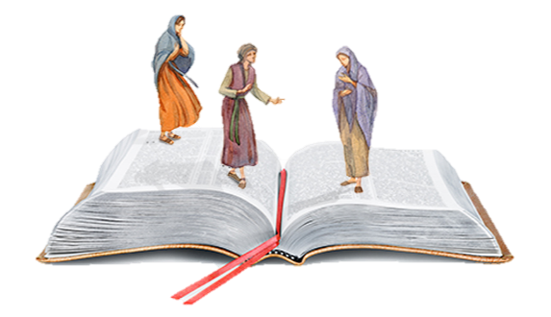
Acknowledge these Facts in John 4
Points to Consider:
Yahusha met the woman
at a well in Samaria.
Samaria had their own temple to worship at for the feasts and festivals. Due to the hatred towards them from the Jews
they were likely very unwelcome to worship
at Jerusalem.
The woman asked Yahusha to settle the question of where they were to worship.
Yahusha gave an answer, but it did not include
the temple at Samaria OR Jerusalem. (Is that a surprising answer? The command was given by Yahuah Himself that everyone was to “come up
to Jerusalem” to worship at the appointed times?)
Vs 23: Yahusha very plainly said that “the hour is now come … to worship in spirit and in truth.”
What does
it mean to worship in spirit & truth?

Slide 30
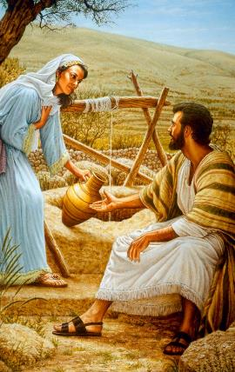

Yahusha said very plainly:
“the hour is now come … to worship in spirit and in truth.”
Where should that worship be conducted and with whom?
Would that be to worship in the location “wherever you are at” because the festivals at both Samaria and Jerusalem were not on the Covenant appointed times to begin with?
So, what in
the world
was Yahusha talking about?
Notice, Yahusha did not
reprimand the woman for not worshipping at Jerusalem!

Slide 31

Yahusha said very plainly to “worship in spirit and in truth” wherever you are, so …
Where did Yahusha honor the Covenant Calendar appointed times when none of the synagogues or temples kept His calendar?
What are some facts
that we do know?

Slide 32
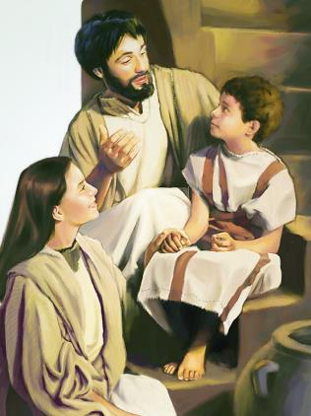
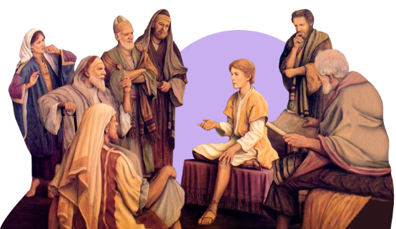
Young Yahusha is Instructed and then, Instructs!
We know:
Yahusha was taught the Torah by Mary and Joseph
(to the best of their “veiled knowledge and understanding.”)
Yahusha honored the Covenant Passover festival at age 12 in Jerusalem. What was The Young Yahusha doing?
  Luke 2:46-47 And it came to pass, that after
  three days they found him in the temple,
  sitting in the midst of the doctors, both
  hearing them, and asking them questions.
  47 And all that heard him were astonished
  at his understanding and answers.
Young Yahusha
was teaching!

Slide 33
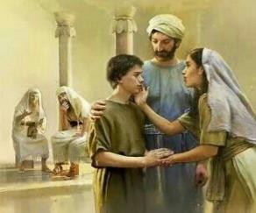
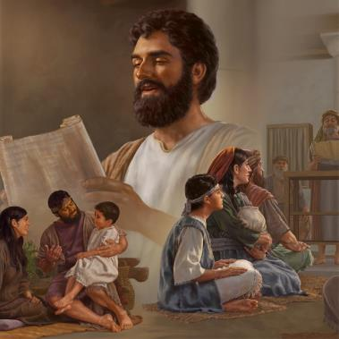
Eventually, “WHO was instructing & teaching?”
Luke 2:48-50 And when they saw him, they were amazed: and his mother said unto him, Son, why hast thou thus dealt with us? behold, thy father and
I have sought thee sorrowing. 49 And he said unto them, How is it that ye sought me? wist ye not that I must be about my Father's business?
50 And they understood not the saying which he spake unto them.
Was Young Yahusha
“teaching” or “worshipping”?
Question: Even though Luke records Mary and Joseph did not understand His WORD regarding “being about my Father’s business,” is it possible that in the future time to come, Yahusha actually taught His parents the Covenant appointed times from the Torah? When?

Slide 34
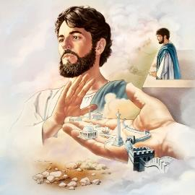
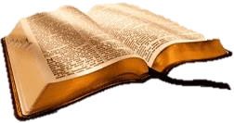
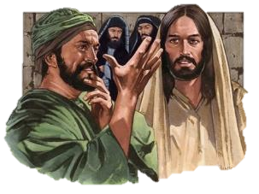
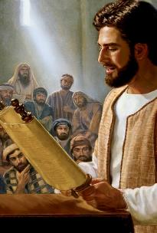
Yahusha’s Mandates After the Wilderness Temptation
Luke 4:13-16 And when the devil had ended all the temptation,
he departed from Him for a season.
14 And Yahusha returned in the power of the Spirit into Galilee: …
15 And He taught in their synagogues, being glorified of all.
Mark 3:1-2, 5 And He entered again into the synagogue;
and there was a man there which had a withered hand.
2 And they watched Him, whether He would heal him
on the sabbath day; that they might accuse Him.
3 … He saith unto the man, Stretch forth thine hand.
… and his hand was restored whole as the other.
#1
Teaching!
Two Mandates to Ponder:
Luke 4:15 is very clear that Yahusha taught in the synagogue. Verse 15 does not say that it was a Sabbath.
It could have been any day of the week. (Vs 16 coming soon.)
In Mark 3, Yahusha preformed healings IN the synagogue.
#2
Healing!

Slide 35
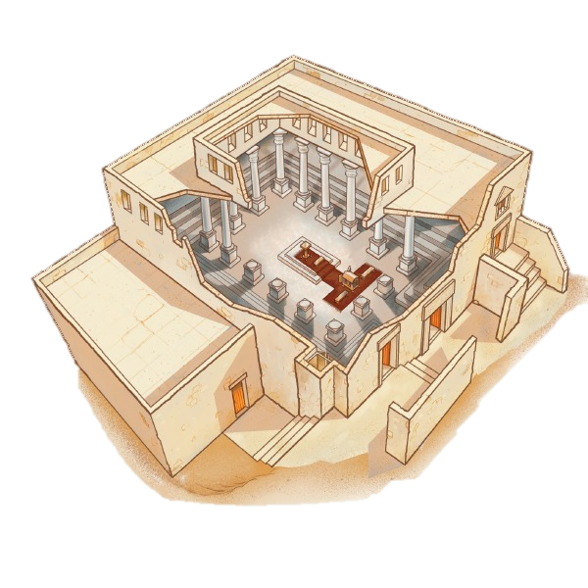
Where did Yahusha honor His weekly Shabbats?
It was Yahusha’s custom to attend the local synagogues on the weekly Shabbat.
  Matt 12:9 And when He was departed thence, He went into their synagogue.
#1 Questions: Whose synagogue? And, why?
To Do What? To Worship?? Or: Something Else?
Were there synagogues in the Old Testament?
#2 Questions:
Is this a Torah “custom” “to worship
in a synagogue on the Sabbath”?
Or was/is this “custom” a “tradition
of the Jews”? A good tradition?
Synagogues
were set up
very differently
than the temple.

Slide 36
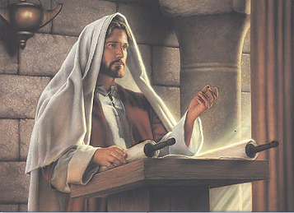
What was Yahusha’s main purpose for visiting a synagogue on the Shabbat?
Luke 4:16 And He came to Nazareth, where He had been
brought up: and, as his custom was, He went into the
synagogue on the sabbath day, and … (1) …
Luke 6:1-2, 6 And it came to pass on the second sabbath after the first, that He went through the corn fields; and His disciples plucked the ears of corn, and did eat, rubbing them in their hands. 2 And certain of the Pharisees said unto them, Why
do ye that which is not lawful to do on the sabbath days?
6 And it came to pass also on another sabbath, that
He entered into the synagogue … (2) …
  (1) … stood up for
  to read.
  (2) … and taught.

Slide 37
Why is this question about Yahusha’s actions
in “their synagogues”
or in “their temples”
even being asked?
What does this have
to do with John 7?

Slide 38
Did Yahusha present Himself
at the synagogues to:
Worship?
2) Teach the Gospel?
3) Or … both?
If it was “to worship” ~ then worship - “Who”?

Slide 39

Where did Yahusha honor His Appointed Times?
Did Yahusha honor them the same as His people?
More Questions:
From age 12 up to Yahusha’s baptism and ordained ministry, where could (or did) He go to honor
the Covenant appointed times?
Yahusha knew about the command to worship [be present] at Jerusalem for the appointed times?
How did He accomplish that when the leaders were constantly watching to either trap Him, or kill Him?
The sunset/lunar calendar of Judah’s leaders did not reflect the Covenant Appointed Times – so
why would He ever have to attend anyway?
During His ministry with His disciples, did they follow Yahusha and His Covenant Appointed Times – “in spirit and in truth”? Wherever they were? Or … must this be at the Jerusalem temple?
John 7 speaks about the Jews’ Feast of Tabernacles with Yahusha’s brothers urging Him to
come with them up to the feast.
What will we find when we compare the appointed times
of the Lunar calendar with the Covenant calendar?

Slide 40
There was an urgency to leave for the feast!
John 7:3 So His brothers said to Him, ‘Get away from here and go into
Yehuḏah, so that Your taught ones also see the works that You are doing.
John 7:4 “For no one acts in secret while he himself seeks to be known openly. If You do these works, show Yourself to the world.”
Paraphrased: Show us your works! Prove your worth! Let’s get going!
Questions:
About “what date” did this conversation take place?
Why was there such an urgency to convince Yahusha in their ways?
What does that have to do with Yahusha purposely avoiding the
beginning cycle of their Lunar Sukkot? He was NOT late!

Slide 41

Remember John records:
Now about
the midst of the feast
Yahusha went up
into the temple,
and taught.
“… midst of
the feast”?
Was Yahusha
right on
time?
John will now show us what cycle it was
for that middle day!
41

Slide 42
Yahusha is discovered teaching in the temple.
Will John pinpoint
one of the three
middle days shown below?
Will one of the days be
a Shabbat?
Remember: This is the middle day
of the 7 day feast.
“about the midst of the week”
15 1 | 16 2 | 17 3 | 18 4 | 19 5 | 20 6 | 21 7
We will search for the answer after a
short look at the 29 CE calendar of Israel.

Slide 43


Comparing the Lunar & Covenant Calendar Dates on the Roman Calendar Profile
Our civil world today functions using the dating on the Roman calendar so we know when to meet appointments, not only for man’s secular dates, but also for locating Scriptural weekly and annual worship dates.
Of the many calendars in the world that lay out what each profess to believe as
the correct Scriptural dating of Yahuah's festivals, right or wrong, these dates are synchronized with the Roman calendar so their followers can meet together.
This is very true for the “lunar” calendar in this study, as well as, Yahuah’s Covenant Calendar, as different as they are.
Fully documented by Julian Morgenstern: the Jews’ changed their method of calculating the new lunar year in many different ways. In John 7, the Jews’ reckon their lunar year to begin after the tequfah/spring equinox! (Note: in the year of Yahusha’s Passover at age 12, the Jews’ lunar calendar began before the tequfah.)
Covenant Calendar’s new year is always reckoned the day after the tequfah/spring equinox.
In Part 3, there will be a very brief comparison of the Jews’ lunar calendar for 29 CE, and Yahuah’s Covenant calendar – overlaid on the Roman calendar.
You will see where the calendar months are found for both examples, and how the
two calendars differ. In Part 3, note how the “months” begin on each calendar.
This is really important information for John 7!

Slide 44

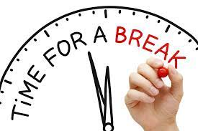

In Part 3 we will compare the [unb]
Jews’ lunar calendar dates with Covenant Calendar dates.
We’ll be right back!

