Slide 1


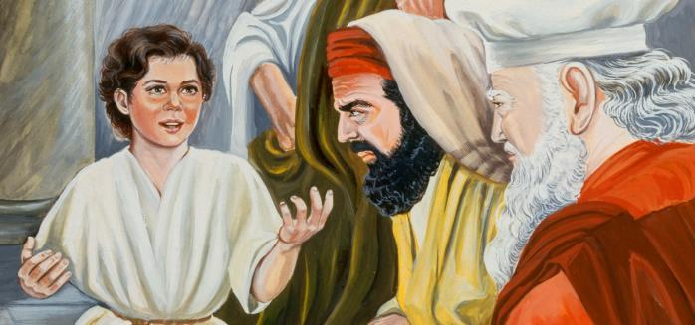





Yahusha
“Lost? Or Discovered!”
2021 Revision
The 3rd Day Calendar Discovery
One Puzzle
Piece
at a Time
Notes:
July 4/21 – comments & questions for the website. Website link: https://studythecalendar.com/4-9-yahusha-lost-and-found/ Youtube: https://youtu.be/NVr2b7_5KCs
Introduction to this study: Covenant Calendar is first based on Torah with additional witnesses in the rest of the Old Testament. The full confirmation to this Covenant Calendar is found in the Gospels with very strong witnesses through Yahusha's life from conception to His gift of the Ruach on the Pentecost/Shavuot of Acts 2. Additional confirmation for Covenant Calendar will continue to be found with the disciples, and especially the apostle Paul. Exact year dates and festival "days and dating" are easily verified through two sources. Those two sources are two very different calendars discovered in the Gospels. The first calendar is the lunar based calendar of the "unbelieving" Jews; the second calendar is the Covenant Calendar which aligns perfectly with His ministry throughout the four Gospels. The calendar details in the Gospels can no longer be glossed over. It is time to take very careful note of everything, including any deviation from "one set of wording" to "another set of wording." For example: If the context is "Passover of the Jews" - it is exactly that - a Passover timing of the Jews' lunar calendar. If the content does not specify anything related to the Jews' it is then time to check and see if the context is around Yahusha and His disciples. It is also important to remember the Gospels give information about "believing Jews" and "unbelieving Jews" - without telling the reader "which is which" - so it is up to the reader to figure out the puzzle. Do remember, Joseph of Arimathaea and Nicodemus were "believing Jews" and were very aware of what was going on - good students of the Torah, and Covenant Calendar timing! With this in mind, there are many witnesses in the Gospels that show beyond any doubt the exact timing between the lunar based calendar and the Covenant Calendar. This is ONE of those studies. It focuses on Yahusha's attendance to His Passover at the age of 12 - remember - when He was left behind for 3 days. As you go through the study, learn to pay attention and pick up the details that are bound to expose the counterfeit calendar of the unbelieving Jews - the very leaders that "took away the key of knowledge" from the common person so that they could not understand how to count & calculate Yahuah's festal calendar for themselves. Think about the following questions as you brace yourself to meet the challenges of this study:
Mary & Joseph attended the Passover at Jerusalem every year, but the year that Yahusha attended at age 12, they started their return home without Him. When He was finally discovered after 3 days, what was Yahusha's answer to them, and did they understand His words? (See Luke 2:49-50.)
Where was Yahusha found after the 3 days and what was He doing?
In Luke chapter 2, is there a difference of "context" between the wording of: a) according to the Torah; and 2) according to the practice of the festival? Was Luke trying to get our attention with his very careful wording of these events?
According to Luke chapter 1, when does life begin: 1) at the time of birth?; 2) at the time of conception? What would this have to co with Covenant Calendar timing?
According to many commentators, there is substantial documentation that the year of Yahusha's birth could have been anywhere from 3 BC to 6 BC. This Gospel study will prove the exact year of Yahusha's Passover at age 12. Could one then determine the year of His birth?
There is only one year that fits the very specific criteria for Yahusha's age 12 Passover. What is the specific Gospel calendar language to unlock this puzzle of the exact year?
There are many different types of lunar calendars all the way from the return of the exiles in 457 BC up to Luke and Paul's documentation in 57 AD. Some lunar calendars were calculated according to the crescent moon before the equinox, and some were calculated by the crescent moon after the equinox. For Yahusha's 12 year Passover, which type of lunar calendar were the unbelieving Jews using then? Do you wonder if that is the same lunar calendar they were using during Yahusha's ministry many years later? What about the lunar calendar that Luke and Paul record almost 30 years after the crucifixion?
Some believe that a "High Sabbath" is always a "feast Sabbath" and the "weekly Sabbath" sharing the same day/date? Is that the case in this study?
Upon what day of the week was Yahusha's Covenant Calendar Passover in this study?
After going through this study, see if the phrase "and a little child shall lead them" has a different meaning for you. Who was that "little child" and who was He leading? ... and how do you think those around Yahusha reacted to "that leading"? Did His example have anything to do with exactly when to observe the festivals as given in the Torah?

Slide 2

I be about My Father’s Business.
must
KJV Luke 2:49
Question: Is this an
anti-semetic statement?
By a child of 12 years?

Slide 3
This is the short version of a
very detailed study called
“Yahusha, Lost … and Discovered at Passover!”
Question:
What is a
Covenant
Calendar?
There will be an interesting
“thought-provoking” comparison between:
The Covenant Calendar Yahusha honoured;
The Lunar-solar Calendar
in use at that time
(Yahusha at age 12) by the unbelieving Jews.

Slide 4
Introduction
Covenant Calendar is first based on Torah with
additional witnesses in the rest of the Old Testament.
The full and most amazing confirmation to this
Covenant Calendar is found in the Gospels with very
strong witnesses through Yahusha's life from conception
to His gift of the Ruach upon Pentecost/Shavuot of Acts 2.
Additional confirmation for Covenant Calendar will
continue to be found with the disciples, and especially
the apostle Paul.
For this study, exact year dates and festival "days and dating" are easily verified through two sources.
Those two sources are two very different calendars discovered in the Gospels.

Slide 5
Two Very Important Calendars
The first calendar is the
Lunar Based Calendar of
the "unbelieving" Jews, fully verified through the research of Julian Morgenstern, 1935.
It must be noted both the research of Morgenstern and the Gospel Covenant Calendar demonstrate the Jews were using more than one method
of Lunar Calendar reckoning.
The Gospels are the final witness to verify Morgenstern’s research as accurate and correct in every detail.
(This may be of interest to some!)
The second calendar is
the Covenant Calendar
which aligns perfectly with Morgenstern’s research
AND Yahusha’s ministry throughout the four Gospels.
Because of this the calendar details in the Gospels can no longer be glossed over.
It is time to take very careful note of everything, including any deviation from "one set
of wording" to "another set
of wording."
This short study is meant to press you to think outside the box!
Next: Start at the Beginning to Count Yahusha’s First 12 Years

Slide 6
At 12, Yahusha, after three days – was doing WHAT?
Luke will provide crucial timing assistance in:
determining what year Yahusha was born
determining which calendars were being used
determining how one can know “who” was following
“what” calendar
determining where Yahusha’s parents fit into this scenario
determining how & why Yahusha challenged His parents
Let’s examine the “lingo of Luke” first!

Slide 7
The “lingo” of Luke 2 & Calendar
Covenant Lingo
Tradition Lingo
Vs 21: “Name given by the messenger”
Vs 22: “according to the Torah”
Vs 23: “has been written in the Torah”
Vs 24: “what is said in the Torah”
Vs 27: “according to the usual
practice of the Torah”
Vs 39: “according to the Torah”
Up to this point Luke specifically
recorded Divine Authority through
the Covenant Lingo of Torah.
Next: Does Luke deviate from his style
in the SAME chapter? And does it matter?
Vs 41: His parents went to the
“Festival of the Passover.”
Vs 42: When Yahusha was 12 years old,
they went up according to “the
practice of the festival.”
Questions:
Why has Luke changed his lingo to generic language such as “the Festival” instead of “the Festival according to the Torah”?
Who governed this particular
“practice of the festival”?
Why was Yahusha discovered in the temple “3 days after” this “practice of
the festival”? Is He really 12 years old?

Slide 8
Luke 1:41(a) And it came to be, when Elisheḇa heard the greeting of Miryam,
that The Baby in her womb.
leaped
What important
DIRECT CONNECTION
does this verse have to do with –
Life begins at conception!
Luke 2:42 And when He was twelve years old, they went up to Yerushalayim according to
the practice of the festival.
In short: Yahusha’s conception is the beginning for the count to His age of 12 years for vs 42.

Slide 9
Yochanon’s first 12 months of
his life starting at conception!
Passover in the
1st month of the Covenant Calendar year. (Abib)
Yochanon’s Conception is 18 Months prior to CE 1.
This calculation is based upon
the angel’s announcement to Zacharias as priest at Shavuot.
1
2
3
4
5
6
7
8
9
10
11
12
Jul 4th Month | Aug 5th | Sep 6th | Oct 7th | Nov 8th | Dec 9th | Jan 10th | Feb 11th | Mar 12th | Apr 1st
May 2nd | Jun 3rd
The 4th Month of Covenant Calendar. Remember, Covenant Calendar months are not identical to Gregorian months. Allow for some variation in time span.
Yochanon in his 9th month, was birthed here on the 1st month just prior to Passover!

Slide 10
Yochanon birthed (at 9 months), here, just before Passover!
Yochanon completed his
first year here at - 12 months!
Review
9
10
11
12
Jan 10th Mon | Feb 11th | Mar 12th | April | May | June | July | Aug | Sept
1
2
3
4
5
6
1
2
3
4
5
6
7
8
9
Yahusha, being 6 months younger than Yochanon (Luke 1:36), was birthed here, in His 9th month, just before Sukkot!
Oct | Nov | Dec
12
Sukkot
10
11
Yahusha COMPLETED His 1st year of
12 months – here, in the 9th month of CC!
NOTE: – “Grand Points of Reckoning”
1st - Yochanon’s birth prior to Passover
2nd - Yahusha’s birth just BEFORE Sukkot
For Yahusha to be 12 years old in the year CE 12 when
He was discovered 3 cycles “later” in the Tabernacle,
He MUST FIRST be 1 year old, upon ENTERING CE 1!
This puzzle can only be solved by counting His years
from the time of conception, complimented by CE 12 !

Slide 11
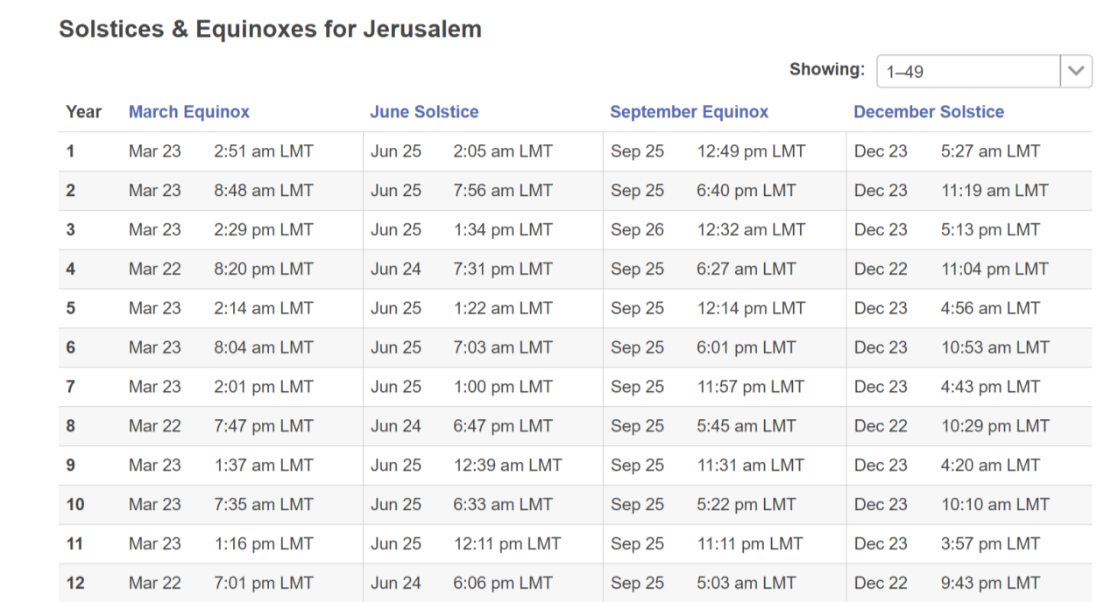
Yahusha - conceived 12 months before 1 CE, being born near Sukkot, He needed 3 more months TO COMPLETE HIS FIRST YEAR PRIOR TO CE 1!
Ages
1
1
2
Local Mean Time
That means in the
9th month CC,
(end of the first year Gregorian), Yahusha turned 2 years old;
and so on and so forth.
3
4
Yahusha was 1 year old,
going INTO – (or)
ENTERING CE1!
5
6
7
8
9
10
In CE 11, at the end of the Gregorian year, Yahusha completed His 12th year.
11
12
11
That means Yahusha was 12 years old at His first recorded Passover.
13

Slide 12
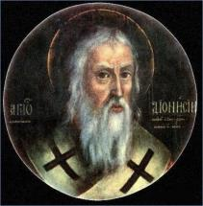
Special Interest Quote -
In what year was Yahusha born if He was to be 12 years old at Luke’s Passover information? 1 BC, or CE1? Does it matter?
See: AD 1 – Wikipedia for the following quote:
Birth of Jesus [Yahusha], as assigned by Dionysius Exiguus in his anno Domini era according to at least
one scholar. However, most scholars think Dionysius placed the birth of Jesus in the previous year, 1 BC.

Slide 13

We will examine only CE 12 to determine WHY Yahusha
was INSIDE the Temple 3 cycles after the feast of the Jews.
CE 11 and 13 are examined in full detail in the complete study. There you will see why CE 11 or 13 can not qualify to fulfill
Luke 2, and the discovery of Yahusha – 3 days after the “practice of the festival” of the Jewish lunar calendar.
Will the year CE 12 have answers?

Slide 14
Luke 2:49 [at age 12]
And He [Yahusha] said unto them, “How is it
that ye sought Me? Wist yet not that I MUST
be about My Father’s business?”
Binding??
Interlinear Scripture Analyzer Luke 2:49
BINDING??? Could a Statute of Yahuah be described this way?

Slide 15
Some Statutes Yahusha Remembered as BINDING!
Deut 16:16 – Three times a year ALL YOUR MALES APPEAR before יהוה your Elohim in the place which He chooses …
[this is attendance for all three Festivals when they begin!]!
Remember the Torah of Mosheh, My servant
which I commanded him in Horeb for all Yisra’el –
Laws and Right-Rulings.
Mal 4:4
Luke 2:46
Question: Could it be when Yahusha was “LOST” and
IN THE TABERNACLE 3 CYCLES AFTER THE FEAST OF THE JEWS,
was Yahusha actually “REMEMBERING” the Torah statutes?

Slide 16
WHY the “MUST” in Yahusha’s remark –
I MUST be about My Father’s business! -?
WHAT IS – His Father’s BUSINESS?
Can we hear - Yahusha’s Compelling
Heart felt Conviction?
Binding?!
Which “calendar” was Yahusha “bound to”?
What was the “calendar year” for confirmation?

Slide 17
Why was Yahusha in the Tabernacle AFTER the Feast of the [unbelieving] Jews?
Next: Comparison of the Two Calendars
17

Slide 18
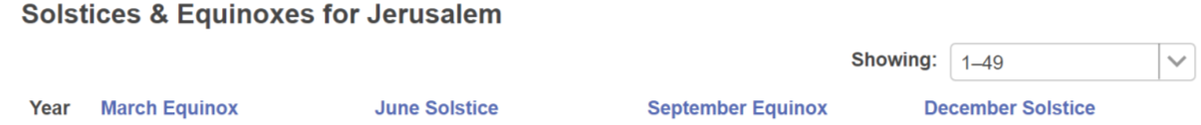
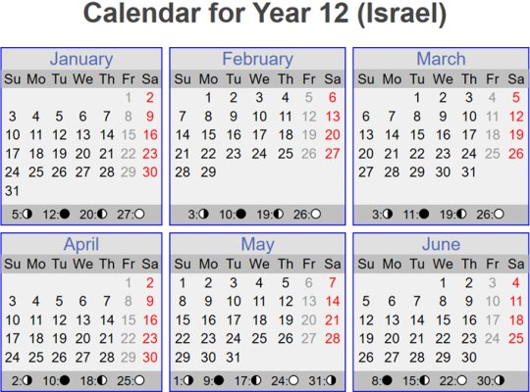

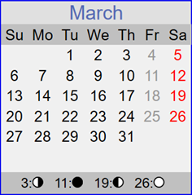
Tequfah
Conjunction
Sliver Moon
New Moonth Day

Slide 19
Tequfah
3rd Cycle
Tequfah
Conjunction
Shaneh New Year Day
Sliver Moon
New Moonth Day

Slide 20
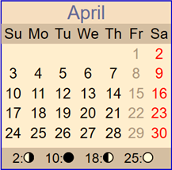
Lunar Calendar CE 12 - Passover Timing
At this time in Judah’s history, the new moonth/year was calculated from the crescent moon before the tequfah.
Sliver Moon
New Moon
Please note the different colours of the months. March’s colour will stay the same as there is no change here. April will reveal two different Passovers – one – Covenant Calendar Blue, and one – Lunar Calendar Beige. Please notice these differences that reveal two separate calendars for your comparison on the slides to follow.
Lunar Passover
Unl. Bread Week
Next: Counting out Passover on Covenant Calendar.

Slide 21
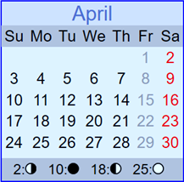
Covenant Calendar CE 12 - Passover Timing
For Covenant Calendar, the new month/year always begins the day following the tequfah.
Cov. Passover
Cov. ULB Week
Tequfah
Shaneh New Year Day
Next: Comparison of Lunar & Covenant Calendars in 12 CE.
Will this year fulfill all the
Gospel Requirements?

Slide 22
Review
Lunar Cal.
The last 3 days of the Lunar Passover
Yahusha’s presence in the Tabernacle was 3 days AFTER the completion of the Lunar Feast!
Sliver Moon
New Moon
Conjunction
New Year
Day
Tequfah
What day was this on Covenant Calendar?
On the 4th cycle of the week, [Wed] in the 1st month of Covenant Calendar
Lunar Passover
Days 1-4 Lunar ULB
Cov. Cal.
Yahusha was IN
the Tabernacle -
(by Statute Exo 23:15-17) presenting Himself
[age 12] & observing the High Shabbat of
Unleavened Bread!
Covenant
Passover
CE 12 is the ONLY
Covenant Calendar year
that can satisfy these Gospel requirements in conjunction
with the Lunar Calendar
of the unbelieving Jews.
Cov. ULB Week

Slide 23

Luke 2:48 When [Yahusha’s] parents saw him,
they were shocked. His mother asked him,
“Son, why have you treated us like this? Your father and I have been worried sick looking for you!” ISV
What was Yahusha’s response at being questioned?
Luke 2:49 He asked them, "Why were you looking for me?
Did you not know
that I would be
IN the house of my Father?"
Yahusha placed His parents “on the stand” for accountability!
Peschitta

Slide 24



They did
not know!
The sad part is to consider the state of Yahusha’s earthly parents in Luke 2:50.
BUT THEY DID NOT UNDERSTAND
the Word - which He spoke to them. Luke 2:50
The Word (of which Yahusha spoke) preserves
The Covenant: the SHANEH based statutes which Yahusha was DIRECTLY being obedient to!

Slide 25


With Yahusha speaking these words
to His parents, is it possible to understand that Yahusha was declaring -
I am observing the Mo-edim of
Yahuah’s Covenant Calendar;
your current practice of the
lunar reckoning for the festivals
is not from the Torah!
Was a little
child leading?
Witnessing? John 7:7

Slide 26

This is just one witness proving the presence of two calendars in the Gospels and the proximity of their closeness in calculations.
There are many more witnesses such as:
John 7: Jews’ Feast of Tabernacles
Yahusha’s Passover
& the 12 hour OFFSET

Slide 27
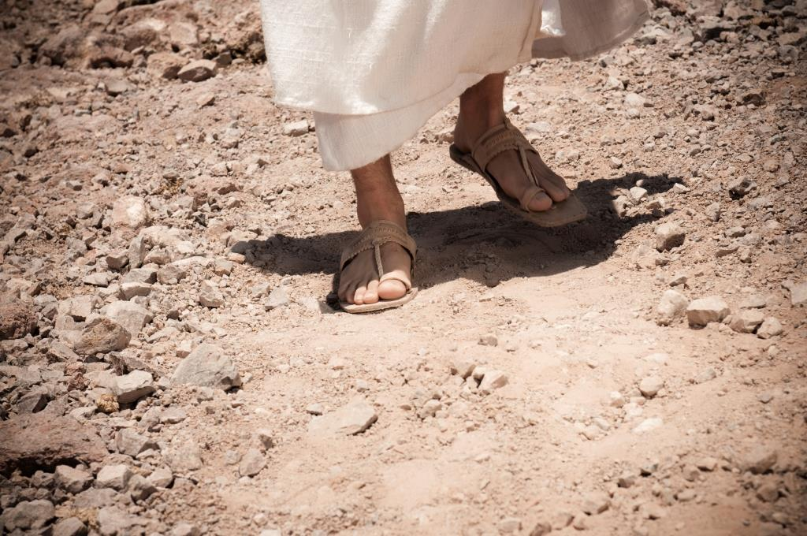
Or, is it the beginning?!
The End!
This has been a most basic outline
of the life of Yahusha!
There is
SOOOO MUCH MORE
to go ☺
Coming!!!

Slide 28

Your Questions Deserve Answers
There are ‘thought questions’ at the website that will be answered in the complete study for “Yahusha – Lost? or Discovered!”
Check out the questions for further study! Enjoy!
Follow this link: Website link:
https://studythecalendar.com/4-9-yahusha-lost-and-found/

Slide 29


We pray this study has blessed your journey of further study as you seek to understand the Covenant of Yahuah and Yahusha.
Questions & Comments can be
sent to Timothy Astleford:
questions@studythecalendar.com
www.studythecalendar.com
Thank –you & Shalom!

Slide 30
Questions Needing Answers
Mary and Joseph attended the Passover at Jerusalem every year, but the year that Yahusha attended at age 12, they started their return home without Him. When He was finally discovered after 3 days, what was Yahusha's answer to them, and did they understand His words? (See Luke 2:49-50.)
Where was Yahusha discovered after the 3 days and what was He doing?
In Luke chapter 2, is there a difference of "context" between the wording of: a) according to the Torah; and 2) according to the practice of the festival? Was Luke trying to get our attention with his very careful wording of these events?
According to Luke chapter 1, when does life begin: 1) at the time of birth?; 2) at the time of conception? What would this have to do with Covenant Calendar timing?
According to many commentators, there is substantial documentation that the year of Yahusha's birth could have been approximately anywhere from 7 BC to 3 BC. This Gospel study will prove the exact year of Yahusha's Passover at age 12. Could one then determine the year of His birth?
There is only one year that fits the very specific criteria for Yahusha's age 12 Passover. What is the specific Gospel calendar language to unlock this puzzle of the exact year?

Slide 31
Questions Needing Answers [con’t]
There are many different types of lunar calendars all the way from the return of the exiles in 457 BC up to Luke and Paul's documentation in 57 AD. Some lunar calendars were calculated according to the crescent moon before the equinox, and some were calculated by the crescent moon after the equinox. For Yahusha's 12 year Passover, which type of lunar calendar were the unbelieving Jews using then? Do you wonder if that is the same lunar calendar they were using during Yahusha's ministry many years later? What about the lunar calendar that Luke and Paul record almost 30 years after the crucifixion?
Some believe that a "High Sabbath" is always a "feast Sabbath" and the "weekly Sabbath" sharing the same day/date? Is that the case in this study?
Upon what day of the week was Yahusha's Covenant Calendar Passover in this study?
After going through this study, see if the phrase "and a little child shall lead them" has a different meaning for you. Who was that "little child" and who was being led? ... and how do you think those around Yahusha reacted to "that leading"? Did His example have anything to do with exactly when to observe the festivals as given in the Torah?

