Slide 1


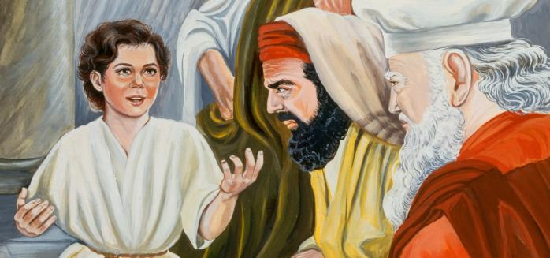





Yahusha
“Lost? Or Discovered!”
2021 Revision
The 3rd Day Calendar Discovery
One Puzzle
Piece
at a Time

Slide 2


I be about My Father’s Business
must
KJV Luke 2:49
THE SINLESS First Fruit
THE Eh-Tzem!

Slide 3
The Baseline Factor
While the Julian calendar was in operation at this time, the Temple was operating on [what was called] the Lunar based 3rd Calendar at the same time. The religious festivals were based on this Lunar calendar. Like today, there was a separate function of the Festal calendar as to the civil Julian calendar. The Julian and the Gregorian calendars are incrementally different. The leap year days being placed within the 5 days of waiting after the Scriptural 360 days cause a fluctuation also.
There is a variation between the Gregorian and Covenant Calendar months.
The Covenant Calendar 1st month begins about mid March and ends about mid April.
The Covenant Calendar 7th month varies in the area of mid Sept to mid Oct.
The Covenant Calendar 9th month varies in the area of mid Dec to mid Jan.
The variation depends on the structure of the variable Gregorian each year.

Slide 4
In this writing, we will come to an understanding of how to account for time according to the Torah standard.
A full time span cannot be counted as complete:
If it begins part way into the time span.
If the full time span is not completed to the full.
Day example: In other words – a “full day” is not counted as a “24 hour day”
if only 21 hours are accounted for.

Slide 5
Note of extreme importance.
The Temple festivals were operating on the lunar calendar.
The civil calendar was the Roman Julian calendar.
You will see the Gregorian calendar months in this study.
It matters not whether the Julian or Gregorian months are used to delineate our recognition of designated time, as it is only the Covenant Calendar and the Jewish Lunar Calendar that have depth of meaning in this study.
The historic documentation in here is given according to the Gregorian calendar. That is what is used for OUR IDENTIFICATION and RECOGNITION OF TIME purposes ONLY.
The facts and reckoning of time strictly belong to the Covenant Calendar and the Lunar Calendar of the Jews.

Slide 6
I - must be about My Father’s Business
KJV Luke 2:49
Did Yahusha consider Malachi relevant in CE 12?
6

Slide 7
Remember the Torah of Mosheh,
My servant which I commanded him
in Horeb for all Yisra’el –
Laws and Right-Rulings.
Mal 4:4
Could it be: When Yahusha was “LOST” and IN THE TABERNACLE 3 CYCLES AFTER THE FEAST OF THE JEWS, was Yahusha actually “REMEMBERING” the Torah statutes?
Luke 2:46

Slide 8
Luke 2:49
And He [Yahusha] said unto them, “How is it that ye sought Me? Wist yet not that I MUST be about My Father’s business?”
Binding??
Interlinear Scripture Analyzer
Luke 2:49
BINDING??? Could a Statute of Yahuah be described this way?

Slide 9

WHY the “MUST” in Yahusha’s remark –
I MUST be about My Father’s business! -?
WHAT IS – His Father’s BUSINESS?
Can we hear - Yahusha’s Compelling
Heart felt Conviction?
Binding??
If there was only one question to be asked
for this writing, it would be the first question.

Slide 10
This writing is making the claim that Yahusha was 12 years old in the 9th Covenant Calendar month (Jan),
going into the year CE 12.
First we will look at the circumstances of exactly why Yahusha should be 12 entering into CE 12 and then we will look at the years of His life up to His age at His death. This will be an overview only and details will follow much later.

Slide 11
Luke 1:39 And Miryam arose in those days and went into the hill country with haste, to a city of Yehuḏah,
Luke 1:40 and entered into the house of Zeḵaryah and greeted Elisheḇa.
Luke 1:41 And it came to be, when Elisheḇa heard the greeting of Miryam, that The Baby in her womb. And Elisheḇa was filled with the Set-apart Spirit.
leaped

Slide 12
Yes, please read this again!
Luke 1:41 (a) And it came to be, when Elisheḇa heard the greeting of Miryam,
that The Baby leaped in her womb.
What important
DIRECT CONNECTION
does this verse have to do with –
Luke 2:42 And when He was twelve years old, they went up to Yerushalayim according to
the practice of the festival.

Slide 13
At 12, Yahusha was, after three days - doing WHAT?
Will Luke provide crucial timing assistance in determining the year that Yahusha was born?
Will it also have an immense bearing on affirming His year of crucifixion?
Luke 2:46 And it came to passe three dayes after, that they found him in the Temple, sitting in the mids of the doctours, both hearing them, and asking them questions. Geneva

Slide 14

What was Yahusha’s response at being questioned?
Luke 2:48 When [Yahusha’s] parents saw him, they were shocked. His mother asked him, ”Son, why have you treated us like this? Your father and
I have been worried sick looking for you!” ISV
Luke 2:49 He asked them, "Why were you looking for me?
Did you not know
that I would be
IN the house of my Father?"
Yahusha placed His parents “on the stand” for accountability!
Peschitta

Slide 15

With Yahusha speaking these words
to His parents,
is it possible to understand that
Yahusha was declaring -
I am observing the Mo-edim of
Yahuah’s Covenant Calendar;
your lunar reckoning is an abomination!

Slide 16

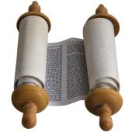
Consider the state of Yahusha’s earthly parents.
BUT THEY DID NOT UNDERSTAND
the Word - which He spoke to them. Luke 2:50
The Word (of which Yahusha spoke) preserves the Covenant - SHANEH based statutes which Yahusha was DIRECTLY being obedient to!

Slide 17

Yahusha’s earthly parents did not have a correct understanding of Covenant Torah! They had been deceived by years and years of lunar reckoning contamination through the 2nd Temple era deception which revered imposter High Priests - (through political assignment!)
Yahusha’s earthly parents were not observing Yahuah’s established Calendar within His Covenant, at that time! They were observing the traditions of the Yahudim! They had syncretism in their lives!
Yahusha was witnessing and giving them notification!
Do we really understand the tremendous long reaching
implications of this last statement?

Slide 18
HalleluYah Scriptures Luke 2:42
In the year that Yahusha was 12 years of age,
the year of His accountability,
He was - “found” – DISCOVERED -
on the 3rd cycle following the “practice of the feast” -
(that “practice” being – a Jewish LUNAR BASED feast.
After their feast, a responsible Yahusha was – DISCOVERED
- IN THE TABERNACLE!
WHERE?
Why “PRACTICE”?
Why is this simple word so revealing?

Slide 19
Time Out!
Do we really think the Creator of the Universe was LOST?
Was Yahusha “found” as some Scripture editions declare?
Or was He Divinely allowed to be discovered by His earthly parents, -
IN THE TABERNACLE?
Binding??
OK! Back to the question:
Why is the word – PRACTICE – used in this text?

Slide 20
What did Luke document as the covering authority for Yahusha?
Luke 2:21 And when eight days were completed for Him to be circumcised, His Name was called יהושע [Yahusha] the Name given by the messenger before He was conceived in the womb.
Luke 2:22 And when the days of her cleansing according to the Torah of Mosheh were completed, they brought Him to Yerushalayim to present Him to יהוה –
Luke 2:23 as it has been written in the Torah of יהוה, “Every male who opens the womb shall be called set-apart to יהוה” –
Luke 2:24 and to give an offering according to what is said in the Torah of
יהוה, “A pair of turtledoves or two young pigeons.”
Luke 2:27 And he came in the Spirit into the Set-apart Place. And as the parents brought in the Child יהושע, to do for Him according to the usual practice of the Torah, HalleluYah Scriptures

Slide 21

Luke 2:39 And when they had accomplished all matters according to the
Torah of יהוה, they returned to Galil, to their city Natsareth.
Up to this point Luke specifically recorded the Divine Authority which governed in Yahusha’s life.
WHY THEN in the same chapter, does Luke deviate from his style of documentation to bring us a totally different aspect of
TIMING AUTHORITY?
Luke 2:41 And His parents went to Yerushalayim every year at the Festival
of the Passover.
Why the generic designation – “the Festival”?
Why is there no mention of Yahuah or the Torah as in the former verses?
Is this just a simple oversight from Luke? Or is there a viable explanation?

Slide 22
Practice of “the festival”?
Luke 2:42 And when He was twelve years old, they went up to Yerushalayim
according to the practice of the festival.
What reason did the Spirit of Inspiration have to cause Luke to refrain from identifying either Yahuah or the Torah as the governing authority for THIS particular feast?
Who governed THIS PARTICULAR feast ?
What is Luke pointing out to us?
Will we listen or just nonchalantly skip over these
blatantly specific choices of highly informative words?

Slide 23
Let’s look at this again.
HalleluYah Scriptures Luke 2:42
In the year that Yahusha was 12 years of age,
the year of His accountability,
He was - DISCOVERED -
on the 3rd cycle following the “practice of the feast” -
(that “practice” being – a Jewish LUNAR BASED feast.
After their feast, a responsible Yahusha was – DISCOVERED
- IN THE TABERNACLE!
WHERE?
Is this even connected?
Hyper Important Question:
Does Yahuah consider the moment of conception, the beginning of life?
Consider John’s excitement - IN THE WOMB (Luke 1:41),
when a newly pregnant Miryam visited Elisheva!

Slide 24
Luke 1:41 And it came to be, when Elisheḇa heard the greeting of Miryam, that the baby
in her womb.
And Elisheḇa was filled with the
Set-apart Spirit,
leaped
Life begins at conception!
Yochanon knew that Yahusha’s earthly life had already begun.

Slide 25
Linking – Life Begins at Conception – to Yahusha’s 12th year!
FACT: Yahusha was twelve years of age when discovered 3 cycles after the
Jewish Lunar Pesach.
WHAT YEAR
was that event?

Slide 26
Please allow me to submit to you -
Both Yochanon & Yahusha’s age count began
AT CONCEPTION!

Slide 27
Yochanon’s first 12 Chodeshim (months) of his life starting at conception!
Passover in the 1st month of the Covenant Calendar year. (Abib)
Yochanon’s Conception –
18 Months prior to CE 1.
Here are the 12 chodeshim of Yochanon.
1
2
3
4
5
6
7
8
9
10
11
12
Jul 04 | Aug 05 | Sep 06 | Oct 07 | Nov 08 | Dec 09 | Jan 10 | Feb 11 | Mar 12 | Apr 01
May 02 | Jun 03
The 4th Shaneh Chodeshim of the Covenant Calendar. Remember, Covenant Calendar months are not identical to Gregorian months so please allow for some variation in time span.
Yochanon in his 9th month, was birthed here on the 1st Chodesh (month) just prior to Passover!

Slide 28
Yochanon birthed (at 9 months), here, just before Passover !
Yochanon completed his first year here at - 12 months!
9
10
11
12
Jan 07 | Feb 08 | Mar 09 | April | May | June | July | Aug | Sept
1
2
3
4
5
6
1
2
3
4
5
6
7
8
9
Yahusha, being 6 chodeshim (months) younger than Yochanon (Luke 1:36), was birthed here, in His 9th month, just before Sukkot!
Oct | Nov | Dec
12
Sukkot
10
11
Yahusha COMPLETED His 1st year of 12 months – here, in the 9th month of CC!
NOTE: – the “Grand Points of Reckoning” are, 1st - Yochanon’s birth prior to Passover and – 2nd - Yahusha’s birth just BEFORE Sukkot.

Slide 29
Yahusha’s years are counted from the time of conception!
For Yahusha to be 12 years old in the year 12 CE when He was discovered 3 cycles “later” in the Tabernacle,
He MUST FIRST be
1 year old, upon ENTERING CE 1!
WHY THIS DEMAND specifically laid upon CE 12?
Why not CE 11, or 13?

Slide 30
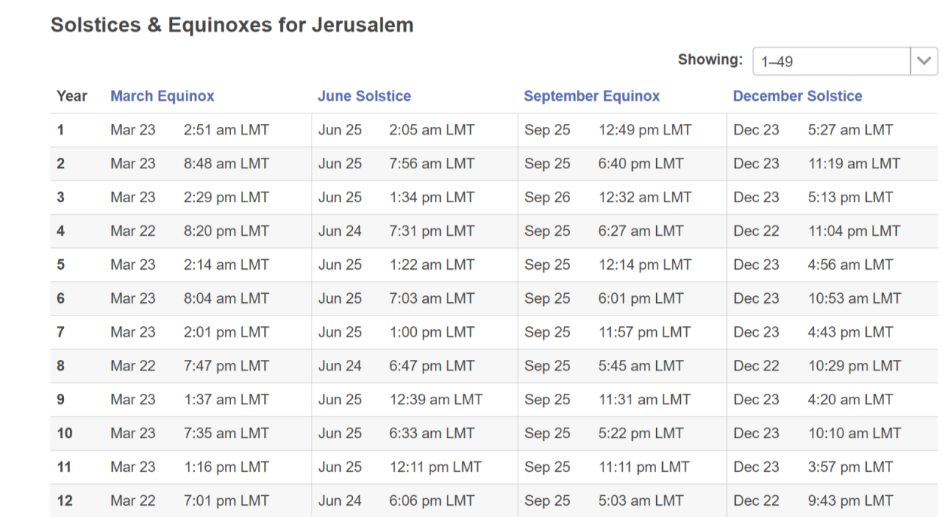
IMPORTANT!
1
1
2
Please note – Yahusha had NO CONCERN about the Gregorian calendar as it did not exist during His time on earth. This writing is using the Gregorian names and timing which are relatively close to the Julian civil Roman calendar references as a marker point.
They are for our timing recognition purpose ONLY!
In actuality, Yahusha needed to be 12 years of age PRIOR TO the 1st Covenant Calendar month which happened
to occur in what we now understand as CE12.
3
4
5
6
7
8
9
10
11
12
13

Slide 31
Yahusha - conceived 12 months before 1 CE, being born near Sukkot, He needed 3 more months TO COMPLETE HIS FIRST YEAR PRIOR TO CE 1!
1
1
2
Local Mean Time
That means in the
9th month CC,
(end of the first year Gregorian), Yahusha turned 2 years old;
and so on and so forth.
3
4
Yahusha was 1 year old,
going INTO – (or)
ENTERING CE1!
5
6
7
8
9
10
11
12
31
In CE 11, at the end of the Gregorian year, Yahusha completed His 12th year.
13

Slide 32
Special Interest Quote -
Who was born in the year 1?
Birth of Jesus [Yahusha], as assigned by Dionysius Exiguus in his anno Domini era according to at least one scholar. However, most scholars think Dionysius placed the birth of Jesus in the previous year, 1 BC. See: AD 1 - Wikipedia

Slide 33
If Yahusha had been only 11 years old entering 12 CE,
how could He have been age 12 for Yahuah’s Passover?
It was 12 CE when He was discovered
PRESENTING HIMSELF BEFORE YAHUAH
“in the place which He chooses!”
(See Exo 23:17; Deut 16:16; Job 1:6; 2:1.)
Yahusha was discovered in the Tabernacle observing the Feast of Passover/Unleavened Bread three cycles after
the LUNAR based Feast of the Jews!
On the next slide, we will examine the serious problem when assuming that Yahusha turned 1 year old AT
(or just before) SUKKOT, ON 1 CE!

Slide 34
Proving Conception, and year of birth! Yahusha was born near Sukkot.
Were 12 more months needed TO COMPLETE HIS FIRST YEAR?
Did Yahusha turn 1 before Sukkot - of CE 1?
!
1
Had Yahusha only achieved His 12th year, here??? CC Passover was long gone at this point! This scenario CANNOT ALIGN with the words of the Scriptures!
2
3
That means - Yahusha was only 11 going into the year CE 12! ????
Will this present a serious problem with Luke 2:42 – (twelve)?
4
5
6
7
8
9
At 11 years young - 3 cycles late, IN the Tabernacle?
10
P/UB
11
12

Slide 35

Is it possible a serious breach would have surfaced if Yahusha was only 11 years of age when
entering CE 12?
WHY CE 12?
What about CE 11 and CE 13?

Slide 36
Next step!
Are there solid Scriptural reasons for making these claims?
On the next slide is the format of how this writing exposes the Life of Yahusha. Please remember this format as it will help your understanding in the slides to come.

Slide 37
Cycle Lunar Date
Cycle Date
CE 12 investigation
Covenant Count
On this side you will see the so named “Hebrew Calendar” which is the lunar based calendar of the appropriate era. The Cycles of the week and month, and some dates also are listed.
The weeks are marked out by the 7th day Sabbaths.
The Gregorian year of the CE is written. The investigation of the Tequfah and its designated cycle of the week will be marked.
Over here is the Covenant Calendar with its Shaneh cycles of the month and dates.
Let’s do the comparison! ☺
WHY was Yahusha in the Tabernacle
– AFTER – the Feast of the Jews???

Slide 38

We will first be looking at CE 12 to determine WHY Yahusha
was INSIDE the Temple 3 cycles after the feast of the Jews.
Then - we will examine CE 11 and 13 to see why it is NOT realistic
for these years that Yahusha – in Luke 2, was discovered
in the Temple.
What about CE 12?
We will view option “A” first and then return to option
“B” for CE 12 towards the end of this writing.

Slide 39
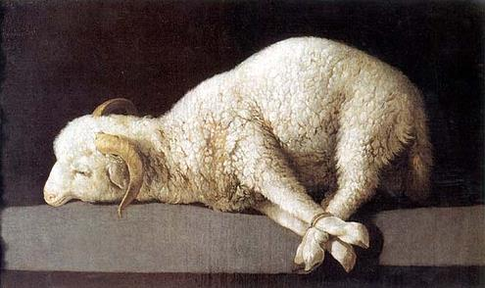


                In OBEDIENCE to His Father’s Business!
Matt 5:17 Think not that I came to destroy the law or the prophets: I came not to destroy, but to FULFILL.
Luke 2:49 And he said unto them, How is it that ye sought me? knew ye not that I MUST BE - IN - my Father's house?

Slide 40
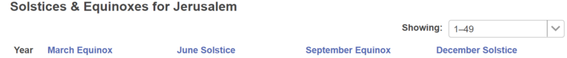

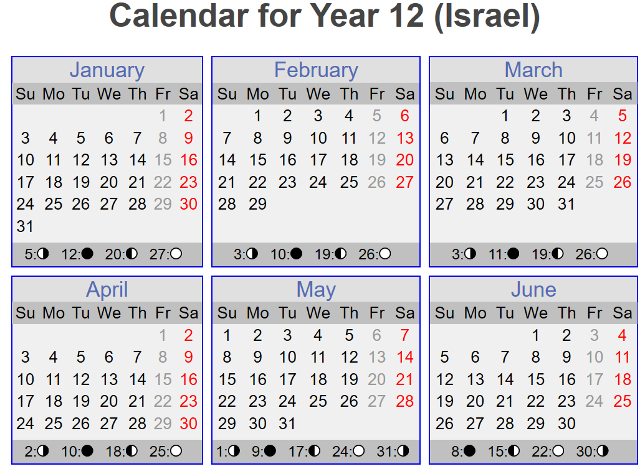
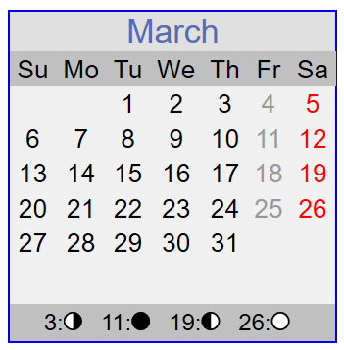
Tequfah
This factor is the “common denominator” between the calendars, and has the essential importance of oxygen!
3rd Cycle
Tequfah
Conjunction
Shaneh New Year Day
Sliver Moon
New Moonth Day

Slide 41
Cycle Lunar Date
Cycle Date
CE 12 investigation
Covenant Count
2nd 1
3rd 2
4th 3
5th 4
6th 5
7th 6
1st 7
2nd 8
3rd 9
4th 10
5th 11
6th 12
7th 13
1st 14
2nd 15
3rd 16
4th 17
5th 18
6th 19
7th 20
1st 21
2nd 22
3rd 23
4th (Wed) 24
5th 25
6th 26
7th 27
1st Month
On the 4th cycle of the week, in the 1st month of Covenant Calendar -
March 22 Gregorian
3rd TEQUFAH (365)
Yahusha was IN the Tabernacle - (by Statute) observing the
High Shabbat of
Unleavened Bread!
4th 1
5th 2
6th 3
7th 4
1st 5
2nd 6
3rd 7
4th 8
5th 9
6th 10
7th 11
1st 12
2nd 13
3rd 14
4th (Wed) 15
5th 16
6th 17
7th 18
1st 19
2nd 20
3rd 21
4th 22
5th 23
6th 24
7th 25
Lunar festival of Unleavened Bread (?)
1st CC Month
Dei - Binding! ISA
1
S
2
Exo 23:15-17
3
If this 3rd day (Wed) , when Yahusha was discovered AFTER THE (LUNAR) FEAST of the Yahudim,
was on the 4th cycle of that week … Luke 2:42 - 46
Yahuah’s Covenant Festivals!

Slide 42
Cycle Lunar Date
Cycle Date
CE 12 investigation
Covenant Count
On the 4th cycle of the week, in the 1st month of Covenant Calendar -
3rd TEQUFAH
Again! Note: CE 12!
Yahusha was IN the Tabernacle - (by Statute) observing the
High Shabbat of
Unleavened Bread!
4th 1
5th 2
6th 3
7th 4
1st 5
2nd 6
3rd 7
4th 8
5th 9
6th 10
7th 11
1st 12
2nd 13
3rd 14
4th 15
5th 16
6th 17
7th 18
1st 19
2nd 20
3rd 21
4th 22
5th 23
6th 24
7th 25
1st CC Month
S
Exo 23:15-17
CE 12! Yahusha was - BY STATUTE, presenting Himself - before Yahuah,
INSIDE the Tabernacle! Exo 23:17
Yahuah’s Covenant Festivals!

Slide 43
In CE 12: Yahusha would have been - IN THE TABERNACLE !
Exo 23:15 – Guard the Festival of Matstsoth. Seven days you eat unleavened bread, as I have commanded you, at the time Appointed in the month Abib – and do not appear before me
empty handed.
Exo 34:23 - “Three times in the year all your men are to APPEAR before the Master, יהוה [Yahuah], the Elohim of Yisra’ĕl.
shaneh
Exo 23:17 - “Three times in the year ALL YOUR MALES are to appear before the Master יהוה [Yahuah].
Where were these offerings {living sacrifices} for Yahuah
to be brought if not to the Tabernacle?

Slide 44
A closer look: This verse originates in the Torah, thousands of years prior to the time when Yahusha’s earthly parents discovered Him observing the Statutes of Yahuah, IN THE TABERNACLE.
QUESTION: Yahusha was observing the Statutes according to the Shaneh (year) of the Torah. Was Yahusha then SINNING by default of the (LUNAR) YEAR of the Jews, occurring earlier and NOW the –
“NEW REALITY?” (Note: There is no Scriptural Hebrew name for a lunar year!)
Shaneh – reckoned by the Tequfah!
Exo 23:17 - “Three times in the year ALL YOUR MALES are to appear before the Master יהוה [Yahuah].
Mal 3:6 “For I am יהוה, I shall not change…”

Slide 45
Continuing on-
Deut 16:16 – “Three times a year ALL YOUR MALES APPEAR before יהוה your Elohim in the place which He chooses: at the Festival of Unleavened Bread,
For 3 days (starting on Abib 14), can it safely be said that Yahusha was “ABOUT MY FATHERS BUSINESS!?”
and at the Festival of Weeks, and at the Festival of Booths. And none should appear before יהוה [Yahuah] empty-handed.

Slide 46
Is it any surprise that perfect alignment is exposed when we simply accept the Words as Yahuah preserved them?
Yahusha was DOING
3rd TEQUFAH 365
that is - SHEMA -
Yahusha was IN the Tabernacle - (by Statute) observing the
High Sabbath of
Unleavened Bread!
4th 1
5th 2
6th 3
7th 4
1st 5
2nd 6
3rd 7
4th 8
5th 9
6th 10
7th 11
1st 12
2nd 13
3rd 14
4th 15
5th 16
6th 17
7th 18
1st 19
2nd 20
3rd 21
4th 22
5th 23
6th 24
7th 25
1st Month
(OBEDIENT TO)
S
Exo 23:15-17
& FULFILLING
Matt 5:17
Yahuah’s Covenant Festivals!
the Covenant Statutes of the MelekTzedek Administration!

Slide 47
Think not that I am come
to destroy the law,
or the prophets:
I am not come to destroy,
BUT TO FULFILL.
Matt 5:17

Slide 48
The Great Sadness about - Yahusha’s earthly parents -
Luke 2:50 But they did not understand
the Word which He spoke!
What was it that the earthly parents of Yahusha did not understand? Was it His audible language? Or was it - Yahuah’s Covenant Calendar which HAD PREVIOUSLY BEEN DISCARDED?
Consider this: – Luke 11:52 – Woe to you learned in the Torah, because you took away the KEY TO UNDERSTANDING. You did not enter yourselves, and those who were entering in you hindered.

Slide 49
More Reality Which Yahusha Spoke!
Luke 2:50 But they did not understand
the Word which He spoke!
John 7:6 יהושע therefore said to them, “My time has not yet come, but your time is always ready.
John 7:7 “It is impossible for the world to hate you, but it hates Me BECAUSE I BEAR WITNESS OF IT, THAT ITS WORKS ARE WICKED.

Slide 50
In this next verse, is it possible (or likely) that Yahusha was referencing His Tequfah / Shaneh based
Covenant Calendar as inculcated at creation ?
Inculcate = instill (an attitude, idea, or habit) by persistent instruction.
The 360 day Festal year had been abandoned shortly after Hezekiah’s sun dial event, in direct defiance to Yahuah; &
the lunar worship practice was officially adopted instead!
Could this be why Yahusha declared in Matt 23:15 –
Woe to you, scribes and Pharisees, HYPOCRITES! Because you go about the land and the sea to win one convert, and when he is won, you make him a son of Gey-Hinnom TWOFOLD more than yourselves.
Who is it that gives their allegiance to the moon?

Slide 51

Speaking to the scribes much later in His life –
What reasoning caused Yahusha to speak these words?
John 7:19 “Did not Mosheh give you the Torah?
Yet NOT ONE of you does the Torah!
Why do you seek to kill Me?”
And yet I am hammered with the idea that – “Salvation is of the Jews”?
What is the correct translation and understanding?
Could it be pointing us to geographical Judah instead of - the Jews?! ☺

Slide 52
Consider these words of Yahusha!
Matt 5:20 “For I say to you, that unless your righteousness exceeds that of the scribes and Pharisees, you shall by no means enter into the reign of the heavens.”
Consider the statements found in these verses below, then carefully ponder from whom you accept doctrine.
Matt 15:3-9; Mark 7:7-13; Acts 7:53; Rom 2:23-27; Gal 6:13.
Exceed – IS NOT – Equal to, nor – Same as!
Exceed is – ABOVE, BETTER and BEYOND!

Slide 53
Now it is time to view CE 11.
Let’s see if CE 11 can match or deliver better reasoning, than CE 12.
We are once again looking for TIMING EVIDENCE to determine exactly WHY Yahusha was “DISCOVERED” in the tabernacle, 3 days after the lunar feast of the Jews!
Note: There will be 2 options for CE 11. Both options use a different placement for the moon month from the position of the tequfah.

Slide 54

CE 11- Option -
A
In OBEDIENCE to -
His Father’s Business!
Examining CE 11 (1A – Sliver BEFORE the Tequfah.)
Historic documentation is recorded and proven that in this era,
they were choosing the sliver moon before the Tequfah.

Slide 55
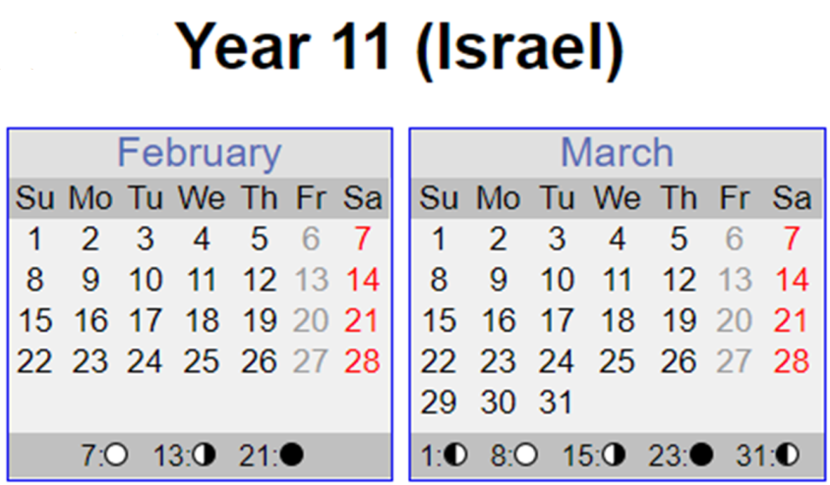
Tequfah
HUGE IMPORTANCE for calendar comparison alignment purposes!
2nd Cycle
Conjunction
Tequfah
Sliver Moon
A Shaneh New Year Day
New Moonth Day

Slide 56
Cycle Lunar Date
Cycle Date
CE 11 investigation
Covenant Count
This slide is specifically to expose the New Moonth day location -
in relation to the Tequfah.
3rd 1
4th 2 (25)
5th 3 (26)
6th 4 (27)
7th 5 (28)
1st 6 (1)
2nd 7
3rd 8
4th 9
5th 10
6th 11
7th 12
1st 13
2nd 14
3rd 15
4th 16
5th 17
6th 18
7th 19
1st 20
2nd 21
3rd 22
4th 23
5th 24
6th 25
7th 26
1st 27
2nd 28 (23)
3rd 29
4th 30??
New Moonth Day
February 24!
Gregorian
Lunar month begins here!
March (Gregorian) begins here.
These are here for our timing location recognition purposes only!
Cycle Date
Covenant Count
1st ³⁶⁴
2nd TEQUFAH 365
Mar 23 / 2nd Cycle- Tequfah

Slide 57
Cycle Lunar Date
Cycle Date
CE 11 investigation
Covenant Count
Lunar festival of Unleavened Bread (?)
5th 10
6th 11 7th 12
1st 13
2nd 14
3rd 15
4th 16
5th 17
6th 18
7th 19
1st 20
2nd 21
3rd 22
4th 23
5th (Thu) 361 24
6th 362 25
7th 363 26
1st 364 27
2nd 365 28
3rd 29
4th 30??
March
Gregorian
Is there anything about the 361st cycle, that could cause Yahusha to be –
“about My Father’s business” (Luke 2:49)?
1
2
3
361st
2nd TEQUFAH 365
3rd 1
4th 2
5th 3
6th 4
7th 5
1st 6
2nd 7
3rd 8
4th 9
5th 10
6th 11
7th 12
1st 13
2nd (Apr) Passover 14
1st Month
This 3rd day, on the 5th cycle of the week) AFTER THE
(LUNAR) FEAST of the Yahudim; (Luke 2:42 – 46)
Was Yahusha discovered HERE?

Slide 58
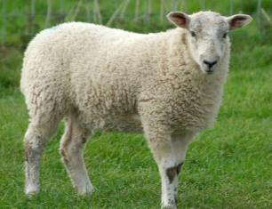
CE 11- Option
B
  In OBEDIENCE to
  His Father’s Business!
  Looking at CE 11 (The Sliver AFTER the Tequfah)
John 7:6 … but YOUR time is ALWAYS ready!

Slide 59

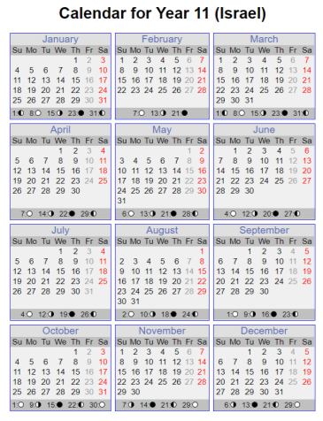
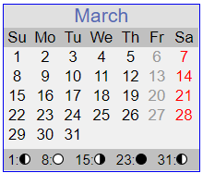
Tequfah
Tequfah is still on the 2nd Cycle of the week, 12th month, 365th cycle,
(or March 23 Gregorian.)
Tequfah
A Shaneh New Year Day
(Also) Conjunction
5th Cycle, New Moonth Day
Sliver Moon

Slide 60
Cycle Lunar Date
Cycle Date
CE 11 investigation
Covenant Count
March 26
Gregorian
2nd TEQUFAH 365
3rd 1
4th 2
5th 3
6th 4
7th 5
1st 6
2nd 7
3rd 8
4th 9
5th 10
6th 11
7th 12
1st 13
2nd 14
3rd 15
4th 16
5th 17
6th 18
7th 19
1st 20
2nd 21
3rd 22
4th 23
5th 24
6th 25
7th 26
1st 27
2nd 28
3rd 29
4th 30
5th 1
6th 2
7th 3
1st 4
2nd 5
3rd 6
4th 7
5th 8
6th 9
7th 10
1st 11
2nd 12
3rd 13
4th 14
5th 15
6th 16
7th 17
1st 18
2nd 19
3rd 20
4th 21
5th 22
6th 23
7th 24 1st 25
2nd 27
3rd 28
4th 2
5th 2
1st Month
5th Cycle –
New Moonth Day
Yahuah’s Moedim!
☺
After the Mo-edim of Yahuah: - Is there a Torah statute concerning the 26th cycle of the 1st month, that could require Yahusha to DO, and EXCLAIM –
“I MUST be IN the house of My Father!?”
Lunar festival of Unleavened Bread (?)
1
2
Was Yahusha discovered HERE?
3
The 3rd cycle – (a 7th day Sabbath) - AFTER THE
(LUNAR) FEAST of the Yahudim. Luke 2:42 - 46

Slide 61
Considering CE 11, have you found any specific Scriptural reason why Yahusha would declare He was being obedient
to the Will of Yahuah
on Abib 26?

Slide 62
In OBEDIENCE to -
His Father’s Business!
Looking at CE 13
Luke 2:49 He said to them, Why were you looking for me? did you not know that I would be IN THE HOUSE of my Father? Ancient Eastern Texts: Aramaic of the Peshitta

Slide 63
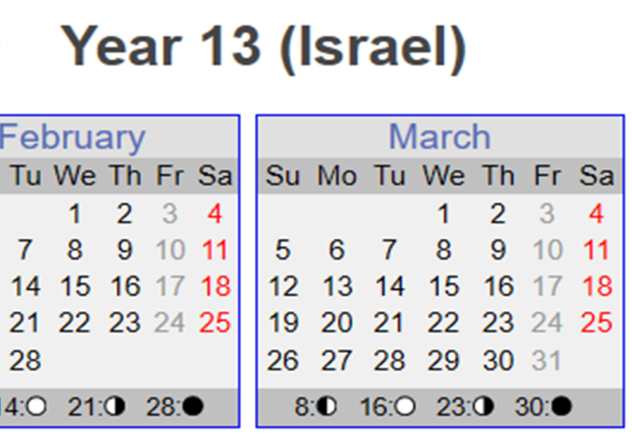
Tequfah
As documented by Morgenstern, and proven, the sliver moon PRIOR TO THE TEQUFAH was chosen in this era, as the beginning of their new year. (Most likely a 13th lunar month!)
New Moonth Day
Tequfah
Conjunction
Sliver Moon
The Shaneh New Year Day

Slide 64
Cycle Lunar Date
Cycle Date
Covenant Count
CE 13 investigation
6th 1
7th 2
1st 3
2nd 4
3rd 5
4th 6
5th 7
6th 8
7th 9
1st 10
2nd 11
3rd 12
4th 13
5th 14
6th 15
7th 16
1st 17
2nd 18
3rd 19
4th 20
5th (Thu) 21
6th 22
7th 23
1st 24
2nd 25
3rd 26
4th 27
5th 28
6th 29
7th 30
New Moonth Day
Did the Torah’s statutes require Yahusha, on the 3rd “day” of the 1st month, to be IN THE HOUSE OF YAHUAH, - “about My Father’s business”?
1st Month
Lunar festival of Unleavened Bread (?)
March 23 Gregorian
5th TEQUFAH
1
2
6th 1
7th 2
1st 3
2nd 4
3rd 5
4th 6
5th 7
6th 8
7th 9
1st 10
2nd 11
3rd 12
4th 13
5th 14
6th 15
3
1st CC Month
Here is the 3rd day – (1st cycle of the week) after the feast of the Yahudim. Luke 2:42 - 46

Slide 65
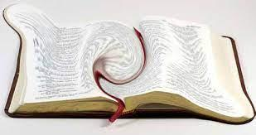
To say the Torah’s statutes require Yahusha, on the 3rd “day”
of the 1st month, to be IN THE HOUSE OF YAHUAH, -
“about My Father’s business” is a twist of Scripture!
OK! ☺
Moving onto the
next step
of this journey.

Slide 66
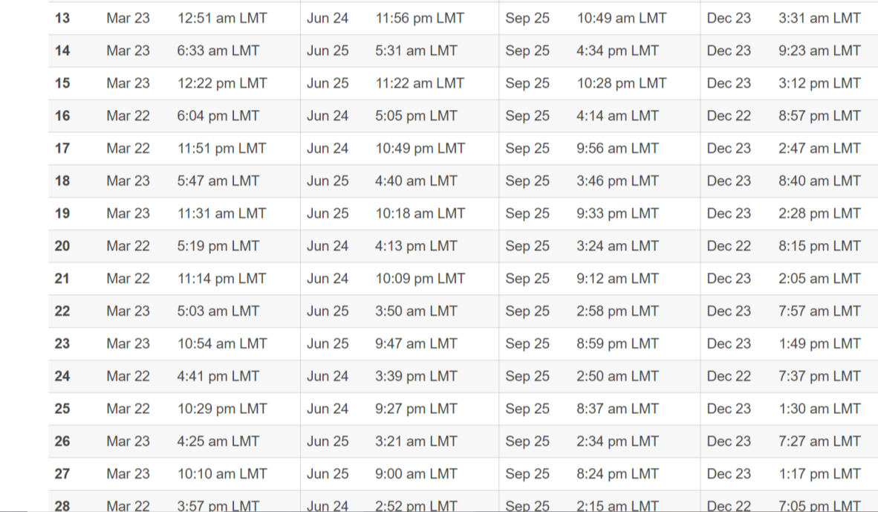
14
At the end of the Gregorian year, Yahusha’s age would change and show the next year’s number.
Yahusha would complete His 14th year in the 9th month of Covenant Calendar,
(or Dec of CE 13).
Does this time reckoning align with Yahusha’s Crucifixion?

Slide 67
14
15
16
17
18
19
Just a slide to show the years and Yahusha’s age.
20
21
22
23
24
25
26
27
28
29

Slide 68
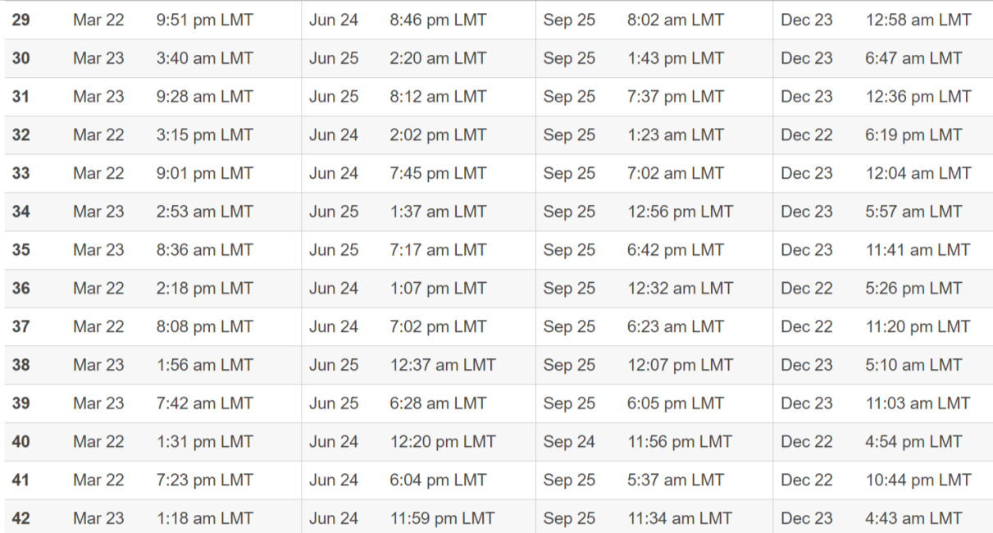
At the beginning of CE 30, Yahusha was already 31 years of age.
Yahusha’s Age
30
31
Remember -Yahusha did not stay on earth until the 9th month CC (Dec/Jan), where He would have then fulfilled 31 earthly years!
Crucifixion - Passover CE 30! Roman Calendar:
Yahusha died at approximately the
4th month, within His 31st year.
Yahusha was still a “lamb of the first year”!
He had not yet accomplished nor completed His 2nd year of ministry!
Exo 12:5 - Your lamb shall be without blemish, a MALE OF THE FIRST YEAR:
ye shall take it out from the sheep, or from the goats:
The Torah’s Type - for Yahusha

Slide 69

A final review -
Let’s have another look at CE 12.
But this time we will view OPTION “B”!

Slide 70
Note the mocking moniker applied by sailors to
the inconsistent characteristics of the moon!
What if the Drunken Sailor, waited to appear on the third evening after the conjunction?
Will this make a significant change in favor of the lunar calendar
for CE 12?

Slide 71
What would have changed?
1. Only the cycle of the week
upon which they started the lunar month;
2. And consequently,
the cycle of the week that Yahusha appeared
IN THE TABERNACLE,
are changed.

Slide 72

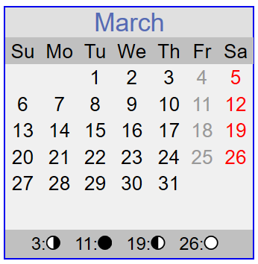
Tequfah
Sliver Moon - now spotted on the 3rd evening after the conjunction!
Conjunction
Shaneh New Day
New Moonth Day is now on the 3rd cycle of the week – the 15th of March (Gregorian)!
Tequfah

Slide 73
Cycle Lunar Date
Cycle Date
Covenant Count
CE 12 investigation
3rd 1
4th 2
5th 3
6th 4
7th 5
1st 6
2nd 7
3rd 8
4th 9
5th 10
6th 11
7th 12
1st 13
2nd 14
3rd 15
4th 16
5th 17
6th 18
7th 19
1st 20
2nd 21
3rd 22
4th 23
5th 24
6th 25
7th 26
1st Month
March 22 - Tequfah
Gregorian
3rd TEQUFAH
Yahusha had been in the Tabernacle - (by Statute) observing the Mo-ed of Unleavened Bread –
FOR TWO CYCLES!!
4th 1
5th 2
6th 3
7th 4
1st 5
2nd 6
3rd 7
4th 8
5th 9
6th 10
7th 11
1st 12
2nd 13
3rd 14
4th 15
5th 16
6th 17
7th 18
1st 19
2nd 20
3rd 21
4th 22
5th 23
6th 24
7th 25
Lunar festival of Unleavened Bread
1st Month
1
2
Exo 23:15-17
1
3
2
Yahuah’s Covenant Mo-edim!
The 3rd cycle – AFTER THE (LUNAR) FEAST of the Yahudim is now the 5th cycle of the week. Luke 2:42 - 46

Slide 74
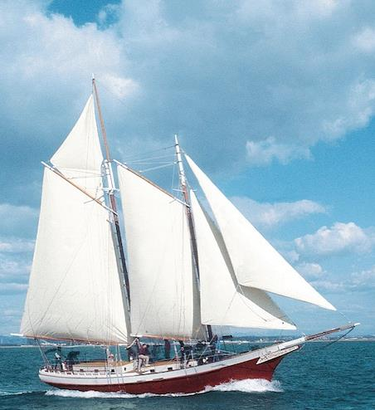
Yahusha, THE LIVING WORD - was most certainly fulfilling the Covenant Calendar statutes of Yahuah. He was living out the Torah in real time!
When He responded – I must be about My Fathers business – Yahusha revealed his ABSOLUTE COMMITMENT to the Blood Ratified Covenant Calendar!
Next we are going to “jump ships”!
We have learned how to count in a different way set by Yahusha’s life example! Shall we keep on going?

Slide 75

Starting at Creation, what was the design of counting the cycles?
Or- better worded –
At what point was the first 6 cycles of creation declared a full 24 hours?
Was it at the beginning of the Light Season?
Was it just near the ereb mixture of the evening?

Slide 76
At what point in time within the first 24 hours of creation, does Yahuah declare – THE 1ST COMPLETED CYCLE (day)?
The first 12 hours of Earth’s history
Creation; and restoration of Light
Did Yahuah declare this a COMPLETED cycle yet? No!
Yahusha – LIGHT – withdraws,
which initiated -
The arrival of <ereb> evening MIXTURE ––
which is – LIGHT BEING OVERTAKEN BY THE DARKNESS.
We now need to consider the word seen in Gen 1:5 (b) – morning or ב ק ר . <boqer>.

Slide 77
Gen 1:5b … And there was evening and there was morning, one day.
The full 24 hours of Cycle #1
Creation; and restoration of Light
And there was morning [twilight], [BOQER]
HalleluYah Scriptures
Yahusha – {LIGHT}, withdraws!
Arrival of the Ereb/evening
twilight mixture.
Day One.
Layil
Layil, the acceptable night darkness passes by unannounced. Why? Nothing occurred in the night darkness!

Slide 78
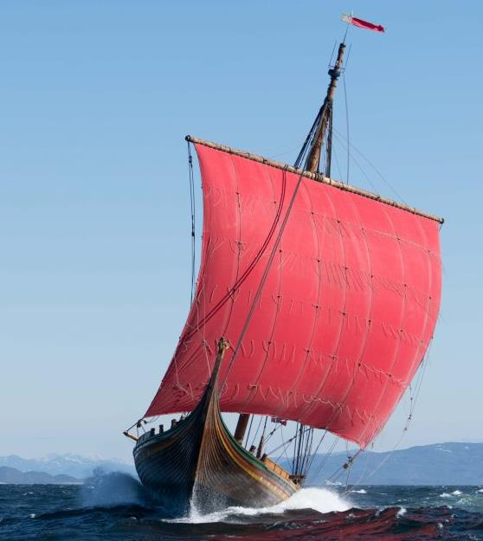
Point: In terms of counting, this was the pattern set by Yahuah for all the cycles of creation.
Yahuah did not account for a PARTIAL CYCLE!

Slide 79
Yochanon birthed (at 9 months), here, just before Passover !
Yochanon completed his first year here at - 12 months!
9
10
11
12
Jan 07 | Feb 08 | Mar 09 | April | May | June | July | Aug | Sept
1
2
3
4
5
6
1
2
3
4
5
6
7
8
9
Yahusha, being 6 chodeshim (months) younger than Yochanon (Luke 1:36), was birthed here, in His 9th month, just before Sukkot!
12
Oct | Nov | Dec
Sukkot
10
11
Yahusha COMPLETED His 1st year of 12 months – here, in the 9th month of CC!
Yahusha COMPLETED His first year in the 12th month
starting from Conception.

Slide 80
Yahusha - conceived 12 months before 1 CE, was born near Sukkot.
He COMPLETED HIS FIRST YEAR PRIOR TO CE 1!
CE Year
Yahusha’s Age
1
1
2
Yahusha, in the 9th month CC, (end of the first year Gregorian), Yahusha turned 2 years old; and so on and so forth.
3
Yahusha was 1 year old,
going IN to – ENTERING CE1!
He was NOT considered 2 years old, entering into CE 1.
4
5
6
7
8
9
10
11
12
80
13

Slide 81
CE Year
Yahusha’s Age
1
AT THE END of the year CE 11,
Yahusha completed His 12th year.
Time must be allowed its full designated cycle to be accounted
as a whole unit.
2
3
4
5
6
7
8
9
10
11
12
81
13

Slide 82
The Scriptures declare that Yahusha was TWELVE years old,
3 months BEFORE Passover began, in what we know as the CE 12 year. Yahusha was NOT considered 13 years old yet!
Not for another 9 months!
1
In the year CE 12, Yahusha completed His 13th year long after
He was observing the Unleavened Bread Festival of the Covenant Calendar –
in the house of
His Father Yahuah!
2
3
4
5
6
7
8
9
10
11
12
82
Passover/Unleavened Bread
13

Slide 83
Point:
A cycle (day) and a year are not accounted for as completed until they have finished their allotted time span.
A week span, is not accounted for as a complete unit until the 7TH day Shabbat has been given opportunity to seal off and complete the first 6 cycles of work –
with a REST! Consider the manna week, and the Omer count with 7 COMPLETED weeks!
What about the year of Yahusha’s death and His age?

Slide 84
CE Year
Crucifixion – CE 30
Yahusha’s Age
30
31
Yahusha was beginning His 31st year!
Passover CE 30 Roman Calendar:
Yahusha died in the early portion of
His 31st year.
He was still a “lamb of the first year”!
He had not yet completed His 31st year!
Yahusha would not have completed His 31st earth year until 9 months after His Crucifixion!
Exo 12:5/Lev 23:12
Point: Time MUST be given full space for completion
before it can be accounted as a whole unit.

Slide 85
Tequfah occurs on CE 30
CE Year
Yahusha’s Age
30
31
Yahusha was beginning His 31st year!
Passover CE 30 - Roman Calendar!
When the Tequfah (Equinox) occurs, it then changes Yahuah’s Festal Year count!
With the spring Tequfah of CE 30, Yahuah’s Festal Year count becomes - CC 31! Why?
It is accounted this way to reflect the Lamb of the 1st year!
And also, the AGE of Yahusha Ha Mashiach!

Slide 86

Really, what has been the need of this last exercise?

Slide 87
This has been laying a Scriptural foundation for calculation of timelines for future studies.
That foundation is: Time must be fully allowed its predetermined time span to be accounted as a whole unit.

Slide 88
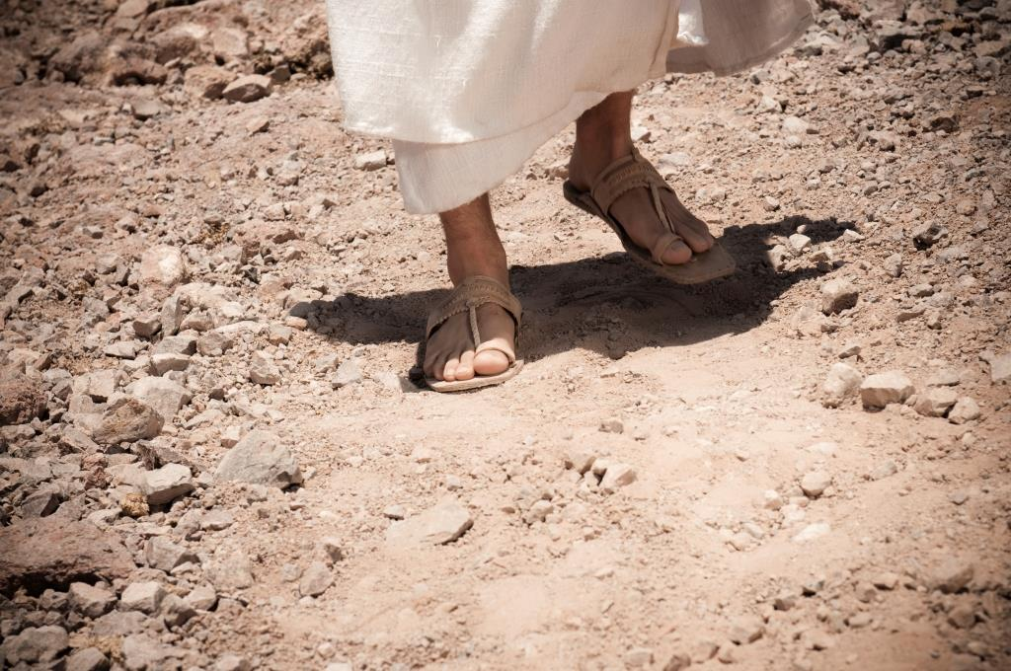
Or, is it the beginning?!
The End!
This has been a most basic outline
of the life of Yahusha!
There is
SOOOO MUCH MORE
to go ☺
Coming!!!

Slide 89


We pray that this has blessed you in your journey of studying to become further immersed in the
Covenant of Yahuah and Yahusha.
Questions & Comments can be
sent to Timothy Astleford:
questions@studythecalendar.com
www.studythecalendar.com
Thank –you & Shalom!

