Slide 1


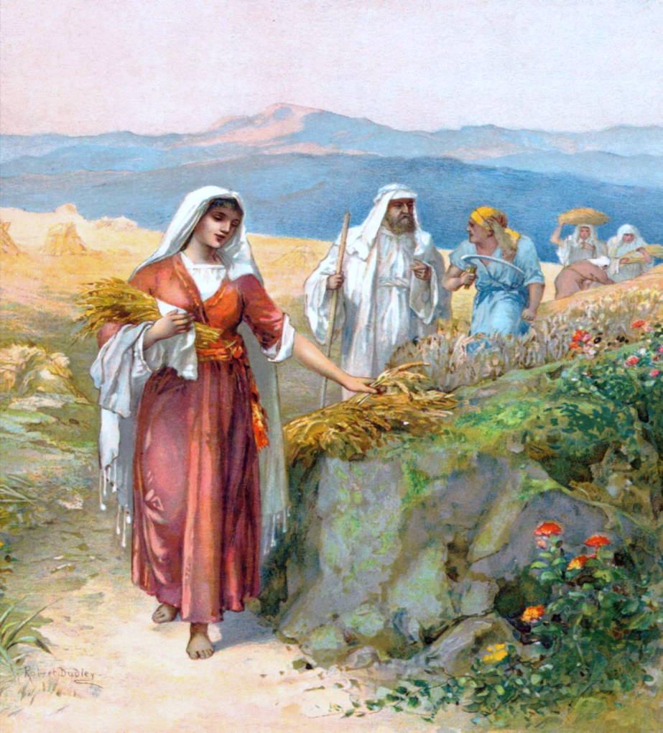
Ruth’s Reply
A Dawn Day
Bible Testimony

Slide 2

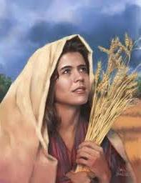
Another Teaching From:
Date: ~1320 BC – about 130 years after Moses died.
Visit: studythecalendar.com
2

Slide 3
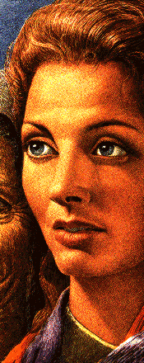
Introduction to Ruth
Introduction to Ruth
Introduction to Ruth
The story of Ruth occurs about 130 years after Moses died.
By this point in time, there was already a lot of apostasy in the land of Israel.
Remember only a few short years after Joshua died (about 44 years after Moses) apostasy set in. Israel had turned their worship to that of the
“Baal/sun god” and “Ashtoroth/moon gods” known as the “no gods”
listed in Judges 2:11-13.
This Scriptural testimony easily demonstrates both Naomi and Ruth were still honoring the true Elohim, as well as His appointed day-start commencement
at dawn.
Who was Ruth? Ruth became the wife of Boaz, and then the mother of Obed and the great-grandmother of King David who also honored Yahuah’s
blood-ratified Covenant Festal Calendar.
Question: Did Ruth honor the dawn day because she was going to be
part of the lineage of her Messiah? NO! She followed what Naomi taught
her because her desire was to follow Naomi’s Elohim and be part of His people.
Following Yahuah also includes following ALL of His instructions whether
we are a simple servant or in the lineage of kings.

Slide 4

If Ruth is going to follow Naomi’s Elohim will it be in every detail, or just some things?

Slide 5
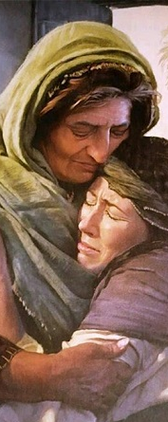
Ruth Chapter 2:1-4
Ruth Chapter 2:1-4
1 And Naomi had a kinsman of her husband’s,
a mighty man of wealth, of the family of
Elimelech; and his name was Boaz.
2 And Ruth the Moabitess said unto Naomi,
Let me now go to the field, and glean ears of
corn after him in whose sight I shall find grace.
And she said unto her, Go, my daughter.
3 And she went, and came, and gleaned in the field after the reapers: and her hap was to light
on a part of the field belonging unto Boaz, who
was of the kindred of Elimelech.
4 And, behold, Boaz came from Bethlehem, and said unto the reapers, Yahuah be with you.
And they answered him, Yahuah bless thee.

Slide 6
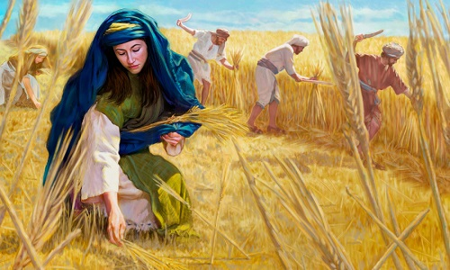
Ruth Chapter 2:5-8
Ruth Chapter 2:5-8
5 Then said Boaz unto his servant that was set over
the reapers, Whose damsel is this?
6 And the servant that was set over the reapers
answered and said, It is the Moabitish damsel that
came back with Naomi out of the country of Moab:
7 And she said, I pray you, let me glean and gather
after the reapers among the sheaves: so she came,
and hath continued even from the morning until now,
that she tarried a little in the house.
8 Then said Boaz unto Ruth, Hearest thou not, my daughter? Go not to glean in another field, neither
go from hence, but abide here fast by my maidens:
6

Slide 7
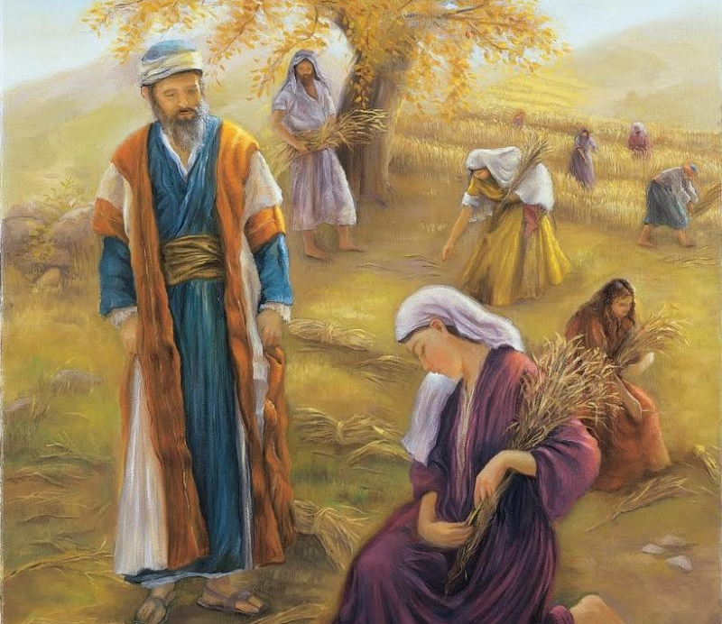
Ruth Chapter 2:9-11
Ruth Chapter 2:9-11
9 Let thine eyes be on the field that they do reap;
and go thou after them: have I not charged the young
men that they shall not touch thee? and when thou art athirst, go unto the vessels, and drink of that which the young men have drawn.
10 Then she fell on her face, and bowed herself to
the ground, and said unto him, Why have I found grace
in thine eyes, that thou shouldest take knowledge of me, seeing I am a stranger?
11 And Boaz answered and said unto her, It hath
fully been shewed me, all that thou hast done unto
thy mother-in-law since the death of thine husband:
and how thou hast left thy father and thy mother,
and the land of thy nativity, and art come unto a
people which thou knewest not heretofore.

Slide 8
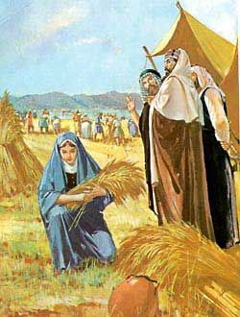
Ruth Chapter 2:12-14
Ruth Chapter 2:12-14
Ruth Chapter 2:12-14
12 May Yahuah recompense thy work, and a full reward be given
thee of Yahuah your Elohim of Israel, under whose wings thou art come to trust.
13 Then she said, Let me find favour
in thy sight, my lord; for that thou hast comforted me, and for that thou hast spoken friendly unto thine handmaid, though I be not like unto one of thine handmaidens.
14 And Boaz said unto her, At mealtime come thou hither, and
eat of the bread, and dip thy morsel
in the vinegar. And she sat beside the reapers: and he reached her parched corn, and she did eat, and was sufficed, and left.

Slide 9
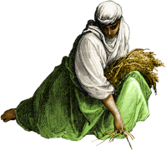
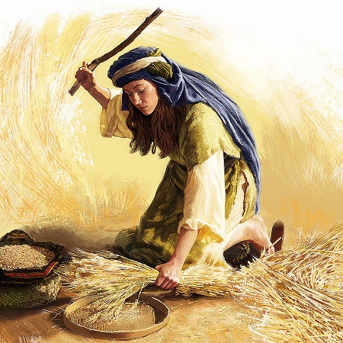
Ruth Chapter 2:15-18
Ruth Chapter 2:15-18
15 And when she was risen up to glean, Boaz commanded his young men, saying, Let her glean even among the sheaves, and reproach her not:
16 And let fall also some of the handfuls of purpose for her, and leave them, that she may glean them, and rebuke her not.
17 So she gleaned in the field until even, and beat out
that she had gleaned: and it was about an ephah of barley.
18 And she took it up, and went into the city: and her mother in law saw what she had gleaned: and she brought forth, and gave to her that she had reserved after she was sufficed.

Slide 10
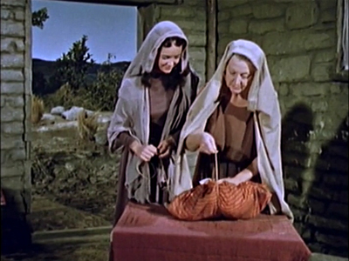
Ruth Chapter 2:19-20
Ruth Chapter 2:19-20
19 And her mother in law said unto her, Where hast thou gleaned to day? and where wroughtest thou? blessed be he that did take knowledge of thee.
And she shewed her mother in law with whom she had wrought, and said, The man's name with whom I wrought to day is Boaz.
20 And Naomi said unto her daughter in law, Blessed be he of Yahuah, who hath not left off his kindness to the living and to the dead. And Naomi said unto her, The man is near of kin unto us,
one of our next kinsmen.

Slide 11
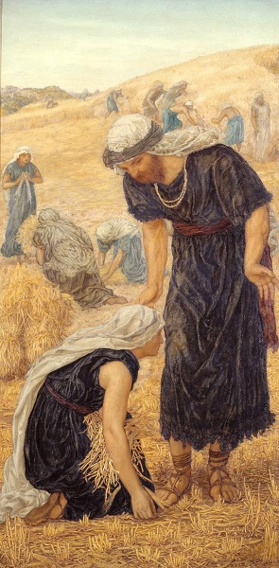
Ruth Chapter 2:21-23
Ruth Chapter 2:21-23
21 And Ruth the Moabitess said, He said unto me also, Thou shalt keep fast by my young men, until they have ended all my harvest.
22 And Naomi said unto Ruth her daughter in law, It is good, my daughter, that thou go out with his maidens, that they meet thee not in any other field.
23 So she kept fast by the maidens of Boaz
to glean unto the end of barley harvest and
of wheat harvest; and dwelt with her
mother-in-law.

Slide 12
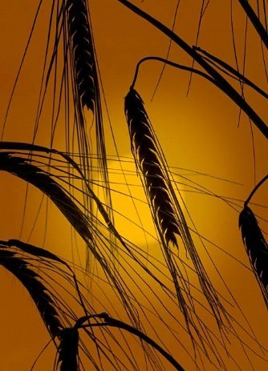
Where hast thou gleaned today?
Where hast thou
gleaned today?
Will the record of Ruth gleaning barley
indicate a sunset start of the new cycle?
Or, will the full record of Ruth gleaning barley indicate a single 24-hour period – therefore eliminating the possibility of supporting sunset theory in this epic of Ruth?
Do the definitions of the Hebrew word
<yowm>(for day) permit a length of time
that includes … TWO CYCLES or TWO DAYS?
12

Slide 13
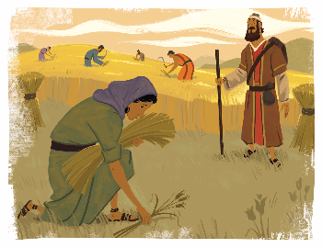
Ruth 2:2-7
Boaz Meets Ruth
Ruth Chapter 2:2-7
Boaz Meets Ruth
2: Ruth seeks permission from Naomi to glean grain
behind the reapers.
3: Ruth was divinely led to glean in the field of Boaz.
4-5: Boaz questions the servant who the new
maiden is in his field.
6: Boaz is informed the new maiden is the
daughter-in-law of Naomi.
7: Ruth’s request was: I pray you, let me glean
and gather after the reapers among the sheaves.
The servant adds: … “so she came, and hath continued even from the morning until now,
that she tarried a little in the house.”
13

Slide 14
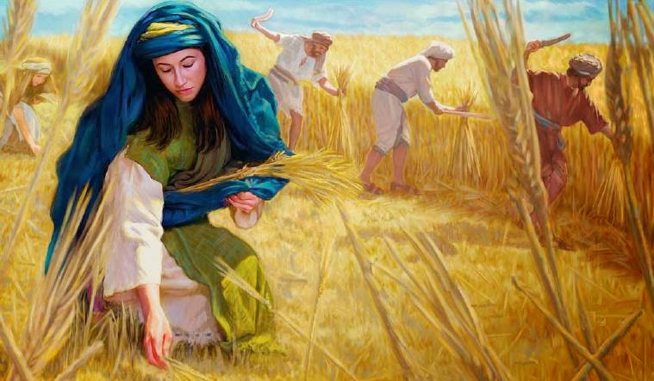
Ruth 2:8-13
Boaz Offers Ruth Protection
Ruth Chapter 2:8-13
Boaz Offers Ruth Protection
Boaz reserves SPECIAL FAVOR
for Ruth.
She can glean
anywhere – as much as she wants!
14

Slide 15
Ruth 2:14
Boaz Invites Ruth to Eat
Ruth Chapter 2:14
Boaz Invites Ruth to Eat
Vs 14: The record shows that Boaz invited her to join at mealtime in
the supplies of food for the workers. The exact time of “mealtime”
is not stated, however, more importantly it is written that after Ruth
had finished, she once again returned to her gleaning. Ruth was there
for the purpose of working; she was not afraid of manual labor.
Ruth had started working early in the morning, (<boqer/first light of the day>). Boaz in his kindness, commanded the workers to purposely leave behind more than the normal amount of grain for Ruth to recover.
Note carefully: Ruth was gleaning after mealtime, which must have been the HIGH noon time of eating.

Slide 16
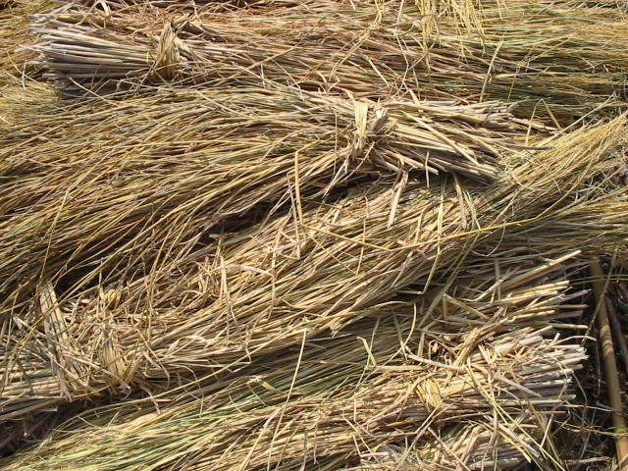
Ruth 2:17 Provisions for Ruth
Ruth Chapter 2:1-4
Ruth Chapter 2:1-4
VS 17: So she gleaned in the field until even and beat out all that she had gleaned: and it was about an ephad of barley.
even - H6153 ‘ereb (eh’reb); from 6150 dusk.
  H6150 ‘arab (aw-rab’); A primitive root [identical with
  H6148 through the idea of covering with a texture];
  to grow dusky at sundown [a mixing of light and darkness].
VS 18: And she took it up and went into the city … after she was sufficed [filled to satisfaction].
16
This Photo by Unknown Author is licensed under CC BY-SA

Slide 17
Timing of Ruth’s Labors
Timing of Ruth’s Labors
Timing of Ruth’s Labors
Ruth gleaned approximately till
the sunset time of day.
Ruth then processed (separated and
cleaned the gleanings), gathered the
fruit of her labors …
then journeyed to the city, her
destination being the home of Naomi.
The twilight time <H5399 nesheph>
offered safety with soft light of dusk
as Ruth returned to the city with her
heavy load of grain.
  Twilight H5399 nesheph (neh’-shef);
  from 5398; properly, a breeze, i.e.
  (by implication) dusk (when the
  evening breeze prevails).
17

Slide 18
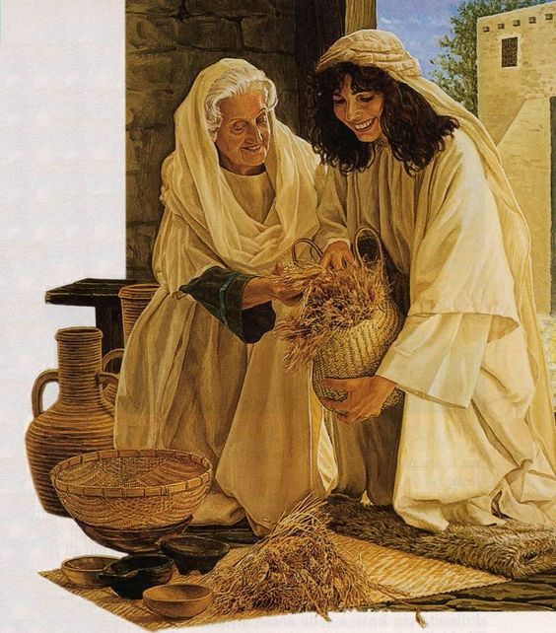
Ruth 2:18 Provisions for Naomi
Ruth 2:18
Provisions for Naomi
Ruth 2:18
Provisions for Naomi
Ruth 2:18
Provisions for Naomi
Vs 18: And she took it up and went into the city, and her mother-in-law saw what she had gleaned: and she brought forth, and she gave to her that she had reserved after she was sufficed [to fill to satisfaction].
From NIV: Ruth also brought out and gave her what she had left over after she had eaten enough.
18

Slide 19
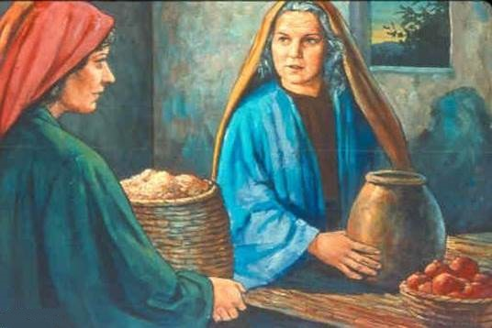
Lateness of the Hour
Lateness of the Hour
Lateness of the Hour
The time is now late.
From “the even” Ruth walked home ‘INTO THE CITY.’
Then she took care of her
hunger after a long day’s work.
After Ruth satisfied her physical hunger, she then brought forth the fruit of her labors (the grain gleanings) to share with her mother-in-law.
This would be well into the
Night Season by this time.
19

Slide 20
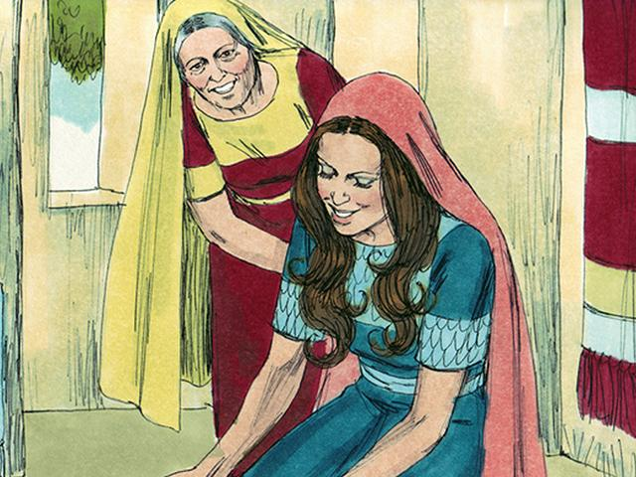
Ruth 2:19a Naomi’s Question
2:19a Naomi’s Question
Ruth 2:19b Ruth’s Reply
Ruth 2:19a Naomi’s Question
2:19a Naomi’s Question
Vs 19a: And her mother-in-law said unto her, “WHERE HAS THOU GLEANED TO DAY? and where wroughtest thou? Blessed be he that did take knowledge of thee.”
2:19b Ruth’s Reply
Vs 19b: And she shewed her mother-in-law with whom
she had wrought, and said, “the man’s name with whom
I wrought to day is Boaz.”
to day is H3117 <yowm>; it is only one 24 HOUR PERIOD!
Naomi, speaking during the Night Season, refers to the previous day – or the Light Season’s work - as to day. Naomi is not referring to YESTERDAY or the Hebrew word <H8543 temowl>.
Ruth’s answer to Naomi also refers to her work of TO DAY, as during the Light Season, not the Light Season of YESTERDAY.
Let’s place these events on 2 different charts.
20
Let’s begin to chart these events.

Slide 21
Ruth Chapter 2:1-4
Ruth Chapter 2:1-4
Ruth 2 [Chart 1 of 2]: Sunset Theory Day Start
After Sunset DAY 2 Begins
Sunset
Sunset
This is DAY 1 on a Sunset to Sunset 24 Hour Cycle Pattern
Night
Light Season
Night
Day
1) Ruth gleans
in the early morning <boqer>.
Ruth 2:7
2) Boaz positively affirms
Ruth’s position to glean in his field, and offers her fresh water.
Ruth 2:9-12
3) Boaz invites Ruth for food; she eats and goes back
to work.
Boaz commands the men to leave extra grain for her.
Ruth 2:14-16
4) Ruth gleans “until even,” then beats out the gleanings, and walks back to Naomi’s home in the city.
Ruth 2:17-18
5) Ruth eats first then brings
the grain to share with Naomi.
Ruth 2:18
6) “WHERE HAST THOU GLEANED
TO DAY?” (2:19)
Note: This Night Season is not part of the same cycle where Ruth was gleaning.
This night falls on Day 2 - or the “tomorrow” according to
Sunset Theory!
Huge ERROR!
Note: Sunset
changed the day & date!
Note: All charts are not to scale.
21
4) And it came to pass IN THE SAME DAY the sun went down, and it was dark a smoking furnace and burning lamp passed between the pieces.

Slide 22

Ruth 2:19 Did Ruth know Hebrew or not?
Ruth 2:19 Did Ruth know Hebrew of not?
Is the Hebrew Correct in Ruth 2:19?
Questions:
What happened with the sunset while Ruth was gleaning?
Did sunset not instigate a new cycle on this particular occasion as many claim?
According to the understanding of Sunset Theory, both
Ruth and Naomi would have needed to use the Hebrew word <H8543 temowl> {yesterday} and not <H3117 yowm> IF this series of events uses portions of 2 days, not just 1 day.
From Strong's definition: “Yesterday” H8543 <temowl>
probably for H865, [definitely yesterday], properly, ago,
i.e., a (short or long [time ago]) time since; especially yesterday, or (with H8032), day before yesterday.
Will the events chart differently for a Dawn start?
22

Slide 23
Ruth 2 [Chart 2 of 2]: Dawn Format Day Start
Dawn
Dawn
Noon
DAY 2
This is DAY 1 on a Dawn to Dawn 24 Hour CYCLE
Ruth Gleans During the Light Season
Night
Day
1) Ruth gleans
in the early morning <boqer>.
Ruth 2:7
2) Boaz positively affirms
Ruth’s position to glean in his field, and offers her fresh water.
Ruth 2:9-12
3) Boaz invites Ruth for food; she eats and goes back
to work.
Boaz commands the men to leave extra grain for her.
Ruth 2:14-16
4) Ruth gleans “until even,” then beats out the gleanings, and walks back to Naomi’s home in
the city.
Ruth 2:17-18
5) Ruth eats first then brings
the grain to share with Naomi.
Ruth 2:18
6) “WHERE HAST THOU GLEANED
TO DAY?” (2:19) “To day” [blue bracket] includes the Night Season in the same cycle as Naomi’s question – WITHOUT
ANY ERROR!
Sunset did not change the date.
All Events have a Perfect Forward Progressive Movement Within ONE 24 Hour Cycle!
23

Slide 24
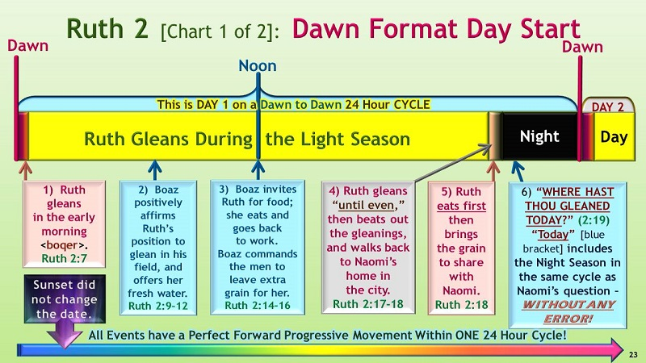
Ruth 2:19 Ruth’s Reply
In accordance with
Yahuah’s Dawn Reckoning,
Ruth’s Reply confidently confirms
the status of her labour in verse 19:
“The man’s name with whom I wrought
TO DAY is Boaz.”
“To day” (blue bracket) = Dawn through
until Dawn, or – one 24 hour cycle.
From Dawn into the Night Season, all events have a “Forward Progressive Movement.”
Naomi’s question did not need to be proposed during the
hours of the Day Season, before sunset, to be in accordance with Scripture. Naomi’s question and Ruth’s answer are included in the same 24 hour timeframe.

Slide 25
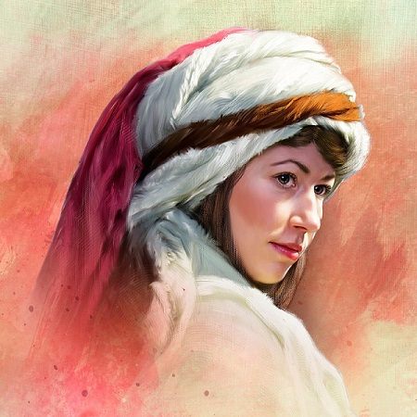
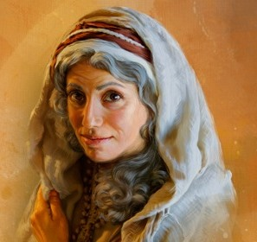
Ruth’s Reply ~ Summary
A Summary for Ruth’s Reply
A Summary For Ruth’s Reply
Exactly what is the significance of this interesting scenario?
The INFUSION of any possible ERROR such as a
Sunset day-start in the Scriptures is effectively ELIMINATED!
Sunset Theory is NOT supported in this historic story.
Only Dawn: Zion’s New Day Order is rightfully recognized and fully supported by the Set-Apart Scriptures.
Ruth & Naomi
will guide you in your choice.
The End

Slide 26
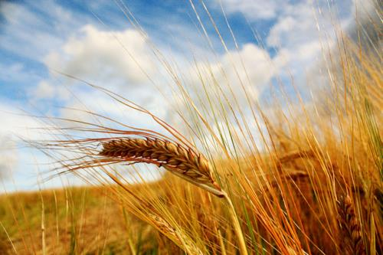

Questions & Comments
can be sent to:
questions@studythecalendar.com
www.studythecalendar.com
Thank –you & Shalom!
26

