Slide 1



Discovering
Yahuah’s
Covenant Calendar
A “2 part” teaching from
a new Calendar Student
(Beth Holtwick ~ Feb 2019)
along with an introduction
by Charlene Fortsch
June 2021

Slide 2

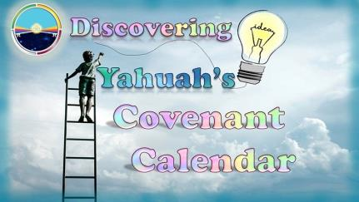
Who is Beth Holtwick?
Recently retired elementary school secretary.
Loves Bible study & learning.
Enjoys teaching others; has a weekly Torah study group.
Feast keeping for about 8 years with sunset; has tried several moon calendars and barley; but the
13th moon month was always a problem.
Friend [David] challenged her on the
“moon” not being “chodesh” aligning with
her theory there is no 13th month anyway.
David shared: maybe the stars were “chodesh” [in charge of the month] and actually the lesser light … not the moon!
(Beth went through many calendar changes since Dec 2018!)
2

Slide 3


Journey to Remember
David also shared the value & importance of the equinox.
Beth tried desperately to figure out the chodesh month using the sun’s entrance into each constellation – this resulted in a miserable failure!
So now “chodesh” is not connected to barley,
the moon or the stars. What is left?
In desperation Beth prays for Yahuah
to open the next door.
In 30 minutes … her story changes!
Becky-Facebook; discussions; & finally answers (on Feb 11/19) that made sense and led Beth into a full blown study on the moon through Covenant Calendar in the Torah.
In just 20 days she presented this PPT on Mar 2/19
and learned about the Dawn day at the same time.
3

Slide 4

4

Slide 5

Introduction
This study addresses only the Feast Calendar, not the
Civil or Jubilee Calendars.
This study is mostly Beth’s steps as she studies a new Calendar.
Note the slide numbers for any questions.
Questions/Comments: at the end of the presentation.

Slide 6
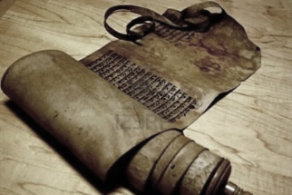
Introduction by Charlene
This presentation is what has been found for Yahuah’s Covenant Calendar “up to this point in time” since Feb 2010.
Covenant Calendar means: The complete foundation of this calendar is found between the pages of Gen 1:1 to Exo 24:11 exactly where the Blood-ratified Everlasting Covenant is found.
The First Covenant: Given on Day 1 of creation – the Covenant of the Day, and the Covenant of the Night. [Jer 33:20-25]
Yahusha’s Covenant: As Creator,
He gave and abided by His Covenant
Calendar in His life, death, burial,
resurrection, and two ascensions.

Slide 7
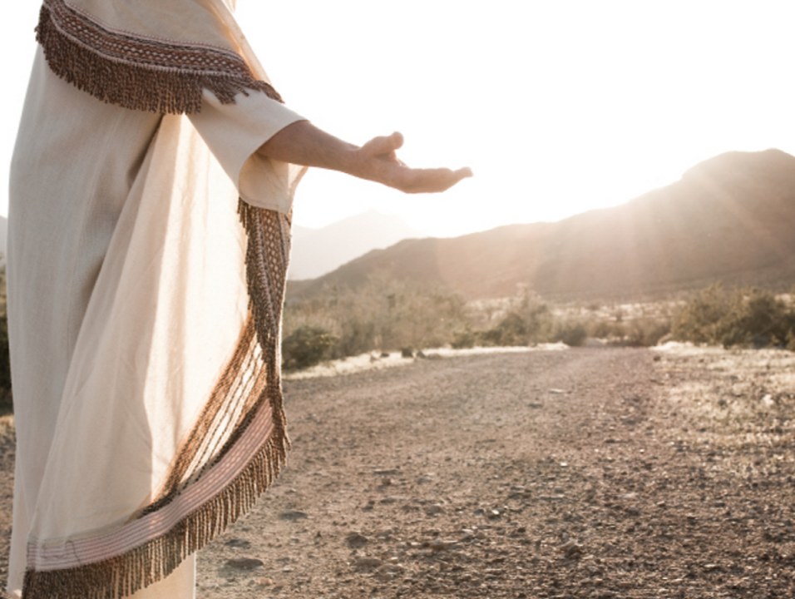
Covenant Calendar Mandate
Is this topic a
“Salvational Issue?”
Mark out Yahuah’s worship statutes: both weekly and annually – as well as defining the timing of the festivals.
Vertical Relationship: Restoration of our relationship with Yahuah in honoring His worship statutes, and festivals.
Horizontal Relationships: Restoration of our relationships with family and friends in all areas of our lives.
(Bonus component: fasting/prayer.)
(Examples of restored relationships through Covenant Calendar.)
Prophecy & Prophetic Timelines of Dan 12 and Rev. timelines will be fully understood through Covenant Calendar of 360 days – a full return to “the beginning” (Isa 46:9-10).

Slide 8
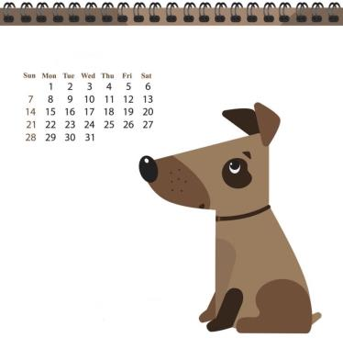
Calendar Explosions
Calendar studies have been explosive and controversial for decades even with a very few calendars that were known.
New Calendar Explosion: 2018 the year of many new calendars. (2013: 26 popular calendars [Eric Bissell]; 2018: 666?? “so called” Biblical Calendars!)
“They’re not all right, and
they could be all wrong!”
  How can the true Calendar of
  Yahuah be found?
  Will the true Calendar be a minority,
  or a majority?
  Are there any Scriptural examples
  to give us a clue?

Slide 9

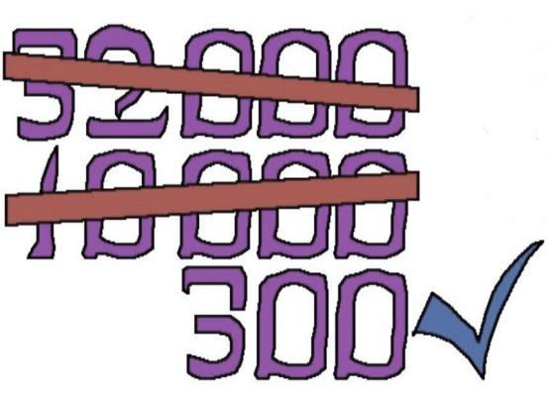

Gideon’s Army of 300:
Judges 7:1-7
Math Corner:
300 / 32,000 = 0.009375%
99.990625%
turned away!
= 0.009375%

Slide 10
“You” and “Calendar Studies”
Calendar Studies aren’t for everyone!
Each individual needs to assess their own situation.
  Are they happy with the calendar that they observe?
  Do they have the time and energy to invest in a new calendar study?
  Is the “calendar confusion” of great, or little, concern?
  Again - Is understanding the true calendar really a salvational issue?
Remember:
8 came out of the ark.
4 came out of Sodom.
2 came out of the wilderness.
0.009375%

Slide 11
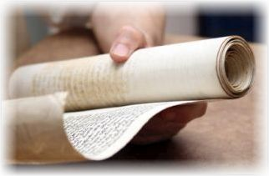
Qualifications for Calendar Study
According to Beth!
Be a Child of YHWH.
Have a mind to understand.
Know how to read, write & count!
Pray…a lot!
Read Yahuah’s Word on a regular basis!
(Divine University)
Trust Yahuah’s Word.
Trust Yahuah’s guidance.
Keep an open mind.

Slide 12
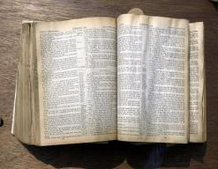

Beth Gives Special Thanks To …
Yahusha
The precious Scriptures
Every single person who has:
  Asked questions
  Made comments
  Studied
  Proof read

Slide 13
Covenant Calendar Journey
Flint for The Rock
Feb 2010: Questions on “When A Day Begins.”
Spring 2013: Questions on the moon month (Deut 4 & 17).
Winter 2015: Year start can’t be married to the moon month.
Spring 2016: Year start connected to tequfah/equinox, not moon.
Summer 2016: The moon is not tied to the festal month.
Fall 2017: Yahuah has 2 types of months; [festal month is counted from Day 1 of creation; the moon month is counted from the 4th day and follows phase changes; the moon is never “chodesh.”]
2018: Not possible for any phase of the moon to determine the month or year; Tanach history of the 2 main ‘no gods.’
2018: Tanach history bears out the ‘no god’ that takes priority is the moon goddess in the Old Testament through to today.
Mar 20/19: More fine-tuning on the year-start – to track not only the shadow, but use more information from the Mazzaroth.
What’s next after all this?

Slide 14
Beth’s Calendar Journey
1st Theory on Chodesh
Around Dec 2018 this is Beth’s understanding:
12 chodesh <months> shown in Scripture.
Could the 12 chodesh be connected to the 12 constellations?
That would mean: beginning each chodesh with the sun’s entry into each individual constellation.
Key problem - each Chodesh month would vary in length because the sun’s path through each constellation is not exactly 30 days each.
Gathered results from Stellarium – based in Jerusalem, facing east, calculating sunrise, numbering of the main stars in each constellation, etc. (This 12 hr. assignment failed miserably.)

Slide 15

Beth Encounters
BREAK DOWN #1…
Beth felt her 12 hrs. of research turned out with ridiculous results and that Yahuah would not use such a “wishy-washy” system for counting the festal calendar months through the Mazzaroth!
(Starting over with prayer!)

Slide 16
Beth’s 2nd Theory on Chodesh
Answered Prayer within 30 minutes!
Connecting with Becky C on Facebook.
Found out Becky has been studying the same exact concern about “is the moon chodesh or not” just 2 weeks before.

Slide 17

Finding Out What
Yahuah’s Calendar ISN’T!
Before Yahuah allowed Beth to go any further on studying His calendar, He insisted that she knew and understood what His Calendar WASN’T!
This is her journey.
All references to Covenant Calendar Studies are from
Series 1 in 2018.

Slide 18
#1 Festal Calendar Isn’t Based on Abib Barley
Exo 13:4 Today, in the month of Abib, you are going out.
Exo 34:18 “You shall keep the Feast of Unleavened Bread. Seven days you shall eat unleavened bread, as I commanded you, at the time appointed in the month Abib, for in the month Abib you came out from Egypt.
Deut 16:1 Observe the month of Abib and keep the Passover to Yahuah your Elohim, for in the month of Abib Yahuah your Elohim brought you out of Egypt by night.
CC#12 Equi-LUX Deception

Slide 19
Festal Calendar Isn’t Abib Barley
(con’t)
Clearly, Abib is a sign regarding Yahuah’s calendar.
However, it is a second witness to the month in which Yah’s Calendar starts. It is not an indicator that kicks off Yahuah’s calendar. Why?
Abib is defined in Scripture as “green in the ear.” When studying this outside the Bible, there are descriptions of “green, light green, white, ripe enough to crush, etc.” These are man’s definitions, not YHWH’s.
Barley matures at different times based on location. If this was important, Yah would have given detailed instructions on where to select the barley. Nowhere in Scripture does it tell us to go by the barley in Jerusalem.
Basing Yahuah’s calendar on Abib barley requires a man-made report, from someone we don’t know, living in another country.
Beth’s final decision: Yahusha is our only Mediator!
Dan 9:27 … all sacrifices & oblations ceased at the cross – including all grain offerings. (Challenge: Was barley ever a grain offering?)
Establishing Yah’s Calendar using Abib is basing it off of man, not Scripture.
When Scripture mentions Abib, consider reading it as “the month in which Abib [greening] occurs.” (By the way, Abib occurs after the vernal equinox!)

Slide 20

#2 Festal Calendar Is NOT
Moon Based in Torah
Gen 37:9 And he dreamed yet another dream, and told it his brethren, and said, Behold, I have dreamed a dream more; and, behold, the sun and the moon and the eleven stars made obeisance to me.
Deut 33:14 And for the precious fruits brought forth by the sun, and for the precious things put forth by the moon.
Deut 4:19 And lest thou lift up thine eyes unto heaven, and when thou seest the sun, and the moon, and the stars, even all the host of heaven, shouldest be driven to worship them, and serve them, which Yahuah thy Elohim hath divided unto all nations under the whole heaven.
Deut 17:3 And hath gone and served other gods, and worshipped them, either the sun, or moon, or any of the host of heaven, which I have not commanded …

Slide 21
#2 Festal Calendar Is NOT Moon Based
(con’t)
When the moon came under suspicion, it seemed
obvious that Yahuah’s Calendar could not be moon based.
Why? Some logic & questions follow (but no answers yet) …
The Hebrew terms for moon are “yareach” (H3394) and “yerach” (H3391). These are not family words with “chodesh” (H2320)
Most concordances will lead you to believe that “chodesh”
means “moon or new moon.”
Scholars admit they are not positive of what the word “chodesh” means; however it is best translated as month.
(More on this research later.)
There are no instructions in the Bible regarding the use of
two (2) witnesses for the sighting of the new moon.
That is a tradition of man.
The moon (as one of the heavenly bodies), was also placed
in the firmament on the 4th day of creation. If this event on
the 4th day determines the beginning of the 1st chodesh [month],
what happens to days 1, 2, and 3 of creation?
Are they considered dead days?
Moon #5: Slides 6-59
Moon #3: Slides 55-73
Notes:
weh

Slide 22
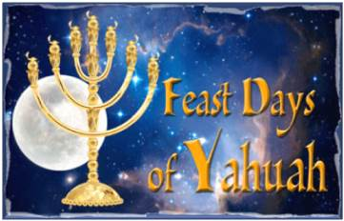
#3 What Is The Purpose of the Moon?
Yahuah created the moon…He does all things for a purpose.
Question: Did Yahuah appoint the moon for worship statutes in:
Psa 104:19 He appointed the moon for seasons …
The word “seasons” here
is “mo`edim” [H4150].
Traditional teaching:
ALL “mo`edim” refer
only to Yahuah’s Feasts. However, Beth recently discovered [H4150] means any appointed time, place or sign pre-arranged by Yahuah.
So, did Yahuah appoint the moon for worship statutes as most of us have been taught?
Moon #2:
Slides 51-58

Slide 23
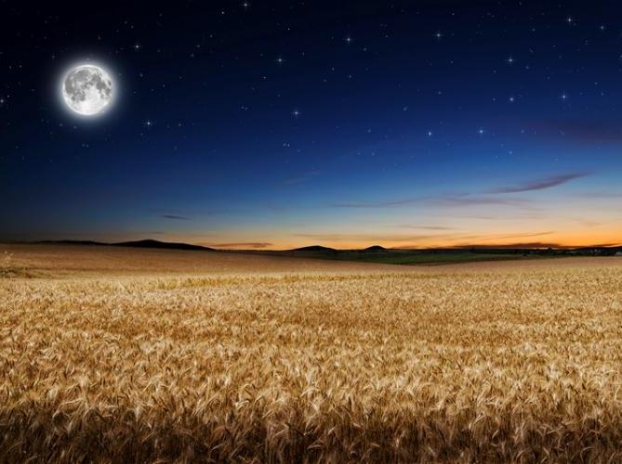
#3 What Is The Purpose of the Moon?
(a) agricultural seasons!
Psa 104:19 He appointed the moon for seasons …
Definitions for mo`edim: 1) agricultural season
2) worship statute 3) appointed signs and/or times for animal migration/reproduction.
For the moon “seasons” (Psa 104:19)
Used for agricultural purposes (Deut 33:14)
Used as an appointed sign/time
(Gen 37:9; Josh 10:13; Isa 60:19-20; Joel 2:10)
(i.e. Rev. blood moons and solar eclipses)
Moon #1:
Slides 59-71
Moon #2:
Slides 64-65

Slide 24

#3 What Is The Purpose of the Moon?
(b) ordinances!
Jer 31:35
Thus saith Yahuah, which giveth …
the ordinances of the moon …
which divideth the sea
when the waves thereof roar.
Moon #2: Slides 34-50

Slide 25

Other Purposes of the
H4150 Mo`edim
Defs. for mo`edim: 1) agricultural season 2) worship statute
3) appointed signs and/or times for animal
migration/reproduction.
For the sun “seasons” (Gen 1:14)
agricultural seasons
tequfah appointed sign
For animal “seasons” (Jer 8:7)
migration
reproduction
Moon #2: Slides 70-79
Moon #2: Slides 66-69

Slide 26
Purpose of the Moon? (con’t)
Beth didn’t find any Scriptures proving the moon’s involvement with setting Yah’s Calendar month. As discussed earlier, moon in Hebrew
is yareach (H3394) and yerach (H3391). Month is chodesh (H2320).
Although scholars admit they are not sure of the definition
of “chodesh,” we do know that Scripture speaks of only
12 Chodesh in a year!
1 Kings 4:7 Solomon had twelve officers over all Israel, who provided food for the king and his household. Each man had to make provision for one month in the year.
1 Chron 27:1-15 …served the king in every matter of the military divisions … month by month throughout all the months of the year, each division having twenty-four thousand.
(Verses 2-15 show 12 divisions/yr – 1 division for each month…)
Rev 22:2 … the tree of life, which bore twelve fruits,
each tree yielding its fruit every month.
Moon #6: Slides 32-43
Moon #8: Slides 99-103

Slide 27

#4 What About a 13th Month?
Many argue there is proof of a 13th month in .
Beth took the time to study this out. Here are her concerns:
Several assumptions have to be made to get the math to work.
Why would Yah wait until Ezekiel (593-570BC [3600 yrs from creation]) to teach us this key point in His Calendar? Shouldn’t this information be given to us in Torah…not to mention Genesis?
No second witness has been found for a 13th month anywhere.
The Bible never mentions a 13th Chodesh…ever. Based on this alone, the term Chodesh cannot refer to the moon or new moon since the moon cycle requires a 13th month about every 3 years to stay aligned with the 365+ day year. If there was a 13th chodesh Yahuah’s Word would have mentioned it and given us detailed instructions on how to handle & count a year with a 13th month.

Slide 28
#5 Oh no! …Moon Worship!
As Beth continued to dig into the words “chodesh” [for month] and “yareach/yerach” [for moon], she began to learn more and more about moon worship. She goes on to say:
“Of course, the typical reaction I get from folks (that follow the moon month) when I’d mention this is” …
“Well, I would never worship the moon or sun!”
That’s what she thought too…

Slide 29

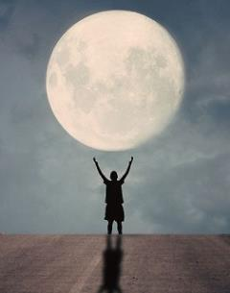
Time to do a Double-Take…
Beth determines it is time …
To ask two good questions at this point:
If sacred regard is given to the sun and/or
moon for any reason, is this classed as worship?
If the sighting of the sun and/or moon are part
of setting your worship calendar, is that action regarded as worship or serving?
Beth personally did a double-take after
pondering these two questions and then asks …
“Is that not exactly what
we have been doing for years?”
Moon #5: Slides 63-73

Slide 30
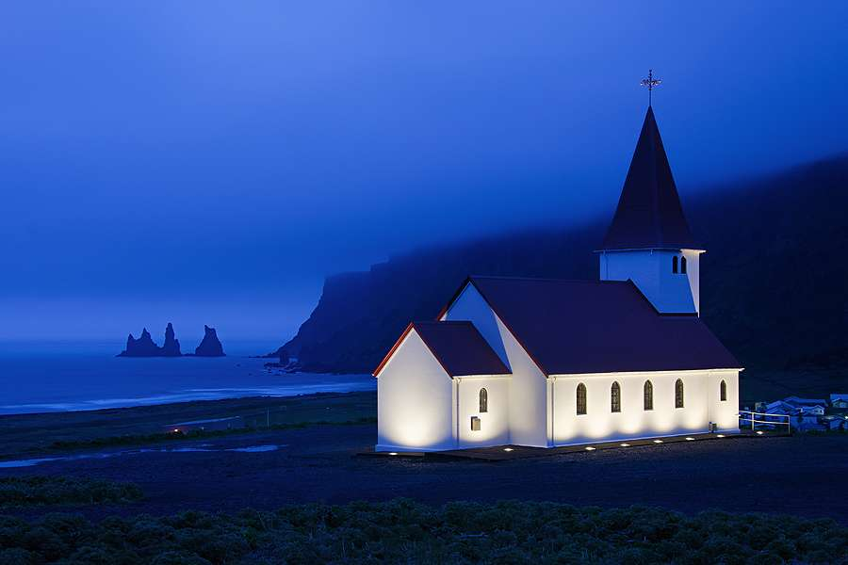

Double-Take #1 on Homage
Sunday Christians honor their day of worship on Sunday – giving homage
to the sun god.
Sabbath Keepers honor their day of worship beginning with the sighting of the sunset the night before Sabbath – giving homage
to the sun god.
Moon #8: Slides 60-62

Slide 31
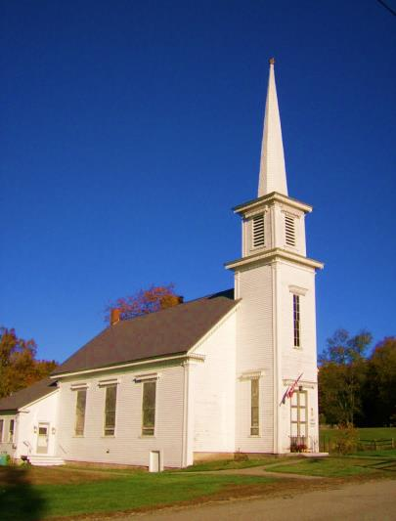

Double-Take #2 on Homage
Sabbath Feast Keepers:
  1) honor the sunset (sun god) for their Sabbath commencement and
  2) they lift up their eyes to
  sight the new moon (linked to the moon goddess) for their festal month start.
Moon #10: Slides 71-86
31

Slide 32
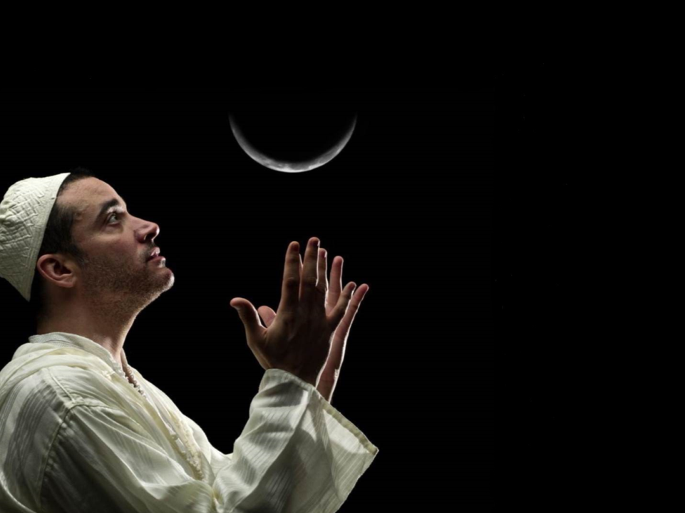
Double-Take #3 on Homage
Unwittingly, most Feast-Keepers rely on the leadership of the moon
for timing their lunar based worship calendar. This is based on mistranslated verses found outside the first five books of Torah.
The Old Testament shows the foundation of this lunar based worship is extracted from Babylonian paganism.
Moon #8 & 9 for OT History

Slide 33
Beth asks: “Don’t believe me?”
Deut 4:19 And take heed, lest you lift your eyes to heaven, and
when you see the sun, the moon, and the stars, all the host of heaven, you feel driven to worship them and serve them, which Yahuah your Elohim has given to all the peoples under the whole heaven as a heritage …
The word “Lift” is H5375 Nasa…it means to exalt, hold up, magnify, respect. Are we lifting the moon up to a position of leadership?
Job 31:26-28 Have I looked at the sun shining in the skies, or the moon walking down its silver pathway, ²⁷ and been secretly enticed
in my heart to throw kisses at them in worship? ²⁸ If so, I should be punished by the judges, for it would mean I had denied the Elohim
of heaven.
Moon #1: Slides 61-67

Slide 34
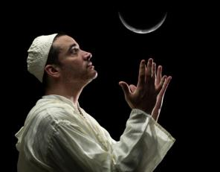
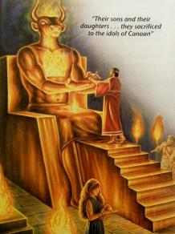
Apostasy Among Yahuah’s People
(630 BC)
Zeph 1:4-6
I will stretch out My hand against Judah,
And against all the inhabitants of Jerusalem.
I will cut off every trace of Baal from this place,
The names of the idolatrous priests with the pagan priests,
⁵ Those who worship the host of heaven on the housetops;
Those who worship and swear
oaths by Yahuah,
But who also swear by Milcom;
⁶ Those who have turned back
from following Yahuah,
And have not sought Yahuah,
nor inquired of Him.”
Moon #9:
Slides 38-42

Slide 35
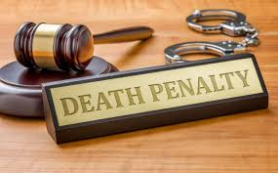
What About a Conspiracy Theory
Against Moses’ Commands in Deut 4 & 17?
TWO similar commands of Moses have been left out of the 613 commandments?
They are very important …
Deut 17:2-5 “If there is found among
you, within any of your towns that Yahuah
your Elohim is giving you …who does what is
evil in the sight of Yahuah … in transgressing
his covenant, ³ and has gone and served other
gods and worshiped them, or the sun or the moon or any of the host of heaven, which I
have forbidden, ⁴ and it is told you and you hear of it … and if it is true and certain that such an abomination has been done in Israel, ⁵ then you shall bring out to your gates that man or woman who has done this evil thing, and you shall stone that man or woman to death with stones.”
RE
V
I
EW
Moon #2: Slides 4-20
Many Jews don’t read their Bibles. They rely on the
613 commandments and the Talmud. Is it possible the
key to Yahuah’s calendar is being strategically hidden
from us, and them?

Slide 36
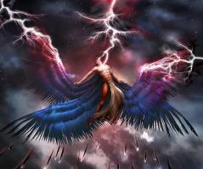
Who Would Hide These
Two Commands?
The word “congregation”
in verse 13 is the word Mo`edim (H4150)!
This means s.a.tan
plans to sit on:
1) Yahuah’s Feasts,
2) Yahuah’s Calendar
(timing) and
3) Yahuah’s Place of
Worship
Isa 14:12-14 How you are fallen from heaven, O Lucifer, son of the morning! How you are cut down to the ground,
you who weakened the nations!
¹³ For you have said in your heart:
‘I will ascend into heaven, I will exalt
my throne above the stars of Elohim;
I will also sit on the mount of the congregation on the farthest sides
of the north;
¹⁴ I will ascend above the heights of the clouds, I will be like the Most High.’

Slide 37
Who Would Hide This? (con’t)
Remember: Mo`edim can mean:
1) Yahuah’s Feasts,
2) any appointed time (including His calendar),
3) an appointed place (such as His temple) or
4) any appointed sign … Anything that Yahuah has pre-arranged.
Dan 7:25 He shall speak pompous words against the Most High, shall persecute the saints of the Most High, and shall intend to change times* and law. Then the saints shall be given into his hand for a time and times and half a time.
*Note: “times” is Aramaic <H2166, zeman; an appointed occasion>
for the Hebrew <H4150, mo`ed>.
Moon #2: Slides 51-63
Moon #5: Slides 60-73

Slide 38
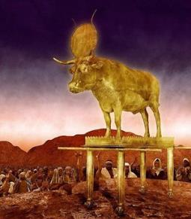
When Did Moon Worship Start?
Was Moon Worship a “change” of Yahuah’s “times”?
The answer to these questions goes all the
way back to Babylon, after the flood.
When Nimrod died, he was the first human that
became deified as the sun god, eventually named Baal.
His wife, Semiramis, became the moon goddess
while she was alive (also named Ashtoreth).
Tammuz, the illegitimate son, became the false messiah.
These are the 3 main false gods of s.a.tan.
Moon #8: Slides 77-90
Moon #8: Slides 38-43
Where did this information lead Beth to next?

Slide 39
False ‘gods’ In Abraham’s Time?
(“new” OT History?)
The word <images> is H8655
teraphim; a family idol.
[TERAphim = Great grandfather TERAh.]
Abraham’s father, Terah, served other gods (Josh 24:2).
They moved to Haran, where a temple was dedicated
to moon worship.
Abraham left Haran; Laban didn’t.
Rachel stole Laban’s images (Gen 31:19).
Laban's name (H3837) is related to lebanah (H3842) meaning whiteness (color of the moon).
Note: The spelling, pronunciation and
word numbers connect Laban's name
to the moon.
Terah’s business of manufacturing idols would have been passed down through several generations, thus creating a line of precious
family idols that Rachel stole.
Joshua referred to these family idols as the
“gods of their fathers” which were directly
related to the moon worship of Babylon (as also noted in the names of Terah & Laban [lebanah]).
Moon #8: Slides 44-60

Slide 40
Names of these ‘no gods’
Have Changed Over Time
Culture | Nimrod (lord of heaven) | Semiramis (queen of heaven) | Tammuz – Son (false messiah)
Israel | Baal | Ashtoreth | Tammuz
Phoenicia | El | Astarte | Bacchus
Babylon | Belus | Rhea, Ishtar | Tammuz
Assyria | Ninus | Beltis | Hercules
Greece | Zeus | Aphrodite | Dionysius
Rome | Jupiter | Cybele, Diana | Attis
Egypt | Ra | Isis, Hathor | Osiris, Horus
Moon #8: Slides 66-76

Slide 41
Moses Dies; Apostasy Grows
Apostasy magnifies after Joshua dies. Judges 2 records the
1st mention of where Baal and Ashtoreth are given together.
Judges 2:11-14 Then the children of Israel did evil in the sight of Yahuah, and served the Baals;
¹² and they forsook Yahuah their Elohim, of their fathers, who had brought them out of the land of Egypt; and they followed other gods from among the gods of the people who were all around them, and they bowed down to them; and they provoked Yahuah to anger.
¹³ They forsook Yahuah and served Baal and the Ashtoreths.
¹⁴ And the anger of Yahuah was hot against Israel. So He delivered them into the hands of plunderers who despoiled them; and He sold them into the hands of their enemies all around, so that they could no longer stand before their enemies.
If we are pledging allegiance to a pagan tradition
of following the moon’s timing for our Feasts,
are we bowing to the Baals and Ashtoreths in this world today?
Beth now begins to wonder?
Moon #8: Slides 91-97

Slide 42
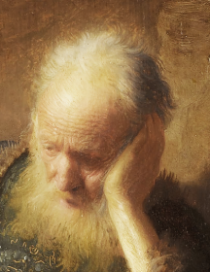
Apostasy Continues to Grow with Judah! (710-605 BC)
By Jeremiah’s time, the Jews were
baking cakes for the queen of heaven
and sacrificing their sons and daughters
(as human sacrifices) to Baal.
Jer 7:18 [710 BC] The children gather wood,
the fathers kindle the fire, and the women knead dough, to make cakes for the queen of heaven; and they pour out drink offerings to other gods, that they may provoke Me to anger.
Jer 19:5 [605 BC] They have also built the high places of Baal,
to burn their sons with fire for burnt offerings to Baal,
which I did not command or speak, nor did it come into My mind.
Moon #8: Slides 107-111
Moon #9: Slides 37-60

Slide 43
(710 BC) Apostasy Infiltrates
Government and Temple
2 Chron 33:3-6 (Manasseh’s Abomination)
For he rebuilt the high places which Hezekiah his father had broken down; he raised up altars for the Baals, and made wooden images; and he worshiped all the host of heaven and served them.
⁴ He also built altars in the house of Yahuah, of which Yahuah had said, “In Jerusalem shall My name be forever.”
⁵ And he built altars for all the host of heaven in the two courts
of the house of Yahuah.
⁶ Also he caused his sons to pass through the fire in the Valley of the Son of Hinnom; he practiced soothsaying, used witchcraft and sorcery, and consulted mediums and spiritists. He did much evil in the sight of Yahuah, to provoke Him to anger.
Moon #8: Slides 102-108

Slide 44
(624 BC) Apostasy Infiltrates
Government and Temple (con’t)
2 Kings 23:4-5 (Reforms under King Josiah)
And the king commanded Hilkiah the high priest, the priests of the second order, and the doorkeepers, to bring out of the temple of Yahuah all the articles that were made for Baal, for Asherah, and
for all the host of heaven; and he burned them outside Jerusalem
in the fields of Kidron, and carried their ashes to Bethel.
⁵ Then he removed the idolatrous priests whom the kings of Judah had ordained to burn incense on the high places in the cities of Judah and in the places all around Jerusalem, and those who
burned incense to Baal, to the sun, to the moon, to the constellations, and to all the host of heaven.
Moon #9: Slides 37-43

Slide 45
(600 BC) Apostasy Infiltrates
Government and Temple (con’t)
Jer 8:1-5 “At that time,” says Yahuah, “they shall bring out the bones of the kings of Judah, and the bones of its princes, and the bones of the priests, and the bones of the prophets, and the bones of the inhabitants of Jerusalem, out of their graves.
² They shall spread them before the sun and the moon and all the host of heaven, which they have loved and which they have served and after which they have walked, which they have sought and which they have worshiped. They shall not be gathered nor buried; they shall be like refuse on the face of the earth.
³ Then death shall be chosen rather than life by all the residue of those who remain of this evil family, who remain in all the places where I have driven them,” says Yahuah the Elohim of hosts.
⁴ “Moreover you shall say to them, ‘Thus says Yahuah: “Will they fall and not rise? Will one turn away and not return?
⁵ Why has this people slidden back, Jerusalem, in a perpetual backsliding? They hold fast to deceit, They refuse to return.
Moon #9: Slides 43-45

Slide 46
Judgment is Sure to Come
Moses commanded “don’t lift up your eyes
to the sun or moon …”
Deut 17:2-7 If there is found among you…
³ one who has gone and served other gods and worshiped them, either the sun or moon or any of the host of heaven…
⁵ then you shall bring out to your gates that man or woman who has committed that wicked thing, and shall stone to death that man or woman with stones.
⁶ Whoever is deserving of death shall
be put to death on the testimony
of two or three witnesses…
So you shall put away
the evil from among you.
How can this command
be misunderstood?
Moon #2: Slides 3-33

Slide 47
Things that must be considered …Today!
One last point before moving on.
There are FIVE major religions in the world today.
Christianity
Judaism
Islam
Hindu
Buddhist
As you are probably aware, Christianity is centered in sun worship.
Moon #1: Slides 23-34
But did you know…the other FOUR establish their worship calendar on the moon?

Slide 48

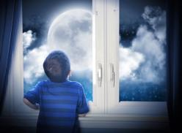
Beth wants to know from Moses…
“Does this mean
we can’t admire the
sunset or the moon anymore???”
Not Really!

Slide 49
It’s Time to be
Moving Forward
Now that we know what Yah’s Calendar ISN’T, we can move forward to discover
what Yahuah’s Calendar IS!
Beth will go over a quick summary of the calendar that she believes is not only based solely on Scripture…but more importantly, based on the CREATION ACCOUNT!
This Calendar is Torah Compliant!
(Gen 1:1 – Exo 24:11)
As we have shown, nowhere in Torah is any phase of the moon declared by Moses as the beginning of the month.
Beth continues: “We will address some immediate questions that came to my mind as I studied. Then we will go into more detail of how Yahuah’s Covenant Calendar truly works!”
Moon #1: Slides 7-20

Slide 50
1st Creation Covenant!
“I am proposing that Yahuah gave us His calendar
in Genesis 1…before man was created.”
The very 1st day of Creation begins Yahuah’s Covenant Calendar when He said “In the beginning.” From that point on, He teaches us what a “day” and a “week” look like. He also tells us how a year will be determined.
He further clarifies the: i) 1st day of the week,
ii) the 1st day of the 1st month; iii) the 1st day of the year!!
Would Yah create a calendar that operates on a year format that must be continuously re-calculated, re-adjusted and manipulated according to man’s belief systems?
Or would Yahuah operate on an established year with a set pattern that duplicates itself automatically (year after year)?
#2 is correct!! Yah’s Covenant Calendar follows the pattern established at creation where plants, animals and humans procreated “according to its kind” setting replicating patterns, not random installations!
CC #1.30 & 1.31 Year/Shaneh Pt 1 & 2

Slide 51

Proposed Calendar Count
1st Day after the Vernal (Spring Equinox) is the 1st day of the year.
That’s where we “Start Counting…”
Every 30 days is a Chodesh starting with day 1. Start over on
the 31st day as day 1 of the 2nd month…and keep counting.
From day 1 in the First Chodesh [Month], count 14 days to Passover and the 15th day to begin Unleavened Bread.
From Wave Sheaf (day after the weekly Sabbath during the
Passover Festival), we count 50 days to Shavuot.
Continue counting the months to Yom Teruah
(Feast of Trumpets) – 1st Day of the 7th Chodesh. Then count …
Yom Kippur (Day of Atonement) - 10th day of the 7th Chodesh.
Count Sukkot - 15th day of the 7th Chodesh…lasts for 8 days.
Keep counting the Chodesh
till the end of the year at 360.
The following were Beth’s immediate questions.
Moon #10: Slide 89

Slide 52
Question #1:
Could Yah’s Calendar Be That Easy?
Yes!
The common person should be able to figure out,
understand and keep Yahuah’s calendar without
having to depend on someone else.
You shouldn’t have to be a math whiz…
Nor should you have to depend on someone you don’t know in another country to tell you what His Calendar is (in other words…a mediator).
Yahusha is our one and only mediator.
And, after seeing the hoops that the Jews & Hebrew Roots people go through to get their moon calendar to work, that was further proof that Yahuah’s Calendar should be easy!
Beth reasons:

Slide 53

Question #2:
What about the Extra 5 Days?
“Five extra days at the
end of the year just didn’t make sense to me and didn’t seem to fit the character of YHWH.”
“I was going to need a really good answer to
this question…!”
Moon #9: Slides 28-33

Slide 54

Question #2 (con’t):
What about the Extra 5 Days?
Our answer lies with Hezekiah’s shadow miracle/sign.
By YHWH moving the shadow back 10 “steps,” the length
of the year changed from a 360 day count to 365+ days.
The term “steps” is sometimes referred to as degrees on a sun dial…however, the word “degree” is most likely a translation error.
The things we do know at this point include:
Hezekiah’s shadow miracle/sign happened around 701 BC.
This sign is recorded 3 times in the Bible (VERY significant!)
2 Chron 32:24
2 Kings 20:9-11
Isa 38:7-8**
30 ancient civilizations changed the length
of their year from a 360 day year to a 365
day year around the same time!
Moon #9: Slides 19-36

Slide 55
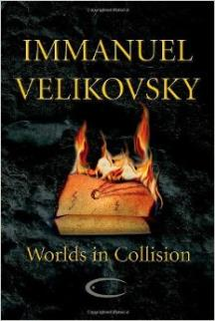
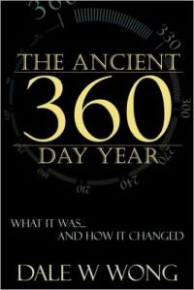
What Civilizations Changed Their Calendar Year?
Two books document
the calendar history of
30 ancient civilizations:
Worlds in Collision by
Immanuel Velikovsky
The Ancient 360 Day Year by Dale W. Wong
Moon #9: Slides 28-33

Slide 56
What Civilizations Changed? (con’t)
30 cultures around the world used
a 360 day year and a 30 day month
calendar before 713 BC including:
Moon #9: Slides 28-33
Vedas of India
Ancient Persia
Sumerians
Babylonians
Assyria
Ancient Egypt
Rome
Mayans of Mexico
Incas of Peru
China
Polynesia
Many religions based their religious beliefs on the number 360;
one for each day of the year. The 360 degree circle and 360 degree compass is a remnant of the year length prior to the change.

Slide 57
Truly A Miracle!
The addition of 5.25+ days to the yearly calendar is almost unfathomable! In order for something of this magnitude to happen, YHWH would have had to:
Flat Earth perspective – slowed down the progress of the sun through the constellations each day…ultimately adding 5+ days per year to return to the original starting point.
Global perspective – decreased the orbit of the earth around the sun permanently [taking longer to travel the same distance].

Slide 58
Before Moving On:
Fun Tidbit: Hezekiah’s sun/shadow [miracle/sign] also affected the lunar cycle by reducing it from 30 days to
27.3 [for the sidereal cycle] or 29.5 days [for the synodic cycle].
1) Sidereal Month: (aligns with the stars)
The time it takes for the moon to complete one orbit of Earth; an average of 27.3 days.
2) Synodic Month: (aligns with the sun)
The time it takes for the moon to reach the same
visual phase; an average of 29.5 days or 29 phases.
Moon #3: Slides 61-73

Slide 59
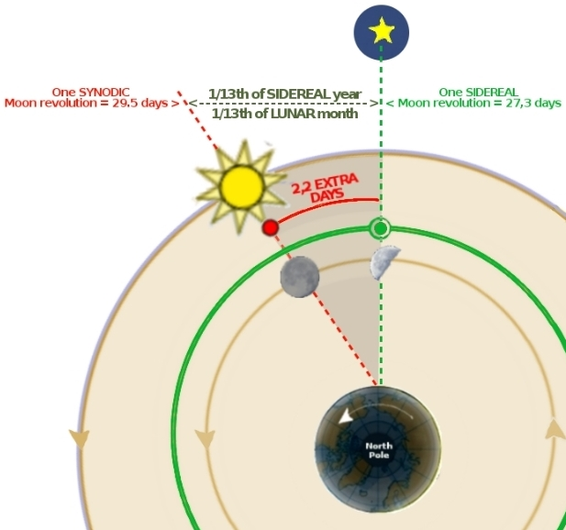
Moon #3: Slides 61-73
1) Sidereal Month:
(aligns with the stars)
The time it takes for
the moon to complete one orbit of Earth;
an average of 27.3 days.
2) Synodic Month:
(aligns with the sun)
The time it takes for
the moon to reach the same visual phase; an average of 29.5 days
or 29 phases.

Slide 60
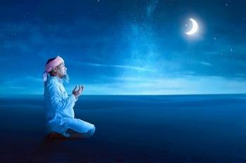
Hezekiah’s BEST Decision
Asking for the sun’s shadow to move backwards about
10 degrees [or 5.25 days], was King Hezekiah’s best decision!
If he had asked for the shadow to move forwards, the year length [keeping all things relevant] would have been shortened to approx. 354.75 days … almost exactly identical to 12 moon cycles in 12 months or 354 days [29.5 x 12].
This would have just confirmed &
added to even more moon worship
as it would APPEAR the moon really
was in charge of the festal month.
The pagans had been practicing this
for a long time, with Yahuah’s
people eagerly following in apostasy!
Moon #9: Slides 19-27

Slide 61
Question #3:
Yahusha’s Calendar vs the Jews’
As Beth was studying, she mentioned the proposed calendar to her friend John who reminded her that Yahusha was on the same calendar as the Jews.
Ugh! At first it seemed he was right…
Fact?! Yahusha had to have died on Yahuah’s Feast Days to fulfill His prophecy. Didn’t the Jews have to be on the same Feast days to see how He fulfilled them?
Thus, the same calendar…right?
CC #14 Yahusha’s Contempt of the Lunar Based Calendar

Slide 62
Beth’s BREAK DOWN #2
  She decided it was time to start over with this study since obviously
  the calendar didn’t change until after Yahusha …
Or did it?
  Right before bed that evening, a thought popped into
  her mind. Yes, a very CRAZY thought…
  Could Yahusha possibly be on His own Covenant Calendar, but in the year He was crucified, His calendar and the Jews’ “moon calculated” calendar somehow closely matched up???
No way…?!
CC #14 Yahusha’s Contempt of the Lunar Based Calendar

Slide 63
So, now it is
“Time to Dig In”!
Beth continues:
“I got so excited, I could hardly sleep that night! I began researching New Moon and Vernal Equinox dates from the years 25AD to 38AD. From what I found, the years that the New Moon and Vernal Equinox were close to each other were 25AD, 30AD, 33AD, and 36AD.”
“Yahusha’s calendar and the Jews’ calendar would have to be very close to each other for Yahusha’s death to be a sign to the Jews and prophetically fulfill Yahuah’s FEASTS.”

Slide 64
Another Bunny Trail?
Beth spent a good week trying to lay out
the timeline for Yahusha’s crucifixion.
(It’s a huge project that is not finished yet
for both Beth & Charlene!)
However, she did find something very interesting because of this study…Scriptural proof that Yahusha very likely was on a different calendar than the Jews’ “moon month” calendar!
(To be continued in Part 2.)
CC #15 The Crucifixion According to John

Slide 65
Discovering
Yahuah’s
Covenant Calendar
Part 2

Slide 66
Proof of Yahusha’s Calendar
Have you ever noticed the term “Feast of the Jews” in the book of John? Beth argued with a Pastor about whether the Feasts were “Jewish” or not. He pointed out this terminology. But of course,
Beth argued that the translators were throwing in their biases against the Jews.
Now, just 5 years later she is taking a second look at this terminology.
It’s used 4 times in the Book of John.
John 2:13 The Passover of the Jews was at hand…
John 5:1 After this there was a feast of the Jews …
John 6:4 Now the Passover, the feast of the Jews, was at hand. (Invalid entry.)
John 7:2 Now the Jews' Feast of Booths was at hand.
Beth begins to realize that it was quite possible for the Jewish Feasts NOT to be on the same calendar as Yahuah’s.
Let’s take a closer look at this concept.

Slide 67
Proof #1: John 7:2-9…
Yahusha at the Feast of Sukkot
John 7:2-16 Now the Jews' Feast of Booths was at hand. ³ So his brothers said to him, “Leave here and go to Judea, that your disciples also may see the works you are doing… ⁶ Yahusha said to them, “My time has not yet come, but your time is always here. ⁷ The world cannot hate you, but it hates me because I testify about it that its works are evil. ⁸ You go up to the feast. I am not going up to this feast, for my time has not yet fully come.” ⁹ After saying this, he remained in Galilee.
The term “at hand” can mean “here” or “very close.”
But we see that Yahusha stayed in Galilee. For how long, we do not know. It sounds as if it was longer than a few hours….
When Yahusha told His brothers “my time has not yet fully come…”
is it possible He was alluding to an imposter calendar issue?
Yahusha said “I testify of it (the world) that its works are evil.”
How is staying away from the feast “testifying” that the world is evil? Is He testifying that the timing of the world is off? Most certainly!

Slide 68
Proof #1: John 7:10-14… (con’t)
¹⁰ But after his brothers had gone up to the feast, then he also went up,
not publicly but in private. ¹¹ The Jews were looking for him at the feast, and saying, “Where is he?” ¹² And there was much muttering about him among
the people. While some said, “He is a good man,” others said, “No, he is leading the people astray.” ¹³ Yet for fear of the Jews no one spoke openly of him. ¹⁴ Now about the middle of the feast Yahusha went up into the temple and taught.
Yahusha did not go to the temple until the middle of the Jews’ Sukkot.
Did He fail to present Himself to YHWH during the first day of Sukkot in accordance to Exo 23:15-17 and Lev 23:34-35?
Again, failure to observe Yah’s statutes is a sin.
We have no indication that Yahusha was at the temple on the 1st day of Sukkot. Rather, the Jews were all looking for Him…including all the people, not just the Pharisees.
The Jews knew He should have been at the Feast…but He wasn’t…yet!!
Remember: Yahusha shows up in the middle of the Jews’ Sukkot.
He would have been on time for something? But, for what day?

Slide 69
Proof #1: John 7:15-19… (final)
¹⁵ The Jews therefore marveled, saying, “How is it that this man has learning, when he has never studied?”
¹⁶ So Yahusha answered them, “My teaching is not mine, but his who sent me. ¹⁷ If anyone's will is to do Yahuah's will, he will know whether the teaching is from Elohim or whether I am speaking on my own authority. ¹⁸ The one who speaks on his own authority seeks his own glory; but the one who seeks the glory of him who sent him is true, and in him there is no falsehood. ¹⁹ Has not Moses given you the law? Yet none of you keeps the law [Torah]. Why do you seek to kill me?”
Yahusha Himself says “Yet not one of you keeps the Torah!” The Jews are celebrating Sukkot, yet Yahusha tells them they are not keeping Torah? How is this? If we understand the Jews are not on Yahuah’s true calendar, we can see why He says they are not keeping Torah.
CC #14 Yahusha’s Contempt of the Lunar Based Calendar

Slide 70
Proof #2: Luke 2:41-43…
The Boy Yahusha at the Temple
Luke 2:41-43 Now his parents went to Jerusalem every year at the Feast of the Passover. ⁴² And when he was twelve years old, they went up to Jerusalem according to the custom of the feast. ⁴³ And when the feast was ended, as they were returning, the boy Yahusha stayed behind in Jerusalem.
Notice the wording "according to the custom of the feast"!
One would think the wording would say “according to Torah”…
instead of “according to the custom.”
Where else do we see this teaching? Matt 15:3, 6-9 He (Yahusha) answered them, “And why do you break the commandment of Yahuah for the sake of your tradition?... ⁶…So for the sake of your tradition you have made void the word of Yahuah. ⁷ You hypocrites! Well did Isaiah prophesy of you, when he said: ⁸ “This people honors me with their lips, but their heart is far from me; ⁹ in vain do they worship me, teaching as doctrines the commandments of men.”
Would Yahusha, honoring a different calendar, explain why He stayed in Jerusalem after His parents left?
Even as a boy, it is possible that Yahusha was following a different calendar?

Slide 71
Proof #2: Luke 2:43-51… (con’t)
⁴³ And when the feast was ended, as they were returning, the boy Yahusha stayed behind in Jerusalem. His parents did not know it, …⁴⁵…they returned to Jerusalem, searching for him. ⁴⁶ After three days they found him in the temple, sitting among the teachers, listening to them and asking them questions… ⁴⁸ …And his mother said to him, “…Behold, your father and I have been searching for you in great distress.” ⁴⁹ And he said to them,
“…Did you not know that I must be in my Father's house?” ⁵⁰ And they did not understand the saying that he spoke to them. ⁵¹ And he went down with them and came to Nazareth and was submissive to them…
Did Yahusha’s parent’s forgetfulness allow for Him to fulfill Torah?
Why did He say “Did you not know that I must be in my Father’s house?”
Yahusha was found “after 3 days” witnessing and fulfilling His Father’s will in the Temple.
3 days!! This is PROPHETIC of what is to come!!!
Yahusha’s Passover at Age 12 Sept 2020 Series 3

Slide 72
Proof #2: Conclusion for Luke 2
Before leaving this section, here is an interesting verse:
Lam 2:6 And He (YHWH) has violently taken away his tabernacle, as if it were of a garden: he has destroyed His Moed: YHWH has caused His Moed and sabbaths to be forgotten in Zion, and has despised in the indignation of his anger the king and the priest.
The term “Mo`ed” includes the timing of His Feasts and the places His people were to meet. YHWH has caused Zion to forget these things!
They have forgotten where the temple used to sit…
Have they forgotten how the timing of the Feasts are calculated?
Very possible!
Understanding that Yahuah has caused His people to forget, recall
what was written in Luke 2:43-51.
Is it coincidence that Yahusha’s parent’s forgetfulness allowed Him
to fulfill Torah?
Is it surprising they didn’t understand what Yahusha meant when
He said “Did you not know that I must be in my Father’s house?”

Slide 73
Proof #3: Revisiting YHWH’s Words
Understanding that the Jews were on a different calendar,
let’s re-examine the words in Isaiah, Amos and Malachi.
Isa 1:12-17 [760 BC] “When you come to appear before me, who has required of you this trampling of my courts? ¹³ Bring no more vain offerings; incense is an abomination to me. New moon and Sabbath and the calling of convocations—I cannot endure iniquity and solemn assembly. ¹⁴ Your new moons and your appointed feasts my soul hates; they have become a burden to me; I am weary of bearing them. ¹⁵ When you spread out your hands, I will hide my eyes from you; even though you make many prayers, I will not listen; your hands are full of blood. ¹⁶ Wash yourselves; make yourselves clean; remove the evil of your deeds from before my eyes; cease to do evil, ¹⁷ learn to do good; seek justice, correct oppression; bring justice to the fatherless, plead the widow's cause.
Moon #6: Slides 53-56

Slide 74
Proof #3: Revisiting YHWH’s Words
Amos 5:21 [785 BC] I hate, I despise your feasts, and I take no delight in your solemn assemblies.
Amos 8:9-10 [785 BC] “And on that day,” declares Yahuah our Elohim, “I will make the sun go down at noon and darken the earth in broad daylight. ¹⁰ I will turn your feasts into mourning and all your songs into lamentation…
Malachi 2:1-4 [397 BC] And now this commandment is for you, O priests. ² If you do not listen, and if you do not take it to heart to give honor to My name,” says Yahuah of hosts, “then I will send the curse upon you and I will curse your blessings; and indeed, I have cursed them already, because you are not taking it to heart. ³ Behold, I am going to rebuke your offspring, and I will spread dung on your faces, the dung of your feasts; and you will be taken away with it.
Moon #8: Slide 104
Moon #9: Slides 70-77

Slide 75
Proof #4: Revisiting Yahusha’s Words
Understanding that the Jews were on a different calendar, let’s revisit some of the Words that Yahusha spoke.
Matt 16:1-4 And the Pharisees and Sadducees came, and to
test him they asked him to show them a sign from heaven.
² He answered them, “When it is evening, you say, ‘It will be
fair weather, for the sky is red.’ ³ And in the morning, ‘It will be stormy today, for the sky is red and threatening.’ You know
how to interpret the appearance of the sky, but you cannot interpret the signs of the times. ⁴ An evil and adulterous generation seeks for a sign, but no sign will be given to it
except the sign of Jonah.” So he left them and departed.
The term “sign” in verse 3 means mark or unusual sign (like the equinox shadow). The term “times” mean a fixed or definite time, a season. Were the Jews not recognizing what was important…the equinox during the Spring of the year?

Slide 76
Proof #4: Yahusha’s Words (con’t)
Matt 23:1-3 Then Yahusha spoke to the multitudes and to His disciples, ² saying: “The scribes and the Pharisees sit in Moses’ seat. ³ Therefore whatever they tell you to observe, that observe and do, but do not do according to their works; for they say, and do not do.
Only the Torah is preached from Moses’ seat. Nowhere in Torah is the New Moon suggested as determining the month!
Matt 23:13 But woe to you, scribes and Pharisees, hypocrites!
For you shut up the kingdom of heaven against men; for you neither go in yourselves, nor do you allow those who are entering to go in.
The term kingdom means “dominion/rule.” And the word heaven can mean “the vaulted expanse of the sky with all things visible in it.” The Pharisee’s were shutting up the rule of the heavenly bodies. Yahusha is referring to Yahuah’s Calendar here!
Moon #9: Slides 90-107

Slide 77
Back to the Calendar
Now that we have addressed what Yahuah’s Calendar isn’t …& we see that He would not have been honoring the Jews’ pagan moon calendar, it is now time to …
go back to the Yahuah’s Covenant Calendar to get more details!

Slide 78
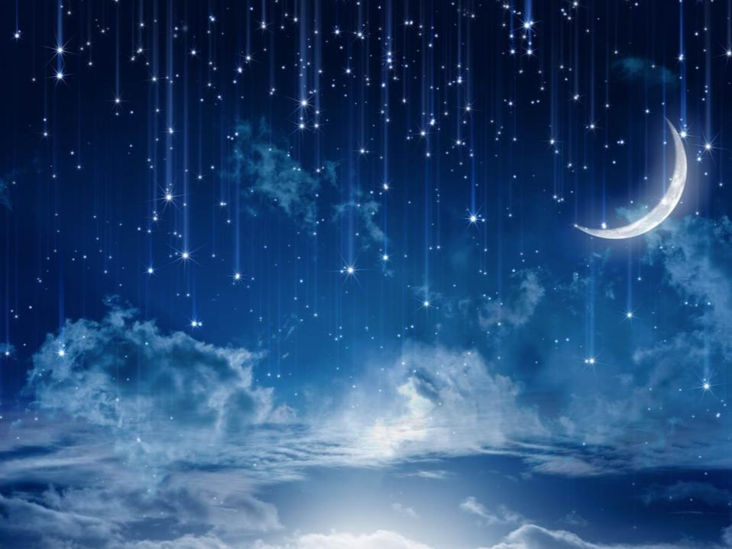
What is the Mazzaroth?
Psalm 19:2
Day unto day utters speech,
And night unto night reveals knowledge.
Night reveals knowledge!
The Mazzaroth is “one great unit” of 12 constellations (as mentioned in Job 9:9/ 38:31-33/41:1). These constellations contain the full outline in detail of infinite knowledge;
in other words…the complete Plan of Salvation from
Genesis 1 to Revelation 22:21! This knowledge is written
in the sky every 24 hours!
Moon #2: Slides 17-41

Slide 79
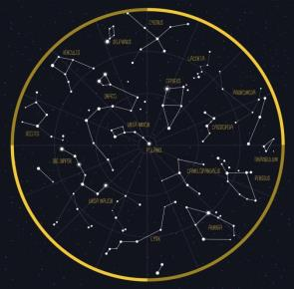
YHWH’s Master Time Clock
Let’s look at Job 38:31-33. This is Yahuah speaking…
Job 38:31-33 Can you tie up the stars of the Pleiades or loosen the ropes of the stars in Orion? ³² Can you bring out the stars on time or lead out the stars of the Bear with its cubs? ³³ Do you know the laws of the sky and consider their rule
over the earth?
Yahuah is referencing the Mazzaroth!
With a question, He clearly shows their
commission for dominion over the earth!
What dominion?? The Mazzaroth governs
YWHW’s time clock…these stars are the
master time clock of Yahuah.
The moon is never used in this divine time clock.

Slide 80
The Ultimate 2nd Witness!
The Mazzaroth is
the ultimate 2nd witness to the Scriptures…
which s.a.tan cannot touch nor tamper with.
But s.a.tan will still try…
Isa 14:12-15 How you are fallen from heaven, O Lucifer,
son of the morning! How you are cut down to the ground,
you who weakened the nations!
¹³ For you have said in your heart: ‘I will ascend into heaven,
I will exalt my throne above the stars of Yahuah; I will also sit on
the mount of the congregation on the farthest sides of the north;
¹⁴ I will ascend above the heights of the clouds,
I will be like the Most High.’
¹⁵ Yet you shall be brought down to Sheol, to the lowest depths
of the Pit.
The “stars of Yahuah” in this verse are the Mazzaroth!

Slide 81
Precedence Over the Sun?
Psa 19:1-4 The heavens [includes the Mazzaroth]declare the glory of Elohim; and the firmament shows His handiwork. ² Day unto day utters speech, and night unto night reveals knowledge [through the Mazzaroth constellations]. ³ There is no speech nor language where their voice is not heard. ⁴ Their line has gone out through all the earth, and their words to the end of the world. In them [the Mazzaroth] He has set a tabernacle for the sun.
** NB: Although the sun is highly respected, it is subordinate to the Mazzaroth. Rather, the sun has been given a dwelling place
(a tabernacle/tent) within the Master Time Clock (the Mazzaroth).
This dwelling place is the start and ending point of its circuit
in the heavens…the equinox (Tequfah)!
Psa 19:4b-6 … In them He has set a tabernacle for the sun, ⁵ Which is like a bridegroom coming out of his chamber, and rejoices like a strong man to run its race. ⁶ Its rising is from one end of heaven, and its circuit to the other end; and there is nothing hidden from its heat.
Notes:
Tim loves the middle comment a lot.

Slide 82
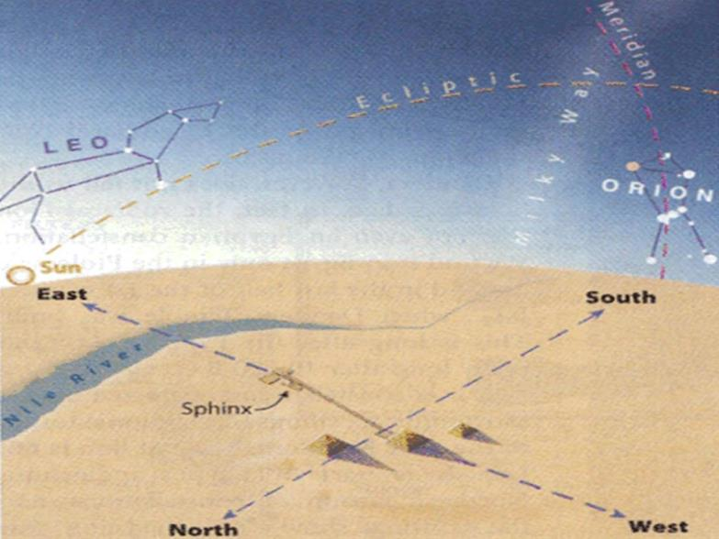
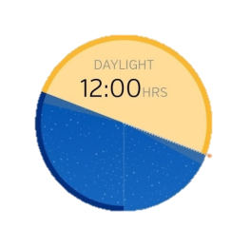
The Faithful Equinox
Notes:
Tim loves the middle comment a lot.

Slide 83
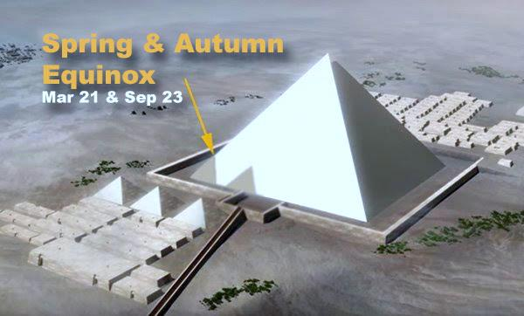
Great Pyramid of Giza
Notes:
Tim loves the middle comment a lot.

Slide 84
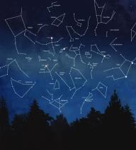
Knowledge & Timing!
The Mazzaroth Light = “Knowledge”
(from the constellations)
The position of the Sun’s Light = “Timing”
(from within the Mazzaroth)
These are the 2 GREAT Lights found in Gen 1:16!
It is from earth that we are to observe the LIGHT of the sun recording its location within the LIGHT of the Mazzaroth constellations.
Moon #3: Slides 20-45

Slide 85
Beth Hits the Brakes!
Wait A Minute! Let’s take a look at Genesis 1:14-16 again…
Gen 1:14-16 Then Yahuah said, “Let there be lights in the firmament of the heavens to divide the day from the night; and let them be for signs and seasons, and for days and years; ¹⁵ and let them be for lights in the firmament of the heavens to give light on the earth”; and it was so. ¹⁶ Then Yahuah made two great lights: the greater light to rule the day, and the lesser light to rule the night, He made the stars also.
What are the 2 great lights in verse 16? When the Hebrew is examined, the words “He made” and “also” are not there!
So, the verse actually says:
¹⁶ Then Yahuah made two great lights: the greater light to rule the day, and the lesser light to rule the night, the stars.
I don’t know about you, but I’ve always assumed the lesser light
was the moon…! (Beth says.)
Moon #3: Slides 20-45

Slide 86
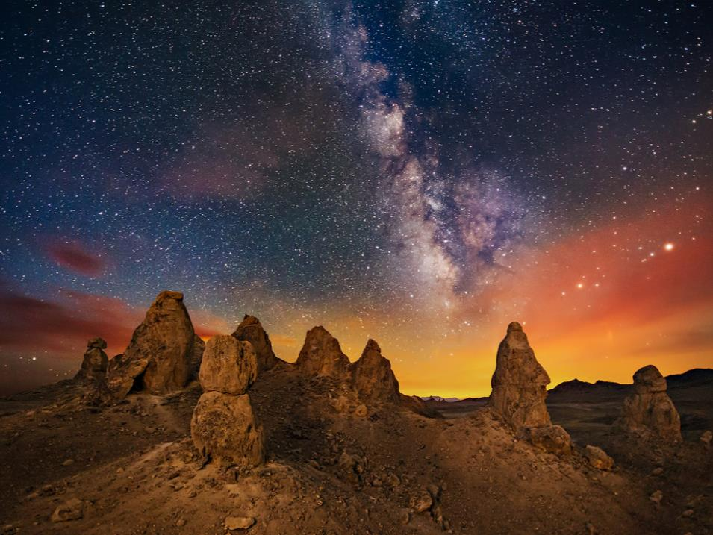
A 2nd Confirmation
Beth had to learn there are only TWO great “lights” … not THREE! We all know the sun is truly a “great light” but
how many of us have visualized the Mazzaroth (that covers the whole sky every night) as the “other GREAT light”?
YES! Beth always assumed the lesser light
was the moon…!
That was until she discovered Jer 31:35.
Thus saith Yahuah, which giveth the sun for a light by day, and the ordinances of the moon
and of the stars for a light by night,
which divideth the sea when the waves thereof roar.

Slide 87

Back to YHWH’s Time Clock
So let’s go back to YHWH’s Time Clock. Visualize it as an actual clock.
Numbers around a clock – Instead of numbers, Yahuah has placed a series of 12 constellations in a circle around the earth.
The Hands on a clock – On a
normal clock, the hands show you
the time. Yahuah’s clock works
the same way! The “hand” is the
sun as it is moving through the
constellations! Not only does the
sun’s movement through the sky
every day tell us the time of day…
the sun’s location within the
Mazzaroth tell us the timing
of the year as well!

Slide 88
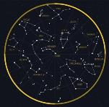

What’s Missing?
One more look at this equation (YHWH’s Time Clock) …
The Mazzaroth Light = “Knowledge”
(from the constellations)
The position of the Sun’s Light = “Timing”
(from within the Mazzaroth)
Did you notice the moon
is not mentioned as part of this equation?
Moon #3: Slides 20-45

Slide 89
What does Yahuah’s Moon do?
As I mentioned before, YHWH definitely has a purpose for the moon. It’s just doesn’t play a part in His Worship Calendar.
Don’t believe me?
Where does the moon end up in the final days?
Rev 12:1 And then a great wonder appeared in heaven: A woman was clothed with the sun, and the moon was under her feet, and a crown of twelve stars was on her head.
Is this a position of authority? Nope!
Psa 47:2-3 For Yahuah the Most High is awesome; He is a great King over all the earth. ³ He will subdue the peoples under us, And the nations under our feet.
Eph 1:22 And He put all things under His feet, and gave Him to be head over all things to the church.
Rev 12: Woman Standing on the Moon Nov 2020 Series 3

Slide 90
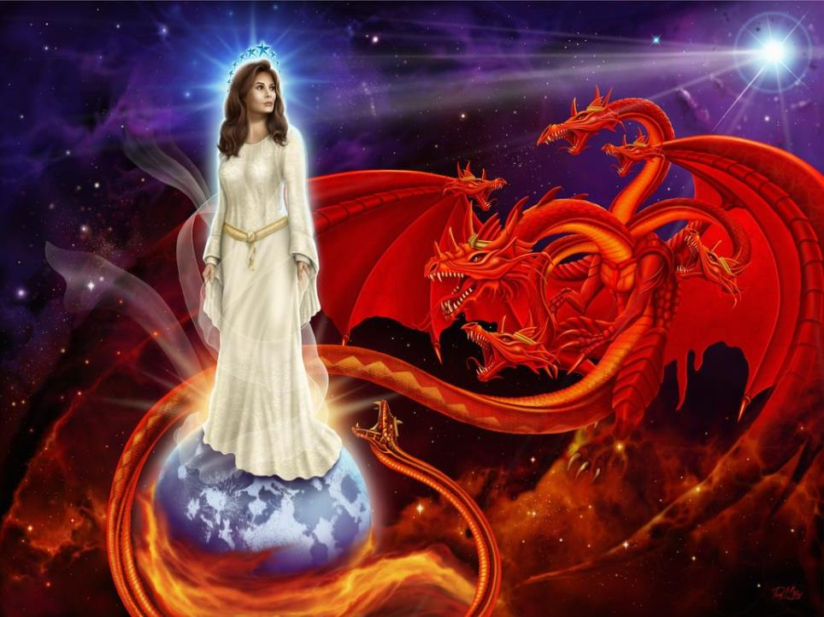
Under Her Feet…?
Through the Rev 12 sign, Yahuah is indicating that the moon (whom so many have lifted up higher than any other heavenly body) will ultimately end up in the lowest position of all…under the feet of the virgin.
The virgin symbolizes the Bride!
The Bride does not lift up the moon!

Slide 91
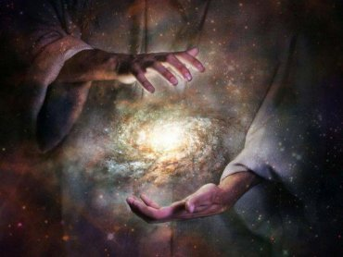
Stars and Sun…Now What?
Now that we know the
stars and sun play a part in
Yahuah’s Covenant Calendar,
where do we
go from here?

Slide 92
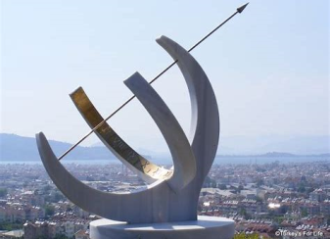
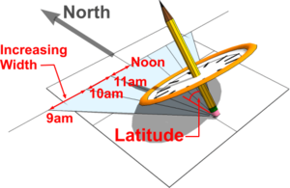
What is the Equinox (Tequfah)?
The Equinox occurs when the center
of the sun crosses over the earth’s equator…from one hemisphere to another indicating the change in seasons.
Only on the Equinox day the sun rises
due east and sets due west.
There are 2 equinoxes in a year:
Spring (Vernal) and Fall (Autumnal).
In the Northern Hemisphere:
The Spring Equinox occurs on
March 19, 20 or 21.
The most common dates are Mar 20,
then Mar 21, rarely Mar 19.
Fall Equinox occurs on/or around
Sept 23.

Slide 93
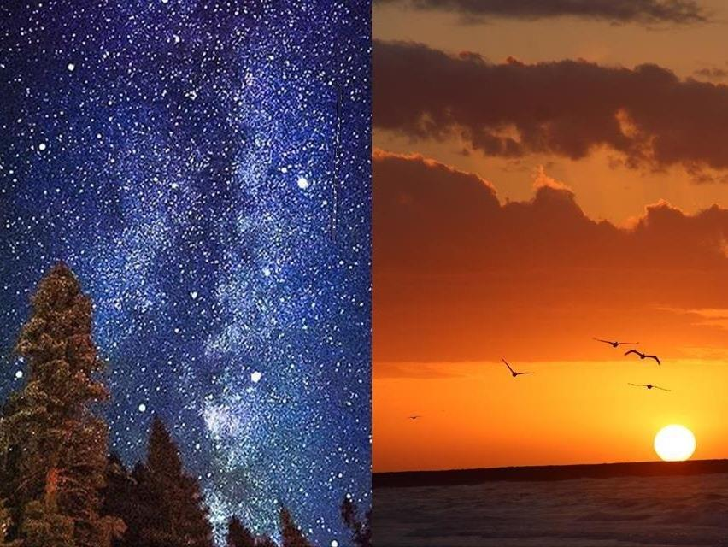
What is the Equinox (con’t)?
It is a “Celestial Event” designed as a sign for determining time.
It is a combination of multiple identities in the heavens. They are:
1. Mazzaroth
(constellations/stars)
2. Sun
(This orb declares
accurate positioning.)
3. Light
(Must be seen from
the sun or there is
no shadow.)
4. Earth
(The vantage point
to receive light & shadows
for measuring purposes.)

Slide 94
Equinox/Tequfah (con’t)?
Mazzaroth
Sun
Light
Earth
The combination of these 4 celestial identities permits a visible sign necessary to determine time as designated in the Scriptures. Take out one component – the “sign will be eliminated!
This combination prevents man from identifying one celestial creation for worship purposes above another. YHWH purposely designed this combination to prevent sun or star worship!
Note: The moon has no involvement in the tequfah!

Slide 95
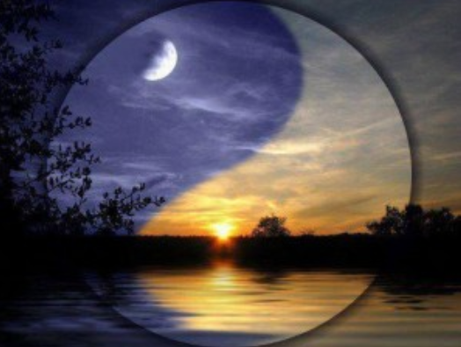
The Perfect Tequfah
This is Yahuah’s Divine Preventative Maintenance Plan which systematically prevents those who follow His Word from worshipping the celestial identities. What a merciful Creator!
Mazzaroth
Sun
Light
Earth
Never includes
a moon!

Slide 96
Always Verify the Equinox!
The equinox moves very slowly over time,
so it should always be verified.
Important Notice #1: If the Tequfah event occurs in the night (darkness) when the shadow cannot be observed, the following day (dawn to dawn) is then considered the day for observing the Tequfah sign and is the final day of the year.
The following day will be day 1.
Important Notice #2: The Gregorian midnight change of the 24 hour cycle may require an adjustment for Covenant Calendar. Yahuah’s day starts at dawn. If looking at NASA, examine your personal time zone and adjust.
For example: If the equinox occurs near midnight or dawn,
this could require an adjustment for the calendar “date.”
(This is only understood by Yahuah’s DAWN day commencement.)

Slide 97
Equinox Proof in the Bible #1 & 2
YHWH’s definition of a 360 degree circuit in the heavens is found in Eccl 1:5 and Psa 19:6.
Eccl 1:5 The sun also rises, and the sun goes down,
and hastens to the place where it arose.
Psa 19:6 Its rising is from one end of the heavens,
and its circuit to the other end of them;
and there is nothing hidden from its heat.
Note: The completion of a circuit in the heavens is the original place of departure. When the sun has achieved a full circuit – 365+ cycles within the Mazzaroth, the Tequfah once again occurs, resetting Yahuah’s Covenant Calendar.

Slide 98
Equinox Proof in the Bible #3
Exo 34:22 You shall observe the Feast of Weeks, the firstfruits of wheat harvest, and the Feast of Ingathering at the turn of the year.
This verse is referring to the second Tequfah (autumnal equinox), which occurs around Sept 22/23 depending on your location.
The Fall Festivals are centered around (but not calculated by)
the autumn Tequfah (in the Northern Hemisphere). This signals the
end of the agricultural season…hence the Feast of Harvest.
On Sept 17, 2019, the Feast of Trumpet occurs…HERALDING (Trumpeting) the arrival of the autumnal equinox (on Sept 22nd).
Fun tidbit! Teshuva refers to a person turning their life around
and returning to Yahusha! The Feast of Trumpets is heralding the
autumnal equinox (a turning of the year)!
The autumnal equinox is a sign for the time of turning…which corresponds nicely with the Day of Atonement!

Slide 99
Equinox Proof in the Bible #4
James 1:16-17 Do not be deceived, my beloved brethren. ¹⁷ Every good gift and every perfect gift is from above, and comes down from the Father of lights, with whom there is no variation or shadow of turning [G5157].
What is a shadow of turning? The purpose of a sun dial is to show a “shadow of turning”!
On a correctly installed sun dial, there will be
no shadow when the Tequfah (equinox) occurs!
So the perfect gift of Yahuah is the point of “no” shadow of turning.
It is the point of the equinox!!

Slide 100
Equinox Proof with G5157 - trope
The word “turning” is G5157 - Trope.
It means “a turning of the heavenly bodies.”
James is referencing the heavenly bodies as the Mazzaroth stars, the sun and the earth.
James also warns us of the change from the Mazzaroth based calendar to the lunar/solar calendar.
This is also a reminder to be aware that
YHWH does not change.
Yahuah’s Tequfah based calendar exposes a perfectly
straight line or disappearing shadow [on tequfah] …it is our
SIGN grounded in Genesis 1:14!
Gen 1:14 Then Yahuah said, “Let there be lights in the firmament of the heavens to divide the day from the night; and let them be
for signs and seasons, and for days and years.

Slide 101
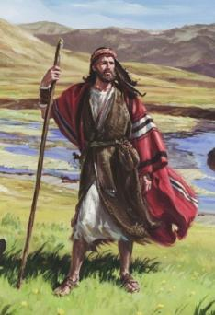
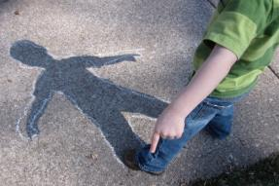
Benefits of the Equinox!
By utilizing Yahuah’s vernal equinox, we can:
Know when it happens with a staff in our hand
while standing in the middle of the wilderness.
We don’t have to depend on the Sanhedrin
to give their “stamp of approval.”
We don’t have to wait for a Jerusalem
report on whether the barley is abib/greening.
The only mediator between us and YHWH is
Yahusha…not to mention He’s perfect!
Finally…we don’t have to be enticed
by “looking up to the heavens” for
His Timing. Rather, we look down
to His shadow…
“a shadow of good things to come!”

Slide 102
The Year Starts When?
How do we know which equinox starts Yah’s Calendar year?
Exo 12:1-2 Now Yahuah spoke to Moses and Aaron in the land of Egypt, saying, ² “This month shall be your beginning of months; it shall be the first month of the year to you.
Exo 13:4 On this day you are going out, in the month Abib.
As we discussed before, Abib means “green in the ear,” referring to the greening of the agricultural produce
in the Spring (of the Northern Hemisphere).
Note: Exodus has definite reference to “the” equinox that will provide the “date & timing” of Yahusha’s Passover
(for those that live in the Southern Hemisphere).
CC #30 & 31 Year/Shaneh Part 1 & 2

Slide 103
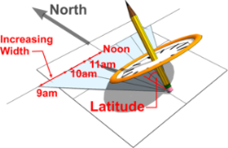
Introducing the Sun Dial!
So how was time measured in ancient times? By a sun dial!
A sun dial will show an equinox in two possible ways
(depending on the type of sun dial that you have).
There will be no shadow on the face of the sun dial during a
few minutes while the sun is directly overhead. Or …
There will be a perfectly straight line during the Tequfah. Otherwise, it will expose a curved shadow
before and after the equinox.
Eccl 1:15 What is crooked cannot be made straight,
and what is lacking cannot be numbered.
When Beth saw this verse, she thought of the moon’s cycle being “lacking” …and not being able to get an accurate “count” for Yahuah’s Calendar. But the crooked vs. straight concept caught her eye as well! She immediately thought of the straight line signaling the equinox vs. the curved line. The whole verse was a perfect fit!!

Slide 104
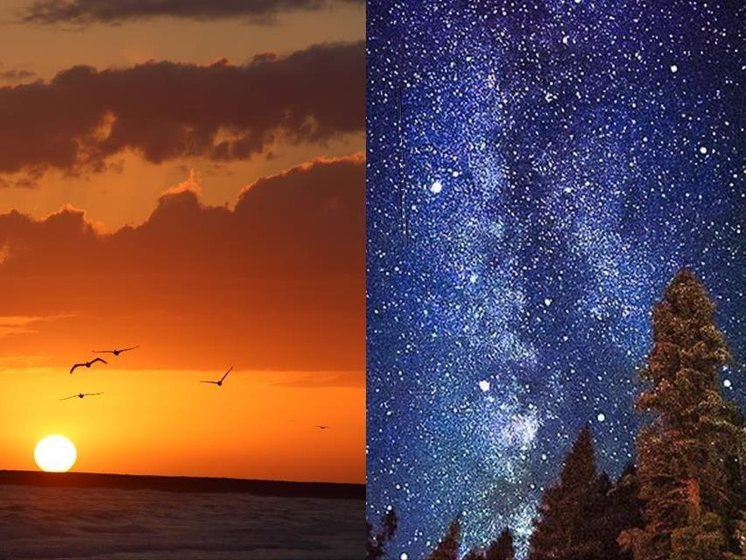
Don’t Be Deceived!
As with everything else, s.a.tan has created
a deception … the equilux!
The equilux may seem very similar to the equinox … but is a counterfeit schedule!
For more information, see teaching on this at www.studythecalendar.com/the-equilux-deception/
Did you know …the moon is at its fullest
when it is OPPOSITE the sun!
CC #12 The Equi-LUX Deception

Slide 105
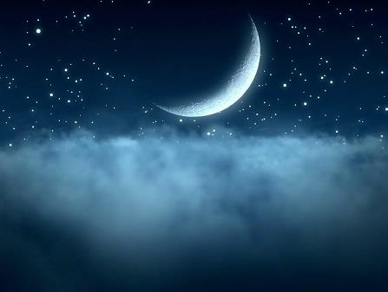
Don’t Be Deceived!
1. It’s a deception to begin the year
with a sighted moon rather than with
the sun’s renewed circuit in the Mazzaroth!

Slide 106
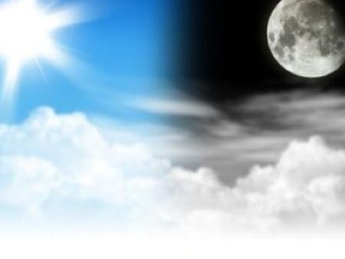
Don’t Be Deceived!
2. It’s a deception to begin the year
with a sighted moon rather than
using the equinox “light” of the sun.

Slide 107
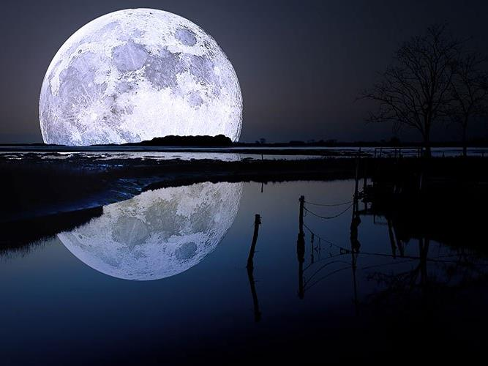

Deception!
3. When man places the moon in first priority and supplants the Mazzaroth and sunLIGHT … he is, in effect,
removing the two GREAT lights
of Genesis 1:16 from having
any importance whatsoever!

Slide 108
Don’t Be Deceived! (con’t)
Matt 23:13 But woe to you, scribes and Pharisees, hypocrites! For you shut up the dominion/rule of heaven against men;
for you neither go in yourselves, nor do you allow those who are entering to go in.
The Pharisees silenced the governing authority of the heavens (the Tequfah/Mazzaroth) …and thus they could not enter into Covenant with YHWH!
They rejected the divine institution from Creation that initiated Yahuah’s Covenant Calendar…and decided to
follow the moon.
Don’t fall for this trap!

Slide 109
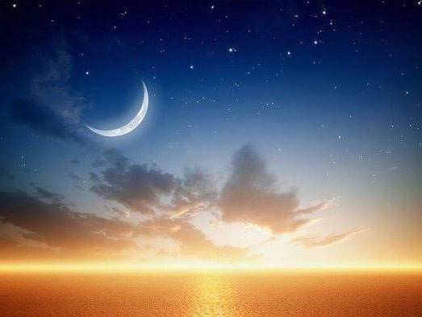

Don’t Be Deceived!
Luke 11:52
Woe unto you, lawyers!
for ye have taken away
the key of knowledge:
ye entered not in yourselves,
and them that were entering in
ye hindered.
These men removed the
“keys of knowledge”
for Yahuah’s year-start
replacing it with the
moon month.
Moon #8 & #9 for OT & NT History

Slide 110
“Teshuva” to – Chodesh!
A month/chodesh is a set amount of time.
It does not come in a variety of lengths
like the “constellation’s theory” creates.
Proof of a set amount:
Lev 27:6 If the person is from a month old up to five years old, the valuation shall be for a male five shekels of silver, and for a female the valuation shall be three shekels of silver.
Num 9:22 Whether it was two days, or a month, or a longer time that the cloud continued over the tabernacle, abiding there, the people of Israel remained in camp and did not set out, but when it lifted they set out.

Slide 111
How long is a Month/Chodesh?
The flood account proves the length of a chodesh month.
Gen 7:11 In the six hundredth year of Noah's life, in the second month,
the seventeenth day of the month, the same day were all the
fountains of the great deep broken up…
Gen 7:24 And the waters prevailed upon the earth an
hundred and fifty days.
Gen 8:3 And the waters returned from off the earth … after the
end of the hundred and fifty days the waters were abated.
Gen 8:4 And the ark rested in the seventh month, on the
seventeenth day of the month, upon the mountains of Ararat.
The flood accounts shows each month is 30 days. 150 days starting from the 17th day of the 2nd month ends at the 16th day of 7th month. This is when the waters were abated. It would have been the following day (the 17th day of the 7th month) that the ark rested. Since we know each month/chodesh is a “set amount of time,” 30 days each month works perfectly.
Moon #8: Slides 25-58

Slide 112
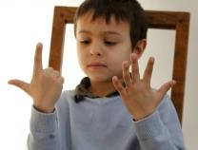
What about the Summer Solstice and Fall Equinox?
The Summer Solstice and Fall Equinox are not extra added days to any calendar 30 day months. This would not correspond to
a 360 day calendar (proven by the 30 ancient civilizations following this year length before the Hezekiah sundial event).
Passover, Unleavened Bread & Wave Sheaf
are all based off of a count.
Shavuot is based off of a count.
If we start adding days to the calendar (from the 5+ extra days after the 360th day), this would throw off the timing for the Feast of Trumpets, Yom Kippur, and Sukkot due to the counting of days.
Remember Psa 90:12!

Slide 113
What is the Festal Month’s Cycle?
Yahuah’s Feasts are based off the 1st day of the 1st Chodesh
(i.e. the first day of Creation).
Each Chodesh is a 30 day cycle with its foundation in
the 1st day of Creation ~ by simple counting.
It is important to note there is another cycle of 30 days.
It was the cycle of the moon BEFORE the time of Hezekiah.
However, this cycle did not start until the 4th day of Creation.
You will see the verb yerach (moon) used in the
moon’s 30 day cycle in the Torah.
It should never be confused with the Hebrew term Chodesh.
Chodesh Information:
Moon #5 Slides 22-63
Moon #6 (Whole study)
Moon #7 Slides 18-27

Slide 114
The 30 Day Lunar Month in the Torah
The Captive Maiden Counts her days of Mourning:
Deut 21:13 And she shall put the raiment of her captivity from off her, and shall remain in thine house, and bewail her father and her mother a full month (yerach): and after that thou shalt go in unto her, and be her husband, and she shall be thy wife.
Why is the moon month listed here? When Israel raided the pagan nations and took maidens captive, these pagan maidens most likely used the moon’s cycle of counting. YHWH was very sympathetic towards these captured maidens.
Captive maidens were to receive every Torah benefit. In this way, she could count out her rightful days of mourning (through the moon phases) before being subject to her captor.
Later, the maiden would learn of Yahuah’s worship calendar.
Moon #4 Slides 68-74

Slide 115

Yahuah’s Calendar Counting!
How did Yah’s people keep count? Did they remind everyone?
Num 10:10 On the day of your gladness also, and at your appointed feasts and at the beginnings of your months, you shall blow the trumpets over your burnt offerings and over the
sacrifices of your peace offerings. They shall be a reminder
of you before your Elohim: I am Yahuah your Elohim.”
So now we count…
Psa 90:12 So teach us to
number our days, that we may
APPLY our hearts unto WISDOM.

Slide 116
Easy Counting Principle
Yahuah’s original year has 360 days.
Once the 360 days have been counted out, then it is time to watch for His
“sign in Gen. 1:14” (the equinox) around
the 365 day mark.
This will occur within the same 24 hour period of when the equinox occurs in each individual time zone the world over ~ unlike the equi-LUX!

Slide 117
Just Keep Counting
Why count the days once we get past the Fall Feasts? Aren’t they just extra days that don’t mean anything?
I believe it is imperative for Yahusha to return
this earth to a 360 day calendar before the events of this world
are all said and done.
But once this happens, how long will it take for
people to figure it out?
We, however, will
notice it at the end of
the year IF we are numbering our days!
Here’s a theory! Take a look at these verses:
Matt 24:15-22 Therefore when you see the ‘abomination of desolation,’ spoken of by Daniel the prophet, standing in the holy place” … ¹⁶ “then let those who are in Judea flee to the mountains. ²⁰ And pray that your flight may not be in winter or on the Sabbath. ²¹ For then there will be great tribulation, such as has not been since the beginning of the world until this time, no, nor ever shall be. ²² And if those days had not been cut short, no human being would be saved. But for the sake of the elect those days
will be cut short.
Beth always thought that meant Yahuah would shorten “each” day. What if it means “the days of the year will be cut short”? Would that be a “sign” for us to head out?

Slide 118
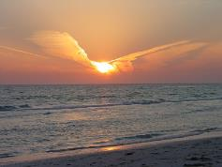
Living in the “shadow” of Yahuah
is the best place to be.
His shadow is A REFUGE!!
Psa 57:1 Be merciful to me, O Yahuah, be merciful to me!
For my soul trusts in You; and in the shadow of Your wings
I will make my refuge, until these calamities have passed by.
Psa 63:7 Because You have been my help, therefore
in the shadow of Your wings I will rejoice.
Psa 17:8 Guard me as the apple of Your eye;
Hide me under the shadow of Your wings.
Psa 91:1-4 He who dwells in the secret place of the Most High
shall abide under the shadow of the Almighty.
² I will say of Yahuah, “He is my refuge and my fortress;
My Elohim, in Him I will trust.”
³ Surely He shall deliver you from the snare of the fowler
and from the perilous pestilence.
⁴ He shall cover you with His feathers, and under His wings
you shall take refuge; His truth shall be your shield and buckler.
118

Slide 119

Walking in Yahusha’s Footsteps is the best place to walk!
“Follow me!” This phrase is given 19 times in the New Testament – 18 are Yahusha’s words. Does following Yahusha mean we don’t follow His instructions as given
by Moses?
Yahusha said: “What did Moses command you?” [Mark 10:3] “If you believe Moses you would believe me.” [John 5:46] “Did not Moses give you the law, yet none of you keep it?”
[John 7:19]
Is ‘Calendar’ Part of the Law? “Three times in a year thou shalt KEEP a feast unto me.” [Exo 23:14]

Slide 120
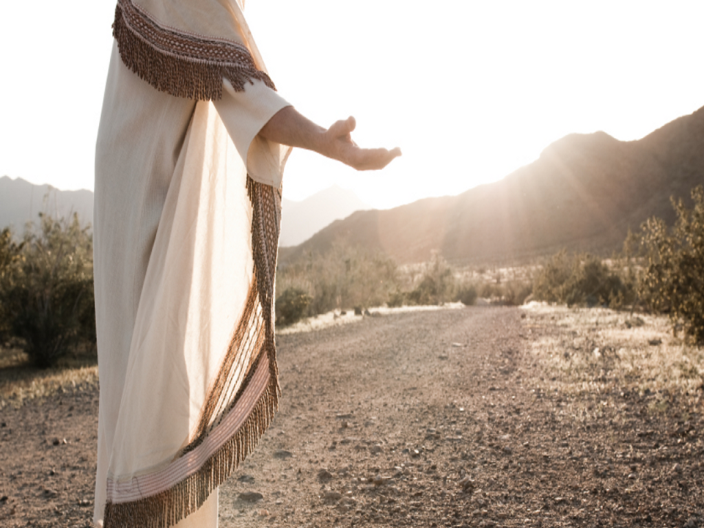

Keep Walking in
Yahusha’s Footsteps!
He said, “Follow me!”
Yahusha’s Covenant Calendar
is found between the pages of
Gen 1:1 to Exo 24:11; ratified by His
own blood on His Passover festival.
Yahusha’s Covenant Calendar Commands are easy for those
who desire to follow them.
He Said: “For my yoke is easy,
and my burden is light.” [Matt 11:3o]
The End
120

Slide 121


Thank you for listening!
And remember:
Send your Questions
& Comments to:
questions@studythecalendar.com
Shalom!
www.studythecalendar.com
121

