Slide 1
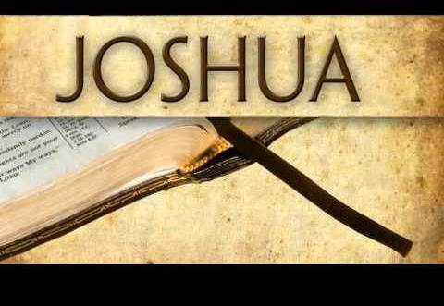


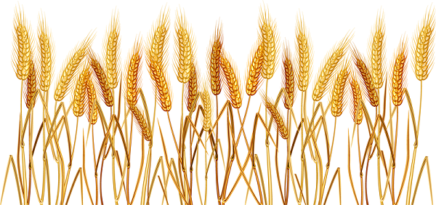
Part 3 of 3
Joshua’s First Observance
of Wave Sheaf in Canaan
Notes:
Tim to teach on Apr 4/21 Wave Sheaf: 6, 9-15; 22-24 and slide 40.
PPT ready to go,

Slide 2

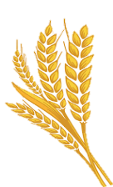
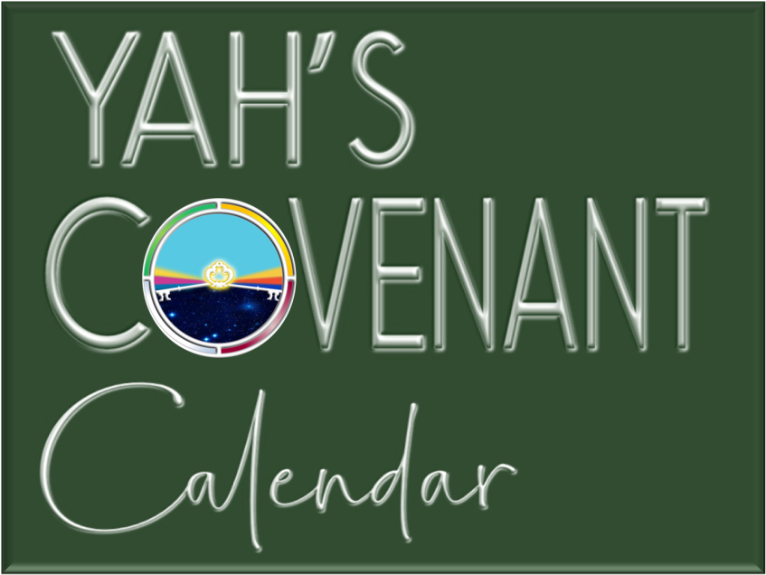


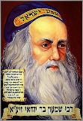
A teaching approx. 1451 BC just after Moses died.
Part 1
Rabbi
Rashbi
Visit: studythecalendar.com

Slide 3


Joshua’s Wave Sheaf
Part 3
How shall the correct method for Counting the Omer be determined?
What is the tradition of how Wave Sheaf became married to Abib 16?
We Shall See!

Slide 4

The Final Disclosure of Part 3
#2 Joshua
#3
History
Joshua has more information on Wave Sheaf dating and the Omer Count.
#1
Leviticus
& Numbers
Plus a statement on the historical aspect from the Hebrew Union College in the USA!

Slide 5
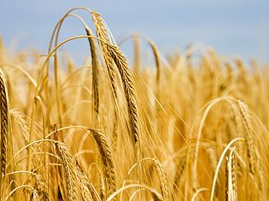

Beware of Error Giving Honour to Abib 16?
Yes ~ Beware & be aware:
A Wave Sheaf festival that is married to Abib 16 has no Scriptural foundation.
Also be aware of any suggestions that say:
Permission to eat the grain was not in effect until Abib 16.
If that were the case, this suggestion would eliminate
the word usage of “the same day.” Why?
Because Israel was given permission to eat the
grain of the land “on the same day”
the grain was used for the Wave Sheaf offering.
(Yes, the grain was harvested, threshed,
ground and baked for unleavened bread
that day – Abib 15! )
Understanding Wave Sheaf is a most
important part of Joshua’s study and
Torah Statutes to the end of time.

Slide 6

#11 Joshua Confirms:
Celebrating Wave Sheaf has priority before honouring the
1st Sabbath of Unleavened Bread.
It is way more significant because
Wave Sheaf is a prophecy given about 1500 years in advance of when Yahusha would ascend heavenward.
The celebration of Wave Sheaf
should never be a forgotten festival!
Question: When Abib 15 and the H7676 Sabbath share
the same date, which “Sabbath” has priority?

Slide 7
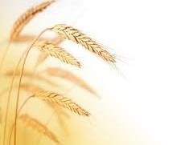
Many that honour the Feasts and Festivals understand the placement of
Wave Sheaf is always and ONLY on Abib 16.
In other words, WHEN Wave Sheaf is married to Abib 16, THEN it will float
on any day of the week from year to year. Why is this a problem?
Reviewing two of the reasons:
By statute - Wave Sheaf must follow the weekly H7676 Sabbath every year.
(It’s NOT possible for Abib 16 to follow the weekly Sabbath every single year!)
The correct prophetic “day of the week” as specified for the Wave Sheaf festival
of our Messiah’s “1st Ascension” is completely obliterated when tied to Abib 16.
For all those years the Yisra'elites would have been practicing foolishness!
R
E
V
I
E
W
Another Abib 16 Floating Wave Sheaf …
… Problem Needs to be Addressed in Category 3:
WHEN the Wave Sheaf is placed on Abib 16 following the
1st annual Sabbath of Unleavened Bread …THEN the
Counting of the Omer will NOT be accurate or correct.
As a result, the Pentecost festival will be seriously misplaced.

Slide 8

Instructions for Counting the Omer
Lev 23:15-16 And you shall count for yourselves from the day after the Sabbath ^{[H7676]}, from the day that you brought the sheaf of the wave offering: seven Sabbaths shall be completed.
16 Count fifty days to the day after the seventh Sabbath ^{[H7676]}; then you shall offer a new grain offering to [Yahuah]. NKJV
Pentecost can only follow a 7th Day Sabbath ^{[H7676]}
because there are no other annual
Sabbaths, or holy convocations,
close to this point in time for the
50th cycle to follow “after”!
The next set of charts will illustrate the problem, and the solution. Abib 14th Passover is placed on the 7th Day Sabbath as seen in the book of Joshua.

Slide 9
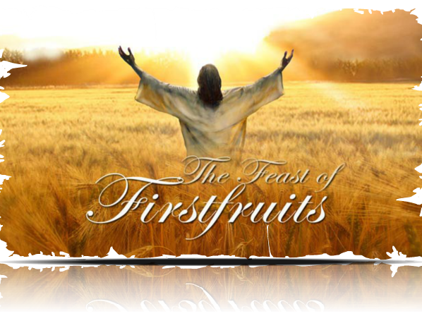
Chart #1
The Problem of a Floating Wave Sheaf on Abib 16 & the Omer Count

Slide 10

Counting the Omer from
Abib 16 Wave Sheaf
1st Cycle [Sun] | 2nd Cycle [Mon] | 3rd Cycle [Tues] | 4th Cycle [Wed] | 5th Cycle [Thur] | Prep Day [Fri] | Sabbath [Sat]
Day 1 Month 1 | 2 | 3 | 4 | 5 | 6 | 7
8 | 9 | 10 | 11 | 12 | 13 | 14 Passover
15 | 16 Wave Sheaf #1 | 17 #2 | 18 #3 | 19 #4 | 20 #5 | 21 #6
22 #7 | 23 #8 | 24 #9 | 25 #10 | 26 #11 | 27 #12 | 28 #13
29 #14 | 30 #15
??
Does not count as a complete week!
1st
Only 1 Completed Omer Week in the Month of Abib.
There needs to be six additional completed Sabbath weeks to the 50th day.

Slide 11

[Con’t] Counting the Omer from
Abib 16 Wave Sheaf
1st Cycle [Sun] | 2nd Cycle [Mon] | 3rd Cycle [Tues] | 4th Cycle [Wed] | 5th Cycle [Thur] | Prep Day [Fri] | Sabbath [Sat]
29 #14 | 30 #15 | Day 1 [M2] #16 | 2 #17 | 3 #18 | 4 #19 | 5 #20
6 #21 | 7 #22 | 8 #23 | 9 #24 | 10 #25 | 11 #26 | 12 #27
13 #28 | 14 #29 | 15 #30 | 16 #31 | 17 #32 | 18 #33 Day | 19 #34
20 #35 | 21 #36 | 22 #37 | 23 #38 | 24 #39 | 25 #40 | 26 #41
27 #42 | 28 #43 | 29 #44 | 30 #45 | Day 1 [M3] #46 | 2 #47 | 3 #48
4 #49 | 5 #50
2nd
3rd
4th
5th
6th
This 50th day does not follow a
H7676 weekly Sabbath (Lev 23:16).
??
Problems! Only 6 Completed Omer Weeks. This method does not fulfill Lev 23:15-16. The Omer Count is Incorrect!

Slide 12
Chart #2
Proper Placement of Wave Sheaf Solves the Omer Count

Slide 13

Counting the Omer from
Wave Sheaf Following the Sabbath
1st Cycle [Sun] | 2nd Cycle [Mon] | 3rd Cycle [Tues] | 4th Cycle [Wed] | 5th Cycle [Thur] | Prep Day [Fri] | Sabbath [Sat]
Day 1 Month 1 | 2 | 3 | 4 | 5 | 6 | 7
8 | 9 | 10 | 11 | 12 | 13 | 14 Passover
15 Wave Sheaf #1 | 16 #2 | 17 #3 | 18 #4 | 19 #5 | 20 #6 | 21 #7
22 #8 | 23 #9 | 24 #10 | 25 #11 | 26 #12 | 27 #13 | 28 #14
29 #15 | 30 #16
1st
2nd
2 Completed Omer Weeks in Abib

Slide 14
[Con’t] Counting the Omer from
Wave Sheaf Following the Sabbath
1st Cycle [Sun] | 2nd Cycle [Mon] | 3rd Cycle [Tues] | 4th Cycle [Wed] | 5th Cycle [Thur] | Prep Day [Fri] | Sabbath [Sat]
29 #15 | 30 #16 | Day 1 [M2] #17 | 2 #18 | 3 #19 | 4 #20 | 5 #21
6 #22 | 7 #23 | 8 #24 | 9 #25 | 10 #26 | 11 #27 | 12 #28
13 #29 | 14 #30 | 15 #31 | 16 #32 | 17 #33 | 18 #34 | 19 #35
20 #36 | 21 #37 | 22 #38 | 23 #39 | 24 #40 | 25 #41 | 26 #42
27 #43 | 28 #44 | 29 #45 | 30 #46 | Day 1 [M3] #47 | 2 #48 | 3 #49
4 #50 | 5
3rd
4th
5th
6th
7th
7 Perfect Completed Omer Weeks

Slide 15
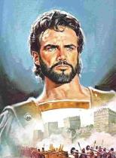
#12 Joshua Confirms:
When Wave Sheaf follows
the H7676 Weekly Sabbath,
(and begins the Omer Count #1)
there will be 7 perfect
completed weeks to
the 50th Day of Pentecost.
Does Pentecost have anything to do with H7676?

Slide 16
Back to this Very Important Note
1st (Sun) | 2nd (Mon) | 3rd (Tues) | 4th (Wed) | 5th (Thur) | 6th (Fri) | 7th (Sabb)
Abib 1 | 2 | 3 | 4 | 5 | 6 | 7
8 | 9 | 10 | 11 | 12 | 13 | 14 H7676 & Passover
15 Wave Sheaf | 16 | 17 | 18 | 19 | 20 | 21
Note: This is a sample calendar year for Joshua 5.
Many feast camps place the Wave Sheaf following the
Unleavened Bread Sabbath on Abib 16 every year.
The Torah instructions (& Joshua’s testimony) show
Wave Sheaf follows the weekly Sabbath within the Passover Festival – not the ULB Sabbath. This was shown by the use of the Hebrew number H7676 for the weekly Sabbath. If we did not have these numbers how would we know that Wave Sheaf doesn’t follow the ULB Sabbath?

Slide 17
Torah Instruction for Pentecost Count Without Hebrew Numbers
Wave Sheaf
Lev 23:11 ‘And he shall wave the sheaf before [Yahuah], for your acceptance.
On the morrow after the Sabbath the priest waves it.’
Note: This “Sabbath” could be understood to follow the ULB Feast Sabbath
if there were no Hebrew numbers to designate it was a weekly Sabbath.
Pentecost
Lev 23:15-16 And ye shall count unto you from the morrow after the Sabbath from the day that ye brought the [wave] sheaf of the wave offering; seven sabbaths shall be complete:
16 Even unto the morrow after the seventh Sabbath shall ye number fifty days; and ye shall offer a new meat offering unto Yahuah.
Note: Can this Pentecost “Sabbath” be understood to follow a
Feast Sabbath if there were no Hebrew numbers to designate a
weekly Sabbath in verse 16?

Slide 18
There are no Feast Sabbaths in the 3rd month! When the Omer count begins with an Abib 16 Wave Sheaf date ~ Pentecost will not follow the weekly Sabbath as Lev 23:16 designates!
No!
1st Cycle [Sun] | 2nd Cycle [Mon] | 3rd Cycle [Tues] | 4th Cycle [Wed] | 5th Cycle [Thur] | Prep Day [Fri] | Sabbath [Sat]
29 #14 | 30 #15 | Day 1 [M2] #16 | 2 #17 | 3 #18 | 4 #19 | 5 #20
6 #21 | 7 #22 | 8 #23 | 9 #24 | 10 #25 | 11 #26 | 12 #27
13 #28 | 14 #29 | 15 #30 | 16 #31 | 17 #32 | 18 #33 Day | 19 #34
20 #35 | 21 #36 | 22 #37 | 23 #38 | 24 #39 | 25 #40 | 26 #41
27 #42 | 28 #43 | 29 #44 | 30 #45 | Day 1 [M3] #46 | 2 #47 | 3 #48
4 #49 | 5 #50
In 6 out of 7 years it is impossible for a Pentecost count from Abib 16 to follow the weekly Sabbath!

Slide 19

Back to this Very Important Note
1st Cycle [Sun] | 2nd Cycle [Mon] | 3rd Cycle [Tues] | 4th Cycle [Wed] | 5th Cycle [Thur] | Prep Day [Fri] | Sabbath [Sat]
29 #15 | 30 #16 | Day 1 [M2] #17 | 2 #18 | 3 #19 | 4 #20 | 5 #21
6 #22 | 7 #23 | 8 #24 | 9 #25 | 10 #26 | 11 #27 | 12 #28
13 #29 | 14 #30 | 15 #31 | 16 #32 | 17 #33 | 18 #34 | 19 #35
20 #36 | 21 #37 | 22 #38 | 23 #39 | 24 #40 | 25 #41 | 26 #42
27 #43 | 28 #44 | 29 #45 | 30 #46 | Day 1 [M3] #47 | 2 #48 | 3 #49
4 #50 | 5 | 6 | 7 | 8 | 9 | 10
Wave Sheaf Torah Instruction:
Lev 23:11 ‘And he shall wave the sheaf before [Yahuah], for your acceptance. On the morrow after the Sabbath ^{[H7676]} the priest waves it.’
3rd
4th
Pentecost Torah Instruction:
Lev 23:16 Even unto the morrow after the seventh Sabbath ^{[H7676]} shall ye number fifty days …
5th
6th
7th
Both Wave Sheaf & Pentecost Must Follow
the H7676 Weekly Sabbath Every Year!

Slide 20


3rd Witness to Settle the
Challenge of Wave Sheaf Placement is:
Is there history around Abib 16?

Slide 21
The Unscriptural Traditional
Command of Wave Sheaf on Abib 16
Truth:
Wave Sheaf is always celebrated on the morrow after
the weekly Sabbath during the Spring Festivals.
This is ‘day one’ for Counting the Omer.
Omer means “sheaf.”
The command for Counting the Omer originates in Lev 23:15.
It is a mitzvah (commandment) to count the Omer for the seven complete weeks between Wave Sheaf and Pentecost.
Tradition:
The Wave Sheaf Festival is always fixed to the Abib 16 date
(as a floating Wave Sheaf / Firstfruits Festival).
Counting the Omer is according to Jewish tradition.
R
E
V
I
E
W
BRAND
NEW

Slide 22


Jewish Tradition Leads the Way
The Jewish Omer Count from Wave Sheaf to Pentecost
always begins on the third day of the Passover spring festival. Wave Sheaf always follows the 1st Sabbath of Unleavened Bread with celebrations on Abib 16.
There are also a series of restrictions that arise during the period of the counting of the Omer up until Lag Ba’Omer, which translates as the 33rd day in the count of the Omer. The tradition is: to mourn the first 33 days
until the 34th day in the morning.
For the Jews, a large portion of the seven-week counting period is considered a mourning period that ends with:

Slide 23



Lag Ba'Omer is a minor Jewish holiday that falls between the festivals of Passover and Pentecost.
In Jewish tradition, the 33rd day of the Omer Count is regarded as a holiday that commemorates the death of “Rashbi” [Rabbi Shimon bar Yochai] (80-160 AD).

Slide 24



Hebrew letters may be used to express numbers.
"Lag" is a combination of two Hebrew letters: Lamed and Gimmel.
The word “Lag” is an acronym for 33 – derived from Lamed (30) and Gimmel (3).
The phrase “Lag Ba’Omer” indicates
the 33rd day of the Omer Count.
This day is always celebrated on the
18th day of the second month on the Jewish Calendar.

Slide 25

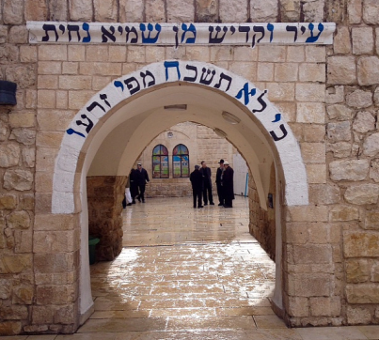
Who is Rabbi Shimon bar Yochai?
“RASHBI” [Rabbi Shimon bar Yochai] (80-160 AD), a disciple
of Rabbi Akiva (50-135 AD); is the author of the Zohar,
the most famous book of the Kabbalah.
Many Jews have witnessed miracles of all kinds after praying at his ‘holy’ grave site.
On the day of Rashbi’s death, he revealed the mystical dimension of the Torah known as the Kabbalah
(a form of Jewish mysticism).

Slide 26
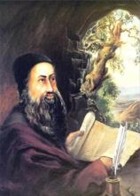

Rashbi’s Connection to Lag Ba’Omer
The day of his death was the 33rd day of the Omer Count.
Every anniversary celebrates this “hidden torah” or
the anniversary of the revelation of Kabbalah.
This Jewish holiday holds equal importance to Pentecost
[the giving of the written Torah to Moses].
Celebrations are held in the village of Meron, near Israel, at Rashbi’s supposed burial site.
Hundreds of thousands of Jews gather at
Mt Meron to pray and celebrate the Kabbalah.
MANY bonfires are lit at sunset on the 32nd
day of the Omer count to commemorate
the death of Rashbi.
(Remember: “sunset” on the 32nd ushers in the 33rd day according to Jewish tradition.)

Slide 27


Rashbi’s Connection to Year 2015
Next we will investigate the connection
of Lag B’Omer (or Omer count #33) in comparison to the year 2015 to note:
What happened world wide as well as in Israel during the year 2015?
How did the Jewish Lag B’Omer lay out on some popular 2015 lunar Festal calendars?
Will this solve some of the problems for the counterfeit count of Torah’s Wave Sheaf?
Example of
Posters &
Calendars

Slide 28
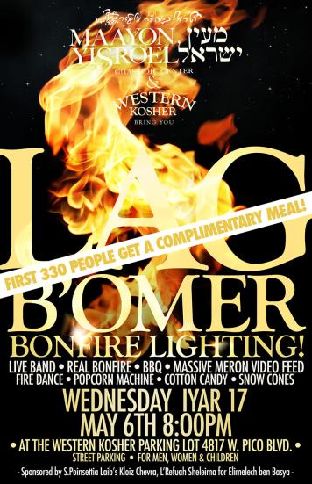

May 2015 Posters
Los Angeles

Slide 29

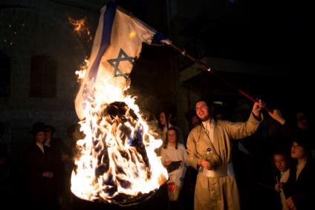
Lag Ba’Omer is a HUGE
Jewish Celebration
The internet is emphatic about this festive day
on the Jewish calendar.
It’s amazing the amount of internet coverage there was for May 7, 2015, Lag Ba’Omer, [the 33rd day of the Omer Count for 2015].
Every year this celebration is
attended with much fanfare
for Rashbi, (the great mystic
sage), on the anniversary
of his death.
There is more!

Slide 30
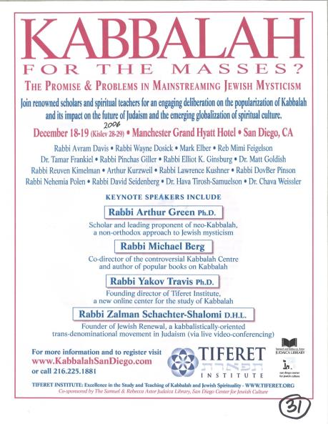

Lag Ba’Omer is Very Popular
New York City
2015
Excellence in the Study and Teaching of Kabbalah and Jewish Spirituality.

Slide 31
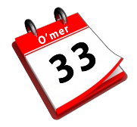
How Did Rashbi’s Death Get Connected to Wave Sheaf?
In the year Rashbi died the Jews could have been celebrating Wave Sheaf
(on the first day of the week),
according to the instructions in Lev 23.
(There is historical evidence of this.)
Therefore: The 33rd day of the Omer Count would be
the 18th day of the second month for THAT year only!
Remember: Rashbi died on the 33rd day of the Omer Count.
(That’s an interesting “mystical number.”)
For nearly 1860 years, RASBHI has been honoured
as a saint on every 33rd day of the Omer Count.
This day ALWAYS links back to Abib 16 as Wave Sheaf …
even if it is not the true Wave Sheaf!

Slide 32
Rashbi’s Death Changed the Correct Timing of Wave Sheaf!
This is how Wave Sheaf became permanently tied to Abib 16.
In THAT YEAR, Wave Sheaf could have been correctly located on Abib 16 – Sunday, the first day of the week. When Wave Sheaf
is married to Abib 16, it does not fall on the 1ST cycle every year.
Since that time, the 33 days are always counted back to the date of Abib 16 so that the Rabbi’s death would always be celebrated on the 18th day of the second month.
However, this event not only became a problem,
but is now a widely accepted counterfeit,
just as sunset is a counterfeit for creation’s day-start.
Be willing to challenge every teaching
to see if it links to a tradition!
Notes:
Beware of traditions that creep in so shrewdly!

Slide 33

Should Covenant Torah-Keepers
Observe Lag Ba’Omer?
No!
This Jewish holiday is not a Torah command.
It is derived entirely from Rabbinic
and occultic tradition.
Everything about this celebration is linked to
the mystical writings of Kabbalah.
Rashbi did not acknowledge Yahusha as the Messiah.
“Kabbalah” is a deceptive system of thought that seduces people into denying that they are sinners in need of salvation.
The Kabbalist believes each of us are essentially divine beings.
There is no need of any Saviour.
Everyone is pure, and just needs to be enlightened
(through the mystical worship of Lucifer).

Slide 34
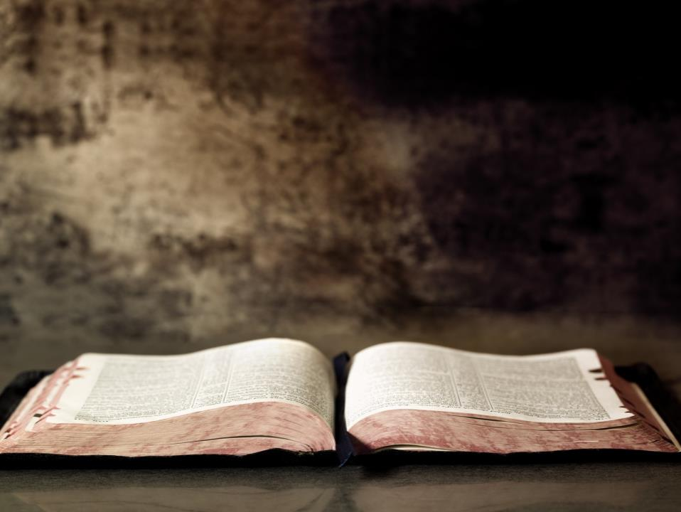
It is clear the traditional Wave Sheaf linked to only Abib 16 has strong ties to Kabbalistic ways including mysticism and all associated links
to the Jesuits and secret societies!
QUESTION:
Why are so many “so called”
Torah (Feast) Keepers
honoring Abib 16 when this date is
widely connected to such mysticism?
Maybe they just don’t know! Let’s tell them!

Slide 35

Lag Ba’Omer definitely counterfeits
the true meaning of Wave Sheaf!
Yahusha DID NOT ascend to heaven on any
day of the week except for the 1st cycle [Sunday]!
Should honest Torah Keepers
sever their connection to a yearly
Abib 16 Wave Sheaf?
Yes!
Absolutely!

Slide 36
Does that mean the Wave Sheaf Festival is NEVER on Abib 16?
R
E
V
I
E
W
There is no rule that Wave Sheaf
can never occur on Abib 16.
If Passover is on Friday Abib 14 …
THEN: Abib 15 is the 7th Day Sabbath AND
the Unleavened Bread Sabbath …
THEREFORE: Abib 16 celebrates Wave Sheaf
(on the “day after the weekly Sabbath”
as given in Scripture).
No!
Many Feast-keepers and ministries have Wave Sheaf married to Abib 16.
It behoves us to wonder how they missed the clear instructions
from the Torah. The result?
Wave Sheaf on Abib 16 becomes a floating date on the calendar
demanding Pentecost is also allocated to a floating date.
On the next slide: Let’s examine a calendar from a Christian Feast
ministry with their Wave Sheaf/Firstfruits Festival married to Abib 16.

Slide 37
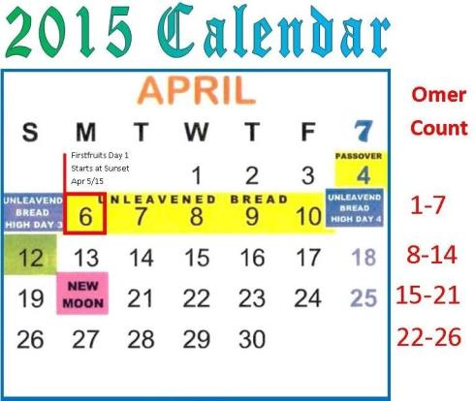
A Christian Calendar for Wave Sheaf
The Question is:
How will the following Christian Feast Calendar compare to the traditional Jewish calendar for 2015?
Day One of the Omer Count begins at sunset on Sunday Apr 5th. Wave Sheaf is Monday Apr 6th.
Will Day 33 of the Omer Count land on Thursday May 7, 2015 exactly like the Jewish calendar?

Slide 38
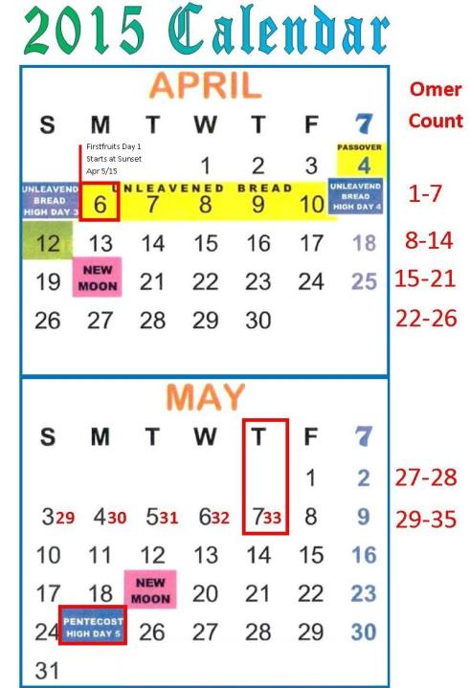
Answer:
Christian Feast Keepers that follow this Jewish calendar likely do not know the 33RD day of the Omer count pays respect to the great mystic sage Rashbi!
When they find out, perhaps they will celebrate the Wave Sheaf/Firstfruits festival according to the instructions of Moses and Joshua.
This Christian Feast
Calendar does
favor Lag Ba’Omer which begins at
sunset on May 6th!
May 7th is the 33rd day.

Slide 39
Endorsement from J. Morgenstern Hebrew Union College (Indiana)
“Actually the legislation for the bringing of the ‘Omer, the first sheaf of the new, annual crop, is recorded in only one passage of the entire Pentateuch, Lev. 23:9-16 … This legislation provides that the ‘Omer is to be waved before Yahweh by the priest upon the day following the Sabbath … The basic difficulty here is the determination of the precise dating implicit in the term, “the day after the Sabbath.” The customary interpretation, accepted by most present-day biblical scholars, is that the Sabbath here is the Sabbath which falls within the week of the Passover-Massot Festival. Such too was the interpretation given of old to this term by three quite ancient Jewish sects, the Samaritans, the Boethusians and the Karaites. This would imply, of course that the day of bringing the ‘Omer was always a Sunday, and also since the counting of the fifty days which intervened between the day of bringing the ‘Omer and the Sabu’ot Festival commenced upon a Sunday, the latter festival also would fall always upon a Sunday…”
(Hebrew Union College [Originally founded 1875; Besides Israel, 5 colleges in USA]
Annual – Article: ‘Lag ba’Omer – Its Origin and Import’ by Julian Morgenstern,
[a President of] Hebrew Union College -Jewish Institute of Religion, p. 81-90.)
Yes!

Slide 40
Besides “History,” Morgenstern’s
Testimony, and the witness
in the Exo 12-16-19 account
of Passover to Pentecost …
#13: Joshua also Confirms:
Wave Sheaf is not married to Abib 16 –
the day following the 1st Sabbath of Unleavened Bread;
Wave Sheaf is always placed
within the Passover Festival
contrary to Enoch’s teaching.

Slide 41

Counsel From the Apostle Paul
Ephesians 5:8-13
8 For you were once darkness, but now you are light in [yahuah]. Walk as children of light
9 (for the fruit of the Spirit is in all goodness, righteousness, and truth),
10 finding out what is acceptable to [Yahuah].
11 And have no fellowship with the unfruitful works of darkness, but rather expose them.
12 For it is shameful even to speak of those things which are done by them in secret.
13 But all things that are exposed are made manifest by the light, for whatever makes manifest is light. NKJV

Slide 42
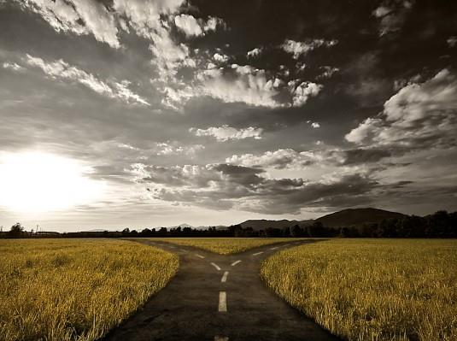
It’s very possible many do not understand it is
“complete darkness” to consistently celebrate
Wave Sheaf on Abib 16.
Lev 23 along with Joshua, Exodus and the Gospel account expose the unfruitful works of darkness.
Once the evidence is brought forth,
everyone must make their choice.

Slide 43
Comparing the Evidence
R
E
V
I
E
W
Wave Sheaf by
Tradition
Wave Sheaf by
Scripture
When Wave Sheaf
is consistently celebrated on Abib 16, it links to a Rabbi that gravitated towards the darkness of mysticism and Kabbalah which has powerful ties to the “prince of darkness.”
When Wave Sheaf is celebrated
on the “Morrow after the weekly Sabbath” it links to our Messiah when He presented Himself as “THE leading First-Fruit” after His resurrection. Wave Sheaf links to that ascension event – a powerful victory for His children. This is extremely significant and important because it is one of
the most basic events known to man providing the foundational [bone] structure of the Plan of Salvation.

Slide 44


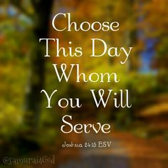
Wave Sheaf Festival Choices
The tradition of Abib 16 pales
in comparison
to the Torah Truth of the Wave Sheaf Festival!
Wave Sheaf Following H7676 Sabbath honoring Yahusha’s Ascension & Victory for US!
Wave Sheaf Following ULB Sabbath on
Abib 16 honoring
Rashbi & Kabbalah Mysticism?

Slide 45

1 Corinthians 14:33, 40
For Yahuah is not the author of confusion …
Let all things be done decently and in order.
May Yahuah
bless you abundantly
in your search
for His
Divine truth.
The End

Slide 46
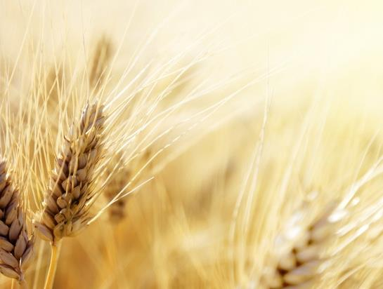



Questions/Comments
on the placement
of Wave Sheaf Pt 3?
questions@studythecalendar.com
www.studythecalendar.com

