Slide 1
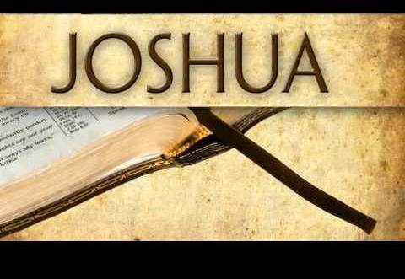


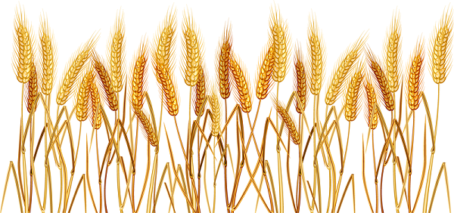
Part 1 of 3
Joshua’s First Observance
of Wave Sheaf in Canaan
Notes:
Apr 4/21 Wave Sheaf: Slides for Tim to teach: Pt 1 they are: 7-18; 24-29 & 44.
PPT is ready to go.
Apr 4th – more corrections in the morning – make the pdf of this file. charlene

Slide 2


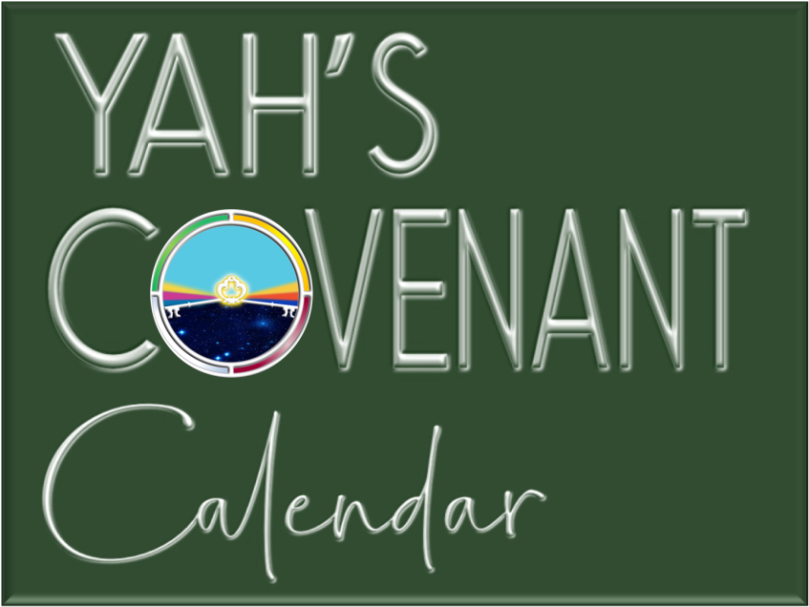
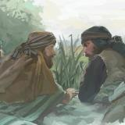


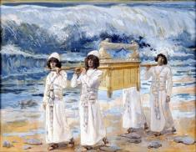
A teaching approx. 1451 BC just after Moses died.
Dec 24/20 Daud:
Charts 13, 17 & 18 needed abib 6 changed on all the dates of the week.
Changed the email at the end to just “questions”
Mar 30/21: revised for passover 2021
730 AM to
Part 1
Visit: studythecalendar.com
Notes:
Mar 2019 changes: took out 3rd hour Wave Sheaf for “early pre-sunrise moment” and covered some of the calendar boxes for teaching control.
To all of our Covenant Calendar members, we welcome you again this week. We had at least 6 new "calendar homes" visit us last week, which has to represent at least 6 new people, maybe even 12! The week before had several new people as well, so our Calendar Family is growing and is a very unique wonderful gathering on friday evenings. If you are reading this announcement, and have not joined a LIVE zoom meeting, please consider treating yourself soon.
We've try to lay out the plans for the weekly meetings as we go along, but sometimes the best plans (in our mind) need to be changed. So, here we are again with a slight change, and hopefully the best option for everyone.
The last presentation on the "6th Cycle Cruci-fiction" did announce that the next presentation would be Matt 28 addressing the "12 or 24 hour Sabbath" ... and had a date of Mar 15/19 ... which we announced before the study began, the Matt 28 study will be post-poned at least to May 3rd or thereabouts. But for any that saw that slide outside of the zoom meeting, we want to correct that timing in this announcement.
Now, here's the change for this week: Normally, the 2nd week is a "hangout" where we have been doing special things for testimonies, question, comments and answers addressing calendar material. Due to the fact that Passover is right around the corner, housing the Feast of Unleavened Bread ... AND ... the Festival of Firstfruits, we have decided this is the time to once again revisit the Joshua study originally given Mar 2/18. For those of you that have seen this already, we're sure this will be a good review, and for our newcomers, a real treat.
Since completing this study, we have realized that the Festival of Firstfruits is of such great importance - that it is time everyone knew about this. How many of us have been to a full 8 day Passover feast - we observe the Unleavened Bread Sabbaths, and the whole week -- without ever giving a thought to Firstfruits? Many feast camps we have been to never even mention Firstfruits, never mind teaching what meaning this day has for each and every follower. It is of extreme importance. Imagine finding this information in the early chapters of Joshua as he enters the land of Canaan? Yes, that was the command: to keep Firstfruits "when they entered the land." So, this feast was not honored in the 42 years of wilderness wanderings.
A few things that will be addressed in Joshua (besides the DAWN day) are:
Many place Firstfruits on Abib 16 every single year. In fact, they have married Firstfruits to Abib 16. Is this what Yahuah intended, and is this what Joshua commanded? Do you really want to know for sure which "cycle" of the week Firstfruits is to be observed?
Is there a Scriptural stipulation that any (or all) of the feasts and fesitvals can never be celebrated on a weekly Sabbath? What does Joshua have to say about that?
The weekly Shabbat is linked to the Hebrew number H7676. Have you been taught the annual Sabbaths are linked to H7677? Is that really true, and does it really matter? Why, or why not?
Does the traditional date for Firstfruits (of Abib 16) within Judaism today align with Torah? If not, what happened, and is there historical documentation to expose what has happened around this unique festival? Whose idea would it be to remove the true value and meaning of Firstfruits?
Should Firstfruits fall within the week of the Passover festival, or is it OK for Firstfruits to be found "outside" the week of the Spring Festivals? Will Joshua give us solid confirmation about this?
Firstfruits is the first day of the Omer count. If Firstfruits is not placed on the proper divine setting, how does this affect the count to Pentecost, and how would that cause a problem for the calendar timing of Exo 19:1?
How important is Firstfruits to you this day? Are you ready for a new experience ... one that will forever change your understanding of who your Messiah is, and actually pinpoints to ONLY the true Messiah?
These are just a few of the more important points in the Joshua study that are well to be reviewed on a regular basis. It is of great importance, as Joshua was appointed to fill the "big shoes" of Moses ... being at his side for 40 years of training. He did not make one mistake about calling the attention to the importance of Firstfruits for the people making this grand entrance into Canaan. If it is that important for them, it is of more importance to us today.
We hope you will be blessed with this teaching and that it will forever impress your mind with these awesome truths, and that you will have a "ready answer" for all that ask of you. Come and join us for fun and learning. This will not be recorded, so Tim & Charlene can teach at the pace of the group - especially for our newcomers.
See you on (Mar 8/19) the 23rd day of the 12th month (353 days of the 360 count) - at the zoom meeting for Covenant Calendar.

Slide 3
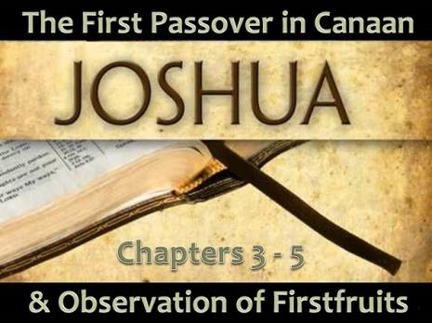
Joshua Enters Canaan –
Covenant Calendar Club
<www.studythecalendar.com>
Note: This study is a revision
of the first study on Joshua in 2018. Both studies have ample evidence from Joshua on:
Three interesting patterns
for “counting to 3.”
Comparisons between Joshua and [the popular] Enoch/Zadok calendar count for placement of Passover and Wave Sheaf Festivals. [Enoch term will be used.]
Comparisons between Joshua and lunar Sabbath reckoning.
Solid confirmation on statute placement for Wave Sheaf.

Slide 4
Restoration of Yahuah’s Calendar
For those that wish to follow Yahuah in His footsteps, responding in worship and adoration … honoring the Sabbatical worship statutes and festivals is of utmost importance.
However, the enemy has been very clever. He has managed to get many of Yahuah’s sincere followers sidetracked when it comes to honoring Yahuah’s appointed times, giving homage to man’s pagan traditions & counterfeit festal calendars that have replaced many/all Divine Appointments.
Restoration of Yahuah’s Divine Calendar is a huge task that has been in the search engines of many for a long time.
The good news is there are a few who believe Yahuah’s perfect Divine Calendar has been restored through a careful search of the Scriptures.
There’s even better news than this: Yahuah’s Divine calendar is simple, easy, logical and elegant. Yes … elegant and pleasing!

Slide 5
Restoration of Yahuah’s Wave Sheaf
Some things to consider about restoration …
even though the weekly Sabbath has been restored to commence at dawn rather than sunset, midnight, sunrise etc.;
even though the commencement of the new month has been restored by just counting to 30 instead of searching for the barley ripeness and/or lunar phases;
even though the commencement of the new year has been restored by waiting for the spring equinox to usher out the
old year through observation of the “shadow sign” and begin the new year the next day (instead of waiting for the confirmation of moon phases, or the barley ripeness, etc.);
…there can still be confusion over the placement of the
Wave Sheaf festival, which ultimately affects the
placement of Pentecost 50 days later.

Slide 6

Wave Sheaf Needs Restoration?
Is there really confusion over the placement
of Wave Sheaf? Could that be so?
Some may say: “Well, it doesn’t really matter, because Wave Sheaf isn’t that important anyway! My feast camp never pays too
much attention to the Wave Sheaf Festival
so it can’t be that crucial!”
If there is any question about the placement
of Wave Sheaf and Pentecost, the best thing
to do is check it out with Scripture.
Joshua will walk us through the proper placement of Wave Sheaf through the wonderful encounter Israel experienced
when they finally entered the Land of
Canaan after over 40 years.
Sometimes
Wave Sheaf
is also known as
“Firstfruits”
during the
Passover festival.

Slide 7

Wave Sheaf Festival Options
This study is going to examine the two main ways the Wave Sheaf Festival is celebrated.
No matter what day Wave Sheaf
is celebrated on, the 50 day Omer Count establishes the placement
of Pentecost on the same “day of the week” as Wave Sheaf.
Both are affected equally.
This study will offer these 2 options.
Wave Sheaf Follows
1st Unleavened Bread
Sabbath on Abib 16??
Wave Sheaf Follows H7676 Sabbath Within the Passover Festival??
Or … Neither!

Slide 8

Several Testimonies for Proper
Placement of Wave Sheaf
For a long time it seemed Lev 23 & Num 15 were the only witnesses for proper placement of Wave Sheaf. There are now 3 more strong additional witnesses from Scripture, plus the secular historical account to help us understand the Divine placement of Wave Sheaf.
Leviticus 23:12-16; Num 15:18-19
Exodus 12 – 16 – 19 Study
Joshua 3-5
Gospel Account including:
a) Wednesday Crucifixion
b) Sabbath Resurrection
c) 1st day Ascension
Secular History around “Rashbi” [Rabbi bar Yochai] & a quote from
Julian Morgenstern [in Part 3].
#3
#4
#5
#2
#1

Slide 9


This Complete Study Covers:
#2 Joshua
#3
History
#1
Leviticus
& Numbers
Joshua includes 3 sets of counting patterns for:
Plus a statement from Hebrew Union College in the USA!

Slide 10
Joshua’s Study Proves:
#2 Unleavened Bread Sabbath
on Abib 15
#3 Wave Sheaf is
placed on Abib 15 – NOT Abib 16!
#1 Passover & weekly Sabbath are on
Abib 14
Are you ready?

Slide 11
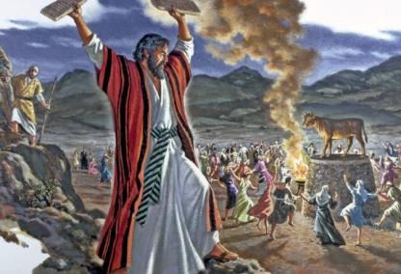
No Observance of Wave Sheaf in the
Wilderness
Because of Israel’s sin with the
golden calf, a whole new set of laws for the Aaronic Priesthood, sanctuary services and sacrificial laws were commanded upon
the people.
Shortly after the sanctuary was raised up, Israel sinned again by refusing to enter Canaan based
upon an evil report of the
ten spies.
Since Moses would not be leading the children into the land of Canaan, Yahuah did give explicit instructions on how to observe the “first” Wave Sheaf upon their entrance.
There were no rehearsals for Wave Sheaf
in the 40+ years
of the wilderness.

Slide 12
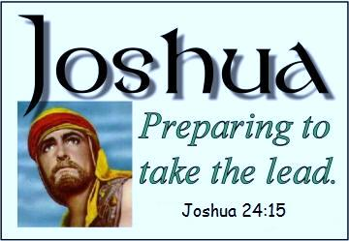
1st Observance of Spring Feasts
(Canaan)
Joshua will show the exact
day of the week for the observance of:
Passover: on Abib 14 - the
7th Day Sabbath!
Wave Sheaf: on Abib 15.
The 1st day of Unleavened Bread: on Abib 15.
This information is necessary
to understand the following charts.
Note: This study is based
on the day beginning
with “dawn”
… not “sunset.”
We are now ready to launch into
the 3 patterns of counting:

Slide 13
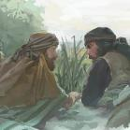
Joshua 1: Prepare the People
Joshua 1:1-9 [Summary] Joshua’s book begins with the Divine commission
to go in and take the land of Canaan. The promise is given in verse 3 that
wherever the soles of their sandals tred, the land is reserved for Israel.
Joshua 1:10-22 Joshua gives commands to the officers for “taking the land.”
Joshua 1:11
  "Pass through the camp and command the people, saying, ‘Prepare provisions for yourselves, for within three days you will cross over this Jordan, to go in to possess
  the land which [Yahuah your Elohim] is giving you to possess.’" NKJV
Chart #1 of 7 (Manna is still being provided.)
Box 1 Cross over the Jordan in 3 days.
(Note: The 3 days do not include Abib 6.)
After the 3rd day, Israel will cross the Jordan.
1st Day
2nd Day
3rd Day
1st Set of “Counting to 3”
 | 6th Cycle Friday Abib 6 |  | Abib 6 Night |  | 7th Cycle Sabbath Abib 7 |  | Abib 7 Night |  | 8th Cycle Sunday Abib 8 |  | Abib 8 Night |  | 9th Cycle Monday Abib 9 |  | Abib 9 Night
Question: Will the calendar events stem from Abib 6?
Notes:
Chart #1 of 7 Make sure you understand why the blue brackets are placed on this chart, as the next chart will also include a set of pink brackets. They are not the same.

Slide 14

#1 Joshua Will Confirm:
Abib 14 is the weekly Sabbath.
1st (Sun) | 2nd (Mon) | 3rd (Tues) | 4th (Wed) | 5th (Thur) | 6th (Fri) | 7th (Sabb)
Abib 1 | 2 | 3 | 4 | 5 | 6 | 7
8 | 9 | 10 | 11 | 12 | 13 | 14
Therefore, by default, Abib 1
must be a 1st cycle [Sun.] in the year
when Israel “enters the land.”
Abib 10 is a special “day & date” as well.

Slide 15
Joshua’s calendar year does not follow the Enoch calendar.
R
E
V
I
E
W
1st (Sun) | 2nd (Mon) | 3rd (Tues) | 4th (Wed) | 5th (Thur) | 6th (Fri) | 7th (Sabb)
Abib 1 | 2 | 3 | 4 | 5 | 6 | 7
8 | 9 | 10 | 11 | 12 | 13 | 14
#1a Enoch Calendar Claims:
Abib 1 is always on the 4th cycle [Wed.]
Only in the Enoch months 3, 6, 9 & 12 will the
14th day of the month align with the
7th day Sabbath of the week.
1st (Sun) | 2nd (Mon) | 3rd (Tues) | 4th (Wed) | 5th (Thur) | 6th (Fri) | 7th (Sabb)
 |  |  | Abib 1 | 2 | 3 | 4
5 | 6 | 7 | 8 | 9 | 10 | 11

Slide 16
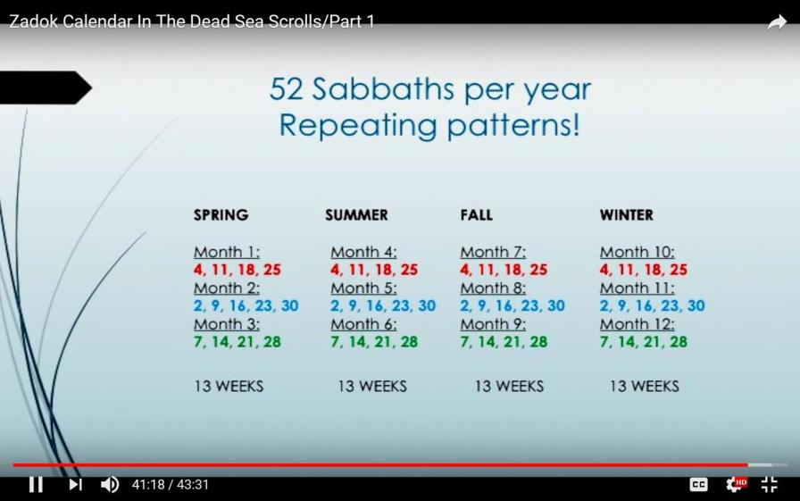

Enoch/Zadok Dated Sabbaths
Let’s look for a Sabbath that exists on the 14th cycle of the 1st or 2nd month of Enoch/Zadok!
A 14th?
No 14th!
No weekly Sabbath exists
on the 14th cycle in the
1st or 2nd calendar months!

Slide 17

Joshua 2: Rahab & the Spies
Chart #2 of 7 (Spies receive instructions to hide 3 days in the mountains.)
It appears that Joshua fully expected the spies to complete this assignment on the Day Season of Friday and be back to camp before Sabbath.
However, the plans were delayed due to suspicions from residents in Jericho.
Box 2 Joshua sends out 2 spies.
Box 3 Rahab hides the spies.
After the 3rd day, Israel will cross the Jordan.
1st Day
2nd Day
3rd Day
1st Day
2nd Day
3rd Day
 | 6th Cycle Friday Abib 6 |  | Abib 6 Night |  | 7th Cycle Sabbath Abib 7 |  | Abib 7 Night |  | 8th Cycle Sunday Abib 8 |  | Abib 8 Night |  | 9th Cycle Monday Abib 9 |  | Abib 9 Night
Box 4 Jericho gates close when it is dark. Rahab declares the spies left before the gates closed.
Box 6 Spies are to hide 3 days in the mountains to the Night of Abib 9.
2nd Set of “Counting to 3”
Box 5 Rahab did not send them away until it was dark! The three days for the spies commenced from the time they fled to the mountains – not from “dawn.”

Slide 18

Joshua 3: Prepare to Cross Jordan
The Spies Return
Abib 9 [Mon] Evening/Night
Joshua 3:2 And it came to be,
after three days, that the officers
went into the midst of the camp,
Busy Abib 9 [Mon] Night
Joshua 3:3 and they commanded
the people, saying, “When you see
the ark of the covenant of [Yahuah
your Elohim], and the priests, the
Levites, bearing it, then you shall set
out from your place and follow it.
Early on Abib 10 [Tues] Morning
Joshua 3:1 And Joshua rose early in
the morning, and they set out from
Shittim and came to the Jordan, he and
all the children of Israel, and stayed
there before they passed over.
1st Day
2nd Day
3rd Day
1st Day
2nd Day
3rd Day
 | 6th Cycle Friday Abib 6 |  | Abib 6 Night |  | 7th Cycle Sabbath Abib 7 |  | Abib 7 Night |  | 8th Cycle Sunday Abib 8 |  | Abib 8 Night |  | 9th Cycle Monday Abib 9 |  | Abib 9 Night
The next chart picks up from [Monday] Abib 9.

Slide 19
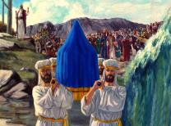
Joshua 3: Crossing the Jordan
3rd Day Before Crossing the Jordan
Chart #3 of 7 (A very memorable day.)
The DAY of CROSSING OVER!
3rd Day ~ Spies Return
 | 2nd Cycle Abib 9 Monday |  | Abib 9 Night |  | 3rd Cycle Abib 10 Tuesday |  | Abib 10 Night
Box 7
Spies return Abib 9 after hiding 3 days.
Box 8 Officers give commands for the Ark of the Covenant.
Box 10 Joshua rose early in the morning (10th day) and he set out for the Jordan with Israel.
Box 12 Yahuah said to Joshua, “This day [10th]
I will begin to exalt you in the sight of all Israel.”
Box 9 People are to sanctify themselves, for tomorrow (10th day) there will be wonders.
Box 11 The priests
take up the Ark of the Covenant and cross over before the people.
Box 13 About
40,000 crossed over Jordan on the tenth day of
the first month.

Slide 20
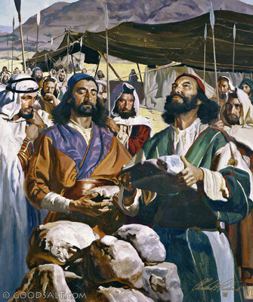
Joshua 4: Jordan Memorial Stones
When all of the people had completely crossed over the Jordan, the next Divine Command to Joshua was
to select twelve men
to represent every tribe.
They were to bring memorial stones back from the river bed of the jordan to erect as an altar for a permanent sign of the “crossing of the Jordan” on the 10th day of the 1st month.

Slide 21
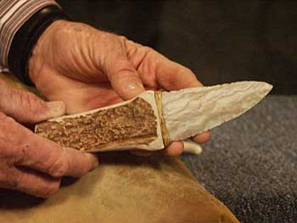
Joshua 5: Men Circumcised
Josh 5:2-3, 8-9
2 At that time [Yahuah] said unto Joshua,
Make thee sharp knives, and circumcise
again the children of Israel the second time.
3 And Joshua made him sharp knives, and circumcised the children of Israel at the hill
of the foreskins.
8 And it came to pass, when they had done circumcising all the people, that they abode in their places in the camp, till they were whole.
9 And [Yahuah] said unto Joshua, This day
have I rolled away the reproach of Egypt
from off you. Wherefore the name of the
place is called Gilgal unto this day. KJV
At this point the Scriptures bring the events to Abib 13.
1st Day
2nd Day
3rd Day
 | 3rd Cycle Tuesday Abib 10 |  | Abib 10 Night |  | 4th Cycle Wednesday Abib 11 |  | Abib 11 Night |  | 5th Cycle Thursday Abib 12 |  | Abib 12 Night |  | 6th Cycle Friday Abib 13 |  | Abib 13 Night

Slide 22
Joshua 5:2-9 Men Circumcised
Chart #4 of 7 (This event reaches to the day before Passover.)
Jordan was crossed on
the 10th day of the 1st month.
All men were circumcised before the Passover and leaving Egypt.
No circumcisions done in the wilderness.
The rest must be circumcised before celebrating Passover in Canaan.
3rd Set of “Counting to 3”
1st Day
2nd Day
3rd Day
 | 3rd Cycle Tuesday Abib 10 |  | Abib 10 Night |  | 4th Cycle Wednesday Abib 11 |  | Abib 11 Night |  | 5th Cycle Thursday Abib 12 |  | Abib 12 Night |  | 6th Cycle Friday Abib 13 |  | Abib 13 Night
Box 14 Flint knives were made to circumcise the sons of Israel.
Box 17 Following the pattern in Gen 34, it can be expected the men
will need at least 3 days of healing hampering any desire to harvest
“old or new grain” of the land! On the 4th day they should be
feeling better just in time for Passover on Abib 14, the next day.
Box 15 After circumcising,
the men stayed in their camp places till they were healed.
Question: How long would it be till they were healed?
Box 16 Gen 34:24-25 has some clues for the healing process. [Story of Simeon, Levi, {Dinah}, Hamor &
the slaying of the Shechemites.]
24 … every male was circumcised, who went out of the gate; 25 … on the third day, when they were in pain …

Slide 23
#2 Joshua Will Confirm:
Abib 11 was the 4th cycle of the week [Wed.] (when the circumcising began).
#2a Enoch Calendar Claims:
Abib 1 is always placed on the 4th cycle [Wed.]
On Enoch’s calendar, Abib 11
always claims a weekly Sabbath.
Joshua does not agree with Enoch’s reckoning.
1st (Sun) | 2nd (Mon) | 3rd (Tues) | 4th (Wed) | 5th (Thur) | 6th (Fri) | 7th (Sabb)
Abib 1 | 2 | 3 | 4 | 5 | 6 | 7
8 | 9 | 10 Crossing the Jordan | 11 | 12 | 13 | 14
1st (Sun) | 2nd (Mon) | 3rd (Tues) | 4th (Wed) | 5th (Thur) | 6th (Fri) | 7th (Sabb)
 |  |  | Abib 1 | 2 | 3 | 4
5 | 6 | 7 | 8 | 9 | 10 | 11

Slide 24
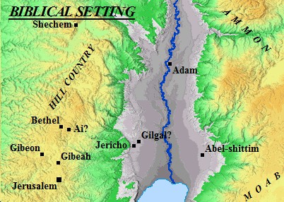

1st Passover Celebrated in Canaan
Josh 5:10 And the children of Israel encamped in Gilgal, and kept the Passover
on the fourteenth day of the month at
even in the plains of Jericho. KJV
Can the Passover and
the weekly Sabbath share the same “day” without Scriptural conflict?
We are still assuming Passover will be on
Sabbath Abib 14.
It will be exposed solidly later in the study.
Remember:
No manna is sent on Sabbath.

Slide 25
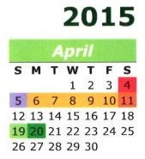
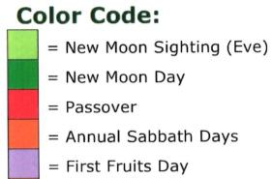
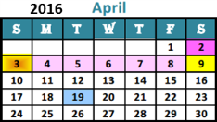
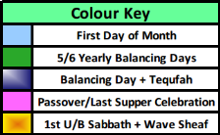
Passover on a 7th Day Sabbath?
Can Passover really occur on the weekly Sabbath?
Should Passover ever be celebrated on the weekly Sabbath? Or …
Should the Festal Calendar be adjusted so Passover never falls on the
weekly Sabbath? These are important questions.
Below are 2 calendars for 2015 and 2016 – the first is a 2015 Luni-Solar Feast Calendar; the next a 2016 Covenant Feast Calendar … both demonstrating the yearly Passover falling on the weekly Sabbath. (Wondering about a Jewish Calendar?)
2015 Luni-Solar Feast Calendar
April 4 (Sabbath): Passover
April 5 (Sunday): Unleavened
Bread Feast & First Fruits
2016 Covenant Feast Calendar
April 2 (Sabbath): Passover
April 3 (Sunday): Unleavened
Bread Feast & Wave Sheaf
Notes:
It really is OK to have Passover on Sabbath. Sacrifices were offered every day; all the Sabbaths had extra sacrifices according to Num 28.

Slide 26
#3 Joshua will be celebrating Abib
14 Passover on the weekly Sabbath. There is no need to adjust the date.
#3a Many Jewish calendars are:
adjusted to avoid the celebration
of certain feasts on
the weekly Sabbath.
Passover & Day of Atonement
are two of these feasts.

Slide 27

Does a Sabbath Passover
Demand Servile Work?
Some feel if [Abib 14] Passover falls on the weekly Sabbath, then Passover should be moved to Abib 15 so the commands of both the 7TH Day Sabbath and Passover can be honoured without conflict.
Even today some of the Jews’ calculations for Jewish festivals are arbitrary and
set by men, not Scripture.
Their annual festivals can be off as much as two days from the original day ordained by THEIR Jewish calendar commands especially IF the annual feasts occur on, or close to, the weekly Sabbath. There is no Scriptural command to exempt Passover from falling on the weekly Sabbath.
As has been noted, the preparations for
Passover can be done on the Preparation
day. The extra Passover sacrifice was not
a Sabbath violation according to Scripture.
No! Passover does not need to be moved.
Notes:
It really is OK to have Passover on Sabbath. Sacrifices were offered every day; all the Sabbaths had extra sacrifices according to Num 28.

Slide 28
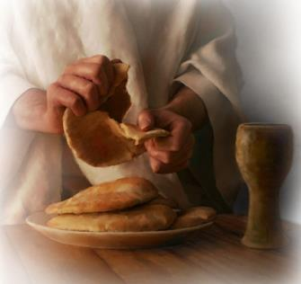
The Unleavened Bread for
1st Passover in Canaan
Even though Israel was in the land of Canaan with grain all around them, the scriptural command was firm: Israel was not allowed to touch any of the Old or New grain for their unleavened bread at the Passover meal on Abib 14.
We are still assuming
Passover is on the
7th Day Sabbath.
Lev 23:6 And on the fifteenth day
of the same month is the feast of unleavened bread unto [Yahuah].
The first partaking of unleavened bread (from grain) became part of the festival on Abib 15 after the Wave Sheaf ceremony was completed.
Let’s place the 1st Sabbath of Unleavened Bread
(Abib 15) on the chart.

Slide 29
Passover (14th) Unleavened Bread (15th)
Chart #5 of 7 Josh 5:10 [Passover] Josh 5:11 [Unleavened Bread]
Box 18 The children kept the Passover on the 14th day of the month at even in the plains of Jericho.
Box 19
Remember the Original Passover Commands:
Exo 12:8, 10 They shall eat the flesh on that night … any of it that is left until morning you shall burn with fire. You shall not leave any of it until morning; any of it that is left until morning you shall burn in the fire.
Dawn Cycle Exchange Right Here
 | 7th Day Abib 14 Passover & Weekly Sabbath |  | Abib 14 Passover Night |  | 1st Day Abib 15 Unleavened Bread Sabbath |  | Abib 15 Night
We are still
assuming Passover
is on Sabbath.
Box 20
Abib 15th [1st ULB Sabbath]
Lev 23:6 And on the fifteenth day of the same month is the feast of unleavened bread unto Yahuah.

Slide 30
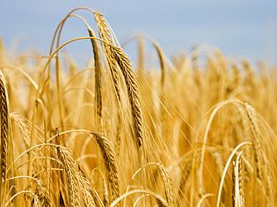
Passover (14th) ~ Wave Sheaf (15th)
Josh 5:11 And they did eat of the old corn [grain] of the land
on the morrow after the Passover, unleavened cakes,
and parched corn in the selfsame day. KJV
morrow - Brown-Driver-Brigg’s - H4283 <mochorath>
    the morrow
    tomorrow
    the day after
Hebrew Definition for “morrow”
None of these definitions are timed anywhere near sunset!

Slide 31
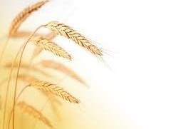
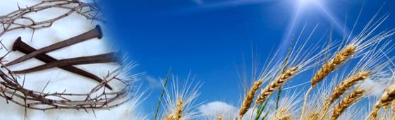

Passover (14th) ~ Wave Sheaf (15th)
Josh 5:11 is specific: the grain is eaten on the “to-morrow after the Passover.”
Note: The “t0-morrow” begins with the “boqer (morning twilight mixture.)”
The Wave Sheaf Festival begins at boqer twilight.
FINALLY: AFTER THE Wave Sheaf CEREMONY, ISRAEL WAS Allowed to take of the “old or new” grain TO MAKE UNLEAVENED BREAD ACCORDING TO THE STATUTE.
Wave Sheaf is established on Abib 15.
We are still assuming Passover
is on the 7th Day Sabbath.

Slide 32
#4 Joshua has Confirmed
Wave Sheaf occurred on Abib 15 –
the morrow after Passover [not Abib 16,
the morrow after the 1st Unleavened Bread Sabbath].
1st (Sun) | 2nd (Mon) | 3rd (Tues) | 4th (Wed) | 5th (Thur) | 6th (Fri) | 7th (Sabb)
Abib 1 | 2 | 3 | 4 | 5 | 6 | 7
8 | 9 | 10 Crossing Over | 11 | 12 | 13 | 14 P/O
15 WS | 16 | 17 | 18 | 19 | 20 | 21
Josh 5:11 And they did eat of the old corn [grain] of the land on the morrow [day] after the Passover, unleavened cakes, and parched corn in the selfsame day. KJV
We still need to confirm if “the morrow after the Passover” is indeed also “the morrow after the weekly Sabbath.”
Question: Are both these “morrows” on Abib 15?

Slide 33
Moses’ Instructions for Wave Sheaf
Lev 23:10 “Speak to the children of Israel, and you shall say to them, ‘When you come into the land [through the leadership of Joshua] which I give you, and shall reap its harvest, then you shall bring a sheaf of the first-fruits of your harvest to the priest.’ ” KJV
Num 15:18-19 “When ye come into the land whither I bring you, Then it shall be, that, when ye eat of the bread of the land, ye shall offer up an heave offering [the Wave Sheaf] unto [Yahuah].” KJV
These two verses along with Josh 5:11 are very specific.
Wave Sheaf will be celebrated in Canaan (not the wilderness).
This next verse in Lev 23:11
is a prophecy of what will happen!

Slide 34

Prophecy of Lev 23:11
Lev 23:11 And he shall wave the sheaf before [Yahuah], for your acceptance. On the morrow after the Sabbath the priest waves it.
Morrow after the Sabbath?
What type of Sabbath is this verse referring to?
The weekly Sabbath?
The 1st Sabbath of Unleavened Bread?

Slide 35


Which “morrow” is it?
In other words:
Is Wave Sheaf established on:
 | 7th Day Abib 14 Weekly Sabbath |  | Sabbath Night Abib 14 |  | 1st Day Abib 15 Unleavened Bread Sabbath |  | Abib 15 Night
The “morrow” after
the weekly Sabbath??
The “morrow” after the 1st ULB Sabbath??
~ or ~
We are still assuming Passover is on the 7th Day Sabbath.

Slide 36
“Sabbath” According to Moses
Lev 23:11 ‘And he shall wave the sheaf before [Yahuah], for your acceptance. On the morrow after the Sabbath^{[H7676]} the priest waves it.
sabbath – Strong’s – H7676; shabbath (shab-bawth'); intensive from H7673; intermission, i.e. (specifically) the Sabbath: KJV - (+every) sabbath.
H7676 is specific noting the Lev 23:11 “Sabbath” is the weekly Sabbath as designated by the Hebrew word number H7676.
However, that raises a question as most believe that
the 1st day of Unleavened Bread is also a “sabbath.”
Are the Feast Sabbaths connected to the Hebrew number H7676?
NO! … and … Yes!

Slide 37
Comparison of H7677 to H7676
H7677; shabbathown; from H7676; a sabbatism or special holiday: KJV - rest, sabbath.
  Some examples of H7677 Feast Sabbaths are:
  1st day of Feast of Trumpets (Lev 23:24);
  1st and 8th days of Feast of Tabernacles (Lev 23:39).
  There is one H7676 Feast Sabbath: Day of Atonement!
  (This is the most holy solemn Sabbath of the year.)
Yes! The only Feast Sabbath connected
to H7676 is Day of Atonement!

Slide 38

Question: Are the ULB Sabbaths connected to H7676 or H7677?
Note the Scriptural account:
Lev 23:5 In the fourteenth day of the first month at even is [Yahuah’s] Passover.
Lev 23:6 And on the fifteenth day of the same month is the feast^{[H2282]}
of unleavened bread unto [Yahuah]: seven days ye must eat
unleavened bread.
Lev 23:7 In the first day [of Abib 15 ULB] ye shall have an holy^{[H6944]} convocation:^{[H4744]} ye shall do no servile work therein. KJV
The Festival Sabbaths of the 1st and 7th days of Unleavened Bread
(and Pentecost) are not numbered with either H7676 or H7677.
But …the Unleavened Bread Sabbaths
are listed as “holy [qodesh] convocations.”

Slide 39
Important Hebrew Definitions
feast [of unleavened bread] – Strong’s – H2282; chag from H2287;
a festival, or a victim therefor: KJV - (solemn) feast (day), sacrifice, solemnity.
holy – Strong’s – H6944; qodesh; from H6942; a sacred place or thing; rarely abstract, sanctity: KJV - consecrated (thing), dedicated (thing), hallowed (thing), holiness, (X most) holy (X day, portion, thing), saint, sanctuary.
convocation – Strong’s – H4744; miqra; from H7121; something called out, i.e. a public meeting (the act, the persons, or the place); also a rehearsal: KJV – assembly, calling, convocation, reading.

Slide 40

H7676/H7677 … H2282 … H6944 … H4744
These Hebrew Numbers are all linked to worship statutes,
whether weekly or annual Sabbaths.
But please note: The phrases Feast ^{[H2282]} of Unleavened Bread and holy ^{[H6944]} convocation ^{[H4744]} are never listed as:
a weekly Sabbath with the Hebrew #H7676;
or an annual feast Sabbath with the Hebrew word #H7677.
There is a very good reason for this.

Slide 41

Hebrew Definitions Confirm
Wave Sheaf Placement
Wave Sheaf does NOT follow the holy convocation
of the 1st Unleavened Bread Sabbath of Abib 15!
In the year of Joshua “crossing of the Jordan,” the
Wave Sheaf follows ONLY the #H7676 weekly Sabbath [Abib 14th] with placement on Abib 15. [Remember Josh 5:11.]
[Wave Sheaf does not follow Hebrew word numbers of: ^{[H2282]} ^{[H6944] [H4744]}.]

Slide 42


Please Take Note!
The next slide is the most
important slide of this presentation.
It will demonstrate 2 Covenant Statutes
of what happens at every
Passover Festival:
On the day AFTER Passover
On the day AFTER the weekly Sabbath
in the Passover week.
Question: Will Joshua have something
to say about these special statutes?

Slide 43

TWO Covenant Calendar Statutes
ABIB 15
1ST Unleavened
Bread Sabbath
Lev 23:6 And on the fifteenth day
of the same month is the feast of unleavened bread unto [Yahuah].
The DAY After:
#1
ABIB 14 PASSOVER
Abib 15 “ULB” always follows after Abib 14 Passover.
The DAY After:
#2
7th Day SABBATH (AFTER or ON PASSOVER)
Wave Sheaf always follows after the 7th Day Sabbath.
1ST CYCLE
Wave Sheaf
Ceremony
Lev 23:11 ‘And he shall wave the sheaf before [Yahuah], for your acceptance. On the morrow after
the Sabbath^{[H7676]} the priest waves it.’
Josh 5:11 fulfills both Calendar Statutes in Absolute Perfection!
Two “Morrows”
(#1) 1ST CYCLE
Wave Sheaf
Ceremony
a) Wave Sheaf always follows Sabbath.
Josh 5:11 And they did eat of the old corn of the land on the morrow after the Passover, unleavened cakes, and
parched corn in the selfsame day.
ABIB 14 PASSOVER is
ON 7TH DAY SABBATH!!
(#2) ABIB 15
1ST Unleavened
Bread Sabbath
b) Abib 15 ULB always follows Abib 14.

Slide 44
Wave Sheaf Follows H7676 Sabbath
Chart #6 of 7 (Passover - Wave Sheaf - Unleavened Bread)
R
E
V
I
E
W
Box 21
The children kept
the Passover on the fourteenth of the month at even in the
plains of Jericho.
Box 22 Remember the Original Passover Commands:
Exo 12:8, 10 They shall eat the flesh on that night … any of it
that is left until morning
you shall burn with fire.
 | 7th Day Abib 14 Passover & Weekly Sabbath |  | Abib 14 Passover Night |  | 1st Day Abib 15 Wave Sheaf & Unleavened Bread Sabbath |  | Abib 15 Night
Box 23 Abib 15 is Wave Sheaf AND
1st Unleavened Bread Sabbath.
Josh 5:11 And they ate of the stored grain of the land on the morrow [H1242] AFTER the Passover [they ate] unleavened bread and roasted grain on this same day.
Wave Sheaf on Abib 15 follows Passover within the Passover Festival week!

Slide 45

Finally Passover is Confirmed on Sabbath
 | 7th Day Abib 14 Passover & Weekly Sabbath |  | Abib 14 Passover Night |  | 1st Day Abib 15 Wave Sheaf & Unleavened Bread Sabbath |  | Abib 15 Night
Wave Sheaf is the “morrow”
after the:
1) Passover and the
2) weekly Sabbath!
The “morrow” after the 1st ULB Sabbath!
~ not ~
The Wave Sheaf of this Festival can only be waved the day after the weekly [H7676] Sabbath!

Slide 46
#5 Joshua Confirms we must pay attention to which
Sabbath days are understood as:
H7676 – Shabbaths
H7677 – Shabbathowns
Wave Sheaf always follows only the
H7676 Sabbath within the
Passover Festal week!
[UNL Bread always follows
Abib 14 Passover.]

Slide 47

#5a Wave Sheaf NEVER follows
“days” linked to the Hebrew:
H2282 – Feast [chag]
H6944 – Holy [qodesh]
H4744 – Convocation [miqra]
~ even if it looks like it!
1st (Sun) | 2nd (Mon) | 3rd (Tues) | 4th (Wed) | 5th (Thur) | 6th (Fri) | 7th (Sabb)
Abib 2 | 3 | 4 | 5 | 6 | 7 | 8
9 | 10 | 11 | 12 | 13 | 14 Passover | 15 H7676 H2282
16 Wave Sheaf | 17 | 18 | 19 | 20 | 21 | 22
Torah Instruction:
Lev 23:11 ‘And he shall wave the sheaf before [Yahuah], for your acceptance. On the morrow after the Sabbath^{[H7676]} the priest waves it.’
Note: This is not a sample calendar year for Joshua 5.

Slide 48

#5b Covenant Calendar Fact if/when:
Wave Sheaf follows the
1st Sabbath of Unleavened Bread on Abib 16?!
R
E
V
I
E
W
Friday Passover
When Passover falls on Friday – a 6th cycle:
1st Sabbath of ULB (as
Abib 15th) will also be on a weekly [H7676] Sabbath.
BUT … Wave Sheaf on Abib 16th is first following the weekly [H7676] Sabbath, NOT the High Sabbath of UL Bread.
1st | 2nd | 3rd | 4th | 5th | 6th | 7th
 |  |  |  |  |  | 1
2 | 3 | 4 | 5 | 6 | 7 | 8
9 | 10 | 11 | 12 | 13 | 14P/O | 15ULB
16WS | 17 | 18 | 19 | 20 | 21 | 22
23 | 24 | 25 | 26 | 27 | 28 | 29
30
This happens about once every 6-7 years!

Slide 49

#5c A Very Important Note
1st (Sun) | 2nd (Mon) | 3rd (Tues) | 4th (Wed) | 5th (Thur) | 6th (Fri) | 7th (Sabb)
Abib 2 | 3 | 4 | 5 | 6 | 7 | 8
9 | 10 | 11 | 12 | 13 | 14 Passover | 15 H7676 H2282
16 Wave Sheaf | 17 | 18 | 19 | 20 | 21 | 22
Torah Instruction:
Lev 23:11 ‘And he shall wave the sheaf before [Yahuah], for your acceptance. On the morrow after the Sabbath^{[H7676]} the priest waves it.’
Note: This is not a sample calendar year for Joshua 5.
So far a lot of emphasis has been placed on the
Hebrew numbers to prove Wave Sheaf follows the
H7676 weekly Sabbath within the Passover Festival.
Hebrew scholars have generated these Hebrew numbers. While they can serve to show “the truth of the matter” there also needs to be a 2nd witness for proof.
This will be established with
the placement of Pentecost.

Slide 50

#6 Joshua Confirms the Wave Sheaf:
On Abib 15 ~ after Passover …
Follows the H7676 weekly Sabbath …
Therefore, Passover was celebrated
on the weekly Sabbath!
#6a Enoch has every Passover celebration on the 3rd cycle
of the week each year.
R
E
V
I
E
W
1st (Sun) | 2nd (Mon) | 3rd (Tues) | 4th (Wed) | 5th (Thur) | 6th (Fri) | 7th (Sabb)
 |  |  | Abib 1 | 2 | 3 | 4
5 | 6 | 7 | 8 | 9 | 10 | 11
12 | 13 | 14 P/O | 15 | 16 | 17 | 18

Slide 51

#7 Joshua Confirms:
The weekly Sabbath was on Abib 14th.
Lunar Sabbaths fall on the:
8th, 15th, 22nd, & 29th according
to the phases of the moon.
Joshua does not allow weekly
Lunar Sabbaths to have
recognition on Yahuah’s Calendar.
R
E
V
I
E
W

Slide 52
Finally Wave Sheaf is Understood
This discovery also eliminates two other false teachings:
The false teaching that Wave Sheaf must always be
celebrated on abib 16!
The false teaching that Wave Sheaf must always follow a feast Sabbath – specifically the
1st Sabbath of unleavened bread!
Joshua sets the record straight.

Slide 53


#8 Joshua has Confirmed:
Wave Sheaf must follow
the weekly Sabbath
during the Passover week.
R
E
V
I
E
W
Do
Note!
Scripture records 3 Passovers that are easy
to calculate for Moses,
Joshua & Yahusha.
Next: Passovers & Wave Sheaf will be illustrated on two different sets of charts.

Slide 54

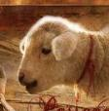





Passover “DAYS”
of the Week
are Flexible
Wave Sheaf “DATES”
of the Month
are Flexible
Abib 14 Passover on: | Wave Sheaf on:
Sunday – 1st Cycle | Sunday – Abib 21st
Monday – 2nd Cycle | Sunday – Abib 20th
Tuesday – 3rd Cycle Year of Moses | Sunday – Abib 19th
Wednesday – 4th Cycle Year of Yahusha | Sunday – Abib 18th
Thursday – 5th Cycle | Sunday – Abib 17th
Friday – 6th Cycle | Sunday – Abib 16th
Sabbath – 7th Cycle Year of Joshua | Sunday – Abib 15th (Also 1st Sabbath of ULB)

Slide 55
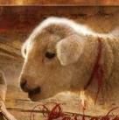


In each case below the day of Wave Sheaf
& the beginning of the Omer count falls within the Days of Unleavened Bread.
Passover | 1st ULB | 2nd ULB | 3rd ULB | 4th ULB | 5th ULB | 6th ULB | 7th ULB
Sunday 14th | Mon | Tues | Wed | Thurs | Fri | Sabbath | W/S
Monday 14th | Tues | Wed | Thurs | Fri | Sabbath | W/S | Mon
Tuesday 14th | Wed | Thurs | Fri | Sabbath | W/S | Mon | Tues
Wednesday 14th | Thurs | Fri | Sabbath | W/S | Mon | Tues | Wed
Thursday 14th | Fri | Sabbath | W/S | Mon | Tues | Wed | Thurs
Friday 14th | Sabbath | W/S | Mon | Tues | Wed | Thurs | Fri
Joshua 4-5 Sabbath 14th | W/S | Mon | Tues | Wed | Thurs | Fri | Sabbath
Note for chart: Joshua follows these
Torah instructions “to the letter.”

Slide 56

R
E
V
I
E
W
A “date” and/or a “day” are usually not the same!
Random Example:
The 15th “date” of the
1st month is not always
on the 4th day/cycle
(or a Wed) like this example.
Likewise … Abib 14 is NOT always:
on a Tues [as Enoch declares].
on a Wed [like Yahusha’s Passover].
Let’s examine Abib 14 for
three different years.
1st Month

Slide 57

How Torah “Dates & Days” are Flexible
Moses’ Passover
Abib 14 Passover on: | Wave Sheaf on:
Sunday – 1st Cycle | Sunday – Abib 21st
Monday – 2nd Cycle | Sunday – Abib 20th
Tuesday – 3rd Cycle | Sunday – Abib 19th
Wednesday – 4th Cycle | Sunday – Abib 18th
Thursday – 5th Cycle | Sunday – Abib 17th
Friday – 6th Cycle | Sunday – Abib 16th
Sabbath – 7th Cycle | Sunday – Abib 15th
1st | 2nd | 3rd | 4th | 5th | 6th | 7th
 |  |  | 1 | 2 | 3 | 4
5 | 6 | 7 | 8 | 9 | 10 | 11
12 | 13 | 14 P/O | 15 | 16 | 17 | 18
19 W/S | 20 | 21 | 22 | 23 | 24 | 25
26 | 27 | 28 | 29 | 30
Year of Moses
Joshua’s Passover
Yahusha’s Passover
1st | 2nd | 3rd | 4th | 5th | 6th | 7th
1 | 2 | 3 | 4 | 5 | 6 | 7
8 | 9 | 10 | 11 | 12 | 13 | 14 P/O
15 W/S | 16 | 17 | 18 | 19 | 20 | 21
22 | 23 | 24 | 25 | 26 | 27 | 28
29 | 30
1st | 2nd | 3rd | 4th | 5th | 6th | 7th
 |  |  |  | 1 | 2 | 3
4 | 5 | 6 | 7 | 8 | 9 | 10
11 | 12 | 13 | 14 P/O | 15 | 16 | 17
18 W/S | 19 | 20 | 21 | 22 | 23 | 24
25 | 26 | 27 | 28 | 29 | 30
Year of Yahusha
Year of Joshua
57

Slide 58

#9 Joshua Confirms:
Covenant Calendar’s Wave Sheaf is in direct opposition to
Enoch’s Wave Sheaf placement.
Why?
Enoch’s Wave Sheaf is always on Abib 26th OUTSIDE the week of the Passover Festival.
Joshua’s Passover
Enoch’s Passover
1st | 2nd | 3rd | 4th | 5th | 6th | 7th
1 | 2 | 3 | 4 | 5 | 6 | 7
8 | 9 | 10 | 11 | 12 | 13 | 14 P/O
15 | 16 | 17 | 18 | 19 | 20 | 21
22 | 23 | 24 | 25 | 26 | 27 | 28
29 | 30
1st | 2nd | 3rd | 4th | 5th | 6th | 7th
 |  |  | 1 | 2 | 3 | 4
5 | 6 | 7 | 8 | 9 | 10 | 11
12 | 13 | 14 P/O | 15 | 16 | 17 | 18
19 | 20 | 21 | 22 | 23 | 24 | 25
26 | 27 | 28 | 29 | 30
Enoch’s Year
Year of Joshua

Slide 59
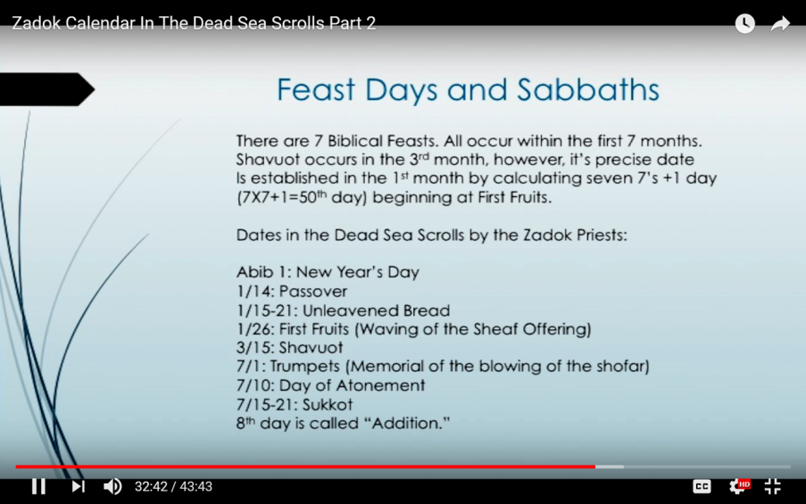
Enoch/Zadok Firstfruits Festival
R
E
V
I
E
W
Sabbath dates for Enoch’s
1st month are: 4th, 11th,
18th, 25th.
Enoch’s Firstfruits is OUTSIDE
of the Passover Spring Festival

Slide 60
Joshua’s Witness is Easy to Understand
Observation: Many that honour Yahuah’s Festivals suggest the Wave Sheaf
must always be celebrated on Abib 16 and it must follow
the 1st Sabbath of Unleavened Bread.
This is NOT true as shown through Joshua’s testimony.
The information from Joshua 5:10-11 clearly eliminates these two false teachings.
In F-A-C-T …
It is impossible for Wave Sheaf to be placed
on Abib 16 in this account with Joshua!
However, this is NOT to say Wave Sheaf can never be on Abib 16 …
– just that Wave Sheaf is not always placed on Abib 16!
The Scriptural support of Wave Sheaf is of most importance.
Besides Joshua, support is found in
Lev 23; Exo 12-16-19 & the Gospel Account.
But this information raises another question!

Slide 61
#10 Joshua Confirms:
Wave Sheaf can be celebrated
on Abib 16, IF Passover falls
on the 6th cycle (Friday).
Then: Sabbath is Abib 15
(with 1st Sabbath of Unleavened Bread);
Wave Sheaf follows on Abib 16th.
R
E
V
I
E
W
1st (Sun) | 2nd (Mon) | 3rd (Tues) | 4th (Wed) | 5th (Thur) | 6th (Fri) | 7th (Sabb)
Abib 2 | 3 | 4 | 5 | 6 | 7 | 8
9 | 10 | 11 | 12 | 13 | 14 P/O | 15 ULB
16 WS | 17 | 18 | 19 | 20 | 21 | 22

Slide 62
About once every 6-7 years
Wave Sheaf & 1st ULB Sabbath
share the same date!
1st (Sun) | 2nd (Mon) | 3rd (Tues) | 4th (Wed) | 5th (Thur) | 6th (Fri) | 7th (Sabb)
Abib 1 | 2 | 3 | 4 | 5 | 6 | 7
8 | 9 | 10 | 11 | 12 | 13 | 14 P/O
15 WS & ULB | 16 | 17 | 18 | 19 | 20 | 21
#10a There is a question that should be pondered when Wave Sheaf and
1st Sabbath of Unleavened Bread share the same date of Abib 15.

Slide 63

Every Feast and Festival is
of utmost importance,
whether an annual Sabbath or not!
In Joshua’s account 2 festivals share Abib 15:
a. 1st Sabbath of Unleavened Bread
b. Wave Sheaf Festival
Which Festival Secures First Place?
Wave Sheaf? ~ Unleavened Bread Sabbath?
Will Joshua give priority to one of them?
Will Joshua make the right choice?
And … Does it matter?

Slide 64


Joshua’s Wave Sheaf
Part 2
With Wave Sheaf and
1st Sabbath of Unleavened Bread both on Abib 15, which one will take priority?
Which Feast will be the “backbone” of our salvation?
Come &See!
The End of Pt 1

Slide 65
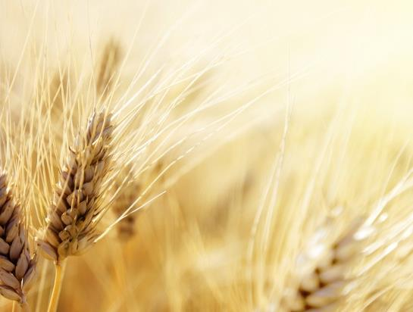



Questions/Comments
on the placement
of Wave Sheaf Pt 1?
questions@studythecalendar.com
www.studythecalendar.com

