Slide 1


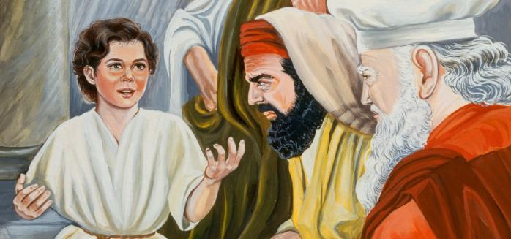





Yahusha
“Lost? Or Discovered!”
Introductory Lesson
is “My Time”
John 7:6,7
The 3rd Day
One Puzzle
Piece
at a Time
Luke 2
Notes:
4.25a Teaser for Yahusha’s Passover 12 CE [16 slides] TA 4 Mar 2022 Website: Youtube:
July 4/21 – comments & questions for the website. Website link: https://studythecalendar.com/4-9-yahusha-lost-and-found/ Youtube: https://youtu.be/NVr2b7_5KCs
Sent pg 29 corrections to Irena & Debbie S.
Introduction to this study: Covenant Calendar is first based on Torah with additional witnesses in the rest of the Old Testament. The full confirmation to this Covenant Calendar is found in the Gospels with very strong witnesses through Yahusha's life from conception to His gift of the Ruach on the Pentecost/Shavuot of Acts 2. Additional confirmation for Covenant Calendar will continue to be found with the disciples, and especially the apostle Paul. Exact year dates and festival "days and dating" are easily verified through two sources. Those two sources are two very different calendars discovered in the Gospels. The first calendar is the lunar based calendar of the "unbelieving" Jews; the second calendar is the Covenant Calendar which aligns perfectly with His ministry throughout the four Gospels. The calendar details in the Gospels can no longer be glossed over. It is time to take very careful note of everything, including any deviation from "one set of wording" to "another set of wording." For example: If the context is "Passover of the Jews" - it is exactly that - a Passover timing of the Jews' lunar calendar. If the content does not specify anything related to the Jews' it is then time to check and see if the context is around Yahusha and His disciples. It is also important to remember the Gospels give information about "believing Jews" and "unbelieving Jews" - without telling the reader "which is which" - so it is up to the reader to figure out the puzzle. Do remember, Joseph of Arimathaea and Nicodemus were "believing Jews" and were very aware of what was going on - good students of the Torah, and Covenant Calendar timing! With this in mind, there are many witnesses in the Gospels that show beyond any doubt the exact timing between the lunar based calendar and the Covenant Calendar. This is ONE of those studies. It focuses on Yahusha's attendance to His Passover at the age of 12 - remember - when He was left behind for 3 days. As you go through the study, learn to pay attention and pick up the details that are bound to expose the counterfeit calendar of the unbelieving Jews - the very leaders that "took away the key of knowledge" from the common person so that they could not understand how to count & calculate Yahuah's festal calendar for themselves. Think about the following questions as you brace yourself to meet the challenges of this study:
Mary & Joseph attended the Passover at Jerusalem every year, but the year that Yahusha attended at age 12, they started their return home without Him. When He was finally discovered after 3 days, what was Yahusha's answer to them, and did they understand His words? (See Luke 2:49-50.)
Where was Yahusha found after the 3 days and what was He doing?
In Luke chapter 2, is there a difference of "context" between the wording of: a) according to the Torah; and 2) according to the practice of the festival? Was Luke trying to get our attention with his very careful wording of these events?
According to Luke chapter 1, when does life begin: 1) at the time of birth?; 2) at the time of conception? What would this have to co with Covenant Calendar timing?
According to many commentators, there is substantial documentation that the year of Yahusha's birth could have been anywhere from 3 BC to 6 BC. This Gospel study will prove the exact year of Yahusha's Passover at age 12. Could one then determine the year of His birth?
There is only one year that fits the very specific criteria for Yahusha's age 12 Passover. What is the specific Gospel calendar language to unlock this puzzle of the exact year?
There are many different types of lunar calendars all the way from the return of the exiles in 457 BC up to Luke and Paul's documentation in 57 AD. Some lunar calendars were calculated according to the crescent moon before the equinox, and some were calculated by the crescent moon after the equinox. For Yahusha's 12 year Passover, which type of lunar calendar were the unbelieving Jews using then? Do you wonder if that is the same lunar calendar they were using during Yahusha's ministry many years later? What about the lunar calendar that Luke and Paul record almost 30 years after the crucifixion?
Some believe that a "High Sabbath" is always a "feast Sabbath" and the "weekly Sabbath" sharing the same day/date? Is that the case in this study?
Upon what day of the week was Yahusha's Covenant Calendar Passover in this study?
After going through this study, see if the phrase "and a little child shall lead them" has a different meaning for you. Who was that "little child" and who was He leading? ... and how do you think those around Yahusha reacted to "that leading"? Did His example have anything to do with exactly when to observe the festivals as given in the Torah?

Slide 2


Do You Wonder …
?
?
? How many have taken a good look
at the title slide – to see exactly
what the message was?
? Has it registered with you how
important the topic is for this
calendar information to come forth?
! Oh yes, some may ask …

Slide 3

Yahusha
What is this …
- 3rd Day - Calendar Discovery?
It is a chance
to know some
very exact timing!
Notes:
July 4/21 – comments & questions for the website. Website link: https://studythecalendar.com/4-9-yahusha-lost-and-found/ Youtube: https://youtu.be/NVr2b7_5KCs
Sent pg 29 corrections to Irena & Debbie S.
Introduction to this study: Covenant Calendar is first based on Torah with additional witnesses in the rest of the Old Testament. The full confirmation to this Covenant Calendar is found in the Gospels with very strong witnesses through Yahusha's life from conception to His gift of the Ruach on the Pentecost/Shavuot of Acts 2. Additional confirmation for Covenant Calendar will continue to be found with the disciples, and especially the apostle Paul. Exact year dates and festival "days and dating" are easily verified through two sources. Those two sources are two very different calendars discovered in the Gospels. The first calendar is the lunar based calendar of the "unbelieving" Jews; the second calendar is the Covenant Calendar which aligns perfectly with His ministry throughout the four Gospels. The calendar details in the Gospels can no longer be glossed over. It is time to take very careful note of everything, including any deviation from "one set of wording" to "another set of wording." For example: If the context is "Passover of the Jews" - it is exactly that - a Passover timing of the Jews' lunar calendar. If the content does not specify anything related to the Jews' it is then time to check and see if the context is around Yahusha and His disciples. It is also important to remember the Gospels give information about "believing Jews" and "unbelieving Jews" - without telling the reader "which is which" - so it is up to the reader to figure out the puzzle. Do remember, Joseph of Arimathaea and Nicodemus were "believing Jews" and were very aware of what was going on - good students of the Torah, and Covenant Calendar timing! With this in mind, there are many witnesses in the Gospels that show beyond any doubt the exact timing between the lunar based calendar and the Covenant Calendar. This is ONE of those studies. It focuses on Yahusha's attendance to His Passover at the age of 12 - remember - when He was left behind for 3 days. As you go through the study, learn to pay attention and pick up the details that are bound to expose the counterfeit calendar of the unbelieving Jews - the very leaders that "took away the key of knowledge" from the common person so that they could not understand how to count & calculate Yahuah's festal calendar for themselves. Think about the following questions as you brace yourself to meet the challenges of this study:
Mary & Joseph attended the Passover at Jerusalem every year, but the year that Yahusha attended at age 12, they started their return home without Him. When He was finally discovered after 3 days, what was Yahusha's answer to them, and did they understand His words? (See Luke 2:49-50.)
Where was Yahusha found after the 3 days and what was He doing?
In Luke chapter 2, is there a difference of "context" between the wording of: a) according to the Torah; and 2) according to the practice of the festival? Was Luke trying to get our attention with his very careful wording of these events?
According to Luke chapter 1, when does life begin: 1) at the time of birth?; 2) at the time of conception? What would this have to co with Covenant Calendar timing?
According to many commentators, there is substantial documentation that the year of Yahusha's birth could have been anywhere from 3 BC to 6 BC. This Gospel study will prove the exact year of Yahusha's Passover at age 12. Could one then determine the year of His birth?
There is only one year that fits the very specific criteria for Yahusha's age 12 Passover. What is the specific Gospel calendar language to unlock this puzzle of the exact year?
There are many different types of lunar calendars all the way from the return of the exiles in 457 BC up to Luke and Paul's documentation in 57 AD. Some lunar calendars were calculated according to the crescent moon before the equinox, and some were calculated by the crescent moon after the equinox. For Yahusha's 12 year Passover, which type of lunar calendar were the unbelieving Jews using then? Do you wonder if that is the same lunar calendar they were using during Yahusha's ministry many years later? What about the lunar calendar that Luke and Paul record almost 30 years after the crucifixion?
Some believe that a "High Sabbath" is always a "feast Sabbath" and the "weekly Sabbath" sharing the same day/date? Is that the case in this study?
Upon what day of the week was Yahusha's Covenant Calendar Passover in this study?
After going through this study, see if the phrase "and a little child shall lead them" has a different meaning for you. Who was that "little child" and who was He leading? ... and how do you think those around Yahusha reacted to "that leading"? Did His example have anything to do with exactly when to observe the festivals as given in the Torah?

Slide 4

It is the very exact timing about Yahusha’s Passover at age 12!
Some may say:
“You actually know the exact calendar dates for Yahusha’s Passover at age 12?”
4

Slide 5

Very seriously, this is …
Shall we ask, “how is this possible?”

Slide 6

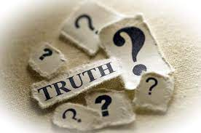


to know this truth on the timing of Yahusha’s Passover
at age 12, because
Covenant Calendar studies…
are right
from the
Word and
hand of our

Slide 7

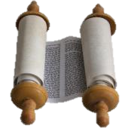
It’s totally possible to see the accuracy of Covenant Calendar WHEN:
Covenant Calendar principles are applied directly from the Torah.

Slide 8
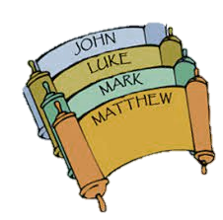
It’s completely possible to see the accuracy of Covenant Calendar WHEN:
Every detail in the Gospel account is fully considered with utmost scrutiny.

Slide 9

It’s entirely possible to see the accuracy of Covenant Calendar WHEN:
One realizes in the Gospels, Yahusha is following His own everlasting blood-ratified Covenant Calendar, to honor His Festivals on the correct dates & start time!

Slide 10
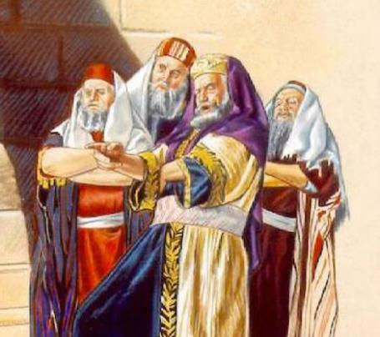
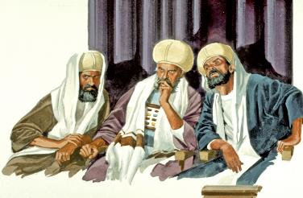
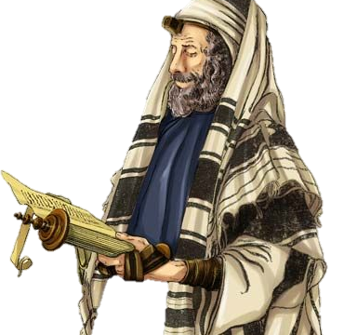
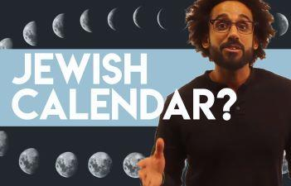
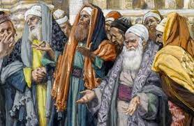
It is fully possible to see the accuracy of Covenant Calendar WHEN:
One realizes that Yahuah made sure to build in the lunar solar calendar of the Unbelieving Jews into the Gospel Account!
Why?

Slide 11

It’s unreservedly possible to see the accuracy of Covenant Calendar WHEN:
One realizes it is the counterfeit lunar/solar calendar of the Unbelieving Jews [also found in the Gospels] that happens to be ONE important “lock & key”! Why?
It also locks in every step of
our Master according to the
reckoning on HIS Festival Calendar!

Slide 12

It’s wholly possible to see the accuracy of Covenant Calendar WHEN:
One realizes how important it is
for the cycles and movements of
the heavenly bodies to be so very accurate, that the necessary
calendar calculations can be
done and compared to the Gospel dates [of the Covenant Calendar]
with the “snap of a finger”!

Slide 13
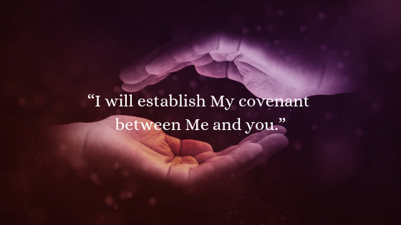
Can we believe Yahuah?
Genesis 17:2
Yahuah’s Promise
to Abram
Or is it wiser to believe questionable sources that cannot provide FULL linear alignment with Yahuah’s Word including His Calendar?

Slide 14

Remember…
of Jeremiah 6:16
were preserved for us so that we can be in full covenant relationship with our Creator, Yahusha!

Slide 15





friends, the word is getting out
around the world now – that we can know,
and do know, Yahusha’s Blood Ratified
Festal Calendar of - His Covenant!
This study is just one example. If you are ready, so are we.
Sit back and enjoy … then PONDER how these things are so. When you study these truths “as they are put forth,” you will hold awesome treasures in your heart. We invite you to make the decision to “Come and See.” Wrap yourself in Yahuah’s Word!
Yes ~
https://www.youtube.com/c/CovenantCalendarClub/videos
questions@studythecalendar.com
The End

Slide 16
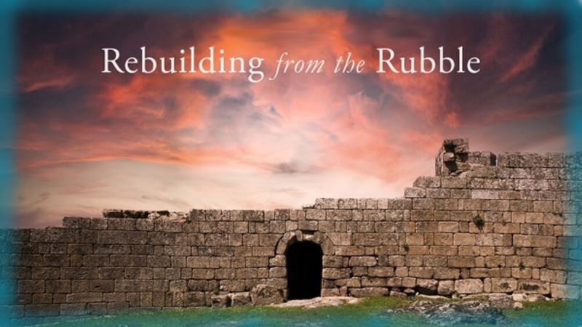


If you enjoyed this short time with us …
Please Plan to Watch the
Full Study Prepared for You!
Sign up with Covenant Calendar Club
for the Friday & Shabbat Zoom Meetings
(including live discussion)
https://studythecalendar.com/sign-up/
Thank-you!
Shalom!
16

