Slide 1


How can we trace the priesthood from Shem to Mosheh?
Will the Torah timelines proclaim Abraham as a
Melki-tzedek?
Melki-tzedek (Part 3)
1
Notes:
4.24a Teaser [14 slides] Melki-tzedek Priesthood Pt 3 Abram-Moses [50 slides] 26 Feb 2022: Website: Youtube:
Blurb for 4.24a Teaser:
As usual, there are always a lot of questions about what has happened with timelines – especially when examining the Melki-tzedek Priesthood study. In this short introduction to Part 3 of the larger study, it’s time to re-group and get down to the serious issue regarding Abraham. Is he one of the patriarchs that will qualify as a Melki-tzedek Priest, or is there something else going on that is going to skip this great man of faith? If you are curious about this as well, then maybe you’ll want to “Come and See.” Shalom!

Slide 2

THE KOHEN
HA GADOL
(High Priest) of the
Melki-tzedek
Order
(Hebrews 5:10/ 6:20)
TODAY?
Will a - PURPOSEFUL KERFUFFLE
in the Torah timelines on Abraham’s
Melki-tzedek
position,
have any impact on Yahusha being
2

Slide 3

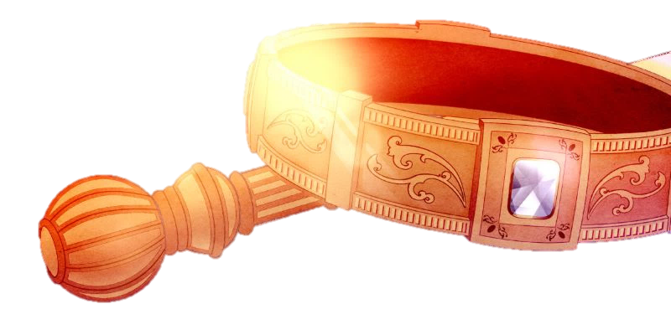

REVIEW
Transferring the
Melki-tzedek Priesthood
to a son after
the 1st born son
is not …
just a theory!

Slide 4
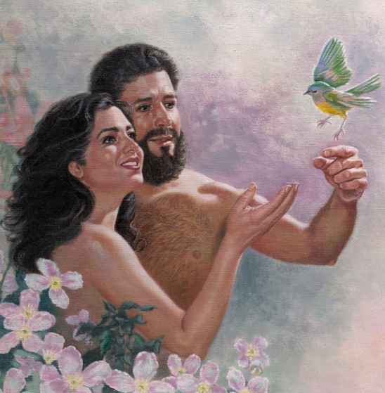

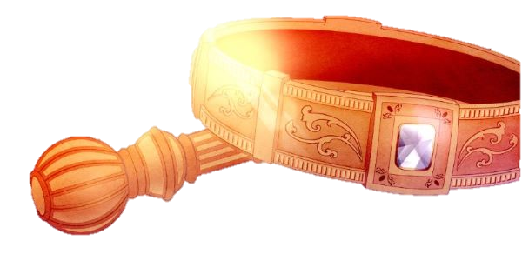
In Part 2 we investigated the priestly timelines beginning with Adam to Shem, only to find there
has been serious tampering with 7 generations beginning with Arphaxad!
REVIEW

Slide 5
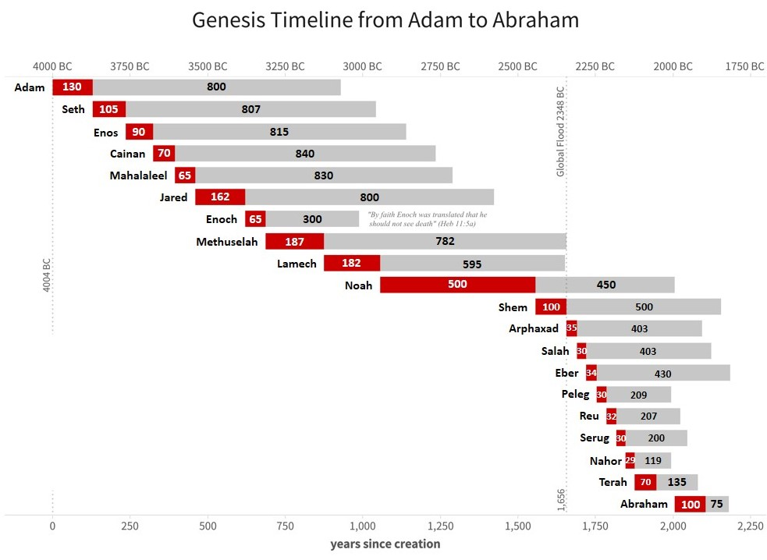
From Adam to Shem,
the Scriptures accurately record the age of each father
when the son (in line for the priesthood baton) was born.
The tampering of these timelines had a definite motive to manipulate
Shem’s position
in Gen 14:18 as
the Melki-tzedek priest that
met Abram.
The timelines from Arphaxad to Serug were
all shortened by 100 years in our
Masoretic derived Scripture editions.
Also, 50 years were removed from Nahor’s timeline, for a total of 650 missing years.

Slide 6
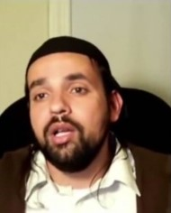
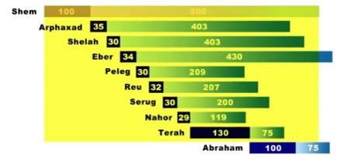
Here is the justification for Shem’s position:
Some say -
Popular Jewish View
this chart of tampered timelines is the proof
of Jewish Views!
Quote: “Unlike Christianity,
our traditions tell us who Melki-tzedek was, - he wasn’t an angel, or God Himself, like the Christians teach, but was actually Shem, the son of Noah – who transferred the title of priest over to Abraham, then Isaac, then Jacob and ultimately Aaron.”
Part 2 explained how and why these timelines from Genesis were tampered, and “who” did it! The yellow shaded area seems to indicate very strongly that indeed it was Shem who transferred the priesthood to Abraham. However, for those that are looking carefully, they must question why Eber didn’t receive the priesthood first – and then notice that he lived much longer than Abraham. In an interesting “round-about” way, the unbelieving Jews actually totally bypass Abraham from ever being a priest of Yahuah.
Remember Yahusha said: “Abraham is not their father.”

Slide 7
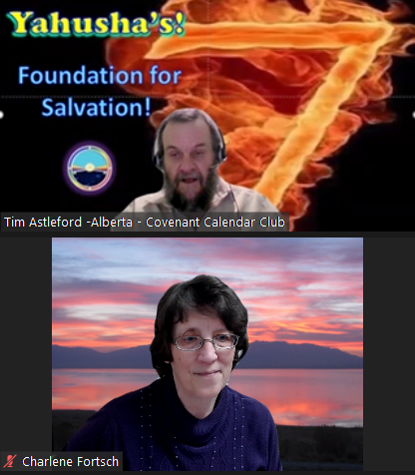
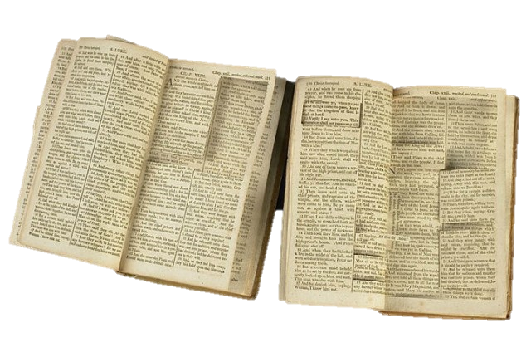
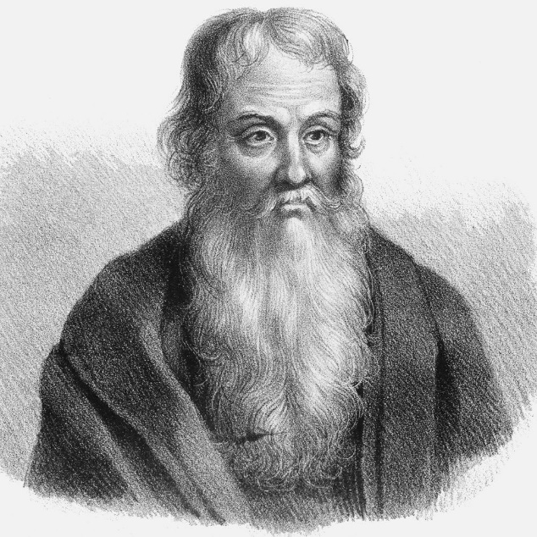

Eusebius Notes about Textual Tampering
Eusebius [260-340 AD] Writes:
HE 4.18.8b: Justin refers
to certain prophecies that
the Jews had cut out of
the scriptures
(see Justin, Apol. 71-73).
HE 5.28.13-19: Certain heretics “have tampered with the divine scriptures without fear … saying that they have corrected them … [while] some of them disdained even to falsify them, and absolutely denied the [authority of the] law and the prophets …”
Jer 17:5 Thus saith Yahuah; Cursed be the man
that trusteth in man, and maketh flesh his arm,
and whose heart departeth from Yahuah.
7

Slide 8


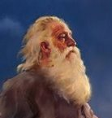
Question
Is it possible for Shem to transfer
the Melki-tzedek priesthood
straight to
Abraham?
Or is the counterfeit message:
Abraham was completely skipped!?

Slide 9
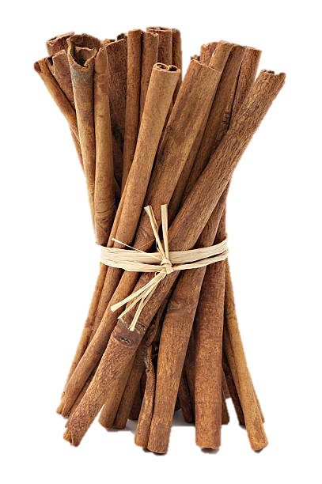

?
What is a bundle?
A simple definition is:
a quantity
of material
gathered
together.

Slide 10
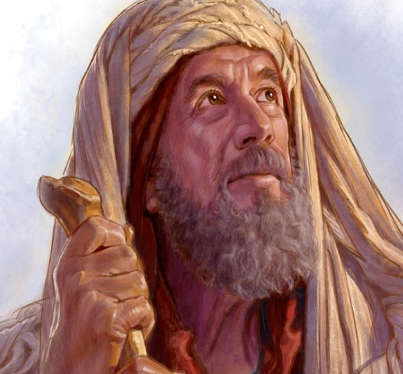
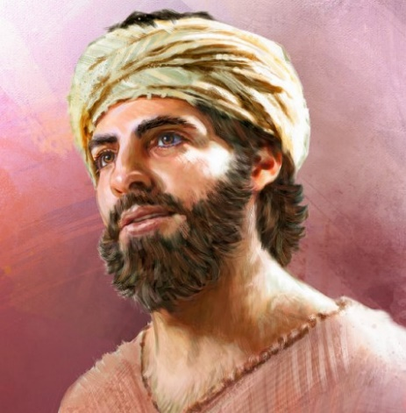
?
Why
is it …
Abraham
Isaac
Jacob
are “bundled” together 33 times in the Scriptures as our forefathers, but Abraham never qualifies as a Melki-tzedek priest,
like Isaac and Jacob do?

Slide 11


What does our Heavenly Priest have to say
about this?
Heavenly Priesthood
Next in Part 3
2a Earthly Priesthood
We will discover if Abram is part of the
Melki-tzedek priesthood
and much more!
Everlasting Covenant

Slide 12
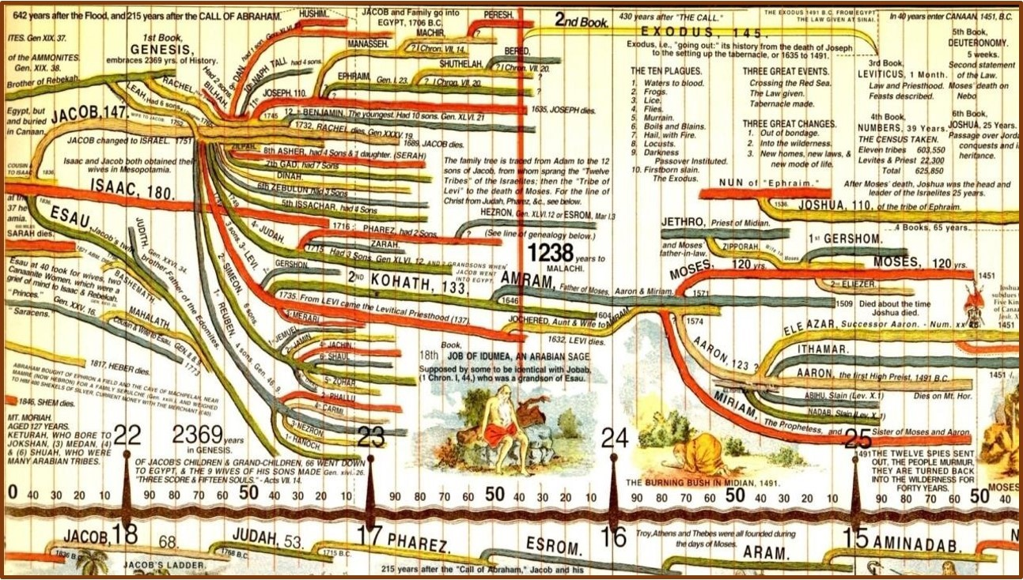
We will take a good look at this timeline chart!
MOSHEH
And, we shall discover how the baton for the
Melki-tzedek Priesthood passed to Mosheh.
12
Source: The Timechart History of the World, 2004

Slide 13
If you have Questions:
and would like to discover how Yahuah designed the plan for each patriarch to serve as His
Melki-tzedek priest …

Slide 14
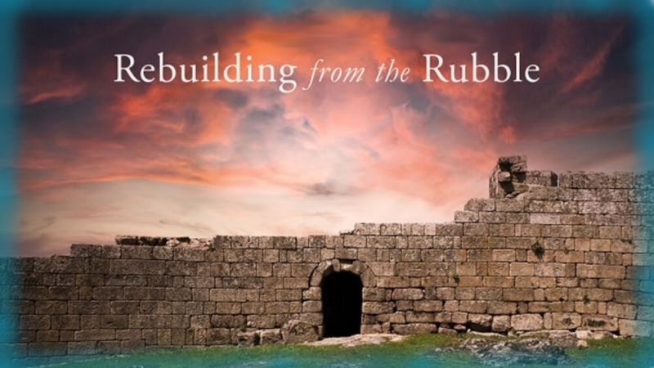

If you enjoyed this study today …
…then:
Please Join Us Live Each Week
Please Join Us for Part 3
Melki-tedek Priesthood
Sign up with Covenant Calendar Club
for the Friday & Shabbat Zoom Meetings
(including live discussion)
https://studythecalendar.com/sign-up/
Thank-you!
Shalom!

Slide 15
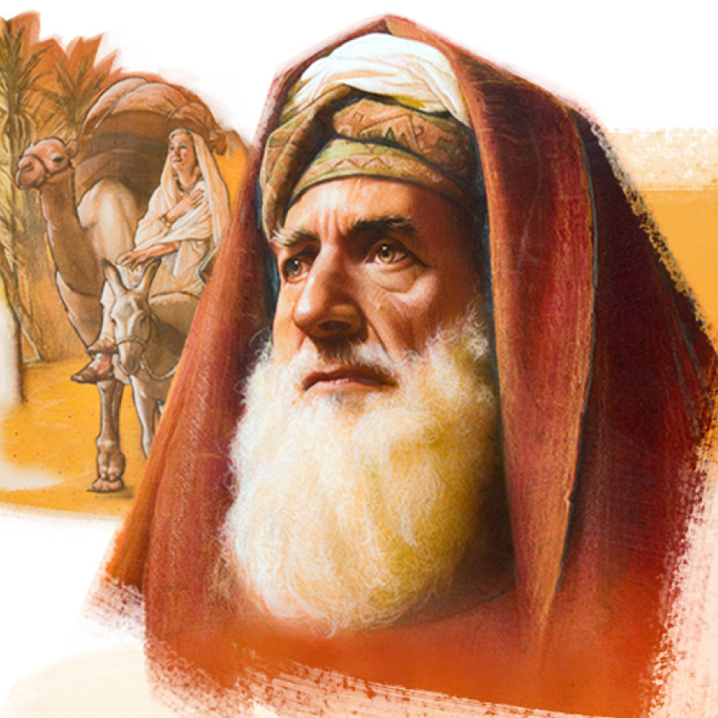

Send Questions &
Comments to:
Timothy Astleford
& Charlene Fortsch
questions@studythecalendar.com
Thank-you!
Shalom!

