Slide 1


How can we find the truth on the position of Noah’s son, Shem?
Is there a difference between the Melki-tzedek
of “Genesis”
& “Hebrews”?
Melki-tzedek
Melki-tzedek (Part 2)
1
Notes:
4.23a Teaser for Mekli-tzedek Part 2: [Feb 11/22] Website: You-tube:
Blurb for teaser 4.23a:
As an introduction to Part 2 of the Melki-tzedek Priesthood series, the "question of all questions" is "how can we find the truth on the position of Noah's son, Shem"? While not too many ministries are teaching the Melki-tzedek Priesthood message, many that do teach it are saying that the Melki-tzedek king found in Gen 14 is indeed Shem, Noah's son. Have you really taken a close look at this? Have you tried to see if the context of Gen 14 will align with Hebrews? And if not, what are you believing? And for those that do ascribe that Gen 14's Melki-tzedek priest "is Shem" - perhaps they have not considered what other problems arise immediately, that are very serious. When you are ready to find out - you will "Come and See" ... Blessings and Shalom

Slide 2
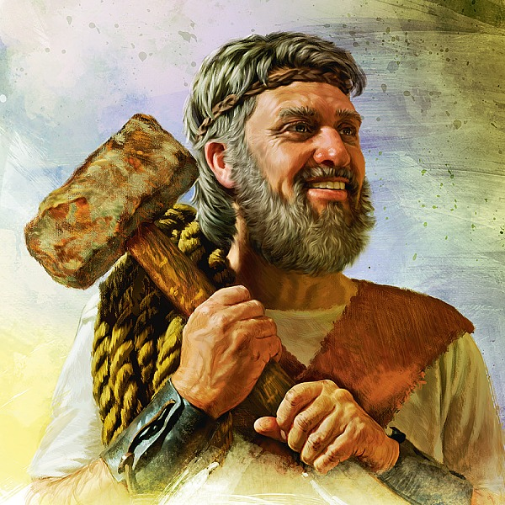
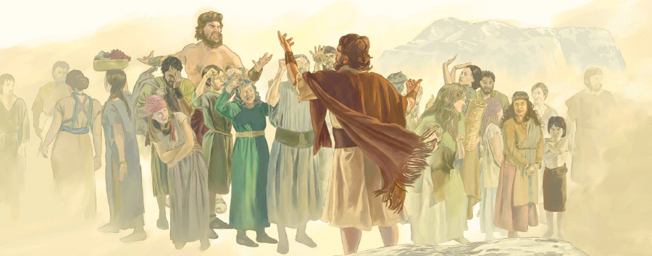
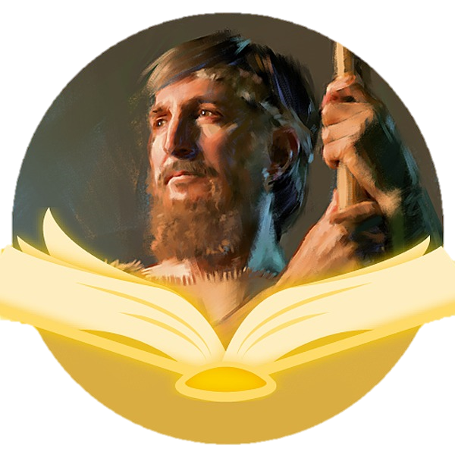
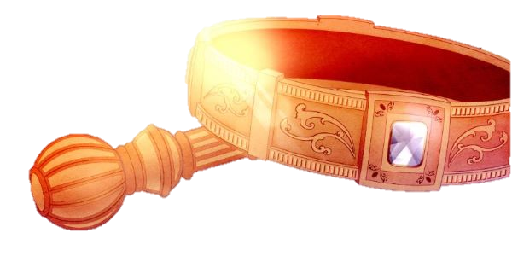
Noah was a preacher of righteousness
and a Melki-tzedek Priest!
His 2nd born son, Shem, was the next Melki-tzedek priest!

Slide 3
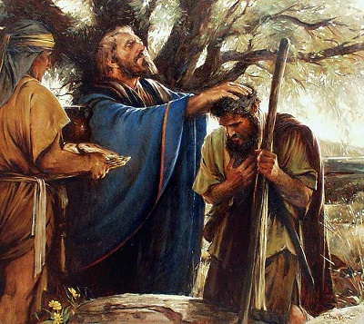
Question:
Is it even possible Shem was the
Melki-tzedek
priest
that blessed
Abram in
Genesis 14:18?
17 And the king of Sodom went out to meet him [Abram] …
18 And Melki-tzedek king of Salem brought forth bread and
wine: and he was the priest of the most high Elohim.
19 And he blessed him, and said, Blessed be Abram of the
most high Elohim, possessor of heaven and earth.

Slide 4

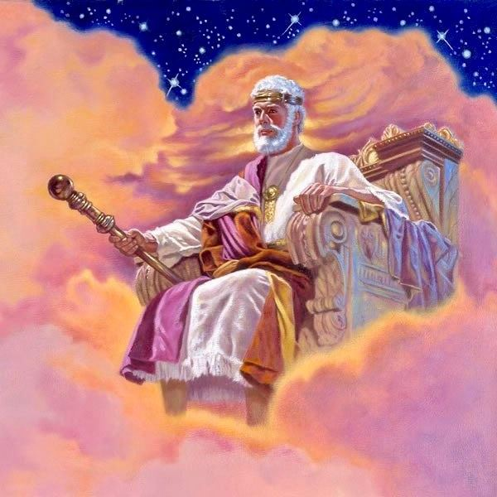
Remember:
Heavenly Priesthood
This series is a
study on the highest
Melki-tzedek
King and Priest
Who was The Seed
from the foundation
of the world.

Slide 5
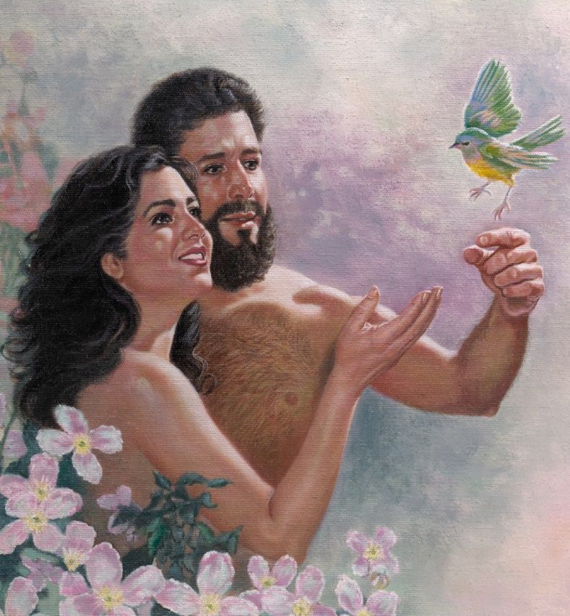
Also remember:
Earthly Priesthood
The entitlement &
the role (mandate)
of this “Divine Seed”
was equally given to
Adam when he was given
dominion to rule the earth as
Melki-tzedek King and Priest.

Slide 6

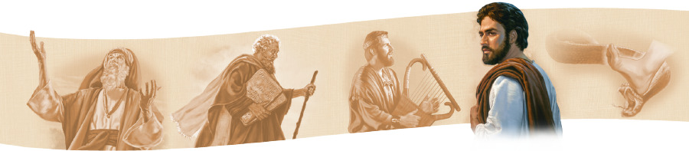

the next step in Yahuah’s plan was for this mandate to be
handed down from
patriarch to patriarch UNTIL
it was passed back to Yahusha.
The plan was perfect!
Because of sin
Notes:
Tim, your comments were this: or was the original plan for EACH PERSON to be a Melki priest? A nation OF priests. Not a nation of ONE priest!
I believe that was the original plan before Adam sinned. After sin, this was NOT the plan - as cain's seed would not qualify for any Melki priest. they are acting as priests for satan.
I do not see in the patriarchal line where all were priests - there was always 1 leader for those under him. Otherwise, we would have heard of Nahor being a priest with Abram - one example.
What you are thinking about [where everyone is a priest] begins with Jacob's sons - this is where ONLY all of the "first born" sons of every family were to be priests. Even tho there was no "TEMPLE" at that time, Yah knew there would need to be some kind of temple with priests to take care of all the sacrifices as the population continues to grow. However, at the golden calf, that all changed - only the tribe of Levi (minus Aaron) did not participate - which disqualified the other 11 tribes from anything to do with the priesthood. Melki mandate was divided here: Aaron's sons rec'd the priesthood [compare to elders right now] ... the rest of Levi's tribe were under the priests as workers in the temple (like deacons - the upkeep and maintenance).
So, there is a difference between the Melki mandate on earth before sin, and then after sin.
There is a difference before Jacob and after Jacob.
This is a teaser - so no explanations can be given - only thoughts to make people think!
Considering what I have just shared, do you think the wording is OK for this slide?
I might be able to add an appropriate smiley face with a puzzled look, or maybe a few words, like: There is so much more - but that would have to be another slide.
I'll wait to hear back from you & I'll try to work on those issues with satan and levi. -c-

Slide 7

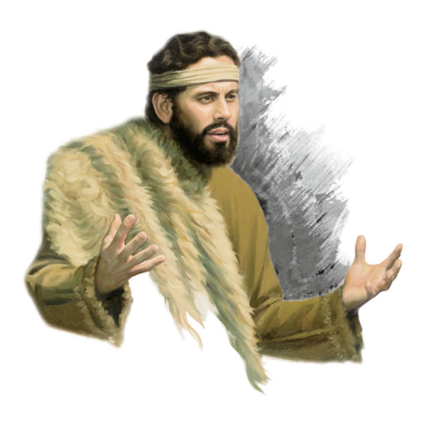
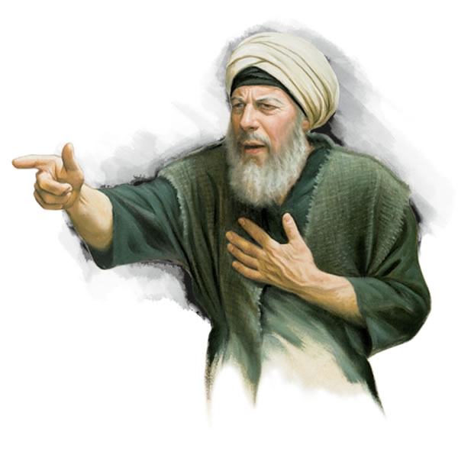
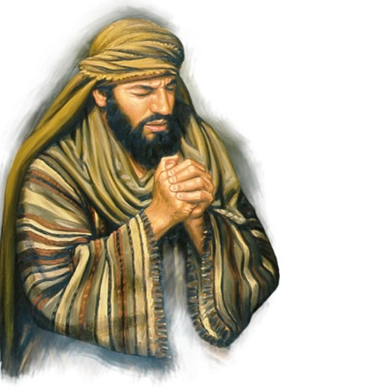
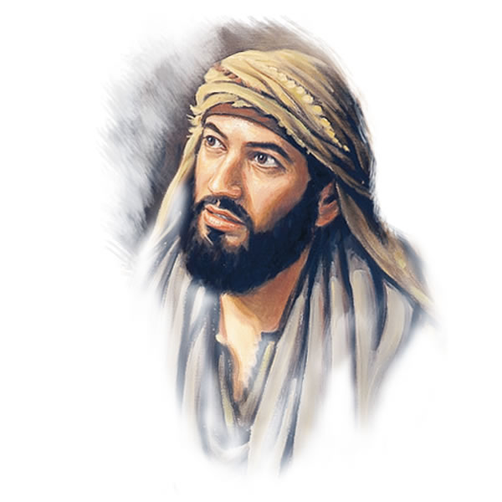
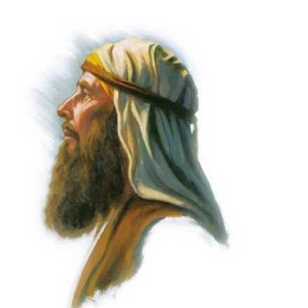
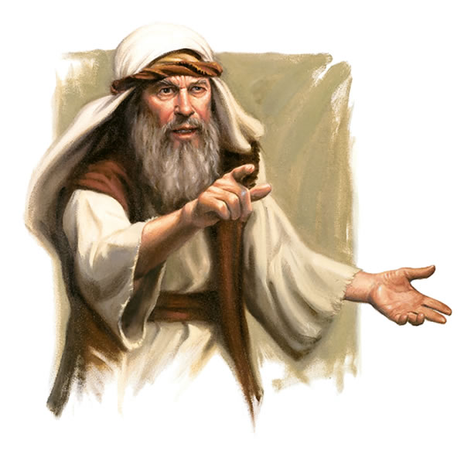
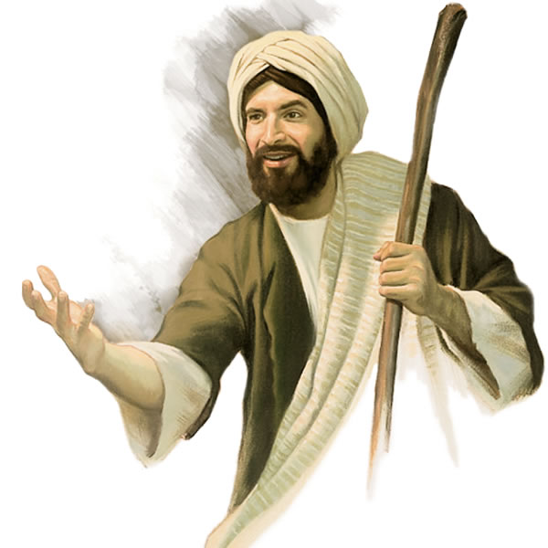
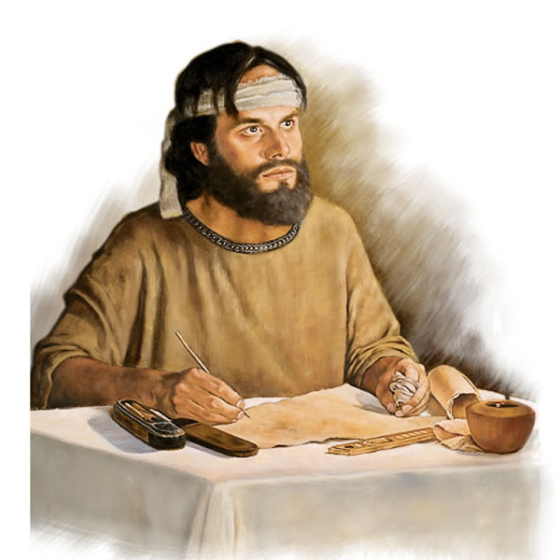
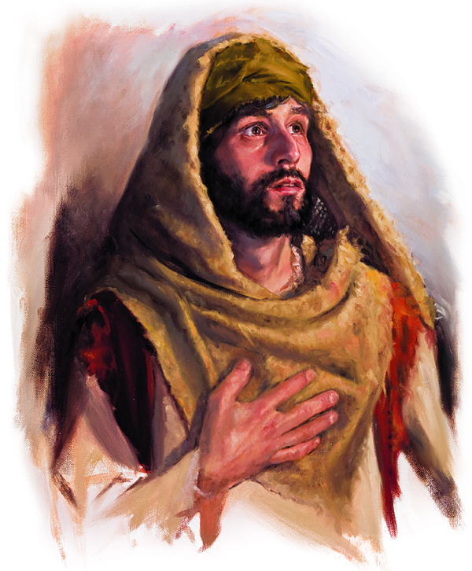
The mantel of
the Melki-tzedek
priesthood was passed through
the generations of patriarchs
from Adam forward.
This has been
accurately recorded only
up to Shem, Noah’s son.

Slide 8
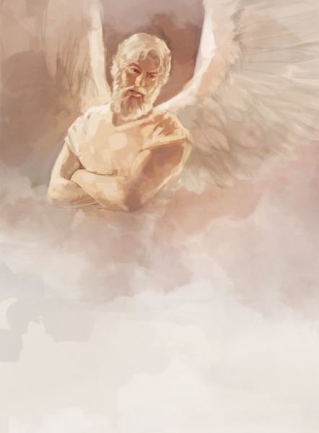
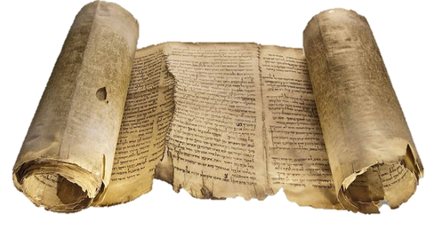
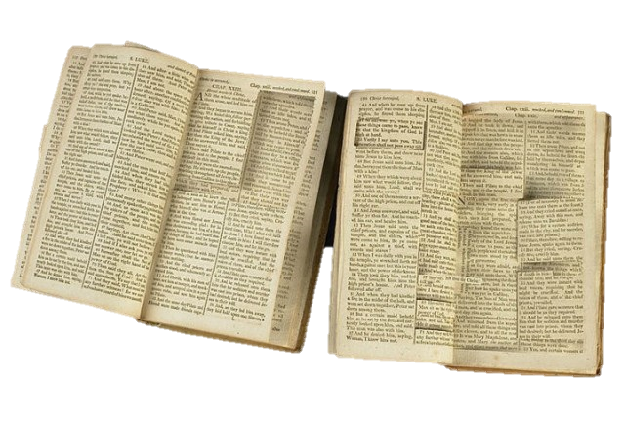

In satan’s plan he used willing unbelievers/scribes to try corrupting
seven Torah timelines
Did
that
really
happen?
from this …
to this!

Slide 9
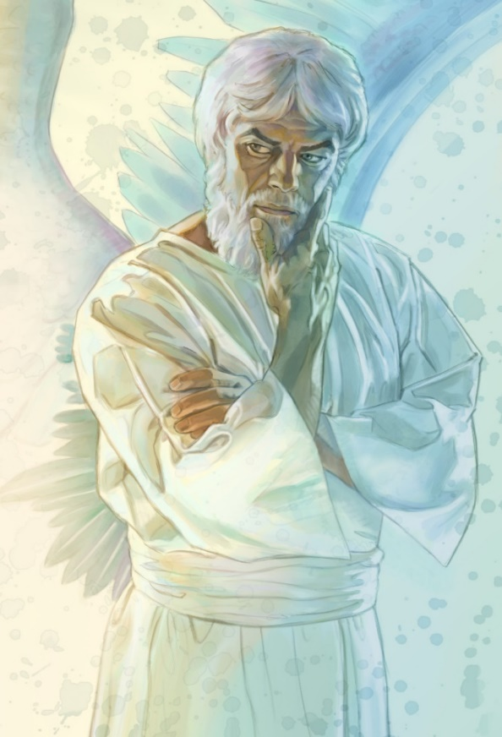


Has satan had any degree
of success in moving his
destructive plan forward?
If so: did his plan link
to the very first time Melki-tzedek is
mentioned in the Scriptures (Gen 14:18)?

Slide 10
Are you Aware …
that most of the people (that know something about this topic), believe that
Shem, the son
of Noah, is the
Melki-tzedek of
Gen 14:18 who met
Abraham with Bread & wine?

Slide 11


Did you know that the timelines of seven (7) generations (following Shem’s line) were severely tampered with?
Yes! It really
did happen!

Slide 12

Considering this timeline manipulation &
ALTERATION,
what effect will this have on Paul’s writings declaring that Yahusha is our Kohen Ha Gadol
TODAY?

Slide 13

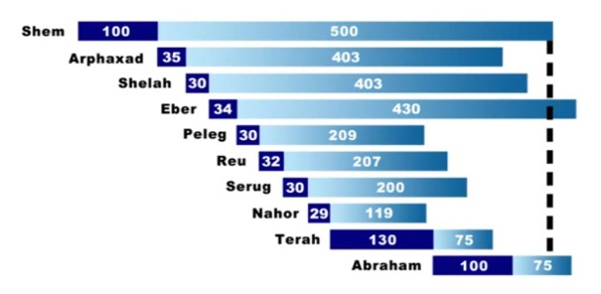
Also notice Eber outlives Abraham!
The design of these timelines completely by-passes
Abraham (a very great patriarch), as a Melki-tzedek earthly priest and king for Yahuah’s people!
According to modern Bibles & the internet, the timelines from Shem to Abraham will look like this.
Does it look
like these timelines
have been altered?

Slide 14


Are you asking questions?
WHY did
they do it??
Who did it?
How did
they do it?

Slide 15

And more questions!
remove Yahusha
as the final
Melki-tzedek
King and Priest with His
Sacrifice?
How does this twisted counterfeit work to completely

Slide 16
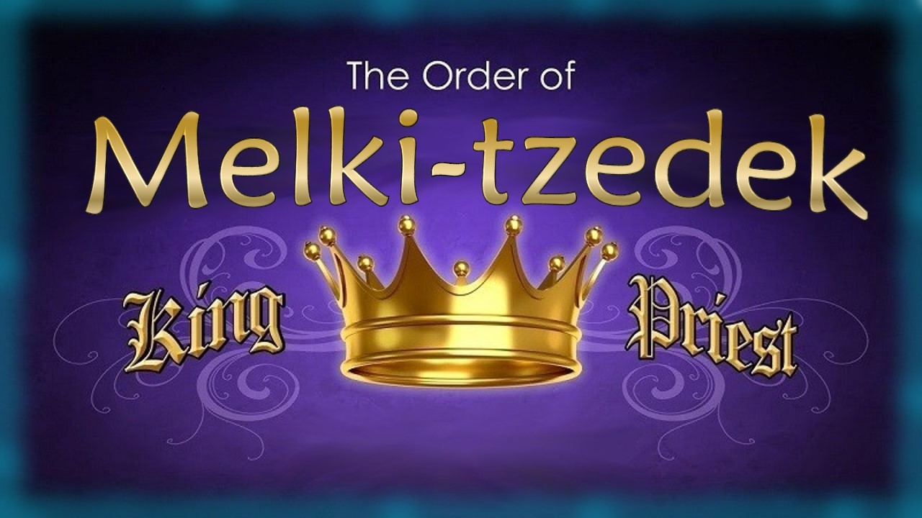

Part 2 of the Melki-tzedek study is meant to fill in the gaps of our understanding and get us back on track with the Torah Truth.
Part 2: Timelines from
Adam to Shem!
Come
& See
Notes:
4.23a Teaser
4.23b Melki-tzedek Priesthood Pt 2 Adam to Moses [ slides] CF
Blurb 4.23b:

Slide 17


If you enjoyed this short time with us …
Please Join Us for Part 2
Melki-tedek Priesthood
Sign up with Covenant Calendar Club
for the Friday & Shabbat Zoom Meetings
(including live discussion)
https://studythecalendar.com/sign-up/
Thank-you!
Shalom!
17

