Slide 1
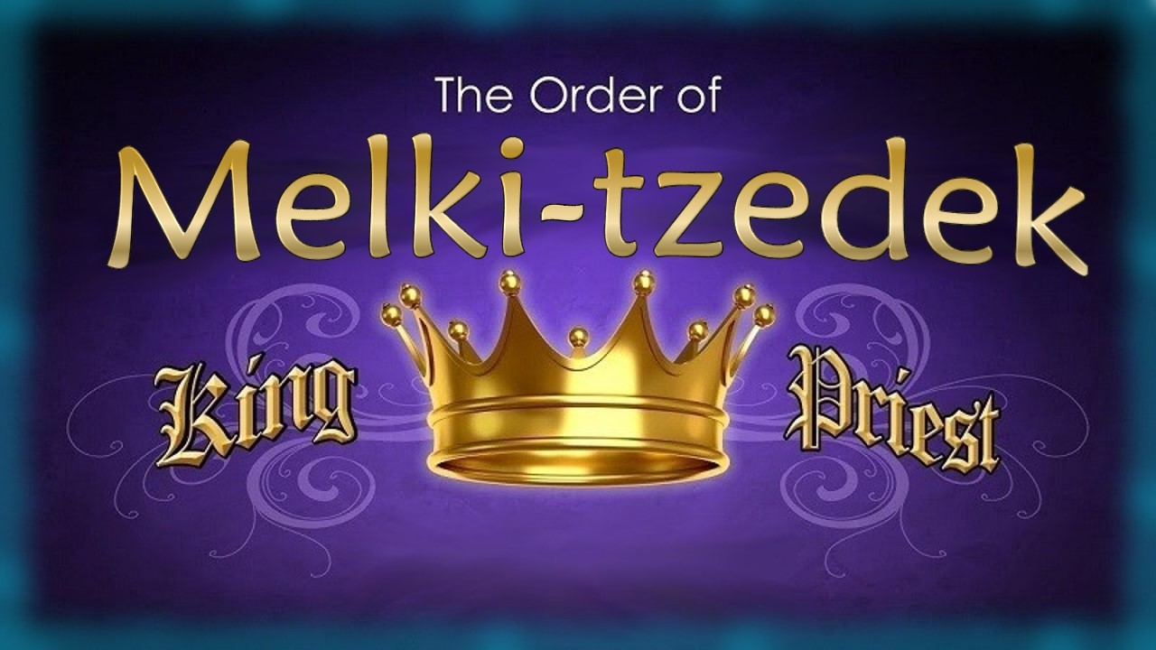

4.23 Part A & B – Original file that was sent to tim feb 2/22 but split into 2 parts to get the size down.
This one is Charlene’s working slide – or the original, but slides 2-3-4 are new this time.
4.23 Edit 2 sent to TA in 2 files. Next: change out the png’s to jpegs and see if that reduces the file size.
Several new slides all over the place – moved slides around for flow. Just the last few slides that need to be finished up yet. 10 hrs on this Feb 3/22
Tim: Feb 6/22 … There’s not much to check in the boxes – just for you to see what has been done – I think there is one slide that you mentioned there should be a “seed” comment (Near the end) – I left a note. I believe this will be ready for Feb 11-12 – and will do up the newsletter. If there is any possible way to just run through all the slides to see the flow (not just the comment boxes) I would appreciate your feedback. I’m really hoping the hardest parts are now done – the only thing that worries me is the genealogies that will be in the last part. We may need a week with a filler to give me some time. At least this is a manageable size now. Hope you enjoy it.
Comments starts on slide 1. Charlene 515 pm video jpeg is printed.
Feb 7/22: finished changing out all the timeline charts and fixed the Abraham chart on 90-92.
Feb 9/22: work on 90-95 for Abraham’s charts.
Feb 10: lop off Abraham slides and add in 2 new ending slides for tampering. Edit 8.
Final has 95 slides. Record Feb 11/22
Part 2: Seed From Adam to Shem
Notes:
4.23a Teaser
4.23b Melki-tzedek Priesthood Pt 2 Adam to Moses [ slides] CF
Blurb 4.23b:

Slide 2

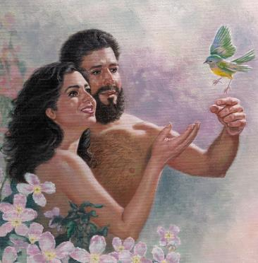
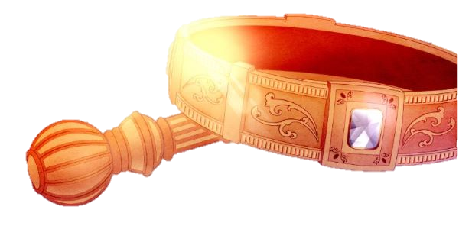
In Part 1 we learned the priesthood of heaven is the “seed” for the established priesthood on earth beginning with
Adam!

Slide 3



Also in Part 1: Yahuah is the Melki-tzedek Priest
administering His
divine covenant to all.
That means He was the “Priest” that gave the moedim count to Adam
in the very beginning.
Melki-tzedek
King & Priest!
Covenant!

Slide 4

a) We now know:
Heavenly Priesthood
The Melki-tzedek Priesthood began in heaven …
b) And we
also know:
Adam received the
authority to be the
representative Melki-tzedek
priest on earth for instruction in righteousness to his descendants.
He was not from the tribe of Levi.
Aharonic Priesthood
Overall Question:
There is an Aharonic Priesthood
on Earth about 2500 years
after creation.
How did the priesthood move from Melki-tzedek to Aharonic?

Slide 5


c) There is a connecting link between the “Heavenly” priesthood & “Aharonic” priesthood.
Heavenly Priesthood
The second level of the
Melki-tzedek priesthood –
passes the “priesthood baton”
from Adam to Moses.
Earthly Priesthood
Aharonic Priesthood
Note:
#2a Melki-tzedek –
Earthly Representatives from Adam “up to” Shem
(in this study)
#2b Shem to Moses
as Melki-tzedeks
(upcoming studies)
Heaven’s original plan was for this earthly Melki-tzedek priesthood to function from Adam (son of Yahuah),
to Yahusha, as the
final High Priest.

Slide 6


Question #5
How can we understand & trace
the Melki-tzedek Priesthood
as it was established first in Adam
by the Most High?

Slide 7
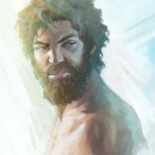
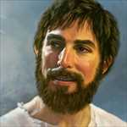
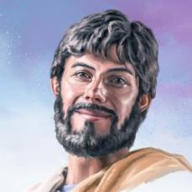
The Chronology of Genesis & Priesthood
Cain forfeited the right to the priesthood when he killed Abel.
It is the chronology of Genesis that builds the priesthood.
The genealogy of Yahusha does not trace the family line through any of the “first-born” sons.
  Cain was disqualified for killing Abel.
The priesthood passed to Seth.
  (The Scriptures do not record the many names of
  additional sons for 8 generations from Seth to Lamech.)
Shem as the 2nd born of Noah, receives the priesthood baton even though Japheth and Ham have a family tree listed in the Scriptures for a short time.
Only Shem’s genealogy continues to Abram.
In some way the ‘first born sons’ disqualified themselves of being worthy to act as intercessor and mediator between
man and Elohim.
This pattern (of 2nd born) must be followed to trace the
Melki-tzedek priesthood all the way to Moses.
Tracing the priesthood baton after Jacob will be challenging
if the established pattern is not followed – this is another case of “knowing the end from the beginning” as we shall see when Joseph is listed as a Melki-tzedek priest (future study).
Seth was the 2nd
in line for the priesthood – setting a pattern.
Shem, Noah’s son, is the 2nd born and honored with the priesthood.

Slide 8
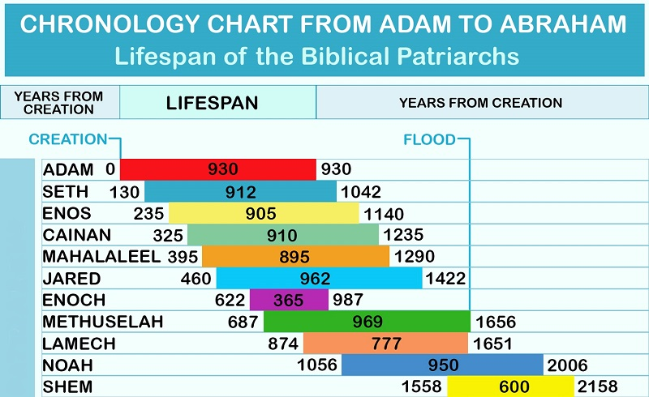
CHRONOLOGY CHART FROM ADAM TO SHEM: Gen 5
(Note: Noah is the 10th Generation, not the 8th!)
Enoch
and
Lamech
did not participate as a
Melki-tzedek priest.
#1
#2
#3
#4
#5
#6
#7
Died before Methuselah
#8
#9

Slide 9
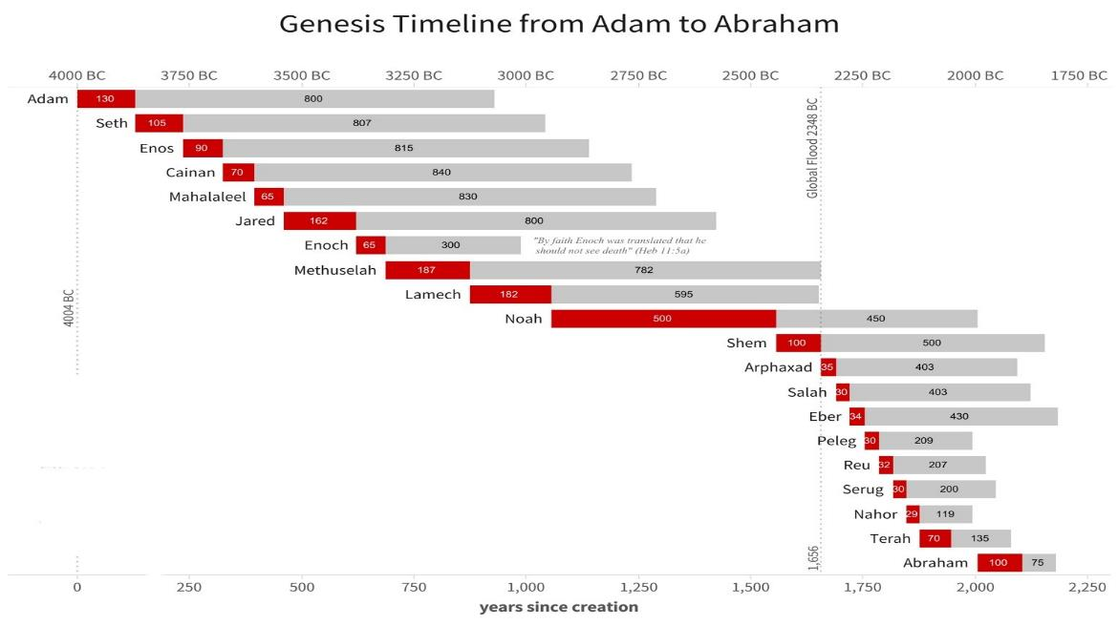
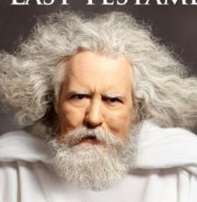
#1
Adam
Adam was ordained the 1st earthly Melki-tzedek priest on earth and had the privilege and responsibility to instruct
8 generations after him up to Lamech for almost 1000 years.
He would have also honored, taught and preserved Yahuah’s Covenant commands, statutes and judgments including the worship statutes of Covenant Calendar.
Luke 3:38
… Adam, which was the
son of Yahuah.
9

Slide 10

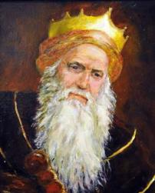
#1
#2
#3
#4
Enoch
#5
#6
During Enoch’s life he would have easily known Adam
the whole time and received instruction in Yahuah’s Covenant, including the Divine Covenant Calendar.
Enoch’s earthly residence ended before he became a priest. Is it possible for Enoch to “walk with Yahuah”
and live in disobedience to the Covenant?
Gen 5:24
And Enoch walked with Yahuah: and he was not;
for Yahuah took him.
10

Slide 11
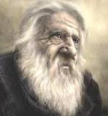
#1
#2
Counting the Patriarchs & Priests
#3
#4
Methuselah
~3317-2348 BC
#5
#6
#7
Methuselah lived 669 years after his father Enoch was no longer.
He was a witness to 11 generations - more than anyone in the world. Being instructed for 300 years by Enoch, with the Covenant truths confirmed in Adam and all previous generations,
Methuselah is an invaluable link by preserving every truth
for future generations.
Gen 5:22
And Enoch walked with Yahuah after he begat Methuselah three hundred years.
11

Slide 12
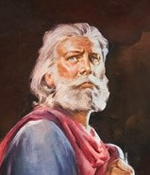
Noah
#1
#2
#3
#4
#5
#6
Enoch & Lamech
are bypassed
as Melki-tzedek priests because the priest before them ruled longer than their days on earth.
#7
#8
Noah is the 10th generation
& the 8th Melki-tzedek Priest.
When Noah dies, Shem
(the 2nd born son), becomes the
9th Melki-tzedek Priest.
2 Peter 2:5 And spared not the old world, but saved
Noah the eighth person, a preacher of righteousness, bringing in the flood upon the world of the ungodly. [KJV]
Note: Melki-tzedek means “king of righteousness.”
When the italicized word “person” is removed, the
verse reads that Noah is the “8th” – rightly meaning
the “8th Melki-tzedek Priest” since Adam.
12

Slide 13
Noah
#1
#2
#3
#4
#5
Gen 6:8-9
8 Noah found grace in
the eyes of Yahuah.
9 … Noah was a just man
and perfect in his generations,
and Noah walked with Yahuah.
Gen 7:5 And Noah did according unto
all that Yahuah commanded him.
2 Peter 2:5 Noah, a preacher of righteousness …
#6
#7
#8
What does this
part of the
timeline
look like?
Noah was able to have instruction from 6 generations before
him that knew Adam and learned from his lips. Noah’s instructions, would have been handed down through the following 10 generations all the way to Abraham. Noah’s testimony for the timing of the flood calendar demonstrates many details of Yahuah’s Covenant Calendar!
13

Slide 14


After Shem died,
the title of
Melki-tzedek priest (on earth), continued
to be inherited from generation
to generation
until it
reached Moses.

Slide 15
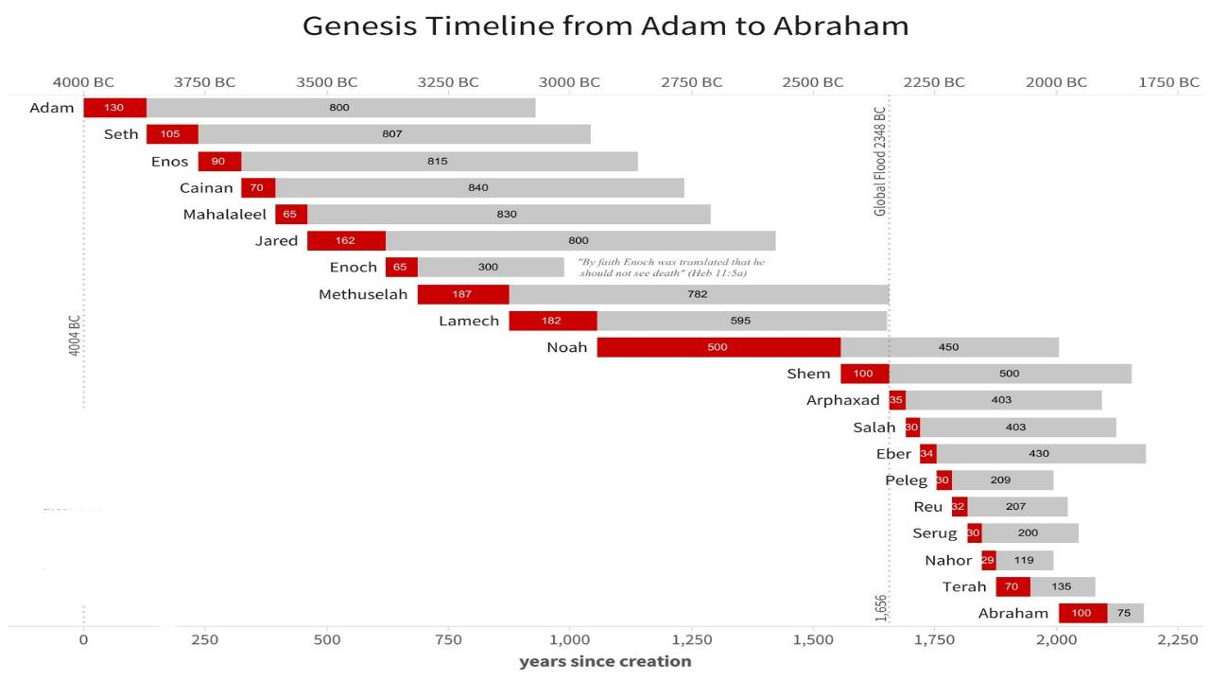
#1
#2
This piece needs to be investigated
further!
#3
#4
#5
#6
#7
Enoch & Lamech are bypassed as Melki-tzedek priests.
#8
Noah is the
10th generation & the
8th Melki-tzedek Priest.
#9
Why?
In many Bibles, the timelines of these 10 generations
from Shem to Abraham are shown
with the life spans significantly shortened.
These problems exist due to the deliberate
miscalculations seen in the KJV (and several other Bibles).

Slide 16
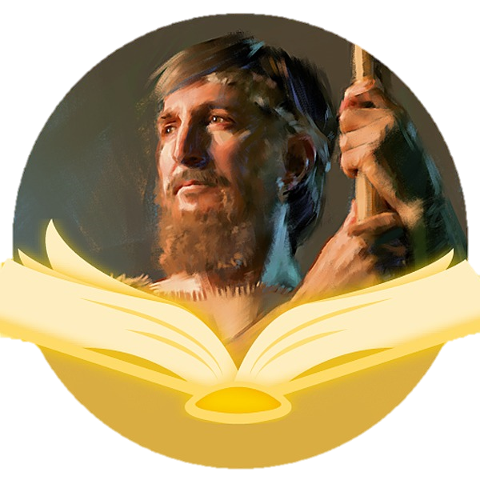
Some claim Noah’s son, Shem, is THE “king of Salem” as found in Gen 14:18 – the very priest that brought bread and wine to Abram also being named as the “priest of the most High Elohim.”
Could that be true?

Slide 17

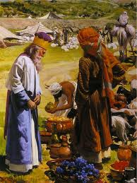
Yahuah’s Promise to Abram
Genesis 14: 17-24
17 And the king of Sodom went out to meet him [Abram]
after his return from the slaughter of Chedorlaomer, and
of the kings that were with him, at the valley of Shaveh,
which is the king's dale.
18 And Melki-tzedek king of Salem brought forth bread and
wine: and he was the priest of the most high Elohim.
19 And he blessed him, and said, Blessed be Abram of the
most high Elohim, possessor of heaven and earth:
20 And blessed be the most high Elohim, which hath
delivered thine enemies into thy hand. And he gave
him tithes of all.
21 And the king of Sodom said unto Abram, Give me the
persons, and take the goods to thyself.
(Sacred Name Used)
22 And Abram said to the king of Sodom, I have lift up mine hand unto
Yahuah, the most high Elohim, the possessor of heaven and earth,
23 That I will not take from a thread even to a shoelatchet, and that I will
not take any thing that is thine, lest thou shouldest say, I have made Abram rich:
24 Save only that which the young men have eaten, and the portion of the
men which went with me, Aner, Eshcol, and Mamre; let them take their portion.
(also see Hebrews 7:1-10)
Notes:
Isa 55:11 – claiming this promise for this study … So shall my word be that goeth forth out of my mouth: it shall not return unto me void, but it shall accomplish that which I please, and it shall prosper in the thing whereto I sent it.

Slide 18
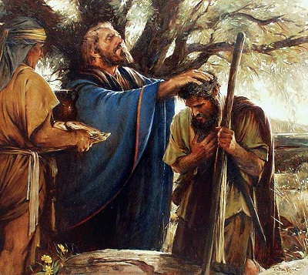
Who is this “king/priest” that came to Abram that is also spoken of in Heb 7:1-10?
Shem,
Noah’s son?
Heavenly King
of Righteousness?

Slide 19

Many People Think …
Shem,
Noah’s son!
There is quite a difference between these two choices!

Slide 20
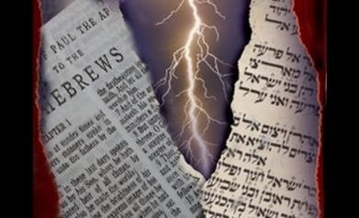
Question #6
Have the Scriptures been altered, revised or tampered with?
Further investigation is necessary because
tampering with timelines is serious.

Slide 21

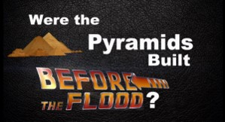

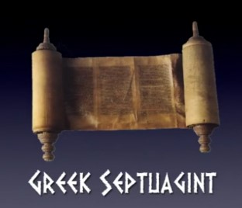
In the next part of this study, we will examine some very detailed information related to Shem, Noah’s son. The information regarding Shem has been gleaned from the You-tube: https://youtu.be/VI1yRTC6kGE - produced May 2017 (30 min).
A thorough comparison
will be done between the Hebrew Masoretic text and the
Greek Septuagint.
The presentation demonstrates the Greek Septuagint does not agree with many Christian scientists on
the placement and lengths of
many Biblical timelines.

Slide 22
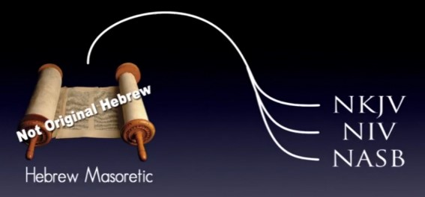
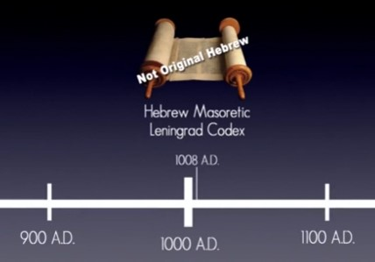
There have been many timelines from Adam to Noah … recorded by Moses.
This information was verbally passed down through the generations one at a time when there was not a lot of written work. Moses was the first to record these timelines – we have to trust that they are accurate those first 2500 years after creation and believe they were carefully preserved by Yahuah.
However, we also have to understand another very important point - modern bible translations are translated from the Hebrew Masoretic text which is not the original Hebrew.
Rather, it is a copy of the Hebrew called the Leningrad Codex which was copied in the 11th century AD.

Slide 23
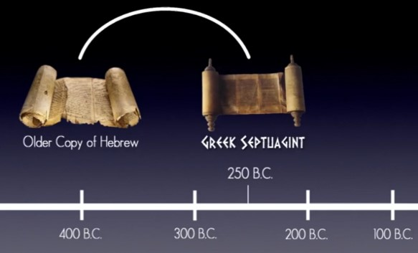
#1 The Greek Septuagint was copied more than 1000 years before the Masoretic in about 250 BC. Therefore, the Septuagint would have been copied from an older copy of the Hebrew which is no longer around today.

Slide 24
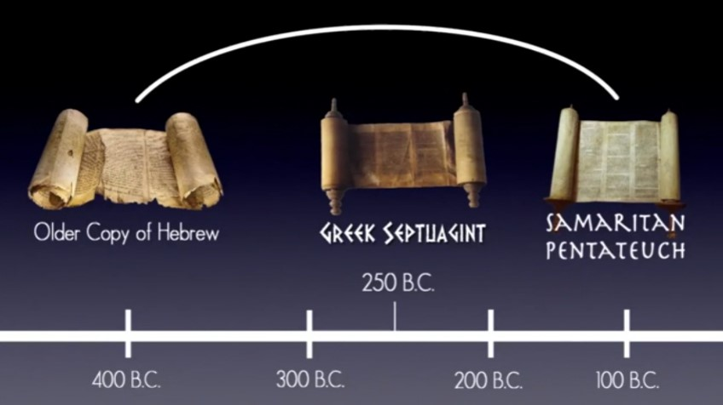
#2 The Samaritan Pentateuch also predates the Masoretic text being taken from an older copy of the Hebrew.

Slide 25
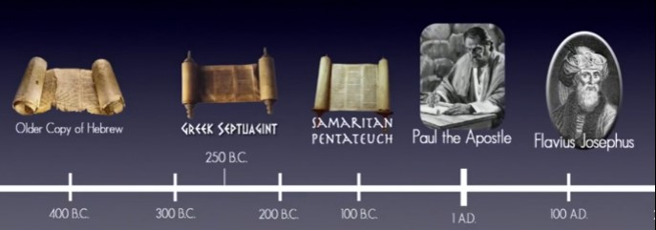
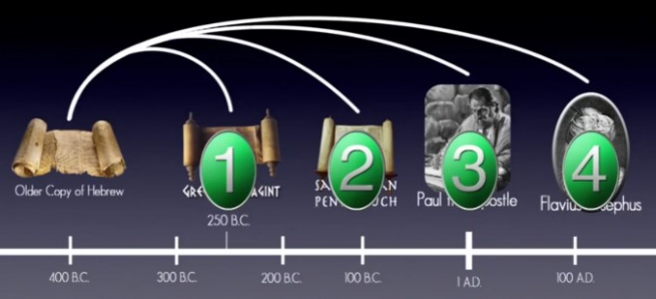
#3 The same is also true of Josephus and #4 Paul the Apostle.
These 4 witnesses from the original Hebrew text have this to say about Exodus 12:40 …

Slide 26
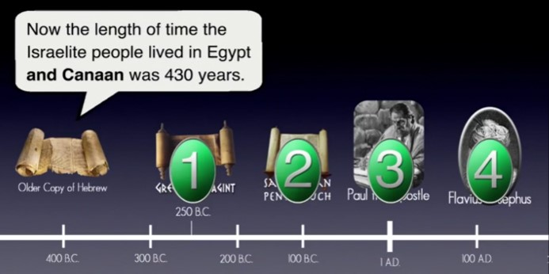
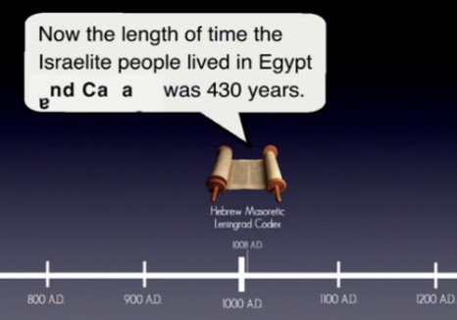
“… the length of time the Israelite people lived in Egypt and Canaan was 430 years.”
That’s the way Exodus 12:40 was written in the original Hebrew.
But more than 1000 years later, that phrase
“and Canaan” was
dropped out of the text.

Slide 27
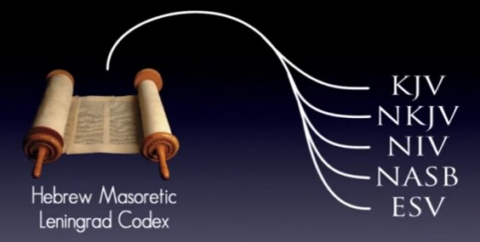
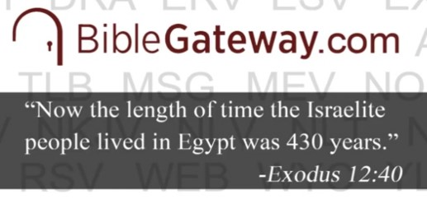
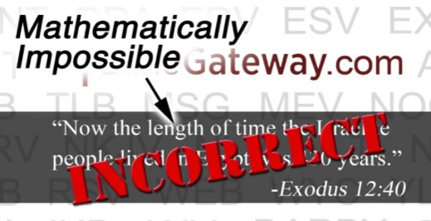
Since all of our Bibles are translated from this corrupted copy of the Hebrew Masoretic, that’s why all of our Bibles specify
“only Egypt” which is incorrect!
The truth is: they were only in Egypt for 215 years – but that’s another study for a later time.
The first 215 years, Abraham’s family lived in the land of Canaan – being under the rule of Egypt.

Slide 28

We’ve just seen a good example of “details” that have been dropped out of the original Hebrew text, - which will cause distortions in biblical timelines.
But, it doesn’t end there!

Slide 29

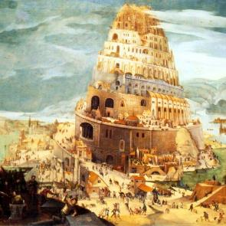
#1: In order to find if other things have been dropped out, we will take a good look at the pattern in the Genesis timelines.
#2: We need to examine details of how many generations after Noah the Tower of Babel was built – and – how did
it happen that 6-7 generations after
Shem - the timelines immediately have a different pattern up to Terah and Abraham?
We may have to take another detour before we find the problem.

Slide 30
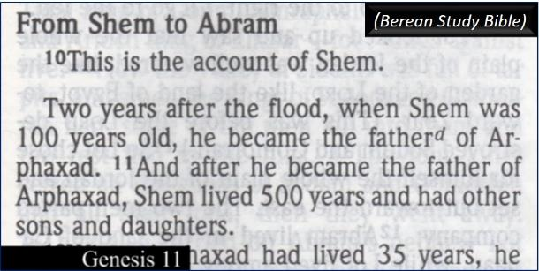
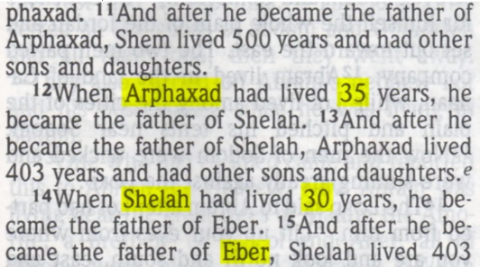
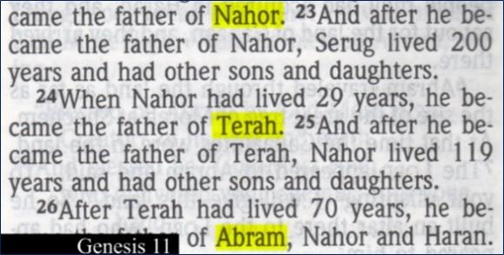
In Gen 11 we find the genealogy of Shem all the way down to Abram – giving all the ages of how old each one of them were when their sons were born.
Berean Study Bible
Genealogy from Shem to Abram
(1 Chronicles 1:17–27)
10This is the account of Shem. Two years after the flood, when Shem was 100 years old, he became the father of Arphaxad. 11And after he had become the father of Arphaxad, Shem lived 500 years and had other sons and daughters.
12When Arphaxad was 35 years old, he became the father of Shelah. 13And after he had become the father of Shelah, Arphaxad lived 403 years and had other sons and daughters.d
14When Shelah was 30 years old, he became the father of Eber. 15And after he had become the father of Eber, Shelah lived 403 years and had other sons and daughters.
16When Eber was 34 years old, he became the father of Peleg. 17And after he had become the father of Peleg, Eber lived 430 years and had other sons and daughters.
18When Peleg was 30 years old, he became the father of Reu. 19And after he had become the father of Reu, Peleg lived 209 years and had other sons and daughters.
20When Reu was 32 years old, he became the father of Serug. 21And after he had become the father of Serug, Reu lived 207 years and had other sons and daughters.
22When Serug was 30 years old, he became the father of Nahor. 23And after he had become the father of Nahor, Serug lived 200 years and had other sons and daughters.
24When Nahor was 29 years old, he became the father of Terah. 25And after he had become the father of Terah, Nahor lived 119 years and had other sons and daughters.
26When Terah was 70 years old, he became the father of Abram, Nahor, and Haran.
Terah’s Descendants
27This is the account of Terah. Terah became the father of Abram, Nahor, and Haran. And Haran became the father of Lot. 28During his father Terah’s lifetime, Haran died in his native land, in Ur of the Chaldeans.
29And Abram and Nahor took wives for themselves. Abram’s wife was named Sarai, and Nahor’s wife was named Milcah; she was the daughter of Haran, who was the father of both Milcah and Iscah. 30But Sarai was barren; she had no children.
31And Terah took his son Abram, his grandson Lot son of Haran, and his daughter-in-law Sarai the wife of Abram, and they set out from Ur of the Chaldeans for the land of Canaan. But when they arrived in Haran, they settled there. 32Terah lived 205 years, and he died in Haran.

Slide 31
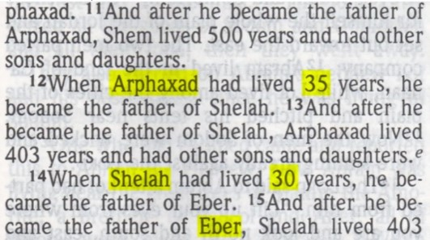
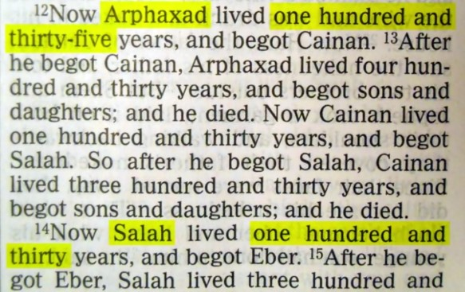

But in the Greek Septuagint, the ages listed have 100 extra years on them as seen below!
Hhmm…

Slide 32
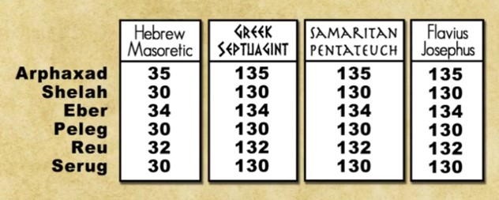
In the 6 generations from Shem, please note the details for the following four comparisons:

Slide 33
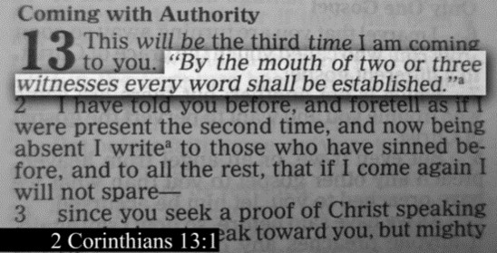
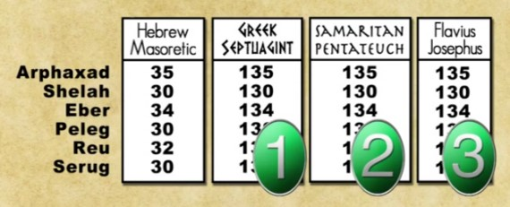
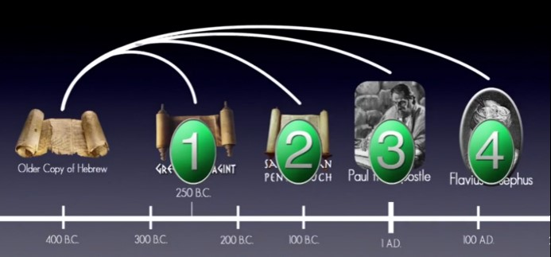
Now remember, the Scriptures say: by the mouth of two or three witnesses …
(NKJV)
Coming with Authority (NKJV)
1This will be the third time I am coming to you. “By the mouth of two or three witnesses every word shall be established.” 2I have told you before, and foretell as if I were present the second time, and now being absent [a]I write to those who have sinned before, and to all the rest, that if I come again I will not spare— 3since you seek a proof of Christ speaking in me, who is not weak toward you, but mighty in you. 4For though He was crucified in weakness, yet He lives by the power of God. For we also are weak in Him, but we shall live with Him by the power of God toward you.
Examine Yourselves (Berean Study Bible)
1This is the third time I am coming to you. “Every matter must be established by the testimony of two or three witnesses.”
2I already warned you the second time I was with you. So now in my absence I warn those who sinned earlier and everyone else: If I return, I will not spare anyone, 3since you are demanding proof that Christ is speaking through me. He is not weak in dealing with you, but is powerful among you. 4For He was indeed crucified in weakness, yet He lives by God’s power. And though we are weak in Him, yet by God’s power we will live with Him to serve you.
Now we have 3 witnesses that all agree on the ages, and we already know these 3 witnesses are from the older copy
of the Hebrew.

Slide 34
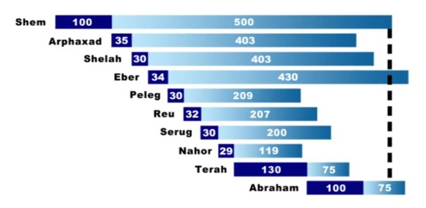
According to modern Bibles & the internet, the timelines from Shem to Abraham will look like this – but also notice that Shem nearly outlives Abraham nine generations later!

Slide 35

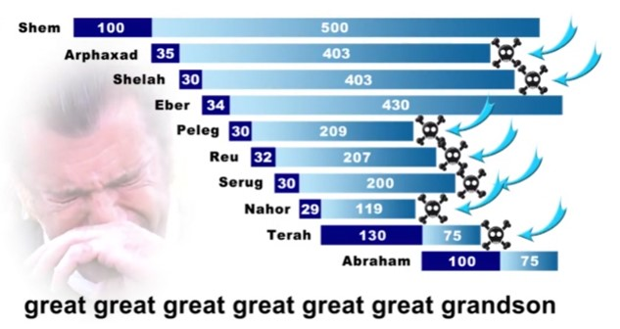
If this is the case, then Shem would have gone through a whole lot of grief – as seen with each generation.
Is the loss of a child really that traumatic?
Did Yahuah ever intend for His patriarch Shem, to endure that much grief and trauma after living his first 400 years?
Yes, Shem did live a long life AFTER the flood, seeing his ‘first born’ son after he lived 100 years.
What happened that now the fathers of the next 7 generations witness the birth of their ‘first born’ sons in their 30s?
Then notice the pattern returns and is similar to the pattern of Shem, Terah
and Abram.

Slide 36
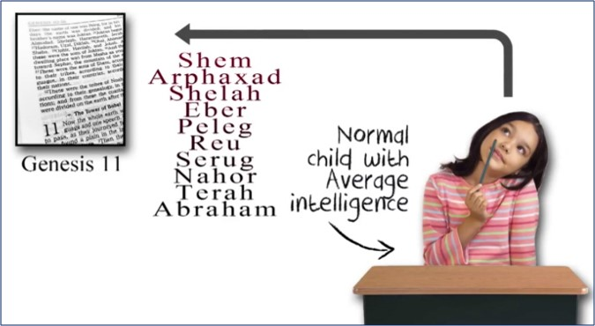
That’s not NORMAL!
Any normal child that reads the genealogy of Genesis 11
in modern-day translations will certainly get the impression that many sons were dying before Shem, their fore-father.

Slide 37
Consider the following popular timeline chart from Adam to Abraham.
Except for Noah, the average timespan for a father’s firstborn was around
100 years of age.
Even considering Adam, Shem and Abraham, the average age for the arrival of the firstborn is 100 years.
Now notice the 7 generations from Shem to Abraham – how they have drastically reduced to an average of 34 years to see their firstborn. Does this not seem strange?

Slide 38

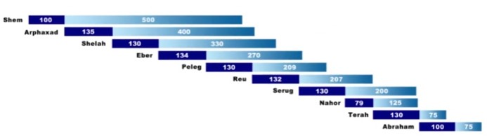
By charting these same timelines according to the 3 witnesses that are translated from the old Hebrew text, the timelines take a different form to look like this!
All of a sudden, things begin
to make a lot more sense.

Slide 39
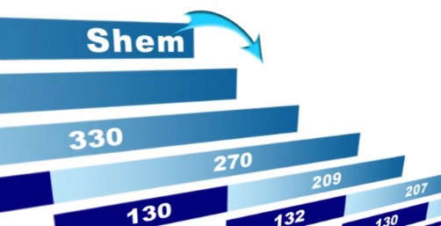
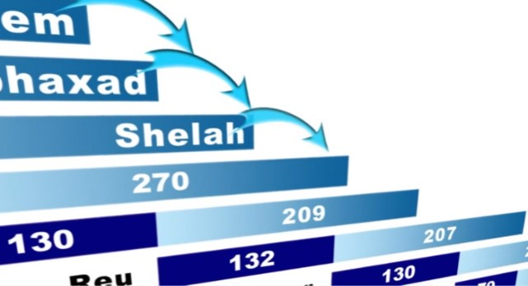
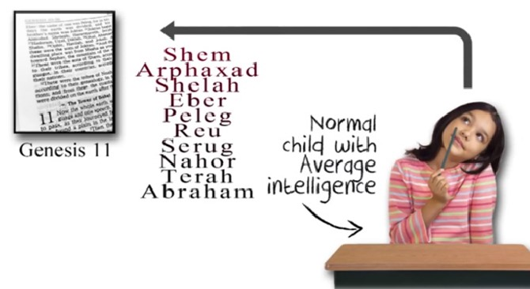
Charting the life spans with the extra years that are missing, we now see that Shem would have died before Arphaxad.
This is NORMAL –
the way it is
supposed to be!
And each “father” after that would have also died before his first born son.
The 3 additional witnesses actually give the correct impression and
the actual way of life – that even
a child could understand.

Slide 40
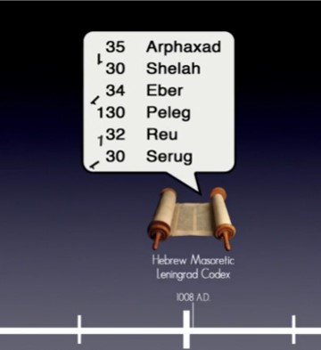
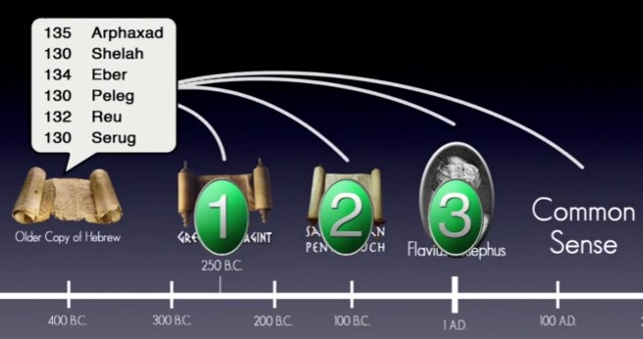
So according to these 3 witnesses – and a little common sense – these six (6) generations actually should have an extra 100 years each as would have been recorded in the older copy of the Hebrew.
Yet several 100 years later, the digit “1”
was dropped from the Masoretic text!

Slide 41
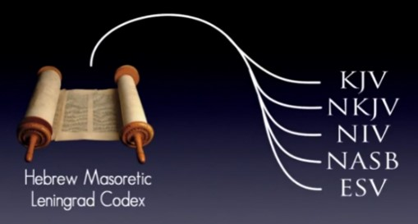

Since all of our Bibles are translated from the Masoretic text, all of them are missing “100 years” in the first six generations.
THAT will grossly distort our understanding of
the typical timelines
for this study.

Slide 42


Many timelines that can be found on the internet and in the back of bibles will look exactly the way our modern Bibles track these generations. For some reason this is supposed to be a “wow moment” for Abraham to know someone that is almost 600 years old. But now we know this is NOT correct.

Slide 43


Shem died about 500 years before Abraham was even born.
Shem could not have lived long enough to know Abraham, Isaac and Jacob, which explains “the lack of dialogue between them” in the Torah.
(And yes, we know many say that Shem was the Melki-tzedek Priest – or the King of Salem that Abraham met in Gen 14.)
But, is that true???
What is the …
Could this be the reason why those “#1 digits”
were all dropped from six generations?

Slide 44


Answer: Most of the chronology is based upon the calculations of James Ussher- who based his calculations on the Hebrew Masoretic text.
How in the world did these mistakes happen?
Remember, the additional three witnesses had an extra 100 years on the timelines of six generations – resulting in an error of 600 missing years of chronology.

Slide 45


The 7th generation of Nahor has a loss of an additional 50 years in the Masoretic text.
While Josephus does not give any information, there are at least two witnesses that do.
There is
still
another
problem!

Slide 46



Simply, the original
Hebrew text included an extra 650 years in the chronology of these seven generations.
The math is simple – another 50 years
of history are missing from our
everyday Scriptures.
What does this mean for 7 generations?

Slide 47

Atheist’s say:

Slide 48


The Tower of Babel event occurred just before the birth of Peleg – his name means “division” – that’s what the Scriptures say:
Most Creationist Scientist’s say:

Slide 49


At the time of Babel:
However, by the time
of Peleg:
… the earth was NOT united!

Slide 50

Peleg was given this name just after the dispersion of Babel.
This is when the languages were confused and all people split off in their own separate directions.

Slide 51



Peleg’s father was Heber (Eber) and when this family split off they were speaking their own language – Hebrew!

Slide 52


The Tower of Babel event occurred within the lifetime of Eber just before the birth of his son Peleg.
Josephus says:

Slide 53



According to the corrupted Masoretic text there was only about 100 year timeframe from Arphaxad to Peleg.
How did that huge tower get built within the next 100 years?

Slide 54


Remember, there were only 8 people that came out of the ark. Using logic, 100 years is not enough time to increase the population in that short amount of time to have the sufficient number of workers needed for the Tower of Babel construction.
It is estimated the great pyramid of Khutu
required 30,000 workers for completion.
(Herodotus, writing more than 21 centuries after the pyramid's completion, was told that labor gangs totaling 100,000 men worked in three-month spells a year to finish the structure in 20 years.)
Surely the Tower of Babel would have needed more workers than that. Is it impossible to achieve a population to support 30,000 workers within 100 years, even if the growth rate is 3.2% - the rate of some nations today?

Slide 55


Starting with 8 people from the ark, at a growth rate of 3.2% - in 100 years you would have only approximately 186 people to build the Tower of Babel. Not possible – giving every atheist a valid point!
Nations today with a growth rate of about 3.2%.

Slide 56


When we go back and consider the extra 100s of years that have been removed the picture changes. When the missing 100 years are added back in, then we find there is about a 400 year timeframe from Arphaxad to Peleg.
Is 400 years enough time to produce a sufficient population growth to build the large Tower of Babel?

Slide 57


Going with a 3.2% growth rate, there would be over 2 million people on the earth in 400 years – certainly that would be enough workers to work on the tower.
Comparing that to the 30,000 workers for the Khutu pyramid, 3.2% is a realistic estimate for population growth.
If our Scriptures today would be consistent with the original Hebrew, Atheist's would not have made this claim to begin with.
Let’s examine a second option next.

Slide 58


In order to go from 8 people to at least 30,000 in the first 100 years, that would be a growth rate of: 8.58%!
However, this is not a realistic growth rate either!
Just to be fair – examine this scenario!
Just to put this in perspective – starting with 8 people
and an 8.58% growth rate over a period of 400 years –
this will yield 159 trillion people.
Compare that with the
population today – of
7.9 billion as of Nov 2021, after 1000s of years!
Clearly a growth rate of 8.58% is not realistic! And yet,
that is the kind of growth rate needed to get at least 30,000 people in 100 years. (And remember, the pyramid had 100,000 workers a year on rotation of 30,000 at a time.)
It’s beginning to be clear that the removal of these 100s
of years from the original text – must have been deliberate. Was there a reason?
Notes:
In demographics, the world population is the total number of humans currently living, and was estimated to have exceeded 7.9 billion people as of November 2021. It took over 2 million years of human prehistory and history for the world's population to reach 1 billion and only 200 years more to grow to 7 billion.

Slide 59


The Greek Septuagint is not perfect either.
But in case you are wondering … ?
In Genesis 11 it includes an extra “Cainan” in between
Arphaxad and Salah.

Slide 60

In Luke 3 for the genealogy of Yahusha, the extra Cainan is also included between Arphaxad and Shelah.
It does not belong here!
(NKJV)

Slide 61



There are 6 witnesses of this extra “Cainan” not being included – even in the Hebrew Masoretic text!
This extra Cainan was added in when it should not have been there. Just ignore it.
The extra “Cainan” has not been included in the new chart.

Slide 62



Why would the Jewish Scribes drop 650 years off from seven generations?
The next question should be:
Was it on purpose, or was it an accident?
And if it was on purpose, what was their motive?

Slide 63




What if the removal of these 650 years was “on purpose” and the Rabbis/Scribes had
“a motive” to disprove what the book of Hebrews was saying about Yahusha being our new High Priest?

Slide 64




Most Jewish people believe that for Yahusha to be a High Priest He has to come from the tribe of Levi – through the son of Aaron.
Yahusha did not come from the tribe of
Levi – He was born and had citizenship
in the tribe of Judah. (Later we will do some work on Mary’s genealogy from the tribe of Levi.)
So according to the Book of the Law, Yahusha cannot qualify to be an Aharonic Priest.
But according to Hebrews, He is our faithful HIGH Priest – not according to a priesthood from the tribe of Levi, but our High priest according to Melki-tzedek.

Slide 65


Hebrews has these interesting things to say about this Melki-tzedek Priest.
Apparently this Priest
is a divine, immortal Being, not according
to a fleshly commandment,
but by the Power
of an Endless Life.
Yahusha

Slide 66


Jewish Rabbis have decided that they would disprove what the book of Hebrews says about Melki-tzedek by saying:
“He’s the same person as Shem, the son of Noah!”
Question: Can this be proven?

Slide 67






Now, with Shem we know who his mother and father were (Noah and his wife).
We know Shem’s genealogy because it is recorded in Genesis.
We know Shem’s beginning of days and end of life – because we know when he was born and when he died.

Slide 68


To say Shem is the same person as Melki-tzedek in Gen 14, would actually disprove what Hebrews says about Melki-tzedek in 5 separate points.
This would also mean that Melki-tzedek is not “of a different or higher” priesthood.
But rather, Shem would be the ancestral founder of the
Aharonic priesthood from the tribe of Levi!
Shem is not Melki-tzedek of Gen 14!
Because many 100s of years are removed from modern day Scriptures, Rabbis say that Shem would have been the one to hand down the priesthood to Abraham, then Isaac, Jacob, and eventually to Levi/Aharon!

Slide 69




The Rabbis go on to say that for Yahusha to be an High Priest,
He would have had to inherit that priesthood
through the tribe of Levi
just like Levi inherited the priesthood from “Shem” as Melki-tzedek.
What does that really mean?
This would mean Yahusha, our Melki-tzedek,
is of the “same
[Levitical]
priesthood,”
not a
different one!
This is NOT true!
Yahusha is not from
the tribe of Levi!
Heb 7:12

Slide 70


Since Yahusha is not a citizen of the tribe of Levi, He cannot be part of the Levitical/Aharonic priesthood. This is the argument that Jewish Rabbis use – even to this day!
What else do the Rabbis say?
Quote: “Unlike Christianity, our traditions tell us who Melki-tzedek was, - he wasn’t an angel, or God Himself, like the Christians teach, but was actually Shem, the son of Noah – who transferred the title
of priest over to Abraham, then Isaac, then Jacob and ultimately Aaron.”

Slide 71



When the day comes that Rabbis offer up
animal sacrifices on a continual basis, what message should that send to Yahuah’s people?
Note: Any animal sacrifices since Yahusha’s death, and especially today, eliminates the prophecies and Old Testament truths of the:
1) red heifer sacrifice, 2) the meaning of the scarlet thread, and
3) the Towla worm. Yahusha referenced Himself as “THE” Towla worm.

Slide 72


The problem with the Rabbinical argument is that they use the Masoretic text to show something significant about this Melki-tzedek that lived the same time as Abraham.
Melki-tzedek interacted with Abram, and Abram gave a tenth of all.

Slide 73


But we now know that Shem died about 500 years before Abraham was born!
How did Shem bring out bread and wine to Abram when he had been dead for the past 500 years?
Clearly Noah’s son Shem cannot be the same person as this Melki-tzedek - as there is a 500 year gap in time!

Slide 74



It appears a long time ago, these unbelieving Jews decided to conspire with the scribes and have them drop 100 years from six generations in a row!
Is that almost
unbelievable?

Slide 75



That way, they could distort the genealogy in such a way so that now Shem’s lifetime overlaps the lifetime of Abram.
In this way they can say Shem lived the same time as Abraham, and then begin to promote the idea that Shem is the same person as Melki-tzedek.
Friends, it’s all an illusion!

Slide 76



In fact, if you ever read an article that says Shem is
Melki-tzedek, you’ll notice the only evidence they provide is: “Look at the Genealogy.
Shem lived the same time as Abraham!”

Slide 77



OK …. But where is the rest of the evidence??? They might quote the Book of Jasher; the Targum or a commentary by a Rabbi.
But – those aren’t Scripture!
Where’s the Scripture evidence that clearly says Shem is Melki-tzedek?
Or … maybe there isn’t any??

Slide 78


They might have been dropped out of an earlier copy of the Masoretic.
Something else that has
to be considered!
Now, those years may not necessarily have been dropped out in the 11th century AD when the Leningrad Codex was copied.

Slide 79

In fact they may have been dropped out in even an earlier copy of the Hebrew, dating all the way back to Paul the Apostle.
“nor give heed to fables and endless genealogies,
which cause disputes rather than godly edification
which is in faith.”
1 Timothy 1:4
“But avoid foolish disputes, genealogies, contentions,
and strivings about
the law; for they are unprofitable and useless.”
Titus 3:9
If that’s the case, that might
be why Paul warned to not
give heed to genealogies
and Jewish fables.
“not giving heed to Jewish fables and commandments of men who turn from the truth.”
Titus 1:14
What is Paul talking about here?

Slide 80

Hhmmm…!!!
Got any ideas?
Maybe it’s because they
(Jews) distorted these timelines in their attempt to disprove truth?
And maybe the distorted genealogy in
Genesis is the one and only single piece of evidence that even remotely supports their ridiculous anti-Scripture fable that
Melki-tzedek is the same person as Shem?
Therefore, they say, Yahusha can’t be the new high priest!
Why would the Jews wish to argue
with Christians & the Scriptures
about Genealogies?
Maybe that’s what Paul was talking about?!

Slide 81


So you see, now we have EVIDENCE of why those years were dropped out, but we also have a MOTIVE as to why they would want these years dropped out.
And that’s why the
suggestion is made:
this is not some
accidental
“copyist error.”
In fact it sounds
like something
directly from satan!

Slide 82



This deception is not an error like when the Greek Septuagint
included an extra
“Cainan.”
(Dropping out the 650 years was not an accidental copyist error!)
(This is an accidental copyist error!)

Slide 83




Many suspect the Jewish scribes dropped out those years “on purpose” with the intent to DECEIVE!
As a matter of fact in 1947 there were
some ancient Hebrew Scrolls discovered
on the outskirts of the Dead Sea known
as the Dead Sea Scrolls. 100s of pieces
of scrolls were carefully pieced together.

Slide 84


The Dead Sea Scrolls date all the way back to the 2nd and 3rd centuries BC – about 1000 years before the Masoretic text was copied.
Now unfortunately, Genesis 11 was not found in the Dead Sea Scrolls.
Is that an
interesting
coincidence?

Slide 85



But whenever the Greek Septuagint and Hebrew Masoretic text disagree, the Dead Sea Scrolls usually side with the Greek Septuagint more often than with the Masoretic. (Note: While the Dead Sea Scrolls will contain some truth – they are not very accurate either. Careful comparisons have to be made everywhere.)
Paul quotes the Old Testament more than 100 times. When the Greek and Hebrew diverge, Paul usually sides with the Greek Septuagint – like in Gal 3:17. Other disciples do this as well ... (to be given in a later study addressing Acts 7:14).

Slide 86

Many examples and evidence have now
been given to correct the teaching of
Shem being the Melki-tzedek priest
that met Abram.
It is now time to ask
the next question…

Slide 87

Question #7
Is there any other proof there has been tampering of the Scriptures?

Slide 88


Part of this Investigation was around the Tower of Babel
As we have noted, from the time of Shem until the Tower of Babel was constructed, there is no possible way to have enough construction workers for such a massive structure, IF …
The timelines from Arphaxad to Peleg were to be understood using the incorrect figures in the timelines
of these four generations.
88

Slide 89



What About Textual Tampering?
Eusebius Writes:
HE 4.18.8b: Justin refers
to certain prophecies that
the Jews had cut out of
the Scriptures
(see Justin, Apol. 71-73).
HE 5.28.13-19: Certain heretics “have tampered with the divine Scriptures without fear … saying that they have corrected them … [while] some of them disdained even to falsify them, and absolutely denied the [authority of the] law and the prophets …”
Jer 17:5 Thus saith Yahuah; Cursed be the man
that trusteth in man, and maketh flesh his arm,
and whose heart departeth from Yahuah.
89

Slide 90

The “Seed” of Tampering?
The issue that has been exposed in this study through the investigation of the tampering of timelines in Genesis is the “seed of Cain.”
It is a “seed of confusion” planted into the Scriptures in a very cunning way by none
other than the Scribes themselves.
This “seed of confusion” that
stems from Cain can easily
divert many to place their
confidence in the Talmud,
or other non-Scriptural
sources!

Slide 91


Why is this kind of
Tampering so Dangerous?
The immensity of deception at this point
is nothing short of preposterous!
This manipulation potentially ELIMINATES eternal life for millions of people who simply accept man’s ideas and writings without thoroughly checking for Scriptural alignment.
Appeal: Let each one be “wise as serpents.”
Be familiar with how the Serpent controls
the ways of the world – “for we should not
be ignorant of his devices” (2 Cor 2:11).
The End of … Part 2

Slide 92

What’s next in Part 3 for Question #8?
How do we trace
the Melki-tzedek priesthood
from Shem to Abraham?

Slide 93

Discovery in Part 3
Heavenly Priesthood
is always over the
Earthly Priesthood
Heavenly Priesthood
#2b Melki-tzedek –
Next Earthly Representatives:
a) From Abram to Amram
as priests over their
individual families.
Will the Melki-tzedek Priesthood continue
to be handed down to
the “second born”?
2a Earthly Priesthood
Everlasting Covenant

Slide 94



If you enjoyed this study today …
Please Join Us Live Each Week
Sign up with Covenant Calendar Club
for the Friday & Shabbat Zoom Meetings
(including live discussion)
https://studythecalendar.com/sign-up/
94

Slide 95


Send Questions & Comments to:
Timothy Astleford
& Charlene Fortsch
questions@studythecalendar.com
Thank-you!
Shalom!

