Slide 1
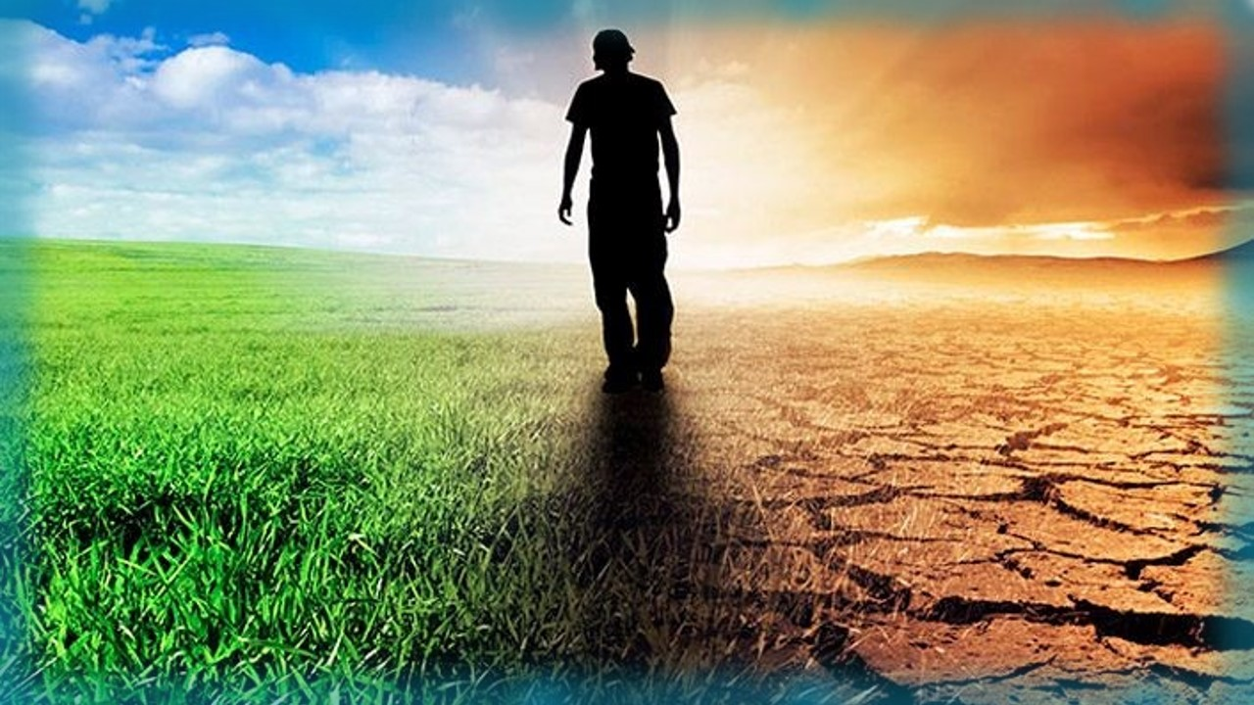

How can we find the truth
on the Priesthoods
of the Scriptures?
Is there a difference between
“Theory” & “Tradition”?
Melki-tzedek
Melki-tzedek (Part 1)

Slide 2

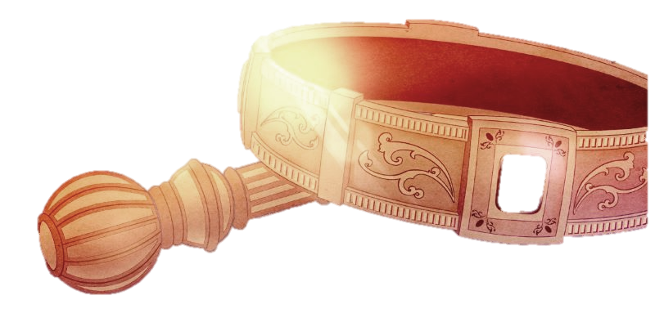
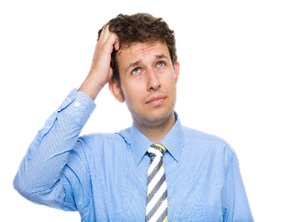
Today, many feel the idea of a
pre-existing priesthood
before the tribe
of Levi
is just a theory!
Melki-tzedek (Part 1)

Slide 3

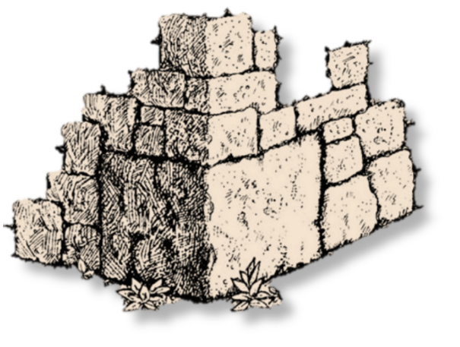

Is it possible the Aharonic Priesthood from the tribe
of Levi is
of the Scriptures?

Slide 4
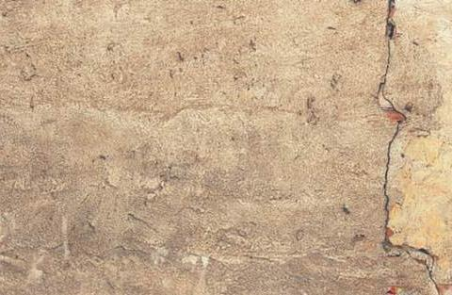
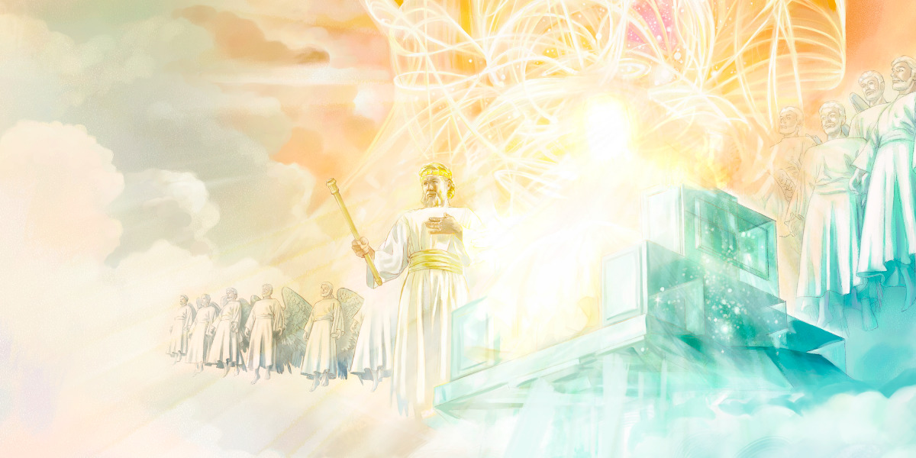
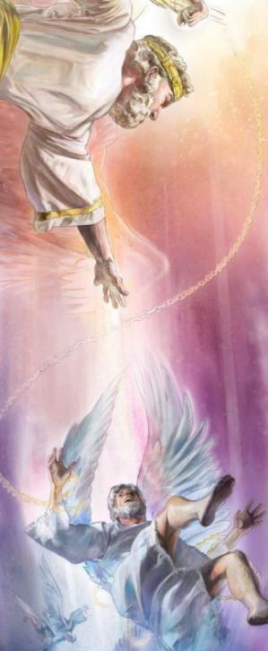
In heaven, was Levi the priest in charge when the disobedient
angels transgressed their
Creator’s Covenant?
Who pronounced judgment
that day?

Slide 5
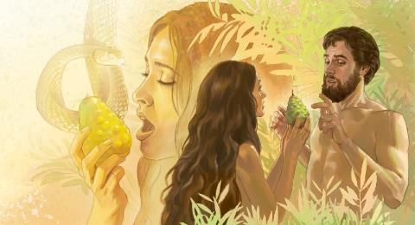
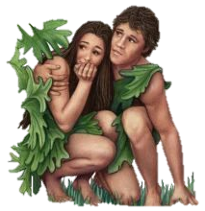
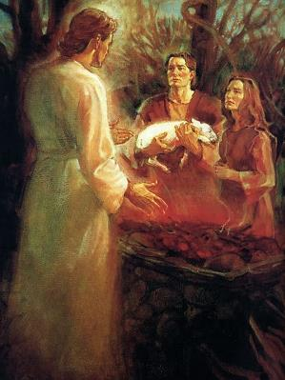
Who was the
priest in charge when
Adam & Eve transgressed
their Creator’s Covenant?
Who officiated over that first animal sacrifice?

Slide 6


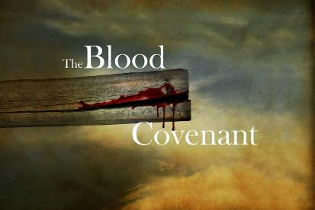
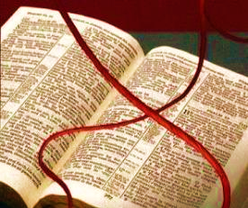
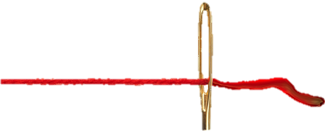
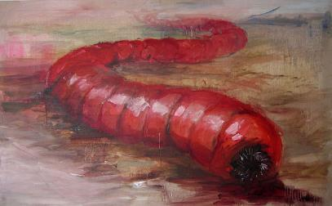
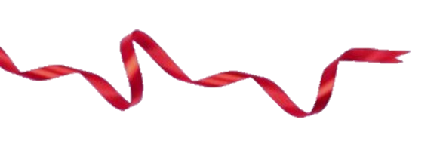

What does Yahusha’s
have to do
with
The Scarlet Thread
and the
Towla Worm
… for a study
on the
priesthood?

Slide 7
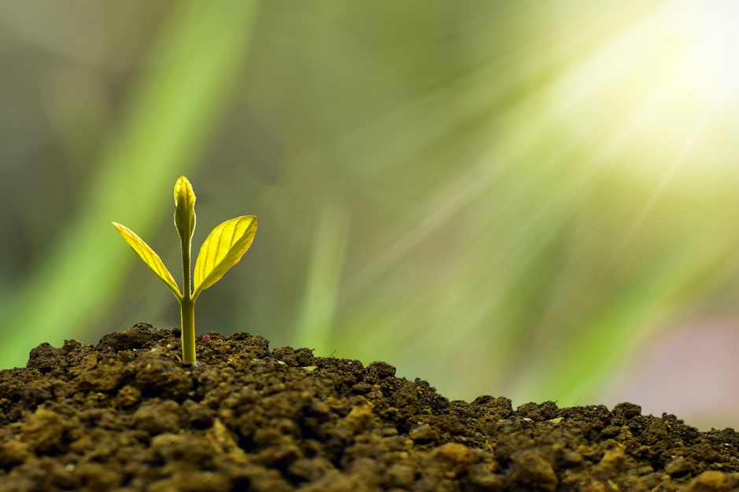
Gen 1:12 … the plant that yields seed according to its kind, and the tree that yields fruit, whose seed is in itself according to its kind.
Is this true?
Or is it just a theory?

Slide 8
Gen 1:12 … the plant that yields
seed according to its kind, and the tree that yields fruit, whose seed is in itself according to its kind.
Has Yahuah declared His “DNA,” (Mode of Operations) throughout His Kingdom?

Slide 9

Or, have we,
as a people,
actually
“missed the boat”
on the
concept of spontaneous combustion?
Priesthood?

Slide 10

Gen 1:12 … seed is in itself
according to its kind.
produce
this???
Can this sprout -
Pig skin
What does this have to do with PRIESTHOOD?

Slide 11
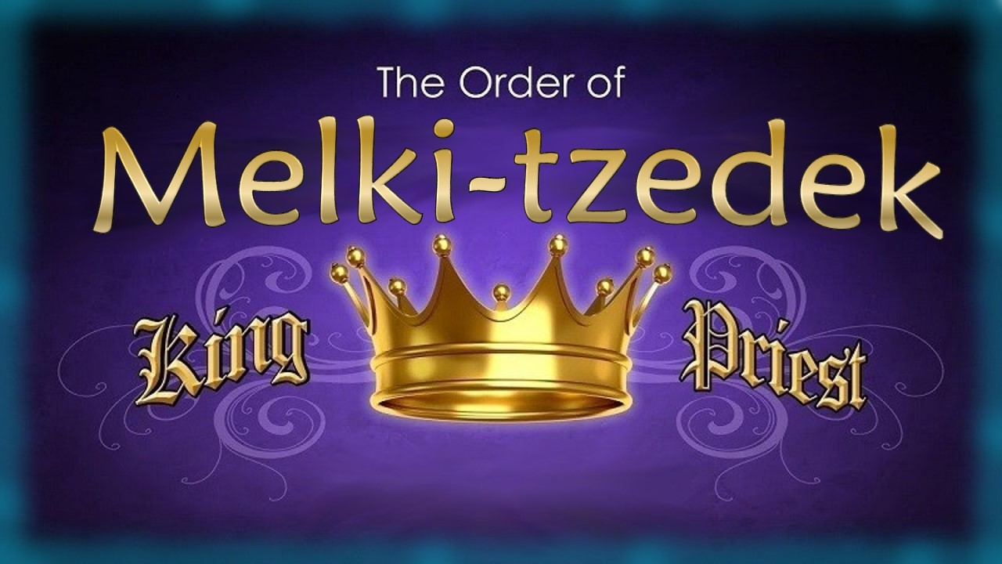
Did the Order of
Originate in Heaven?
Or is it just a theory?
Notes:
Tim and I had concerns about the content in this PPT – many errors. Need to let Life Line Ministries (Carmen & Andy) know as well. Apr 24/21

Slide 12

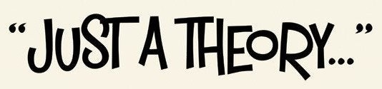

If you have questions that any priesthood before Levi is:
“come and see”
how the Scriptures
introduce this topic!
questions@studythecalendar.com

Slide 13
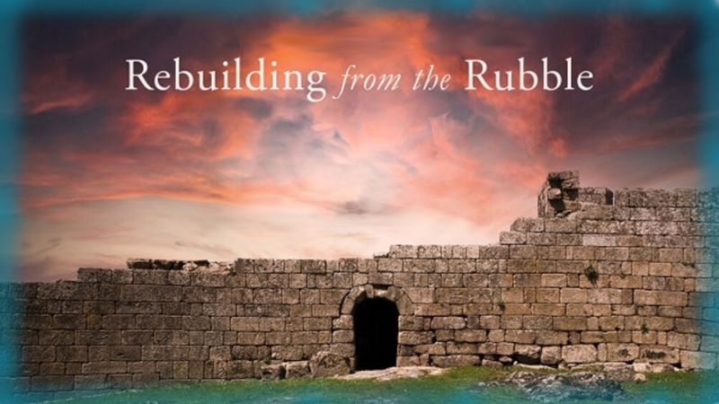

If you enjoyed this short time with us …
Please Join Us for Part 1
Melki-tedek Priesthood
Sign up with Covenant Calendar Club
for the Friday & Shabbat Zoom Meetings
(including live discussion)
https://studythecalendar.com/sign-up/
Thank-you!
Shalom!

