Slide 1
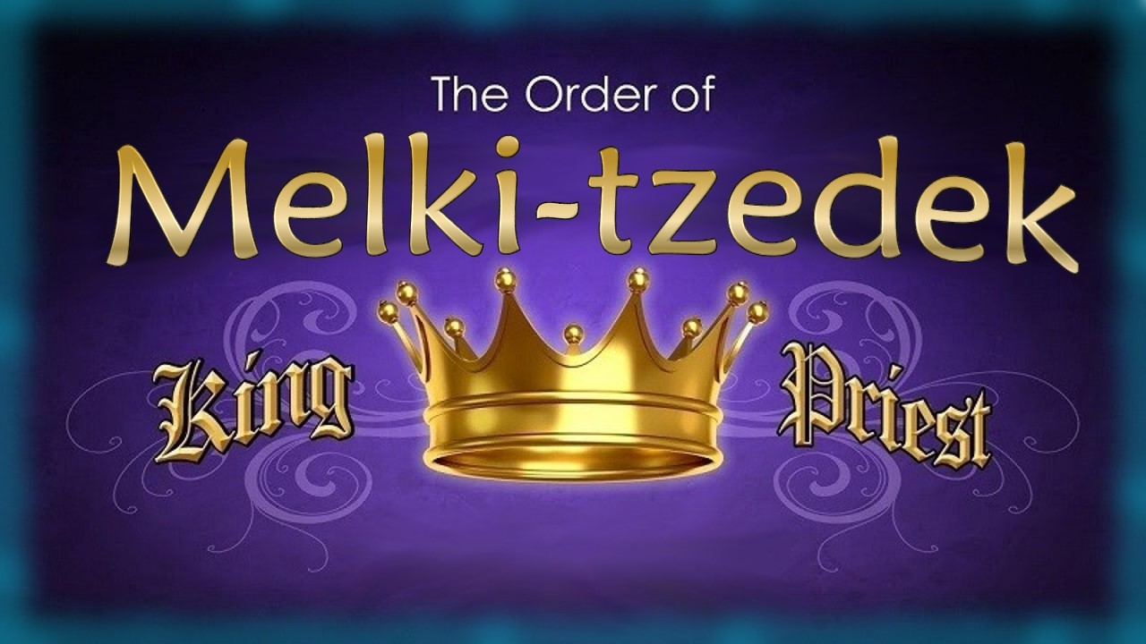

Part 1: Seed of Like Kind
Notes:
Tim and I had concerns about the content in this PPT – many errors. Need to let Life Line Ministries (Carmen & Andy) know as well. Apr 24/21

Slide 2

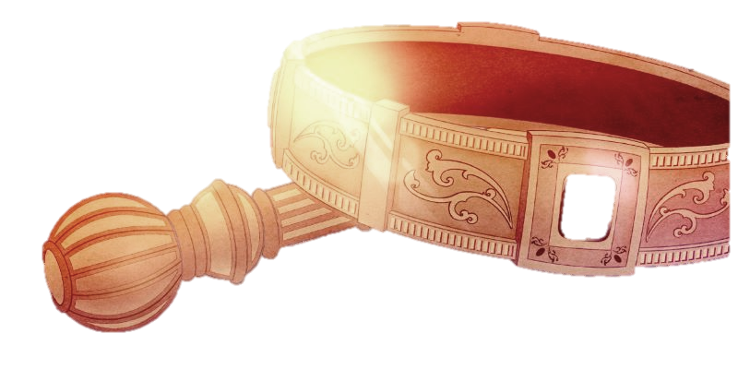
Is the idea of a pre-existing priesthood before the tribe of Levi, just a theory?
Or…

Slide 3



Was Yahuah “the”
Melki-tzedek covering
for His children
beginning in heaven?
Was there a covenant? If so, what was it?
This is the beginning of some very important questions!
Melki-tzedek
King & Priest?
Covenant?

Slide 4

Gen 1:12 … the plant that yields seed according to its kind, and the tree that yields fruit, whose seed IS IN ITSELF
according to its kind.
Is this
true?
Or is it just a theory?

Slide 5
Gen 1:12 … SEED IS IN ITSELF
according to its kind.
Yahuah is INSTRUCTING US that for something Qodesh (Holy) to be permanently established in His Universe, it must already have been
in existence.

Slide 6
Gen 1:12 … SEED IS IN ITSELF
according to its kind.
Eccl 1:9 What has been is what shall be, what has been done is what shall be done, and there is no new matter under the sun.

Slide 7

Gen 1:12 … SEED IS IN ITSELF
according to its kind.
- produce – this???
Can the seed
of this sprout -
Pig Skin
Is Yahusha – ROGUE?

Slide 8
Is this true?
Originated in Heaven?
Or is it just a theory?
Notes:
Tim and I had concerns about the content in this PPT – many errors. Need to let Life Line Ministries (Carmen & Andy) know as well. Apr 24/21

Slide 9

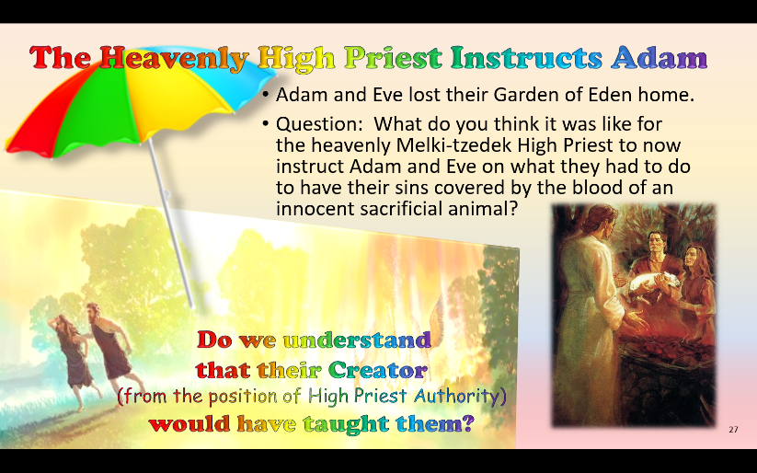
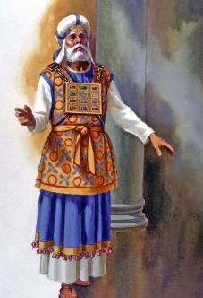
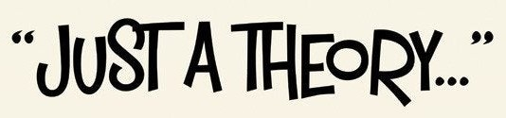

If the “seed of like kind”
in Genesis 1 is not …
what does this concept
have to do with a study on
the Melki-tzedek Priesthood?

Slide 10
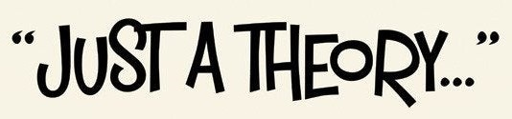

If the “seed of like kind” for the
Melki-tzedek Priesthood is not …
what does that concept
have to do with the
Heavenly Tabernacle for
the Melki-tzedek Priesthood?

Slide 11
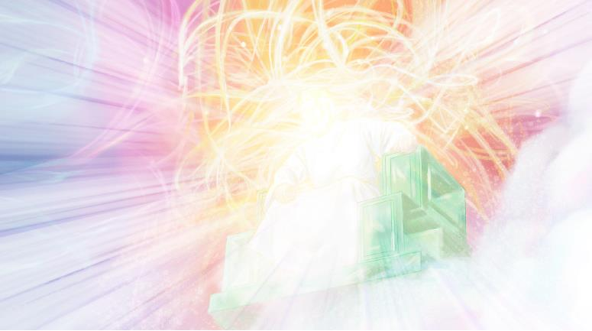

Something to Think About
The Tabernacle in heaven which held
the original pattern for the one on earth,
was the SEED FOR WHICH SUBSEQUENT tabernacles must abide to.
That seed established from eternity is a
visual picture of everything which must
occur on this earth in Yahuah’s time plan.
That Tabernacle which has its origin in
Heaven also has a Priest (KOHEN HA GADOL).
That base foundation of a Kohen Ha Gadol
is a “Seed within Itself” after its own kind which also must reproduce within the time
on this earth.
Any process that strays from this Divine Pattern is a ROQUE contamination derived from the Adversary.
Looking at nature and all around us the “seed within itself” is seen – without any natural violation.
No one has ever seen, nor heard of, an apple tree seed producing avocados. Yet that is exactly what the enemy would want us to believe.

Slide 12
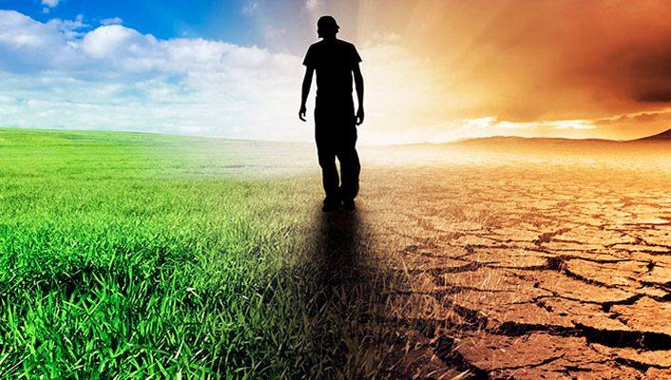
Something Else to Think About
From Tim Jan 22nd: your original thoughts – with adjustment – are on this new slide.
maybe you already have this but I am going to write it - we need to remember that the tabernacle was patterned after the one in the heaven. That Tabernacle in heaven which held the original pattern for the one on earth, was the SEED A FOR WHICH SUBSEQUENT tabernacles must abide to. That seed established from eternity, see Heavenly Tabernacle - is a visual picture of everything which must occur on this earth. Going back to Shaneh, - the Shaneh (which I understand as - ETERNTY by its own definition, is the seed which produces within itself, applied right here on earth. Time is the base of that which produces of itself after like kind. Time is that which Satan has done his best to destroy. Mo-edim, Mazzaroth etc.
That Tabernacle which has its origin in Heaven also has KOHEN HA GADOL. That base foundation of a Kohen Ha Gadol is a seed within itself after is own kind which also must reproduce within the time on thie earth. Any process that strays from this Divine Pattern is a ROQUE contamination derived from the Adversary. We look at nature and all around us the seed within itself is seen. I have never seen nor heard of an apple tree seed producing avocados. Yet that is exactly what satan would have us do and believe.
What ever satan duplicates by contamination is rogue. It does not have a seed within itself. Never. Yahuah would not allow it because then we would not be able to discern Yahuah's Truth from the deception. We must always strive to see the "seed within itself" results and pattern in all that we hold dear to. Anything else is rogue and destruction. Just writing out my thoughts at the moment. Thanks for "listening"! LOL!
Tim, what if the Tent of Meeting that Moses first erected was a round design after the pattern in heaven? It leaves a lot of questions.
Also, if the sanctuary of Moses was a box, still everything is AROUND the Holy of Holies – there is still the idea of circles.
What ever the enemy duplicates by contamination is rogue. It does not have a seed within itself. Never!
Yahuah would not allow this eternally because then His people would
not be able to discern His Truth
from the deceptions & counterfeits.
The importance of this study – at the very beginning – is to always strive to see the "seed within itself."
We must seek for this pattern in all that we hold dear.
Anything else is rogue and destructive.

Slide 13

Heaven’s “Seed” for
Priesthood & Covenant
Melki-tzedek
King & Priest
Yahuah was “the”
Melki-tzedek covering
for His children
beginning in heaven.
The Covenant requirements were simple: Obey; or be brought under judgment if no repentance!
Covenant

Slide 14

In the VERY Beginning …
Everything began with our Creator Yahuah!
Is He really the -
“Seed” of everything?
Is He the “King/Leader” of everything? If so, is there always “order”?
Is He the “High Priest” of everything? If so,
is there a “covenant”?
Yahuah knows the –
“end from the beginning” including the birth of sin.
The Plan of Salvation
was laid down before the foundation of the world …
The Plan: Yahusha would die “once” to provide forgiveness for all sin upon repentance & acceptance!
Here are the 10 verses for “foundation of the word: .
Matthew 13:35 That it might be fulfilled which was spoken by the prophet, saying, I will open my mouth in parables; I will utter things which have been kept secret from the foundation of the world.
KJV for all of them
Matthew 25:34 Then shall the King say unto them on his right hand, Come, ye blessed of my Father, inherit the kingdom prepared for you from the foundation of the world:
Luke 11:50 That the blood of all the prophets, which was shed from the foundation of the world, may be required of this generation;
John 17:24 Father, I will that they also, whom thou hast given me, be with me where I am; that they may behold my glory, which thou hast given me: for thou lovedst me before the foundation of the world.
Ephesians 1:4 According as he hath chosen us in him before the foundation of the world, that we should be holy and without blame before him in love:
Hebrews 4:3 For we which have believed do enter into rest, as he said, As I have sworn in my wrath, if they shall enter into my rest: although the works were finished from the foundation of the world.
Hebrews 9:26 For then must he often have suffered since the foundation of the world: but now once in the end of the world hath he appeared to put away sin by the sacrifice of himself.
1 Peter 1:20 Who verily was foreordained before the foundation of the world, but was manifest in these last times for you,
Revelation 13:8 nd all that dwell upon the earth shall worship him, whose names are not written in the book of life of the Lamb slain from the foundation of the world.
Revelation 17:8 The beast that thou sawest was, and is not; and shall ascend out of the bottomless pit, and go into perdition: and they that dwell on the earth shall wonder, whose names were not written in the book of life from the foundation of the world, when they behold the beast that was, and is not, and yet is.

Slide 15

The First Sin in Heaven
Yahuah’s Word does
not return to Him void!
Does that mean the Plan of Salvation laid down in the beginning was inclusive of Lucifer and his followers?
We know Lucifer and
his angels were expelled from heaven, right?
This first sin in heaven:
… was in violation of a “Royal Covenant” set
down from the beginning!
… had to have judgment!
Who administered the pending judgment?
A King? or a Priest?
Is that “King” and “Priest” “THE SEED” for all “kings
& priests” to come?
ACCORDING TO ITS KIND!

Slide 16
The Seed of the King & Priesthood
In heaven, the sin of Lucifer and
his followers could not be judged without some form of government including a King, Judge and Priest.
Lucifer and his followers were
given the option to repent and
be forgiven through the Plan of Salvation that was laid down
long before.
This gift of forgiveness would
have been “through faith” when
the blood sacrifice would be given according to the Plan of Salvation.
They did NOT repent!
Therefore judgment was pending.
Questions:
Who issued forth this judgment?
The King? The Priest? Or both?
Does this scenario in heaven not proclaim there were positions of king/leadership and priests to
deal with violation?
Are these heavenly positions not
the “seed” for the positions of
“kings and priests” on the earth
that would be needed for leadership, instruction and judgment?
Is the idea of a pre-existing priesthood before the tribe of Levi, still just a theory?

Slide 17
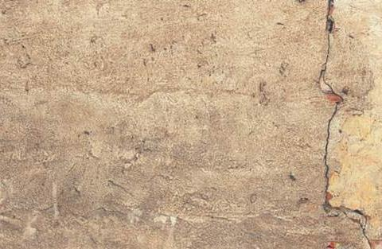
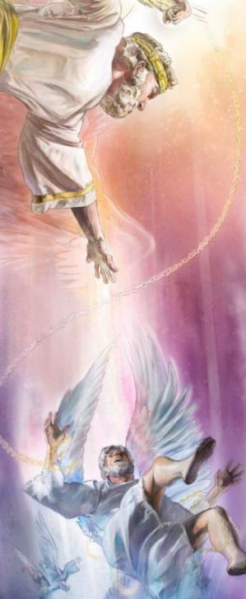
In heaven, the disobedient angels transgressed their Creator’s Covenant/SEED! In time our King/leader & Priest pronounced judgment casting those
unrepentant beings to this earth!
Is this “THE SEED” of Melki-tzedek’s Kingship & Priesthood
which provides an OPTION - that
will be put in place on earth?

Slide 18
The Original “Seed” of Priesthood
The “Seed” had to be present before the first sin in heaven:
Think about that for a moment!
How can a seed be produced on this earth without having a heavenly beginning? How can the COVENANT of the “Seed within Itself,” (as written in Genesis 1) be IGNORED, and a system of government never before known suddenly come to fruition when it never had alignment with the Covenant seed within itself in the first place?
Melki-tzedek cannot be “new” and it is NOT “rogue”!
YES! This “Seed” of Melki-tzedek’s Kingship
& Priesthood was implemented on earth!
And also:

Slide 19
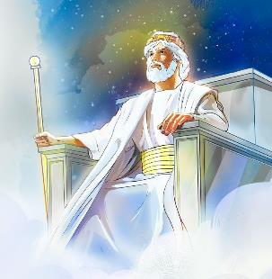
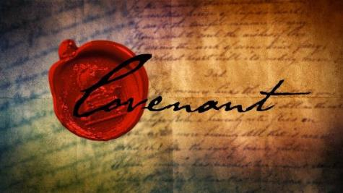
In the Scriptures, when there is a divinely appointed King/leader & Priesthood there is also an accompanying covenant for each.

Slide 20

Who is this Priest on earth? It seems:
Practically, everyone that reads the Scriptures knows there is/was a Levitical Priesthood!
But do they know the accurate term is
Aharonic [Aaronic] Priesthood (from the tribe of Levi)?
And do they know:
There is “another” Priesthood that has been around much longer and is supreme today?

Slide 21
Introduction for the Beginning
Isaiah tells us 7 times that
we can know the end from
the beginning. (See Isa 46:9-10.)
Most people understand the Scriptures declare Yahusha
is our Melki-tzedek Priest
today, ministering in the
courts of heaven.
As “the” Melki-tzedek Priest
in heaven, Yahusha also qualifies Himself with these titles:
  Aleph-Tav
  Alpha & Omega
  First & Last
Questions:
Did Yahuah implement an earthly
Melki-tzedek Priesthood position
for mankind at creation?
If so, how can this priesthood be found & traced in the Scriptures?
How could this earthly priesthood legitimately transfer back to
Yahusha, as the Sovereign
Majesty of Heaven?
Does this priesthood message have anything to do with His Bride?
For this study series many Scriptures
will be considered, not just a few!

Slide 22
Where is the Beginning Seed?
When considering any “seed”
(no matter what it may be) how
many relate to “heaven” as the “beginning” of the Covenant
for the “Seed within Itself”?
Answer: Likely very few!
“Every seed” always existed
with our Creator in heaven!
And then …
Each “seed” was implemented, onto and within, this earth. This invariably included the Seed of Priesthood and Covenant.
Heaven’s original plan for earth was
to have a nation “OF” priests, not a nation with “a” high priest.
(This will be explained later).
Heaven’s perfect plan was contaminated by the adversary.
Yet in the final outcome this “Seed within Itself” (in the plan of heaven) will prevail. That “Seed within Itself” will be seen in full fruition
on the earth made new in a kingdom “OF” priests returning back to heaven’s original design.

Slide 23
Question for Consideration:
What kind of study needs to be done to understand the statement in Hebrews 7:12?
“For the priesthood being changed,
of necessity there takes place
a change of law also.”
How does this relate to Yahuah’s mode of operation - “Seed within Itself”?

Slide 24

If the Aharonic Priesthood has been changed (as per Heb 7:12),
Then in accordance with a
“Seed within Itself” &
“Nothing new under the sun”
“For the priesthood being changed,
Pray tell – WHAT PRIESTHOOD ALREADY HAS EXISTENCE IN YAHUAH’S UNIVERSE?

Slide 25

Are “priesthood & law” connected to “covenants”?
What is a “covenant”
and how is it related to priesthood & law?
How is “covenant” related to the “Seed within Itself”?

Slide 26
What is a Covenant?
“Covenant” is one of those words that just keeps coming up when you read the Scriptures—and certainly with study and research.
This word has different definitions depending on who you communicate with.
For the Jews/Sabbath keepers: covenant relates strongly to “law.”
For the nominal Christian:
covenant relates strongly to “grace.”
For many that hear of “covenant” today, it sounds like a lofty legal term for “contract,” or an “agreement.”
Most people look for ways to
“get out of this contract” if it has anything to do with Yahuah’s laws.
Nevertheless, covenant is a weighty theme that dominates Scripture: it’s good to get an idea of what it means in the Scriptures.
This study is meant to address the most important of all Scriptural covenants, and exactly what it means for everyone today.

Slide 27
https://www.blueletterbible.org/study/larkin/dt/26.cfm
I just chose 2 of the 8 – the 8th is very interesting. Mar 12/21
V. The "Mosaic" Covenant.
The "Mosaic Covenant" was given to Moses on Mt. Sinai, shortly after the Exodus from Egypt. It ushered in the "Dispensation of Law." It was conditioned on obedience, and may be divided into three parts.
The Moral Law. Ex. 20:1-26. This consists of the Ten Commandments.
The Civil Law. Ex. 21:1-24:18.
The Ceremonial Law. Ex. 25:1-40:38. This includes the Tabernacle, the Priesthood, and the order of service. See Chart of Book of Leviticus. The "Sign" of this Covenant is the Sabbath. Ex. 31:12-18.
This Covenant continued in force until the Jews were scattered at the destruction of Jerusalem in A.D. 70. It will be renewed when Israel is converted and restored to their own land, and will then be known as the "Palestinian Covenant," which Covenant ends with the "Renovation of the Earth by Fire."
VIII. The "New" Covenant.
Heb. 8:7-13.
This Covenant has not yet been made. It is to be made with Israel after they get back to their own land. It is promised in Jer. 31:31-37. It is unconditional, and will cover the Millennium and the New Heaven and New Earth. It is based on the finished work of Christ. Matt. 26:28. It has nothing to do with the Church and does not belong to this Dispensation. It is the "Eighth Covenant," and speaks of Resurrection and Eternal Completeness.
The Biblical Covenants https://www.gcu.edu/blog/theology-ministry/theology-thursday-what-are-biblical-covenants#:~:text=There%20are%20several%20covenants%20in,Covenant%20and%20the%20New%20Covenant.
There are several covenants in the Bible, but five covenants are crucial for understanding the story of the Bible and God’s redemptive plan: the Noahic Covenant, the Abrahamic Covenant, The Mosaic Covenant, the Davidic Covenant and the New Covenant.
The Noahic Covenant
From Genesis 9, this is a covenant God establishes with Noah after the flood in which he resets and renews the blessings of creation, reaffirming God’s image in humanity and the work of dominion. This covenant promises the preservation of humanity and provides for the restraint of human evil and violence.
The Abrahamic Covenant
See Genesis 12 and 15. This is the most central to the biblical story. In it, God promises Abraham a land, descendants and blessing. This blessing promised to Abraham would extend through him to all the peoples of the earth. Understanding the Abrahamic Covenant is paramount to understanding theological concepts like a Promised Land, election, the people of God, inheritance and so on. It provides context for understanding practices like circumcision, conflicts with surrounding nations and divisions between Jews and Gentiles.
The Mosaic Covenant
See Exodus 19 and 24. This is the covenant God establishes with the people of Israel at Mt. Sinai after he led them out of Egyptian slavery. With it, God supplies the Law that is meant to govern and shape the people of Israel in the Promised Land. This Law was not a means of salvation but would distinguish the people from the surrounding nations as a special kingdom of priests (Exodus 19:1-7). This covenant was conditional and defined blessings and curses based on obedience or disobedience (see Deuteronomy 28-29). Understanding the Mosaic Covenant is foundational to understanding the cycles of blessing and curse in the Old Testament, the exiles of Israel and Judah, the disputes between Jesus and the Pharisees and Paul’s pastoral teachings about law and grace.
The Davidic Covenant
See 2 Samuel 7. This is the covenant where God promises a descendant of David to reign on the throne over the people of God. It is a continuation of the earlier covenants in that it promises a Davidic king as the figure through whom God would secure the promises of land, descendants, and blessing. This covenant becomes the basis for hope of a Messiah and makes sense of the Gospels’ concern to show Jesus was the rightful King of the Jews.
The New Covenant
See Jeremiah 31:31-34 and Luke 22:14-23. This is language first used in Jeremiah’s promise of rescue and renewal of the exiled people of God in Babylon. It promises a coming day when God would make a new covenant unlike the one which Israel had broken. This coming day would bring forgiveness of sin, internal renewal of the heart, and intimate knowledge of God. On the night of Jesus’s Last Supper, Jesus takes the cup and declares that his death would be the inauguration of this new covenant.
These five covenants provide the skeletal framework and context for practically every page of the Bible. They are fundamental to understanding the Bible rightly. The Old Testament covenants establish promises that look forward to fulfillment. Much of the New Testament is concerned to show how Jesus Christ fulfills these covenant promises and what life should look like for a people living in the New Covenant inaugurated by his death and resurrection.
https://www.beautifulchristianlife.com/blog/8-covenants-in-the-bible 8 Covenants of the Bible
God always keeps his promises. In "2 Kinds of Covenants in the Bible You Need to Know," we looked at the two main kinds of promises in the Bible: conditional and unconditional covenants. At first glance, these covenants can seem like strange practices from the long-ago past that have no relevance for us today, but nothing could be further from the truth. Following is a brief explanation of the eight significant covenants of the Bible—and what each one means for you personally.
1. The Covenant of Works (Conditional)
God made a conditional covenant with Adam in the garden of Eden. Adam was supposed to obey all God’s commands to earn the right to eat from the tree of life and merit eternal life. Adam rebelled against God and earned instead death and condemnation for himself and all his descendants (Gen. 2:17–18; Gen. 3).
What does this covenant mean for you personally? Because all humans come from Adam and were represented by him, they are all under this same covenant and guilty of failing to keep it (Rom. 5:12; 1 Cor. 15:21–22). Because God is holy, you are at enmity with God based on your own imperfect works. Furthermore, because you have a sinful nature due to the corruption resulting from Adam’s fall, you commit more sins that heap more guilt upon you.
2. The Covenant of Grace (Unconditional)
We first find the unconditional covenant of grace in Genesis 3:15 where God promises that a savior will come who will crush the head of the serpent (i.e. Satan). In the covenant of grace, people are saved by God’s grace through faith in Christ alone because of Christ’s perfect keeping of the law and his perfect and complete sacrifice once and for all for sin (Rom. 5:12–21; Heb. 7:27; 10:14).
What does this covenant mean for you personally? Because you are sinful, you can never keep God’s law perfectly and be pure in order to stand in his presence. Through faith in Christ alone, you are declared righteous in God’s sight, are forgiven of your sins, have peace with your Creator, and have been gifted all the rights and privileges as God’s child for eternity (Eph. 2:8–9; Rom. 5:1; 8:15).
3. The Noahic Covenant (Unconditional)
In the unconditional Noahic covenant, God made a promise to Noah to never again bring a flood to destroy the earth (Gen. 9:1–17). God instituted the Noahic covenant to preserve the earth so that humans would not destroy each other, in order that the savior, Jesus Christ, could come at the appointed time in God’s redemptive plan.
What does this covenant mean for you personally? Since Christ has come and done his saving work, God “is patient toward you, not wishing that any should perish, but that all should reach repentance” (2 Pet. 2:9). Jesus will return one day to fully establish his kingdom (Rev. 21). If you have not received Christ as your Savior, do so right away, for now is the day of salvation (2 Cor. 6:2).
4. The Covenant of Abraham (Unconditional)
The covenant of grace is more fully revealed in the covenant of Abraham. God made an unconditional, permanent covenant with Abraham: “‘I will bless those who bless you, and him who dishonors you I will curse, and in you all the families of the earth shall be blessed’” (Gen. 12:3; 15:5–6). God fulfilled his promise to Abraham by sending his only begotten Son Jesus to the earth as the Savior of the world to be born in the flesh from a descendant of Abraham (Matt. 1:1–17; Luke 3:23–38; Gal. 3:16).
What does this covenant mean for you personally? All who receive Christ as Savior are the true heirs of Abraham and have all rights and privileges thereof. Abraham believed God would keep his promise, “and if you are Christ’s, then you are Abraham’s offspring, heirs according to promise” (Gal. 3:29).
5. The Mosaic Covenant (Conditional)
Like the Abrahamic covenant, the Mosaic (old) covenant was part of the covenant of grace but it was temporary in nature. The Mosaic covenant was a conditional agreement between God and the people of Israel that was mediated by Moses (Exod. 19–24). The people of Israel had to fulfill God’s stipulations in this covenant to stay and prosper in the land God had given them. None of the Israelites were ever pure before God through the keeping of this covenant, because it was impossible for anyone to obey it perfectly. They were only declared righteous by faith alone, just as their father Abraham was (Gen. 15:6).
This covenant was extremely important for two reasons: 1) it showed the nation of Israel (and us) the impossibility of keeping God’s law perfectly and the need for a savior and 2) it provided a forum for Christ to come and be the perfect Son of Israel who would obey God’s law in all things and be the once-for-all sacrifice for sin.
What does this covenant mean for you personally? The Mosaic covenant shows us that, because of indwelling sin, the law is a taskmaster that humans can never appease (Rom. 3:19–20). Yet, there is no need for you to despair: Through faith in Christ, you are declared righteous before God, since Christ’s perfect obedience is counted to you and your sin is counted to Christ (Rom. 5:12–21; Heb. 7:27; 10:14).
6. The Davidic Covenant (Unconditional)
In 2 Samuel 7, God made a promise that he would raise up David’s offspring and “establish the throne of his kingdom forever” (7:12–13). God promised unconditionally to put a son of David on the throne, but only the righteous son would reign for eternity. While David’s son Solomon ruled over Israel, he failed to keep God’s commands (1 Kings 9:4–9; 11:4–8). Only David’s descendant Jesus was the true and faithful Son deserving of the everlasting throne of David (Ps. 2; 16; 110).
What does this covenant mean for you personally? Unlike mere human rulers who disappoint us with their failure to rule justly, Jesus obeyed God in all things—even giving his own life out of his love for the world—and earned the right to rule in glory forever (John 3:16; 1 Kings 2:35; Rev. 11:15). You can take comfort in knowing that the resurrected Christ is the one truly righteous King who has not only secured eternal life for all believers but will also put an end to all injustice and evil one day (Rev. 21:4).
7. The New Covenant (Unconditional)
The new covenant ushered in the new creation. This covenant is new in relationship to the old (Mosaic) covenant, but both are part of the Abrahamic covenant. While Moses was the mediator of the old covenant between God and the nation of Israel, Christ is the mediator of the new covenant between God and believers through his finished work of redemption in his life, death, and resurrection. While the old covenant required national obedience, the new covenant requires faith in Christ, the perfectly obedient Son of Israel (Jer. 31:31–34; Matt. 26:28; Gal. 3:16–18).
What does this covenant mean for you personally? While the new covenant requires faith in Christ, this faith itself is a gift from God, given to all who trust in Christ as their Savior (John 1:12; Eph. 2:8–9). As a Christian, you can rejoice that you have peace with God (Rom. 5:1), eternal life (Rom. 6:23), are indwelt by the Holy Spirit (1 Cor. 3:16), and are being conformed to the image of Jesus (Rom. 8:29).
8. The Covenant of Redemption (Conditional)
Without the covenant of redemption, the only other covenant in this list that could exist is the first one: the covenant of works. The covenant of redemption was established before creation and is the pact between the persons of the Trinity in which the Father sends the Son to do the work of redemption, the Son submits to the Father’s will, and the Holy Spirit applies the benefits of the Son’s accomplished work to believers (Ps. 40:6–8). As a reward for his obedience, the Father gifts the Son with glory and an everlasting kingdom (Ps. 110; Isa. 53; Zech. 6:12–13; John 17:1–5).
What does this covenant mean for you personally? If the persons of the Trinity didn’t make this pact—and keep it—we would all be under God’s condemnation without any hope for meeting his holy standards. God did not have to save any of us from the consequences of our sin, but he did so out of his unfathomable love (Rom. 3:23–26). Don’t depend on your own imperfect works to be right before God; instead, believe in and receive Jesus Christ as your Savior today.
Digging deeper: If you would like to learn more about the eight significant covenants in the Bible, check out Sacred Bond: Covenant Theology Explored (Second Edition) by Michael G. Brown and Zach Keele.
Which Covenant is Being Addressed?
From the internet – some definitions:
“There are several covenants in the Bible, but five covenants are crucial for understanding the story of the Scriptures and Yahuah's redemptive plan:
the Noahic Covenant,
the Abrahamic Covenant,
the Mosaic Covenant,
the Davidic Covenant and
the New Covenant.”
“Some believe there are 8 covenants listed as:
Adam,
Noah,
Abraham,
Mosaic Covenant with Israel,
Aharon & Sons,
Phinehas,
David,
Yahusha.”
This study will only address the Covenant of the Melki-tzedek Priesthood.

Slide 28
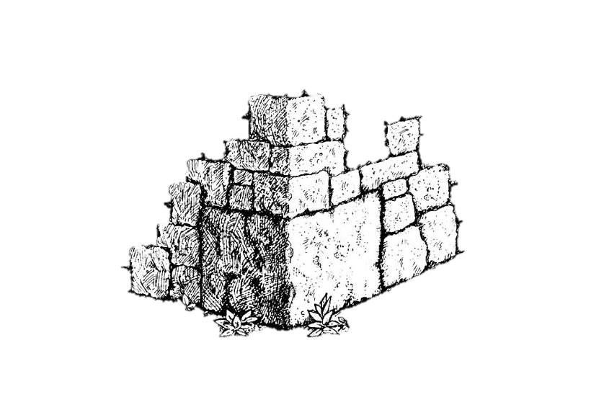
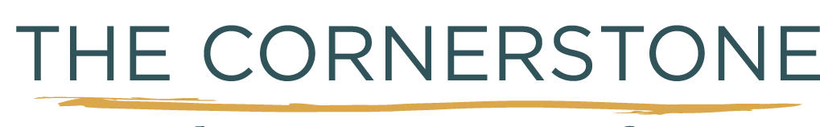
Covenant Under the Order of Melki-tzedek
Introduction
This study is one of Priesthoods and respective Covenants.
It is the cornerstone of the Scriptures.
Few understand the Melki-tzedek Order,
never mind the covenants connected to it.
And there is confusion about how this covenant
relates to all the other Scriptural covenants.

Slide 29

What Comes to Mind First?
Question: When people hear the word “covenants” what is the first thing that comes to the mind of many?
Answer: Old Covenant and New Covenant, right?
Then some believe: the Old Covenant is done away with at the crucifixion, and the New Covenant is in its place.
Meaning, the Old Covenant is Yahuah’s Law
from Mt Sinai that is old and worn out,
and the New Covenant is:
“Saved by grace; set free from the law!”
Is that true?

Slide 30


How can we find the truth on the Melki-tzedek Covenant?
Here are some things that are true:
True: There is something that is “old.”
True: There is something that is “new.”
True: There are some things that Yahusha’s death finalized and terminated!
Questions? But did Yahusha’s death do away with the priesthood, the covenants, or the Law?
And if so: which covenant? which priesthood?
and which law?

Slide 31
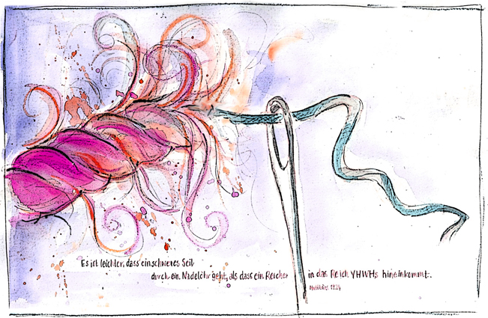
The Needle! One Strand of Yarn?
This study will attempt to unravel the many tangled pieces of the “Covenant Strand” and thread them through
the needle one at a
time and then allow
the needle to weave this golden tapestry strand through the Scriptures in this introductory study.
Art: compliments of Sabine

Slide 32
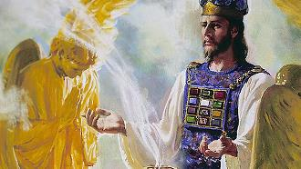
The Umbrella Illustration
Psalm 110:4
“You are a priest forever according to the
order of Melki-tzedek.”
“Forever” means from “eternity past” to “eternity future.”
There are six other Scriptures referring to the Majesty of Heaven.
This is important to understand as many people, (teachers & leaders), speak
against any kind of priesthood before the mention of the Aharonic Priesthood (Exo 25-31) about 2500 years after creation.
This multi-colored umbrella represents the all encompassing, glorious priesthood from the beginning before there was any sin problem (in heaven or on earth), to the point where sin was defeated by Yahusha at His death.

Slide 33

FROM THE INTERNET JAN 5TH:
Did God Perform the First Sacrifice in Genesis 3:21?
Many believe that the first sacrifice was carried out by God Himself in Genesis 3:21 which says that God made tunics of skin for Adam and Eve so that they could be clothed.
Did God Sacrifice an Animal in Genesis 3:21?
Although the text says nothing about a sacrifice, many believe that a sacrifice is implied.
It is often taught that after the first sin was committed, God wanted to show Adam and Eve that sin has consequences, and so He slew an animal in front of them, and made clothes for them from the hide of the dead animal.
Some have even speculated that the animal was a lamb, thereby presenting a prophetical picture of Jesus, the Lamb of God, slain from the foundation of the world (Revelation 5:6; 13:8).
Furthermore, some have argued that in this death of the animal, God was teaching Adam and Eve the theological principle of substitutionary atonement. He had told Adam that if they ate of the fruit they would surely die, and so after they ate of the fruit, God should have killed them, but instead He killed an animal in their place.
But Did God Really Perform the First Sacrifice?
But is any of this really true? Did God really practice the first animal sacrifice? Was it truly a lamb? Did God intend for Adam and Eve to learn about substitutionary atonement?
Frankly, this seems to be an awful lot to read into one single verse which says nothing other than that “God made tunics of skin, and clothed them.”
The death of an animal is never mentioned. A lamb is never mentioned. Substitutionary atonement isn’t even inferred. So where did God get the skin in which he clothed Adam and Eve? The text simply doesn’t say.
Maybe he made it.
The word for “skin” that is used can refer to either human or animal skin.
There have been some streams of Judaism and Christianity which believed that prior to the event described in Genesis 3:21, humans did not have “skin” the way we see it today, but existed in some other form. They believed that we were “clothed in light” like God (Psalm 104:2) and that when Adam and Eve sinned, the light left them and they tried to replace the light with leaves (Genesis 3:7), which was an insufficient covering, and so God gave them skin instead.
This view is a little too mystical (or maybe even Gnostic) for most Christians, and yet it cannot be proven or disproven from the text any more than the traditional view that God killed an animal to make clothes for Adam and Eve.
Maybe it was snake skin.
It is interesting to note, however, that one of the more common Jewish explanations of this text is that the skin which Adam and Eve were clothed with was snake skin. The Jewish Targum Pseudo-Jonathan says that the Lord made garments for Adam and Eve from the skin which the serpent in the garden had cast off. This seems pretty far-fetched if you have ever seen the papery skin shed by serpents.
A related view is that since God had said to the serpent, “he will crush your head and you will strike his heel” (Genesis 3:15 NIV), that Adam had taken it upon himself to kill the serpent by crushing its head with his heel, and from the skin of the dead serpent God made clothes for Adam and Eve.
This sounds far-fetched, but it is just as speculative as every other view.
We simply don’t know where the skin came from, or what kind of skin it was.
The simple fact of the matter is that the text simply doesn’t say how God made clothes for Adam and Eve. Therefore, we tread on dangerous ground if we claim that Genesis 3:21 contains the first sacrifice in Scripture, for it says nothing of the sort. All it says is that God gave them skin to wear.
We read substitutionary atonement and the sacrificial system into Genesis 3:21 at our own theological peril.
Was there really a Royal King &
Royal Priest before Creation?
YES! The Plan of Salvation was set down before the foundation of the world requiring:
1) a priest 2) a covenant 3) a sacrifice
Our Creator is the Royal King of His universe reigning supreme over all heavenly beings before this earth
was created & also before Adam & Eve.
Would this communion time have
been like a Torah class?
Melki-tzedek as the “Royal King” for Adam & Eve, led them and taught them His ways as their “Royal Priest.”
As their King & Priest He walked with them in the cool of the evening and had “face-to-face” communion with His prize creation of mankind.
1-19-22 update: Tim is OK with the information on this slide.
This is the kind of stuff on the internet to do away with Yahuah offering the first sacrifice - because people read only what is there not knowing that verses such as Gen 3:21 need research, which is going to be a huge part of priesthood which most know nothing about. I admit, I was once in the same place. The writer makes a good point that Adam and Eve were covered with "skin" since they lost their robe of light ... and it sounds good and could likely have been the case, but that does not negate the fact that an animal sacrifice has to be offered for their sin - and I strongly believe it was a LAMB, not an ox, goat, pigeon, sparrow, heifer, or even a goat. Altho it could be a goat - since goats were used on yom kippur for atonement. John the B called Yahusha the "Lamb of ... " not the "Goat of ..." etc.
It seems to me only the priesthood research has the answer, so that is the purpose of this slide to set down the foundation of where this all started. Ok, hope you can read between the lines.
The more we work in Torah, and the more I see these flimsy excuses, the more it confirms to me that people are just plain lazy - they want "every word to be written in the text" so they know what to believe instead of using Isa 46:9-10 and "here a little, there a little." It's the same problem with all of the lunar cal. people and Gen 1 and the gospels where they think that Yahusha had to say something about the dawn day sabbath.

Slide 34
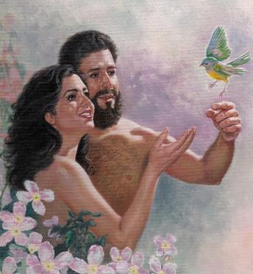
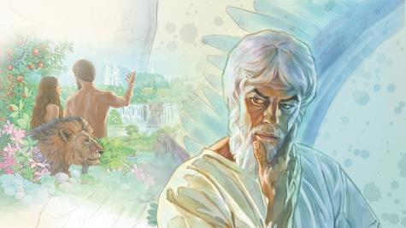
FROM THE INTERNET JAN 5TH:
Did God Perform the First Sacrifice in Genesis 3:21?
Many believe that the first sacrifice was carried out by God Himself in Genesis 3:21 which says that God made tunics of skin for Adam and Eve so that they could be clothed.
Did God Sacrifice an Animal in Genesis 3:21?
Although the text says nothing about a sacrifice, many believe that a sacrifice is implied.
It is often taught that after the first sin was committed, God wanted to show Adam and Eve that sin has consequences, and so He slew an animal in front of them, and made clothes for them from the hide of the dead animal.
Some have even speculated that the animal was a lamb, thereby presenting a prophetical picture of Jesus, the Lamb of God, slain from the foundation of the world (Revelation 5:6; 13:8).
Furthermore, some have argued that in this death of the animal, God was teaching Adam and Eve the theological principle of substitutionary atonement. He had told Adam that if they ate of the fruit they would surely die, and so after they ate of the fruit, God should have killed them, but instead He killed an animal in their place.
But Did God Really Perform the First Sacrifice?
But is any of this really true? Did God really practice the first animal sacrifice? Was it truly a lamb? Did God intend for Adam and Eve to learn about substitutionary atonement?
Frankly, this seems to be an awful lot to read into one single verse which says nothing other than that “God made tunics of skin, and clothed them.”
The death of an animal is never mentioned. A lamb is never mentioned. Substitutionary atonement isn’t even inferred. So where did God get the skin in which he clothed Adam and Eve? The text simply doesn’t say.
Maybe he made it.
The word for “skin” that is used can refer to either human or animal skin.
There have been some streams of Judaism and Christianity which believed that prior to the event described in Genesis 3:21, humans did not have “skin” the way we see it today, but existed in some other form. They believed that we were “clothed in light” like God (Psalm 104:2) and that when Adam and Eve sinned, the light left them and they tried to replace the light with leaves (Genesis 3:7), which was an insufficient covering, and so God gave them skin instead.
This view is a little too mystical (or maybe even Gnostic) for most Christians, and yet it cannot be proven or disproven from the text any more than the traditional view that God killed an animal to make clothes for Adam and Eve.
Maybe it was snake skin.
It is interesting to note, however, that one of the more common Jewish explanations of this text is that the skin which Adam and Eve were clothed with was snake skin. The Jewish Targum Pseudo-Jonathan says that the Lord made garments for Adam and Eve from the skin which the serpent in the garden had cast off. This seems pretty far-fetched if you have ever seen the papery skin shed by serpents.
A related view is that since God had said to the serpent, “he will crush your head and you will strike his heel” (Genesis 3:15 NIV), that Adam had taken it upon himself to kill the serpent by crushing its head with his heel, and from the skin of the dead serpent God made clothes for Adam and Eve.
This sounds far-fetched, but it is just as speculative as every other view.
We simply don’t know where the skin came from, or what kind of skin it was.
The simple fact of the matter is that the text simply doesn’t say how God made clothes for Adam and Eve. Therefore, we tread on dangerous ground if we claim that Genesis 3:21 contains the first sacrifice in Scripture, for it says nothing of the sort. All it says is that God gave them skin to wear.
We read substitutionary atonement and the sacrificial system into Genesis 3:21 at our own theological peril.
The Priesthood is Shared
Yahuah gave Adam dominion over the
earth (as earth’s “king”); taught them all of His perfect laws (nature, etc.); especially His laws of obedience and adoration.
The pair was taught to stay away from the Tree of Knowledge of Good and Evil.
In summary our Creator’s Royal Law was a simple
covenant like this: “Obey and live; disobey and die.”
Question: Would Adam not have been the earthly “priest” in his Eden home to guard and lead?
In addition to this, Adam and Eve were under the umbrella of the Royal King & Priesthood known as Melki-tzedek while at the same time Adam was
the representative on earth of the heavenly order
of Melki-tzedek and known as the First Adam.
1-19-22 update: Tim is OK with the information on this slide.
This is the kind of stuff on the internet to do away with Yahuah offering the first sacrifice - because people read only what is there not knowing that verses such as Gen 3:21 need research, which is going to be a huge part of priesthood which most know nothing about. I admit, I was once in the same place. The writer makes a good point that Adam and Eve were covered with "skin" since they lost their robe of light ... and it sounds good and could likely have been the case, but that does not negate the fact that an animal sacrifice has to be offered for their sin - and I strongly believe it was a LAMB, not an ox, goat, pigeon, sparrow, heifer, or even a goat. Altho it could be a goat - since goats were used on yom kippur for atonement. John the B called Yahusha the "Lamb of ... " not the "Goat of ..." etc.
It seems to me only the priesthood research has the answer, so that is the purpose of this slide to set down the foundation of where this all started. Ok, hope you can read between the lines.
The more we work in Torah, and the more I see these flimsy excuses, the more it confirms to me that people are just plain lazy - they want "every word to be written in the text" so they know what to believe instead of using Isa 46:9-10 and "here a little, there a little." It's the same problem with all of the lunar cal. people and Gen 1 and the gospels where they think that Yahusha had to say something about the dawn day sabbath.
Beware! Trouble is lurking in the garden.

Slide 35

Heavenly bliss on earth
did not last long!

Slide 36

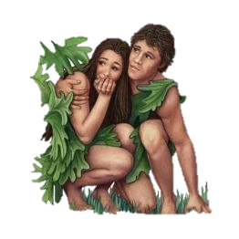
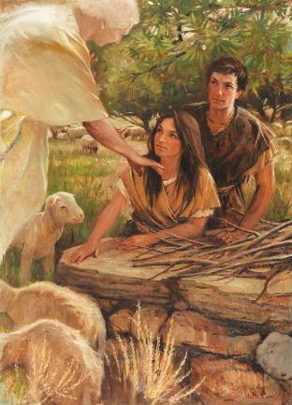
The Heavenly High Priest Over Adam & Eve
When Adam and Eve sinned there had to be a
“priest” to officiate over the sacrifice for their offense!
Who do you think was the appropriate option for this qualification? Answer: Only the “One” that was destined to be the Sacrifice for the sins of the whole world in the Plan of Salvation. Yahuah Elohim was the Priest that officiated the first sacrifice for the sin of Adam and Eve.
Does all of this sound like a far stretch of the truth?

Slide 37
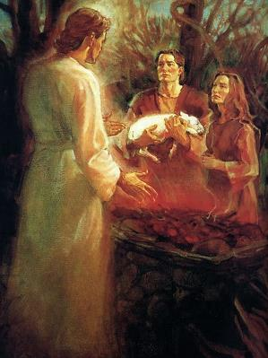

The Heavenly High Priest Instructs Adam
Adam and Eve lost their Garden of Eden home.
Question: What do you think it was like for
our heavenly Melki-tzedek High Priest to now instruct Adam and Eve on what they had to do to have their sins covered by the blood of an innocent sacrificial animal?
Do we understand that
our heavenly Creator
(from the position of High Priest Authority) would have taught them?

Slide 38
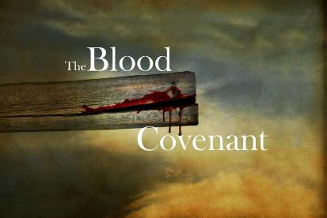
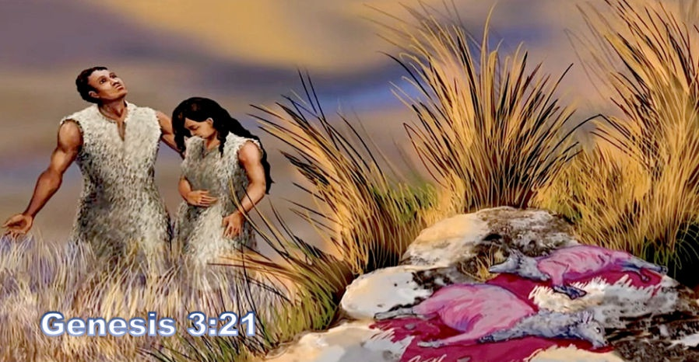
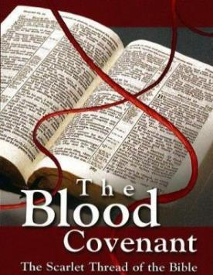

The Covenant of Blood
Adam & Eve had to be taught about the Blood Covenant – that will weave through the Scriptures like a scarlet thread.
These first lessons
were not for only
Adam and Eve.
This scarlet thread
weaves the story
for the plan of full
and complete
redemption!

Slide 39


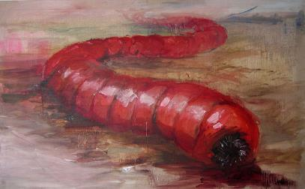

I am struggling wit h making a connection. Gen 38:28 is the first mention of scarlet. It was tied around the wrist of Zerah. Isa 60:3 uses the word – zerah translated as
rising light”, to which the Gentiles would come. Of course the scarlet rope saved the “harlot” of Jericho and her family. (Not really a harlot as we’ve assumed). Scarlet represented salvation there. Also the Red Heifer. The Red Heifer symbolized Yahusha, who IS the Saviour in charge of Salvation who today is the Kohen Ha Gadol of the Melki-Tzedek Order!
But where is the scarlet link going back to Adam?
CF: I see “scarlet” as “salvation” (Rahab) and as “cleansing” (Heifer).
How does that connect to Adam? Upon that 1st sin he/they needed both “cleansing” and “salvation” or be under the same judgment as Lucifer and the cast out angels. Tho your sins be as scarlet – they are white as snow – cleansing? The whole plan of salvation is about “cleansing” after forgiveness, the you’re ready to enjoy salvation. At least that is how I see things – simply! Does that help? Jan 27th
This was tim’s question on the next slide – which resulted in this new slide being added and the next slide being revised quite a bit. Tim will have to fix the wording to capture his thoughts. -c
Question to help this slide. Does this Majesty of heaven connect within the character to the Towla worm (Scarlet thread) which is within Yahusha which is in charge of Salvation starting with Adam and Eve? (Jan 26)
What does Yahusha’s
have to do
with
The Scarlet Thread
and the
Towla Worm?
We know Yahusha is in charge of Salvation from heaven to earth.
How does our Majesty of Heaven connect all these components in His tapestry?
Is there a special Umbrella covering for this Plan of Salvation?

Slide 40

Could this study about:
Heavenly Priesthood
#1 Melki-tzedek Priesthood
in Heaven
Earthly Priesthood
#2 Melki-tzedek Priesthood on Earth
Aharonic Priesthood
#3 Aharonic Priesthood on Earth
The
Umbrella Illustrations Demonstrate Priesthoods
& Covenants
… be the
Scarlet Thread
connection?

Slide 41

Questions for “Priesthood” & “Covenant”
For illustration purposes, the “umbrella” represents the Priesthood’s authority over its “Covenant.” There is more than one Priesthood.
Questions:
Does every “Covenant” under every Priesthood umbrella have the same “covenant words”?
If Yahuah does not change, can “covenants” change? Are they not HIS Covenants?
Most people believe “Covenant” is THE Law.
What if “THE Law” is only “part”
of THE Covenant? Then what?
Could “Covenant” include more than just “laws”?
Priesthood!
Covenant?

Slide 42


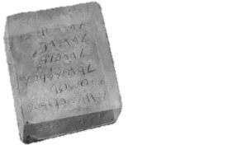
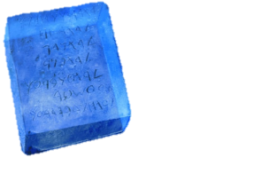
What are Old & New Covenants?
Laws!
OLD
Covenant
NEW
Covenant
What’s the first thing most people think about when they hear the word Covenant? Do they think of “Law(s)?”
Questions: What’s the first thing most think about when they hear
“Old Covenant” & “New Covenant”? Old Laws? … and New Laws or No Laws?
Answer: Most think the “Law” is the OLD Covenant and is forever obsolete;
and they think the NEW Covenant has “No Laws.”
In other words, since the crucifixion most people think New Covenant means “under grace, and finally not under any law anymore.”

Slide 43

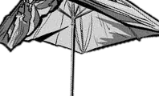
CF Jan 25th – Tuesday: Jan 26: OK given by Tim – good enough for this point in time.
As I'm looking and comparing this slide to the old one in the wee jpeg, this is what I see should be illustrated:
Heavenly Umbrella is always perfect - is always overseeing every priest and covenant all the time.
Only the earthly Mel. Pr was suspended (- not BoC) [due to rejection] when the Aaronic Pr was put in place.
The AR Pr. became very corrupt by the time this priesthood became obsolete.
that is why the purple and green umbrella's/priesthoods have the broken look - they are no longer functioning as originally intended [the people rejected Moses, and Yahusha rejects the AR. Pr. To make way for the final P. Hood.] - yet the heavenly Pr. is always overseeing everything UNTIL Yahusha implements the final priesthood – taking everything back to the SEED at the beginning.
Not all that explanation will be given here - this is just an outline for WHAT is coming in the rest of all parts of the study.
Just wanted to see if you can see the visual picture I have in mind of how this may be taught in an easier manner.
Old & New Covenants According to “who”?
Heavenly Priesthood
Melki-tzedek Priesthood
Melki-tzedek Priesthood
Why?
Aharonic Priesthood
Aharonic Priesthood Ended
& now what???
Yes, ALL were
under the Law
in the
OLD Testament!
Finally ALL are
under Grace
in the
NEW Testament? ?

Slide 44

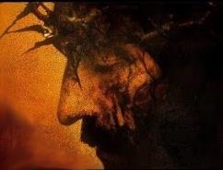

Because of this
crucifixion!
Heavenly Priesthood
Earthly Priesthood
Aharonic Priesthood
Nominal Christianity also Thinks …
Nominal Christianity Thinks …
Finally all are
under Grace
in the NEW
Testament!
We’re no longer
under the Laws
of the OLD
Testament!
Everyone should be asking the question: “Is this true?”

Slide 45

What is this Study all About?
This will be a short introductory study around the Melki-tzedek Priesthood
and a few related areas that are very important for our understanding of Yahuah’s perfect requirements for
His people in these last days of
earth’s history.
Acts 3:21 reveals there will be a time
“of restoration of all things” – things that have been spoken of by Yahuah’s prophets since the beginning of time. That time is now!
Some “commands” (mitzvot) have
been legally terminated through
Torah’s prophetic writings, and will
not be restored – such as animal sacrifices.
Also, there are many “things” that have been lost through the ages that do need to be restored for our full restoration in relationship to Yahuah.
The study of the Melki-tzedek Priesthood shows with clarity what needs to be restored – what the words are of the everlasting covenant and where to find these words.
The study on the Aharonic Priesthood shows with clarity the temporary covenant that has been fulfilled to completion with Yahusha’s death –
what those words are and where to
find these words.
Both priesthoods which operated independently are important. Both have a
purpose and should be fully understood including two very important books.

Slide 46
What Does Torah Include Today?
Torah is known as the first five books
of Moses - Gen to Deut.
Torah includes everything found in
the first five books of the Scriptures.
Torah includes "law" and "laws" - every command given either by Yahuah, or Moses. (Moses asked for the laws of divorce - they were not
in the Book of the Covenant, and not included in the Book of the Law at the beginning.)
Torah includes the 10 commandments.
Torah includes the laws found in
the Book of the Covenant.
Torah includes the statutes, commands
and judgments of the Book of the Covenant.
Torah includes the laws found
in the Book of the Law.
Torah includes the statutes, commands and judgments of
the Book of the Law.
Torah includes the Melki-tzedek Priesthood.
Torah includes the Aharonic Priesthood.
Torah includes the sanctuary
and all of its services.
Torah includes the sacrifices and offerings ... and a whole lot more - this is a basic list for starters.
The binding parts of Torah are important for today and to be honoured.
Notes:
From Irma Nov 16/21: not sure if I know what she is trying to tell me – except the slide is not organized well enough and too much information. Charlene
very interesting and quite comprehensive. A serious study, indeed! Beloved sister, if all of that was on slide 3 as laid out, I have to tell you Galations 3 was much easier to follow Perhaps laying it out in table form would give it a visual effect thats easier for beginners like me to grasp. For example: Torah includes:1st column 2nd column
1. 5 books of Moses | a. Gen-Deut
| b. everything | in 5 books
|
2. “Law” and “Laws”.| a. every command given by Yahuah or Moses
3. Book of Covenant | a. all statutes b. all judgements
c. all commands
4. Book of Laws. | a. (repeat of previous… too tedious to type)
5. Melquizedeck
priesthood
6. Aharonic priesthood
7. Sanctuary and its
services
8. Sacrifices and
offerings
A third column could clarify further. The highlights in RED definitely are plus.Its just the repetitious way it was written begs a person skip the whole thing and turn the page. Red highlights could be in the 3rd column? I use to write procedures for my job so I had to be really detailed. But yours is teaching so, maybe that should be presented different. Just presenting my 2 cent suggestion.Forgive me. I’m eagerly looking forward to your study. Which reminds of a question I needed to ask when I first read thru WORKS filled slide 3. What should come first, the Melki-tzedek priesthood or the Torah applicable commands, laws, statues and judgement? For me, the Melki-tzedek priesthood anointing comes first; the Torah is then accomplished in its fullness. shalom

Slide 47

What Does Torah Really Mean Today?
Not everything listed in Torah is still to be kept and honored since the cross /tree [as noted in red on the previous slide – basically the “laws” relating to the Book of the Law] - that is the difference.
So when we hear phrases like, “we have to keep the Torah" ... Hhmm....
it seems we better be ready to "define" and "specify" what parts of Torah
are kept – (AS DEFINED BY TORAH ALONE) - since Yahusha's death.
  Could this be why so many still feel they need to keep fleshly circumcision,
  find Levitical priests, rebuild the temple and start up sacrifices?
We do not keep the parts of the Torah, AS DEFINED BY TORAH, that have expired with Yahusha’s death,
in accordance with statutes and prophecy. Only the part of Torah that is still binding is kept today.
The final say of what is binding, or not binding, is settled with the final Priesthood. Torah begins with Adam's Melki-tzedek Priesthood - we are given detailed instructions about what is kept under this priesthood for 2500 years after Adam ... and when this Melki-tzedek Priesthood is passed back to Yahusha - it is only those precepts of Torah that are still kept and honored.
The Torah portions of the Majestic Heavenly Melki-tzedek Priesthood
are the foundation of what is to be honored today.
Notes:
From Irma Nov 16/21: not sure if I know what she is trying to tell me – except the slide is not organized well enough and too much information. Charlene
very interesting and quite comprehensive. A serious study, indeed! Beloved sister, if all of that was on slide 3 as laid out, I have to tell you Galations 3 was much easier to follow Perhaps laying it out in table form would give it a visual effect thats easier for beginners like me to grasp. For example: Torah includes:1st column 2nd column
1. 5 books of Moses | a. Gen-Deut
| b. everything | in 5 books
|
2. “Law” and “Laws”.| a. every command given by Yahuah or Moses
3. Book of Covenant | a. all statutes b. all judgements
c. all commands
4. Book of Laws. | a. (repeat of previous… too tedious to type)
5. Melquizedeck
priesthood
6. Aharonic priesthood
7. Sanctuary and its
services
8. Sacrifices and
offerings
A third column could clarify further. The highlights in RED definitely are plus.Its just the repetitious way it was written begs a person skip the whole thing and turn the page. Red highlights could be in the 3rd column? I use to write procedures for my job so I had to be really detailed. But yours is teaching so, maybe that should be presented different. Just presenting my 2 cent suggestion.Forgive me. I’m eagerly looking forward to your study. Which reminds of a question I needed to ask when I first read thru WORKS filled slide 3. What should come first, the Melki-tzedek priesthood or the Torah applicable commands, laws, statues and judgement? For me, the Melki-tzedek priesthood anointing comes first; the Torah is then accomplished in its fullness. shalom

Slide 48
Two Priesthoods & Two [Covenant] Books
Melki-tzedek Priesthood
(a Kingdom “of” priests)
Aharonic Priesthood
(a kingdom with “a” high priest)
Connected to a blood ratified
ever-lasting Covenant.
Covenant Instructions [Book of the Covenant] were lived out by the patriarchs from Adam to Moses – as covenant testimonies.
Eternal Covenant Words are found between Exodus 20:1 - 23:33.
Book of the Covenant has no additions or deletions.
Written on tables of stone
and placed inside the Ark
of the Covenant.
Connected to a temporary Covenant from the golden calf to Yahusha’s Passover day (fulfilling Dan 9:27).
Temporary Instructions [Book of the Law] were also necessary from the point of the golden calf.
Original Temporary Words are found between Exo 25:1 to Exo 31:18.
Book of the Law covenant allows
for additions and deletions, etc.
Written on parchment and placed outside the Ark of the Covenant.
Both “books” are important; both “books/covenants” have a purpose.

Slide 49

Components of Two Different Priesthoods
Melki-tzedek Priesthood
Aharonic Priesthood
Dan 9:27
… is connected to a blood ratified
ever-lasting Covenant.
Proposal to come into a covenant agreement has to be given.
Acceptance to the covenant agreement has to be given.
Covenant agreement has to be blood-ratified to be everlasting.
Covenant Confirming Meal that nothing will be added or removed from this covenant.
Upon acceptance, the one
that breaks the covenant
is under immediate
death penalty.
… is connected to only a temporary priesthood & its laws. This priesthood & BoL covenant is not valid when the Melki-tzedek Priesthood is in operation.
The covenant was imposed upon the people.
The covenant will be broken many times – with accompanying curses.
This covenant can have additions/changes at
any time by man under agreement of Yahuah.
According to Book of the Law instruction, Caiaphas annulled his high-priest position by tearing his robe. Immediately upon Yahusha’s death, the Aharonic priesthood and Book of the Law covenant is annulled as Yahusha is next recognized as the Highest Priest of Melki-tzedek.

Slide 50
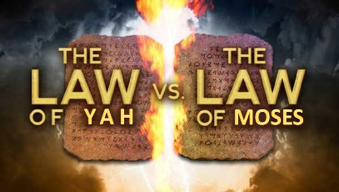
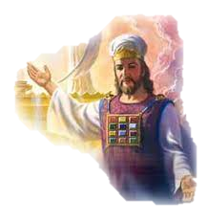
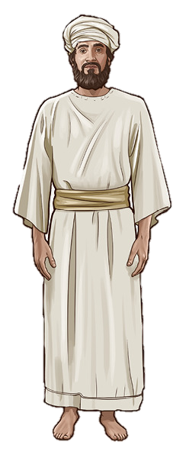
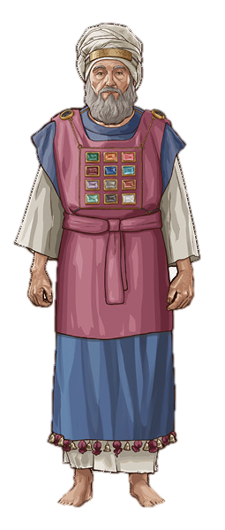
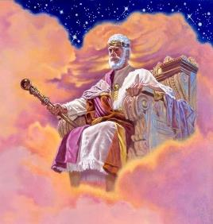

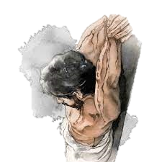
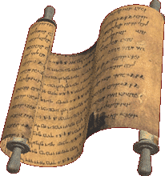
Comparison of the TWO Priesthoods on Earth
Melki-tzedek Priesthood
Aharonic Priesthood
blood ratified covenant
temporary covenant
Both covenants are important
and have a purpose.
Both “covenants” use a
different style of lingo!

Slide 51


Question #1
What was Yahuah’s original plan for mankind?

Slide 52


Yahuah’s original plan for mankind was to be
a kingdom OF priests and kings,
(and NOT a kingdom with “a” high priest);
obedient to the Book of the Covenant that would represent blessings and righteousness and to be a shining light to the whole world.
It was deemed that through our love, obedience
and kindness to mankind, many would come to know
the only true Elohim and worship Him alone.

Slide 53
Exodus 19:5-6
5 “And now, if you diligently obey My voice, and shall guard My covenant, then you shall be My treasured possession above all the peoples – for all the earth is Mine –
6 ‘and you shall be to Me a reign of priests and a set-apart nation.’ Those are the words which you are to speak to the children of Yisra’ěl.” TS2009
1 Peter 2:5, 9
5 You also, as lively stones,
are built up a spiritual house,
a set-apart priesthood …
9 you are a chosen race,
a royal priesthood, a
set-apart nation, a people for
a possession; that ye should proclaim the praises of Him who called you out of darkness into His marvellous light. TS2009
53

Slide 54

Question #2
Who is our
High Priest under the order of
Melki-tzedek?

Slide 55

Hebrews 4:14,15 “Seeing then that we have a great high priest, that is passed into the heavens, Yahusha
the Son of Yahuah, let us hold fast our profession.”
Hebrews 7:26 “For such an high priest became us,
who is holy, harmless, undefiled, separate from sinners, and made higher than the heavens.”

Slide 56
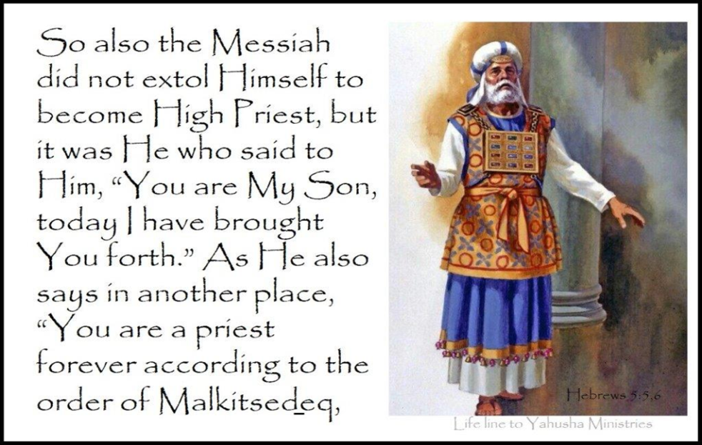
Hebrews 5:5-6

Slide 57


How many know and understand there is a Melki-tzedek Priesthood in the Scriptures
and it’s not a theory?
Why is the
Melki-tzedek Priesthood
so relevant
and important
for us today?
57

Slide 58
Where is this “Order of Melki-tzedek” Found?
Psalms 110:4 Yahuah hath sworn, and will not repent, Thou art a priest for
ever after the order of
Melki-tzedek.
Hebrews 5:6 As he saith also in another place, Thou art a priest for ever after the order of Melki-tzedek.
Hebrews 5:10 Called of Yahuah an high priest after
the order of Melki-tzedek.
Hebrews 6:20 Whither the forerunner is for us entered,
even Yahusha, made an high priest for ever after the order of Melki-tzedek.
Hebrews 7:11 If therefore perfection were by the Levitical priesthood, (for under it the people received the [book of the temporary] law,) what further need was there that another priest should rise after the order of Melki-tzedek, and not be called after the order of Aharon?
Hebrews 7:17 For he testifieth, Thou art a priest for ever after the order of Melki-tzedek.
Hebrews 7:21 (For those priests were made without an oath; but this with an oath by him that said unto him, Yahuah sware and will not repent, Thou art a priest
for ever after the order of
Melki-tzedek:)
Any phrase found 7 times should be investigated!

Slide 59
Question #3
Who was Melki-tzedek, the King of Salem, mentioned in
Gen 14:18?
“And Melki-tzedek king of Salem
brought forth bread and wine:
and he was the priest of the most high Elohim.” KJV

Slide 60

Hebrews 7:1-3 “For this Melki-tzedek, king of Salem, priest of the most high Elohim, who met Abraham returning from the slaughter of the kings, and blessed him; 2 To whom also Abraham
gave a tenth part of all; first being by interpretation King of righteousness, and after that also King of Salem, which is,
King of peace; 3 Without father, without mother, without descent (genealogy), having neither beginning of days, nor
end of life; but made like unto the Son of Yahuah; abideth
a priest continually (forever).”

Slide 61
Question #4
What does
Melki-tzedek
King of Salem,
Priest of the
Most High mean?

Slide 62
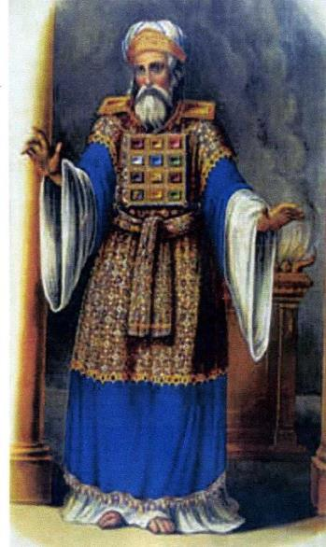
From Hebrews 7 we are told Melki-tzedek was king of Salem [H8004] and Priest of Yahuah the Most High. Exactly what does that mean?
H8004 Shalem (shaw-lame'); the same as H8003; peaceful; Shalem, [&] an early name of Jerusalem: KJV - Salem.
  Shalom; See H7965 [peace]. H7965 shalowm (shaw-lome'); or shalom; from H7999; safe, i.e. (figuratively) well, happy, friendly; also (abstractly) welfare, i.e. health, prosperity, peace.
“Salem” is used only 2 times in the Old Testament as
(1) “King of Peace” and (2) “city of peace.”
Genesis 14:18 And Melki-tzedek king of Salem [shalom/peace] brought forth bread and wine:
and he was the priest of the most high Elohim. KJV

Slide 63
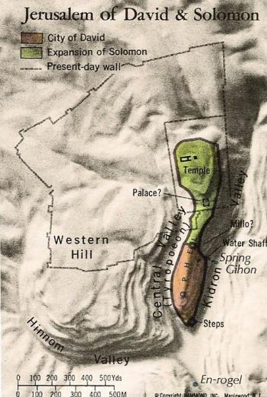
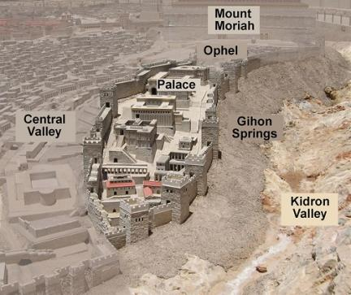
Remember: “Salem” is used only 2 times in the Old Testament as (1) “King of Peace” and (2) “city of peace.”
Psalms 76:2 KJV In Salem [Jerusalem] also is his
tabernacle, and his dwelling place in Zion [H6726].
“Zion” is found 152 times
in the Tanach – always in
reference to Jerusalem –
named as the
“city of peace.”

Slide 64
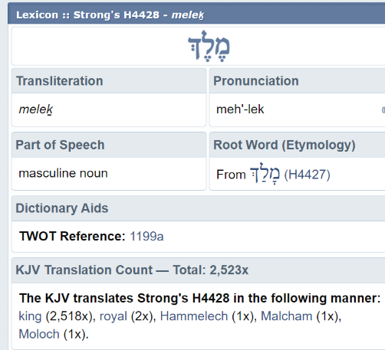
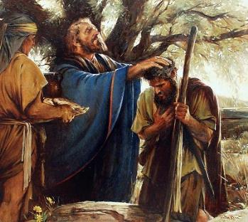
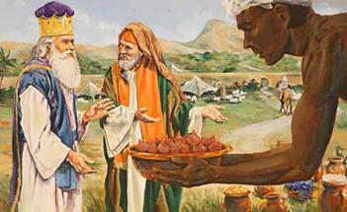
In Gen 14:18, the Melki-tzedek King of Salem met Abraham as he returned from the defeat of the kings. This Priest of the most high Elohim brought bread and wine and blessed Abraham. It is also recorded that Abraham gave him a tenth of everything.
Remember: King of Salem means King of Peace.
Melki-tzedek also has a special meaning:
“Malki/Melki” means “king”
“tzedek” means “righteousness”
This “king of righteousness” (or “king of peace”)
is the Most High Elohim, Who will be known as the
One [Yahusha] that offers the sacrifice of Salvation.
This can only refer to the Majesty of Heaven – NOT – any Melki-tzedek representative from the lineage of Adam.

Slide 65
Remember what this study is about?
Heavenly Priesthood
#1 Melki-tzedek –
The Majesty of Heaven
as the High Priest for Adam
Earthly Priesthood
#2 Melki-tzedek –
The Earthly Representative from Adam to Moses
(~2500 Yrs)
Aharonic Priesthood
The
Umbrella Illustrations Demonstrate Priesthoods
& Covenants
#3 Aharonic Priesthood on Earth
From Aharon to
the crucifixion
(~1500 Yrs)

Slide 66



Waiting to hear from Tim if he wants this info in part 1. 1150 AM jan 26th.
Jan 19/22 – saving this comment for a while yet … crf
There are "several“ priesthoods I think – like this:
1] heavenly Mel. order;
2a] earthly Mel. Order begins with Adam
2b] earthly Mel. Order from Adam to Moses breaking stone tablets
3a] Aaronic order that was to go to John the B through the judges, kings and priest – and the genealogy of Matt and Luke;
3b] broken (contaminated) Aaronic order that went to Caiaphas;
5] return to heavenly Mel. order in the end.
These are my thoughts as of the moment as I'm trying to sort this out. Originally I thought the umbrella was THE covenant, but now I see it is the KING & Priesthood as the umbrella, and the covenant is below the umbrella - it is given by the authority person.
The covenant mandates change with the "order." I haven't done these slides yet - and we'll start with the rainbow umbrella and go from there - interspersing them through the PPT.
Additional Levels of Priesthood
Yahuah has provided several levels of “Priesthood” to compensate for a variety
of situations. These can be listed as:
1] Heavenly Melki-tzedek Priesthood
2a] Earthly Melki-tzedek Priesthood
beginning with Adam
2b] Earthly Melki-tzedek Priesthood
from Adam to Moses at Mt Sinai
Covenant
3a] Aaronic Priesthood that was to reach to John
the Baptist through the appointed judges and
kings as outlined in the Gospel lineages.
3b] Aaronic Priesthood (broken, contaminated)
that terminated with the corrupt Caiaphas
4] Return to heavenly Melki-tzedek Priesthood
at the crucifixion (knowing the end from the beginning).
Rogue!

Slide 67

What to Expect From the Full Study
The full study will demonstrate each “Covenant” is under THE umbrella of authority and leadership (kings & priests).
There are many components under each (priesthood) “Umbrella.”
These “Covenants” include much more than just THE Royal Law.
We’ll see some of these components vary from one covenant to the next, governed
by their particular Priesthood.
It will be easily seen why Yahusha’s Passover made the distinction for the
final outcome of each component under the final Priesthood Umbrella.
Covenant
Every covenant is always under the guidance of the Heavenly Melki-tzedek until the priesthood
returns back to the
original “seed.”

Slide 68

Overall Review & Summary Thus Far:
#1 Heavenly Priesthood
Heavenly Priesthood
#1 Melki-tzedek –
The Majesty of Heaven
is the High Priest for
all created beings in
the heavenly realm
Covenant
Worship, obey and follow Yahuah and live, or …
Come under judgment if there is no repentance!
Every covenant is meant to bring forth
joy and happiness with obedience.
Lucifer and the angelic host were
under this very first covenant.
When the covenant was violated, judgment cast the guilty, unrepentant beings out of heaven “first” before the consequence of their eternal separation.

Slide 69


#2 Earthly Priesthood
Heavenly Priesthood
#2a Melki-tzedek –
The Majesty of Heaven
as the High Priest for Adam
BEFORE Sin Entered -
Institutes the Melki-tzedek
on earth (Adam in training)
2 Earthly Melki Priesthood
Covenant
The covenant with Adam & Eve
was also meant to bring forth joy
and happiness with obedience.
When they violated Yahuah’s covenant, the guilty pair were
spared from the instant death penalty through the sacrificial blood.
Obey and live, or …
Disobey and die!

Slide 70
Question #5 in Part 2
How can we understand & trace
the Melki-tzedek Priesthood
as it was established first in Adam
by the Most High?

Slide 71
Discovery in Part 2
Heavenly Priesthood
is always over the
Earthly Priesthood
from Adam to Moses
Heavenly Priesthood
#2b Melki-tzedek –
The Earthly Representatives:
Each representative is priest/leader over their individual patriarchal families.
We will track how the
Melki-tzedek Priesthood
was passed down from Adam to Moses for approximately the first 2500 years
after creation.
2a Earthly Priesthood
Everlasting Covenant
The End of … Part 1

Slide 72
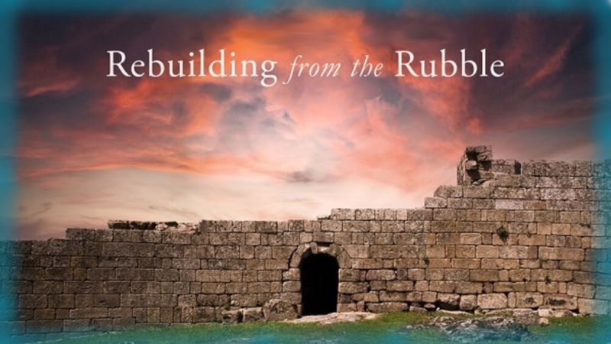


If you enjoyed this study today …
Please Join Us Live Each Week
Sign up with Covenant Calendar Club
for the Friday & Shabbat Zoom Meetings
(including live discussion)
https://studythecalendar.com/sign-up/

Slide 73

Send Questions & Comments to:
Timothy Astleford
& Charlene Fortsch
questions@studythecalendar.com
Thank-you!
Shalom!

Slide 74
Heavenly Priesthood
Heavenly Priesthood
over
Earthly Priesthood
2a Earthly Priesthood
Everlasting Covenant
#2a Melki-tzedek –
The Earthly Representative starts with Adam
all the way to Moses
(~2500 Yrs after creation)
Each representative is priest/leader over their individual patriarchal families
The worship was conducted at a simple altar
built of unhewn stone
Yahuah instructs the Eden pair on what His
covenant is and how to walk in covenant
relationship with Him.
This would include the commandments,
statutes and judgments.
Upon disobedience there must be confession,
repentance and the offer of the required sacrifice
for forgiveness and atonement
Adam was given dominion over the earth upon his creation – his priestly Melk-tzedek duties are
handed down to the 2nd born through the ages.
For 2500+ years from Adam to Moses, Yahuah
had a Melki-tzedek representative on the earth
to mediate between man and their Elohim.

Slide 75
What is a Covenant?
WITH THIS FOUNDATION OF SEED WITHIN ITSELF AND EVERYTHING IN YAHUAH’S KINGDOM HAS A FORMER EXISTENCE – THIS PUTS A WHOLE BASELINE UNDER
THE NEW COVENANT
OOPS! Another solid hit on Christianity!

