Slide 1
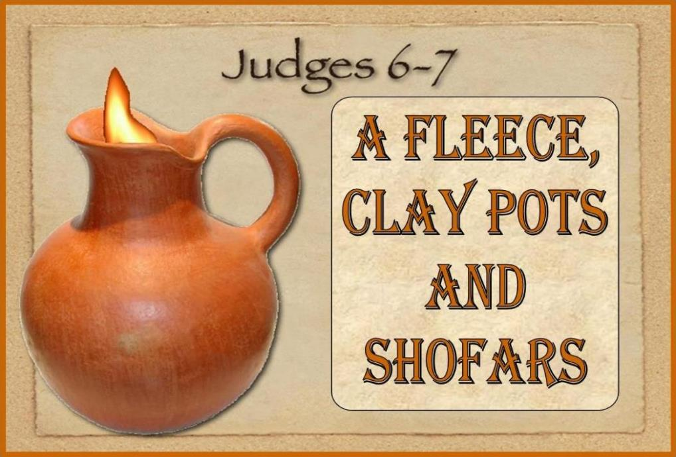
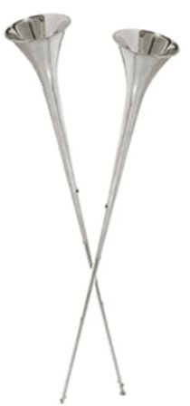
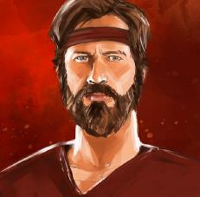
Notes:
4.21b – Gideon’s Fleece 80 slides TA Jan 15/22 Website: Youtube:
Blurb 4.12b Gideon’s Fleece: This Scripture testimony from Judges 6-7 is one that has thrilled children and adults for ages – the wonder of how Yahuah fought for Gideon through an army of 300 men instead of 32,000. And yes, we now know this is ANOTHER testimony for Yahuah’s Covenant Calendar day-start in the morning, and not at sunset as so many of us have been taught. But, many of you already know there are many dawn-day calendar studies in the Old Testament alone, so why do we need yet another one? Well, in our studies and our search, we have also found it pays to dig a little deeper as many of the “dawn-day studies” have very special gems of truth that we would not have found otherwise, EXCEPT to just DIG Deeper. So, everyone, here is the invitation to “Come and See” what has been found while enjoying the full study – and – see if this “gem” has anything to do with Yahuah’s Covenant Calendar! Shalom!

Slide 2
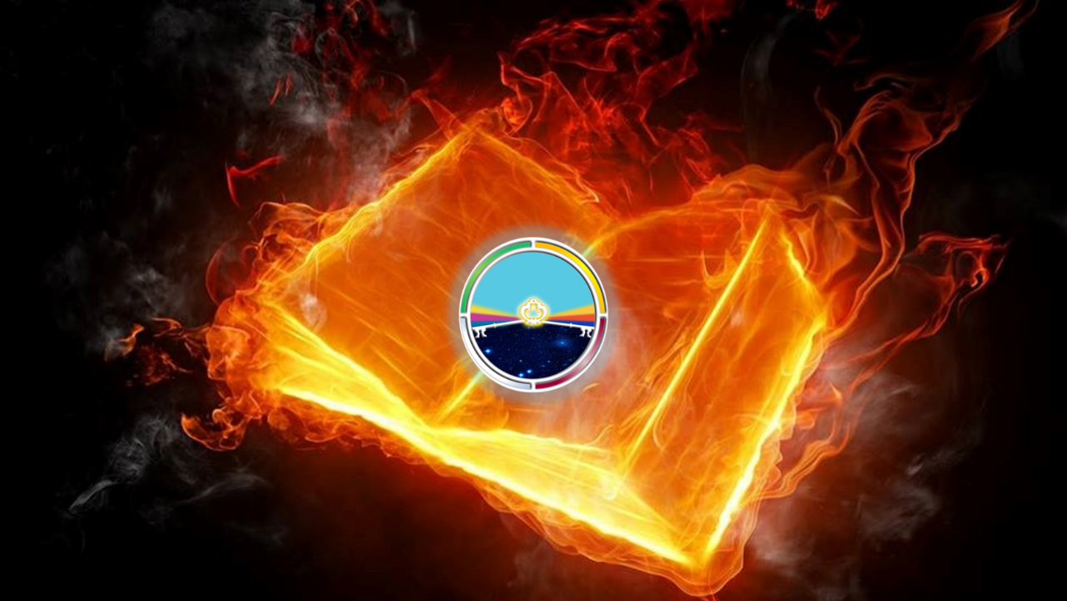
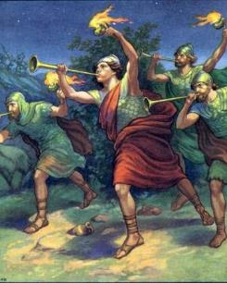
This is a message from
Yah’s Covenant Calendar!
Judges 6 & 7
The year was ~
1291 BC.

Slide 3
Getting Started
Note:
These studies try to refrain from using the word “day” that has been translated from the original Hebrew word <yowm>.
The word “day” loses a massive amount of definitive correctness in its ambiguous definitions.
Day can indicate 12 or 24 hours, day or night, or both!
To understand Scripture correctly we need to be much more accurate.
Preference is given to the word “cycle” in place of day.
When quoting the Scriptures or citing the Shabbat Day you will see it.
Otherwise cycle is the word of choice.
The 24 hour cycle will be defined below to pinpoint the two seasons.
Cycle = 24 hours containing the 2 seasons, one of light – H216 <’owr> and
one of night – H3915 <layil>.
Season H6256 - <`eth>, = (approx.) 12 Hour blocks of time whether it is
Light Season or Night Season.
A very important application example of “season” is found in Yerimyahu (Jer) 33:20-25.

Slide 4
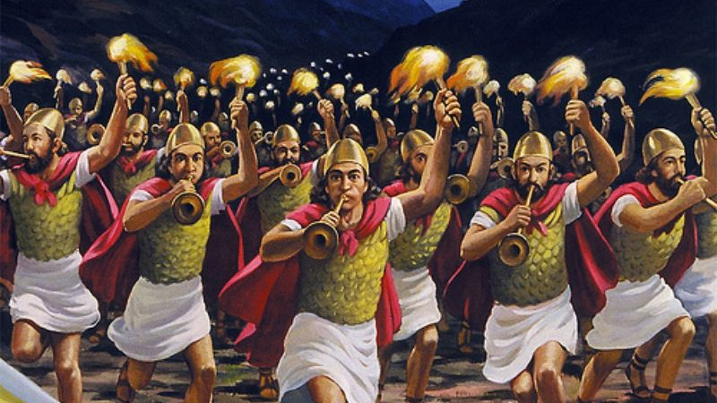
Will you be a Flint for
The Rock, igniting your torch & holding
it high, as Gideon did?
Let’s read Judges 6 to set some context for us to consider.

Slide 5
Jdg 6:1 And the children of Yisra’ĕl did evil in the eyes of יהוה [Yahuah], and יהוה gave them into the hand of Miḏyan for seven years,
Jdg 6:2 and the hand of Miḏyan was strong against Yisra’ĕl. And before the faces of the Miḏyanites the children of Yisra’ĕl made for themselves the refuges which are in the mountains, and the caves, and the strongholds.
Jdg 6:3 And it came to be, whenever Yisra’ĕl had sown, that Miḏyan would come up, and Amalĕq and the people of the East would come up against them,
Jdg 6:4 and encamp against them and destroy the increase of the soil as far as Azzah, and leave no food in Yisra’ĕl, neither sheep nor ox nor donkey.
Jdg 6:5 For they came up with their livestock and their tents, coming in as numerous as locusts. And they and their camels were without number. And they came into the land to destroy it.
Jdg 6:6 Thus Yisra’ĕl was brought very low because of Miḏyan, and the children of Yisra’ĕl cried out to יהוה.

Slide 6

Again!
Jdg 6:6 Thus Yisra’ĕl was brought very low because of Miḏyan, and the children of Yisra’ĕl
cried out to יהוה [Yahuah].
Remember when Saul gave credit to Yahuah for saving Yisra’el?
Yahuah then answered Saul!
Will Yisra’el also receive a positive response from Yahuah to their intense plea for assistance in improving their lives?
1 Sam 14:39 “For as יהוה [Yahuah] lives, who saves Yisra’ĕl …”

Slide 7
Jdg 6:7 And it came to be, when the children of Yisra’ĕl cried out to
יהוה because of Miḏyan,
Jdg 6:8 that יהוה sent a prophet to the children of Yisra’ĕl, who said to them, “Thus said יהוה Elohim of Yisra’ĕl, ‘I have brought you up from Mitsrayim and I brought you out of the house of bondage,
Jdg 6:9 and I delivered you out of the hand of the Mitsrites and out of the hand of all your oppressors, and drove them out before you and gave you their land.
Jdg 6:10 ‘And I said to you, “I am יהוה your Elohim, do not fear the mighty ones of the Amorites, in whose land you dwell.
And you have not obeyed My voice.” ’
Jdg 6:11 And the Messenger of יהוה came and sat under the terebinth tree which was in Ophrah, which belonged to Yo’ash the Aḇiʽezerite, while his son Giḏʽon threshed wheat in the winepress, to hide it from the eyes of the Miḏyanites.
Jdg 6:12 And the Messenger of יהוה appeared to him, and said to him, “יהוה is with you, you mighty brave one!”

Slide 8
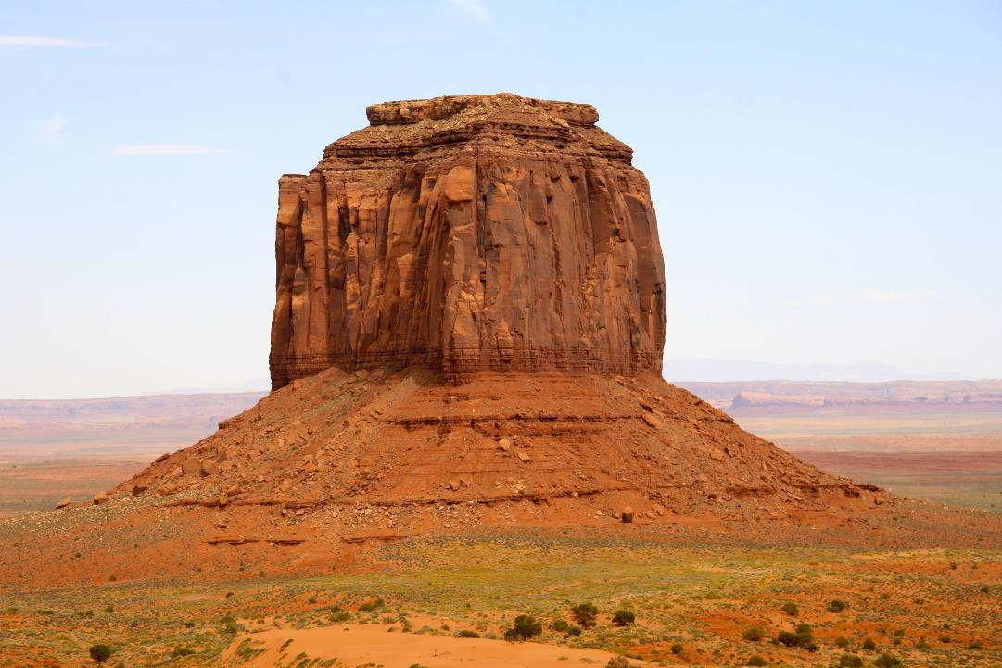
Jdg 6:11 And the Messenger of יהוה came and sat under the terebinth tree …
Was this just
“a tree”?
Or was it a tree of special renown?
Re-Cap
Moving forward with the Divine encounter.

Slide 9
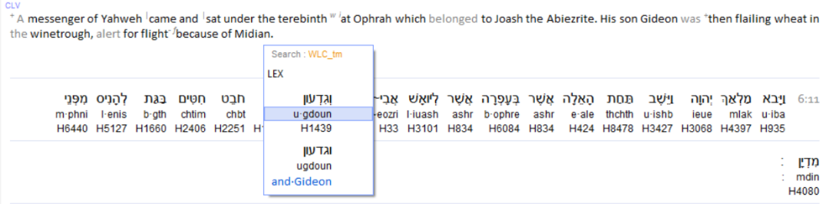
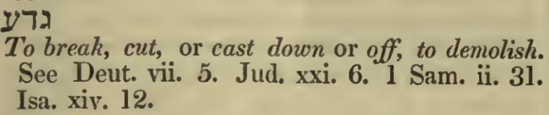
A Mighty, Brave One!
This is the first mention of Gid’on! Who is Gid’on? The Messenger (Melek) of
Yahuah declared Gid’on a mighty brave person. Is this seen in his name?
Judges 6
Gid’on’s name has this root word within it.
Did Gid’on SHEMA according to these characteristics of his name, in his exploits?

Slide 10
A Melek (Kingly) “Messenger” from Yahuah?
The Melek (Messenger) seen in this verse is an extremely important clue for exactly who was addressing Gid’on. Would Gid’on verify this authority?
Judges 6
Repeat verse
Just Who was this Divine Messenger? With the description of melek (king) and with the aura of righteousness in the heavenly realm, this character must be of a Divine origin!? Why is the Hebrew word for angel not used here? (H4398 malak)?

Slide 11

Jdg 6:13 And Giḏʽon said to Him, “O my master, if יהוה is with us, why has all this come upon us? And where are all His wonders which our fathers related to us, saying, ‘Did not יהוה bring us up from Mitsrayim?’ But now יהוה has left us and given us into the hands of Miḏyan.”
Gid’on at this point understands he is being addressed by a heavenly Being, he feels that Yahuah has abandoned Yisra’el and he expresses it clearly. But please note Who it is that faces Gid’on in this very next verse, and addresses him concerning the oppressed situation of Yisra’el!
Jdg 6:14 And יהוה turned to him and said, “Go in this strength of yours, and you shall save Yisra’ĕl from the hand of the Miḏyanites.
Have I not sent you?”

Slide 12
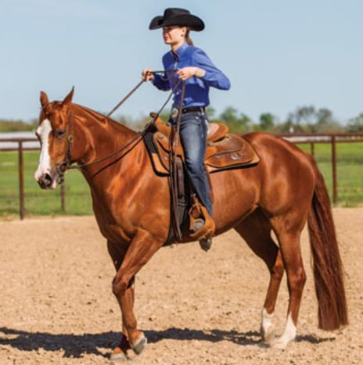
John 1:18 No one has ever seen God; the only God, who is at the Father's side, he has made him known. ESV
John 1:18 No one has ever seen Elohim. The only brought-forth Son, who is in the bosom of the Father, He did declare. TS
John 5:37 “And the Father who sent Me, He bore witness of Me. You have neither heard His voice at any time, nor seen His form.
1 Jn 4:12 No one has seen Elohim at any time. If we love one another, Elohim does stay in us, and His love has been perfected in us.
OK! Let’s slow this horse down! What does the Scripture declare about visually seeing Yahuah?

Slide 13
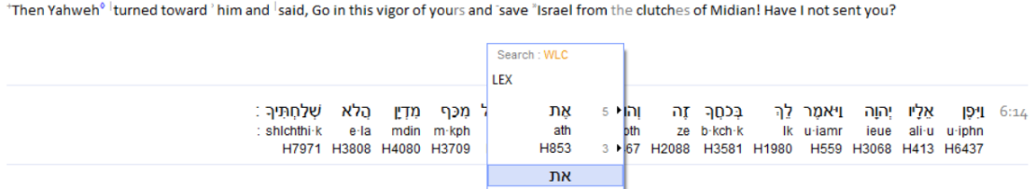
Jdg 6:14 And יהוה turned to him and said, “Go in this strength of yours, and you shall save Yisra’ĕl from the hand of the Miḏyanites.
Have I not sent you?”
Have we been able to identify theאת .in this verse? This is the direct connection to Yahusha, the One Who Saves! Yet here in the same verse we read Yod Hey Vav Hey, (Yahuah), the Name of our Father! How can this be?
How can the Aleph Tav be connected to Yahusha the Son, have Father Yahuah identified by His Qodesh Name, and still give the command/commission to Gid’on to SAVE YISRA’EL? Who is The Redeemer? Yahusha or Yahuah?
Judges 6

Slide 14
Joh 4:42 And they said to the woman, “We no longer believe because of what you said, for we ourselves have heard, and we know that this is truly the Messiah, the Saviour of the world.”
Php 3:20 For our citizenship is in the heavens, from which we also eagerly wait for the Saviour, the Master יהושע Messiah.
Scripture writings show both Yahuah and Yahusha Ha Mashiach as the Saviour! The same writing also declares Yahuah is the ONLY - ONE Divine entity entitled to be our Saviour and Redeemer!

Slide 15
How can THESE TWO identities be ONE?
Yahuah will not share His glory. Yet Yahuah declares Himself AND Yahusha Ha Mashiach as
the Saviour of this world!
What gives - ELOHIM?
Plural!
Yahuah
Melki-tzedek
Michael
Yahusha
Emmanuel

Slide 16




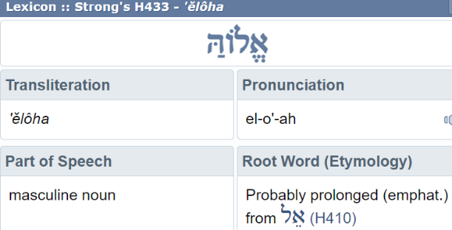
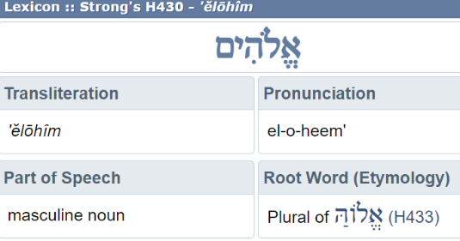
How can a plurality (Elei-nu) be singular - Echad?
Plural
Deut 6:4
Singular!
Plural!
El

Slide 17

What if Yahuah is the invisible omnipotent El, and Yahusha – is of the same substance;
but made tangibly visible to expressly connect visibly and physically with man?
Would this then allow Yahusha who
is in charge of Salvation, to be within
His perimeter in commanding Gid’on
to SAVE Yisra’el?

Slide 18

Which ONE is The Redeemer? Yahusha or Yahuah?
We read in -
Isa 42:8 “I am יהוה, that is My Name, and My esteem I do not give to another, nor My praise to idols.”
How can we see the Aleph Tav which connects to Yahusha the Son,
in the verse of Judges 6:11, and still read the Name of Yahuah as the
One talking to Gid’on?
Who is The Redeemer?
Psa 19:14 Let the words of my mouth and the meditation of my heart Be pleasing before You, O יהוה, my rock and my redeemer.

Slide 19
Ascertaining context for the next slide.
Col 1:1 Sha’ul, an emissary of יהושע [Yahusha] Messiah by the desire of Elohim, and Timothy our brother,
Col 1:2 to the set-apart ones in Colosse, and true brothers in Messiah: Favour to you and peace from Elohim our Father and the Master
יהושע Messiah.
Col 1:3 We give thanks to the Elohim and Father of our Master יהושע Messiah, praying always for you,
Col 1:4 having heard of your belief in Messiah יהושע and of your love for all the set-apart ones,

Slide 20

Context - Yahusha Ha Mashiach
Col 1:10 to walk worthily of the Master, pleasing all, bearing fruit in every good work and increasing in the knowledge of Elohim,
Col 1:11 being empowered with all power, according to the might of His esteem, for all endurance and patience with joy,
Col 1:12 giving thanks to the Father who has made us fit to share in the inheritance of the set -apart ones in the light,
Col 1:13 who has delivered us from the authority of darkness
and transferred us into the reign of the Son of His love.
Shared Glory?????

Slide 21

Context - Yahusha Ha Mashiach
Col 1:12 … the Father …
Col 1:13 … transferred us into THE REIGN of the Son …
HOW DOES THIS ALIGN WITH –
Isa 42:8 “I am יהוה [Yahuah] that is My Name, and My esteem I do not give to another,
nor My praise to idols.”
More on this verse soon, but first some more verses with Yahusha in the Light!

Slide 22
Is Yahusha Ha Mashiach One (Echad) with Yahuah?
Col 1:15 Who is the LIKENESS of the INVISIBLE Elohim,
the first-born of all creation.
Col 1:16 Because in Him were created all that are in the heavens and that are on earth, visible and invisible, whether thrones or rulerships or principalities or authorities – all have been created through Him and for Him.
Heb 1:6 And when He again brings the first-born into the world, He says, “Let all the messengers of Elohim do reverence to Him.”
Yahusha THE CREATOR – Shared Glory?
Is it ECHAD (ONE) GLORY? – Deut 6:4 Elohim is One (Echad)!

Slide 23

Deu 6:4 “Hear, O Yisra’ĕl: יהוה our Elohim,
יהוה. is ONE!”
Invisible
Plural!
Yahuah
Yahuah
Yahusha
More support on its way! ☺

Slide 24

Yahusha Ha Mashiach - in the Glory of Yahuah
Joh 8:12 Therefore יהושע [Yahusha] spoke to them again, saying,
“I am the light of the world. He who follows Me shall by no means walk in darkness, but possess the light of life.”
Joh 12:46 “I have come as a light into the world, so that no one who believes in Me should stay in darkness.”
Context – Yahusha, from v:15 -
Acts 26:18 ‘To open their eyes, to turn them from darkness to light, and the authority of Satan to Elohim, in order for them to receive forgiveness of sins and an inheritance among those who are set-apart by belief in Me.”
A Co-Redeemer?
Is this not SHARED GLORY?

Slide 25
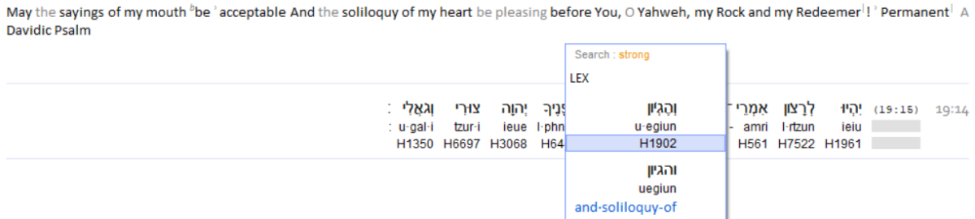
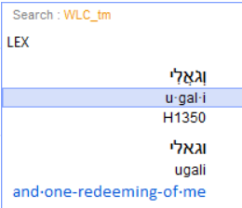
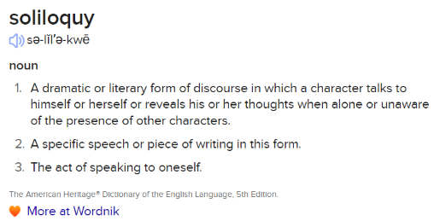
A closer look!
Psalms 19:14
Here we read that Yahuah is the Redeemer! Does that align with other Scripture and the title
of - Saviour?
What about – Saviour?

Slide 26
Some different thoughts!
Could - Soliloquy - answer the question of the "voice from heaven" at the baptism?
The supposed godhead controversy appears as a "Me, Myself & I" revelation.
This also goes along with the words
"My El, My El why have You forsaken Me?"
... in other words ... Yahusha would be saying, "I made this vow, I cannot break it, what in the world was I thinking about?!”

Slide 27
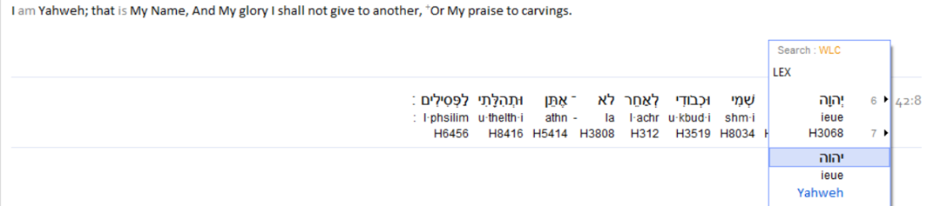

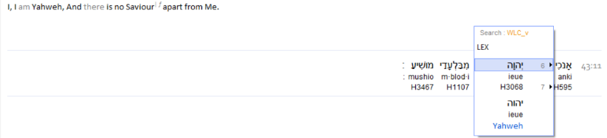

What does Yahuah declare about His Glory/Esteem?
How is it written that Yahuah is the Redeemer, and that He will not allow any other god to share His Glory/Esteem?
Yet we see other writings that expose Yahusha Ha Mashiach as the Saviour?
I am Yahuah, that is My Name, and My Glory I shall not give to another, or My praise to carvings.
Isaiah 42:8
Another Witness
Isaiah 43:11
I am Yahuah, And there is no Saviour apart from me.

Slide 28

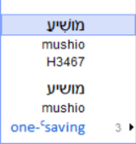
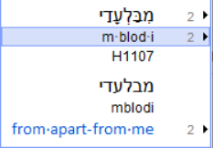
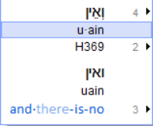


Let’s re-examine Isaiah 43:11 -
Yahuah, in the Scripture, declares He is the
- One -facilitating Salvation!
Who then is this Yahusha Ha Mashiach we hear and read so much
about as our Saviour, if there is NO OTHER THAN - YAHUAH?

Slide 29
Isa 49:26 “And I shall feed those who oppress you with their own flesh, and let them drink their own blood as sweet wine. All flesh shall know that I, יהוה, am your Saviour, and your Redeemer, the Elohim of Yaʽaqoḇ.”
Isa 19:20 And it shall be for a sign and for a witness to יהוה of hosts in the land of Mitsrayim.
When they cry to יהוה because of the oppressors,
He sends them a Saviour and an Elohim,
AND SHALL DELIVER THEM.
Is Yahuah shirking from His self proclaimed duties?
OOPS! Didn’t we just read that Yahuah would NOT
share His glory and esteem with another god?
Are we crying out to Yah, today?

Slide 30
Luk 2:11 “Because there was born to you today in the city of Dawiḏ
a Saviour, who is Messiah, the Master.”
A Saviour, a Mashiach, who is claimed as MASTER, born on earth?
Is this BLASPHEMY?
Who then is Yahusha Ha Mashiach?

Slide 31

Isa 9:4 For You shall break the yoke of his burden and the staff of his shoulder, the rod of his oppressor, as in the day of Miḏyan.
Isa 9:6 For a Child shall be born unto us, a Son shall be given unto us, and the rule is on His shoulder. And His Name is called Wonder, Counsellor, Strong Ěl, Father of Continuity, Prince of Peace.
Father of Continuity? = Everlasting Father (KJV). Do we find it interesting that along with the prophecy of Yahusha Ha Mashiach, just prior is mentioned the oppression of Yisra’el, by the Midianites?
Isn’t this when Gid’on was blessed with the presence of the Aleph Tav and given the commission to destroy this evil?

Slide 32

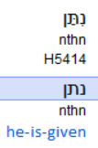

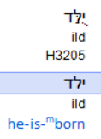


In the next few slides we are going to break down this verse, word for word.
Isa 9:6 For a Child shall be born unto us, a Son shall be given unto us, and the rule is on His shoulder. And His Name is called Wonder, Counsellor, Strong Ěl, Father of Continuity, Prince of Peace.
Isaiah 9:6
NO ALARM thus far! A Child (boy) was born and
He was commissioned
specifically for mankind.

Slide 33
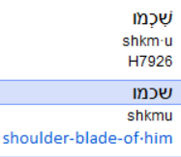

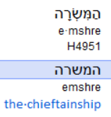
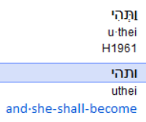
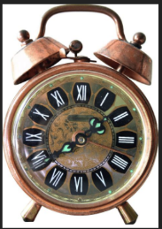

Continuing on - Part #2
Isa 9:6 For a Child shall be born unto us, a Son shall be given unto us, and the rule is on His shoulder. And His Name is called Wonder, Counsellor, Strong Ěl, Father of Continuity, Prince of Peace.
Isaiah 9:6
Alarm bells should be LOUD right now!
?
Glory &
Esteem
Upon Yahusha Ha Mashiach!

Slide 34

Isa 9:6 (b) and the RULE is on His shoulder.
Isaiah 9:6
?
Prophecy has just announced a transfer of authority!
This “Son” was/is to attain the Ultimate position of Glory and Esteem! Yet we have read in Isa 42:8 (slide 18) that Yahuah will NOT SHARE HIS GLORY WITH ANOTHER god!

Slide 35


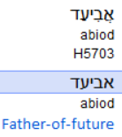


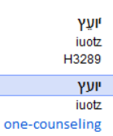
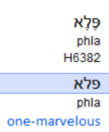
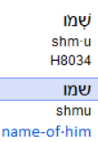
Shared Glory?
Isa 9:6 For a Child shall be born unto us, a Son shall be given unto us, and the rule is on His shoulder. And His Name is called Wonder, Counsellor, Strong Ěl, Father of Continuity, Prince of Peace.
Isaiah 9:6

Slide 36
Is it possible for Yahusha to attain any higher accolades - from Yahuah?
Maybe not, yet there is another witness!

Slide 37
Yes, Shared Glory Indeed!
Isa 11:1 And a Rod shall come forth from the stump of Yishai,
and a Sprout from his roots shall bear fruit.
Isa 11:2 The Spirit of יהוה shall rest upon Him –
the Spirit of wisdom and understanding,
the Spirit of counsel and might,
the Spirit of knowledge
and of the fear of יהוה.

Slide 38
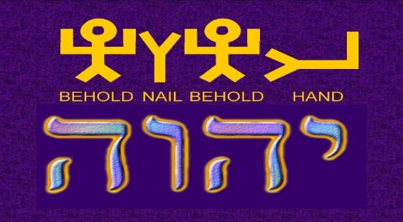
Yahusha Ha Mashiach
The transfer of Glory and Esteem to
The transfer of Glory and Esteem to Yahusha; is this a sharing of glory to ANOTHER god? Is Yahusha a SEPARATE IDENTITY from YAHUAH?

Slide 39
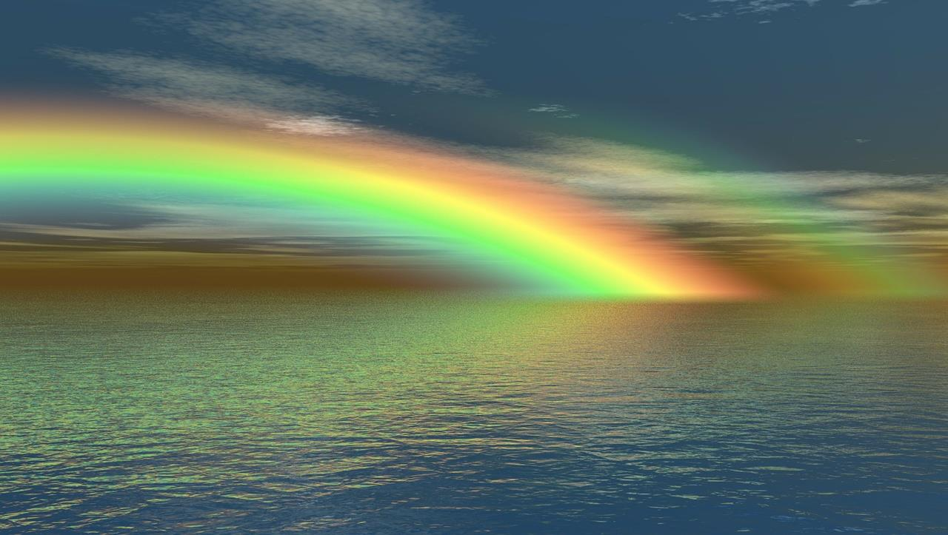

The Word from Yahuah
Deu 6:4 “Hear, O Yisra’ĕl:
יהוה our Elohim,
יהוה is ONE!”
Invisible
Yahuah
Yahuah
Yahusha
Yahuah
Melki-tzedek
Yahusha
Emmanuel
Michael

Slide 40


Yahuah bestowed His Glory and Esteem with
the visible identity of Himself.
Yahuah and Yahusha are One and the Same. Yahusha is an integral facet of Yahuah;
yet in various designed functions &
applications with “visibility.”

Slide 41
Zech 14:9 In that day there shall be ONE Yahuah
and His Name ONE.

Slide 42
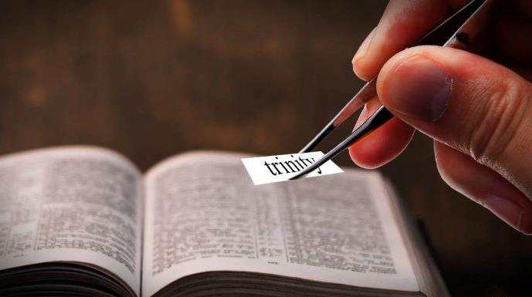
Who consistently attempts to insert this pagan tradition into Yahuah’s Word, thus stealing unsuspecting minds?
42

Slide 43
Moving forward with - Gid’on’s Commission and The Name
When Gid’on responded to the commission as issued to save Yisra’el, note the Name he responded with!
At this point Gid’on began to realize with Whom he might be speaking. Are we also able to recognize this too?
Jdg 6:15 And he said to Him, “O יהוה, with what do I save Yisra’ĕl? See, my clan is the weakest in Menashsheh, and I am the least in my house.”
Jdg 6:16 And יהוה said to him, “Because I am with you, you shall smite the Miḏyanites as one man.”
Jdg 6:17 And he said to Him, “Please, if I have found favour in Your eyes, then show me a sign that it is You who are speaking with me.”

Slide 44
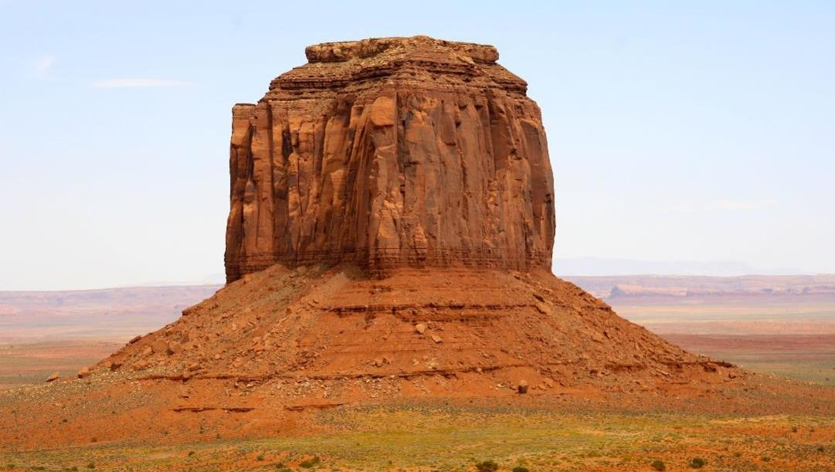
Jdg 6:18 “Please do not move away from here, until
I come to You and bring out my offering and set it before You.” And He said,
“I shall stay
until you return.”
Jdg 6:19 And Giḏʽon went in, and prepared
a young goat, and unleavened bread from an ĕphah of flour. The meat he put in a basket, and he put the broth in a pot. And he brought them out to Him, under THE TEREBINTH TREE,
and presented it.

Slide 45
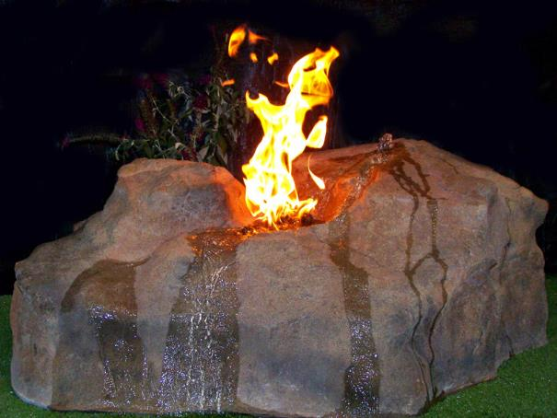
Jdg 6:20 And the Messenger of Elohim said to him, “Take the meat and the unleavened bread and lay them on this rock, and pour out the broth.” And he did so.
Jdg 6:21 And the Messenger of יהוה put forth the end of the staff that was in His hand, and touched the meat and the unleavened bread. And fire went up out of the rock and consumed the meat and the unleavened bread. And the Messenger of יהוה went from his sight.
What ROCK was it that actually produced the (Refiner’s) Fire?

Slide 46
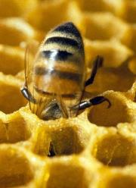
How could these two verses apply to us - TODAY?
Jdg 6:20 And the Messenger of Elohim said to him, “Take the meat and the unleavened bread and lay them on this rock, and pour out the broth.” And he did so.
Is it possible to understand this verse TODAY as –
YOU/ ME, - being a LIVING SACRIFICE, - plant yourself upon
The Rock - Yahusha Ha Mashiach.
Not just a part of you (a mixture), but ALL OF YOUR BEING.
Full commitment!

Slide 47
Application for us - TODAY?
Jdg 6:21 And the Messenger of יהוה put forth the end of the staff that was in His hand, and touched the meat and the unleavened bread. And fire went up out of the rock and consumed the meat and the unleavened bread. And the Messenger of יהוה went from his sight.
As we present ourselves a - LIVING SACRIFICE,
our character will be purged by the Refiner’s Fire
[the Fire from The Rock].
This purging from sin will be completed, visited only once –
it will be – in our lifetime on this earth.

Slide 48
melek
Jdg 6:22 And when Giḏʽon saw that He was a Messenger of יהוה,
Giḏʽon said, “Oh Master יהוה!
For I have seen a Messenger of יהוה face to face.”
Gid’on realized he had seen a Qodesh being of Yahuah, face to face and was terrified of dying. Did Gid’on know about the concept within this next verse?
Exo 33:20 But He said, “You are unable to see My face, for no man does see Me and live.”
Who was it that Gid’on actually saw - face to face - and conversed with?
AGAIN!

Slide 49
Deu 34:10 And since then no prophet has arisen in Yisra’ĕl like Mosheh,
whom יהוה KNEW FACE TO FACE.
Come to think of it - WHAT OF THIS VERSE?
Mosheh did not die from this!
Which identity was
it that Mosheh saw
FACE TO FACE??
OK, back to the fire coming UP FROM THE ROCK!

Slide 50
Why did the fire come UP OUT OF THE ROCK, and not – come down
(1 Kings 18:38) (from heaven) as when Elijah was offering sacrifice
exposing the priests of Ba’al?
Jdg 6:21 (b) And fire went up out of the rock and consumed the meat and the unleavened bread. And the Messenger of יהוה went from his sight.
Was The Rock (with eternal authority) standing beside the rock, ready
to accept sacrifice and offering? Is this where the fire originated?
Gid’on received full confirmation to his question about having sufficient ability to perform the command to save Yisra’el from the Midianites.
And what about his fear of death from seeing “The Messenger” face to face?

Slide 51
Jdg 6:23 And יהוה said to him, “Peace be with you! Do not fear, you do not die.”
Jdg 6:24 And Giḏʽon built an altar there to יהוה, and called it: יהוה Shalom. To this day it is still in Ophrah of the Aḇiʽezerites.
What an interesting Name on the location of the altar!
                יהוה Shalom!
Understanding what we have just read from prophecy in Isaiah 9:6 (slide 35)
where Prophecy applies the title of Shar Shalom – Prince of Peace, to Yahusha Ha Mashiach (future tense),
and understanding that Yahusha is ECHAD – ONE with Yahuah,
is it easy to discern Gid’on’s decision to name the altar location
as - יהוה Shalom?

Slide 52

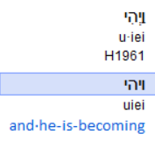
At that point in time, Gid’on did not know the Melek (“Messenger”) of Yahuah as – Yahusha Ha Mashiach! This Name and Title became known much later!
Jdg 6:25 And the same night it came to be that יהוה said to him, “Take the young bull of your father, and the second bull of seven years old, and you shall throw down the altar of Baʽal that your father has, and cut down the Ashĕrah that is beside it.
The same night? Same as WHAT? Same cycle timeframe as the twilight mixture after sunset, OR SAME AS THAT WHICH STARTED WITH THE DAWN??
Getting back to Gid’on!
It became Layila –
Night!
The Light Season state of existence, transitioned
into another form of existence!

Slide 53
We have travelled over a lot of ground on just “Who” is Echad for the Majesty of Heaven – even though this barely scratches the surface.
It is very clear that Yahuah has preserved information in this Gideon study to teach us a most special “gem of truth” that will never align with the false trinity teaching so prevalent in “Christianity.”
However, this is supposed to be a Dawn Day study, so let us connect with Gideon again to see if indeed the day-start is in the morning, or if the sunset manages to have any foothold this time.
We will demonstrate these calendar details on charts.
Gid’on’s Gem!

Slide 54

Shall we begin to chart Gid’on’s escapade according to the Genesis account of
Dawn to Dawn?
Sunset did not change the cycle of the week.
Gid’on was threshing wheat in the winepress when the Messenger of Yahuah met him. The commission was issued to save Yisra’el and the offering (U/B) was accepted.
Jdg 6:25 And the same night it came to be that יהוה said to him, “Take the young bull of your father, and the second bull of seven years old, and you
shall throw down the altar of Baʽal
that your father has, and cut
down the Ashĕrah that is beside it.
Dawn
Dawn
Sunset
Light Season #1 | Night Season #1
The sunset and twilight events passed.

Slide 55
Jdg 6:26 “And you shall build an altar to יהוה your Elohim on top of this rock in an orderly way, and shall take the second bull and offer a burnt offering with the wood of the image which you cut down.”

Slide 56
Jdg 6:27 And Giḏʽon took ten men from among his servants and did as יהוה had said to him. And it came to be, because he feared his father’s household and the men of the city too
much to do it by day, that he did it by night.
Boqer
Dawn
Dawn
Sunset
Light Season | Night Season

Slide 57
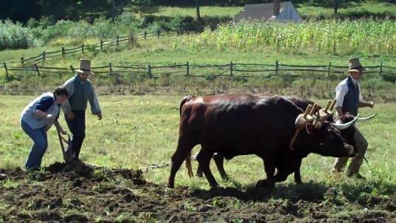
Boqer
Jdg 6:28 And the men of
the city arose early in the morning and saw the altar of Baʽal was broken down, and the Ashĕrah that was beside it had been cut down, and the second bull was being offered on the altar which was built.
Gid’on and his men
had DESTROYED the Asherah and the altar
of Ba’al in the Night.
Boqer
Dawn
Dawn
Sunset
Light Season | Night Season

Slide 58
The Action of Boqer/Dawn’s First Light
Yesterday
Tomorrow
Separate
Isolate
Split
Boqer
Originate
Activate
Prompt
Dawn
Distinguish
Extricate
Disengage
Divide
Detach
Initiate
Instigate
Inaugurate
Trigger
Generate
Sunset
Night Season | Light Season
Hopefully you have noticed that sunrise is not even recorded!

Slide 59
Jdg 6:29 And they said to each other, “Who has done this deed?” And when they had inquired and asked, they said, “Giḏʽon son of Yo’ash has done this deed.”
Jdg 6:30 And the men of the city said to Yo’ash, “Bring out your son, so that he dies, for he has broken down the altar of Baʽal, and because he has cut down the
Ashĕrah that was beside it.”

Slide 60
Jdg 6:31 And Yo’ash said to all who stood against him, “You, would you plead for Baʽal? You, would you save him? Let the one who would plead for him be put to death BY MORNING! If he is a mighty one, let him plead for himself,
because his altar has been broken down!”
Yoash spoke into the CLOSING PERIMETER of the 24 hour cycle for the time to finalize their desired justice, however Yoash rightly
transferred it on those who chose to defend a LIFELESS IMAGE!
Jdg 6:32 So that day he called him Yerubbaʽal, saying, “Let Baʽal plead against him, because he has broken down his altar.”
Boqer
Dawn
Dawn
Sunset
Light Season | Night Season

Slide 61
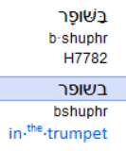
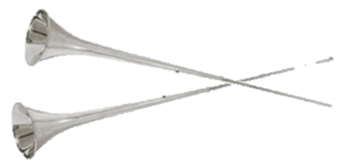
Jdg 6:33 Now all Miḏyan and Amalĕq and the people of the East, were gathered together. And they passed over and encamped in the Valley of Yizreʽĕl.
Jdg 6:34 Then the Spirit of יהוה came upon Giḏʽon, and he blew the ram’s horn shofar, and the Aḇiʽezerites gathered behind him.
Why are the words – ram’s horn – crossed out, and in grey?
The original Hebrew word is seen below and the definition (very basic) is a straight hollow trumpet.

Slide 62
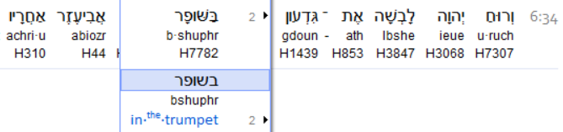
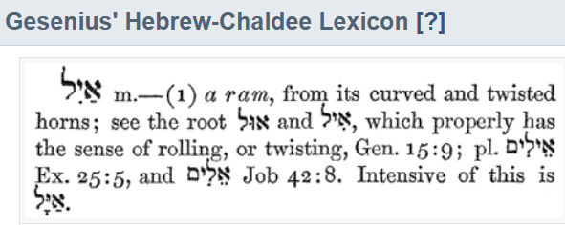
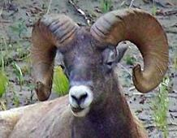

Judges 6:34
ISA
Is there a valid reason to SWITCH from the original Inspired Word?
Why then does the Tanach have the correct Hebrew word, and yet when translated into English, we are expected to receive that the Hebrew word translated to - RAM
- is an
acceptable
replacement?
Why the switch to this word/definition?
Usage – 185 x
The IRONY is flowing!

Slide 63
Re-Cap from verse 34 –
Gid’on blew the shofar and the Abi’ezerites gathered to him.
Jdg 6:35 And he sent messengers throughout all
Menashsheh, who also gathered behind him.
And he sent messengers to Ashĕr, and to
Zeḇulun, and to Naphtali. And they came
up to meet them.

Slide 64
Jdg 6:36 And Giḏʽon said to Elohim, “If You are saving Yisra’ĕl by my hand as You have said,
Jdg 6:37 see, I am placing a fleece of wool on the threshing-floor.
If there is dew only on the fleece, and it is dry on all the ground, then I shall know that You are saving Yisra’ĕl by my hand, as You have said.”
Farmers need to stop their combining of grain around 1 – 3 AM (approx.), because of the
dew making the stalks of grain too wet to process.
Num 11:9 And when the dew fell on the camp at night, the manna fell on it.
Boqer
Dawn
Dawn
Sunset
Light Season | Night Season

Slide 65
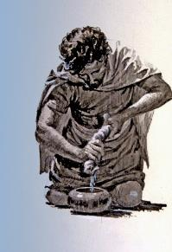
Jdg 6:38 And it was so, and he rose early the next morning and pressed the fleece, and wrung dew out of the
fleece, to fill a bowl with water.
The dew fell on the fleece that night
in the early hours before Dawn.
Boqer
Dawn
Dawn
Sunset
Light Season | Night Season

Slide 66
Gid’on, had arose early at Dawn, and then wrung out the fleece!
Jdg 6:39 And Giḏʽon said
to Elohim, “Do not be displeased with me, and let me speak only this time: Please let me try only this time with the fleece, please let it be dry only on the fleece, and let there be dew on all the ground.”
Jdg 6:40 And Elohim did so that night, and it was dry on the fleece only, but there was dew on all the ground.
Note: there are NO
Hebrew words to indicate
that this Night Season was
separate from the Light Season!
Boqer
Dawn
Dawn
Sunset
Light Season | Night Season

Slide 67
Jdg 7:1 And Yerubbaʽal, that is Giḏʽon, and all the people who were with himתא .rose up early and encamped by the fountain of Ḥaroḏ, so that the camp of Miḏyan was on the north side of them by the hill of Moreh in the valley.
Jdg 7:2 And יהוה said to Giḏʽon, “The people who are with you are too many for Me to give Miḏyan into their hands, lest Yisra’ĕl boast against Me, saying, ‘My own hand has saved me.’
Jdg 7:3 “And now, proclaim in the hearing of the people, saying, ‘Whoever is afraid and trembling, let him turn back, and leave Mount Gilʽaḏ.’ ” And twenty-two thousand of the people turned back, while ten thousand remained.
Jdg 7:4 And יהוה said to Giḏʽon, “The people are still too many. Bring them down to the water, and let Me prove them for you there. And it shall be, that of whom I say to you, ‘This one goes with you,’ let him go with you. And of whomever I say to you, ‘This one does not go with you,’ let him not go.”

Slide 68
Jdg 7:5 So he brought the people down to the water. And יהוה said to Giḏʽon, “Everyone who laps the water with his tongue, as a dog laps, separate him from everyone who bows down on his knees to drink.”
Jdg 7:6 And the number of those who lapped, putting their hand to their mouth, was three hundred men, and all the rest of the people bowed down on their knees to drink water.
Jdg 7:7 And יהוה said to Giḏʽon, “By the three hundred men who lapped I save you, and shall give Miḏyan into your hand. Let all the other people go, each to his place.”
Jdg 7:8 And the people took food and their ram’s horns shophartheim [trumpets of them] in their hands. And he sent away all the rest of Yisra’ĕl, each to his tent, but kept those three hundred men. Now the camp of Miḏyan was below him in the valley.

Slide 69
The time of separating: the ones afraid and the ones who bent at the knees to drink, from - the strong ones that accompanied
Gid’on.
Jdg 7:9 And it came to be, on that night, that יהוה said to him, “Arise, go down against the camp, for I have given it into your hand.
Jdg 7:10 “But if you are afraid to go down, go down, you and Purah your servant, to the camp.
Jdg 7:11 “And you shall hear what they say, and after that let your hands be strengthened. And you shall go down against the camp.” So he went down with Purah his servant to the edge of
the formation of fives who were in the camp.
Boqer
Dawn
Dawn
Sunset
Light Season | Night Season

Slide 70
Jdg 7:12
And Miḏyan and Amalĕq, and all the people of the East, were lying in the valley as many as locusts. And their camels were as numerous as the sand by the seashore.
… ON THAT NIGHT … v:12
Jdg 7:13 And Giḏʽon came, and see,
a man was relating a dream to his companion, and said, “See I had a dream, and see, a loaf of barley bread tumbled into the camp of Miḏyan, and it came to a tent
and smote it so that it fell and overturned, and the tent fell down.”
Boqer
Dawn
Dawn
Sunset
Light Season | Night Season

Slide 71
Jdg 7:14 And his companion answered and said, “This is nil else than the sword of Giḏʽon son of Yo’ash, a man of Yisra’ĕl. Elohim has given Miḏyan and all the camp into his hand.”
Jdg 7:15 And it came to be, when Giḏʽon heard this dream related, and its interpretation, that he bowed himself down. And he returned to the camp of Yisra’ĕl, and said, “Arise, for יהוה has given the camp of Miḏyan into your hand.”
Jdg 7:16 And he divided the three hundred men into three companies, and he put a ram’s horn shopharuth [trumpets] into the hands of all of them, with empty jars, and torches inside the jars.
Jdg 7:17 And he said to them, “Watch me and do likewise. And see, when I come to the edge of the camp do as I do.
Jdg 7:18 “And I shall blow the ram’s horn b-shophar [in the trumpet], I and all those with me, then you shall also blow the ram’s horns
b-shopharuth [in the trumpets] round about all the camp,
and say, ‘For יהוה and for Giḏʽon!’ ”

Slide 72
… ON THAT NIGHT … v:12
Jdg 7:19 And Giḏʽon and the hundred men who were with him came to the edge of the camp at the beginning of the middle watch, as they had but newly posted the watch. And they blew the ram’s horns b-shopharuth [in the trumpets] and broke the jars that were in their hands.
Boqer
Middle Watch
Dawn
Dawn
Sunset
Light Season | Night Season

Slide 73
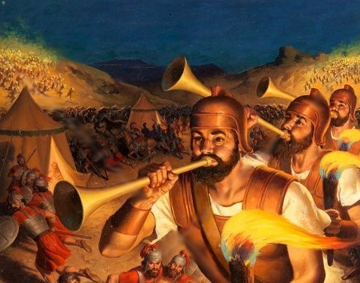
By the Sword of Yahuah
and of Gideon!

Slide 74
Jdg 7:20 And the three companies blew the ram’s horns
b-shopharuth [in the trumpets] and broke the jars, and held the torches in their left hands and ram’s horns e-shopharuth [the trumpets] in their right hands for blowing. And they cried,
“For יהוה and for Giḏʽon!”
Jdg 7:21 And each stood in his place, round about the camp. And all the army ran and cried out and fled,
Jdg 7:22 and the three hundred blew the ram’s horns e-shopharuth [the trumpets], and יהוה set the sword of each one against the other throughout all the camp. And the army fled to Bĕyth Shittah, toward Tserĕrah, as far as the border of Aḇĕl Meḥolah, by Tabbath.

Slide 75
Jdg 7:23 And the men of Yisra’ĕl were called from Naphtali, and from Ashĕr, and from all Menashsheh, and pursued Miḏyan.
Jdg 7:24 Then Giḏʽon sent messengers throughout all the mountains of Ephrayim, saying, “Come down to meet Miḏyan, and capture from them the watering places as far as Bĕyth Barah and the Yardĕn.” So all the men of Ephrayim were called and captured the watering places as far as Bĕyth Barah and the Yardĕn.
Jdg 7:25 And they captured two princes of Miḏyan, Orĕḇ and Ze’ĕḇ, and slew Orĕḇ at the rock of Orĕḇ, and Ze’ĕḇ they slew at the winepress of Ze’ĕḇ while they pursued Miḏyan. And they brought the heads of Orĕḇ and Ze’ĕḇ to Giḏʽon beyond the Yardĕn.

Slide 76

Incidentally, the treasures and very specifically, the crescent moons taken by the army, which Gideon kept for himself, became a snare to him and his family.
Even righteous men are tempted and snared by the adversary.
Shall we pay attention here?

Slide 77
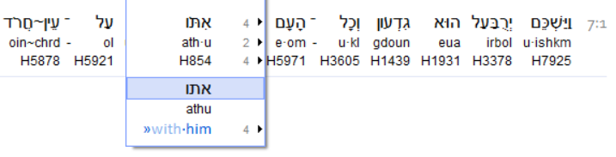
One more item before we end.
Judges 7:1
Here we see the Aleph Tav with the suffix – Vav, and
the translation is given to us – the men with Gid’on.
Yet the Vav being the Nail, that which attaches, and/or connects, is seen placed here beside the Aleph Tav which represents Yahusha Himself.
So these men (including Gid’on), who were “attached and connected,” were they attached to Yahusha “The Son,” the Aleph Tav?
The Beginning and the End? Were these men the very ones whom Yahuah had chosen by the WATER of the brook, connected specifically to Yahuah/Yahusha - The ECHAD ELOHIM? !!!!

Slide 78
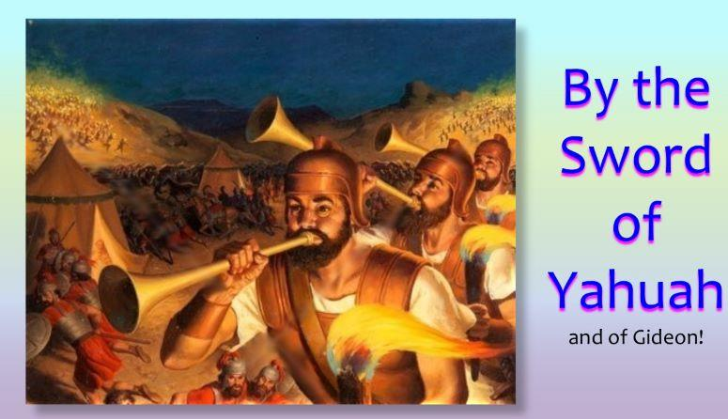
The End

Slide 79
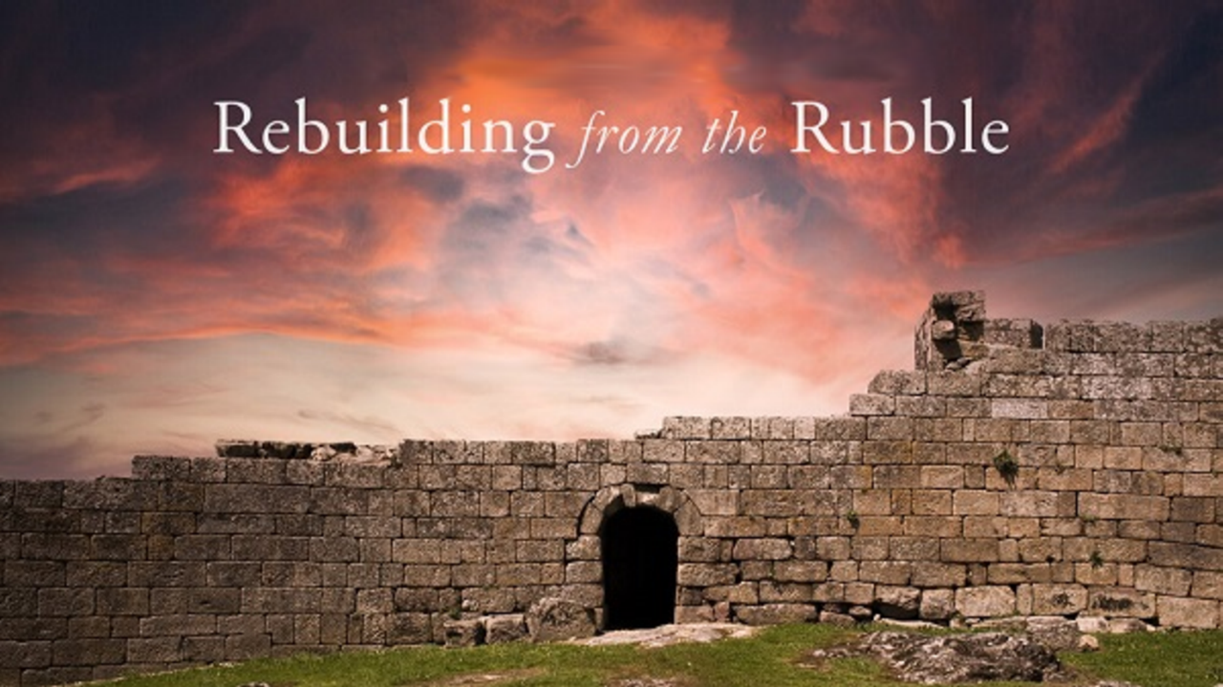


If you enjoyed this study today …
Please Join Us Live Each Week
Sign up with Covenant Calendar Club
for the Friday & Shabbat Zoom Meetings
(including live discussion)
https://studythecalendar.com/sign-up/
79

Slide 80
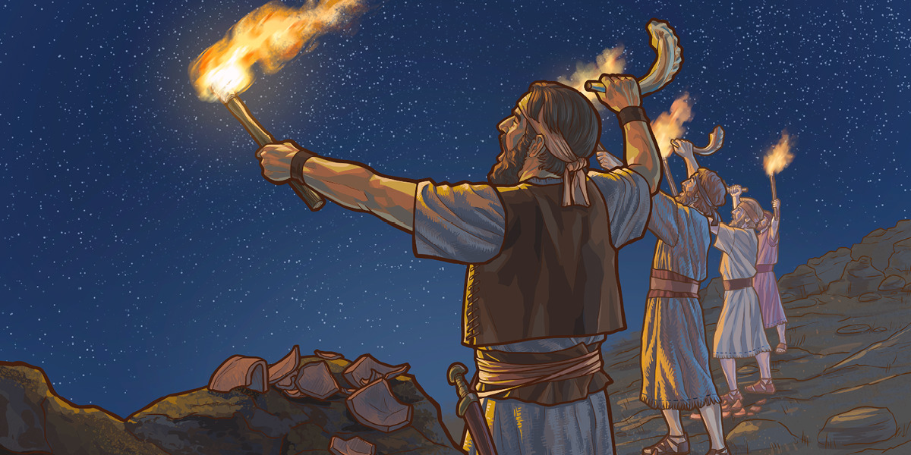


Hold your torch of Torah Truth high for Yahuah.
Send your comments to:
Timothy Astleford
& Charlene Fortsch:
Thank-you!
questions@studythecalendar.com
Shalom!

