Slide 1
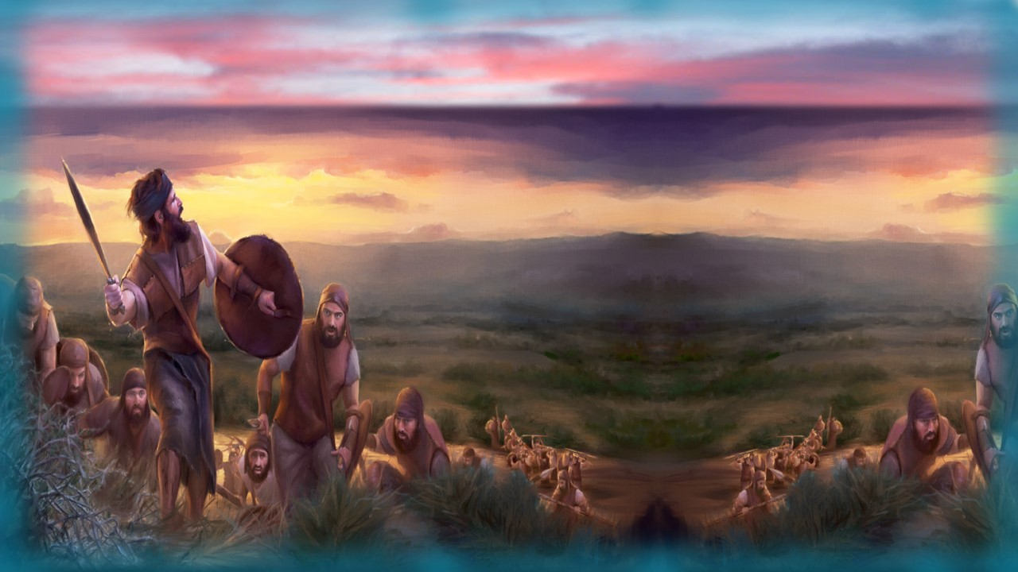

Covenant Calendar Club
Introduction to:
Gideon’s Fleece,
Clay Pots
& Shofars
Judges 6-7
Notes:
4.21a – Teaser for Gideon’s Fleece 13 slides TA Jan 14/22 Website: Youtube:
Blurb 4.12a teaser for Gideon’s Fleece: This video is just a very short introduction into what there is to discover in the full study of Gideon’s Fleece in Judges 6-7. Once the Torah has established Yahuah’s day begins with the first dawn twilight every morning, there shouldn’t be any reason for having many more witnesses in the rest of the Old Testament. Yet there are many – along with Gideon. This short introduction will tell you “why” it may be worth your while to take another look. Remembering that every word of Scripture is very important, and every story is very important, so is the “new lesson” in this story – it is of extreme importance and a topic of huge controversy for most everyone. All you have to do is: “Come and See!” Shalom!

Slide 2
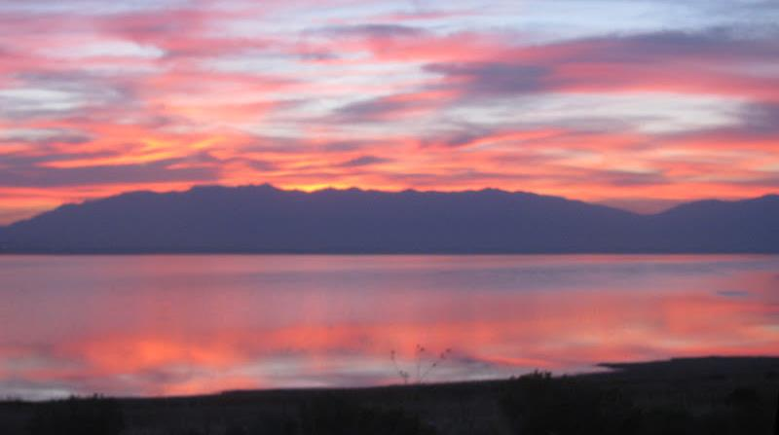

In the last 18 months there have been over 75,000 views for Yahuah’s Covenant Calendar.
By now a lot of people around the world are understanding Yahuah’s days begin everyday with the “break of day” ~ not sunset!
This is known as <boqer> in Hebrew.
Boqer is “always and only” the first
daylight in the sky before the sun
peeks above the horizon.

Slide 3


This twilight time varies in “length of time” depending on where you live in the world.
If the twilight time in your area of the world is very short, you may have been missing it all this time,
so check it out!

Slide 4

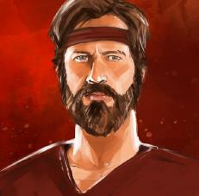
There are
several Scripture testimonies
that speak of this twilight
(or the mixing of
light and night darkness),
but the story of Gideon
is not one of them.

Slide 5
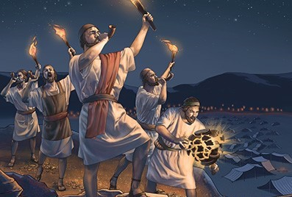
Judges 7 tells the story of how Gideon’s army of 32,000 men was reduced to a mighty 300 warriors under Yahuah’s instructions.
This is a very simple story that shows in humble detail each
new day began at dawn.
We already know there are around 40 Scripture testimonies
in the Old Testament alone that confirm this same day-start truth.

Slide 6

And YES, every one of these testimonies
are meant to also be a firm report
of Yahuah’s Covenant
of the Day
and
Covenant
of the Night!
(Jer 33:20)
That is:
… No matter how many secular historical documents can be found to support sunset!

Slide 7

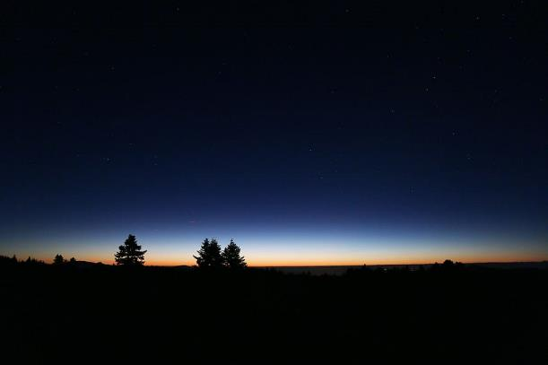
HOWEVER - Many Dawn Day Scripture testimonies do have a very special gem of information that really may not have been found UNLESS you understand the day begins with
dawn. THEN you
have to decide
to break open
every story in
great detail to
find that gem!

Slide 8





This Gideon testimony happens to be one of
the dawn-day stories that has a surprising “gem” of information.
Hhmm…
In fact it’s very interesting this “gem”
is connected to the word “soliloquy” –
a dramatic or literary form
of discourse in which a character talks
to himself revealing his thoughts
when alone or unaware of
the presence of others.

Slide 9



This “gem” also breaks open a very controversial topic of the Scriptures.
Could this “gem” be connected to Yahuah’s Covenant Calendar?

Slide 10

The Sunset Theory teachings have put forth a lot of resistance against Yahuah’s “Covenant for the Day” commencement.
Most will say: “I don’t have time for this right now! I’m just fine with sunset!”

Slide 11
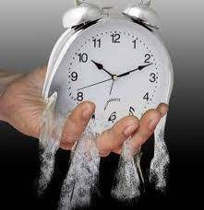



Question: “Are you satisfied
with sunset Sabbaths if you
haven’t really checked things out?”
Time is quickly passing by.
That’s why
To “Come and See” what Gideon’s Testimony has for you.

Slide 12

The End
for now!

Slide 13
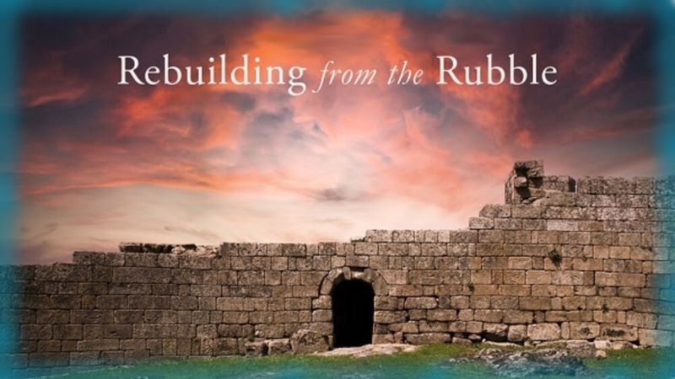


If you enjoyed this short introduction …
Plan to see the full study in detail!
And: Sign up with Covenant Calendar Club
for the Friday & Shabbat Zoom Meetings
(including our live discussion)
https://studythecalendar.com/sign-up/
questions@studythecalendar.com
Thank-you!
Shalom!

