Slide 1


Introductory Study
Follow the
Old Paths
for
Yahuah’s
Day-start
Notes:
4.19 a Teaser Historical Day-start Quotes [20 slides] CCC group Dec 31 2021 Website: You-tube:

Slide 2

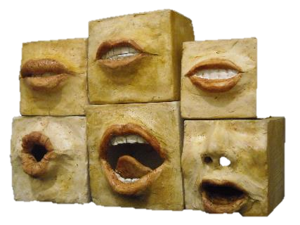

For some reason they feel there
has to be
secular historical documentation
to support Torah.
Well, now there is!
There are some
(or many) people that simply cannot accept the pure Torah truth that Yahuah’s
day-start begins with the dawn day-break.

Slide 3

MORE
AND remember: the enemy has also made sure every teaching of error also has plenty of secular historical support!
How do you plan to sort it out?

Slide 4




Where do you go to find the truth on Yahuah’s day-start?
Back in 2010 when this
study began with the
sunset Sabbath challenge, there was basically nothing on the internet!

Slide 5


That is no longer the case today! The internet
has a lot of information!
But what can be trusted if one doesn’t know what Torah teaches?

Slide 6

In these last days, there are
many voices “out there” about
when Yahuah’s
days begin!
They can’t all
be right!
Noon!
Sunset!
Midnight!
But they could
all be wrong!

Slide 7

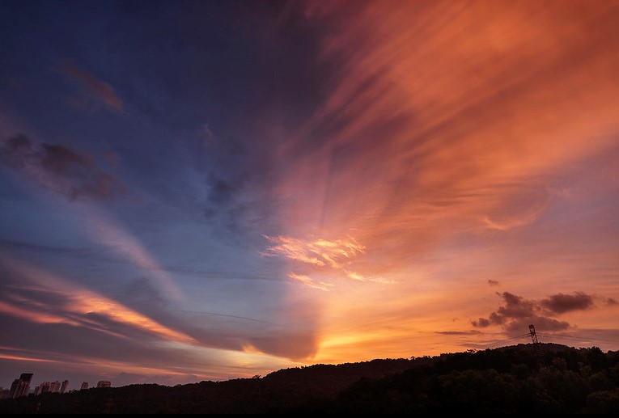
There are many sources to investigate on the topic of Torah’s day-start!
But …
UPDATE #1

Slide 8

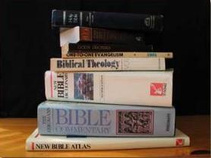

Sunset teachers with sunset theory documentation are
in the lead to save the
sunset commencement as truth!
UPDATE #2
2022
Some say: “Sunset should
not be questioned when the majority
honor this day-start and it’s working
just fine for millions of people”!

Slide 9
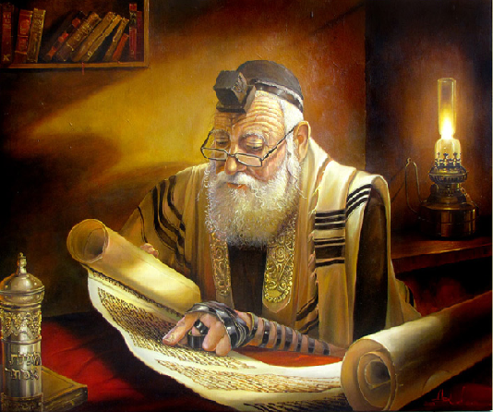
Besides, sunset has been honored for 1000s of years by the Jews who
must be right!

Slide 10

IF one is to lean heavily on the testimony of rabbinic tradition, he will be confronted with the question:
Which
rabbinic tradition
should be chosen
and followed?

Slide 11


There are about 40
Scripture story testimonies
in the Tanach that show the
day-start is in the morning
AND the story events always have a
“forward progressive movement”!
That is a basic hermeneutic principle of proper Scriptural study!

Slide 12
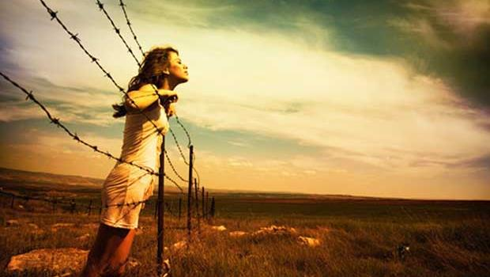


Many sunset teachers are now saying that these Scripture testimonies with “calendar language”
were NEVER meant to be “calendar teachings”?
Would that be considered a lot of “idle words” in Scripture?
Did Yahuah make a blatant mistake to have calendar language recorded so many times ~ with the
story events always given in perfect order?

Slide 13

There are over 30
Secular Historical Quotes Regarding the
Commencement of
Yahuah’s days/Sabbaths ~
And … none of them come close to supporting sunset?
Here’s one author that will not be in the larger study. See what you think!

Slide 14

A Good Paper with a Sad Ending!
This article is from:
Conservative Judaism Journal
Vol 35, No. 1, Fall 1981
© 1981 The Rabbinical Assembly
Title: The Counting of 'Day' and 'Night'
By: Meir M. Ydit - RABBI DR. MEIR M. YDIT, who presently lives in Western Germany, was founder and spiritual leader of Adar Shalom synagogue in Rehovot.
A special selection of quotes will be given – the author also quotes from … “Prof. M.D. Cassuto, in his magnificent commentary of Genesis (in the Hebrew Soncino edition: Perush al Sefer Bereishit, 1962, pp. 15-17). He proves his thesis by a number of convincing biblical references, which I [Ydit] shall try to elaborate upon here.”

Slide 15
Excerpts from: The Counting of ‘Day’ and ‘Night’
“In the Jewish tradition it is customary to count the day from the onset of night (i.e., the visibility of three stars in the sky) until after the sunset of the following day. … However, a more precise scrutiny of this text shows that the opposite is true. … With the process of creation, which started with the divine fiat "Let there be light,'' the first daylight began and lasted until the arrival of evening. As the darkness, too, ran its course, the entire day ended and a new day began. This is what the Bible really expresses: "and it was evening [= after the daylight ended],
and it was morning [= a new day arrived, therefore it was the definite end of] the first [second, third, etc.) day."
“It stands to reason that in biblical times, under the existing economic and social conditions, almost all human activities were conducted during daytime. The night was the time for rest and sleep. Thus days were naturally counted ''from one morning until the next morning,'' while the passive night time was counted as belonging to the day which ceased. Thus there existed no difference between the calculation of the day as practiced in everyday-life and the calculation by which the holy service in the Temple was conducted.”

Slide 16
Excerpts from: The Counting of ‘Day’ and ‘Night’
“… yet another excellent proof for the main thesis of this paper can be marshalled from the biblical commandment:
''You should not let his corpse hang on the stake overnight,
but must surely bury him the same day" (i.e., of his execution, Deut 21:23). According to this biblical injunction, sunrise {dawn}, the arrival of the morning, heralds the next day.”
“After the destruction of the Second temple, however, the importance of continuing to calculate the day in conformity with the Temple, was no longer felt a necessity. Thus the conformity which existed between the people's counting
of the day and the priests' counting at the Temple, ceased. Gradually the rabbis laid down many new halakhot with regard to the start of the Sabbath rest and of the Festival observances. Their entrance was fixed with the onset of sunset and their duration lasted until sunset of the following day.”

Slide 17


Excerpts from: The Counting of ‘Day’ and ‘Night’
(Conclusion – and the Sad Part!)
RABBI DR. MEIR M. YDIT ends his paper with this last paragraph:
“This paper intends, therefore, in no way whatsoever, to disparage [belittle/ridicule] our present custom to start our Sabbaths and Festivals at sunset!
But we should know that this time-honored
custom which we regard and accept
as obligatory evolved gradually and
is the result of
historical changes.”
(Final Conclusion: Sunset still Rules day-start!)

Slide 18
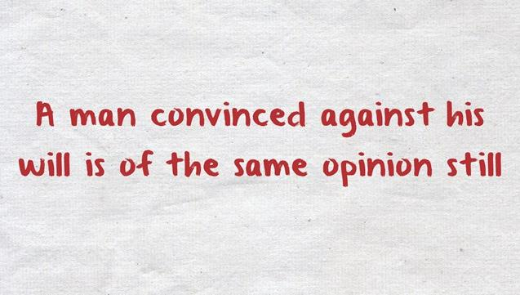
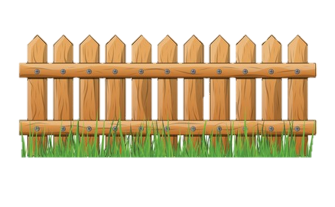
Sadly, most sunset believers are not willing
to take the challenge to see
what’s on the other side of the fence.

Slide 19



Now is the time to understand as much as possible of Yahuah’s Covenant Calendar.
As the internet increases with information, each one needs to have the tools to discern the truth from any error, great or small.
In the full presentation, these secular historical quotes will align with Torah,
even though they are in the minority.
How often have you seen truth settled with the majority
in the last 6000 years?
The End

Slide 20
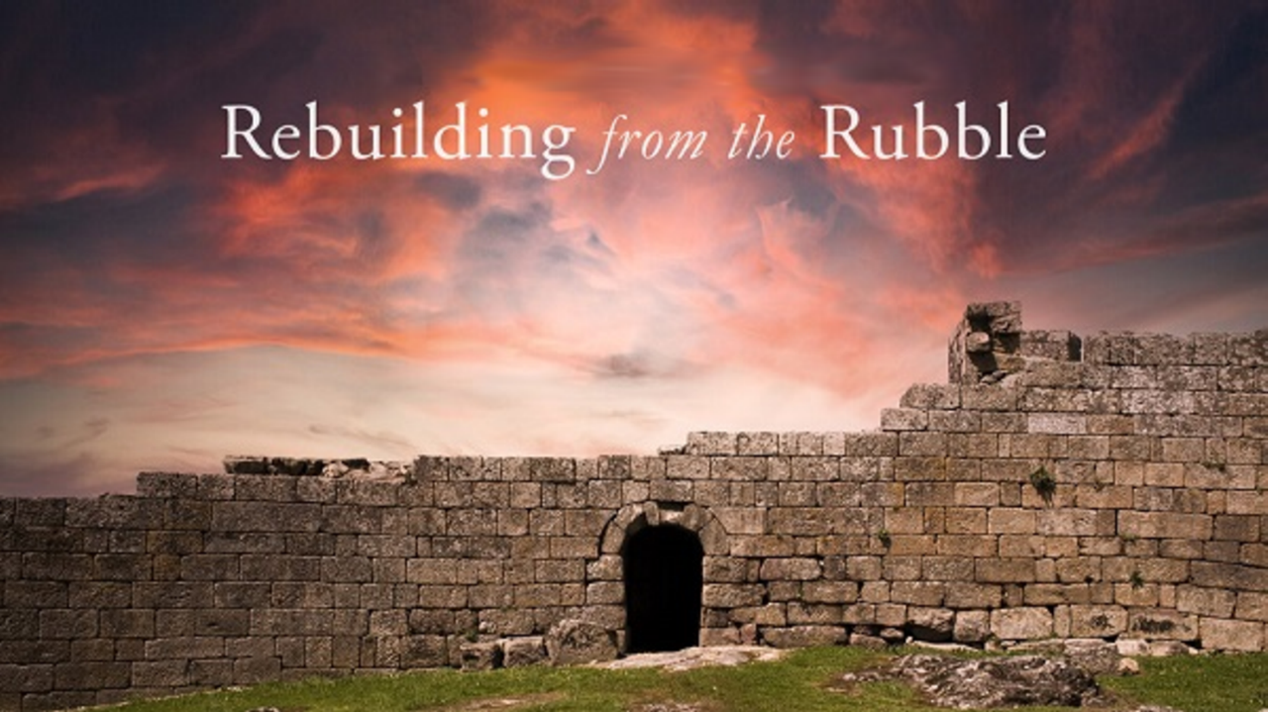


If you enjoyed this short introduction …
Plan to see the full study in detail!
And: Sign up with Covenant Calendar Club
for the Friday & Shabbat Zoom Meetings
(including live discussion)
https://studythecalendar.com/sign-up/
Thank-you!
Shalom!
20

