Slide 1


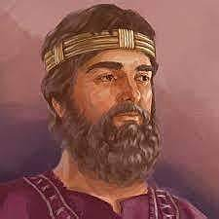
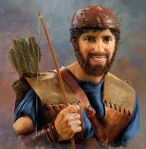


Killer Bees, or Honey Bees?
Saul
Yonathan
Did Yahuah bless Yonathan, or was the HONEY - a curse?

Slide 2


Yahuah’s End Time Message from 1st Samuel 14
Date: ~1087 BC – or 365 years after Moses
What does this story have to do with honey bees?

Slide 3



Why another “dawn” day study?
The truth of the “dawn day” commencement was lost
a long time ago – about the time the exiles returned
from Babylon changing it to the “sunset/evening”
commencement. Rome made changes to “midnight.”
History books speak of day commencements as being
at 6 PM every day. Over recent years some claim
Yahuah’s day begins at sunrise or noon. In the last 10
years this truth is being restored according to creation
and Torah, so you can experience the …
Sweetness of Dawn!
Every Single Day of the Week!

Slide 4
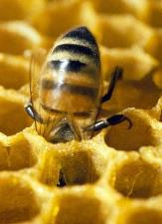
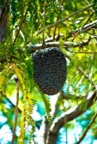
Beehive of Chai
Yahuah provided a
Life
And his eyes lit up! 1 Sam 14:27 (e)
Would Yonathan loose his life VIOLENTLY, a result of
hunger, and innocently eating honey?
Could this hunger and honey factor be a catalyst for exposing
the Dawn start to the cycles of 7, in Yahuah’s Kingdom?

Slide 5
Getting Started
Note:
These studies try to refrain from using the word “day” that has been translated from the original Hebrew word <yowm>.
The word “day” loses a massive amount of definitive correctness in its ambiguous definitions.
Day can indicate 12 or 24 hours, day or night, or both!
To understand Scripture correctly we need to be much more accurate.
Preference is given to the word “cycle” in place of day.
When quoting the Scriptures or citing the Shabbat Day you will see it.
Otherwise cycle is the word of choice.
The 24 hour cycle will be defined below to pinpoint the two seasons.
Cycle = 24 hours containing the 2 seasons, one of light – H216 <’owr> and
one of night – H3915 <layil>.
Season H6256 - <`eth>, = (approx.) 12 Hour blocks of time whether it is
Light Season or Night Season.
A very important application example of “season” is found in Yerimyahu (Jer) 33:20-25.

Slide 6

Note the commitment of this honey bee. It is “ALL IN”! It “dives in head first” in full commitment.
Is there a lesson here?
Luke 10:27 And He answering, said, “ ‘You shall love יהוה your Elohim with ALL your heart, and with ALL your being, and with ALL your strength, and with ALL your mind,’ and ‘your neighbour as yourself.’ ”

Slide 7
Josh 22:5 “Only, diligently guard to do the command and the Torah which Mosheh the servant of יהוה [Yahuah] commanded you, to love יהוה your Elohim, and to walk in ALL His Ways (H1870 derek), and to guard His commands, and to cling to Him, and to serve Him with ALL your heart and
with ALL your being.”

Slide 8
What level of COMMITMENT
do we see from Yonathan?

Slide 9
“ONE CYCLE” of Yonathan’s Life Begins!
The Premier Witness
1 Sam 14:1 And it came to be ONE DAY that Yonathan son of Sha’ul said to the young man who bore his armour, “Come, and let us go over to the outpost of the Philistines which is on the other side.” But he did not inform his father.
What reason did Inspiration have to document the words - And it came to be one day? Why does not Scripture just declare - And it came to be …?
Is this phrase purposely declaring the length of time in detailing this honey event? The Hebrew warriors saved Yonathan’s life after he ATE HONEY!

Slide 10
The Hebrew declares - Yowm!
Yowm (1/7th of the week) is not plural as in multiple cycles, but is singular as in ONE 24 HOUR period. Again, when does it begin? We are not told here. We will have to wait until the end of the story when the Hebrew warriors saved Johnathan’s life!
The warriors will make it clear beyond any shadow of doubt!
1 Sam 14:6 And Yonathan said to the young man who bore his armour, “Come, and let us go over to the outpost of these uncircumcised. If so be, יהוה [Yahuah] does work for us. For there is no hindrance for יהוה to save by many or by few.”

Slide 11
Yonathan’s “Honeybee Armour Bearer!”
1 Sam 14:7 And his armour-bearer said to him, “Do all that is in your heart, incline yourself. See, I am with you, according to your heart.”
Yonathan’s armour bearer had full trust in Yonathan’s leadership and his faith in Yahuah. The armour bearer, like the honey bee, was “all in, without reserve.” He too was FULLY COMMITTED to the purpose of routing the evil from destroying Yisra’el. Maybe we ALSO should - “BE the BEE”! ☺
Committed!

Slide 12
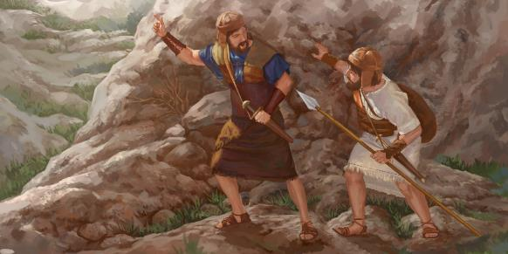
Yonathan was dependent upon Yahuah!
1 Sam 14:8 And Yonathan said, “See, we are passing over to the men – and show ourselves to them.
1 Sam 14:9 “If they say this to us, ‘Wait until we come to you,’ then we shall stand still in our place and not go up to them.”

Slide 13
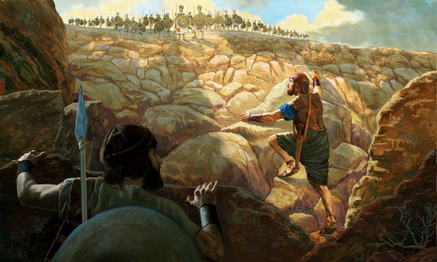
Contact under guidance from Yahuah!
1 Sam 14:10 “But if they say this, ‘Come up to us,’ then we shall go up. For יהוה [Yahuah] has given them into our hand, and this is the sign to us.”
1 Sam 14:11 And both of them disclosed themselves to the outpost of the Philistines, and the Philistines said, “See, the Heḇrews are coming out of the holes where they have hidden.”

Slide 14
Have you noted that Yonathan’s relationship with Yahuah was vertical?
Yonathan did not depend on the physical presence of the Ark of the Covenant for his empowerment from Yahuah!
He knew Yahuah was with him.

Slide 15
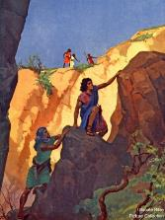
Yahuah gave consent to Yonathan to exterminate the Philistines! Note the beginning of this war!
1 Sam 14:12 And the men of the outpost called to Yonathan and his armour-bearer, and said, “Come up to us, and let us teach you a lesson.” Then Yonathan said to his armour-bearer, “Come up after me, for יהוה has given them into the hand of Yisra’ĕl.”
1 Sam 14:13 And Yonathan climbed up on his hands and knees with his armour-bearer after him. And they fell before Yonathan, and his armour-bearer was putting them to death behind him.
1 Sam 14:14 And that first slaughter which Yonathan and his armour-bearer made was about twenty men, in about half an acre of land.

Slide 16
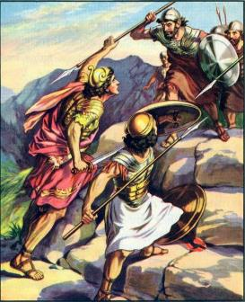
2 Men of Faith, against 20, in the space of about half an acre!
It becomes quite clear that Yahuah was directly working with Yonathan
and his armour bearer.
Can the same be said for Saul?

Slide 17
1 Sam 14:15 And there was trembling in the camp, in the field, and among all the people. The outpost and the raiders also trembled, and the ground shook. And it became a trembling of Elohim.
1 Sam 14:16 And the watchmen of Sha’ul in Giḇʽah of Binyamin looked and saw the crowd melting away, and they went here and there.

Slide 18
In verse 16 we read the Philistines and their co-horts were brought into confusion.
Verse 17 - After Saul had inquired if anyone was missing, he realized that Yonathan and his armour bearer were not present.
Next verse -

Slide 19
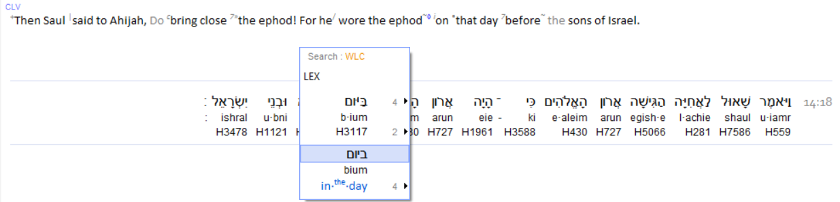
1 Sam 14:18
Confirmation #2
Yowm, a singular cycle in this battle!

Slide 20
In the next few verses we learn that Saul withdrew his request from the Priest, for communication from Yahuah. The reason - too much noise distraction in the Philistine camp.
Had Yahuah wanted to communicate with Saul, would the commotion have prevented it?
Was Saul mentally prepared to communicate with Yahuah?
We also learn that the Hebrew warriors who happened to come for the battle alongside the Philistines, turned their faces to join with their brothers of Yisra’el.
Even the Hebrews who had hid in the mountains of Ephrayim join in the fray of battle.

Slide 21
Note the chronology:
The next verse concludes the
GENERAL OUTLINE
of this important battle.
Next comes the details that occurred within the 24 hour battle timeframe.

Slide 22
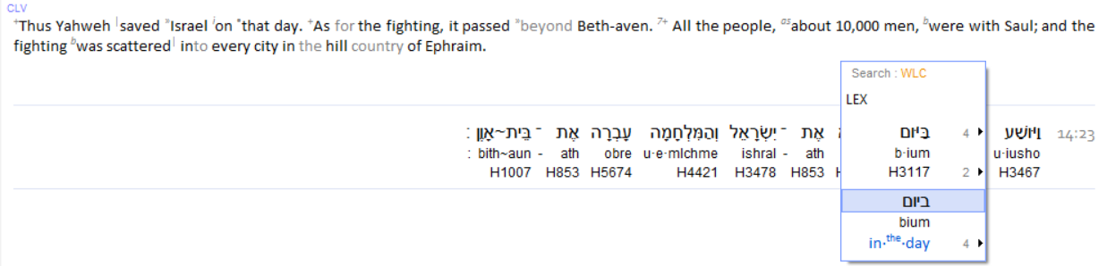
1 Sam 14:23 Thus יהוה [Yahuah] saved Yisra’ĕl
THAT DAY,
and the battle passed over to Bĕyth Awen.
Confirmation #3
Yowm, a singular cycle in this battle!

Slide 23
This next verse provides the contextual foundation for this study.
Please note the time frame recorded and the oath taken by Saul,
and the timeframe within that oath!
Note the IMMENSE BLUNDER on Saul’s part!
Yahuah EMPOWERED Yonathan to the great initial victory!
What effect will Saul’s massively foolish oath have on the Hebrew warriors?
What “power” is revealed to be working inside Saul’s mind?

Slide 24

The Contextual Foundation for this study is the oath taken by Saul
which impaired the warriors full ability to defend Yisra’el!
Note the end time of the oath – evening – AFTER SUNSET!
1 Sam 14:24 And the men of Yisra’ĕl were distressed
that day,
for Sha’ul had placed the people under oath, saying, “Cursed be the man who eats food
until evening,
and I have taken revenge on my enemies.”
Therefore none of the people tasted food.
After sunset!!!

Slide 25

Yonathan and
“the bee” {commitment}
(armour bearer) slew about 20 men!
1 Sam 14:14
Thus Yahuah saved Yisra’el that day … !
1 Sam 14:23
Stage #1
1 Sam 14:24 then tells us:
And the men of Yisra’ĕl were distressed that day, for Sha’ul had placed the people under oath, saying, “Cursed be the man who eats food until evening, and I have taken revenge on my enemies.” Therefore none of the people tasted food.
Hebrew nation united and routed the Philistines!
1 Sam 14:20-22
Dawn
Sunset
Light Season of War. Saul: Do not eat food!!!!

Slide 26
Saul, ERRONEOUSLY thinking he had some positive power of his own, wanted to place “HIS OWN” (?) influence on the battle.
The question is: Did Saul’s oath EMPOWER or DEBILITATE the Hebrew warriors? Ultimately then, WHO actually saved Yisra’el?
Stage
#2
Dawn
Sunset
1 Sam 14:24 And the men of Yisra’ĕl were distressed that day, for Sha’ul had placed the people under oath, saying, nn
“Cursed be the man who eats food UNTIL EVENING …”
The evening twilight mixture arrives
AFTER THE SUN HAS SET!
Light Season of War. Do not eat food!!!!

Slide 27
The Hebrew warriors were expending massive amounts of energy defending the nation. They, not being allowed to eat food on account of DEATH,
were extremely hungry!
Again:
Did Saul’s oath empower them, or debilitate them?
Ultimately, to which authority was Saul submitting?
What innocent action did Yonathan take on?

Slide 28
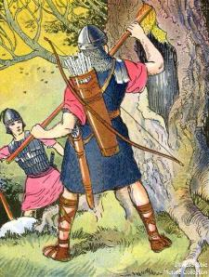
1 Sam 14:25 And all they of the land came into the woods, and there was honey on the ground.
1 Sam 14:26 And the people came into the woods and saw the honey, dripping. But no one put his hand to his mouth, for the people feared the oath.
1 Sam 14:27 But Yonathan had not heard that his father had taken an oath of the people, and he stretched out the end of the rod that was in his hand and dipped it in a honeycomb, and put his hand to his mouth. And his eyes lit up.

Slide 29
Yahuah had ensured the warriors had access to near
instant energy by supplying honey available to all.
Stage
#3
Yonathan, not knowing of his father Saul’s oath ate some rejuvenating honey. It was before the sunset occurred and he had no idea of the consequences per Saul’s oath.
Dawn
Sunset
Light Season of War. Do not eat food until evening!

Slide 30
Yonathan’s energy was quickly and innocently restored with the natural sugars in the honey. Is it possible that Yahuah had arranged this vital need before hand? Would Yahuah know the needs of the warriors?
1 Sam 14:28 Then one of the people said, “Your father strictly took an oath of the people, saying, ‘Cursed be the man who eats food today.’ ” And the people were weary.
1 Sam 14:29 And Yonath0n said, “My father has troubled the land. Now see how my eyes lit up when I tasted a little of this honey.
1 Sam 14:30 “How much better if the people had well eaten today of the spoil of their enemies which they found! For then, would not the slaughter among the Philistines have been greater?”
1 Sam 14:31 And they smote the Philistines that day from Miḵmash to Ayalon. So the people were very weary.

Slide 31
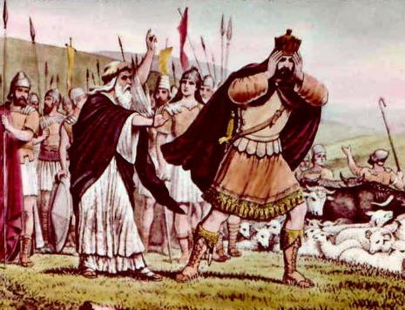
1 Sam 14:32 And the people pounced on the spoil, and took sheep, and cattle, and calves, and slaughtered them on the ground.
And the people ate with the blood.
1 Sam 14:33 And they told Sha’ul, saying, “Look, the people are sinning against יהוה [Yahuah] by eating with the blood!” And he said,
“You have acted treacherously. Roll a large stone to me today.”
We must give credit where it is due. At least Saul had the presence of mind to stop the reckless slaughter with the eating of blood.

Slide 32
This “power” that held Saul under such strong influence,
was the force that seriously reduced the energy and
effectiveness of the Hebrew warriors.
Was this the same power that caused Saul to seek out the
witch of Endor? 1 Sam 28:7.
Was this a habitual pattern from Saul?
Ultimately – WHO was responsible for the sins of the Hebrew warriors eating the meat with the blood?
Was it Saul who readily accepted the influence of pride??
And … have we passed over an important calendar detail?

Slide 33
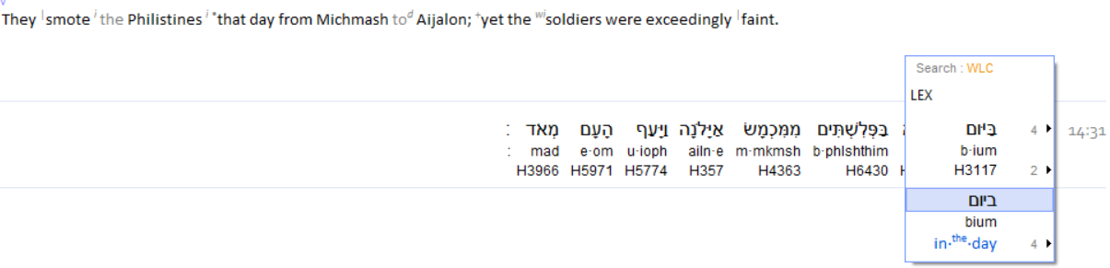

1 Sam 14:31 And they smote the Philistines
that day
from Miḵmash to Ayalon. So the people were very weary.
Confirmation #4
Yowm, a singular cycle in this battle!
Please note the word – Yowm. Once again we see a singular 24 hour period written here.
It does NOT have the
2nd ‘Mem’ letter at the end!
Plural
Yowm

Slide 34
At this point we still have not been informed of a specific change in time pertaining to the events. What corrective action did Saul undertake to stop the people from sinning by the EATING OF BLOOD?
Will there be MORE WITNESSES to the sunset NOT CHANGING THE CYCLE OF THE WEEK?

Slide 35
1 Sam 14:34 And Sha’ul said, “Scatter among the people, and say to them, ‘Each one bring his ox near to me, and each one his sheep, and you shall slaughter them here, and eat. And do not sin against יהוה [Yahuah] by eating with the blood.’ ” So every one of the people brought his ox with him that night, and slaughtered it there.
Yes, Saul had corrected the actions of eating blood by the famished warriors. Have you also noticed the extremely accurate acclamation of specific time? It was now the Night Season, and sunset had passed!

Slide 36
The warriors were slaughtering animals and eating the flesh
with the blood out of sheer ravishing hunger!
And Saul’s corrective action?
Stage
#4
1 Sam 14:34 … “Each one bring his ox near to me, and each one his sheep, and you shall slaughter them here, and eat. And do not sin against יהוה [Yahuah] by eating with the blood.’ ” So every one of the people brought his ox with him THAT NIGHT, and slaughtered it there.
Dawn
Sunset
Light Season of War. Do not eat food until evening!
Was this the next “day”?

Slide 37
1 Sam 14:36 And Sha’ul said, “Let us go down after the Philistines by night, and plunder them until the morning light, and not leave a man of them.” And they said, “Do whatever seems good to you.” But the priest said, “Let us draw near to Elohim here.”
1 Sam 14:37 And Sha’ul asked of Elohim, “Should I go down after the Philistines? Do You give them into hand of Yisra’ĕl?” But He did not answer him THAT DAY.
Confirmation #5
Yowm, a singular cycle in this battle!

Slide 38
Saul wanted to continue pursuing the Philistines that night!
Stage
#5
1 Sam 14:37 And Sha’ul asked of Elohim, “Should I go down after the Philistines? Do You give them into the hand of Yisra’ĕl?” But He did not answer him THAT DAY.
Dawn
Sunset
Was this then the
2nd cycle of the war?
Light Season of War. Do not eat food until evening!
Had Sunset changed
the “day”?

Slide 39
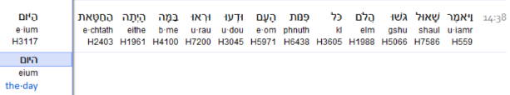
Yahuah did not answer Saul!
Saul knew very well that something MORE was wrong.
1 Sam 14:38 And Sha’ul said, “Come over here, all you chiefs of the people, and know and see what this sin was TODAY.
1 Sam 14:39 “For as יהוה [Yahuah] lives, who saves Yisra’ĕl, though it be in Yonathan my son, he shall certainly die.” But not one among
all the people answered him.
Confirmation #6
Then, Saul, not knowing the depth of what he was about to say -, voiced out the DEATH sentence that landed on Yonathan’s neck!

Slide 40

That Night Season!
Stage
#6
1 Sam 14:39 (a) “For as יהוה [Yahuah] lives, who saves Yisra’ĕl, though it be in Yonathan my son, he shall certainly die.”
Dawn
Sunset
Suddenly TIME becomes a Life and Death situation!
TIME –
Life and Death?
Do not eat food until evening!
Is today, actually -
THE TOMORROW?
Did Saul make a mistake? Did Saul actually want to say – tomorrow?

Slide 41
Yahuah previously did not answer Saul’s inquiries!
Why would Yahuah answer Saul now?
Did you notice in the last verse that Saul gave full credit to Yahuah
for saving the Yisra’elite nation?
1 Sam 14:39 “For as יהוה [Yahuah] lives, who saves Yisra’ĕl …”
Can we find a lesson here somewhere?
This event is about to get extremely serious!
1 Sam 14:41 Then Sha’ul said to יהוה [Yahuah] Elohim of Yisra’ĕl,
“Give a perfect lot.” And Sha’ul and Yonathan were taken,
but the people escaped.
1 Sam 14:42 And Sha’ul said, “Cast lots between my son Yonathan and me.” And Yonathan was taken.
Recall the DEATH sentence?

Slide 42



OK, we now know the impending result of Saul’s foolishness.
According to his declaration, Yonathan must die.
Because of the reason for this study, we must continue with the charts
to make certain we know the time span covered thus far.
The questions are:
Did the sunset change the cycle of the week?
What will the belief structure of the Hebrew warriors –
in the heat of battle – indicate in terms of Torah?
Will the words of the Hebrew warriors elevate and glorify the
Dawn start to the day?
Or will they confirm sunset as the time to change the cycle of the week
and allow Yonathan to DIE?
What does “ ” (Yowm) in –
have to do with SAVING Yonathan’s LIFE?

Slide 43
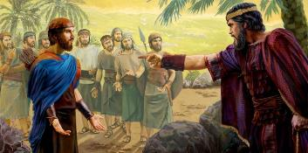
1 Sam 14:43 Sha’ul then said to Yonathan, “Explain to me what you have done.” And Yonathan explained to him, and said, “I only tasted a little honey with the end of the rod that was in my hand.
See, let me die!”
1 Sam 14:44 And Sha’ul answered,
“Elohim do so and more also,
for you shall certainly die, Yonathan.”

Slide 44
Stage
#7
In the Previous Light Season!
And Yonathan explained to him, and said,
“I only tasted a little honey…”
Dawn
Tasting honey before the sunset! What if he ate honey AFTER the sunset?
Sunset
Do not eat food until evening!
What about – “Today”?

Slide 45
That Night Season!
Stage
#8
1 Sam 14:44 And Sha’ul answered,
“Elohim do so and more also,
for you shall certainly die, Yonathan.”
Dawn
Sunset
Do not eat food until evening!
Die Today? ?????????
Is it not a NEW “Day”???

Slide 46
1 Sam 14:45 (a) But the people said to Sha’ul, “Should Yonathan die, who has wrought this great deliverance in Yisra’ĕl? Far be it! As יהוה [Yahuah} lives, let not one hair of his head fall to the ground …”
What GREAT DELIVERANCE had Yonathan performed?
Was that GREAT DELIVERANCE executed on the morning of
the yesterday H8543 - temole? Or yesterday H570 emesh?
Or yesterday - H865 ethmole?

Slide 47
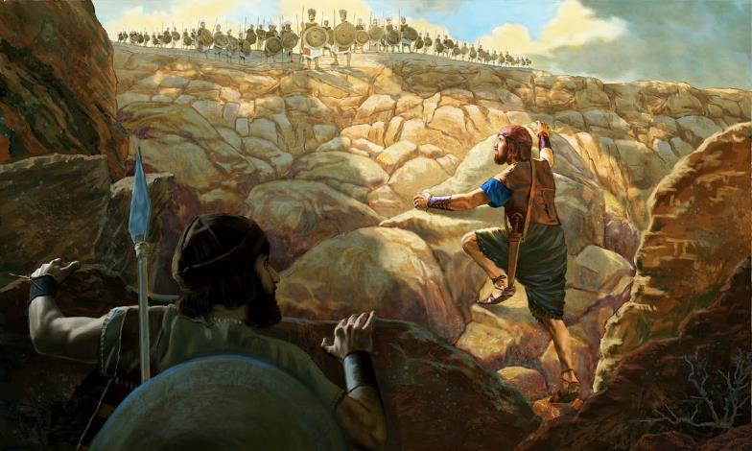
Time Frame: AFTER THE SUN HAD SET! That FIRST battle; REFERENCED BY THE Hebrew warriors: fought FIRST by Yahuah, then Yonathan & the armor bearer, in the early portion of the Light Season, was it -
Yesterday
H8543 - temole?
Or Yesterday H570 - emesh?
Or Yesterday H865 - ethmole?
How did the Hebrew warriors reference it? ???

Slide 48

Which yesterday was it according to the Hebrew words?
Or, better yet, WAS IT ON A “YESTERDAY” - AT ALL?
When was this GREAT DELIVERANCE AS SPOKEN INTO BY THE Hebrew warriors, who now had filled their tummies
in the present NIGHT SEASON?

Slide 49
The Covenanted - Yowm!
Stage
#9
Dawn
Yonathan and his armour bearer exterminated 20 men on this early morning!
The battle continued through the Light Season. Yonathan ate honey late in the Light Season.
Sunset
Do not eat food until evening! Yesterday?
Was before sunset -

Slide 50
The Two Covenants of - Yowm!
Stage
#10
Dawn
That night after the sun had set, lots were drawn. Yonathan
was sentenced to DEATH.
Sunset
Do not eat food until evening!
Today?
Yesterday?
Death
or LIFE

Slide 51
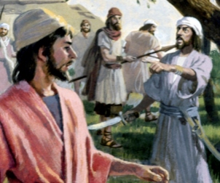
What did the Hebrew
warriors have to say?

Slide 52
The Two Covenants of - Yowm!
Stage
#11
The Hebrew warriors cited the GREAT DELIVERANCE performed by Yonathan
the MORNING PRIOR TO
that Night Season.
Dawn
Sunset
Do not eat food until evening!
LIVE Today! !!!!!!!!!!

Slide 53

What did the Hebrew warriors have to declare about the sunset changing the cycles of the week?

Slide 54
The Hebrew Warriors Declare - Yowm!
1 Sam 14:45 (b) “As יהוה lives, let not one hair of his head fall to the ground, for he
has wrought with Elohim THIS DAY.”
Dawn
Battle of Deliverance AFTER Dawn!
Sunset
DAWN to DAWN
Do not eat food until evening!
Light Season
Night Season of Saul’s shame

Slide 55
Stage
#13
The Two Covenants of - Yowm!
In this very night season, the Hebrew warriors identified YONATHAN’S EARLY MORNING BATTLE as
ONE AND THE SAME YOWM ! (A SINGLULAR CYCLE!)
They knew the sunset never changed any cycle of the week!
Dawn
Battle of Deliverance AFTER Dawn!
Sunset
Dawn
Do not eat food until evening!
Yonathan LIVES TODAY! !!!!!!!!!!
Dawn to Dawn! Yes the Hebrew warriors understood the creation account!

Slide 56
Review
1 Sam 14:45 But the people said to Sha’ul, “Should Yonathan die, who has wrought this great deliverance in Yisra’ĕl? Far be it! As יהוה [Yahuah] lives, let not one hair of his head fall to the ground, for he has wrought with Elohim
THIS DAY.”
Thus the people delivered Yonathan, and he did not die.

Slide 57

THIS DAY – YOWM -
was
NOT YESTERDAY! !!!!!
The sunset never changes the cycles of the week!
Take time to investigate the “yesterday” Hebrew definitions.

Slide 58
What are the definitions of this word YESTERDAY?
yesterday H8543 temole; probably for H865; properly, ago,
i.e. a (short or long) time since; especially yesterday, or (with H8032) day before yesterday: KJV - before (-time), these [three] days, heretofore, time past, yesterday.
yesterday H570 emesh; time past, i.e. yesterday or last night: KJV - former time, yesterday (-night)
yesterday H865 ethmole; probably from H853 or H854 and H4136; heretofore; definitely yesterday: KJV - before (that) time, heretofore, of late (old), times past, yester [day].

Slide 59

Yonathan’s testimony illustrates the
every day of the week which also applies to every worship statute as well. Why? Because …
Yahuah does not change!
(Mal 3:6)
(Matt 28:1 – at the end of Shabbat, the dawn arrives.)
Sweetness of Dawn

Slide 60
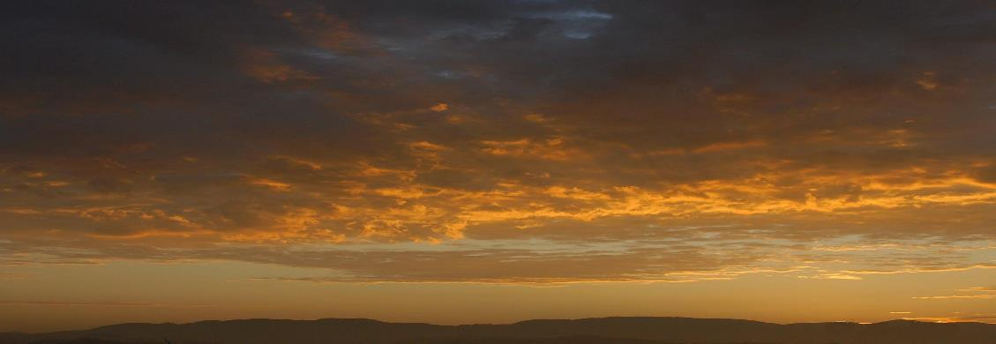
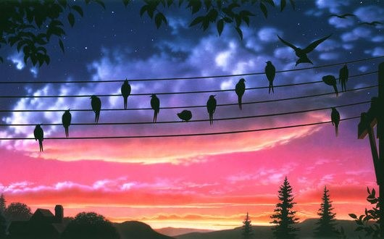
All of nature waits for “dawn” to begin a new day.
How about you?

Slide 61
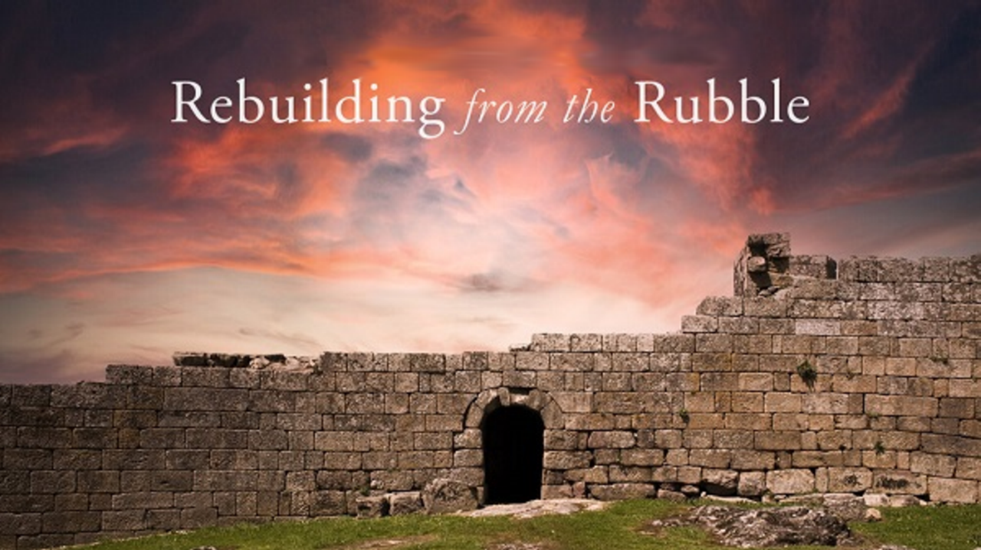


If you enjoyed this study today …
Please Join Us Live Each Week
Sign up with Covenant Calendar Club
for the Friday & Shabbat Zoom Meetings
(including live discussion)
https://studythecalendar.com/sign-up/

Slide 62


If you need assistance with this information, please send your questions
to:
Timothy Astleford
& Charlene Fortsch:
questions@studythecalendar.com
Thank-you!
Shalom!
www.studythecalendar.com

